Slide 1
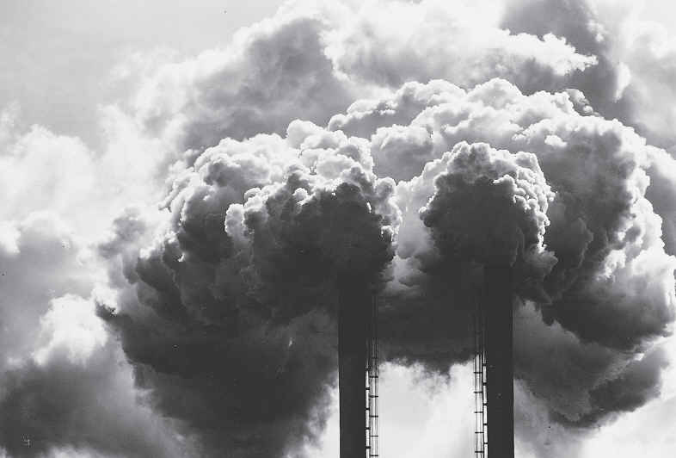
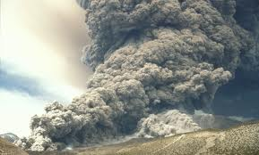
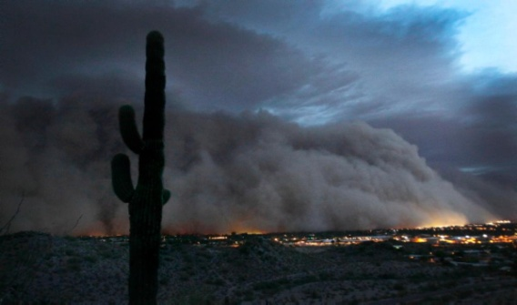
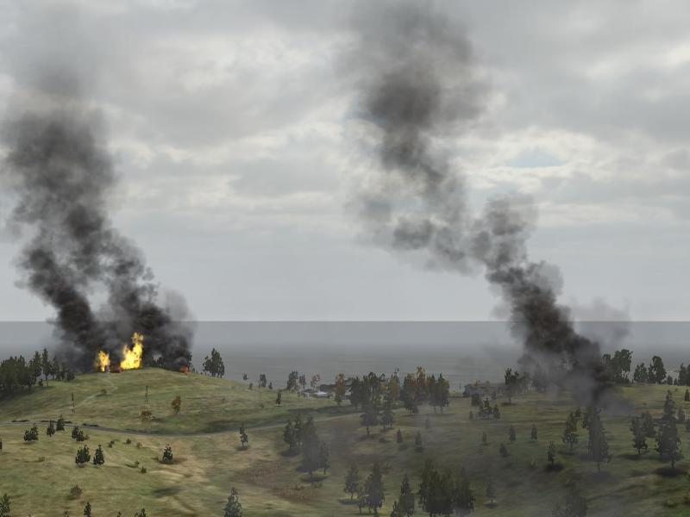
eIDEA: NOAA’s New Website for Fire and Smoke Products
Amy K. Huff (Penn State University)
Shobha Kondragunta (NOAA)
Hai Zhang (IMSG at NOAA)

Slide 2
eIDEA: Like IDEA, but Simpler
Several requests from AQPG user group to have separate section/tab on IDEA to show only current info – make IDEA “simpler”
Around same time, NOAA launched Blended Fire and Smoke Initiative (began May 2014)
Objectives:
Evaluate the current use of geostationary and polar-orbiting satellite capabilities in support of the Fire and Smoke mission
Identify current SNPP/JPSS and new GOES-R data and capabilities with the potential to improve support to this mission
Establish methodologies and procedures for the operational demonstrations of these capabilities
Identify the satellite capabilities whose operational impacts are sufficient to warrant transition from research to operations
Result is eIDEA (“enhanced” IDEA)

Slide 3
Enhanced Infusing satellite Data into Environmental Applications
http://www.star.nesdis.noaa.gov/smcd/spb/aq/eidea/
animations and external links
main product overlay buttons

Slide 4
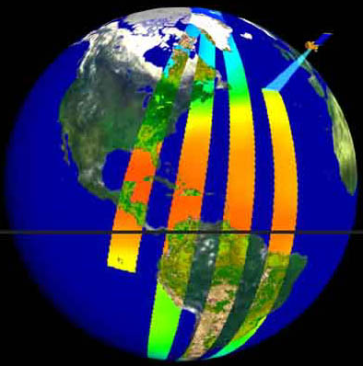
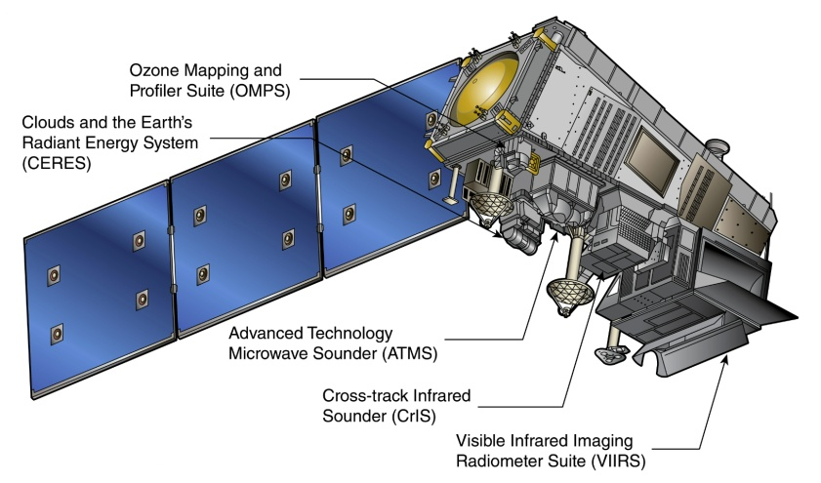
eIDEA Uses Data from the VIIRS Instrument on SNPP Satellite
SNPP launched Oct 28, 2011
VIIRS has 22 spectral bands with high spatial resolution (up to 750 m)
Afternoon overpass time, so observations made ~1:30 PM local time (1 day temporal resolution)
So “today’s” near-real time VIIRS observations on eIDEA are available in the mid-afternoon, typically ~2-3 hours after overpass
Archived VIIRS products in eIDEA begin on Feb 29, 2016

Slide 5
Fire and Smoke Products on eIDEA
Overlays:
VIIRS aerosol optical thickness (AOT)
VIIRS smoke mask
VIIRS fire hotspots and fire radiative power (RFP)
VIIRS estimated surface fine particulate matter (PM_{2.5}) concentration
VIIRS true color imagery (RGB)
Ambient surface PM_{2.5} concentrations (from U.S. EPA’s AirNow network)
Animations:
48-hour aerosol forward trajectories
3-day movies (AOT, smoke mask, and PM_{2.5})

Slide 6
Aerosol Optical Thickness (AOT)
Aerosol optical thickness (AOT) is a measure of the scattering and absorption of visible light by aerosols (particles) in the atmosphere
AOT is also called aerosol optical depth (AOD)
Challenge for satellite instruments is to distinguish aerosols from clouds in atmosphere and from bright surfaces (e.g., cities, mountains)
AOT algorithm used to calculate AOT from satellite instrument measurements at various wavelengths
Algorithm compares measurements from wavelengths in the visible and near-IR to find contribution from aerosols versus clouds and surface reflectance
For example, most aerosols do not absorb/scatter around 2.1 μm (near-IR), so this wavelength can be used to obtain the contribution of the surface reflectance
Other infrared channels are used to detect clouds
Usually different AOT algorithms for land and ocean

Slide 7
VIIRS Aerosol Optical Thickness (AOT)
AOT Scale (no units)
AOT indicates the presence of aerosols, like smoke, in the atmosphere
AOT is unitless; values typically range from 0 to 1 in the U.S.
Higher values of AOT (red, orange, yellow colors) correspond to higher amounts of aerosols
Clouds block the measurement of AOT, so there is no AOT in white cloud-covered areas
Example: smoke in Midwest, Aug 29, 2015

Slide 8
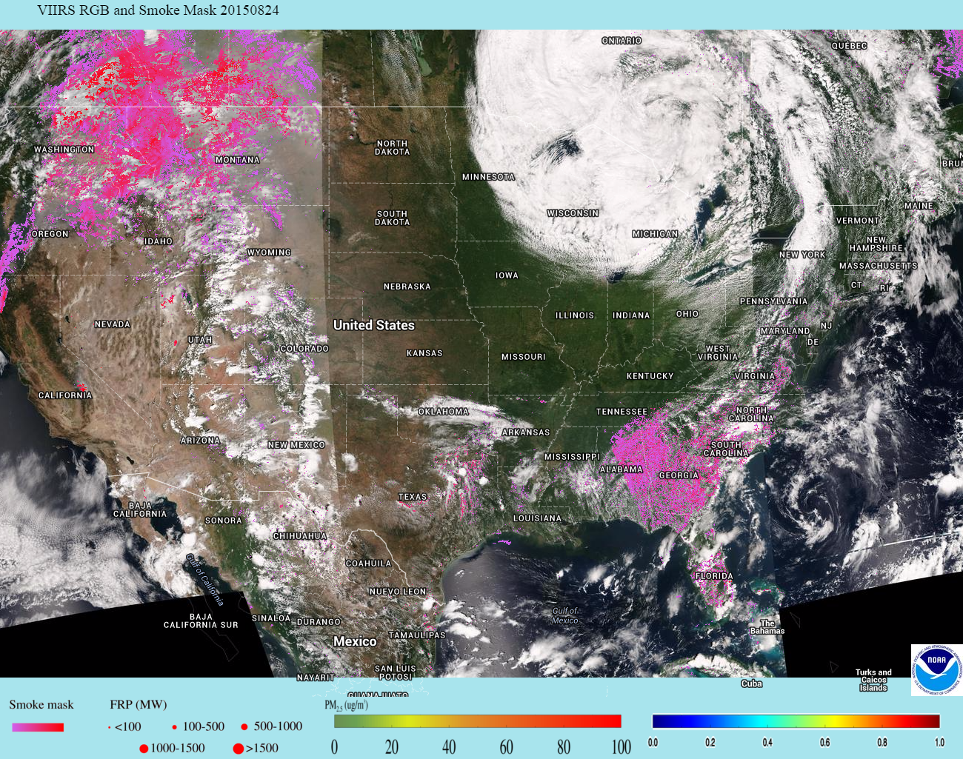
VIIRS Smoke Mask
Smoke Mask Scale
The smoke mask is a qualitative indicator of smoke
Use the smoke mask to identify local and transported smoke plumes
Smoke mask derived using spectral and spatial threshold tests based on VIIRS measurements in visible and IR
Colored in shades of pink:
Light pink: thin smoke
Bright pink: thick smoke
Scale at top of image
Example: smoke from fires in Pacific NW, Aug 24, 2015

Slide 9
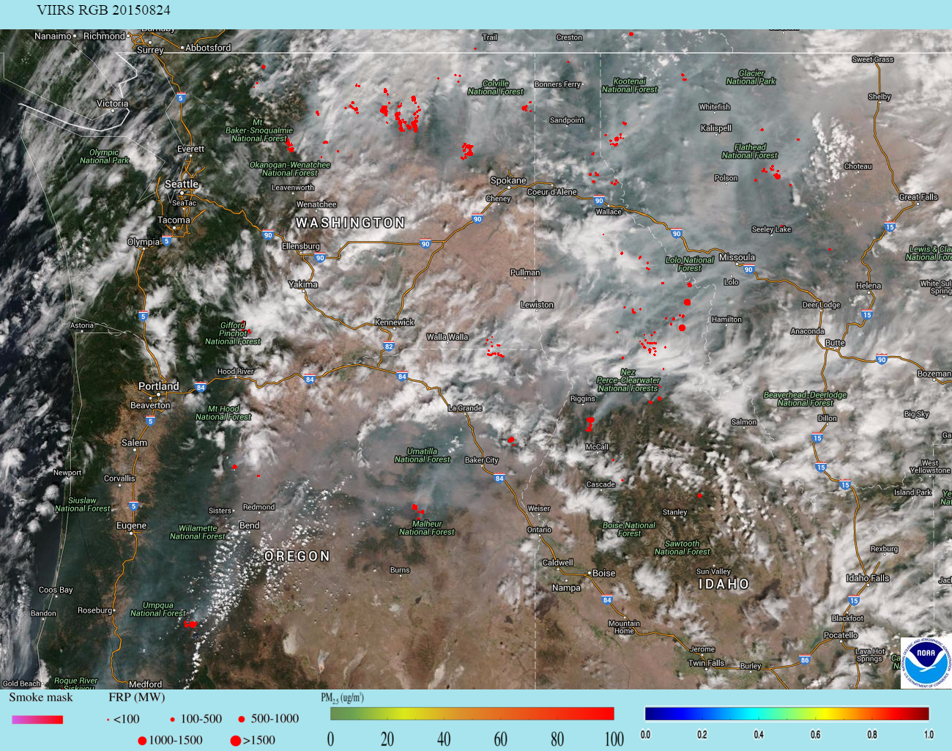
VIIRS Fire Hotspots (Fire Detections)
Fire Radiative Power (FRP) scale (in MW)
Red-colored fire hotspots indicate the location of fires sensed by VIIRS
Quantitative measure of fire intensity given by fire radiative power (FRP) in units of MW
Size of red dots indicates magnitude of FRP:
Larger the dot, the more intense the fire
Scale at top of image
Example: fires in Pacific NW, Aug 24, 2015

Slide 10
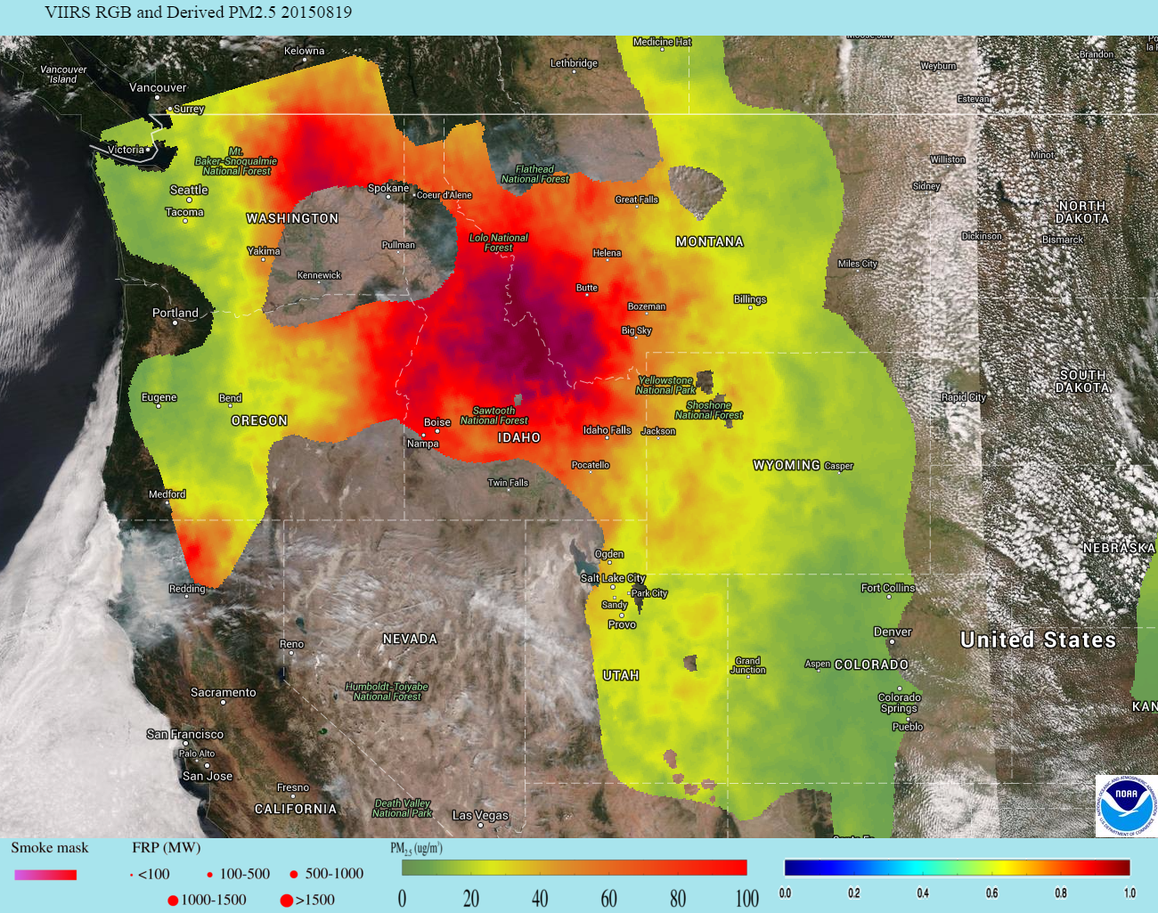
VIIRS AOT-Derived Surface PM_{2.5}
PM_{2.5} scale (in μg/m³)
PM_{2.5} is a criteria air pollutant; general name for small aerosols (diameter ≤2.5 μm) in the atmosphere, including smoke
AOT can be used to estimate surface PM_{2.5} concentrations; provides idea of health risk of smoke
Color coded scale (μg/m³)
Green/yellow: low PM_{2.5}
Orange/red: high PM_{2.5}
Example: smoke in Pacific NW, Aug 19, 2015

Slide 11
VIIRS Satellite Data are Not Surface Measurements
It is very important to remember that VIIRS aerosol products are measurements in a column of the atmosphere
VIIRS does not measure smoke or AOT directly at the surface
Sometimes VIIRS will indicate areas of smoke that are aloft in the atmosphere
To know if the smoke is reaching the surface, look at ambient PM_{2.5} concentrations (next slide)
High ambient PM_{2.5} indicates smoke mixing to surface

Slide 12
Overlay of Ambient PM_{2.5} Concentration Measurements from AirNow Network
PM_{2.5} scale (in μg/m³)
Ambient PM_{2.5} from U.S. EPA’s AirNow network available as an overly of colored dots
Same color coded scale (μg/m³) as for estimated PM_{2.5} from VIIRS
High ambient PM_{2.5} tells you smoke is reaching surface
Example: smoke in Pacific NW, Aug 19, 2015, reaching surface in WA, ID, OR (red/orange dots)

Slide 13
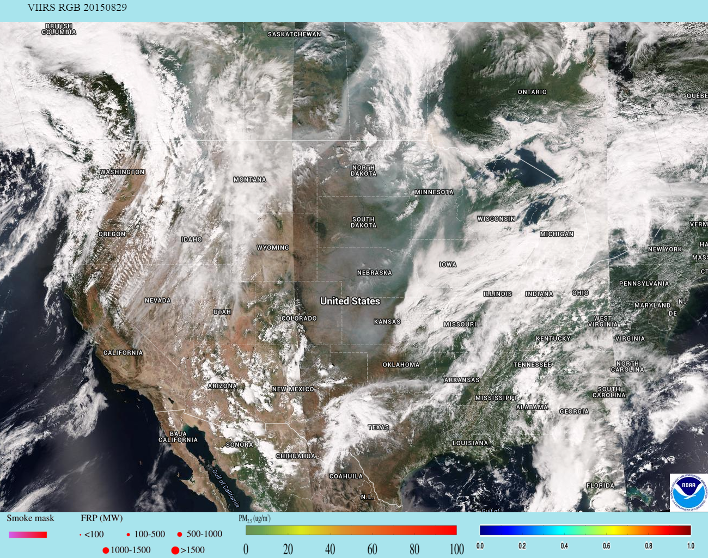
True Color Imagery (RGB)
True color image looks like a picture but it is made from combining the red, green, and blue bands of VIIRS (abbreviated RGB)
Clouds are white
Forests/fields are green
Mountains/deserts are brown
Oceans/lakes are blue
Smoke is grey
Example: smoke in Midwest, Aug 29, 2015
smoke

Slide 14
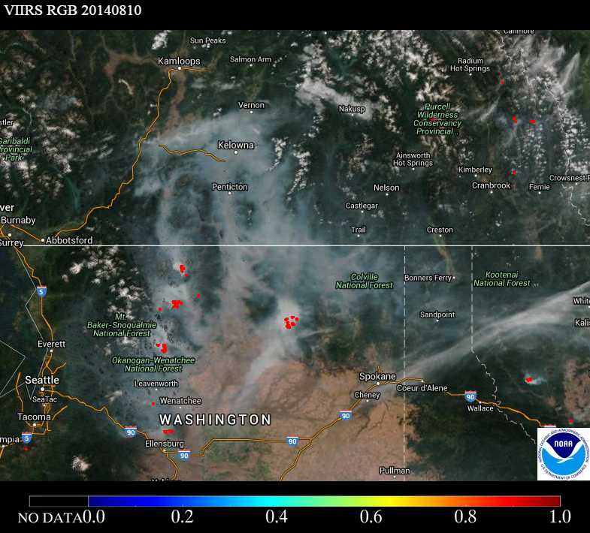
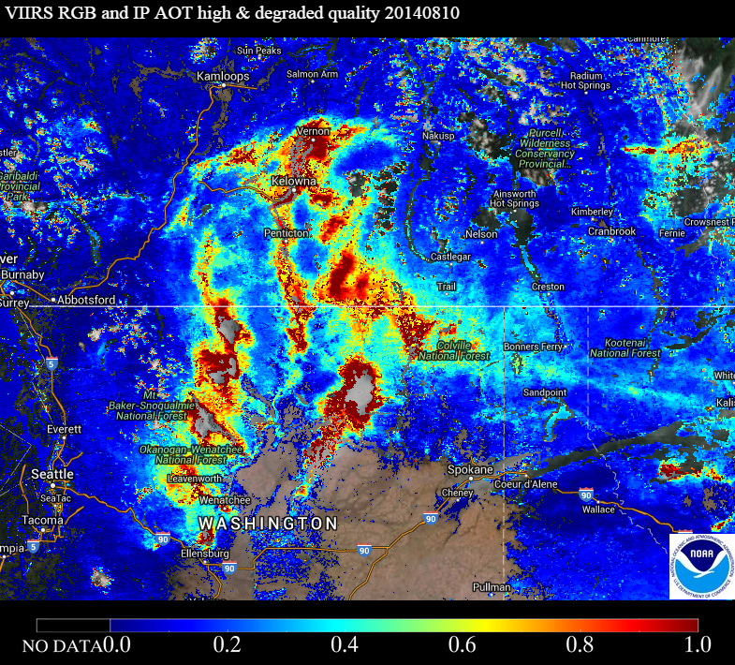
VIIRS AOT and True Color Imagery Complement Each Other
Carlton Complex Fires in Washington State, Aug 10, 2014
VIIRS True Color Imagery showing smoke from fires (and red fire hotspots)
VIIRS AOD high AOD corresponds to smoke

Slide 15
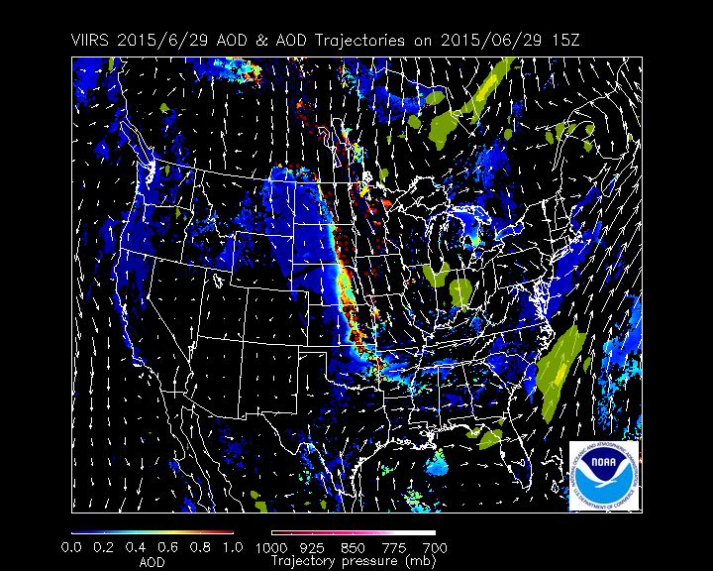
48-Hour Forward Aerosol Trajectories
Trajectories give idea of transport of aerosol plumes
Areas of high AOT (>0.4) used as starting locations
Trajectories initialized at 50, 100, 150, and 200 mb above surface
Trajectories run using NAM 12Z run output:
Pink: near surface
White: away from surface
850 mb wind vectors (white)
3-hr accumulated precipitation (yellow)

Slide 16
eIDEA: Overlays
Product legends
“Smoke Mask” is default smoke product; click on “AOT” or “Satellite Derived PM_{2.5}” to switch b/w smoke products
Slider bars adjust opacity of RGB and smoke products
Add/remove additional product overlays using toggle buttons
Click “Save Image” to save configuration as a graphics file

Slide 17
Anomaly in Smoke Mask Display
May notice “missing” smoke mask data in locations where VIIRS swaths overlap (such as central US)
Caused by two issues:
Algorithm issue
Smoke mask algorithm behaves differently for different solar- satellite viewing geometries
Display issue
RGB only displays the last overpass
Smoke mask displays both (overlapping) overpasses
May see inconsistency between smoke mask and RGB, such as smoke over clouds, shift of smoke mask, etc.
Aerosol team working to resolve this anomaly

Slide 18
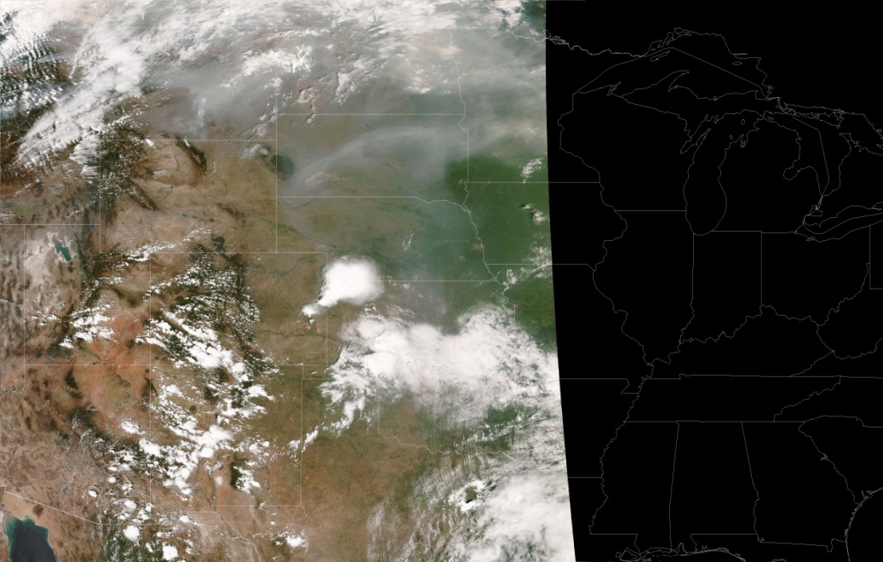
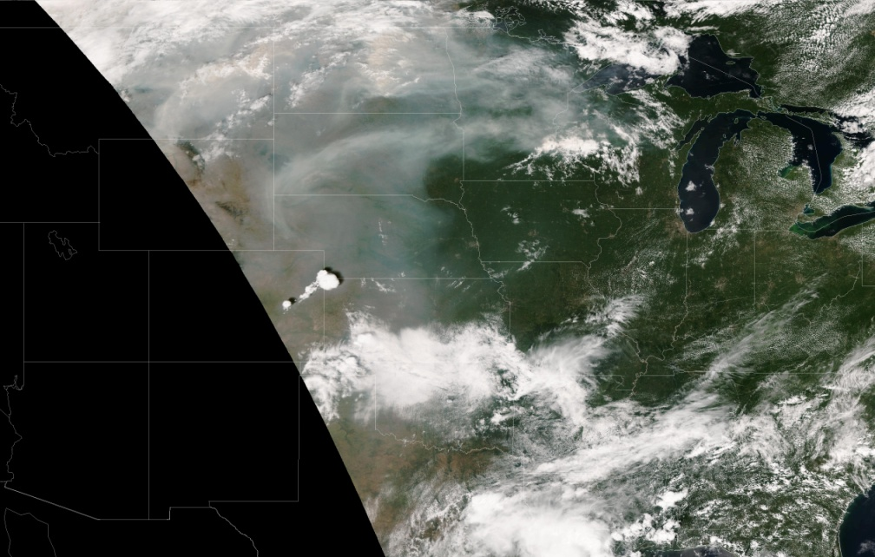
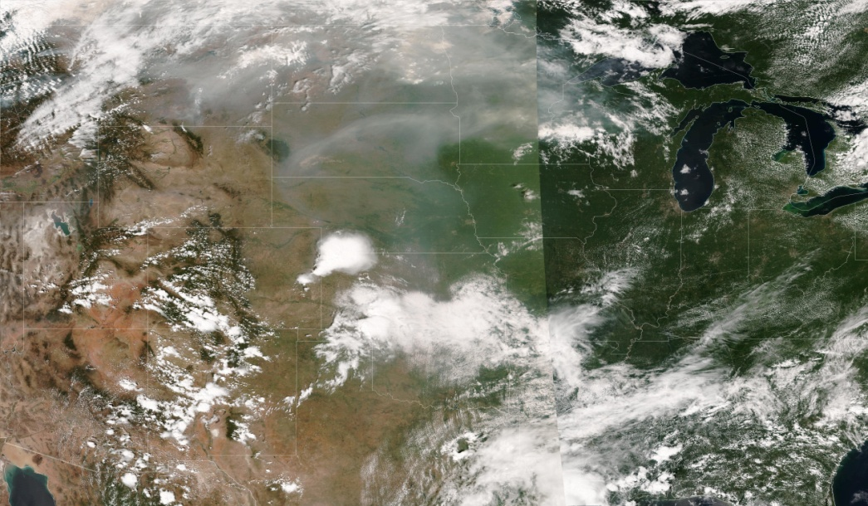
Example for August 21, 2015: RGB Imagery
Overpass 2 (2020 UTC)
Overpass 1 (1840 UTC)
eIDEA only plots the RGB image from Overpass 2 for the overlapping region

Slide 19
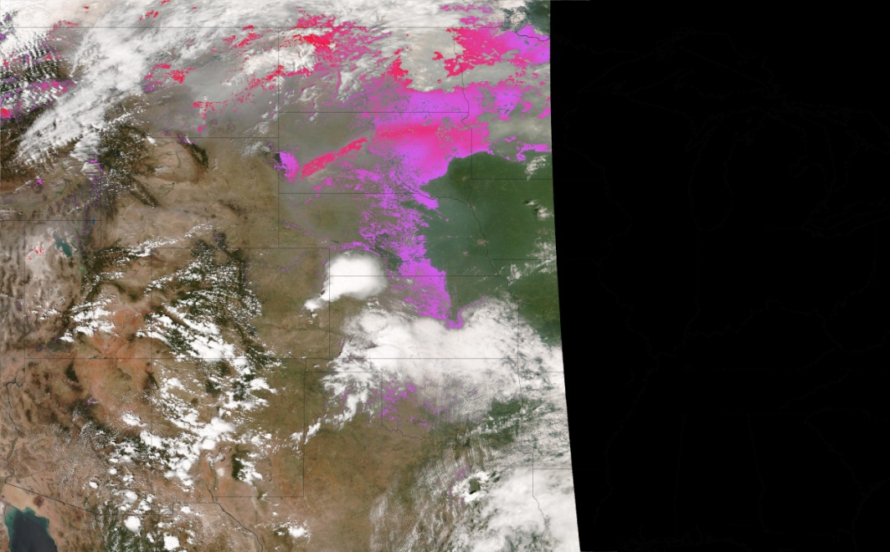
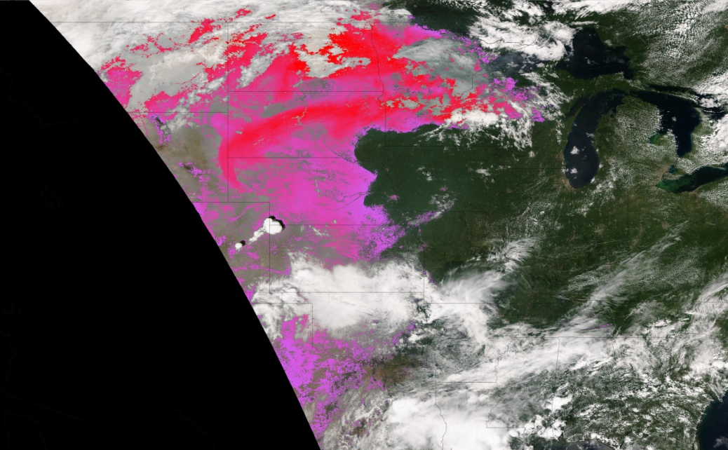
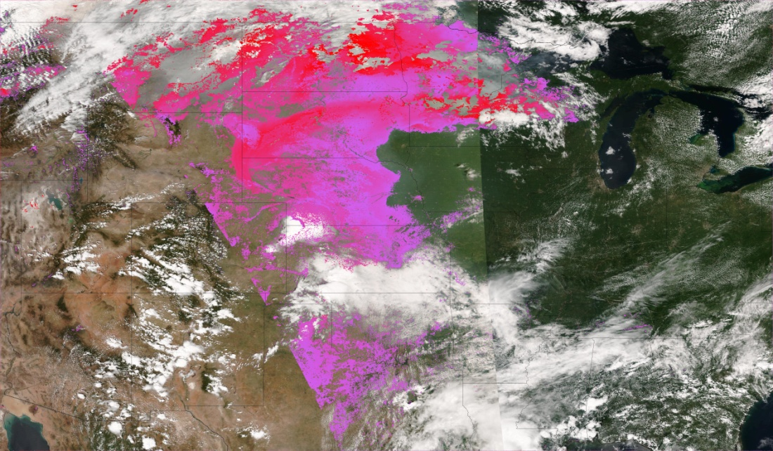
Example for August 21, 2015: Smoke Mask
Overpass 2 (2020 UTC)
Overpass 1 (1840 UTC)
Because of different solar/satellite geometries, the smoke mask algorithm obtains different results
In this case, Overpass 2 detected much less smoke
Plot Overpass 1 if nothing detected in Overpass 2 for overlapping region to increase data coverage

Slide 20
eIDEA: Animations
Click “Home” or eIDEA logo to return to home page
Click to view animations
Link to additional documentation
Product Description
Links to NOAA Hazard Mapping System (HMS), main IDEA, and eIDEA-Alaska webpages
Animation controls
Product legends

Slide 21
3-Day Movie Loops
Smoke Mask and RFP
PM_{2.5}
Animation controls
AOT
Regional subsets

Slide 22
Navigation Tools
Use arrows on either side of selected date to load data for previous or next day
Use + or – buttons to zoom in/out
Or double click on map to zoom in
Or scroll forward/backward
Click on date to open calendar
Click on specific date to select it
“Today” is shaded yellow
Use arrow buttons in calendar to change month

Slide 23
Visualization Tools
Click on “County” button to turn county boundaries on/off
Click on “Labels” button to turn local, state, and national labels and boundaries on/off

Slide 24
Next Steps for eIDEA
We demonstrated eIDEA to NWS Incident Meteorologists (IMETs) in March 2016
We already used their initial feedback to improve eIDEA
Expecting additional feedback after the 2016 fire season
We will use your feedback from today to improve eIDEA as well! (group discussion)
Working toward additional formats for fire and smoke products:
Mobile app coming in next year
AWIPS-II coming soon
GOES-R data coming next year!!!

Slide 25
Breakout Session
Please break into groups of 2-3; at least one group member must have a laptop
Focus on a few days this summer when smoke impacted your region or forecast area
Open the eIDEA website: http://www.star.nesdis.noaa.gov/smcd/spb/aq/eidea
Use the “Case Study Worksheet” to guide your analysis
Answer questions on the “Case Study Questionnaire” – we will use it to guide our discussion before lunch (and I’ll collect it so we can capture your feedback)

