Slide 1
Navy Aerosol and Visibility Forecasting: Use of Satellite Aerosol Data
Edward Hyer
NRL – Monterey, CA
NOAA Satellite Aerosol Workshop – College Park, MD
14 September 2016

Slide 2
In This Talk
Navy Aerosol Forecasting: Motivation
Satellite Data in the Forecasting System
Specific product needs for data assimilation
Satellite data pre-processing for assimilation
Results with VIIRS IDPS Aerosol product
Results with VIIRS Enterprise Aerosol product
Next Steps

Slide 3
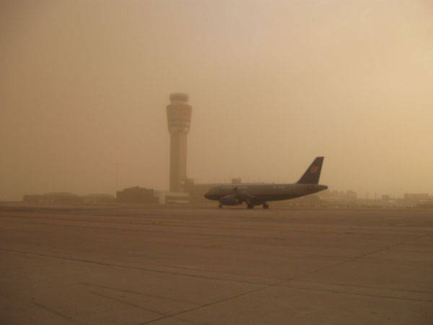
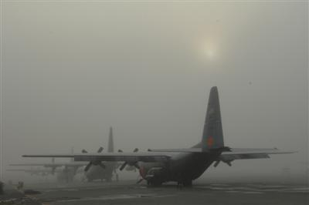
Navy Aerosol Prediction - Motivation
18 July 2009
Phoenix Sky Harbor Intl. Airport
26 October 2007
Channel Islands Air National Guard Base
Can you tell us when this is coming?
How long until we can see again?
Visibility Impacts: Optical Atmosphere
Physical Impacts: e.g. dust/ash in jet engines
Health impacts

Slide 4
Satellite Data in Navy Aerosol Applications
Component Assimilated Data
FLAMBE – Hourly, global, biomass emission fluxes in real-time and archived since 2000
DSD – Global dust source database
NAVDAS-AOD – data assimilation, produces 6-hourly, global 3-d distributions of aerosol species (sulfate, smoke, dust, salt), in real-time and back to 2000
NAAPS Validation
MODIS and GOES data used to produce gridded smoke emissions (FLAMBE, WF-ABBA)
R&D: Himawari-8 (GOES-R to come)
MODIS Dust Enhancement Product, NRL DEBRA product from Meteosat, and TOMS AI used to identify dust sources
NRL Level 3 version of MODIS AOD
--+VIIRS AOD +AVHRR AOD
AERONET and CALIPSO climatology used for speciation
R&D: CALIPSO used for 3-d var data assimilation and validation , GEO AOD under testing
AERONET – AOD, absorption, size
CALIPSO and MISR – Vertical Profile

Slide 5
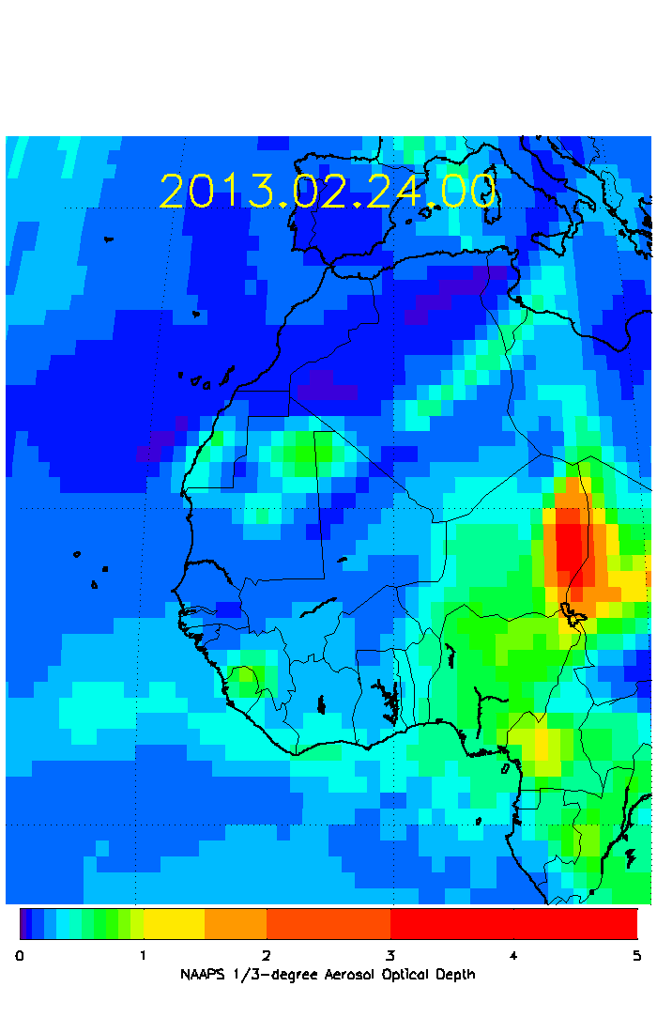
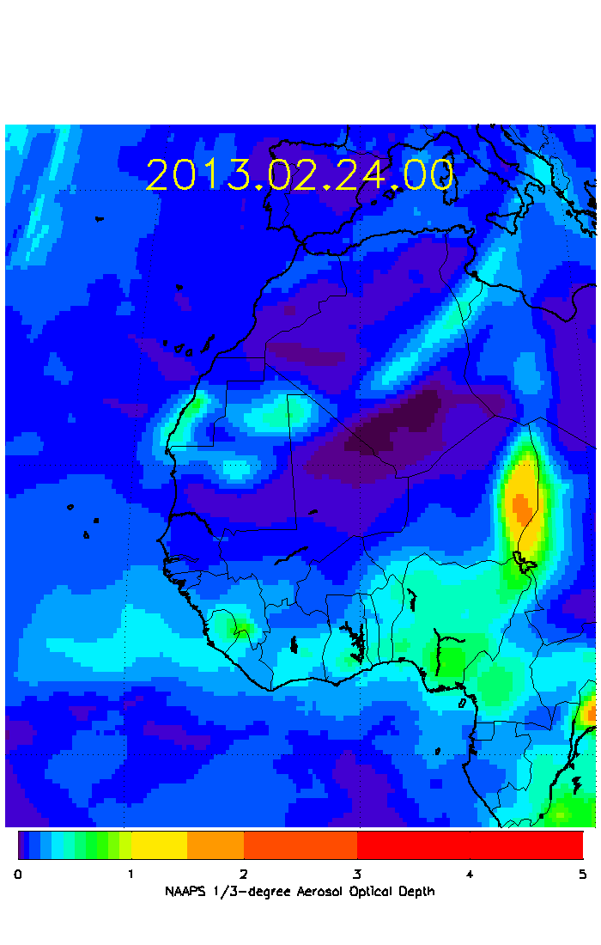
The Navy Aerosol Analysis and Prediction System (NAAPS)
Operational since 2005 (first global operational forecast in the world)
Satellite AOD assimilation operational since 2009 (world’s first)
In 2013, NAAPS was upgraded from 1-degree to 1/3-degree resolution
Also upgraded from NOGAPS to NAVGEM meteorology
Model details in Lynch et al. GMD 2016

Slide 6
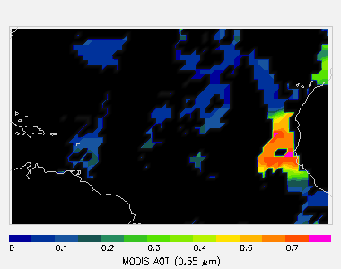
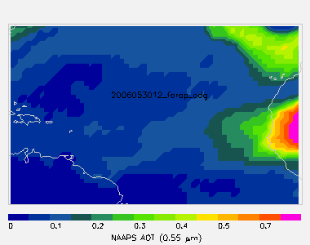
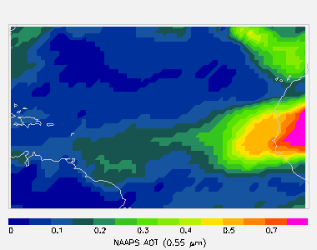
AOD Data Assimilation for NAAPS
MODIS RGB
MODIS AOD
Navy Aerosol Analysis and Prediction System (NAAPS) operational since 2005
Navy Variational Data Assimilation System for AOD (NAVDAS-AOD) Operational at FNMOC from September 2009 (MODIS over ocean)
Global MODIS is assimilated operationally as of February 2012
J.L. Zhang et al., “A System for Operational Aerosol Optical Depth Data Assimilation over Global Oceans”, JGR 2008.
NAAPS “Prior”
NAAPS + NAVDAS

Slide 7
Preparation of Satellite AOD for Assimilation
We start with Level 2 products generated by upstream data centers

Slide 8
Preparation of Satellite AOD for Assimilation
Post-process developed by NRL and UND, includes
Aggressive cloud filtering
Ocean wind speed correction
Land albedo correction
land surface and snow filters
Microphysical AOD bias correction
Aggregation for noise reduction
Estimation of prognostic uncertainty

Slide 9
NRL’s process for QA/QC of new satellite AOD products: 5 stages
Starting with a multi-month record of L2 data…
L2/L2 comparison to AERONET at full resolution
L2/L2 comparison to MODIS
Generation of candidate L3 AOD…
L3/L3 comparison to currently assimilated datasets
Test runs of NAAPS+NAVDAS-AOD using new data…
Model/Model comparison of analyzed aerosol fields
Model/AERONET comparison and model verification

Slide 10
Aerosol Data Products – Lots of Them!
Polar
MODIS
Dark Target
Levy et al., AMT 2013
Deep Blue
Sayer et al., JGR 2013
MAIAC
Lyapustin et al., JGR 2011
VIIRS
IDPS
(Jackson et al., JGR 2013)
(Liu et al., JGR 2014)
MODIS-like
Levy et al., AMT 2015
NOAA NDA-Enterprise
Liu et al. JGR 2016
More on this later!
And many more!
Geostationary
GOES
GASP
Prados et al., JGR 2007
Korea COMS
Meteorological Imager
Mijin et al., RSE 2013
Global Ocean Color Imager
Lee et al., RSE 2010
Myungje Choi et al., AMTD
Himawari-8
And many more!
Nighttime AOD retrieval
VIIRS DNB: McHardy et al. AMT 2015

Slide 11
Aerosol Data Products – Lots of Them!
Polar
MODIS
Dark Target
Levy et al., AMT 2013
Deep Blue
Sayer et al., JGR 2013
MAIAC
Lyapustin et al., JGR 2011
VIIRS
IDPS
(Jackson et al., JGR 2013)
(Liu et al., JGR 2014)
MODIS-like
Levy et al., AMT 2015
NOAA NDA-Enterprise
Liu et al. JGR 2016
More on this later!
And many more!
Geostationary
GOES
GASP
Prados et al., JGR 2007
Korea COMS
Meteorological Imager
Mijin et al., RSE 2013
Global Ocean Color Imager
Lee et al., RSE 2010
Myungje Choi et al., AMTD
Himawari-8
And many more!
Nighttime AOD retrieval
VIIRS DNB: McHardy et al. AMT 2015
We cannot hope to transition all of these products to our operational data assimilation system!
Is there some way we can predict the forecast impact of each new product?

Slide 12
Forecast Data Impact Study: Zhang et al., JGR 2014
Ocean-only, Terra only
RMSE
NAAPS vs AERONET
Land+OceanTerra+Aqua
Forecast Length (hours)

Slide 13
More Data, Better Forecast: Some Follow-up Questions
Why does forecast improvement not scale with data volume?
Why does the forecast skill not degrade smoothly?
More Coverage!
(+DB+MISR)
Can we predict the impact of added observations?

Slide 14
Using Time-Since-Last-Observation gives linear impact of additional data
Using Terra+Aqua buys nearly 12 hours improvement in T-S-L-O
Terra+Aqua forecast errors fall very close to estimate based on Aqua only

Slide 15
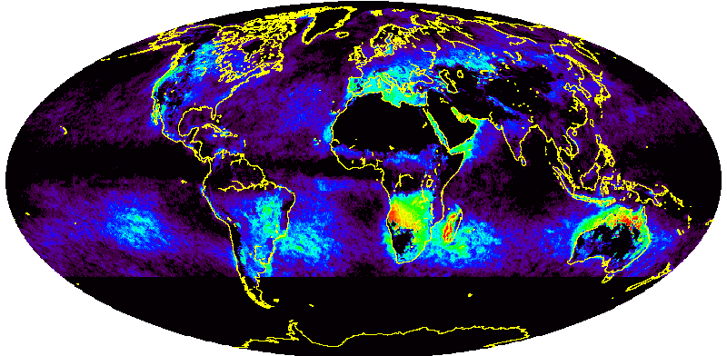
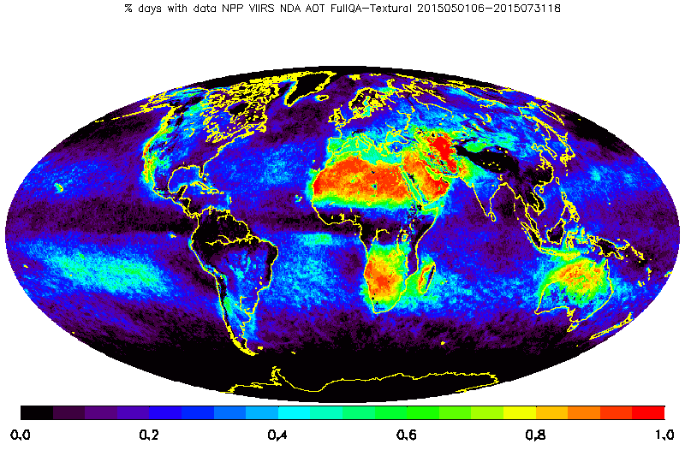
VIIRS Enterprise AOD can add very high observation volume
NRL/UND MODIS Level 3
VIIRS NDA ‘FullQA’
Fraction of Days with Assimilation Data (May-June-July 2015)
Comparison for May-June-July 2015
MODIS Collection 5 processed to NRL/UND L3 Data Assimilation Product
VIIRS Enterprise AOD processed using in-granule QA + Textural Filtering

Slide 16
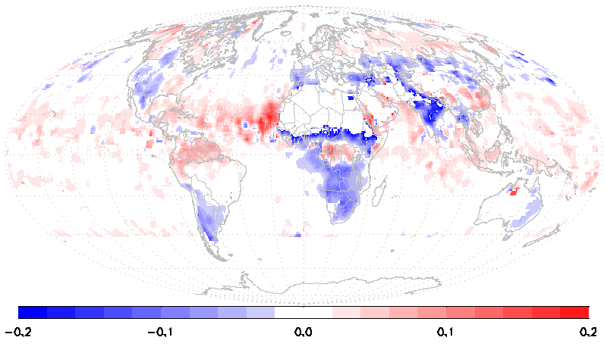
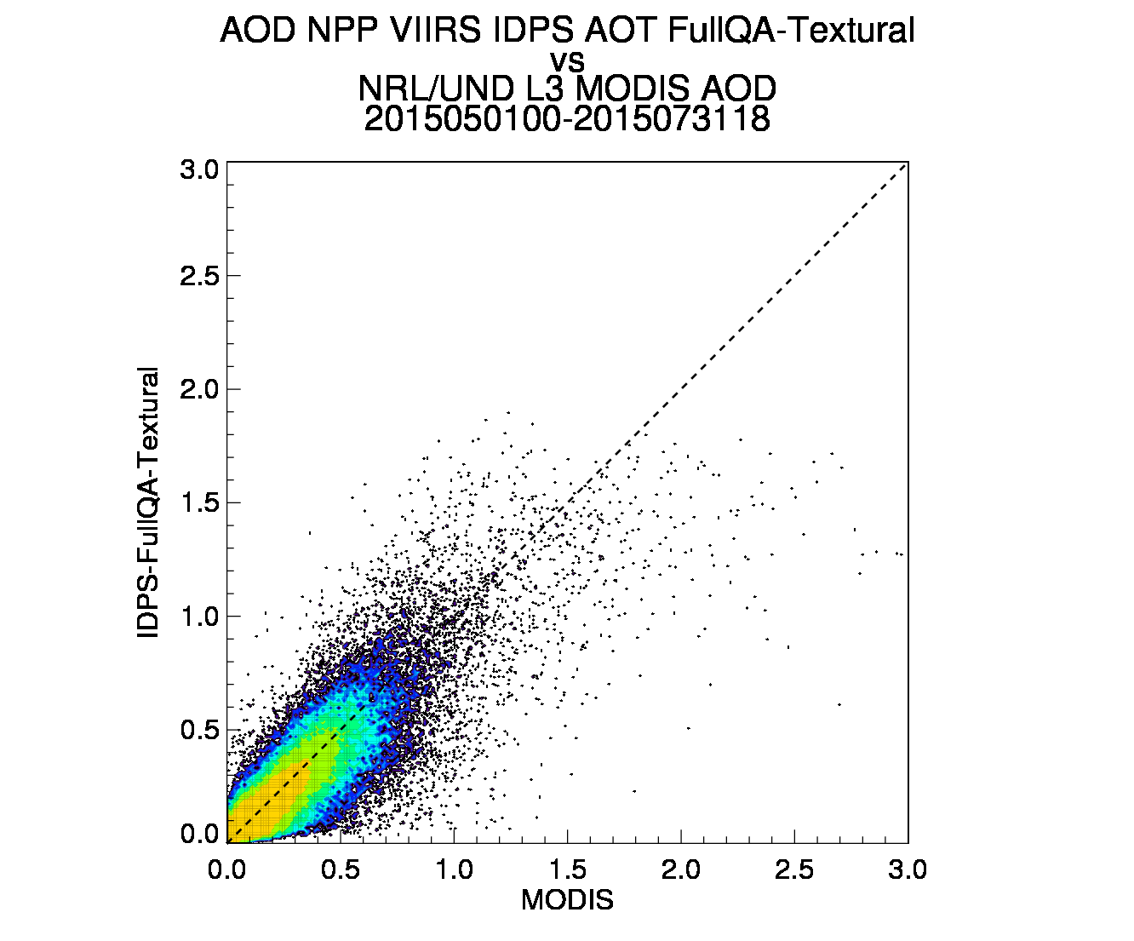
NOAA Enterprise AOD vs IDPS VIIRS Aerosol EDR
1
3
2
IDPS
Mean AOD difference (VIIRS-MODIS)
3-month comparison to MODIS NRL/UND L3 Data Assimilation product: 201505-201507
VIIRS data aggregated and filtered ‘FullQA’ + buddy checks and neighborhood tests
Left: map of AOD differences (paired) (smoothed for plotting)
Right: scatter-density plot of AOD differences vs MODIS

Slide 17
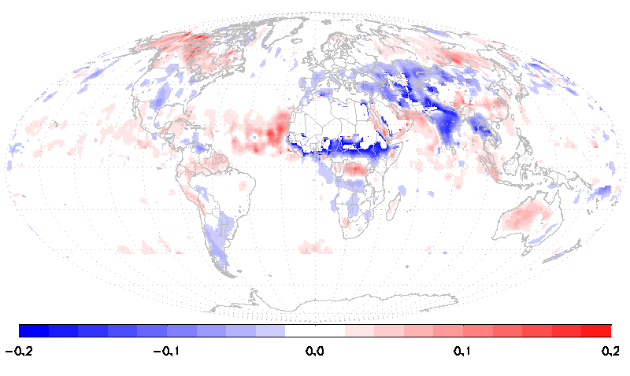
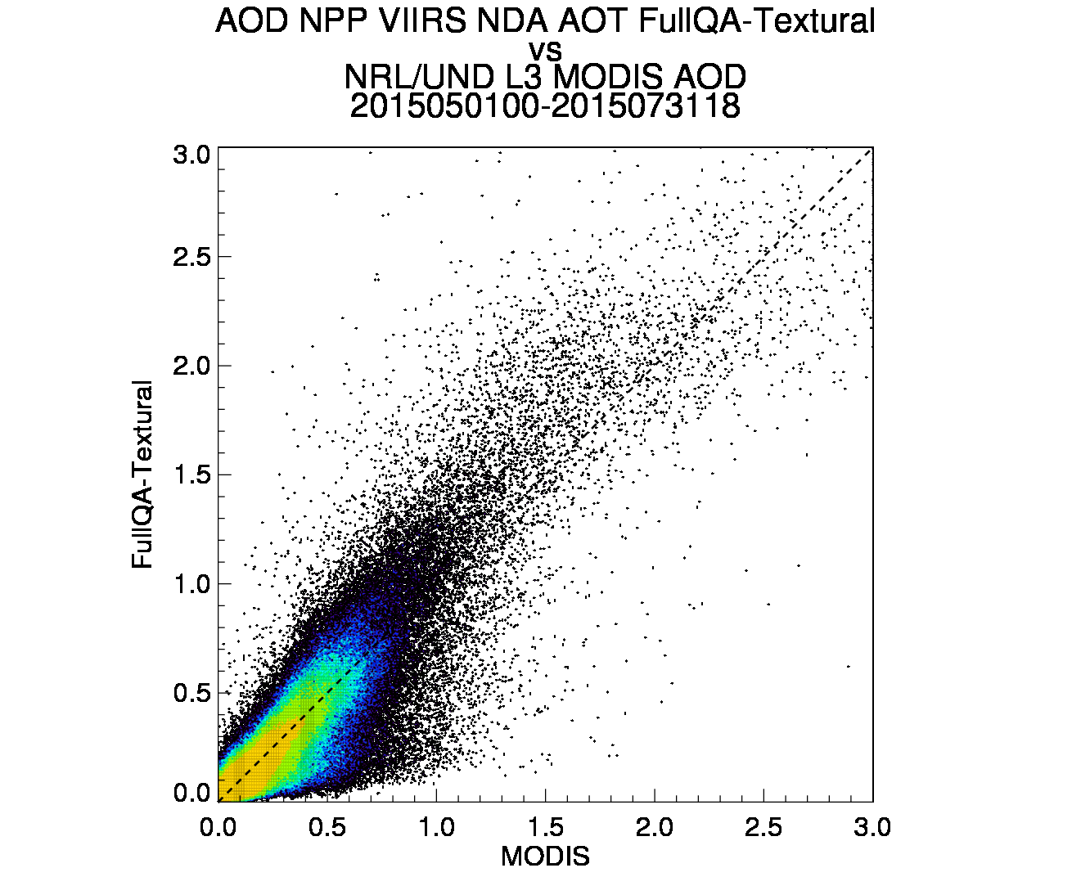
NOAA Enterprise AOD vs IDPS VIIRS Aerosol EDR
1
3
2
Enterprise
Mean AOD difference (VIIRS-MODIS)
VIIRS data aggregated and filtered ‘FullQA’ + buddy checks and neighborhood tests
3-month comparison to MODIS NRL/UND L3 Data Assimilation product: 201505-201507
Left: map of AOD differences (paired) (smoothed for plotting)
Right: scatter-density plot of AOD differences vs MODIS
Reduced bias over open ocean
Reduced bias over land
Inclusions of high AOD values (excluded from IDPS product)
Data assimilation testing of new Enterprise product is underway at NRL

Slide 18
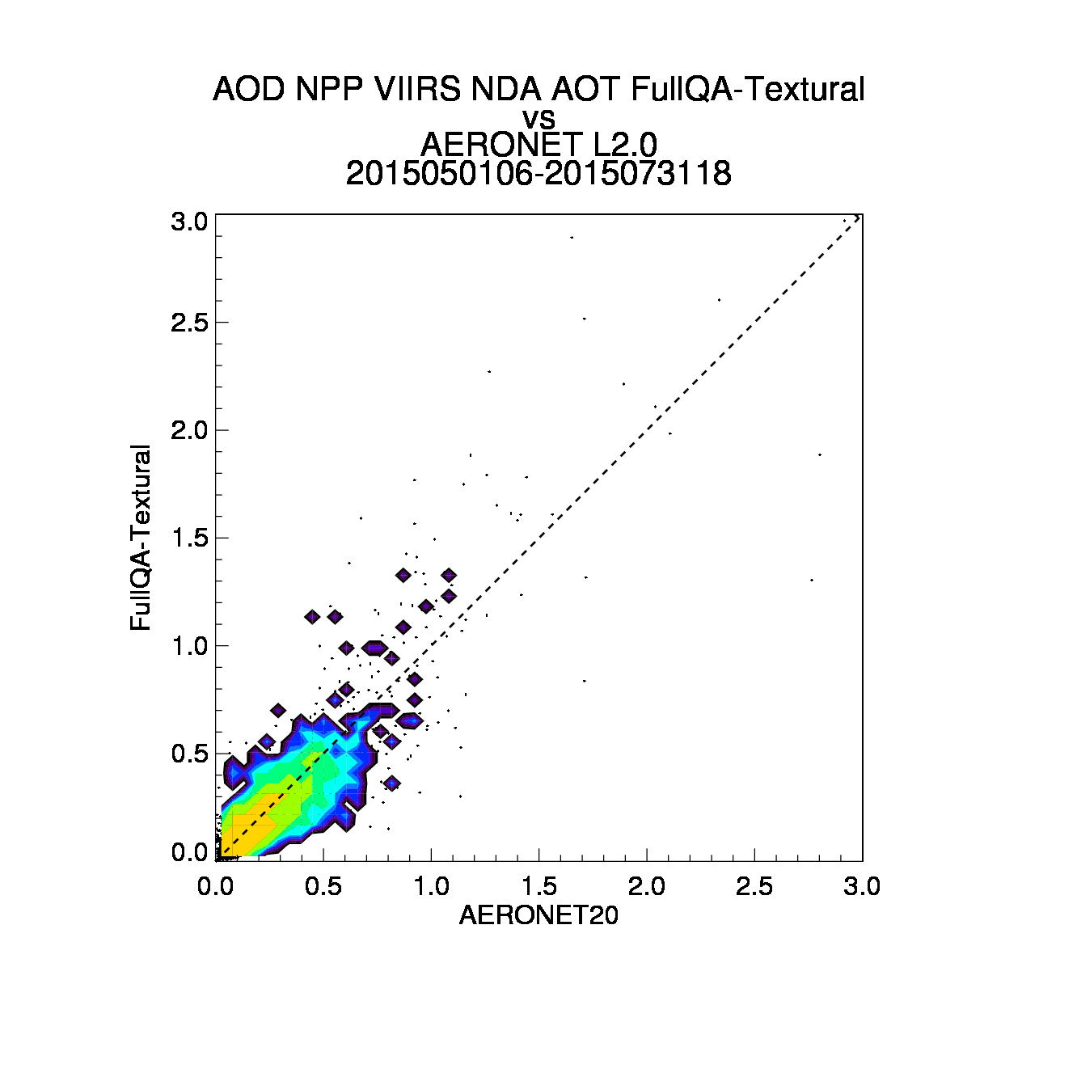
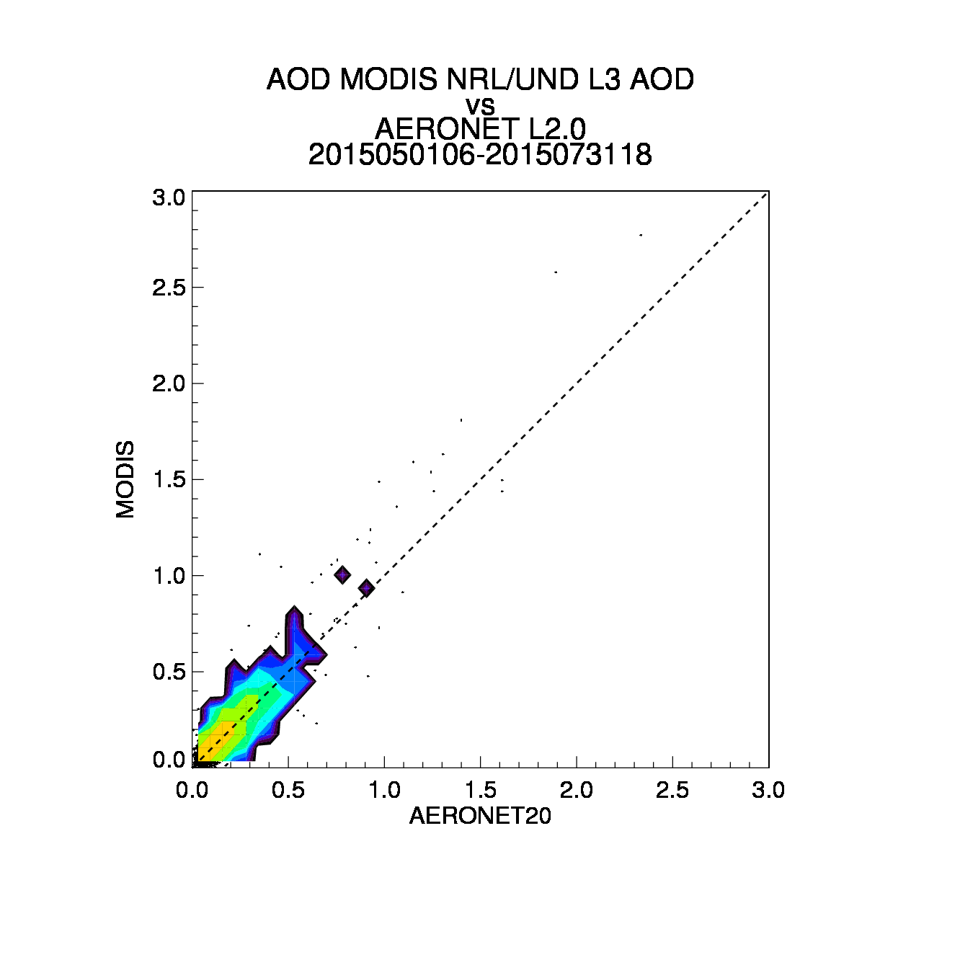
VIIRS Enterprise Product shows good agreement with AERONET
VIIRS NDA ‘FullQA’
NRL/UND MODIS Level 3
Comparison for May-June-July 2015
Gridded comparisons to global AERONET L2.0
See Liu et al. JGR 2016 for L2 detailed comparisons to AERONET

Slide 19
Conclusions
Navy aerosol applications require high-quality datasets in near-real-time
Aerosol forecasts are data-limited: additional high-quality data needed to maximize forecast skill
VIIRS Enterprise AOD product is a high-quality AOD dataset
Compares well with NRL/UND L3 MODIS currently assimilated
Compares well with ‘gold standard’ AERONET AOD
NRL is currently testing forecast impact of NOAA Enterprise AOD product

Slide 20
Thank You!
NRL:
Jeff Reid
Doug Westphal
Peng Lynch
Arunas Kuciauskas
U. North Dakota:
Jianglong Zhang
Yingxi Shi
(now at NASA-GSFC)
Ted McHardy
Sponsors:

Slide 21
Extra Slides

Slide 22
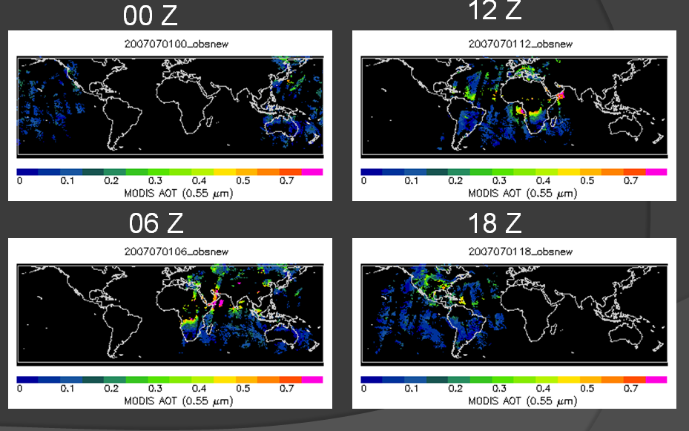
We know the location and time of all our assimilated observations
MODIS orbit (sunlit node only) dictates patterns of data availability

Slide 23
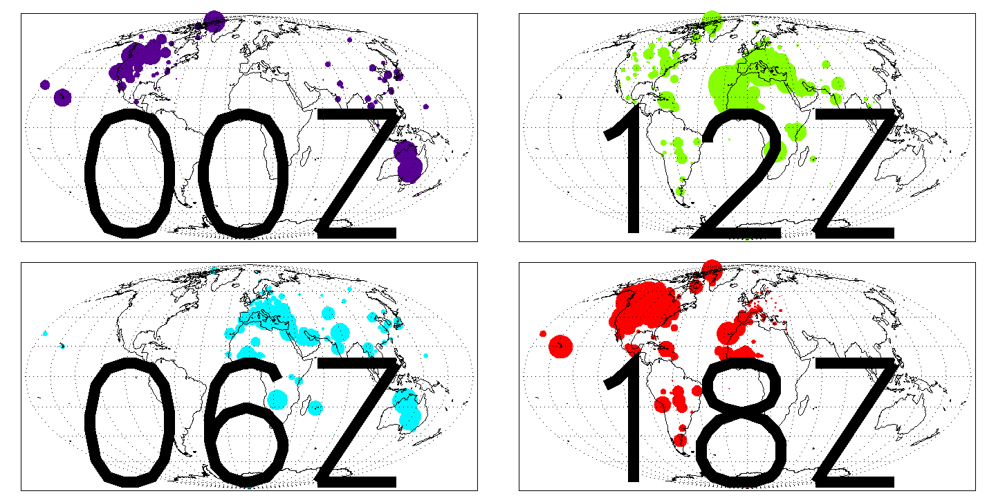
We know the location and time of all our verification data
These spatial differences will affect the distribution of AODs used for verification (land vs. ocean, polluted vs clean)

Slide 24
Prognostic Error Model: MODIS vs Enterprise VIIRS
Satellite Retrieved AOD (Prognostic)

Slide 25
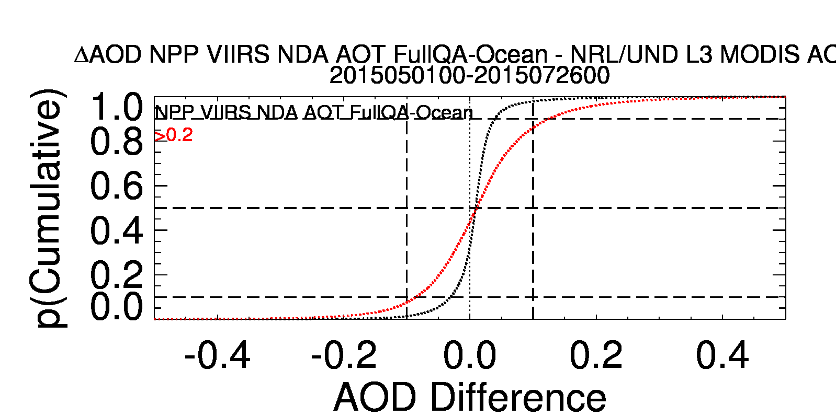
VIIRS Enterprise “OCEAN” vs MODIS L3

Slide 26
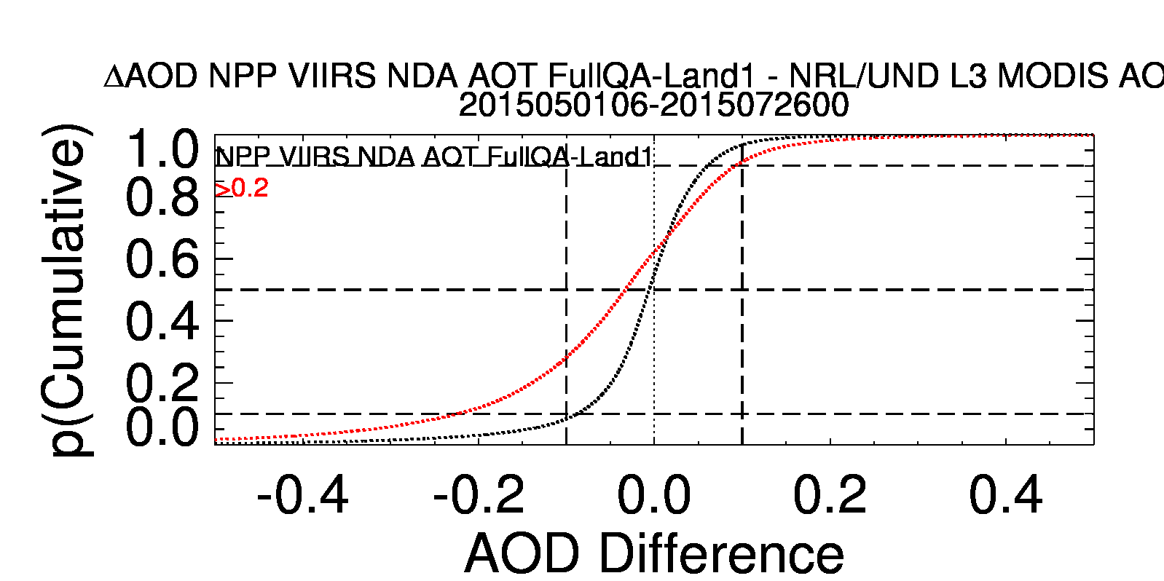
VIIRS Enterprise “LAND-SW” vs MODIS L3

Slide 27
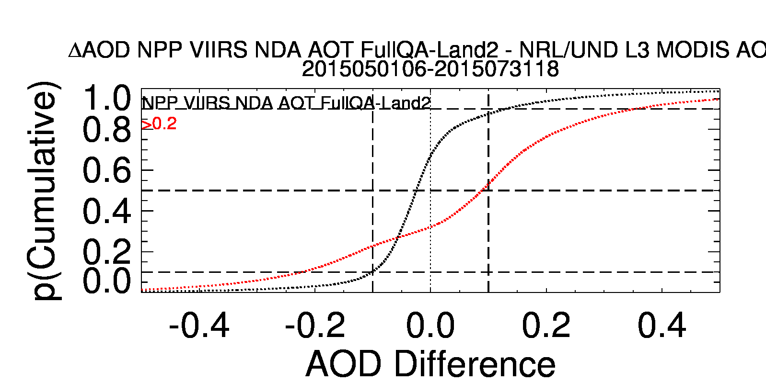
VIIRS Enterprise “LAND-SWIR” vs MODIS L3

Slide 28
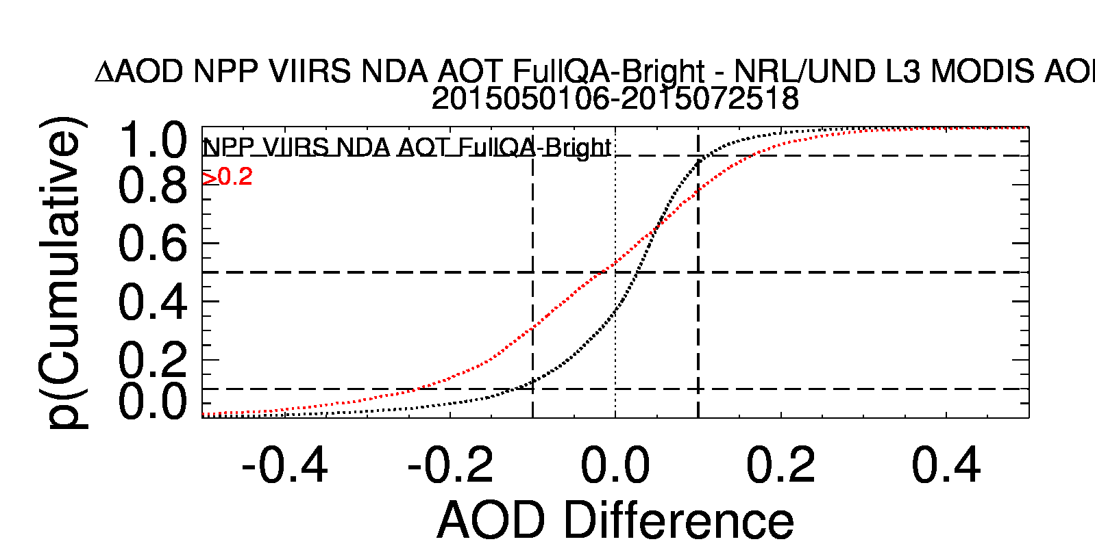
VIIRS Enterprise “LAND-BRIGHT” vs MODIS L3

Slide 29
VIIRS Enterprise vs MODIS: Smoke Box

Slide 30
VIIRS Enterprise vs MODIS: Dust Box

Slide 31
VIIRS Enterprise vs MODIS: Boreal Fire Smoke

