Slide 1




Enterprise Processing System (EPS) Aerosol Detection Product
Shobha Kondragunta and Istvan Laszlo
NOAA/NESDIS Center for Satellite Applications and Research
Pubu Ciren
IMSG

Slide 2
Aerosol Detection Product
Identify the presence of aerosol in the atmosphere and classify it as dust or smoke or volcanic ash.
  Required accuracy: 80% for dust; 70% for smoke; 60% for volcanic ash
  Attributes:
  Qualitative imagery product
Useful applications: operational air quality forecasting; aerosol data assimilation in numerical models
 | GOES-R ABI | SNPP VIIRS
Spatial | 2 km | 750 m
Temporal | 5 min | Once a day
Coverage | Regional | Global
SNPP VIIRS RedGreenBlue Image

Slide 3
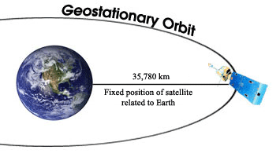
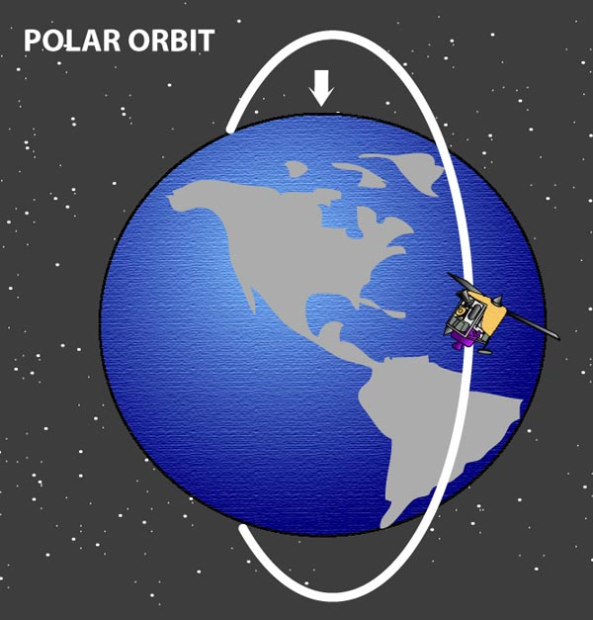
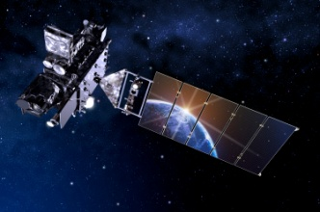
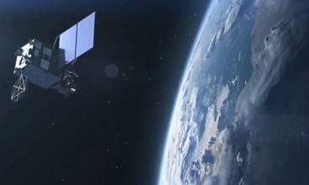
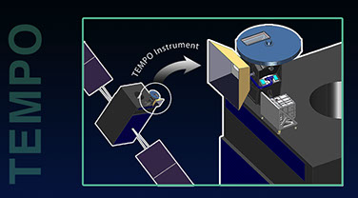
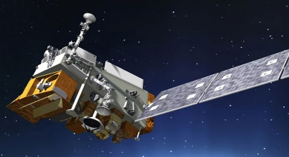
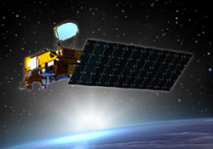
Enterprise Processing System Approach
ABI
AHI
TEMPO
SNPP
Aqua
Sensors with different bands, resolution, pixel size, geographical coverage, and frequency but one scientific algorithm and software to process the data and generate aerosol product outputs in same format.

Slide 4
EPS Aerosol Detection
Start
Start
Start
Allocate RAM & read input
Allocate RAM & read input
Allocate RAM & read input
Initialize output
Initialize output
Initialize output
Done
Output
results
Output
results
Process each pixel
Output
results
Process each pixel
Process each pixel
No
No
No
Daytime?
Daytime?
Daytime?
End
End
End
Yes
Yes
Yes
Clouds and snow/ice screening
over land
Yes
Clouds, snow/ice and turbid water screening over ocean
Yes
Land?
Land?
Yes
Land?
No
No
No
Algorithm path
Algorithm path
1
2
1
2
3
3
IR-Visible
Dust
detection
IR-Visible
Smoke
detection
Deep-blue
Dust
detection
Deep-blue
Smoke
detection
IR-Visible
Dust
detection
IR-Visible
Smoke
detection
Deep-blue
detection
Deep-blue
Smoke
detection
Update output for current pixel
Update output for current pixel
Update output for current pixel

Slide 5
Sensors and Wavelengths
EPS Algorithm |  | Sensor
 |  | VIIRS | MODIS | ABI | AHI
1 | 0.412µm | M1 | Band 8 | X | X
2 | 0.445 µm | M2 | Band 9 | X | X
3 | 0.488 µm | M3 | Band 3 | Band 1 | Band1
4 | 0.555 µm | M4 | Band 4 | X | x
5 | 0.640 µm | M5 | Band 1 | Band 2 | Band3
6 | 0.746 µm | M6 | Band 15 | X | X
7 | 0.865 µm | M7 | Band 2 | Band 3 | Band 4
8 | 1.24 µm | M8 | Band 5 | X | X
9 | 1.38 µm | M9 | Band 26 | Band 4 | X (Band 5)*
10 | 1.61 µm | M10 | Band 6 | Band 5 | Band 5
11 | 2.25 µm | M11 | Band 7 | Band 6 | Band 6
12 | 3.70 µm | M12 | Band 20 | X(Band 7)* | X(Band 7)*
13 | 4.05 µm | M13 | Band 21 | Band 7 | Band 7
15 | 10.7 µm | M15 | Band 31 | Band 14 | Band 14
15 | 12.01 µm | M16 | Band 32 | Band 15 | Band 15
Green: used by both deep-blue based and IR-visible based detection algorithms
Blue: only used by deep-blue based detection algorithm
Brown: only used by IR-Visible based detection algorithm.
*: band is missing but using the corresponding band in the parentheses instead.
X: channel is missing, but not needed, and filled with “-999.9”

Slide 6
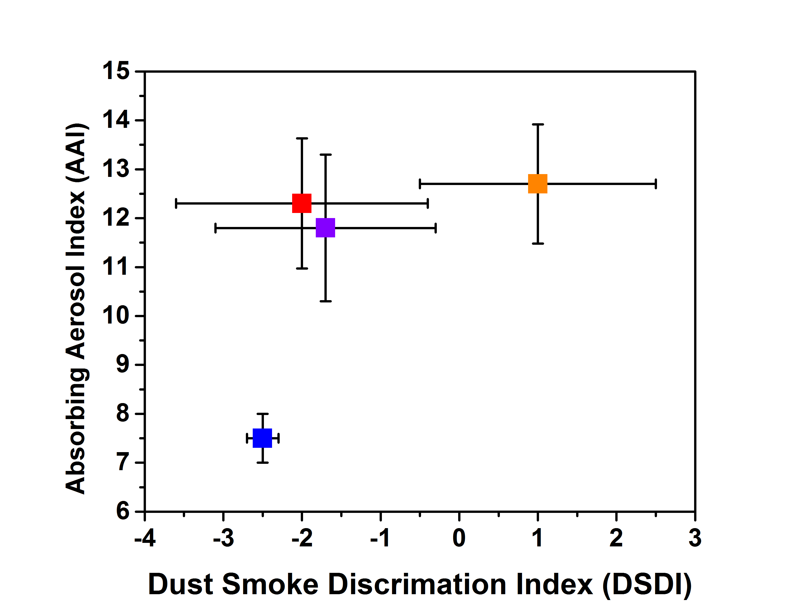
EPS Aerosol Detection Algorithm Overview (1)
Input Reflectances:
Dust: 412, 440, 2250 nm
Smoke: 412, 440, 2250 nm
Spatial Variability Test: 412 nm
Turbid Water Test: 488 nm, 1.24 µm, 1.61 µm, 2.25 µm
Bright Pixel Test:1.24 µm, 2.25 µm
NDVI Test: 640 nm, 865 nm
Snow Test: 865 nm, 1.24 µm
dust
smoke
smog
clear
Absorbing Aerosol Index
AAI = -100[1og₁₀(R₄₁₂/R₄₄₀) – log₁₀(R’₄₁₂/R’₄₄₀)]
Dust Smoke Discrimination Index
DSDI = -10[1og₁₀(R₄₁₂/R₂₂₅₀)

Slide 7
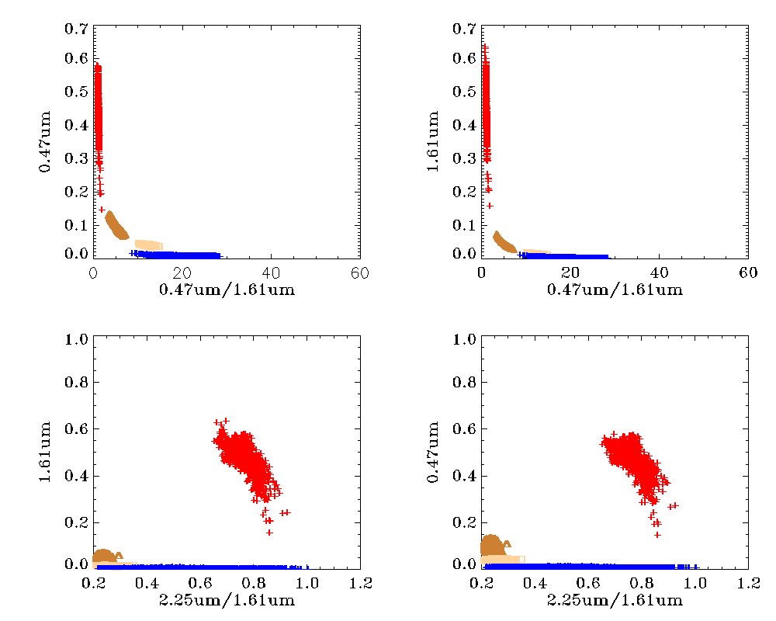
EPS Aerosol Detection Algorithm Overview (2)
For illustration purpose, scenes with dust, smoke, clouds, and clear sky over Ocean were manually chosen
Thick Dust
Clouds
Thin Dust
Thick Smoke
Clear Sky
Thin Smoke
Clear Sky
Algorithm takes advantage of spectrally varying absorption and scattering of dust, smoke, clouds, and surface

Slide 8
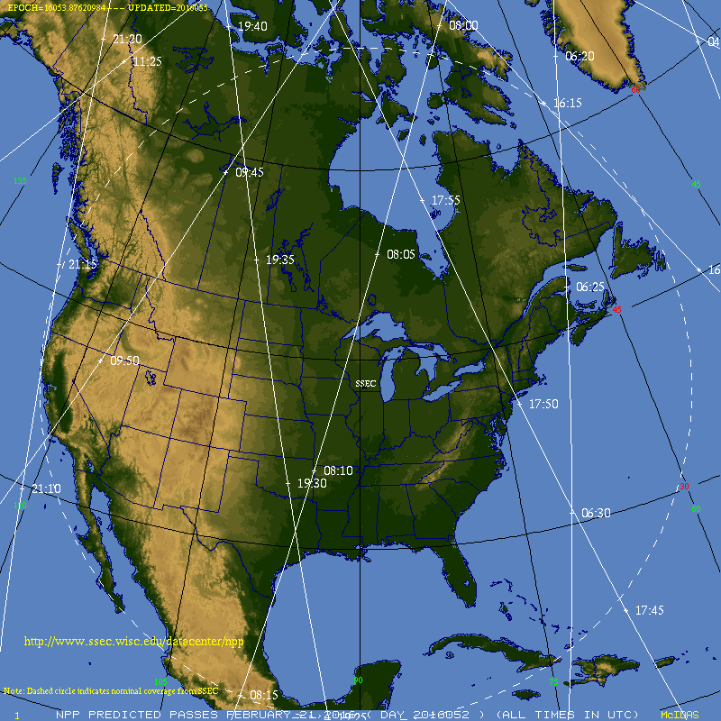
Status of the EPS algorithm
Developed, tested, and implemented on Direct Broadcast data covering the CONUS. eIDEA displays the data.
  Download data and/or imagery in near real time
It is new. Not operational (24/7) yet globally for data coming into NOAA operations. Expected to be by November 2016
Reprocessed entire 2015 global data and other select time periods
NOAA Satellite Aerosol Product Workshop
September 13-14, 2016

Slide 9
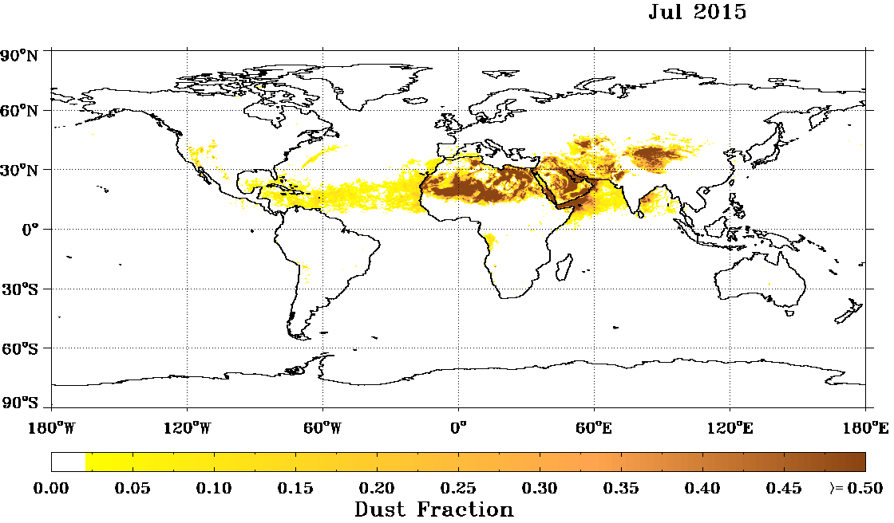
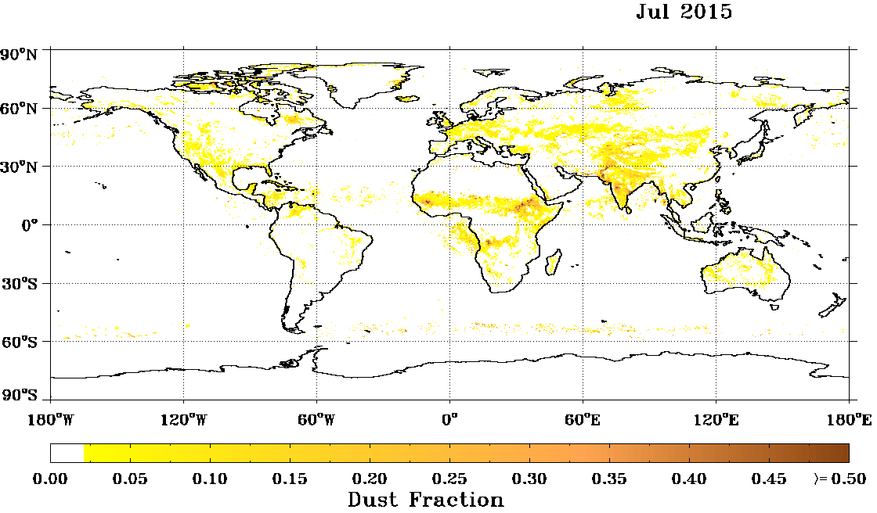
Dust Detection Product Improvements: Operational vs. EPS

Slide 10
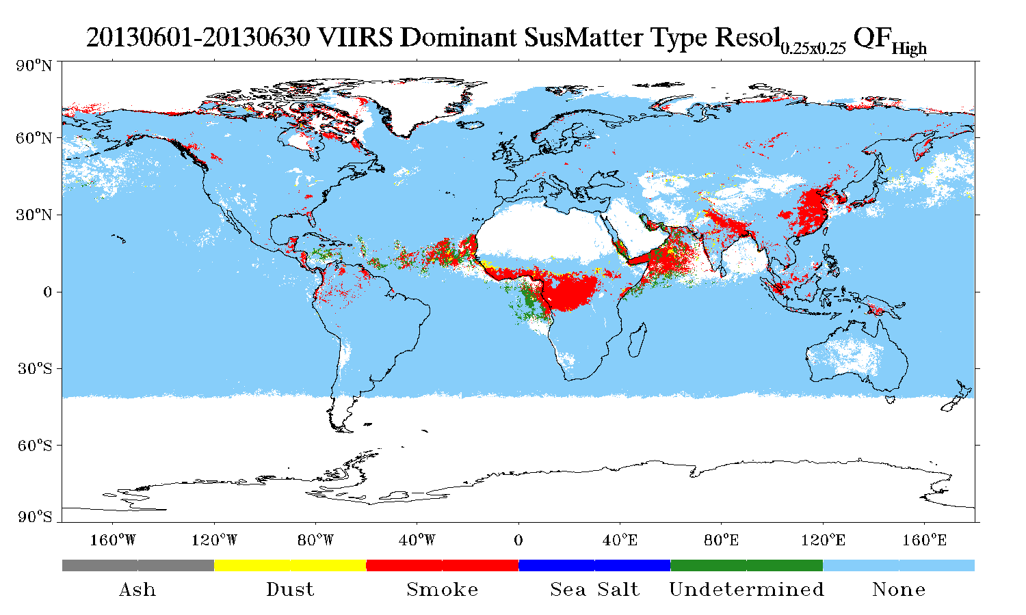
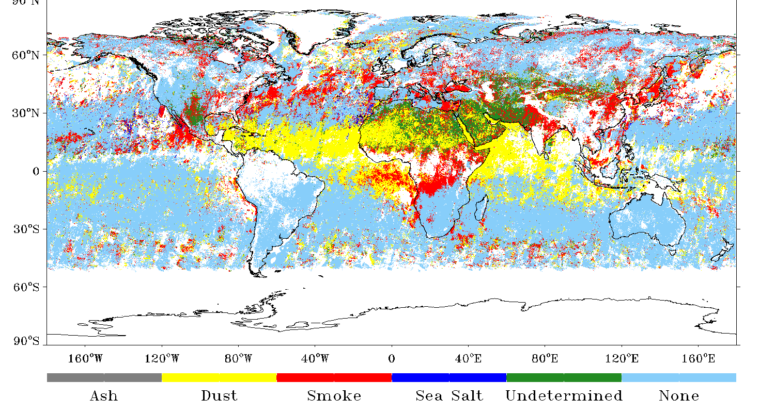
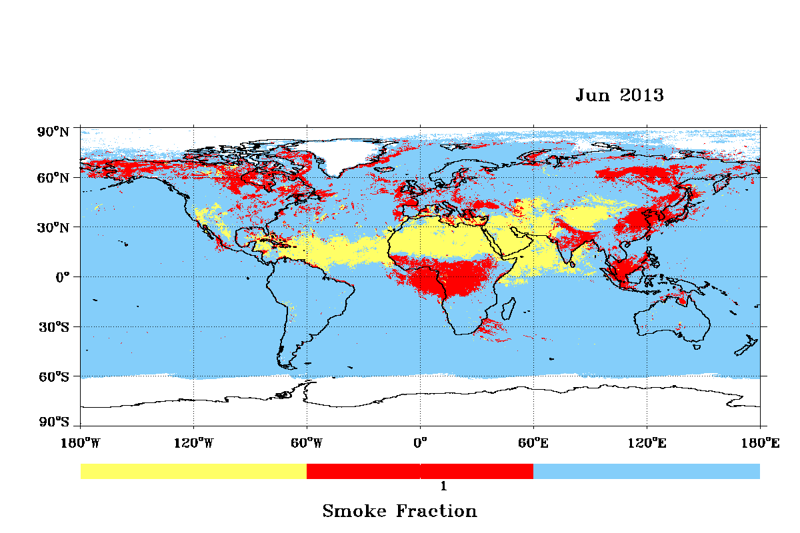
Operational
MISR
EPS
June 2013
0.25º x 0.25º
Ash Dust Smoke Sea Salt Undetermined None
Removed in EPS

Slide 11
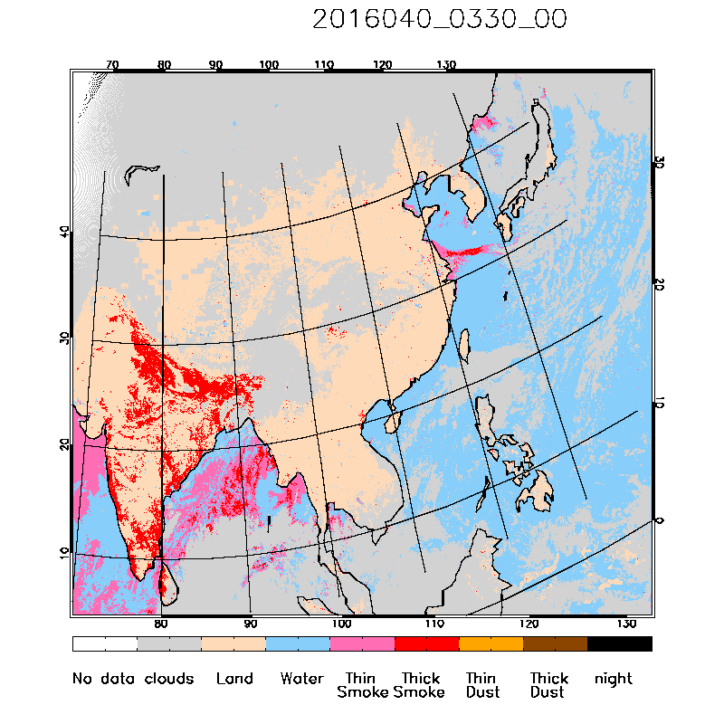
EPS: Himawari-8 AHI
NOAA Satellite Aerosol Product Workshop
September 13-14, 2016

Slide 12
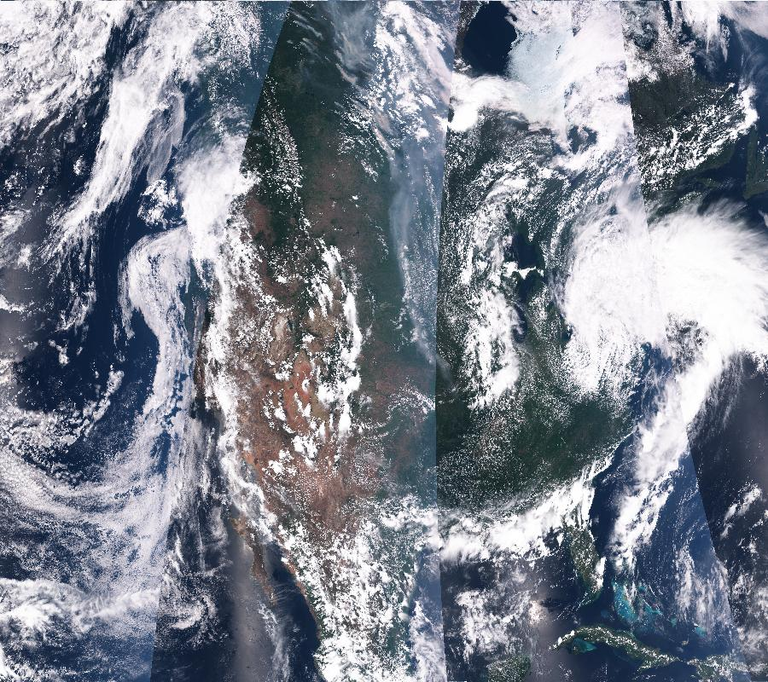
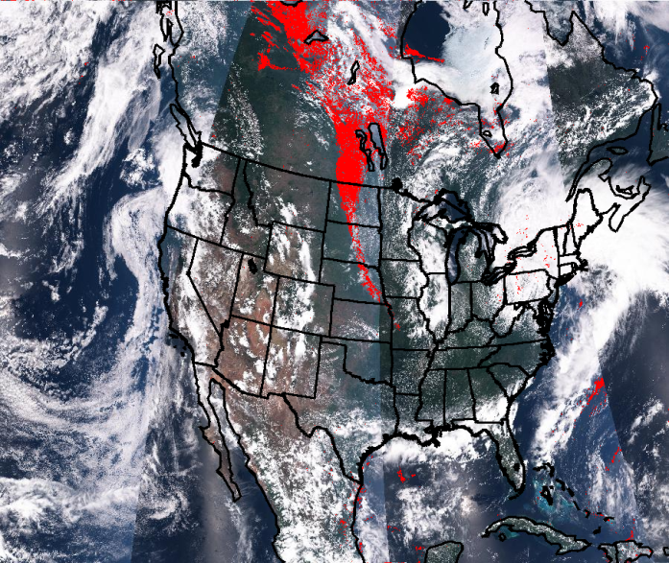
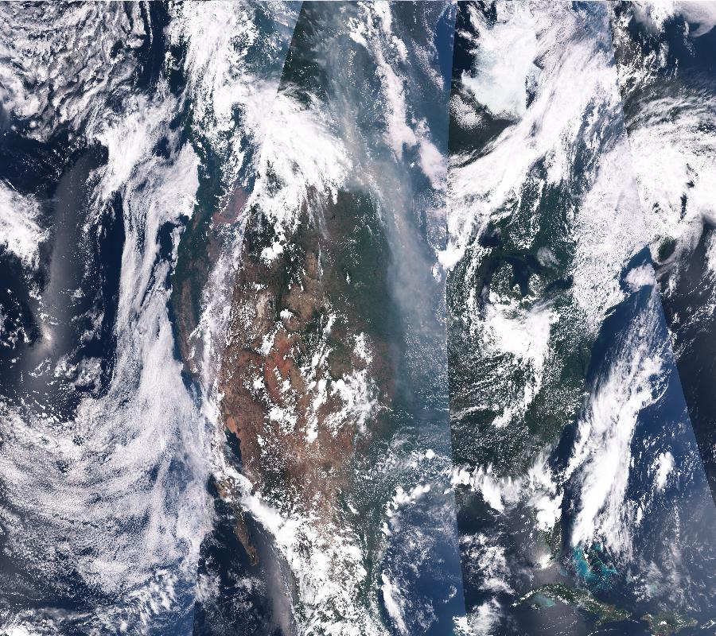
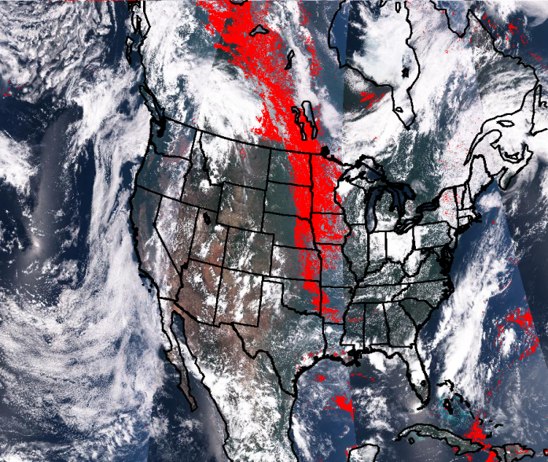
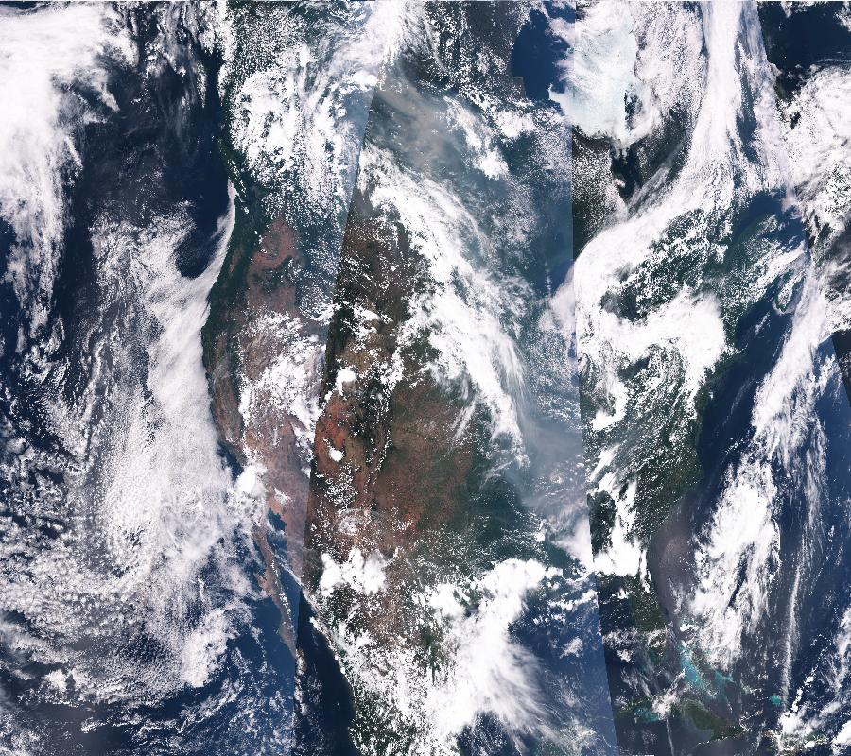
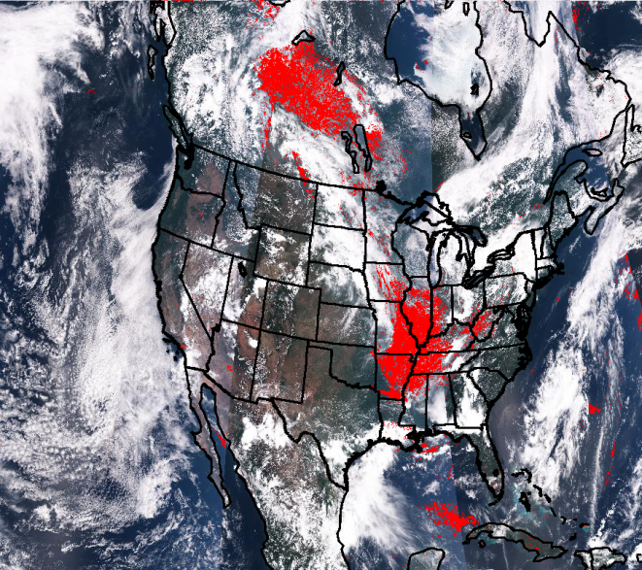
EPS: SNPP VIIRS
June 28, 2015
June 29, 2015
June 30, 2015
NOAA Satellite Aerosol Product Workshop
September 13-14, 2016

Slide 13
Performance Metrics (VIIRS vs. CALIPSO): Operational vs. Reprocessed
14-month Mean Accuracy
Operational
Reprocessed
Land
Type | True positive | False positive | True negative | False Negative | Accuracy (%) | POCD (%) | POFD (%)
Dust | 2202 | 69 | 2397 | 375 | 91.1 | 85.3 | 3.1
Smoke | 117 | 98 | 4214 | 1 | 95.4 | 99.2 | 45.5
Water
Type | True positive | False positive | True negative | False negative | Accuracy (%) | POCD (%) | POFD (%)
Dust | 297 | 11 | 139 | 10 | 95.4 | 96.4 | 3.3
Smoke | 107 | 85 | 2309 | 3 | 92.7 | 97.2 | 44.2

Slide 14
 | Pixel Quality Level |  |  |  | Applies to
Condition | Low | Medium | High | Not produced | Land |  | Water
 |  |  |  |  | smoke | dust | smoke | dust
Cloud contamination (corresponding tests in VCM/ECM shown cloudy or R_{M1}>0.5) |  |  |  | x | x | x | x | x
Snow/ice (presence of snow/ice in ancillary snow/ice mask, or internal snow/ice test) |  |  |  | x | x | x | x | x
Cloud shadow | x |  |  |  | x | x | x | x
Cloud adjacency | x |  |  |  | x | x | x | x
fire spot | x |  |  |  | x
sun-glint | x |  |  |  |  |  | x | x
bright pixel | x |  |  |  |  | x
residual cloud (M₁ STD>0.01) |  |  |  | x | x | x
residual cloud (M₇ STD>0.005) |  |  |  | x |  |  | x | x
bad SDR |  |  |  | x | x | x | x | x
SZA>80° |  |  |  | x | x | x | x | x
SZA>65° and SZA<=80° | x
Turbid/shallow water |  |  |  | x |  |  | x | x
phytoplankton bloom |  |  |  | x |  |  | x
Overall Quality | Unless determined in above conditions, it is determined by the following paths
IR-visible algorithm path only | Determined by the average confidence value (between 0-1) for all tests. Confidence value for each test is calculated by how close the actual test value is to the threshold. If average confidence value < 0.33 then low quality is set If average confidence value > 0.66 then high quality is set Between 0.33 and 0.66 then medium quality is set |  |  |  | x | x | x | x
DAI-based algorithm path only | Determined by the average confidence value (0-1) for all tests. Confidence value for each test is calculated by how close the actual test value is to the threshold. ( Quality flags setting is the same as above) |  |  |  | x | x | x | x
Both algorithm path | Determined by ensemble confidence values from above two paths, i.e., ensemble confidence=average confidence(IR-visible path)+average confidence(DAI-based path) If ensemble confidence value < 0.33 then low quality is set If ensemble confidence value > 0.66 then high quality is set Between 0.33 and 0.66 then medium quality is set |  |  |  | x | x | x | x

Slide 15
User Applications
eIDEA → accessed by operational air quality/weather forecasters (both AOD and aerosol detection are from EPS algorithms)
Smog blog (alg.umbc.edu/usaq)
Researchers
Exceptional events monitoring
Air quality modelers
Education and outreach (NOAA booth at AMS and AGU)
NOAA Satellite Aerosol Product Workshop
September 13-14, 2016

Slide 16
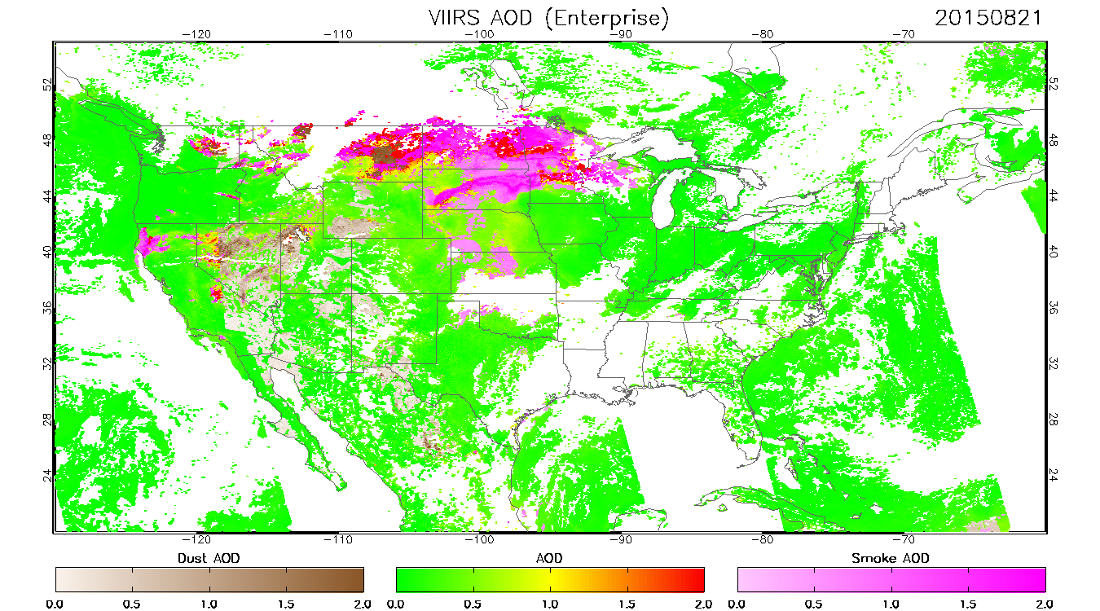
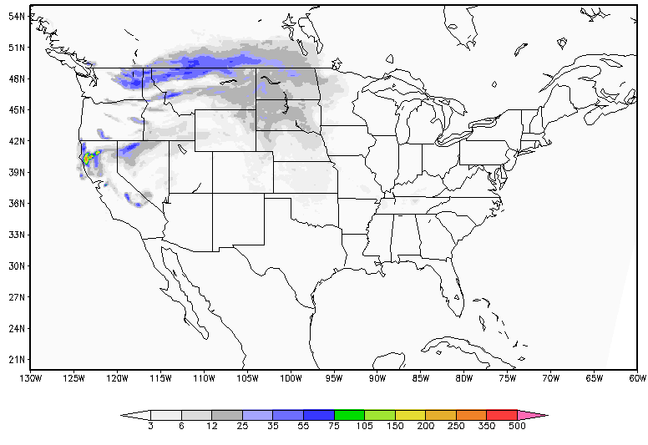
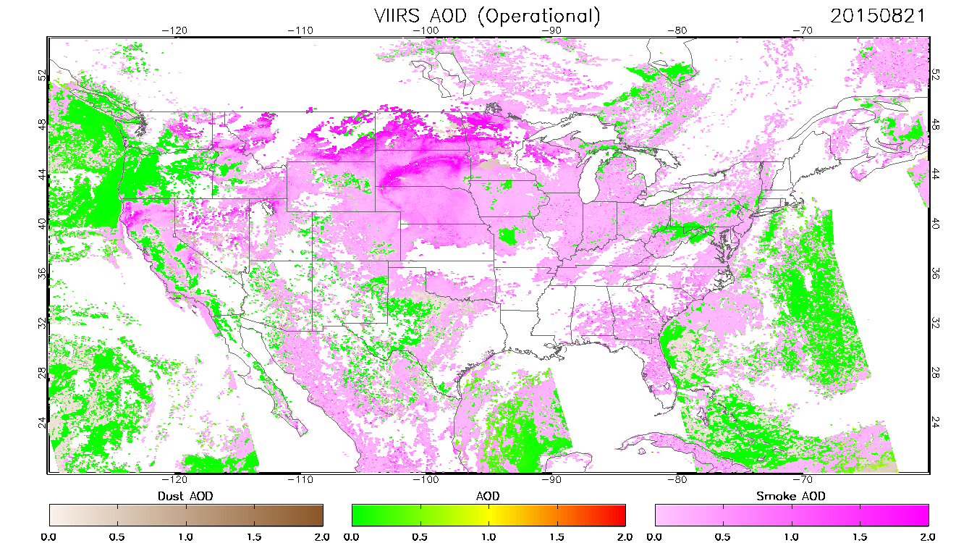
Potential User Applications
HYSPLIT smoke forecast
µg/m³
NOAA Satellite Aerosol Product Workshop
September 13-14, 2016

Slide 17
Acknowledgements
NOAA JPSS Program
NOAA GOES-R Program

