Slide 1
SNPP VIIRS Aerosol Product Latencies
Shobha Kondragunta
NOAA/NESDIS Center for Satellite Applications and Research
Note: All presentations will be uploaded to satelliteaqpg.psu.edu and an email sent to workshop attendees.

Slide 2
Types of Aerosol Products
Operational
Data are near real time, generated at NOAA Office of Satellite and Product Operations (OSPO)
24/7 support
Data Access
NRT data can be obtained through the Environmental Satellite Processing Center (ESPC)
Must fill out the Data Access Request Form to NOAA-NESDIS
http://www.ospo.noaa.gov/Organization/About/access.html
For numerical models that need to assimilate the data. NCEP

Slide 3
Types of Aerosol Products
Archive
OSPO sends near real time data to NOAA CLASS for archive and distribution
Latency: 6 hours to one day
Data time period: launch to present day. Data reside their permanently
Data Access
Order from CLASS website (registration is required)
http://www.nsof.class.noaa.gov/saa/products/welcome
For science (research) users

Slide 4
Types of Aerosol Products
Reprocessed
Entire or parts of time record re-generated when a new algorithm (e.g., EPS) comes online
Latency: Subjective
Data time period: launch to present day
Data Access
Request from product developers
Eventually back filled at CLASS and can be ordered from CLASS. TBD
For science users with particular applications related to climate quality datasets

Slide 5
Types of Aerosol Products
Direct Broadcast (DB)
Product generated using DB data by product developers to meet user needs
No 24/7 tech support
Latency: ~2 hrs but 20 min can be achieved
Data time period: launch to present day
For forecasters (WFOs, state/local agencies)
Data Access
Imagery through eIDEA website
3-day rotating data files from ftp://ftp.star.nesdis.noaa.gov/pub/smcd/hzhang/VIIRS_NRT/

Slide 6
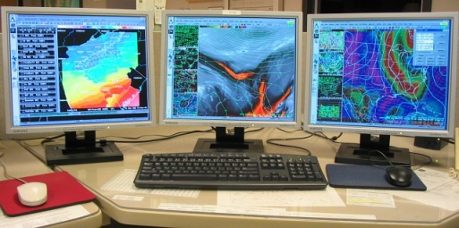
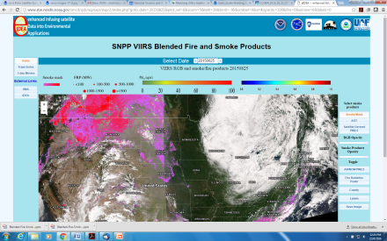
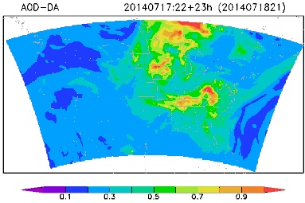
SNPP VIIRS Data (UW and UAF)
CSPP @UW and UAF
CSPP: Community Satellite Processing Package
SDR: Sensor Data Record
VCM: VIIRS Cloud Mask
20 min
SDRs
VCM
2 hrs
FTP pull to STAR computers
STAR Enterprise AOT, SM, and Fire Algorithms
AWIPS-II
eIDEA
NCEP
ESRL Aerosol Assimilation

Slide 7
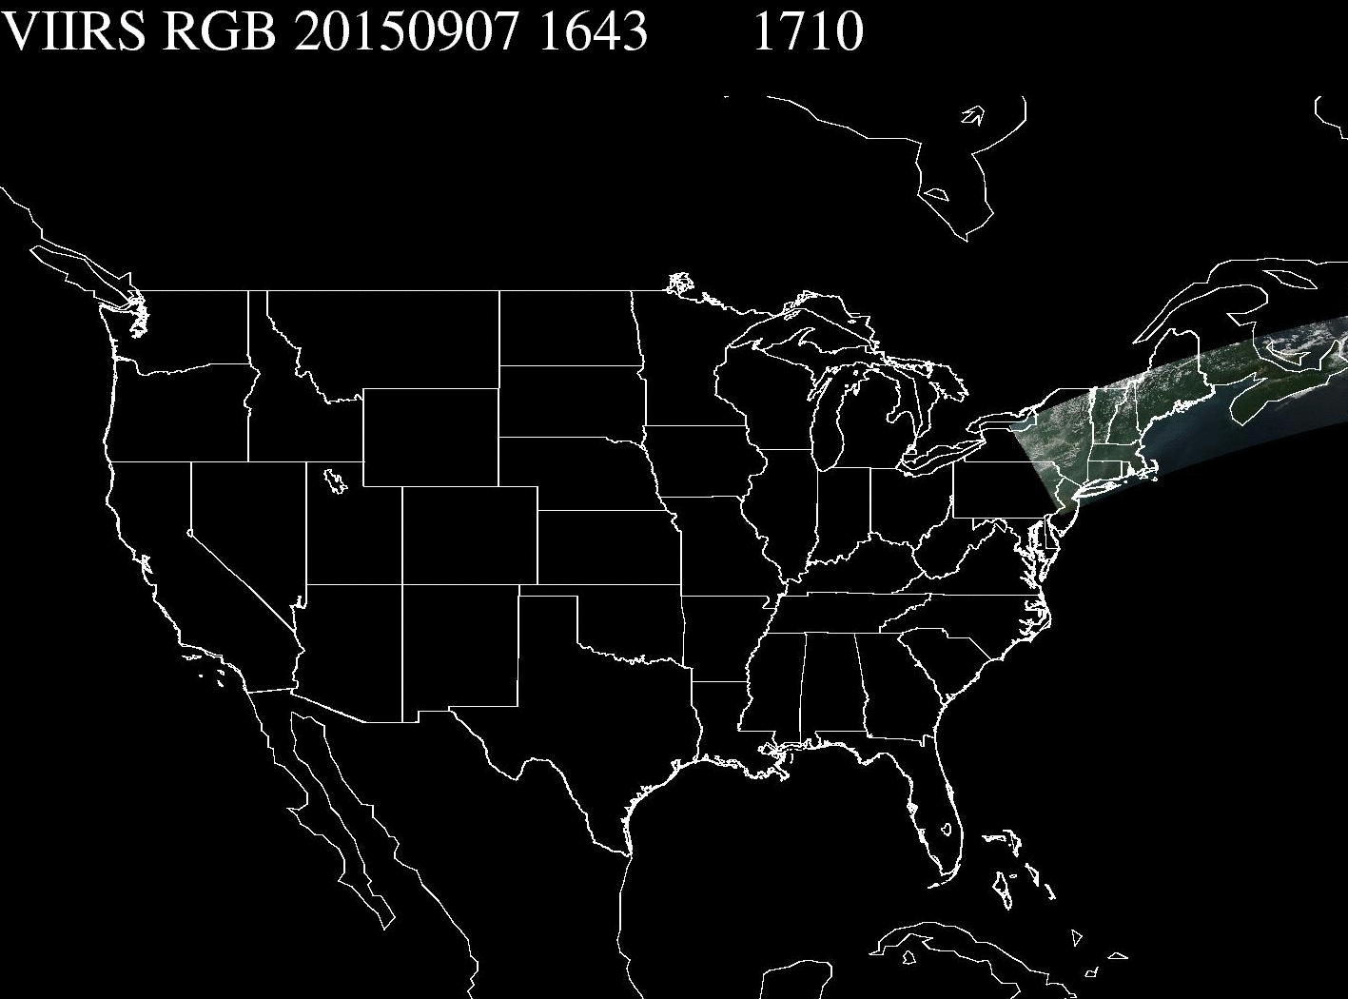
Direct Broadcast data from UW-Madison
Observation time
Time when SDRs are available

Slide 8
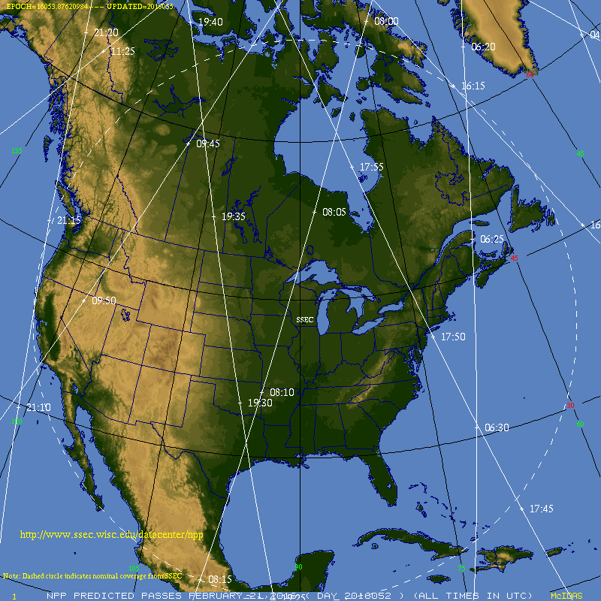
UW site coverage

Slide 9
User Feedback
Forecasters from PA, CT, VA: VIIRS aerosol products very useful for forecasting air quality in the mid-Atlantic region when transported smoke from fires in Alaska and Canada impacts local air quality.
Forecasters from GA: Expand the spatial coverage to capture dust transport events. Transported dust impacts regional air quality in the US.
Latency: Products not available on time for air quality forecasters who have a 2:45 PM deadline to issue the forecast.

Slide 10
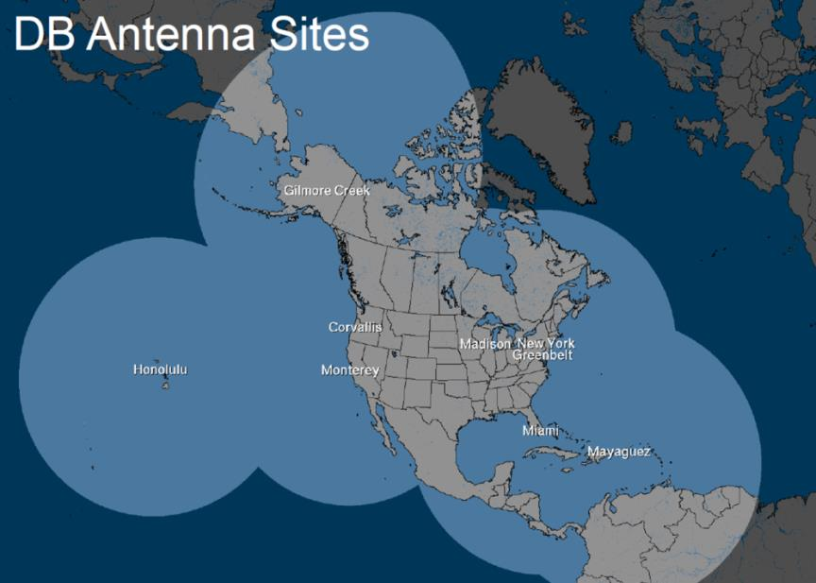
Way Forward
Implement/update algorithms to CSPP software so products are generated at DB locations and then distributed
Some risk involved but protocols can be established

