Slide 1
Enterprise Approach to the Aerosol Optical Depth Algorithm
Istvan Laszlo
NOAA/NESDIS/STAR
Hongqing Liu, Hai Zhang, et al.
2016 Satellite Aerosol Products Workshop for Science and Operational Users

Slide 2
The “Enterprise” Approach
Enterprise Architecture: optimizes processes and use of resources.
Same method (physics and assumptions) and its realization (software) are applied to retrieve aerosol optical depth (AOD) regardless of source of satellite input.
The “enterprise” algorithm is NOT a “proper subset” algorithm (not only algorithm A ∩ algorithm B)
  does not ignore information available from a more capable sensor;
  instrument specific tasks are built around a common core.
Not trivial to build it.
Sensor A
Sensor B
Sensor-A specific tasks
Sensor-B specific tasks
Tasks common to Sensors A & B
Common Core Algorithm
Uniform Output

Slide 3
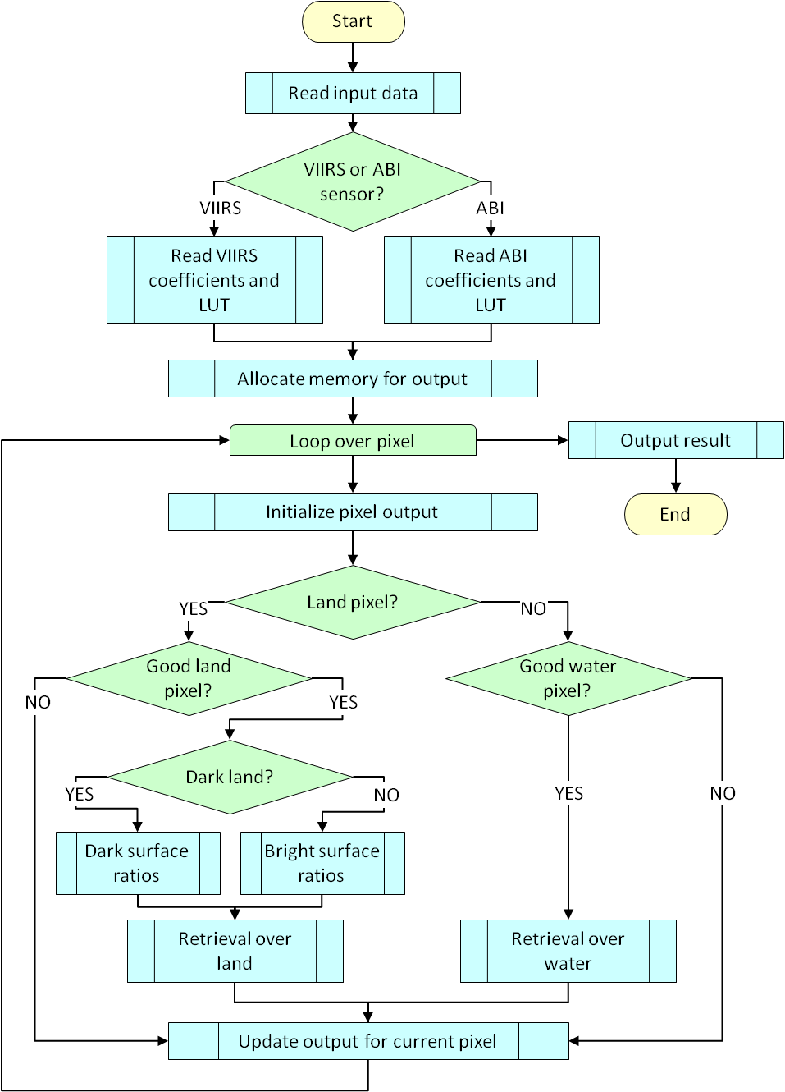
EPS AOD Algorithm
High level flowchart
Designed to handle VIIRS and ABI
VIIRS: Visible Infrared Imaging Radiometer Suite on Suomi-NPP and JPSS polar-orbiting satellites
ABI: Advanced Baseline Imager on GOES-R and follow-on geostationary satellites
Common Core
Separate algorithms over land and water
Separate paths over dark land and bright land

Slide 4
Channel-Role Matrix
Band | Central Wavelength (µm) |  | Retrieval |  |  |  | Internal Test
 |  |  | Land |  | Water |  | Land |  | Water
 | VIIRS | ABI | VIIRS | ABI | VIIRS | ABI | VIIRS | ABI | VIIRS | ABI
M1 | 0.412 |  | X |  |  |  | X |  | X
M2 | 0.445 |  | X |  |  |  | X |  | X
M3 | 0.488 | 0.470 | X | X |  |  | X | X | X | X
M4 | 0.555 |  |  |  | X |  | X |  | X
M5 | 0.672 | 0.640 | X | X | X | X | X | X | X | X
M6 | 0.746 |  |  |  | X
M7 | 0.865 | 0.865 |  |  | X | X | X | X | X | X
M8 | 1.240 |  |  |  | X |  | X
M9 | 1.378 | 1.378 |  |  |  |  | X | X | X | X
M10 | 1.610 | 1.610 |  |  | X | X |  | X | X | X
M11 | 2.250 | 2.250 | X | X | X | X | X | X | X | X
M15 | 10.763 | 11.2 |  |  |  |  | X | X | X | X
M16 | 12.013 | 12.3 |  |  |  |  | X | X

Slide 5
Over-Land Retrieval
TOA reflectance affected by amount of aerosol
In general AOD, aerosol model (MODIS C5: urban, smoke, dust, generic) and surface reflectance must be retrieved
For healthy vegetation, M3, M5 and M11 surface reflectances (ρ) are correlated (Kaufman et al. , 1997) – Used to decrease number of unknowns.
Aerosols change the ratios of M-band reflectances from those of the surface values.
Two classes by predictors
  ρ_{M11}→ ρ_{M5}→ ρ_{M3}
  ρ_{M5}→ ρ_{M3}
Aerosol + surface “signal” is “buried” in TOA reflectance

Slide 6
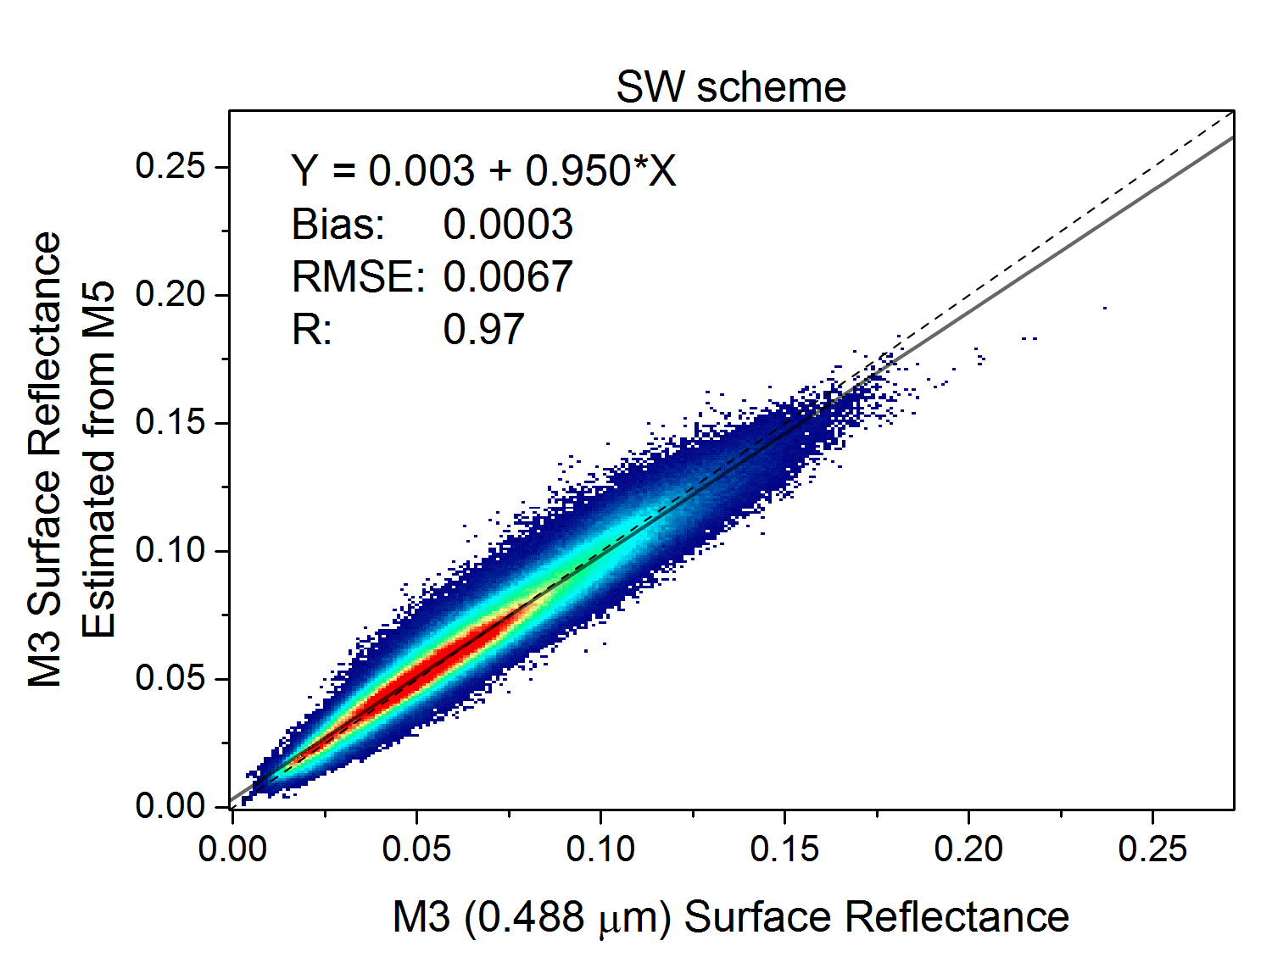
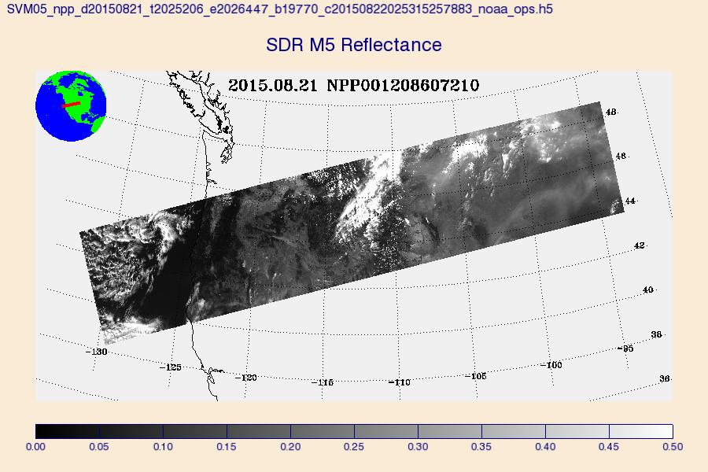
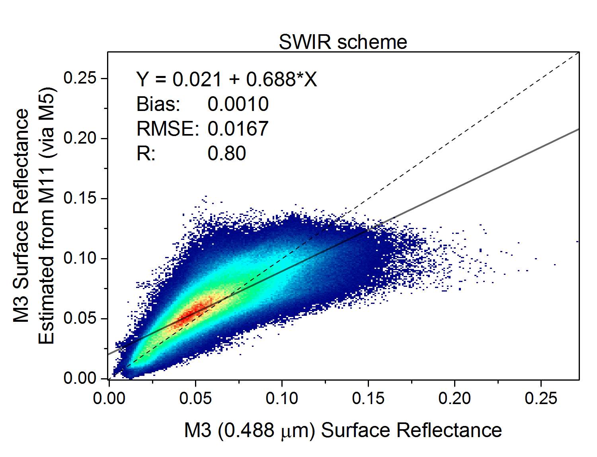
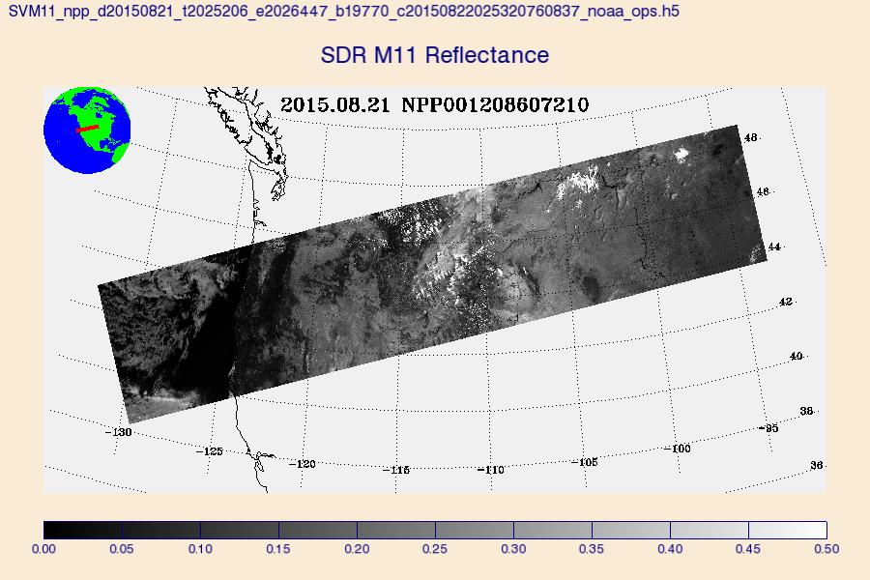
EPS AOD Algorithm – Dark Land
Two variants of the dark-target approach are combined:
  SW-scheme : more accurate ρ_{M3} from ρ_{M5} for low AOD
  SWIR-scheme : more accurate ρ_{M3} from ρ_{M11} for high AOD
ρ_{y} = C₀ + C₁ * ρ_{x}
    C_{0,1} = f(NDVI,M5/M4,G, surface type)
    y={M5,M3,M2,M1}
    x={M11,M5,M3,M3}
SW to SWIR switch :
  AOD is from extrapolation
  ρ_{M3}(SW)-ρ_{M3}(SWIR) > 0.1
(ρ = surface reflectance)
M5
M11

Slide 7
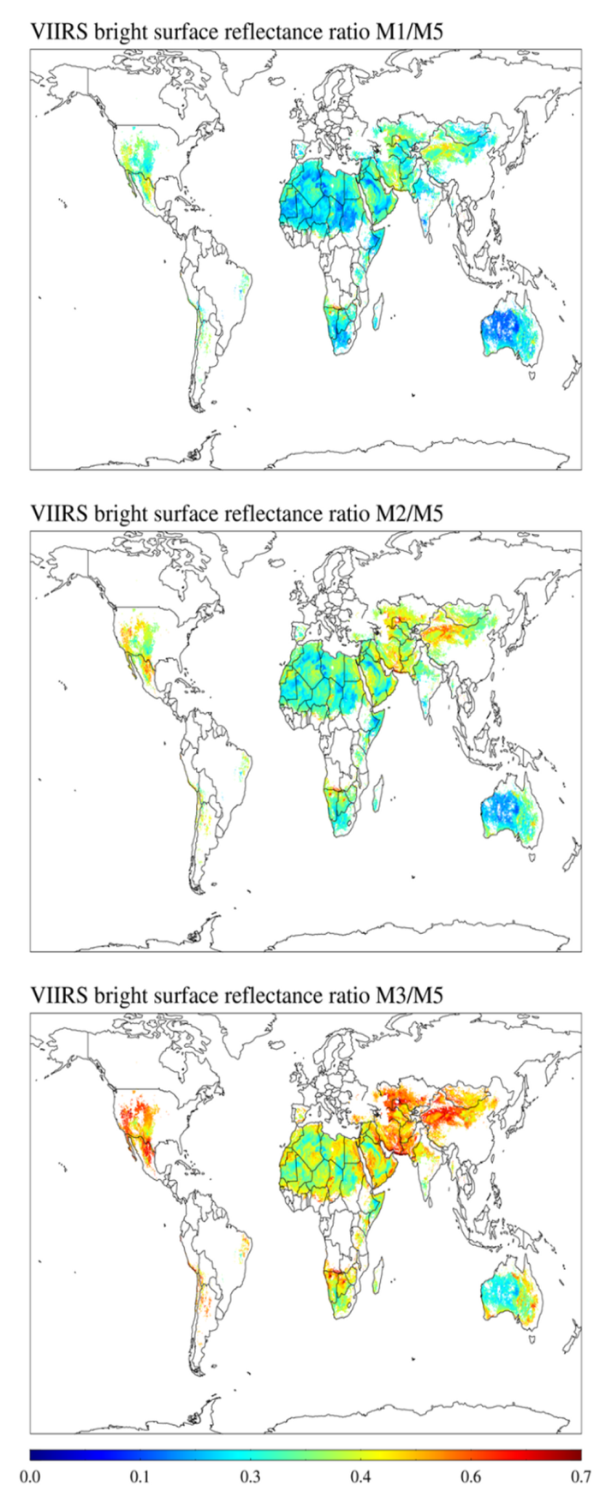
EPS AOD Algorithm – Bright Land
Processing is same as that for dark land, but …
Uses regional (0.1ºx0.1º) database of surface reflectance ratios for bright surface (M11 ≥0.25)
Ratios tend to be less variable than albedos
  ρ_{M1,M3}/ρ_{M5}= c₀(φ,λ)+c₁(φ,λ)*θ_{forward/backward}
Surface reflectance ratios:
  Retrieve M1, M3, M5 surface reflectances using a global background AOD.
  Global background AOD from interpolating (inverse distance weighting) lowest 5th percentile AERONET AOD (May 2012-Apr 2014) to the 0.1x0.1 degree grid.
    Uncertainty is not well know
Region | Ratio | Model
North Africa, Arabian Peninsula | M3/M5 | dust
Other bright | M1/M5 | algorithm selected
Zhang et al., 2016, JGR (accepted)

Slide 8
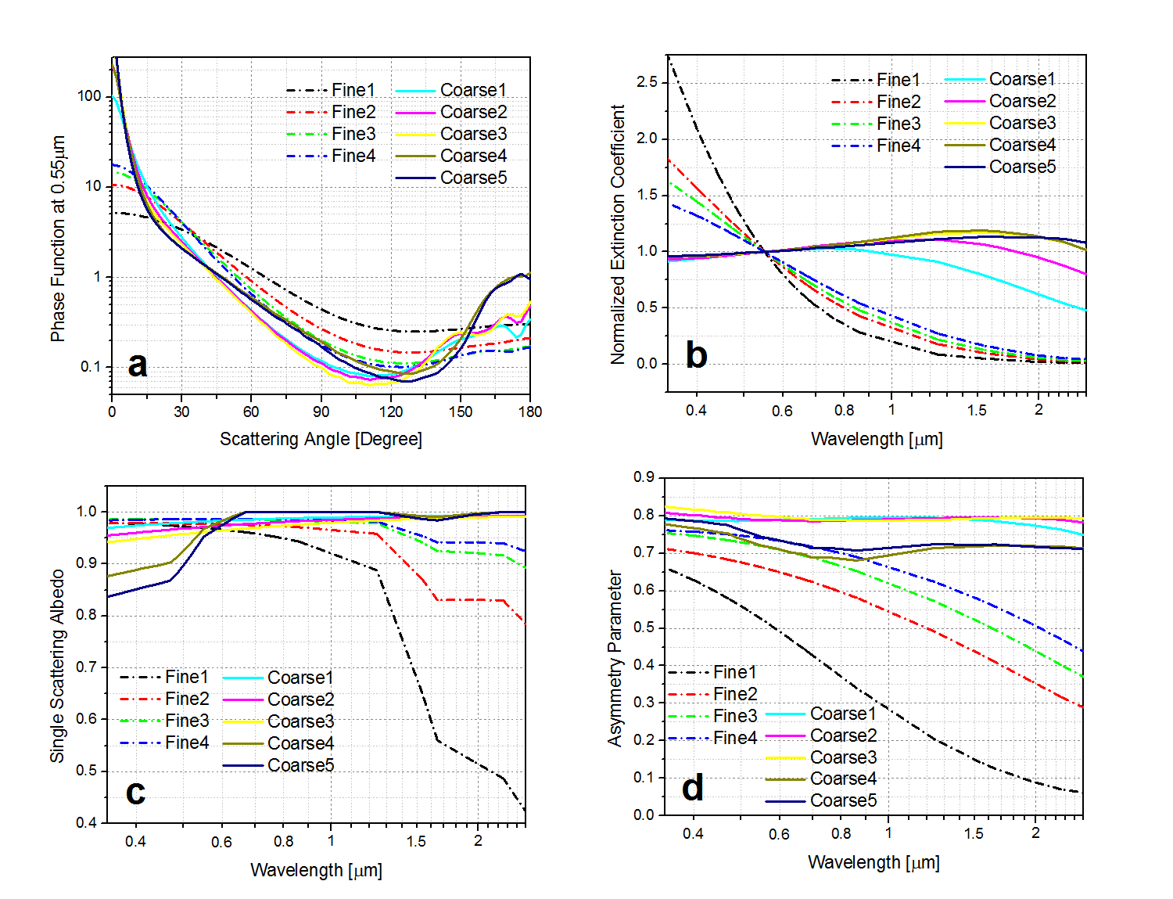
Over-Water Retrieval
MODIS heritage (Tanré et al., 1997; Remer et al., 2005)
Surface reflectance
  calculated from model as sum of bidirectional and Lambertian reflectances
  depends on wind speed and direction
Aerosol model:
  four fine mode and five coarse mode aerosol models (MODIS C5 models)
Assumes TOA reflectance is fine-mode-weighted average of fine and coarse mode reflectances (2020 discrete models)
TOA reflectances calculated in selected M bands are compared to observed ones to retrieve AOD, pair of fine and coarse mode aerosol models and fraction of fine mode simultaneously.
  AOD is from M7 (0.865 µm)
Aerosol models over ocean

Slide 9
IDPS vs. EPS Products
Outputs | IDPS |  | EPS
 | EDR | IP
Nominal spatial resolution | 6 km | 0.75 km | 0.75 km
Granule size | 86 seconds | 86 seconds | 86 seconds
AOD at 550-nm | [0, 2] range | [0, 2] range | [-0.05, 5] range
AOTD at M-bands | M1 –M11 except M9 | M1 –M11 except M9 | M1 –M11
Slant Path AOT at 550-nm |  | X
Ångström Exponent | Land: 445 vs. 672-nm Ocean: 865 vs. 1610-nm |  | Land: N/A Ocean : 555 vs. 865-nm 865 vs. 1610-nm
Fine Mode Fraction | Mean Value | X | X
Ocean Fine Mode | Dominant Type | X | X
Ocean Coarse Mode | Dominant Type | X | X
Land Aerosol Model | Dominant Type | X | X
Surface Reflectance |  |  | X
Retrieval Residual |  |  | X
Spatial Variability |  |  | X
AOD at 550-nm for Each Candidate Land Aerosol Model |  |  | X
Retrieval Residual for Each Candidate Land Aerosol Model |  |  | X
IDPS: Interface Data Processing Segment - current (as of Sep 2016) operational algorithm/product
EDR: Environmental Data Record; IP: Intermediate Product

Slide 10
Pixel Selection & Quality Levels
EPS
Condition | Quality Level |  |  | Applies to |  | Detected by
 | No Retrieval | Low | Medium | Land | Ocean | CM | Internal Tests
Invalid input data | X |  |  | X | X |  | X
Cloud | X |  |  | X | X | X | X
Snow/Ice | X |  |  | X | X | X | X
Fire | X |  |  | X |  | X
Ephemeral Water | X |  |  | X |  |  | X
Sun Glint | X |  |  |  | X | X | X
Shallow Water | X |  |  |  | X |  | X
AOD Out-of-Range |  | X |  | X | X |  | X
Low Sun (solzen > 80°) |  | X |  | X | X |  | X
External & Internal cloud tests contradict |  | X |  | X | X | X | X
High Inhomogeneity |  | X |  | X | X |  | X
High Residual |  | X |  | X | X |  | X
Cloud Shadow |  |  | X | X | X | X
Thin Cirrus |  |  | X | X | X |  | X
Cloud Adjacency |  |  | X | X | X |  | X
Snow Adjacency |  |  | X | X | X |  | X
Medium Inhomogeneity |  |  | X | X | X |  | X
Medium Residual |  |  | X | X | X |  | X
NDVI Out-of-Range |  |  | X | X |  |  | X
Redness Out-of-Range |  |  | X | X |  |  | X

Slide 11
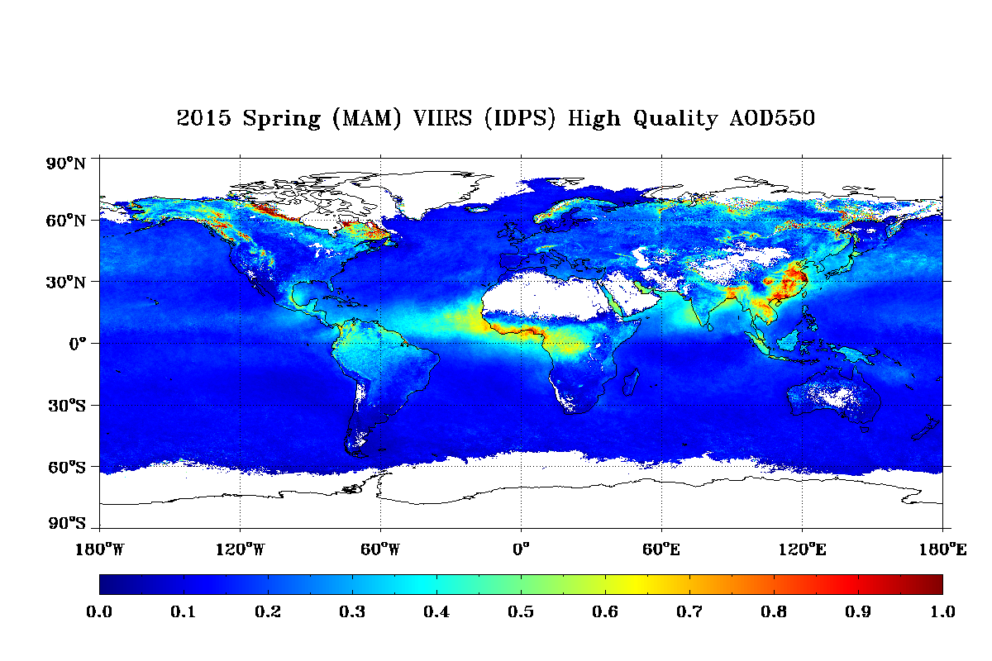
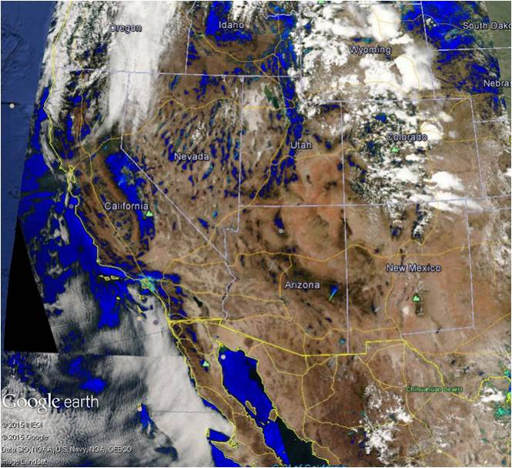
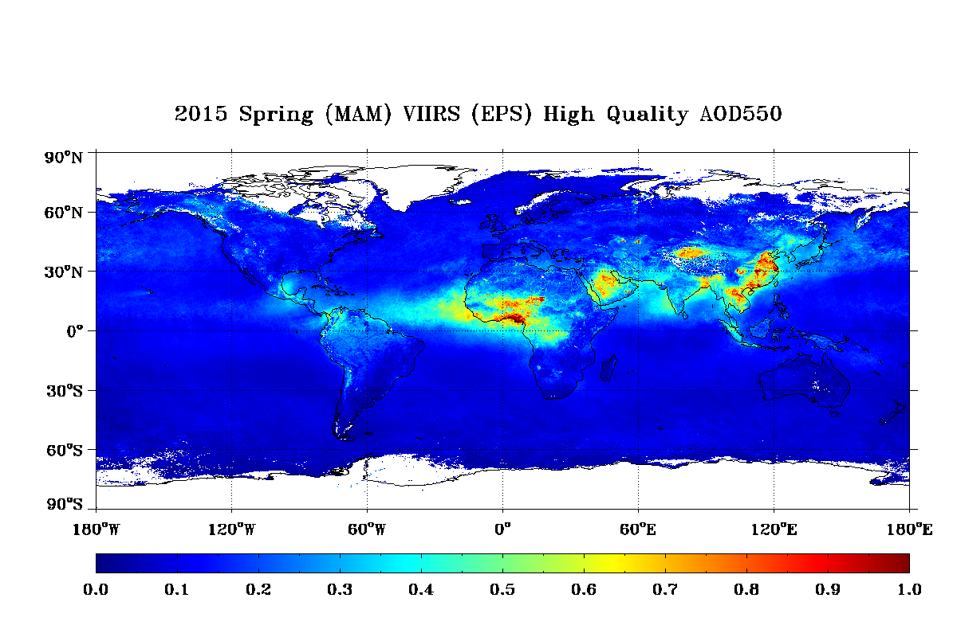
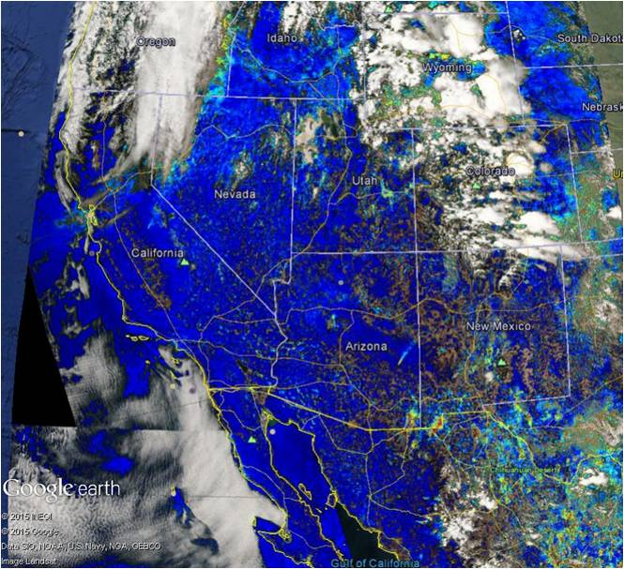
Examples: EPS vs. IDPS
IDPS vs. EPS seasonal mean AOD
IDPS vs. EPS AOD spatial coverage
IDPS
EPS

Slide 12
Evaluation: AOD over Land
Reference data: Level 2.0 AERONET AOD
Period: 10/26/2012 – 3/12/2016
Matchup
  At least 2 AERONET L2.0 measurements within one-hour
  At least 750 retrievals of VIIRS AOD within a circle of 27.5-km radius

Slide 13
Evaluation: AOD & AE over Water

Slide 14
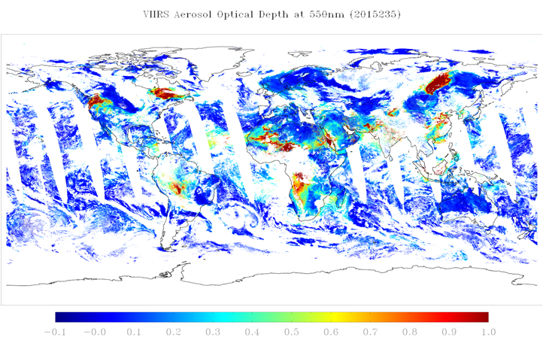

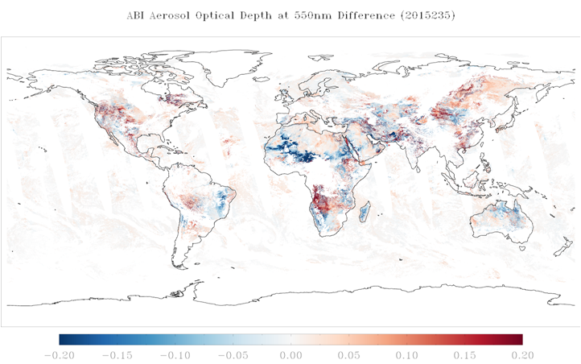
EPS VIIRS vs. EPS ABI (1)
VIIRS
VIIRS : all available VIIRS inputs
ABI mode: no M1, M2, M4, M6, M8
One day global retrieval
  August 23, 2015
Only high Quality AOD
AOD | ALL | Water | DrkLnd | BrtLnd
VIIRS | 0.196 | 0.122 | 0.259 | 0.309
ABI | 0.225 | 0.126 | 0.338 | 0.306
ABI
ABI-VIIRS

Slide 15
EPS VIIRS vs. EPS ABI (2)
VIIRS-AERONET Matchup data
Time period:
  10/26/2012 – 1/1/2016
Products
  EPS VIIRS
    All VIIRS channels
    Retrieval over bright land (M1/M5 and M3/M5)
  EPS ABI
    VIIRS input data at ABI channels
    Retrieval over bright land (M3/M5 ratio, fix generic aerosol model)
  AERONET L2.0
Application of EPS algorithm does not mean products will be identical!

