Slide 1
Status of GOES-R and JPSS Aerosol Optical Depth Products
Istvan Laszlo
Shobha Kondragunta
Hongqing Liu, Mi Zhou, et al.
2016 Satellite Aerosol Products Workshop for Science and Operational Users

Slide 2
Geostationary operational Environmental Satellite - R series (GOES-R) – geostationary satellite
Aerosol is from the Advanced Baseline Imager (ABI)
GOES-R Aerosol Optical Depth Product
Products: - Aerosol Optical Depth (AOD)
- Aerosol Particle Size (Ångström exponent)
- Dust & smoke
(This presentation only covers AOD)

Slide 3
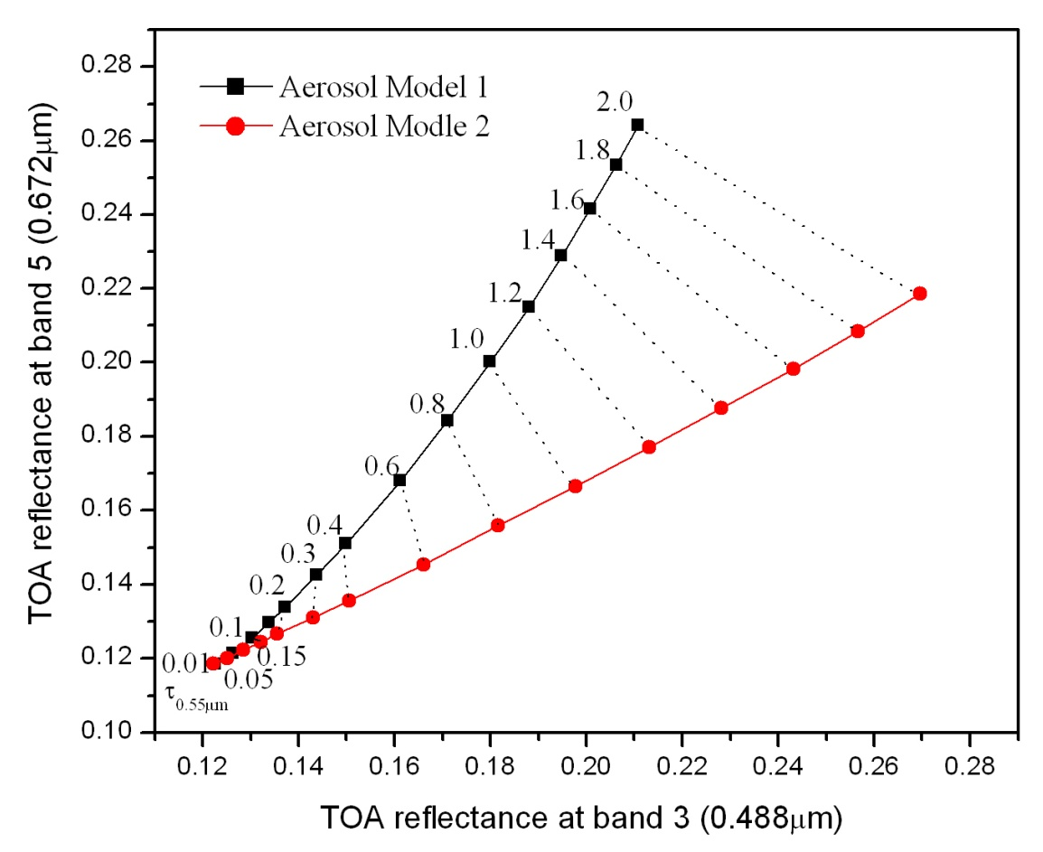
GOES-R AOD Algorithm
MODIS and early VIIRS heritage
Retrieves AOD and aerosol type (from finite number of candidates) simultaneously by comparing reflectances calculated for varying AOD and set of discrete aerosol models with reflectances observed at multiple wavelengths
Ocean: surface contribution is calculated
Land: surface contribution (reflectance) is retrieved using the dark-target approach
No retrieval for bright land or sun glint
aerosol model 1
aerosol model 2
Residual 1
TOA reflectance in band 2
Observation
Residual 2
Retrieved AOD550
TOA reflectance in band 1
Proxy ABI data:
MODIS
Simulated ABI
AHI (Advanced Himawari Imager)
Baseline algorithm

Slide 4
ABI & AHI
AHI is similar to ABI; we use it as proxy for ABI

Slide 5
ABI AOD Products
Outputs | ABI
Nominal spatial resolution | 2km
Domains | CONUS: 5 mins Full Disk: 15 mins
AOD at 550-nm | [-1, 5] range
Ångström Exponent | Land and Ocean 470 vs. 860 nm 860 vs. 225 nm
Quality Flags | high, medium, low, no retrieval
Meta data | min, max, mean and standard deviation of AOD at 550nm and ABI channels over land and ocean for eighteen 10 degree latitude bands min, max, mean, and standard deviation of surface reflectance at the ABI channels for eighteen, 10 degree latitude bands
Product Users Guide will be made available when the product is released

Slide 6
What will happen after
GOES-R launch?
Post-launch Beta Tests (L+197 days = Post Launch Test, PLT)
  Evaluation of limited data
  Comparison with AERONET (reference data)
    Expected to reveal any major issues, but not a “full” evaluation
Post-launch Provisional Tests (PLT+6 months)
  Comparison with AERONET for broader but still limited conditions
    Stratification of accuracy and precision on time of day, region and retrieved/measured AOD
  Release of data to users
Post-launch Validated Tests (PLT+15 months)
  Algorithm update tasks:
    Re-generate sensor-specific data used in retrieval
    Re-derive SWIR –VIS land surface reflectance relationship
  Comparison with AERONET for large set of conditions
  Inter-comparison with other satellite-based aerosol data (MODIS, VIIRS)

Slide 7
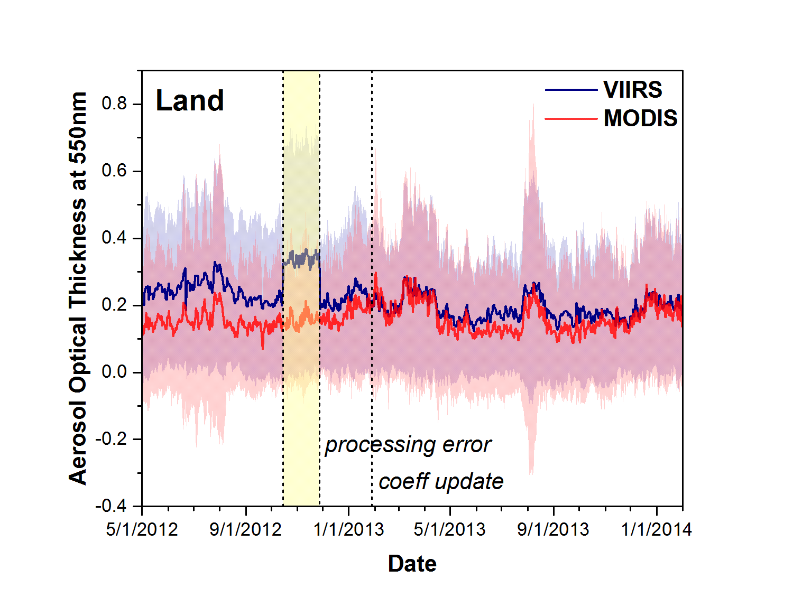
What can be expected after
GOES-R launch? (1)
Expect sub-optimal quality (may have large bias) of over-land AOD product right after GOES-R launch
Had same experience with the currently operational VIIRS AOD product
IDPS VIIRS AOD over land has large bias relative to MODIS before revising sensor-specific coefficients
Expect improved quality (reduced bias) by the end of Provisional and Validated Phases

Slide 8
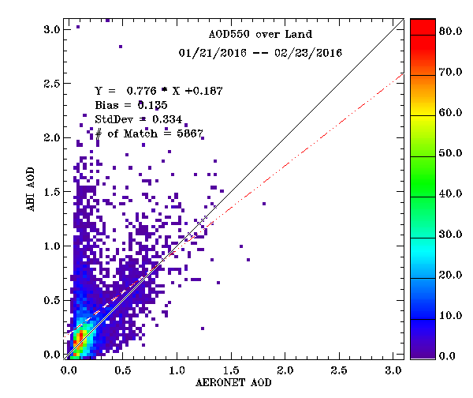
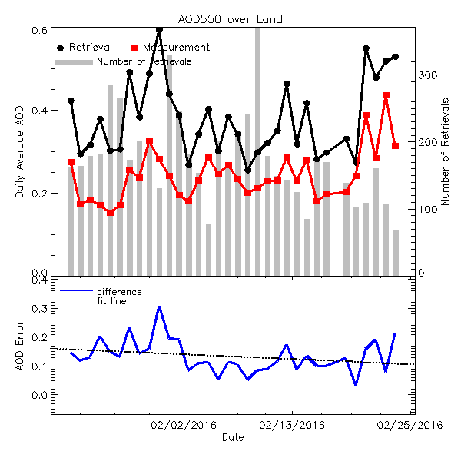
What can be expected after
GOES-R launch? (2)
AHI
No internal test
AERONET Level 1.5 data used as ground-truth reference; Co-location: 1-hour window centered on the AHI observation time, a circle of 27.5-km radius centered on the AERONET ground stations;
Current baseline ABI algorithm does not have internal tests for detecting contamination -> large bias and standard deviation (only developers will see it) …

Slide 9
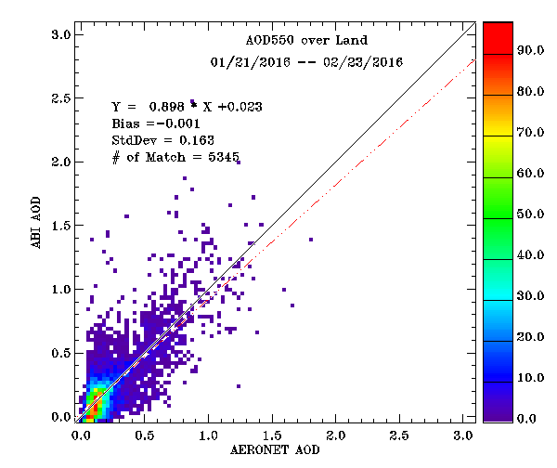
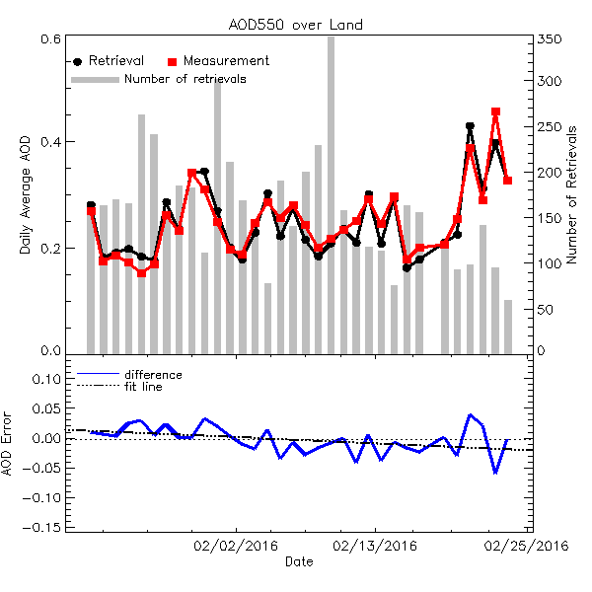
Updated Baseline Algorithm
AHI
With internal tests
… Applying internal tests to detect contamination (cloud, snow) in an updated algorithm significantly improves performance
  bias changed from 0.135 to -0.001, standard deviation changed from 0.334 to 0.163
Test will be implemented in operational algorithm NLT Provisional

Slide 10
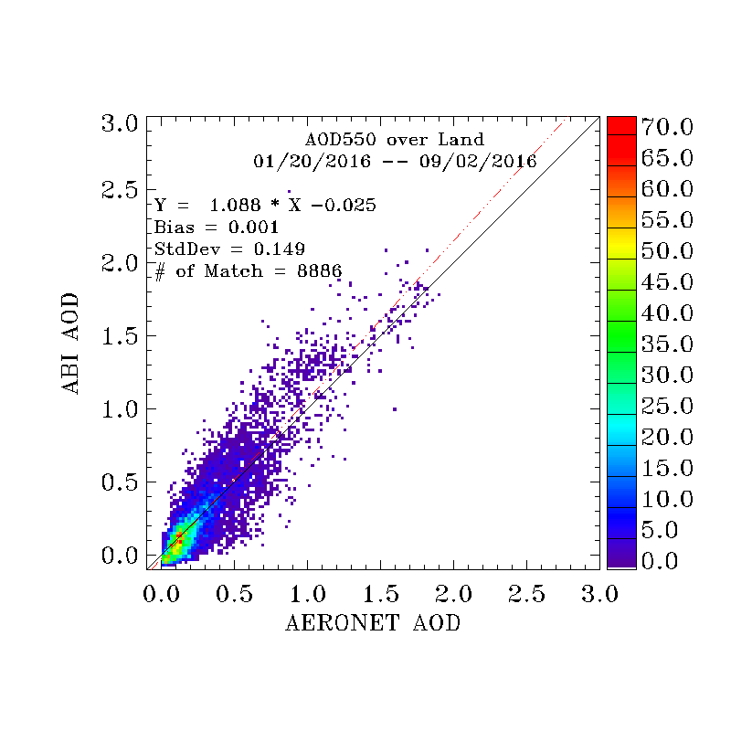
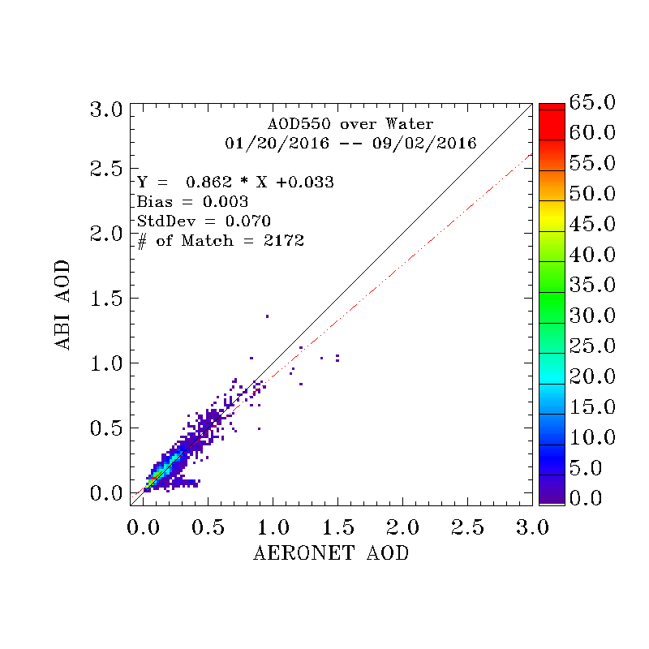
AOD Validation with AERONET
AHI
Over Land
Over Water
Land: high + medium quality
Water: high + shallow water
Updated ABI algorithm: Retrievals use internal tests

Slide 11
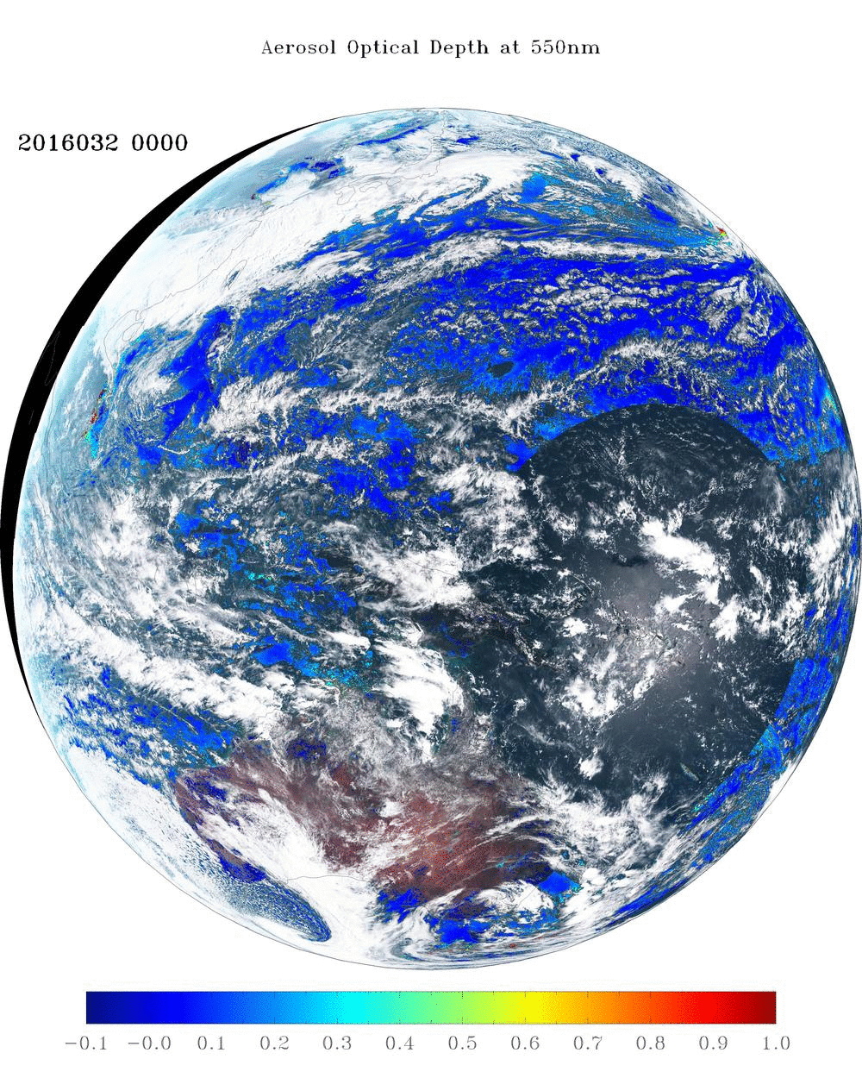
Example AOD from AHI

Slide 12
Joint Polar Satellite System (JPSS) - polar-orbiting satellite
Aerosol is from the Visible Infrared Imaging Radiometer Suite (VIIRS)
JPSS Aerosol Optical Depth Product
Products: - Aerosol Optical Depth (AOD)
- Aerosol Particle Size (Ångström exponent)
- Dust & smoke
(This presentation does not cover dust and smoke)

Slide 13
VIIRS AOD Algorithms
Retrieves AOD and aerosol type (from finite number of candidates) simultaneously by comparing reflectances calculated for varying AOD and set of discrete aerosol models with reflectances observed at multiple wavelengths
Ocean: surface contribution is calculated
No retrieval for sun glint over water
Land: surface contribution (reflectance) is retrieved using the dark-target approach
IDPS: Interface Data Processing Segment - current (as of Sep 2016) operational algorithm/product
  Retrieval tries to “recover” prescribed SW ratios of surface reflectances over land
  No retrieval over bright, snow-free land
EPS: Enterprise Processing System expected to become operational Dec 2016/Jan 2017
  Two flavors of the dark target approach over land – approves high AOT retrievals
  Retrieval over bright land
  Extended reporting range [-0.05-5.0]
  Extensive internal test

Slide 14
IDPS and EPS Products
Outputs | IDPS |  | EPS
 | EDR | IP
Nominal spatial resolution | 6 km | 0.75 km | 0.75 km
Granule size | 86 seconds | 86 seconds | 86 seconds
AOD at 550-nm | [0, 2] range | [0, 2] range | [-0.05, 5] range
AOTD at M-bands | M1 –M11 except M9 |  | M1 –M11
Slant Path AOT at 550-nm |  | X
Ångström Exponent | Land: 445 vs. 672-nm Ocean: 865 vs. 1610-nm |  | Land: N/A Ocean : 555 vs. 865-nm 865 vs. 1610-nm
Fine Mode Fraction | Mean Value | X | X
Ocean Fine Mode | Dominant Type | X | X
Ocean Coarse Mode | Dominant Type | X | X
Land Aerosol Model | Dominant Type | X | X
Surface Reflectance |  |  | X
Retrieval Residual |  |  | X
Spatial Variability |  |  | X
AOD at 550-nm for Each Candidate Land Aerosol Model |  |  | X
Retrieval Residual for Each Candidate Land Aerosol Model |  |  | X
IDPS: Interface Data Processing Segment - current (as of Sep 2016) operational algorithm/product
EDR: Environmental Data Record; IP: Intermediate Product

Slide 15
Pixel Selection & Quality Levels
EPS
Condition | Quality Level |  |  | Applies to |  | Detected by
 | No Retrieval | Low | Medium | Land | Ocean | CM | Internal Tests
Invalid input data | X |  |  | X | X |  | X
Cloud | X |  |  | X | X | X | X
Snow/Ice | X |  |  | X | X | X | X
Fire | X |  |  | X |  | X
Ephemeral Water | X |  |  | X |  |  | X
Sun Glint | X |  |  |  | X | X | X
Shallow Water | X |  |  |  | X |  | X
AOD Out-of-Range |  | X |  | X | X |  | X
Low Sun (solzen > 80°) |  | X |  | X | X |  | X
External & Internal cloud tests contradict |  | X |  | X | X | X | X
High Inhomogeneity |  | X |  | X | X |  | X
High Residual |  | X |  | X | X |  | X
Cloud Shadow |  |  | X | X | X | X
Thin Cirrus |  |  | X | X | X |  | X
Cloud Adjacency |  |  | X | X | X |  | X
Snow Adjacency |  |  | X | X | X |  | X
Medium Inhomogeneity |  |  | X | X | X |  | X
Medium Residual |  |  | X | X | X |  | X
NDVI Out-of-Range |  |  | X | X |  |  | X
Redness Out-of-Range |  |  | X | X |  |  | X

Slide 16
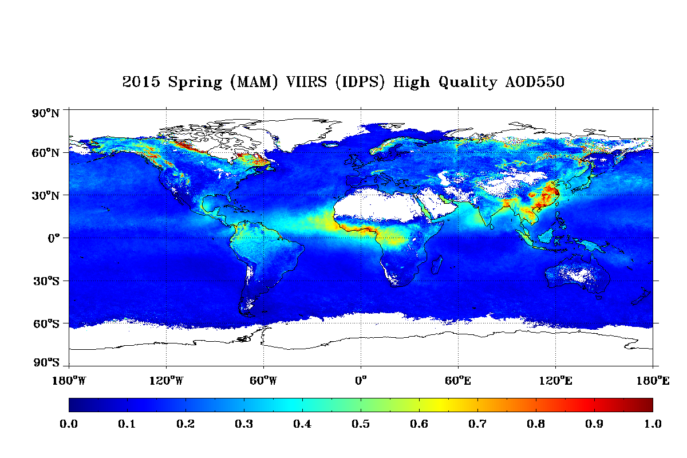
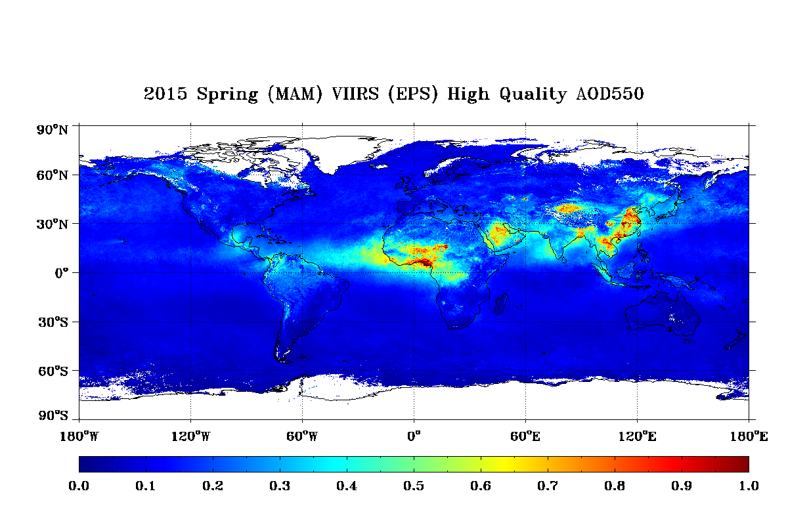
Examples: EPS vs. IDPS
IDPS vs. EPS seasonal mean AOD
Reprocessed VIIRS aerosol data
EPS algorithm is used
2015 completed
Output:
  Pixel-level retrieval and diagnostic outputs in compressed HDF5 format for each granule
  Total size 7.7T (~ 22G/day) !
  Available on request.
Expected to replace current IDPS in archive

Slide 17
Evaluation: EPS AOD over Land
Reference data: Level 2.0 AERONET AOD
Period: 10/26/2012 – 3/12/2016
Matchup
  At least 2 AERONET L2.0 measurements within one-hour
  At least 750 retrievals of VIIRS AOD within a circle of 27.5-km radius

Slide 18
Evaluation: EPS AOD & AE over Water

Slide 19

Viewing NPP from Himawari-8

Slide 20
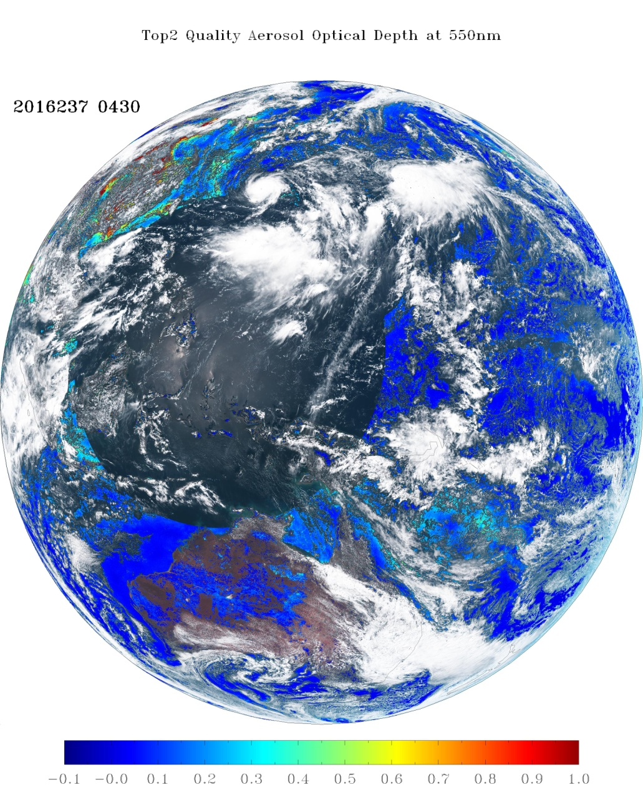
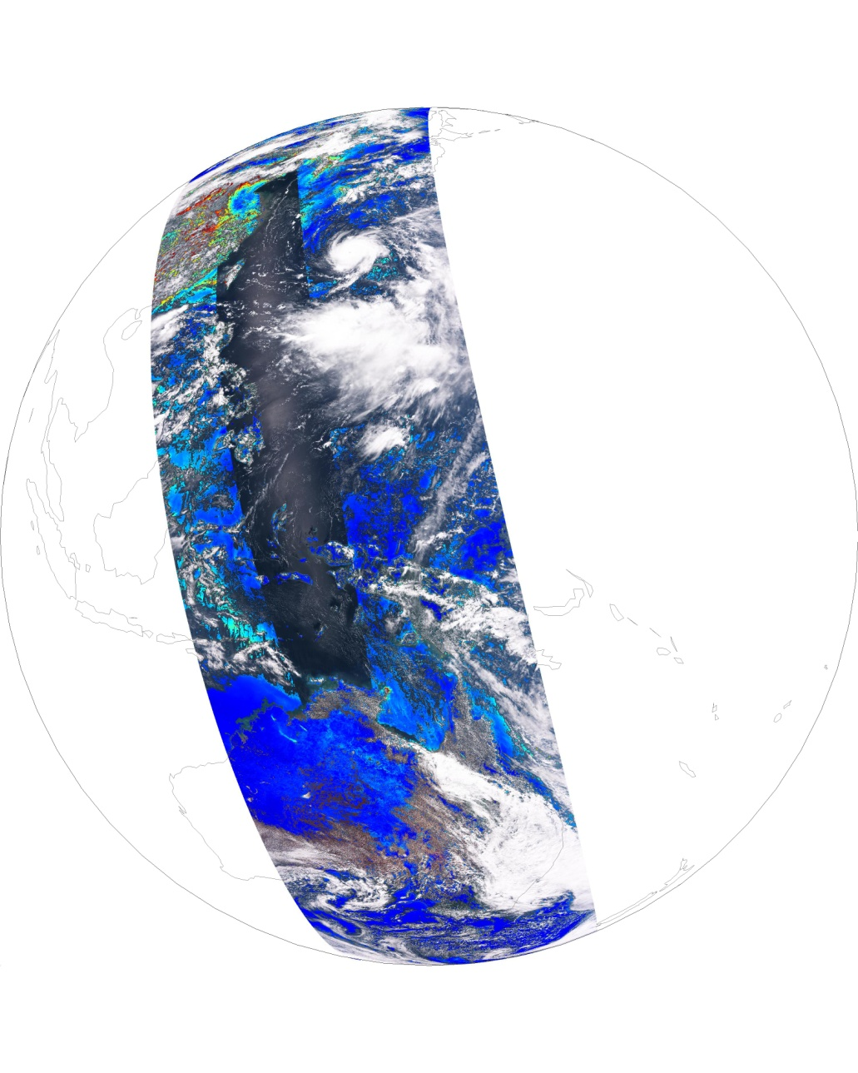
EPS AOD - AHI vs. VIIRS view
Aug 24, 2016
AHI: 04:30 UT
VIIRS: 04:20 – 04:55 UT

Slide 21
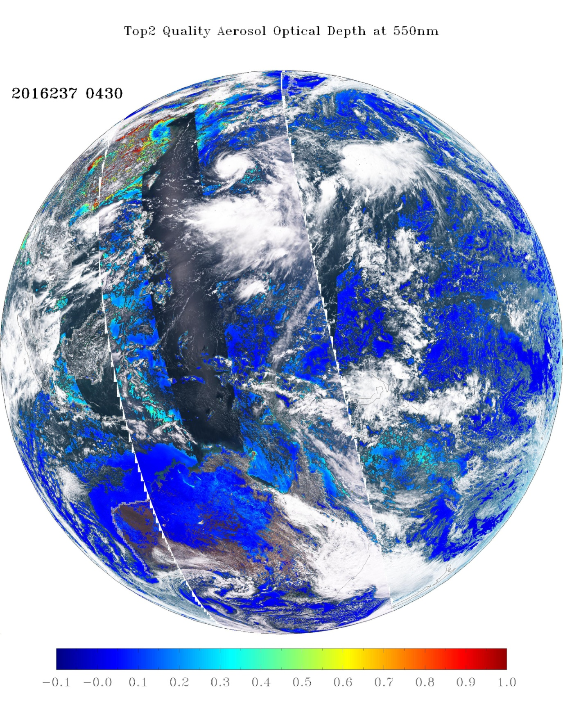
EPS AOD - AHI & VIIRS Superimposed
Aug 24, 2016
AHI: 04:30 UT
VIIRS: 04:20 – 04:55 UT

Slide 22
Summary
algorithm
Jan 2017
product availability
EPS VIIRS
TBD
EPS ABI
IDPS VIIRS
Baseline ABI
Baseline ABI Update
Baseline ABI
PLT+6 months
GOES-R launch (day 1)
Now (operational)

Slide 23
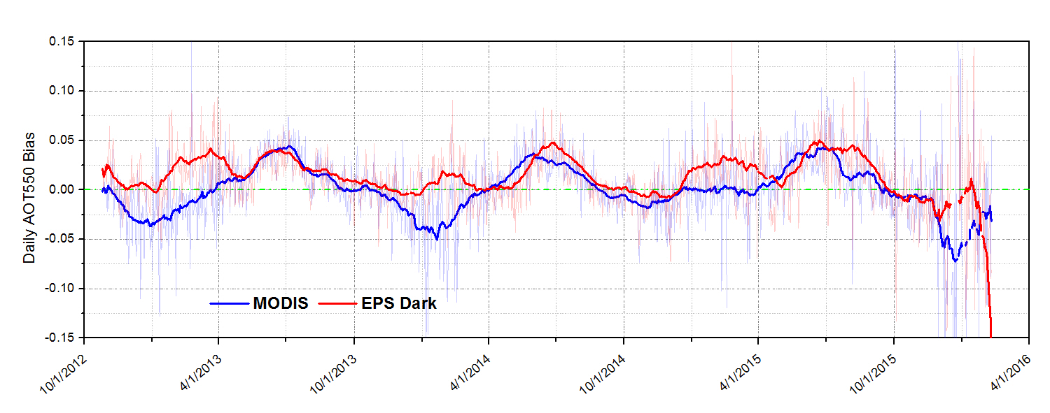
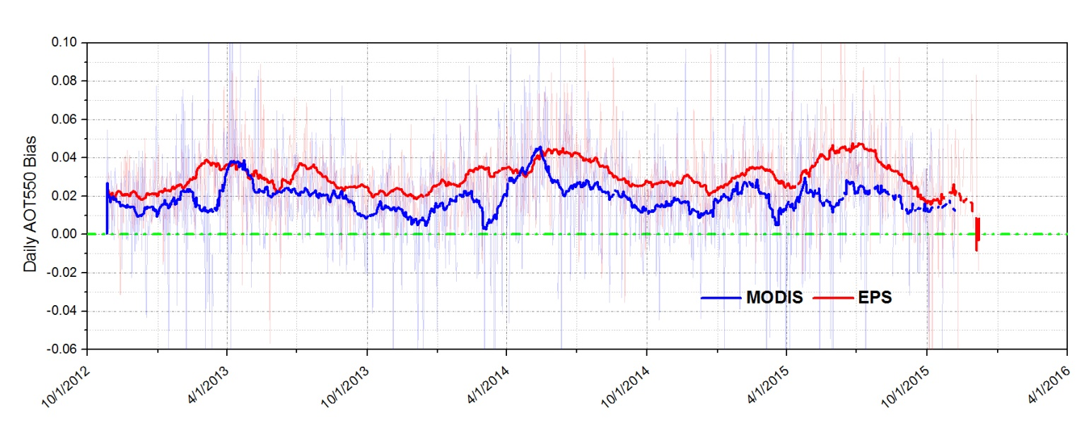
Time Series
Land
Water

