Slide 1
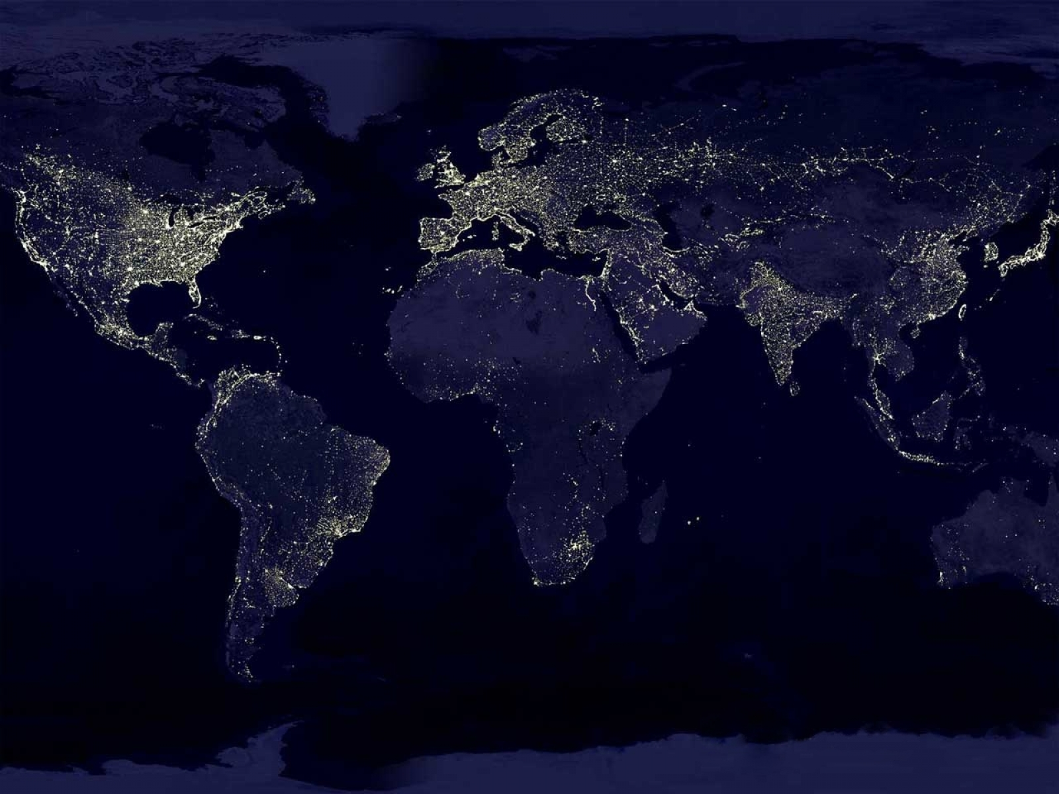
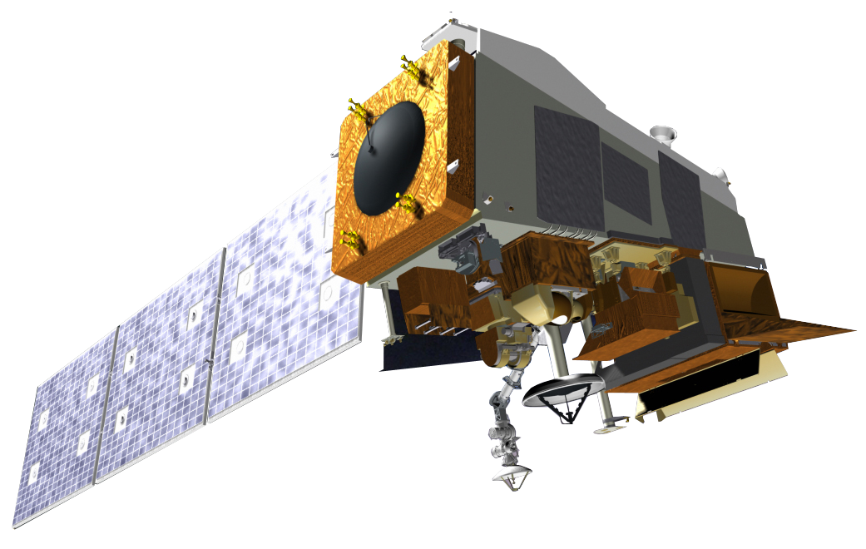
2016 NOAA Satellite Aerosol Product Workshop
Arron L. Layns
Algorithm Management Project Lead
Deputy Project Scientist for the JPSS Proving Ground
Joint Polar Satellite System
September 13, 2016
www.jpss.noaa.gov

Slide 2
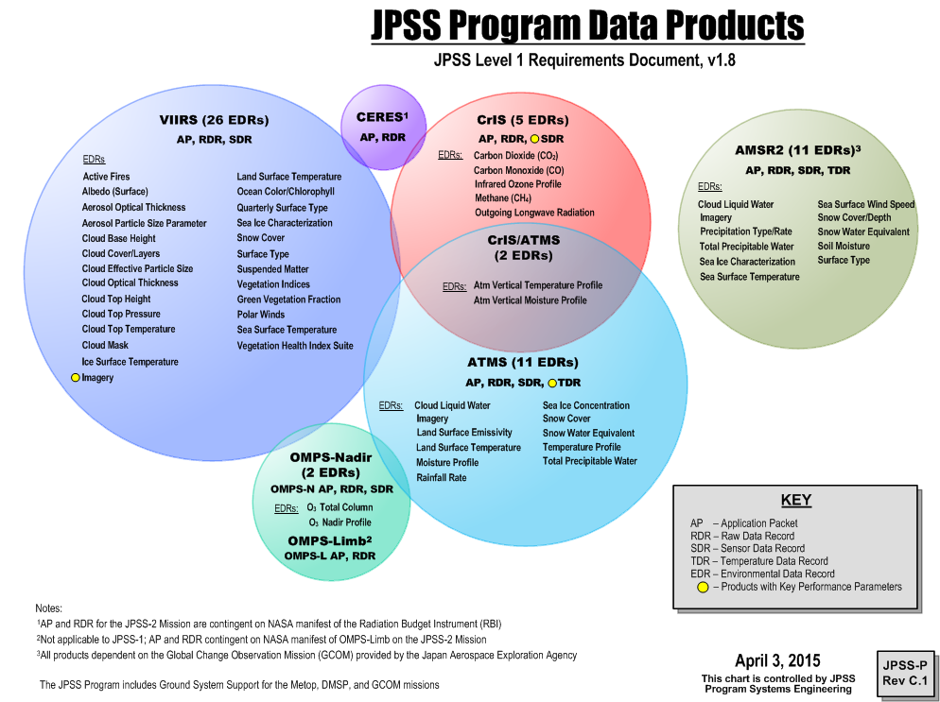

Slide 3
Enterprise Algorithms
An enterprise algorithm is an algorithm that uses the same scientific methodology and software base to create the same classification of product from differing input data.
Benefits:
Brings continuity of NOAA products between current and future NOAA oeprational satellites
Supports NWS’s strategy of multi-sensor algorithms and products
Cost-effective processing for NOAA products
Maintenance of fewer algorithms and systems within operations

Slide 4
Addressing Needs Across NOAA
Aviation Weather and Volcanic Ash
Fire Weather
Hydrology and Water Resources
Marine Weather and Coastal Events
Hurricane/Tropical Storms
Routine Weather
Severe Weather
Space Weather
Tsunami
Winter Weather
Environmental Modeling Prediction
Science, Services and Stewardship
Ecosystem Monitoring, Assessment and Forecast
Fisheries Monitoring, Assessment and Forecast
Habitat Monitoring and Assessment
Protected Species Monitoring
Science, Services and Stewardship
Coastal Water Quality
Marine Transportation
Planning and Management
Resilience to Coastal Hazards and Climate Change
Science, Services and Stewardship
Assessments of Climate Changes and Its Impacts
Climate Mitigation and Adaptation Strategies
Climate Science and Improved Understanding
Climate Prediction and Projections
HEALTHY OCEANS
RESILIENT COASTS
CLIMATE
WEATHER READY NATION
National Weather Service
National Marine Fisheries Service
National Ocean Service
Office of Oceanic and Atmospheric Research
NOAA Mission Service Areas by Line Office
Notes:
It all starts with the priorities of our users - The architecture studies will address needs across NOAA’s mission areas. NESDIS is often recognized for the support we prove to the National Weather Service for warnings and prediction. What is often less apparent is the support we provide in support of needs across NOAA. Many of our observations and operational data products support the Marine Fisheries Service, the National Ocean Service, and the Office of Oceanic and Atmospheric Research as well – and these information services are also part of our architecture planning.

Slide 5
End-to-End Science Approach
User requirements and prioritization
Determining and prioritizing products user needs - Critical, Supplemental High, Supplement Low(subset of critical becomes Key Performance Parameters (KPP) via LORWG, TPIO, NOSC
User input gathered via the LORWG, chaired by Program Scientist.
User workshops/conferences to reach broader community
Assessing solutions to meet requirements, does the proposed system satisfy the need?
Algorithms and Cal/Val
Develop algorithms to generate products- meeting requirements (accuracy, precision, latency)
Develop tools to visualize /validate the products
Generate validation reports, understanding and correcting outliers
Provide science and R2O maturity artifacts (Enterprise Life Cycle)
ATBDS, Cal/Val Plans, User manuals, Preliminary and Critical Design Reviews, Algorithm and Operational Readiness Reviews
Reprocess mission data to maintain consistency of products after algorithms errors are corrected or improvements are made to the algorithm, and deliver reprocessed data to NCEI
Delivery of software packages to operations & CSPP (Direct Broadcast package)

Slide 6
End-to-End Science Approach
User Readiness (Proving Ground)
User engagement and priorities through JPSS Proving Ground Executive Board and Satellite Development Executive Board and Proving Ground and User Readiness Meeting.
Projects to improve NOAA products and services throughout NOAA LOs via infusion of JPSS data into applications (prioritized by PGED/SDEB).
Proving Ground Initiative Process for improved user interactions
Training for better understanding of how to best use our products in key applications
New Science (Risk Reduction)
To meet user needs (e.g. flood mapping and river ice, improved data fusion of multiple data source)
User of Direct Readout to test new algorithms or to further reduce latency.

Slide 7
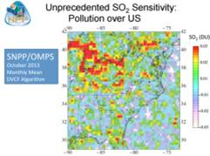
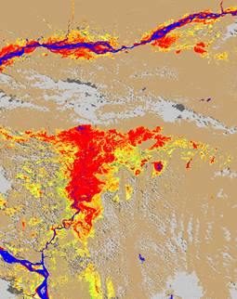
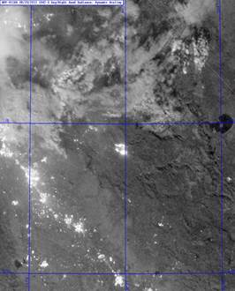
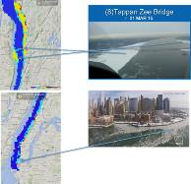
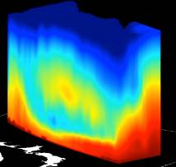
Climb the Application Pyramid
Decisions
Warnings
Impact Assessments
Specialty Forecasts – e.g., floods
Weather Forecasts e.g., 3-5 days
Baseline of Robust and Accurate Observations
7
Notes:
Warnings are provided by the government - since the governments service the public

Slide 8
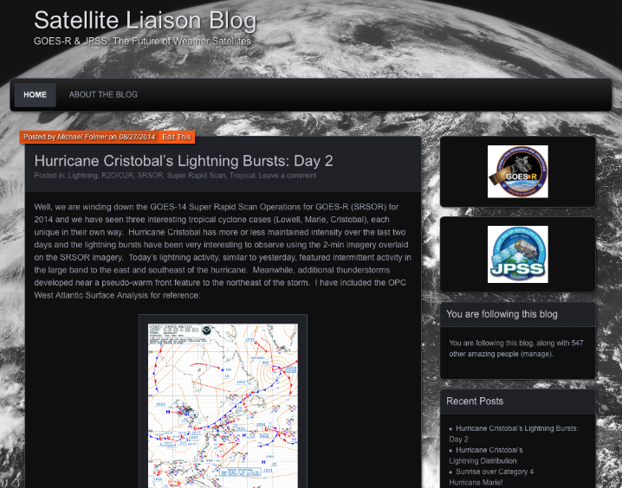
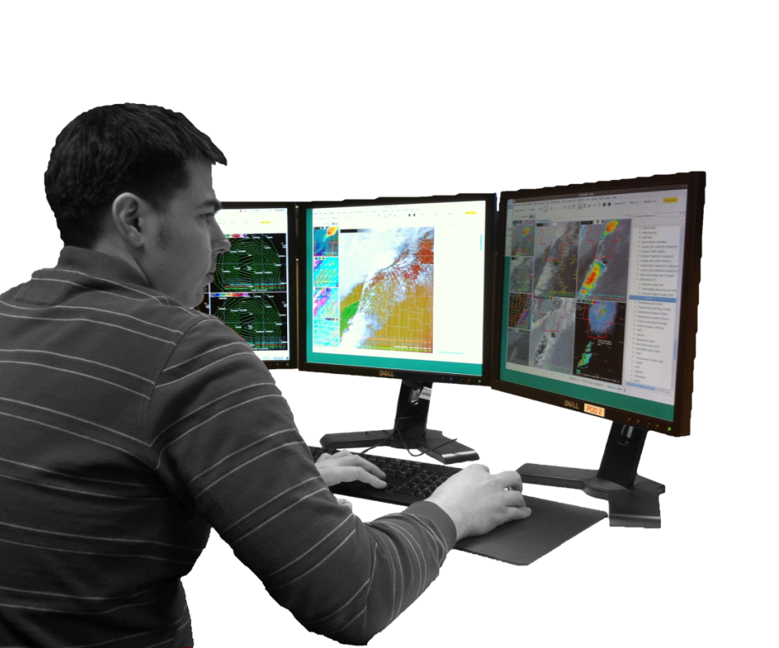
Satellite Proving Grounds
Key Aspects:
Demonstrations
Satellite liaisons (subject matter experts) at NWS National Centers
Develop training for users
International Projects
Visiting Scientist Program
http://satelliteliaisonblog.wordpress.com
8
Notes:
GOES-R/JPSS Proving Ground Provide mechanism to
Involve Cooperative Institutes, Algorithm Working Group, National Centers, NOAA Testbeds and WFOs in user readiness
Get prototype GOES-R/JPSS products in hands of forecasters into operations
Keep lines of communication open between developers and forecasters
Allow end user to have say in final product, how it is displayed and integrated
Some examples of international collaboration through the testbeds include:
Testing our GOES-R Products at the EUMETSAT ESSL Testbed- Convective Initiation, Overshooting Top Detection, and Nearcasting model;
International participation at the Hazardous Weather Testbed in Norman, Oklahoma where they were introduced to GOES-R Products
Among other internationals, EUMETSAT training officer Vesa Nietsovaara participated in the HWT during the first week of June 2014, and Paola Salio from the University Buenos Aires participated at HWT the first week of May 2014; and
Himawari demos will get underway this summer in Pacific and Alaska Regions.
Several GOES-R level 2 products are demonstrated in the GOES-R Proving Ground. Through the satellite proving grounds we make GOES-R test products available to forecasters, and GOES-R level 2 products for research. Examples can be found on the Proving Ground blogs and through the website www.goes-r.gov.

Slide 9
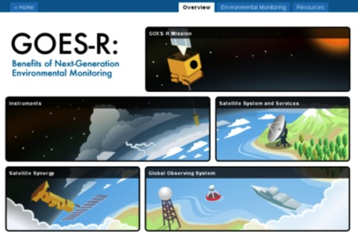
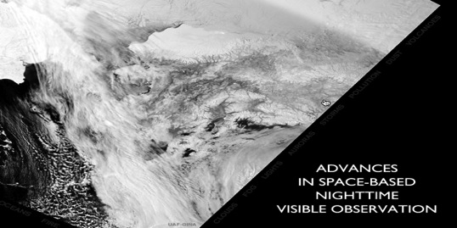
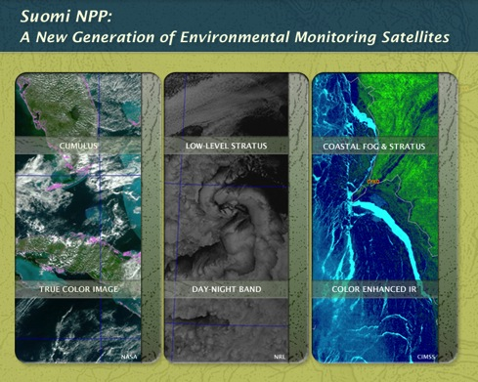
Training and Education
JPSS COMET Online Training Modules
Suomi NPP
Advances in Space-Based Nighttime Visible Imagery (VIIRS Day Night Band)
Remote Sensing Using Satellite, 2nd Edition (COMET)
Multispectral Satellite Applications: RGB Products Explained
Coming attractions from COMET:
Polar Sat updates on hyperspectral, wildland fires, and VIIRS
Nighttime Polar Applications Module
Satellite Data Informing NWP
Satellite Feature ID: Three Dimensionality of Water Vapor
GOES-R Online Training Modules (COMET)
GOES-R GLM: Introduction to the Geostationary Lightning Mapper
How Satellite Observations Impact NWP
GOES-R ABI: Next Generation Satellite Imaging
GOES-R: Benefits of Next-Generation Environmental Monitoring
Satellite Hydrology and Meteorology for Forecasters (SHyMet)
SPoRT product training modules
VISIT Training Resources
GOES-R: beneficios de la observación ambiental de próxima generación Suomi NPP: Una nueva generación de satélites de observación ambiental
Numerous other training modules in Spanish at http://bit.ly/COMETspanish
Printed Materials
ABI Bands Quick Information Guides
GOES-R Fact Sheets (18)
User Readiness Plan
GRB Downlink Specifications and Product Users Guide
Proving Ground Demonstration Final Reports and Annual Reports
Notes:
COMET: Cooperative Program for Operational Meteorology, Education, and Training (http://cimss.ssec.wisc.edu/)
In addition to specific GOES-R and JPSS (S-NPP) modules available in Spanish listed here – there are a number of other modules available in Spanish as well.
VISIT: Virtual Institute for Satellite Integration Training (http://rammb.cira.colostate.edu/training/visit/)
SPoRT: Short-term Prediction Research and Transition Center (NASA) (http://weather.msfc.nasa.gov/sport/training/)
New GOES-R Satellites Orientation Distance Learning Course. This course consists of three self-paced lessons, “GOES-R: Benefits of Next-Generation Environmental Monitoring”, ”GOES-R ABI: Next Generation Satellite Imaging”, and “GOES-R GLM: Introduction to the Geostationary Lightning Mapper”, that introduces forecasters, students, researchers, and other interested learners to the capabilities, products, and applications anticipated with the next-generation GOES-R satellites.

Slide 10
Proving Ground Initiatives
What is an initiative? An interagency group of developers and operational users that frequently interact in a structured forum to address forecast and mission support challenges in NOAA operational focus areas.
Initiative activities
Products/capabilities are evaluated to ensure their optimal use in these focus areas.
Based on user feedback, changes to these capabilities are considered to increase their effectiveness
Actions to transition these capabilities to user operations are identified and implemented
Why are initiatives successful?
Well defined objectives established and specific actions worked
NOAA stakeholders are actively participating
Products and capabilities are evaluated in operational environments
Monthly and bi-monthly meetings ensure proposed improvements can be worked on and then implemented quickly

Slide 11
PGRR Proving Ground Initiatives
River Ice and Flooding
Fire and Smoke (Aerosols)
Sounding Applications
NWP Data Assimilation
Imagery/Nowcasting
Ocean and Coastal
Hydrology
Arctic
Land Data Assimilation
Atmospheric Chemistry

Slide 12
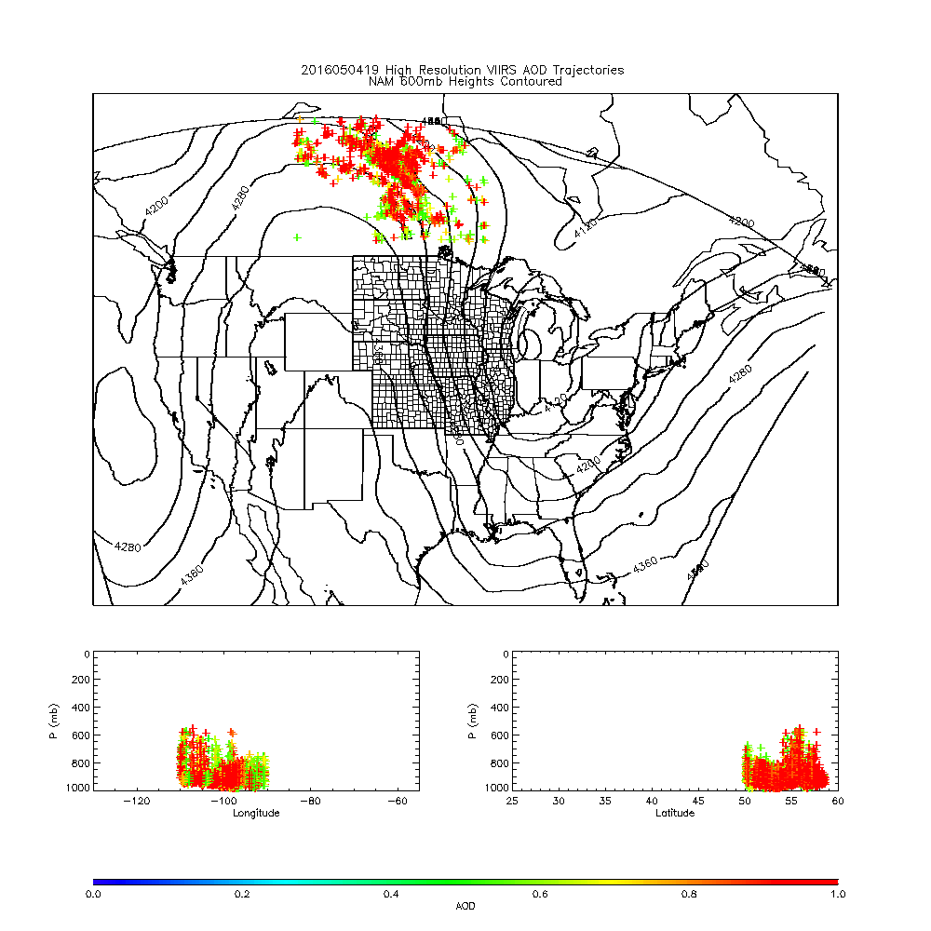
Fire/Smoke Initiative
HRRR-Smoke Modeling and Air Quality Forecasting
User and stakeholder feedback
Desire to transition capabilities to operations
High resolution (NAM 3km) trajectory forecast
Fort McMurray Wildfire May 04, 2016

Slide 13
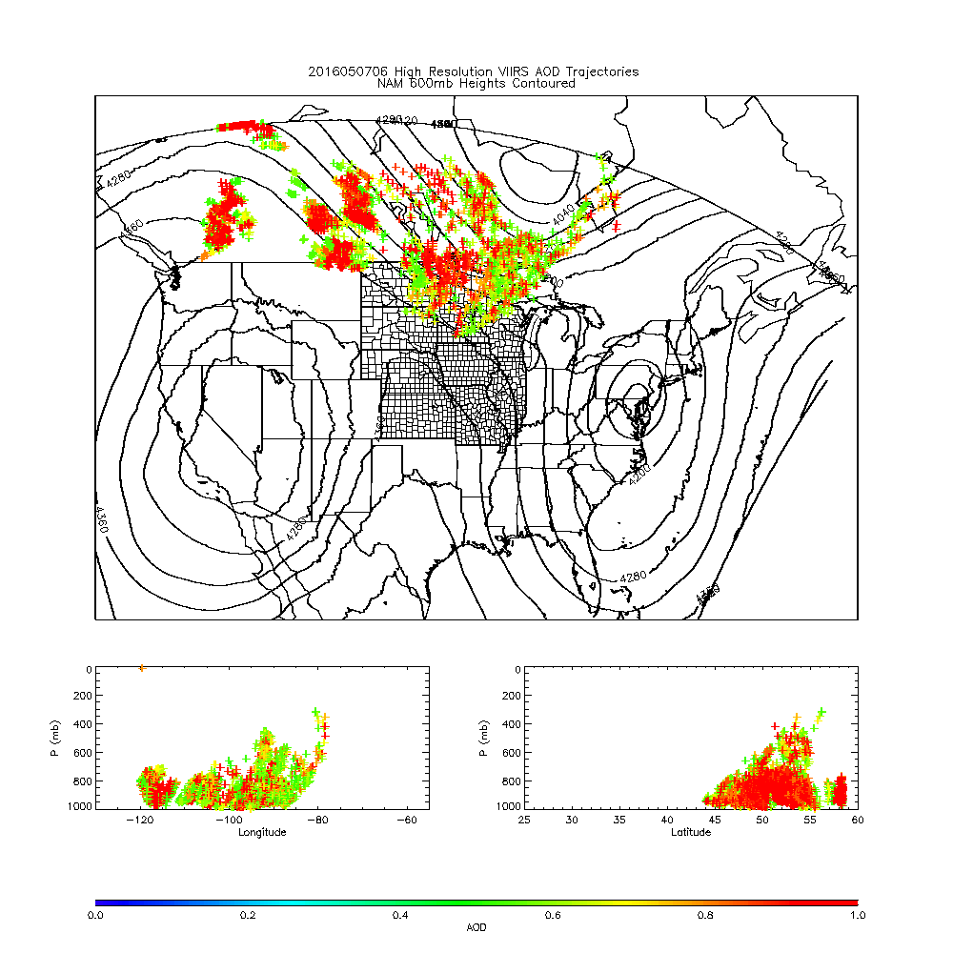
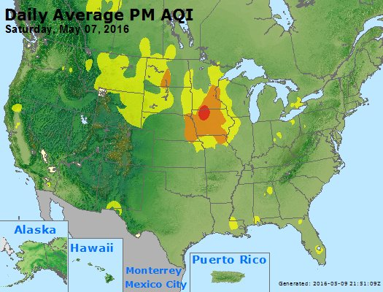
652 WWUS83 KMPX 070627 SPSMPX SPECIAL WEATHER STATEMENT NATIONAL WEATHER SERVICE TWIN CITIES/CHANHASSEN MN 127 AM CDT SAT MAY 7 2016 ...SMOKY CONDITIONS TO PERSIST THROUGH THE OVERNIGHT HOURS... WIDESPREAD SMOKE FROM BOTH THE LARGE CANADIAN WILDFIRES AND A SMALLER WILDFIRE NEAR LAKE HATTIE IN HUBBARD COUNTY MINNESOTA HAS BLOWN INTO CENTRAL MINNESOTA...PARTICULARLY WITHIN AND NEAR THE TWIN CITIES METROPOLITAN AREA...DUE TO STRONG WINDS FROM THE NORTHWEST. VISIBILITIES HAVE BEEN REDUCED TO BETWEEN 1 AND 3 MILES...AND AIR QUALITY HAS BEEN SIGNIFICANTLY IMPACTED.
From Andy Edman/NWS
https://www.airnow.gov/

Slide 14
Summary
JPSS PGRR program near-term focus is O2O. Operational products at NESDIS/OSPO used operationally by the users.
Requires good communication between algorithm developers and users.
Good success through the PGRR Inititatives
At the end of the day, it’s the applications, but the applications will depend on the performance.

