Slide 1
Assimilate AOD retrieval to constrain emission and surface PM_{2.5} concentration prediction by CMAQ
Youhua Tang^{1,2}, Pius Lee¹ , Greg Carmichael³, Tianfeng Chai^{1,2} ,
Li Pan^{1,2}, Daniel Tong^{1,2,4} and Hyun-Cheol Kim^{1,2}
1. NOAA Air Resources Laboratory, 5830 University Research Court, College Park, MD
2. Cooperative Institute for Climate and Satellites, University of Maryland, College Park, MD
3. Department of Chemical and Biochemical Engineering, University of Iowa, Iowa City, IA
4. Center for Spatial Information Science and Systems, George Mason University, Fairfax, VA
NOAA Satellite aerosol product workshop, College Park, MD, September 13-14, 2016

Slide 2
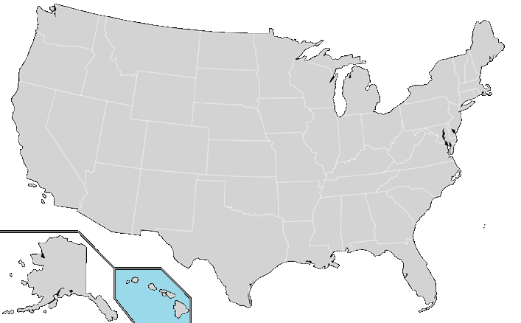
Current NAQFC: Prod
Chemical Transport Model:
CMAQ4.6 for CONUS, AK & HI
CB05 gas chemistry
Aero4 aerosol chemistry
LBC: monthly varying GEOS-CHEM
O₃ product dissemination: TOC
2016: O₃ & PM_{2.5} (CONUS)
2010: O₃(AK)
Lee, McQueen, Stajner,
Kondragunta, Lu et al.,
Weather & Forecasting 2016
DOI: WAF-D-15-0163.1
2010: O₃ (HI)
http://airquality.weather.gov/
O₃ Performance (FVS by NCO):
Max Daily 8h (MDA8) O₃ for domains above: Bias, RMSE, and % Hit Rate
Feed of EPA AIRNow O₃ and PM_{2.5} in Bufr format
NOAA Satellite aerosol product workshop, College Park, MD, September 13-14, 2016

Slide 3
Data Assimilation Methods
Optimal interpolation (OI)
  Easy to apply, computationally efficient
3D-Var
  Adjusts all variables in the whole domain simultaneously. Currently, GSI is being developed at NOAA/NASA/NCAR
4D-Var
  Provides more flexibility, requires adjoint model
Kalman Filter
NOAA Satellite aerosol product workshop, College Park, MD, September 13-14, 2016

Slide 4
Optimal Interpolation (OI)
OI is a sequential data assimilation method. At each time step, we solve an analysis problem
We assume observations far away (beyond background error correlation length scale) have no effect in the analysis
NOAA Satellite aerosol product workshop, College Park, MD, September 13-14, 2016
Notes:
OI: applied to AOD:
a: Analysis; b: background state;B: background error covariance; O: Observation error; H: transformation from model extinction to AOD as Y (observed AOD).

Slide 5
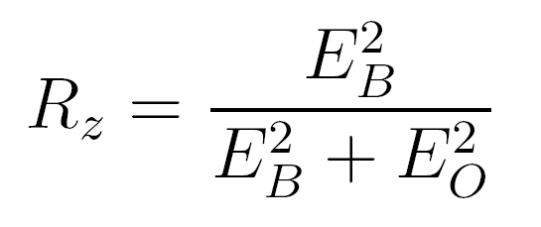
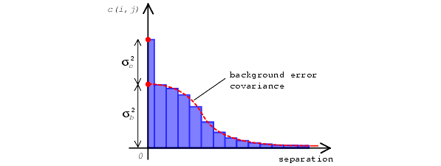
Estimate Model Error Statistics w/ Hollingsworth-Lonnberg Method
At each data point, calculate differences between forecasts (B) and observations (O)
Pair up data points, and calculate the correlation coefficients between the two time series
Plot the correlation as a function of the distance between the two stations,
NOAA Satellite aerosol product workshop, College Park, MD, September 13-14, 2016
Notes:
Calculate differences between forecasts (B) and observations (O) at each AIRNOW station as a time series
Pair up AIRNOW stations, and calculate the correlation coefficients between the two time series at the paired stations
Plot the correlation as a function of the distance between the two stations,
Intercept Rz can be used to calculate the ratio between model error (EB) and and observational error (including representative error)
Horizontal length scale can be inferred as well

Slide 6
Horizontal Error Statistics
Rz:
~ 0.9
E_{B}²/ Eo²:
~ 9
Correlation length:
~ 160 km
NOAA Satellite aerosol product workshop, College Park, MD, September 13-14, 2016

Slide 7
Adjust Initial Condition Using Optimal Interpolation (OI1-case )
AOD ingest: PM2.5
00Z
06Z
12Z
18Z
Tang, Lee et al.,
J. W&WMA 2015
AIRNOW ingest: PM2.5
NOAA Satellite aerosol product workshop, College Park, MD, September 13-14, 2016

Slide 8
NOAA Satellite aerosol product workshop, College Park, MD, September 13-14, 2016

Slide 9
NOAA Satellite aerosol product workshop, College Park, MD, September 13-14, 2016

Slide 10
AirNOW data OI was only applied up to PBL height, and MODIS data affects the whole column
NOAA Satellite aerosol product workshop, College Park, MD, September 13-14, 2016
Notes:
This figure shows cross-sectional plots over 39°N from 90°W to 70°W. Figure 4a shows the accumulation-mode sulfate change with AIRNow-only OI from the 14Z simulation applied to layers within the PBL; the sulfate-concentration adjustment was up to 60 µg/m³, and all the adjustments were below 2km. When MODIS OI was included (Figure 4b), the whole column changed if there was no AIRNow PM_{2.5} observation nearby. Alternatively, the column changed above the PBL if an AIRNow PM_{2.5} observation was available. In most areas, MODIS and AIRNow OI yielded a consistent trend of adjustment. For example, over 88°W, both data showed that the 14Z simulation underestimated aerosols, so OI increased sulfate below and above the PBL. A similar situation occurred over 85°W, where both adjustments decreased sulfate concentration. However, over 76.6°W, the two adjustments gave contradictory adjustment trends: AIRNow OI decreased sulfate, while MODIS OI increased sulfate. Although the two adjustments were applied below and above the PBL, respectively, thus avoiding direct conflict with each other in this study, more quality control for the observations and further study of aerosol’s vertical distribution are needed to address this contradiction. Unfortunately, these two sets of observation cannot give us information about aerosol’s vertical distribution.

Slide 11
Base Case
After Assimilation (OI4)
Tang, Lee et al.,
J. W&WMA 2015
NOAA Satellite aerosol product workshop, College Park, MD, September 13-14, 2016
Notes:
One of our goals was to generate a reasonable aerosol field comparable to AIRNow measurements. This figure shows the base model and OI4 PM_{2.5} biases over the Northeastern USA at 18 UTC, i.e. the first forecast hour from the 17 UTC assimilation. The base model under-predicted PM_{2.5} over most regions, except for several stations near the Great Lakes. After the OI4 adjustment, the low biases were corrected over most areas, especially over the New England region, Indiana, Michigan, and Ohio. The high biases over the two stations near Southeastern Wisconsin and Northwestern Indiana near Lake Michigan persisted; since there were other nearby stations showing low or no biases, the OI method failed to adjust due to these contradictory signals. It should also be noted that we adjusted only the initial condition. Biases of emission and other persisting factors could quickly overwrite the correction, especially over polluted areas with relatively high emissions.

Slide 12
Evaluation comparison
Cases of Predictions | O3 | PM2.5
PARA5 (NAM-CMAQ 4.6.3 L22) | R=0.62 MB=5.6 | R=0.42 MB=-5.08
L42-fire1 CMAQ5.02 | R=0.53 MB=2.54 | R=0.23 MB=-7.14
OI1 | R=0.56 MB=2.36 | R=0.24 MB=-2.63
OI4 | R=0.56 MB=1.55 | R=0.40 MB=-0.11
NOAA Satellite aerosol product workshop, College Park, MD, September 13-14, 2016

Slide 13
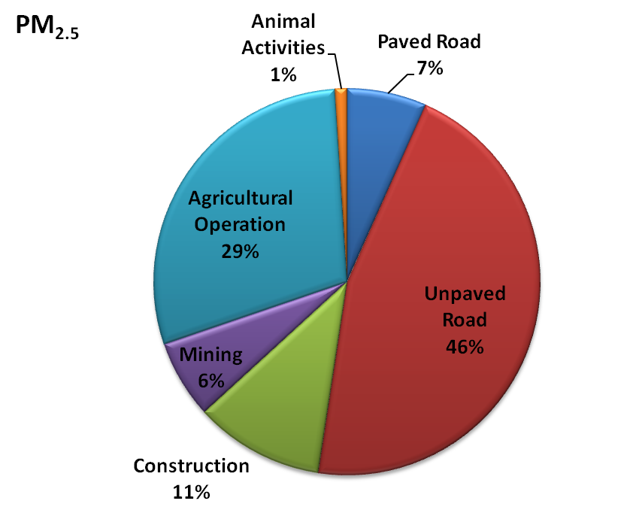
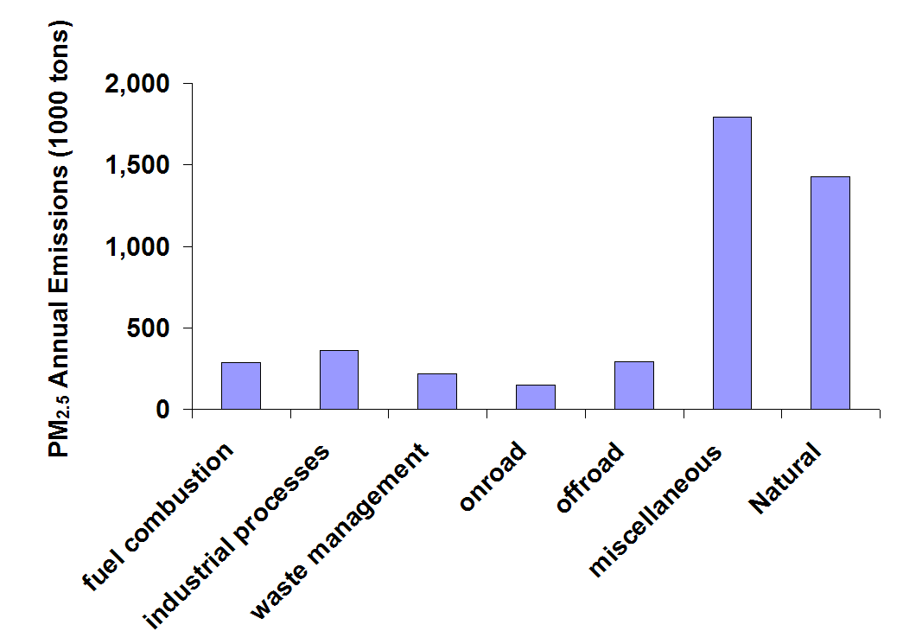
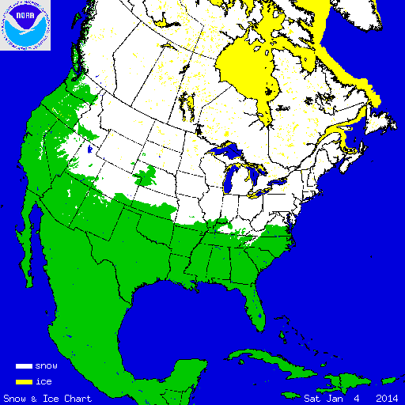
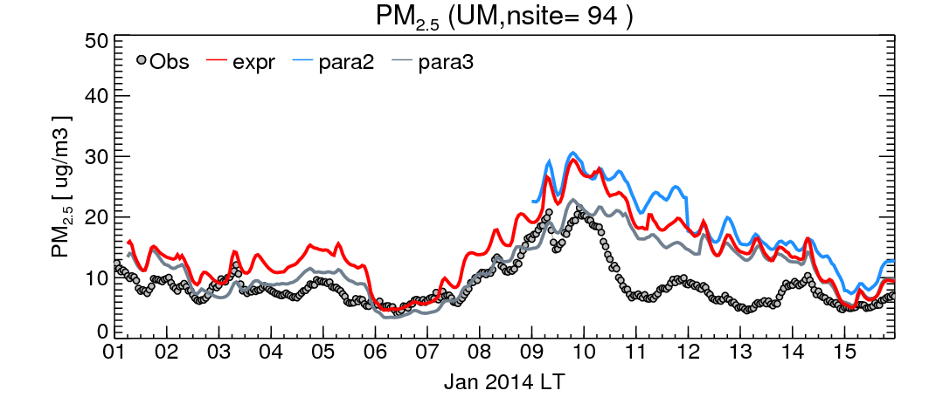
Weather Aware Emission: Snow/ice effect
Anthropogenic
?
(Courtesy: NOAA NIC)
13
NOAA Satellite aerosol product workshop, College Park, MD, September 13-14, 2016

Slide 14
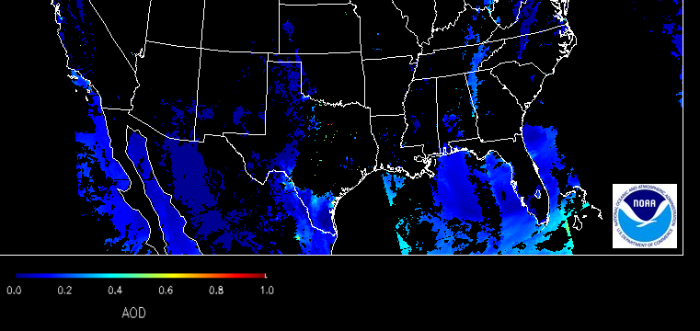
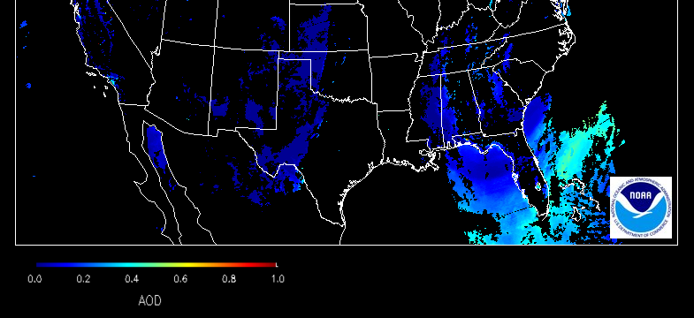
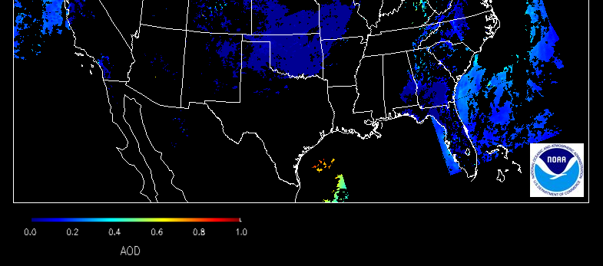
A Recent Sahara Dust Intrusion
Sahara dust event May 9-11 2015
VIIRS AOD
Courtesy: NESDIS
12 UTC May 9
12 UTC May 10
12 UTC May 11
NOAA Satellite aerosol product workshop, College Park, MD, September 13-14, 2016
Notes:
An Saharan dust intrusion event occurred between May 9-11 2015 was recorded by imageries compiled by the VIIRS instrument on board of JPSS-1. The blue swaths on the imageries reflects the aerosol optical depth in accordance with the color scale shown in the lower left corner color bars.

Slide 15
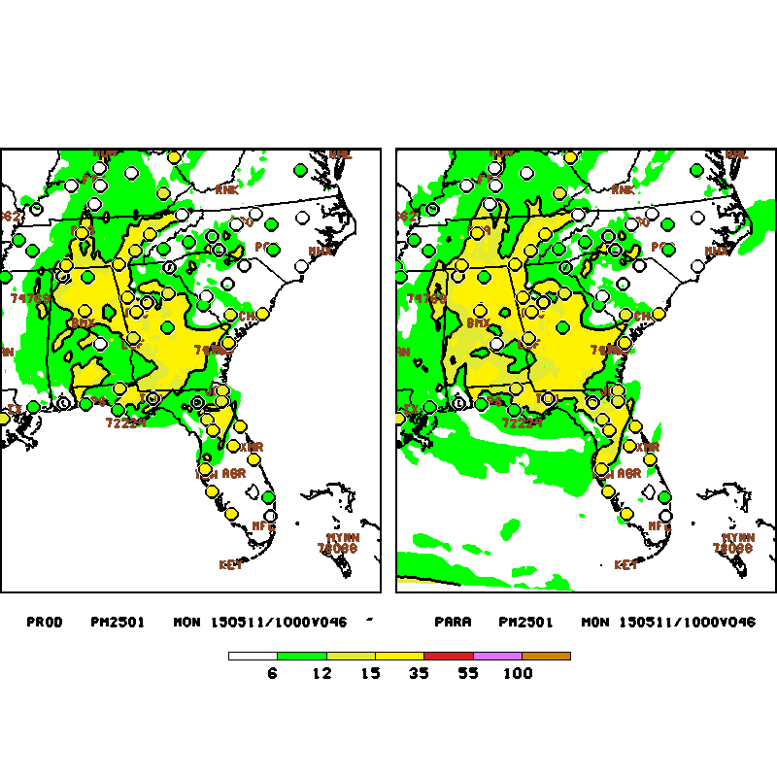
Surface concentration of PM_{2.5} at 10 UTC May 11 2015: modeled (background shading),
measured (filled circle)
Without dynamic boundary condition With dynamic boundary condition
PM_{2.5} in µg m⁻³
NOAA Satellite aerosol product workshop, College Park, MD, September 13-14, 2016
Notes:
The same Saharan dust intrusion case shown in the previous slide impact a large swath in southern FL. The background shading represents NAQFC predicted surface concentration of PM2.5 where the filled circle represents measured value by the AIRNow surface network. Both sets of values are depicted in accordance with the color bar in the bottom of the plots.

Slide 16
Effort to reduce emission uncertainty for wildfires
Improving Spatial Resolution of Wildland Fire Location and Fuel Biomass Data Inputs to NOAA’s NAQFC (S. Drury et al., Sonoma Tech, 2016)
Drury, Larkin et al.,
J Fire Ecology 2014
NOAA Satellite aerosol product workshop, College Park, MD, September 13-14, 2016

Slide 17
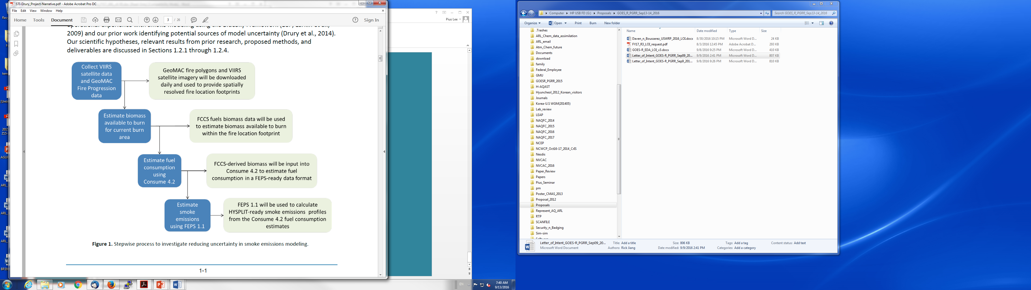
Courtesy: S. Drury, Sonoma Tech
Q: Finely resolved fire activity:
Spatially
Thermally & Chemically
NOAA Satellite aerosol product workshop, College Park, MD, September 13-14, 2016

Slide 18
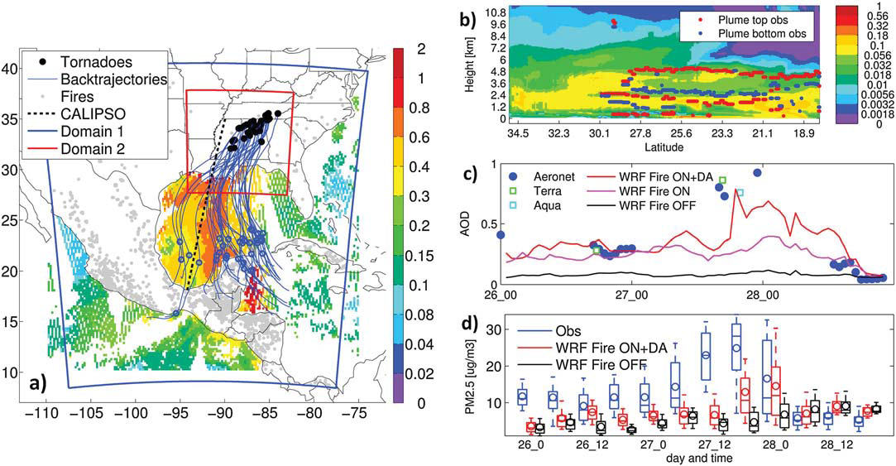
Saide, Pierce, Da Silva et al.,
GRL 2015
Saide, Pierce, Carmichael et al.,
JGR 2016
Biomass burning smoke before and during the outbreak of 27 April 2011. Forty two hours back trajectories (blue lines) computed with the FLEXPART model from the beginning of a violent tornado outbreak (EF4 and EF5), with circles marking 24-h after the outbreak, observed AOD over ocean on 27 April (color-shaded), fire locations for the day before (grey dots), CALIPSO track for 26 April at 0800 UTC, and modeling domains (blue and red quadrilaterals).
NOAA Satellite aerosol product workshop, College Park, MD, September 13-14, 2016

Slide 19
Summary
The OI chemical data assimilation combining AirNOW surface measurements and AOD retrieval yielded significantly improve PM_{2.5} forecast accuracy: especially on reducing mean biases (OI technique is sensitive to uncertainty assumptions):
Some of our assumptions, such as the aerosol speciation ratios and vertical distribution, need to be further verified.
Emission projection constrained by VIIRS:
Wildfire emission uncertainties
Dust emission suppression and dust intrusion
VIIRS AOD constrains aerosol mass and number: feedback to meteorology
NOAA Satellite aerosol product workshop, College Park, MD, September 13-14, 2016

Slide 20
AOD Comparison
NOAA Satellite aerosol product workshop, College Park, MD, September 13-14, 2016

