Slide 1
VIIRS Aerosol Assimilation Activities at NWS/NCEP
Sarah Lu*, Shih-Wei Wei, Sheng-Po Chen (SUNYA)
Shobha Kondragunta, Qiang Zhao (NESDIS/STAR)
Jeff McQueen, Jun Wang, Partha Bhattacharjee (NWS/NCEP)
*: clu4@albany.edu; Sarah.Lu@noaa.gov

Slide 2
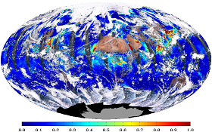
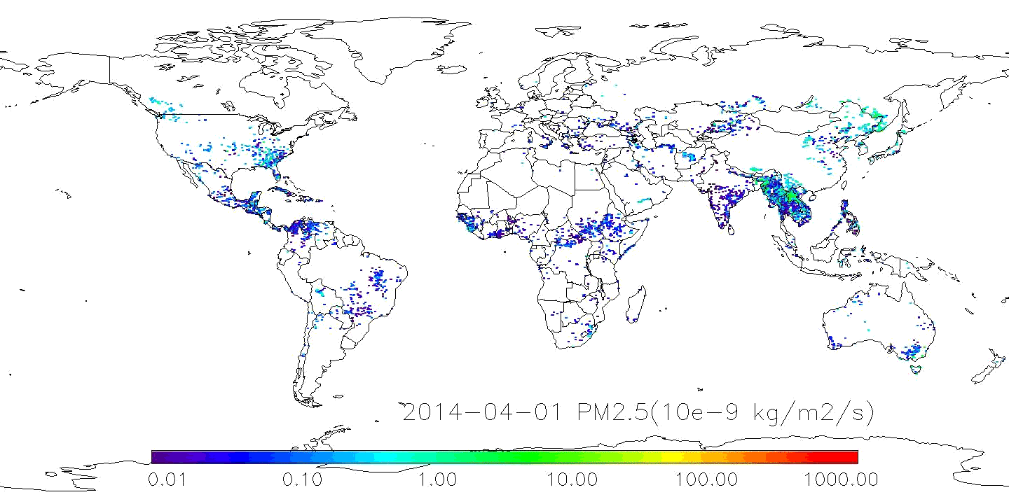
Using satellite data to improve aerosol forecasting
Satellite observations have been used to improve aerosol products
Routine monitoring of model performance
Near-real-time biomass burning emissions from satellite observations
Data assimilation of satellite aerosol observations (this presentation)
Aerosol observations from VIIRS
Near-real-time biomass burning emissions from multiple satellites
From NOAA/NESDIS/STAR website

Slide 3
Outline
Scope of global aerosol prediction at NCEP
Status update in aerosol data assimilation
Summary

Slide 4
NCEP global aerosol modeling and assimilation
Long-term goal
Allow aerosol impacts on weather forecasts and climate predictions to be considered
Enable NCEP to provide quality atmospheric constituent products serving the stakeholders, e.g., health professionals, policy makers, climate scientists, and solar energy plant managers
Phased implementation for NEMS GFS Aerosol Component (NGAC)
Phase 1: Dust-only forecasts (operational)
Phase 2: Multi-species forecasts for dust, sulfate, sea salt, and carbonaceous aerosols using NESDIS’s NRT GBBEPx smoke emissions (planned FY16 implementation)
Phase 3: Multi-species forecasts initialized from aerosol analysis

Slide 5
NCEP global aerosol modeling and assimilation –cont’d
Incremental updates for aerosol data assimilation
JCSDA-funded project to assimilate VIIRS AOD retrievals using GSI 3DVar data assimilation system
The AOD DA algorithm is based on Liu et al. (2011), Schwartz et al. (2012), and Pagowski et al. (2014)
The system will be extended to use multi-sensor and multi-platform aerosol observations and evolve to an ensemble-based system
The path to operational implementation is uncertain and likely driven by NWS initiatives, e.g., Unified Coupled Global System (UCGS) and Next Generation Global Prediction System (NGGPS)

Slide 6
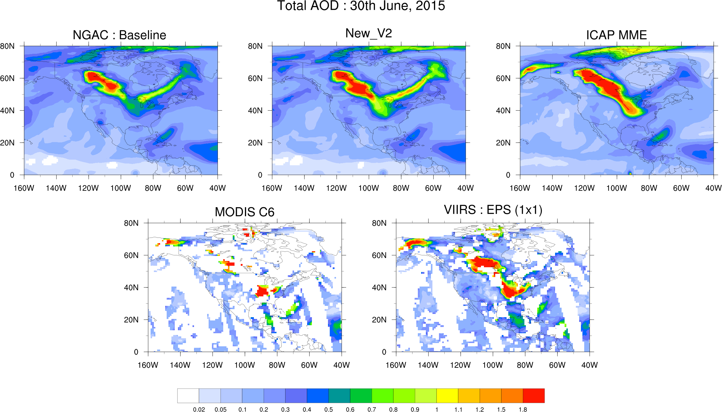
July 2015 case: Lower AOD in NGACv2 than ICAP-MME for the areas affected by Alaska and Africa smoke

Slide 7
NGAC AOD MERRA2 AOD MERRA2 analysis increment
00Z
12Z
Comparable smoke emissions between QFED2 (for MERRA2) and GBBEPx (for NGAC)
The AODs differences between MERRA2 and NGACv2 are attributed to analysis increment

Slide 8
Outline
Scope of global aerosol prediction at NCEP
Status update in aerosol data assimilation
Data ingestion and observational errors
NGAC guess and background errors
Preliminary VIIRS AOD DA results
Summary

Slide 9
Technical/Scientific Progress
With GSI/CRTM, NCAR and ESRL assimilates MODIS AOD using WRF-CHEM as first guess. We are extending the new GSI option to use NGAC as first guess and VIIRS AOD as observation input.
GOCART reading interface in GSI:
GSI code modified to read NGAC first guess
Observation reading interface in GSI:
GSI code modified to read VIIRS AOD
Observation thinning for VIIRS AOD is done in reading step
Specification of background error
Calculated using the NMC method
Spatial correlation for GOCART aerosol species

Slide 10
Technical/Scientific Progress –cont’d
Specification of observation errors
Determined from VIIRS versus AERONET comparisons (VIIRS Cal/Val efforts)
Observation operator
Use JCSDA Community Radiative Transfer Model (CRTM V2.2.3) as observation operator for VIIRS AOD
Forward and Jacobian models
Synergistic activities:
VIIRS AOD from Enterprise algorithm has been encoded in BUFR format and dumped to a development database at EMC

Slide 11
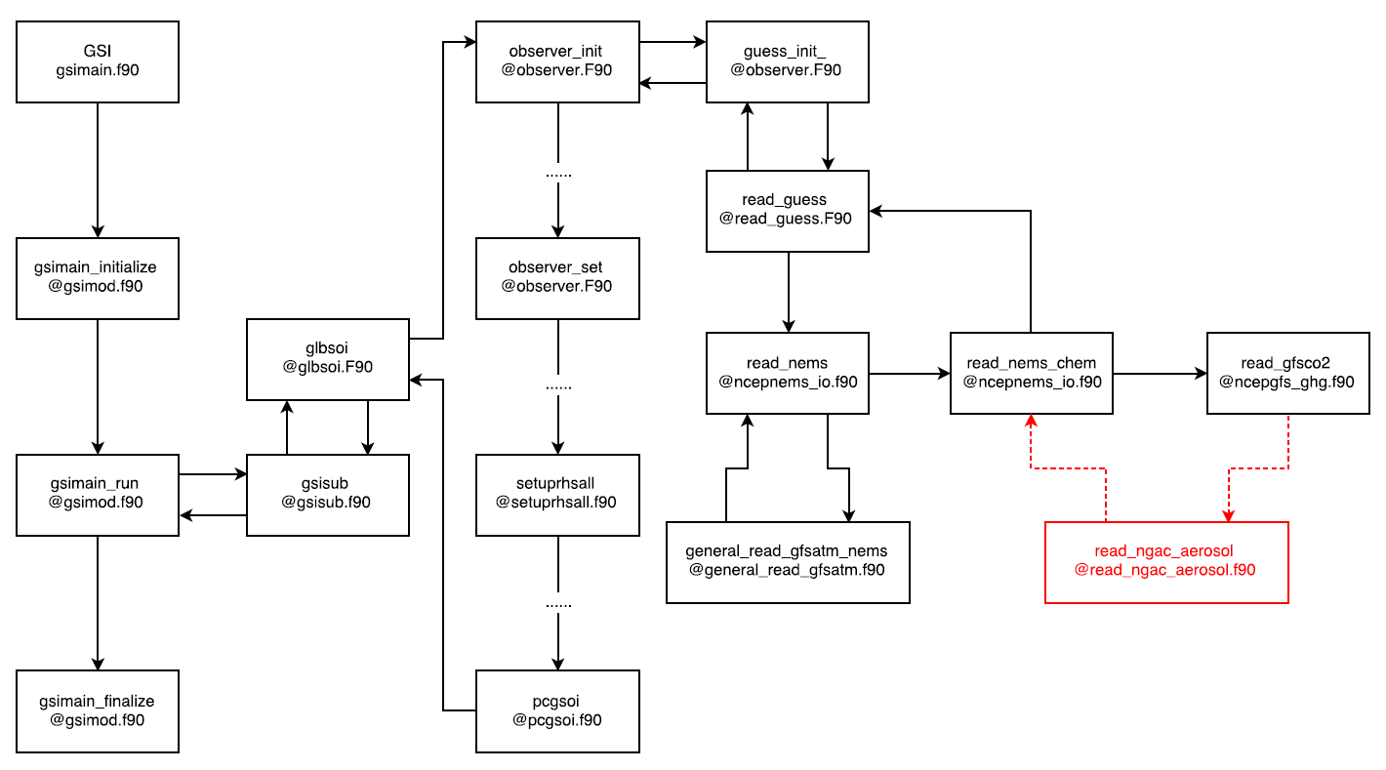
GSI workflow
Add read_ngac_aerosol.f90 to read in GOCART species (du, ss, su, oc, bc) using nemsio module

Slide 12
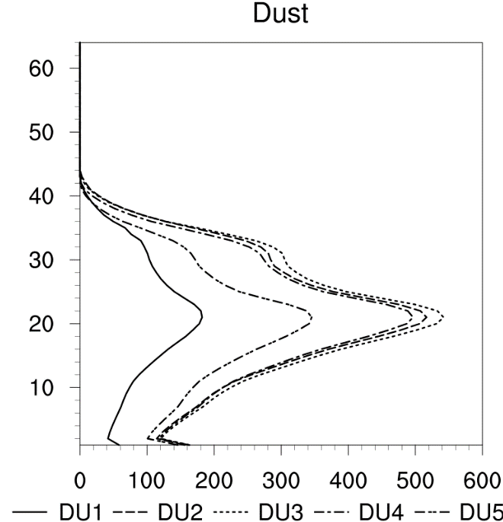
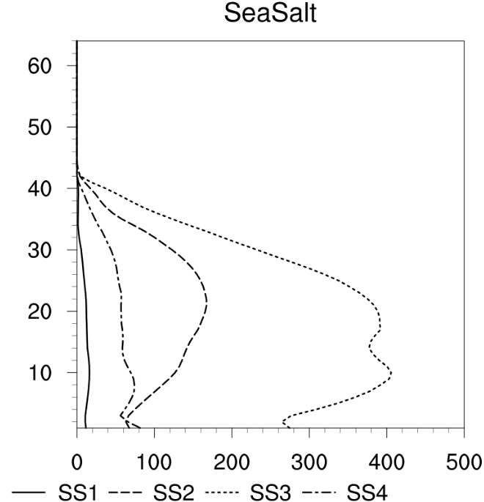
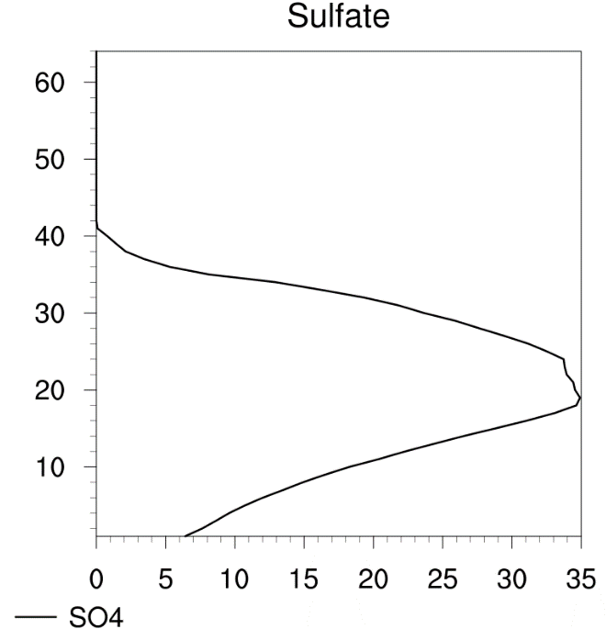
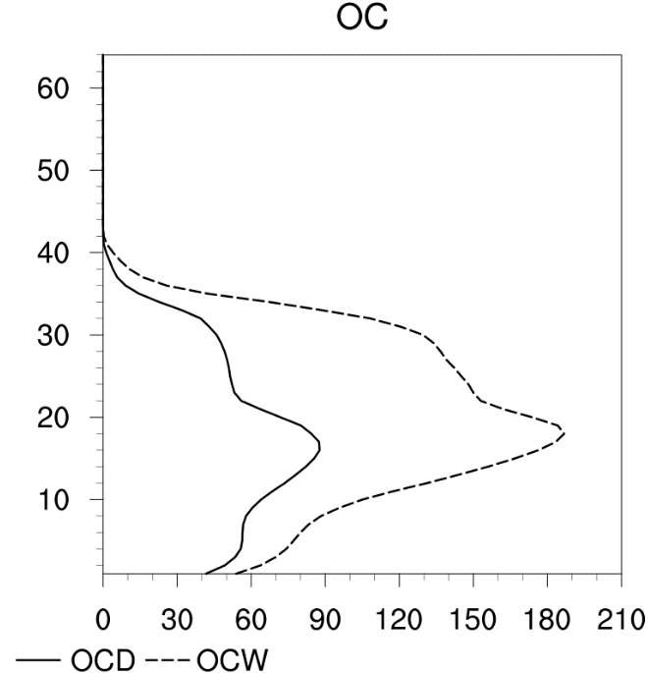
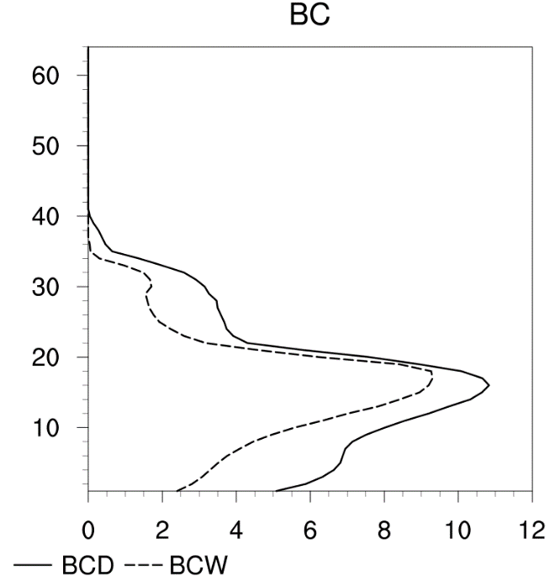
Specification of background errors
Standard Deviation (ug/kg)

Slide 13
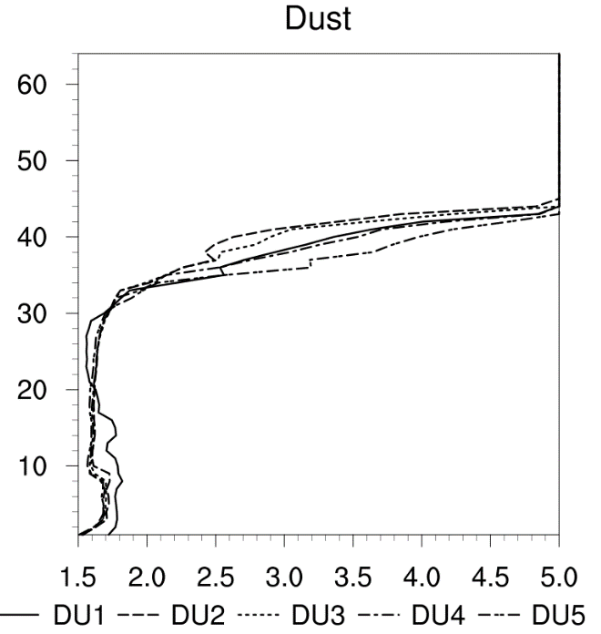
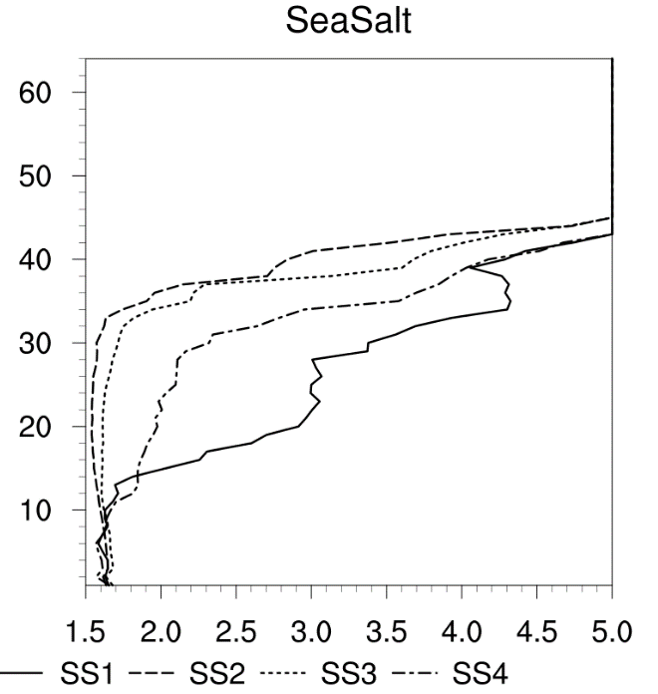
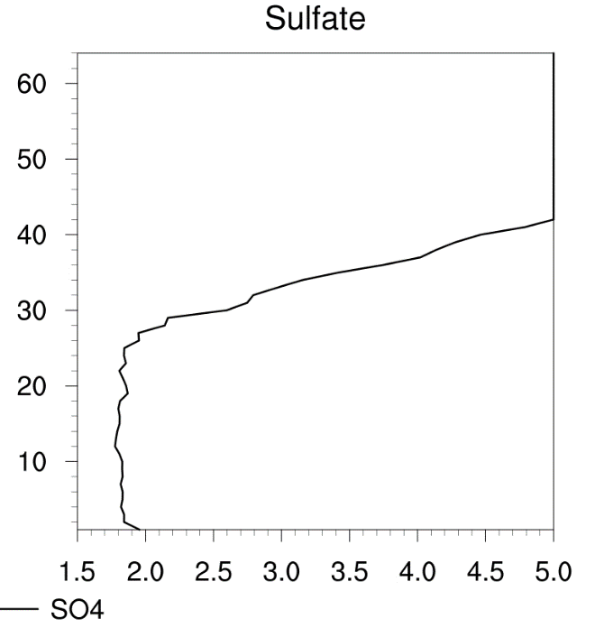
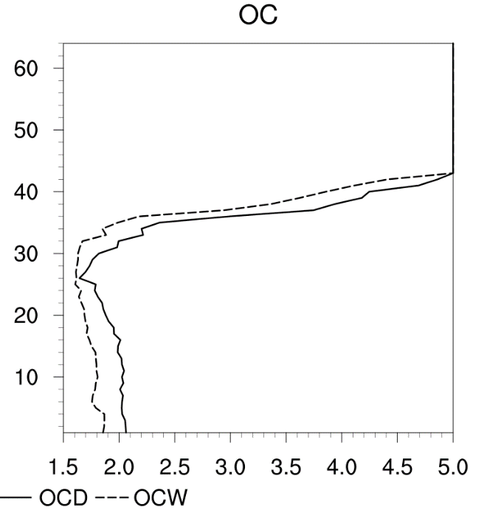
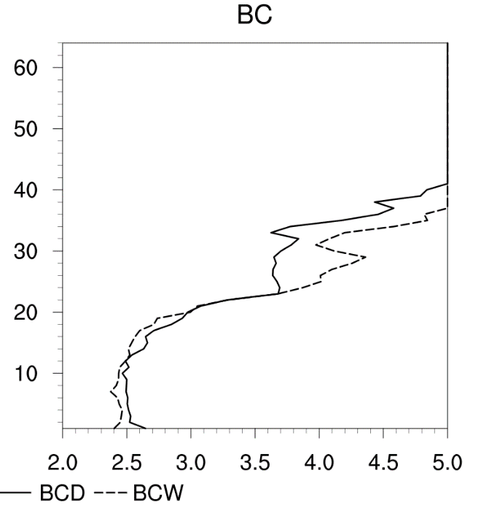
Specification of background errors –cont’d
Horizontal Scale Length
(100km)

Slide 14
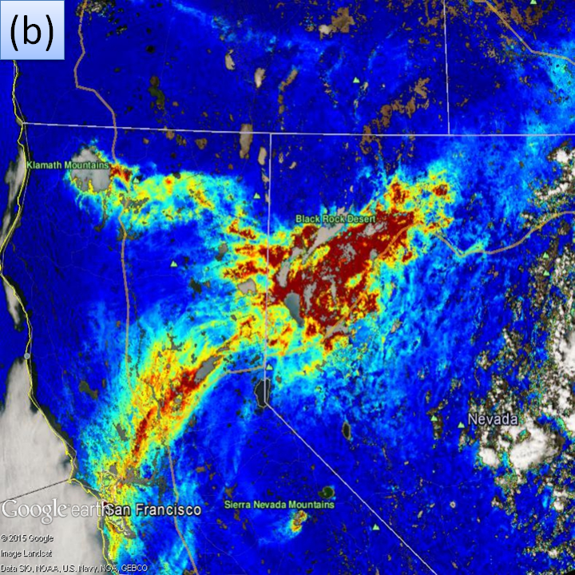
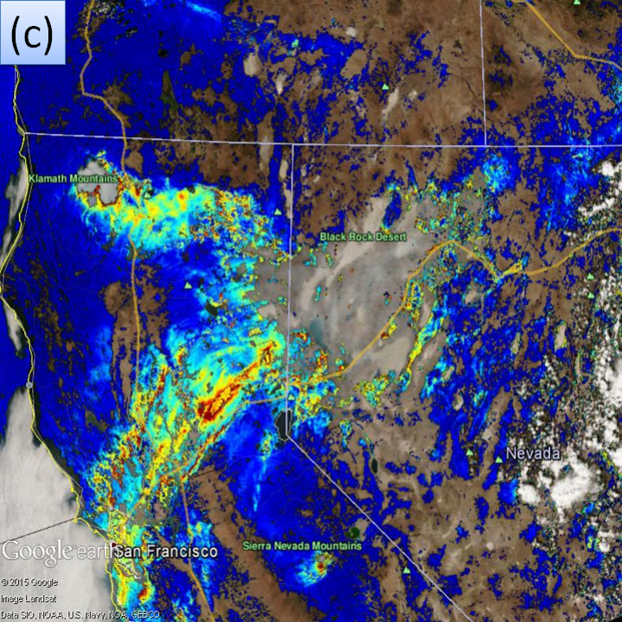
VIIRS Enterprise Algorithm AOD Product
Enterprise Algorithm
AOD@550nm + @11 moderate channels
We currently use AOD@550nm only
Moderate spatial resolution: ~750m
Data thinning may be needed
Daily global coverage with 14-15 orbits
Multiple DA cycles per day
Surface categories:
Water, dark land, bright land
Retrieval quality flags:
0: no retrieval; 1: low quality; 2: medium quality; 3: high quality
Currently in HDF5 format, will be in netCDF format in operational mode
Converted into BUFR and then BUFR dump files
Operational Algorithm

Slide 15
Data Ingestion in GSI
Screening out “bad” data
Outside model domain (for regional model only)
Outside observation cut-off window
+/- 3 hours around the analysis time
Low retrieval quality
Only retrievals with quality flags 2 and 3 are retained
Out of range of valid values
Current range is set to 0-5

Slide 16
Data Ingestion in GSI –cont’d
Data thinning
Decide the thinning grid
Set up thinning criteria
Offset from the analysis time
Distance from the thinning grid point
Surface category
Retrieval quality

Slide 17
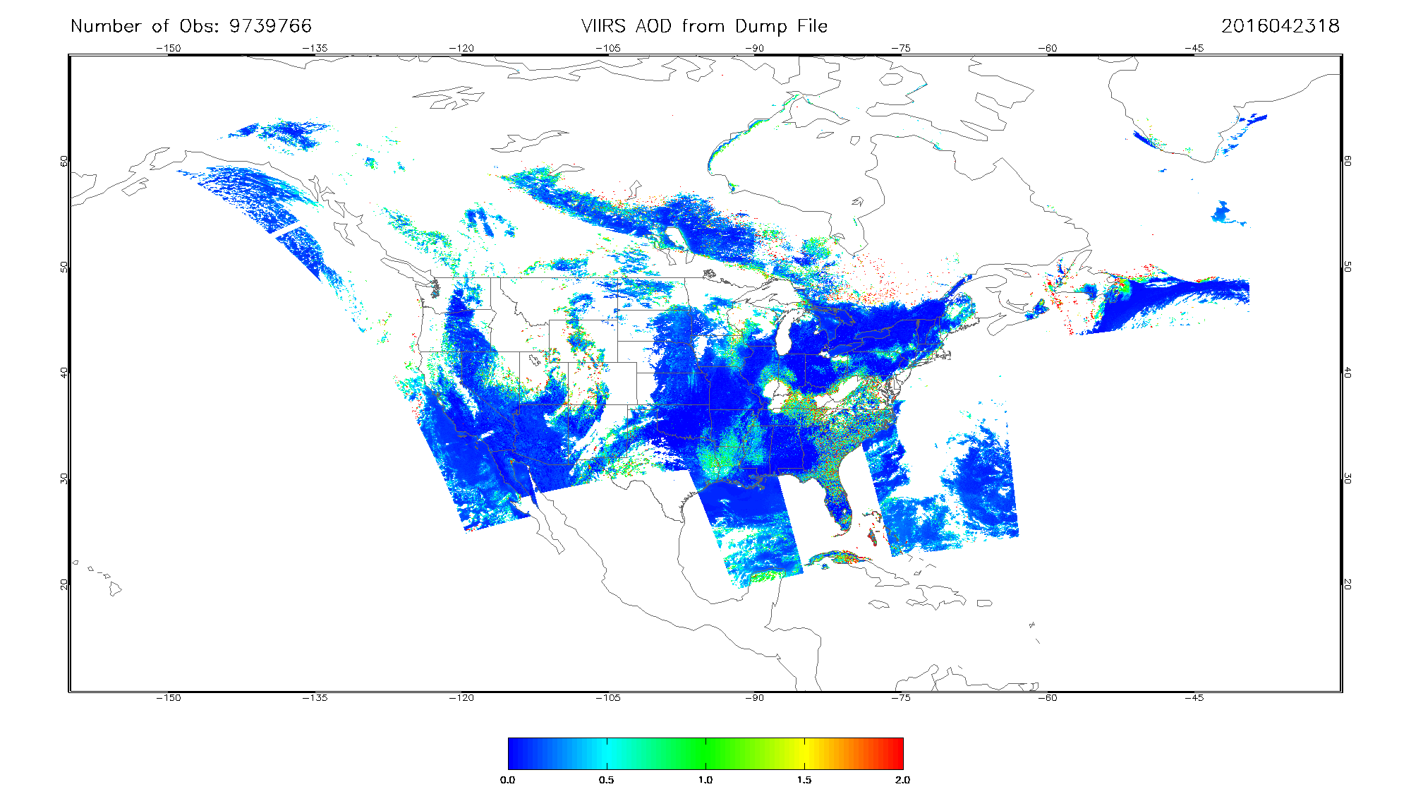
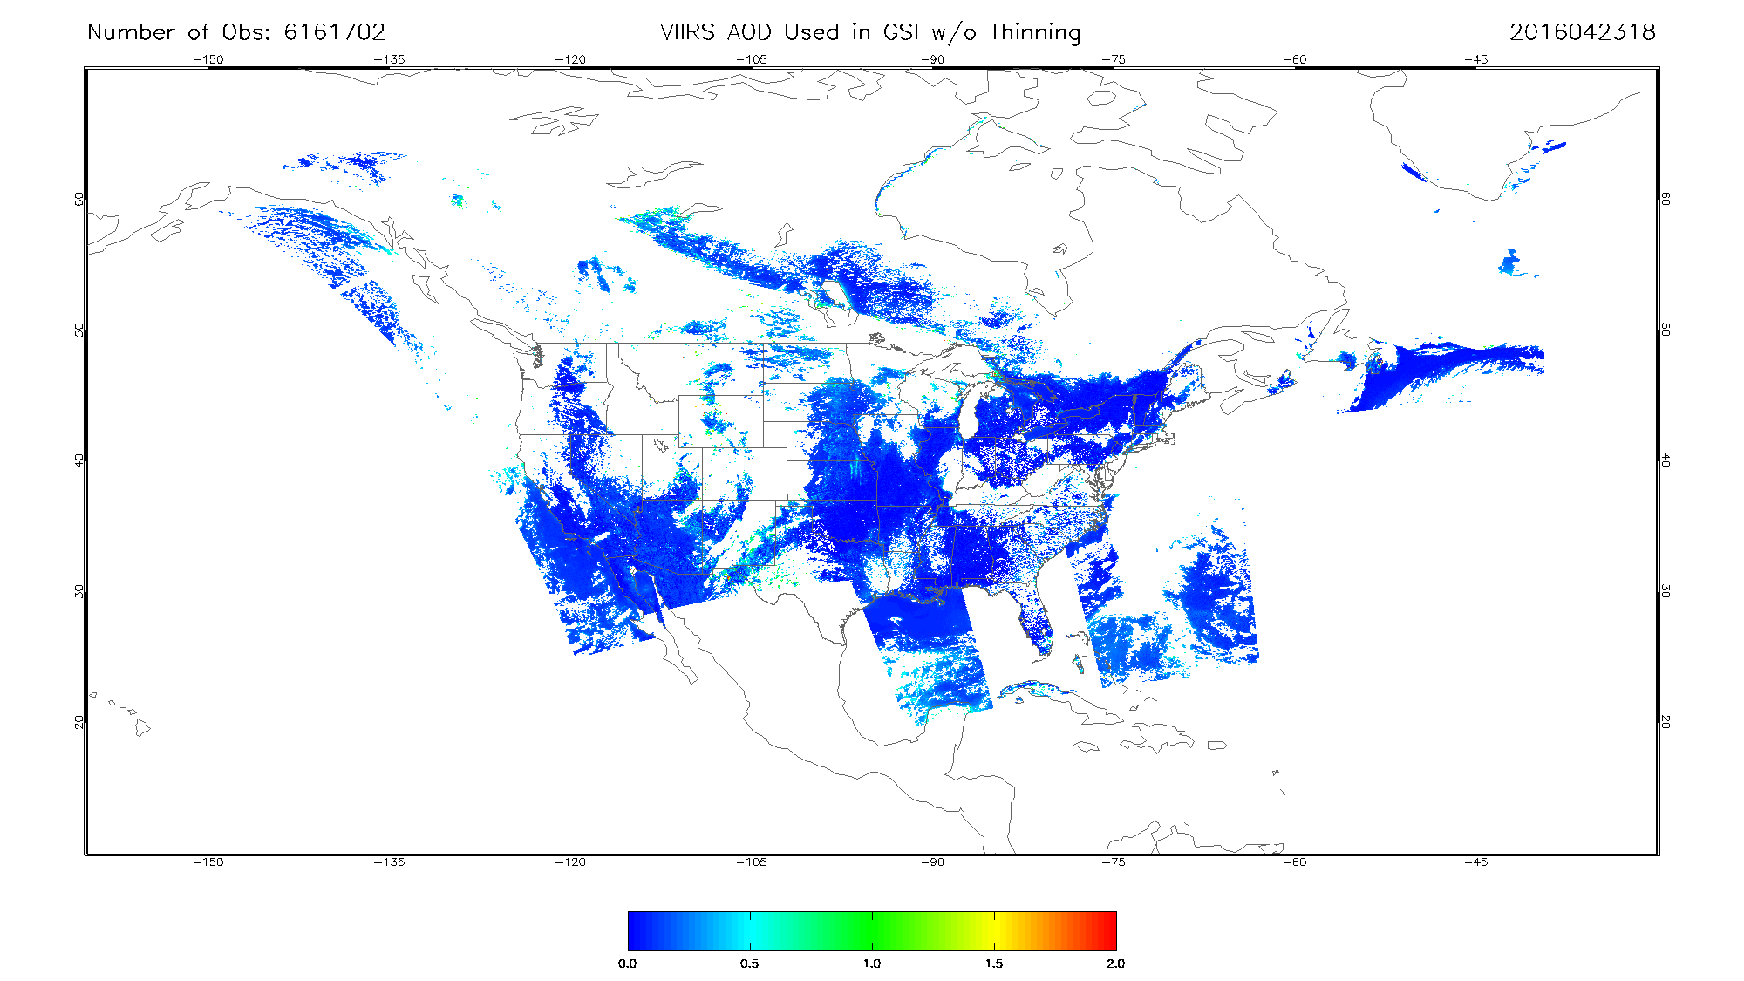
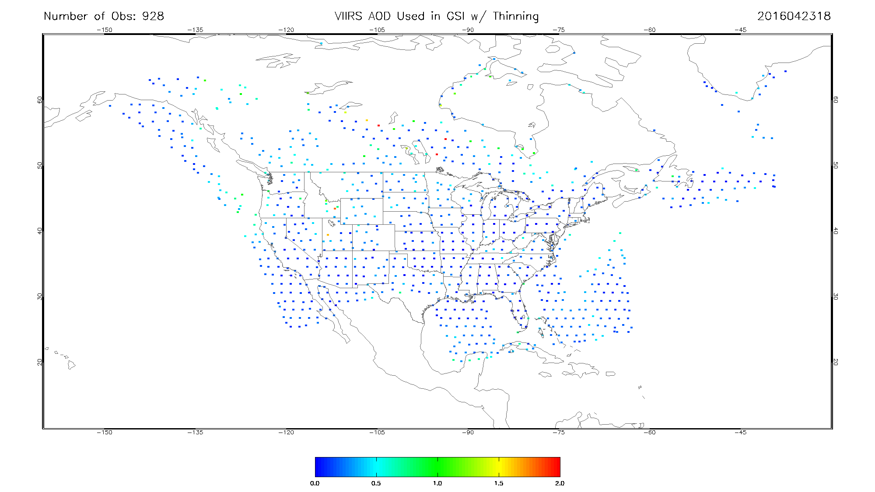
Data Ingestion in GSI – cont’d
A
B
Test with sample data (2016-04-23 18z)
AOD retrievals from BUFR dump file (total number of observations: 9739766)
AOD retained in GSI without thinning (total number of observations: 6161702)
AOD retained in GSI with thinning (total number of observations: 928)
C

Slide 18
Specification of Observation Errors
The observation error statistics were provided by the NESDIS STAR aerosol algorithm science team
The statistics are based on linear regression with VIIRS AOD retrieval as the independent variable
Surface Category | Retrieval Quality | C₀ | C₁
Water | Medium | 0.0416146 | 0.0808841
 | High | 0.00784394 | 0.219923
Dark Land | Medium | 0.0374849 | 0.266073
 | High | 0.111431 | 0.128699
Bright Land | Medium | 0.0693246 | 0.270070
 | High | 0.0550472 | 0.299558

Slide 19
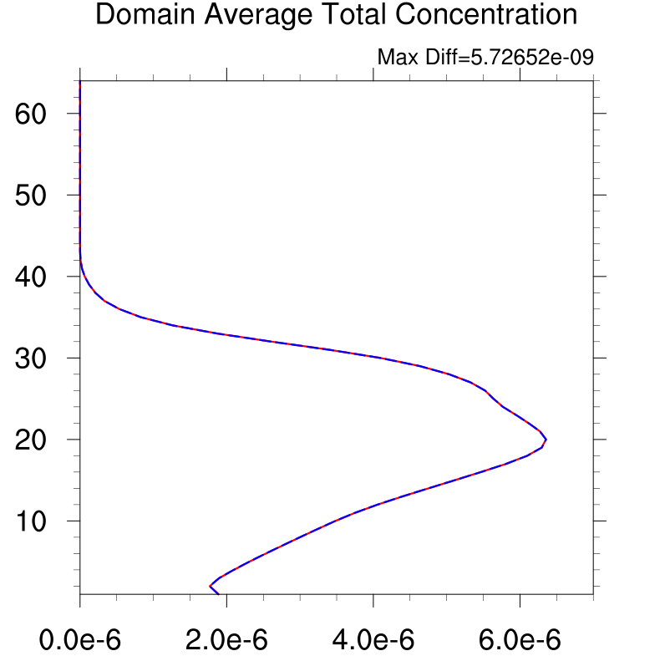
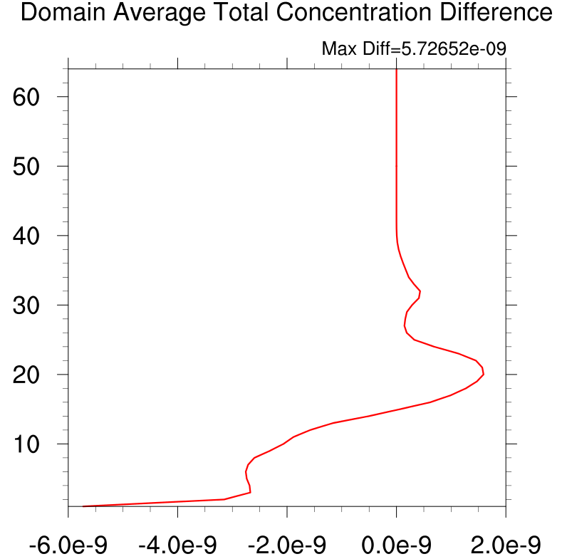
Preliminary Results for 2016-04-23 18z
--- Analysis
— First guess
— Analysis - First guess
(Analysis Increment)

Slide 20
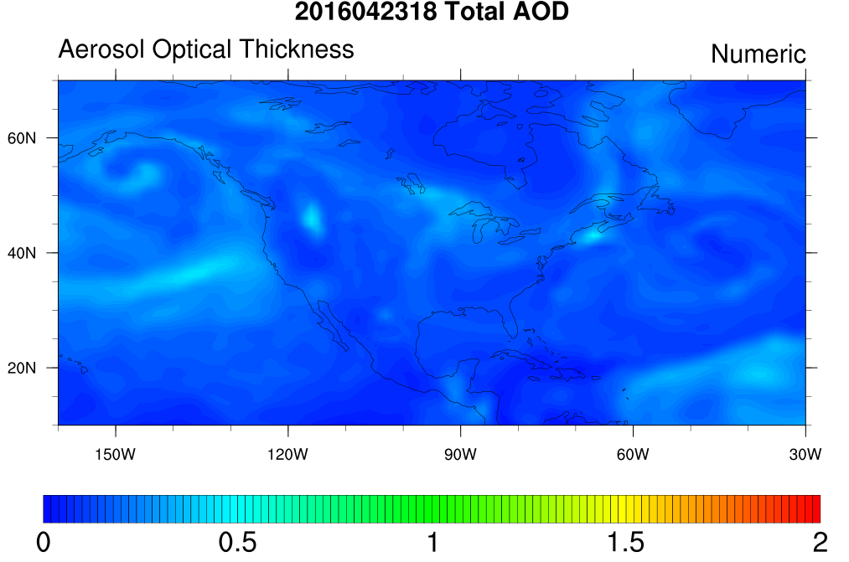
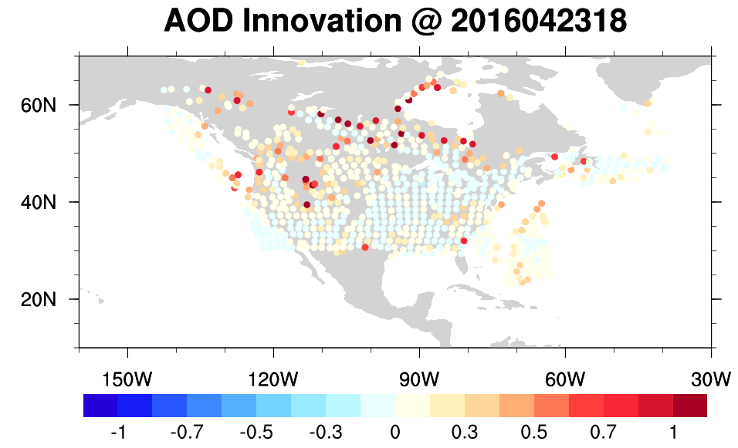
Preliminary Results for 2016-04-23 18z –cont’d
Observations (VIIRS AOD with data thinning) First Guess (NGAC AOD)
AOD innovation from GSI

Slide 21
Outline
Scope of global aerosol prediction at NCEP
Status update in aerosol data assimilation
Summary

Slide 22
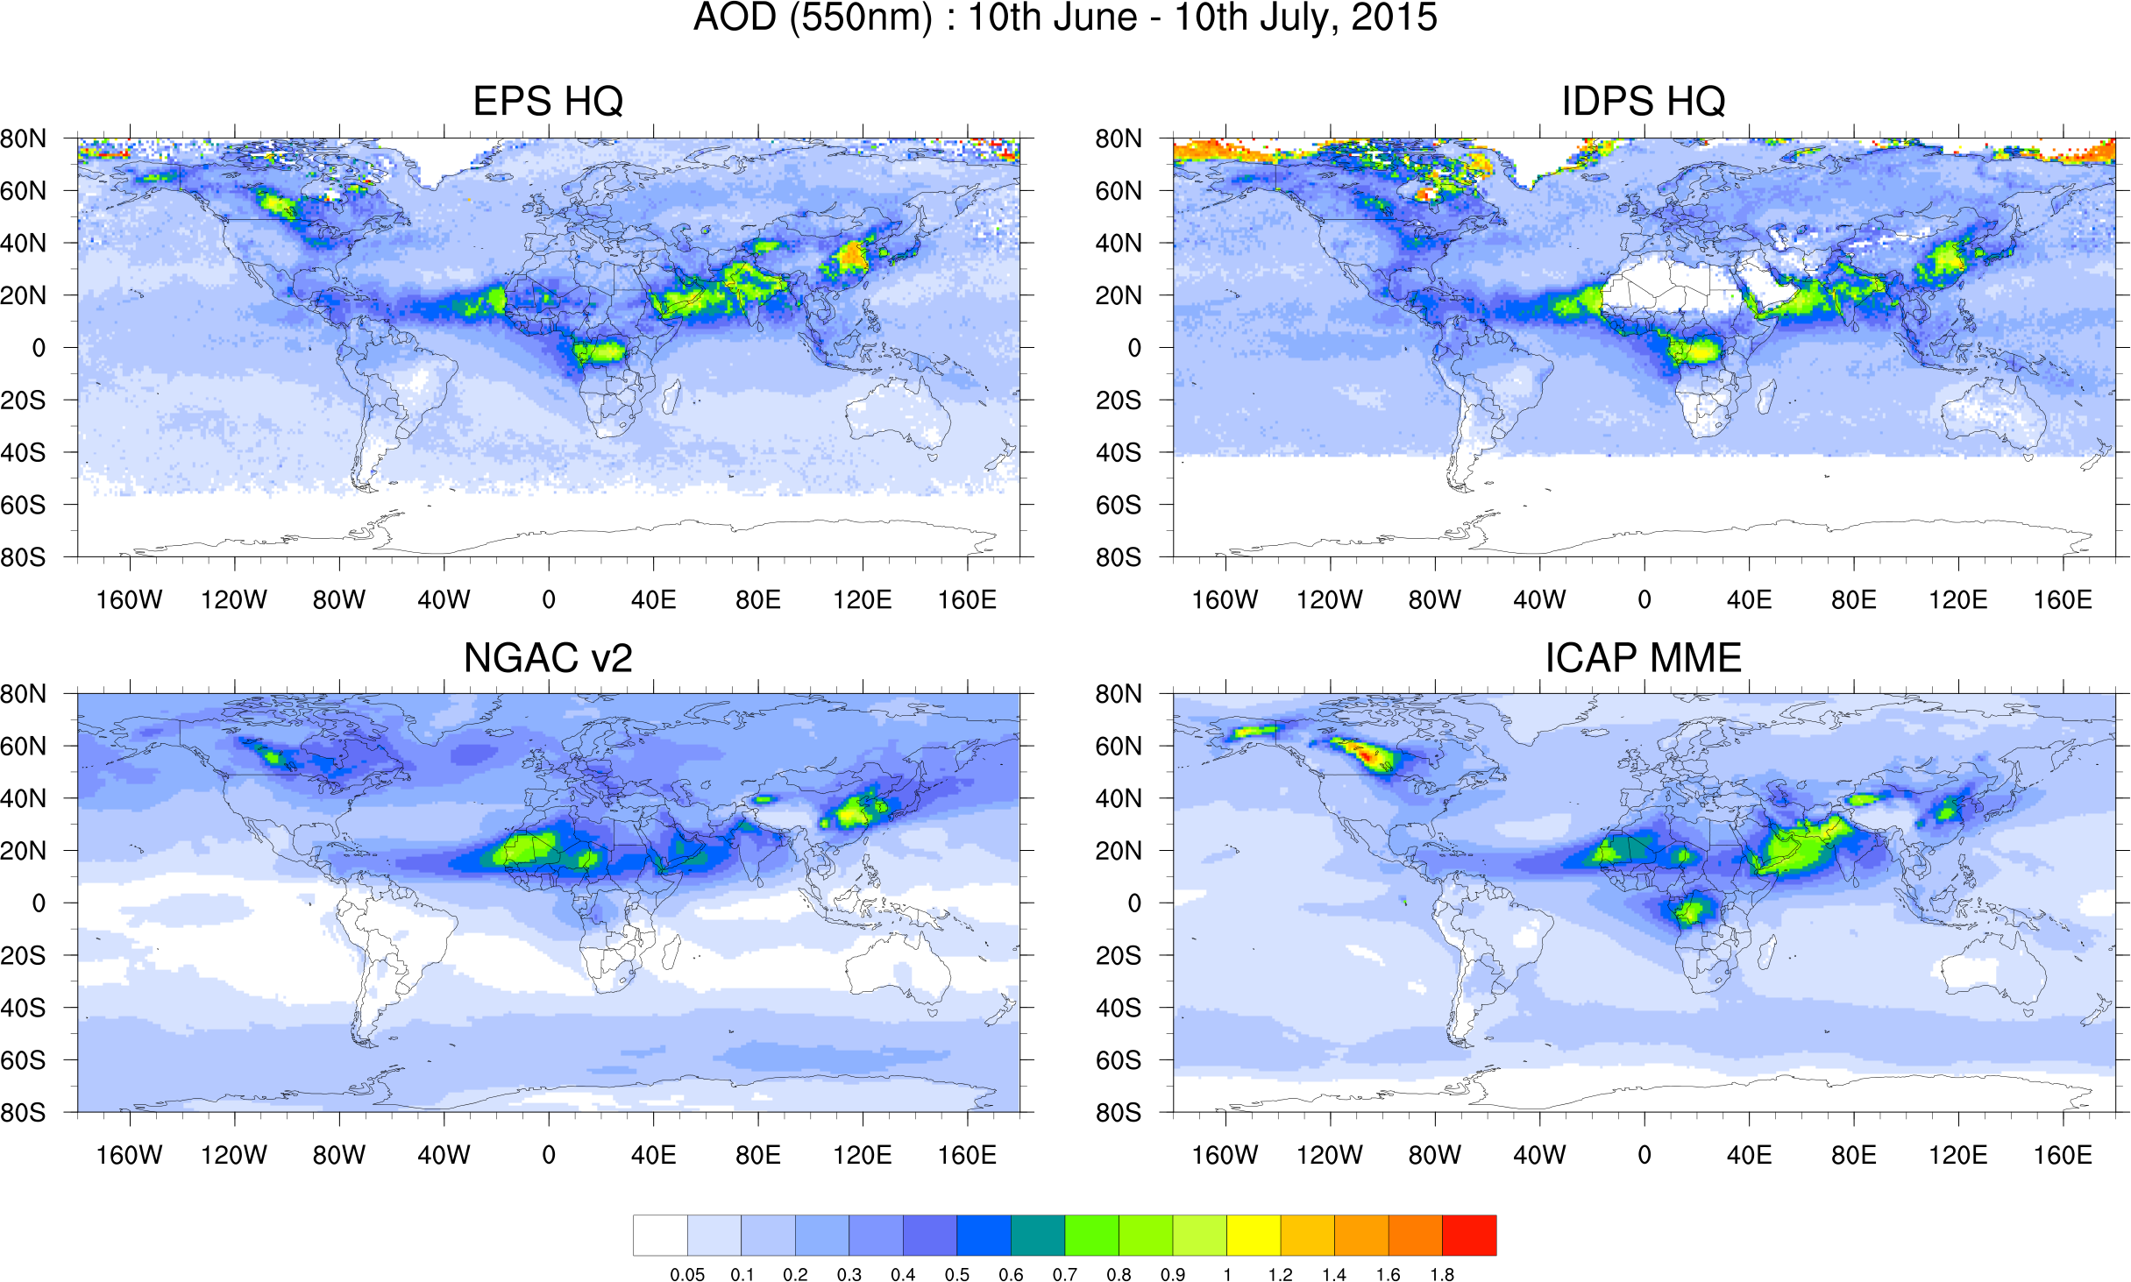
Concluding Remarks
NESDIS new Enterprise Processing System (EPS) VIIRS High Quality (HQ) AOD product provides coverage over bright surfaces
Aerosol features seen in EPS mean AOD map are present in ICAP but not in NGAC v2 (experimental)

Slide 23
Concluding Remarks –cont’d
Ongoing efforts:
GSI 3DVar aerosol data assimilation system has been extended to assimilate VIIRS AOD using NGAC guess
The prototype system is being tested and evaluated
Next-step:
Refine the AOD DA system, e.g., revisit how background errors are determined
Sync the specification of VIIRS observation errors with ESRL’s on-going GSI work
Conduct benchmark study to demonstrate the impact of VIIRS AOD data assimilation
Need to align the work with NWS NGGPS initiative

Slide 24
Backup Slides

Slide 25
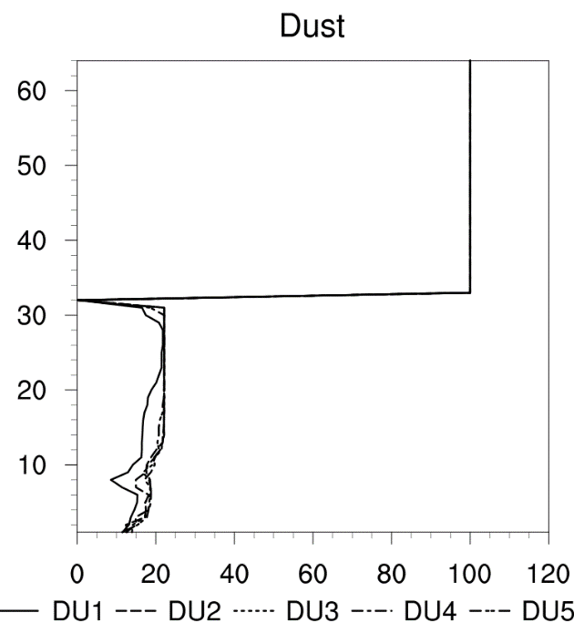
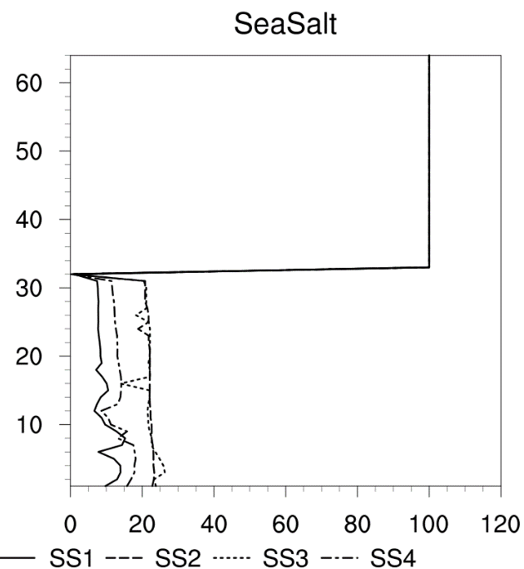
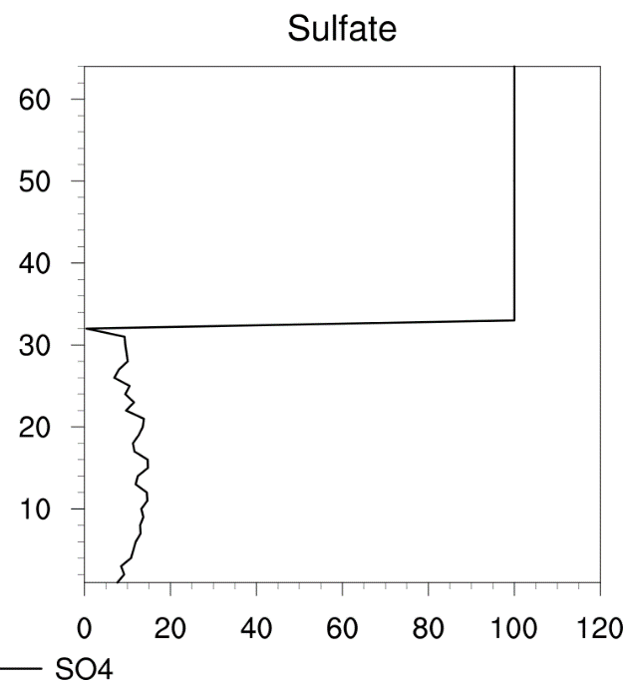
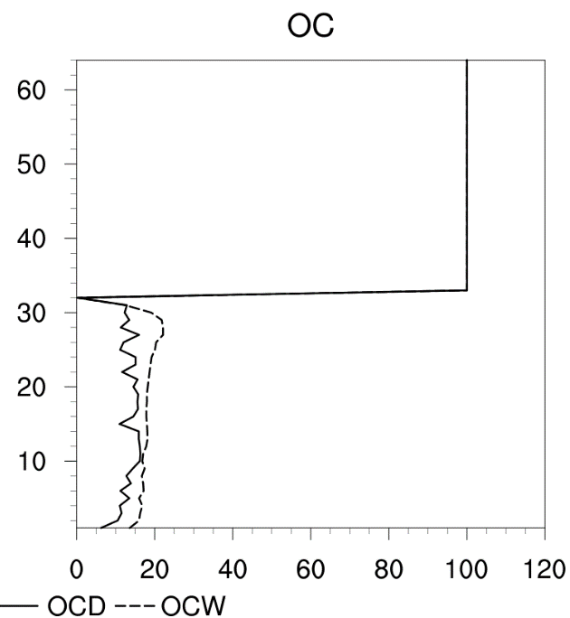
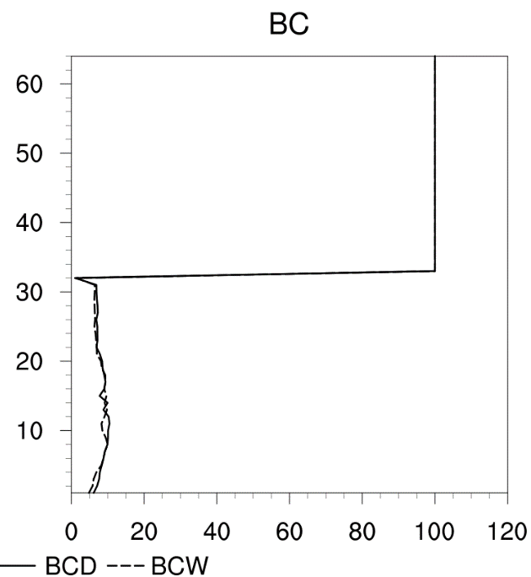
Specification of background errors
Vertical Scale Length
(Levels)

