Slide 1
Forecasting Perspective on Use of Aerosol Satellite Products: Mid-Atlantic
NOAA Satellite Aerosol Product Workshop
September 14, 2016
College Park, MD

Slide 2
Agenda
Tools for the Forecaster
Uses of Satellite Products
Analysis of Two Smoke Episodes in 2015
Conclusions

Slide 3
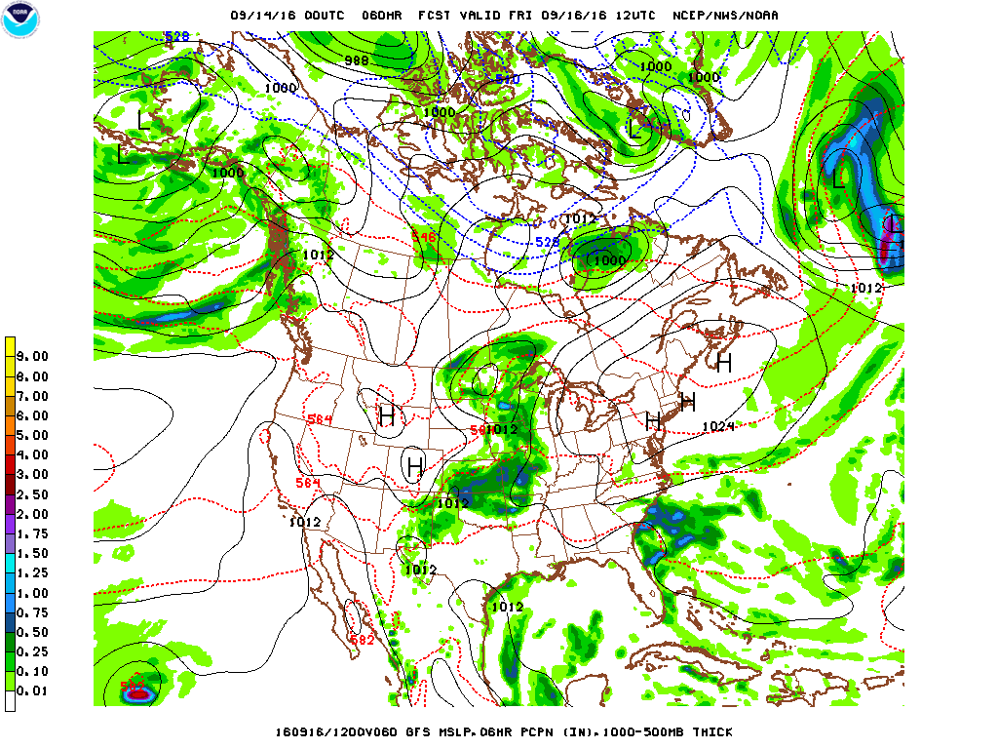
Tools for the Forecaster

Slide 4
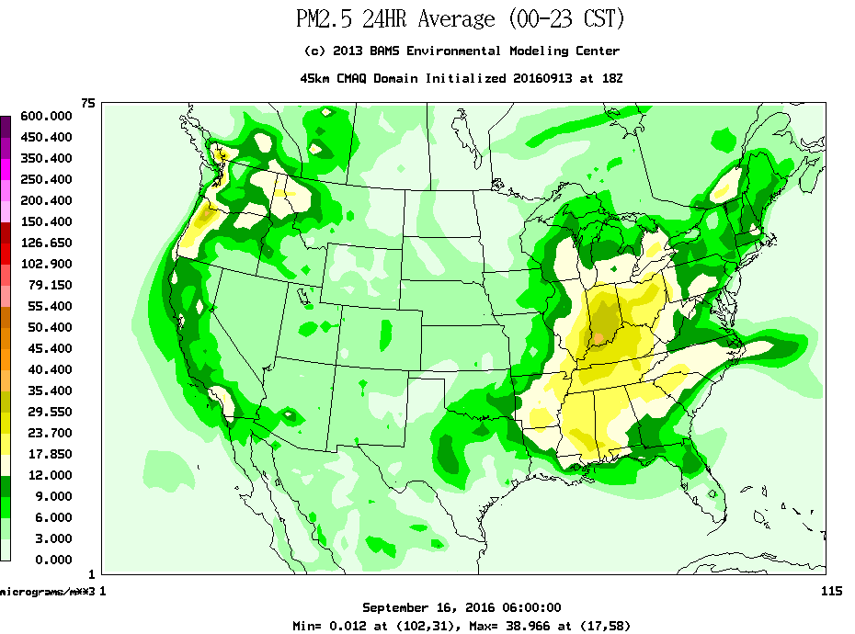
Tools for the Forecaster

Slide 5
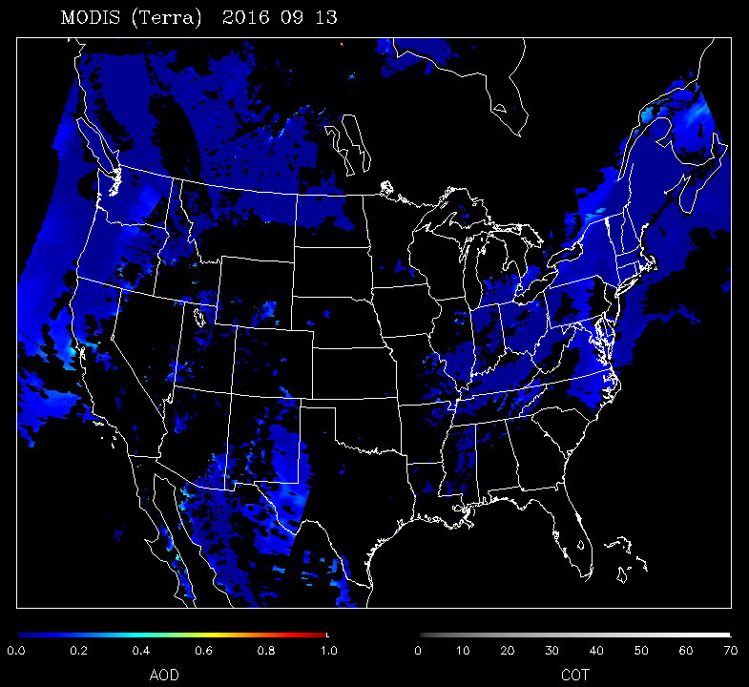
Tools for the Forecaster

Slide 6
Use of Satellite Products
Tool to assist with daily air quality forecasting responsibilities.
Tool to assist with post air quality event analysis.
Can also be used for support in development of exceptional event documentation (after flagging data within EPA’s Air Quality System (AQS) database).
Can be used to truth test photochemical model performance.

Slide 7
Ozone Episode – June 11, 2015
On June 11, multiple monitors across the Commonwealth (and the Mid-Atlantic states, in general) exceeded the threshold for the 2008 ozone standard.
The setup – The meteorological pattern promoted transport from Canada. Usually the air mass is cleaner in nature as it moves into the region… this time it was different.

Slide 8
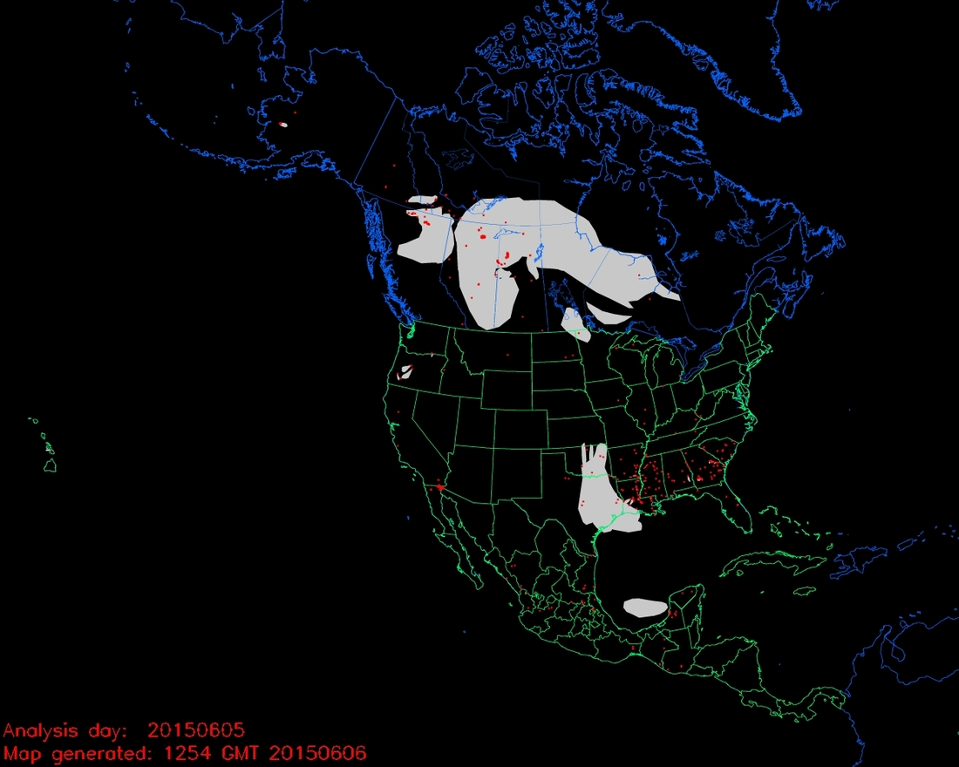
Fire Map – June 5, 2015

Slide 9
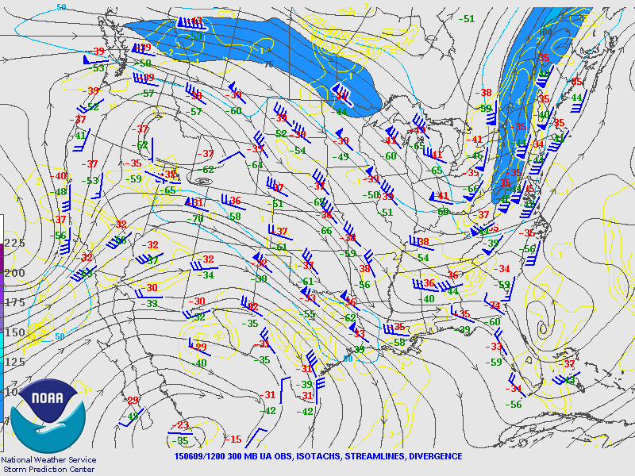
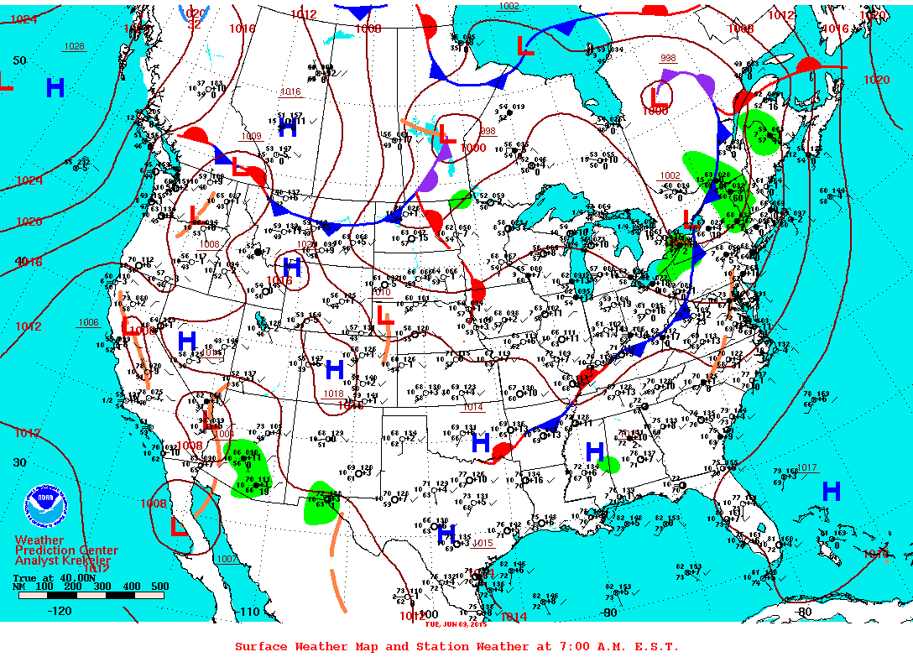
Meteorology – June 9, 2015
Upper Air
Surface

Slide 10
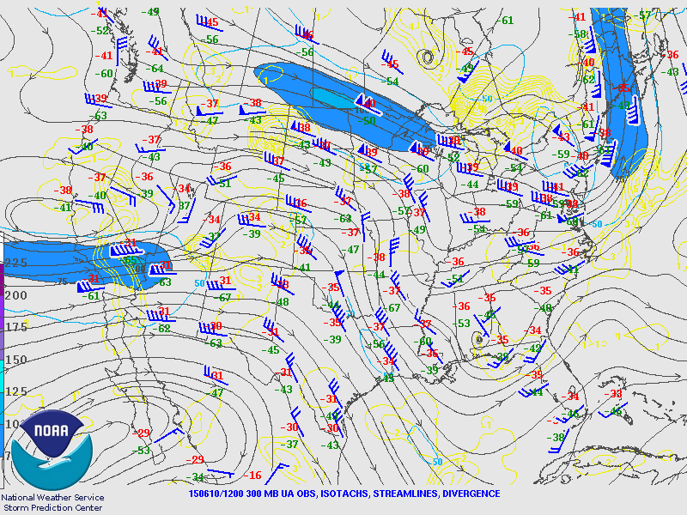
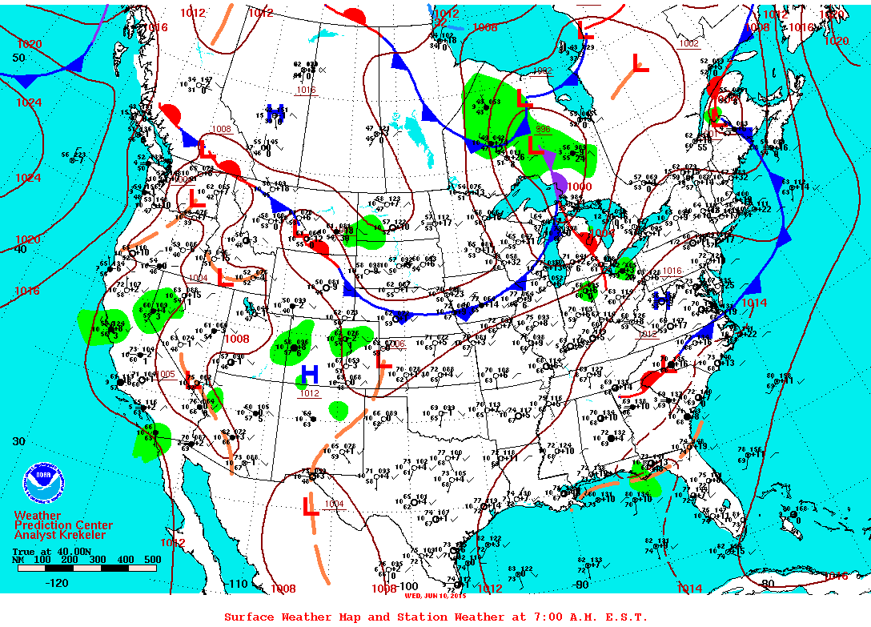
Meteorology – June 10, 2015
Upper Air
Surface

Slide 11
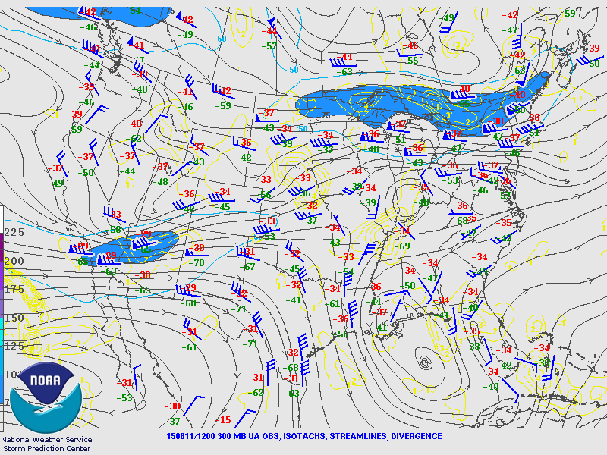
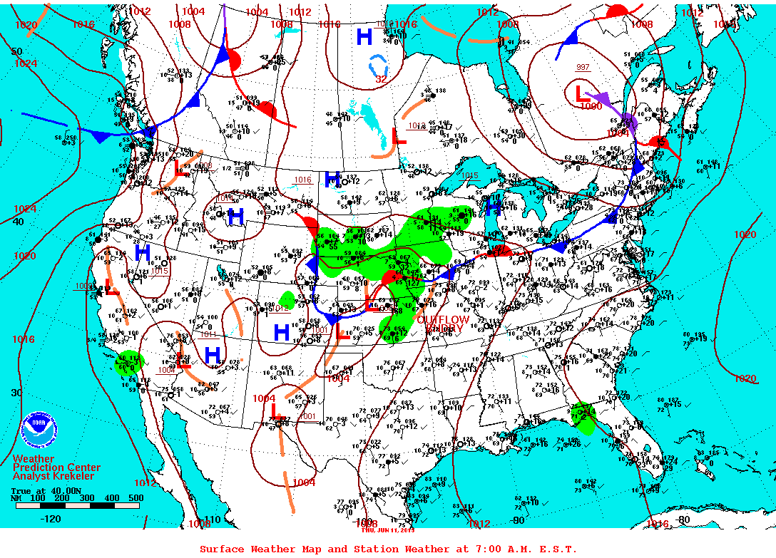
Meteorology – June 11, 2015
Upper Air
Surface

Slide 12
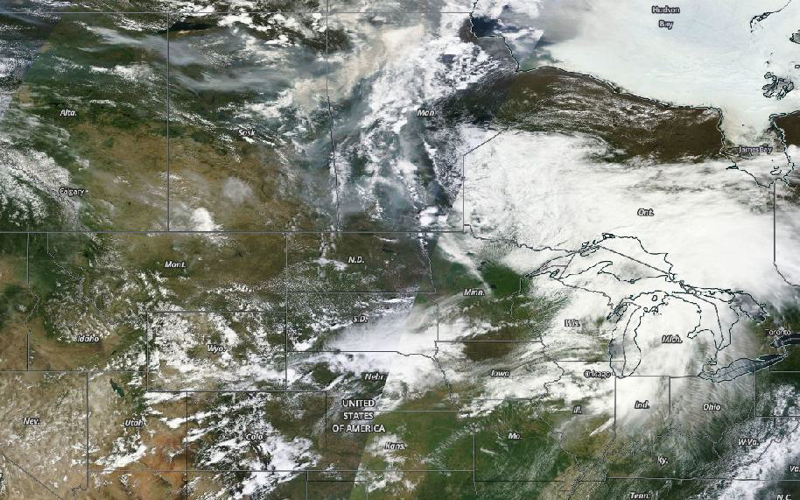
Satellite Imagery – June 7, 2015

Slide 13
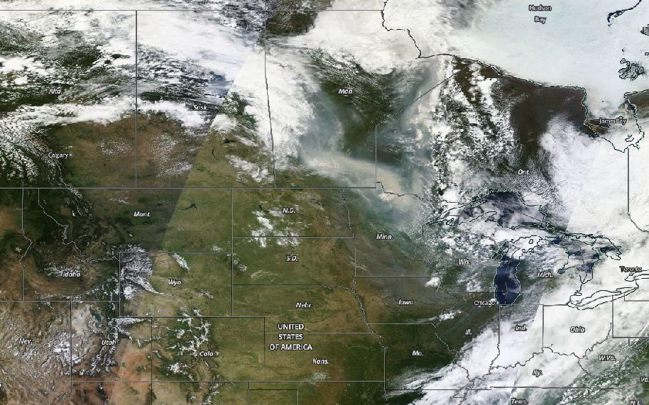
Satellite Imagery – June 8, 2015

Slide 14
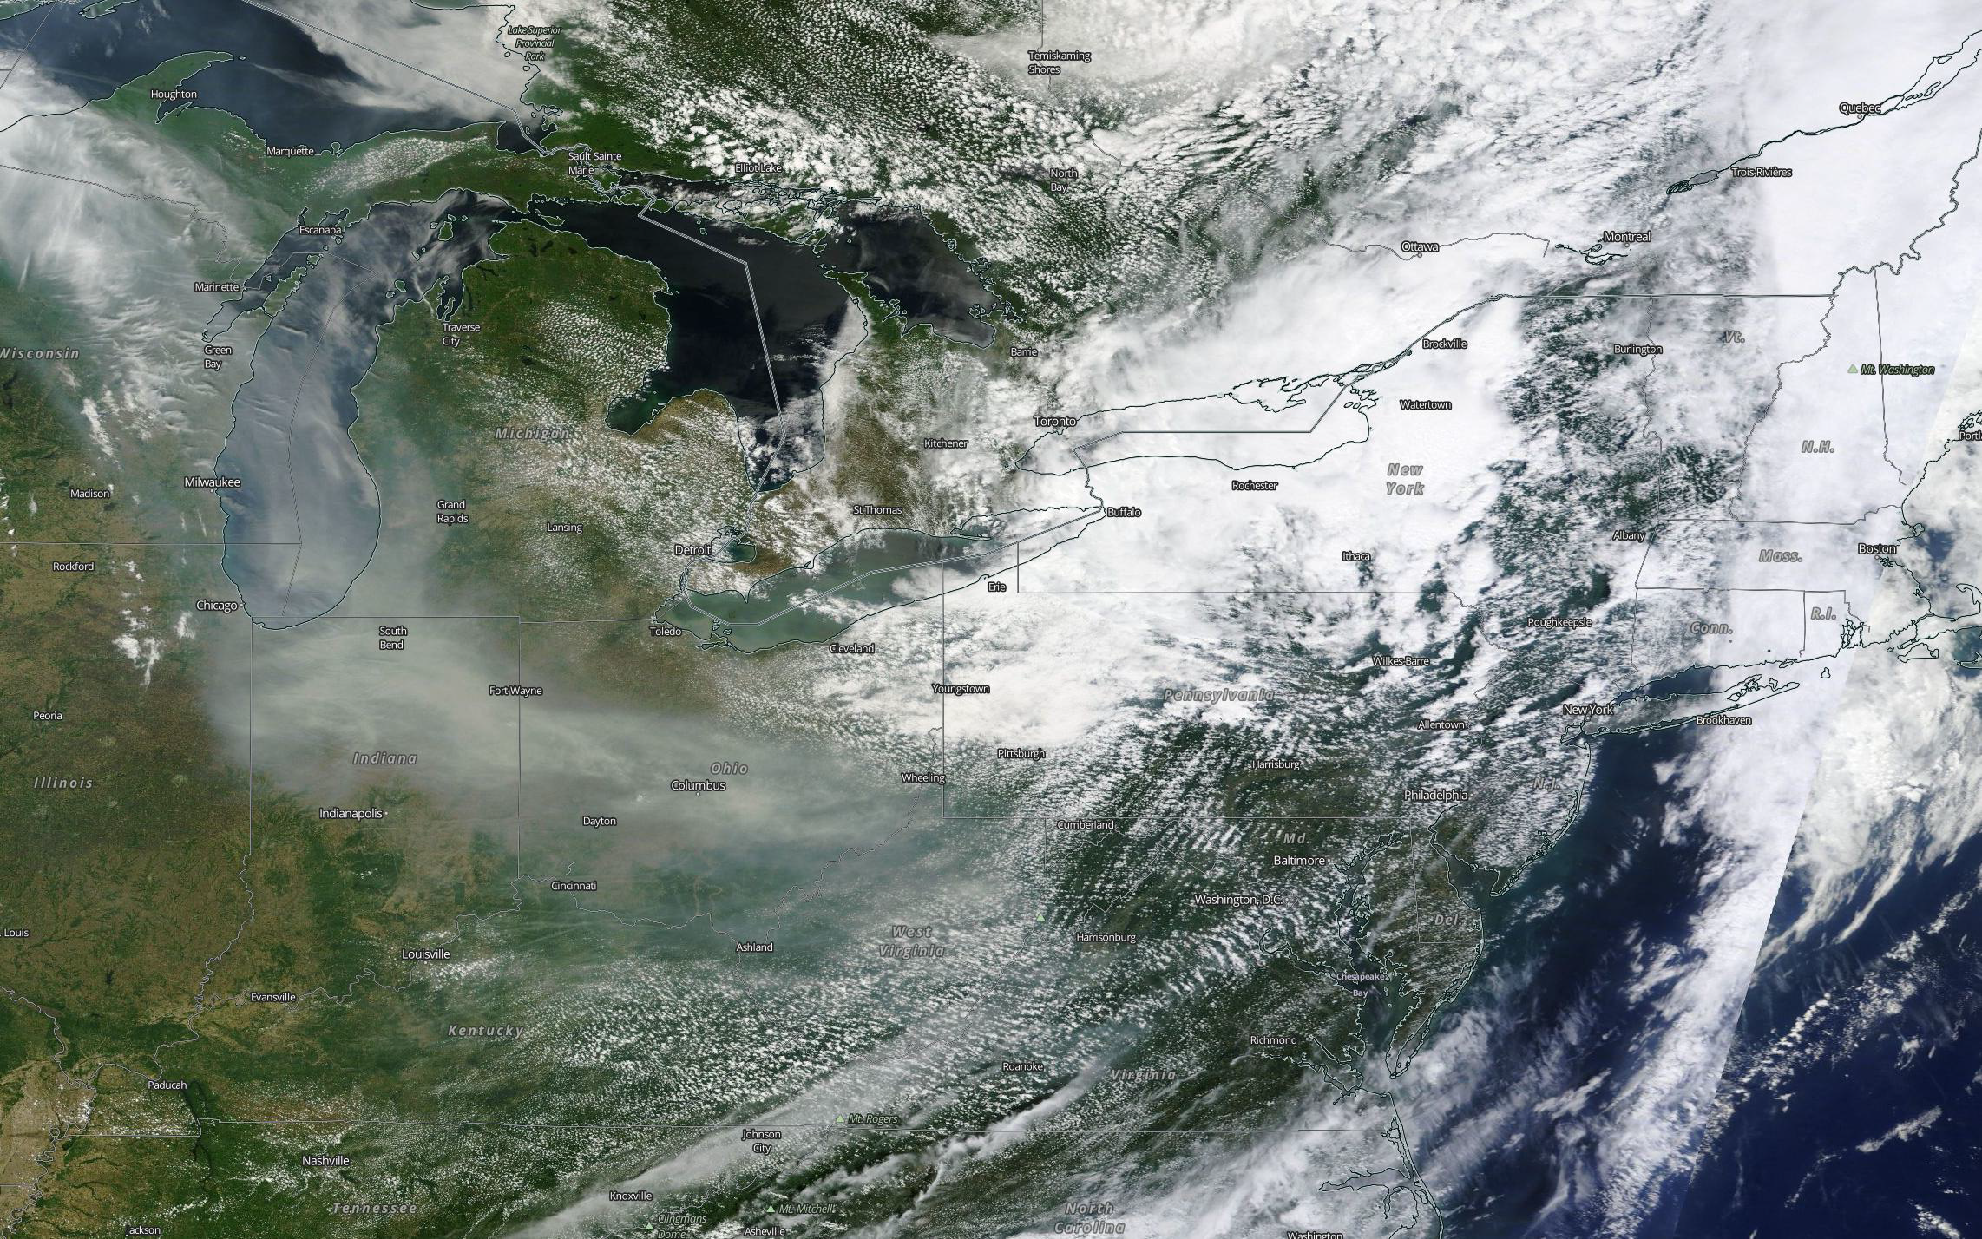
Satellite Imagery – June 9, 2015

Slide 15
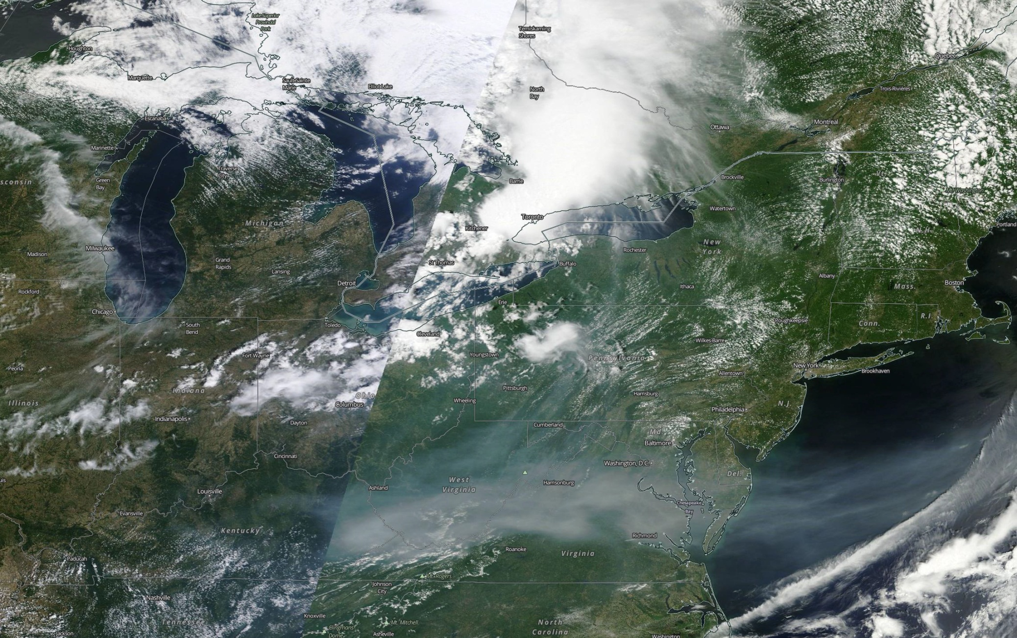
Satellite Imagery – June 10, 2015

Slide 16
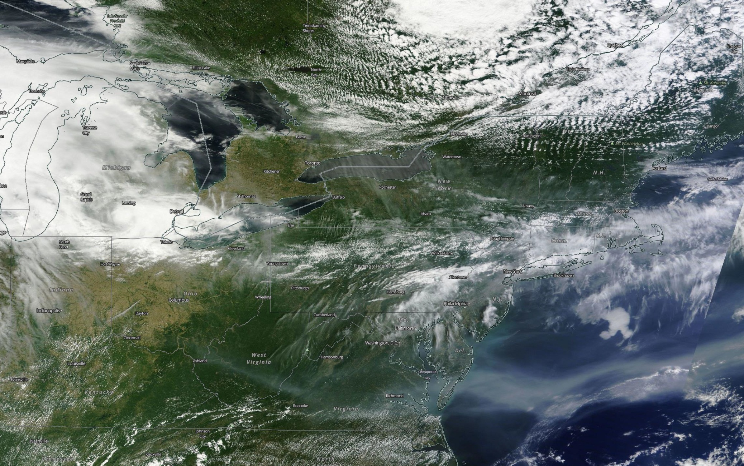
Satellite Imagery – June 11, 2015

Slide 17
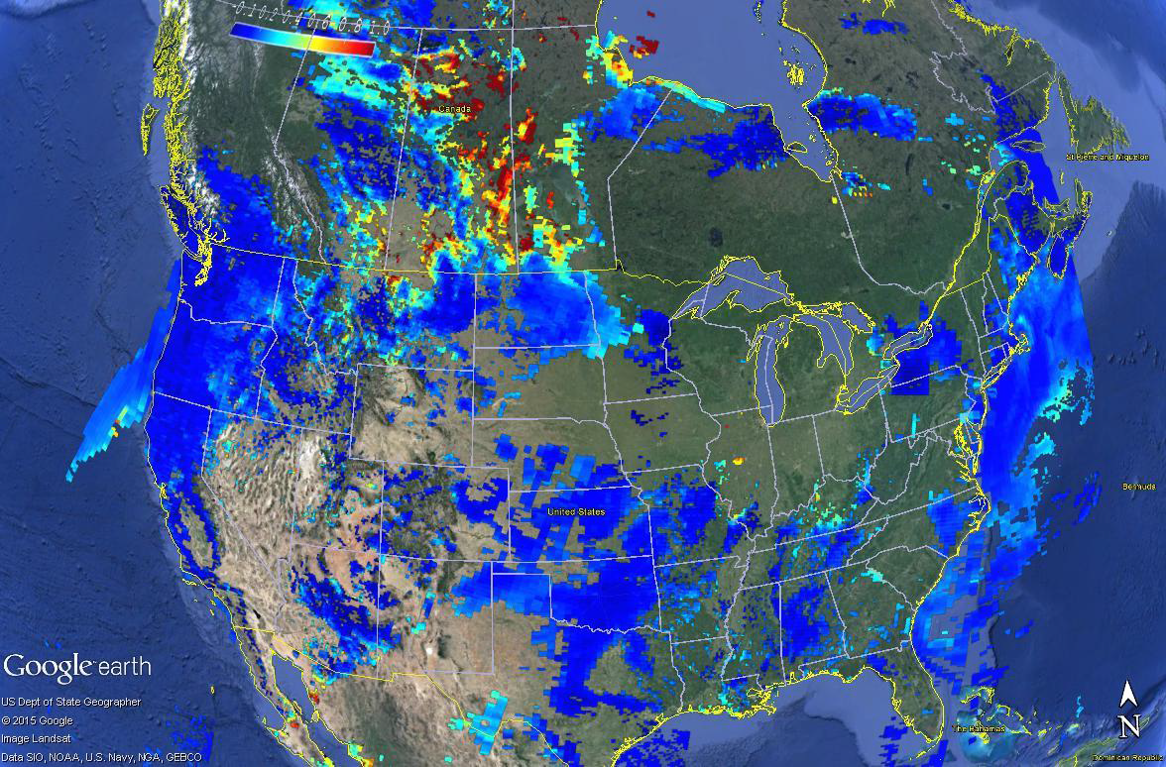
Aerosol Optical Thick. – June 7, 2015

Slide 18
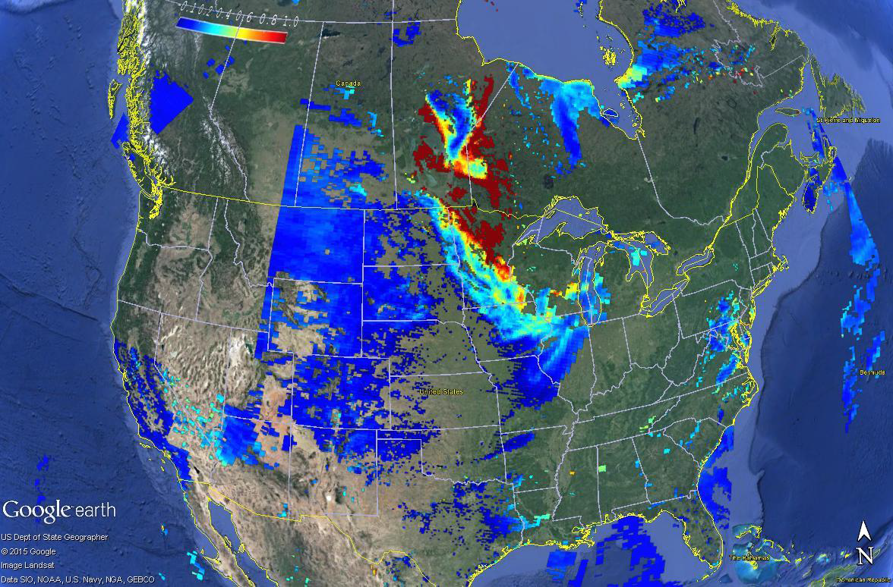
Aerosol Optical Thick. – June 8, 2015

Slide 19
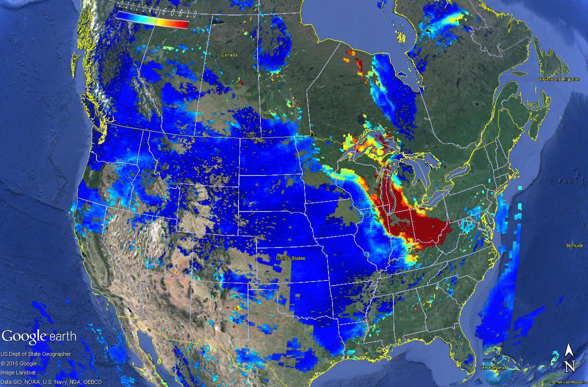
Aerosol Optical Thick. – June 9, 2015

Slide 20
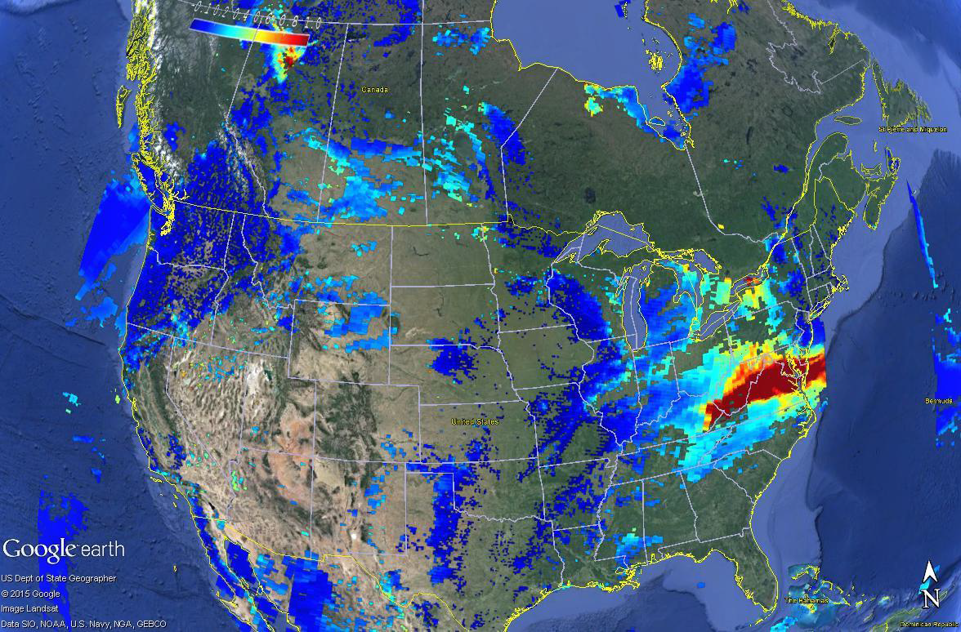
Aerosol Optical Thick. – June 10, 2015

Slide 21
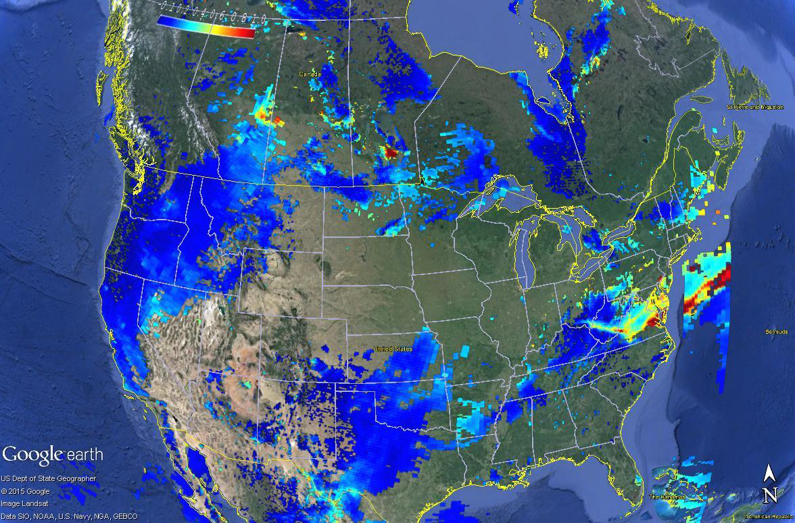
Aerosol Optical Thick. – June 11, 2015

Slide 22
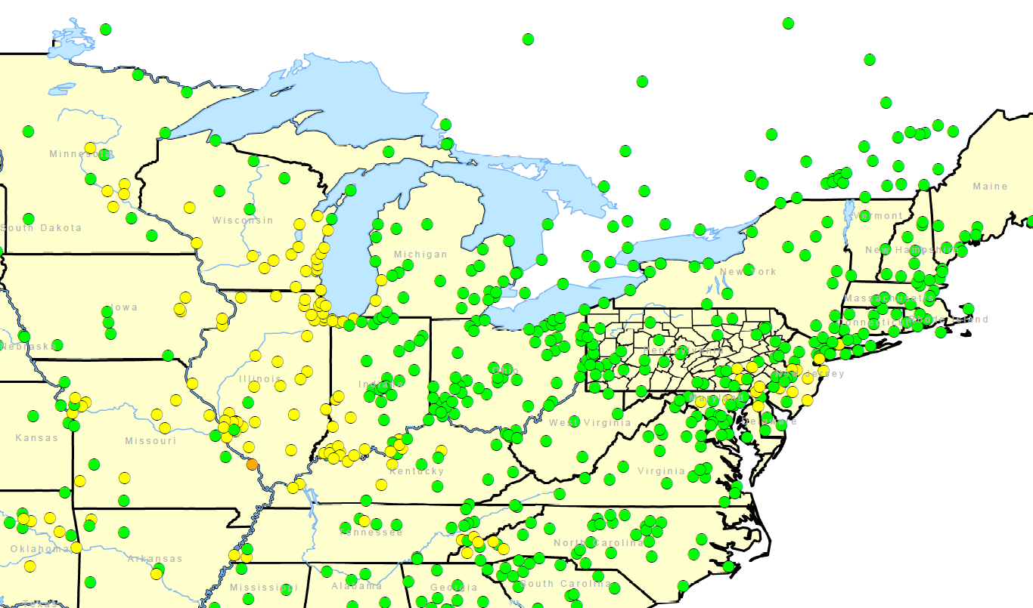
Ozone Concentrations – June 9, 2015

Slide 23
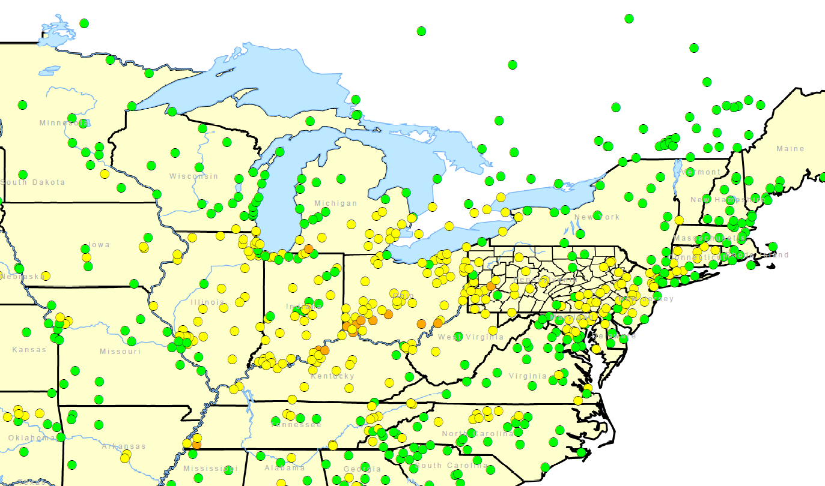
Ozone Concentrations – June 10, 2015

Slide 24
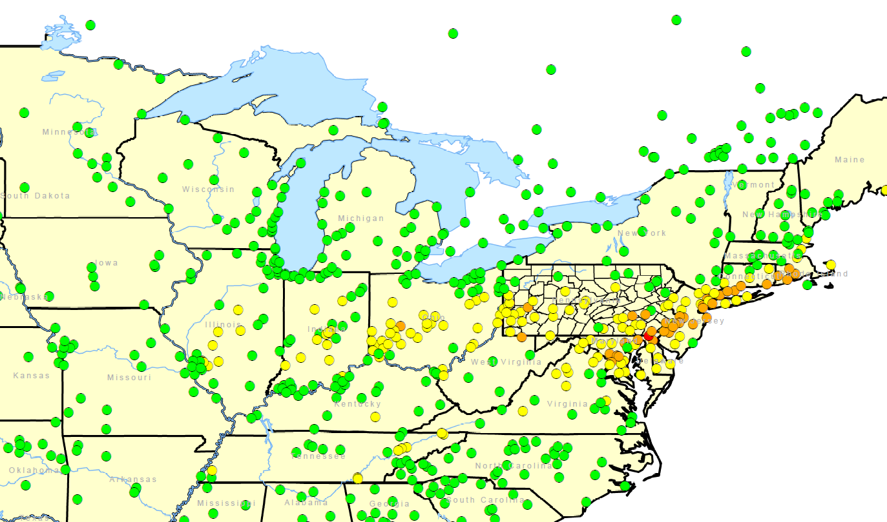
Ozone Concentrations – June 11, 2015

Slide 25
Ozone Episode – Sept 2-4, 2015
From September 2 to 4, 2015, multiple monitors across the Commonwealth (and the Mid-Atlantic states, in general) exceeded the threshold for the 2015 ozone standard.
The setup – The meteorological pattern promoted transport from the northwestern US. Like the June 2015 episode, smoke could have enhanced ozone formation.

Slide 26
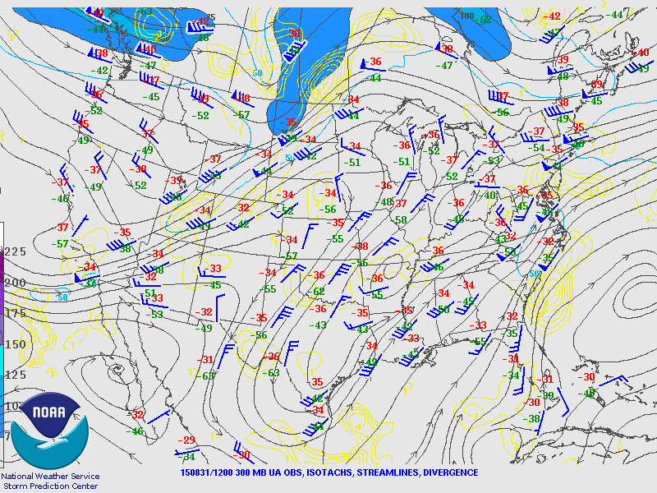
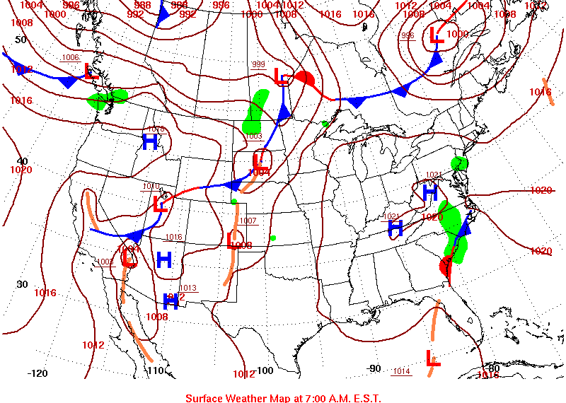
Meteorology – August 31, 2015
Upper Air
Surface

Slide 27
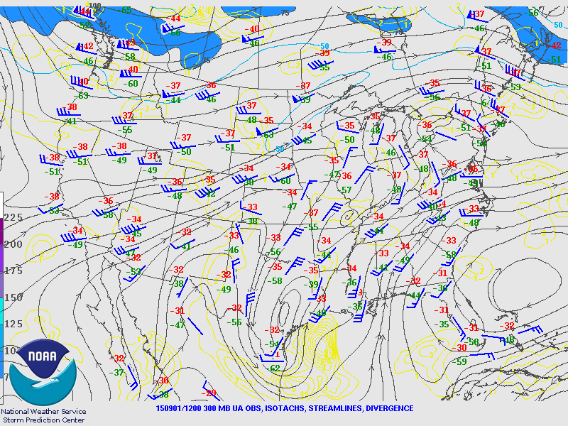
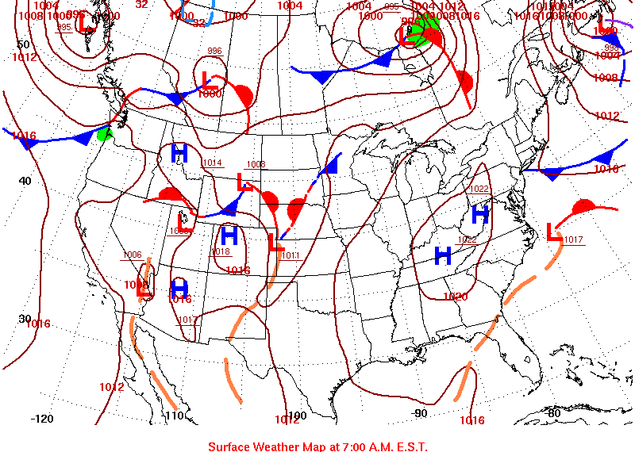
Meteorology – September 1, 2015
Upper Air
Surface

Slide 28
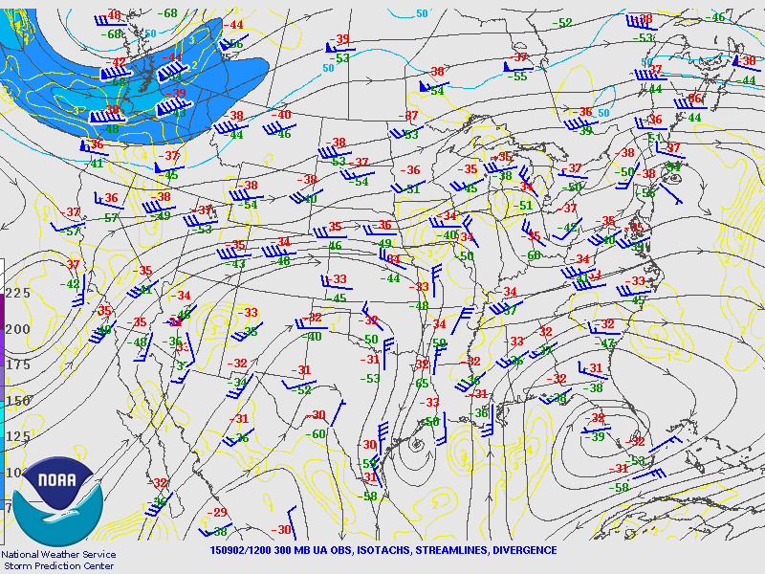
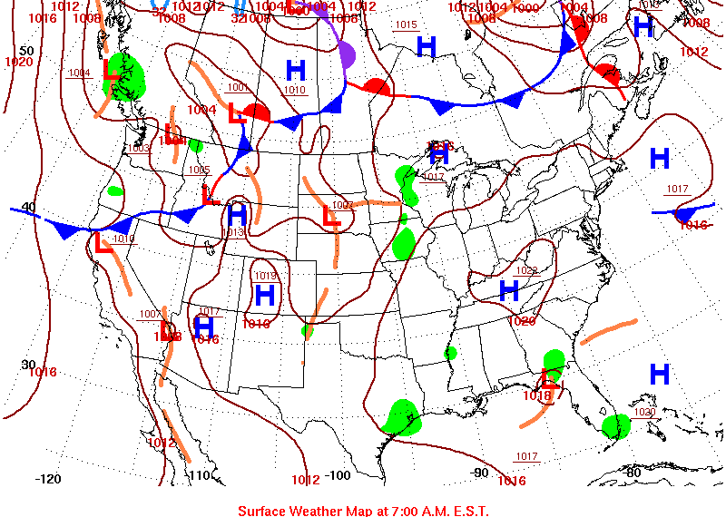
Meteorology – September 2, 2015
Upper Air
Surface

Slide 29
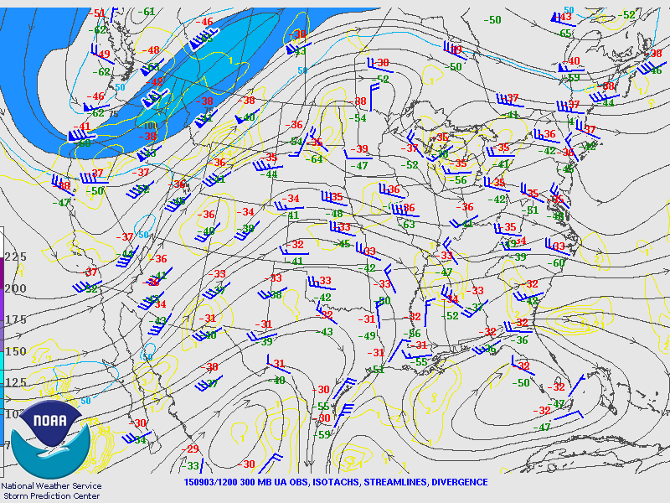
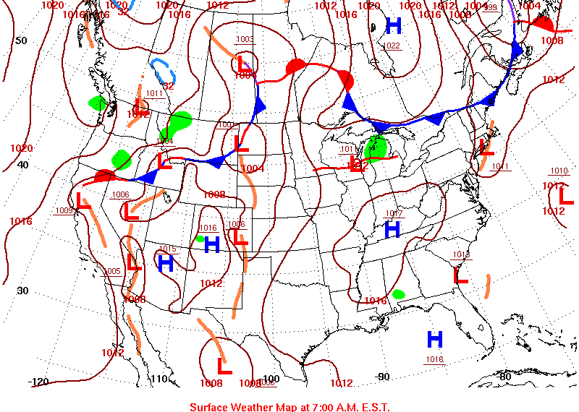
Meteorology – September 3, 2015
Upper Air
Surface

Slide 30
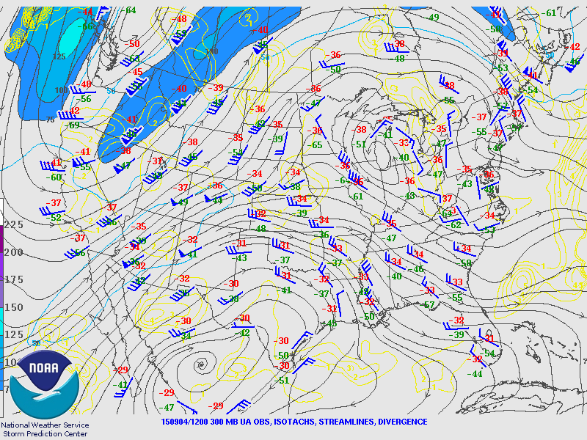
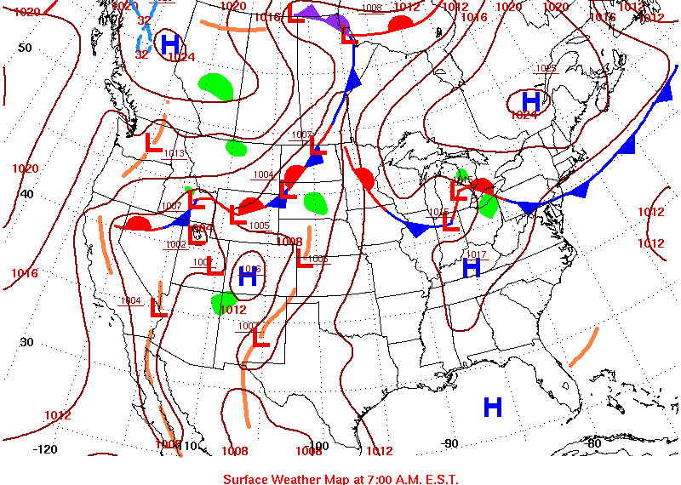
Meteorology – September 4, 2015
Upper Air
Surface

Slide 31
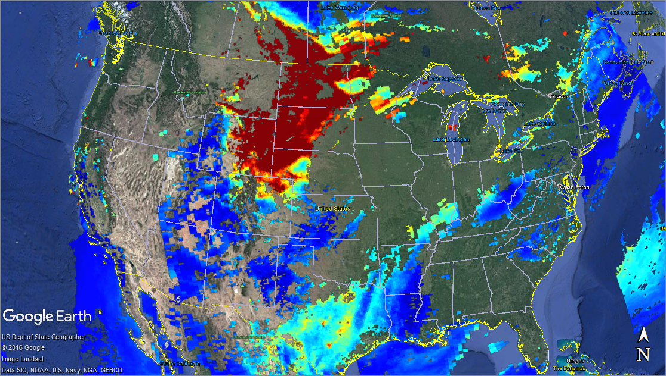
Aerosol Optical Thick. – Aug 28, 2015

Slide 32
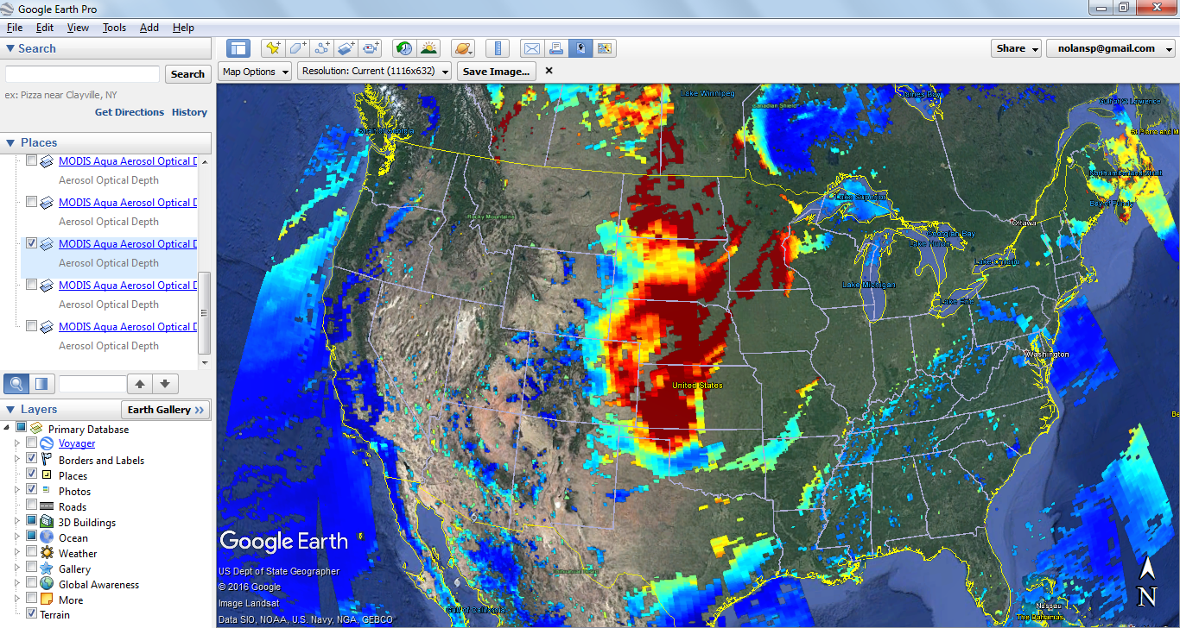
Aerosol Optical Thick. – Aug 29, 2015

Slide 33
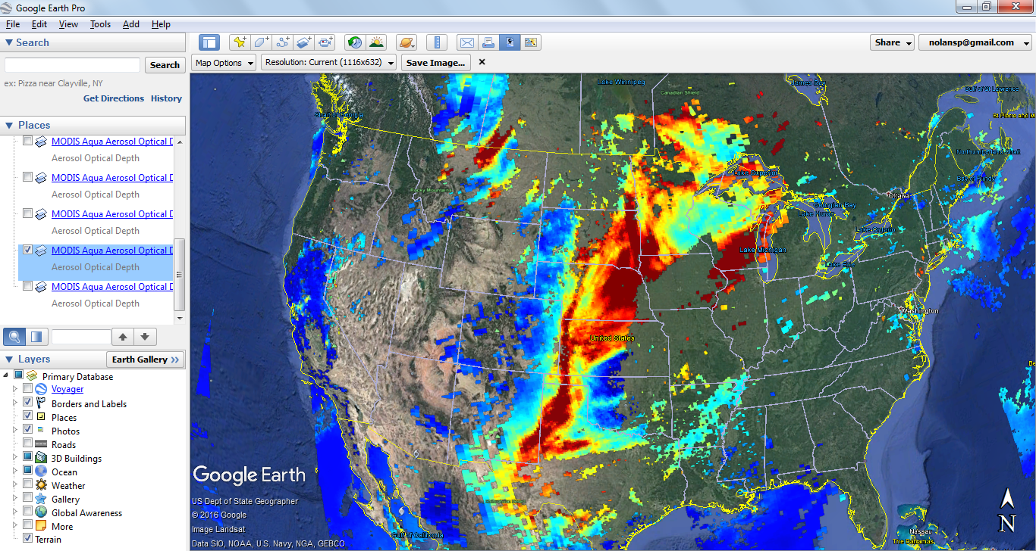
Aerosol Optical Thick. – Aug 30, 2015

Slide 34
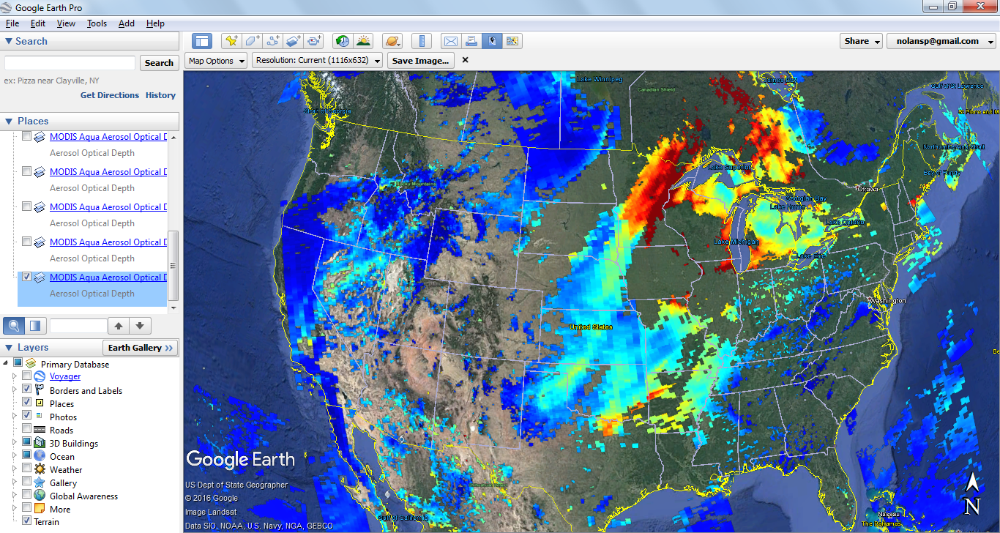
Aerosol Optical Thick. – Aug 31, 2015

Slide 35
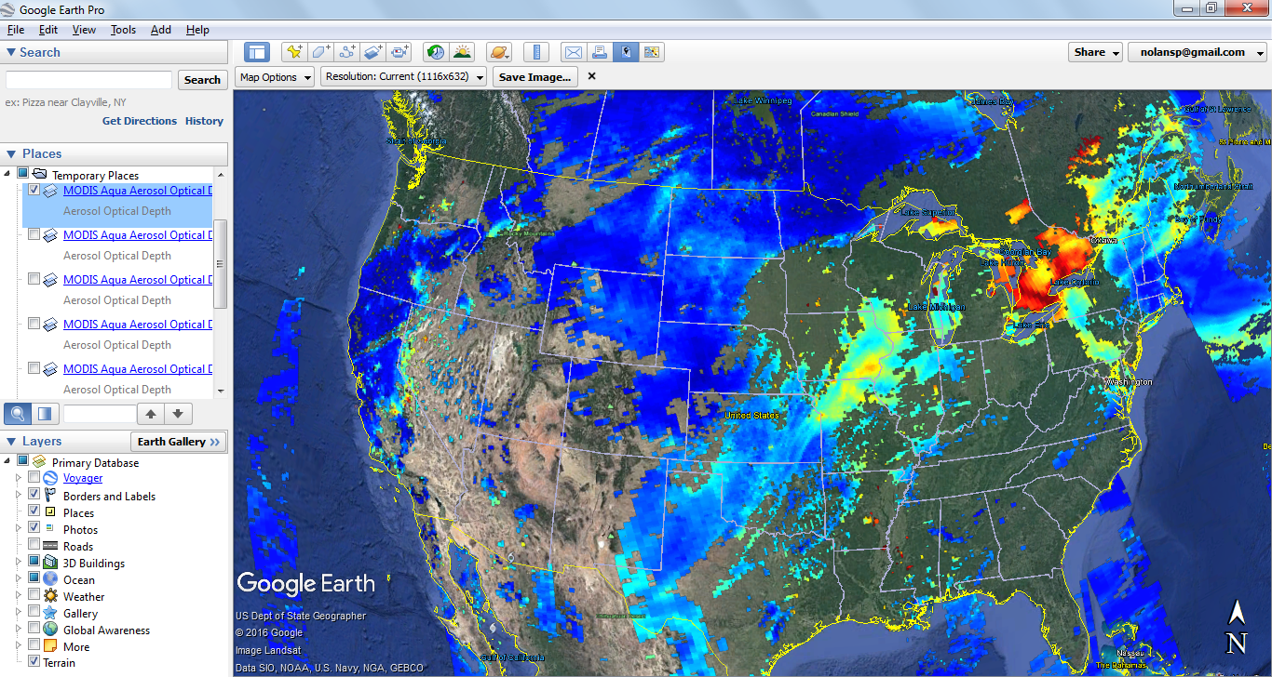
Aerosol Optical Thick. – Sep 1, 2015

Slide 36
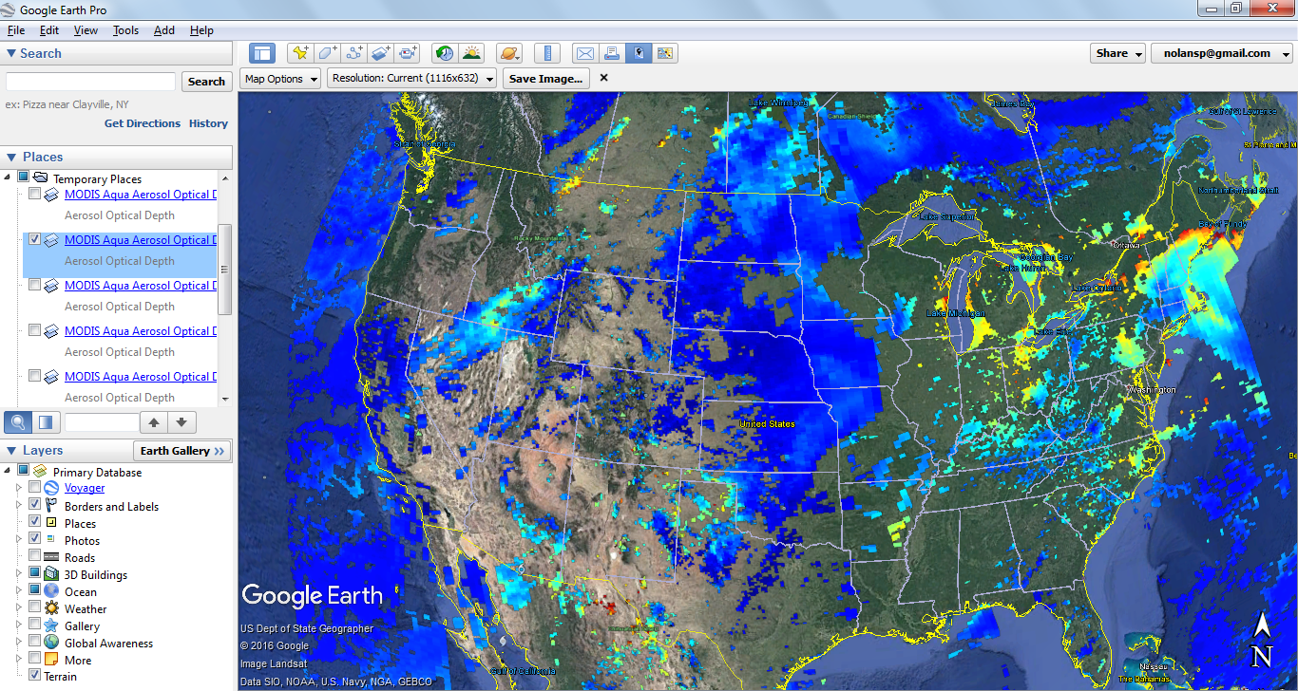
Aerosol Optical Thick. – Sep 2, 2015

Slide 37
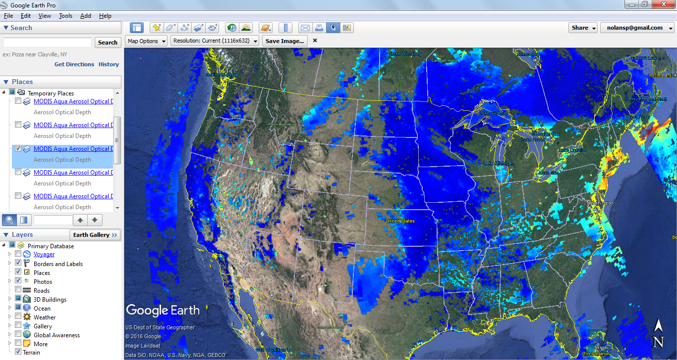
Aerosol Optical Thick. – Sep 3, 2015

Slide 38
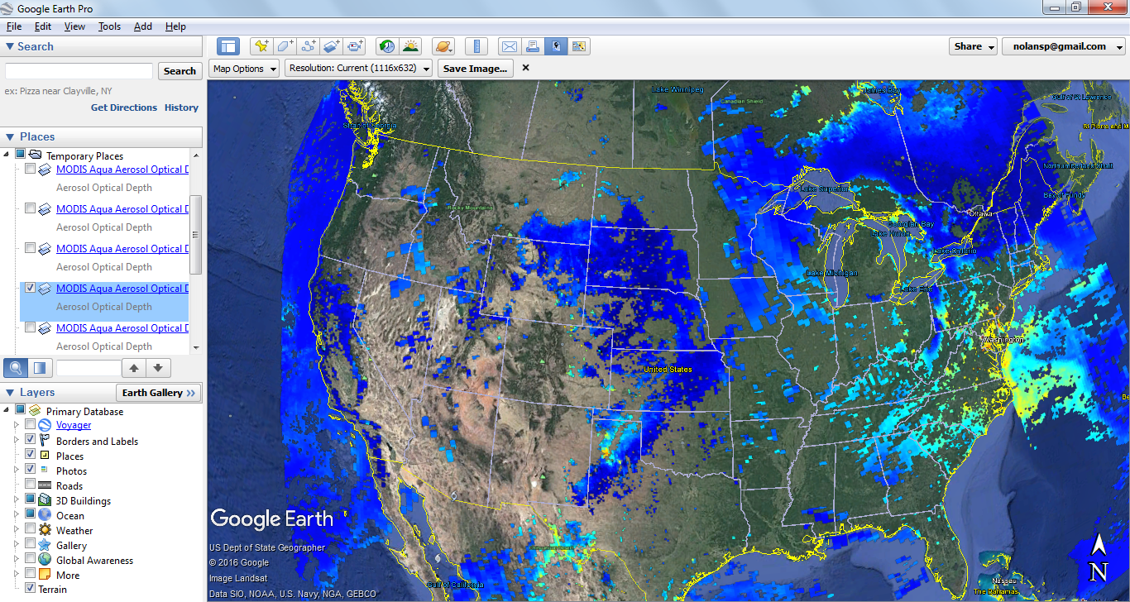
Aerosol Optical Thick. – Sep 4, 2015

Slide 39
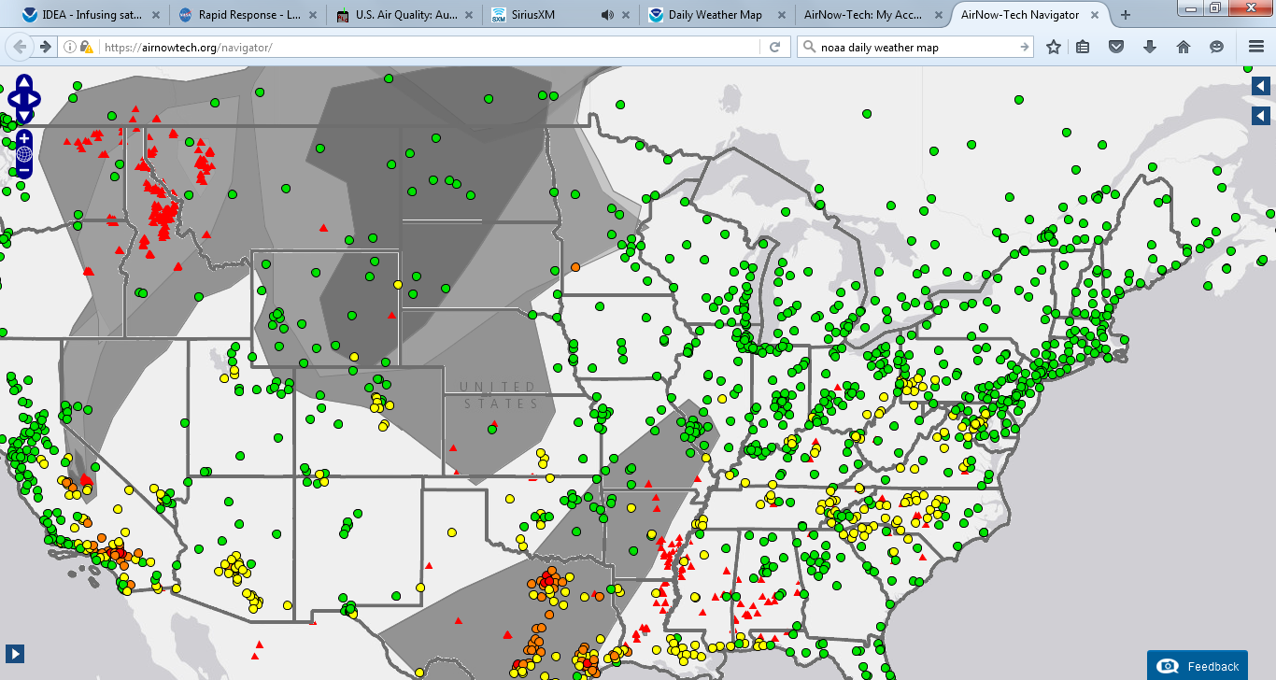
Ozone Concentrations – Aug 28, 2015

Slide 40
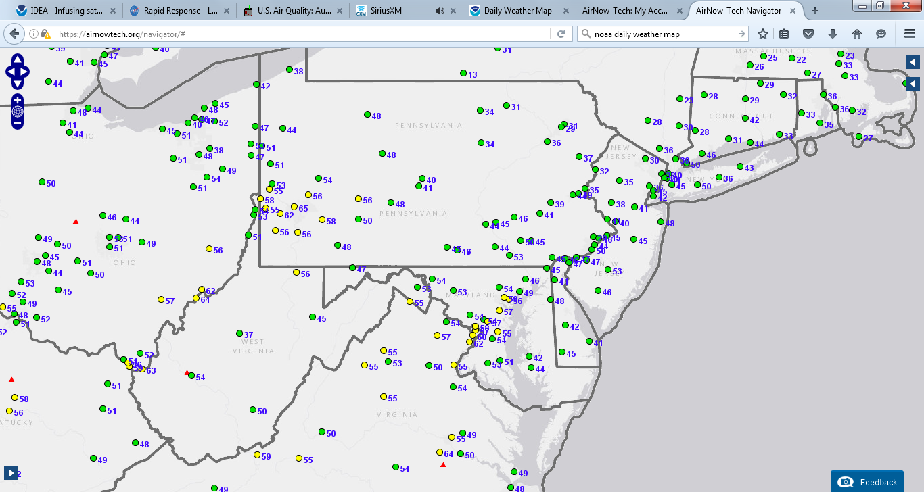
Ozone Concentrations – Aug 28, 2015

Slide 41
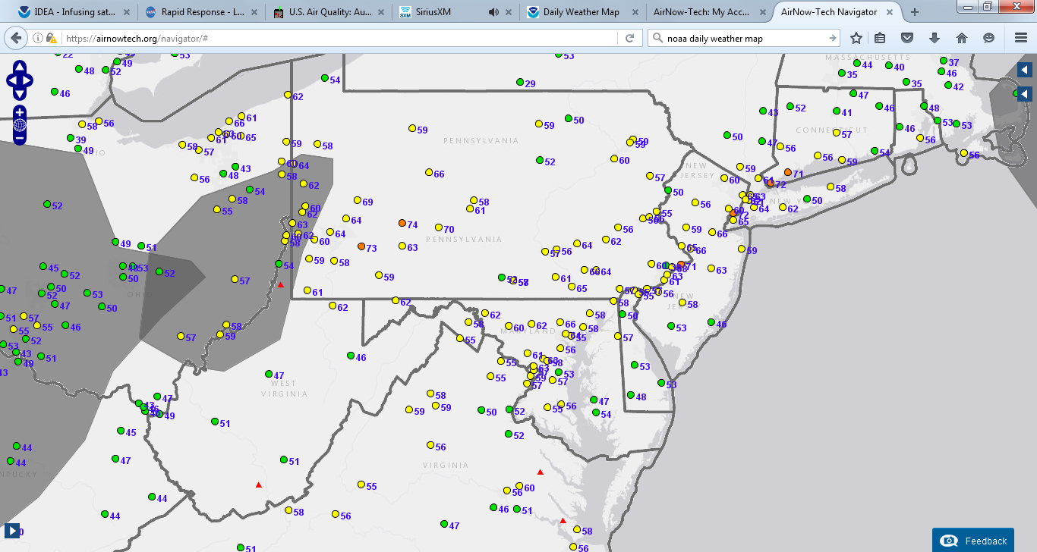
Ozone Concentrations – Aug 29, 2015

Slide 42
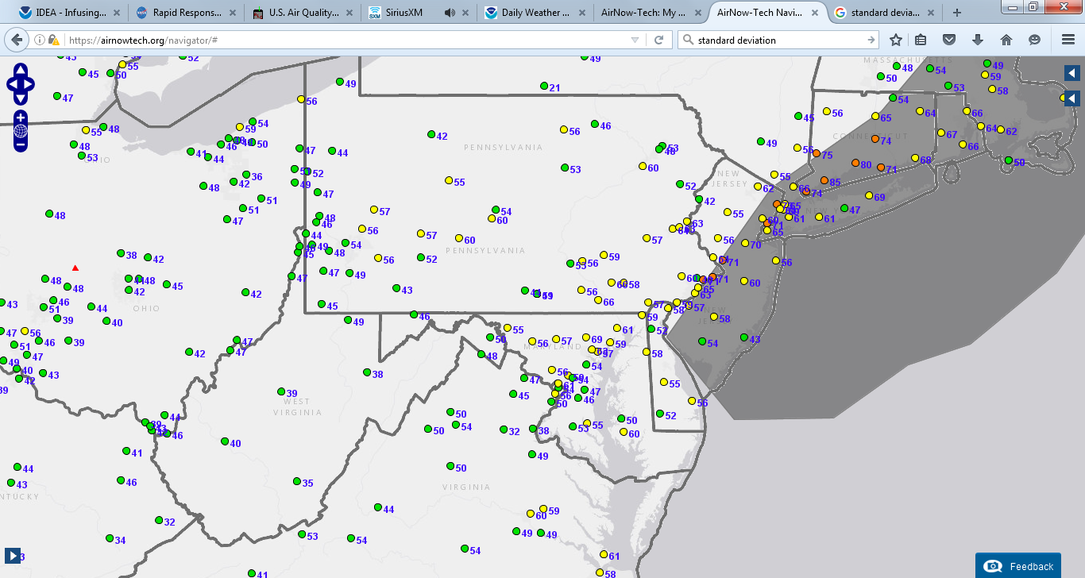
Ozone Concentrations – Aug 30, 2015

Slide 43
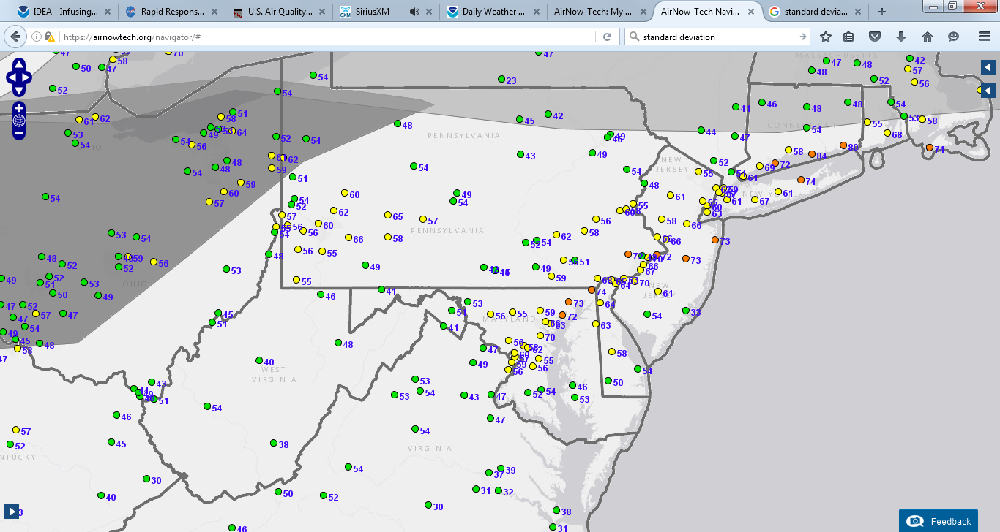
Ozone Concentrations – Aug 31, 2015

Slide 44
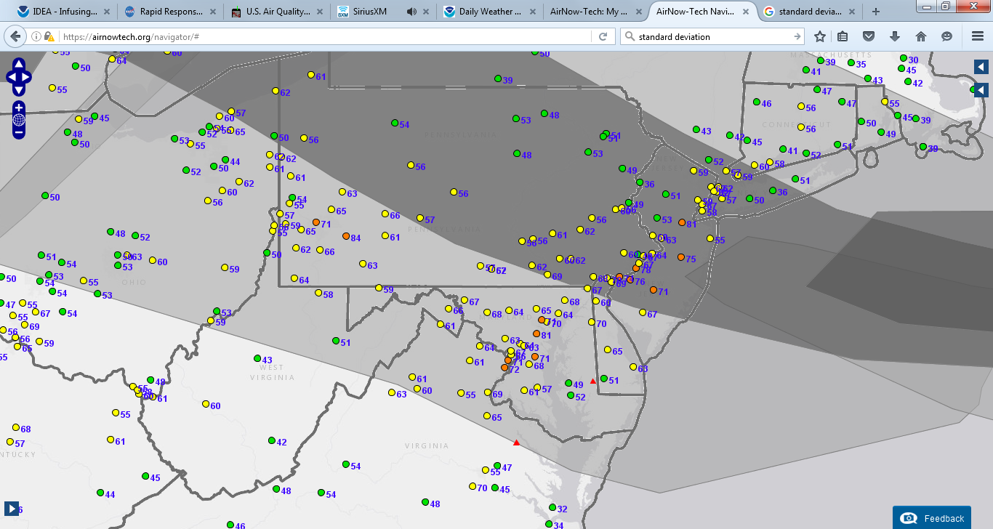
Ozone Concentrations – Sep 1, 2015

Slide 45
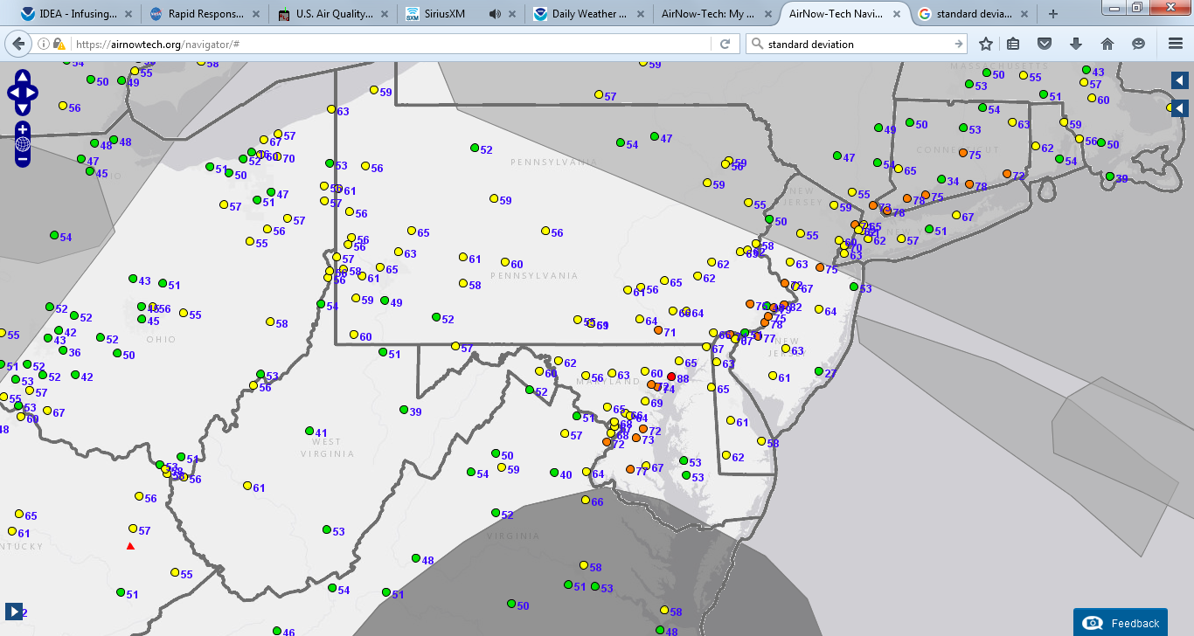
Ozone Concentrations – Sep 2, 2015

Slide 46
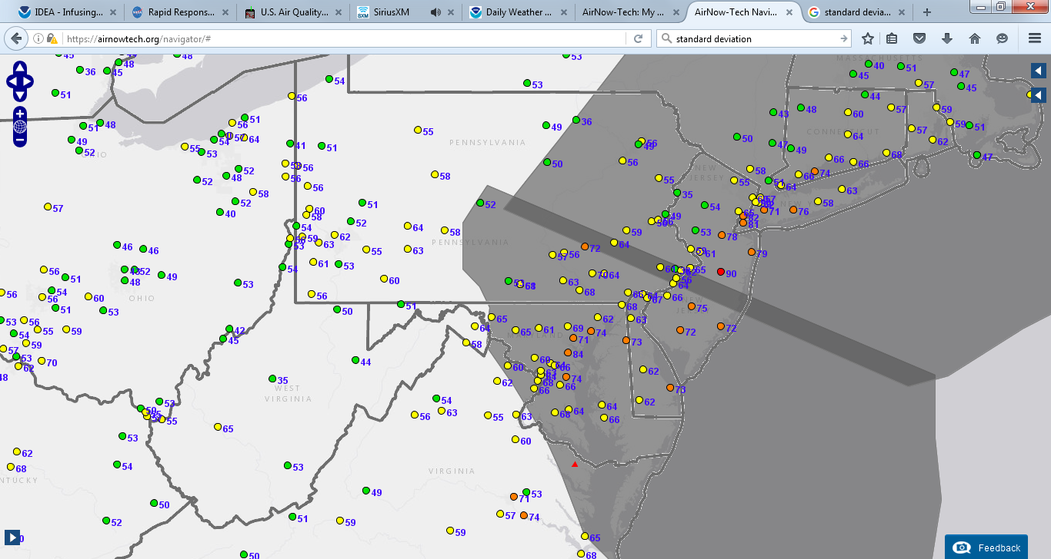
Ozone Concentrations – Sep 3, 2015

Slide 47
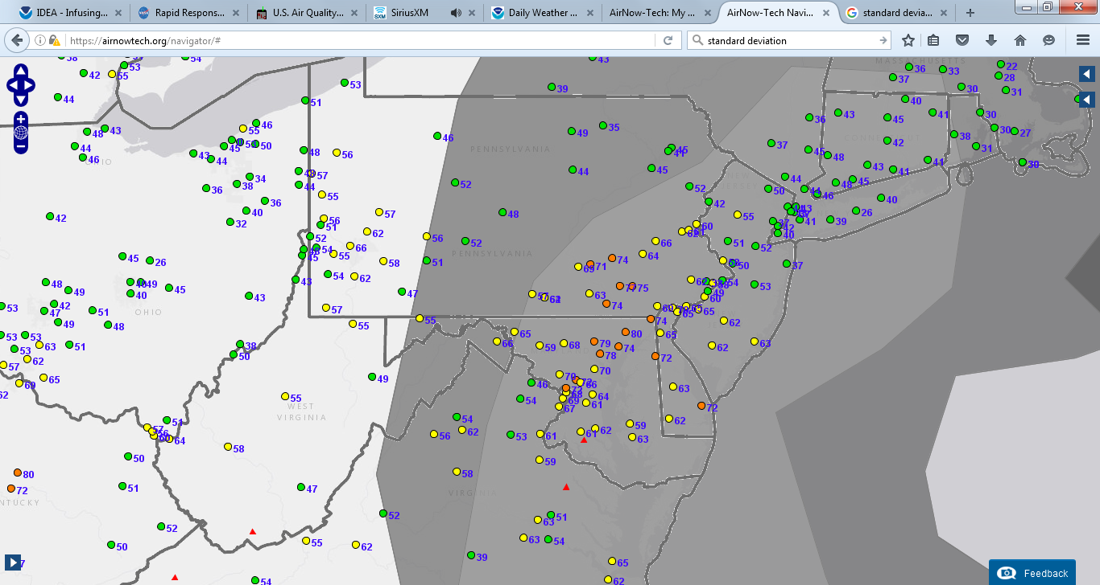
Ozone Concentrations – Sep 4, 2015

Slide 48
Elevated Ozone Link to Fires
PM2.5 Speciation Data -
Potassium Ion (K+)

Slide 49
Elevated Ozone Link to Fires
PM2.5 Speciation Data -
Potassium Ion (K+)

Slide 50
Elevated Ozone Link to Fires
PM2.5 Speciation Data -
Organic Carbon

Slide 51
Elevated Ozone Link to Fires
PM2.5 Speciation Data -
Organic Carbon

Slide 52
Elevated Ozone Link to Fires
PM2.5 Speciation Data -
Organic Carbon

Slide 53
Elevated Ozone Link to Fires
PM2.5 Speciation Data -
Organic Carbon

Slide 54
Elevated Ozone Link to Fires
PM2.5 Speciation Data -
Organic Carbon

Slide 55
Conclusions
Aerosol satellite imagery has a variety of uses, including assisting with daily air quality forecasting and post air quality episode analysis.
Support of aerosol satellite imagery illustrates potential link between ozone exceedances and transport of ozone precursor (as a byproduct of forest fires).
This knowledge could eventually be used for exceptional event determination.

Slide 56
Sean Nolan Environmental Group Manager Air Quality Monitoring Division 717-772-3377 senolan@pa.gov

