Slide 1
Assimilation of VIIRS AOD and smoke and dust products for regional forecasting of aerosols
Mariusz Pagowski, Georg Grell ¹
Shobha Kondragunta, Pubu Ciren, Hai Zhang ²
¹ NOAA/ESRL, Boulder, CO, USA
² NOAA/NESDIS, College Park, MD, USA

Slide 2
Outline
Simulations with regional model WRF-Chem of smoke fires over CONUS in July 2016 and a dust storm over Northern Africa/Europe in March 2014 .
Assimilation of VIIRS Aerosol Optical Depth at 550 nm using 3D-Var algorithm in the Gridpoint Statistical Interpolation (GSI) (assimilation of VIIRS AOD at 550 nm has been implemented in the GSI and submitted for review to be include in the trunk for public distribution)
In parallel to the above assimilation of VIIRS AOD 550nm combined with smoke and dust masks. VIIRS AOD and masks are obtained daily from NESDIS ftp with minimal delay and are being tested for application for assimilation into RAP-Chem and HRRR-Smoke forecasts.

Slide 3
VIIRS dust detection algorithm takes advantage of changes to spectral contrast with and without dust in the atmosphere - Spectral contrast change provides absorbing aerosol index (AAI).
Dust Smoke Discrimination Index (DSDI) separates smoke from dust (next slide)
AAI = -100[1og₁₀(R₄₁₂/R₄₄₀) – log₁₀(R’₄₁₂/R’₄₄₀)]
Contrast between 412 and 440 nm for dust in the atmosphere
Contrast between 412 and 440 nm for Rayleigh atmosphere

Slide 4
Dust Smoke Discrimination Index (DSDI) separates the absorbing aerosol into dust or smoke
Contrast between VIIRS-measured reflectance at 412 nm and 2.13 µm for clear sky (Rayleigh atmosphere) is reduced for smoke and dust.
VIIRS measured reflectance at 2.13 µm is higher for dust (due to scattering) than smoke (transparent)
clear
smoke
DSDI = -10[log₁₀(R₄₁₂/R₂₁₃₀)]
dust
Reflectance (2.13 µm)
dust
smoke
clear
Reflectance (412 nm)

Slide 5
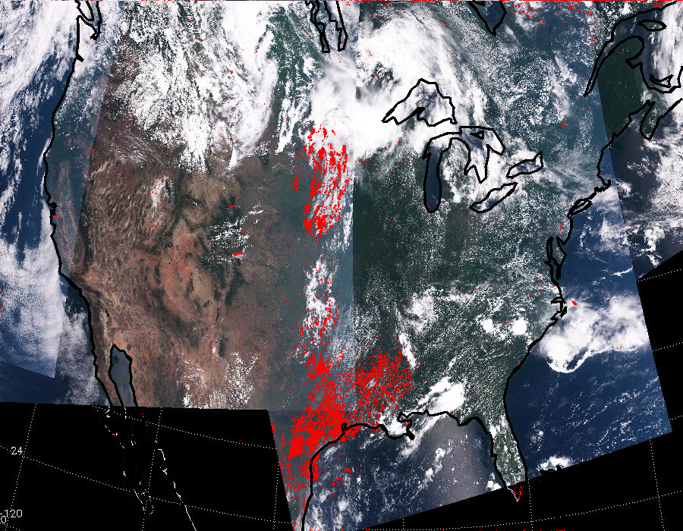
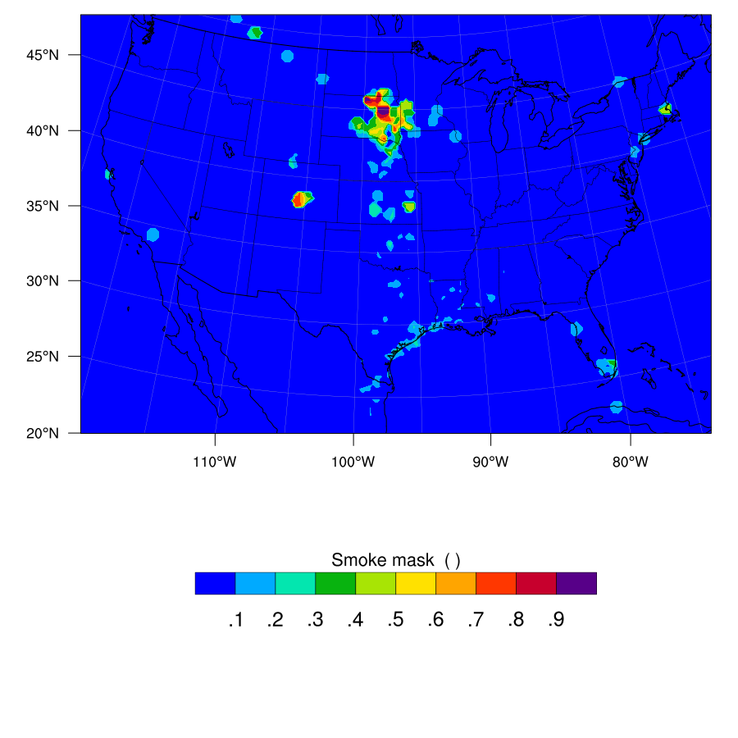
Smoke assimilation: 20160711
Smoke mask (not AOD i.e. neither intensity nor dust/smoke index); composition of three satellite passes from ~17 UTC to ~21 UTC.
Smoke index interpolated in model space.

Slide 6
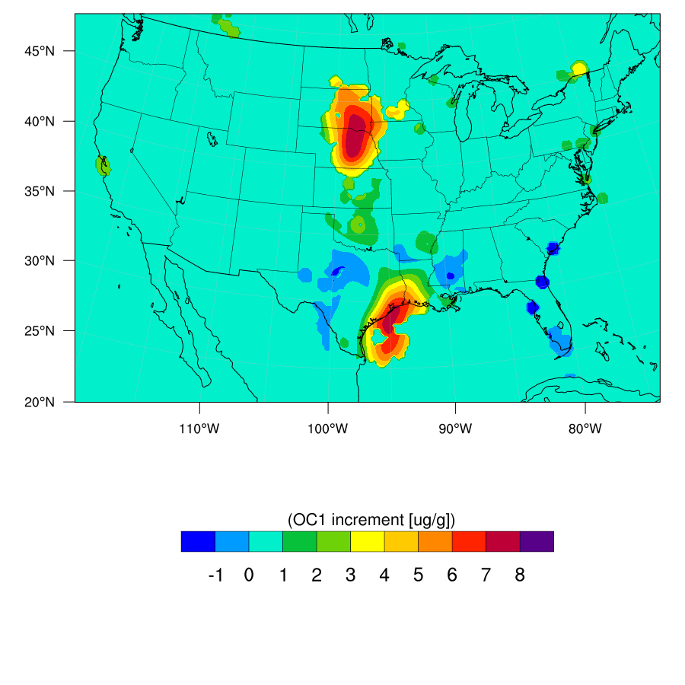
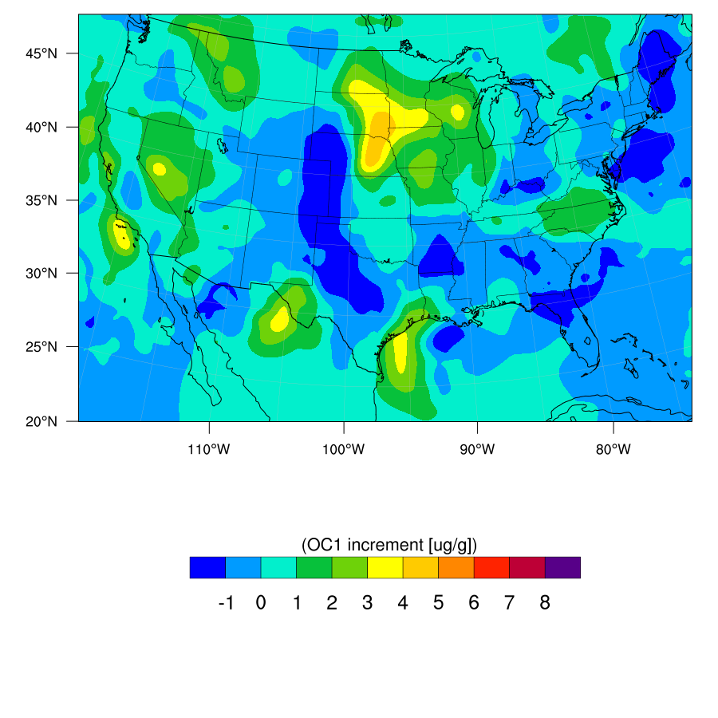
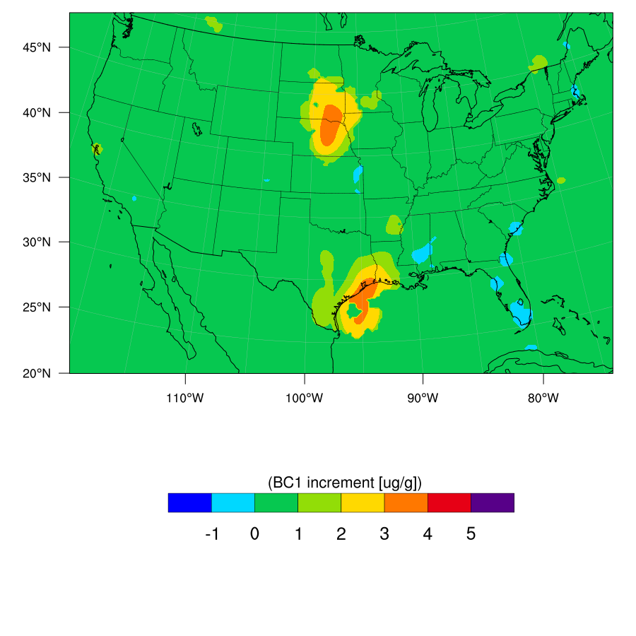
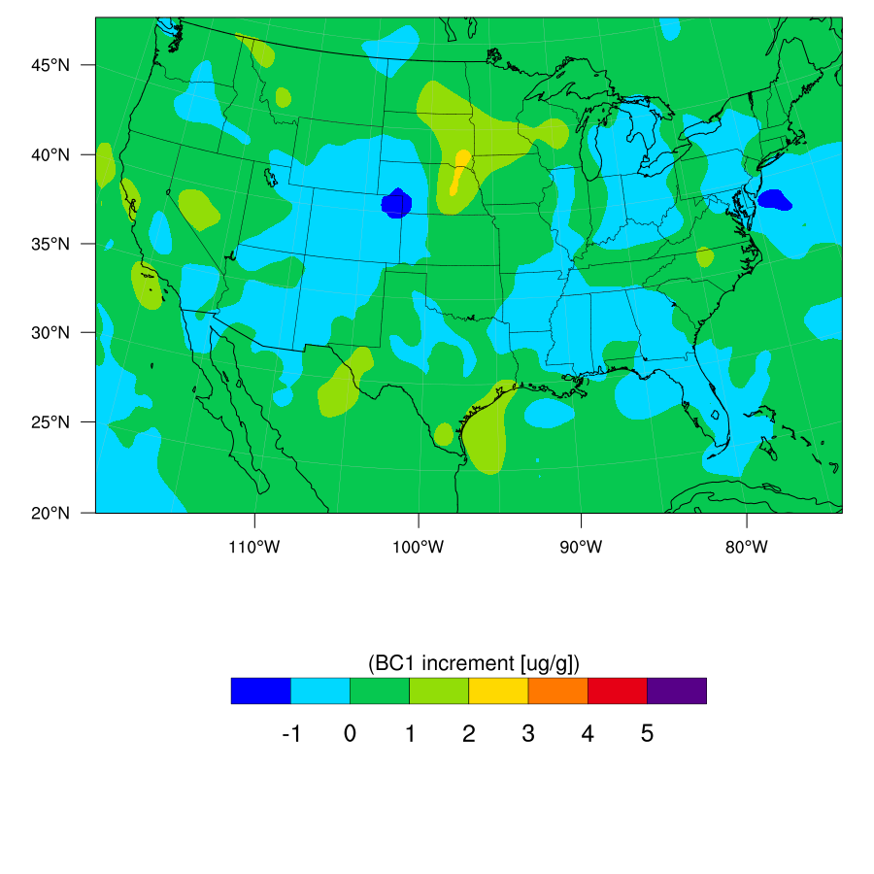
Smoke assimilation: 20160711
Assimilation of AOD at 550 nm centered at 1800 UTC with 3-hr window.
Increment with smoke mask
Increment without smoke mask

Slide 7
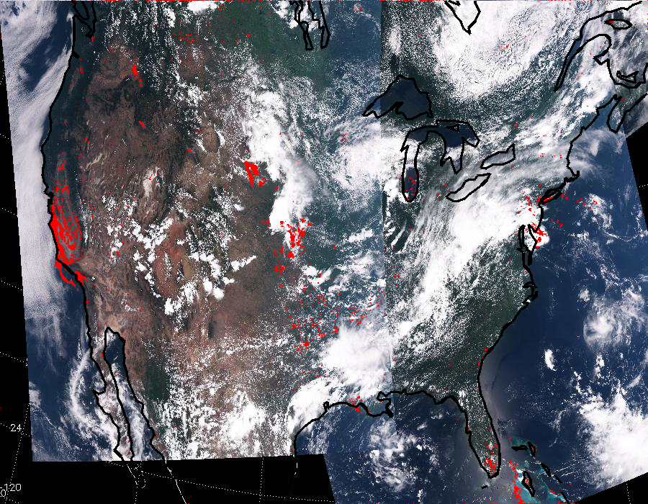
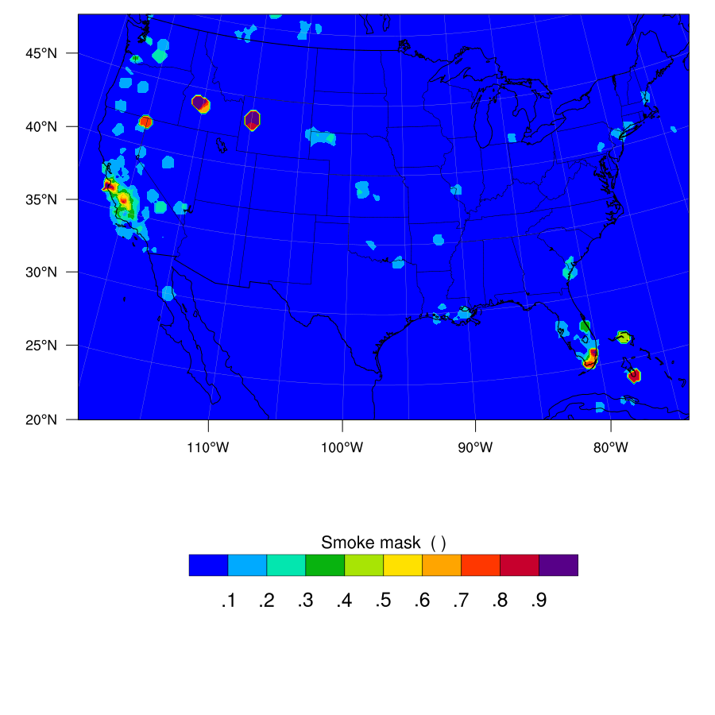
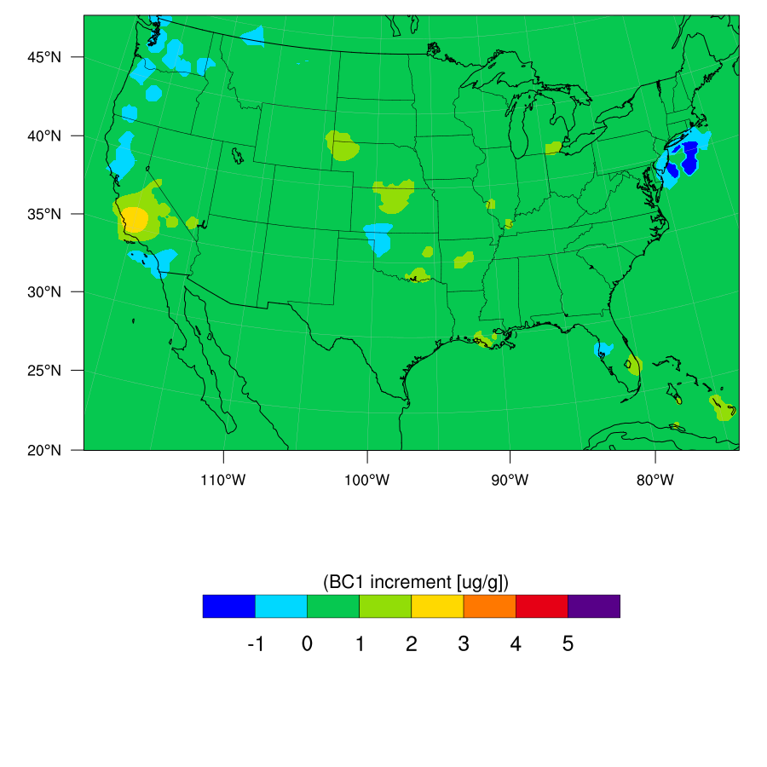
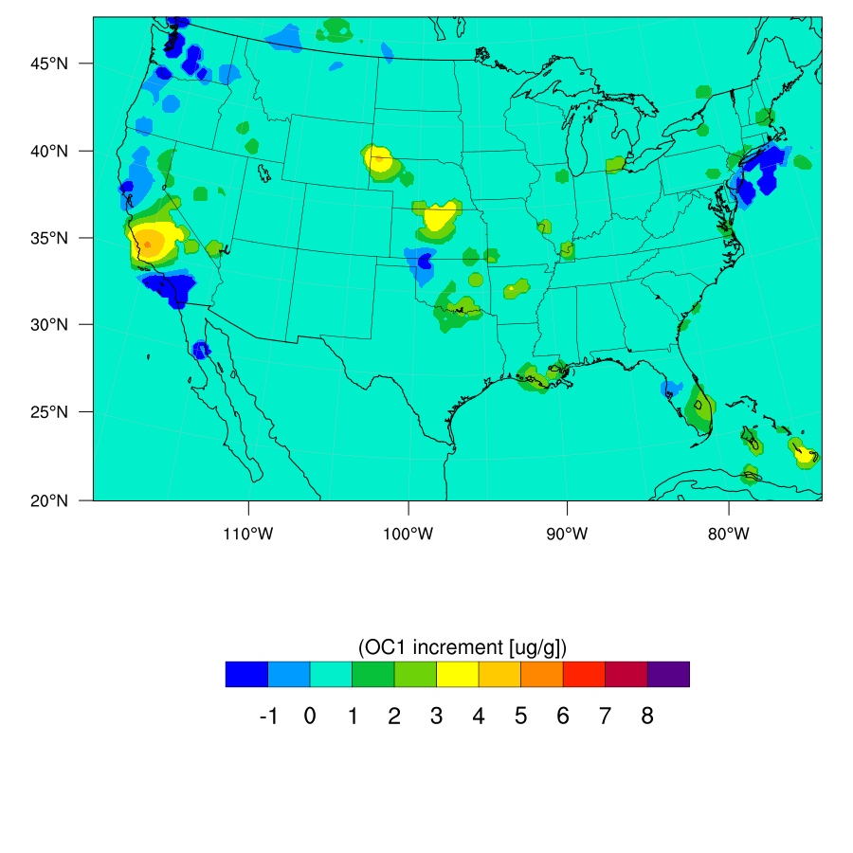
Smoke assimilation: 20160728 (Sorbanes fire)

Slide 8
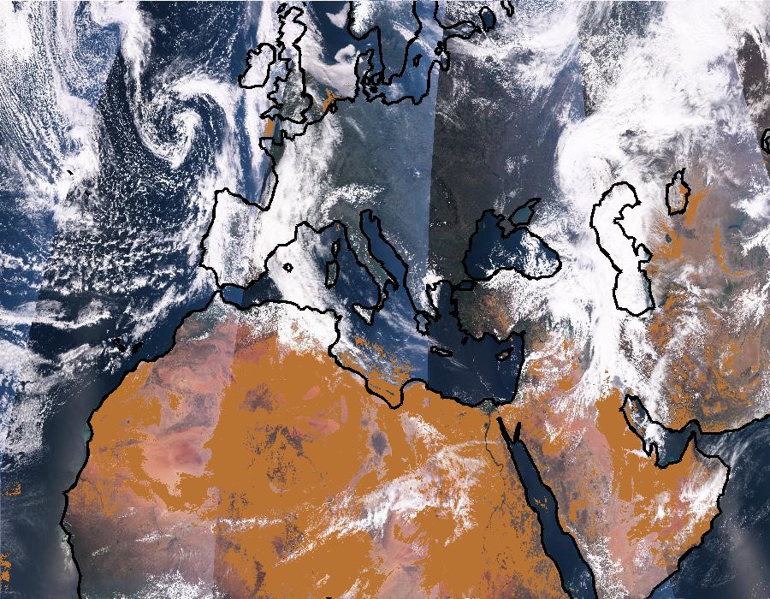
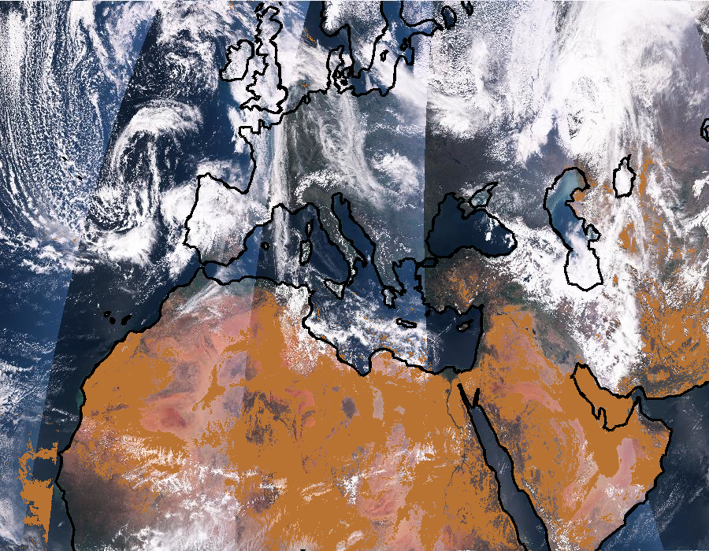
Dust assimilation
20140330
20140331
Dust mask (not AOD i.e. not intensity).
Composition of five satellite passes from ~09 UTC to ~16 UTC.
Assimilation of AOD at 550 nm centered at 1200 UTC with 3-hr window.

Slide 9
Dust assimilation
Increment of total dust at the surface at 2014033012
due to the assimilation of VIIRS AOD at 550 nm with dust mask

Slide 10
Conclusions
Testing of assimilation of VIIRS AOD 550nm and masks and their influence on aerosols forecasts is underway for possible application in r-t RAP-Chem and HRRR-Smoke.
Possible application of VIIRS AOD assimilation to a global model that is being developed at ESRL.

Slide 11
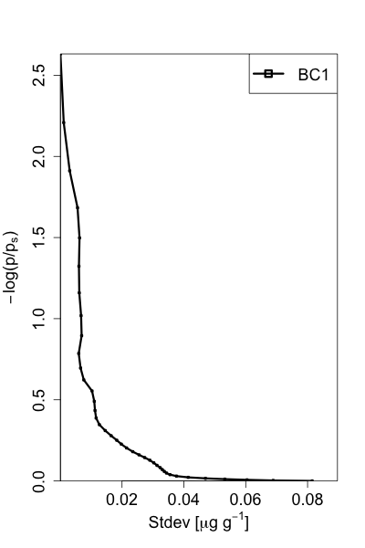
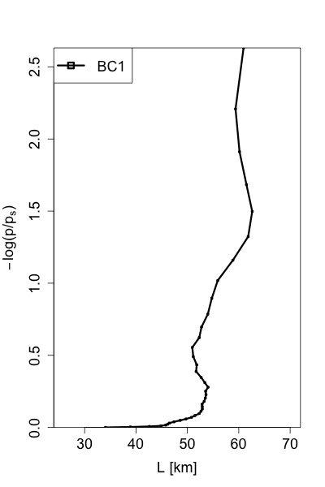
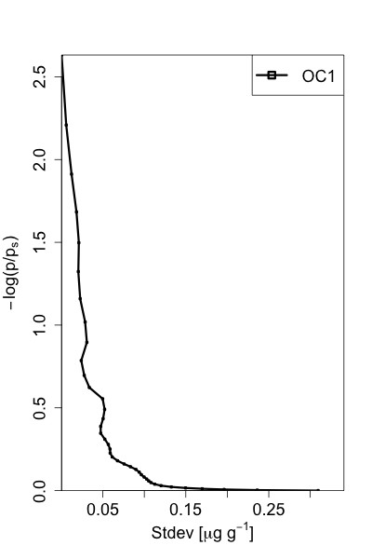
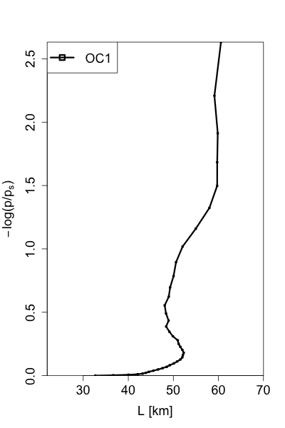
3D-Var (assimilation) algorithm
J – cost function to be minimized
B – model error matrix (approximated with error variance, and vertical and horizontal scales - below)
R – observation error matrix
H – forward model that converts model variable(s) to observation space
x_{b} – initial model state (forecast)
x – optimal state (solution)

