Slide 1
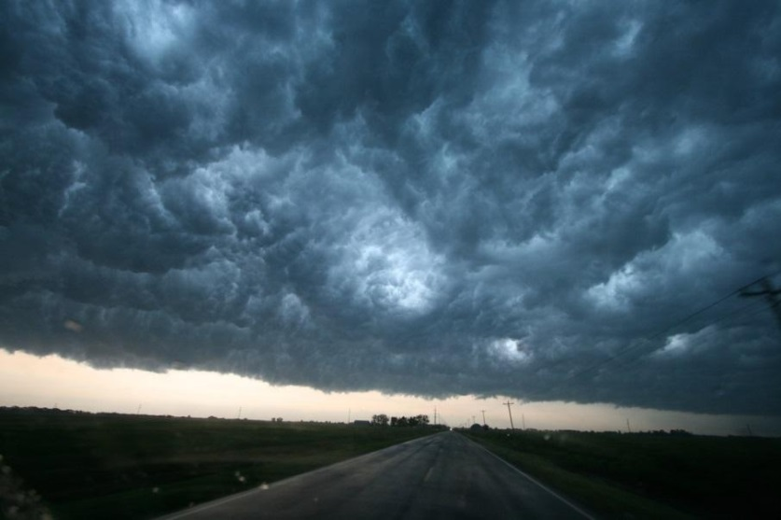
Next Generation Global Prediction System (NGGPS) Overview NOAA Satellite Aerosol Product Workshop September 13, 2016
Fred Toepfer/Tim Schneider, Program Manager

Slide 2
NGGPS Goals and Objectives¹
Design/Develop/Implement NGGPS global atmospheric prediction model
Non-hydrostatic scalable dynamics
Improve data assimilation and physics
Position NWS for next generation high performance computing
Engage community in model/components development
Reduce implementation time
Increase effectiveness of product distribution
Post-processing, assessments, and display
World’s Best Global Forecast Guidance
¹From NWS Budget Initiative proposal to OMB
Notes:
Develop and implement NGGPS by 2019. This will extend useful forecast skill to 30 days, and utilize new high performance computing capabilities. This is not just an NWS effort, it is a community effort with participation of NOAA and other federal laboratories and universities.

Slide 3
NGGPS Description
Fully coupled system: ocean, waves, sea ice, land surface, atmosphere, aerosols and atmospheric composition
Built using NEMS/Earth System Modeling Framework
Each component model will be community code
Atmospheric Components
Aerosols/
Atm Composition
(GOCART/MAM)
Whole
Atm Model
(WAM)
Atm Dycore
(FV3)
Atm Physics
(CCPP)
Data Assimilation
NEMS/ESMF
Land Surface
(NOAH)
Ocean
(HYCOM)
(MOM)
Wave
(WW3)
(SWAN)
Sea Ice
(CICE/KISS)

Slide 4
Project Activities and Status Highlights
Develop Implementation Plan
Broaden community participation
Select the dynamical core
Accelerate NEMS - Develop Prototype Coupled System
GSM, LIS/Noah, HYCOM, MOM5/6, CICE, are WW3 are all integrated into NEMS. GSM, MOM5, and CICE are now coupled
Upgrade EMC infrastructure to support community participation
Software and Scientific Development at EMC (SciTech Task) awarded
NEMS development, software engineering, technical support for infrastructure upgrades, R&D for upgrade of global modeling components - Physics and DA development are in progress
Transition of MET+ into EMC environment - in progress

Slide 5
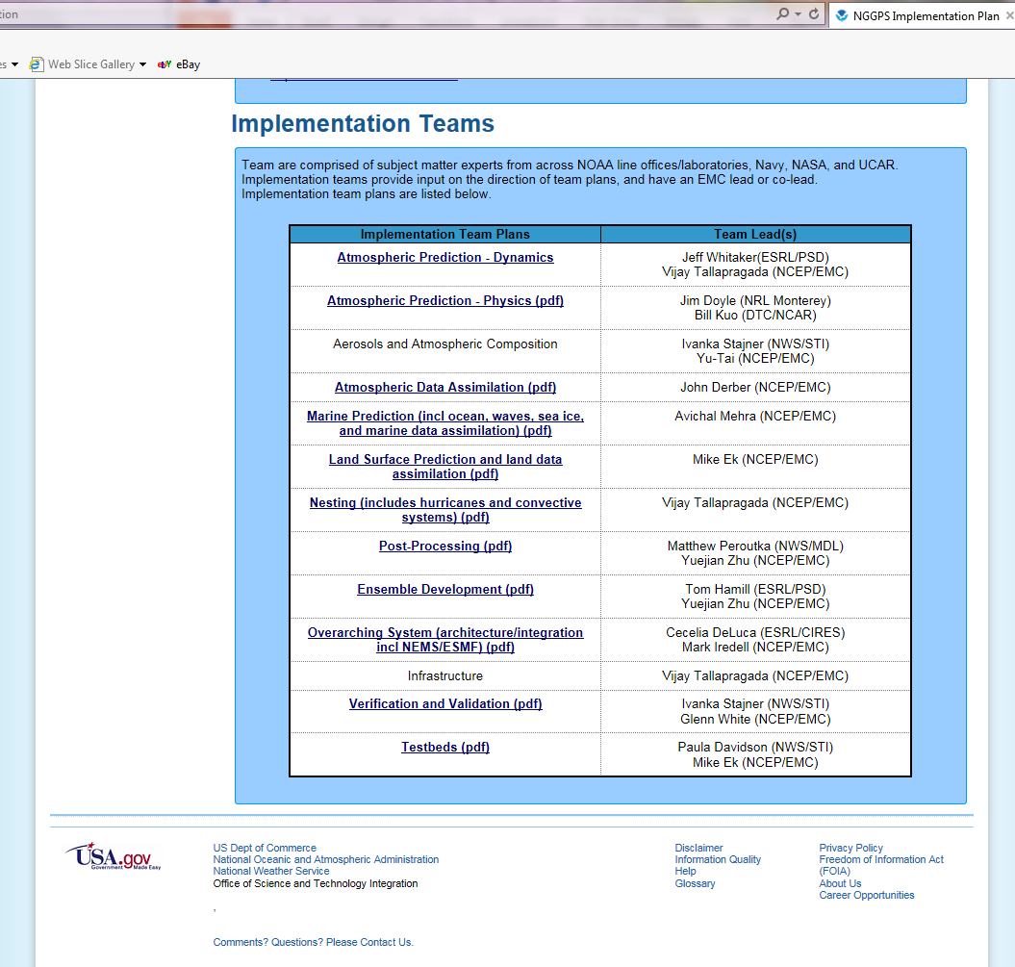
NGGPS Implementation Plan
Developed Implementation Plan
Team participation across NOAA line offices/laboratories, Navy, NASA, UCAR and coordination with the High Impact Weather Prediction Project and the National Earth System Prediction Capability program
Team Plans posted on NGGPS website:
http://www.weather.gov/sti/stimodeling_nggps_implementation

Slide 6
Enhanced Community Participation Since 2015
2015 Federal Funding Opportunity (FFO):
14 NGGPS proposals selected, $5M funded over two years
9 NGGPS testbeds proposals selected, $3.4M funded over two years
Research and development topic areas funded
Physics driver and parameterization
Aerosol model
Atmospheric model and data assimilation
Ocean, wave and sea ice models, and associated data assimilation
Land surface model and data assimilation
Ensemble development
Model coupling and efficiency
Testbeds
The new CSTAR website lists all grants http://www.weather.gov/sti/stigrants

Slide 7
Expanded Community Participation in 2016
2016 Federal Funding Opportunity (FFO)
11 NGGPS proposals awarded, $1.9M for first year
6 NGGPS testbed proposals awarded, $1M for first year
Funding community participation in coordination with other programs
Coordination and co-funding with CPO and USWRP
Accelerating development and use of community components
NGGPS Test Bed Activities/Global Modeling Test Bed (GMTB)
Developmental testing of new functionality
Facilitates community involvement in ongoing development of operational modeling systems (e.g. code management, test and evaluation of operational system upgrades proposed by external community)

Slide 8
Global Model Test Bed (GMTB) – Role
Extension of current DTC (NCAR and GSD partnership)
Developmental testing of new functionality
Facilitates community involvement in ongoing development of operational modeling systems
Community code management
Facilitates use of code in non-NOAA platforms
Provides necessary infrastructure for community to interact with code system
Supports code system to external developers
Independent test and evaluation of proposed upgrades to operational system from external community

Slide 9
GMTB – Current Focus
Atmospheric physics
Create and support a Common Community Physics Package (CCPP) with carefully vetted physics suites for global modeling at various resolutions
Develop a design and implementation plan to evolve current Interoperable Physics Driver (IPD) to meet the needs of NGGPS
Implement a testbed for innovations
NGGPS Physics Workshop planned for 7-9 November 2016
Sea ice model evaluation
Participate in efforts to create a plan for fostering community collaboration in Los Alamos Sea Ice Model (CICE) development

Slide 10
NGGPS Global Atmospheric Model Technical Strategy
Reduce implementation time and risk by separating dynamic core and model physics
Identify and implement an advanced dynamical core for global weather forecast applications
Highly scalable
Non-hydrostatic
Accelerate evolution of model physics
Develop/Implement Common Community Physics Package (CCPP)
Based on current GFS physics package
Integration of best of other existing physics packages
Scale-aware
Develop a new community approach
Employ Global Modeling Test Bed (GMTB)/Developmental Testbed Center (DTC) and a more robust Joint Center for Satellite Data Assimilation (JCSDA) to encourage and facilitate community interaction
Accelerate O2R & R2O

Slide 11
NGGPS Phase 1 Candidate Dynamical Cores
MPAS (NCAR) – Unstructured grid with C-grid discretization
FV3 (GFDL) – Cubed sphere, finite-volume
NIM (ESRL) – Non-hydrostatic Icosahedral Model
NEPTUNE (Navy) – Flexible grid with adaptive mesh Refinement
NMMB-UJ (EMC) – Finite difference, cartesian grid, global extension of regional model
GSM-NH (EMC) – Non-hydrostatic extension of Semi-Lagrangian Global Spectral Model
Global Spectral Model not included – Non-hydrostatic version not available

Slide 12
NGGPS Atmospheric Model Phased Implementation Approach
Phase 1 (FY15) – Identify Qualified Dynamic Cores (Complete)
Evaluate technical performance
Scalability
Integration of scheme stability and characteristics
Phase 2 (FY16) – Select Candidate Dynamic Core (Complete)
Integrate with operational GFS Physics
Evaluate meteorological performance
Phase 3 (FY17-19) – Dynamic Core Integration and Implementation (Underway)
* NGGPS Dycore Test Group guided effort throughout Phases 1 and 2
Notes:
Phase 3 (FY17-19) – Dynamic Core Integration and Implementation
Implement candidate dynamic core in NEMS
Implement Common Community Physics Package
Implement data assimilation (4DEnVar with 4D incremental analysis update and stochastic physics)
Implement community model environment

Slide 13
Overall Assessment and NGGPS Program Manager Recommendation
The FV3 core represents the lowest risk, lowest cost candidate for the new NGGPS atmospheric model
Compared to the MPAS, FV3:
Meets all technical needs
Less expensive to implement
Higher readiness for implementation
Significantly better technical and computational performance
Lower risk
NGGPS strategy has always been to find and implement the best global model (not the best convective scale model, although nothing in results precludes eventual global/convective-scale unification based on FV3)
Director, NWS Decision (with NOAA Administrator concurrence): Select GFDL FV3 and proceed to NGGPS Phase 3 dynamic core integration and implementation
Notes:
FV3 dynamic core will satisfy development of NGGPS and serve NWS needs for global weather and climate applications.
Out of the box, FV3 produced skillful forecasts comparable to GFS.

Slide 14
NGGPS Program Next Steps
Develop a NOAA Modeling Strategic Plan
Implement selected dynamical core
Implement Common Community Physics Package
Implement improved data assimilation (4DEnVar with 4D incremental analysis update and stochastic physics)
Develop enhanced post-processing, ensemble methods; verification and validation; visualization tools and techniques
Initiate community model environment, beginning with DTC, GMTB and JCSDA
Conduct robust and ongoing testing and evaluation of components and systems, with community involvement

Slide 15
Summary
Global model dynamic core selected (GFDL FV3)
Teams continue to identify, prioritize and develop model component and system improvements for NGGPS
Community Involvement
Coordinate proposal driven scientific development by universities, federal labs, and testbeds (including 2016 FFO selections); establishment of GMTB; collaboration with JCSDA through JEDI
Future focus areas
Phase 3 dynamic core integration
Accelerate evolution of model physics - develop/implement Common Community Physics Package (CCPP)
Data assimilation improvements
Enhance across-team coordination
Accelerate model component and system development and integration of community development into testing at EMC

Slide 16
STI Modeling Program Website:
http://www.weather.gov/sti/stimodeling
Information NGGPS:
http://www.weather.gov/sti/stimodeling_nggps
Information on Grants:
http://www.weather.gov/sti/stigrants

Slide 17
Back-up

Slide 18
NGGPS Over-Arching Objectives
Re-establish US as the World leader in Global Weather Prediction
Extend forecast skill beyond 8 to 10 days
Improve hurricane track and intensity forecast
Extend Weather Forecast to 30 days
Implement a fully-coupled NWP System Atmosphere, Ocean, Sea Ice, Land Surface, Waves, Aerosols and Atmospheric Composition
Support development of products for weeks 3 and 4
Support unification of the NWS Numerical Weather Prediction Suite
5-year Community Effort
Notes:
A research to operations (R2O) initiative is underway to design, develop and implement the Next Generation Global Prediction System (NGGPS) by 2019.
This will be a fully coupled system to extend useful forecast skill to 30 days. This system will be designed to utilize new high performance computing capabilities.
This is not just an NWS effort, it is a community effort with participation of NOAA and other federal laboratories and universities.
For example, the new dynamical core for NGGPS will be selected from several dynamical cores undergoing testing and evaluation. These dynamical cores are provided by: NCAR, NOAA/GFDL, NOAA/ESRL, Navy and NOAA/NWS/EMC.

Slide 19
Strategy for Years 3 - 5
Demonstrate increased skill out to longer time scales
7-day skill extended to 14 days
Increased predictability of severe weather
Accelerate development of model components and improve coupling capabilities
Research from community should start translating into operational development plans
Improve system and software architecture to increase performance and interoperability
Efficient transfer to fine-grain computing platforms
Operationally implement the fully coupled global ocean-atmosphere-ice-wave prediction system

Slide 20
NGGPS Phase 1 Dynamical Core Evaluation
Evaluate technical performance
Scalability
Integration of scheme stability and characteristics
Proceed to Phase 2 testing and evaluation with two dynamical cores: FV3 and MPAS
low technical risk
no unique dynamical core quality will be lost
Briefed to NWS and OAR Assistant Administrators, July 2015

Slide 21
NGGPS Phase 2 Dynamical Core Testing Criteria
# | Evaluation Criteria*
1 | Plan for relaxing shallow atmosphere approximation (deep atmosphere dynamics)
2 | Accurate conservation of mass, tracers, entropy, and energy
3 | Robust model solutions under a wide range of realistic atmospheric initial conditions using a common (GFS) physics package
4 | Computational performance with GFS physics
5 | Demonstration of variable resolution and/or nesting capabilities, including supercell tests and physically realistic simulations of convection in the high-resolution region
6 | Stable, conservative long integrations with realistic climate statistics
7 | Code adaptable to NEMS/ESMF
8 | Detailed dycore documentation, including documentation of vertical grid, numerical filters, time-integration scheme and variable resolution and/or nesting capabilities
9 | Evaluation of performance in cycled data assimilation
10 | Implementation Plan (including costs)
Integrate with operational GFS Physics/CCPP
Evaluate meteorological performance
Results publicly available; report in preparation http://www.weather.gov/sti/stimodeling_nggps_implementation_atmdynamics
* Evaluation criteria approved by DTG consensus in January 2016

Slide 22
Joint Effort for Data assimilation Integration (JEDI)
Goals
Next-generation unified data assimilation system
Increase R2O transition rate (from academia to operations)
Increase science productivity and code performance
Strategy
Modular code for flexibility, robustness and optimization
Mutualize model-agnostic components across:
- Applications (atmosphere, ocean, strongly coupled, etc)
- Models & Grids (operational/research, regional/global models)
- Observations (past, current and future)
Collective reduction of entropy

Slide 23
Joint Effort for Data assimilation Integration (JEDI)
Simultaneous top-down and bottom-up approach
Top-down approach
Start with a clean slate
Redesign entire architecture (ECMWF, Met Office, NCAR)
Bottom-up approach
Start from existing codes
Incremental modularization (NCEP GSI refactoring, Navy)
Roadmap gradually connecting the two approaches

