Slide 1






VIIRS product status
Ivan Csiszar
NOAA NESDIS Center for Satellite Applications and Research
Marina Tsidulko
I.M. Systems Group, Inc.
Wilfrid Schroeder, Louis Giglio, Evan Ellicott
University of Maryland, Department of Geographical Sciences

Slide 2
Outline
VIIRS active fire product status and data access
  VIIRS baseline (MODIS heritage) fire product
  Improved hybrid VIIRS fire product
Ongoing science issues and product improvements
Examples of key operational applications
Reprocessing the Suomi NPP VIIRS data record
Summary

Slide 3
NDE output file content
Missing – 0 | Brightness temperatures for M13 or M15 unavailable
Scan – 1 | Not processed (trim)
Other – 2 | Not processed (other reason)
Water – 3 | Pixel classified as non fire water
Cloud – 4 | Pixel classified as cloudy
No Fire – 5 | Pixel classified as non fire land
Unknown – 6 | Pixel with no valid background pixels
Fire Low – 7 | Fire pixel with confidence strictly less than 20% fire
Fire Medium – 8 | Fire pixel with confidence between 20% and 80%
Fire High – 9 | Fire pixel with confidence greater than or equal to 80%
Name | Description | Type
fire mask | Fire mask 2D array (unit-less) | 8 bit int
algorithm QA | Fire algorithm QA mask 2D array (unit-less) | 32 bit Int
FP_line | Fire pixel line Sparse data array | 16 bit Int
FP_sample | Fire pixel sample Sparse data array | 16 bit Int
FP_latitude | Fire pixel latitude Sparse data array (deg) | 32 bit Float
FP_longitude | Fire pixel longitude Sparse data array (deg) | 32 bit Float
FP_power | Fire radiative power Sparse data array (MW) | 32 bit Float
FP_confidence | Fire detection confidence Sparse data array (%) | 8 bit Int
FP_land | Land pixel flag Sparse data array | 8 bit Int
0-1 | Surface Type (water=0, coastal=1, land=2)
2-3 | Atmospheric correction (reserved for future use)
4 | Day/Night (daytime = 1, nighttime = 0)
5 | Potential fire (0/1)
6-10 | Background window size parameter
11 | Fire Test 1 valid (0 - No, 1 - Yes)
12 | Fire Test 2 valid (0 - No, 1 - Yes)
13 | Fire Test 3 valid (0 - No, 1 - Yes)
14 | Fire Test 4 valid (0 - No, 1 - Yes)
15 | Fire Test 5 valid (0 - No, 1 - Yes)
16 | Fire Test 6 valid (0 - No, 1 - Yes)
17-19 | N/A
20 | Adjacent clouds (0/1)
21 | Adjacent water (0/1)
22-23 | Sun Glint Level (0-3)
24 | Sun glint rejection
25 | False Alarm 1 (excessive rejection of legitimate background pixels)
26 | False Alarm 2 (water pixel contamination)
27 | Amazon forest-clearing rejection test
28-31 | N/A
Total output for one granule: 11.7 Mb + number of fires * 79 bytes
Fire pixel information is also available in text files

Slide 4
NDE output file content
Missing – 0 | Brightness temperatures for M13 or M15 unavailable
Scan – 1 | Bowtie deletion
Other – 2 | Not processed (other reason)
Water – 3 | Pixel classified as non fire water
Cloud – 4 | Pixel classified as cloudy
No Fire – 5 | Pixel classified as non fire land
Unknown – 6 | Pixel with no valid background pixels
Fire Low – 7 | Fire pixel with confidence strictly less than 20% fire
Fire Medium – 8 | Fire pixel with confidence between 20% and 80%
Fire High – 9 | Fire pixel with confidence greater than or equal to 80%
Name | Description | Type
fire mask | Fire mask 2D array (unit-less) | 8 bit int
algorithm QA | Fire algorithm QA mask 2D array (unit-less) | 32 bit Int
FP_line | Fire pixel line Sparse data array | 16 bit Int
FP_sample | Fire pixel sample Sparse data array | 16 bit Int
FP_latitude | Fire pixel latitude Sparse data array (deg) | 32 bit Float
FP_longitude | Fire pixel longitude Sparse data array (deg) | 32 bit Float
FP_power | Fire radiative power Sparse data array (MW) | 32 bit Float
FP_confidence | Fire detection confidence Sparse data array (%) | 8 bit Int
FP_land | Land pixel flag Sparse data array | 8 bit Int
0-1 | Surface Type (water=0, coastal=1, land=2)
2 | EDR trim zone (0=false, 1=true)
3 | Atmospheric correction performed (0=false, 1=true)
4 | Day/Night (daytime = 1, nighttime = 0)
5 | Potential fire (0/1)
6 | Spare (set to 0)
7-10 | Background window size parameter
11 | Fire Test 1 valid (0 - No, 1 - Yes)
12 | Fire Test 2 valid (0 - No, 1 - Yes)
13 | Fire Test 3 valid (0 - No, 1 - Yes)
14 | Fire Test 4 valid (0 - No, 1 - Yes)
15 | Fire Test 5 valid (0 - No, 1 - Yes)
16 | Fire Test 6 valid (0 - No, 1 - Yes)
17-19 | Spare (set to 0)
20 | Adjacent clouds (0/1)
21 | Adjacent water (0/1)
22-23 | Sun Glint Level (0-3)
24-28 | Individual rejection test flags (0=false, 1=true)
29-31 | Spare (set to 0)
Total output for one granule: 11.7 Mb + number of fires * 79 bytes
Fire pixel information is also available in text files

Slide 5
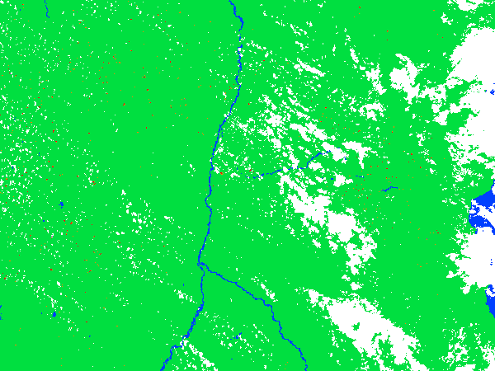
NOAA NDE VIIRS ACTIVE FIRE PRODUCT: FIRE MASK
Central Africa, 5/1/2017 11:33 UTC
Input unavailable
Water
Cloud
Land
Unknown
Fire low
Fire medium
Fire high
Lake Tanganyika
Fire locations, confidence and FRP are available in sparse array and text files

Slide 6
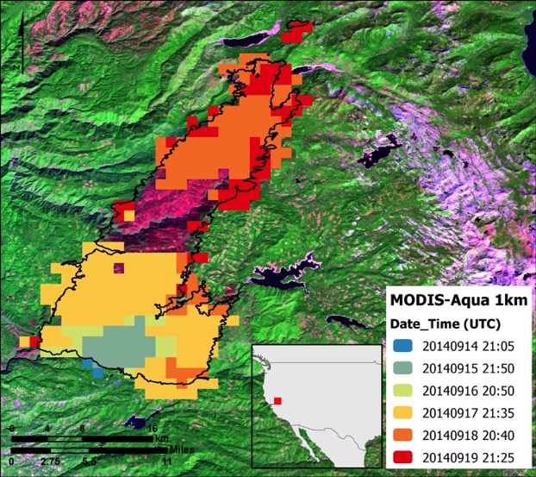
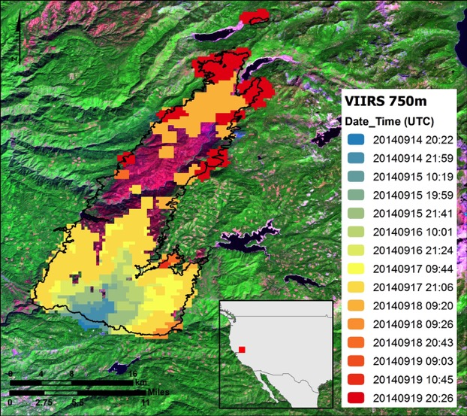
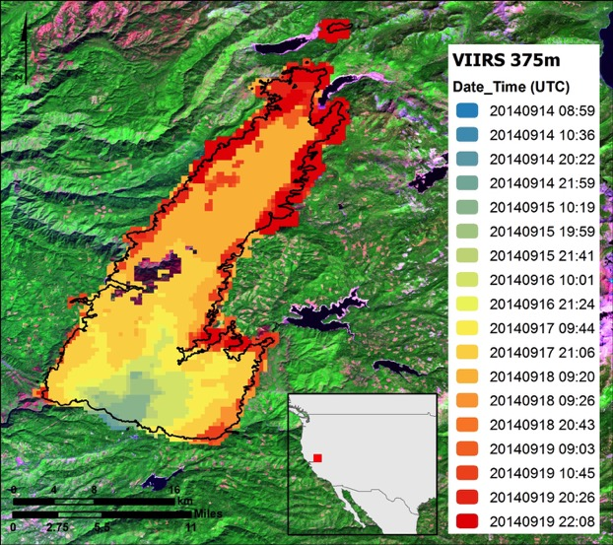
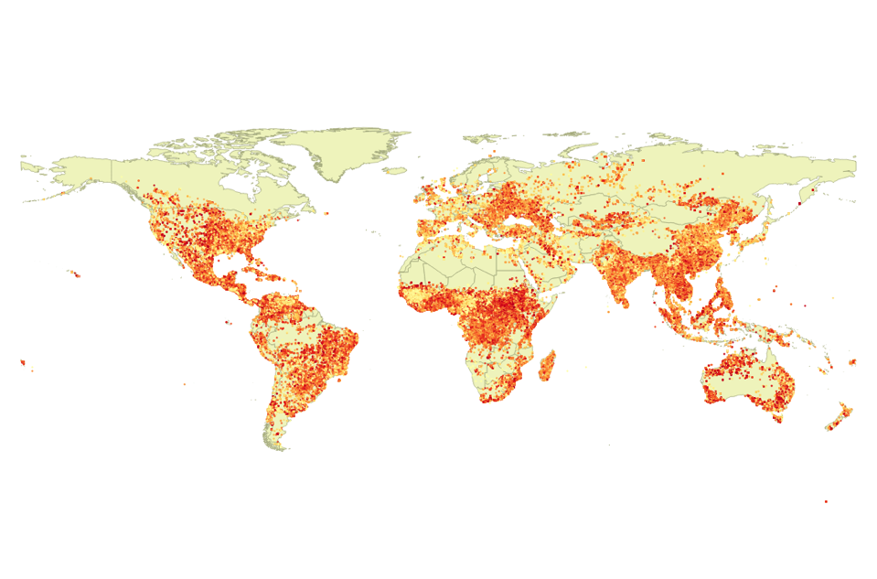

King Fire/CA, September 2014
Scenario 1
Scenario 2
Hybrid I/M-band product
375m
375m
375 & 750 m colocation
FRP (MW)
750m
750m
calculate FRP
FRP_{i} = FRP
FRP_{i} = FRP ÷ 2

Slide 7
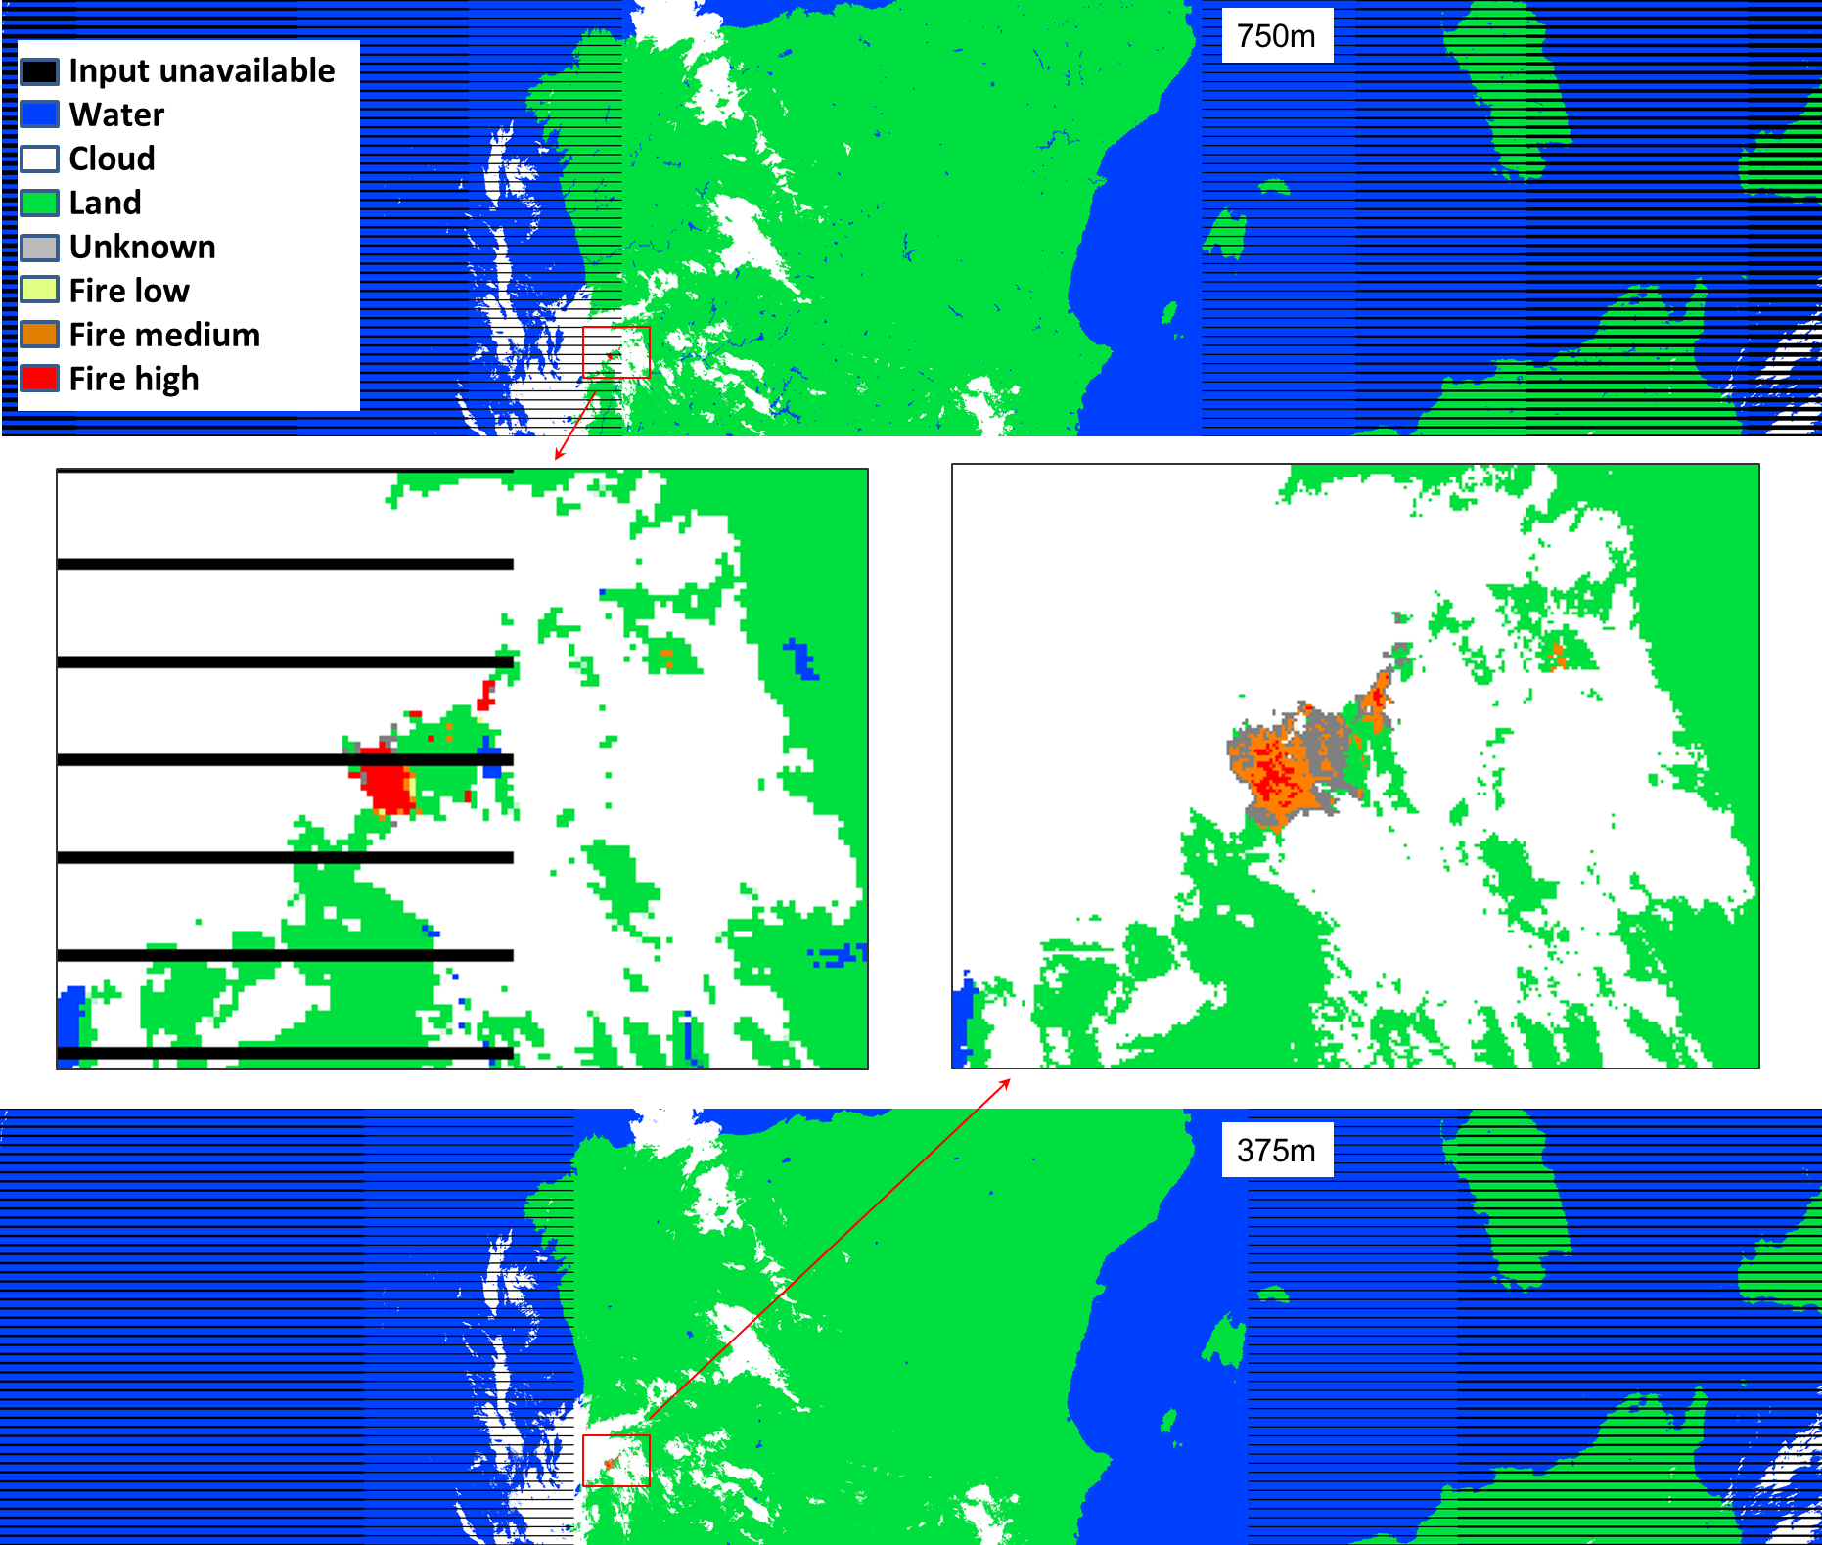
M-band vs. I-band
The JPSS VIIRS active fire products provide high quality information
  750m M-band product in operations since March 15, 2016
  375m I-band algorithm evaluated for operational implementation
  both products deliver fire mask and fire radiative power (FRP)
  FRP used in air quality, and smoke analysis and prediction systems
  FRP is incorporated into AWIPS-II
Updated M-band algorithm in delivery to NDE.
Fire masks from the M-band (top and left) and I-band (bottom and right) algorithms on 6/18/2017 02:04 UTC.
I. Csiszar, STAR; M. Tsidulko, IMSG@STAR, W. Schroeder, UMD

Slide 8
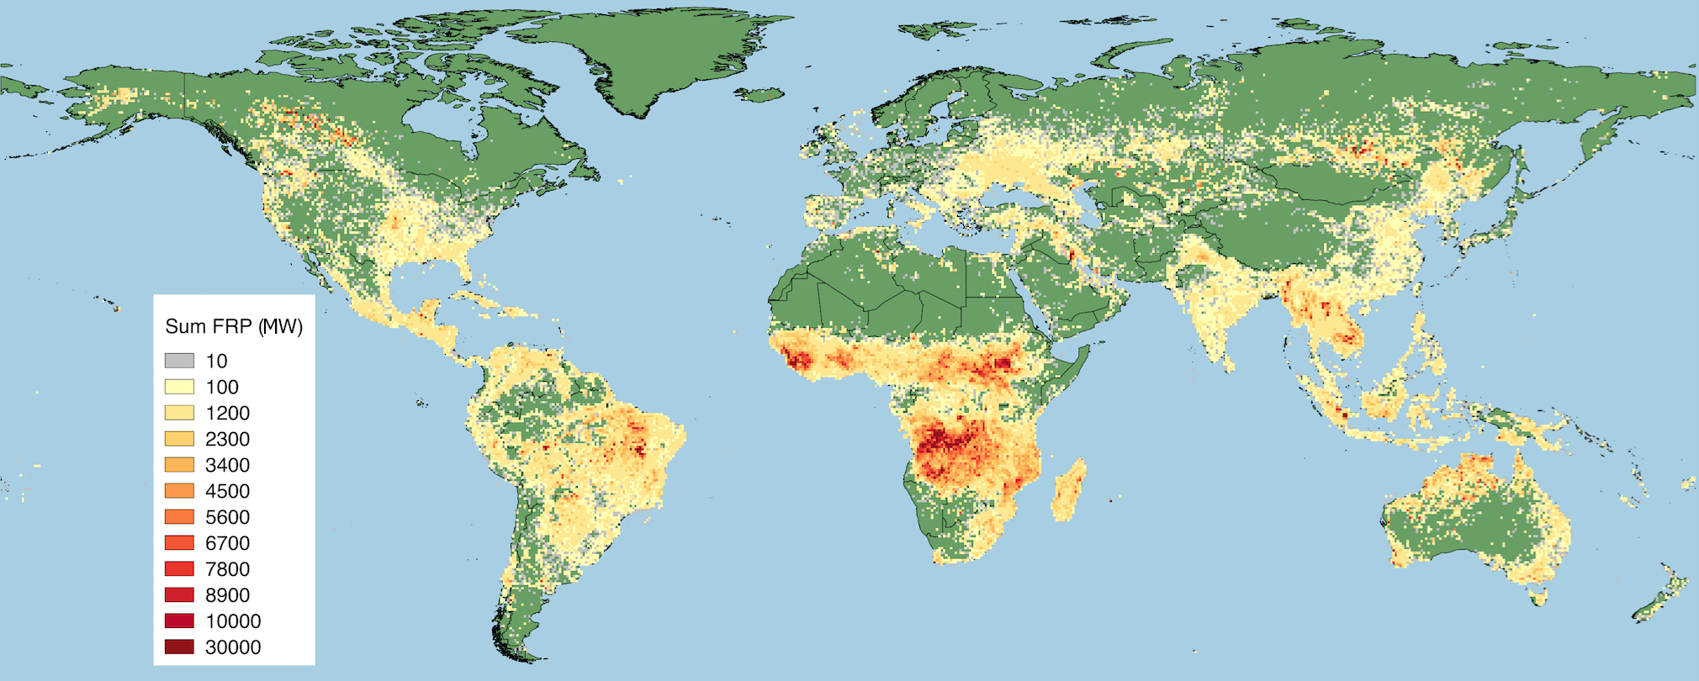
VIIRS 375 m Fire Radiative Power
Jan-Dec 2015 (Julian days 1,10,20,…,360)
Sum of top-of-atmosphere (TOA) FRP over sampling period
using 0.5º grid
Frequent saturation prevents FRP retrieval using
375 m mid-IR data
Alternative calculation implemented using co-located 750 m mid-IR unsaturated data

Slide 9
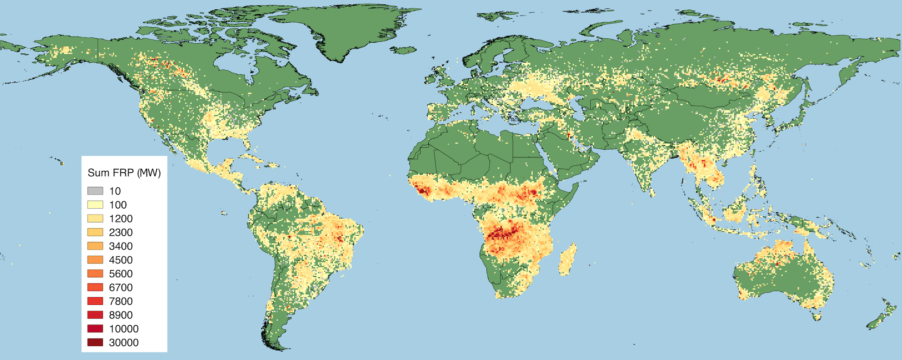
MYD14 1km Collection 6 Fire Radiative Power
Jan-Dec 2015 (Julian days 1,10,20,…,360)
Sum of top-of-atmosphere (TOA) FRP over sampling period
using 0.5º grid
Higher VIIRS spatial resolution means:
3-4 more daytime fire pixels
20-25 more nighttime fire pixels
Compared to Aqua/MODIS
Global TOA FRP totals:
Terra/MODIS: 6.1×10⁶ MW
Aqua/MODIS: 13.4×10⁶ MW
S-NPP/VIIRS: 19.6×10⁶ MW

Slide 10
VIIRS 375 m x MODIS 1km
TOA Fire Radiative Power (FRP)
Alaska
North America
Russia
45% of daytime and 80% of nighttime VIIRS 375m fire pixels have no match in Aqua/MODIS fire data
VIIRS 375m systematically detecting more fires than same-day MODIS (Terra & Aqua) in areas dominated by small/low-intensity fires
South America
Africa
South East Asia

Slide 11
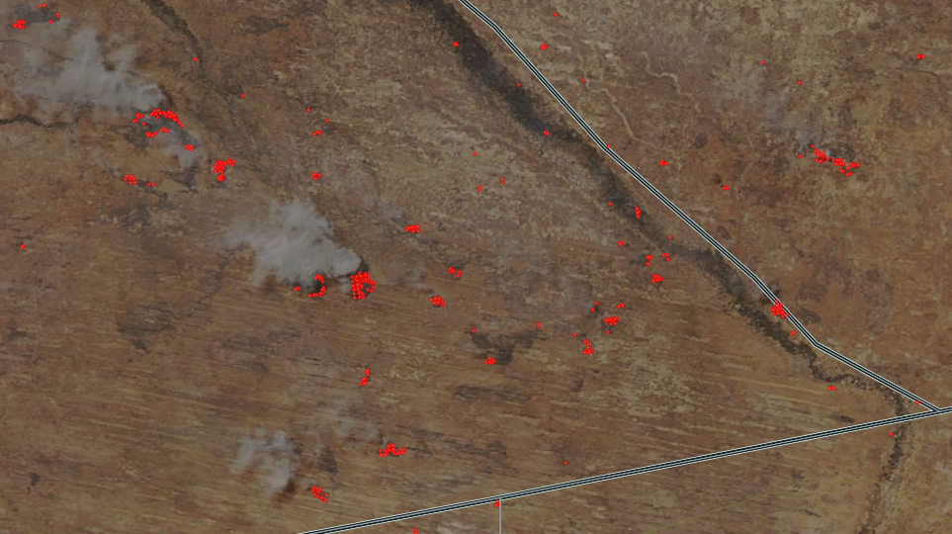
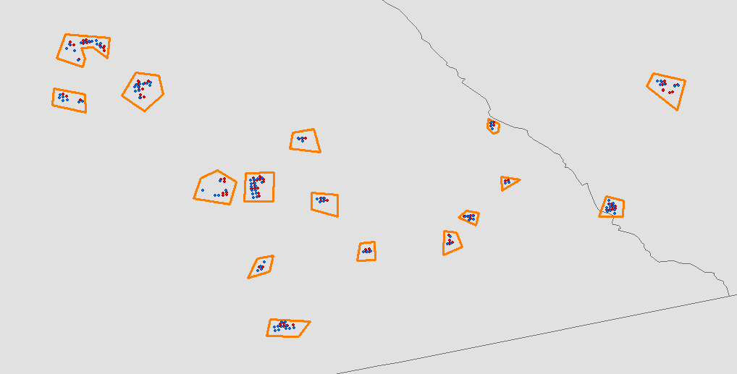
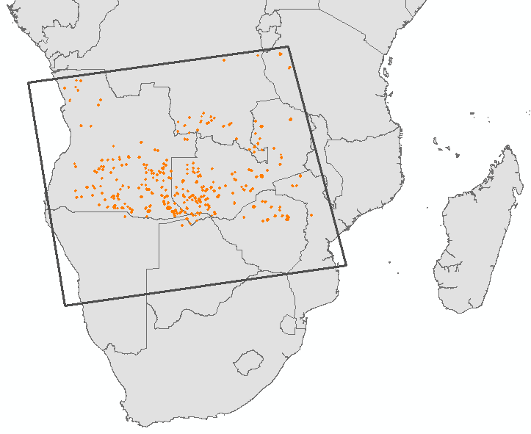
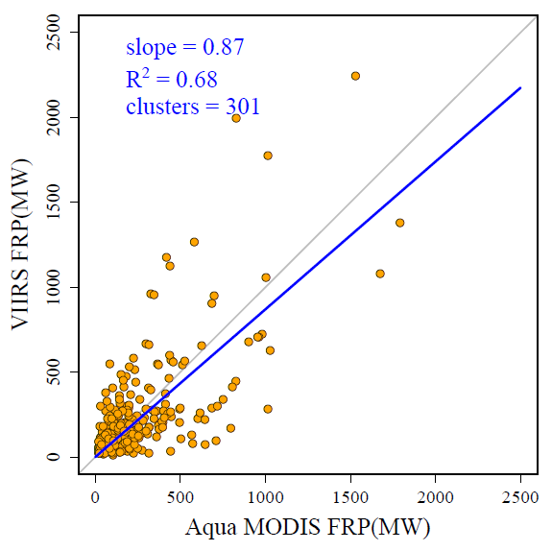
Aqua MODIS vs. VIIRS 750m FRP
MODIS color composite
8/22/2016
Fires from MODIS and VIIRS matched in individual fire events. Each fire event is considered as a cluster ( total 301 fire events were selected)

Slide 12
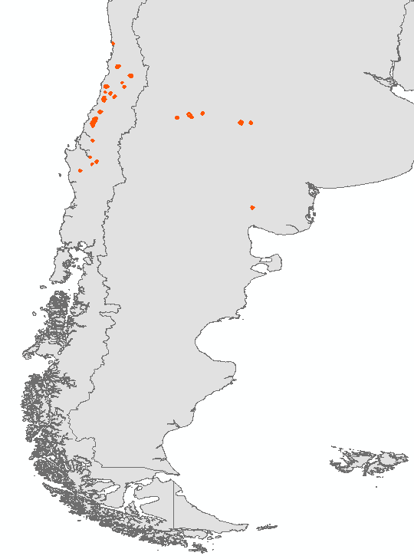
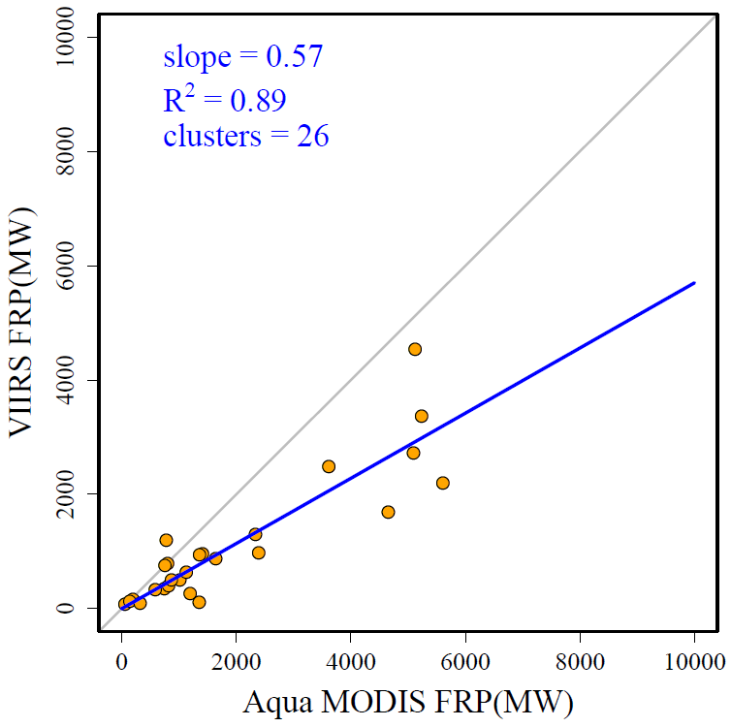
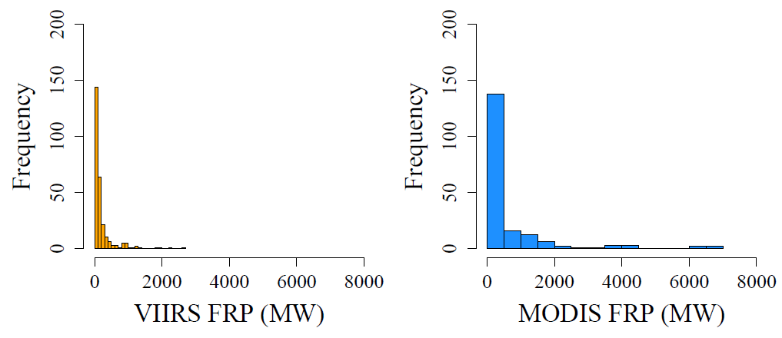
Aqua MODIS vs. VIIRS 750m FRP
1/21/2017
Comparison of current
Operational / systematically generated products

Slide 13
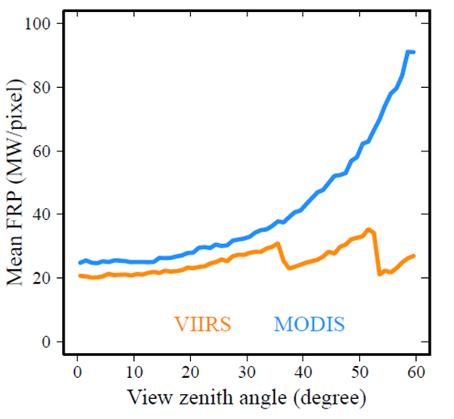
MODIS vs. VIIRS FRP considerations
Differences in
  Scanning geometry
    Pixel size distribution
  Handling of bow-tie effects
    Duplicate detections
  Pixel aggregation
    Relative signal within pixel
  Atmospheric transmittance
    More CO₂ absorption in VIIRS M13
FRP is critical input for emission estimates!

Slide 14
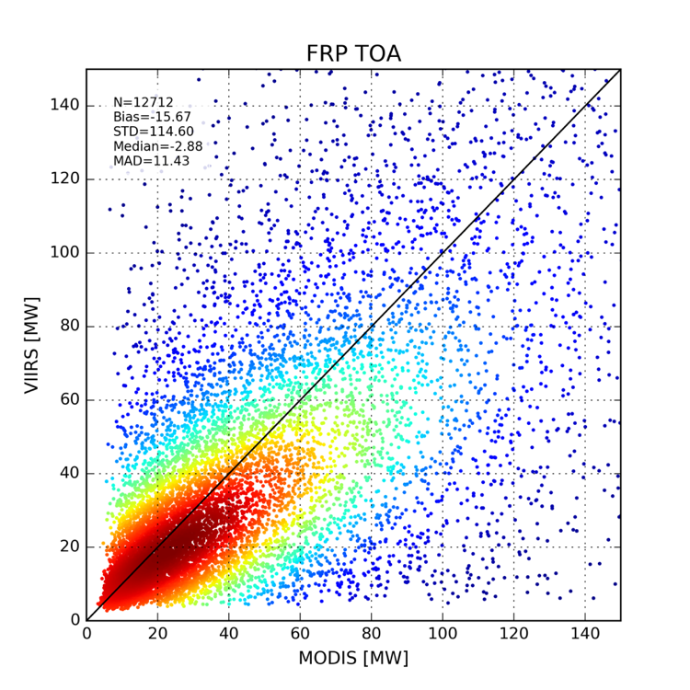
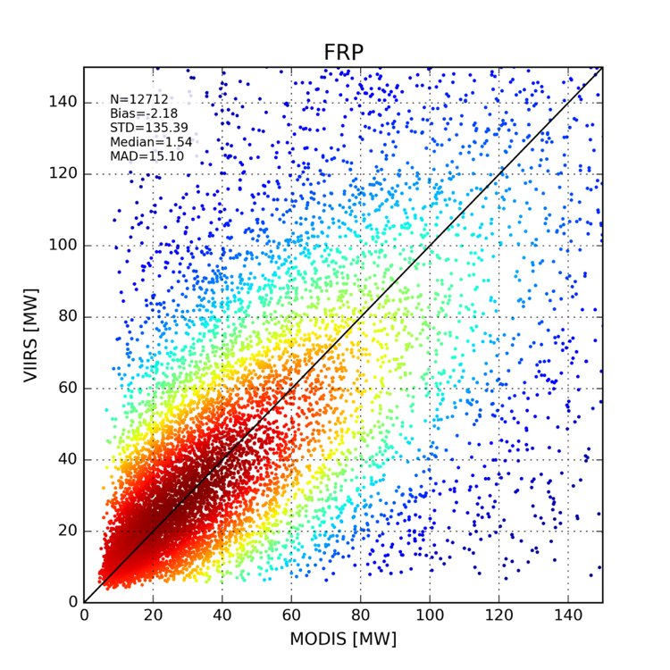
Cross-comparison of atmospherically corrected
MODIS x VIIRS FRP Data
FRP retrievals corrected for atmospheric attenuation using
MODTRAN + MERRA-2 (0.625º x 0.5º)
Before atmospheric correction
After atmospheric correction

Slide 15
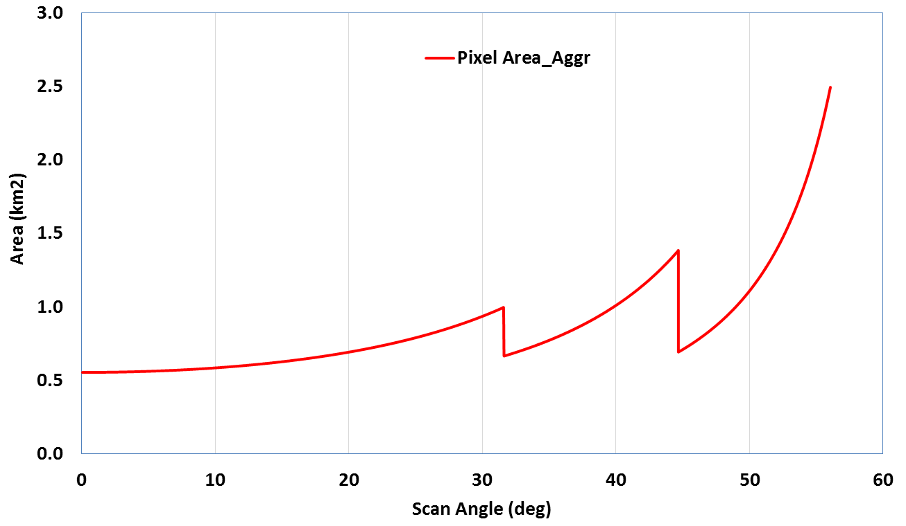
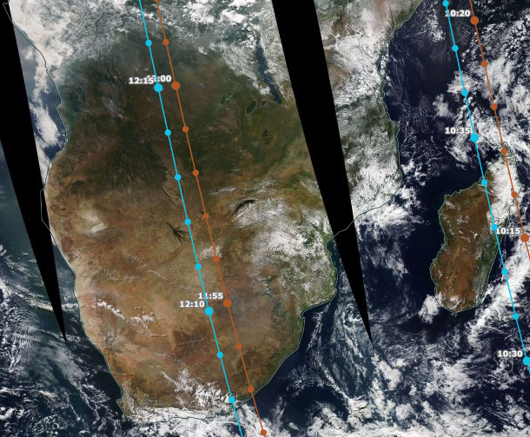
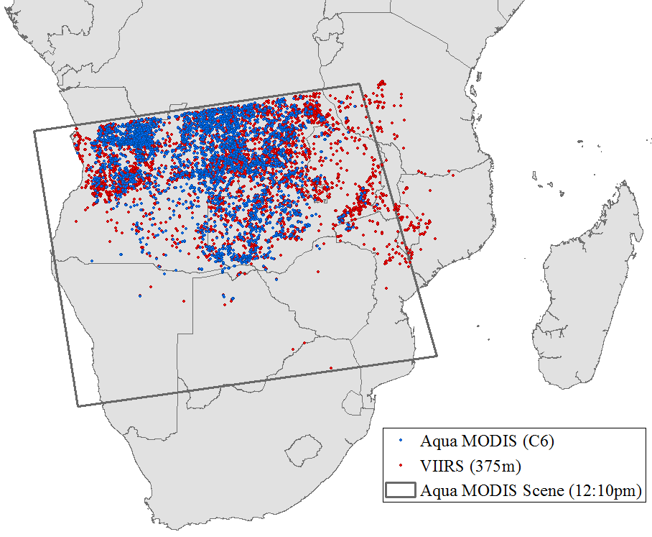
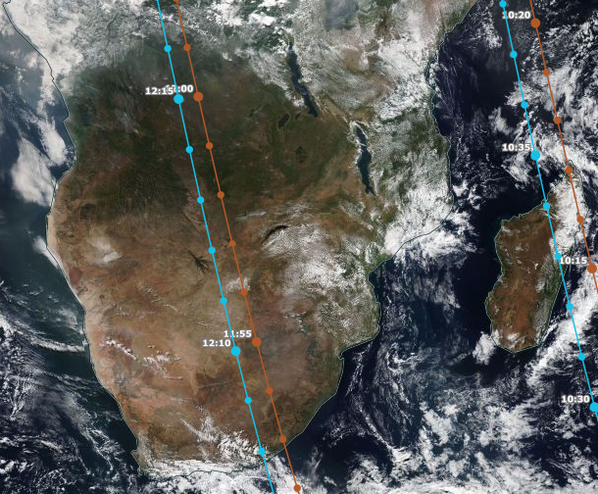
VIIRS vs. MODIS pixel area and swath width
VIIRS M band
MODIS
MODIS
June 3, 2016
VIIRS
1 km to 4 km
No VIIRS gaps at low latitudes!
750 m to 1.2 km (M-band)

Slide 16
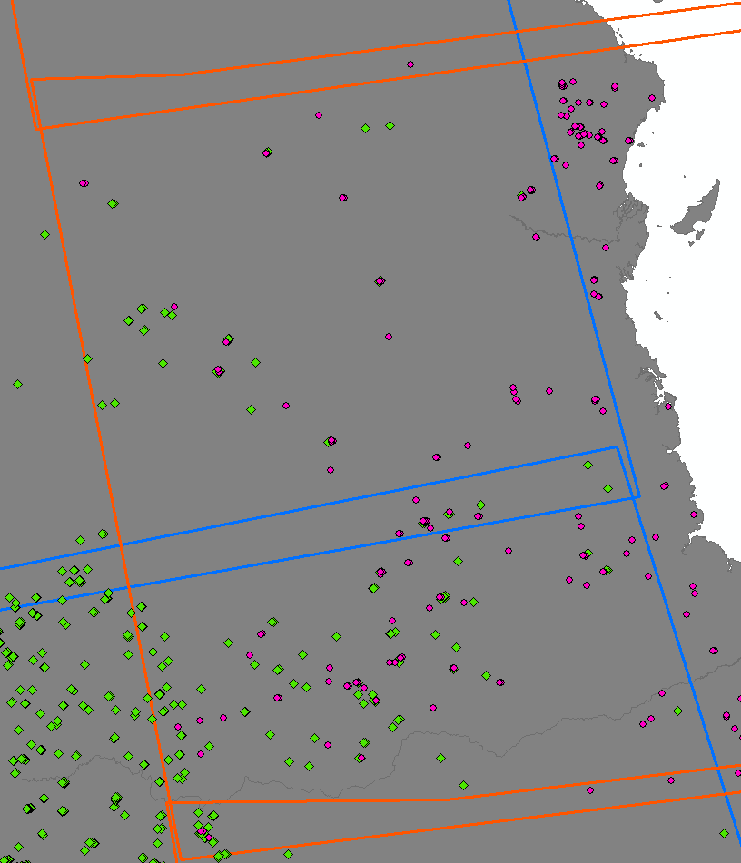
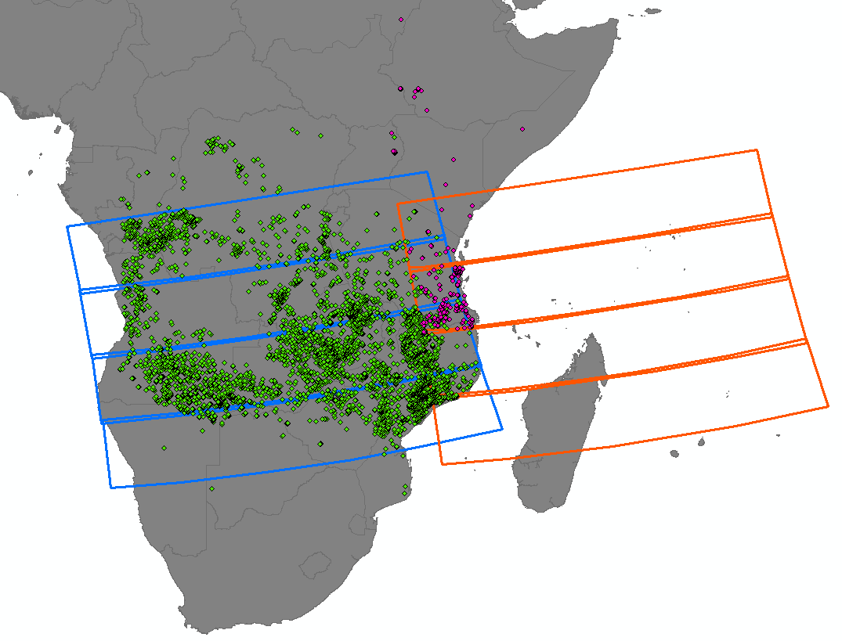
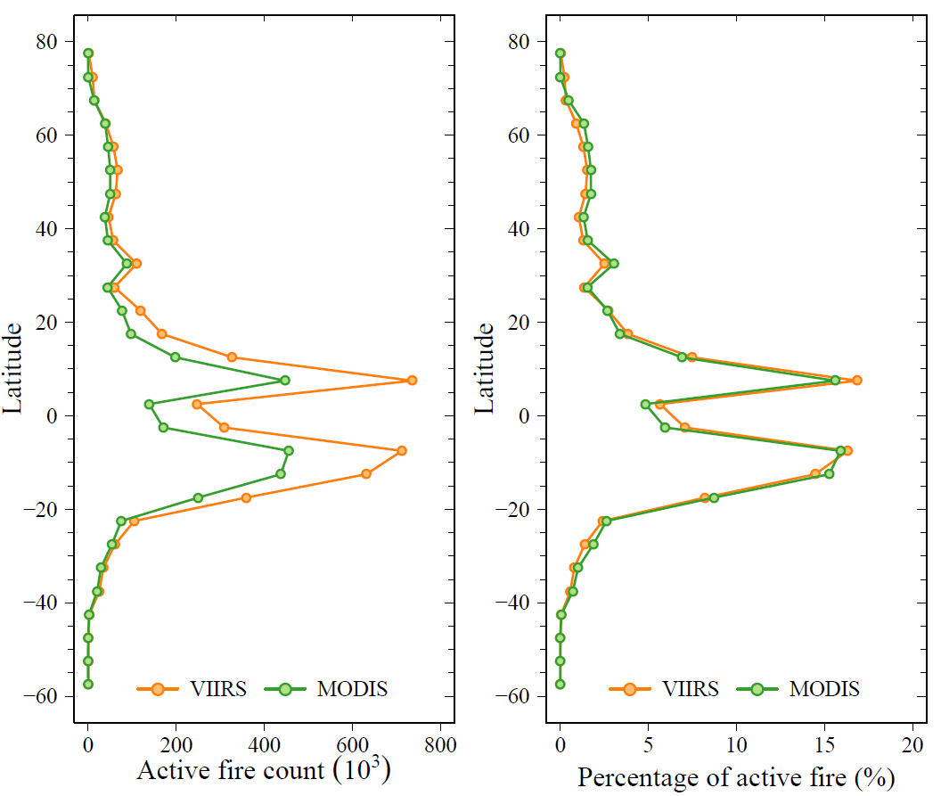
VIIRS vs. MODIS pixel area and swath width
Granules of two neighboring orbit tracks
(blue: 11:48-11:53am, orange: 10:09-10:12am)
April 2016 – March 2017
Significantly more
VIIRS 750m detections
at low latitudes
Good quality VIIRS observations at low latitudes from consecutive orbits!

Slide 17
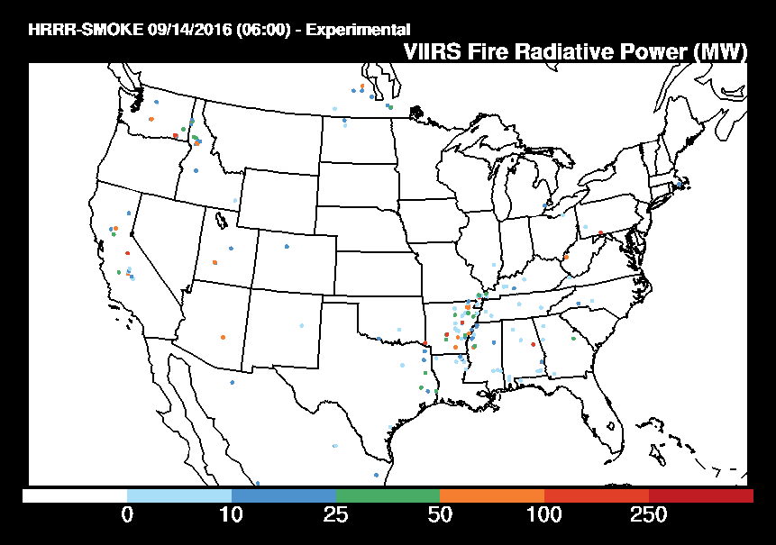
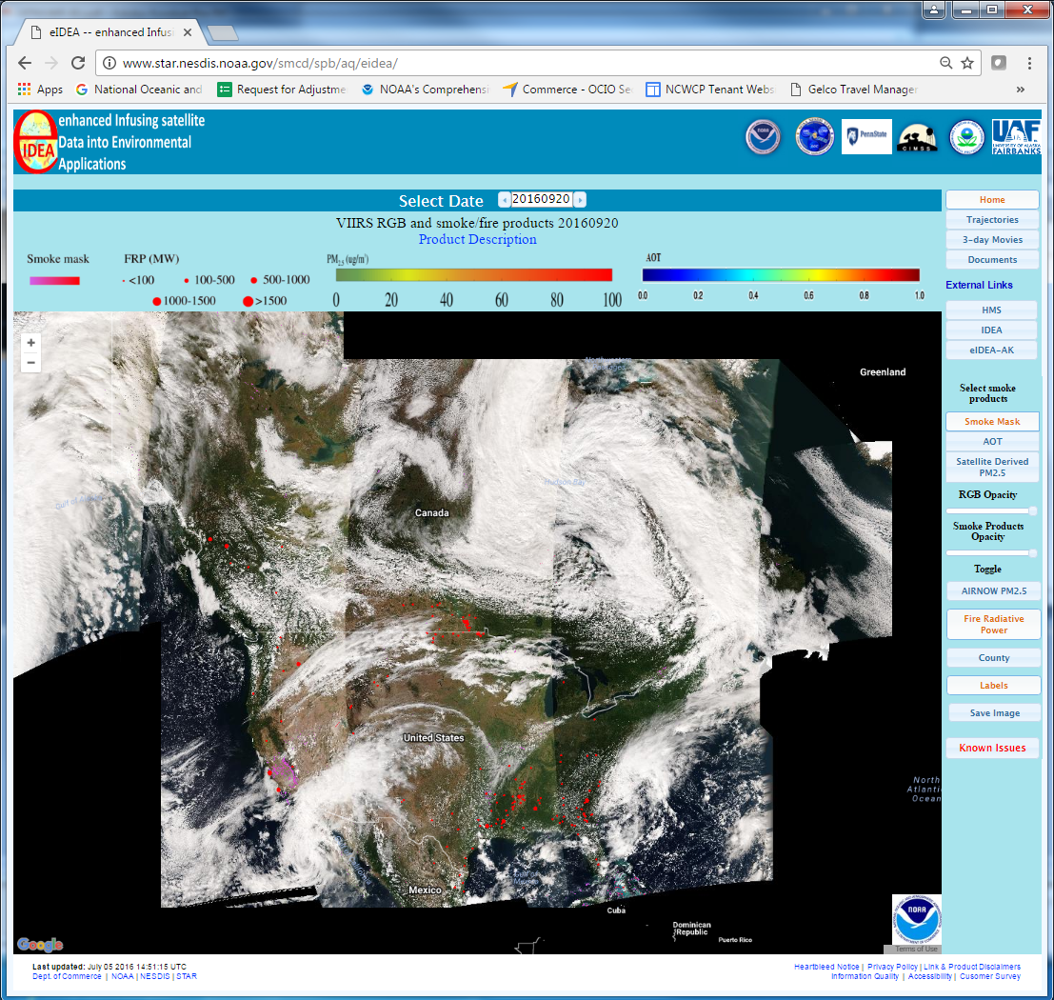
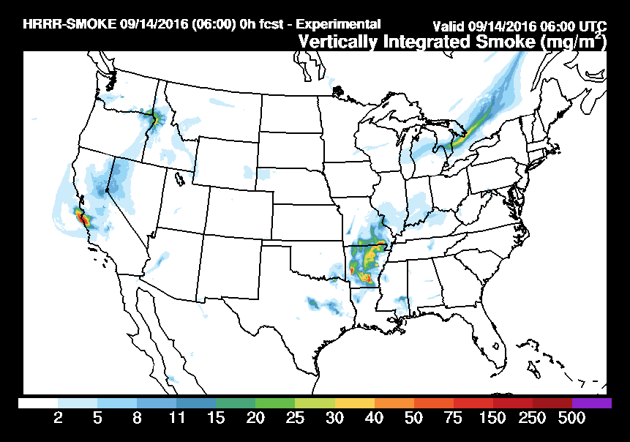
Examples of real-time fire and smoke monitoring systems using VIIRS active fire data
HRRR: High Resolution Rapid Refresh
eIDEA: enhanced Infusing satellite Data into Environmental Applications
Smoke analysis and prediction
https://www.star.nesdis.noaa.gov/smcd/spb/aq/eidea/
https://www.star.nesdis.noaa.gov/smcd/spb/aq/eidea-ak/
https://rapidrefresh.noaa.gov/HRRRsmoke

Slide 18
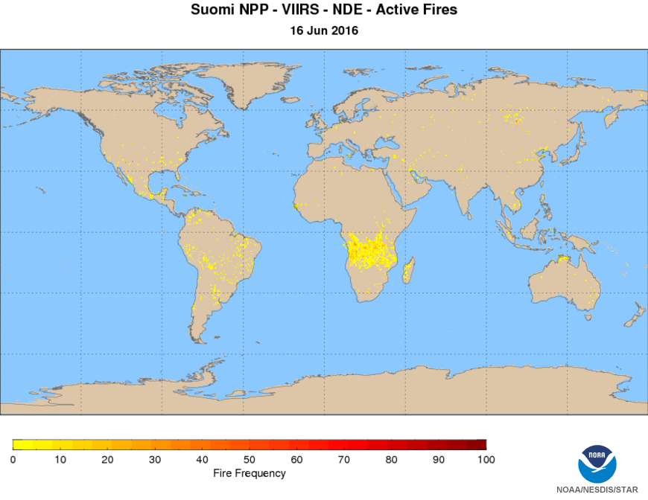

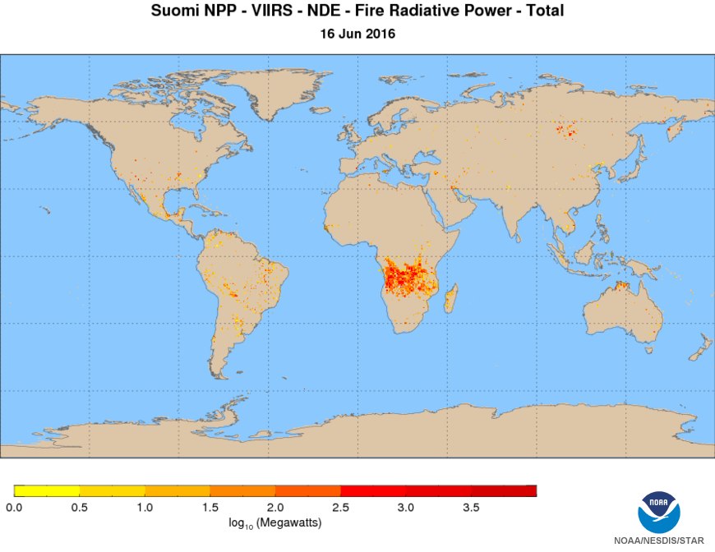
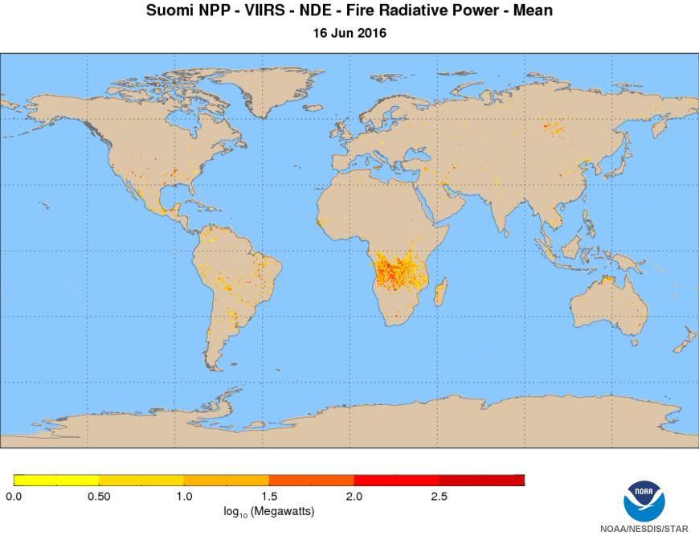
VIIRS Active Fire Long-term Monitoring http://www.star.nesdis.noaa.gov/jpss/EDRs/products_activeFires.php

Slide 19
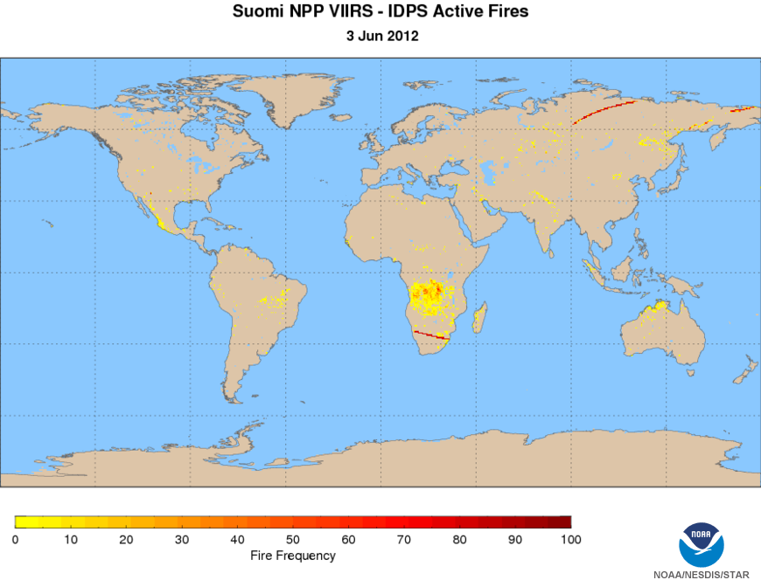
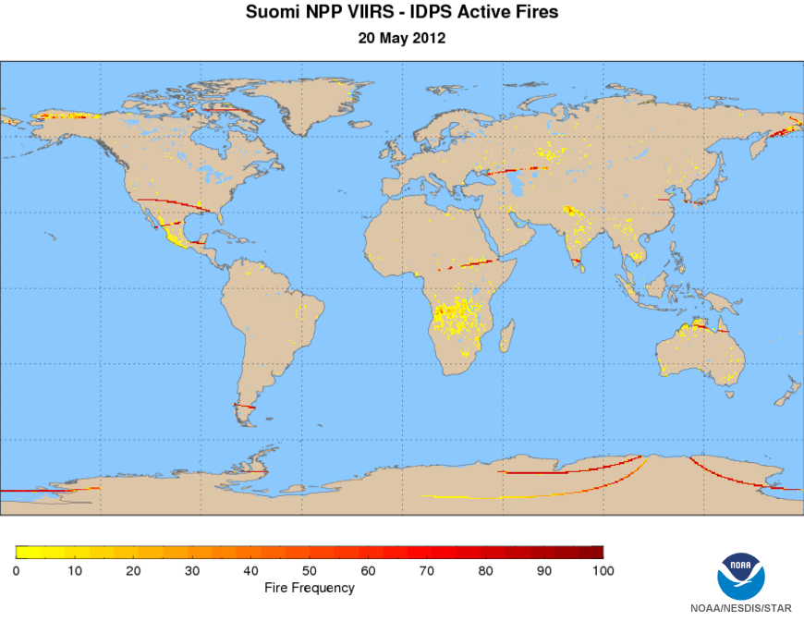
Active fire data anomalies during the early period of the Suomi NPP data record
Examples of the first operational real-time IDPS product as archived in NOAA CLASS
(http://www.class.ncdc.noaa.gov/).
Not reprocessed; not to be used for science analysis. Reprocessing is ongoing.

Slide 20



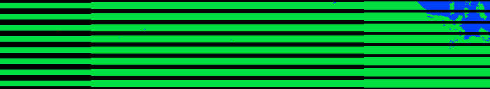
Missing data packets / calibration mismatch npp_d20120520_t1533555_e1535197
original
real-time
IDPS M13 SDR
Earth scene data with calibration mismatch
bow-tie deletion
missing data
Earth scene data with correct calibration
NDE fire mask*
fire
clear land
missing data
water
reprocessed
M13 SDR
NDE fire mask *
*including on ground bow-tie deletion

Slide 21
Summary
Operational NDE production with a mature 750m algorithms is now ongoing
  Some changes forthcoming
Near-real-time product and distribution enables regional applications
Algorithms incorporated into major direct broadcast packages
  IPOPP and CSPP
Extensive outreach, resulting in critical operational applications
  e.g. coupled with air quality / smoke monitoring and modeling
  Weather / fire
Reprocessing of the data record with highest quality input and most mature algorithms is ongoing
  Not only eliminates spurious detections, but also enables the detection of previously missed fires

