Slide 1
AerosolWatch: New NOAA Website for Near Real-Time ABI Aerosol Imagery
Amy K. Huff, Penn State University
Shobha Kondragunta, NOAA NESDIS
Hai Zhang, IMSG at NOAA
NOAA Satellite Aerosol Products Workshop September 26, 2017

Slide 2
Open AerosolWatch Right Now!
AerosolWatch takes a few minutes to load
Very high data volume!
You are going to work with site during activity. Get a head start by opening AerosolWatch right now, so it can load while I’m talking:
https://www.star.nesdis.noaa.gov/smcd/spb/aq/AerosolWatch/
For best results, open in Google Chrome!

Slide 3
Summary of Key ABI Info
GOES-16 is in a geostationary orbit
Very high temporal resolution!
Scan mode 3 (”flex mode”):
15 min, full disk (North and South America)
5 min, CONUS
1 min, 2 mesoscale regions (selectable based on current hazards)
Very high data volume!!
GOES-16 currently in check-out position at 89 °W
Will move to 75 °W in Nov and become GOES-East
What are implications for US west coast data users?

Slide 4
How Do We Make ABI Imagery Accessible?
VIIRS aerosol imagery is on eIDEA website
Polar-orbiting satellite, so only one set of images per day
How to handle ABI imagery?
High data volume (more images per day)
Full disk and CONUS views
More types of products
Result is new AerosolWatch website
NRT ABI imagery animations for “today”
Daily archive begins Sept 10, 2017
Currently, separate websites for JPSS (VIIRS) and GOES (ABI) products
You tell us how to move forward

Slide 5
Provisional ABI Products on AerosolWatch
Provisional maturity products can be used now:
Synthetic RGB
Band combination (made from multiple ABI bands)
Like MODIS true color (RGB) but made with synthetic green band
Looks like what you see with your eyes
Dust RGB
New product! Band combination
Highlights blowing dust, which appears as magenta color
Natural Color RGB
New product! Band combination
Highlights vegetation and cloud types; smoke appears turquoise
Visible (Band 2 – red band – 0.6 μm)
Similar to current GOES visible band (black/white/grey)

Slide 6
β-Maturity ABI Products on AerosolWatch
β-maturity products are NOT recommended for use yet; they are available for information purposes:
Aerosol Optical Depth (AOD)
Similar to VIIRS AOT
Quantitative measure of aerosols in atmosphere
Smoke/Dust Mask
Similar to VIIRS smoke/dust mask
Highlights smoke (pink) and dust (yellow)
Qualitative measure of aerosols in atmosphere
Fires (Fire Radiative Power or FRP)
Similar to VIIRS FRP
Red hotspots indicate location of fires sensed by ABI
Size of dots is a quantitative measure of FRP

Slide 7
Data Characteristics on AerosolWatch
Latency: ~20 min (note typo in activity worksheet)
Temporal resolution: 15 min for full disk and CONUS
Data start flowing at sunrise!
Not max of 5 min for CONUS in order to make data volume manageable
Spatial resolution
Full disk: all products 4 km
CONUS 1 km:
Synthetic RGB
Natural color RGB
Visible (red band)
CONUS 2 km:
Dust RGB
AOD
Smoke/dust mask
Fires

Slide 8
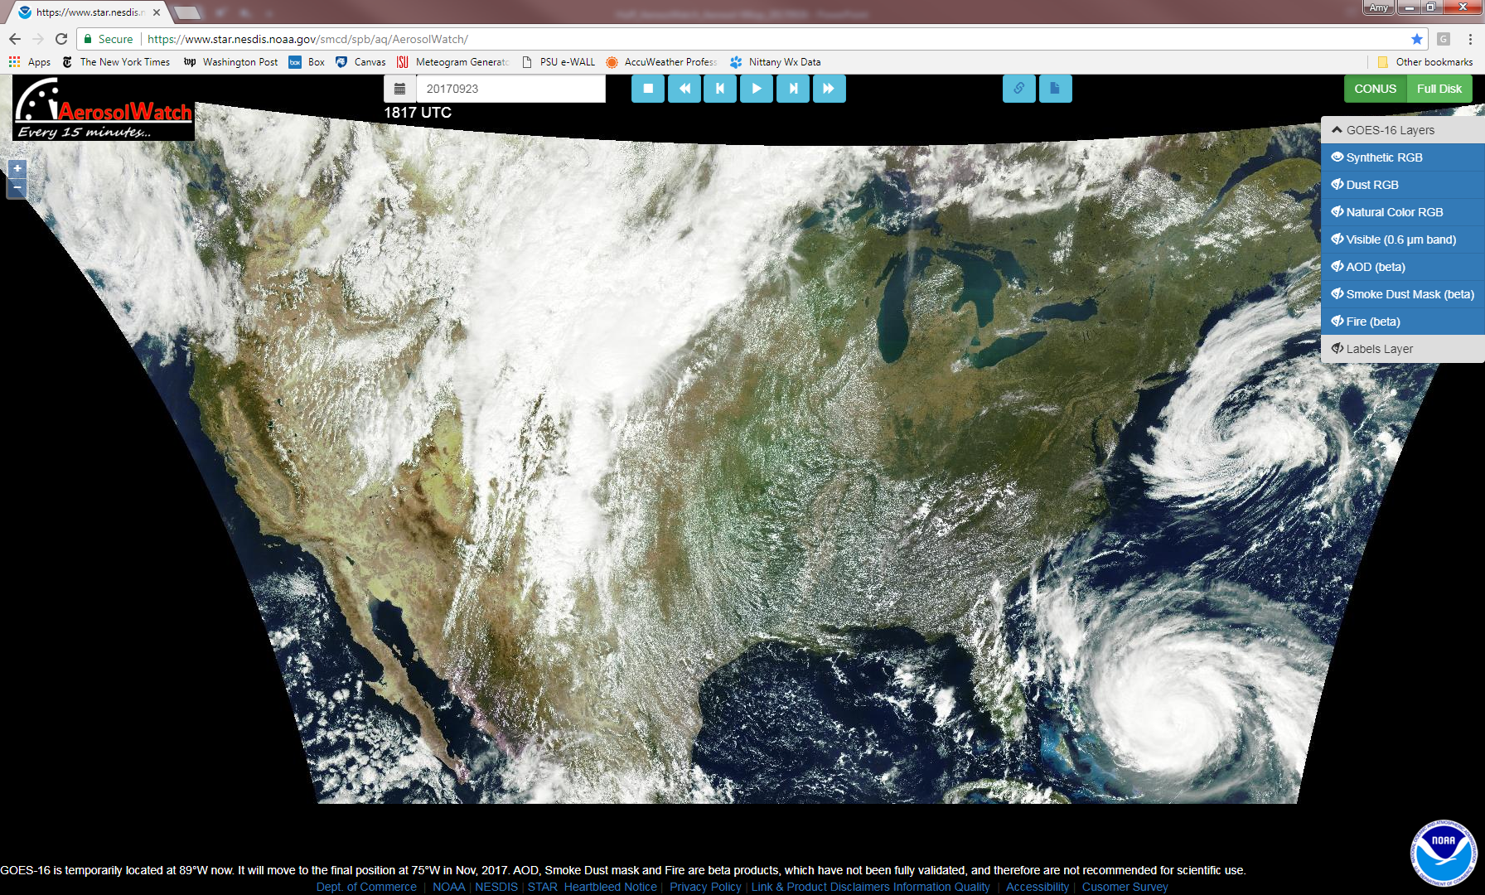
Aerosol Watch Homepage
CONUS or Full Disk view
Open archive;
Time Stamp
Animation controls
Select ABI Layer
Zoom in/out
Overlay state and national labels
Default is “today,” CONUS view, synthetic RGB

Slide 9
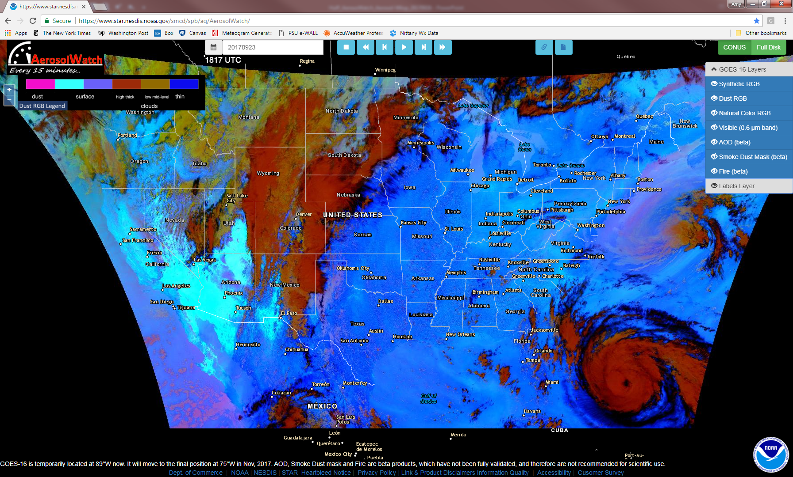
Dust RGB with Labels Layer
“Eye” symbol indicates if layer is “on” or “off”
Legend for chosen layer(s)
Can only view one color imagery layer at a time

Slide 10
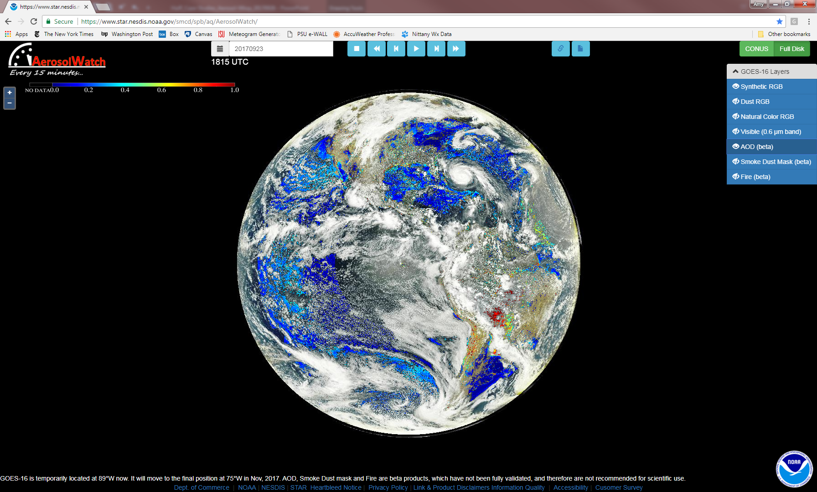
Full Disk Synthetic RGB with AOD Overlay

Slide 11
Some Things to Keep In Mind
No way currently to save images or animations on AerosolWatch
NOAA will make animations available via ftp once GOES-16 is operational (Nov 2017)
No 48-hr forward aerosol trajectories on AerosolWatch
We’re working on it
Need to consider how to address huge data volume
As new data become available during day, AerosolWatch will NOT automatically update
If you open AW in morning, for example, you will need to refresh periodically as new images become available every ~15 min

Slide 12
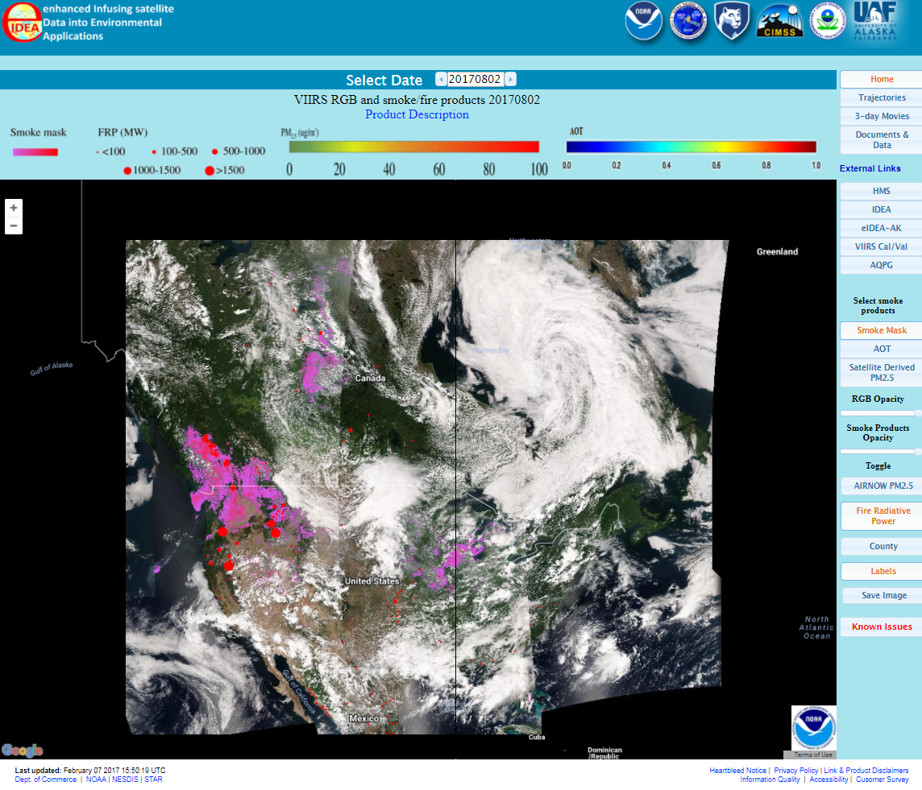
Reminder: VIIRS Imagery on eIDEA
http://www.star.nesdis.noaa.gov/smcd/spb/aq/eidea/
animations and external links
main product overlay buttons

Slide 13
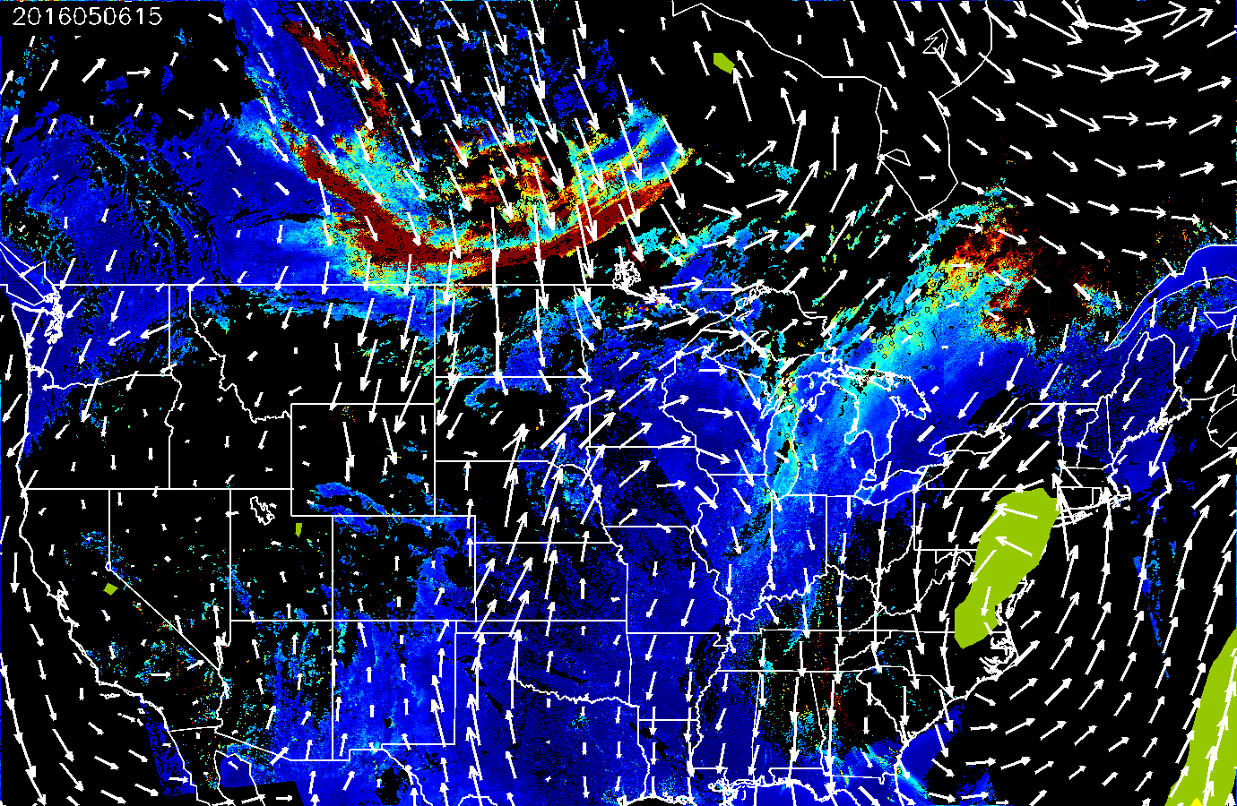
VIIRS 48-Hour Forward Aerosol Trajectories
Smoke transport from Ft McMurray fire May 6-7, 2016
Trajectories give idea of transport of aerosol plumes
Areas of high AOT (>0.4) used as starting locations
Trajectories initialized at 50, 100, 150, and 200 mb above surface
Trajectories run using NAM 12Z run output:
Pink: near surface
White: away from surface
850 mb wind vectors (white)
3-hr accumulated precipitation (yellow)
Magenta/pink lines indicate transport of smoke south into U.S., remaining near surface

Slide 14
AerosolWatch Activity
Please break into groups of 2-3; at least one group member must have a laptop
Look at the ABI imagery on AerosolWatch, both CONUS and full disk
Use the “Case Study Worksheet” to guide your analysis
Answer questions on the “Case Study Questionnaire”
Will help guide our discussion (~4:30 PM)
And I’ll collect it so we can capture your feedback
If you have time, use the available ABI imagery from AerosolWatch and available VIIRS imagery from eIDEA and do a mock forecast for tomorrow

