Slide 1
ABI Data Access
Liz Kline and Kathryn Mozer
NOAA Satellite Aerosol Product Workshop September 26, 2017

Slide 2
ABI Data Distribution Paths
Acronym | System Name | Description
GRB | GOES Rebroadcast | One channel of the space data relay service of GOES-R for Level 1b data products (ABI L1b, Space Weather L1b, and GLM L2). These data are available to all users with GRB receivers in view of a GOES-R series satellite at the East or West operational longitudes.
AWIPS | Advanced Weather Interactive Processing System | Interactive computer system that integrates meteorological and hydrological data, enabling forecasters to prepare forecasts and issue warnings. GOES-R will provide selected products through AWIPS. Sectorized Cloud and Moisture Imagery will be delivered via NOAAPORT/SBN (Satellite Broadcast Network).
HRIT/ EMWIN | High Rate Information Transmission/ Emergency Managers Weather Information Network | EMWIN is a direct service that provides users with weather forecasts, warnings, graphics and other information directly from the NWS in near real-time. The HRIT service is a new high data rate (400 Kpbs) version of today’s LRIT (Low Rate Information Transmission), broadcasting GOES-R satellite imagery and selected products to remotely-located user terminals.
PDA | Product Distribution and Access | The Environmental Satellite Processing and Distribution System (ESPDS) is responsible for receiving and storing real-time environmental satellite data and products and making them available to authorized users (ABI L1b and L2+, Space Weather L1b, and GLM L2PDA will provide real-time distribution and access services for GOES-R users with demonstrated real-time operational data requirements.
CLASS | Comprehensive Large Array-data Stewardship System | Web-based data archive and distribution system for NOAA’s environmental data. CLASS will provide retrospective data access and distribution services of GOES-R data to all users.
GNC-A | GEONETCast Americas | Commercial Satellite Based, C-band broadcast of GOES-R level 2 imagery and other products. These data are available to all users with GNC-A receivers in view of the Intelsat IS-21 satellite located at 58 deg West Longitude. Reception details at geonetcastamericas.noaa.gov

Slide 3
Data Access via CLASS: Overview
The comprehensive Large Array-data Stewardship System (CLASS) continues to be NOAA’s archive for satellite data, primarily geostationary & polar orbiting missions.
The datatype family of GRABIPRD (GOES-R ABI Products) can be searched using spatial, temporal, or advanced filters.
This includes ABI L1b radiances, L2 imagery, and L2+ products.
CLASS provides links to FAQ and README pages hosted by NCEI and goes-r.gov.
Login credentials set up for the CLASS archive can be used to save search criteria and past searches.
Users can order an unlimited amount of data, but are limited to 500 orders per day via the web interface. Other requests can be made to class.help@class.noaa.gov.

Slide 4
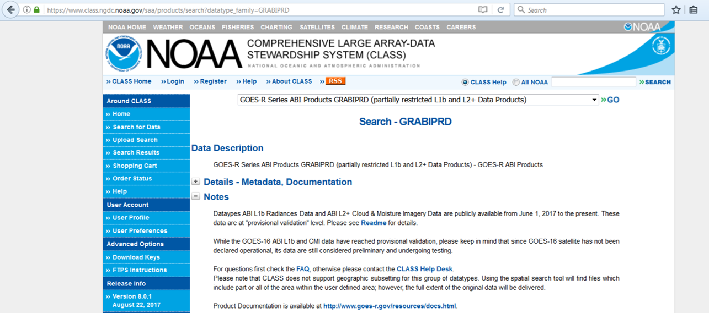
Data Access via CLASS: Product Search

Slide 5
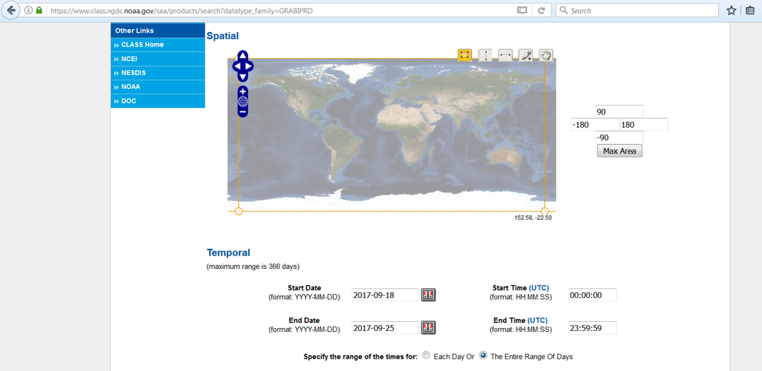
Data Access via CLASS: Spatial and Temporal Search

Slide 6
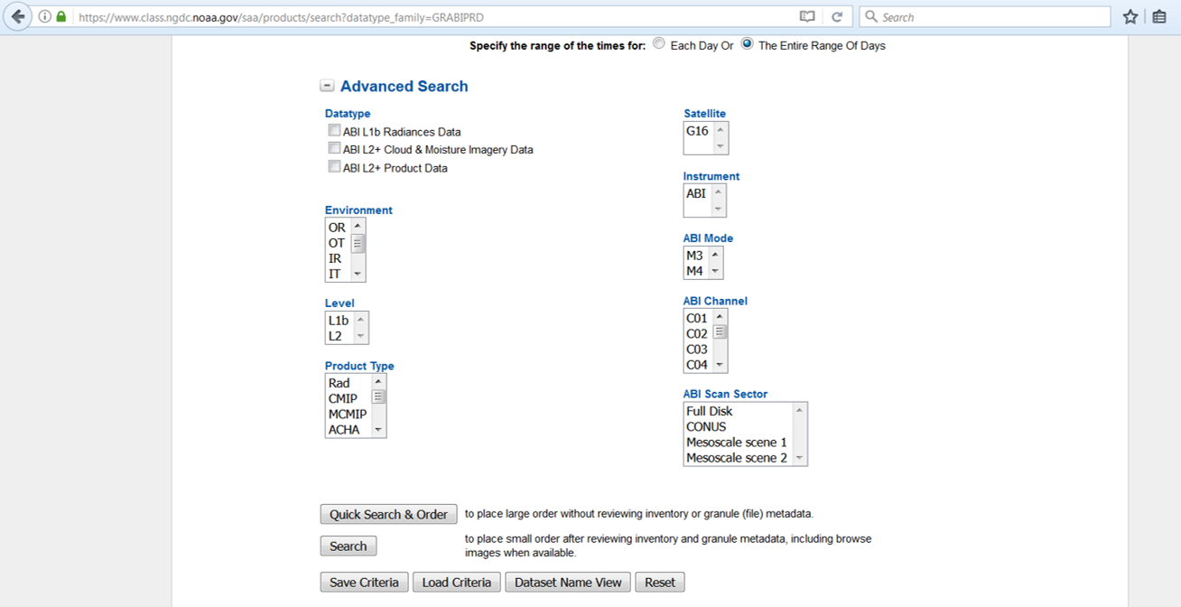
Data Access via CLASS: Advanced Search

Slide 7
Data Access via NCEI: Overview
NCEI (National Centers for Environmental Information) are the official data stewards for all environmental information, not just satellite data.
They have a great set of GOES-R websites including:
Overview and data access: https://www.ncdc.noaa.gov/data-access/satellite-data/goes-r-series-satellites
FAQ: https://www.ncdc.noaa.gov/goes-r-series-satellites/goes-r-series-frequently-asked-questions
Data access is available through AIRS (Archive Information and Request System), which uses the same login credentials as CLASS.
AIRS supports orders up to 1000 files, anything greater can be requested through the CLASS help desk (class.help@noaa.gov).
Any questions regarding the AIRS system can be directed to NCEI.Sat.Info@noaa.gov.

Slide 8
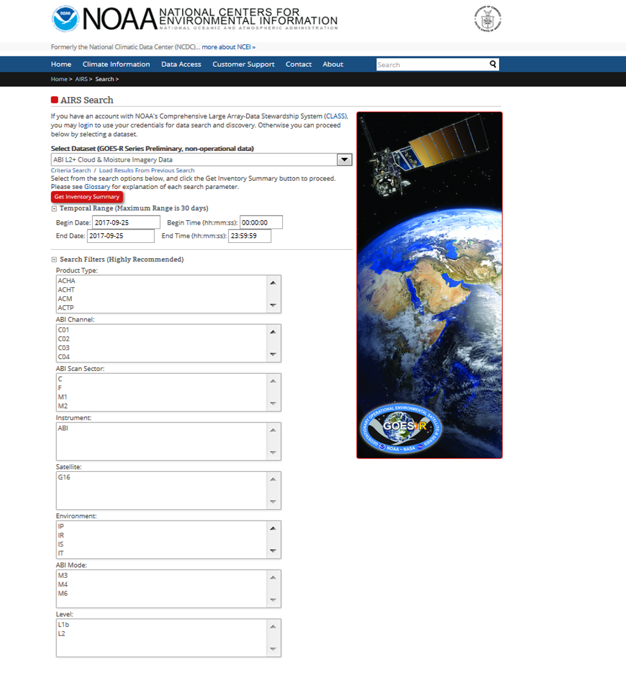
https://www.ncdc.noaa.gov/airs-web/search

Slide 9
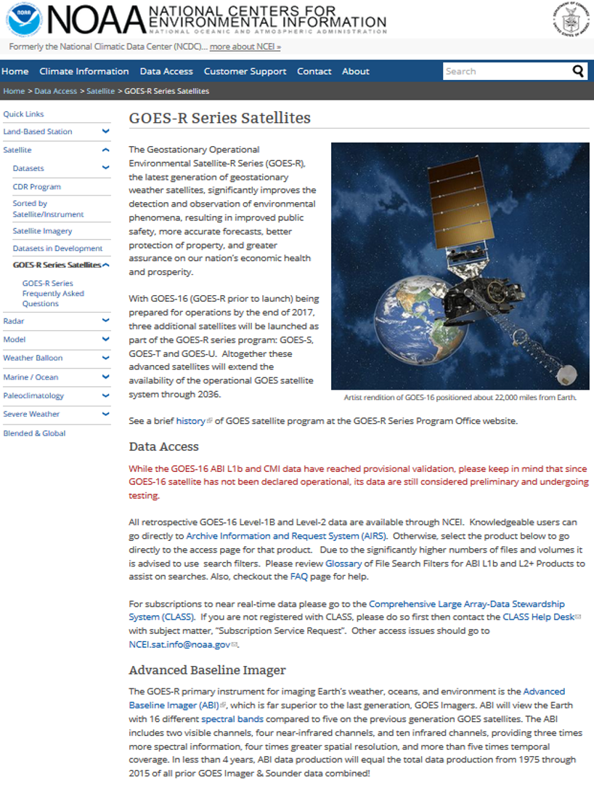
https://www.ncdc.noaa.gov/data-access/
satellite-data/
goes-r-series-satellites

Slide 10
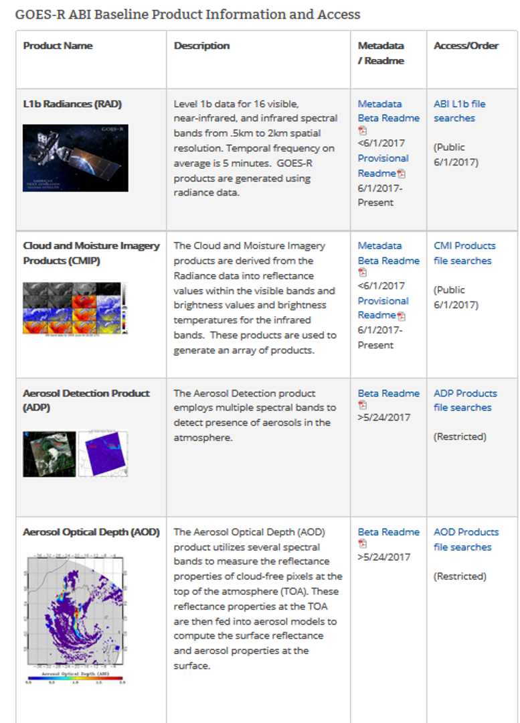
https://www.ncdc.noaa.gov/data-access/
satellite-data/
goes-r-series-satellites

Slide 11
Definition of Provisional Product Maturity
Completed: Definition and prior activities:
Validation activities are ongoing and the general research community is now encouraged to participate.
Severe algorithm anomalies are identified and under analysis. Solutions to anomalies are in development and testing.
Incremental product improvements may still be occurring.
L2+ only: Users are engaged in the Product Feedback Forums and user feedback is assessed.
Next steps: Status after Provisional Validation:
Product performance has been demonstrated through analysis of a small number of independent measurements obtained from select locations, periods, and associated ground truth or field campaign efforts.
Product analysis is sufficient to communicate product performance to users relative to expectations (performance baseline).
Documentation of product performance exists that includes recommended remediation strategies for all anomalies and weaknesses. Any algorithm changes associated with severe anomalies have been documented, implemented, tested, and share with the user community.
Testing has been fully documented.
Product is ready for operational use and for use in comprehensive cal/val activities and product optimization.

Slide 12
L2+ Science Product Validation Status
ABI L2+ Products | Beta | Prov | Full |  | ABI L2+ Products | Beta | Prov | Full
Cloud and Moisture Imagery (CMI) and Sectorized CMI (KPP) | 2/28/17 | 6/1/17 | 9/3/18 |  | Downward S/W Radiation: Surface | 6/23/17 | 3/16/18 | 9/3/18
Aerosol Detection (Smoke & Dust) | 5/24/17 | 1/26/18 | 9/3/18 |  | Fire/Hot Spot Characterization | 5/24/17 | 1/26/18 | 9/3/18
Aerosol Optical Depth (AOD) | 5/24/17 | 1/26/18 | 9/3/18 |  | Hurricane Intensity Estimation | 9/25/17 | 12/1/17 | 9/3/18
Clear Sky Mask | 4/19/17 | 12/1/17 | 9/3/18 |  | Land Surface Temperature | 5/24/17 | 1/26/18 | 9/3/18
Cloud Optical Depth | 6/8/17 | 2/23/18 | 9/3/18 |  | Legacy Vertical Moisture Profile | 5/16/17 | 12/22/17 | 9/3/18
Cloud Particle Size Distribution | 6/8/17 | 2/23/18 | 9/3/18 |  | Legacy Vertical Temperature Profile | 5/16/17 | 12/22/17 | 9/3/18
Cloud Top Height | 5/16/17 | 12/22/17 | 9/3/18 |  | Rainfall Rate/QPE | 9/13/17 | TBD | 9/3/18
Cloud Top Phase | 5/16/17 | 12/22/17 | 9/3/18 |  | Reflected S/W Radiation: TOA | 6/23/17 | 3/16/18 | 9/3/18
Cloud Top Pressure | 5/16/17 | 12/22/17 | 9/3/18 |  | Sea Surface Temperature | 6/14/17 | 1/26/18 | 9/3/18
Cloud Top Temperature | 5/16/17 | 12/22/17 | 9/3/18 |  | Snow Cover | 12/30/17* | 3/30/18* | 9/3/18*
Derived Motion Winds | 6/8/17 | 2/23/18 | 9/3/18 |  | Total Precipitable Water | 5/16/17 | 12/22/17 | 9/3/18
Derived Stability Indices | 5/16/17 | 12/22/17 | 9/3/18 |  | Volcanic Ash: Detection and Height | 9/13/17 | 2/23/18 | 9/3/18
While some L2+ products may reach Provisional Maturity before others, the current configuration requires all^ L2+ products reach Provisional before distribution via CLASS/AIRS can commence.
Validation Maturity Levels:
Not Validated
Beta Maturity
Provisional Maturity
Full Maturity
*Snow Cover has a waiver. It is dependent upon a non-baseline Albedo Product which is in development.
^ Except for Imagery, Hurricane Intensity Estimate, and Winds.

Slide 13
Current Distribution Status as of 9/25/17
GRB – All L1b instrument data is being sent (ABI, SUVI, SEISS, MAG, EXIS, GLM L2)
NOAAPORT/SBN – All ABI L2 sectorized cloud and moisture imagery (SCMI) and select Beta mature ABI L2 products
CLASS – All ABI L1b data and select Beta mature ABI L2 products
PDA – All ABI L1b and cloud and moisture imagery (CMI), GLM L2, and select Beta mature ABI L2 products
HRIT/EMWIN – ABI Full Disk in bands 2, 7, 8, 9, 13, 14 and 15 with 2 km spatial resolution every 30 minutes coupled with ABI mesoscale images in bands 2, 7 and 13 every 15 minutes
GNC-A – ABI CMI bands 2, 7, 8, 9, 13, 14, 15

Slide 14
Thank you! Questions?
GOES-16 CLASS / NCEI data access questions:
Elizabeth.Kline@noaa.gov
All other GOES-16 data access or User Services questions:
Kathryn.Mozer@noaa.gov

