Slide 1
Utilization of satellite observations for improving aerosol forecasts
Sarah Lu*, Shih-Wei Wei, Sheng-Po Chen (State University of New York at Albany)
Shobha Kondragunta, Qiang Zhao (NOAA/NESDIS/STAR)
Xiaoyang Zhang (South Dakota State University)
Partha Bhattacharjee, Jun Wang, Jeff McQueen (NOAANWS/NCEP)
Ho-Chun Huang and Jianping Huang (NOAA/NWS/NCEP)
*: clu4@albany.edu; Sarah.Lu@noaa.gov

Slide 2
Global aerosol forecasting
Aerosol modeling, traditionally serving regional air quality and climate communities, has seen rapid development at several operational NWP centers over the last few years
Why include aerosols in the predictive systems ?
Improve weather forecasts and climate predictions by taking into account of aerosol effects on radiation and clouds
Improve the handling of satellite observations by properly accounting for aerosol effects during the data assimilation
Provide aerosol (lateral and upper) boundary conditions for regional air quality predictions
Produce quality aerosol information that address societal needs and stakeholder requirements, e.g., air quality, health professionals, policy makers, climate scientists, and solar energy plant managers

Slide 3
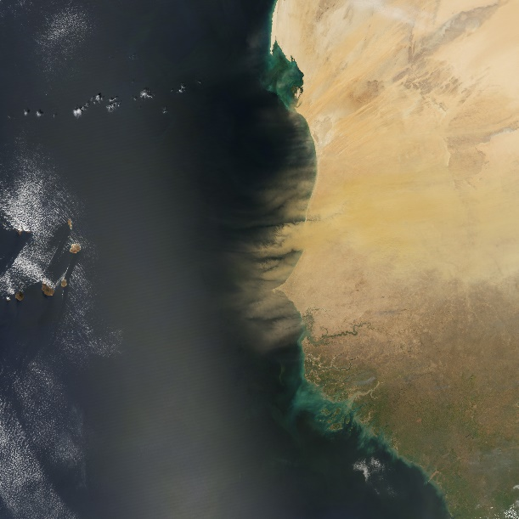
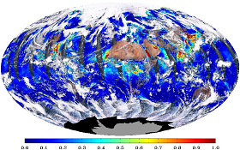
Using satellite data to improve aerosol forecasting
Satellite observations have been used to improve aerosol products
Routine monitoring of model performance
Near-real-time biomass burning emissions from satellite observations
Data assimilation of satellite aerosol observations
Dust off Africa, observed by the Moderate Resolution Imaging Spectroradiometer (MODIS) onboard NASA’s Aqua satellite
Aerosol optical depth (AOD) from Visible Infrared Imaging Radiometer Suite (VIIRS) sensor onboard the Suomi National Polar Orbiting (SNPP) satellite
https://earthobservatory.nasa.gov
https://www.star.nesdis.noaa.gov

Slide 4
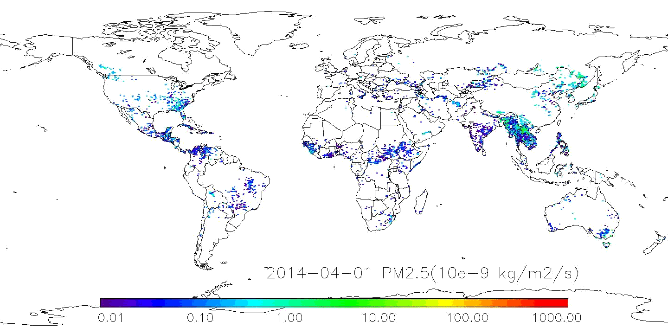
Near-real-time fire emissions from satellites
NRL: FLAMBE (Fire Locating and Modeling of Burning Emissions), fire counts from MODIS/GOES
ECMWF: GFAS (Global Fire Assimilation System), FRP from MODIS
GMAO: GFED2 (Quick Fire Emission Dataset Version 2), FRP from MODIS
NCEP: GBBEPx (Blended Global Biomass Burning Emissions Product – eXtended), FRP from MODIS and multiple geostationary satellites
GBBEPv” “ FRP from VIIRS and multiple geostationary satellites
Temporal and Spatial Variation in GBBEPx Fire Emissions

Slide 5
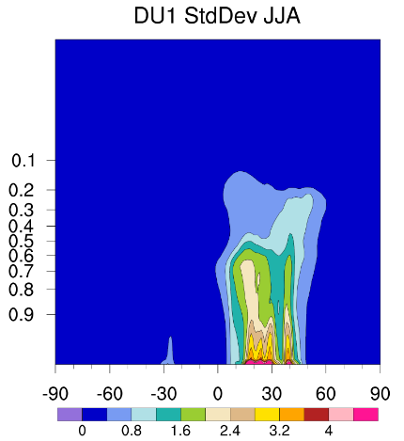
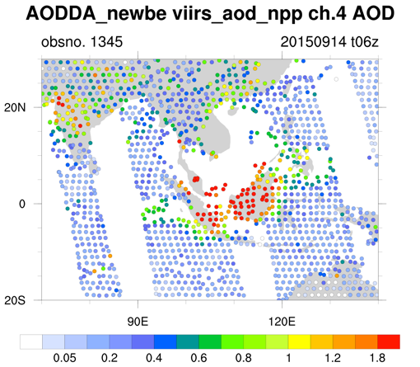
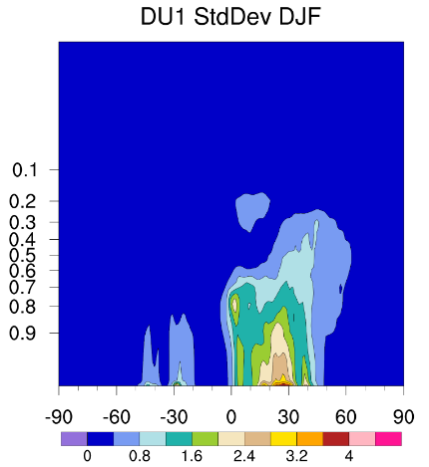
Assimilating satellite aerosol retrievals
With GSI, NCAR and ESRL assimilates MODIS AOD using WRF-CHEM as first guess. The GSI option is extended to assimilate VIIRS AOD using NGAC as first guess.
AOD DA
(GSI)
Observation operator: CRTM v2.2.3
Background Errors
Observation Inputs
(VIIRS AOD)
First guess
(NGACv2)
First global in-line aerosol forecast system at NCEP
Multi-species forecasts (dust, sulfate, sea salt, and carbonaceous aerosols) at T126 L64
Data screening and thinning, considering offset from analysis time, distance from the grid, and retrieval quality
Observation errors are determined from VIIRS versus AERONET comparisons
NMC method is used to determine BE from 12-month NGAC runs

Slide 6
NGACv2 Experiments
Objective: To investigate the effects of aerosol DA on improving aerosol forecasts as well as to assess the performance gain resulted from the use of satellite emission information.
T126 L64 NGACv2 experiments are conducted using different configuration:
GBBEPx (NRT smoke emissions), the operational NGACv2 configuration
GFED (climatological smoke emissions)
GFED + VIIRS AOD DA
The experiments cover Sept 10-17, 2015
The initial condition are taken from EMC’s NGACv2 parallel run

Slide 7
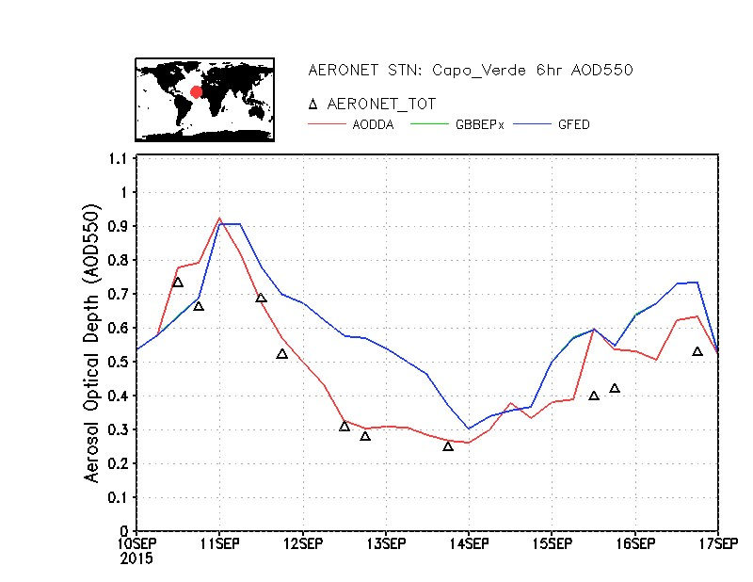
GFED vs GFED+DA: the inclusion of VIIRS observations
GFED vs GBBEPx: the use of NRT smoke emissions
Positive impact from assimilating AOD. With the assimilation of VIIRS aerosol retrievals, NGACv2 AOD agree well with AERONET AOD.

Slide 8
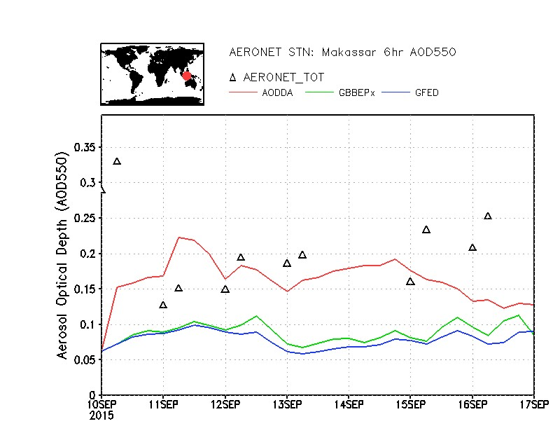
GFED vs GFED+DA: the inclusion of VIIRS observations
GFED vs GBBEPx: the use of NRT smoke emissions
AOD DA can reduce model errors over the areas where the estimates of smoke emissions are problematic.

Slide 9
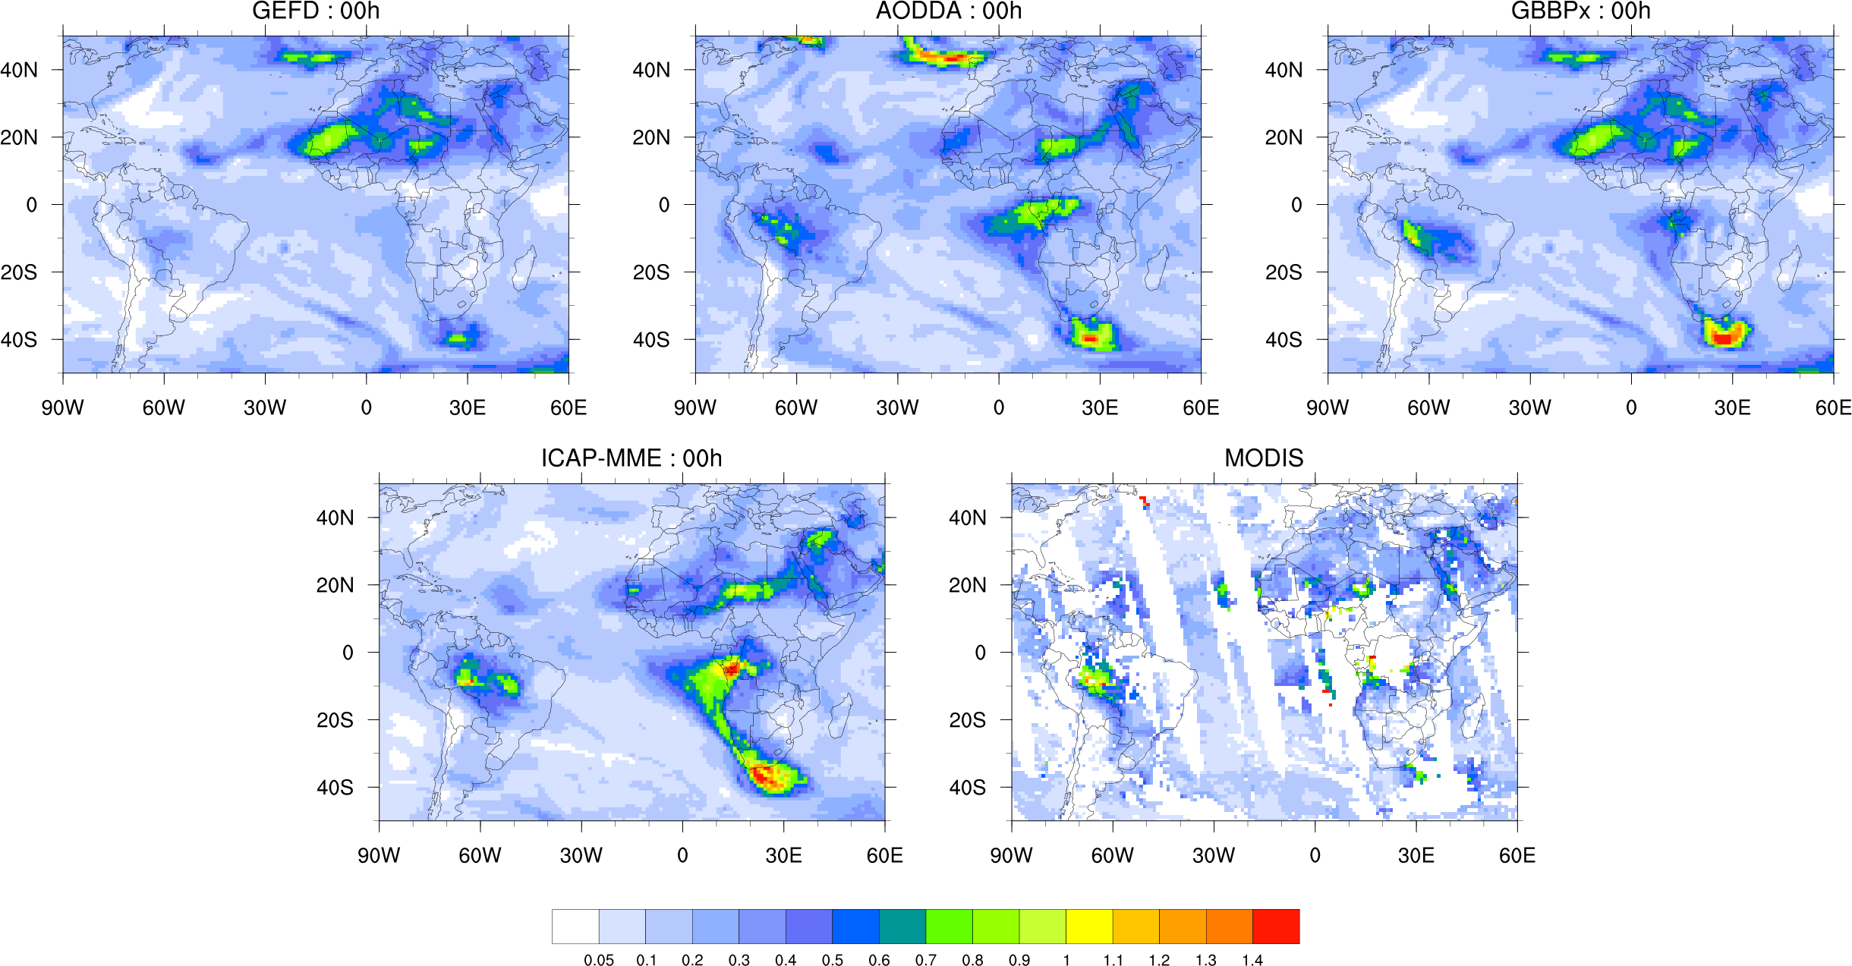
GFED vs GFED+DA: the inclusion of VIIRS observations
GFED vs GBBEPx: the use of NRT smoke emissions
ICAP (International Cooperative for Aerosol Prediction) MME (Multi-model Ensemble)
NGACv2 simulations are improved by assimilation of VIIRS AOD and the use of satellite-based smoke emissions.

Slide 10
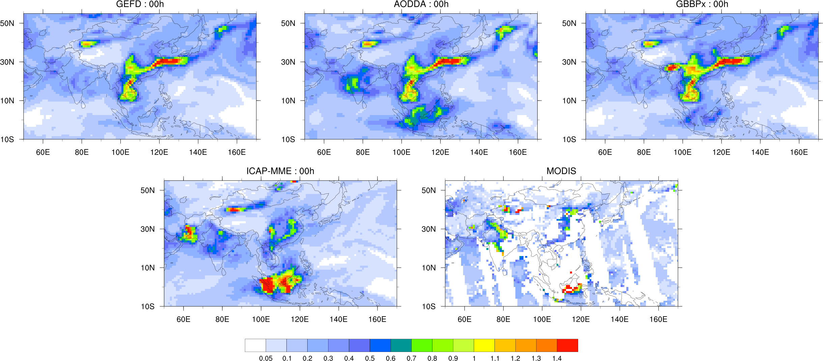
GFED vs GFED+DA: the inclusion of VIIRS observations
GFED vs GBBEPx: the use of NRT smoke emissions
While encouraging results are found, the spatial distributions shown here indicate that additional refinement is needed.

Slide 11
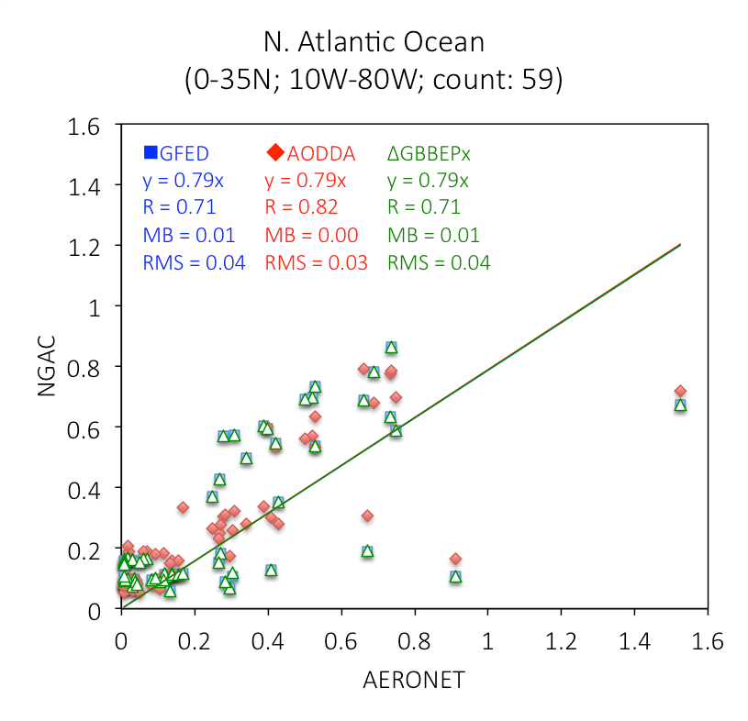
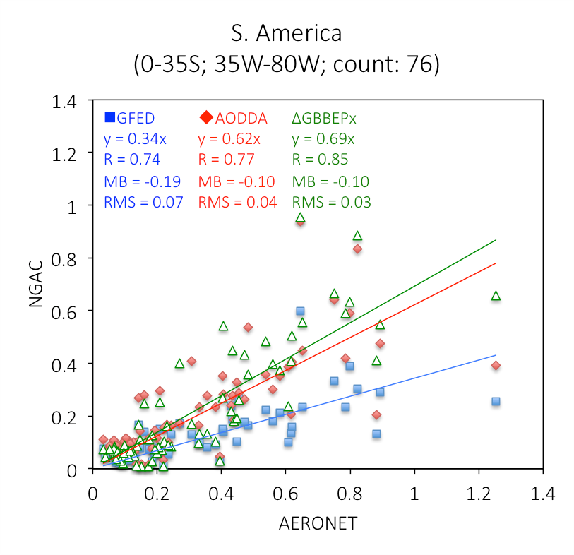
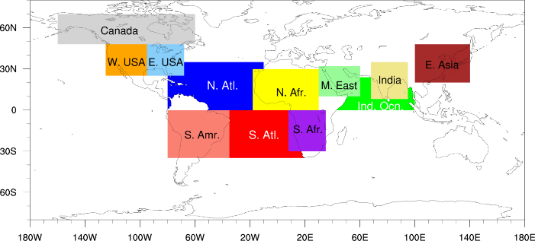
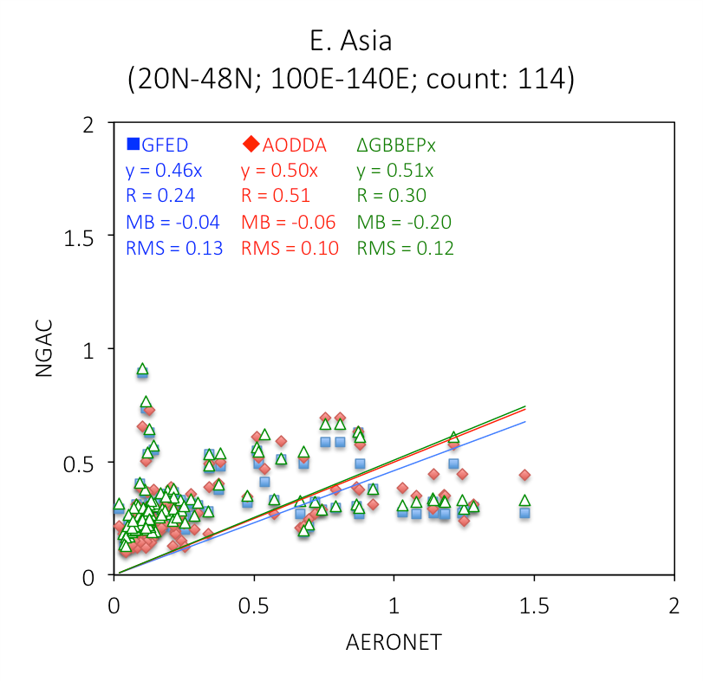
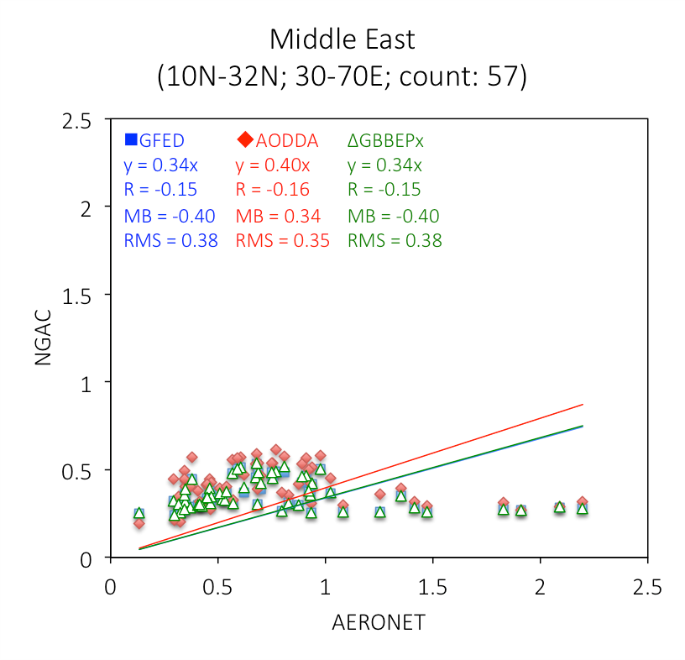
NGACv2 versus AERONET comparisons

Slide 12
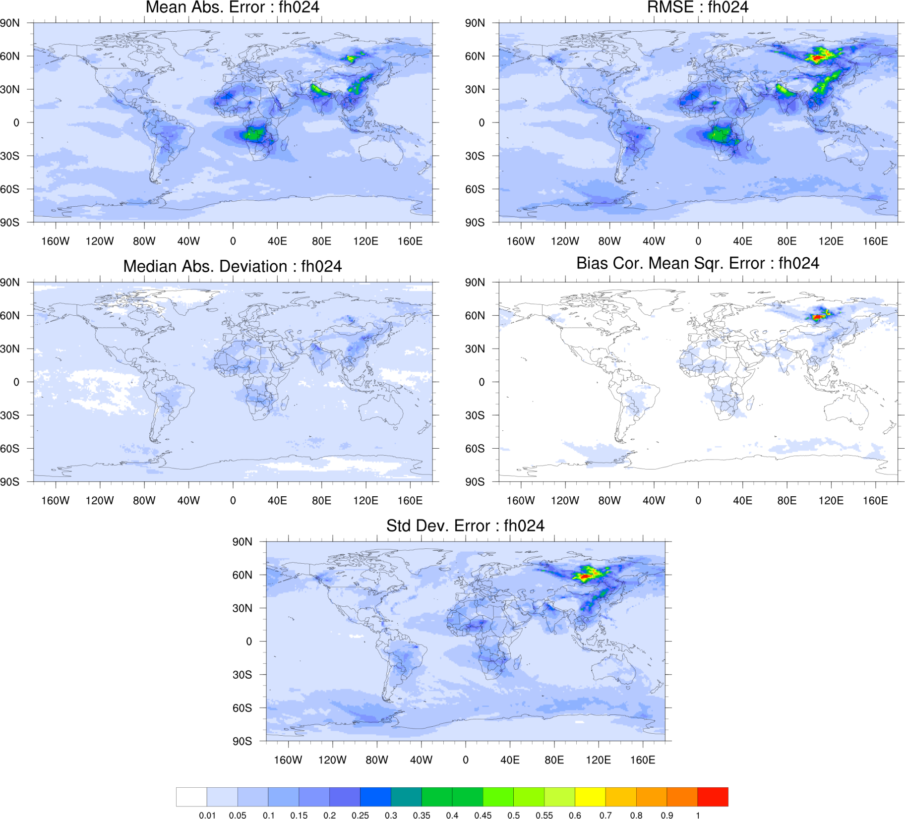
NGAC smoke differences when initialized w/ Gbbepx
(18 Sep – 17oct, 2016)

Slide 13
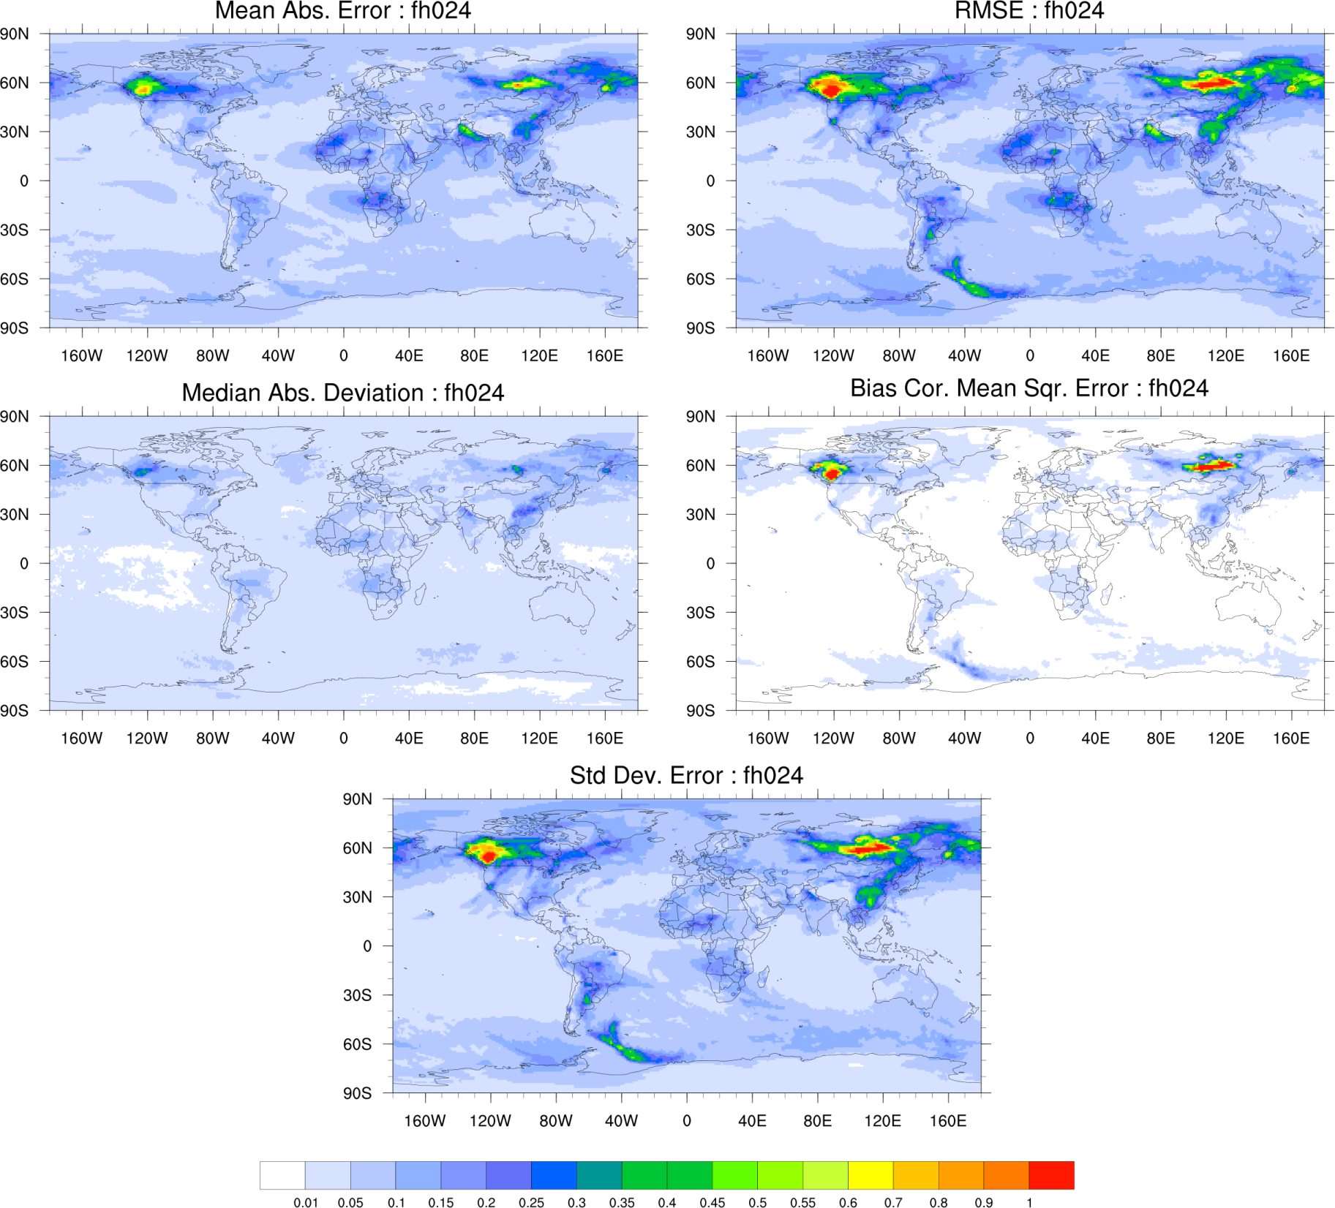
NGAC smoke diffs when initialized w/ Gbbepv (18 Sep – 17oct, 2016)
Notes:
Larger error with GBBEPv vs ICAP

Slide 14
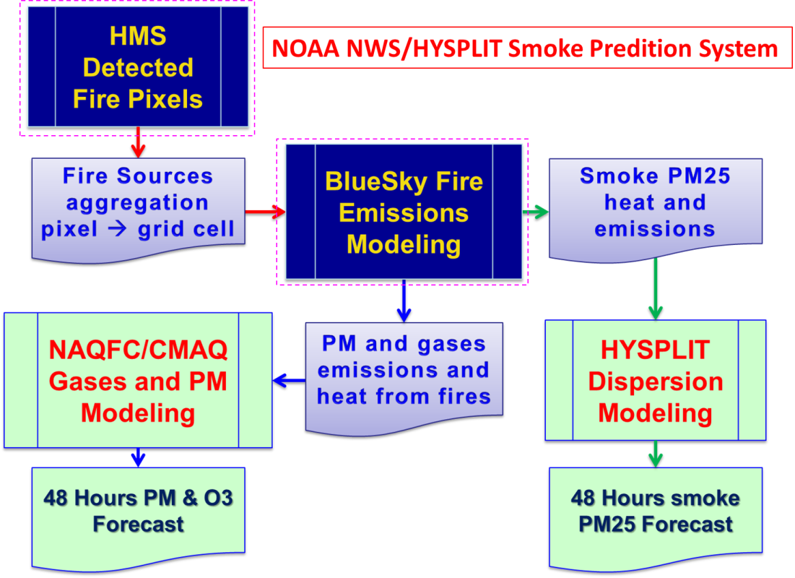
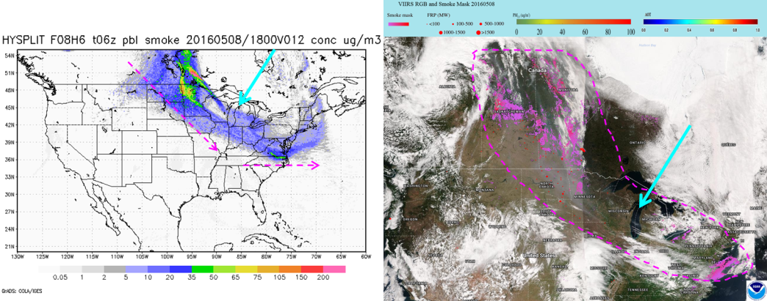
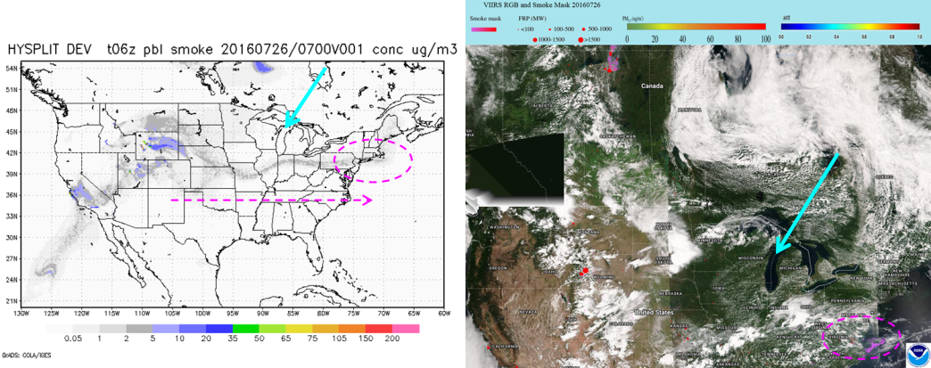
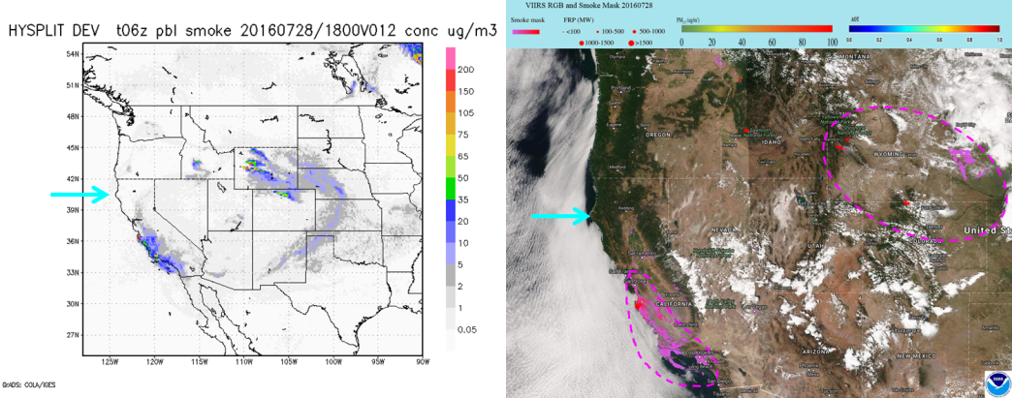
May 2016 Ft McMurry (Canada) Fires
July 2016 Northern Wyoming Fires
Updated USFS BlueSky smoke emissions:
The Fuel Characteristic Classification System version 2 (FCCS2) which includes a more detailed description of the fuel loadings with additional plant type categories.
Explicit fuel load map for Alaska
improved fuel consumption model and fire emission production system (FEPS).
July 2016 California Big Surf Fires
Courtesy Ho-Chun Huang, EMC
HYSPLIT/Smoke prediction
eIDEA Smoke Mask
Notes:
This is run as part of HYSPLIT processing so it does impact HYSPLIT predictions as well. Both CMAQ and HYSPLIT use the same smoke emissions system.
Includes a more detailed land use/fuel loading. Worked closely with USFS to transiition this code.

Slide 15
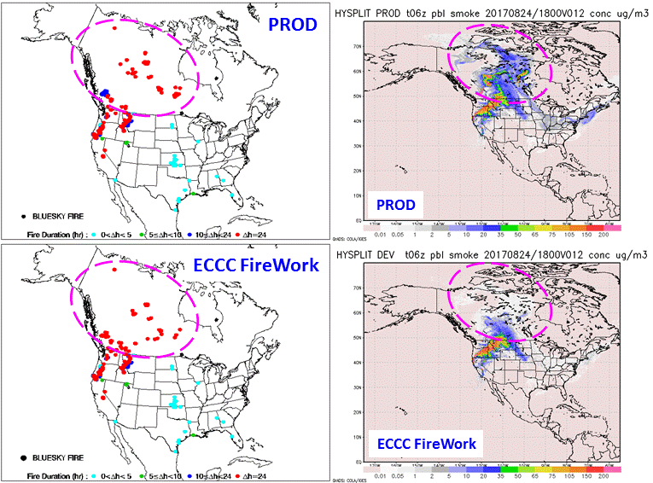
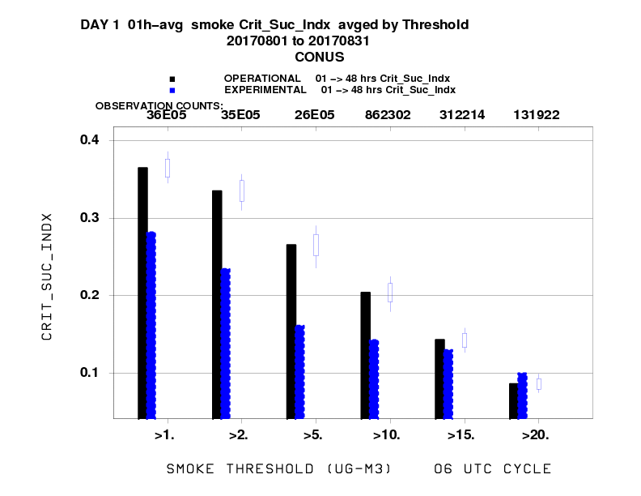
Testing Environment and Climate Change Canada’s (ECCC) FireWork
Diurnal Hourly Smoke Emission in HYSPLIT/Smoke applications
Replace NOAA HMS Canadian Fire Emission with ECCC Fire Work Emissions.
In general, some of the wildland fire locations of ECCC FireWork are different from NOAA HMS.
Daily fire smoke PM₂₅ emissions of ECCC, in general, are less than that of NOAA HMS/BlueSky.
The impact of different fire emission and diurnal emitted pattern can reach as far as the US East Coast.
decreased performance w/ ECCC for August 2017 for concentration < 20 µg/m³. Slightly better for that > 20 µg/m³.
http://www.emc.ncep.noaa.gov/mmb/hchuang/web/html/hysplit_bluesky.html
Courtesy Ho-Chun Huang, NCEP/EMC
Notes:
Canada’s Wildfire Smoke Prediction System (FIREWORK) fire smoke emissions is derived from the input fire information of Canadian Wild Fire Information System (CWFIS) and Canadian BlueSky system (which is similar to USFS BlueSky system employed at the NCEP for operational HYSPLIT/ SMOKE predictions.
ECCC FireWork fire smoke emissions is ingested daily at the NCEP

Slide 16
Concluding Remarks
Satellite observations have been utilized extensively to improve aerosol forecasts. This includes:
Monitoring of model performance
The use of near-real-time biomass burning emissions
Data assimilation of satellite aerosol retrievals.
GSI 3DVar aerosol data assimilation system has been extended to assimilate VIIRS AOD using NGACv2 as first guess.
The prototype AOD DA system is being tested and evaluated
The assimilation of VIIRS AOD has found to improve NGACv2 aerosol simulations. NGACv2 sensitivity experiments suggest NRT estimates of smoke emissions also play a critical role.
Preliminary use of GBBEPv smoke emissions yield larger differences from ICAP than with GBBEPx
Use of HMS & GOES for regional HYSPLIT/CMAQ smoke predictions

