Slide 1
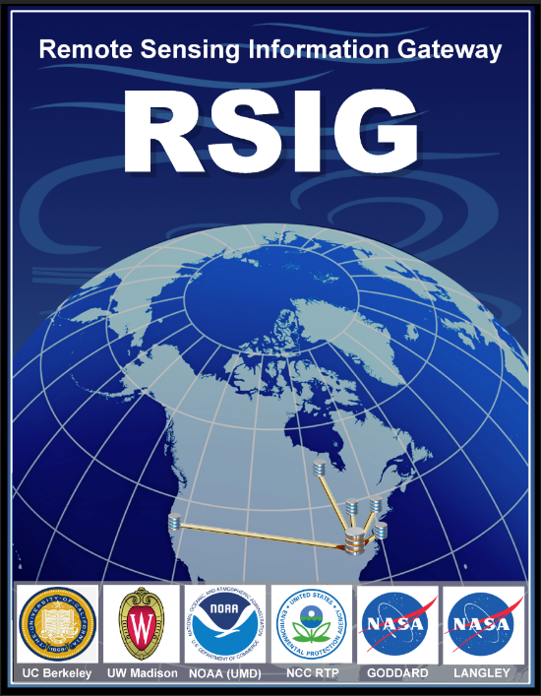
U.S. EPA Remote Sensing Gateway 3D-Beta Version
RSIG Development Team
NOAA Satellite Aerosol Products Workshop,
National Center for Weather and Climate Prediction (NCWCP), College Park, MD 20740
September 25-26, 2017

Slide 2
Remote Sensing Information Gateway
Background
Interoperable web-based infrastructure application for 2D and 3D visualization and data retrieval of air quality and atmospheric data.
Allows users to quickly visualize and save subsets of multi-terabyte data from original data archives holdings of satellite, model and air quality network data.
The application functions on your individual computer using safe http scripts and brings the requested data directly to your system.
The Graphical User Interface provides 3-Dimensional viewing and allows users to quickly see associations between complex air quality datasets in time and space.
The RSIG maintains a dynamic data inventory focused on providing data access and creating targeted, processed and user-friendly datasets (added value) for air quality relevant earth science data sets.
Notes:
R

Slide 3
Remote Sensing Information Gateway 3D Beta Testing
Seeking feedback from Beta Users on:
Ease of getting started – installation and ability for quick start/use
Usefulness of video demonstrations
Overall functionally of GUI to visualize intended data and customize views
Functions as a data delivery system
Availability to access unique data set, i.e., level of effort versus other access methods
Overall relevance for use in air quality application, either standalone or as part of a larger system
Limitations/bugs
Additional features – analyses and/or data access
Notes:
R

Slide 4
Remote Sensing Information Gateway
Data Inventory – Satellite
Full Archive Access:
NOAA Satellite Measurements
GOES: GASP (GOES Aerosol Smoke Product- Aerosol Optical Depth),
Hazard Mapping System (HMS) fire location, radiative power, ecosystem classification
VIIRS AOD data products – EPS algorithm (access under development)
NASA Satellite Measurements
MODIS: Aerosol Optical Depth (AOD), Cloud Optical Thickness (COT), Visible Imagery ancillary products - ozone, pressure, temperature
CALIPSO: L1b Backscatter and Depolarization and L2 Aerosol and Cloud: Backscatter, Extinction, Depolarization, Aerosol/Cloud Layer Fraction and Column Optical Depth.
OMI: (Ozone Monitoring Instrument): CONUS BErkeley High Resolution (BEHR) NO2 retrieval.
Access Under Development:
VIIRS AOD data products – NASA dark target retrievals
GOES – Univ. of AL Huntsville
Notes:
R

Slide 5
Remote Sensing Information Gateway
Data Inventory - Model
U.S. EPA WRF-CMAQ
2002-12 Weather Research Forecast model, version 3.4 (WRF v3.4)-Community Multiscale Air Quality (CMAQ) modeling system version 5.0.2 CONUS12 km grid size and a Lambert Conformal projection, Layers 1-35
2002-12 Fused Air Quality Surfaces Using Downscaling (FAQSD) – based on a Bayesian space-time downscaler model used to "fuse" daily ozone (8-hr max) and fine particulate air (24-hr average) monitoring data from the National Air Monitoring Stations/State and Local Air Monitoring Stations (NAMS/SLAMS) with 12 km gridded output from the Models-3/Community Multiscale Air Quality (CMAQ) model
Notes:
R

Slide 6
Remote Sensing Information Gateway
Data Inventory – Surface/In-situ
Full Archive Access:
Air Quality System (AQS – O₃, NO_{x}, SO₂, CO, PM_{2.5})
AIRNow O₃ and PM_{2.5}
Limited Archive Access
Measurement of Ozone and Water Vapor by Airbus In-Service Aircraft (MOZAIC) -2006
Notes:
R

Slide 7
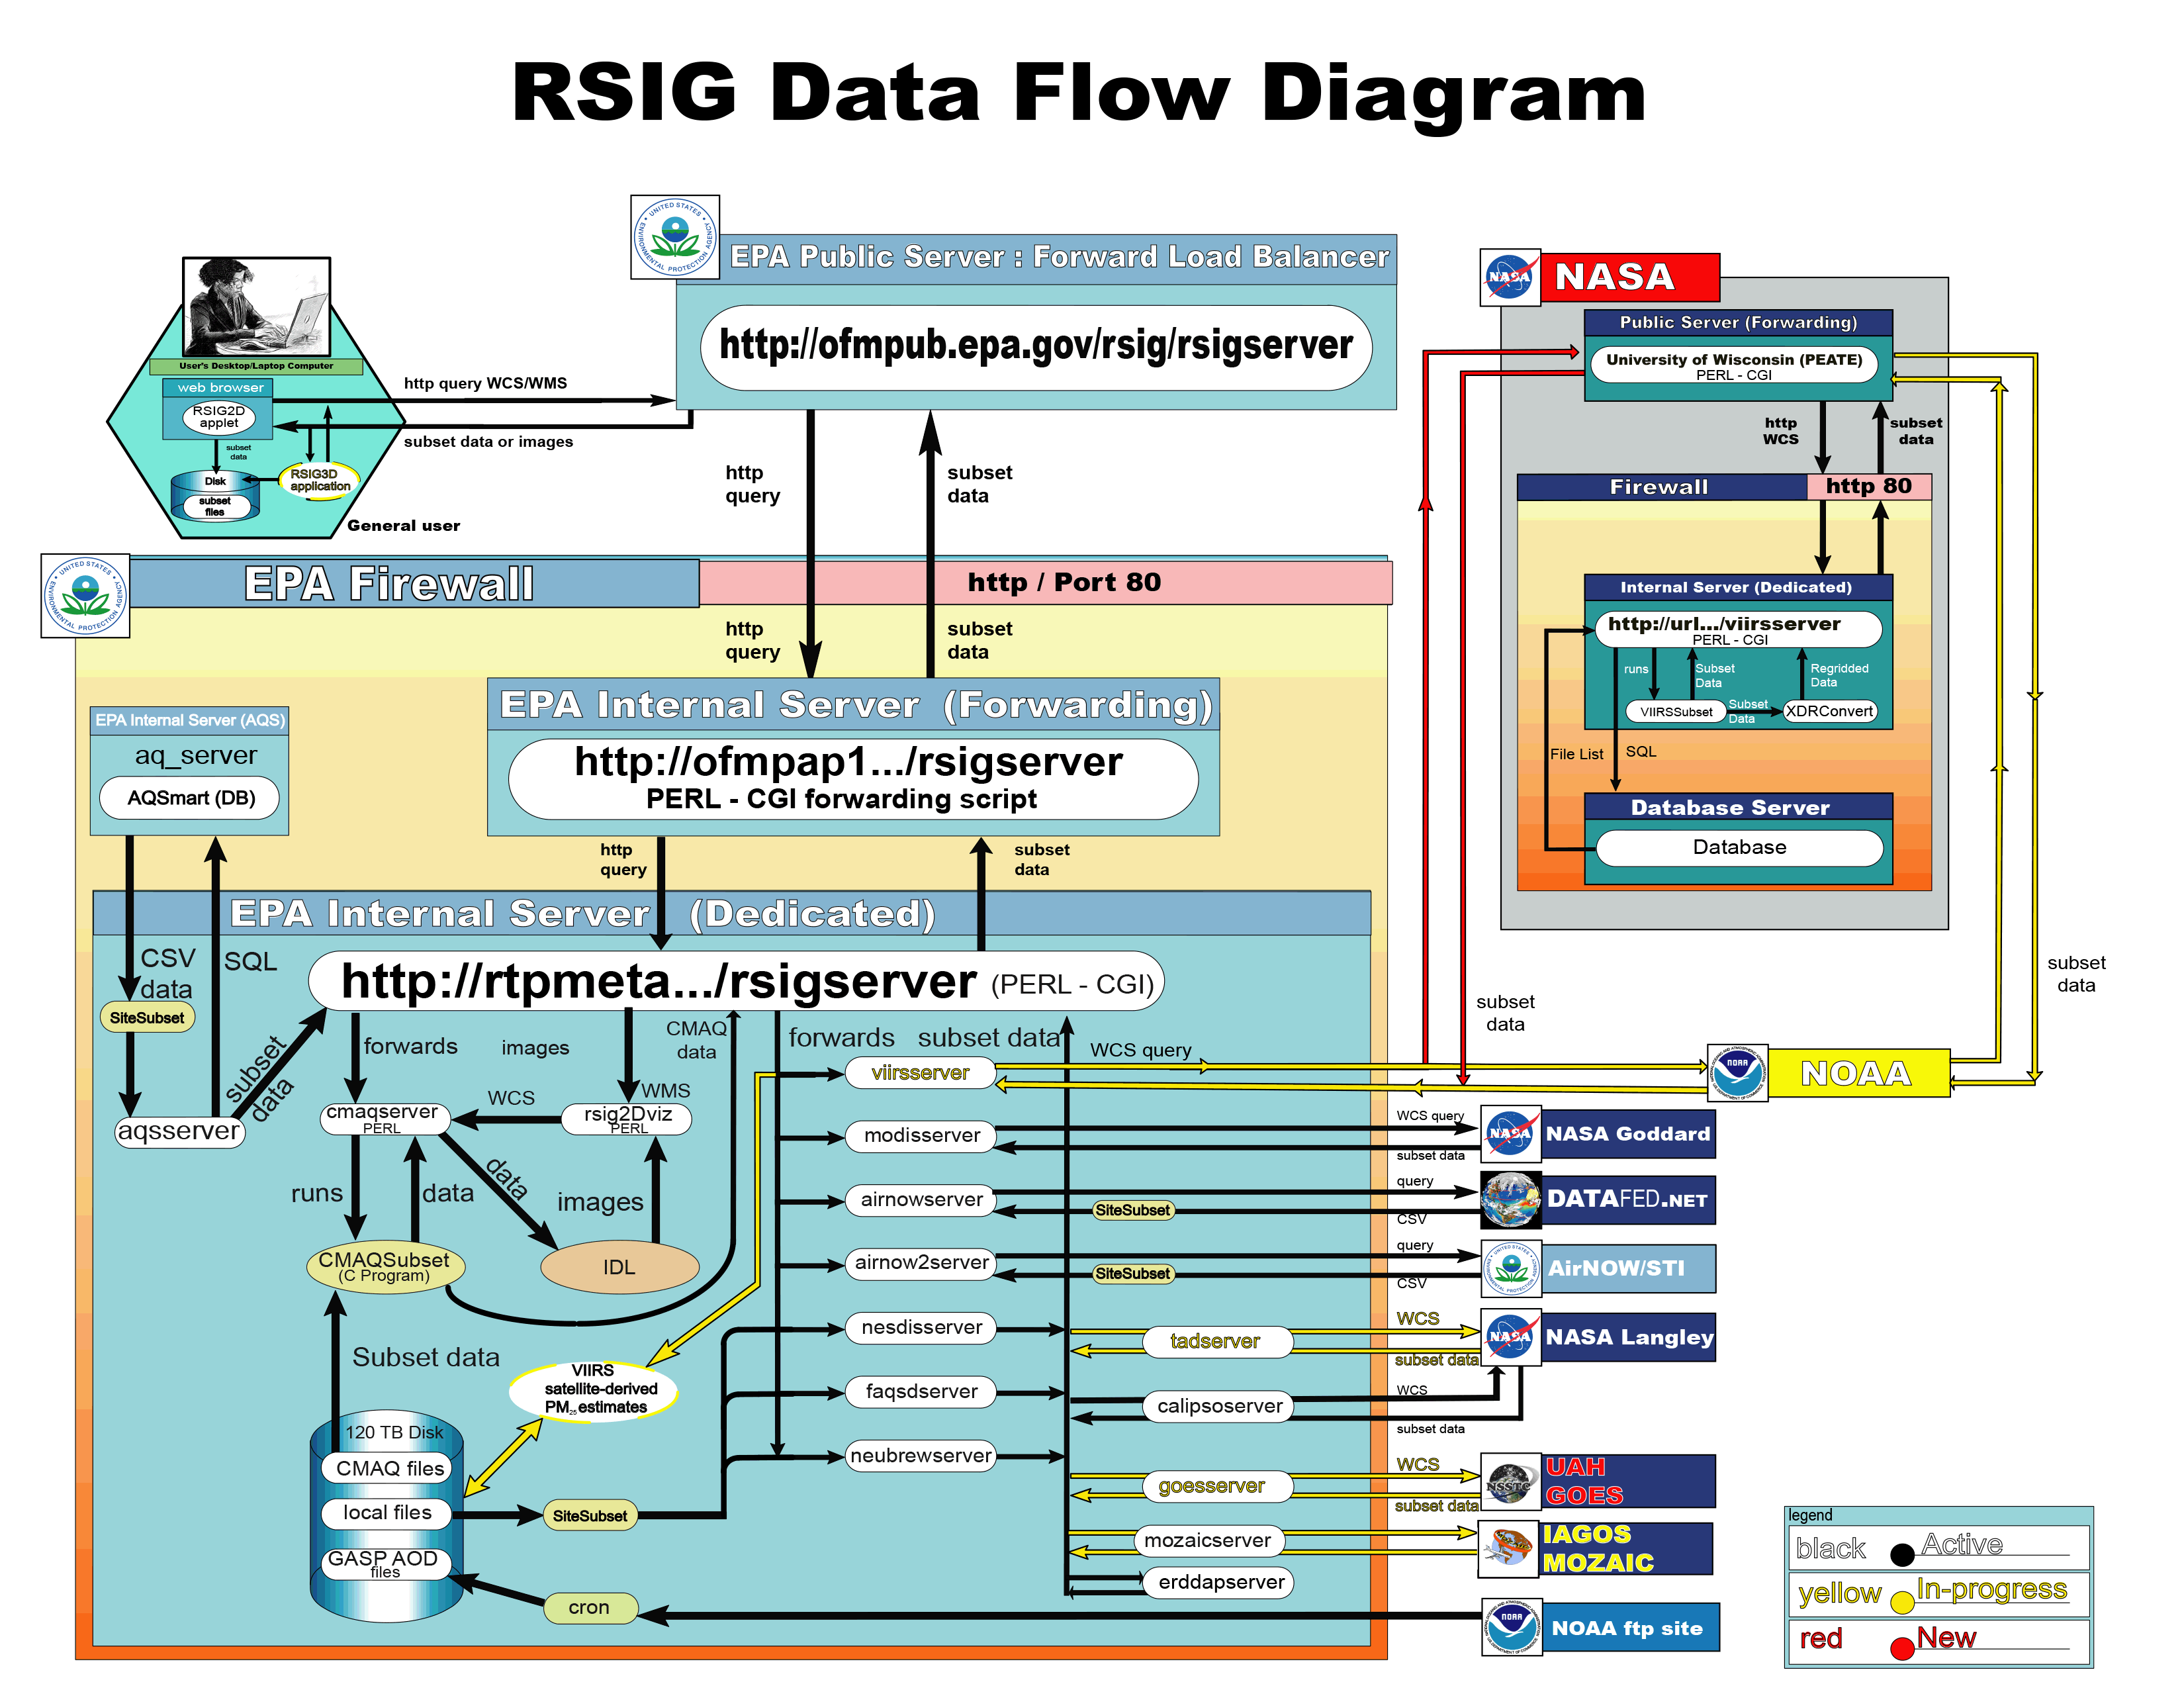

Slide 8
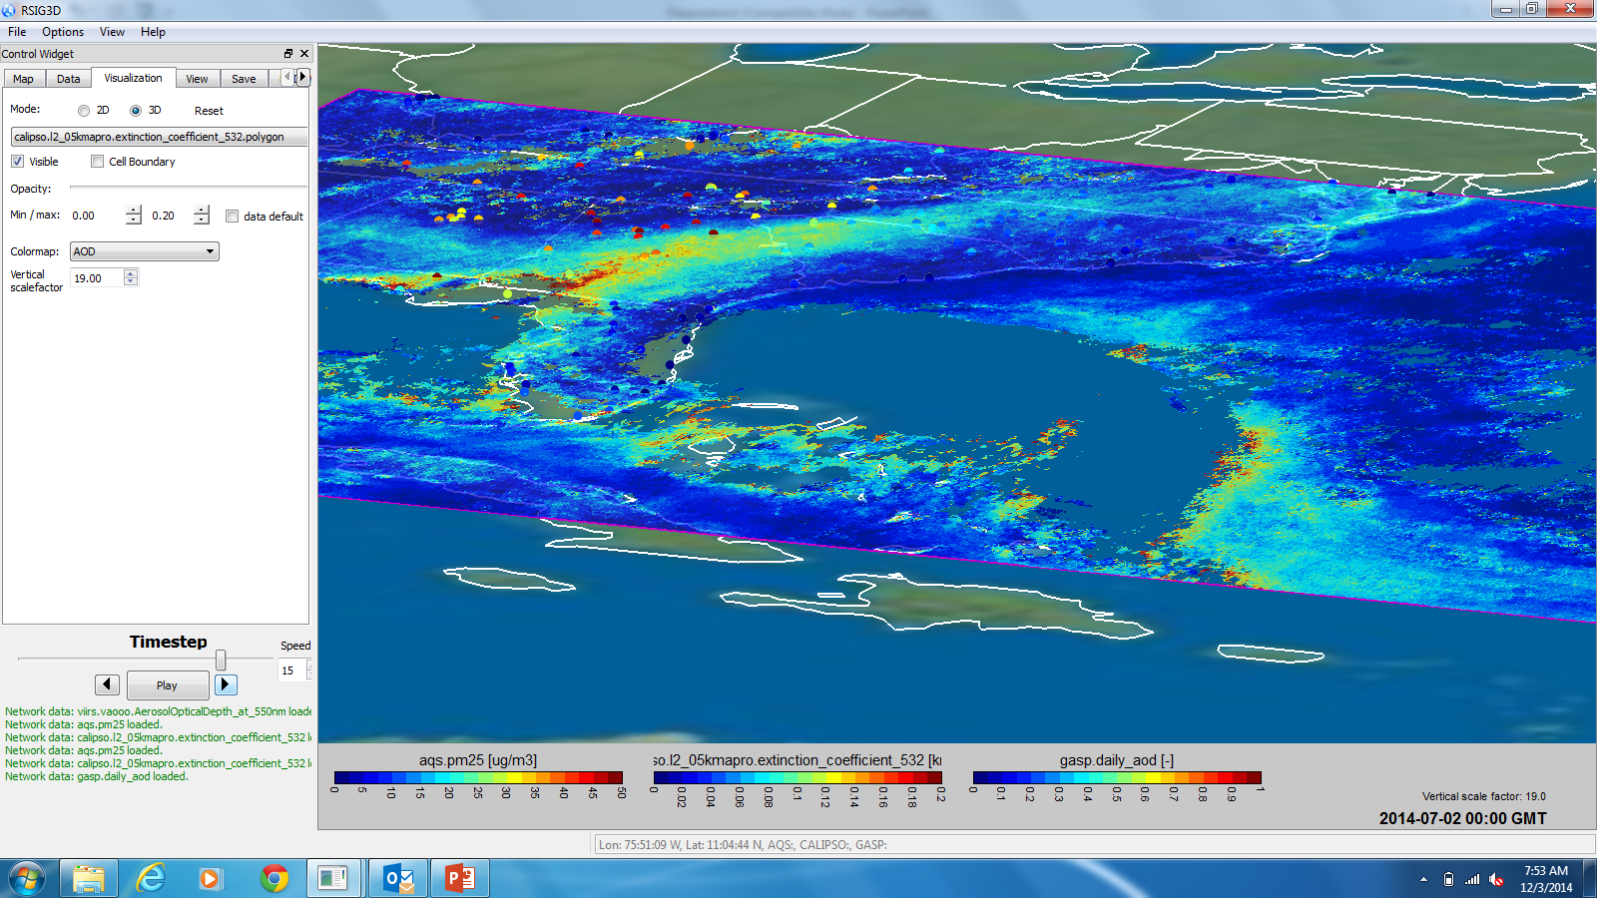
Remote Sensing Information Gateway
3D Application GUI

Slide 9
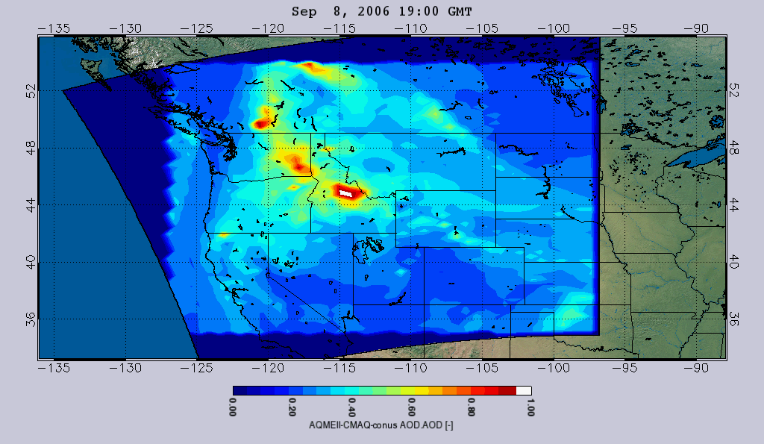
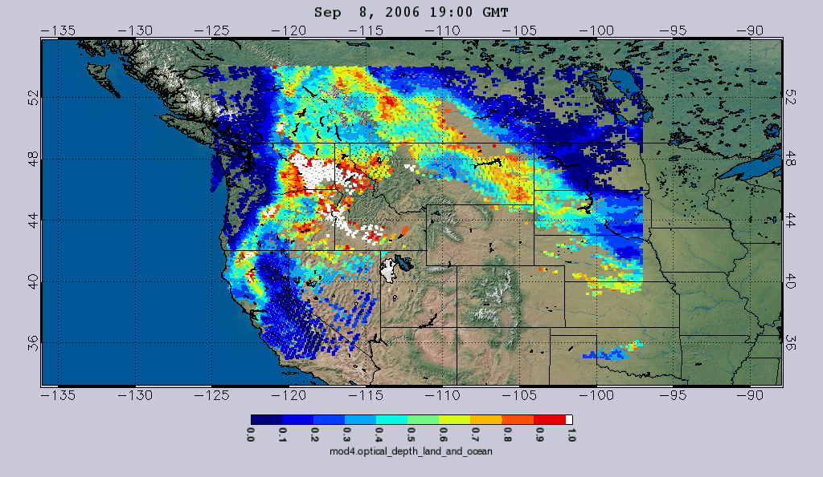
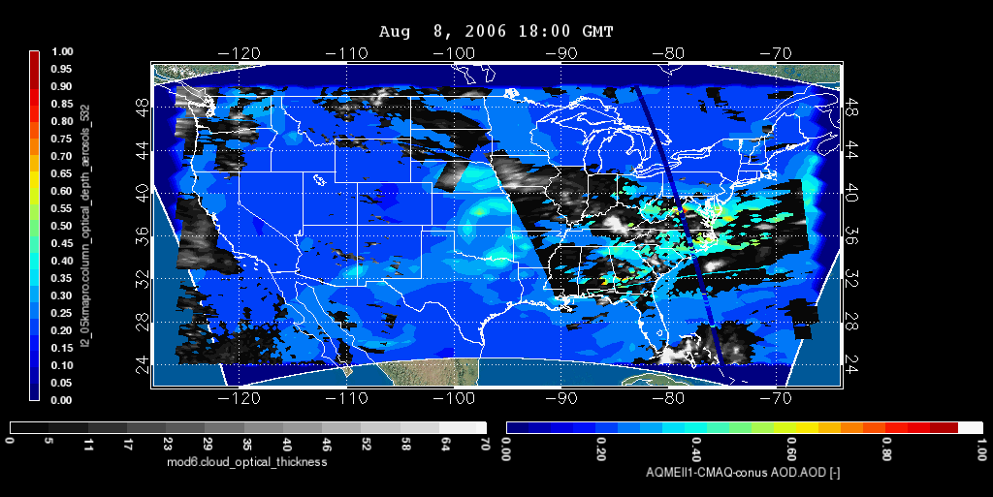
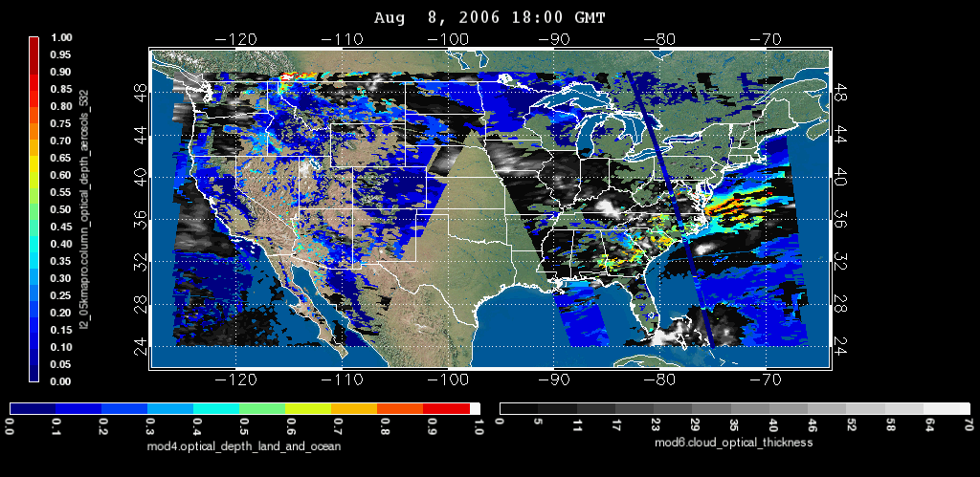
Visualize, regrid, overplot
12km CMAQ AQMEII 4.7.1 AOD
Aqua MODIS AOD on the same grid
CMAQ AQMEII 5.0 AOD and CALIOP L2 AOD (532 nm)
MODIS L2 AOD (550nm) and CALIOP L2 AOD (532 nm)

Slide 10
Remote Sensing Information Gateway
Satellite AOT/AOD
Satellite AOT/AOD is one of the most accessed data sets via RSIG
Primary Uses include:
CMAQ Modeling Evaluation
Exceptional Event Analysis
Data Fusion Modeling for surface PM2.5 concentrations
Notes:
R

Slide 11
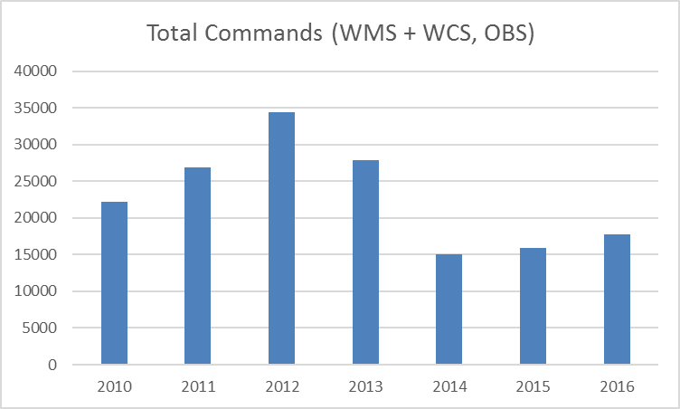
Remote Sensing Information Gateway
Observation Data Inventory Stats
Notes:
R

Slide 12
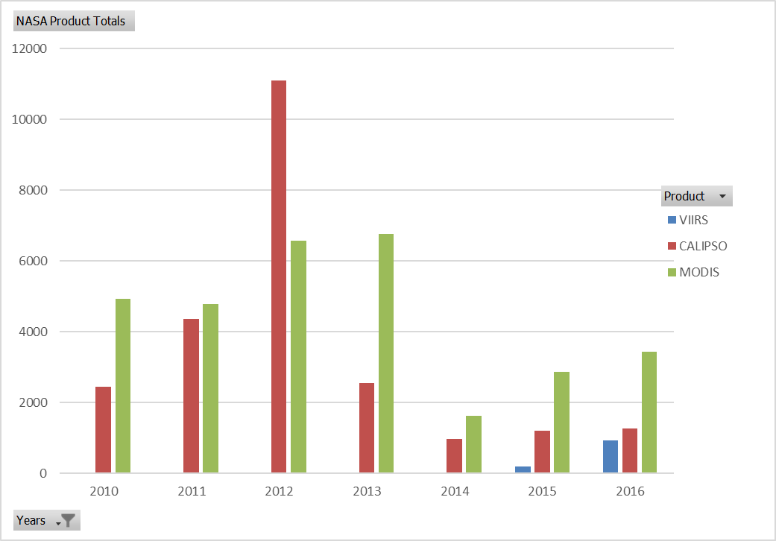
Remote Sensing Information Gateway
Satellite Data Inventory Stats
Notes:
R

Slide 13
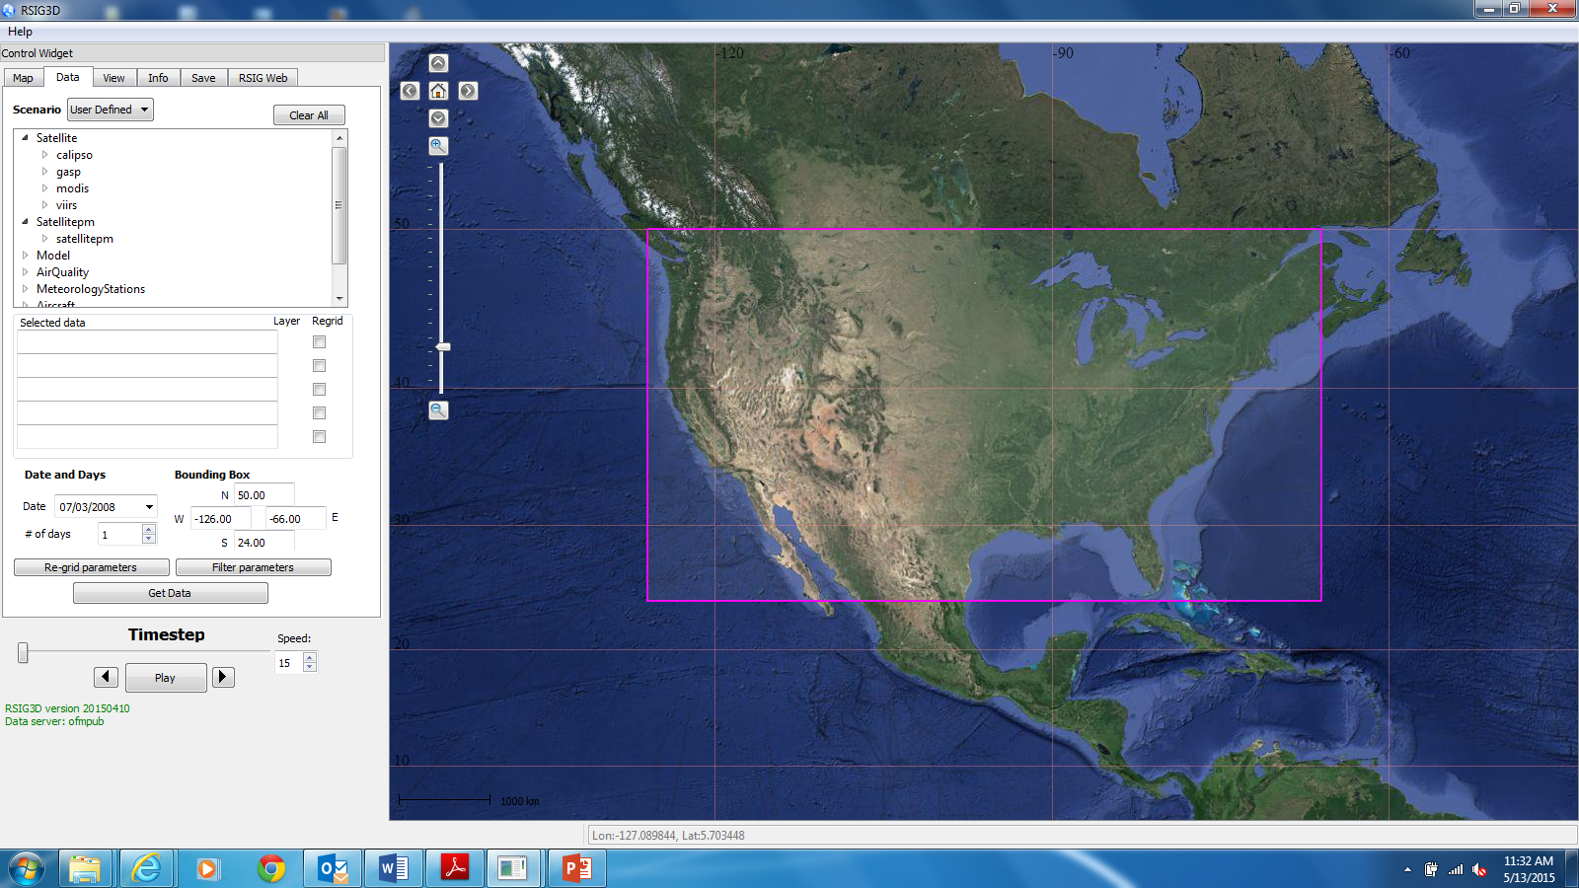
Use of EPA Remote Sensing Information Gateway to delivery NOAA-VIIRS EPS AOT
User Interface for New RSIG 3-Dimensional application.
Delivers data/products to user via web coverage services.
Currently undergoing Beta testing.

Slide 14
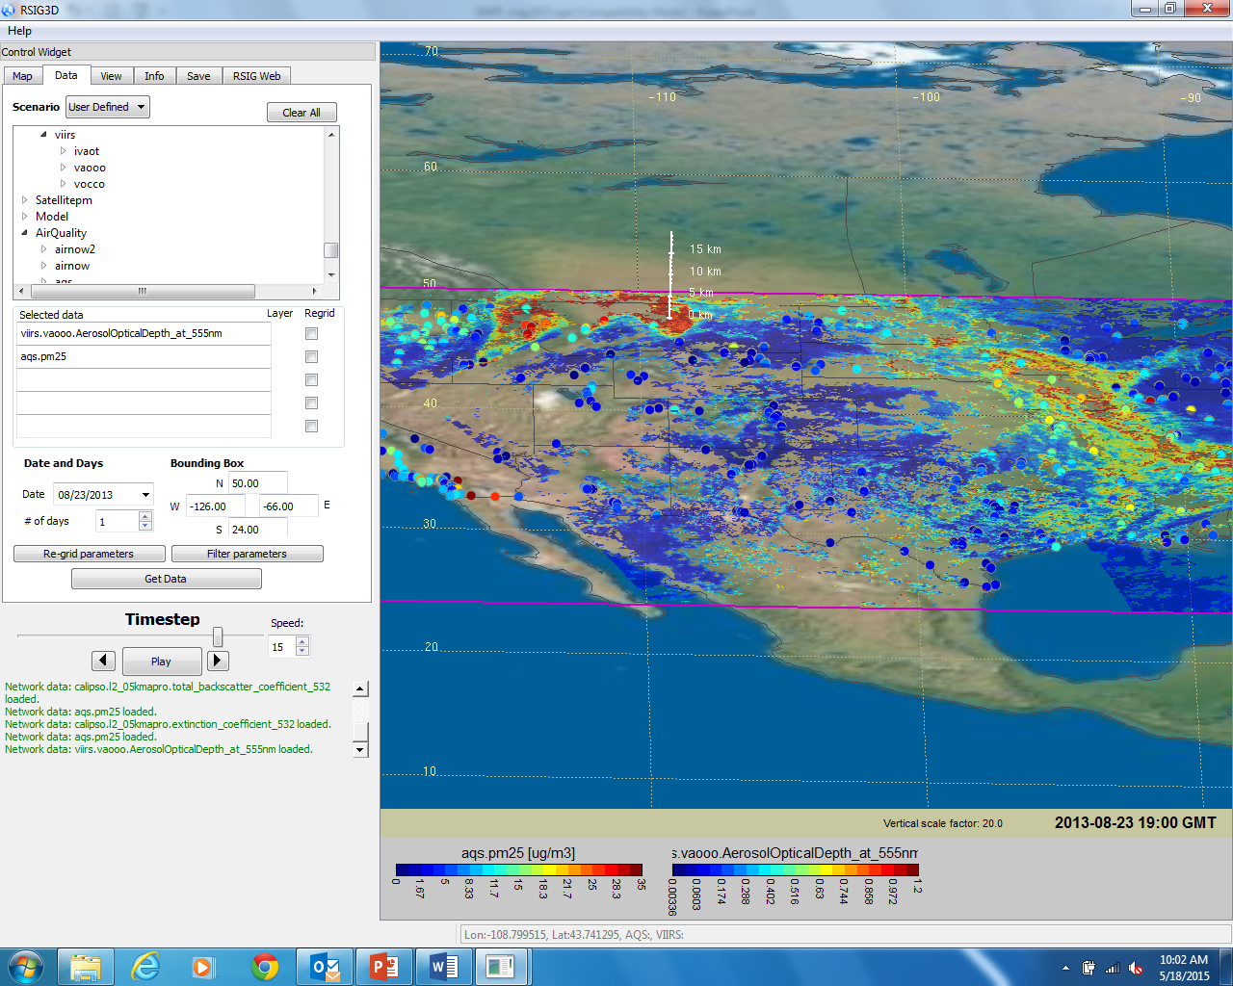
Use of EPA Remote Sensing Information Gateway to delivery NOAA-VIIRS EPS AOT
Currently updating VIIRS AOT from NOAA-EDR to NOAA-EPA algorithm.
VIIRS captures high AOT covering most of MT and moving into the Dakotas, both areas associated with sparse surface PM_{2.5} monitoring coverage.

Slide 15
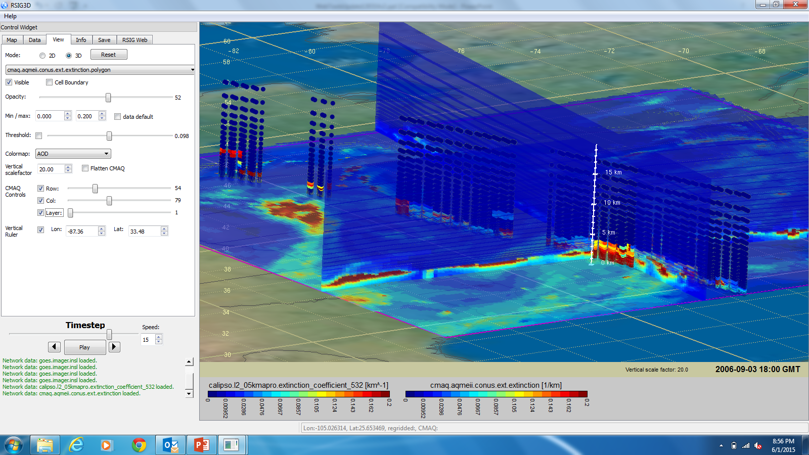
CMAQ Row and Column “Slices” CALIOP Satellite Overpass Intersect
CALIOP 532 nm extinction coefficient profile

Slide 16
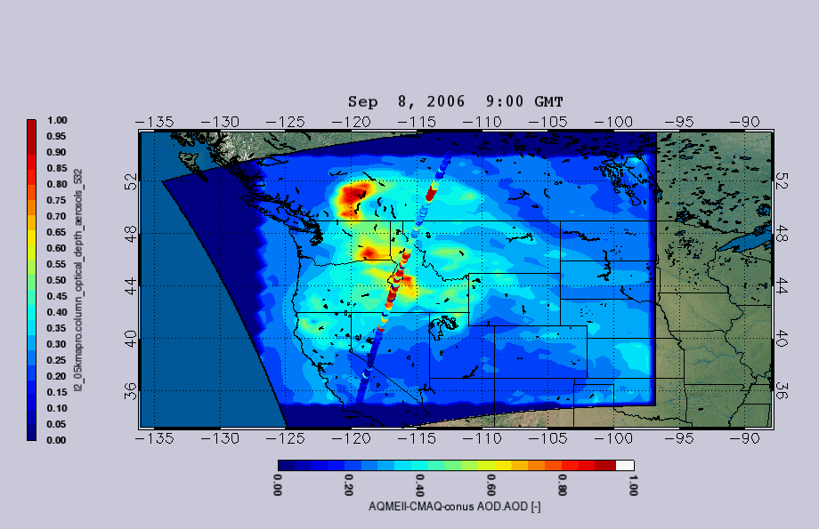
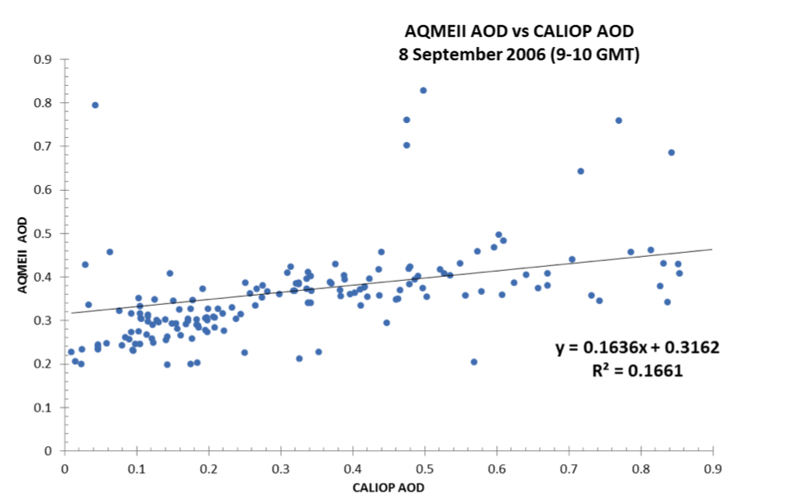
Episode Analysis & Evaluation
CMAQ AQMEII 4.7.1 AOD over-plotted with CALIOP AOD
Scatter along overpass
With a few clicks, RSIG provides quick access to model:obs comparison on the model grid

Slide 17
Satellite visualization for exceptional events
RSIG quickly combines Satellite AOD, CALIOP extinction profile, and AQS PM2.5 over multiple days to capture the progression of a Sharan Dust event impacting the SE U.S.

Slide 18
Summary
Satellite AOT/AOD is one of the most accessed data sets via RSIG
NOAA VIIRS AOT EPS Algorithm data will provide improved coverage for:
High resolution CMAQ Modeling Evaluation – 4 km or less spatial resolution.
Fire related Exceptional Event Analysis conducted by state and local air quality agencies.
Data Fusion Modeling for surface PM2.5 concentrations.
Notes:
R

