Slide 1
Recent Impacts of Fire and Smoke on Air Quality Forecasting in the Mid-Atlantic
Bill Ryan
Penn State
Department of Meteorology
NOAA Satellite Aerosol Products Workshop
National Center for Weather and Climate Prediction
September 25-26, 2017

Slide 2
This Must Be The New World
Emissions of O₃ and PM_{2.5} precursors, primarily NO_{x} and SO_{x}, in the eastern US have been reduced dramatically over the past two decades.
These reductions in precursor emissions resulted in large decreases in ambient concentrations of both primary and secondary pollutants of interest to air quality forecasters.

Slide 3
Mid-Atlantic Monitors Above Thresholds (Averages for 8-h >= 96 ppbv)
1994-2002: 305 yr⁻¹
2013-2016
0.5 yr⁻¹
Notes:
Figure 1. The number of monitors exceeding selected O₃ mixing ratio thresholds in the mid-Atlantic coastal plain from 1994 to 2016. Number values are shown for exceedances of the 96 ppbv threshold.

Slide 4
Shenandoah NP (Big Meadows) PM_{2.5} “Bad Air” Days
~ 12 μgm⁻³
Notes:
Figure 2. SNP surface PM_{2.5} observations at SNP via IMPROVE monitor observations.

Slide 5
No Good Deed Goes Unpunished
As the “regional load” of O₃ and fine particles has decreased, forecasting episodes of poor air quality has become more difficult.
The conceptual model of a “standard” poor air quality weather pattern is no longer reliable.
In general, high frequency variations in metropolitan-scale peak O₃ responds as much to meso-scale as synoptic scale effects.

Slide 6
Hot Weather Is No Longer a Good Predictor of Poor Air Quality
Likelihood of exceeding 76 ppbv given T_{max} ≥ 90°F.
Notes:
Basic Statistics: Association of T_{max} and Peak O₃
PHL Metro Area, JJA, Domain Peak 8-h O₃
r
r²
Best Linear Fit
2005-2007
0.77
0.60
(2.25 * T_{max}) – 125.2
2010-2012
0.74
0.55
(1.74 * T_{max}) – 87.5
2013-2016
0.55
0.30
(1.19 * T_{max}) – 44.6
Table 2. Correlation with T_{max} (JJA, peak domain 8-h ozone) in the PHL metro forecast area.

Slide 7
T_{max} and Local Persistenc Are Much Weaker Predictors of Peak O₃

Slide 8
Transport Patterns: Meso-scale Recirculation?
2005-2007
2013-2015

Slide 9
Numerical AQ Forecast Models Tend To Under-Predict on the “Worst” O₃ Days
Shown at left, observations and numerical model forecasts for Philadelphia metropolitan area peak O₃, 2014-2016.
Red bar demarcates observed peak O₃ ≥ 80 ppbv.
Strongest events are routinely under-predicted.

Slide 10
Worst Air Quality Days Now Rare
In the PHL metro area, days with peak 8-hour O₃ ≥ 80 ppbv have become rare beginning in 2014.
Also true of the coastal mid-Atlantic.
In total, for the period 2015-2017, there were a total of 19 days ≥ 80 ppbv with 70 monitors reaching that threshold – approximately 3 monitors per event.

Slide 11
A Closer Look Shows That Truly Widespread High O₃ is Even Rarer
60% of the monitors exceeding 80 ppbv
occurred on only 4 days!

Slide 12
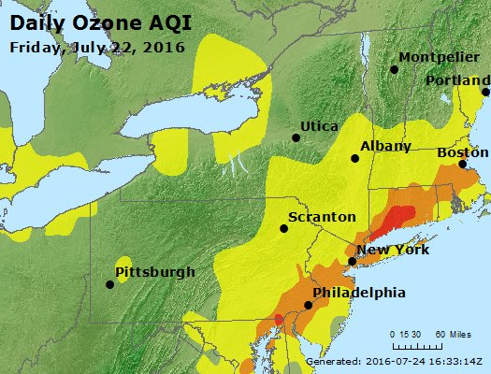
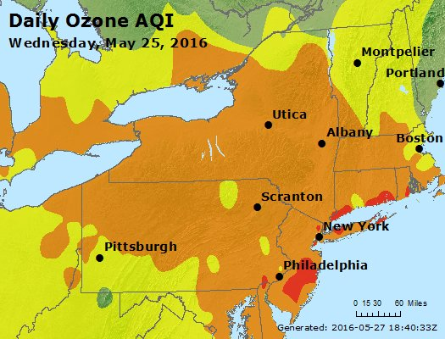
The Four Very Bad Days
It appears that remnant wildfire smoke is a factor in all of these widespread high O₃ days.

Slide 13
Mother of All Mid-Atlantic Smoke Events (July, 2002)

Slide 14
MODIS AOD (Aqua) June 10 (left) and June 11 (right)

Slide 15
UMBC ELF Aerosol Backscatter (left) and AIRNow O₃ Map (right)
Figure courtesy of UMBC (Smog Blog), data from Elastic Lidar Facility (ELF).

Slide 16
Regional O₃ Event May 25-26, 2016

Slide 17
VIIRS Image, May 22 (left) and Back Trajectory for May 24 (right)

Slide 18
VIIRS Images for May 24 (left) and May 25 (right)

Slide 19
VIIRS Image with Smoke Mask May 16 (left) and May 17 (right)

Slide 20
AirNow O₃ Maps May 17, 2017 (left) and May 18 (right)

Slide 21
VIIRS Image with Smoke Mask July 19, 2016 (left), July 20 (right)

Slide 22
Back Trajectory for July 22 (left) and AirNow O₃ (right)

Slide 23
Comments (1 of 2)
The frequency of widespread O₃ events in the mid-Atlantic have been significantly reduced – nearly eliminated – by emissions reductions on the local and regional scale.
The “very bad air” days that remain appear to be enhanced by wildfire smokes emissions.

Slide 24
Comments (2)
The extent of this enhancement by wildfire smoke remains uncertain.
In the most recent cases there has been no significant signature in total mass PM_{2.5}.

