Slide 1
Satellite Aerosol Products in Air Resources Laboratory’s models
Ariel Stein
Acting Director, NOAA/OAR/ARL
Daniel Tong, Tianfeng Chai, HyunCheol Kim
NOAA Satellite Aerosol Products Workshop – Sept 25-26, 2017

Slide 2
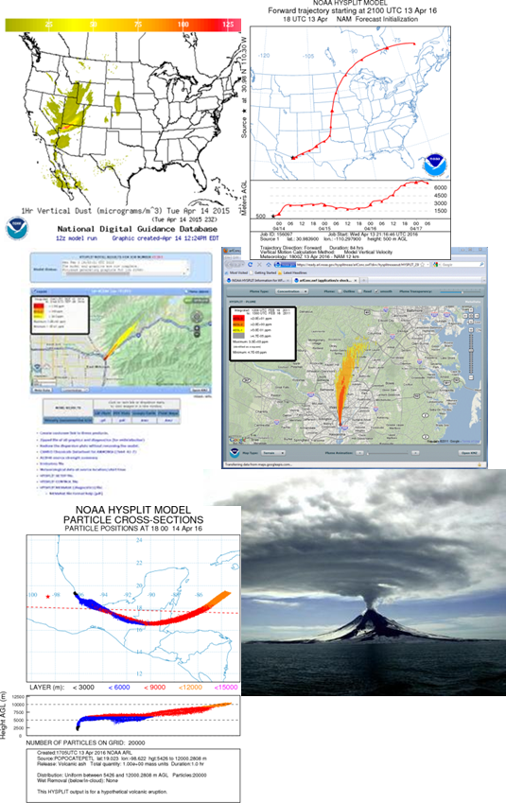
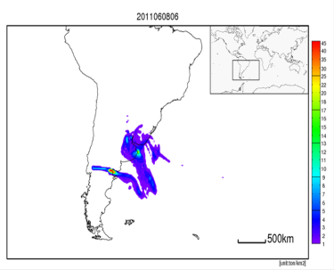
HYSPLIT: Research to Operations/Applications
Radiological
Fukushima-Daiichi accident 2011.
Comprehensive Test Ban Treaty Organization (CTBTO) - WMO Backtracking Response System
Chemical
Link to Computer-Aided Management of Emergency Operations (CAMEO) chemicals data. Web access from NWS Weather Forecasting Offices.
Volcanic ash
International Civil Aviation Organization – FAA - Washington Volcanic Ash Advisory Center
Wind-blown dust
NWS operational model.
Wildfire smoke / prescribed burns
Collaboration with USFS

Slide 3
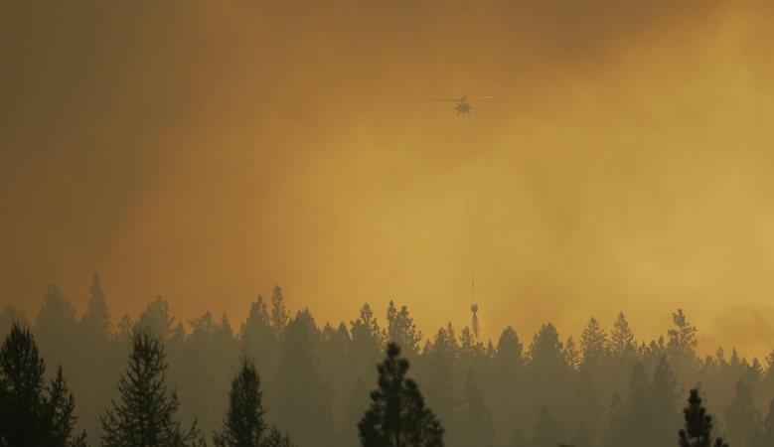
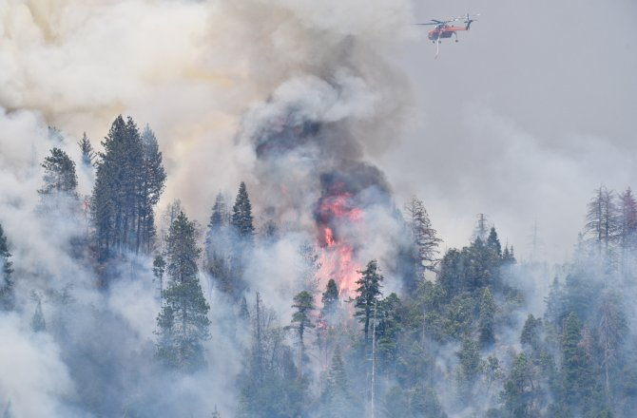
Wildfire application
A helicopter makes a water bucket drop as it flies through smoky air while fighting a wildfire that flared up in the late afternoon near Omak, Wash., on Thursday (Aug 27, 2015). (Ted S. Warren/AP)
http://www.seattletimes.com/seattle-news/northwest/washington-wildfires-update-2/
Smoke from wildfires caused many extreme events affecting public health;
The PM_{2.5} forecast quality is greatly hindered by the large uncertainties of the wildfire emission estimates;
Current wildfire emission estimates incorporates satellite information to identify fire activity but require vegetation productivity for emission estimates
We aim to objectively and optimally estimate the fire sources based on the satellite observations of the fire plumes in a 4D sense using HYSPLIT dispersion model.
Meanwhile since Friday, more than 1,000 firefighters have struggled with a blaze started by lightning in the Chelan, Wash., area, where at least 49 buildings have been destroyed and authorities have issued evacuations that affect some 3,000 people. http://news.discovery.com/earth/weather-extreme-events/will-more-wildfires-combust-our-health-150828.htm

Slide 4
Smoke forecasts with HYSPLIT: Current status
NOAA NESDIS HMS Smoke and fire detection
Smoke column from the HYSPLIT model (blue) and NESDIS Hazardous Mapping System (orange)
Incorporates imagery from NOAA and NASA satellites (GOES-West, GOES-East, Terra/Aqua MODIS, AVHRR on NOAA-15/-17/-18)
Provides fire locations, starting time, durations
USFS’s BlueSky: Estimate PM_{2.5} emissions and plume rise
Emission aggregated and assumptions are made to for the forecasting period

Slide 5
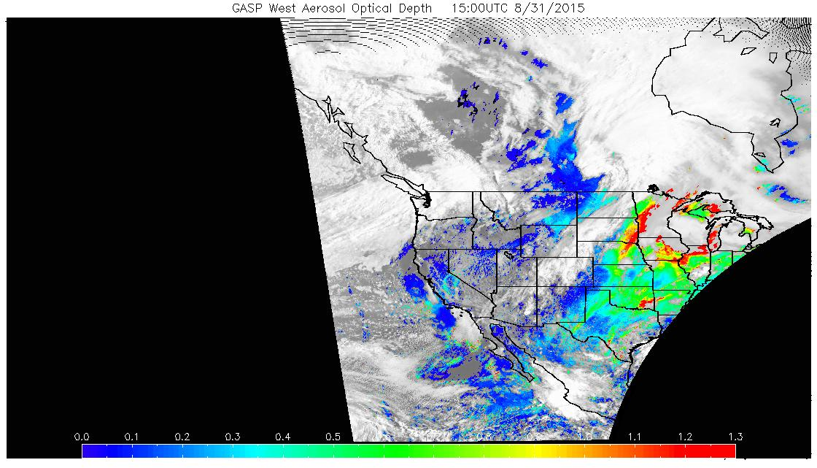
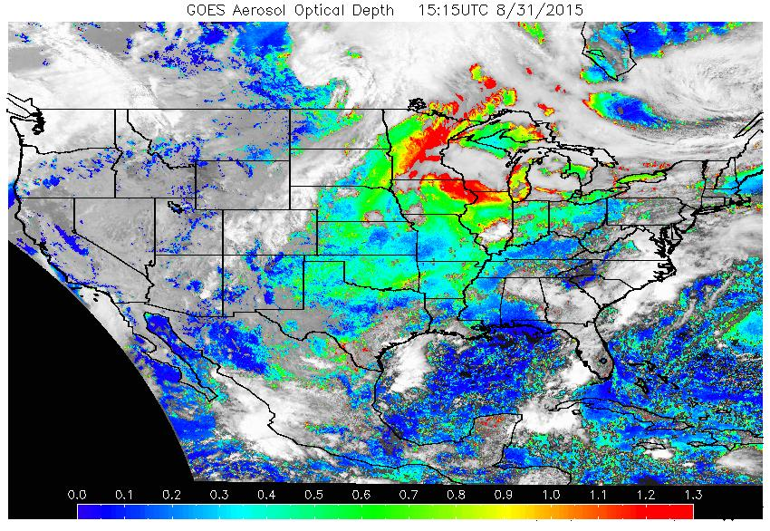
NOAA NESDIS GOES Aerosol/Smoke products (GASP)
The GASP product is a retrieval of the Aerosol Optical Depth (AOD) made from the current GOES West/East visible imagery. Satellite measured aerosol optical depth (AOD) is available at a 30-minute interval and 4 km X 4 km spatial resolution during the sunlit portion of the day. (http://www.ssd.noaa.gov/PS/FIRE/GASP/gasp.html)

Slide 6
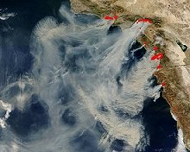
Methodology
An independent HYSPLIT simulation at each HMS fire location (i), at each possible release height (k) for each burning period (t) is run with unit source, to generate a Transfer Coefficient Matrix (TCM).
Source terms are solved by minimizing a cost function built to mostly measure the differences between model predictions and observations, following a general data assimilation approach.
Hourly gridded GASP

Slide 7
Smoke forecasts with HYSPLIT inverse modeling
Twin experiments: 9 fire locations, constant releases each day for 2 days from 6Z on 8/17/15, at 1500m or 2000m, MET: gdas1
Pseudo-satellite -observations, hourly, at 0.5ºx0.5º resolution
With pseudo observations generated using HYSPLIT model simulations (twin experiments), true emissions (release height and emission rate) can be recovered;
First day emission sources are better resolved using the second day observations.

Slide 8
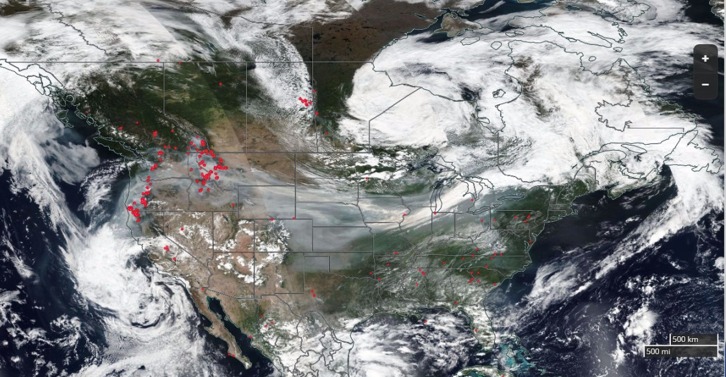
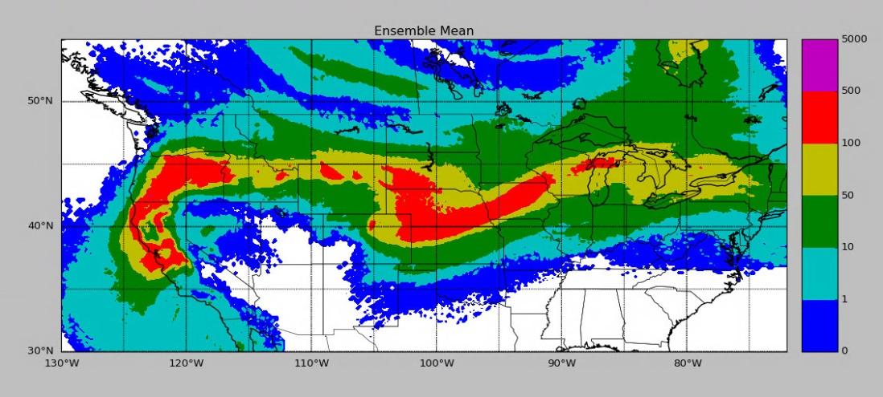
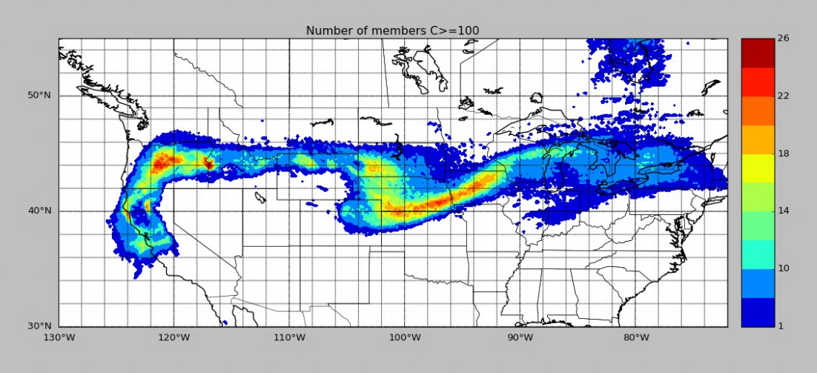
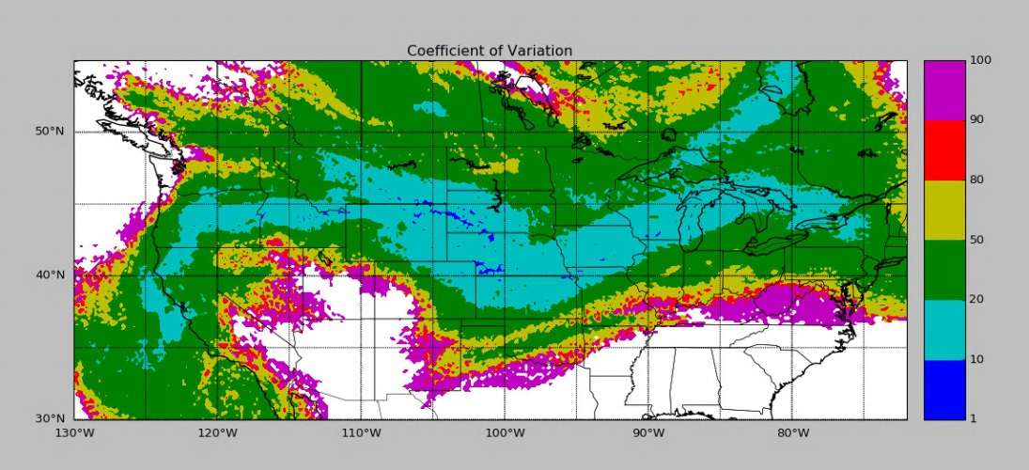
HYSPLIT 26-member ensemble based on Short Range Ensemble Forecast (SREF) :September 4, 2017

Slide 9
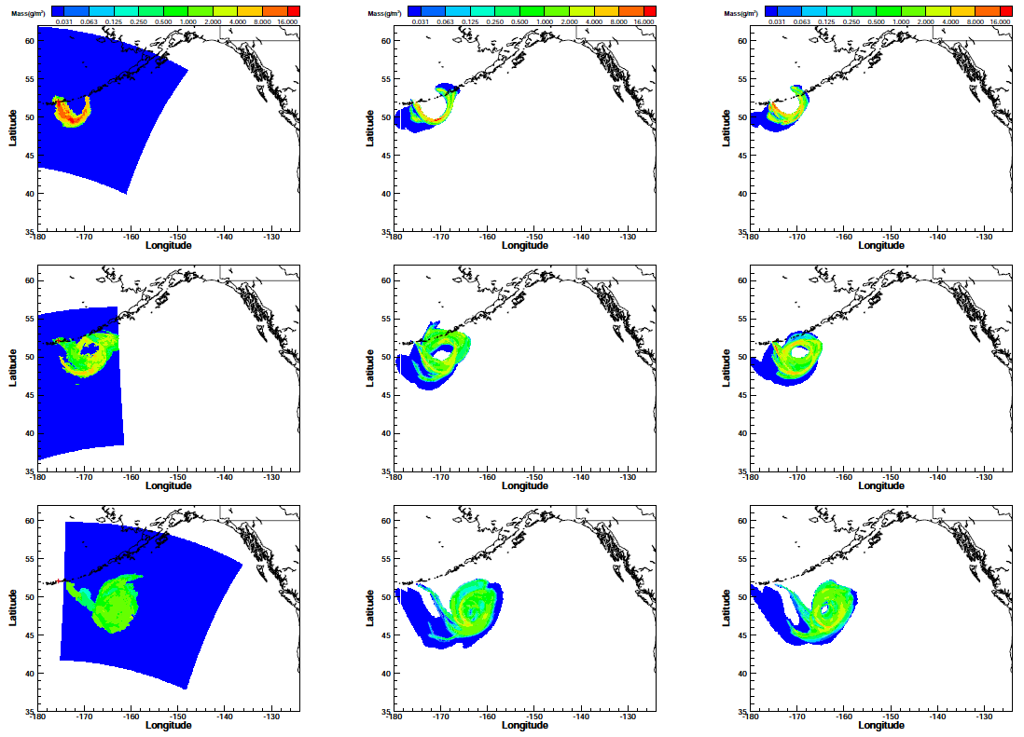
HYSPLIT inverse modeling using MODIS ash retrievals
Notes:
First 3 granules of MODIS retrievals (left column, ~12 hours apart from one to the next) are assimilated to estimate the volcanic source terms.
Right 2 columns are with GDAS and ECMWF

Slide 10
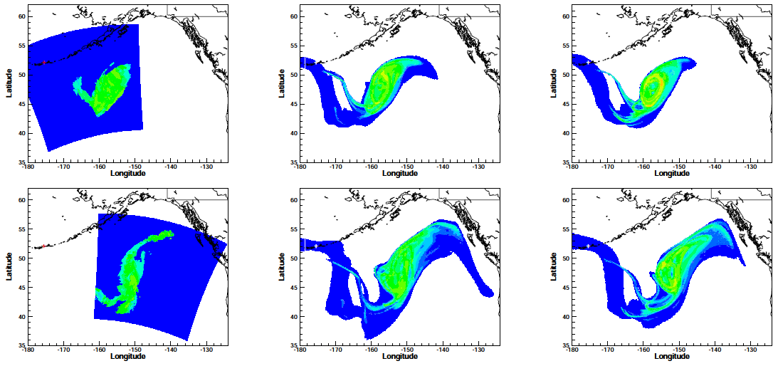
Volcanic ash predictions after inverse modeling
Improving volcanic ash predictions with the HYSPLIT dispersion model by assimilating MODIS satellite retrievals, Chai, T., Crawford, A., Stunder, B., Pavolonis, M., Draxler, R., and Stein, A., Atmos. Chem. Phys., 2017.
Notes:
Comparisons between MODIS un-assimilated observations (granule 4 & 5) and HYSPLIT predictions.
The source terms after assimilating the first 3 granules are used here.

Slide 11
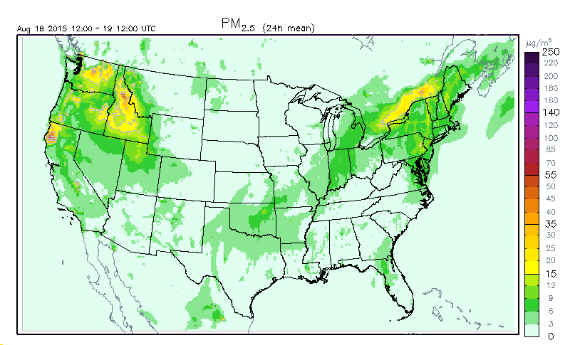
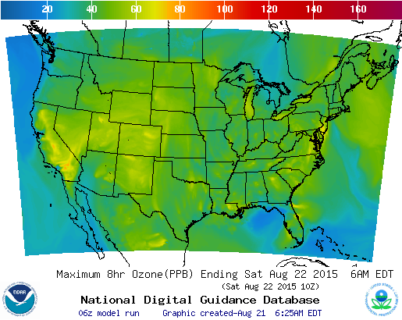
NOAA National Air Quality Forecast Capability (NAQFC): CMAQ
Developed by OAR/Air Resources Laboratory; Operated by National Weather Service (NWS)
Provides national numerical air quality guidance for ozone (operational product) and PM_{2.5} (particulate matter with diameter < 2.5 μm);
O₃ Forecasting
PM_{2.5} Forecasting
http://airquality.weather.gov/
NAQFC is one of the major gateways to disseminate NOAA satellite observations and model prediction of air quality to the public.

Slide 12
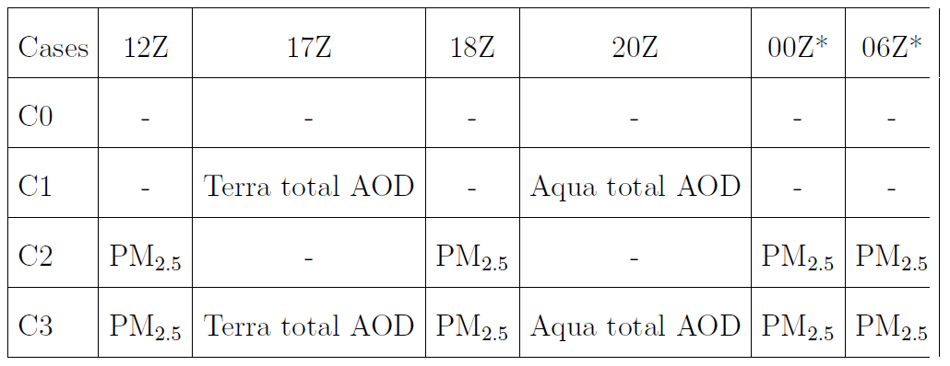
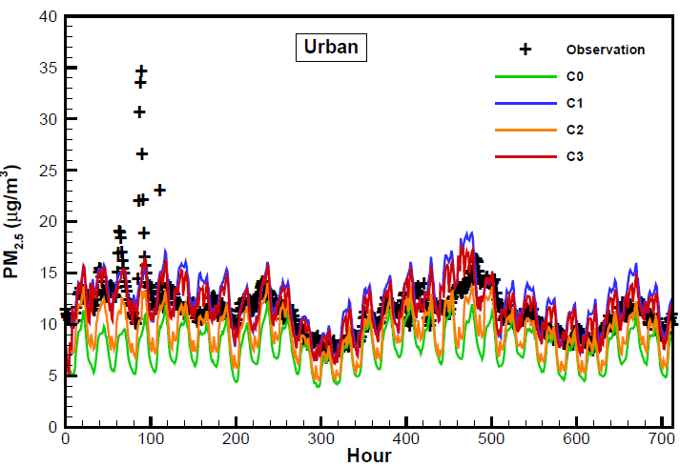
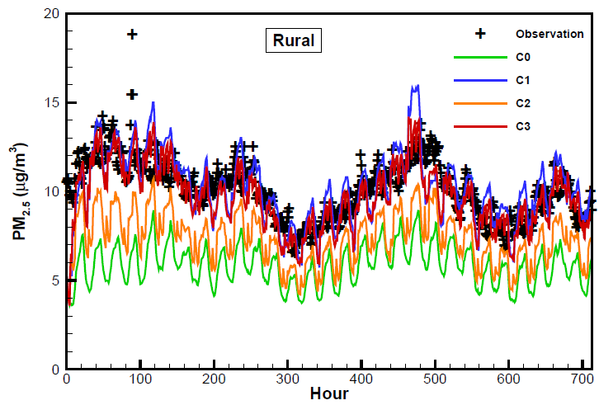
NAQFC PM_{2.5} Forecasts with AOD assimilation
Hour 0: 12 Z 7/1, 2011
Terra Aqua
7/19, 2011
7/20, 2011
Impact of MODIS AOD and AirNow PM2.5 assimilation on Community Multi-scale Air Quality aerosol predictions over the contiguous United States Chai, T., H. Kim, L Pan, P Lee, D Tong, J. Geophys. Res. Atmos. 122 (10), 5399–5415
Using optimal interpolation to assimilate surface measurements and satellite AOD for ozone and PM2. 5: A case study for July 2011, Tang, Y., T Chai, L Pan, P Lee, D Tong, HC Kim, W Chen, Journal of the Air & Waste Management Association 65 (10), 1206-1216
Notes:
MODIS AOD helps to improve NAQFC PM2.5 forecasts better than assimilating measurements from the AIRNow surface stations. It is probably because the satellite data has a much better spatial coverage than the current surface network. NOAA VIIRS is expected to have AOD products better than the current MODIS AOD data from NASA Terra and Aqua satellites.
Impact of Moderate Resolution Imaging Spectroradiometer Aerosol Optical Depth and AirNow PM2.5 assimilation on Community Multi-scale Air Quality aerosol predictions over the contiguous United StatesT Chai, HC Kim, L Pan, P Lee, D Tong
J. Geophys. Res. Atmos. 122 (10), 5399–5415

Slide 13
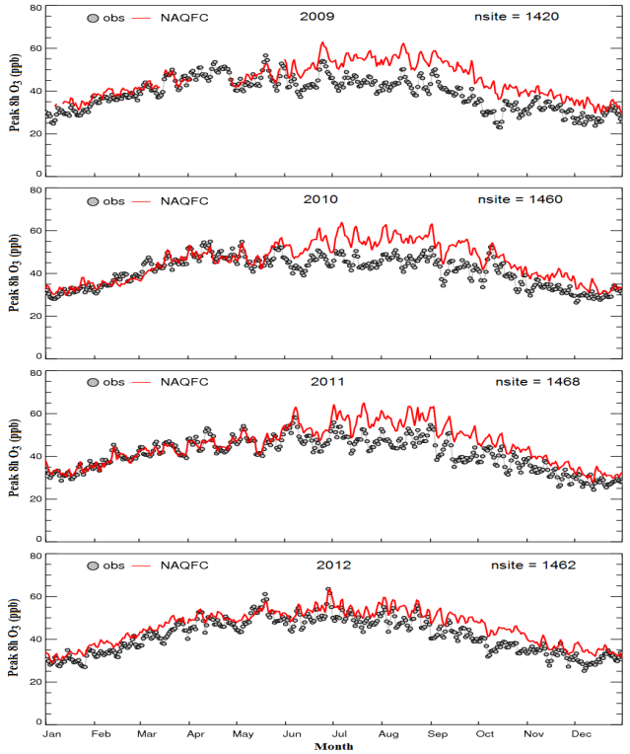
Challenges in NAQFC Emission Forecasting
Time lag is a major obstacle for NAQFC emission forecasting.
Forecasters want: emission of tomorrow;
Data availability: emission data 4+ years old.
(three years labor, one year QA, post-processing and release).
How to overcome this problem?
NAQFC Practices:
Option 1, no update (2007-2011) - Dear price paid;
Option 2, use EPA emission projection (2012-2015).
Option 3, emission data assimilation (2016-?).
(Tong et al., Atmos. Environ. 2015)

Slide 14
Impact of the Great Recession on US Air Quality
Starting – Ending time: December 2007 – October 2009;
Cause: Bursting of the housing bubble in 2007, followed by a subprime mortgage crisis in 2008;
Impacts:
Unemployment rate: 4.7% in Nov 2007 → 10.1% in Oct 2009.
Income level: dropped to 1996 level after inflation adjustment;
Poverty rate: 12% → 16% (50 millions);
GDP: contract by 5.1%;
Worst economic recession since the Great Depression
Question: What does it mean to Air Quality (and Emissions)?

Slide 15
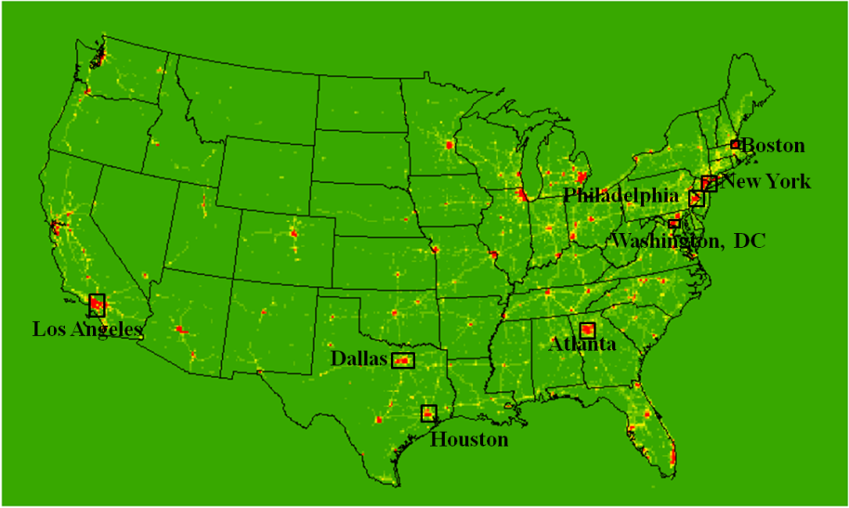
Methodology
Emission Indicator – Urban NOx in Summer
Short lifetime → proximity to emission sources
Urban NO2 dominated by local sources;
High emission density → low noise/signal ratio;
NOx Data sources
Satellite remote sensing (OMI-Aura NO2).
Ground monitoring (EPA AQS NOx);
Emission data ( NOAA National Air Quality Forecast Capability operational emissions);
Deriving the trend: (Y2–Y1)/Y1×100%
Selection of urban areas

Slide 16
Distinct regional difference;
Average NOx changes are consistent for OMI and AQS data;
-6%/yr - -7%/yr prior to Recession;
-9%/yr - -11%/yr during Recession;
-3%/yr after Recession (Recovery?).

Slide 17
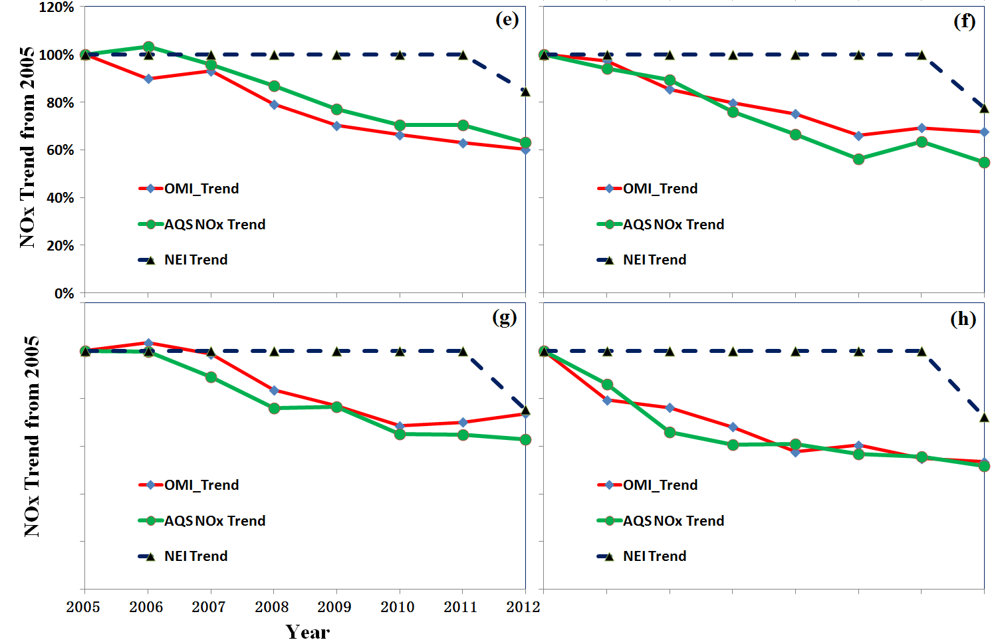
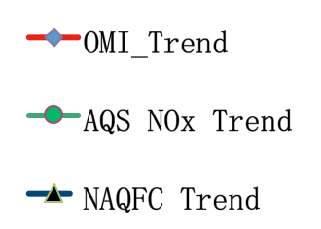
Inter-Comparison of OMI, AQS and NAQFC
Los Angeles
New York
NOx Change from 2005 Level (%)
Philadelphia
Washington, DC

Slide 18
Feasibility Study: Emission Data Assimilation
Can satellite data be used to rapidly refresh NOx emission?
Approach: Replace EPA projection factors by observation-based factors
Use both satellite and ground observations;
Optimal data fusion algorithm.
ΔS and N_{S} - changing rate and data number of satellite data;
ΔG and N_{G} -- rate and number of ground data;
f_{S} and f_{G} -- weighting factors for satellite and ground data;

Slide 19
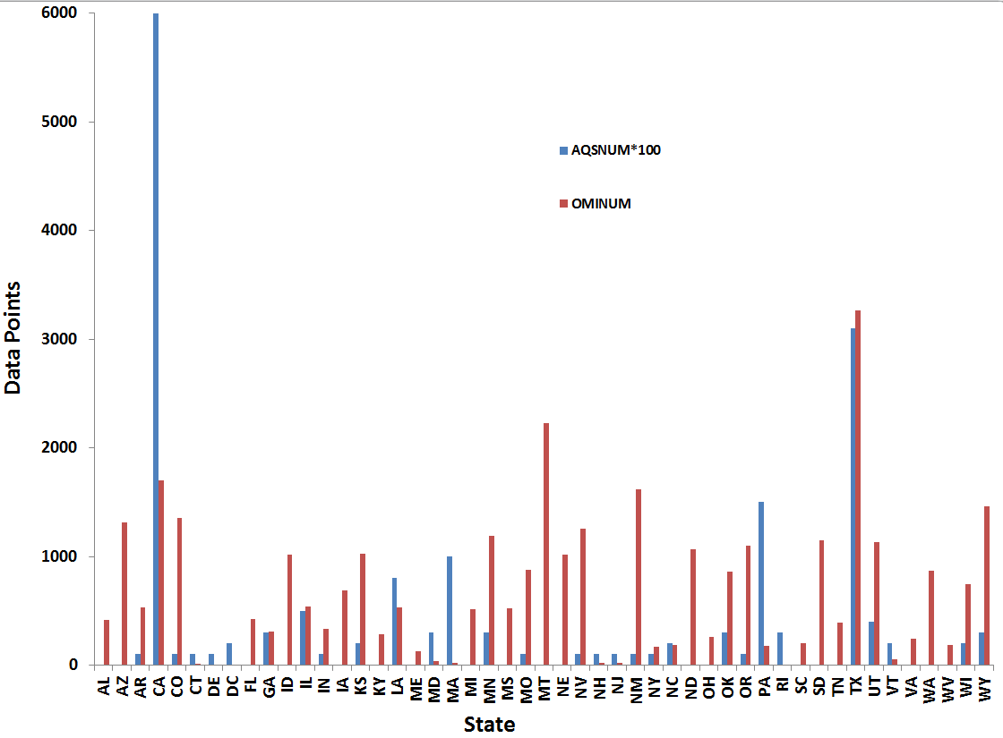
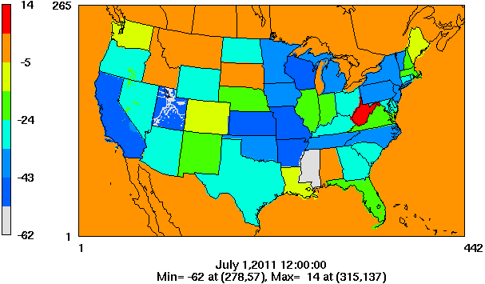
Why both satellite and ground observations?
Comparison of OMI and AQS (x100) Samples
State-level Projection Factors from OMI and AQS
OMI Preprocessing: 1) Quality filter; 2) Set a cut-off value; 3) Calculate lower and higher 25% percentiles

Slide 20
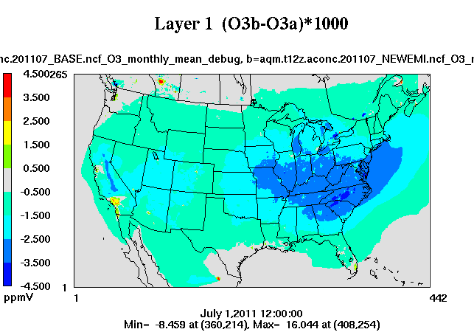
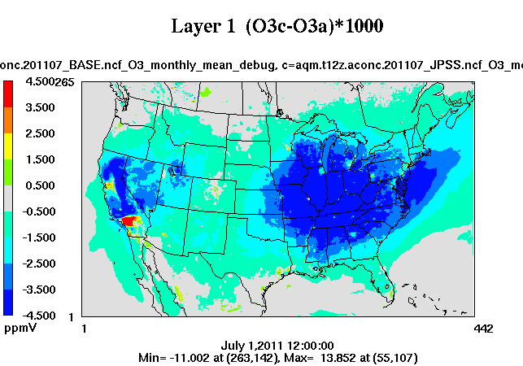
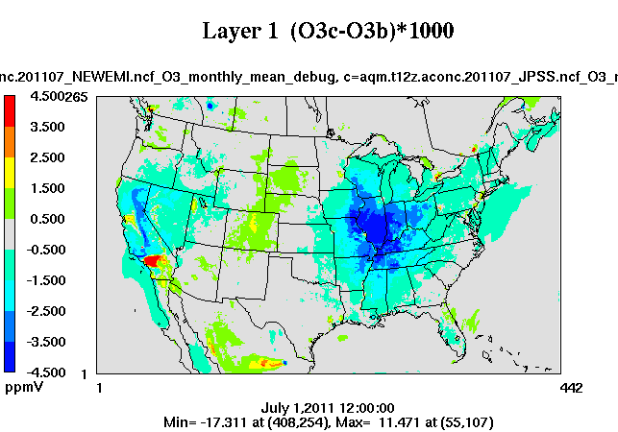
Performance Evaluation of NAQFC O₃ Forecasting
Effect of Using EPA Projection
Effect of Using New Factors
Difference

Slide 21
Model Performance Evaluation
Performance Metrics
Prediction with the new assimilated emission data outperforms the current operational system.

Slide 22
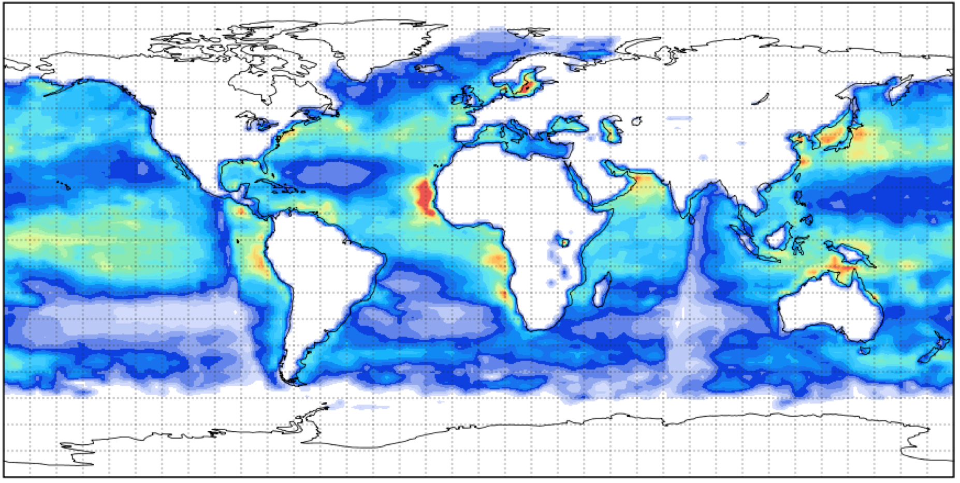
VIIRS Marine Isoprene Emission
Global Isoprene
(April 2014)
Isoprene into model domains
Notes:
Message: ARL is working with NESDIS to develop a new satellite product, marine isoprene, to support NOAA air quality forecasting and Earth System modeling.
The ocean covers 70% of the Earth’s surface. It is a major emission source of trace gases and aerosols that affect coastal air quality and atmospheric chemistry. Until now, there is no marine emission data available to drive these models.
The new JPSS product is expected to bridge the gap between user demands and data availability. The map at the top is the global marine isoprene emission derived from VIIRS for the month of April 2014.
Currently, ARL is working with NESDIS and National Weather Service to test the new product with the NAQFC system. Figures at the bottom show the isoprene product cast into two regional model domains.
The marine isoprene is retrieved using ocean color data from the VIIRS sensor aboard the Suomi-NPP satellite, and meteorology from the global forecast system or GFS model. We use 10m wind speed and solar radiation.

Slide 23
Summary & Future Plan
Satellite observations can be used to detect emission changes consistent with ground observations;
Demonstrate the feasibility of assimilating satellite and ground observations to rapidly update anthropogenic emissions;
The assimilated emission data can improve NAQFC forecasting capability, outperforming the current operational system.
Future plans include testing with GOME-2 and OMPS NO2 products beyond monthly means (e.g., daily change, over land and ocean).
Inverse source attribution using GOES-R with ensembles.

