Slide 1
Air Pollution Modeling and Health Effects Research
Yang Liu, PhD
NOAA Satellite Aerosol Product Workshop
September 25, 2017

Slide 2
Outline
Overview of satellite retrieval of PM_{2.5} mass concentration
Overview of satellite applications in health effects research
Challenges and needs for new data

Slide 3
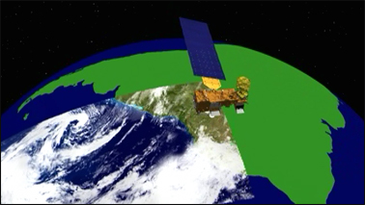
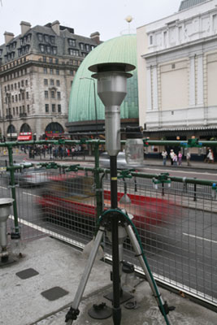
AOD and PM_{2.5} are different
AOD – Column integrated value (TOA to surface) - Optical measurement of ambient particle loading.
Sensors on polar orbits only provide snapshots.
Relative accuracy: ~15%
PM_{2.5} – cumulative dry mass concentration for particles less than 2.5 µm in aerodynamic diameter at ground level
Relative accuracy: < 5%

Slide 4

From AOD to PM_{2.5}
ρ – particle density
Q – extinction coefficient
r_{e} – effective radius
f_{PBL} – % AOD in PBL
H_{PBL} – mixing height
Composition
Size distribution
Vertical profile
Diurnal Variability too!
These factors cause the AOD-PM_{2.5} association to vary in time and space

Slide 5
Methods Developed So Far
Statistical models
  Multivariate linear regression
  Linear mixed effects models (LME)
  Geographically weighted regression (GWR)
  Generalized additive models (GAM)
  Multi-stage (Hierarchical) models
  Bayesian models
Machine learning models
  Neural network
  Random forest
Data fusion models
  Combining satellite data with model simulations
Data assimilation
  Improving chemical model simulations with satellite data

Slide 6
Case Study: Estimating PM_{2.5} in MA with GOES AOD, Meteorology, and GIS Information
Notes:
15”

Slide 7
Study Objectives
Develop a spatial model using GOES AOD, meteorology, and land use information to estimate daily PM_{2.5} concentrations measured by EPA monitors in MA and nearby states
Predict daily PM_{2.5} concentrations in the modeling domain, where there are no ground measurements, for health effect studies
Notes:
25”

Slide 8
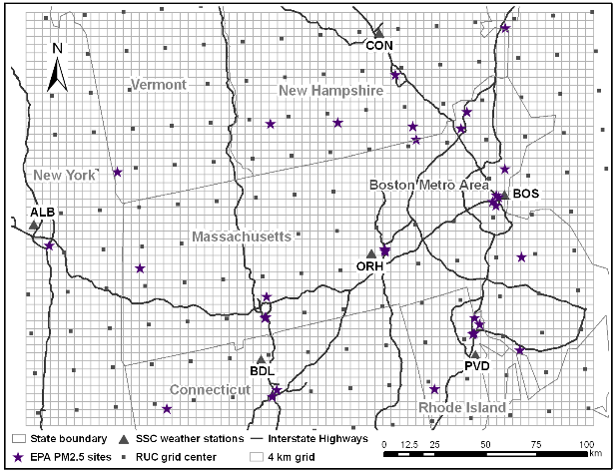
Modeling Domain
2003/04 – 2005/06, 32 EPA sites, 4 km grid for prediction
Notes:
2’30”

Slide 9
Predictor variables
Satellite Data
  GOES AOD : daily average
Meteorology
  RUC20 : assimilated mixing height, temperature, relative humidity, and wind
  SSC : weather types
Land use at 4 km resolution
  Population density based on census data
  Road lengths (Class 1, 2, 3, and total)
Notes:
SSC is a weather type indicator. For example, SSC = 3 means very hot and dry weather. Ssc=6 means warm and very humid weather. In our model, it is considered as an interaction term for the individual met parameters. The idea is that individual meteorological parameters may not fully
The predictor variables have values in the entire domain so we can make predictions.
To fit the model, these predictor variables need to be temporally and spatially matched with EPA measurements at the 32 sites.

Slide 10
Two-Level GAM Model
Level 1: RHS only has temporally varying variables (N = 2,570)
Level 2: RHS only has spatially varying variables (N = 32)
Final prediction (N = 2,570)
Notes:
2’00”
The model we developed has two major features. First it is a GAM model. We do not use a linear model because a linear model assumes that pm25 has a linear relation with each predictor so you get a bunch of slopes, but this assumption may be too simplistic.
Second feature is that this is a two-level model. In level 1, the predictors on the RHS are domain-averaged parameters so that they only vary from day to day. In level 2, the dependant variable is the residual pm concentration taken from level 1, then averaged by site. The predictors on the RHS are constant in time and only vary with location. Therefore, level 1 explains the temporal variability in PM2.5, and level 2 explains the remaining spatial variability. Finally we add level 1 and level 2 to obtain final predicted pm25 concentration.
This is because the temporal dimension of data, defined by the number of days, is much larger than its spatial dimension, defined by the sites. If we put all the variables in one model, land use info will not be significant.

Slide 11
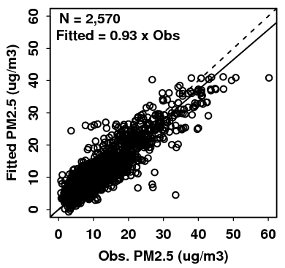
Model Performance
Mean EPA PM_{2.5} = 10.7 μg/m³
Mean fitted PM_{2.5} = 10.7 μg/m³
Mean abs. diff. = 2.4 μg/m³
Mean relative error = 30%
R²= 0.79
Cross Validation by site to prevent overfitting
CV R² ranges from 0.50 to 0.91, overall 0.79
Notes:
1’45”
Now we combine the results of the levels.
Scatter plot shows the overall fitted pm25 concentrations vs. EPA measurements. We have a pretty good linear relationship. There is 7% low bias, which is caused by the underestimation at high pm25 levels.
CV, that is..
The CV R2 of an overfitted model would be much lower than the model R2.
Our model structure is pretty robust and the quality of its predictions are consistent across the sites. Overfitting is unlikely an issue for our model.

Slide 12
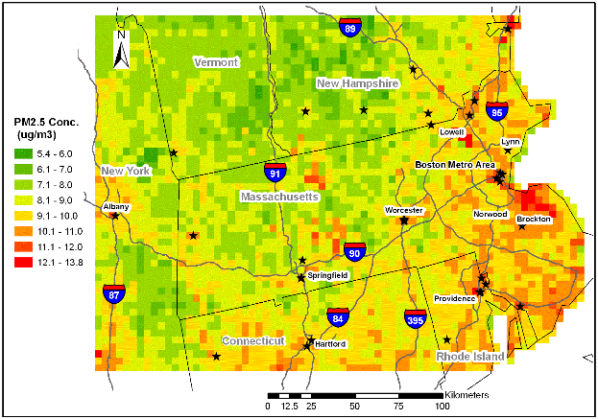
Mean Predicted PM_{2.5} Distribution
High concentrations are found in urban centers and along highways.
Now we can assign exposure levels to people living in this region.
Liu et al. EHP. 2009
Notes:
This plot shows the mean predicted pm25 concentrations. I can only make predictions when I have satellite observations.
First the domain looks OK. By current annual standard, it is in compliance. If new standard comes up, annual PM2.5 will be required to be below 12 mg/m3, then we see some areas will be in trouble.
If we conduct an epi study in the region, not every subject lives within 5 miles of a monitor. Now we can …

Slide 13
Latest work: full-coverage 1 km resolution PM2.5 model in the YRD
Raw AOD pattern
Gap-filled AOD pattern
Xiao et al. RSE. 2017

Slide 14
2013, 2014 Model Performance

Slide 15
Predicted PM2.5 Spatial Distribution

Slide 16



Satellite Applications in PM2.5 Health Effects Research
From a novelty to mainstream in 10 years
Highly influential studies published this year

Slide 17
Where Does Satellite Fit Into PM_{2.5} Health Effects Research?
Short term Long term
Small
population
Large
population
Direct method feasible
Exposure model feasible
Satellite-based statistical models are a new kind of exposure model. Its advantages are most significant for estimating the long-term exposure of a large population.
Notes:
1’40’’
My work focuses on ambient air quality. Exposure assessment is the bridge between pollution and health effects
It tries to decide where and when people are exposed to air pollution and by how much.
How the exposure assessments are done is often decided by two dimensions, one is the size of the study population, the other is the study duration.
To study the exposure of a small group of people in a short period of time, we can make direct measurements. It is accurate and straightforward.
Direct method is less and less feasible when we try to follow a large population, or try to estimate people’s long term exposure. Modeling is more and more feasible. Long-term exposure of a large population is almost impossible to directly measure. So the SOPHIA database here in Atlanta is exceptionally rare and valuable.
Satellite-based model is a new type of indirect exposure estimation method.
In fact, as long as one of the dimension is large, satellite models can be valuable.

Slide 18
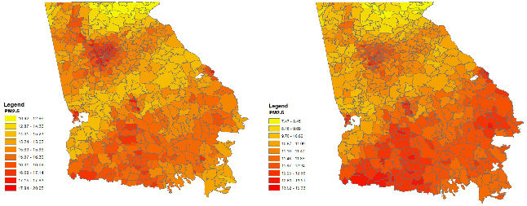
Case Study: Pediatric ED Visits and Short-Term Changes in PM2.5 Levels in GA
Objective: associations between daily PM2.5 levels and ED visits for six pediatric conditions in Georgia by urbanicity classification.
Method: map 1 km PM2.5 estimates to the ZIP codes.
Figure: long-term seasonal average PM2.5 at ZIP code level in GA
Strickland et al. EHP. 2016

Slide 19
Satellite Data Allows the Inclusion of Rural Regions Away from Monitors
Differences in the association estimates across levels of urbanicity were not statistically significant.

Slide 20
Satellite Data Missingness Biases the Epi Results Towards the Null
Figure: sensitivity of odds ratios according to the percentage missingness of 1 km PM2.5 concentration estimates in each ZIP code.

Slide 21
Challenges and Needs for New Satellite Data
Capturing the remaining 20% variability in PM2.5
  Vertical distribution
  Diurnal variability
Reduce data missingness
  Multiple measurements per day
Better understanding of PM2.5 composition
  Fire detection and smoke masks
  User friendly aerosol model information

Slide 22
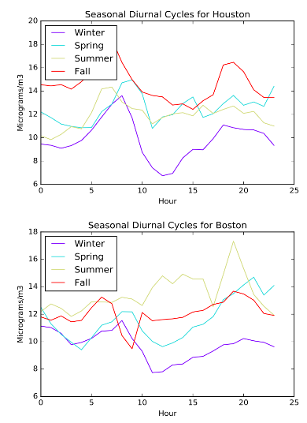
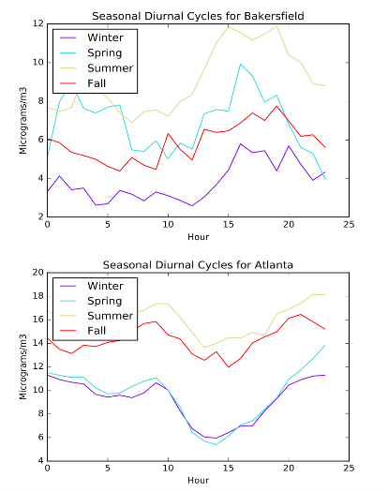
Impact of PM2.5 Diurnal Cycle

