Slide 1
VIIRS Aerosol Product Status and Update
Shobha Kondragunta and Istvan Laszlo
NOAA/NESDIS Center for Satellite Applications and Research
Hongqing Liu, Hai Zhang, Pubu Ciren
IMSG

Slide 2
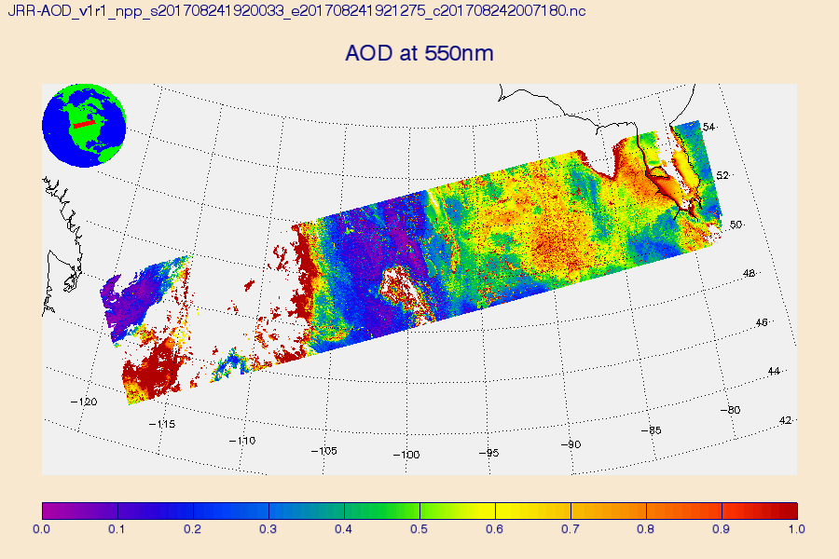
Enterprise Aerosol Optical Depth (AOD)
AOD: quantitative indicator of aerosol amount
AOD is unitless; values typically range from 0 to 1 in the U.S.
Higher AOD values correspond to higher aerosol concentrations
AOD is not retrieved in cloudy regions
Data are available as individual 86 seconds granule
Multi-spectral aerosol retrieval algorithm
Retrieval Coverage
Bright and dark surfaces except snow covered and glint regions
Product range -0.05 to 5.0
~750 m resolution
Extensive internal tests to throw away un-retrievable pixels

Slide 3
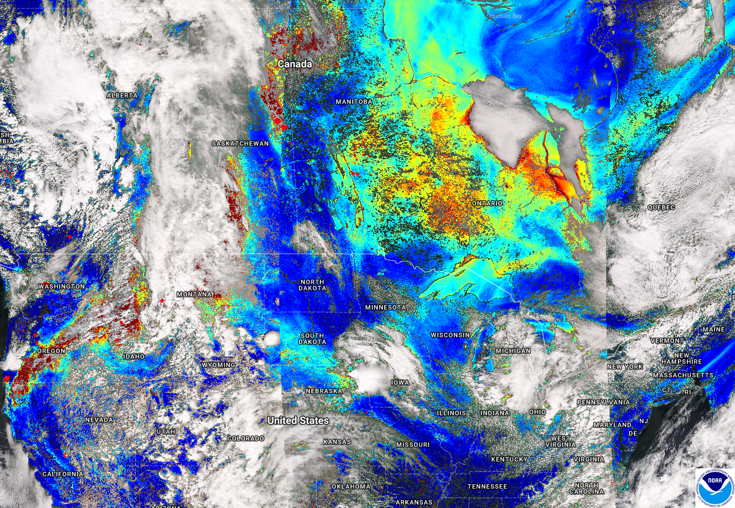
Enterprise Aerosol Optical Thickness (AOD)
Better pixel resolution (750 m – 1.2 km) and coverage over bright surfaces compared to previous algorithm or MODIS dark target products
Aug 24, 2017

Slide 4
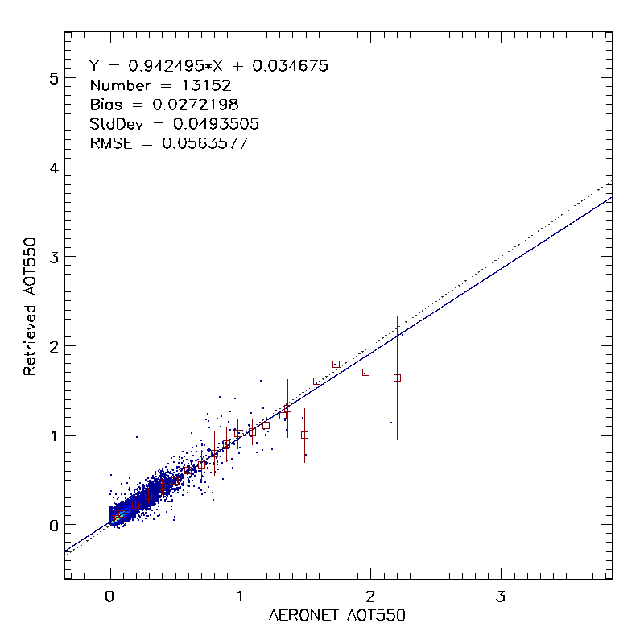
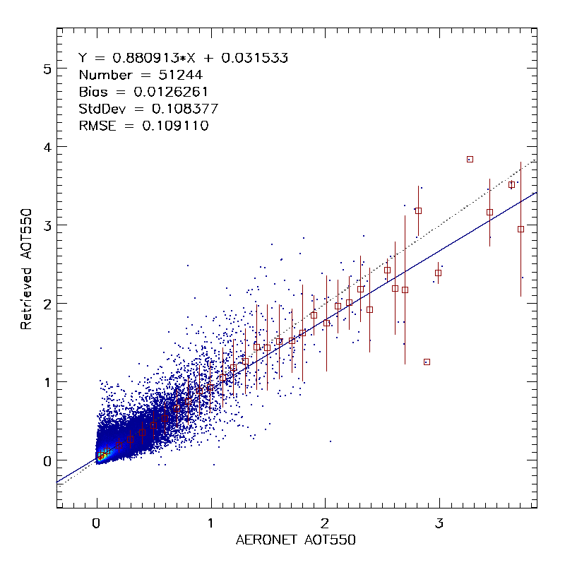
Enterprise Aerosol Optical Thickness (AOT)
Validation
5
Y = 0.035+0.942X
Number = 13,152
Bias = 0.027
RMSE = 0.056
5
Y = 0.032+0.881X
Number = 51,244
Bias = 0.017
RMSE = 0.109
Over Land
Over Water
4
4
3
3
Retrieved AOD550
Retrieved AOD550
2
2
1
1
0
0
0 1 2 3
AERONET AOD550
0 1 2 3
AERONET AOD550

Slide 5
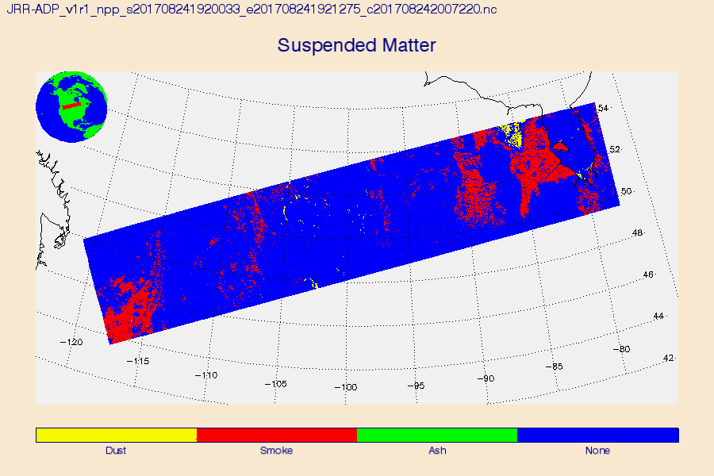
Enterprise Aerosol Detection Product (ADP)
ADP: qualitative indicator of aerosol type
Smoke, dust, volcanic ash
Absorbing Aerosol Index can be used as a proxy for intensity
ADP is not retrieved in cloudy regions
Data are available as individual 86 seconds granule
Multi-path aerosol detection algorithm
Relies on absorbing aerosol index and dust smoke discrimination index derived using 412, 441, and 2250 nm
Uses spectral and spatial variability tests of various infrared bands
Retrieval coverage
All surfaces except snow covered and glint regions
~750 m resolution
Future updates will include aerosol concentration

Slide 6
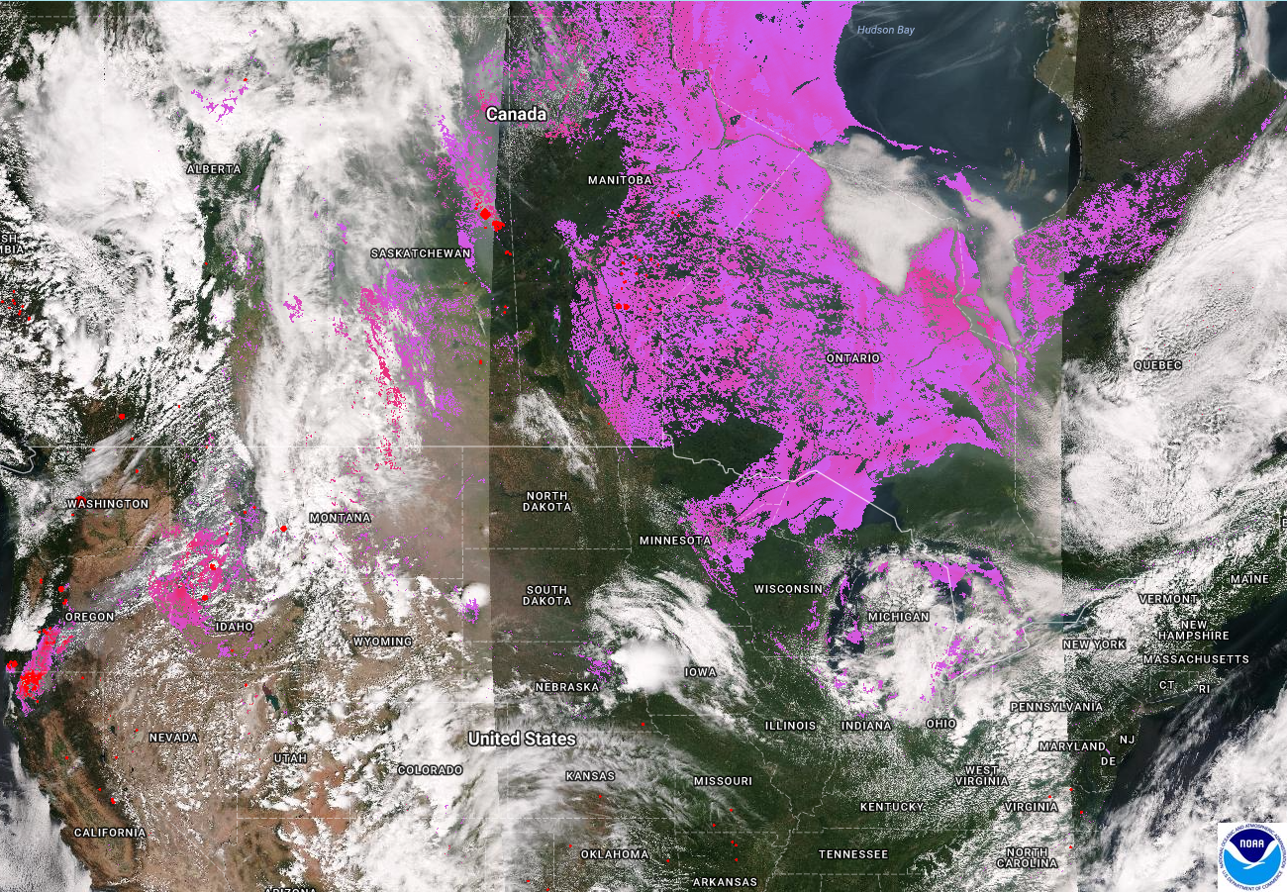
Enterprise Aerosol Detection Procut (ADP)
New product from SNPP VIIRS
No legacy MODIS product
Aug 24, 2017

Slide 7
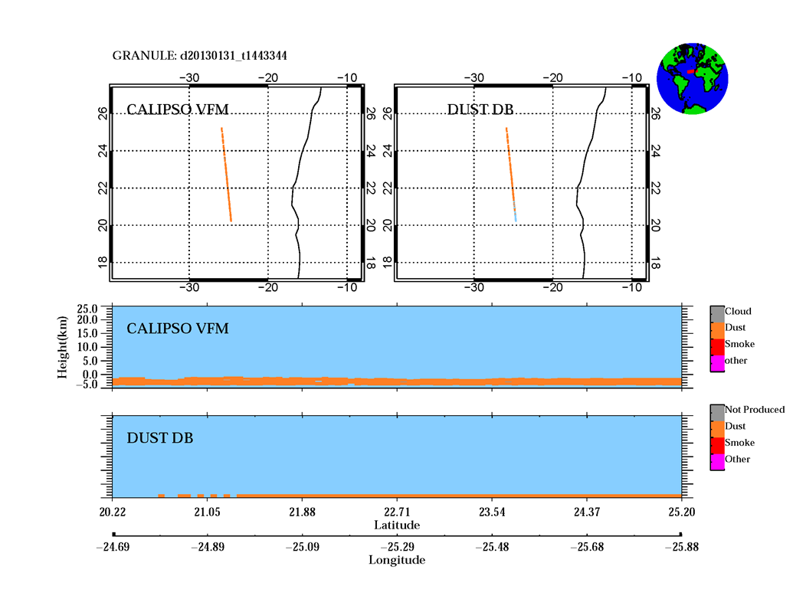
Enterprise Aerosol Detection Product (ADP)
Smoke
Metric | Land | Water
Accuracy (%) | 96.4 | 97.3
POCD (%) | 79.4 | 82.5
POFD (%) | 27.7 | 32.5
Dust
Metric | Land | Water
Accuracy (%) | 99.2 | 99.0
POCD (%) | 80.3 | 86.6
POFD (%) | 12.5 | 22.6
Validation based on data from Jan 2015 – Jul 2017

Slide 8
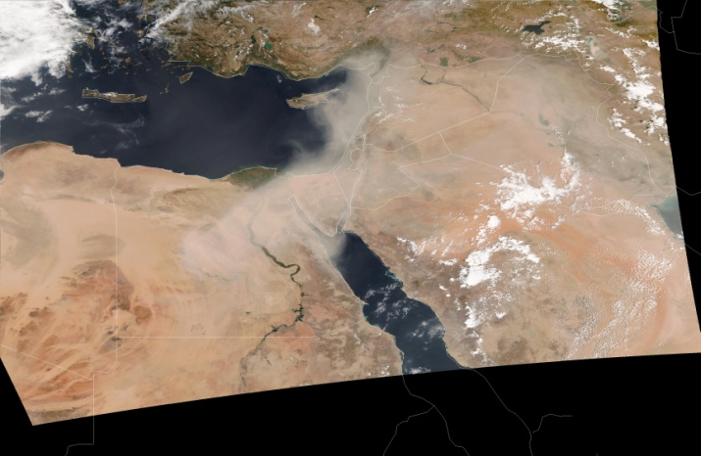
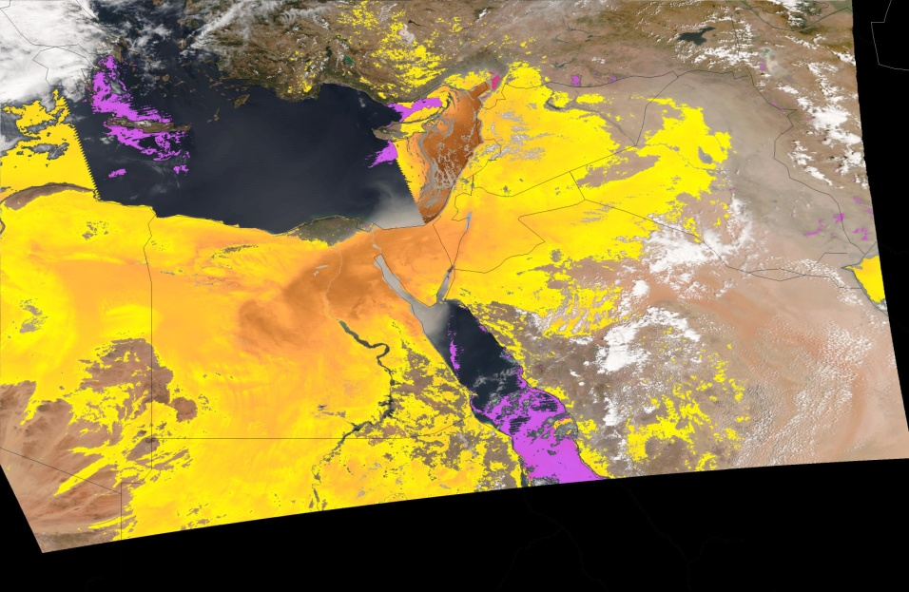
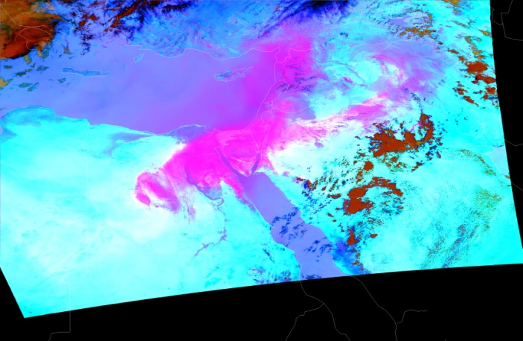
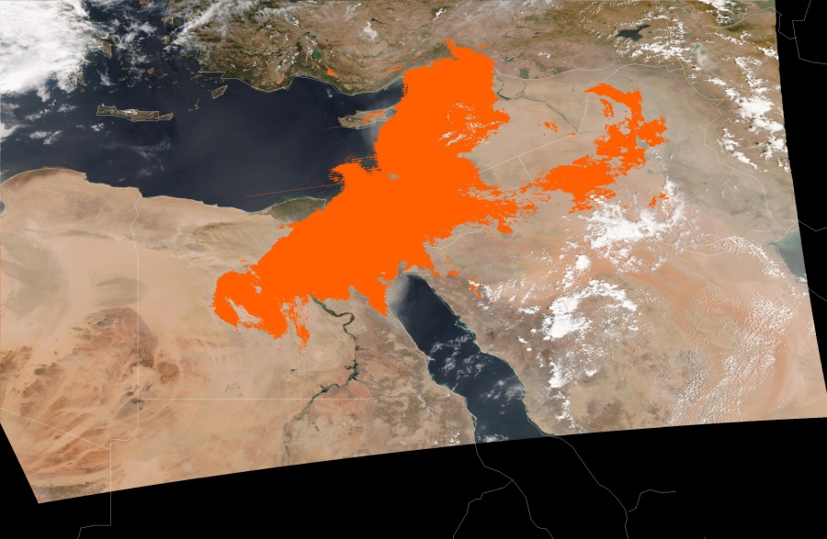
Enterprise Aerosol Detection Product (ADP)
Improvements
RGB
EPS Dust and Smoke
IR based Dust RGB
New Dust Detection
EPS dust detection product has false detections over bright surfaces and no detection in backward viewing geometry.
Dust RGB (IR spectral differing tests) test will be implemented in the next revisions to the EPS algorithm.

Slide 9
How to Access VIIRS Aerosol Imagery
Near Real Time 2-hr Latency (Granules covering US, Canada, Mexico/Central America)
https://www.star.nesdis.noaa.gov/smcd/spb/aq/eidea/
One Day Latency (Global gridded maps)
https://www.star.nesdis.noaa.gov/smcd/emb/viirs_aerosol/products_gridded_eps.php
Note: EPS product became operational in summer and data are available at CLASS beginning August 23, 2017. Prior to that the products are from an older (dark target, atmospheric correction) algorithm. We will reprocess the entire data record with EPS algorithm and replace the archive. But for now, going forward products are EPS.

Slide 10
How to Access Data Products (I)
EPS products became operational and data available from CLASS (from August 23, 2017)
Granules, global coverage
Latency is six hours
Access is via NOAA CLASS (you will get to submit a data download request during the demo)
Data format is netCDF4
EPS products through eIDEA website (https://www.star.nesdis.noaa.gov/smcd/spb/aq/eidea/)
Granules, CONUS, Alaska, Canada, Mexico/Central America
Latency is two hours
Access is via FTP (link on eIDEA website)
ftp://ftp.star.nesdis.noaa.gov/pub/smcd/hzhang/VIIRS_NRT/
Data format is netCDF4

Slide 11
How to Access Data Products (II)
EPS products global 0.25º x 0.25º grid
Latency is one day
Access is via FTP
ftp://ftp.star.nesdis.noaa.gov/pub/smcd/VIIRS_Aerosol/npp.viirs.aerosol.data/epsaot550
Data format is binary
EPS historic data
Reprocessed 2015. Other years (2012-2014, 2016-2017) available in the near future. Specific time periods of interest can be made available for studies
Access is via FTP upon request
Data format is netCDF4

Slide 12
How to Access Data Products (III)
Readers
Software to read EPS aerosol product granules given to you. You will work with them during the demo
Standalone IDL readers for both AOD and ADP are at the webpage (under Documents)
https://www.star.nesdis.noaa.gov/smcd/spb/aq/aqpg/2017/
Software to read global gridded datasets
Readme file explains the file format. If you need, IDL reader can be provided
Other netCDF4 readers (plug and play to display data)
Panoply (https://www.giss.nasa.gov/tools/panoply/download/)
HDFview (https://www.hdfgroup.org)
Weather and Climate Tool (https://www.ncdc.noaa.gov/wct/)

Slide 13
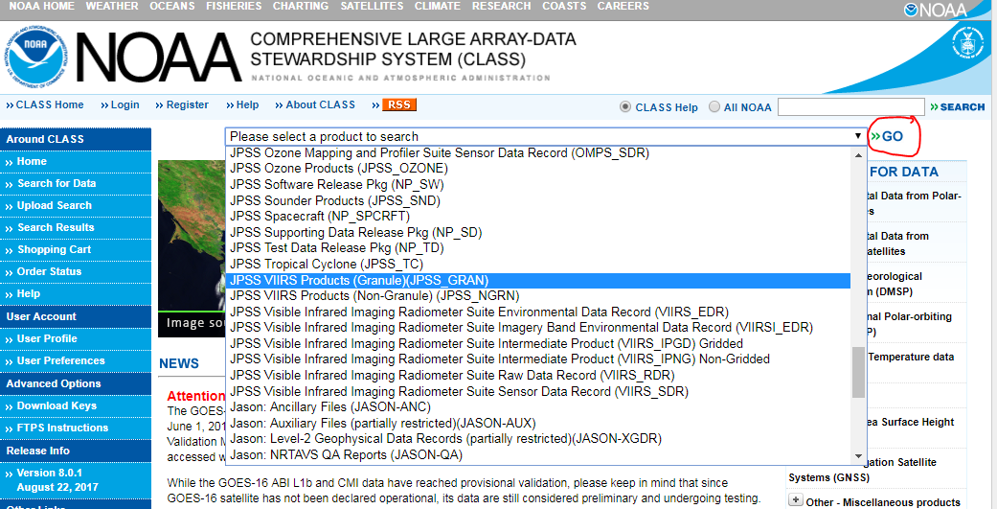
Ordering EPS AOD and ADP files from CLASS (https://www.class.ncdc.noaa.gov)
Select JPSS VIIRS Products (Granule)(JPSS_GRAN) from the drop-down list at the top of the CLASS page and click GO;

Slide 14
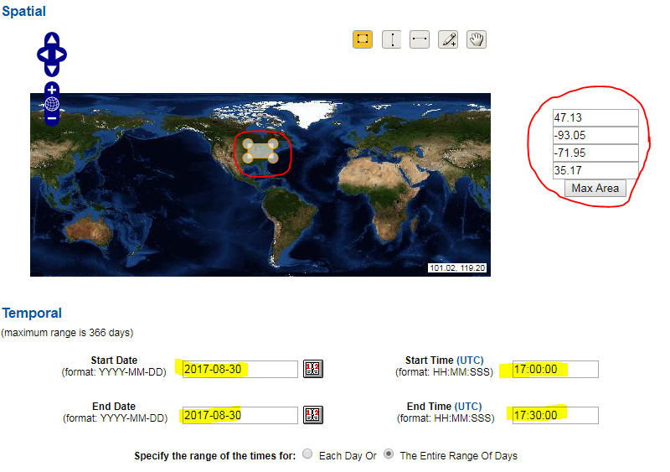
Ordering EPS AOD and ADP files from CLASS (https://www.class.ncdc.noaa.gov)
On the resulting page select the desired geographic area from the map and the date/time period;

Slide 15
Ordering EPS AOD and ADP files from CLASS (https://www.class.ncdc.noaa.gov)
Select VIIRS Aerosol Optical Depth and Aerosol Particle Size EDRs from the Datatype section under Advanced Search;
Ordering VIIRS Aerosol Detection EDR is similar; AOD is shown in the examples

Slide 16
Ordering EPS AOD and ADP files from CLASS (https://www.class.ncdc.noaa.gov)
Click the Search or the Quick Search & Order button depending on the volume (small/large) of order;

Slide 17
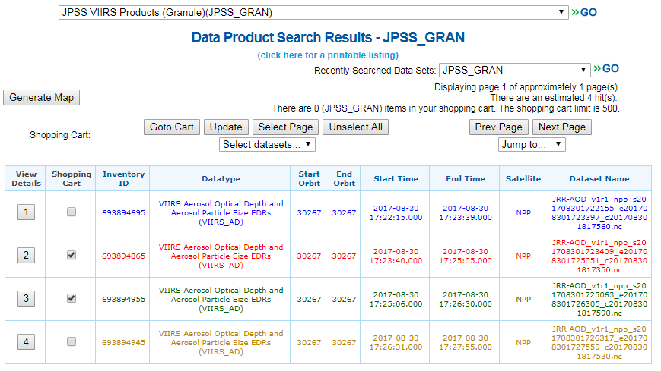
Ordering EPS AOD and ADP files from CLASS (https://www.class.ncdc.noaa.gov)
On the page that opens select the files you want from the list;
AOD (ADP) filenames will start with the string JRR-AOD_ (JRR_ADP_)
Selection can be made manually or by using the Select Page, Unselect Page buttons, or the Select datasets… drop down menu

Slide 18
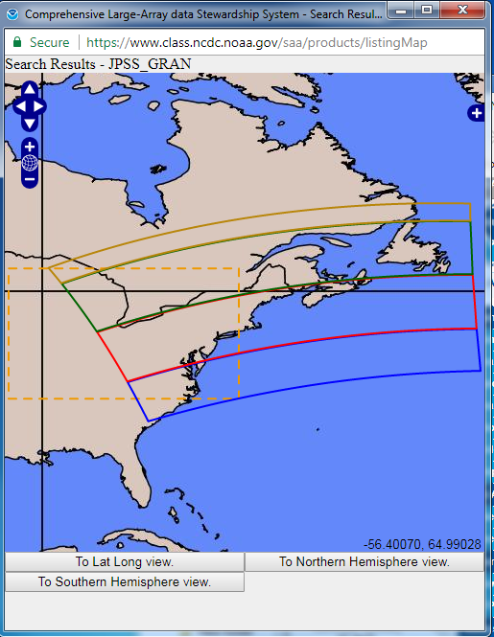
Ordering EPS AOD and ADP files from CLASS (https://www.class.ncdc.noaa.gov)
You can also plot a map of the actual area covered by the individual files in the list by clicking the Generate Map button;
After selecting the files click Goto Cart;

Slide 19
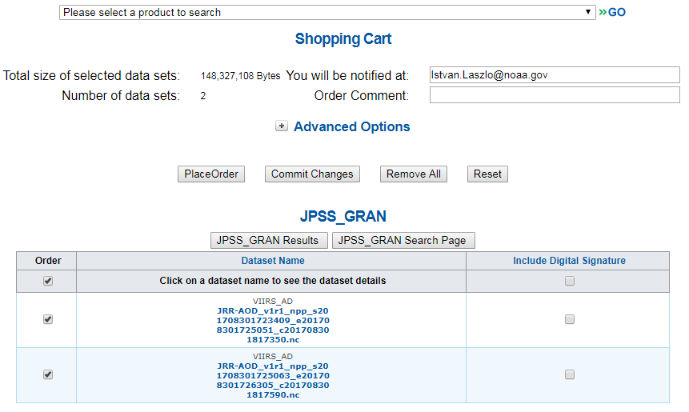
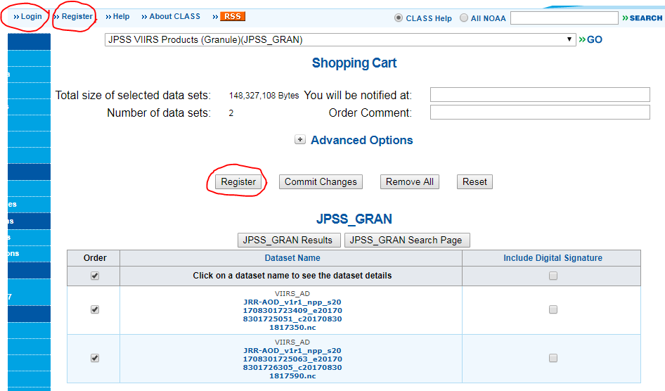
Ordering EPS AOD and ADP files from CLASS (https://www.class.ncdc.noaa.gov)
On the Shopping Cart page check the file selection again if needed and click the Place Order button to place your order;
IMPORTANT: For ordering you must be registered at CLASS and must be logged in. You can register by clicking the Register button or menu and log in by clocking the Login menu.

Slide 20
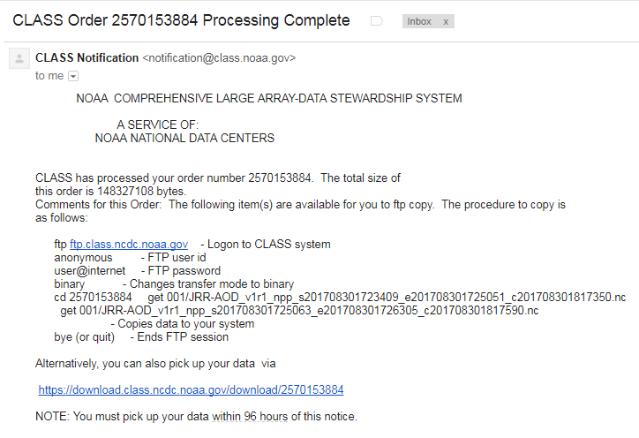
Ordering EPS AOD and ADP files from CLASS (https://www.class.ncdc.noaa.gov)
Once CLASS is done preparing your order you will receive an email from them with instructions on how to download the files.

Slide 21
Ordering EPS AOD and ADP files from CLASS (https://www.class.ncdc.noaa.gov)
Subscription without Manual Download

Slide 22
Hands-on Demo
To participate:
You should have IDL virtual machine downloaded to your laptop;
You should have downloaded viirs_eps_aero_granule_vistool-save zip file and unzipped
Why participate:
Deep dive analysis (e.g., folks filing exceptional events waivers). Understand input data, quality flags, retrieval issues
Generate images at granule level for other regions of the globe
Understand the product strengths/limitations (e.g., science users)
If all you want to do is display AOD or ADP, you can do it with easy plug and play tools like panoply, HDFview, wct

