Slide 1
Updates on the JPSS Program Lihang Zhou AMP Deputy for Science & JPSS STAR Program Manager Mitch Goldberg JPSS Program Scientist Sept 9nd, 2015 NOAA Satellite Air Quality Proving Ground Annual Advisory Group Workshop, Silver Spring, MD

Slide 2
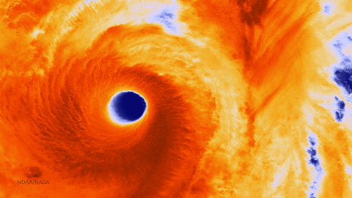
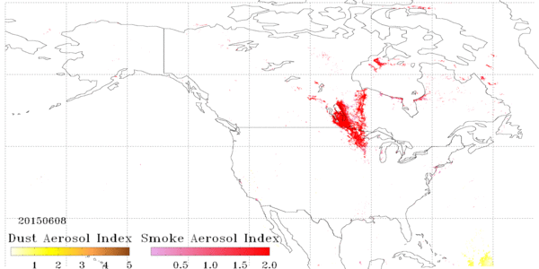
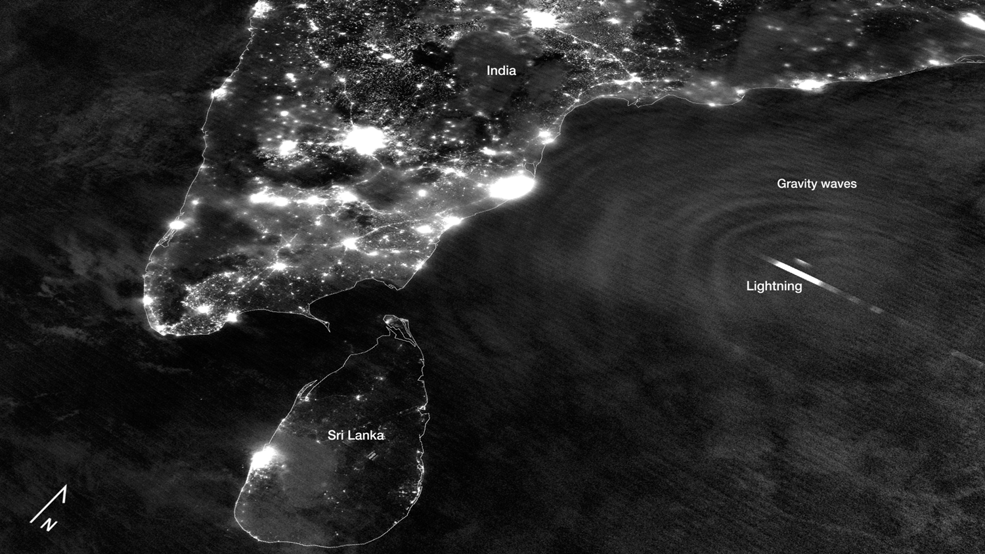
Why JPSS? JPSS provides…
…the most critical data for numerical weather prediction
to enable accurate 3-7 day ahead forecasts, giving high confidence to emergency managers in advance of severe weather events
…operational weather and environment satellite observations for Alaska and Polar Regions operational forecasting
…global coverage and unique day and night imaging capabilities in support of civilian and military needs
October 2014 - Vongfong IR
March 2015 - ice congests Chesapeake Bay
6/8/15-7/15/15: Smoke outbreak over U.S
Without JPSS, the Nation will experience an immediate degradation in weather & environmental forecasting capability
May 2013 - Tropical Cyclone Mahasen
Notes:
EOP: Executive Office of the President
OSTP: White House’s Office of Science and Technology Policy
JPSS: Joint Polar Satellite System
DWSS: Defense Weather Satellite System

Slide 3
JPSS Instruments
JPSS Instruments |  | Measurements
 | ATMS - Advanced Technology Microwave Sounder | ATMS and CrIS together provide high vertical resolution temperature and water vapor information needed to maintain and improve forecast skill out to 5 to 7 days in advance for extreme weather events, including hurricanes and severe weather outbreaks
 | CrIS - Cross-track Infrared Sounder
 | VIIRS – Visible Infrared Imaging Radiometer Suite | VIIRS provides many critical imagery products including snow/ice cover, clouds, fog, aerosols, fire, smoke plumes, vegetation health, phytoplankton abundance/chlorophyll
 | OMPS - Ozone Mapping and Profiler Suite | Ozone spectrometers for monitoring ozone hole and recovery of stratospheric ozone and for UV index forecasts
 | CERES - Clouds and the Earth’s Radiant Energy System | Scanning radiometer which supports studies of Earth Radiation Budget (ERB)

Slide 4
A Glance of JPSS

Slide 5
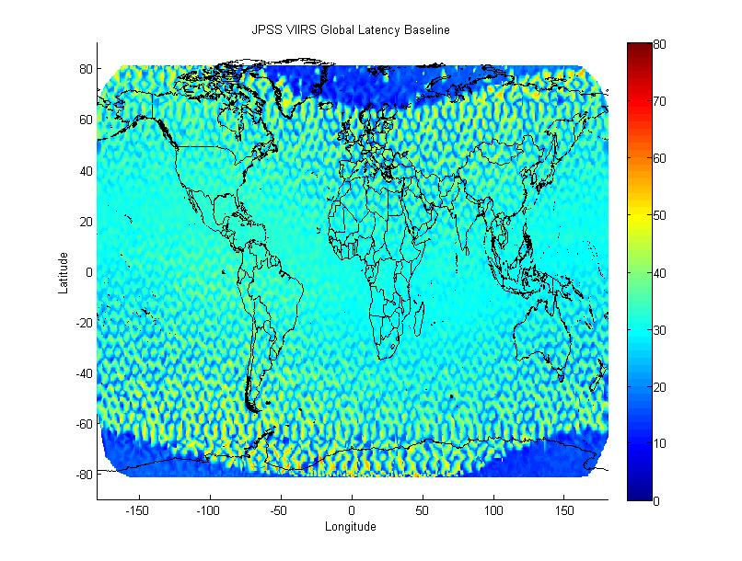
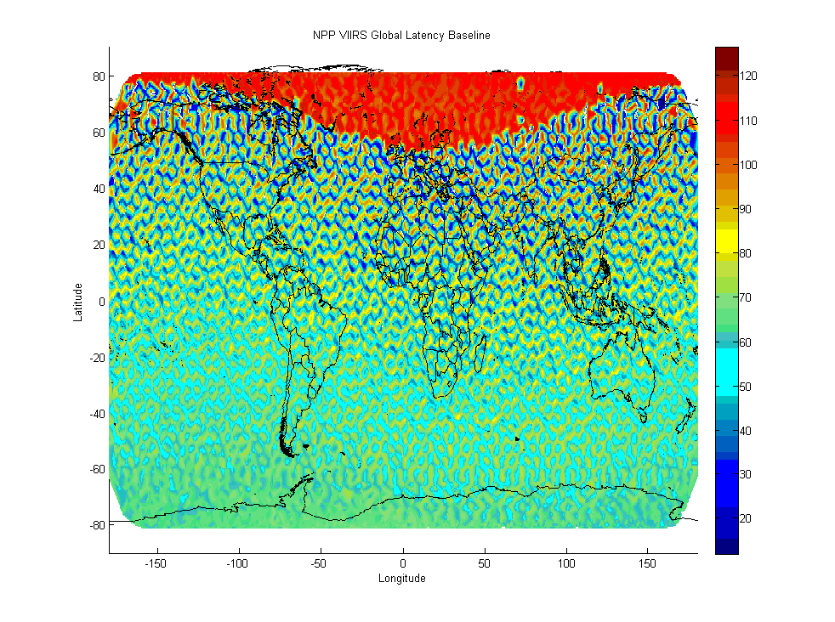
Much improved latency starting with JPSS-1
JPSS
SNPP
Polar region latency improved from 2 hours to 10 minutes
95% of the data is within 50 minutes (taking into account BUFR conversion, etc)
Between +- 50 degrees latitude ~ 30 minutes
Actual performance will be 50% better than specification
JPSS-1 uses real-time playback of data at least while still in view of the ground station, which reduces the minimum latency number, while SNPP plays back first the oldest data of the entire orbit

Slide 6
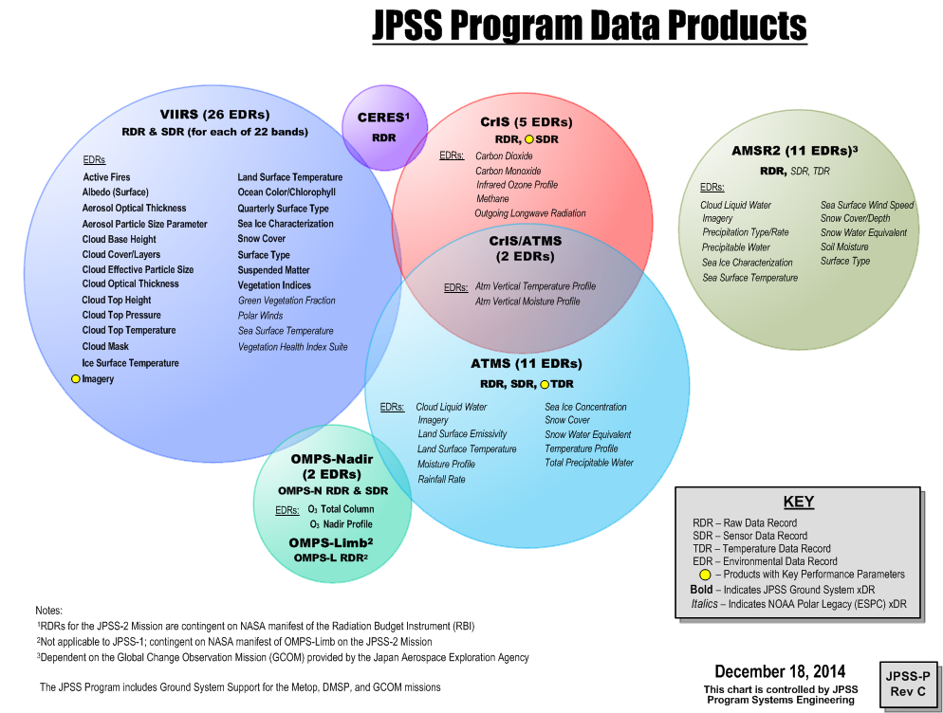
A Glance of JPSSC
Challenges
User Readiness: Products to
Applications
Ensure users are ready for NPP/JPSS
data and improve their key
operational and research product
and services
Severe weather forecasts and warnings
Aviation weather forecasts and warnings
Improve fire and air quality forecasts and warnings
Improve warnings and prediction of poor
water quality in coastal regions
- Improve drought, precipitation, snow and ice assessments and predictions
• Periodic feedback from keys users
on the impact of NPP/JPSS data and
to identify improvements needed
for products and applications

Slide 7
JPSS-STAR (JSTAR) Program
PURPOSE: To provide robust, affordable, and flexible state-of-art scientific solutions to meet JPSS requirements
Leverages hundreds scientists from NOAA, NASA, DOD, and NOAA’s Cooperative Institutes (University partners) and Industry Partners
Applies first-hand knowledge of algorithms and cal val, developed in POES, GOES, DMSP, EOS, MetOP, and GOES-R, for JPSS Program
Works closely with JPSS Program Science and all other elements to ensure the developments are in line with the users’ requirements, and efficient science to operation transitions
Facilitate algorithm consistency across platforms
Supports science for multiple satellite systems (Enterprise Approaches)

Slide 8
JSTAR FY15 Key Deliveries/Milestones
Milestones | Delivery Date
CrIS SDR: Full spectral resolutions SDR | Jan-15
CrIS SDR: Fringe Count Error module update | Jun-15
CrIS SDR: JPSS-1 Instrument Test Data Analysis Report | Mar-15
VIIRS SDR: JPSS-1 Instrument Test Data Analysis Report | Aug-15
OMPS SDR: JPSS-1 Instrument Test Data Analysis Report | Jul-14
OMPS SDR: Algorithm improvements to support extended spectral range, and reduced horizontal cell size at nadir | Apr-15 (TC) May-15 (NP)
OMPS Ozone NP: V8Pro | Feb-15
OMPS Ozone TC: V8TOz | Jul-15
Vegetation Indices: Add top-of-canopy NDVI | Mar-15
Ocean Color: OCC for coastal and inland water | Apr-15
Active Fires: 2D fire mask; include water for global coverage | Jun-15
JPSS-1 Cal Val Plans Draft Delivery | Jul-15
VIIRS SDR: LUT and GEO code update for JPSS-1 | Aug-15

Slide 9
JPSS Significant Proving Ground Accomplishments
• VIIRS Active Fire, Air Quality imagery and data portals
• Use of fire location and radiative power in NOAA’s High Resolution Rapid Refresh (HRRR) model to better forecast fire spread and smoke dispersion
• Global Data Assimilation Experiments of ATMS, CrIS; and Aerosol products
• S-NPP Direct Broadcast - Provide Community Satellite Processing Package (CSPP); Routine use of VIIRS Imagery by forecast offices (significant use by Alaska)
• Tropical Cyclone Forecasting Improvements using ATMS
and CrIS
• Education and Training (New COMET VIIRS Day Night
Module)
• Two (2013, 2015) Airborne Validation Campaign via
NASA ER2 to assess CrIS SDR accuracy @0.1K level
• Established monthly science seminars and operational
demonstration initiatives to continue broad user
involvement
• Supported pathfinders for reprocessing

Slide 10
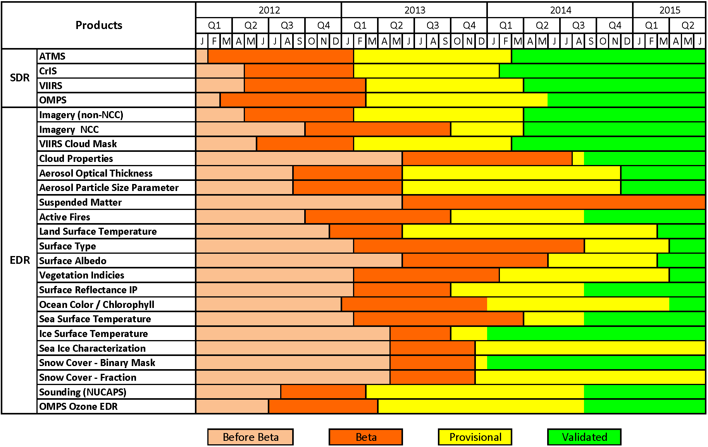
Suomi NPP Product Maturity Will be applied to all JPSS-1 products
10

Slide 11
JPSS-1 Test Data Sets
JPSS Test Data Working Group (TDWG) generated J1 RDRs from J1 TVAC and Suomi NPP data sets as desired by STAR SDR teams.
STAR teams utilized J1 RDRs to develop and test SDR algorithms for sensor changes and waiver mitigations.
STAR SDR teams also developed tools to manipulate the data sets and create new proxy data sets to verify SDR and EDR algorithms at several levels.
Running J1 test data sets though the algorithms helps us better prepare for J1 post launch cal val activities.

Slide 12
Priorities Moving Forward
Ensure Cal/Val Team Readiness for JPSS-1
Develop roadmap/plans toward enterprise algorithms
Algorithm development/Improvements for J1
Implement code to meet JPSS-1 requirements
Develop and update the Cal/Val plans
Continue Support for Suomi NPP Mission Objectives
Provide Suomi NPP data products to support NOAA’s operational missions.
Provide a pre-operational demonstration for JPSS user engagement (Testbed)
12

Slide 13
More Future Improvements
Optimal and reliable data products and uses from a fusion of sensors onboard U.S. and international POES/GOES satellite constellation
Science Quality Data Processing (Reprocessing) is necessary for Cal Val and users.
Globalization and unification of Cal/Val processes and Maturity Definition of products derived from a variety of satellite Platforms
Further promote the SNPP/JPSS products for operational uses

Slide 14
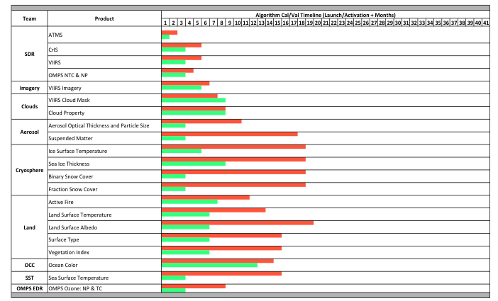
JPSS-1 vs. SNPP Cal Val Timeline Beta
DRAFT

Slide 15
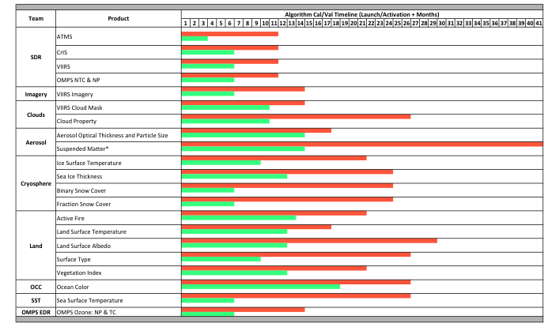
JPSS-1 vs. SNPP Cal Val Timeline Provisional
DRAFT

Slide 16
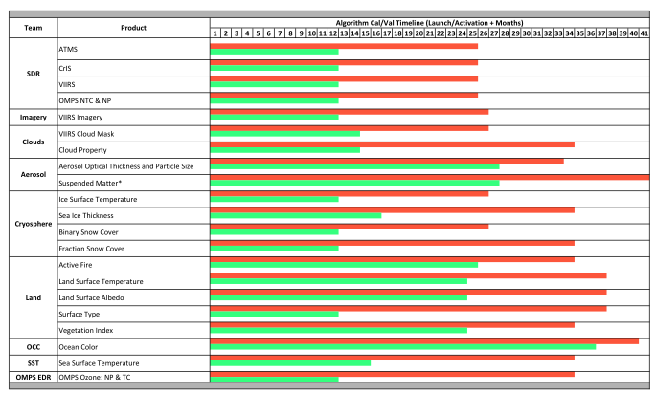
JPSS-1 vs. SNPP Cal Val Timeline Validated
DRAFT

Slide 17
Want to Learn More
STAR JPSS Website
http://www.star.nesdis.noaa.gov/jpss/index.php
Algorithm Theoretic Basis Documents
Cal/Val Docs
OAD and CDFCB
Requirements Documents
SDR/EDR Team Leads/Contacts
Links to ICVS
Links to EDR websites
17

Slide 18
Summary
Suomi NPP is producing outstanding data – great job done by JSTAR teams on algorithms and cal val
The satellite is healthy and producing a high availability of data (~99.99%)
Operations of the satellite transferred from NASA to NOAA in 2013
Suomi NPP is the primary operational polar-orbiting satellite for NOAA
JPSS-1 is executing as planned – algorithms upgrades deliveries, pre-launch and post launch preparation
Instruments and spacecraft are proceeding well
Instruments are assembled and undergoing testing; one is prepared for integration
The spacecraft bus is built and undergoing testing
Development and implementation of the new ground data processing system are underway
JPSS-2 procurement activities are progressing well
The VIIRS, OMPS, CrIS, and ATMS and Radiation Budget Instrument are under contract
The spacecraft bus procurement is underway

Slide 19
JSTAR Imagery of the Month VIIRS Imagery Team: Curtis Seaman, Don Hillger
False color (Natural Color) image of Hurricane Ignacio as a Category 4 hurricane approaching Hawaii seen by VIIRS with 375 m resolution on 29 August 2015 at 22:48 UTC.

