Slide 1
Recent Updates to the VIIRS Aerosol Algorithm
The STAR VIIRS AOT algorithm
Istvan Laszlo (NOAA/NESDIS/STAR)
with contributions by
Hongqing Liu and Hai Zhang (IMSG, Inc.)

Slide 2
Outline
The IDPS VIIRS AOT algorithm
The STAR VIIRS over-land AOT algorithm
  Dark surface
  Bright surface
  Examples

Slide 3
Aerosol from VIIRS
Aerosol products are derived from Visible Infrared Imaging Radiometer Suite (VIIRS).
Current operational processing is in the Interface Data Processing Segment (IDPS).
Aerosol retrieval is from M bands with 750 m nadir resolution.
Separate algorithms for aerosol optical thickness (AOT) retrieval over land and over ocean.
Band name | Wavelength (nm) | Bandwidth (nm) | Use in algorithm
M1* | 412 | 20 | L
M2* | 445 | 14 | L
M3* | 488 | 19 | L, T_{L}, T_{O}
M4* | 555 | 21 | T_{O}
M5* | 672 | 20 | L, O, T_{O}
M6 | 746 | 15 | O
M7* | 865 | 39 | O, T_{L}
M8 | 1,240 | 27 | O, T_{L}, T_{O}
M9 | 1,378 | 15 | T_{L}
M10 | 1,610 | 59 | O, T_{L}, T_{O}
M11 | 2,250 | 47 | L, O, T_{L}, T_{O}
M12 | 3,700 | 191 | T_{L}
M13 | 4,050 | 163 | none
M14 | 8,550 | 323 | none
M15 | 10,763 | 989 | T_{L}, T_{O}
M16 | 12,016 | 864 | T_{L}, T_{O}
*dual gain, L: land, O: ocean; T_{L,O}: internal test land/ocean

Slide 4
The IDPS VIIRS Dark Surface AOT Algorithm

Slide 5
Over-land AOT in IDPS
Key Requirements/Assumptions:
Surface reflectance ratios (e.g., M3/M5, M11/M5) can be established a priori (for dark-dense vegetation).
Aerosols change the ratios of M-band reflectances from those of the surface values.
Retrieval:
Estimate surface reflectances from surface+aerosol (s+a) reflectance for a set of AOTs and candidate aerosol models [dust, smoke (low and high absorption), urban (clean/polluted)].
Select AOT and aerosol model that provide the best match between ratios of retrieved surface reflectances and their expected values.

Slide 6
The STAR Dark Surface over-land AOT Algorithm (VRR)
(VIIRS Risk Reduction Algorithm)

Slide 7
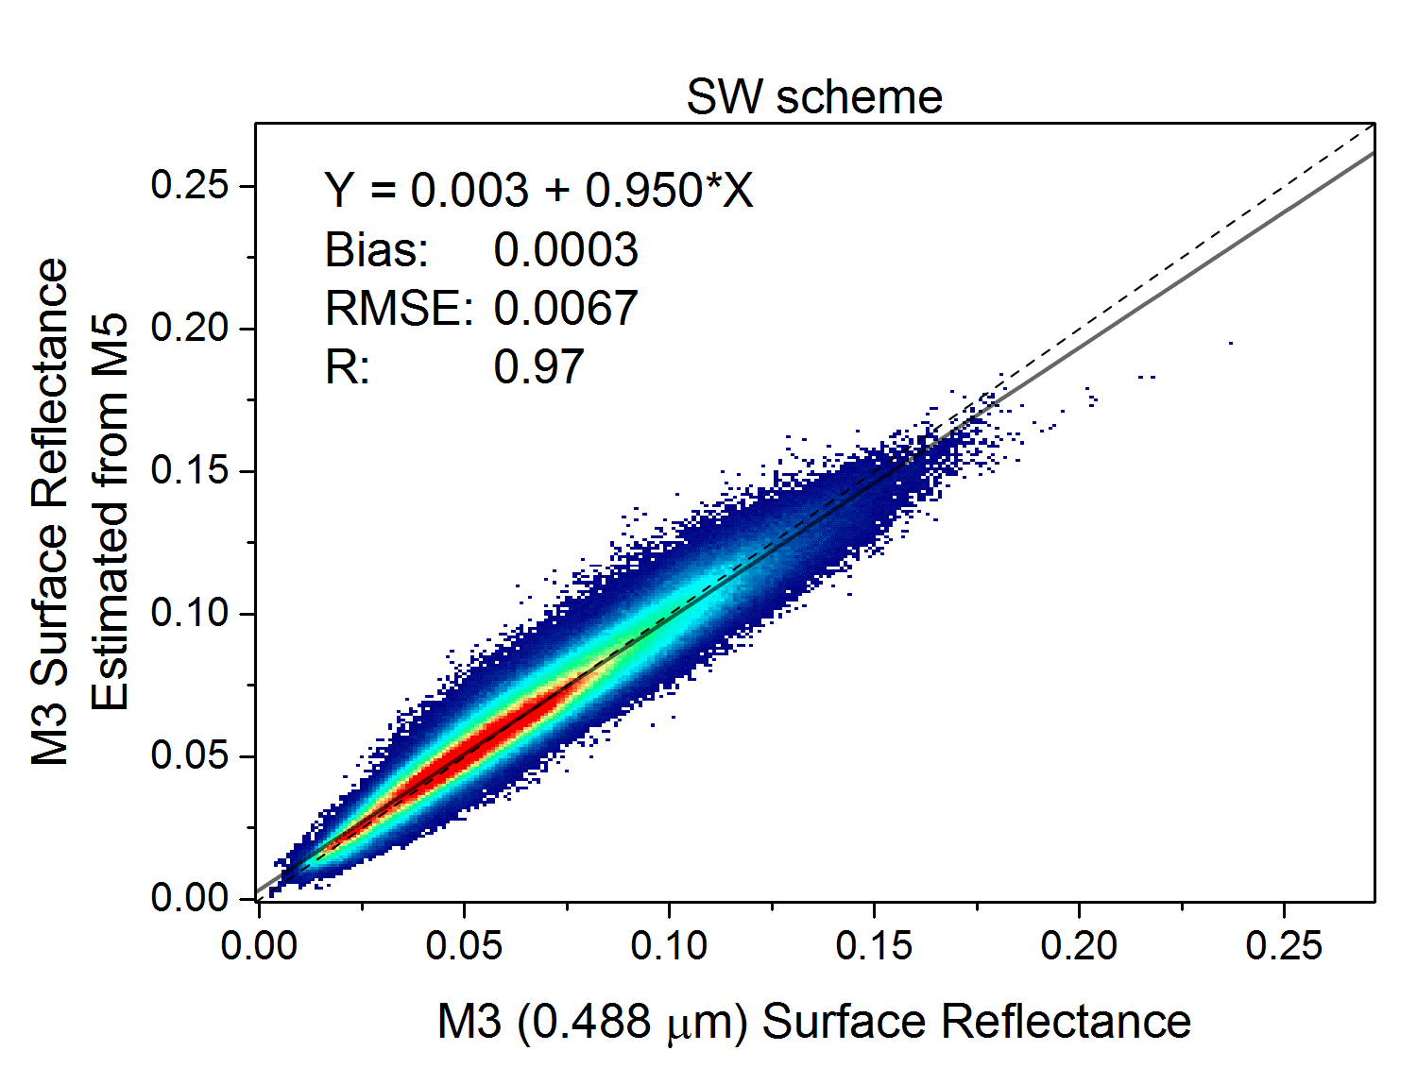
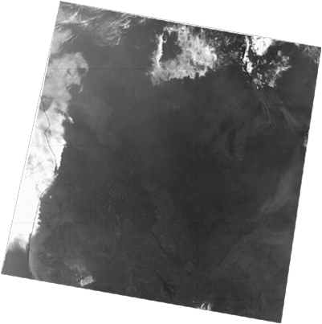
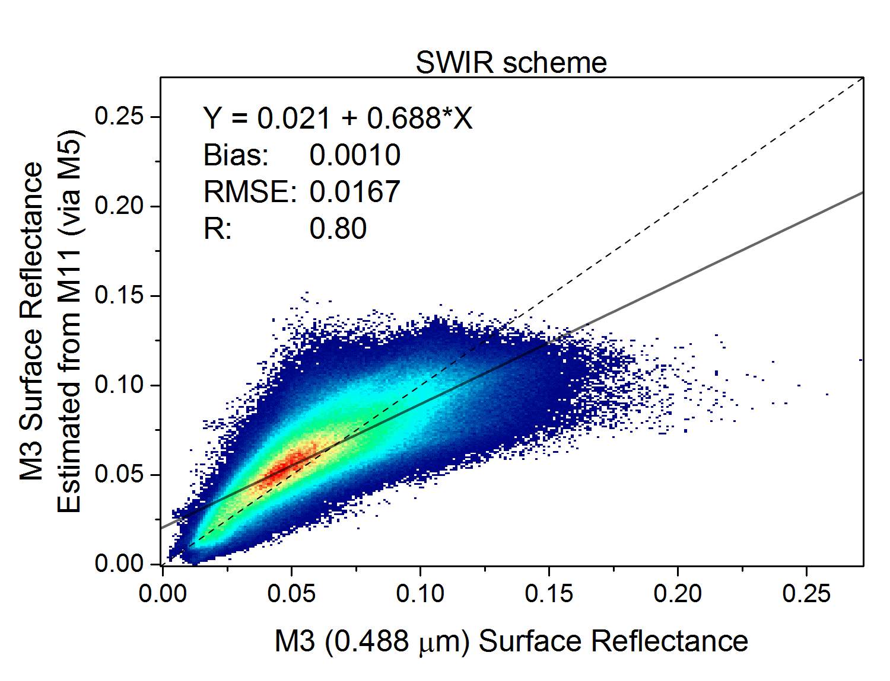
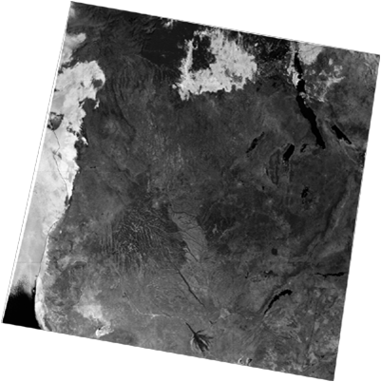
STAR (VRR) Algorithm
Combines IDPS and MODIS/GOES-R:
  SW-scheme (IDPS): more accurate estimation of M3 surface reflectance from M5 for low AOT
  SWIR-scheme (MODIS): more transparent M11 allows more accurate estimation of M3 (from M11) surface reflectance for high AOT
AOT range: -0.05 – 5.0
Non-constant surface reflectance ratios
Less reliance on VCM – extensive internal tests
Spatial variability test to better detect snow and cloud (M1 std in 3x3 pixels > threshold)
M3
M11

Slide 8
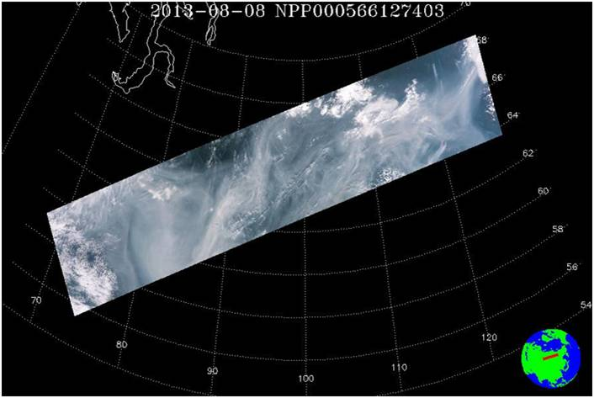
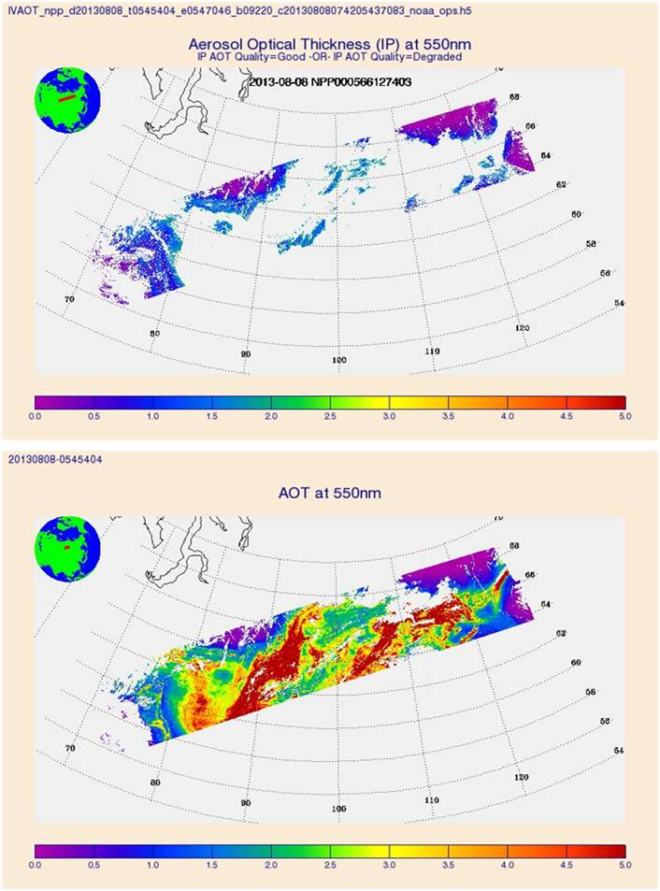
IDPS vs. STAR (VRR) Example
RGB
IDPS
STAR (VRR)
IDPS misses smoke plume from Siberian fires (08/08/2013).
More retrievals and extended AOT range in STAR (VRR) algorithm allow to capture full extent of smoke.

Slide 9
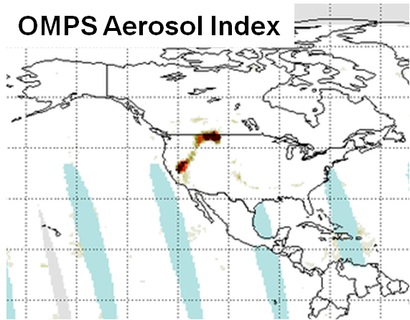
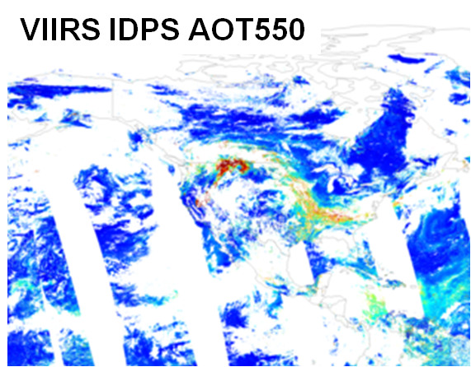
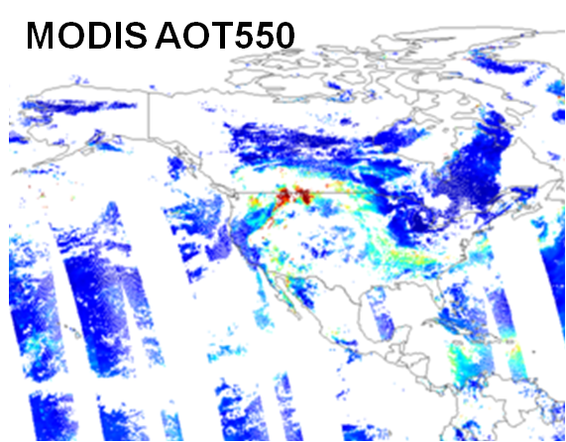
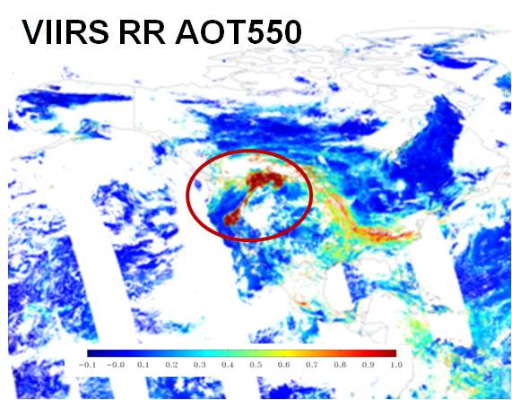
California Rim Fire 08/23/2013
OMPS indicates aerosol over a large area.
MODIS and VIIRS IDPS reports smaller extent of aerosol from fires.
As a result of more retrievals aerosol from fire is better captured by STAR (VRR).

Slide 10
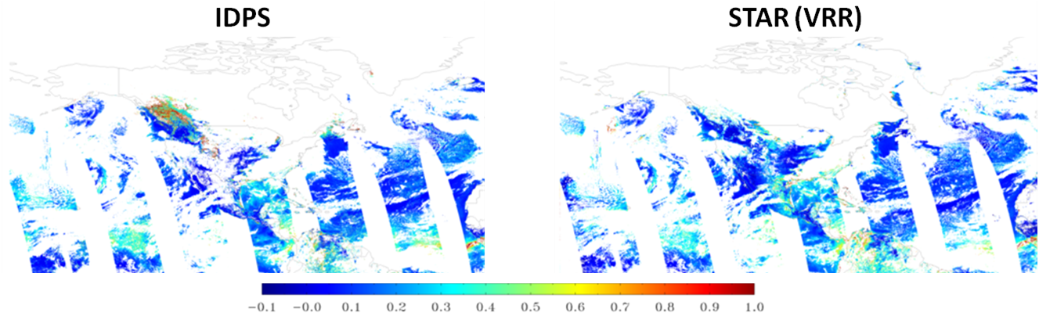
Spring “thaw” 03/31/2013
possible snow contamination
7 x 7
Spatial variability test in STAR (VRR) reduces snow contamination.
Implemented in IDPS 06/22/2015 at 19:43 UTC;
IDPS also flags pixels adjacent to snow (degraded quality).
 | snow
 | degraded
 | excluded
 | not produced

Slide 11
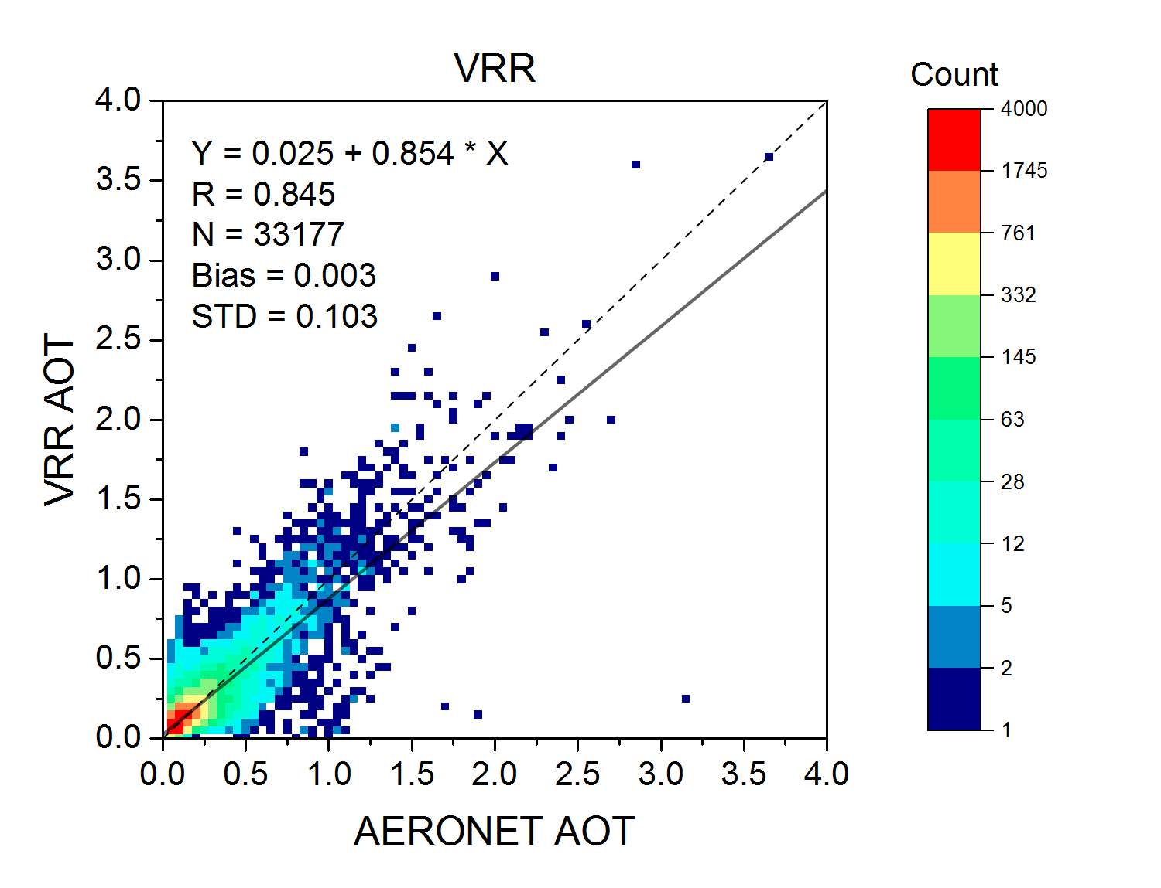
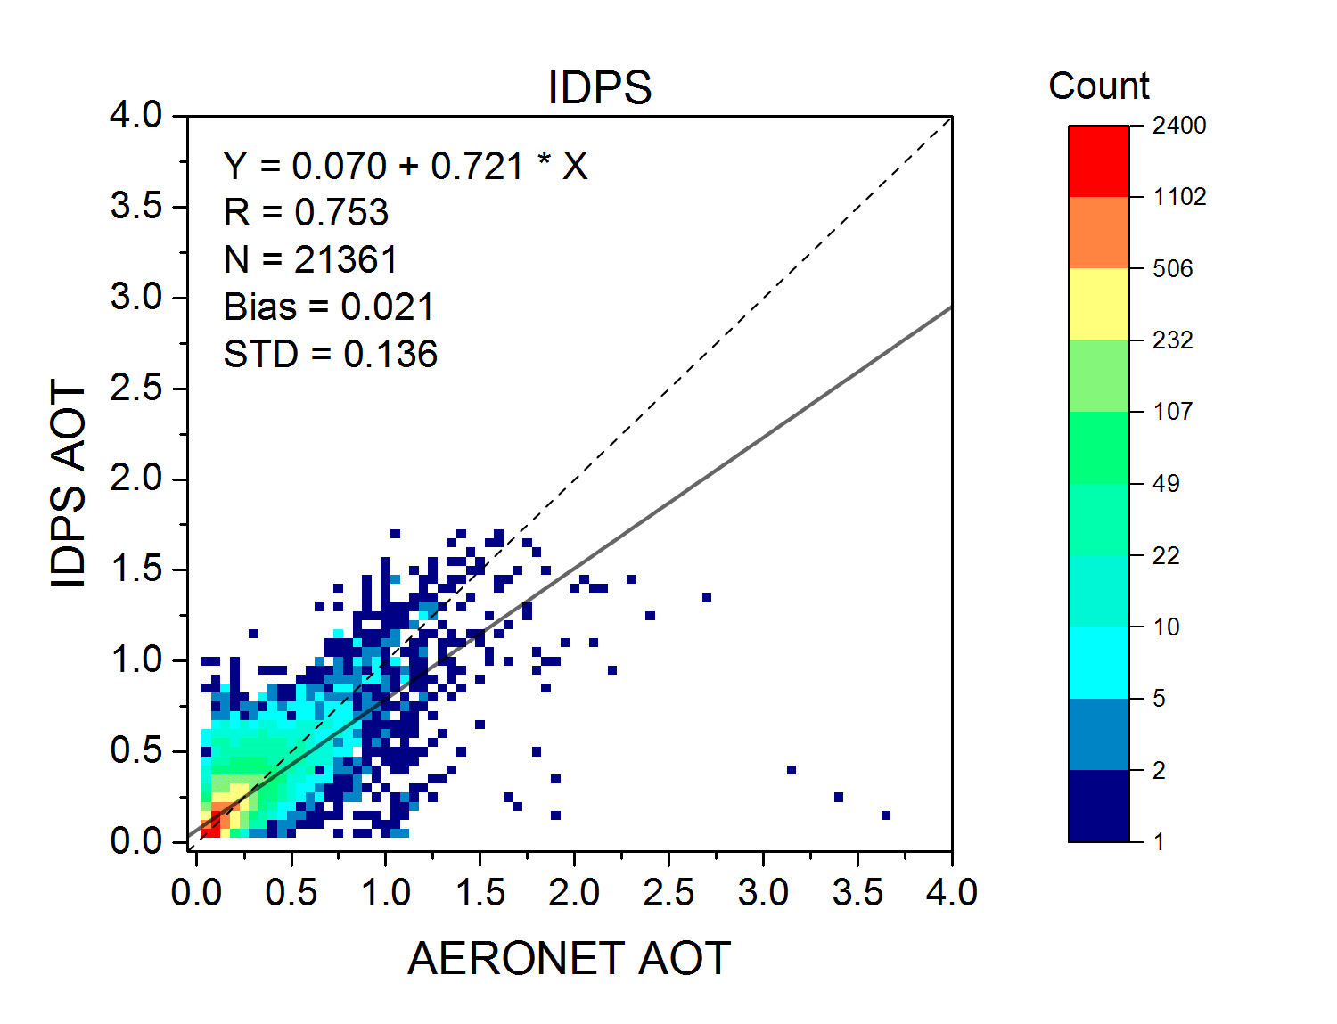
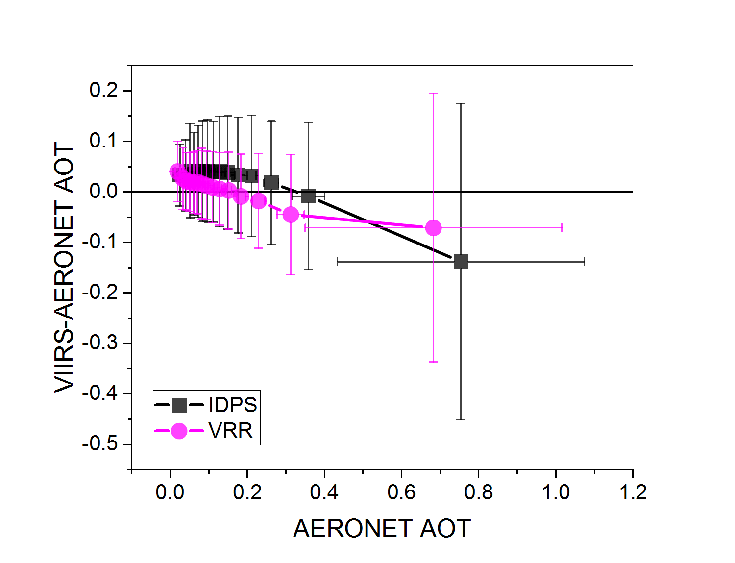
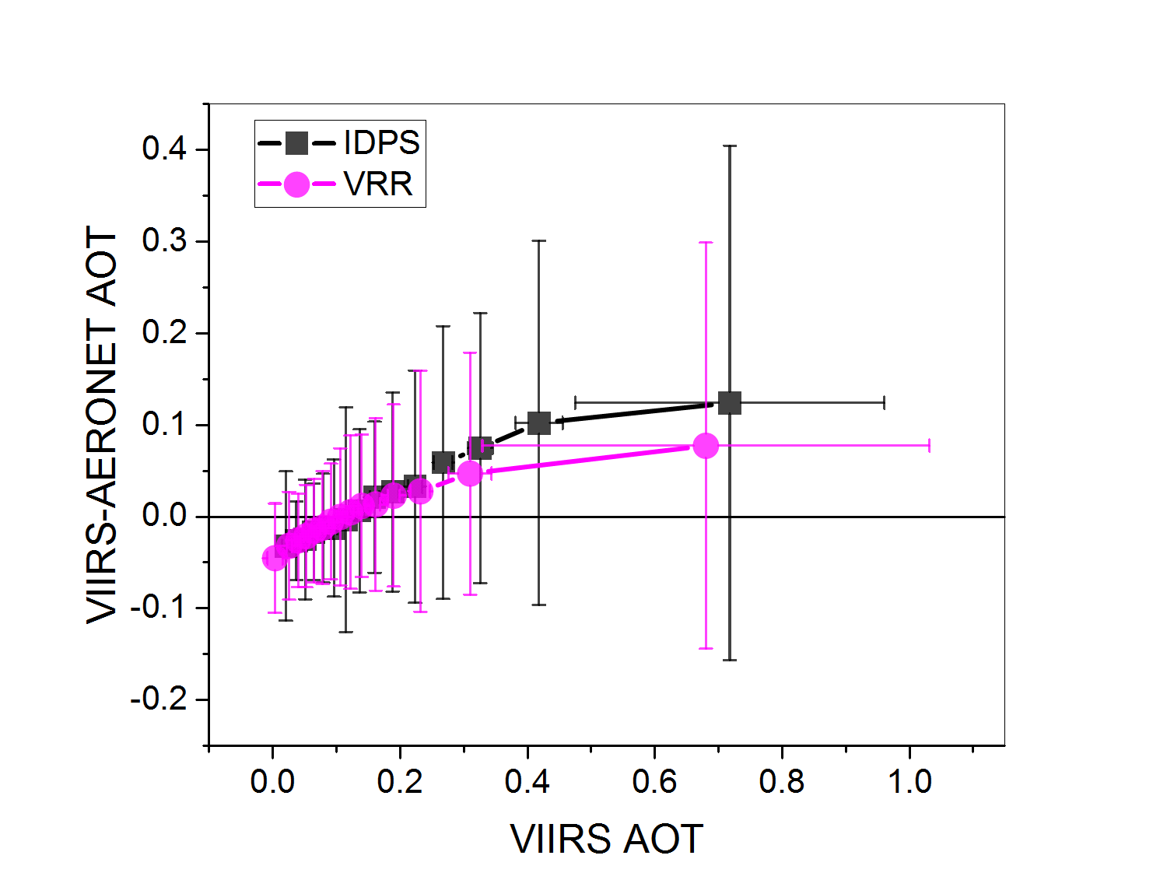
Evaluation with AERONET

Slide 12
The STAR bright Surface (BS) AOT Algorithm

Slide 13
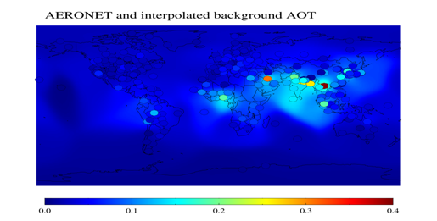
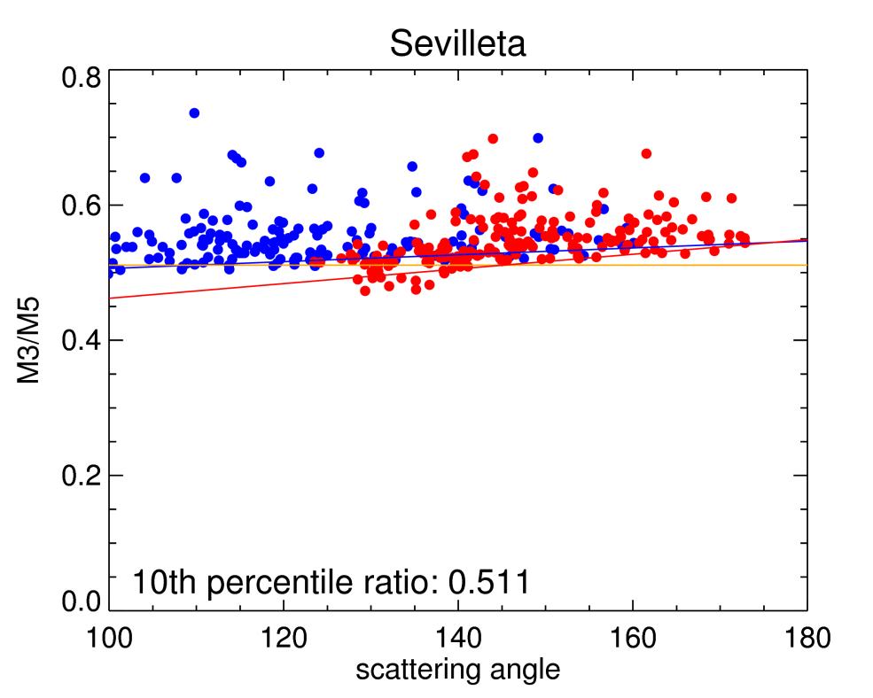
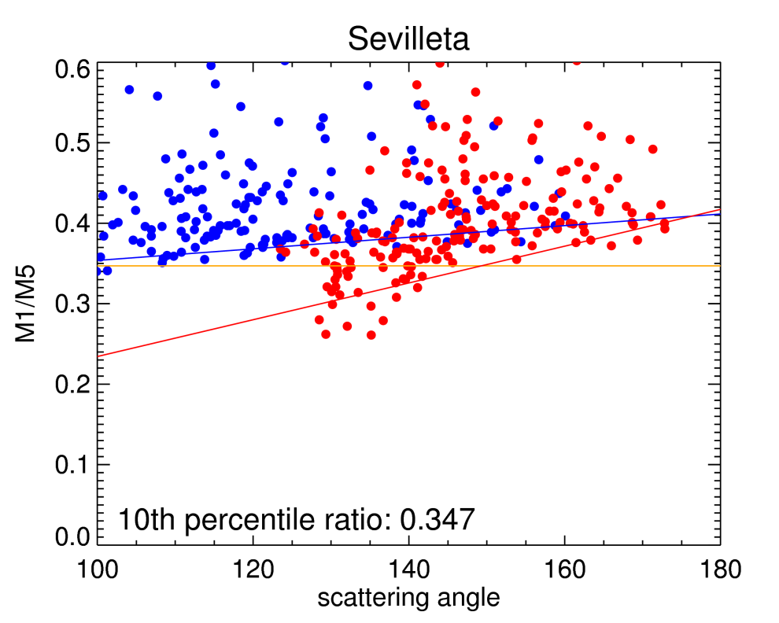
STAR (BS) Algorithm
Deriving the database:
Estimate background AOT
Estimate M-band surface reflectances from VIIRS and calculate their ratios
Fit ratios as function of scattering angle for forward and backward directions
Works as IDPS but uses regional (0.1ºx0.1º) database of surface reflectance ratios for bright surface (M11 ≥0.25)
  M3/M5 for North Africa/Arabian Peninsula
  M1/M5 for the other regions
Aerosol model:
  dust for North Africa/Arabian Peninsula
  selects IDPS models for other regions
forward
backward

Slide 14
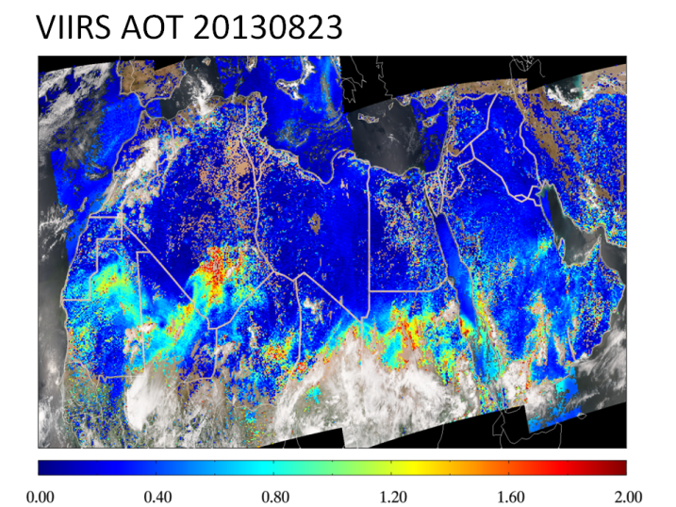
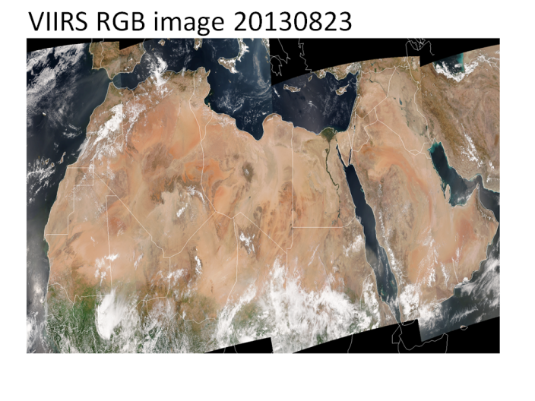
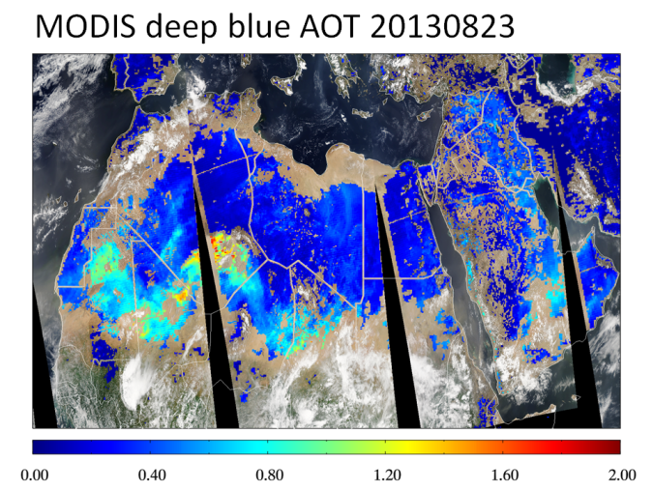
STAR (BS) Algorithm Example
Broad, qualitative agreement between STAR (BS) and MODIS/Deep-Blue AOT
  Low and high (dust) AOTs
More coverage from STAR (BS)
  some high AOTs are absent in high-quality MODIS/Deep-Blue

Slide 15
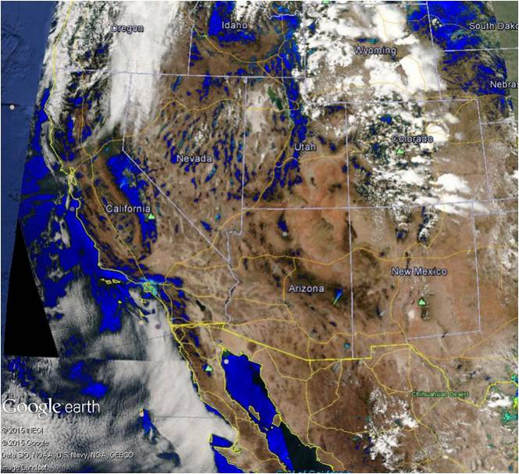
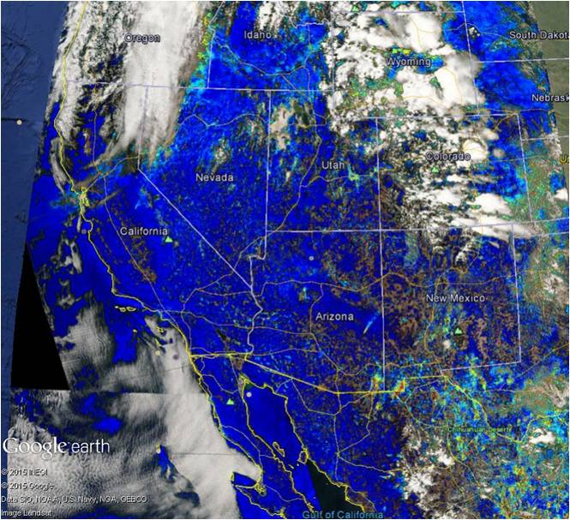
AOT over Western US 06/18/2013
IDPS
STAR (BS)
STAR (BS) algorithm significantly extends spatial coverage of AOT retrieval

Slide 16
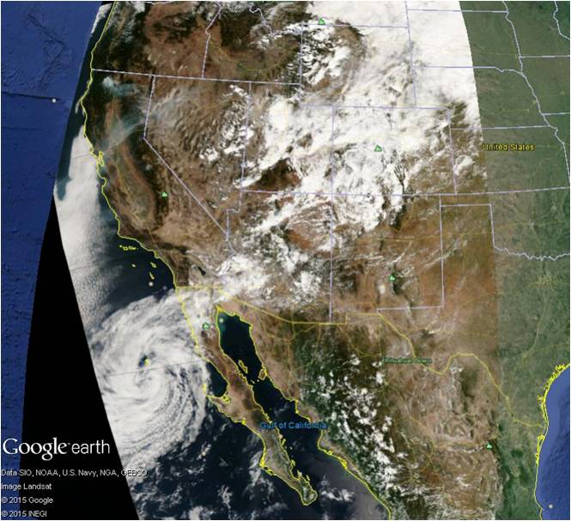
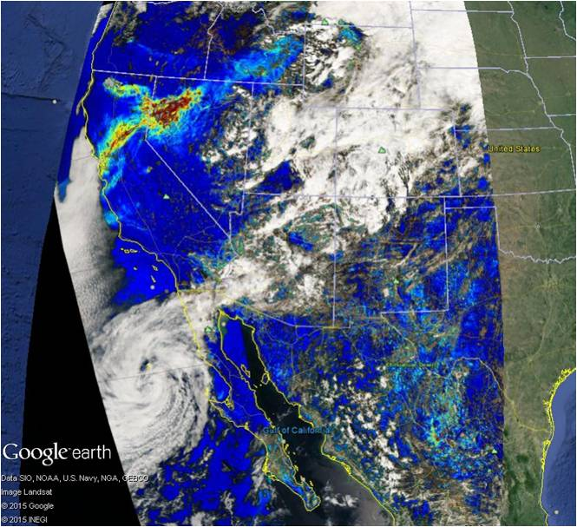
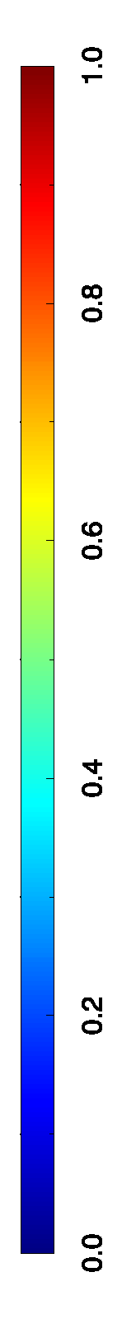
AOT over Western US 09/09/2014
RGB
STAR (BS) AOT
Smoke is captured by STAR (BS) AOT algorithm

Slide 17
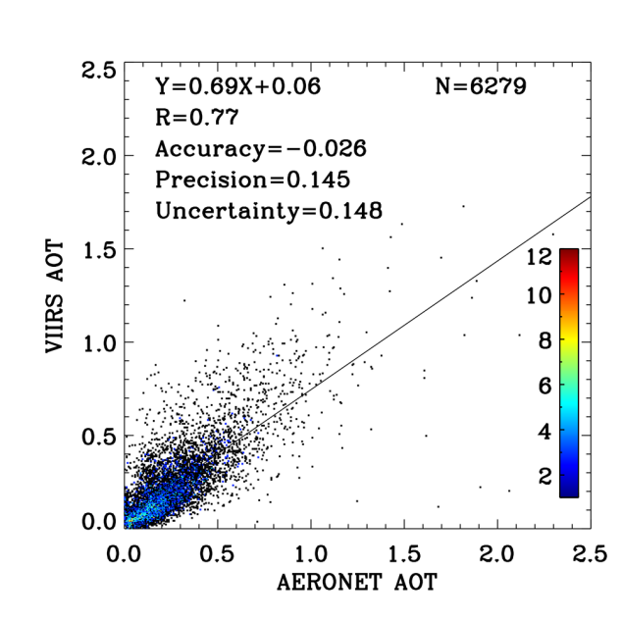
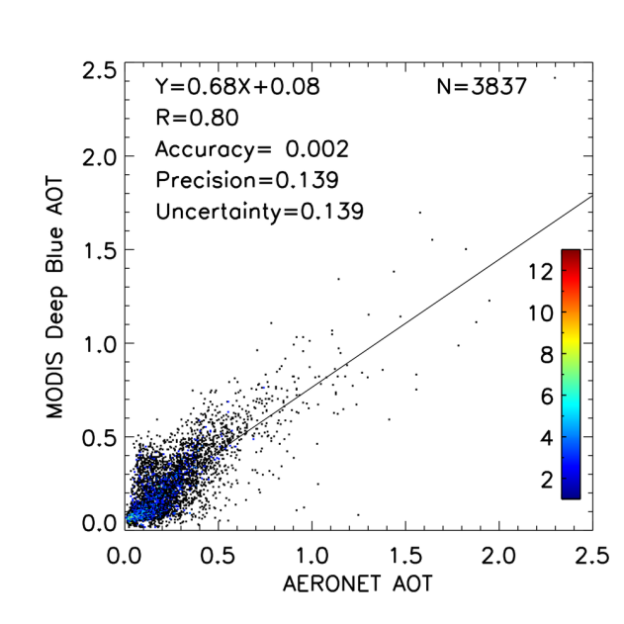
Evaluation with AERONET
Time period: May 2012- Apr 2014
Most sites are in North Africa, Arabian Peninsula, and western CONUS
Overall, STAR (BS) performance is comparable to that of MODIS/Deep-Blue

Slide 18
IDPS vs. STAR Algorithm
 | IDPS | STAR
Algorithm (general)
Data screening | External VCM + internal tests | Internal tests + external VCM
Residual calculated as | Absolute difference | Dark surface: Relative difference Bright surface: Same as IDPS
Over-land algorithm
Channel used | 0.41, 0.44, 0.48, 0.67, 2.25 µm | Same
Retrieve over | Dark surface only | Dark + bright surface
Aerosol model | five models from AERONET | Dark surface: MODIS C5 Bright surface: same as IDPS
Spectral surface reflectance ratio | Constant | Dark surface: function of TOA SWIR-NDVI, redness and glint Bright surface: location and scattering angle
Match to | Surface reflectances | Dark surface: TOA reflectances Bright surface: same as IDPS
Over-ocean algorithm
Channel used | 0.67, 0.74, 0.86, 1.24, 1.61, 2.25 µm | Same + 0.55 µm
Surface reflection | Non-Lambertian, function of wind speed and direction | Same + weighting with foam fraction
Aerosol model | Combination of fine and coarse modes (MODIS C4) | Same , but MODIS C5
Match to | TOA reflectances | Same
Retrieval over inland water | No | Yes

Slide 19
IDPS vs. STAR Products
 | IDPS | STAR
Products
Nominal spatial resolution | 0.75 km (IP) 6 km (EDR) | 0.75 km
Granule size | 86 seconds | Same
AOT range | [0, 2] | [-0.05, 5]
Main product land | M-band and 550-nm AOT (EDR) AOT at 550 nm only (IP) Aerosol model | Same Same
Main product ocean | M-band and 550-nm AOT (EDR) AOT at 550 nm only (IP) Small mode aerosol model Large mode aerosol model Small mode fraction Ångström exponent: [0.86 vs. 1.61 µm] | Same Same Same Same same + [0.55 vs. 0.86 µm]
“Same in STAR column means product is produced; it does not mean it is identical to that in IDPS; for example, aerosol models in IDPS and STAR are different, but both provide model information.

Slide 20
Pixel Selection & Quality Flags
Condition | Quality Flag |  |  | Applies to |  | Detected by
 | Not Produced | Excluded | Degraded | Land | Ocean | VCM | Internal Tests
Invalid SDR data | X |  |  | X | X |  | X
Cloud Contamination | X |  |  | X | X | X | X
Sun Glint | X |  |  | X | X | X | X
Snow/Ice | X |  |  | X | X | X | X
Fire | X |  |  | X |  | X | X
Bright Surface | X |  |  | X |  |  | X
Coastal or Inland Water | X |  |  |  |  | X
Turbid Water | X |  |  |  | X |  | X
Ephemeral Water* | X |  |  | X |  |  | X
SolZA ≥ 80° | X |  |  | X | X |  | X
Out of Spec Range |  | X |  | X | X |  | X
Cloud Adjacency |  |  | X | X | X |  | X
Cloud Shadow |  |  | X | X | X | X
Cirrus |  |  | X | X | X | X | X
Soil Dominated |  |  | X | X |  |  | X
65° ≤ SolZA < 80° |  |  | X | X | X |  | X
Large Retrieval Residual |  |  | X | X | X |  | X
Large M1 STD |  |  | X | X |  |  | X
Snow adjacency* |  |  | X | X |  |  | X
*to be deleted in IDPS; *in IDPS, to be implemented in STAR (VRR)

Slide 21
Additional QFs in STAR (VRR)
Quality Flag (QF)Retrieval with SW scheme
  Retrieval with SWIR scheme
  Retrieval over bright surface
  Retrieval over dark barren surface
  Retrieval from extrapolation
  Retrieval failed
  NDVI out of range
  Redness out of range
Optional Outputs
  Surface reflectance
  Retrieval residual

Slide 22
Summary
STAR (VRR) algorithm
  has extended AOT range allowing to see high AOT events,
  reduced snow contamination,
  comparable performance to IDPS, but provides more 750-m retrievals,
  better accuracy at higher AOT,
  less reliance on upstream products (VCM).
STAR (BS) algorithm provides AOT for bright surface enabling dust and smoke plumes to be captured.
Next: Must implement BS algorithm in unified STAR algorithm.

