Slide 1
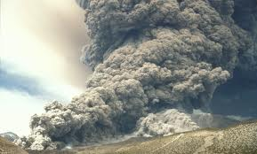
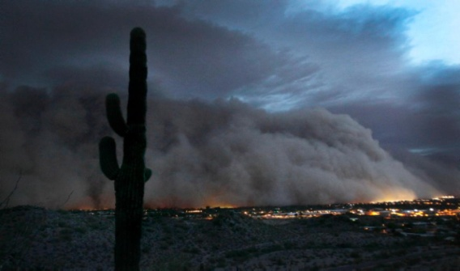
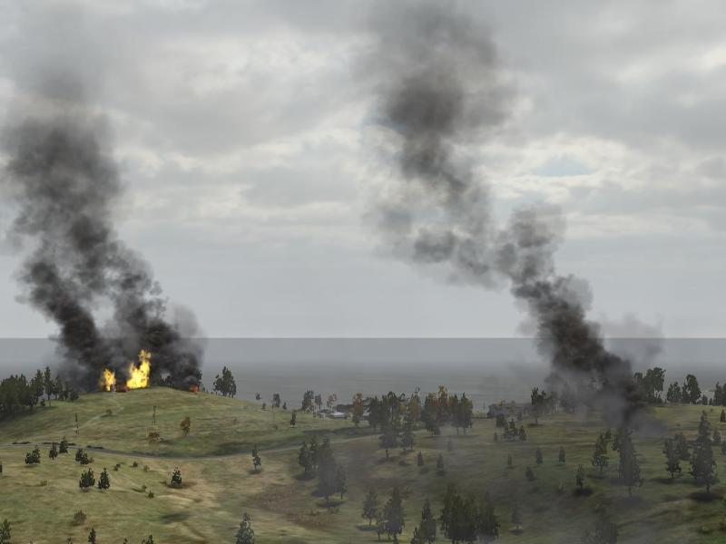
SNPP VIIRS Dust and Smoke Products
Shobha Kondragunta¹ and Pubu Ciren²
¹NOAA/NESDIS/STAR ²IMSG@NOAA
NOAA Satellite Air Quality Proving Ground Workshop
September 9, 2015

Slide 2
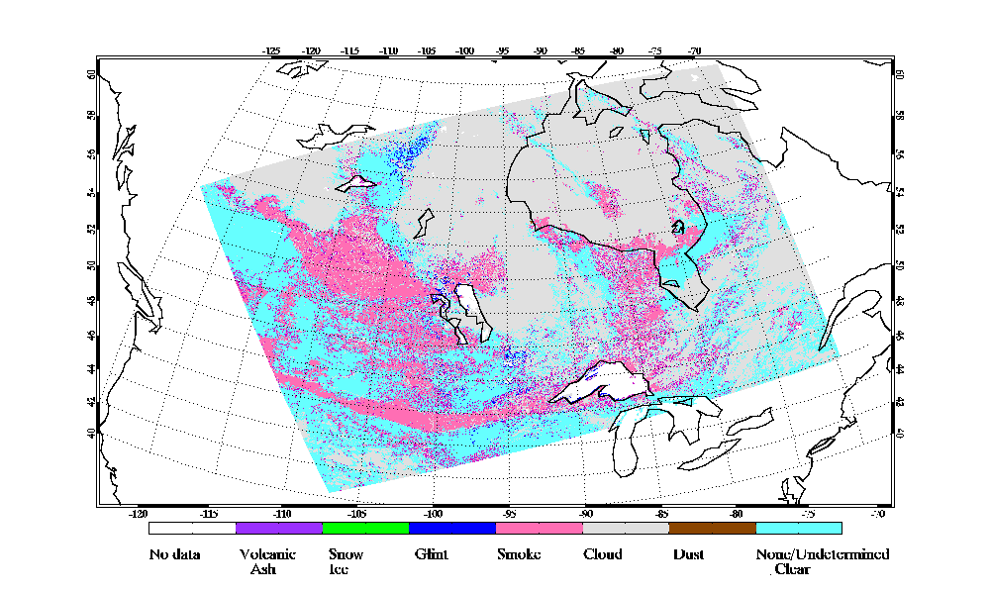
SNPP VIIRS Suspended Matter (SM)
Output for each pixel (~750 m)
SM type flag (1 – yes; 0 – no)
Volcanic ash flag – passed on from VIIRS cloud mask algorithm
Dust flag
Smoke flag
Smoke concentration (right now fill values)
No aerosol
Unknown aerosol
Clear sky
Quality flags
Low
Medium
High

Slide 3
Dust Aerosol Index (DAI)
DAI = -100*[log₁₀(R_{412nm}/R_{445nm})-log10(R’_{412nm}/R’_{445nm})]
NDAI = -10*[log₁₀(R_{412nm}/R_{2250nm})]
R’ -- reflectance from Rayleigh scattering
Detection not performed for the following conditions:
Clouds: screened by using R412 nm and cloud mask
Residual clouds
Over water: screened by 860 nm spatial variability test
Over land: screened by using 412 nm spatial variability test
Bright surfaces: normalized difference index of 1.24 and 2.25 µm
Turbid water: screened using 746 nm and 1.24 µm
Sunglint
Snow/ice
fires

Slide 4
Product Accuracy
Two years of SNPP VIIRS dust and smoke detection product validated against CALIPSO

Slide 5
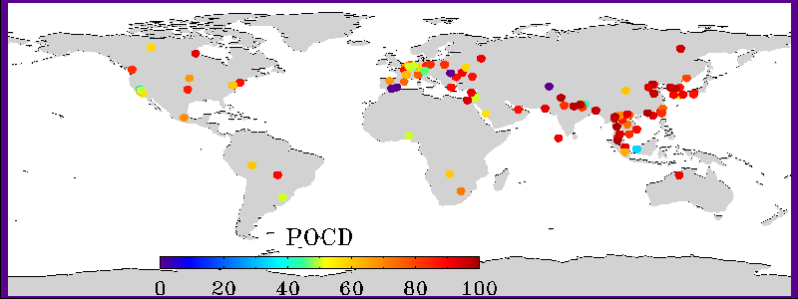
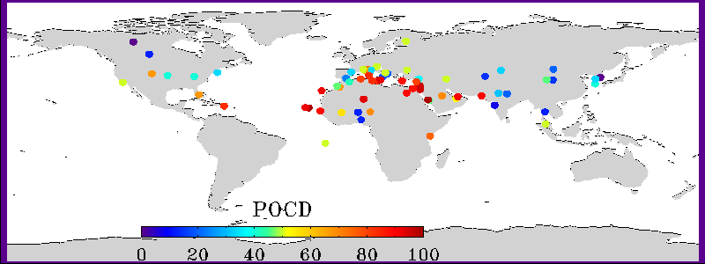
Product Accuracy
Two years of VIIRS smoke/dust vs. AERONET aerosol classification based on Angstrom Exponent
Smoke
Dust

Slide 6
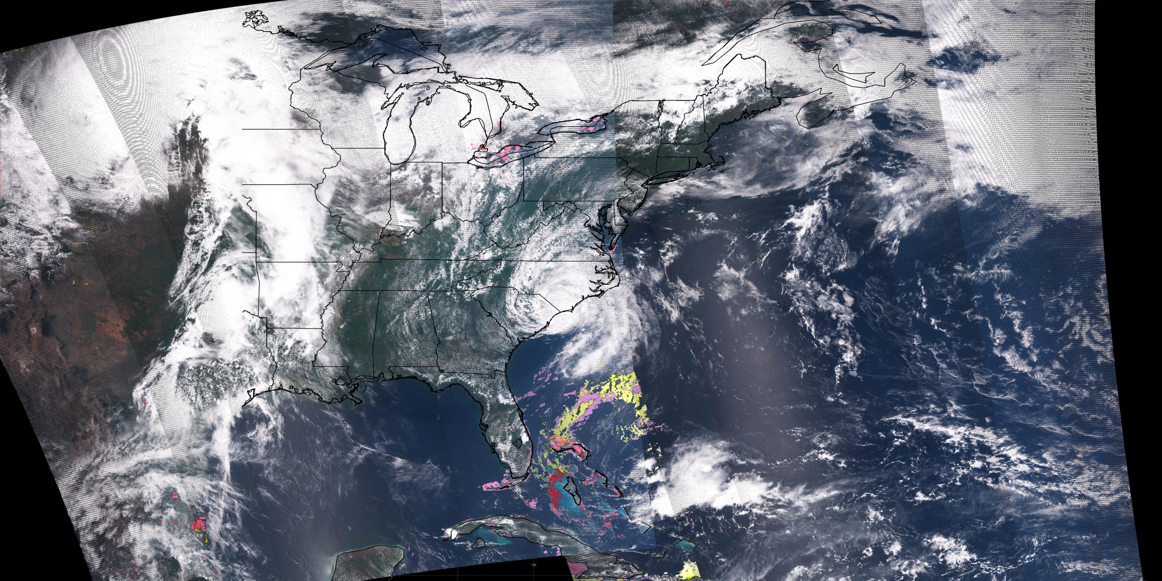
Transatlantic dust transport
Year of 2014
May 10, 2015

Slide 7
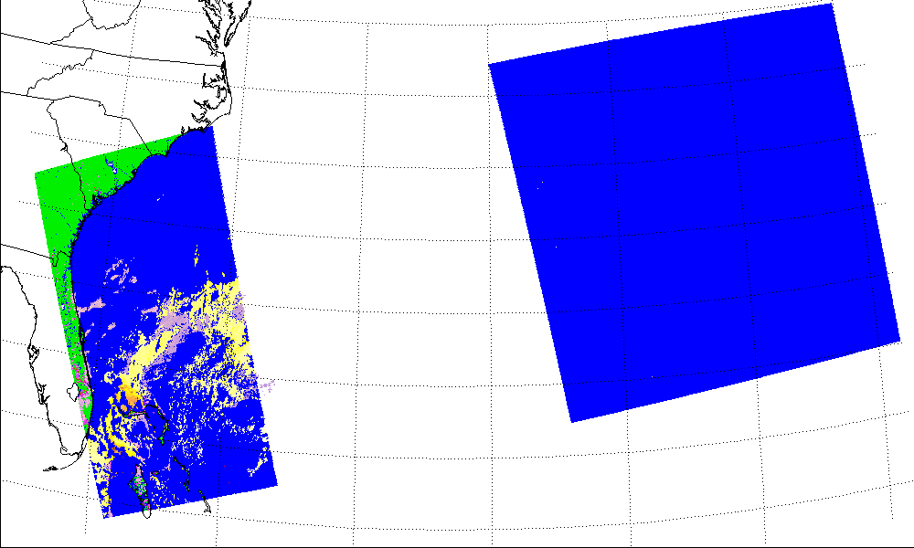
May 10, 2015
Sunglint region

Slide 8
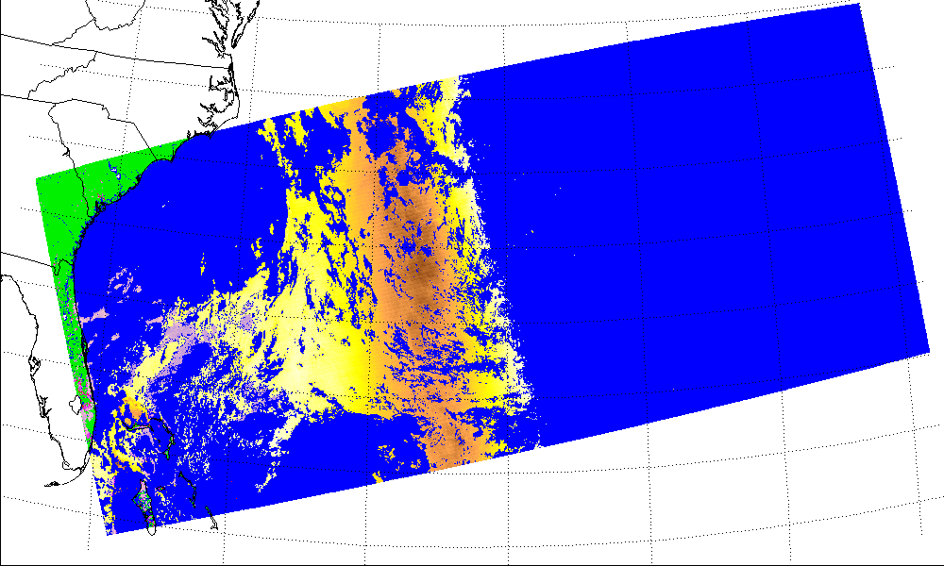
May 10, 2015

Slide 9
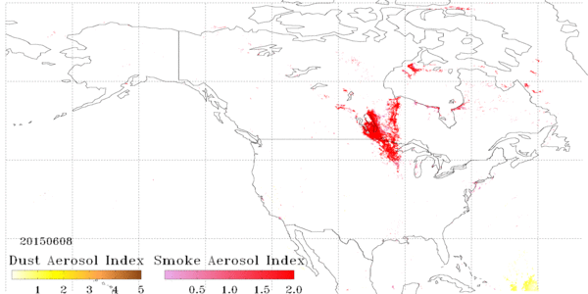
Smoke Transport June 8 to July 15, 2015

Slide 10
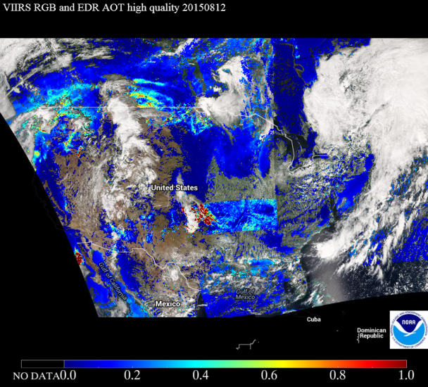
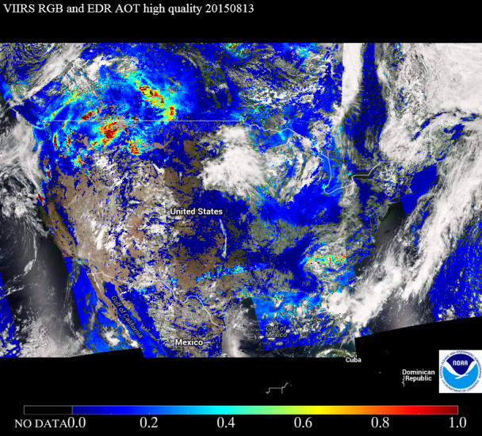
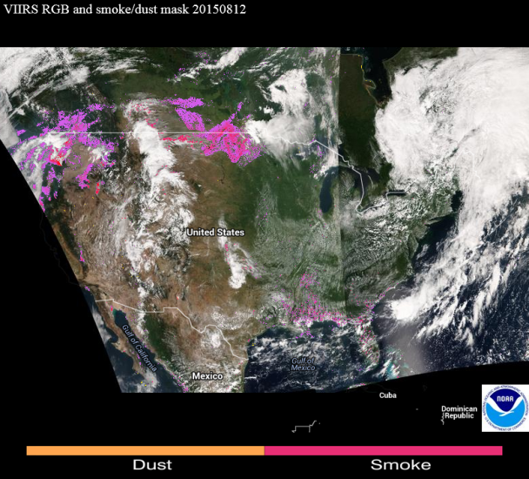
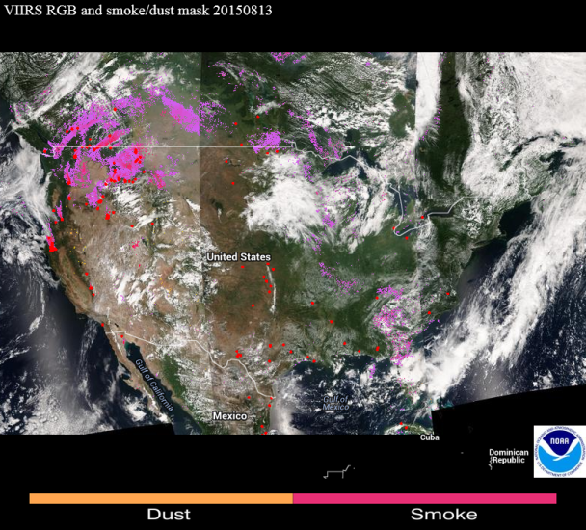
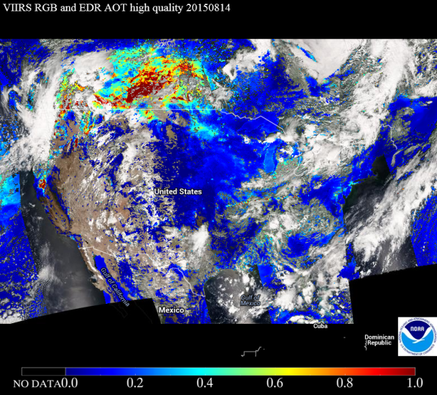
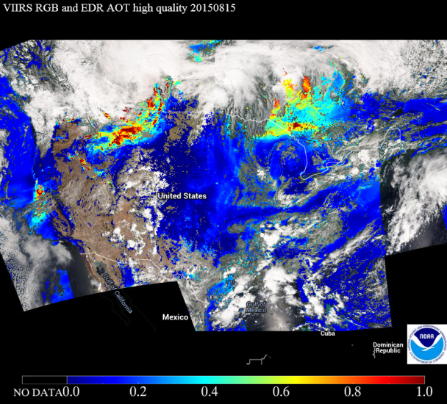
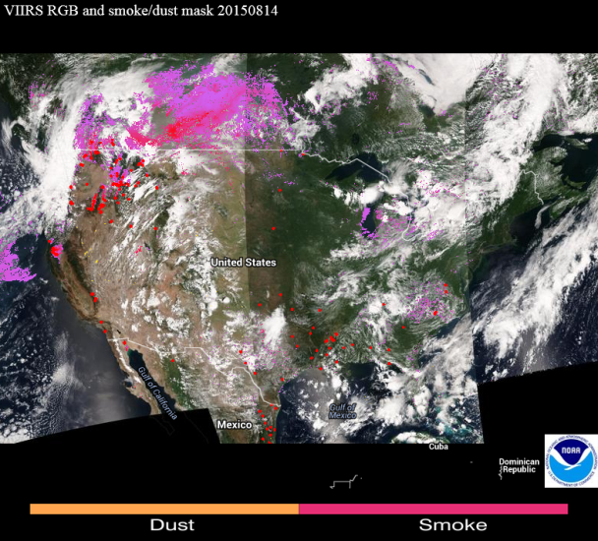
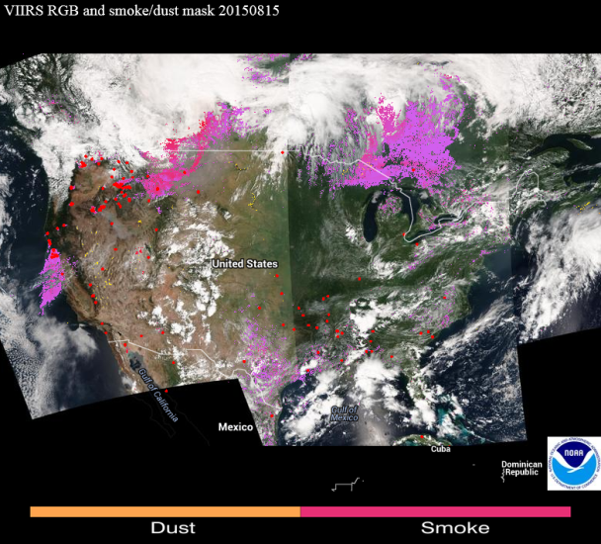
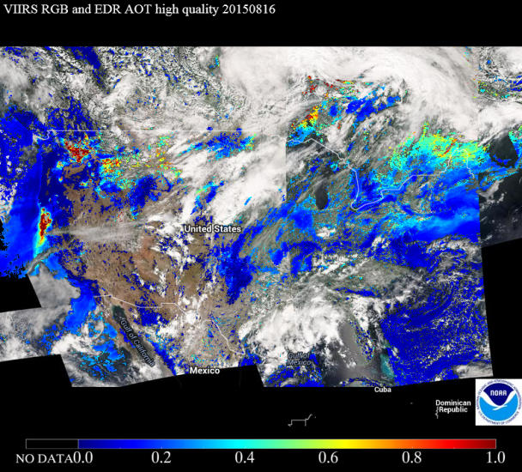
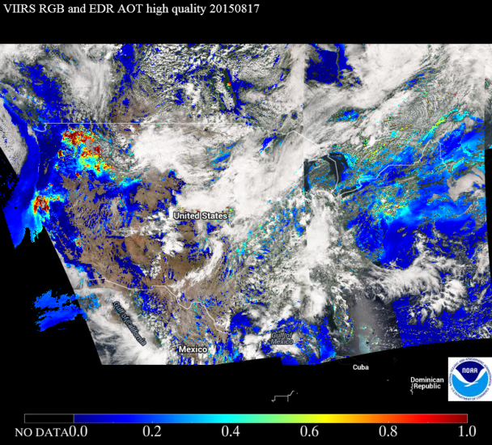
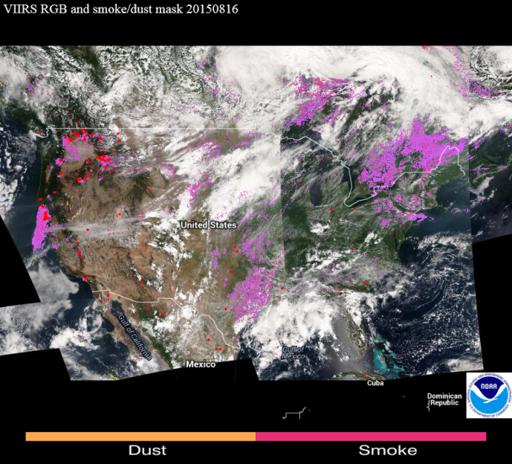
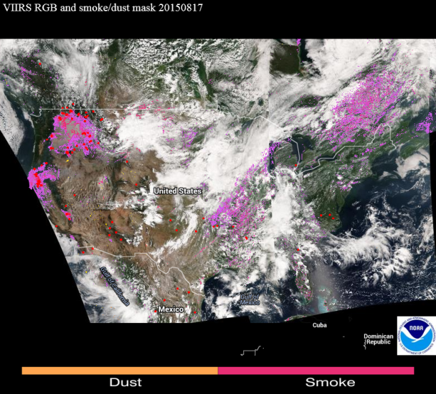
12 Aug
13 Aug
12 Aug
13 Aug
14 Aug
15 Aug
14 Aug
15 Aug
16 Aug
17 Aug
16 Aug
17 Aug

Slide 11
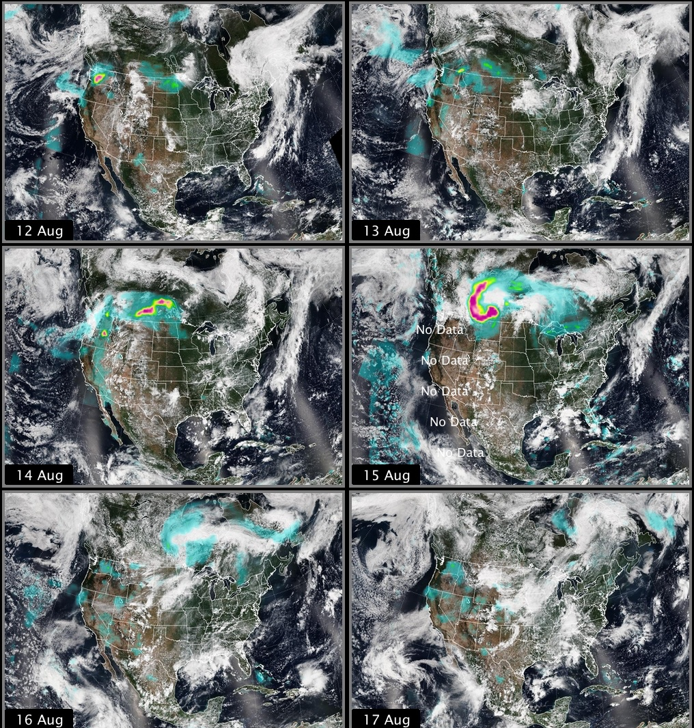
VIIRS
OMPS
12 Aug
13 Aug
14 Aug
15 Aug
16 Aug
17 Aug

Slide 12
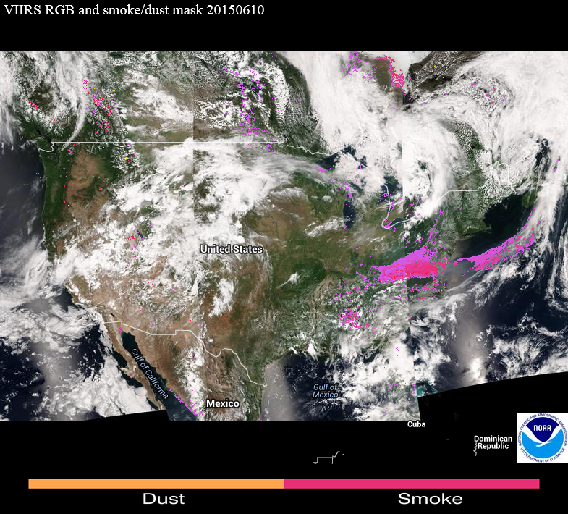
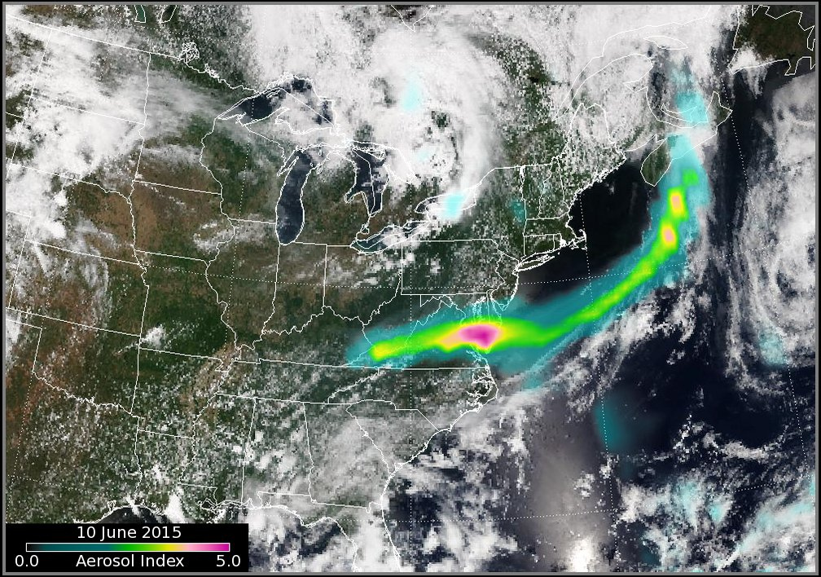
June 10, 2015
VIIRS
OMPS

Slide 13
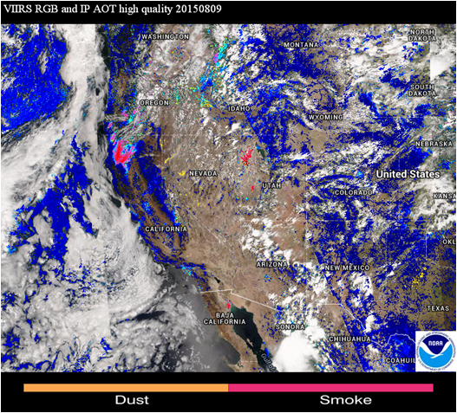
August 9, 2015
Dry lake beds flagged as smoke
Some bright surfaces get flagged as smoke

Slide 14
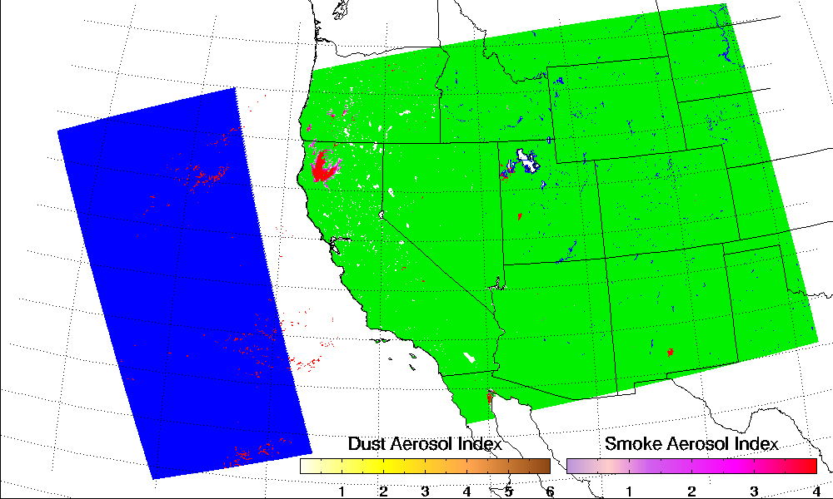
M5: 672 nm
M8: 1240 nm

Slide 15
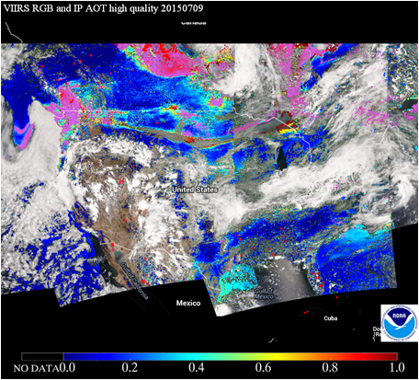
July 9, 2015
Smoke mis-identified as cirrus flag in VCM

Slide 16
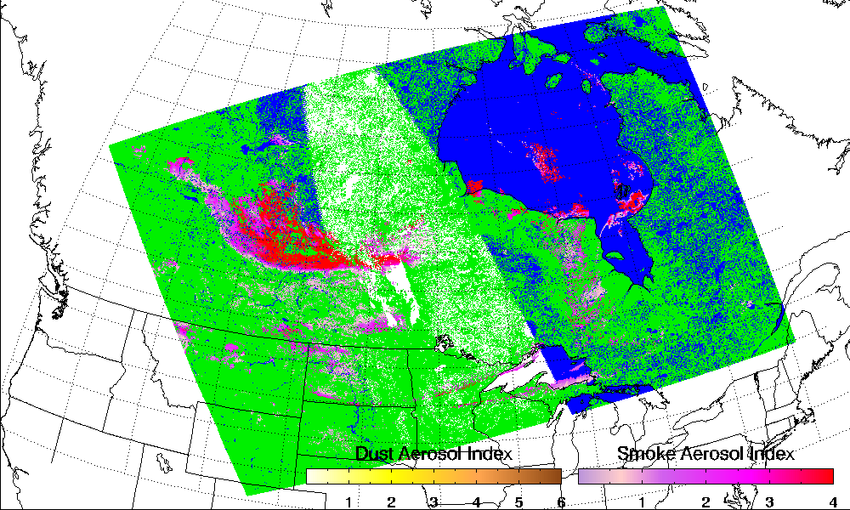
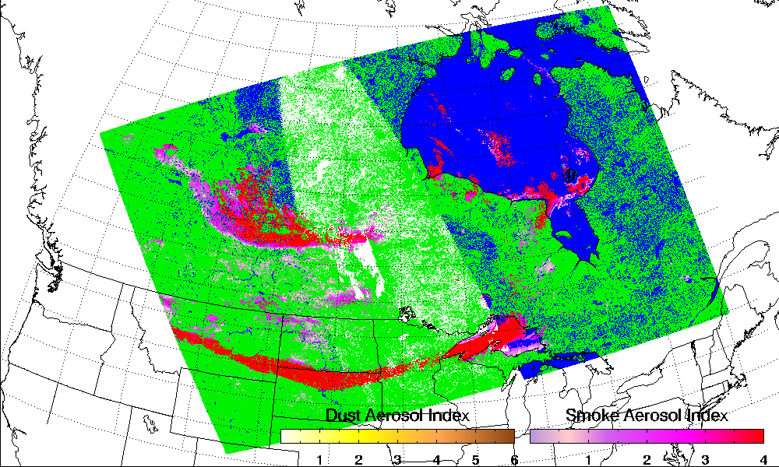
With cirrus flag turned off

Slide 17
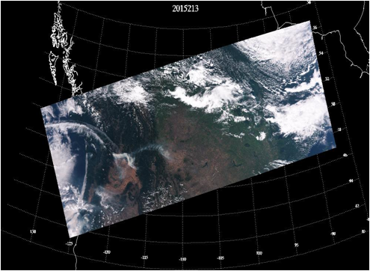
Smoke plume

Slide 18
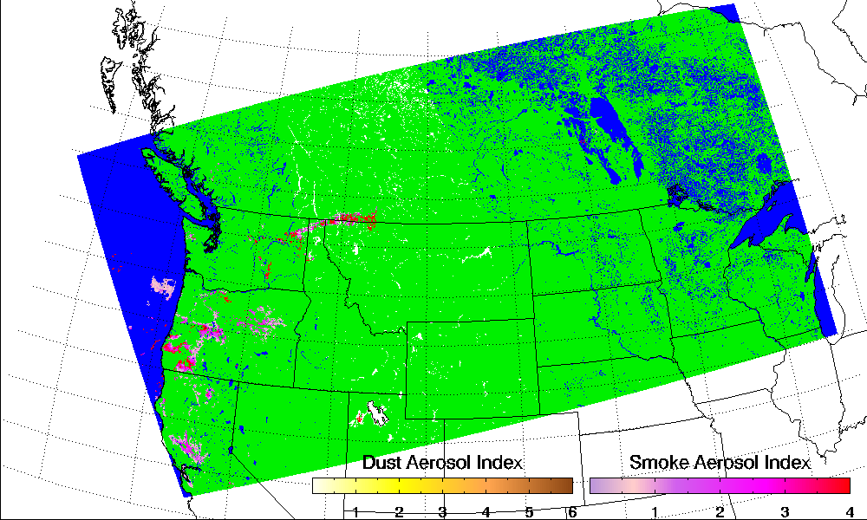
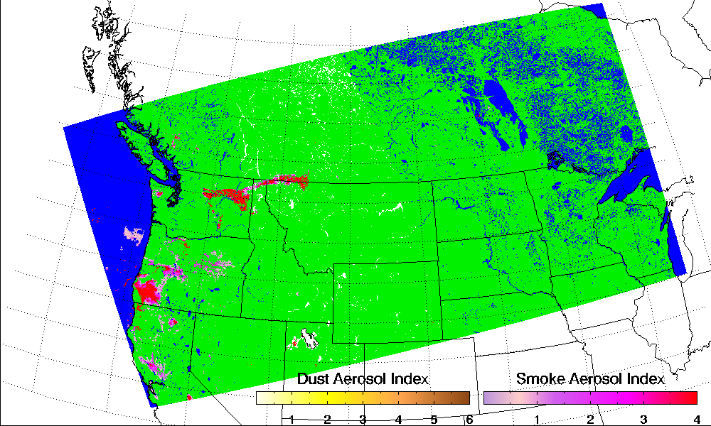
With cirrus flag turned off

Slide 19
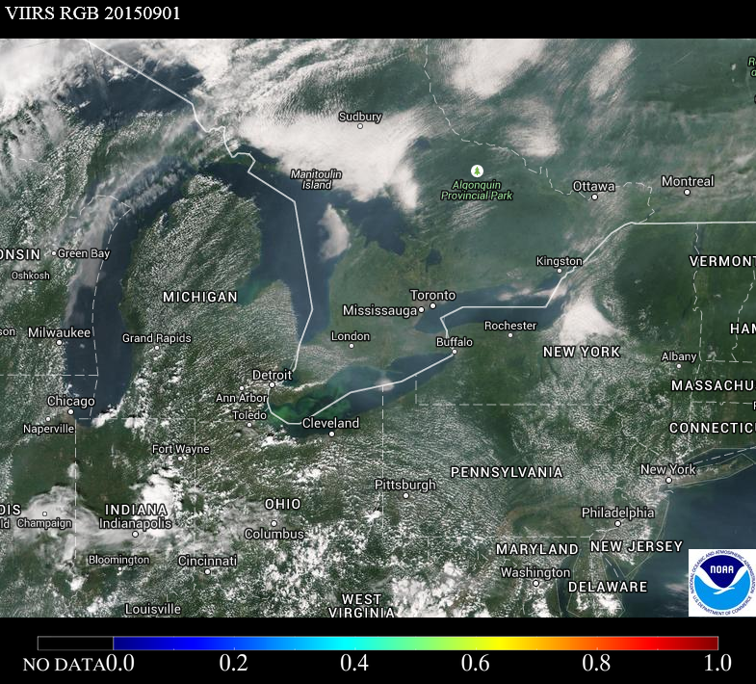
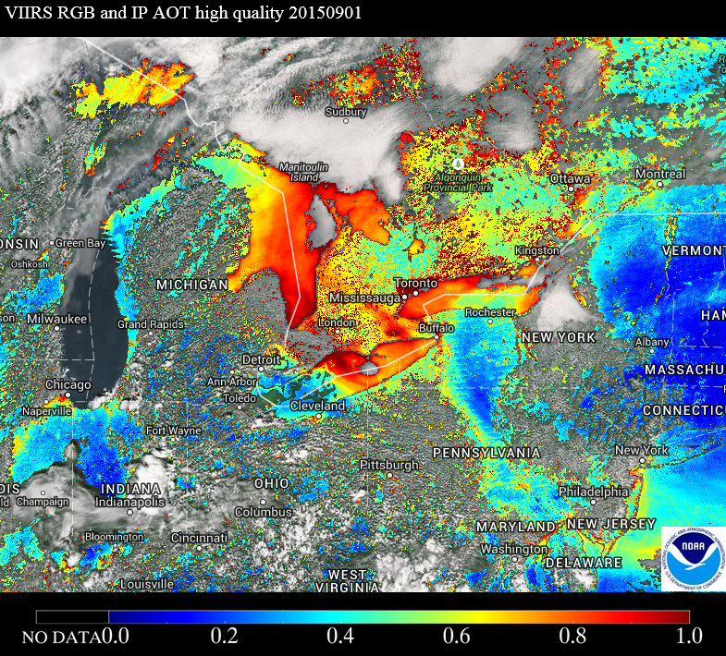
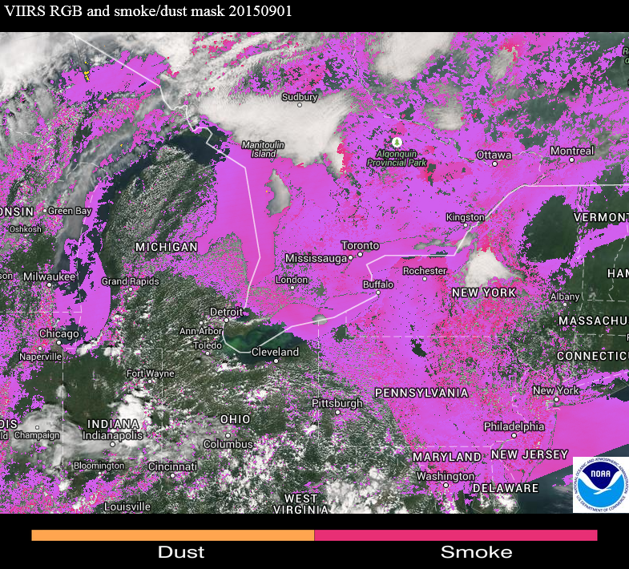

Slide 20
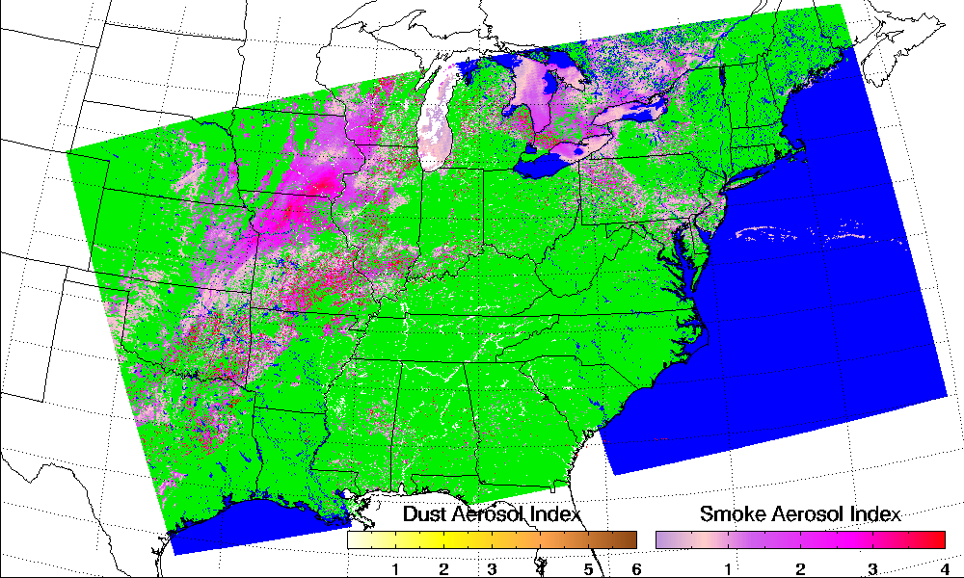
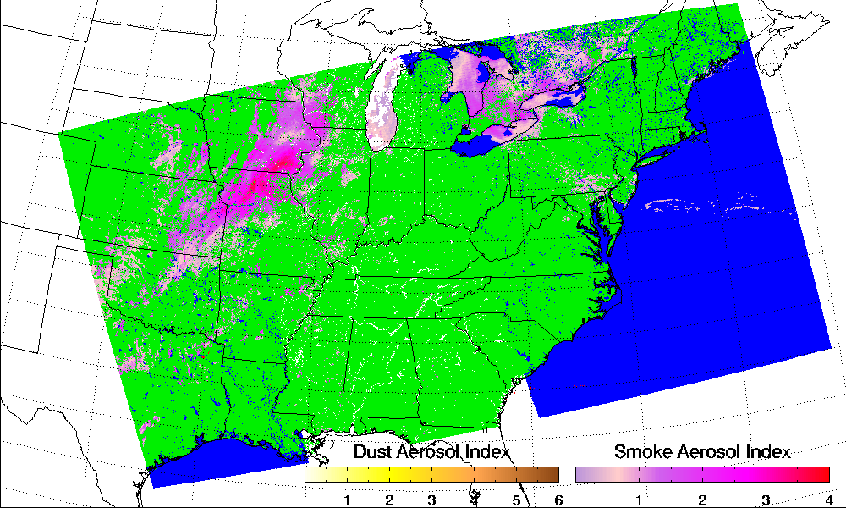
Smoke near clouds assigned “low quality” using a standard deviation test:
StdDev_M1 > 0.01

Slide 21
Backup Slides

Slide 22
Validation Strategy
TRUTH DATA
Dust/smoke detection algorithm run on VIIRS data for the entire year of 2013 and 2014.
VIIRS smoke/dust detection matchup with AERONET Observations
VIIRS smoke and dust detection matchups with CALIPSO VFM
Derive performance metrics
Accuracy
Probability of Correct Detection (POCD)
Probability of False Detection (POFD)
 | Yes | No
Yes | A | B
No | C | D
VIIRS
POCD = A/(A+C)
POFD = B/(A+B)
Accuracy* = (A+D)/(A+B+C+D)

Slide 23
VIIRS vs. CALIPSO
Year of 2013 and 2014
Land
Type | True positive | False positive | True negative | False Negative | Accuracy (%) | POCD (%) | FAR (%)
DUST | 10669 | 170 | 5676 | 2840 | 84.4 | 80.0 | 1.6
SMOKE | 307 | 159 | 19534 | 14 | 99.1 | 96.7 | 34.1
Water
Type | True positive | False positive | True negative | False negative | Accuracy (%) | POCD (%) | FAR (%)
DUST | 297 | 11 | 139 | 10 | 95.4 | 96.4 | 3.3
SMOKE | 601 | 507 | 7605 | 15 | 94.0 | 97.5 | 45.7
Global Granules for the year of 2013

Slide 24
VIIRS vs. AERONET (DUST)
Stations |  | True positive | False positive | True negative | False negative | Accuracy | POCD | POFD
Darkar | 2013 | 63 | 1 | 106 | 10 | 93.9 | 86.3 | 0.2
 | 2014 | 74 | 3 | 45 | 10 | 90.1 | 88.1 | 0.4
Solar_Village | 2013 | 81 | 26 | 59 | 30 | 71.4 | 73.0 | 24.3
 | 2014 | 11 | 4 | 65 | 5 | 89.4 | 68.8 | 26.7
Capo_Verde | 2013 | 44 | 0 | 56 | 3 | 97.1 | 93.6 | 0.0
 | 2014 | 53 | 1 | 17 | 1 | 97.2 | 98.1 | 0.2
Over 440 AERONET stations | Accuracy | POCD | POFD
Year of 2013 and 2014 | 98.5 | 84.6 | 14.7

Slide 25
VIIRS vs. AERONET (Smoke)
Stations (Biomass –burning) | True positive | False positive | True negative | False negative | Accuracy | POCD | POFD
Alta_Floresta | 10 | 0 | 178 | 0 | 100.0 | 100.0 | 0.0
Bonanza_Creek | 1 | 0 | 48 | 0 | 100.0 | 100 | 0.0
Jabiru | 1 | 0 | 313 | 0 | 100.0 | 100.0 | 0.0
Moscow_MSU_MO | 16 | 2 | 92 | 1 | 97.2 | 94.1 | 11.0
Tomsk_22 | 17 | 1 | 83 | 0 | 99.0 | 100.0 | 5.0
Yakutsk | 22 | 1 | 88 | 1 | 98.2 | 95.6 | 4.3
Over 401 AERONET stations | Accuracy | POCD | POFD
Year of 2013 and 2014 | 97.5 | 91.6 | 18.5

Slide 26
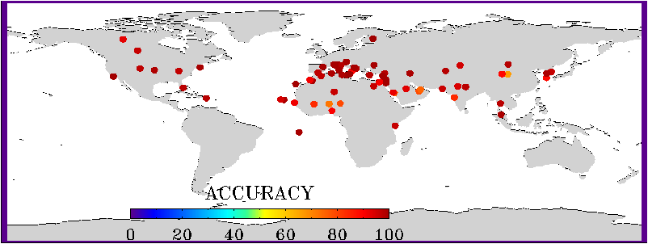
VIIRS vs. AERONET (dust)

Slide 27
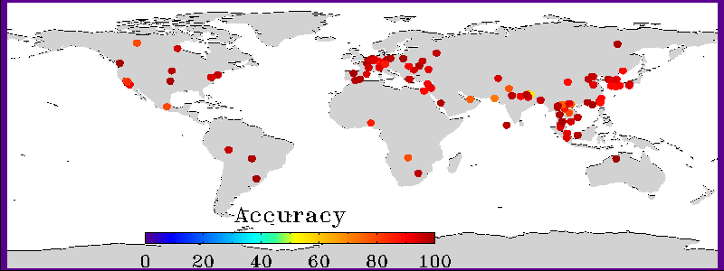
VIIRS vs. AERONET (smoke)

Slide 28
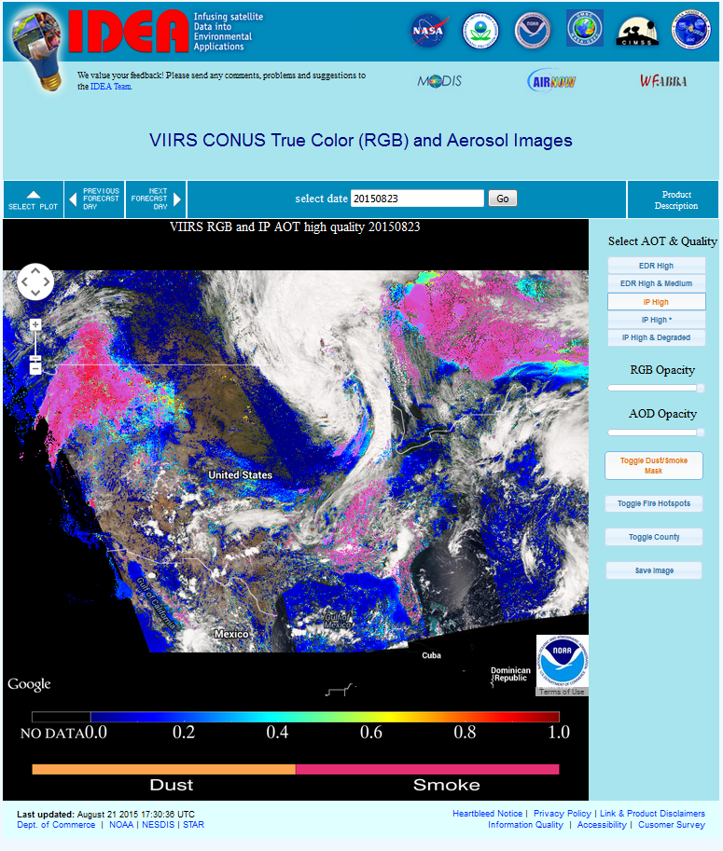
Near-real time run of JPSS SM algorithm on S-NPP VIIRS DB data
JPSS RR SM algorithm has been Implemented by using near-real time S-NPP VIIRS DB data over both CONUS and OCONUS
It provides daily monitoring of smoke/dust event OVER CONUS and Alaska

Slide 29
Summary
JPSS RR Suspended Matter algorithm is simple, fast, and easy to be implemented operationally.
Validation results indicated that Accuracy and POCD for dust and smoke detection can be as high as 90% and 80 %, respectively.
Additional investigation of data artifacts (false detections) is required to enhance product accuracy.

