Slide 1
Using VIIRS Aerosol Products in an Operational Environment
Hai Zhang¹, Amy Huff², , Shobha Kondragunta³ Hongqing Liu¹, Pubu Ciren¹
IMSG at NOAA
Pennsylvania State University
NOAA NESDIS
NOAA Satellite Air Quality Proving Ground Annual Advisory Group Workshop 2015
9/9/2015

Slide 2
Outline
Introduction to IDEA
Demo of IDEA for VIIRS
Issues users should be aware of

Slide 3
IDEA: Infusing satellite Data into Environmental Applications
Provide near-real-time satellite aerosol information and analysis over the United States to the operational air quality community
Satellite data
MODIS Terra, Aqua, VIIRS, GASP East, GASP West
AOD (aerosol optical depth) or AOT (aerosol optical thickness)
RGB images (MODIS, VIIRS)
Other data for analysis
Meteorological data: wind, precipitation
In-situ PM2.5
OMI Aerosol Index (AI)
WF_ABBA (Wild Fire Automated Biomass Burning Algorithm), fire hotspots
Developed by NASA for MODIS and transitioned to NOAA. NOAA enhanced IDEA to include GOES-E, GOES-W, OMI, VIIRS and surface PM2.5 estimation

Slide 4
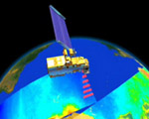
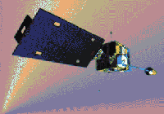
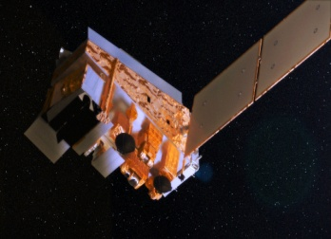
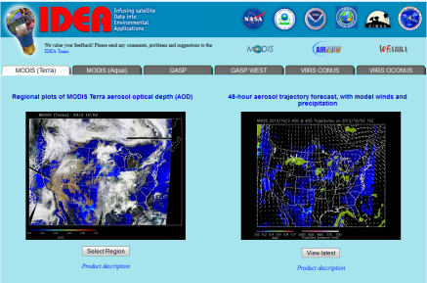
IDEA Data flow diagram
MODIS Terra and Aqua
GOES
East
and West
VIIRS
VIIRS L1B, cloud mask data
MODIS data processing L1B, aerosol products
GOES data processing
GASP Aerosol product
Generate VIIRS aerosol product locally (STAR research version)
EPA AIRNow PM2.5
NOAA
Meteorological data
Data processing, forward trajectories, composite plots, etc
IDEA Website
Local computer at NOAA
NOAA
WF_ABBA
http://www.star.nesdis.noaa.gov/smcd/spb/aq/

Slide 5
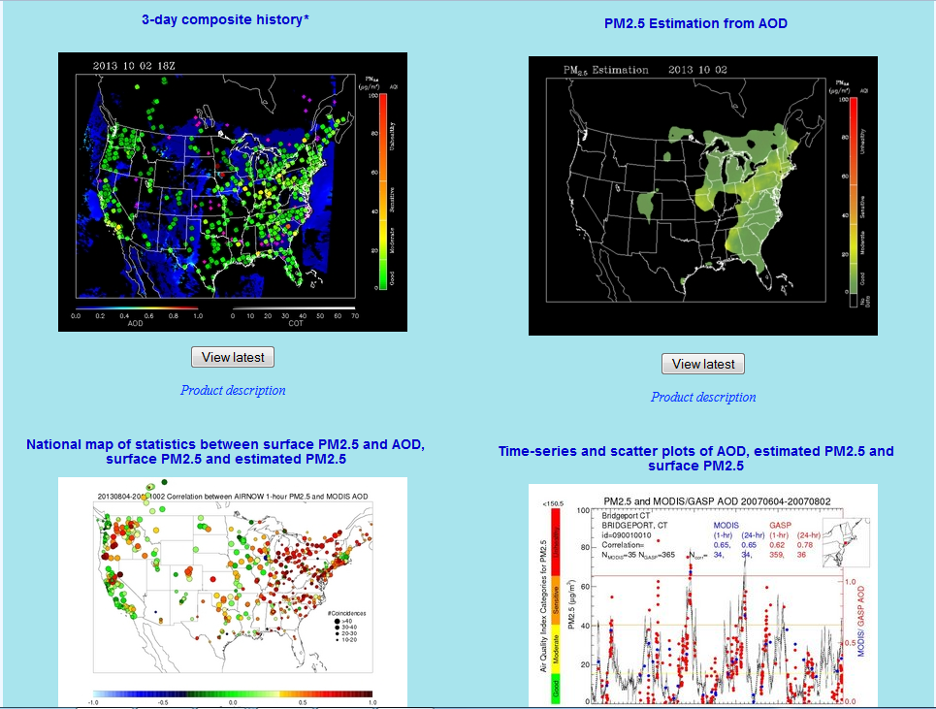
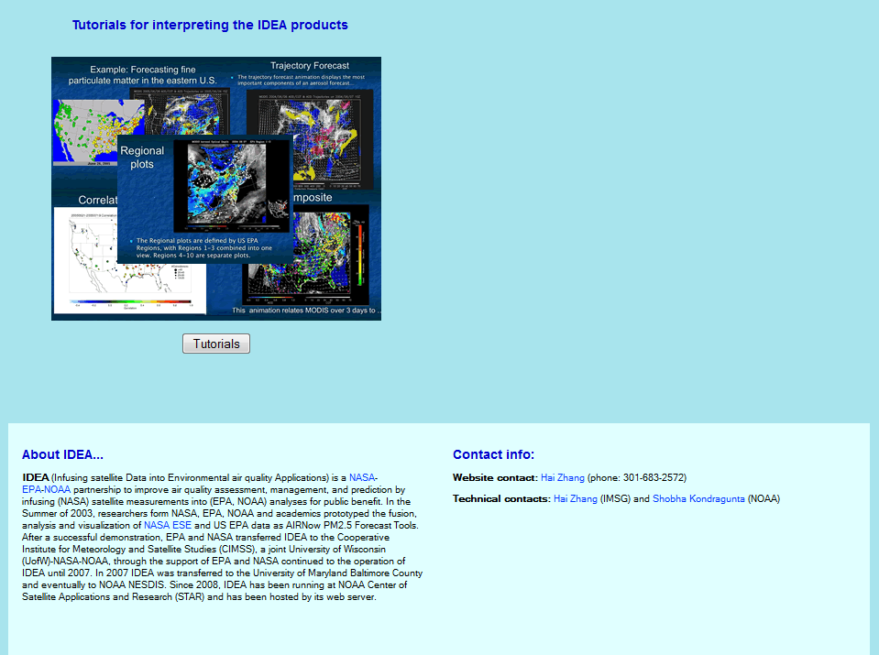
IDEA web page http://www.star.nesdis.noaa.gov/smcd/spb/aq/
Click tabs to select satellite
Click panels to select product

Slide 6
Products on IDEA
Satellite RGB and AOD images, VIIRS smoke/dust mask, fire hotspots
48-hour forward trajectories
3-day composite history of AOD, wind, in-situ PM2.5, and fire hotspots
Daily PM2.5 estimates from MODIS AOD
AOD-PM2.5 correlation, Estimated PM2.5 vs in-situ PM2.5 correlation and RMSE maps
Time series, scatter plots, histogram, etc for AOD, estimated and in-situ PM2.5 at PM2.5 stations

Slide 7
New Updates on IDEA
Interactive google map for VIIRS since 1/6/2014
VIIRS AOT products EDR (6 km), IP (750 m) and quality selection
VIIRS smoke/dust mask images
VIIRS fire hotspots

Slide 8
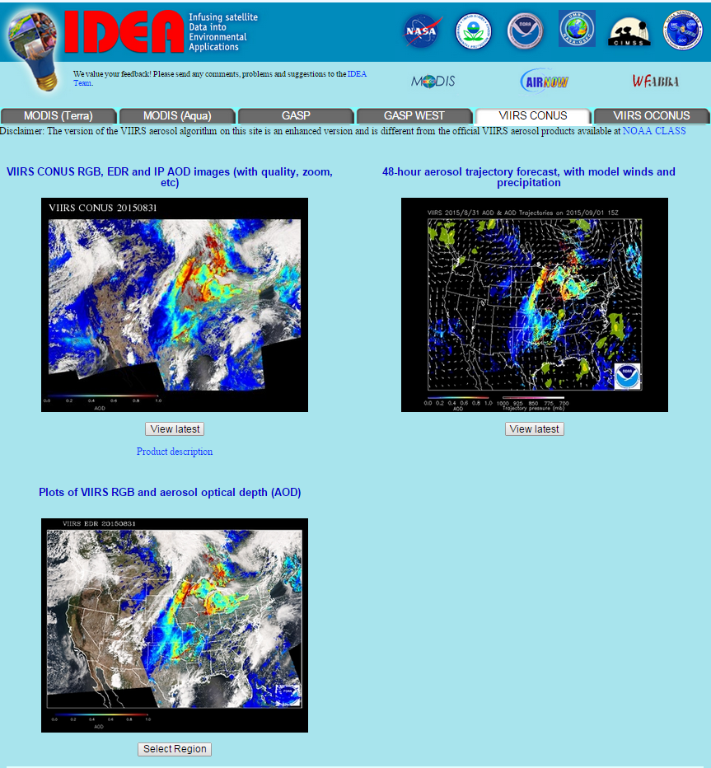
Main page of VIIRS CONUS
Click here to get to this page
Click each image to get to the individual product

Slide 9
VIIRS CONUS imagery on google map

Slide 10
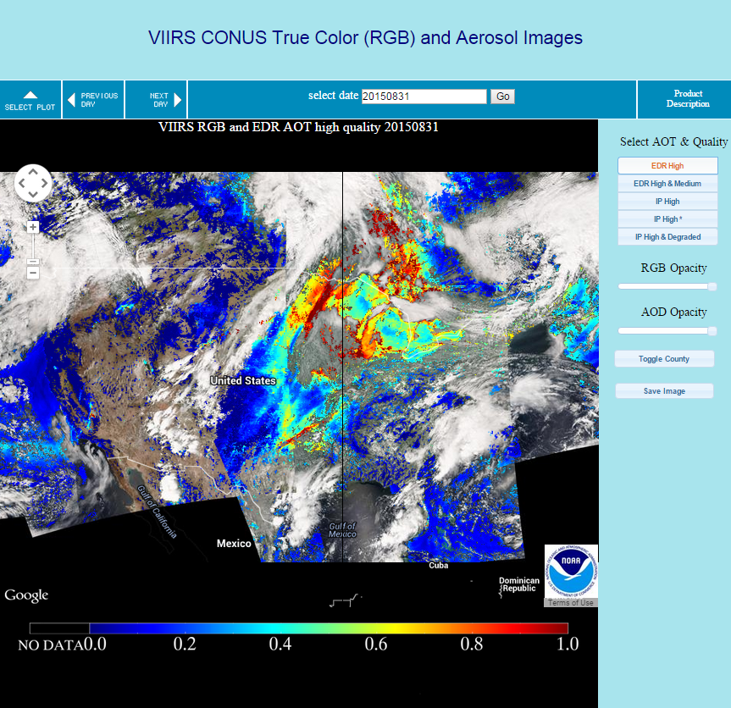
VIIRS CONUS imagery on google map

Slide 11
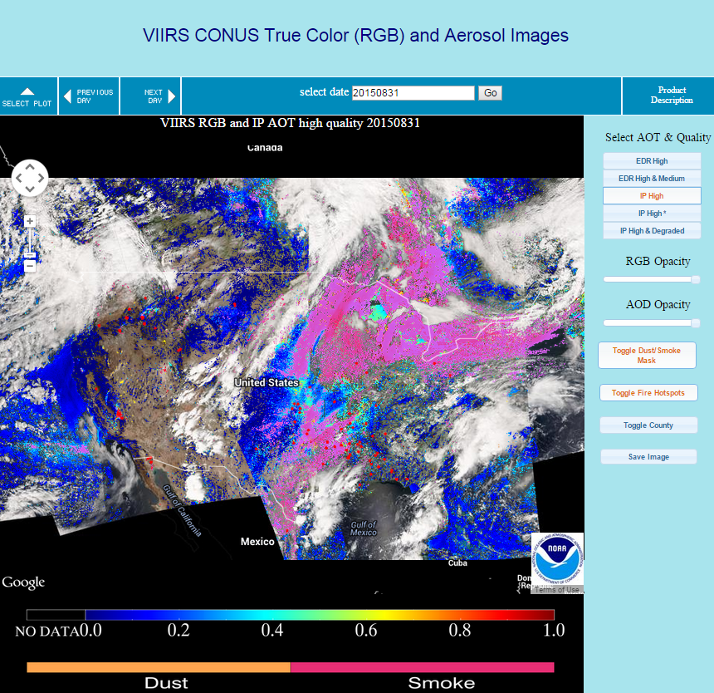
VIIRS CONUS imagery on google map
These two buttons will appear when IP AOT is selected

Slide 12
VIIRS CONUS forward trajectory

Slide 13
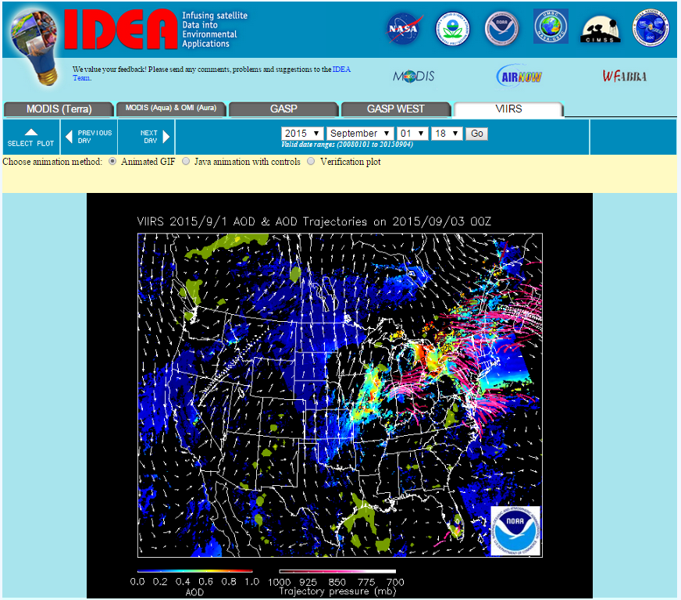
VIIRS CONUS forward trajectory
Initiated at locations with AOD > 0.4, 50mb, 100mb, 150mb, and 200 mb above the surface
48 hour trajectories
AOD (red-blue)
850 mb winds (white arrows)
Precipitation (yellow)
Trajectories from high AOD regions (pink-white):
Dark pink – close to the surface
White – high above surface
Verification plot is linked to the AOD plot two days later

Slide 14
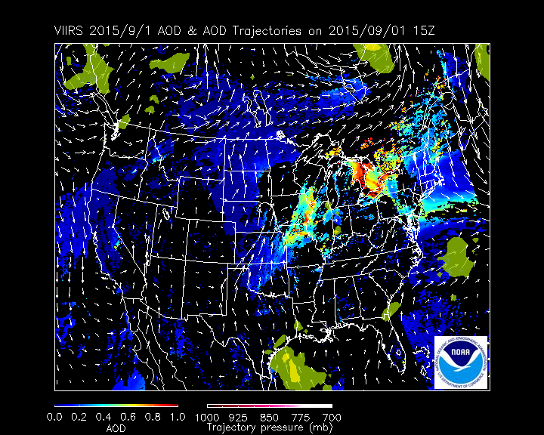
VIIRS CONUS forward trajectory
Initiated at locations with AOD > 0.4, 50mb, 100mb, 150mb, and 200 mb above the surface
48 hour trajectories
AOD (red-blue)
850 mb winds (white arrows)
Precipitation (yellow)
Trajectories from high AOD regions (pink-white):
Dark pink – close to the surface
White – high above surface
Verification plot is linked to the AOD plot two days later

Slide 15
Forward trajectory initiated from other satellites’ aerosol data
MODIS Terra, GASP, GASP-West: Same initialization condition as VIIRS, i.e. initiated at locations with AOD > 0.4, 50mb, 100mb, 150mb, and 200 mb above the surface)
MODIS Aqua AOD and OMI AI (aerosol index)
If AI is higher than 2.0, we will initialize the trajectories at 300mb above surface
Otherwise, same as above

Slide 16
VIIRS CONUS imagery (original version)

Slide 17
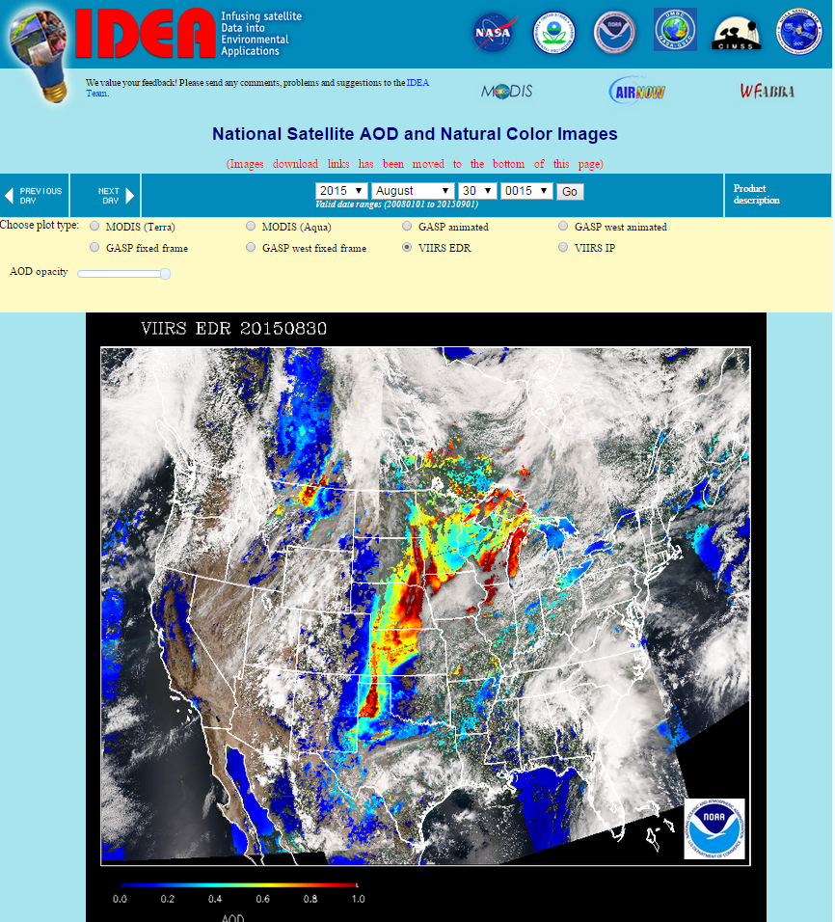
VIIRS CONUS imagery (original version)

Slide 18
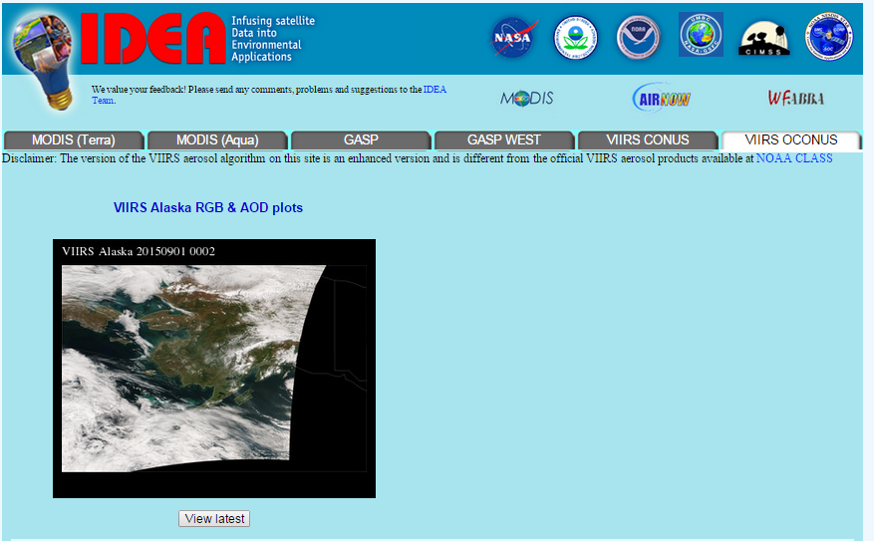
VIIRS OCONUS (Alaska) imagery

Slide 19
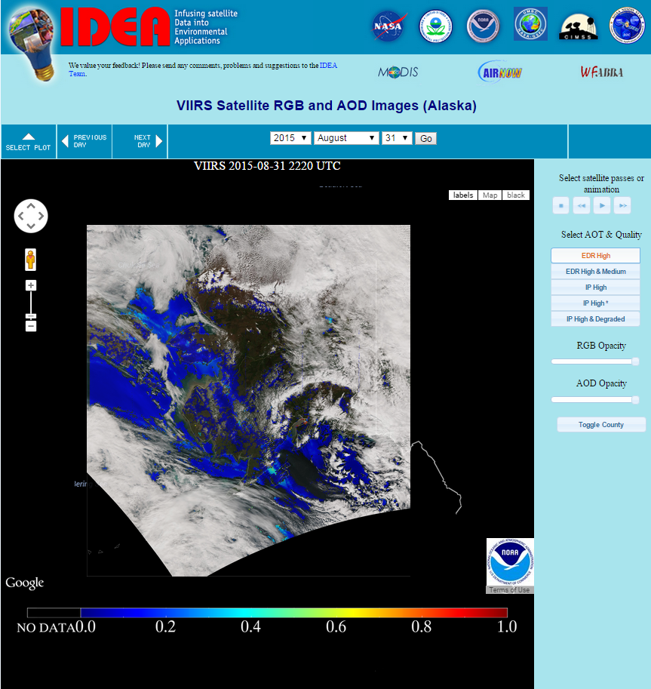
VIIRS OCONUS (Alaska) imagery

Slide 20
Granule Overlap region
VIIRS covers some regions twice per day during sun-lit time with time difference of about 1.5 hours
On IDEA in the overlapping region
We display RGB of the latest overpass
We display AOD and dust/smoke mask of the latest overpass if there are retrievals. Otherwise, we show AOD and dust/smoke mask from the previous overpass.
This can improve aerosol data coverage, but may lead to some confusions.

Slide 21
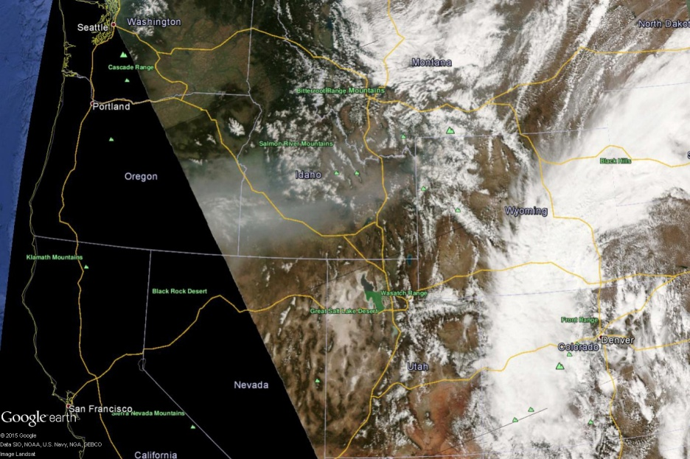
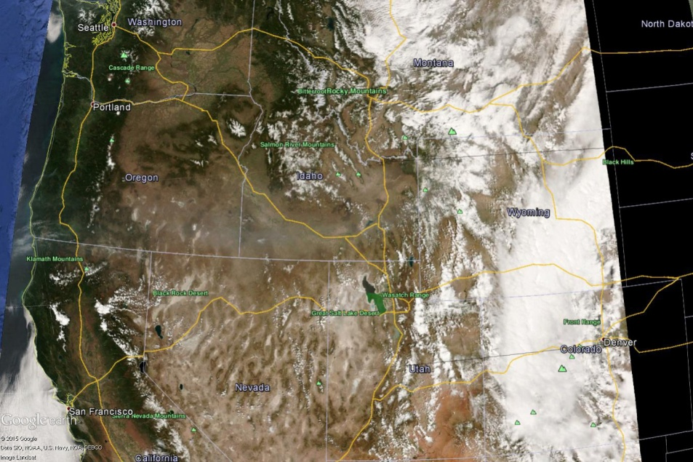
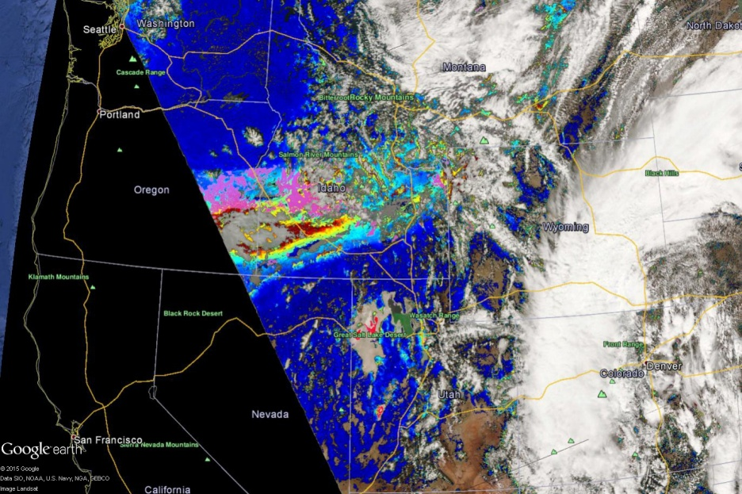
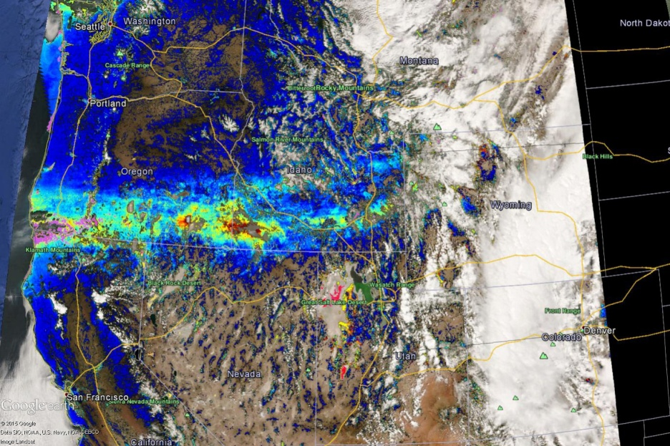
Granule overlap example 20150418
First overpass
Second overpass
AOT & smoke/dust mask
AOT & smoke/dust mask

Slide 22
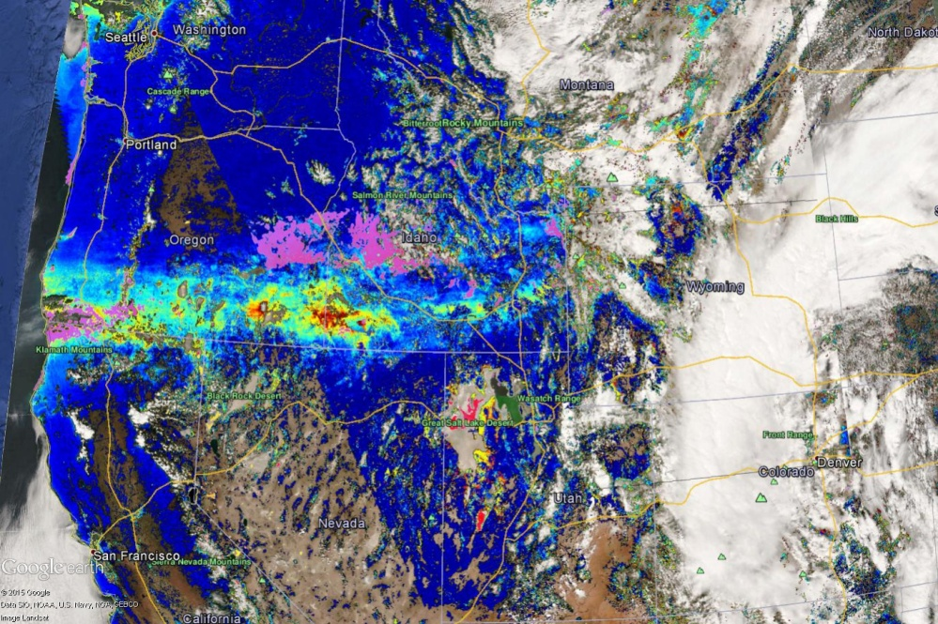
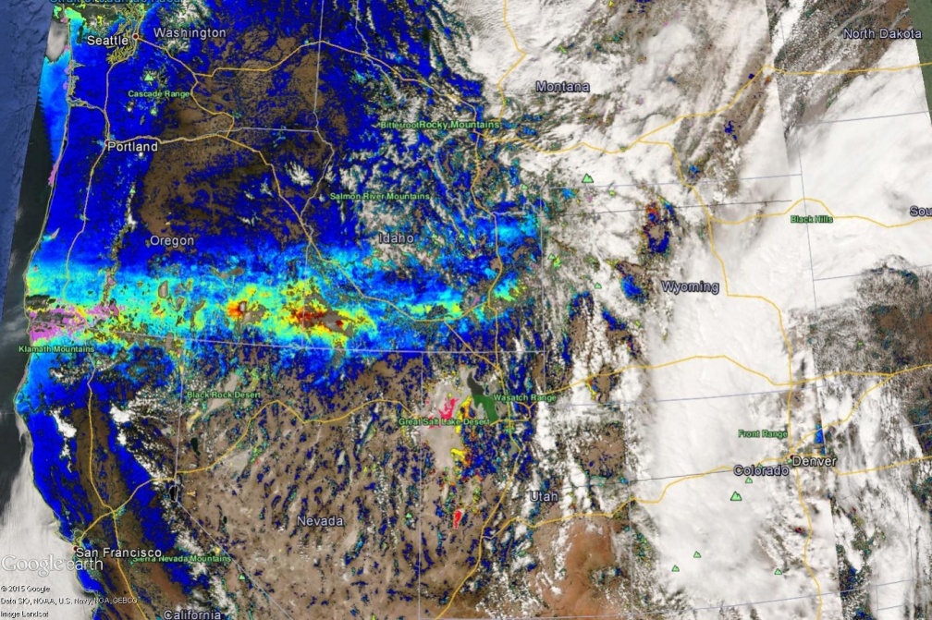
Granule overlap example 20150418
When we plot the two overpass on the same image, we can have to choices:
Choice I
show bottom granule AOT and smoke/dusk mask if top granule does not have retrievals
Better data coverage
Inconsistency
currently adopted on IDEA
Choice II
only show latest AOT and smoke/dusk mask
No inconsistency
less data coverage
Currently not used on IDEA

Slide 23
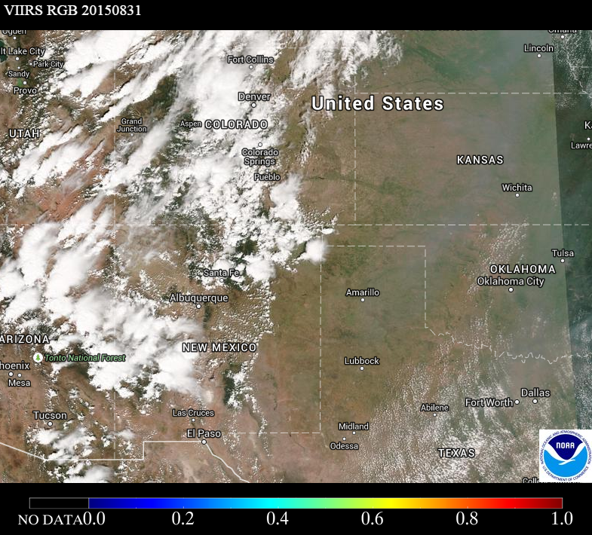
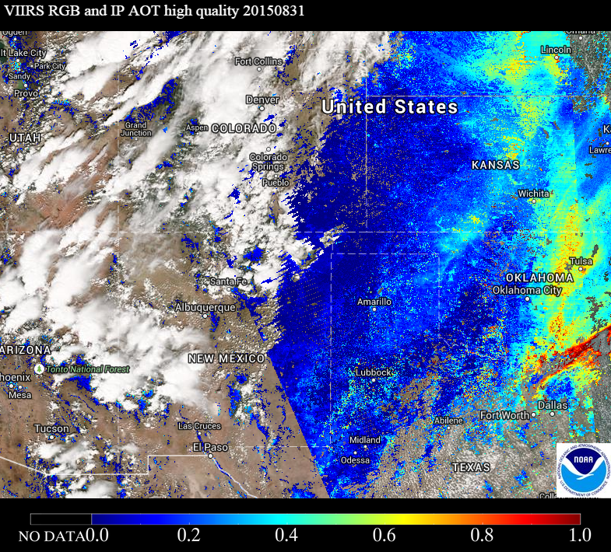
Granule Overlap – another example 20150831
Looks like some AOT retrievals are over cloudy region. But the AOT retrievals are from the earlier granules when those pixels are cloud free.

Slide 24
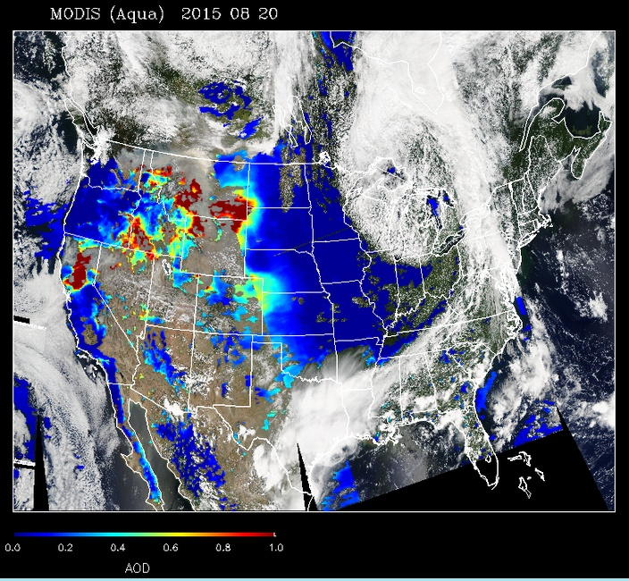
Granule overlap is also in MODIS AOD images

Slide 25
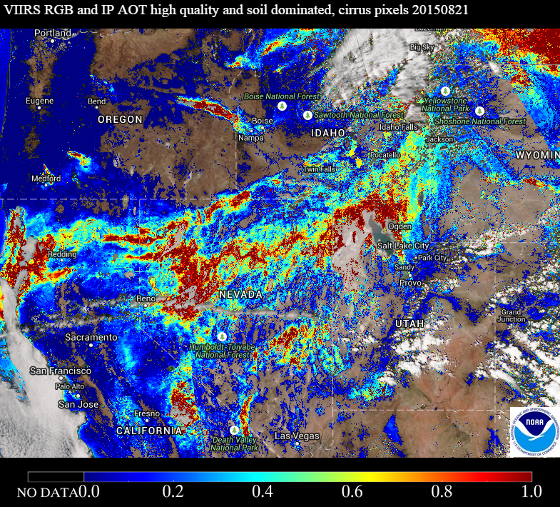
VIIRS IP AOT high *
VIIRS IP AOT high * quality include high quality AOT pixels and degraded AOT flagged as “soil dominated” and “cirrus” pixels
Improve data coverage over western US for qualitative use

Slide 26
Summary
VIIRS imagery products on IDEA
RGB
AOT with different qualities
Smoke cloud mask
Fire hotspots
Forward trajectory
CONUS and OCONUS regions
Issues
Granule overlap
VIIRS IP AOT high *

Slide 27
Acknowledgements
Liam Gumley and Kathy Strabala (University of Wisconsin Madison)
Direct broadcast VIIRS data over CONUS
Scott Macfarlane (Univ. of Alaska)
Direct broadcast VIIRS data over Alaska

