Slide 1
Visualization Tools and Cal/Val Website for VIIRS Aerosol Products
Hongqing Liu, Istvan Laszlo, Shobha Kondragunta, Stephen Superczynski, Hai Zhang, and Jingfeng Huang

Slide 2
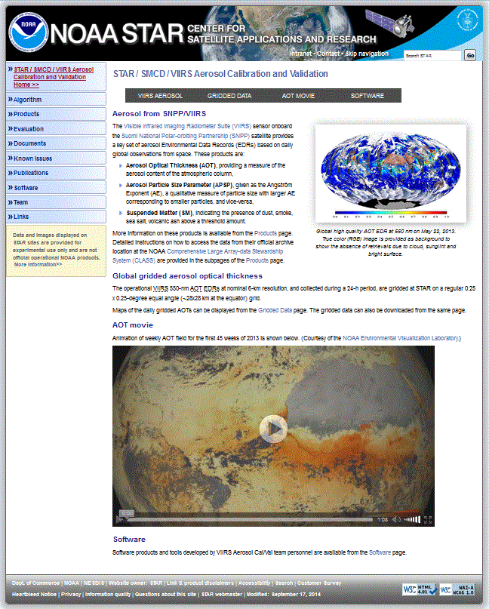
VIIRS Aerosol Calibration and Validation Website
http://www.star.nesdis.noaa.gov/smcd/emb/viirs_aerosol/index.php
Contains the valuable information about the VIIRS aerosol algorithm and products.

Slide 3
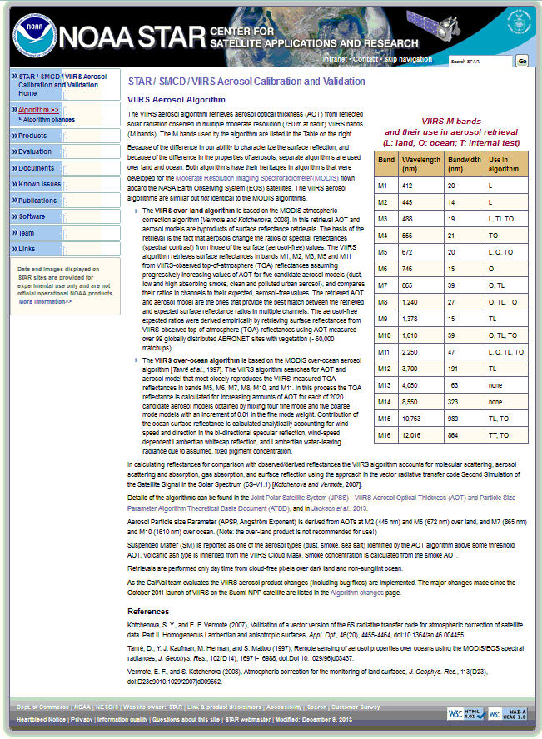
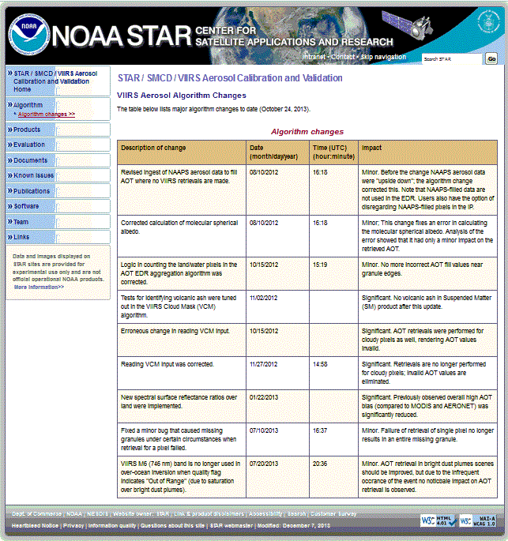
Algorithm
Algorithm changes

Slide 4
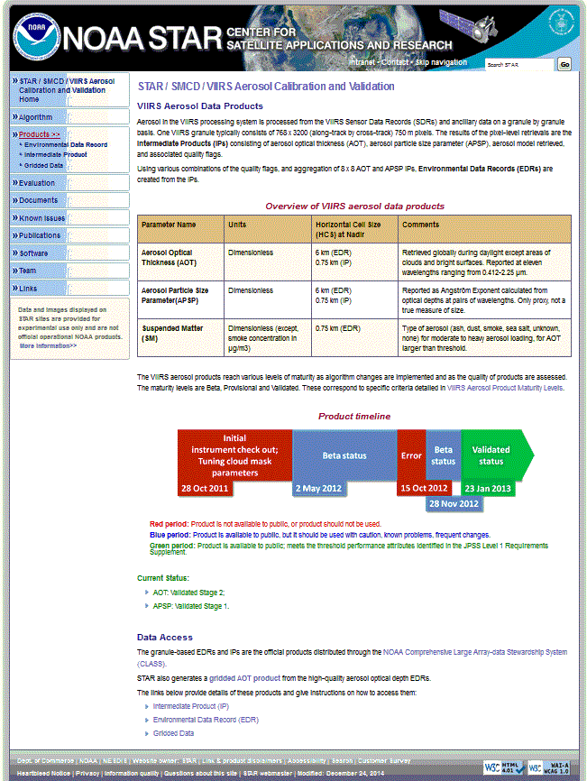
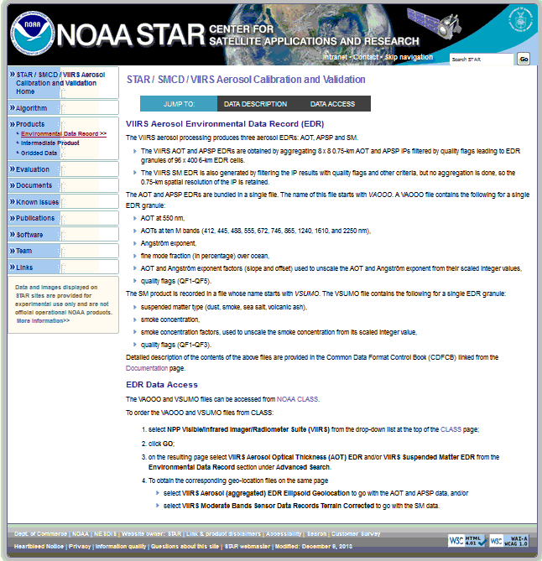
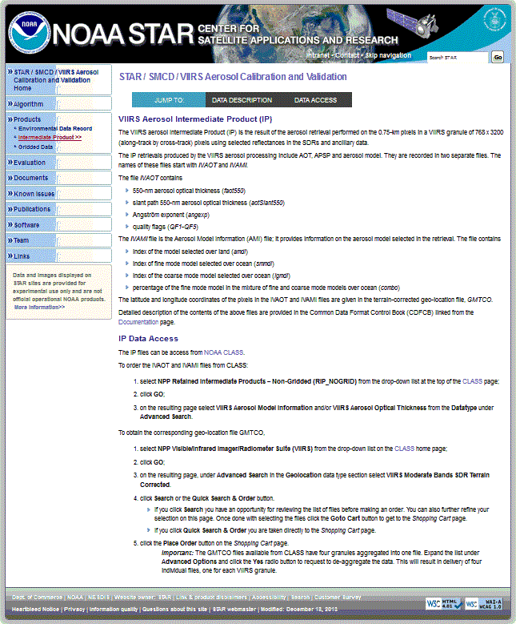
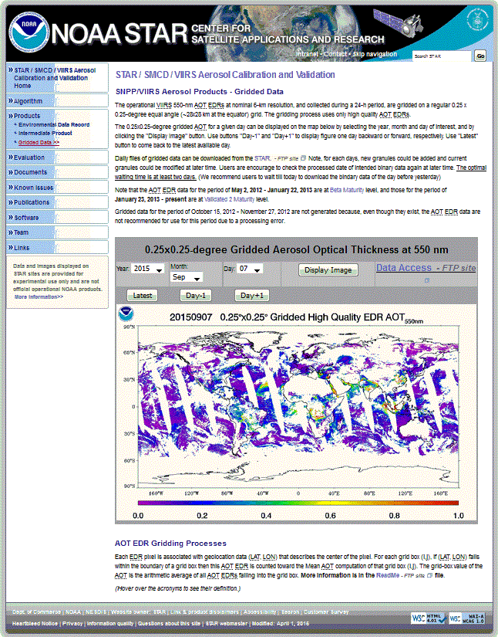
Products
Environmental Data Record
Intermediate Product
Gridded Data

Slide 5
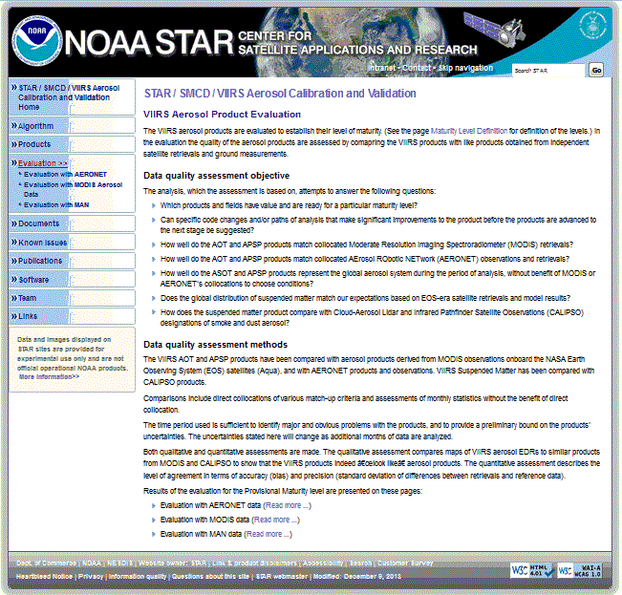
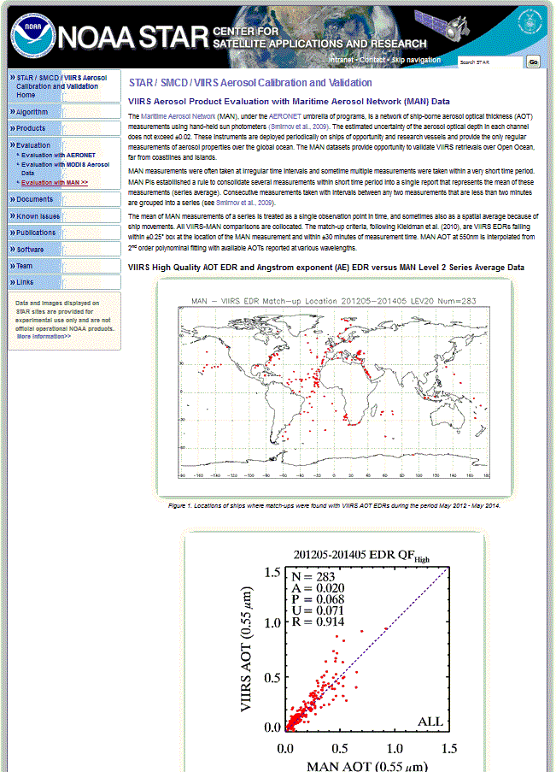
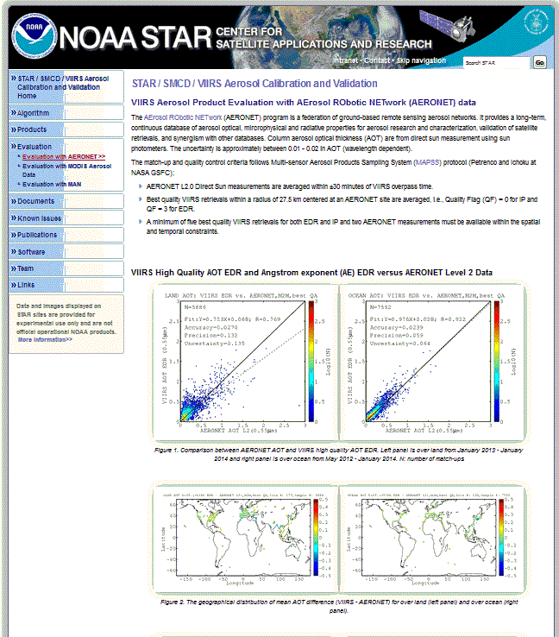
Evaluation
Evaluation with AERONET
Evaluation with MODIS Aerosol Data
Evaluation with MAN

Slide 6
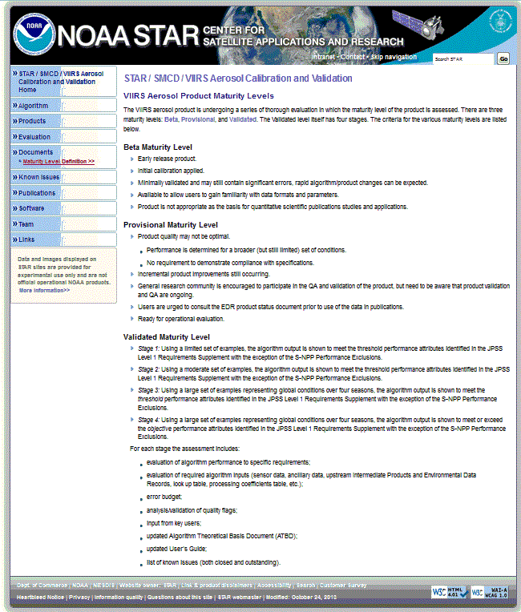
Documents
Maturity Level Definition

Slide 7
Known Issues

Slide 8
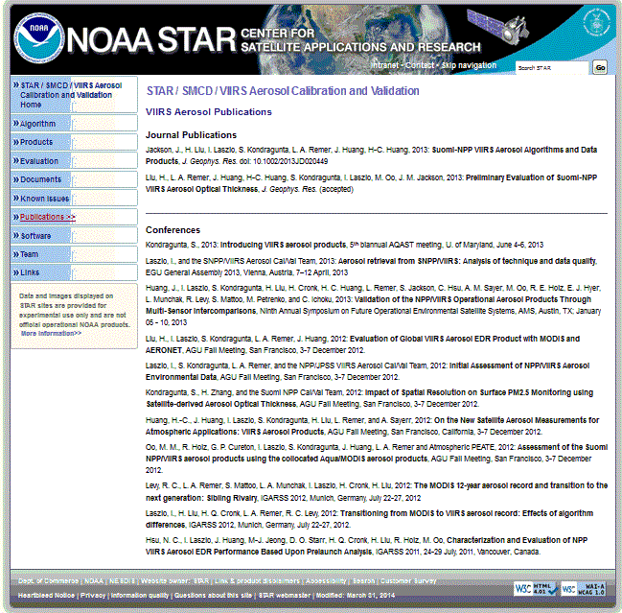
Publications

Slide 9
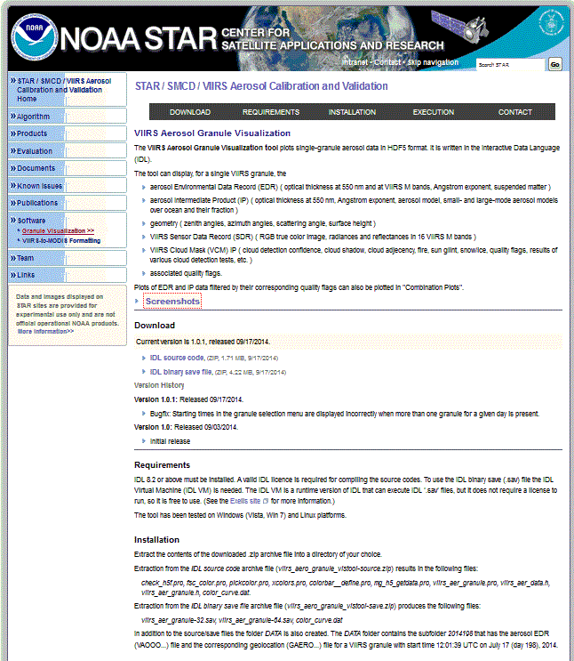
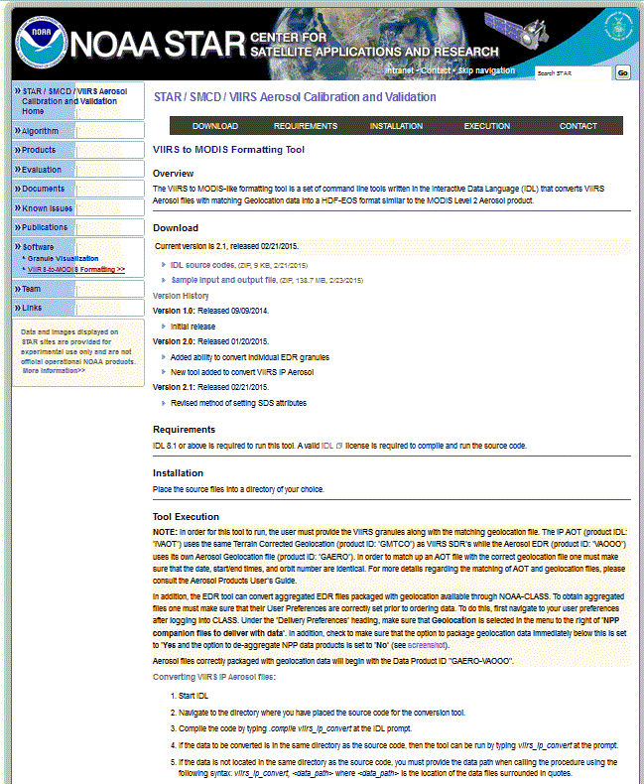
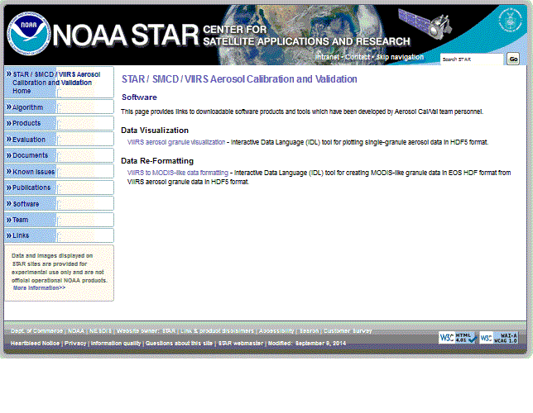
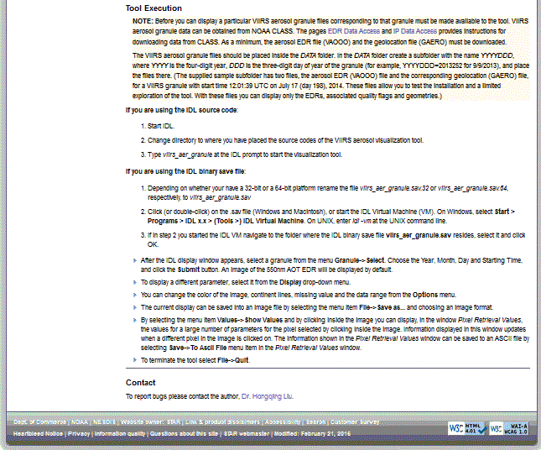
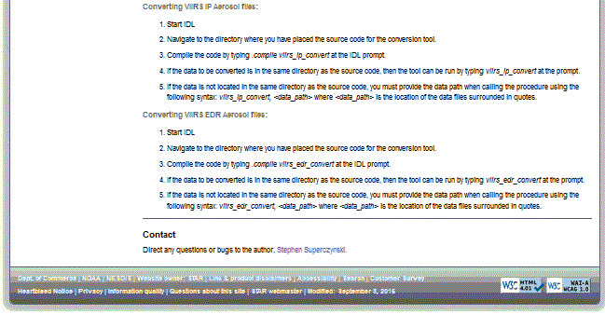
Software
Granule Visualization
VIIRS-to-MODIS Formatting

Slide 10
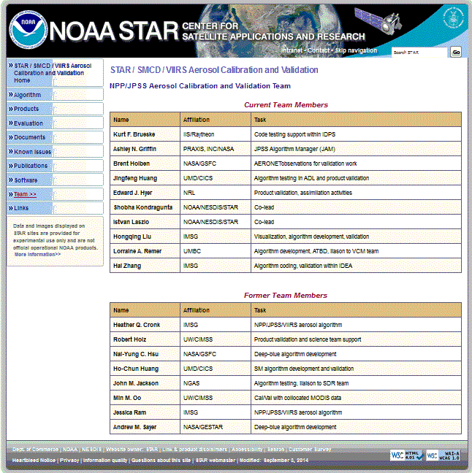
Team

Slide 11
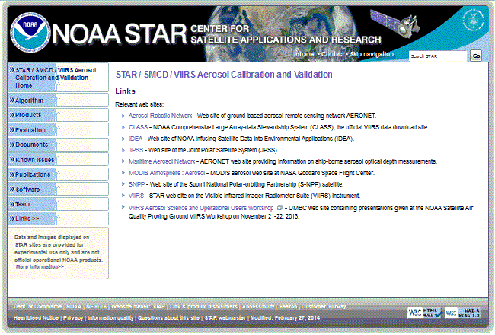
Links

Slide 12
Granule Visualization Tool

Slide 13
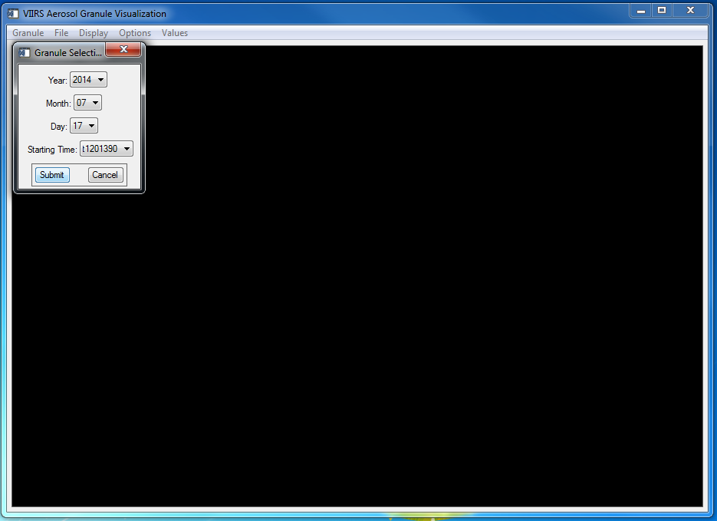

Slide 14
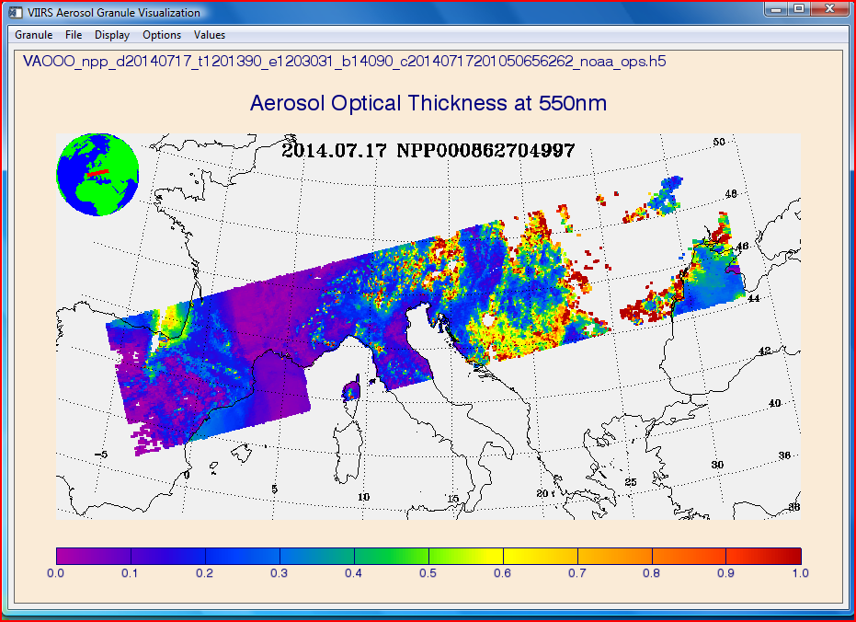

Slide 15
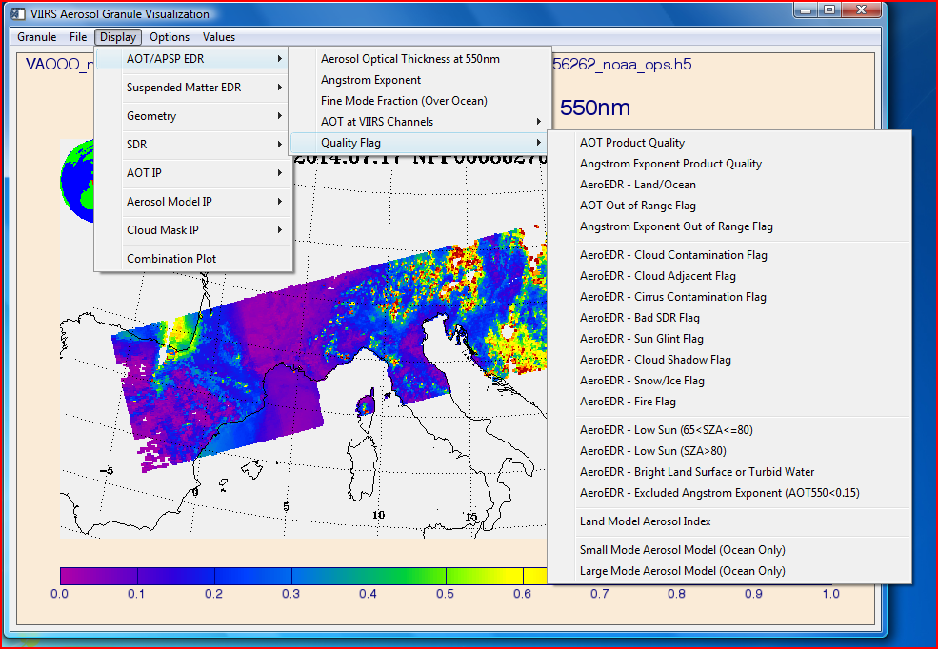

Slide 16
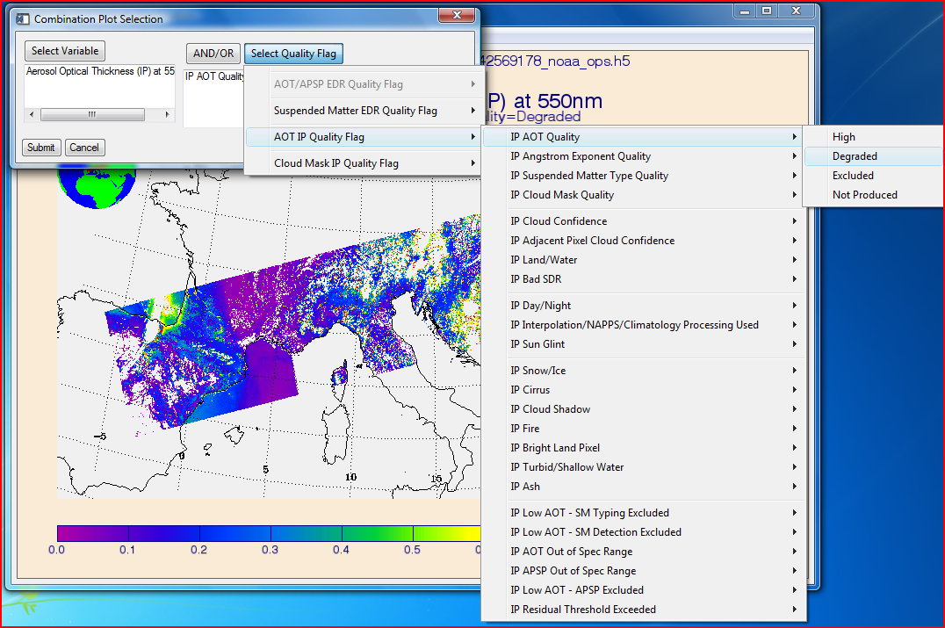

Slide 17
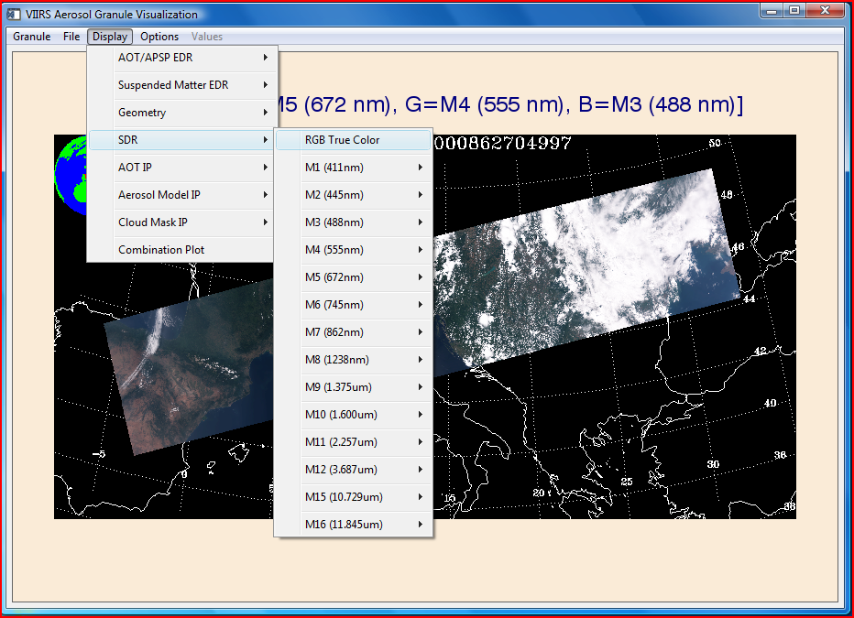

Slide 18
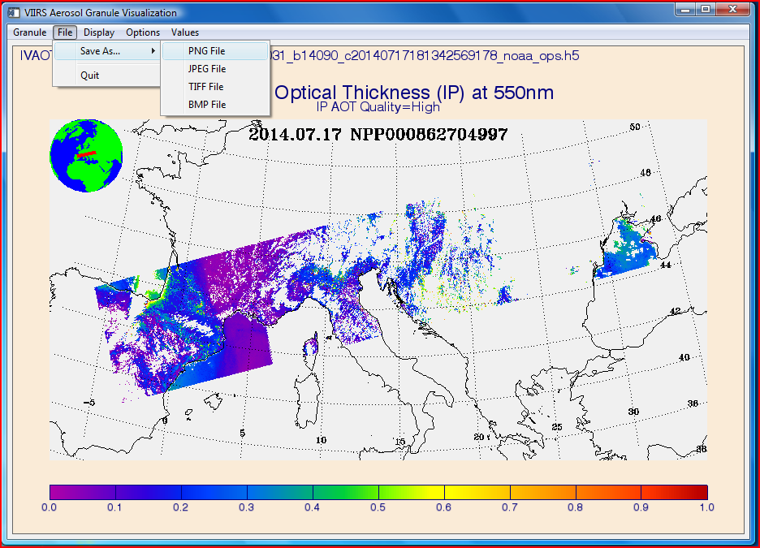

Slide 19
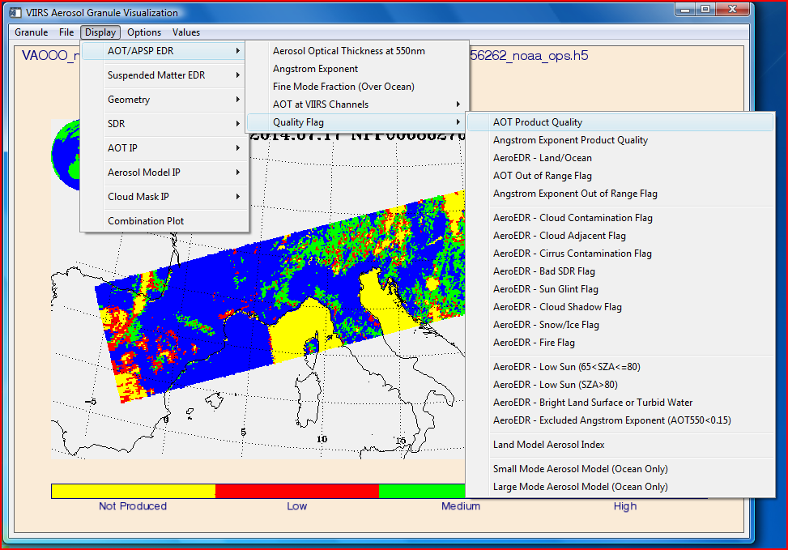

Slide 20
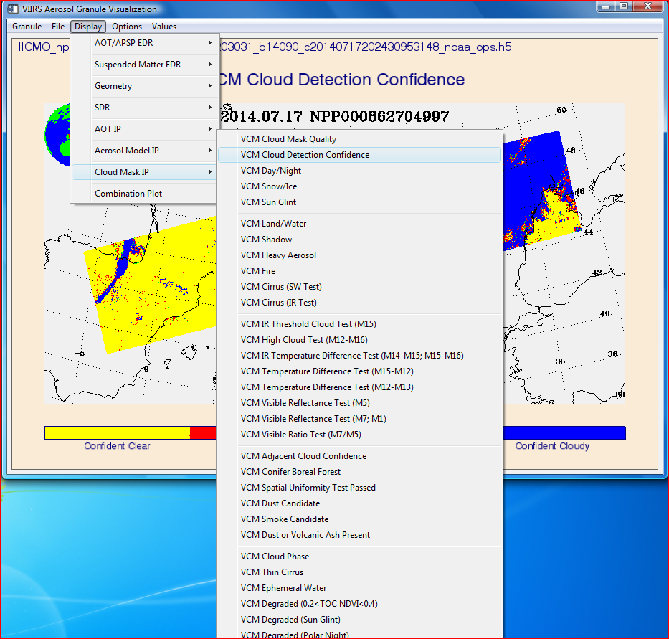

Slide 21
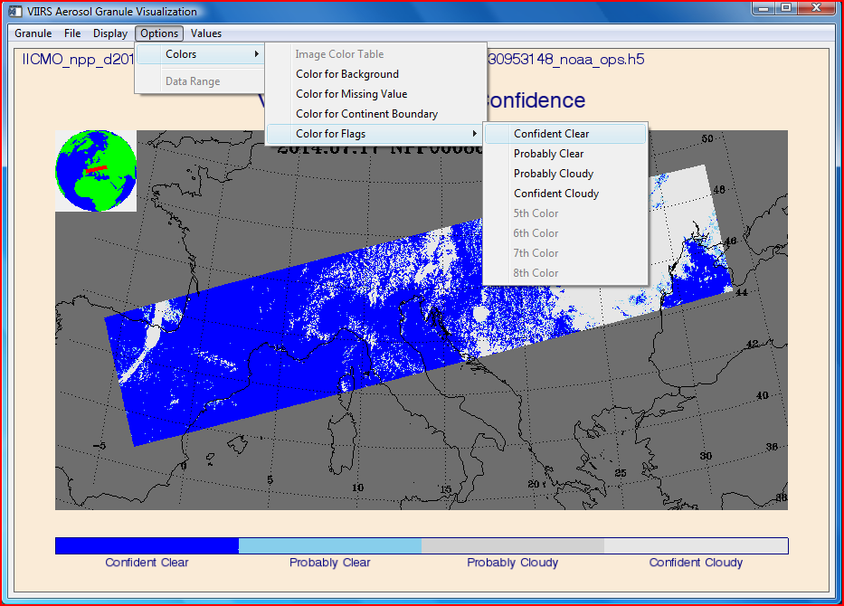

Slide 22
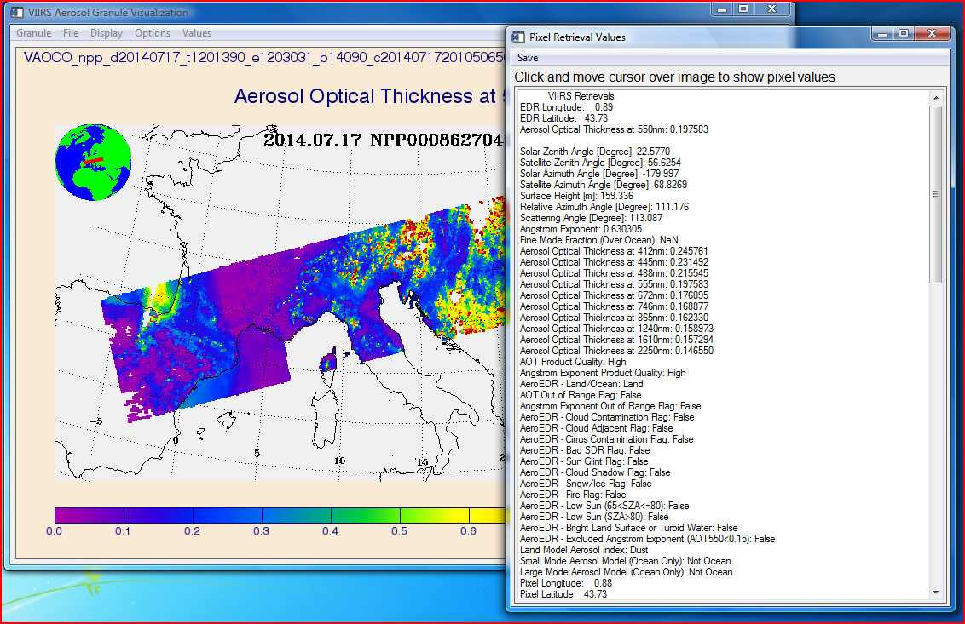

Slide 23
VIIRS-to-MODIS Re-formatting Tool

Slide 24
IDL command line toolset was developed which converts VIIRS H5 files to MODIS-like HDF-EOS format.
Data can then be read by HDF viewers commonly used by the user community (e.g. HDFLook)
Allows users to explore VIIRS Aerosol products without having to redevelop their own file readers to work with HDF5.
Use of the Re-formatting Tool
Package includes source code to convert EDR or IP Aerosol files, a header file, and Readme file.
Tool requires matching geolocation file for each granule.
Can also convert “aggregated” data files available from NOAA-CLASS, which attempts to reproduce the 5-min MODIS granule by combining 4 VIIRS granules and geolocation information into one file.

Slide 25
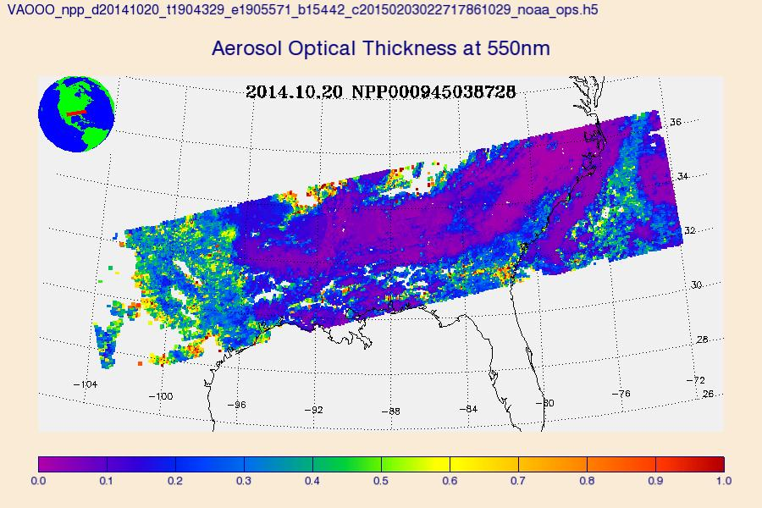
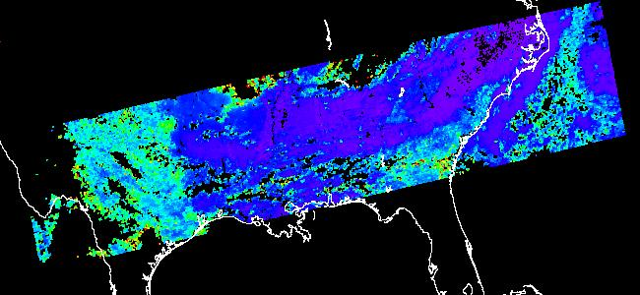
Data Output
For each input file, the tool will produce an HDF file containing all VIIRS Aerosol science data sets (SDS).
Processing status updates for each dataset in the files are printed out to the screen for the user.
Output filename will match that of the input file with ‘_EOS.hdf’ amended to the end.
No change to the dataset names or geographic extent.
The only direct change to the data is the rescaling of the EDR data to match the MODIS convention of a zero offset.
Original H5 file
Same granule converted to HDF

Slide 26
Software Info and website
Code has been tested by Aerosol team and some users at NASA.
Initially released in Fall 2014. Version history and downloads available on the VIIRS Aerosol Cal/Val website:
http://www.star.nesdis.noaa.gov/smcd/emb/viirs_aerosol/software.php
Link to provide feedback at the bottom of above website

