Slide 1
NOAA Satellite AQ Proving Ground Annual Advisory Group Workshop
NOAA’s Joint Polar Satellite System’s Proving Ground and Risk Reduction Program
JPSS PGRR Fire & Smoke Initiative
Bill Sjoberg, Mitch Goldberg
9 Sep 2015

Slide 2
Outline
Introduction
PGRR Background
PGRR Proving Ground Initiatives
Fire & Smoke Initiative
Summary

Slide 3
JPSS PGRR Background Definitions
Proving Ground
Demonstration and utilization of data products by the end-user operational unit, such as a NWS Weather Forecast Office or Modeling Center.
Promote outreach and coordination of new products with the end users, incorporating their feedback for product improvements
Risk Reduction
Development of new research and applications to maximize the benefits of JPSS satellite data
Example - use of Day Night Band for improved fog and low visibility products at night, benefiting transportation industry.
Encourages fusion of data/information from multiple satellite, models and in-situ data
Primary work is done at the algorithm and application developer’s institution.
Address potential risk in algorithms and data products by testing alternative algorithms.
.

Slide 4
JPSS PGRR Background Application Areas
Weather Forecasting - Improving Global, Regional forecasts
Tropical Cyclones
Severe Weather (Nowcasting)
Ocean/Coastal - Coral Bleaching, Harmful Algal Bloom alerts
Land - Droughts, Agriculture
Hazards - Smoke, Fire, Volcanic Ash, Air Quality
Hydrological - Precipitation, Floods, Soil Moisture, Snow/Ice, River Ice
Climate - Integrated products, real-time anomaly products
Education and Training
Infrastructure - Direct Readout + Software (CSPP), Airborne campaigns

Slide 5
JPSS PGRR Background 2012 Call-for-Proposals
The PGRR Program was established in early 2012, following the launch of the Suomi National Polar Partnership (SNPP) satellite.
The initial Call-for-Proposals in Jan 2012 resulted in nearly 100 teams providing Letters-of-Intent (LOIs). These LOIs were evaluated and teams were selected to provide full proposals.
These proposals went through a rigorous user-led selection – nearly 40 projects selected for funding.
Project leads work with the users to determine how best to use new JPSS data, and to quickly transition these capabilities to operations.
The JPSS Program worked with projects to ensure their user community played a major role in actions taken by each PGRR Project.
As these researcher-user teams kept the projects moving forward a new way of interacting was proposed. Today the JPSS Program calls it PGRR Initiatives

Slide 6
PGRR Proving Ground Initiatives Responding to User Feedback
The River Ice and Flooding Initiative was the first attempt at this new partnership and it was established in response to Galena AK flooding in May 2013.
The Initiative included River Ice and River Flooding Project teams, direct broadcast SMEs, and National Weather Service River Forecast Center forecasters
The success of River Ice and Flooding Initiative led to creation of Fire and Smoke Initiative and NUCAPS Initiative
The continued success of the multi-agency initiative teams further solidified with FY15-16 JPSS PGRR Call for Proposals establishing 13 Initiatives
Initiatives will seek to leverage NOAA Testbed capabilities to maximum extent possible

Slide 7
PGRR Initiatives Details
The JPSS PGRR Program had a second PGRR Program Call-for-Proposals in Dec 2014. Over 130 Letters-of-Intents (LOIs) were received.
These LOIs went through a similar selection process to request formal proposals and final funding decisions.
The funding decisions caused some projects to end after their initial work, other projects had new work, and additional projects were new starts.
Nearly all of the PGRR Projects are now part of one of the Initiative’s Working Group. These groups work to combine individual project objectives to focus on specific operational capabilities that support key user needs.
The initiatives have monthly telecons to evaluate progress, establish priorities, identify milestones and dates for future actions.

Slide 8
PGRR 2014 Call-for-Proposals Initiatives List
• River Ice and Flooding (6)
• Fire and Smoke (5)
• Sounding Applications including NOAA Unique CrIS/ATMS Processing System (NUCAPS) (17)
• NWP impact studies (via HRRR and GFS) and other critical weather applications (13)
• OCONUS and NCEP Service Centers AWIPS Initiative (9)
• Cryosphere Initiative (5)
• Land Data Assimilation (7)
• Ocean and Coastal (12)
• Atmospheric Chemistry (1)
• Hydrology (6)
• Aerosol Data Assimilation (3)
• Innovation (40)
• Training (8)

Slide 9
Fire and Smoke Initiative
Initiative began in May 2014
Initiative Objectives were established
Evaluate the current use of geostationary and polar orbiting satellite capabilities in support of Fire and Smoke mission
Identify current SNPP/JPSS and new GOES-R data and capabilities with the potential to improve support to this mission
Establish methodologies and procedures for the operational demonstrations of these capabilities
Identify the satellite capabilities whose operational impacts are sufficient to warrant transition from research to operations
Initiative has been working NWS and Air Quality personnel responding to and NWS Western Region Fires in 2014
2014 Accomplishments
Convened stakeholder monthly telecon
Briefed on how WFOs currently use satellite products for fire and smoke forecasting

Slide 10
Fire and Smoke Initiative
2014 Accomplishments
Active Fire and other fire and user websites
HRRR Smoke Forecast products made available for Western Region. Received informal feedback on how HRRR Smoke Product functioned.
Stakeholder visits and briefings to key user forums (NICC, NWCC, 2014 Predictive Services Fall Meeting, etc)
Conducted verification of July 16-20, 2014 Pacific Northwest Wildfire forecasts from the 3km Western US HRRR-chemfire wildfire smoke PM2.5 predictions (http://rapidrefresh.noaa.gov/hrrrchemzeus ) using US EPA AIRNOW PM2.5 measurements
Conducted assessment of NOAA Biomass Burning Emissions Product
Conducted study using High Spectral Resolution Lidar backscatter cross section to assess the impact of assimilation of MODIS Aerosol Optical Depth on Western US Smoke predictions using the Real-time Air Quality Modeling System (RAQMS during July-August, 2014 FRAPPE/DISCOVER-AQ field mission
Fire & Smoke Projects built on 2014 success to justify proposals to PGRR Call in Dec 2014. Additional funding received

Slide 11
Fire and Smoke Initiative Background
Funny River Fire, Kenai Peninsula, approximately 1am local time, May 21, 2014
Photo courtesy Bill Rash at Alaska Dispatch newspaper

Slide 12
Plans for 2015
Work closely with the Predictive Services branches (Intelligence, Weather, and Fuels/Fire Danger) of the National Interagency Coordination Centers (NICC) to see the implementation of AWIPS II and insure VIIRS AF is, or can be, included
Enhance fire, smoke, and aerosol product distribution generated from SNPP VIIRS Direct Broadcast (DB) data for CONUS and Alaska for targeted regions
Engage wildland firefighting community in a dialogue to understand VIIRS and use it for situational awareness.
Quantify select key socio-economic impacts of fires and smoke
Extend user outreach by porting the new VIIRS fire and smoke products into NOAA’s Hazard Mapping System and AWIPS-II
Position Initiative Working Group to support AK Fire Season

Slide 13
Plans for 2015
Establish an initiative sub-group to begin dialog on a Blended Fire & Smoke Product
Improve HRRR smoke forecasts through improved emissions via VIIRS Fire Radiative Power Product
Engage Western Region WFOs to increase their awareness and use of VIIRS Fire & Smoke capabilities and get feedback from them on smoke models
Increase opportunities to use prescribed fires to validate VIIRS this spring in New Jersey and Virginia with the US Fire Service.

Slide 14
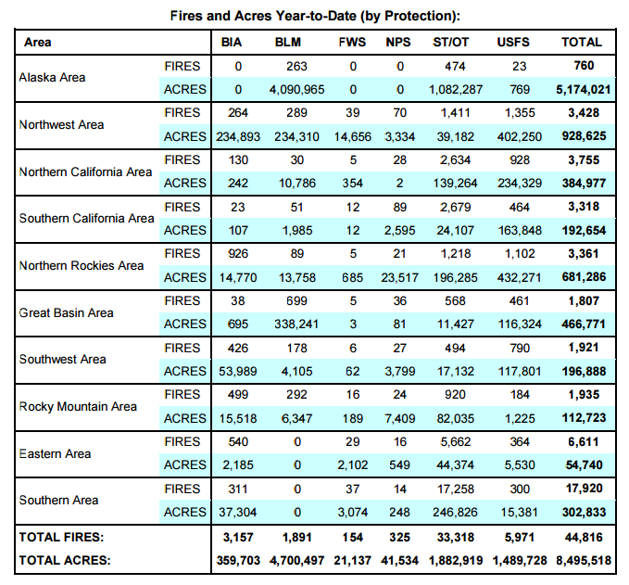
US 2015 Fire Season-to-Date
Sep 8 – 5:30 MT

Slide 15
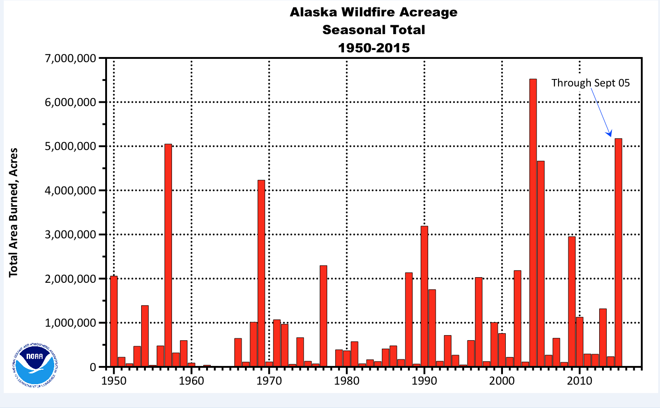
AK Fire Season 2015 Details

Slide 16
Western Region Fire Season 2015 Details
Acreage
Currently 66 wildfires have burned nearly 1.7 million acres.
The Okanogan Complex is by far the largest with ~293,000 acres burned. It is also the largest fire in Washington state history.
Personnel
28,000 firefighters and personnel are supporting wildfires in the western U.S.
68 firefighters from Australia and New Zealand are being deployed to incidents in Oregon and Washington.
200 soldiers from the 17th Field Artillery Brigade based out of Fort Lewis, Washington are deployed in Washington state.
5 wildland fire suppression crews and one CL-415 scooper group from Ontario, Canada and one Convair 580 airtanker group from both Saskatchewan and Alberta are supporting fire suppression efforts in the Northern Rockies Area.
58 fireline management personnel from Alberta and Ontario, Canada are assigned to support large fires in the Northern Rockies Area.
Direct Costs
Roughly ~$440,000,000 ($440 M) spent on currently active fires (per NIFC Situation Report)
Note that this number excludes costs for previous fires and is not a seasonal total
The costliest of the current fires are Stouts Creek ($36.1m), Rough ($33.8m) and the Mad River Complex ($30.6m).
Overall, 12 current fires have costs exceeding $15m

Slide 17
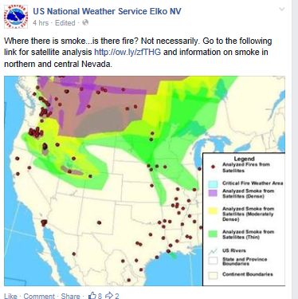
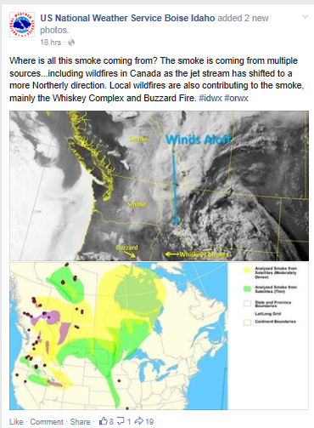
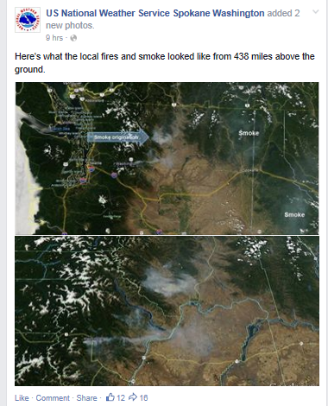
How WFOs Currently Use Satellite Imagery
Fire and Smoke Initiative

Slide 18
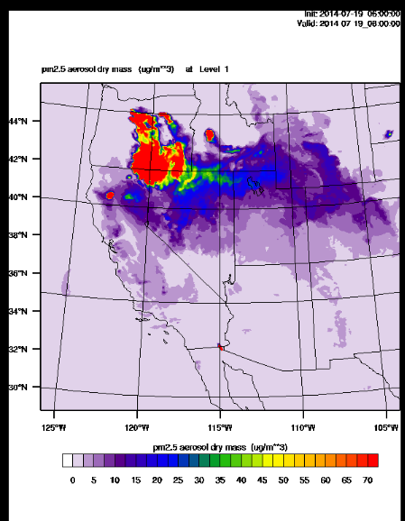
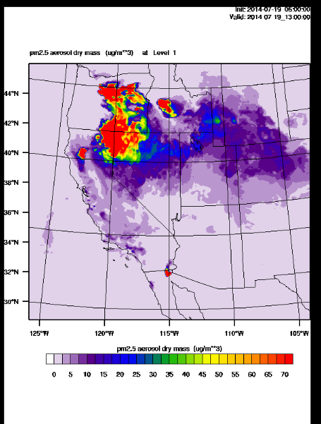
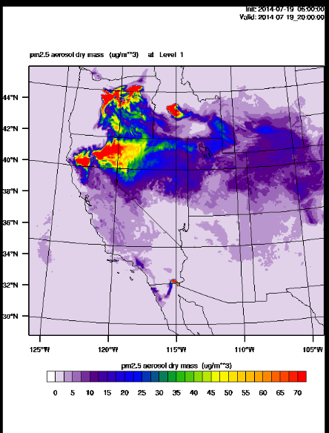
HRRR Smoke Product
Fire and Smoke Initiative
Weak east-west frontal boundary from northern UT to northern CA -- smoke from fires get caught up along front -- verified pretty well

Slide 19
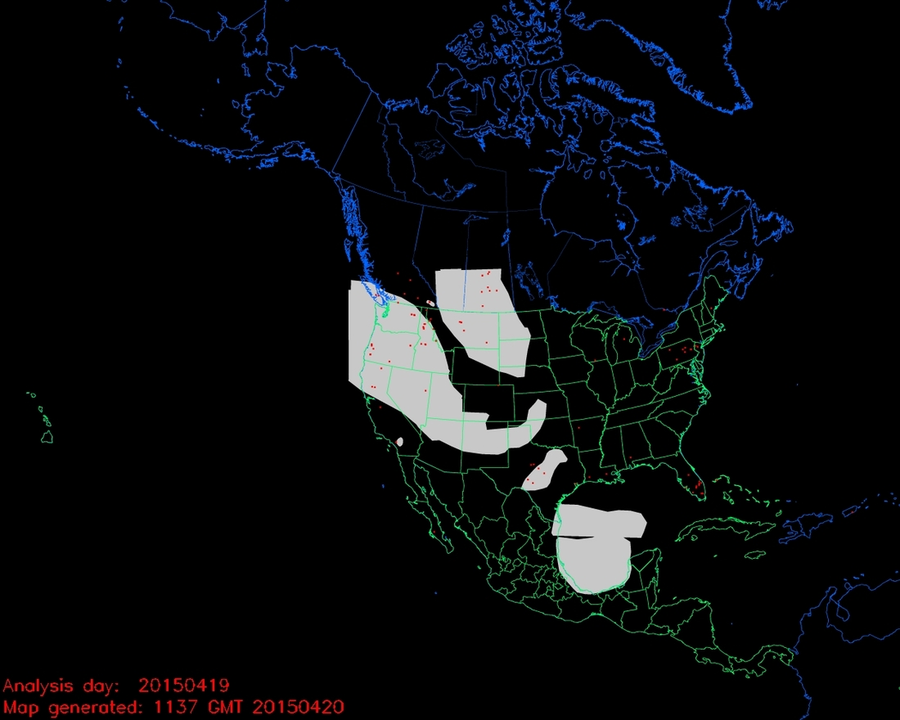
NESDIS Hazard Mapping System (HMS)
http://www.ospo.noaa.gov/data/land/fire/currenthms.jpg
Smoke from intercontinental transport over Pacific NW and into Four Corners on April 19, 2015

Slide 20
Fire and Smoke Initiative
VIIRS Imagery

Slide 21
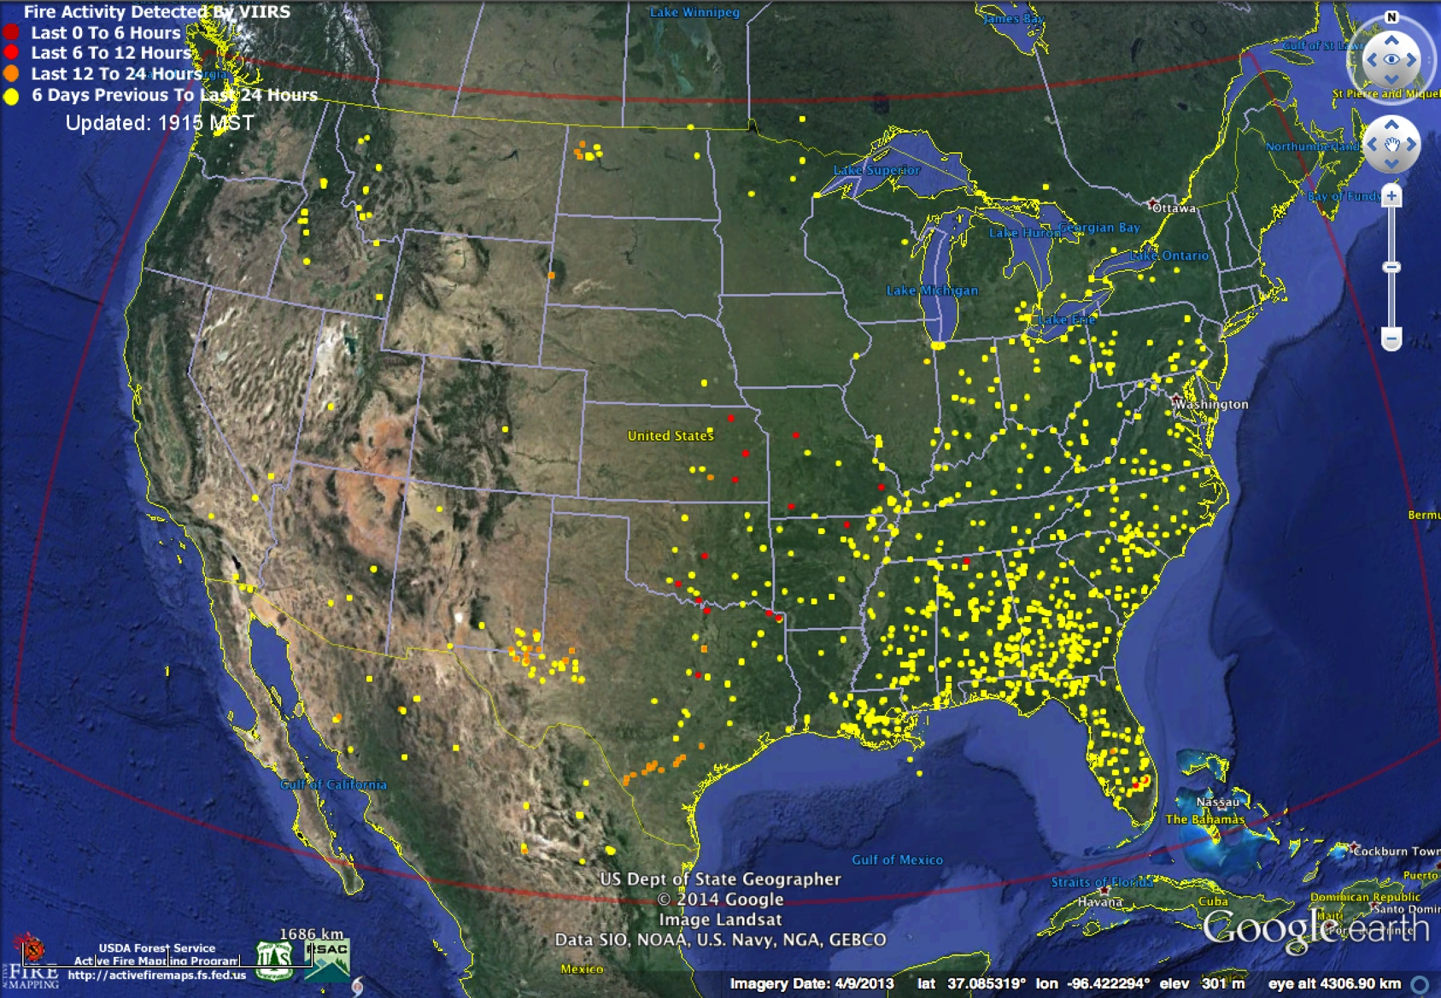
VIIRS 375 m NRT Fire Data Implemented for
North America USDA-Remote Sensing Applications Center
http://activefiremaps.fs.fed.us/

Slide 22
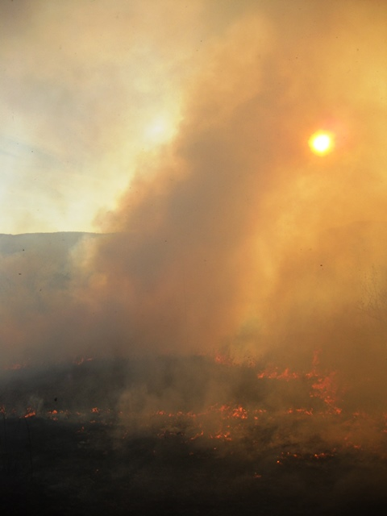
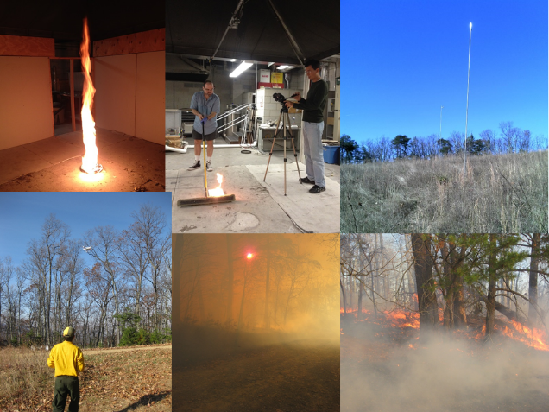
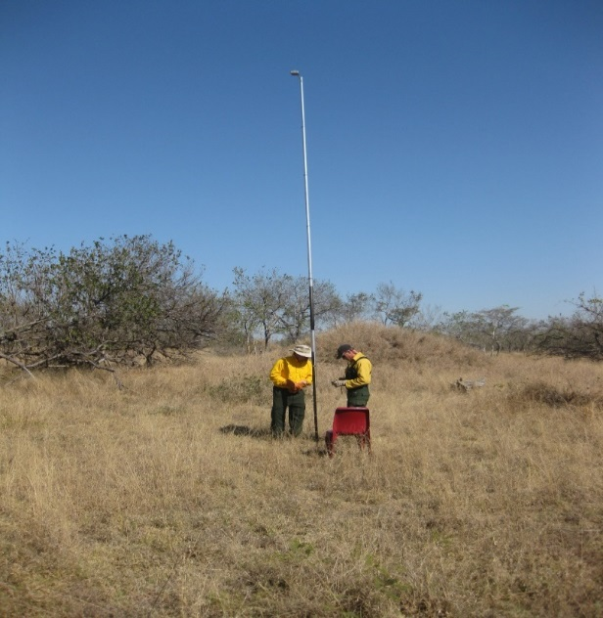
VIIRS Active Fire
Evaluation 2015
Fire chamber burns and field experiments over the summer and fall
c

Slide 23
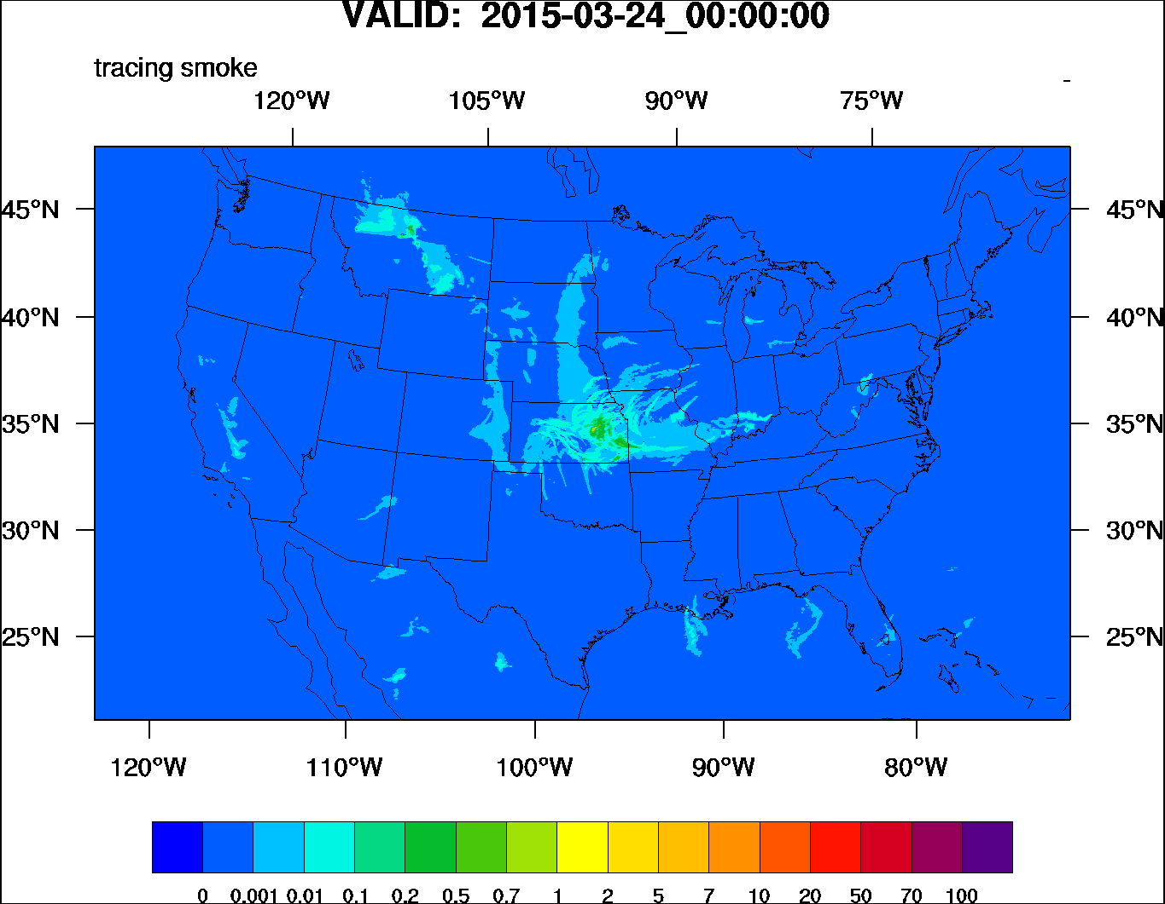
HRRR-smoke Products
HRRR-smoke Forecast information
http://activefiremaps.fs.fed.us/index.php
Notes:
Smoke plots show Surface concentration and Vertical average log₁₀ [ pm2.5(sfc to 8 km)]

Slide 24
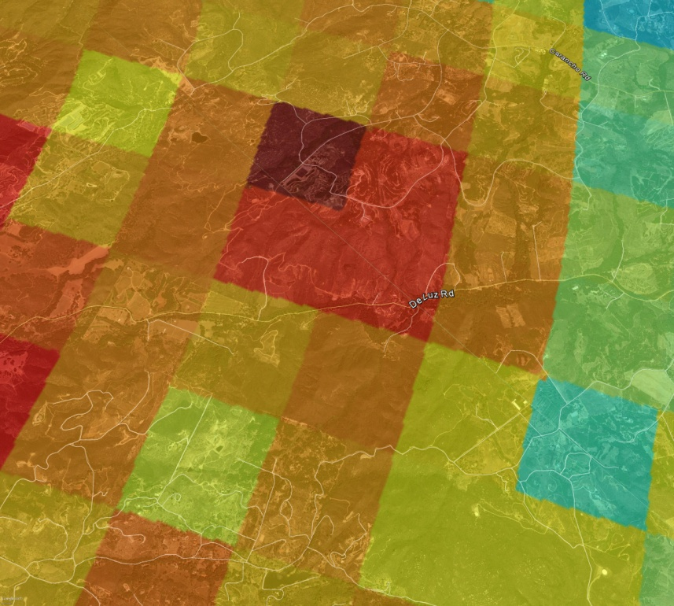
Key Features of eIDEA to Deploy as NWS Western Region Demo
1
Access to high resolution VIIRS aerosol and fire products
Pixel level AOT
2
Fire category
3
Burned area
4
Mortality risk factors for smoke exposure
Information accessible on web and any portable device of choice to aid fire managers in short-term resource allocation planning and long-term assessment of land management policies

Slide 25
Blended Fire & Smoke Product Elements
Fire Weather Outlook – Red Flag Warnings
Past Fire/Smoke - Loop
Current Fire
Current Smoke
Forecast Smoke

Slide 26
Summary
The JPSS PGRR Program has provided critical funds encouraging the transition SNPP capabilities from research to operations in preparation for JPSS
PGRR Initiatives provide the forum for vital interaction between Project Teams and their users
The Fire & Smoke Initiative continues to evaluate ways to improve NOAA’s support to our nation’s response to fire emergencies
Basic satellite, and specific fire and smoke product, training will help maintain this initiative’s innovations for the long term
Now that NOAA users have experienced the operational value of JPSS’ leading edge of satellite capabilities for the Fire and Smoke Missions – they will become agents of change to drive even more creative ways of using SNPP and JPSS data

Slide 27
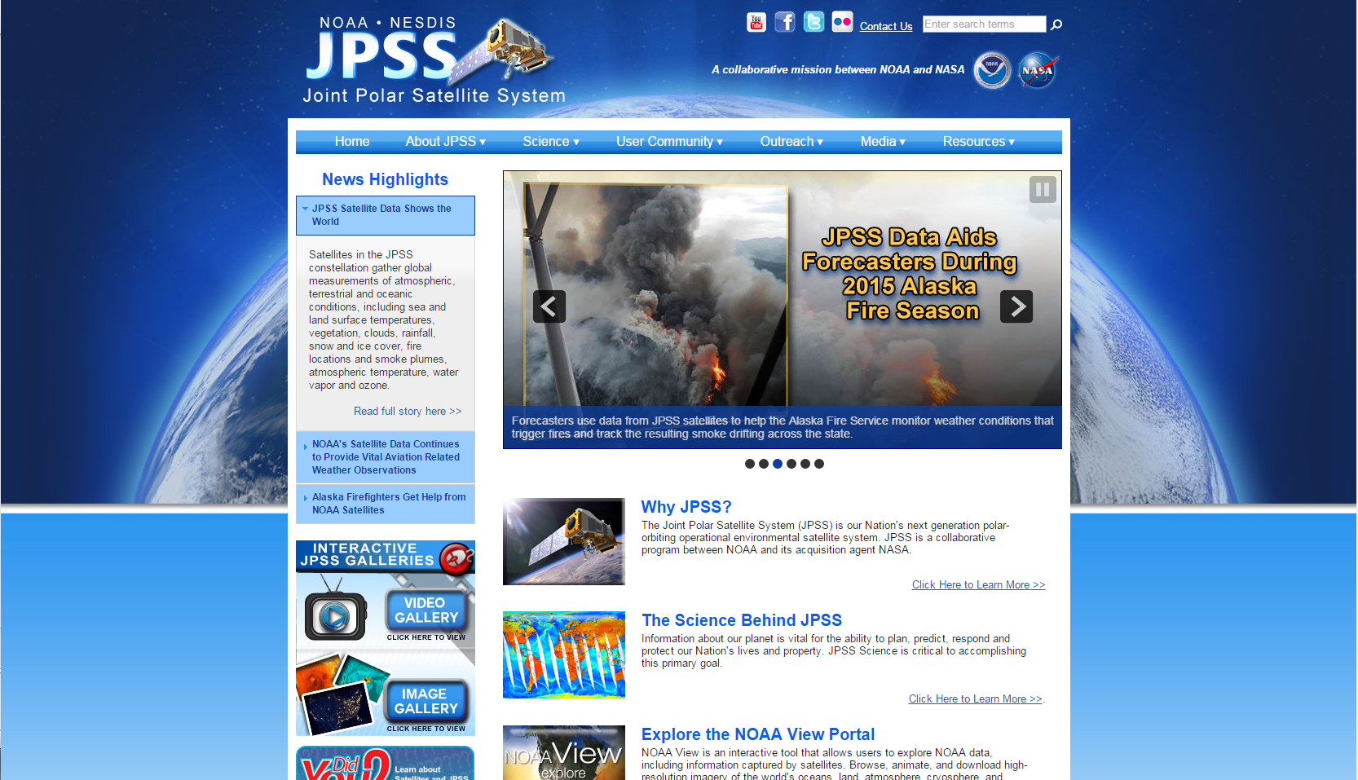
For More Information on the JPSS Program (WWW.JPSS.NOAA.GOV)

