Slide 1

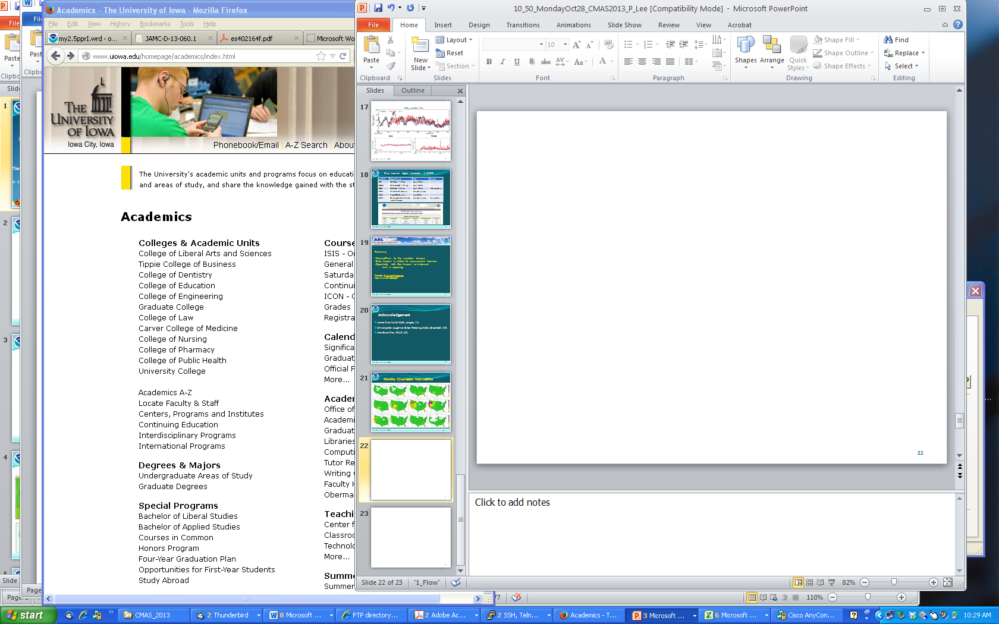



AQ OSSE, Forecasting & Reanalysis
(optimizing assimilation of column AOT & sfc data)
Pius Lee¹, Youhua Tang, Jeff McQueen², Brad Pierce³,
Greg Carmichael⁴, Ted Russell⁵, Dick McNider⁶, Shobha Kondragunta⁷,
Li Pan¹, Ivanka Stajner⁸, Chai Tianfeng¹, Daniel Tong¹¹, Hyuncheol Kim¹,
Mark Liu⁷, Sarah Lu⁹, Jun Wang², Jim Szykman¹¹, Rick Saylor¹², Ariel Stein¹,
Yang Liu¹², Min Huang¹, Jianping Huang², Sheng-Po Chen⁹, Ho-Chun Huang²
¹ Air Resources Lab. (ARL), NOAA Center for Weather and Climate Prediction (NCWCP), College Park, MD
² Environmental Modeling Center (EMC), NCEP, NCWCP, College Park, MD
³ National Environmental Satellite and Information Service (NESDIS), Madison, WI
⁴ College of Engineering, University of Iowa, Iowa City, IA
⁵ School of Civil and Environmental Engr., Georgia Institute of Technology, Atlanta, GA
⁶ Department of Atmospheric Science, University Alabama, Huntsville AL
⁷ NOAA/ESDIS/STAR, College Park, MD
⁸ Office of Science and Technology Integration, National Weather Service, NOAA, Silver Spring, MD
⁹ State University of New York, Albany, NY
¹⁰ U.S. EPA, Hampton, VA
¹¹ ARL, Atmospheric Turbulence and Diffusion Division, Oak Ridge, TN
¹² Department of Environmental Health, Emory University, Atlanta, GA
NOAA Satellite AQ Proving Ground, Silver Spring, MD Sep 9, 2015
Notes:
Overall team leadership provided by Professor Greg Carmichael.
Dr. Carmichael is serving as the chair of the Science Steering Committee for Global Atmospheric Watch (GAW)
GURME is a part: GAW Urban Research for Meteorology and Enviornment.

Slide 2
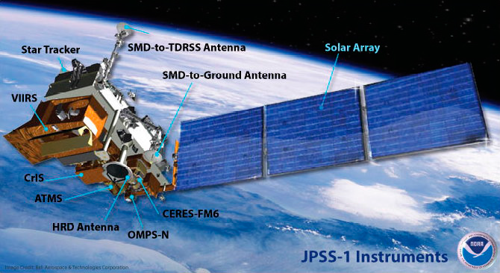
JPSS-2 3 4 seemed to be lining up
NOAA Satellite AQ Proving Ground, Silver Spring, MD Sep 9, 2015
Notes:
The final contract was signed on June 19, 2012, with Raytheon Space and Airborne Systems of El Segundo, Calif., for the Visible Infrared Imager Radiometer Suite (VIIRS) instrument. The Advanced Technology Microwave Sounder (ATMS) contract was signed with Northrop Grumman Electronic Systems in April, 2012. NASA completed the JPSS-1 Spacecraft and the Ozone Mapping and Profiler Suite instrument contract with Ball Aerospace in 2011. The contract to Raytheon Intelligence and Information Systems for the JPSS Ground System was also completed in 2011, as was the Crosstrack Infrared Sounder (CrIS) instrument contract with ITT Exelis.

Slide 3
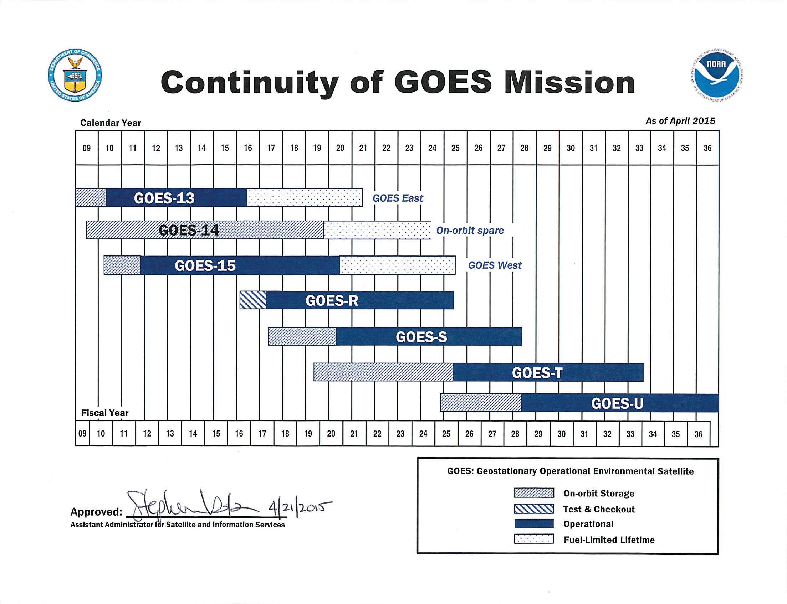
NOAA Satellite AQ Proving Ground, Silver Spring, MD Sep 9, 2015
Notes:
2038 and beyond

Slide 4
OSSE with AIRS on board
G_13 staring over 75⁰W
Timmermans et at., AE 2015
Robert Atlas, NWP, Silver Spring, MD Oct29-Nov1, 1979
NOAA Satellite AQ Proving Ground, Silver Spring, MD Sep 9, 2015
Notes:
Subjective evaluation of the combined influence of satellite temperature sounding data and increased model resolution on numerical weather forecasting
The present evaluation is concerned with (1) the significance of prognostic differences resulting from the inclusion of satellite-derived temperature soundings, (2) how specific differences between the SAT and NOSAT prognoses evolve, and (3) comparison of two experiments using the Goddard Laboratory for Atmospheric Sciences general circulation model. The subjective evaluation indicates that the beneficial impact of sounding data is enhanced with increased resolution. It is suggested that satellite sounding data posses valuable information content which at times can correct gross analysis errors in data sparse regions.

Slide 5
Preliminary AIRS_G13 impacts (00Z runs)
 |  |  | Anomaly Correlation |  |  |  |  |  |  |  | RMS Error |  |  |  |  |  |  |  |  | Anomaly Correlation |  |  |  |  |  |  |  | RMS Error
Domain | Parameter | Level |  | Forecast Day |  |  |  |  |  |  | Forecast Day |  |  |  |  |  | Domain | Parameter | Level |  | Forecast Day |  |  |  |  |  |  | Forecast Day
 |  |  | 1 | 2 | 3 | 4 | 5 | 6 | 7 | 1 | 2 | 3 | 4 | 5 | 6 | 7 |  |  |  | 1 | 2 | 3 | 4 | 5 | 6 | 7 | 1 | 2 | 3 | 4 | 5 | 6 | 7
 |  | 250/200 hPa |  |  |  |  |  |  |  |  |  |  |  |  |  |  |  |  | 250/200 hPa
 | Temperature | 500 hPa |  |  |  |  |  |  |  |  |  |  |  |  |  |  |  | Temperature | 500 hPa
 |  | 850 hPa |  |  |  |  |  |  |  |  |  |  |  |  |  |  |  |  | 850 hPa
 | Wind | 250/200 hPa |  |  |  |  |  |  |  |  |  |  |  |  |  |  |  | Wind | 250/200 hPa
Pac NA |  | 850 hPa |  |  |  |  |  |  |  |  |  |  |  |  |  |  | SH |  | 850 hPa
 |  | 250/200 hPa |  |  |  |  |  |  |  |  |  |  |  |  |  |  |  |  | 250/200 hPa
 | Geopotential | 500 hPa |  |  |  |  |  |  |  |  |  |  |  |  |  |  |  | Geopotential | 500 hPa
 |  | 700 hPa |  |  |  |  |  |  |  |  |  |  |  |  |  |  |  |  | 700 hPa
 |  | 1000 hPa |  |  |  |  |  |  |  |  |  |  |  |  |  |  |  |  | 1000 hPa
 |  | 250/200 hPa |  |  |  |  |  |  |  |  |  |  |  |  |  |  |  |  | 250/200 hPa
 | Temperature | 500 hPa |  |  |  |  |  |  |  |  |  |  |  |  |  |  |  | Temperature | 500 hPa
 |  | 850 hPa |  |  |  |  |  |  |  |  |  |  |  |  |  |  | Tropics |  | 850 hPa
 | Wind | 250/200 hPa |  |  |  |  |  |  |  |  |  |  |  |  |  |  |  | Wind | 250/200 hPa
NH |  | 850 hPa |  |  |  |  |  |  |  |  |  |  |  |  |  |  |  |  | 850 hPa
 |  | 250/200 hPa |  |  |  |  |  |  |  |  |  |  |  |  |  |  |  | prs382hwa significantly better than prs382hna
 | Geopotential | 500 hPa |  |  |  |  |  |  |  |  |  |  |  |  |  |  |  | prs382hwa better than prs382hna, nonsignificant
 |  | 700 hPa |  |  |  |  |  |  |  |  |  |  |  |  |  |  |  | no discernible difference
 |  | 1000 hPa |  |  |  |  |  |  |  |  |  |  |  |  |  |  |  | prs382hwa worse than prs382hna, nonsignificant
 |  |  |  |  |  |  |  |  |  |  |  |  |  |  |  |  |  | prs382hwa significantly worse than prs382hna
Bright Green, Red = statistically significant
Visual interpretation, erred on side of caution (i.e., calling results “significant” only if clear without a doubt)
Separation will be quantitative in a comprehensive scorecard
NOAA Satellite AQ Proving Ground, Silver Spring, MD Sep 9, 2015
Notes:
Assuming that we had AIRS instrument for wind observation in 2005 to assist AQ modeling,
This is impact for a 10 days simulation on GFS. GFS will drive NMMB and in turn provide met for CMAQ

Slide 6
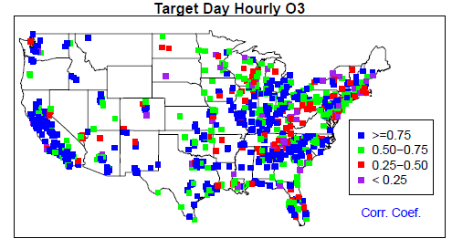
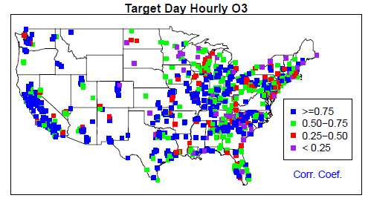
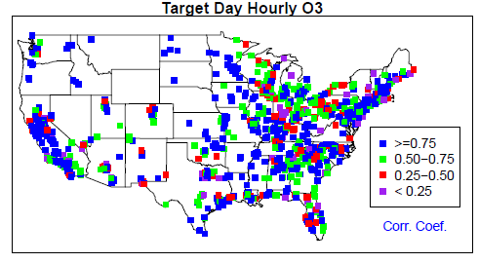
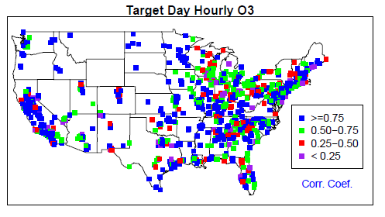
CONTROL- standard GFS
AIRS-assisted GFS
O3 on 20050803
O3 on 20050803
Localized improvement in r & other metrics
O3 on 20050805
O3 on 20050805
Spatial distribution of correlation coefficient for surface O3 on Aug 3,5 2005
NOAA Satellite AQ Proving Ground, Silver Spring, MD Sep 9, 2015
Notes:
After GFS is equipped with a state-of-the-science AIRS (atmospheric Infrared Sounder – 2378 channels)
Corr coeff improved for CMAQ prediction (good wind helped)

Slide 7
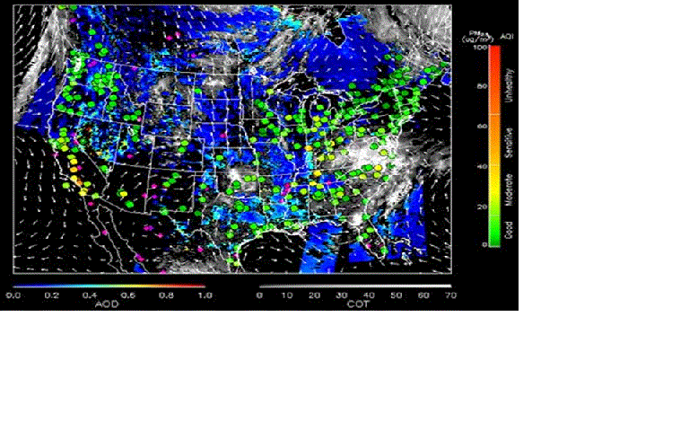
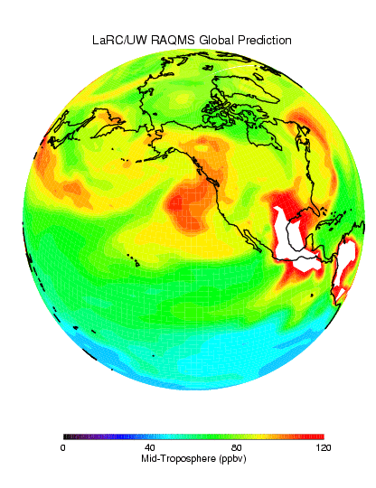
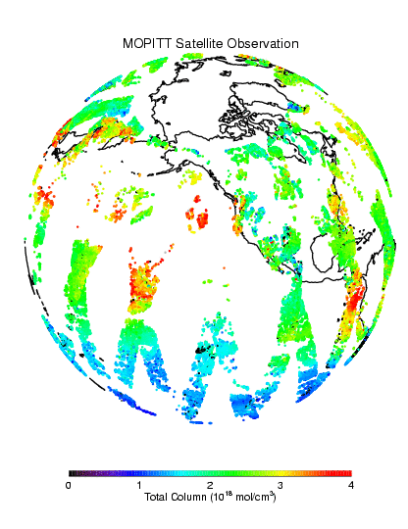
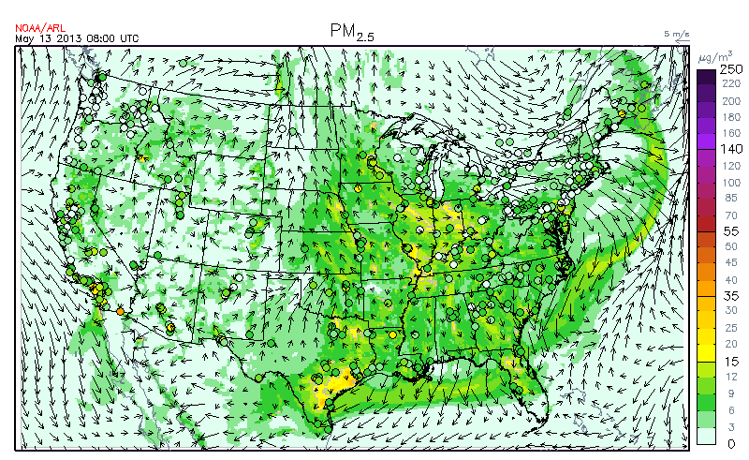
ARL leverages AQAST Project: Air Quality Reanalysis
(Translating Research to Services)
+ AQ Assessments
+ State Implementation Plan Modeling
+ Rapid deployment of on-demand rapid-response forecasting; e.g., new fuel type,…, etc.
+ Health Impacts assessments
+ Demonstration of the impact of observations on AQ distributions
+ Ingestion of new AQAST products into operations
Robichaud and Ménard, ACP 2014
Ménard et al., MWR 2000
Global
Assimilation
Satellite
Products
Constrained
http://acmg.seas.harvard.edu/aqast/projects.html
NOAA Satellite AQ Proving Ground, Silver Spring, MD Sep 9, 2015
Notes:
A ‘reanalysis’ is a climate or weather model simulation of the past that includes data assimilation of historical observations. The observations can be very comprehensive (satellite, in situ, multiple variables) or relatively sparse (say, sea level pressure only), and the models themselves are quite varied. Generally these models are drawn from the weather forecasting community (at least for the atmospheric components) which explains the odd terminology. An ‘analysis’ from a weather forecasting model is the 6 hour (say) forecast from the time of observations. Weather forecasting groups realised a decade or so ago that the time series of their weather forecasts (the analyses) could not be used to track long term changes because their models had been updated many times over the decades. Thus the idea arose to ‘re-analyse’ the historical observations with a single consistent model. These sets of 6 hour forecasts using the data available at each point are then more consistent in time (and presumably more accurate) that the original analyses were. - See more at: http://www.realclimate.org/index.php/archives/2011/07/reanalyses-r-us/#sthash.WKOIKeHl.dpuf
Copericus seminar

Slide 8
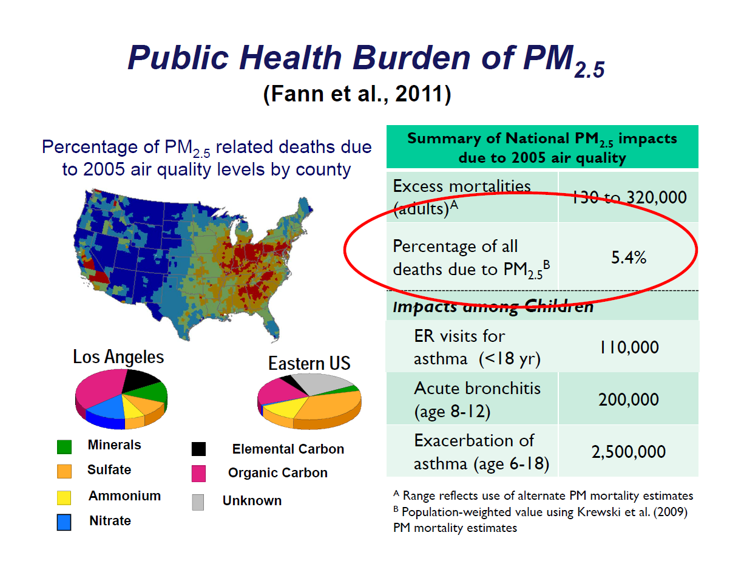
Courtesy: Dan Costa
“New Directions in Air Quality Research at the US EPA”
NOAA Satellite AQ Proving Ground, Silver Spring, MD Sep 9, 2015
Notes:
Health relevance
Current state-of-science believes chronic exposures are harmful
Needs urban scale long term estimates of these criterion pollutants
Opening remark by Dr. Steve Fine annually in the U.S. Over 100,000 premature death due to PM-induced
Cardiac pulmonary diseases “put in perspectives” with severe weather induced harm to the U.S.A.

Slide 9
WRF_ARW-MCIP-CMAQ forward model
WRF-ARW (LCC)
(42 σ-P model Layers)
LBC from GFS
EPA Emissions Inventory + simple obs-based adjustment
C-grid
MCIP
C-grid
42 σ-P met. Layers
Projection of
endo-domain intermitten sources: Obs’d wild fire
and prescribed burns
VIIRS/MODIS-
AOD-based adjusted IC,
BC: RAQMS
C-grid
Column integrated AOD
C-grid
Saide et al. GRL 2014
CMAQ 4.7.1
C-grid
Hourly 3-D Gridded Chemical Concentration
NOAA Satellite AQ Proving Ground, Silver Spring, MD Sep 9, 2015

Slide 10
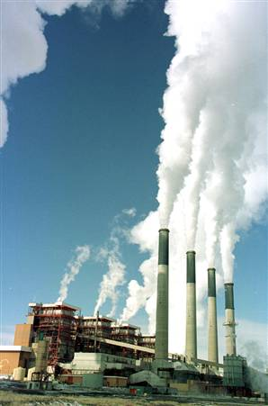
Comparison of DOE projected changes and CEM observations from 2011 to 2013 in 22 EMMs
NOAA Satellite AQ Proving Ground, Silver Spring, MD Sep 9, 2015

Slide 11
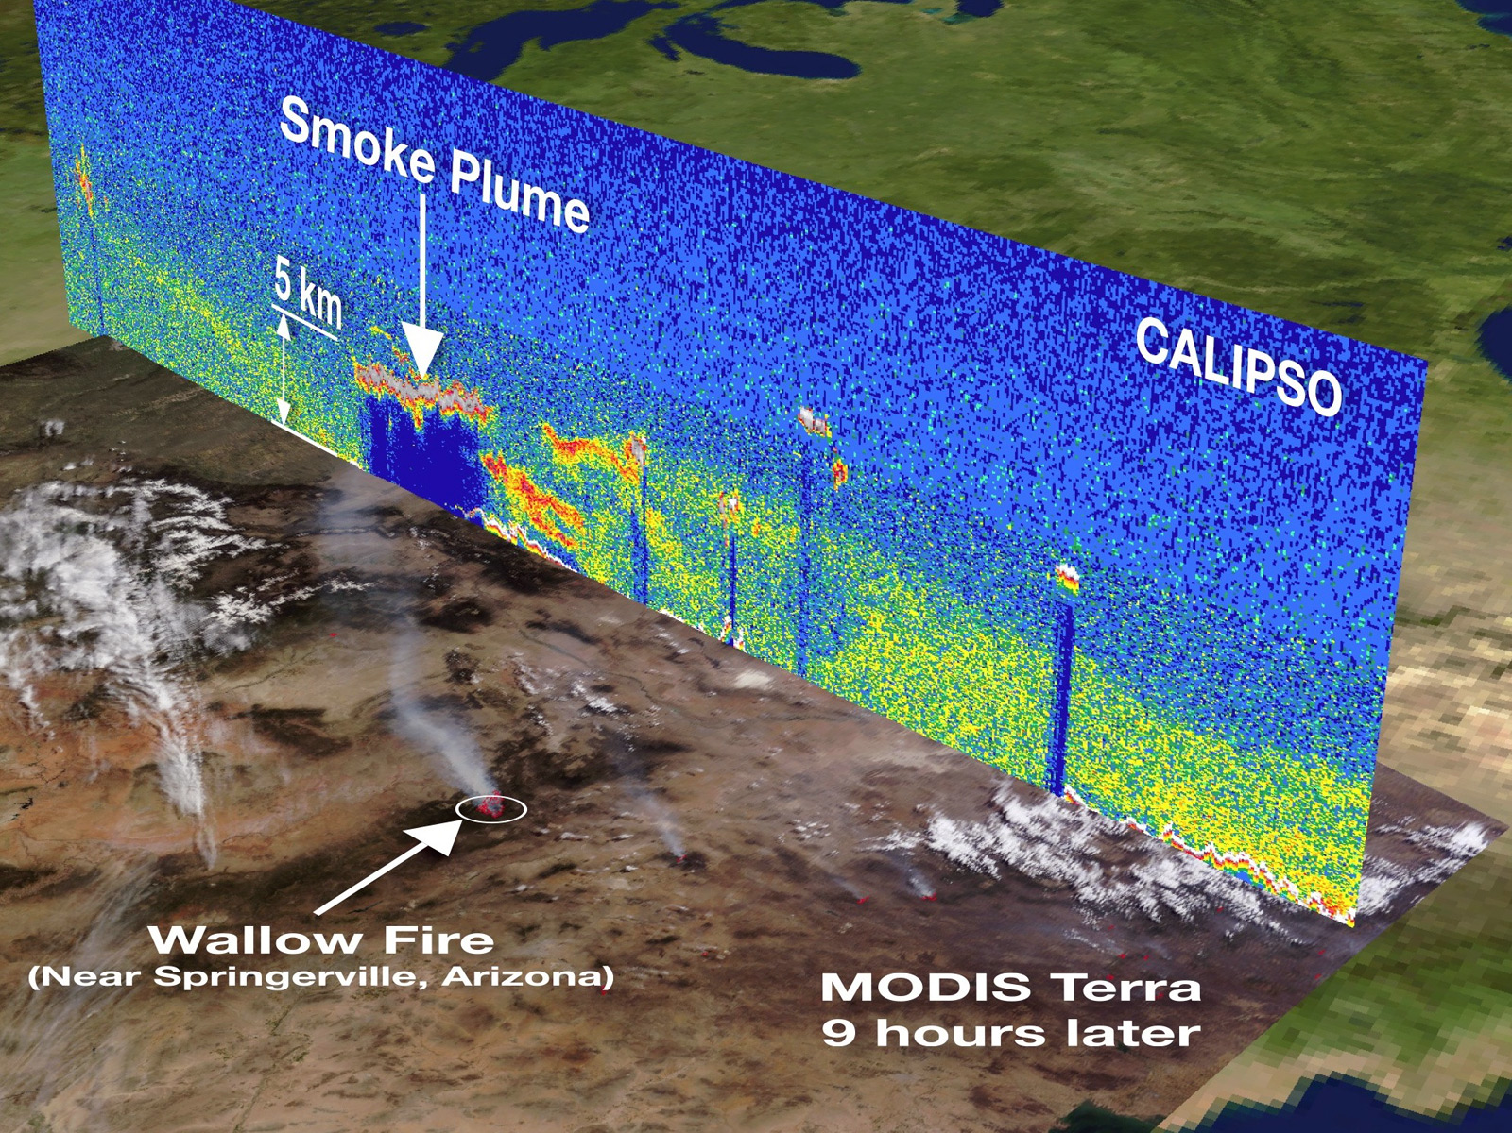
NASA
NOAA Satellite AQ Proving Ground, Silver Spring, MD Sep 9, 2015
Notes:
Complexity of the physical aspects of the atmosphere

Slide 12
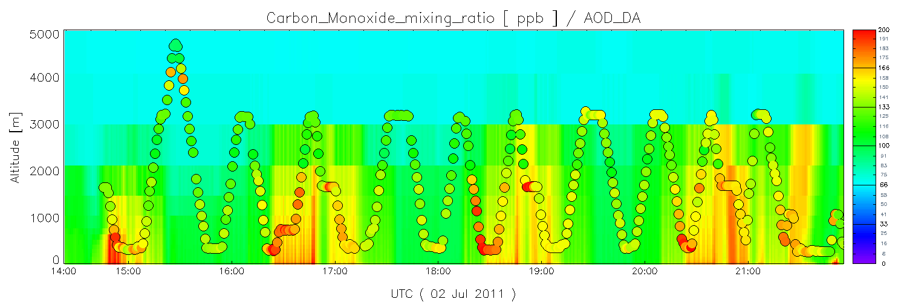
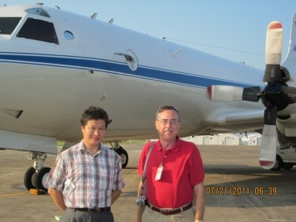
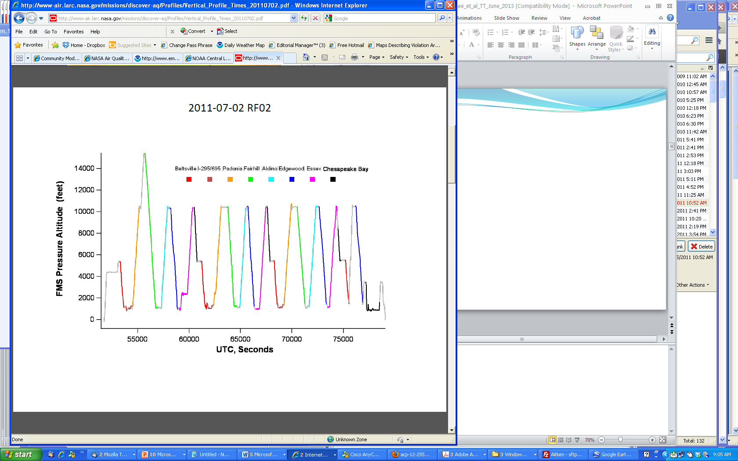
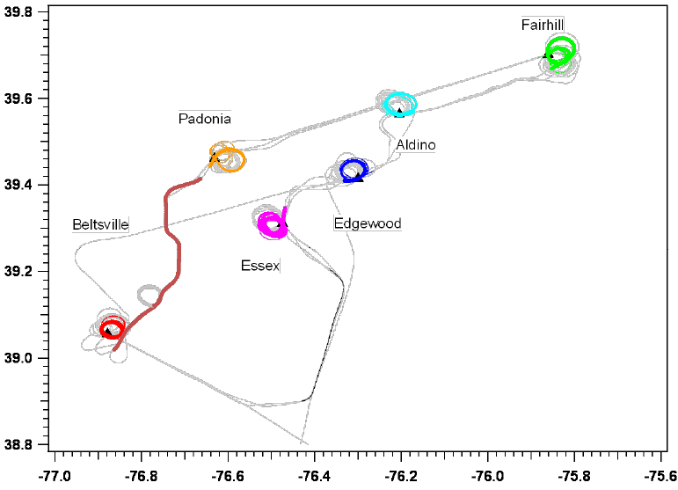
CO (ppb) along the P3 Flight – July 2 2011: AOD_DA case vs. Obs
200
P3 Three and a half loops:
Beltsville
Padonia
Fairhill
Aldino
Edgewood
Essex
Chesapeake Bay
100
Pickering and Lee, EM 2014
NOAA Satellite AQ Proving Ground, Silver Spring, MD Sep 9, 2015
Notes:
A curtain plot along an afternoon transect of P3 -- verse obs will be shown in a moment for O3 and Noy
Shown by Russ yesterday
Prof. Newchurch on ground truthing “early adopting users” GOES-R April 26-27 2016 in Huntsville

Slide 13

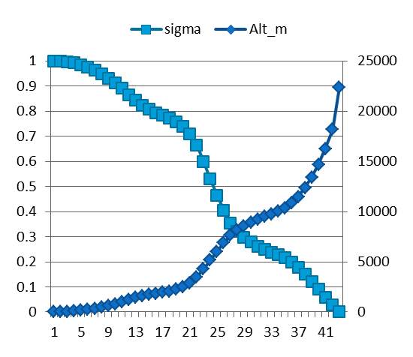
WRF_ARW-MCIP-CMAQ model physics and chemistry options
WRF-ARW | Both North America (12 km) & CONUS (4 km)
Map projection & grid | Lambert Conformal & Arakawa C staggering
Vert. co-ordinate | 42 σ-p unevenly spaced levels
advection | RK3 (Skamarock and Weisman (2008))
SW & LW radiation | RRTMG (Iacono et al. 2008))
PBL Physics | Mellor-Yamada-Janjic (MYJ) level 2.5 closure
Surface layer scheme | Monin-Obukhov Similarity with viscous sub-layer
Land Surface Model | NCEP NOAH
Cloud Microphysics | Thompson et al. (2008)
Cloud convective mixing | Betts-Miller-Janjic Mass adjustment
AQ forecast: ^12 km nested to 4 km
CMAQ4.7.1 | Both CONUS(12 km) & SENEX (4 km)
Map projection & grid | Lambert Conformal & Arakawa C staggering
Vert. co-ordinate | 42 σ-p unevenly spaced levels
Gas chemistry | Cb05 with 156 reactions
Aerosol chemistry | Aero5 with updated evaporation enthalpy
Anthropogenic emission | 2008NEI as base year, mobile projected using AQS*, area and off-road used CSPR^, point source uses 2012 CEM data
 | WRAP oil and gas emissions data
Biogenic emission | BEIS-3.14
Lateral BC | RAQM (B. Pierce)
42 vertical layers
NOAA Satellite AQ Proving Ground, Silver Spring, MD Sep 9, 2015
Notes:
^12 km domain is set a bit large to match National AQ Forecasting Capability for side-by-side verification.
Efficiently vectorizable. Courant–Friedrichs–Lewy (CFL) condition

Slide 14
CMAQ base v5.0.2: cb05_ae5)
2008 anthropogenic emission inventory projected to 2011
NOAA HMS (hazard mapping system) fire emission with Bluesky algorithm
GOES cloud fraction adjustment provided by U. of Alabama at Huntsville
RAQMS lateral boundary condition every 6 hours.
VIIRS/MODIS AOD
(Terra and Aqua)
Prediction Cycle
00Z
06Z
12Z
14Z
17Z
19Z
AIRNOW PM2.5, PM10, Ozone
(applied to below PBL)
NOAA Satellite AQ Proving Ground, Silver Spring, MD Sep 9, 2015

Slide 15
Optimal Interpolation (OI)
OI is a sequential data assimilation method. At each time step, we solve an analysis problem
We assume observations far away (beyond background error correlation length scale) have no effect in the analysis
In the current study, the data injection takes place at 1700Z daily
Chai et al. JGR 2006
NOAA Satellite AQ Proving Ground, Silver Spring, MD Sep 9, 2015
Notes:
OI: applied to AOD:
a: Analysis; b: background state;B: background error covariance; O: Observation error; H: transformation from model extinction to AOD as Y (observed AOD).

Slide 16
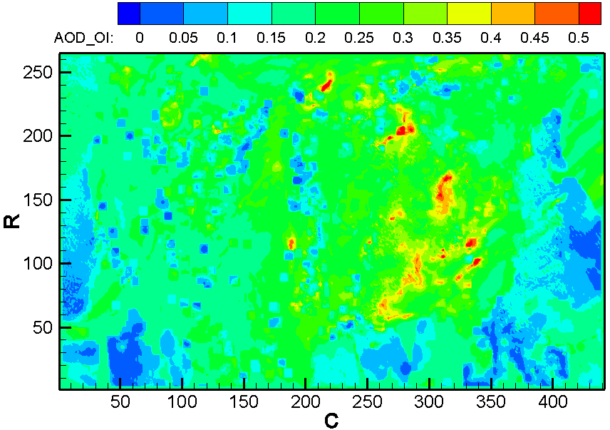
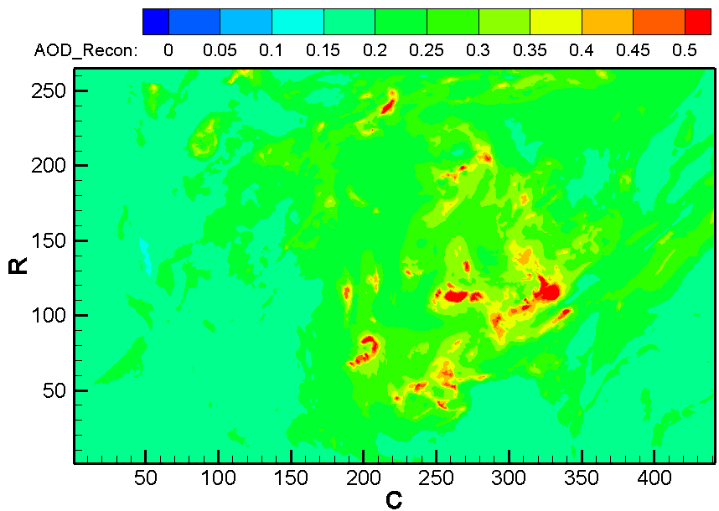
Objective (A): Improve PM forecast
Methodology of OI: Take account for
background input; Obs; and
physical processes from model
Observation Input
OI
Background Input
Analysis output
NOAA Satellite AQ Proving Ground, Silver Spring, MD Sep 9, 2015
Notes:
Optimization problem solved by OI: B, Y, and H as in the formula in previous slide

Slide 17
Cases of Studies | Assimilation Times | Settings of Uncertainties
OI1 (7x7 OI) | 00z, 06Z, 12Z, 18Z for AirNOW data 18Z for MODIS AOD (+/- one hour) | 0.6 for modeled aerosols 0.4 for modeled O₃
OI2 (7x7 OI) | 00Z, 06Z, 12Z, 14Z, 17Z, 19Z for AirNOW 17Z and 19Z for MODIS (+/- two hours) | 2.0 for modeled aerosols 0.4 for modeled O₃
OI3 (7x7 OI) | 00Z, 06Z, 12Z, 14Z for AirNOW 17Z and 19Z for MODIS (+/- two hours) | dynamic uncertainties up to 5.0 for modeled PM2.5, and up to 0.6 for modeled O_{3.}
OI4 (11x11 OI) | 00Z, 06Z, 12Z, 14Z, 17Z, 19Z for AirNOW 17Z and 19Z for MODIS(+/- two hours) | dynamic uncertainties up to 10.0 for modeled PM2.5, and up to 1.0 for modeled O_{3.}
Tang et al., JA&WMA 2015
NOAA Satellite AQ Proving Ground, Silver Spring, MD Sep 9, 2015
Notes:
Raqms
The RAQMS analyses include assimilation of real-time Aura MLS stratospheric ozone profiles (above 50mb) and cloud cleared OMI total column ozone as well as Terra and Aqua MODIS aerosol optical depth that uses modeled upper tropospheric RH to filter potential cirrus cloud contamination. Wild fire emissions are based on Terra and Aqua MODIS fire detections.

Slide 18
Cases | O₃ | PM2.5
Base case | R=0.53 MB=2.54 | R=0.23 MB= -7.14
OI1 | R=0.56 MB=2.36 | R=0.24 MB= -2.63
OI2 | R=0.58 MB=1.06 | R=0.39 MB= -1.33
OI3 | R=0.52 MB=2.08 | R=0.36 MB= -1.89
OI4 | R=0.56 MB=1.55 | R=0.40 MB= -0.11
Hourly Statistic Results for CONUS
12Z, 07/06/2011- 12Z, 07/07/2011
NOAA Satellite AQ Proving Ground, Silver Spring, MD Sep 9, 2015

Slide 19
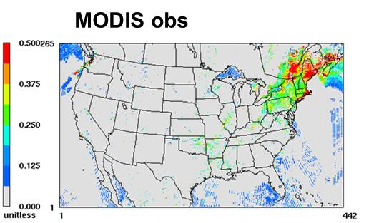
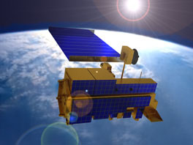
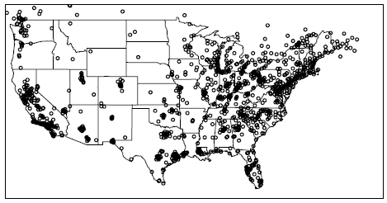
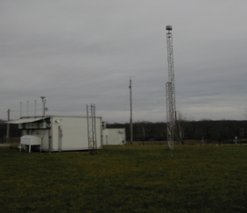
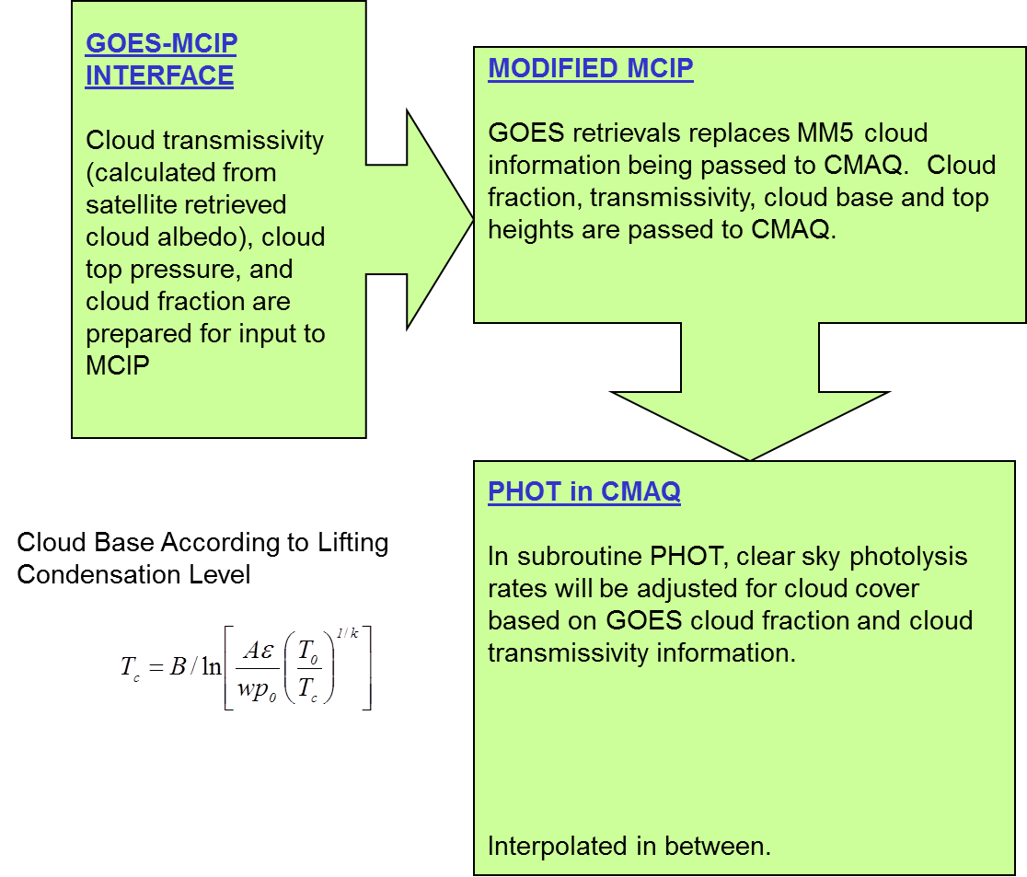
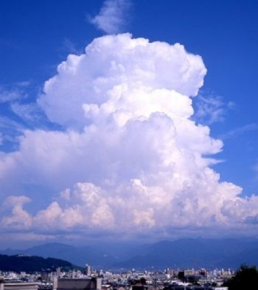
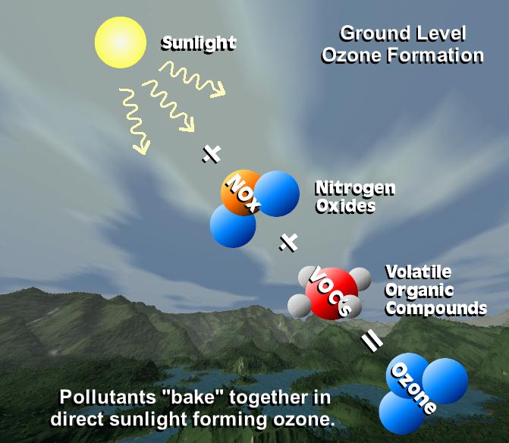
Lee and Liu, IEPH 2014
Pan et. al., AE 2014
Kim et al., GMD 2015
AIRNow
Cloud-obs Photolysis rates
Isoprene
& PAR
Transmittance
Tong et al. AE 2015
NOAA Satellite AQ Proving Ground, Silver Spring, MD Sep 9, 2015

Slide 20
Summary
NOAA Service: Chemical Re-analyses
Translate Science to Service
Protect life, environment and economy
Benefit NAQFC
Observation System Simulation Experiment: an AQ prospective: Preliminary test with AIRS on GOES
NOAA Satellite AQ Proving Ground, Silver Spring, MD Sep 9, 2015
Notes:
Long term – user, and on-demand subseting and downloading gui e.g.

Slide 21
EXTRA SLIDES
Contact: Pius.Lee@noaa.gov
Daniel.Tong@noaa.gov
http://www.arl.noaa.gov/
21
NOAA Satellite AQ Proving Ground, Silver Spring, MD Sep 9, 2015

Slide 22
Current approach useed by NAQFC to update power plant emissions (left) and DOE projection factors for FY 2015 operation (right).
NOAA Satellite AQ Proving Ground, Silver Spring, MD Sep 9, 2015

Slide 23
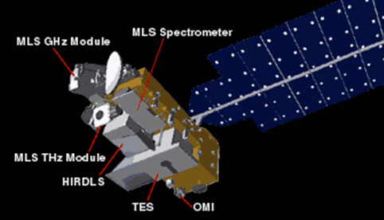
Rapid refresh of NOx emission projection in NAQFC
Comparison of satellite (OMI), ground (AQS) and NAQFC model NOx emissions in New York and Washington, DC from 2005 to 2012 (Tong et al., 2015).
NOAA Satellite AQ Proving Ground, Silver Spring, MD Sep 9, 2015

Slide 24
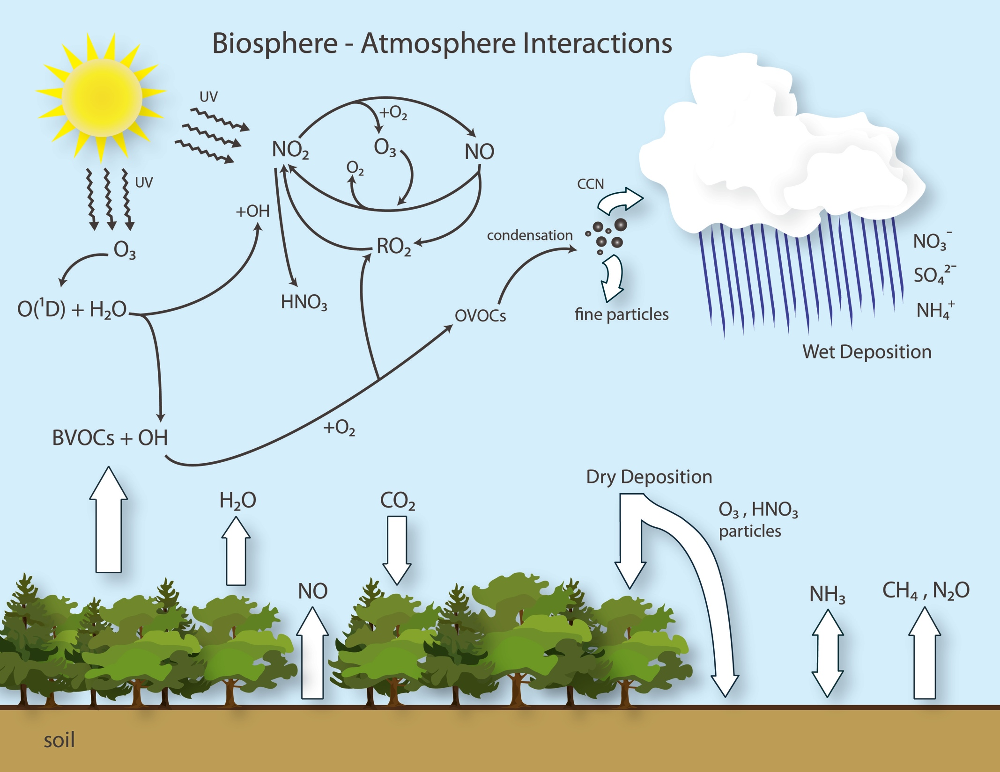
Surface-Atmosphere Interactions
NOAA Satellite AQ Proving Ground, Silver Spring, MD Sep 9, 2015
Courtesy: Rick Saylor

Slide 25
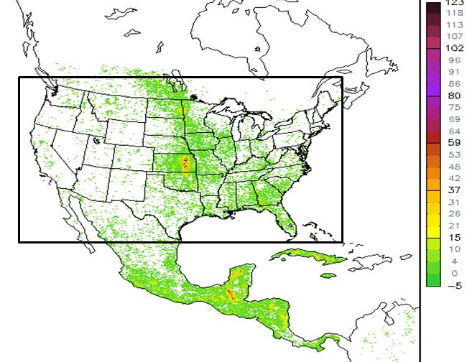
Next data set
To be include
In data assimilation?
MLS & MODIS
AOD from global
Model: e.g., RAQMS
Exo-domain as well
as endo-domain
wild fires & prescribed
burns
Tang et al., EFM, 2009
25
NOAA Satellite AQ Proving Ground, Silver Spring, MD Sep 9, 2015

