Slide 1
2013 Science and Operational User Workshop Feedback
Data access and tools – take 1
Data assimilation needs (reflectances, metadata, etc. in one place) ×
Image browse capability 
Data and documents/code in one place 
Data access and tools – take 2
My tool doesn’t work so please change the format
Best approach is to write a code to repackage the data into input formats the tool expects 
IDL software to read individual granules, extracting quality flags, displaying global maps exist and we are willing to distribute – advanced user who wants to understand the data and apply the data to do science 

Slide 2
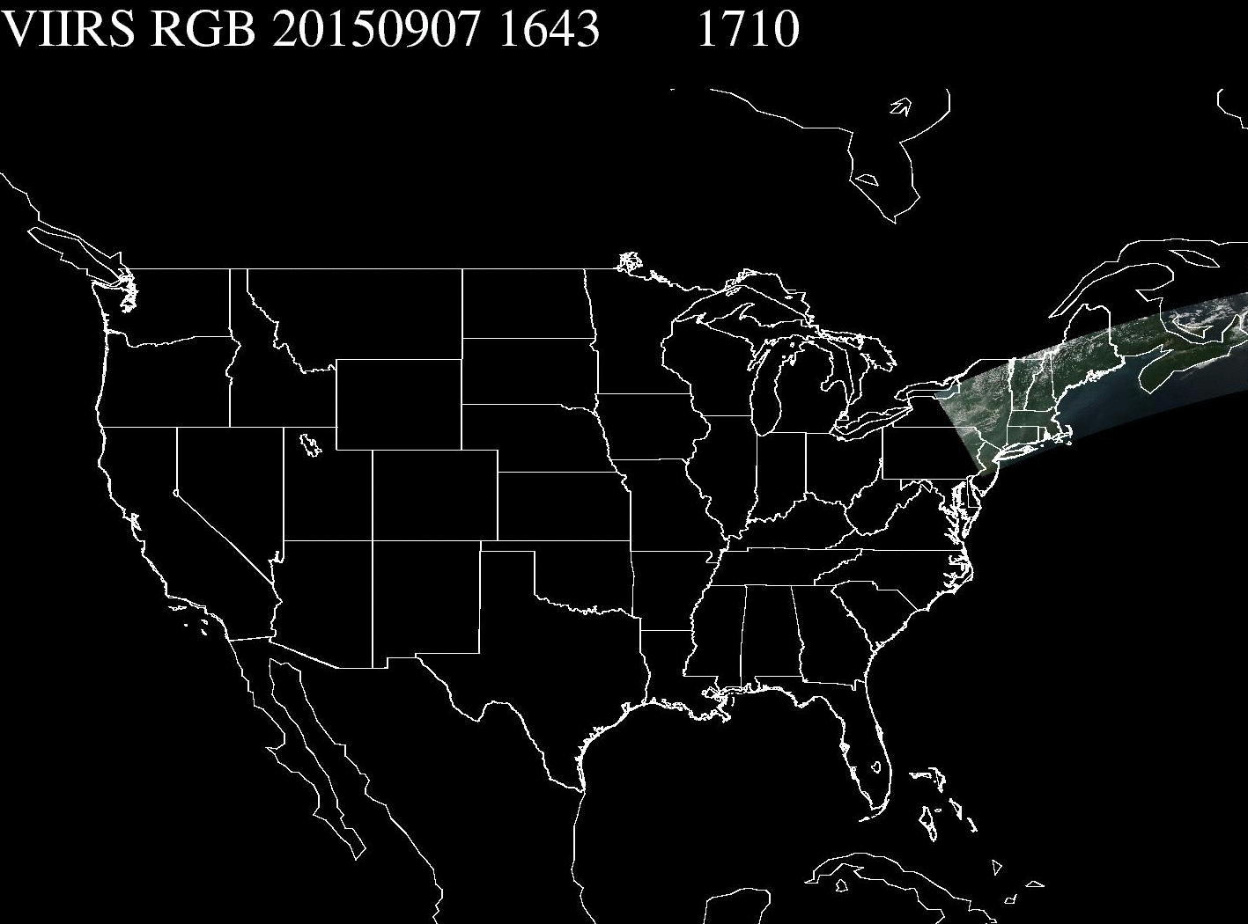
Decrease the Data Latency
Investigating running algorithms at the receiving station location and FTP over the processed images for IDEA display and dissemination

Slide 3
New Algorithms and Products
Operational in January 2016
Smoke/dust mask already running on the IDEA website
Bright surface AOT algorithm: do you want it on the IDEA website
Do users want both IDPS and products from new research algorithms at the same time for a better understanding before we phase out the IDPS products that are currently available on the IDEA website?

Slide 4
SNPP VIIRS Aerosol Team Expectations from Users
Use AOT data, smoke and dust flag information in filing for exceptional events waivers with the EPA
Ask for help with analysis
Provide feedback to the team on experience with various products described
Do not hesitate to ask for help with data access and handling
Publish work based on VIIRS aerosol products
Report issues back to the aerosol team

