Slide 1


Synthetic Natural Color ABI Products
Louie Grasso, Don Hillger, and Steve Miller
CIRA and NOAA/NESDIS/RAMMB
Colorado State University
Fort Collins, Colorado
AQPG 12 January 2012
Email: grasso@cira.colostate.edu

Slide 2
Outline
GOES-R ABI synthetic imagery at CIRA.
Natural color imagery.
Synthetic imagery of smoke plumes and volcanic ash.
Air quality imagery.

Slide 3
1) GOES-R ABI synthetic imagery at CIRA

Slide 4
Synthetic Imagery
MOTIVATION
1) To extend the operational use of the satellite by producing synthetic GOESR-ABI before the satellite is put into orbit.
2) The only way to examine temporal sampling is through the use of a numerical cloud model.
GOALS
1) Demonstrate we can create realistic synthetic GOESR-ABI imagery.
2) Use synthetic imagery for product development; for example, real-time imagery.
3) Use synthetic imagery for model evaluation; for example, microphysics errors.

Slide 5
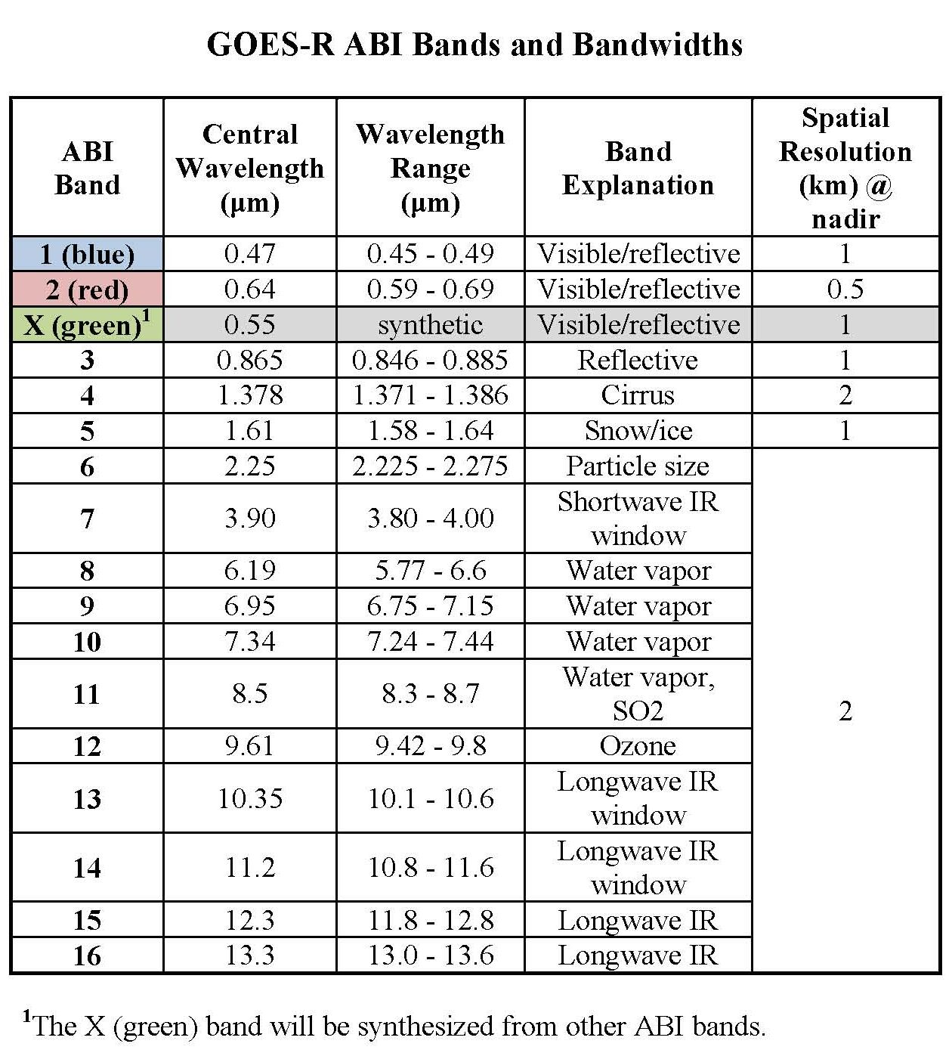

Slide 6
Creating Synthetic Imagery
Numerical cloud models: RAMS,WRF-ARW, and COAMPS
Microphysics
  Two-moment cloud microphysics: mass mixing ratio and number concentration are predicted
  Two-way interactive nested grids
  Four grids: 50 km, 10 km, 2 km (GOES-R), and 400 m (fires).
Run cloud model and use output as input to an observational operator to generate synthetic GOES-R satellite observations at different channels.

Slide 7
Horizontal grid spacing for the grids shown above are as follows: Grid 1: 90 x 66 points with 50 km spacing; Grid 2: 192 x 162 points with 10 km spacing; Grid 3: 502 x 522 points with 2 km spacing; and Grid 4: 852 x 1027 points with 400 m spacing. Each grid had 60 vertical levels. Total machine ram was 22 Gbytes.

Slide 8
Observational Operator
  Community Radiative Transfer Model (CRTM) code used only to calculate gaseous transmittances
  Modified anomalous diffraction theory (MADT) for cloud optical properties for λ > 3.9 µm
  Look-up tables for optical properties for λ <= 3.9 µm
  Delta-Eddington formulation for IR bands
  Spherical Harmonics Discrete Ordinate Method (SHDOM) for Vis and Near IR bands
    Plane parallel version (1-D) of SHDOM from CU (F. Evans)
A point spread function is applied to 400 m data to build the appropriate GOES-R ABI footprint.

Slide 9
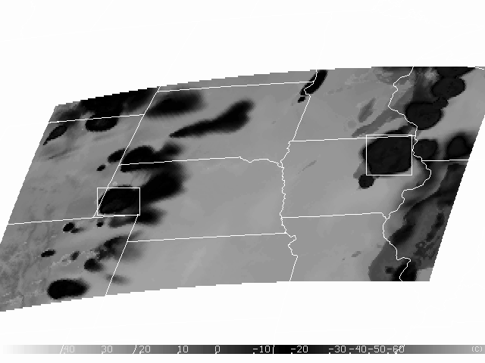
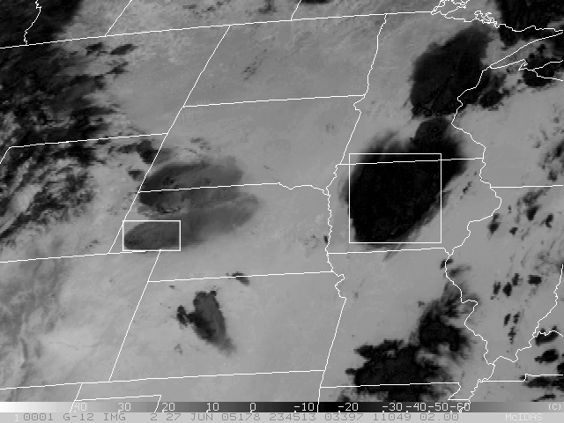
Something is wrong!
Observed 3.9 µm GOES-12 at 23:45 UTC 27 June 2005
Synthetic 3.9 µm GOES-12
Solar energy at 3.9 µm reflects off of ice particles. The smaller the ice crystals, the larger the brightness temperature.
Cooler synthetic temperatures suggest simulated ice crystals are too large.

Slide 10
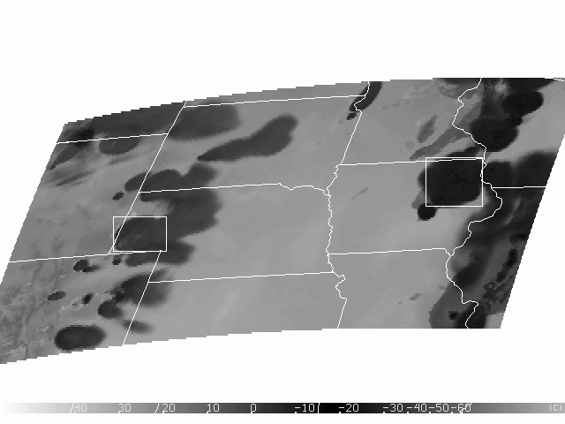
Improvement
Observed 3.9 µm GOES-12
Synthetic 3.9 µm GOES-12
Unpleasant “feature” in microphysics found and resolved.
How would you know of such a problem without synthetic imagery?

Slide 11
2) Natural color imagery

Slide 12
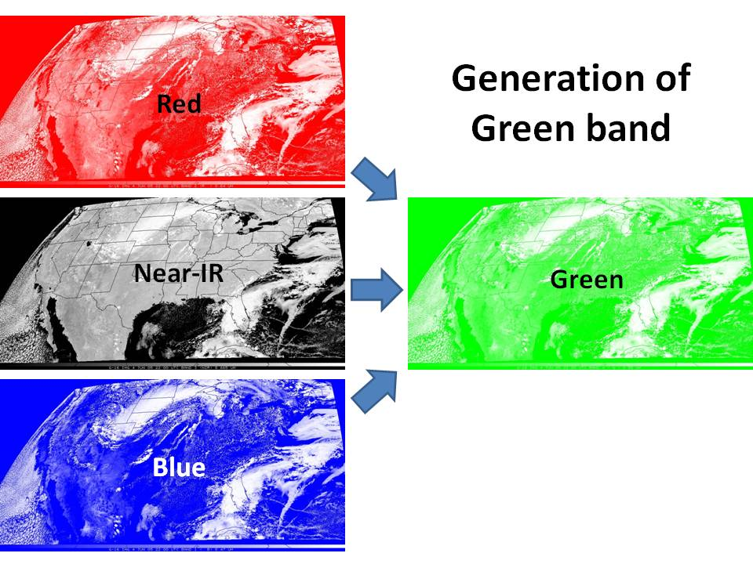
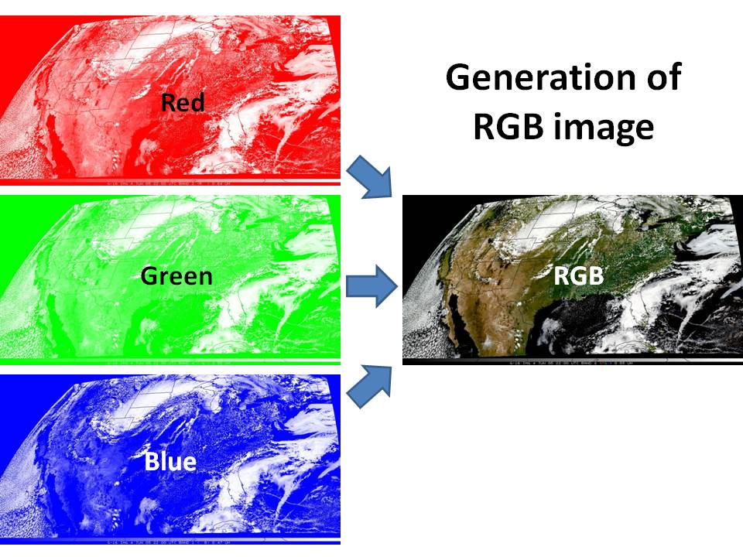
Schematic for generating missing Green and RGB images for GOES-R ABI
Step 1: Green from Red, Near-IR, and Blue bands, using a MODIS-trained LUT*.
Step 2: RGB from Red, Green, and Blue bands.
Green is produced using a Look Up Table (LUT) trained on MODIS imagery, which includes the necessary Blue, Red, Green, and Near-IR bands.

Slide 13
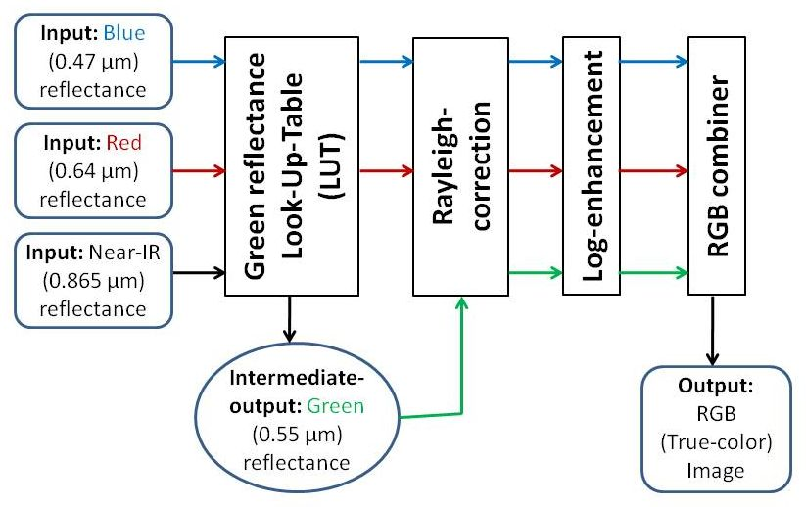
Green Look-Up-Table for GOES-R ABI plus image enhancements

Slide 14
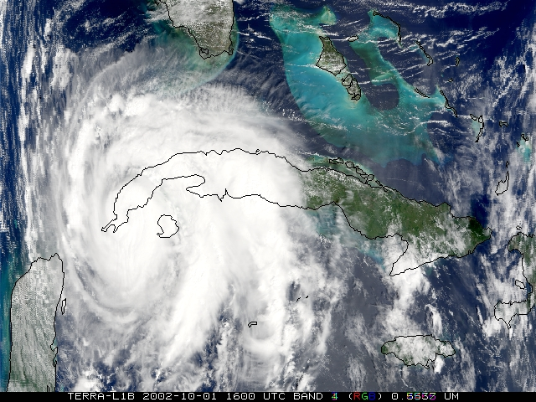
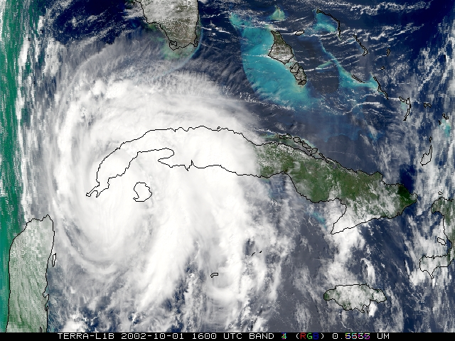
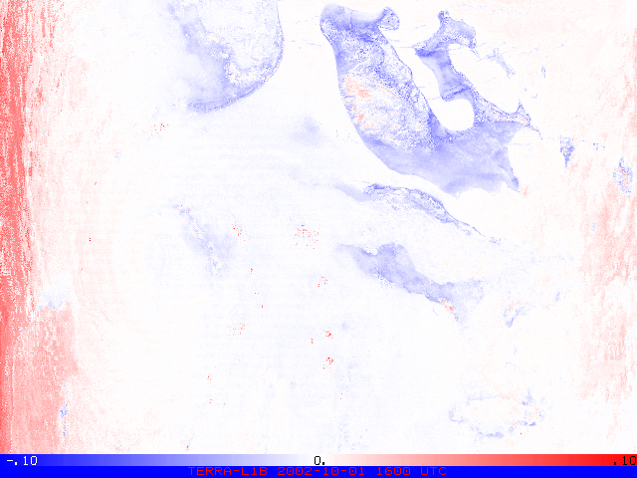
MODIS Observed-RGB
MODIS Simulated-RGB
Examples of MODIS RGB images, observed and simulated (as if Green band were missing, such as on GOES-R ABI). Difference image is blue (red) for under (over)-estimation of Green. Note over-estimated Green at left edge of synthetic RGB, where zenith angles are large.
Enhanced difference
Notes:
RGB images are Rayleigh-corrected and log-enhanced

Slide 15
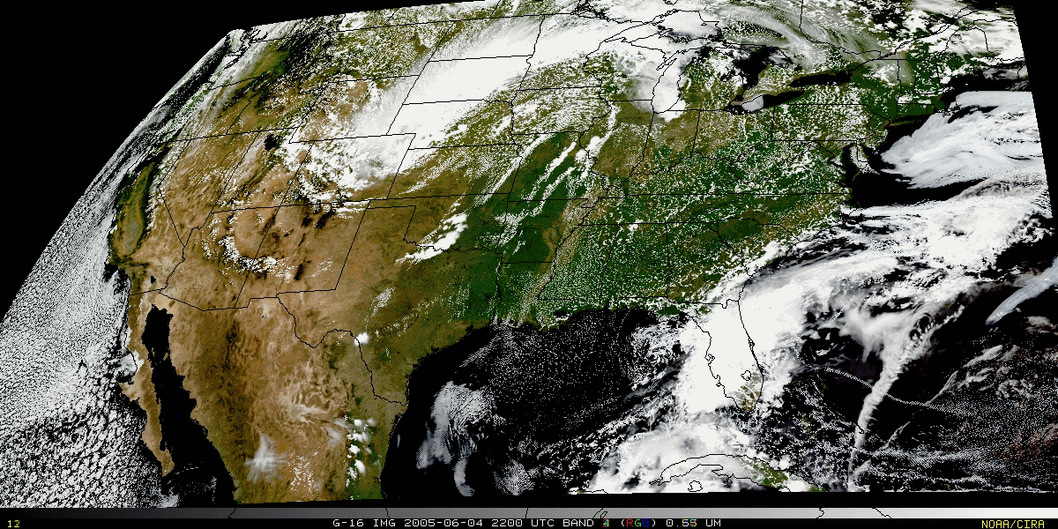
RGB natural color imagery
Simulated-ABI RGB image generated at CIRA from WRF output provided by CIMSS.
Rayleigh corrected – log enhanced

Slide 16
3) Synthetic imagery of smoke plumes and volcanic ash

Slide 17
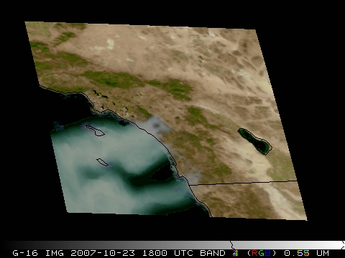
Smoke added to synthetic natural color GOES-R image
CIRA

Slide 18
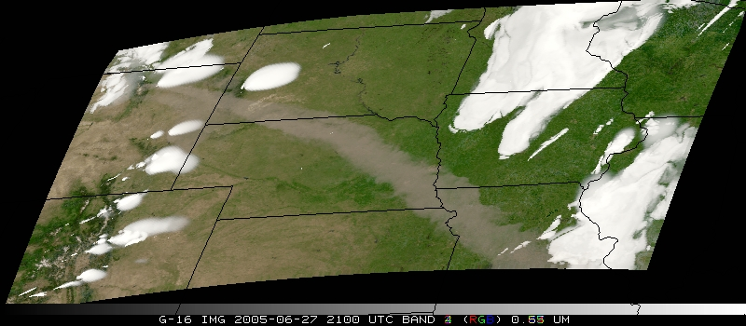
Synthetic GOES-R ABI natural color image of an idealized volcanic ash plume
CIRA

Slide 19
4) Natural color imagery and air quality

Slide 20
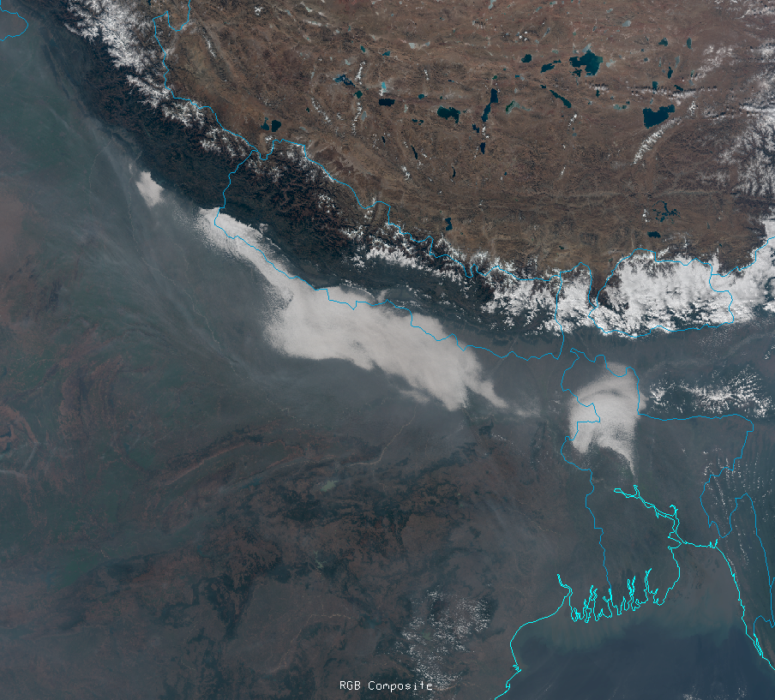
Natural color image of haze over northern India.

Slide 21
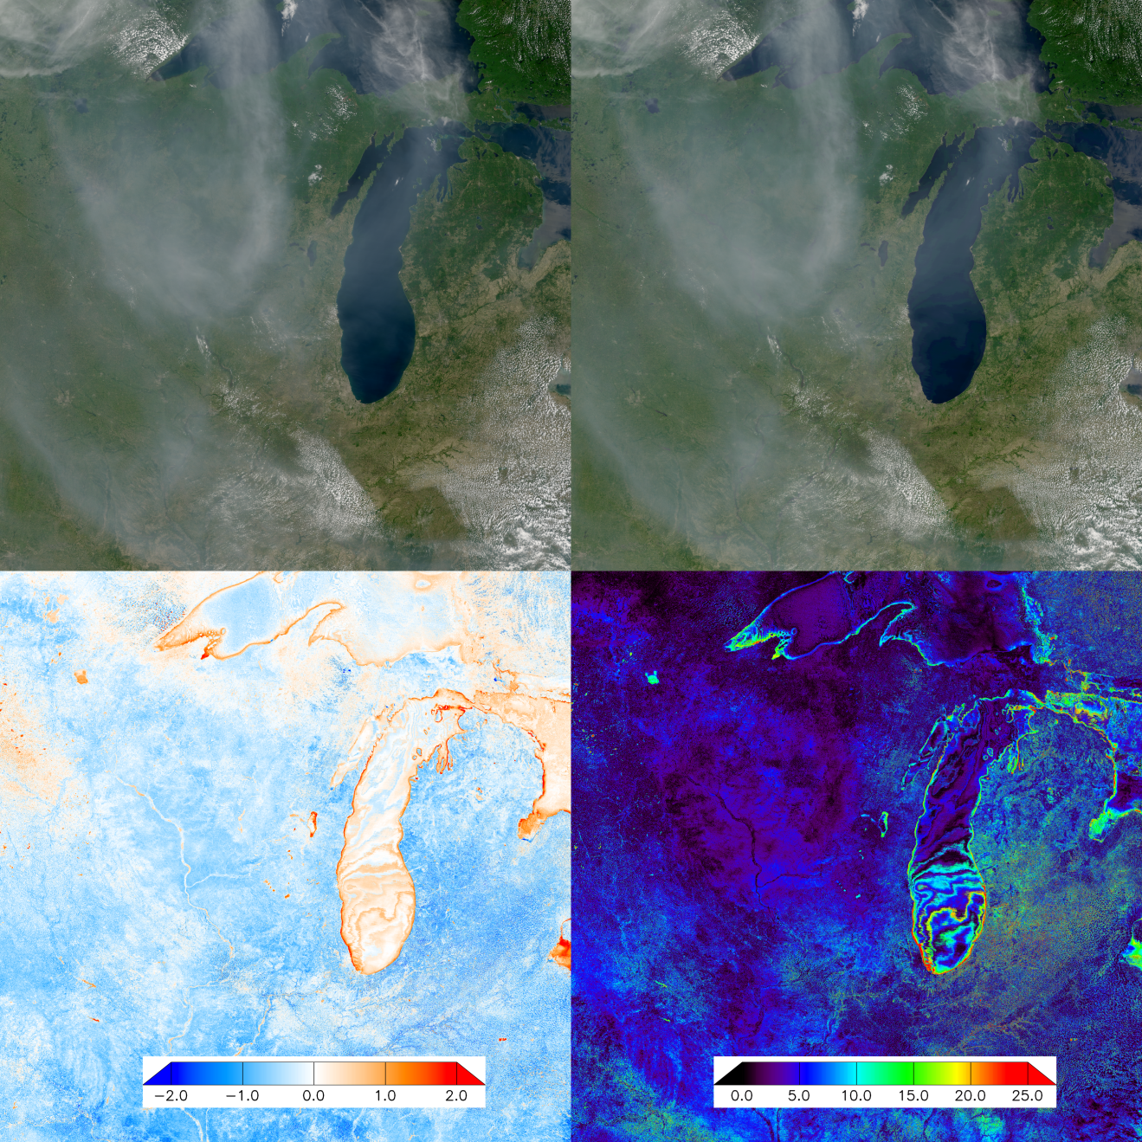
A
B
C
D
A) Modis natural color, B) LUT method, C) Modis green minus LUT green, and D) relative difference of smoke.

Slide 22
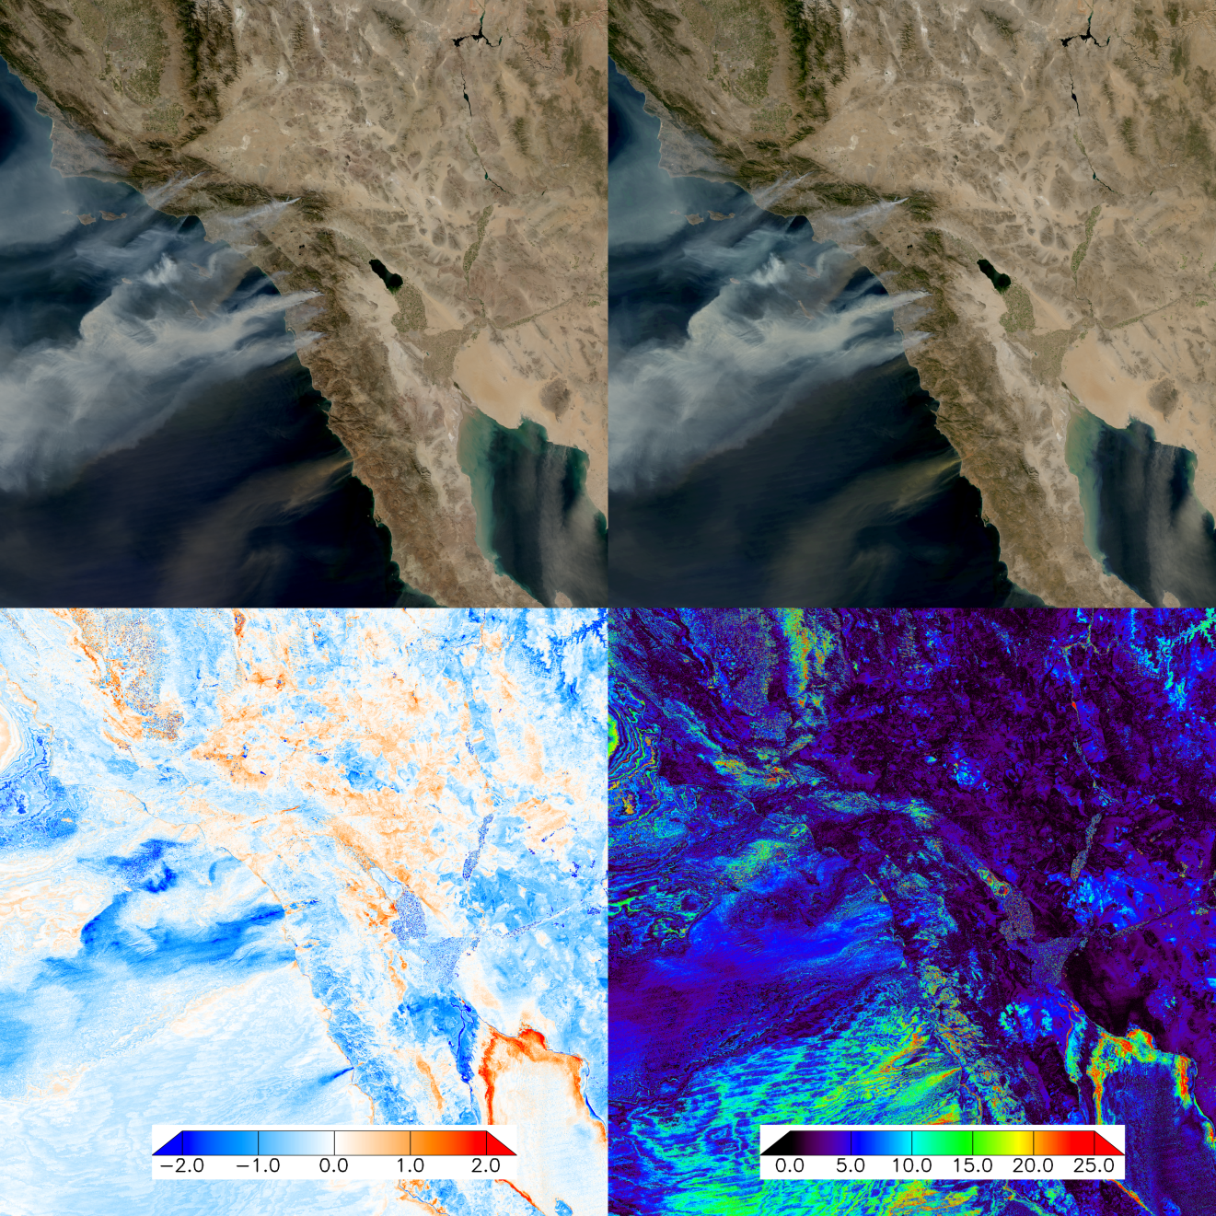
Same as last figure but for smoke from the 23 October 2007 wildfires over southern California

Slide 23
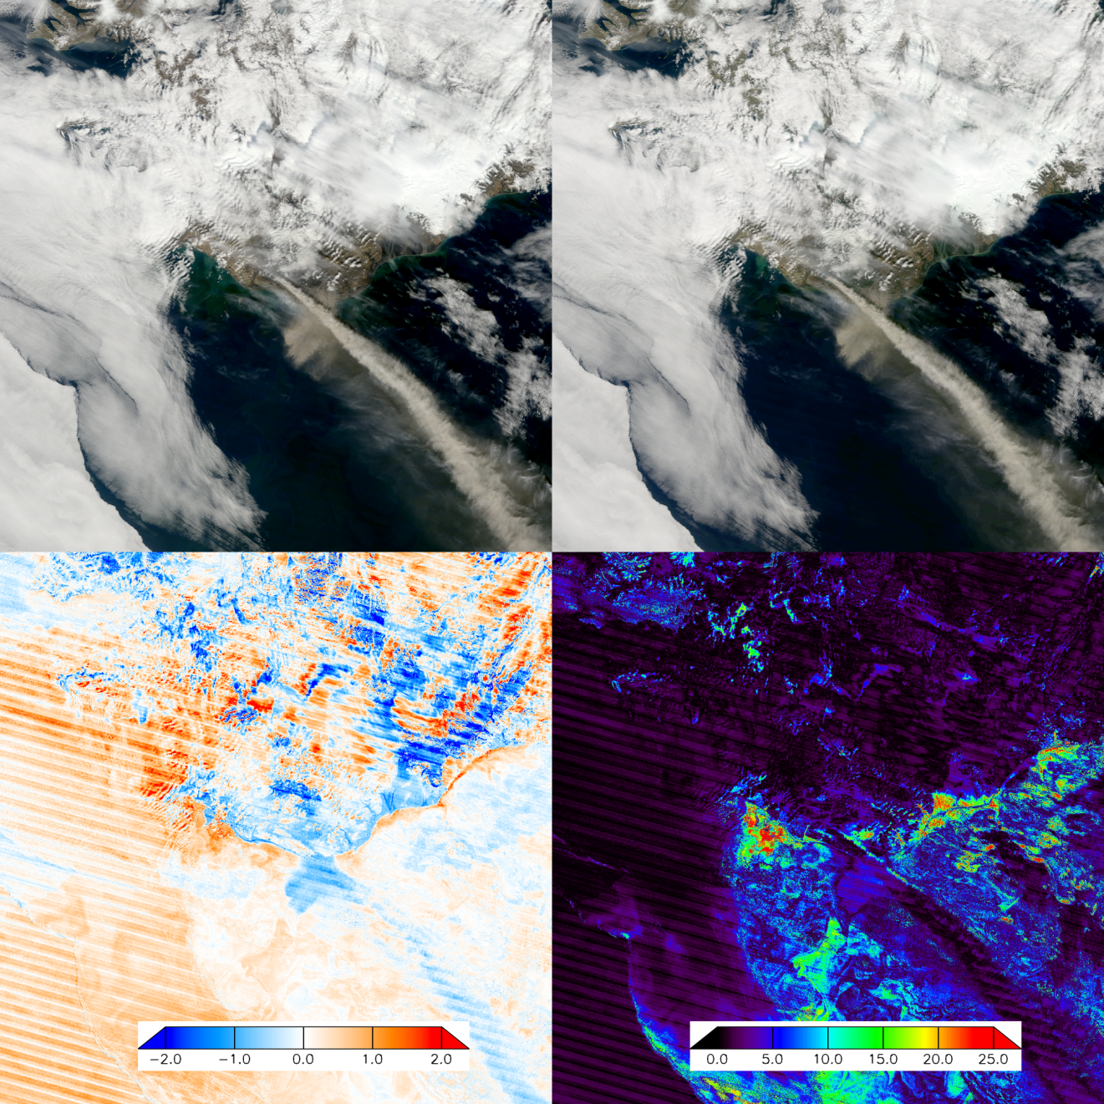
Icelandic eruption of Eyjafjallajökull

