Slide 1
Joint Polar Satellite System (JPSS) Proving Ground and Risk Reduction Program Supporting the NOAA Mission through Applications and Research
Mitch Goldberg National Oceanic & Atmospheric Administration | NOAA
JPSS Program Scientist
Ingrid Guch, Ralph Ferraro, and Bill Sjoberg

Slide 2
Challenge
Move from Products to End User Applications
Ensure users are ready for NPP/JPSS data and improve their key operational and research product and services
Severe weather forecasts and warnings
Aviation weather forecasts and warnings
Improve fire and air quality forecasts and warnings
Improve warnings and prediction of poor water quality in coastal regions
Improve drought, precipitation, snow and ice assessments and predictions
Periodic feedback from keys users on the impact of NPP/JPSS data and to identify improvements needed for products and applications
To meet this challenge, the NOAA JPSS Office has established a JPSS Proving Ground and Risk Reduction Program

Slide 3
Proving Ground and Risk Reduction Application Areas
Weather Forecasting (Improving Global, Regional forecasts)
Tropical Cyclones
Severe Weather (Nowcasting)
Ocean/Coastal (Coral Bleaching, Harmful Algal Bloom alerts)
Land (Droughts, Agriculture)
Hazards (Smoke, Fire, Volcanic Ash, Air Quality)
Hydrological (Precipitation, Floods, Soil Moisture, Snow/Ice, River Ice)
Climate (integrated products, real-time anomaly products)
Education and Training
Infrastructure (Direct Readout and Software (CSPP), Airborne campaigns)
CSPP is a critical component of the JPSS Proving Ground!

Slide 4
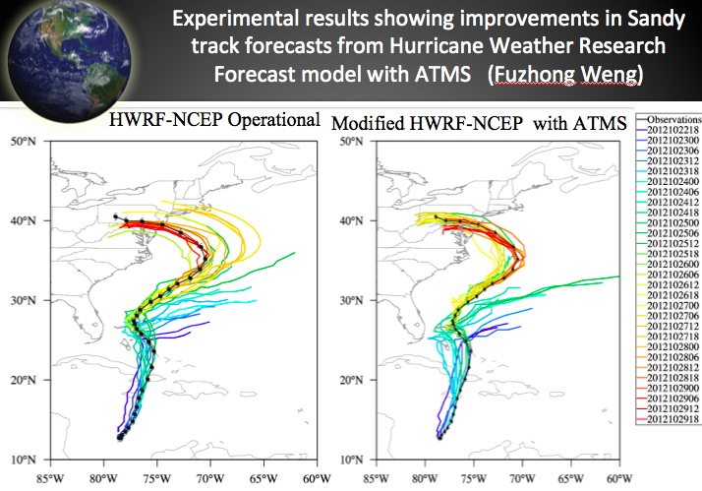
Mapping NOAT Priorities to JPSS PGRR
PGRR Projects
Soundings/Radiances for Hurricane Intensity and Track
Sounding applications over Alaska including nearcasting
Soundings in AWIPSII

Slide 5
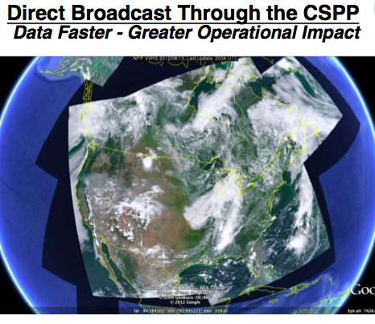
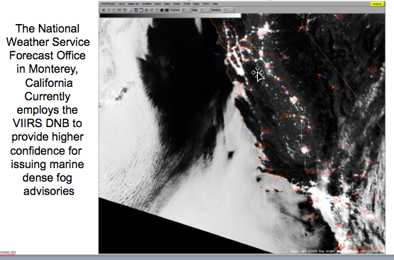
Mapping NOAT Priorities to JPSS PGRR

Slide 6
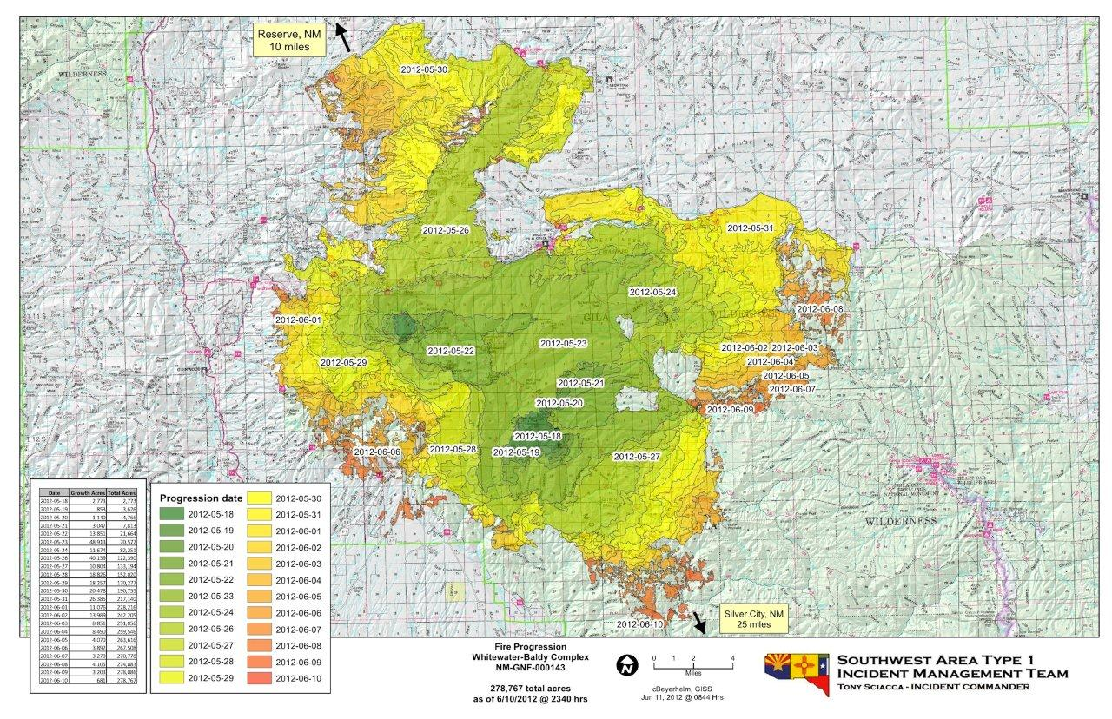
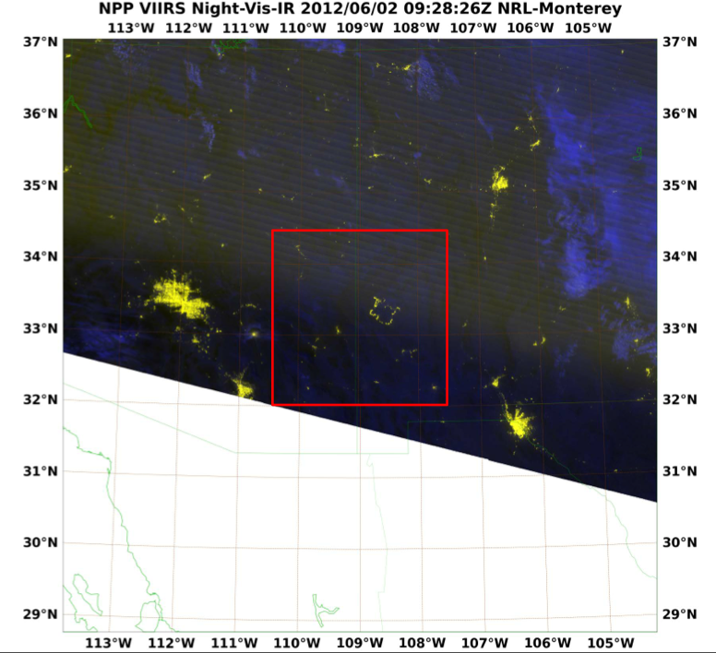
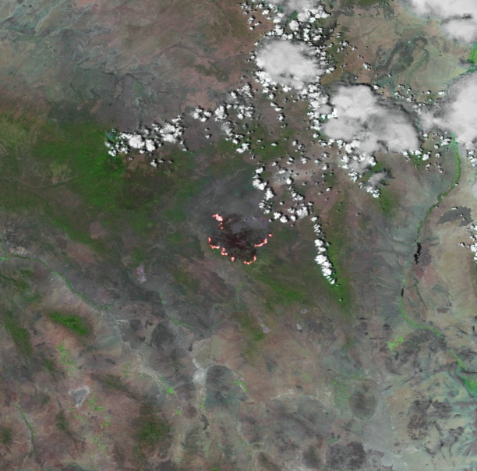
From Imagery to Decision Support 2 June 2012
Time lapse of VIIRS detected fire locations and National Interagency Fire Center burn scar
JPSS works with NWS and USFS to better integrate satellite fire detection to improve decision support tools
Credit: Ivan Csiszar, STAR

Slide 7
JPSS Supporting Smoke and Dust Detection through OMPS
June 26, 2012
Credit: NASA image by Jesse Allen, using OMPS data provided courtesy of Colin Seftor (SSAI)
Source: http://earthobservatory.nasa.gov/IOTD/view.php?id=78389
Notes:
The map above depicts the relative concentration of aerosols in the skies above the continental United States on June 26, 2012. The map was assembled from data acquired by the Ozone Mapper Profiler Suite (OMPS) on the new Suomi National Polar-orbiting Partnership (S-NPP) satellite.
In the image, the aerosol signal is strong to the north and east of the North Schell, Dump, and Wood Hollow fires in Nevada and Utah. Thick smoke plumes from wildfires across Colorado moved east and south into the plains states. Further south in Texas, New Mexico, and Mexico, it is unclear if the aerosols were blown in from distant fires, if there is local burning, or if they are dust storms, which are also a result of hot, dry, and windy weather.

Slide 8
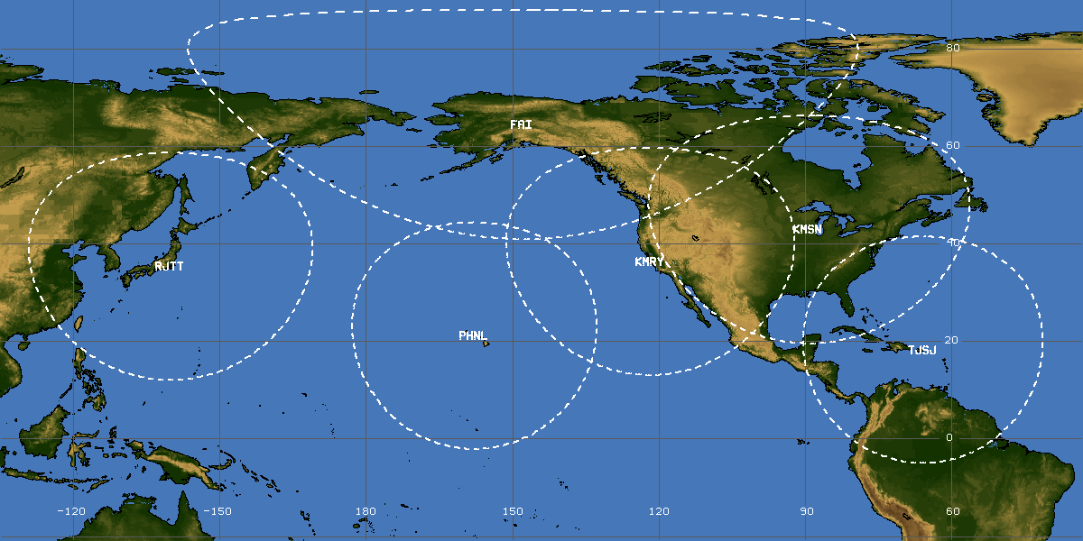
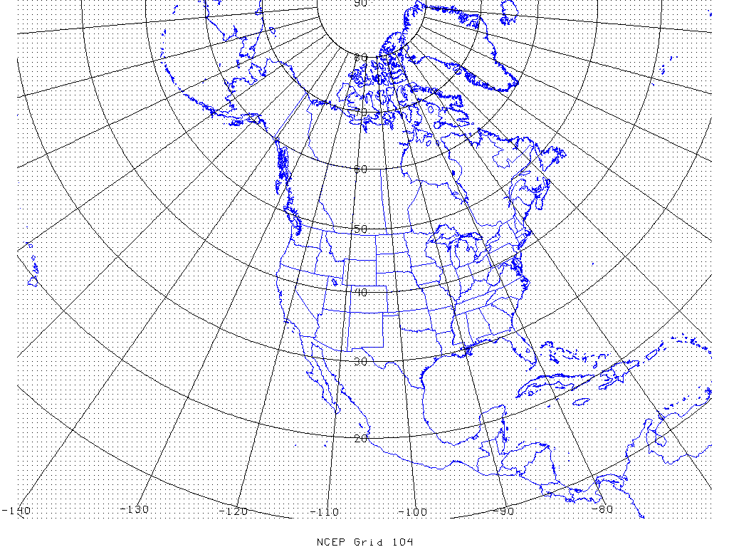
Community Supported Processing Package (CSPP) demonstrates the value of 30 minute latency for nowcasting and regional forecast model applications by establishing a network of direct readout stations
Potential Sites to Support NWS 30 minute latency objectives

Slide 10
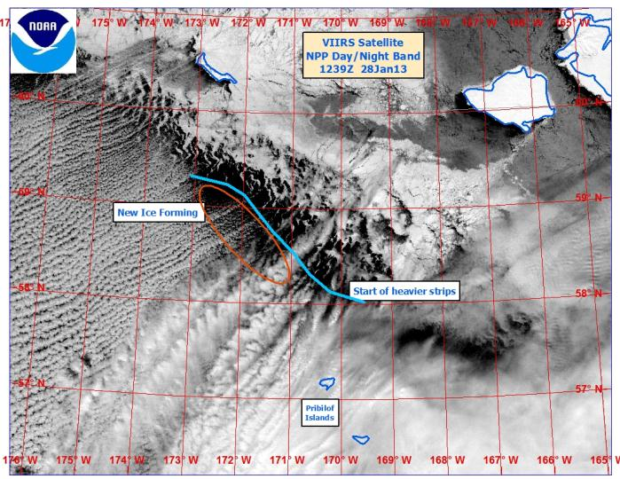
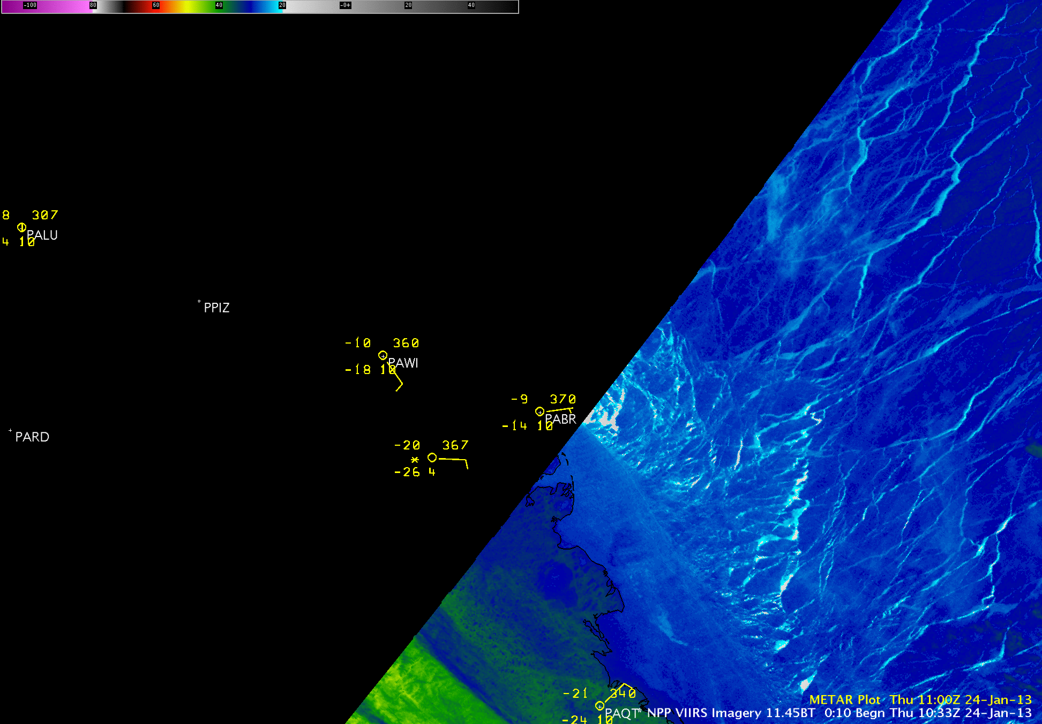
NWS in Alaska, through the JPSS Proving Ground, has become a primary and proactive user of VIIRS products and imagery.
The examples demonstrates exploitation of critical data for arctic access and navigation, and safe transportation.
VIIRS being used for sea ice analysis
VIIRS animation showing strong Easterly Flow (Polynyas* and Leads) in Ice.
Barrow
* An area of open water surrounded by sea ice. It is now used as a geographical term for an area of unfrozen sea within the ice pack.

Slide 11
Mapping NOAT Priorities to JPSS PGRR
Fund JCSDA for data assimilation and data denial studies
Blended TPW project
Enterprise algorithms – ABI algorithms being used on VIIRS for clouds, volcanic ash, aerosols, etc in NDE

Slide 12
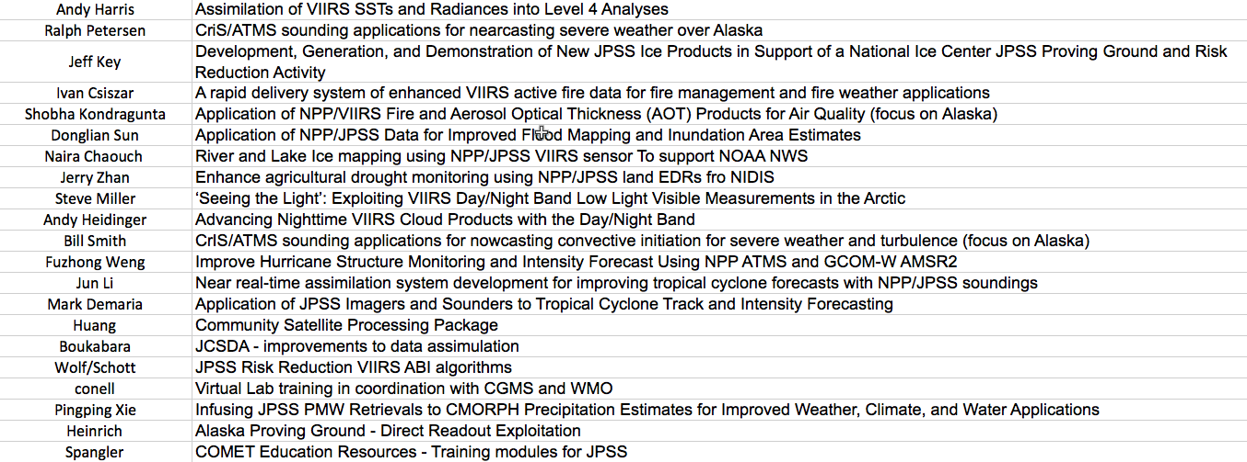
JPSS PGRR NWS Roster

Slide 13
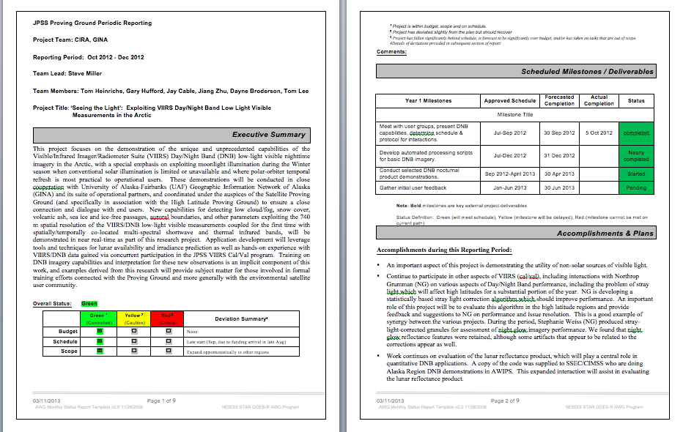
Track Progress via Quarterly Reports and Monthly JPSS Science Seminars

Slide 14
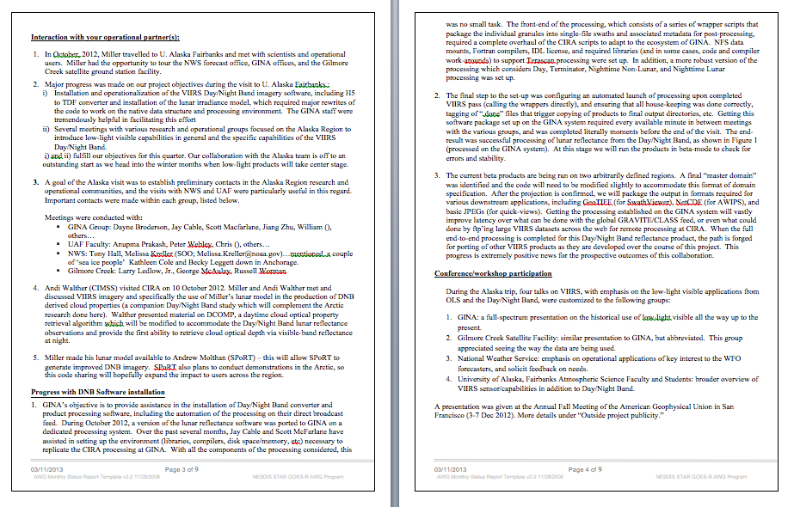
Quarterly Reports (cont)

Slide 15
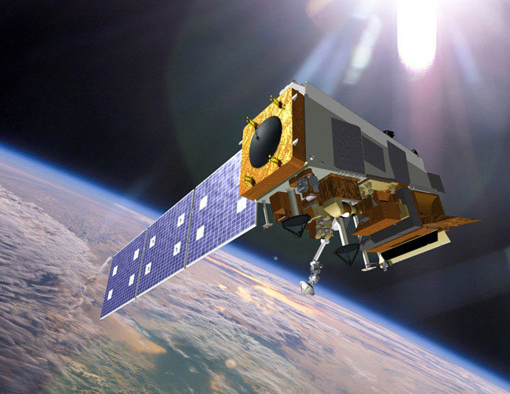
Summary
An understanding of how JPSS data used throughout NOAA is pivotal to evolving and maintaining a robust satellite mission that serves the needs of all Line Offices.
This is why guidance from the NOAT is important to prioritize how best to use JPSS data in combination with other data to improve critical product and services
Alaska proving ground is an excellent example of rapid use and deployment of Suomi NPP data.
JPSS continues to engage the NOAA user community, ensuring that both the best product and new, enhanced products (via the Proving Ground) are made available in the most timely manner possible.

