Slide 1

Air Quality Applications of VIIRS Aerosol
Products within U.S. EPA
James Szykman
National Exposure Research Laboratory
Office of Research and Development
U.S. Environmental Protection Agency
NOAA GOES-R Air Quality Proving Ground Workshop
UMBC, Baltimore, MD
March 14, 2013

Slide 2
Air Quality Applications of VIIRS Aerosol
Products within U.S. EPA
Contributors:
Phil Dickerson , John White, Tesh Rao, Rich Scheffe, Rohit Mathur, George Pouliot, Tim Watkins - U.S. EPA
Shobha Kondragunta, Hai Zhang (IMGS), and Chuanyu Xu (IMGS) – NOAA/NESDIS
Adam Pasch and Patrick Zahn and others - Sonoma Technology Inc.
Aaron von Donkelaar and Randall Martin, Dalhousie University
Matt Freeman and Todd Plessel – Lockheed-Martin, US EPA,
And other ….

Slide 3
Talk Outline
Air Quality Applications of VIIRS Aerosol
Products (plus) within U.S. EPA
Recent Strategic Changes on Integration of Satellite Data into Air Quality Research and Applications
  Air, Climate, Energy Research Program
  Forthcoming CENR/ AQRS Report
Air Quality Standards/Societal Impact
Use of S-NPP VIIRS Environmental Data Records (EDRs) in Air Quality
  AIRNow
    Air Quality Index
  National Ambient Air Quality Standards
    Exceptional Events
    Fire Emission Inventory
    Model Evaluation
Summary

Slide 4
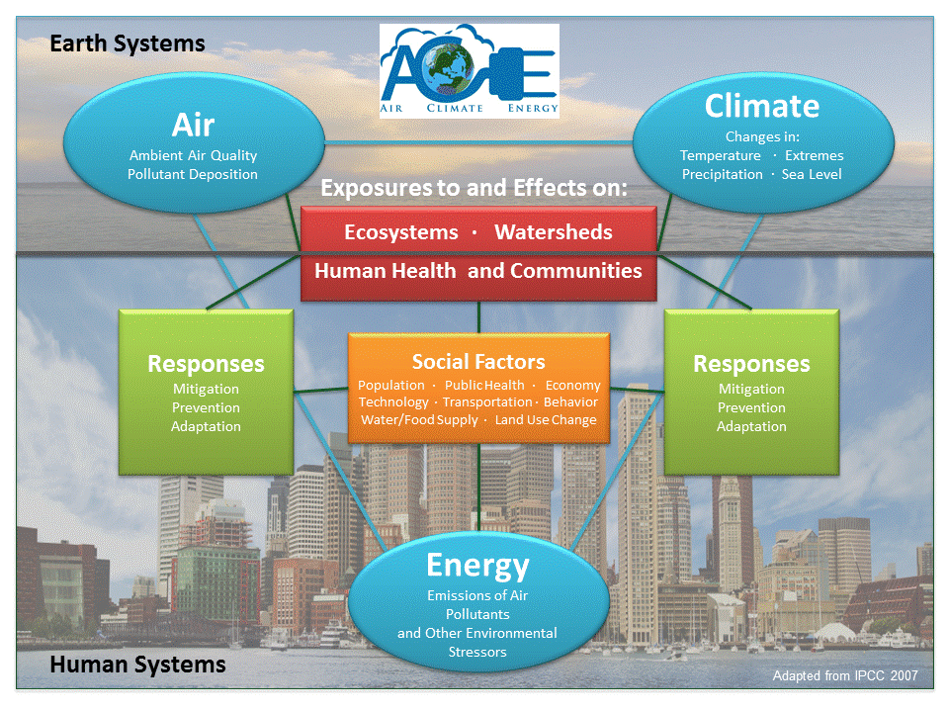

Slide 5
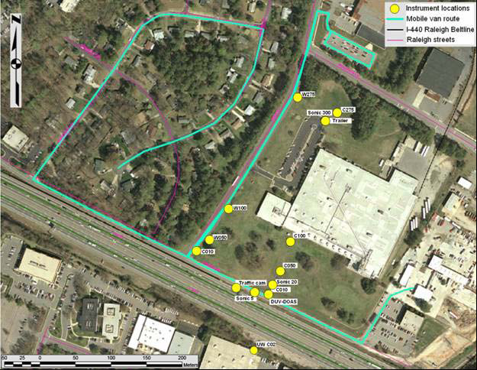
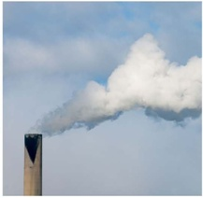

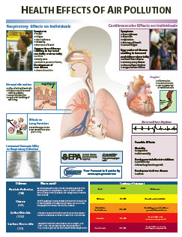

ACE Research Themes
Near Road
Theme 1: Assess Impacts
  Assess human and ecosystem exposures and effects associated with air pollutants and climate change at individual, community, regional, and global scales
  Theme 2: Prevent and Reduce Emissions
    Provide data & tools to develop and evaluate approaches to prevent and reduce emissions of pollutants to the atmosphere, particularly environmentally sustainable, cost effective, and innovative multipollutant and sector-based approaches
  Theme 3: Respond to Changes in Climate & Air Quality
    Provide human exposure and environmental modeling, monitoring, metrics and information needed by individuals, communities, and governmental agencies to adapt to the impacts of climate change and make informed public health decisions regarding air quality
Notes:
Theme 1: Assess Impacts
Assess human and ecosystem exposures/effects of air pollutants and climate change at individual, community, regional, and global scales
Inform the review of the NAAQS
Assess multipollutant exposures and effects
Innovative approaches to assess exposures/effects of pollutants in the atmosphere
Susceptible human and ecosystem populations
Theme 2: Prevent and Reduce Emissions
Provide data & tools to develop and evaluate approaches to prevent and reduce emissions of pollutants to the atmosphere, particularly environmentally sustainable, cost effective, and innovative multipollutant and sector-based approaches
Support implementation of NAAQS
Innovative technologies to support AQ management strategies
Evaluate pollution reduction and prevention solutions
Life-cycle analyses of alternative pollution reduction and energy options
Theme 3: Respond to Changes in Climate & Air Quality
Provide human exposure and environmental modeling, monitoring, metrics and information needed by individuals, communities, and governmental agencies to adapt to the impacts of climate change and make informed public health decisions regarding air quality
Evaluate alternative adaptation strategies
Devise innovative methods to inform individual- and community-level adaptation to climate change and decision making for air quality
Evaluate social, behavioral, and economic factors that influence adaptation strategies for climate change and decision making for air quality

Slide 6

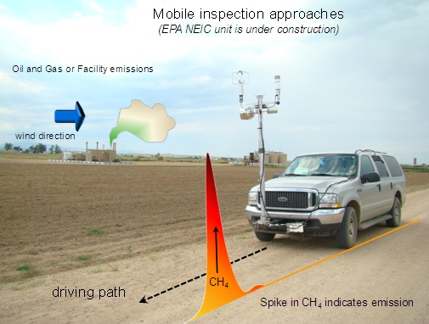
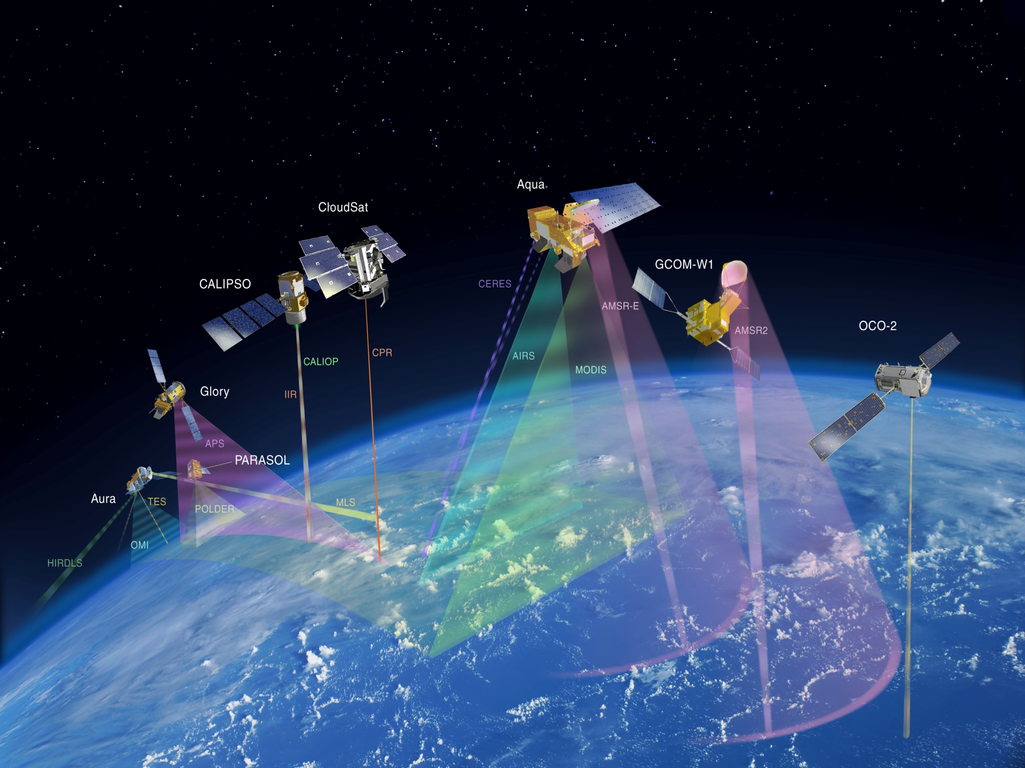
Changing the Paradigm for Air Pollution Monitoring: From Sensors to Satellites
One of Five Signature Projects under ACE
(communitysensing.org)
Satellite Data
  Evaluating and enhancing existing and new air quality applications
      Emission Inventories – Use of satellite data to improve or develop new methods
      Monitoring – Use of data fusion/assimilation techniques to Integrate modeling data with monitoring data to fill spatial and temporal gaps
      Model Development and Evaluation - Use of satellite data to inform and evaluation global and regional model development
  Workshops
    Satellite and Above-Boundary Layer Observations for Air Quality Management (May 2011 and Jan 2012)
  Leveraging investments from NOAA and NASA
    NOAA Air Quality Proving Ground (AQPG)
    NASA DISCOVER-AQ and NASA Applied Sciences Program

Slide 7
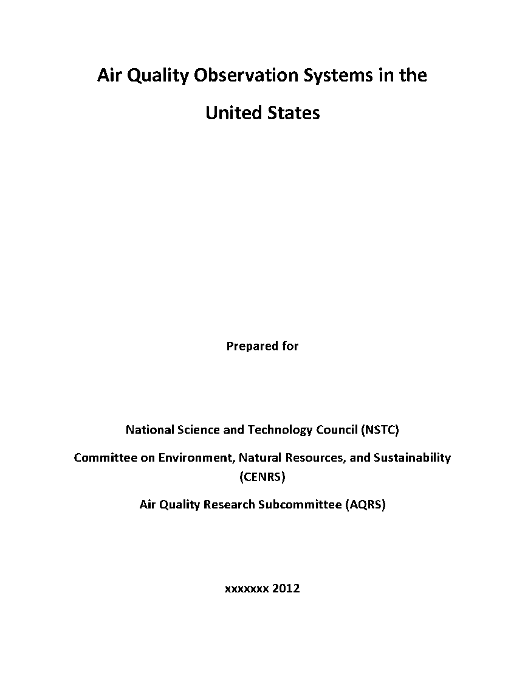
Air Quality Observation Systems in the United States
Report finalized and approved by all agencies in late 2012.
Report provides:
  a comprehensive listing of observation programs in the U.S. relevant to air quality, including NASA-NOAA Suomi-NPP VIIRS and NOAA JPSS VIIRS.
  EPA a framework to better integrate satellite observations with existing surface networks, field observations, and models.
Currently in OSTP and being finalized for release in 2013.

Slide 8
Air Quality Applications of VIIRS Aerosol Products within U.S. EPA
VIIRS 24 EDRs
Land, Ocean, Atmosphere, Snow
Within EPA continuity of MODIS data products via S-NPP VIIRS is the most critical data source from an operational and research perspective:
AIRNow Air Quality Index
National Ambient Air Quality Standards
  Exceptional Events
  Fire Emission Inventory
  Model Evaluation
* Product has a Key Performance attribute
8

Slide 9
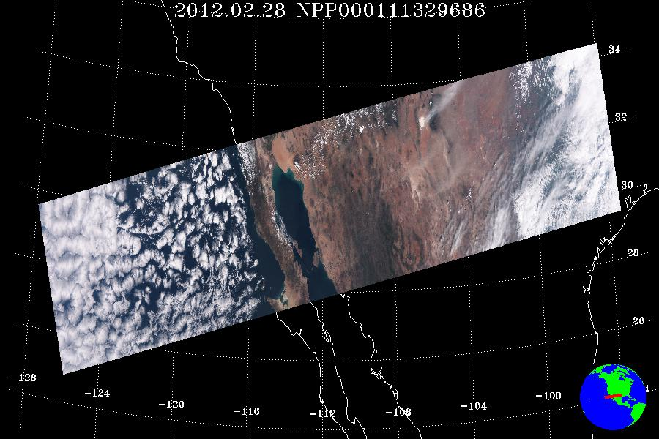
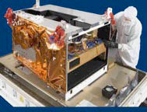
VIIRS AOT product at beta maturity level beginning May 2, 2012 with data blackout time period between 13 October and 27 November 2012 due to a coding error during a build upgrade.
Visible Infrared Imaging Radiometer Suite (VIIRS)
Currently flying on a joint NASA-NOAA Suomi NPP mission and scheduled to fly on NOAA JPSS series
Aerosol Product Output Files (HDF5 format) for each granule:
Aerosol Optical Thickness pixel level Intermediate Product (IP): 750 m (@nadir), 1.1 km (@1500 km off-nadir), 1.6 km (@3000 km off-nadir)
Aerosol Optical Thickness aggregated Environmental Data Record (EDR): 6 km (@nadir) and 12 km (@scan edge)
Suspended Matter pixel level (SM)
Aerosol Model Information (AMI)
Geolocation file for IP and SM
Gelocation file for EDR
Altitude: 842 km
Orbit inclination: 98.7º
Equator Crossing Time:1:30 PM
Swath Width: 3040 km
No. of M-bands: 16
No. of Scan Lines: 48
Fixed array size per granule: 768 x 3200
Granule Size: 86s

Slide 10
National Ambient Air Quality Standards: PM_{2.5}
Adversity of Effects
Current NAAQS (Primary)
  Annual – 12 ug/m3 (2012)
  24hr – 35 ug/m3 (2006)
Proportion of Population Affected
Notes:
December 2005 proposed new PM2.5–Primary 24-hour Standard
Under the proposal, EPA would revise the level of the 24-hour standard from the current level of65 μg/m3to 35 μg/m3.
EPA is proposing this change based on its assessment of a significantly expanded body of scientific information.
Studies show health effects at and below the level of the current standard
EPA also is considering alternative levels for the 24-hour standard, between the range of 35 and 30 μg/m3 and is soliciting public comment on these levels.
Final Rule to be signed by September 27, 2006 (consent agreement)

Slide 11
Impacts: Human Health (Aerosols) PM_{2.5}
Health effects caused by long-term exposure to fine particles (PM2.5), which is based on an annual standard, include:
  Premature death, especially related to heart disease
  Cardiovascular effects, such as heart attacks and strokes
Long-term exposure to fine particles also is linked to reduced lung development as well as the development of chronic respiratory diseases, such as asthma, in children
  Some studies also suggest that long-term PM2.5 exposures may be linked to cancer and to harmful developmental and reproductive effects, such as infant mortality and low birth weight.
Health effects caused by short-term exposure to fine particles (PM2.5), which is based on a daily standard, include:
  Premature death, especially death related to heart and lung diseases
  Increased hospital admissions and emergency department visits for cardiovascular effects, such as non-fatal heart attacks and strokes.
Short-term PM2.5 exposures also are linked to increased hospital admissions and emergency department visits for respiratory effects, such as asthma attacks, as well as increased respiratory symptoms, such as coughing, wheezing and shortness of breath. In addition, short-term PM2.5 exposures are linked to reduced lung function, especially in children and people with lung diseases, such as asthma.

Slide 12

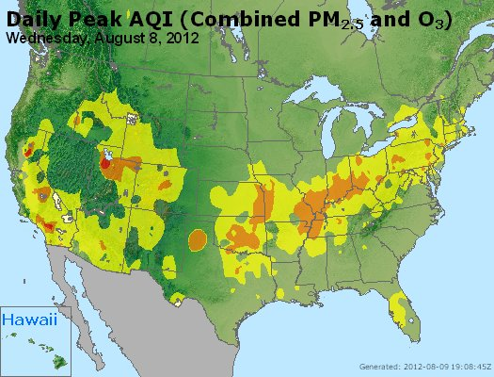
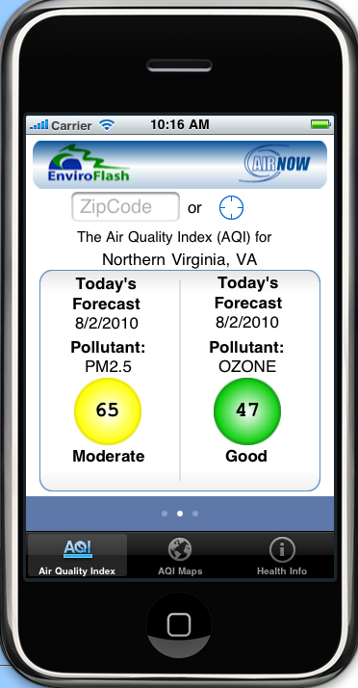


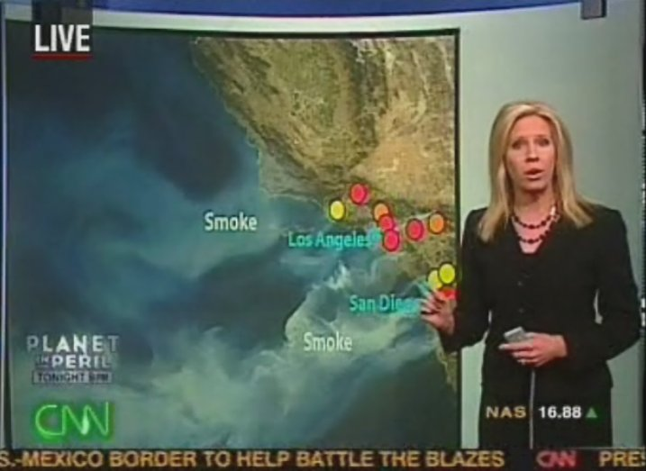
AirNow
AirNow is the national framework for acquiring and distributing air quality information
  Collects, quality assures, and transfers real-time and forecasted air quality information to the public
  Gathers data provided by 130 federal, state, and local air quality agencies
  Issues weather/air quality news stories
  Partners with national media and other agencies
  Provides air quality education and outreach
America’s “go to” resource for current and forecasted air quality information
12

Slide 13
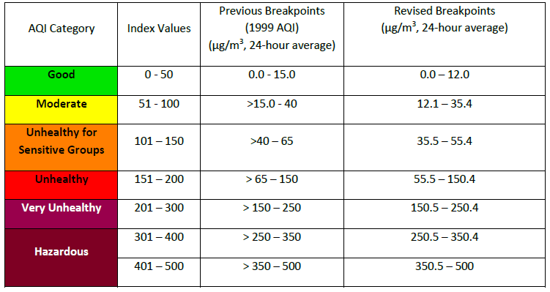
Recent Revisions to Air Quality Index

Slide 14
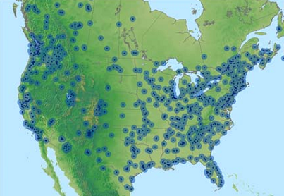
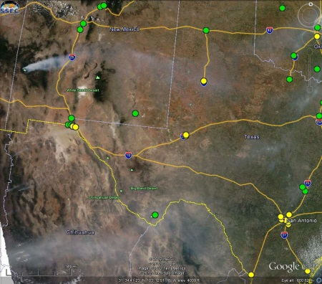
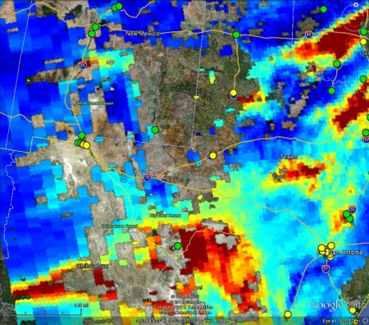
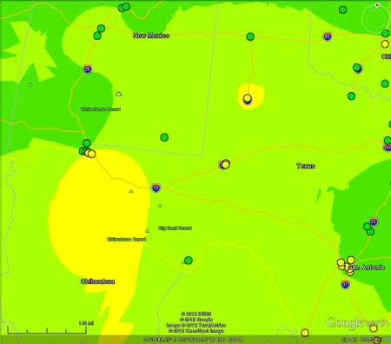
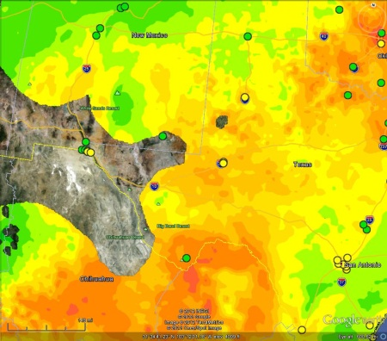
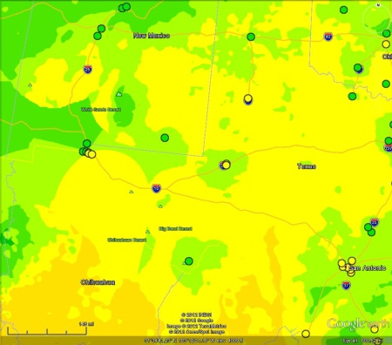
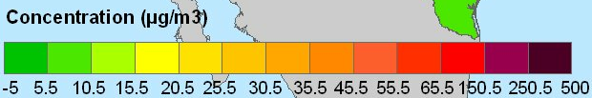
AirNow Satellite Data Processor
(ASDP)
Spatial coverage of current AirNow maps is limited
There are significant data gaps resulting in over 36 million American (~40% of the area) not covered by a monitoring network
Satellite data, specifically AOD can provide information to “fill-in” these gaps for PM_{2.5}
ASDP development primarily funded through NASA ROSES
Example: New Mexico and Mexican Fires 5/24/2012
MODIS True Color:
Smoke
MODIS AOD
Current continuous AirNow PM_{2.5} monitoring sites
AirNow Observations
Satellite Data
Fused Data
Satellite data captures the smoke and observed aerosols not in the AirNow data.
Concentration (µg/m³)
14

Slide 15
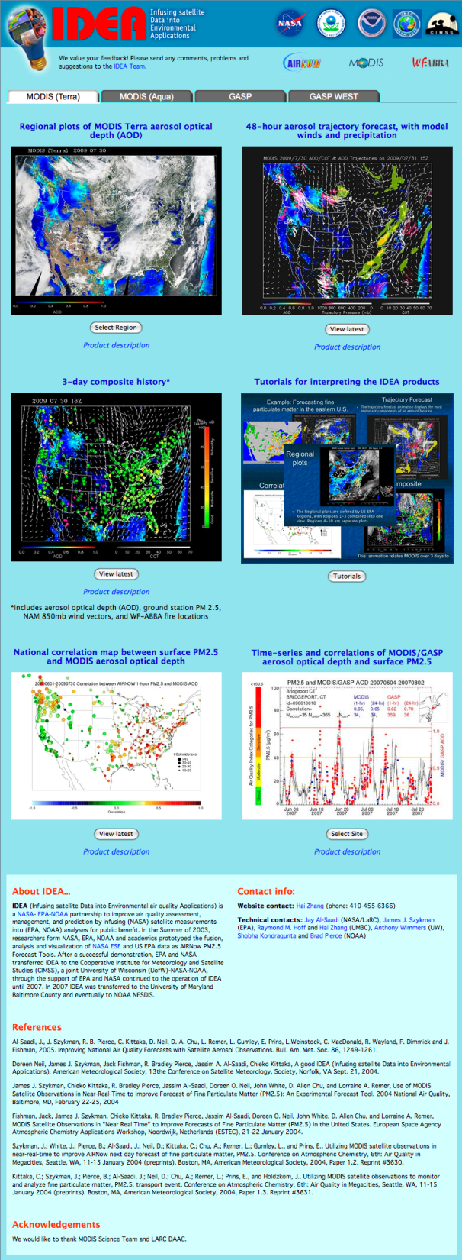
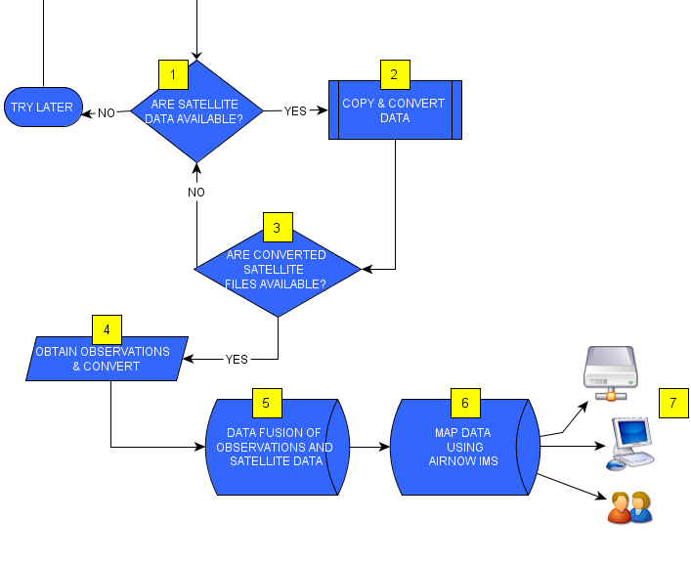
ASDP Incorporates Daily Satellite-AOD
Derived PM_{2.5} concentrations
Method documented in van Donkelaar et. al., 2012, ES&T.
Daily [PM_{2.5}] and uncertainty fields derived use only MODIS Terra and Aqua AOD via NOAA/NESDIS IDEA infrastructure
GEOS-Chem relationship between AOD and PM_{2.5} used in on-line calculation via a day specific LUT (climatology).
Satellite derived [PM_{2.5}] combined with Surface Monitor [PM_{2.5}] via a weighted average fusion approach.
SATELLITE DERIVED PM_{2.5} & UNCERTAINTY
FIELDS ON STANDARD 12km GRID
AirNow Satellite Data Processor (ASDP)
15

Slide 16
ASDP Fusion Approach: Weighted Average
  Determine uncertainty ( ) for each field; variance of prediction (VOP)
  Weighting of each data type, a measure of uncertainty (indexed by grid cell and hour)
  The final fused product is then
  Uncertainty of the final fused product is then
w = weight
j = index of grid cell
O = raw value
F = fused product

Slide 17
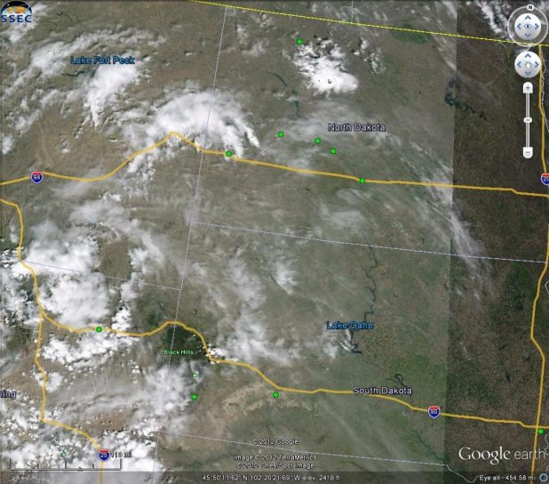
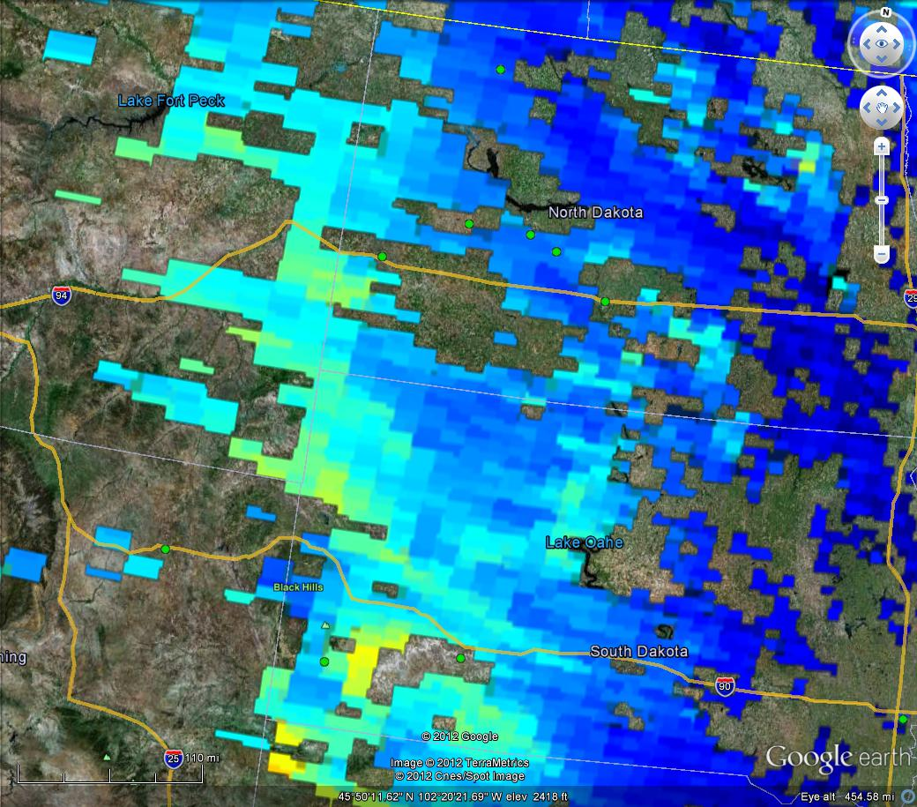

Preliminary Results:
Smoke and No Monitors (Dakotas)
May 16th, 2012
MODIS True Color
and AirNow Observations
AOD and AirNow Observations
Smoke and aerosols
17

Slide 18
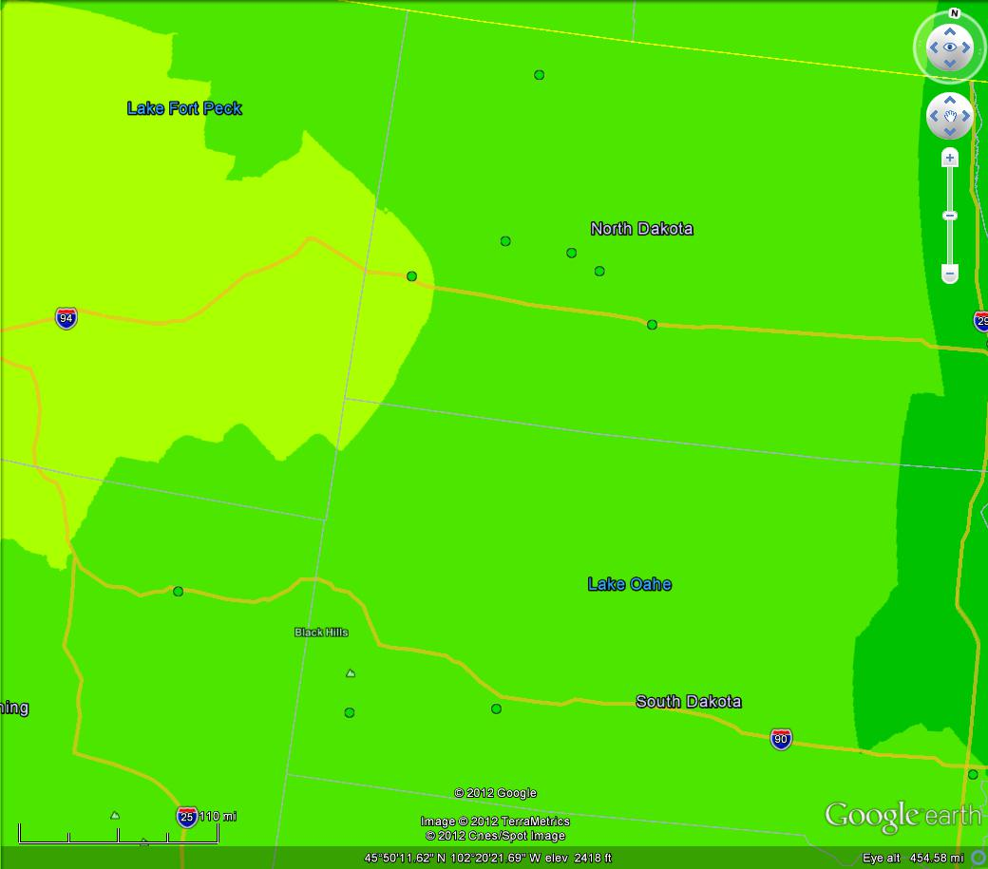
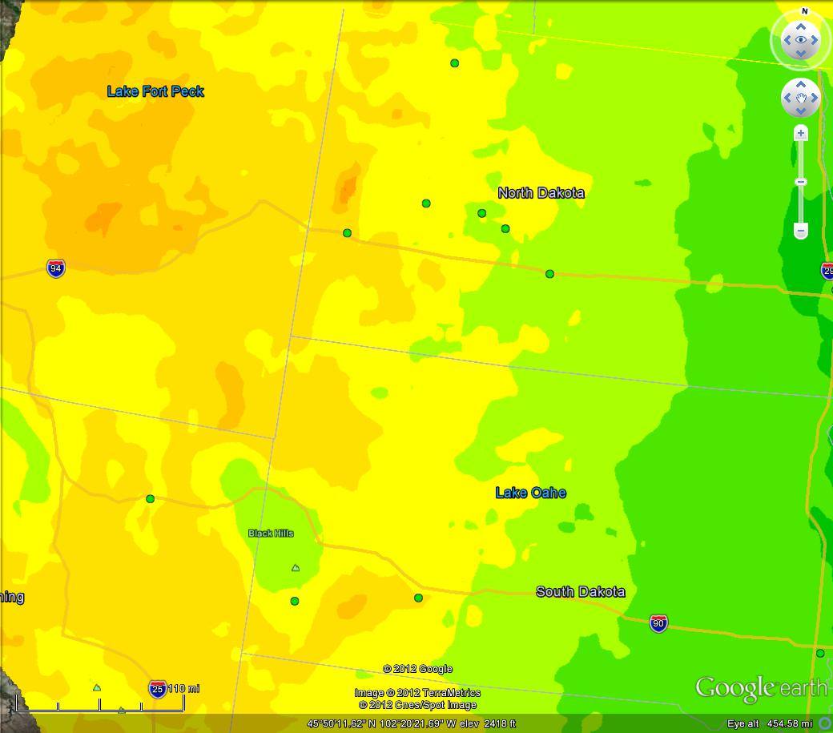
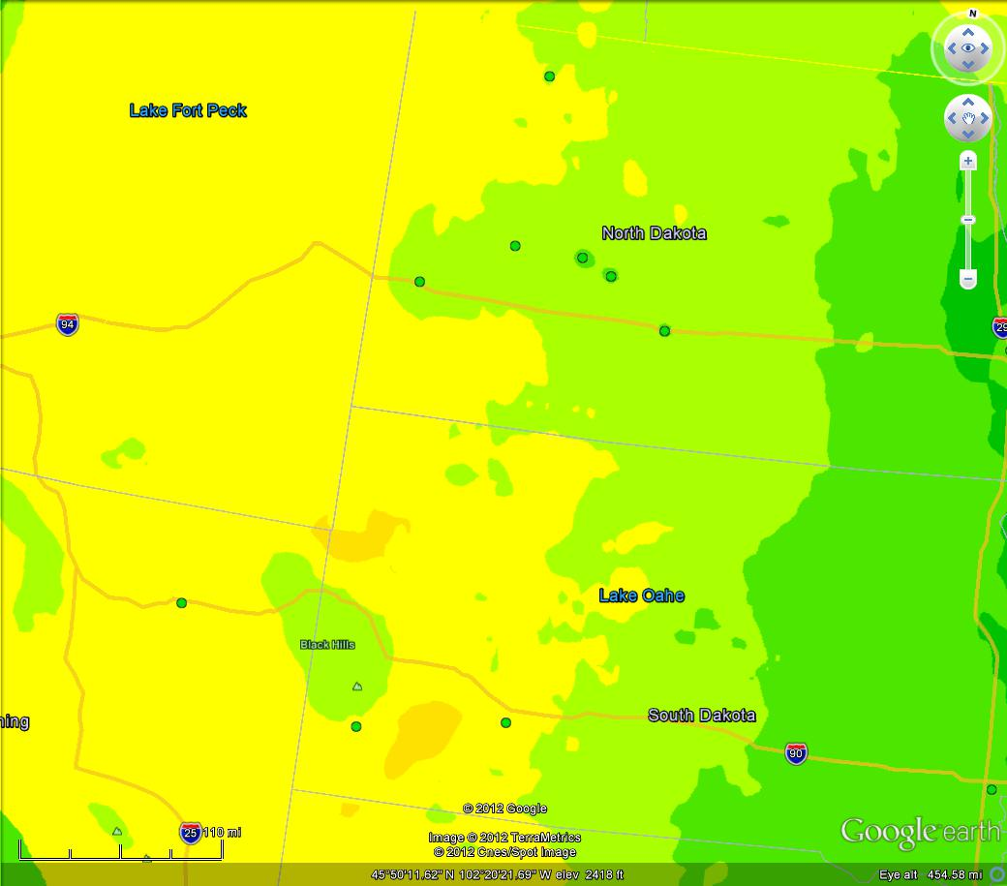
Preliminary Results:
Smoke and No Monitors (Dakotas)
Satellite Estimates
and AirNow Observations
Fused Product
and AirNow Observations
AirNow Observations
PM_{2.5} Concentration (µg/m³)
Smoke in Dakotas (MODIS and AOD)
Limited Air Quality Monitors
ASDP Product adds information (Moderate)
Next Steps: How good is this information (scientific and socio-economic POV)
18

Slide 19
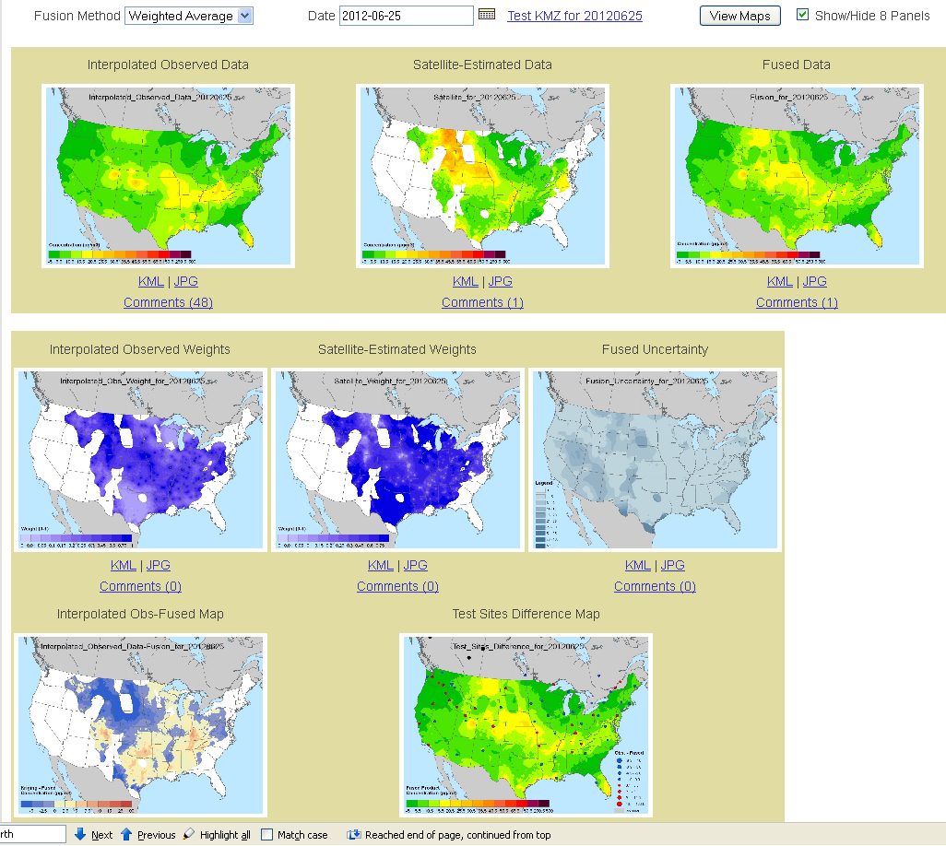
ASDP Products
Operational ASDP Project website: aspd.airnowtech.org
19

Slide 20
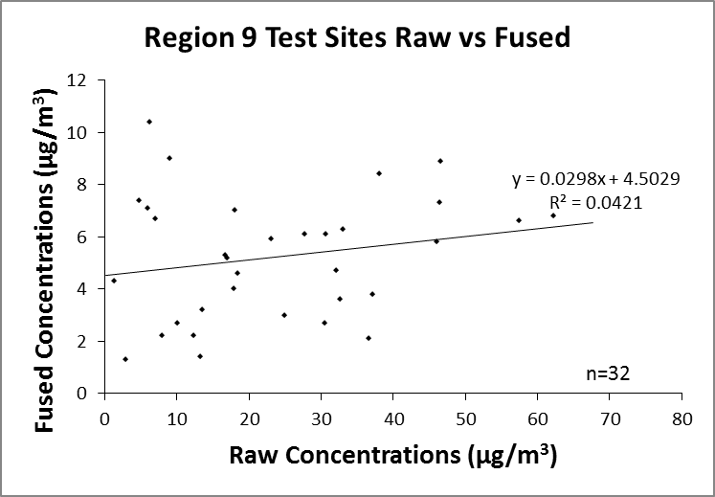
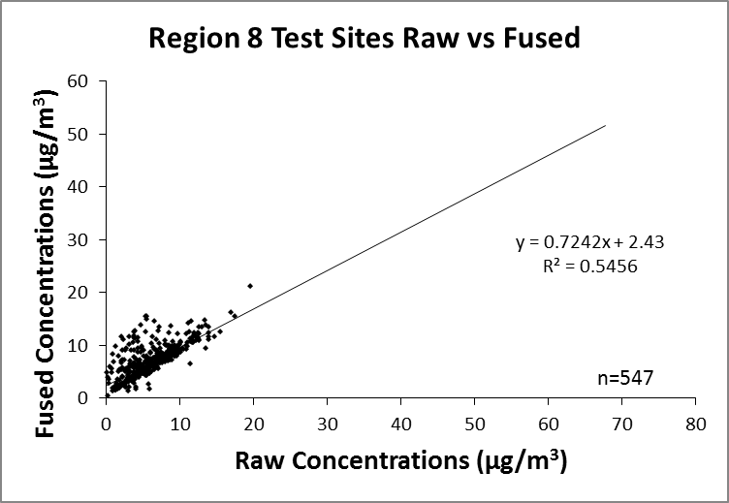
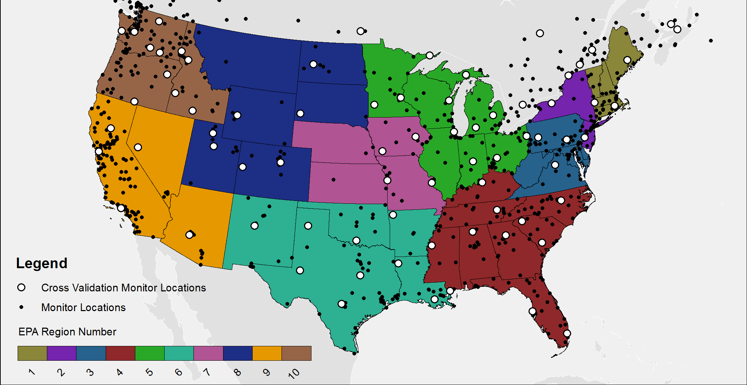
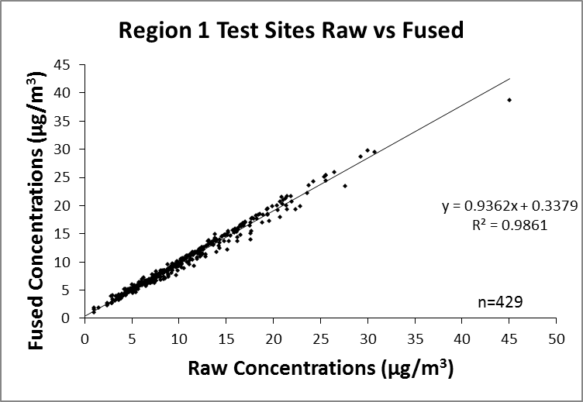
Testing: Scatter Plots
Poor performance over Mountains and Plains
Data issues in Pacific Southwest
Good performance over New England
Source: A. Pasch STI
Notes:
JLD to insert additional ideas and discuss

Slide 21
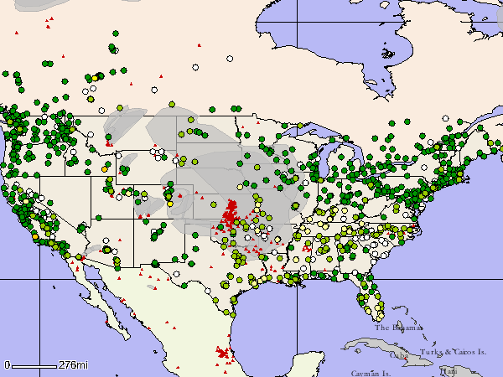
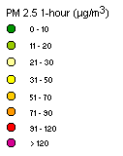
Wildfire Event: June 2012 Case Study
MODIS and VIIRS AOT EDR
AIRNow Tech Observed PM_{2.5} Values (green/yellow dots),
Smoke Plumes (gray), and Fire Locations (red) at 4:00 p.m. MDT on 6/25/12
Data Sparse Regions

Slide 22
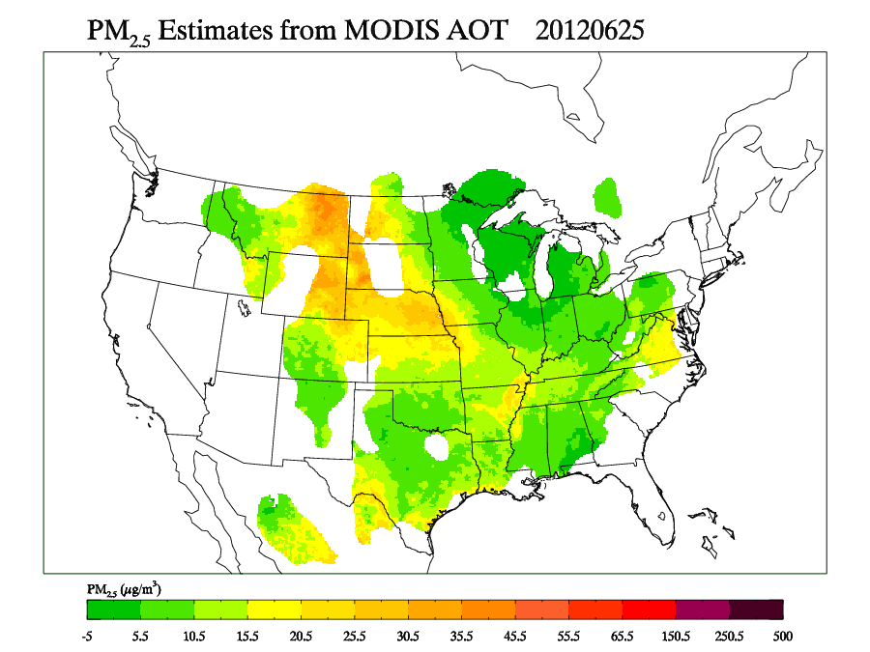
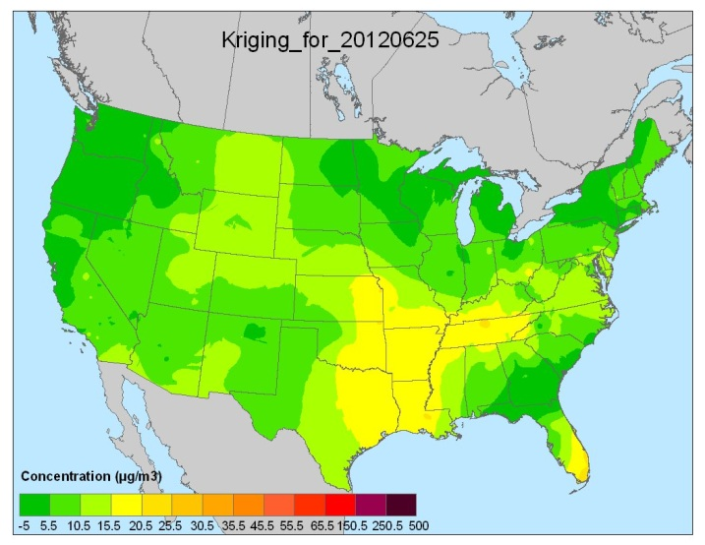
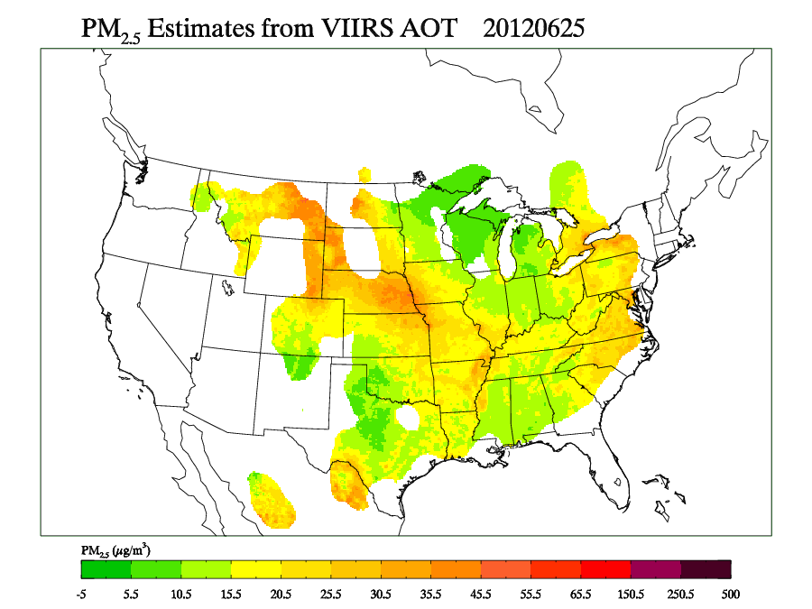
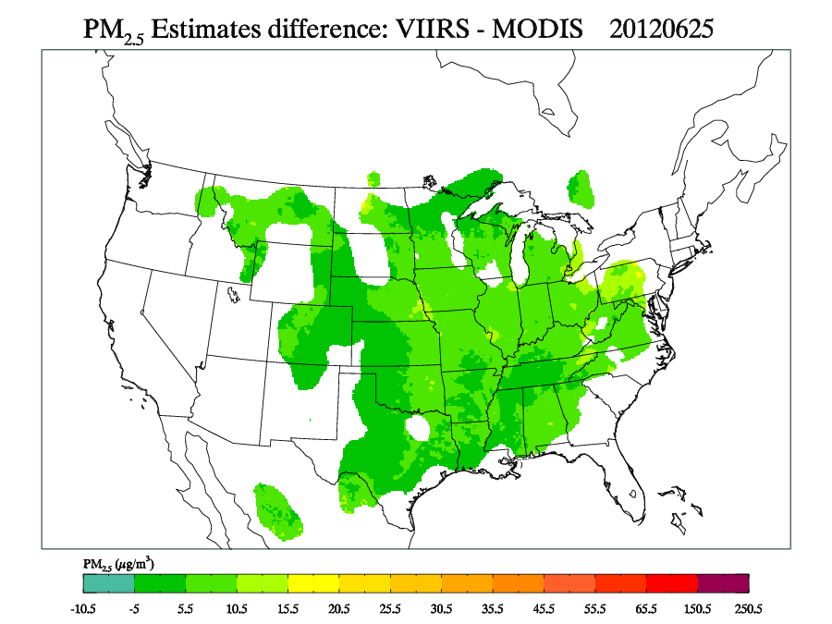
MODIS (Terra & Aqua) vs. VIIRS Surface PM_{2.5} - 6/25/12 Wildfires
AIRNow Interpolated PM_{2.5} Ground Observations

Slide 23
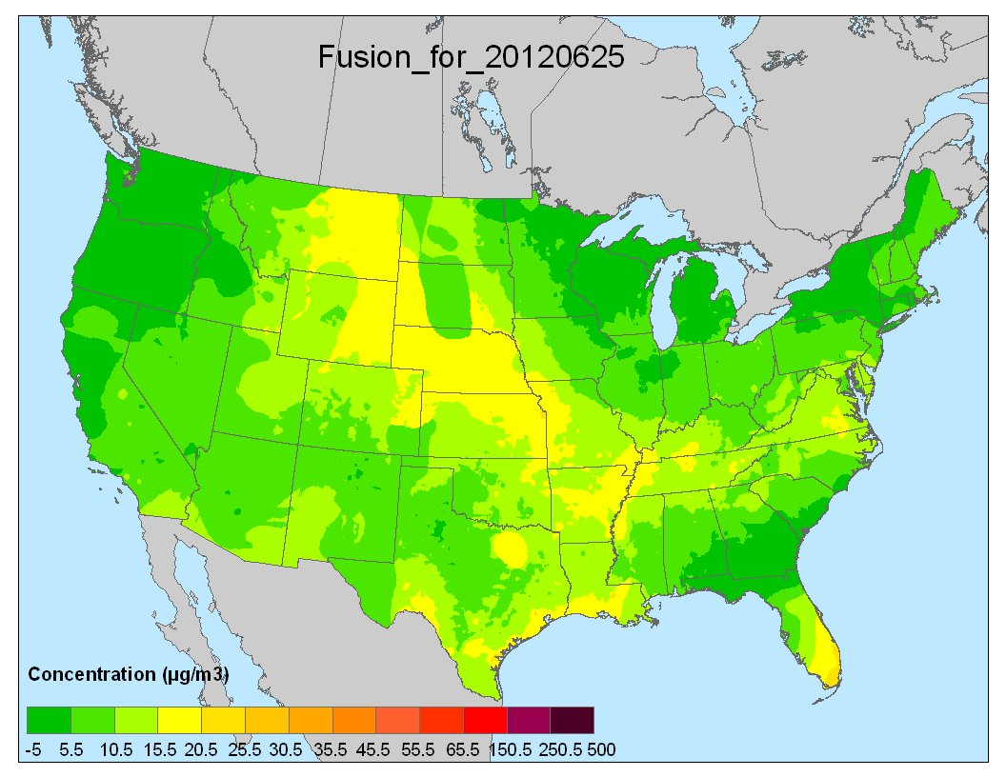
MODIS (Terra & Aqua) vs. VIIRS Surface PM_{2.5} - 6/25/12 Wildfires
AIRNow Interpolated PM_{2.5} Ground Observations
+
ASDP Fused PM_{2.5} Product
(MODIS Terra and Aqua)

Slide 24
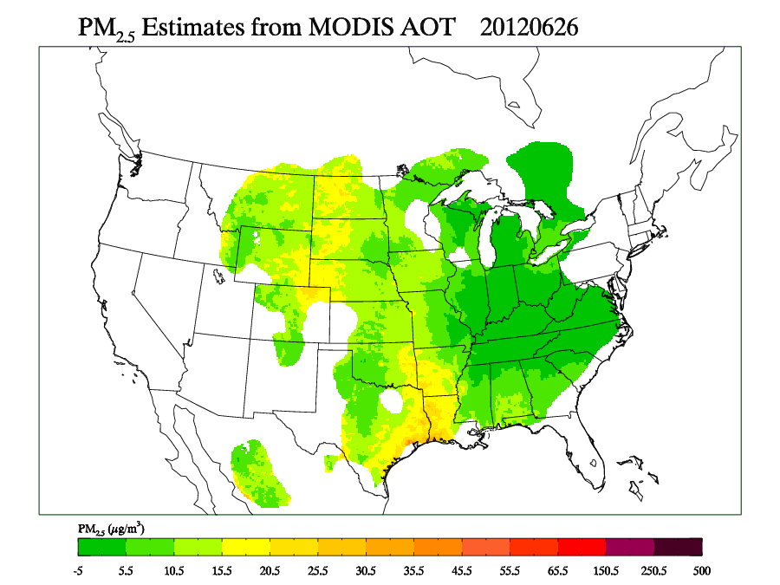
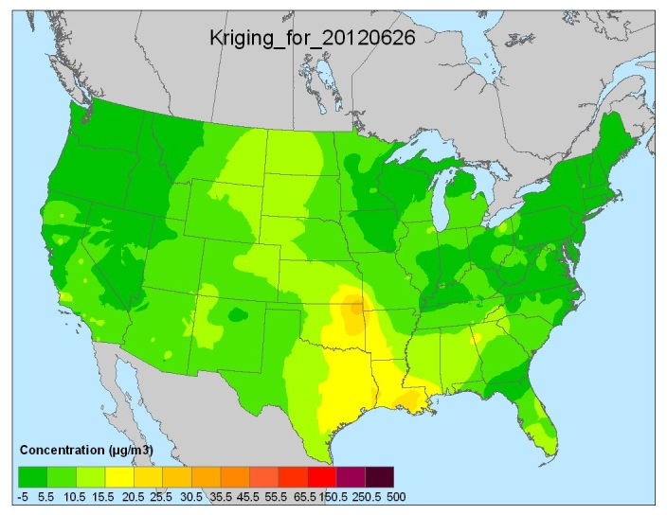
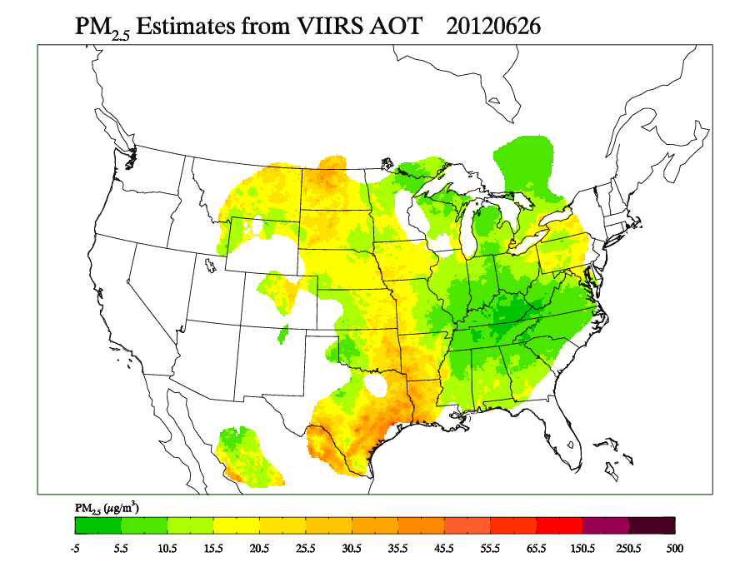
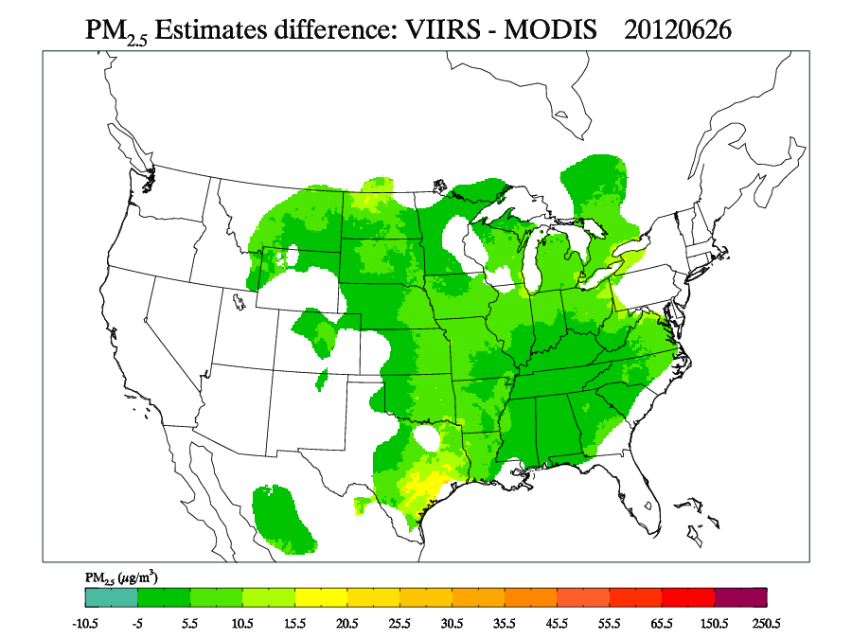
MODIS (Terra & Aqua) vs. VIIRS Surface PM_{2.5} - 6/26/12 Wildfires
AIRNow Interpolated PM_{2.5} Ground Observations

Slide 25
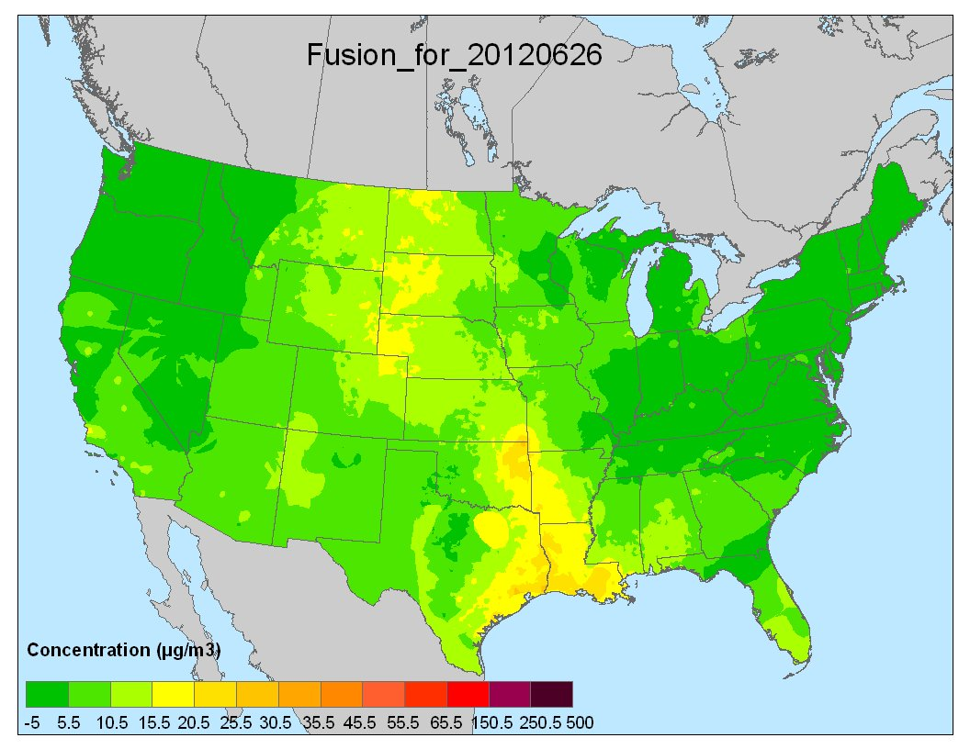
MODIS (Terra & Aqua) vs. VIIRS Surface PM_{2.5} - 6/26/12 Wildfires
AIRNow Interpolated PM_{2.5} Ground Observations
+
ASDP Fused PM_{2.5} Product
(MODIS Terra and Aqua)

Slide 26
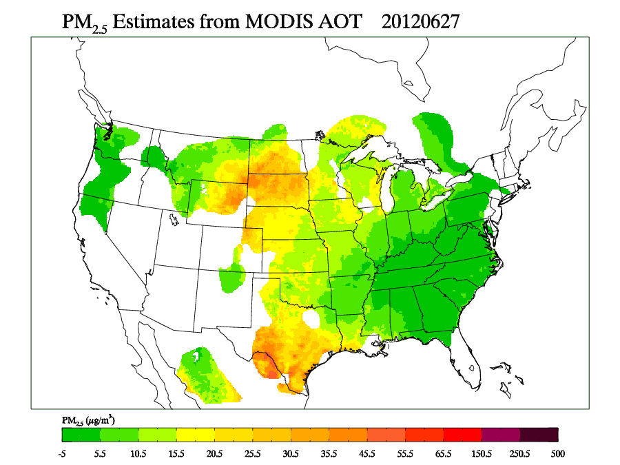
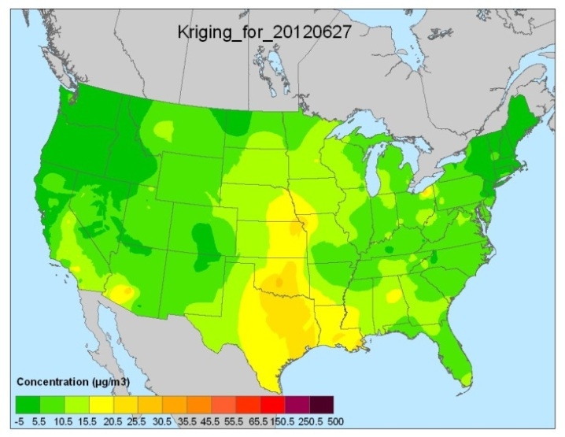
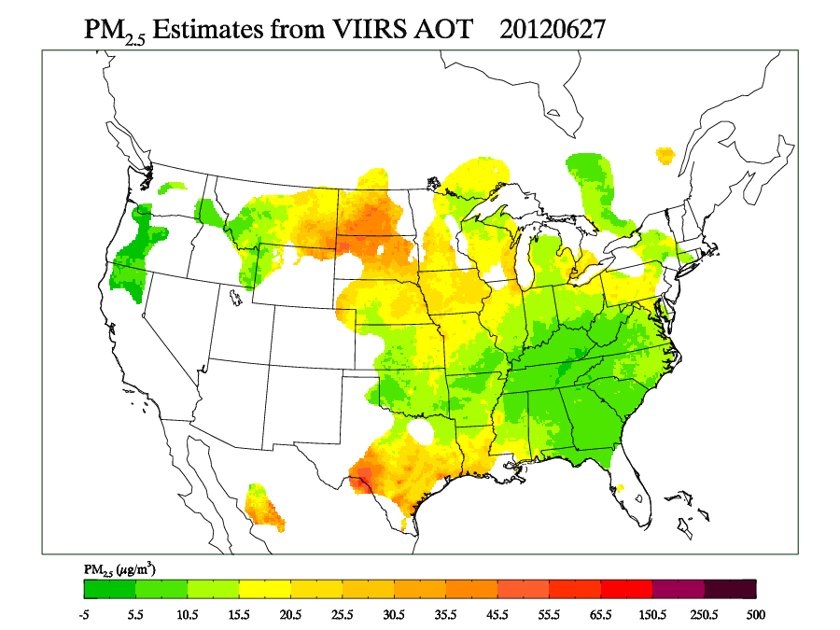
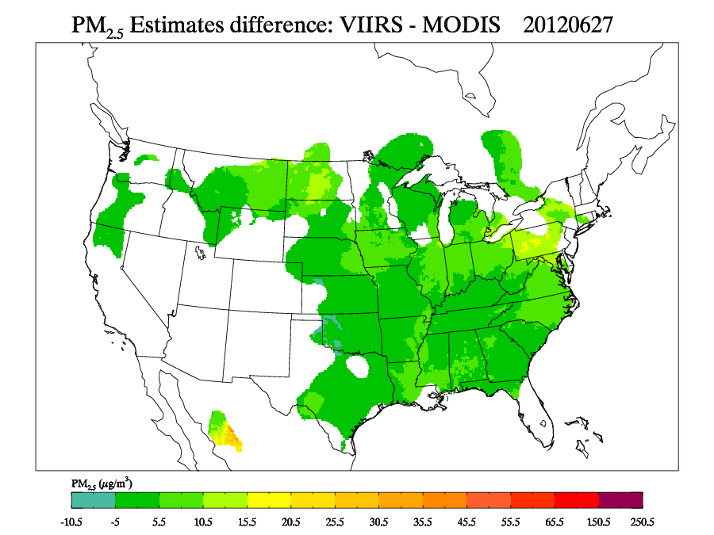
MODIS (Terra & Aqua) vs. VIIRS Surface PM_{2.5} - 6/27/12 Wildfires
AIRNow Interpolated PM_{2.5} Ground Observations

Slide 27
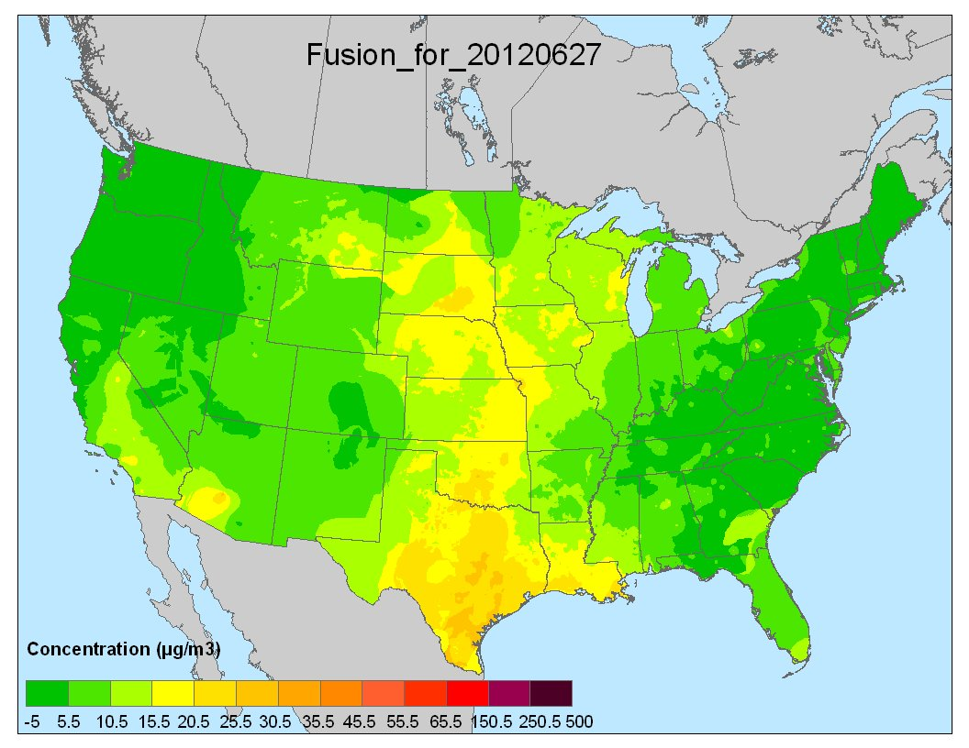
MODIS (Terra & Aqua) vs. VIIRS Surface PM_{2.5} - 6/27/12 Wildfires
AIRNow Interpolated PM_{2.5} Ground Observations
+
ASDP Fused PM_{2.5} Product
(MODIS Terra and Aqua)

Slide 28
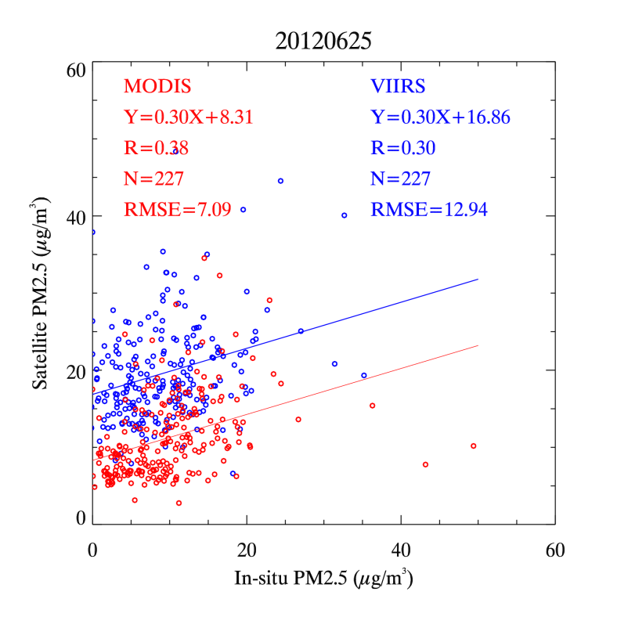


MODIS (Terra & Aqua) and VIIRS derived PM_{2.5} vs. Surface PM_{2.5-} 6/25-27/12
MODIS derived PM_{2.5} µg/m3 (Terra/Aqua avg.) compared to 12:00 LT
VIIRS derived PM_{2.5} µg/m3 to 13:30 LT
VIIRS derived PM_{2.5} RSME ~2 times that of MODIS derived PM_{2.5} RSME compared to In-situ PM_{2.5}. Both VIIRS and MODIS bias high.
VIIRS AOT known to be biased high compared to MODIS - findings of cal/val team.

Slide 29
Application of S-NPP/VIIRS Aerosol and Fire and Products under National Ambient Air Quality Standards:
-Evidence for EPA’s Exceptional Events Rule
-Fire Emission Inventory Development
-Model Evaluation/Development

Slide 30
Exceptional Events and Satellite Data
Dust storms – airborne fine and coarse mode particles
Fires – airborne smoke particles
Satellites observe fire hot spots and aerosol loading (as aerosol optical thickness). Attributing the observed aerosol optical thickness due to dust or smoke is currently difficult. Therefore, independent algorithms to qualitatively flag dust and smoke in a pixel have been developed
  Automated Smoke Detection and tracking Algorithm using GOES fire and aerosol optical thickness
  Deep Blue Dust Index (DBDI) algorithm for MODIS
These algorithms have been adapted for VIIRS and the products are currently being tested

Slide 31

ASDA algorithm applied to VIIRS AOT to isolate smoke AOT. Example shown for September 3, 2012 and integrated with CALIOP extinction and surface PM2.5 within RSIG.

Slide 32

Dust mask algorithm applied to VIIRS radiances to derive a dust flag.
VIIRS experimental global dust index algorithm uses blue and mid-infrared bands (M1, M2, and M11) to generate a global dust index for National Weather Service air quality forecast applications. Movie loop shows dust outbreaks over the desert regions over a 3-day time period in September 2012. This algorithm is running at NESDIS STAR on VIIRS DB data covering the CONUS with a latency of 2 hrs or less.
Courtesy of Ciren (IMSG) and Kondragunta (NESDIS/STAR)

Slide 33


Slide 34

Fires most important contributor to 2008
PM2.5 Emissions…
Total PM2.5 Emissions in 2008 is ~ 6.1 million tons; Fires ~ 1.8 million tons
Fires here include: wild fires, prescribed fires, and agricultural fires
Final NEI represents a blending of S/L and EPA data
Notes:
This chart shows the final 2008NEI for PM2.5 emissions. Take note of the fact that fires represent nearly 30% of the emissions and is the leading sectoral contributor to PM.5 emissions. It is expected that the “fire slice” will get bigger in out years.

Slide 35
2008 NEI v2 – Data source setup for Fire Activity via SmartFirev2.0
Data Element | First Choice | Second Choice | Third Choice
Location/shape | MTBS | HMS | ICS-209
Final size | MTBS | ICS-209 | HMS
Daily growth | HMS | ICS-209 | MTBS
Fire type (WF/Rx) | ICS-209 | MTBS | HMS
Name | ICS-209 | MTBS | HMS
Start date | First reported
End date | Last reported
Fire info → Fuels → Consumption → Time profile → Emissions → Plume rise
Notes:
This table shows the hierarchy that SFv2 uses in getting the location of the fire; the name of the fire; the final size of the fire; the daily growth of the fire; and the fire type. A key thing to note here is that the fire type in SFv2 is absolute in that every fire is identified as either a wild fire or prescribed fire. ICS209s are used first to do this; if not there, then MTBS data are used, and if not there; HMS data are used along with a climatological analysis of when these different types of fires occur over a given part of the US. Once this step is completed, we have an idea of daily fire information for every identified fire in the US for the year in question.
“Association” algorithm is used to avoid double counting (spatio-temporal uncertainties)
Location/Shape refers to the geographic location of the fire and its burn perimeter. MTBS shapefiles derived from LANDSAT burn severity imagery analysis produced by the MTBS team. HMS data are “hot spot” pixels, which are detections of actively burning area fires form satellite sensors. Pixels from each sensor archived into a single 1-km grid. To estimate fire shape from HMS, a circle with radius of 800 m was created for each pixel. Large fires are typically detected by more than one pixel. Overlapping circles were then merged to produce the final fire shape. Spatial data in ICS209 reports are limited to lat/longs (ignition point). A circle centered on the reported ignition point with total Area equal to the area reported in the ICS209 report is created.
Final size: MTBS: total area of burn scar. ICS209: “area” field that provides an estimate of the total cumulative area burned at time of report. HMS: final size is inferred by assigning an area burned per pixel and multiplying by the number of pixels in the fire. see Asubp map on next page.
Growth: HMS: provides daily snapshot of fire activity. Fractional growth determined by dividing a fire’s daily HMS pixel count by its total HMS pixel count. ICS209 reports cumulative area burned, that was used with daily area burned to estimate growth. MTBS provides no temporal information (only start date), daily frac gowth assigned as 100% on the start date of the fire.
Fire Type: ICS209 provides this info explicitly. MTBS—can be inferred sometimes from name field. HMS—educated guesses used. A fire climatology map was used, etc.

Slide 36


Expansion of regional air pollution models to hemispheric scales
Tightening of air quality standards places greater emphasis on the ability of air quality models to simulate the entire spectrum of concentrations
1997 NAAQS – 0.08 ppm
2008 NAAQS – 0.075 ppm
Possible revisions ~0.065 ppm
Greater emphasis on models to accurately simulate background levels, inter-regional transport, and multi-day chemistry
2004-2006
data
New applications require expanding model domains (Continental and larger) and longer-term simulations (seasonal to annual)
  Sufficient opportunities for exchange between BL and FT
  Need for accurately representing effects of long-range transport
In regional calculations, simulated variability in FT is largely dictated by specification of LBCs due to efficient transport by fast winds
  Static LBCs can not adequately represent the variability
  Global model biases can propagate and influence regional calculations and confound inferences
Enables consistent representation of various processes at the disparate scales

Slide 37

CMAQ Northern Hemisphere
Model Development
Horizontal
  Polar Stereographic projection
  108 km resolution (187x187)
  ~5 ºN
Vertical
  Top: 50mb
  35/44 layers; lowest layer 20m
Meteorology: WRF on same grid and projection
  Data assimilation: GFS + global upper air re-analysis
  Configuration: RRTMG, Kain-Fritsch, Morrison 2-moment microphysics, ACM2 PBL, PX LSM, MODIS 20 category land-use
CMAQ
  v4.7.1(CB05) + Hg
  Potential Vorticity scaling @50mb to specify O₃

Slide 38






AOD/AOT data products are important for
Model Development and Evaluation
Aug. 4: Export to North Atlantic
March Average: Asia
Comparison with AERONET
MODIS
MODEL

Slide 39
Summary
Consolidation of MODIS and VIIRS data streams into existing IDEA infrastructure at NOAA/NESDIS ensures continuity for satellite derived PM_{2.5} estimates.
Modular design of AirNow SDP provides flexibility required for incorporation of new VIIRS data stream.
VIIRS AOT data products provide needed continuity for EPA Exceptional Events Rule.
  EPA working to incorporate AOT and ASDA into RSIG
Incorporation of VIIRS Active Fire Detection into NOAA/NESDIS HMS ensures continuity for National Fire Emission under SmartFire.
  Consideration should be given for Burn Area Product

Slide 40
Disclaimer
Although this work was reviewed by EPA and approved for publication, it may not necessarily reflect official Agency policy.

