Slide 1
Validation of MODIS based GOES-R ABI AOD retrievals using Ground based LIDAR Data
R. Bradley Pierce
Ed Eloranta, Dave Turner, Shobha Kondragunta,
Pubu Ciren, Istvan Laszlo, Ralph Kuehn, Rick Wagener
During the past year we have focused on developing validation capabilities for GOES-R Advanced Baseline Imager (ABI) aerosol, cloud, land and sounding retrievals using surface and airborne measurements during NSF and NASA sponsored field campaigns conducted during 2012 under support from the GOES-R Program Office.
The airborne and surface validation tools and procedures developed using ABI proxy measurements (MODIS, GOES, etc) provide the foundation for post-launch ABI validation activities in 2015.
This presentation summarizes the demonstration of use of ground based lidar to validate GOESR-R ABI aerosol optical depth (AOD) retrievals through comparison with validation approaches using neighboring AERONET measurements
NOAA GOES-R Air Quality Proving Ground 3rd Annual Advisory Group Workshop Thursday, March 14, 2013, UMBC, Baltimore MD

Slide 2
MODIS radiance as ABI proxy data sets
The ABI algorithm is run using MODIS clear-sky reflectances using Look-Up-Tables (LUTs) specific to the MODIS channels and band passes.
The ground-based AEROsol Robotic Network (AERONET) sun photometer data have been widely used as ground “truth” data for evaluation and validation of satellite remote sensing of aerosols.
Recommended accuracy requirements for different AOD ranges
Recommended precision requirements for different AOD ranges
Comparison of ABI AOD with AERONET AOD at 550 nm over land. The solid red line is the linear regression line. The dashed blue lines denote the expected uncertainty in MODIS AOD (GOES-R Advanced Baseline Imager (ABI) Algorithm Theoretical Basis Document For Suspended Matter/Aerosol Optical Depth and Aerosol Size Parameter, Version 2.0 September 25, 2009)

Slide 3
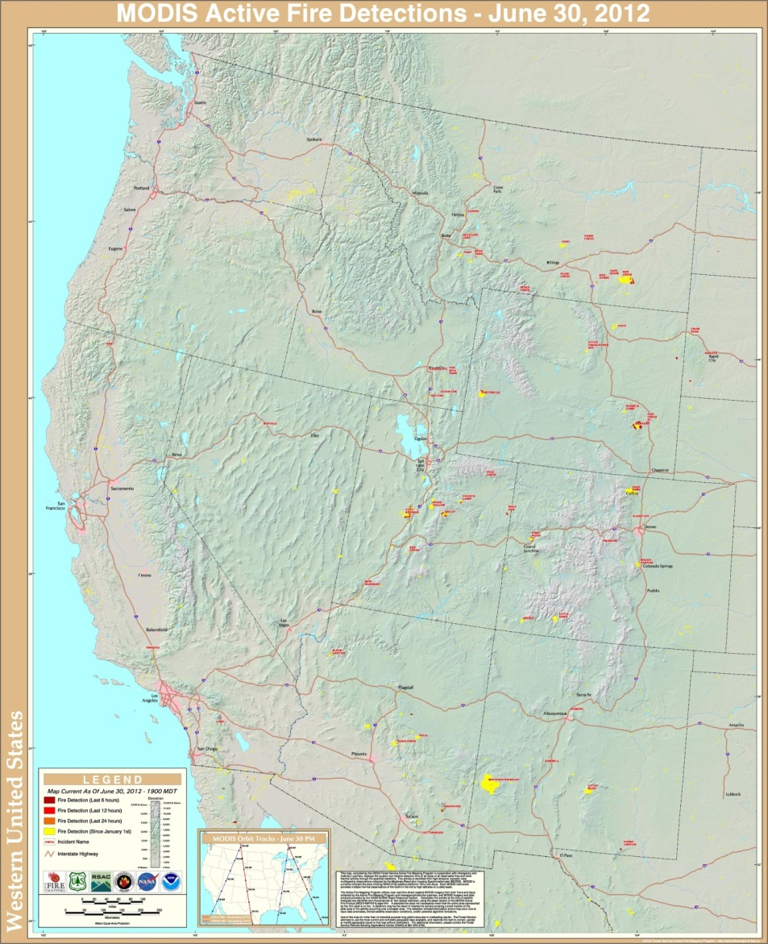
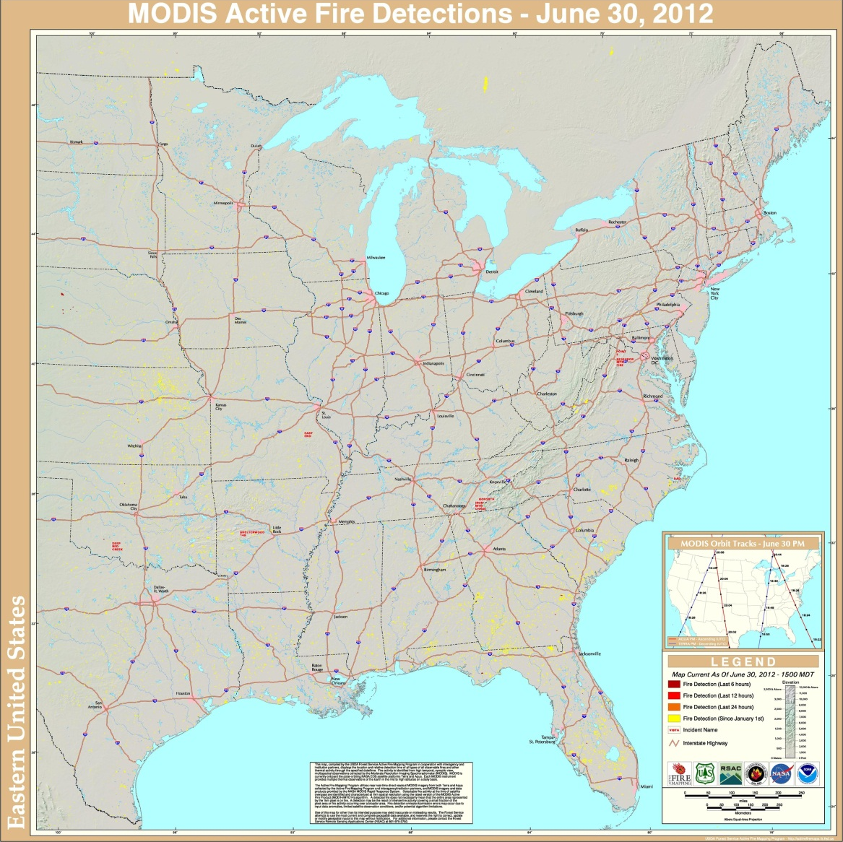

Location of AHSRL (Norman, OK) and AERONET
(ARM-CART) sites relative to upwind biomass burning
The High Park fire, which was sparked by a lightning strike on June 09, burned 87,284 acres West of Fort Collins, CO (http://www.inciweb.org/about/).
The Whitewater-Baldy fire, which was sparked by a lightning strike on May 16, burned 296,980 acres in New Mexico (http://www.inciweb.org/about/).
Yellow=Fire detection since January 1, 2012
ARM-CART
Norman, OK
MODIS fire detection maps from the
USDA Forest Service Remote Sensing Applications Center
InciWeb is an interagency all-risk incident information management system
http://activefiremaps.fs.fed.us/index.php

Slide 4
Autonomous High-spectral Resolution Lidar (AHSRL)
The UW-SSEC lidar group (Edwin Eloranta, Lead) has developed a High Spectral Resolution Lidar (HSRL) for both ground-based and aircraft platforms.
  The HSRL lidars provide vertical profiles of optical depth, backscatter cross-section depolarization, and backscatter phase function.
  All HSRL measurements are absolutely calibrated by reference to molecular scattering that is measured at each point in the lidar profile.
  This enables the HSRL to measure backscatter cross-sections and optical depths without prior assumptions about the scattering properties of the atmosphere.
A compact and autonomous HSRL has been developed with operation and data transfer controlled remotely.
  This autonomous HSRL was deployed to Norman, OK during the National Science Foundation (NSF) Deep Convective Clouds and Chemistry (DC3) Experiment during May-June, 2012
MODIS and GOES-R ABI proxy AOD retrieval validation studies using the Norman AHSRL and neighboring ARM-CART Aeronet measurements allow us to demonstrate the use of AHSRL measurements for GOES-R ABI validation.

Slide 5
AHSRL data processing
Compute 5-minute averages and standard deviation of 30-second, 30 meter aerosol backscatter and extinction profiles
Apply box-car (1-2-1) smoother in vertical and compare to raw 5-minute average to identify high frequency “noise” in backscatter profile
  Remove extinction measurements above the altitude where the “noise” first becomes larger than 50% of the smoothed aerosol backscatter
Use a 1.e⁻³ 1/(m str) mean aerosol backscatter and 1.e⁻⁴ 1/(m str) standard deviation of aerosol backscatter threshold to identify clouds
  Remove extinction profiles where either the 5-minute mean aerosol backscatter or standard deviation satisfy the cloud threshold
Integrate cloud and noise filtered extinction profile in vertical to obtain AHSRL AOD

Slide 6
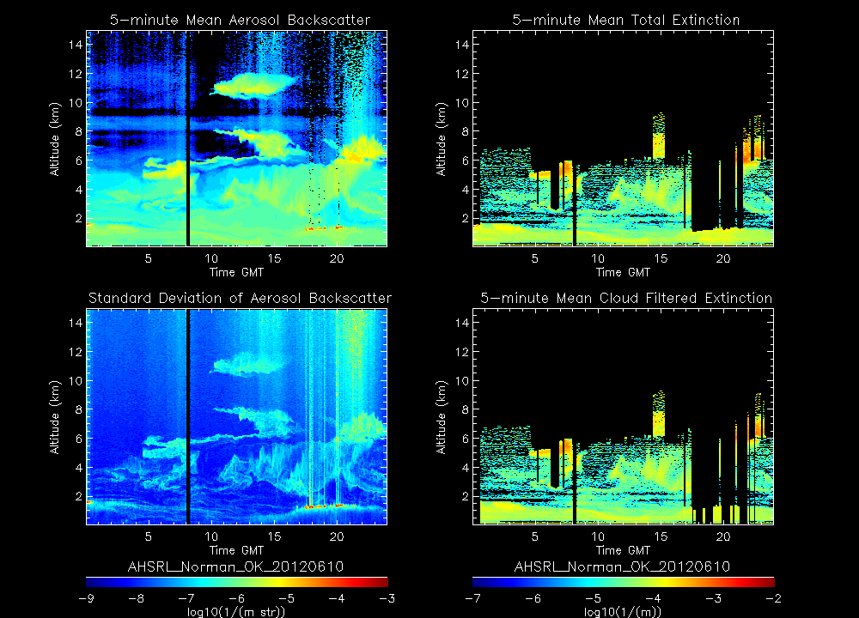
Illustration of AHSRL data processing June 10, 2012
Threshold=1.e⁻³ 1/(m str)
Noise filtered Extinction
Threshold=1.e⁻⁴ 1/(m str)
Noise and cloud filtered Extinction

Slide 7
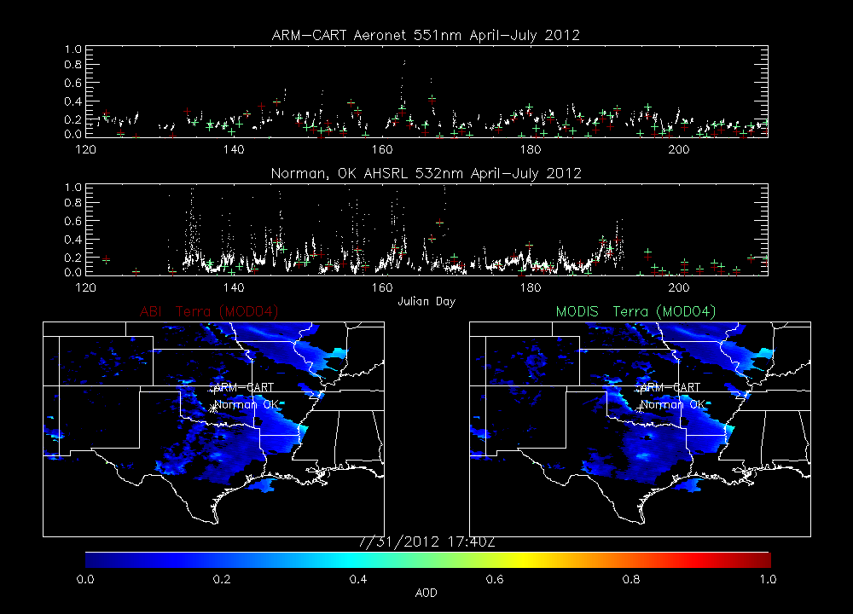
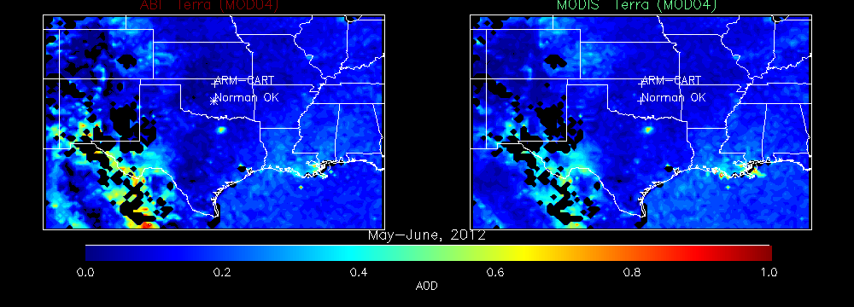
MODIS/ABI Terra Validation

Slide 8
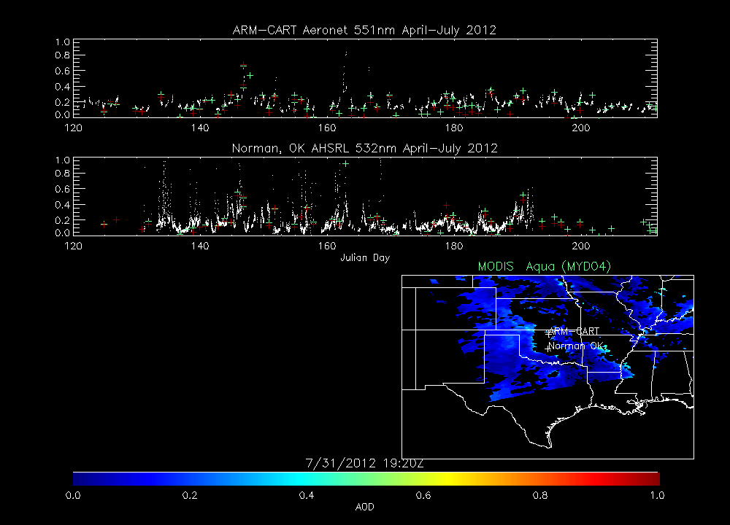
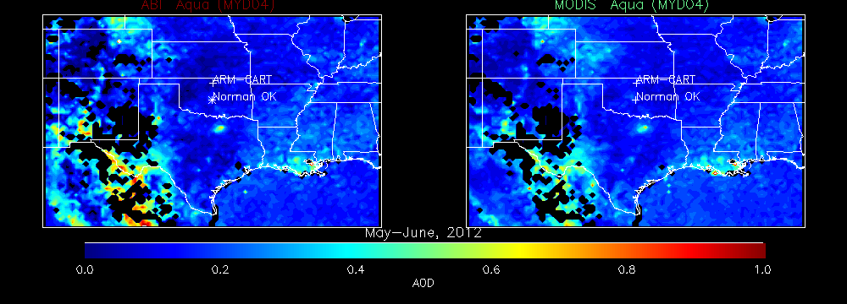
MODIS/ABI Aqua Validation

Slide 9
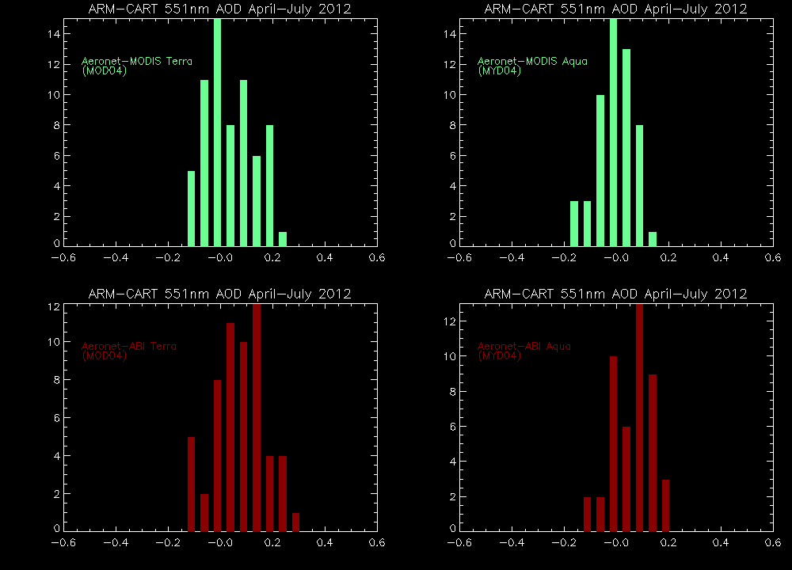
ARM-CART AERONET Validation Statistics
ABI Precision
ABI Precision

Slide 10
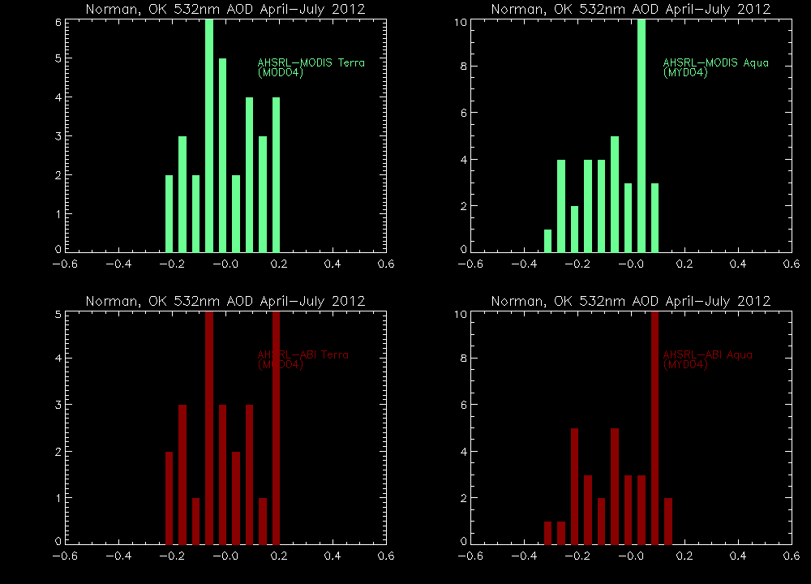
Norman, OK AHSRL Validation Statistics
ABI Precision
ABI Precision

Slide 11
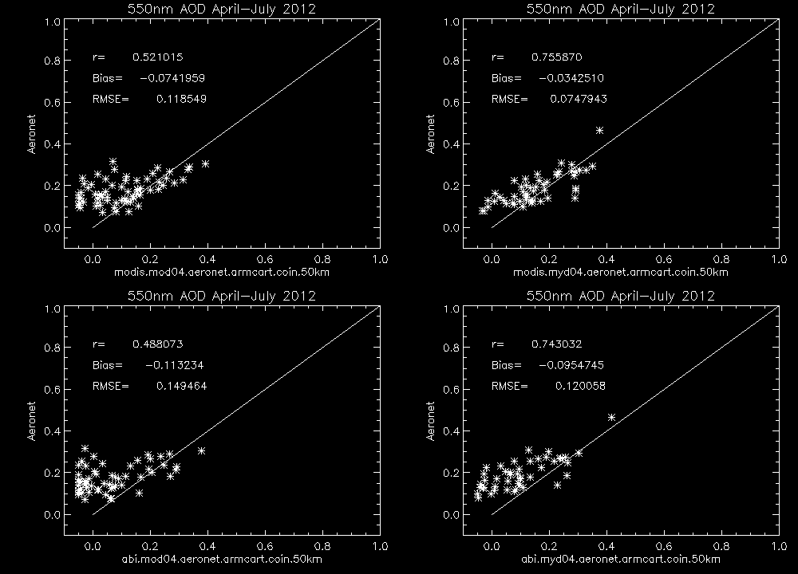
ARM-CART AERONET Validation Statistics
ABI Accuracy=0.04

Slide 12
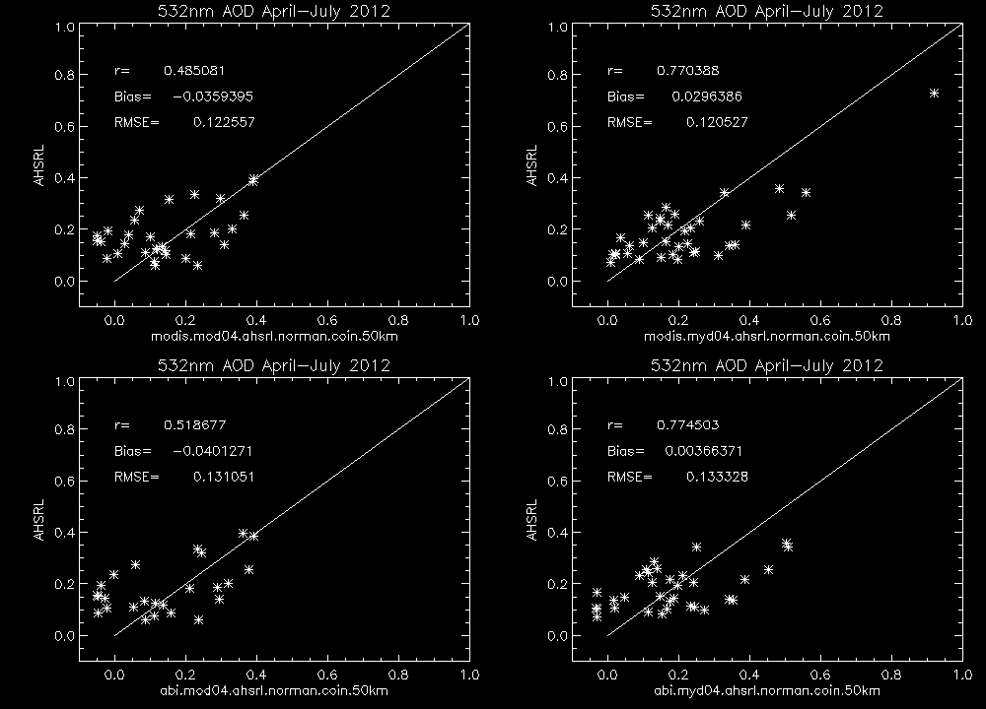
Norman, OK AHSRL Validation Statistics
ABI Accuracy=0.04

Slide 13
Norman, OK AHSRL Validation Statistics
ABI Accuracy=0.04
Low AOD cases where both MODIS and ABI retrievals underestimate AOD at both AERONET and AHSRL locations

Slide 14
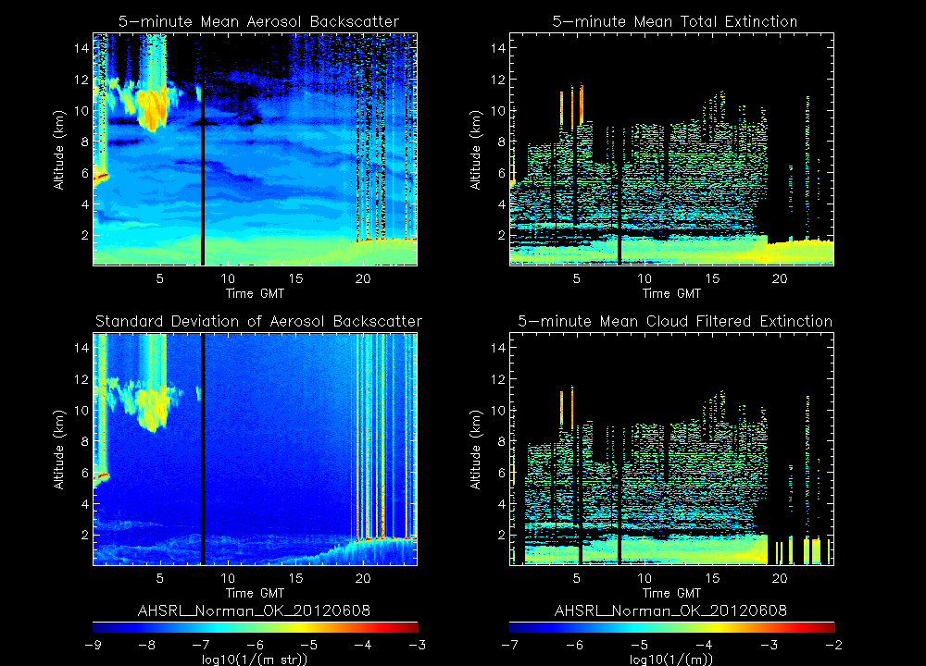
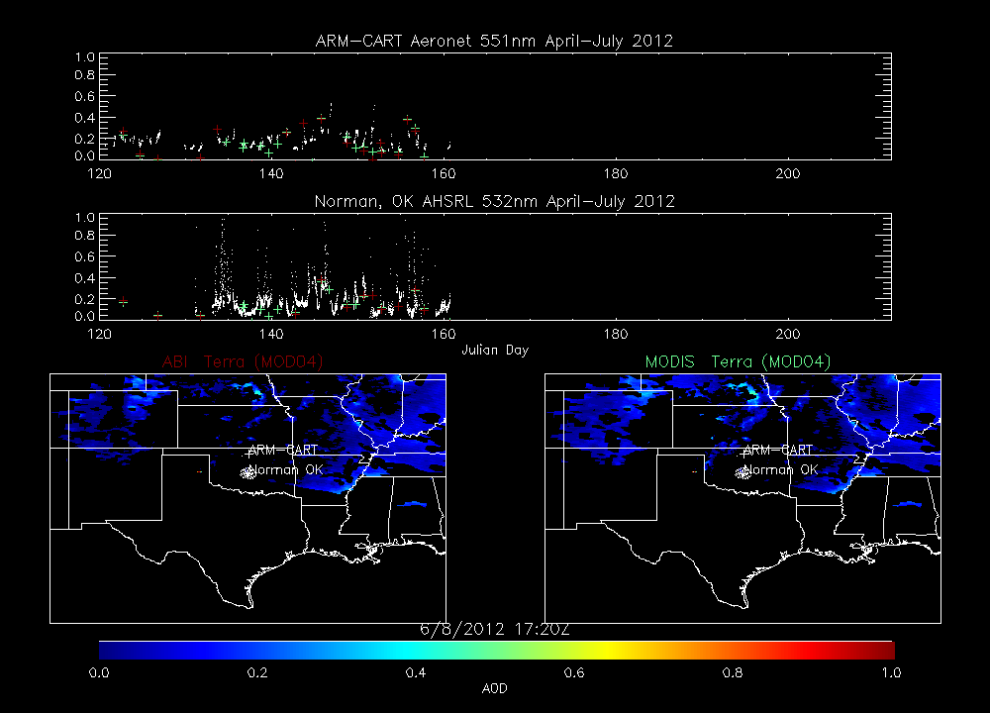
17:20 on June 8, 2012:
MODIS and ABI underestimate relative to AHSRL is associated with thin layer of enhanced aerosol below 1km.
This thin layer forms during morning growth of the planetary boundary layer (BL)
Same true for June 24, 26 July 01,03 low AOD cases where MODIS and ABI underestimates AHSRL AOD
AM BL Growth

Slide 15
Conclusions
We have demonstrated the use of autonomous High Spectral Resolution Lidar (AHSRL) for validating GOES-R ABI aerosol optical depth retrievals using ground based measurements collected at Norman, OK during the NSF DC3 field experiment in May-June, 2012
ABI AOD validation results using Norman, OK AHSRL and neighboring ARM-CART AERONET measurements show consistent correlations and RMSE although the AHSRL based bias estimates are smaller then Aeronet.
  AHSRL validation shows that ABI AOD is within the expected accuracy and precision while AERONET validation shows biases which are larger then the expected accuracy for both Terra and Aqua
  Both MODIS and ABI retrievals systematically underestimate low (<0.2) AOD during the morning (Terra) overpass relative to both AERONET and AHSRL measurements.
  The AHSRL backscatter and extinction measurements show that these underestimates are associated with thin aerosol layers below 1km that occur during the morning growth of the planetary boundary layer over Norman, OK
Future AHSRL validation efforts will utilize co-located AERONET measurements so that more accurate overlap corrections can be applied. This will result in improved accuracy in the extinction retrievals and allow for better assessment of the satellite based AOD accuracy and precision.

Slide 16
Extra Figures

Slide 17
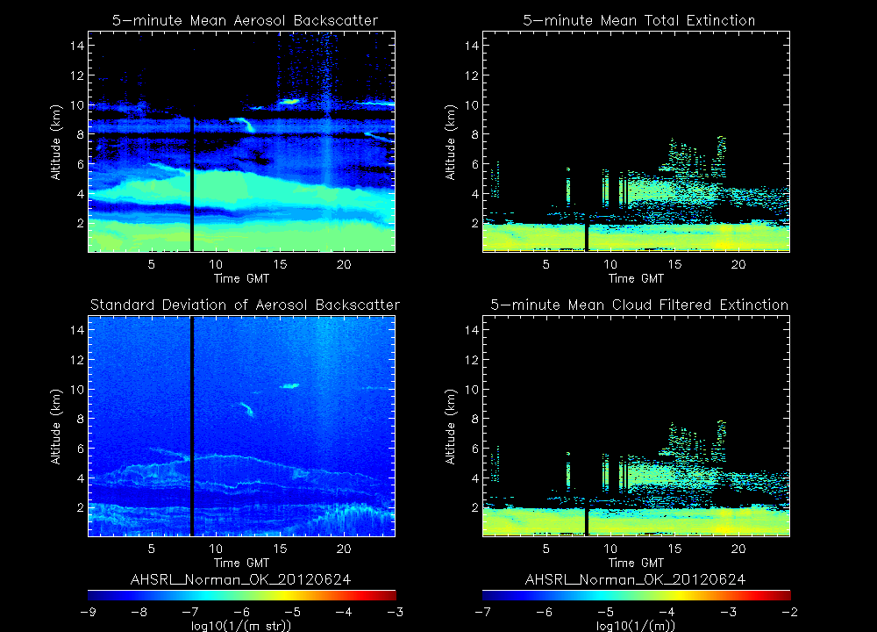
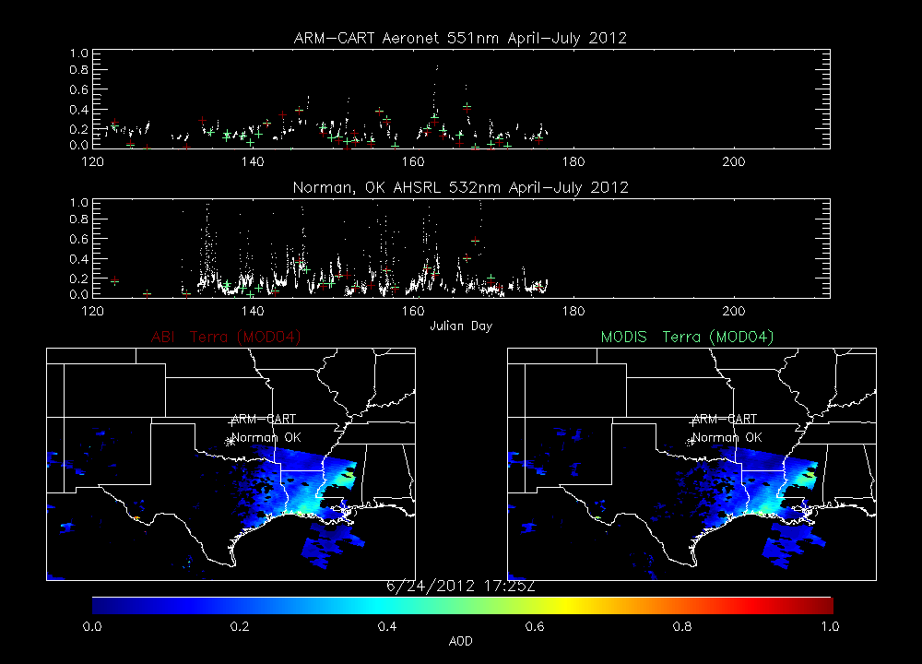
17:25 on June 24, 2012:
MODIS and ABI underestimate relative to AHSRL is associated with thin layer of enhanced aerosol below 1km
AM BL Growth

Slide 18
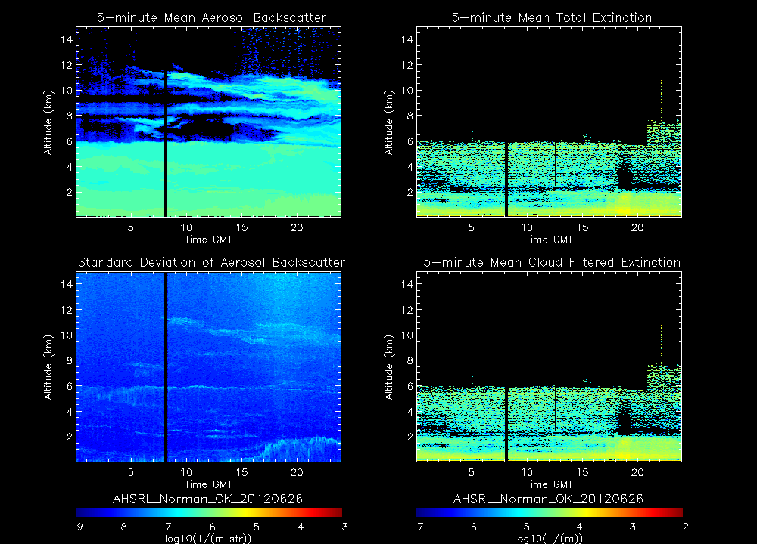
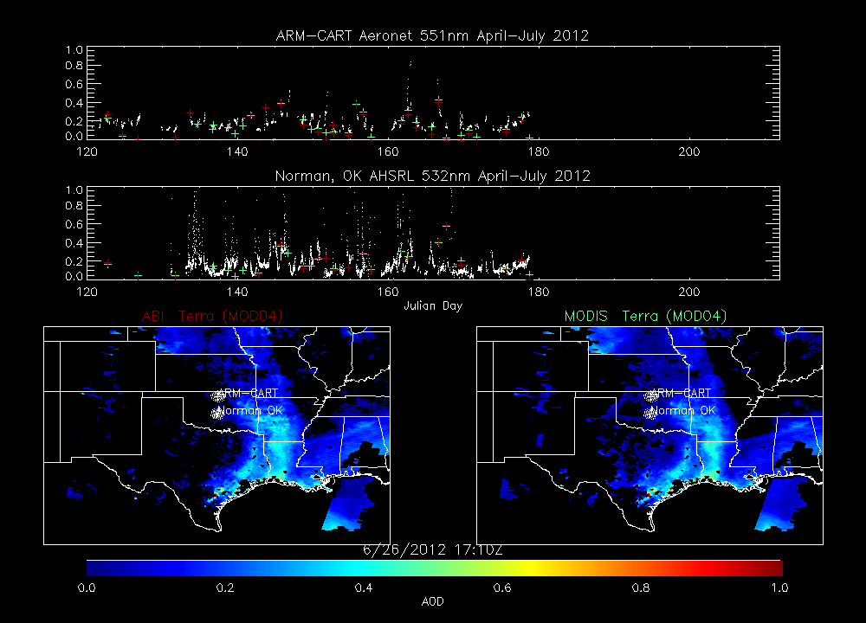
17:10 on June 26, 2012:
MODIS and ABI underestimate relative to AHSRL is associated with thin layer of enhanced aerosol below 1km
AM BL Growth

Slide 19
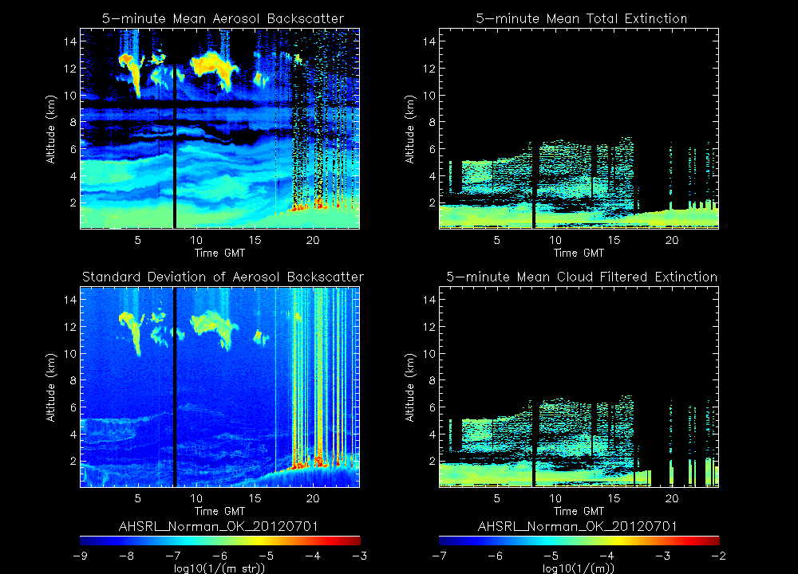
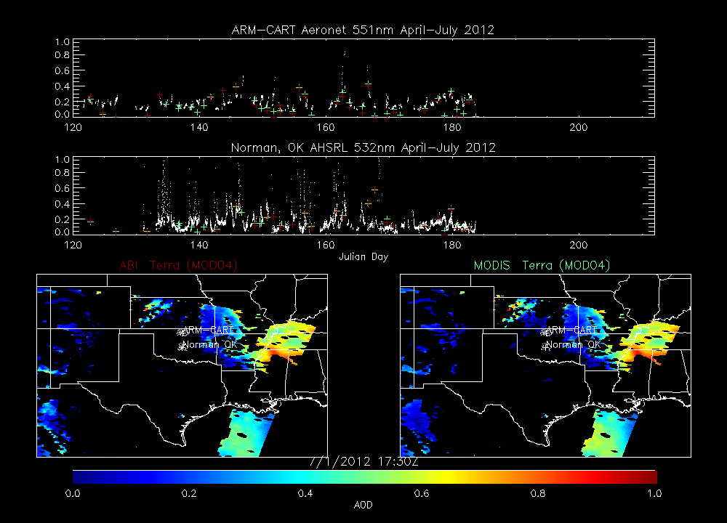
17:30 on July 1, 2012:
MODIS and ABI underestimate relative to AHSRL is associated with thin layer of enhanced aerosol below 1km
AM BL Growth

Slide 20
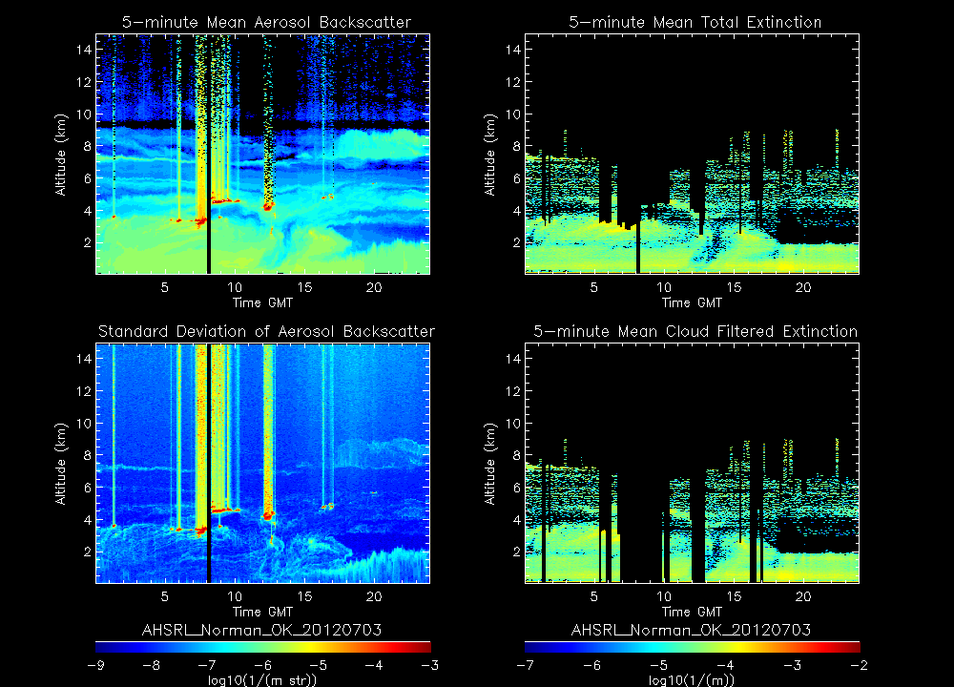
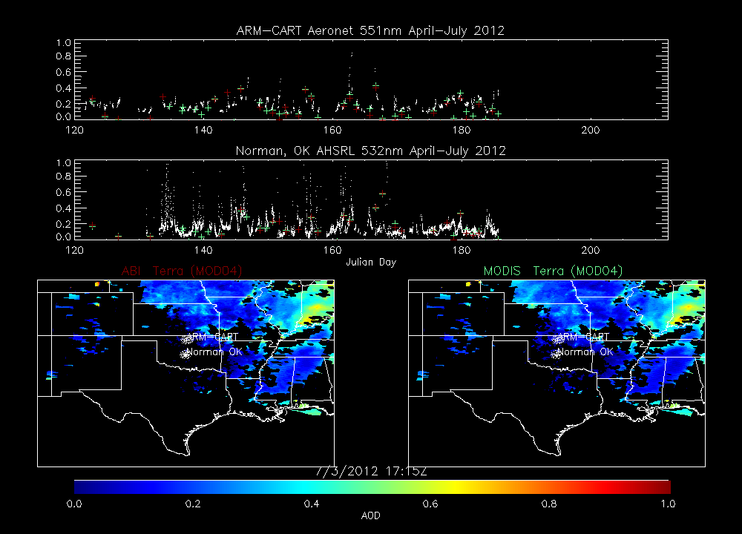
17:30 on July 1, 2012:
MODIS and ABI underestimate relative to AHSRL is associated with thin layer of enhanced aerosol below 1km
AM BL Growth

