Slide 1
Development of a Simulated Synthetic Natural Color ABI Product for GOES-R AQPG
Hai Zhang
UMBC
1/12/2012
GOES-R AQPG workshop

Slide 2
Outline
Overview of the problem and our solution
The method used in AQPG 2011 summer demo
Further improvement of the method

Slide 3
The problem for GOES-R natural color image generation
We need red, green, blue reflectance to generate natural color image
MODIS has the three channels so that it is easy for us to generate natural color images from MODIS data
GOES-R does not have a green channel
Following is a list of GOES-R visible and NIR/SWIR channels and the corresponding MODIS channels
GOES-R channel number | Wavelength range (μm) | Central wavelength (μm) | MODIS channel number
1 | 0.45-0.49 | 0.47 | 3
2 | 0.59-0.69 | 0.64 | 1
3 | 0.846-0.885 | 0.865 | 2
4 | 1.371-1.386 | 1.378 | 5
5 | 1.58-1.64 | 1.61 | 6
6 | 2.225-2.275 | 2.25 | 7

Slide 4
Our solution
Use MODIS data to find the relationship of reflectance in green channel to the other channels
The relationship can be different for different types of surface, atmospheric condition, and different for different seasons, sun-satellite geometry …
Land
Ocean
Cloud
Aerosol
Apply the relationship on GOES-R data to derive green reflectance from the channels available

Slide 5
Land surface reflectance generation
Land surface reflectance varies for different satellite-sun geometry. Such variation can be modeled by BRDF (bidirectional reflection distribution function)
MODIS land surface BRDF product
The product is derived using 16 days of MODIS data and updated every 8 days
The 6 channels corresponding to GOES-R visible/NIR/SWIR channels and the green channel
With BRDF data, we can calculate land surface reflectance in any sun-satellite geometry
For the summer 2011 demo, the satellite is assumed to be located at 75°W above equator, which is the position of GOES-East.

Slide 6
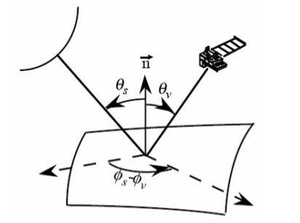
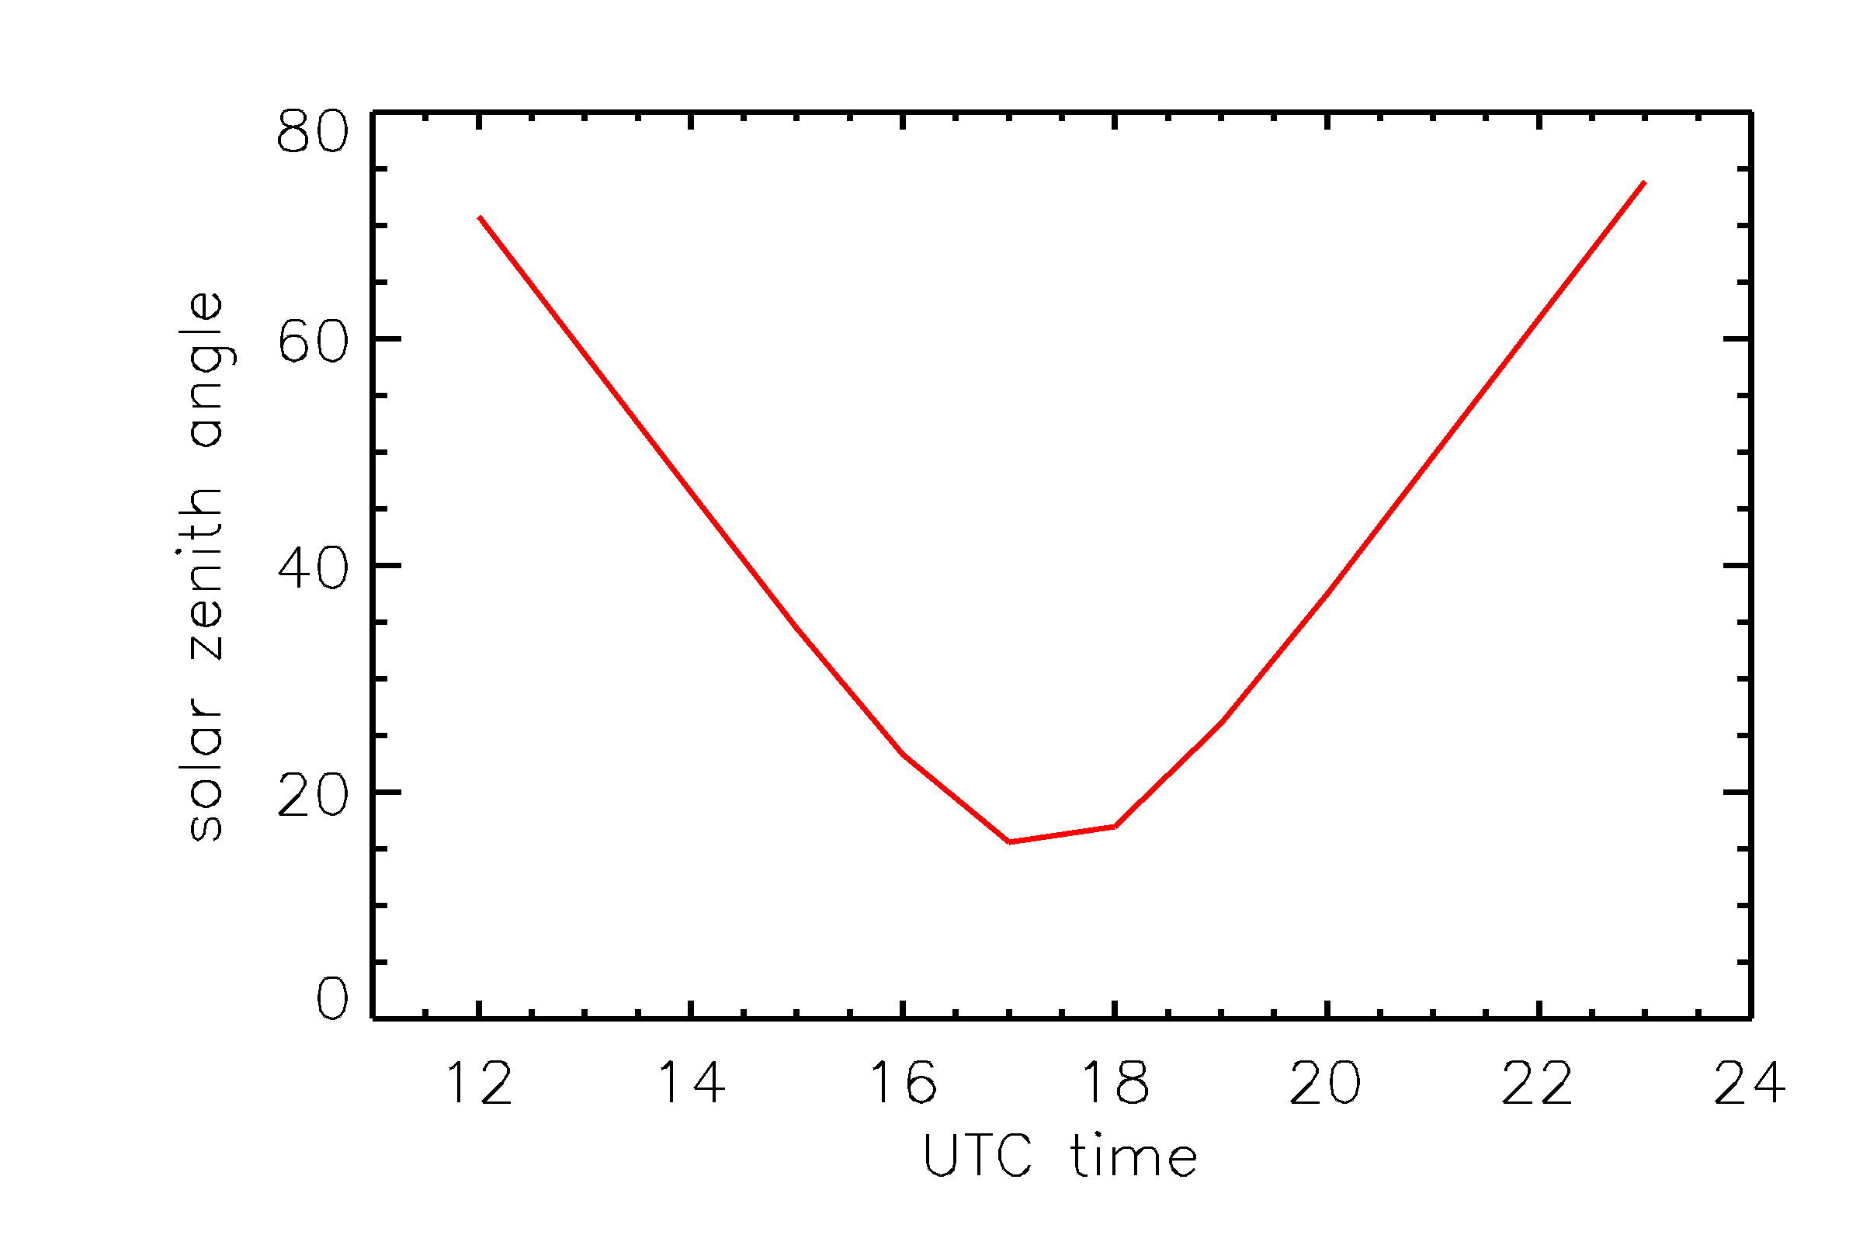
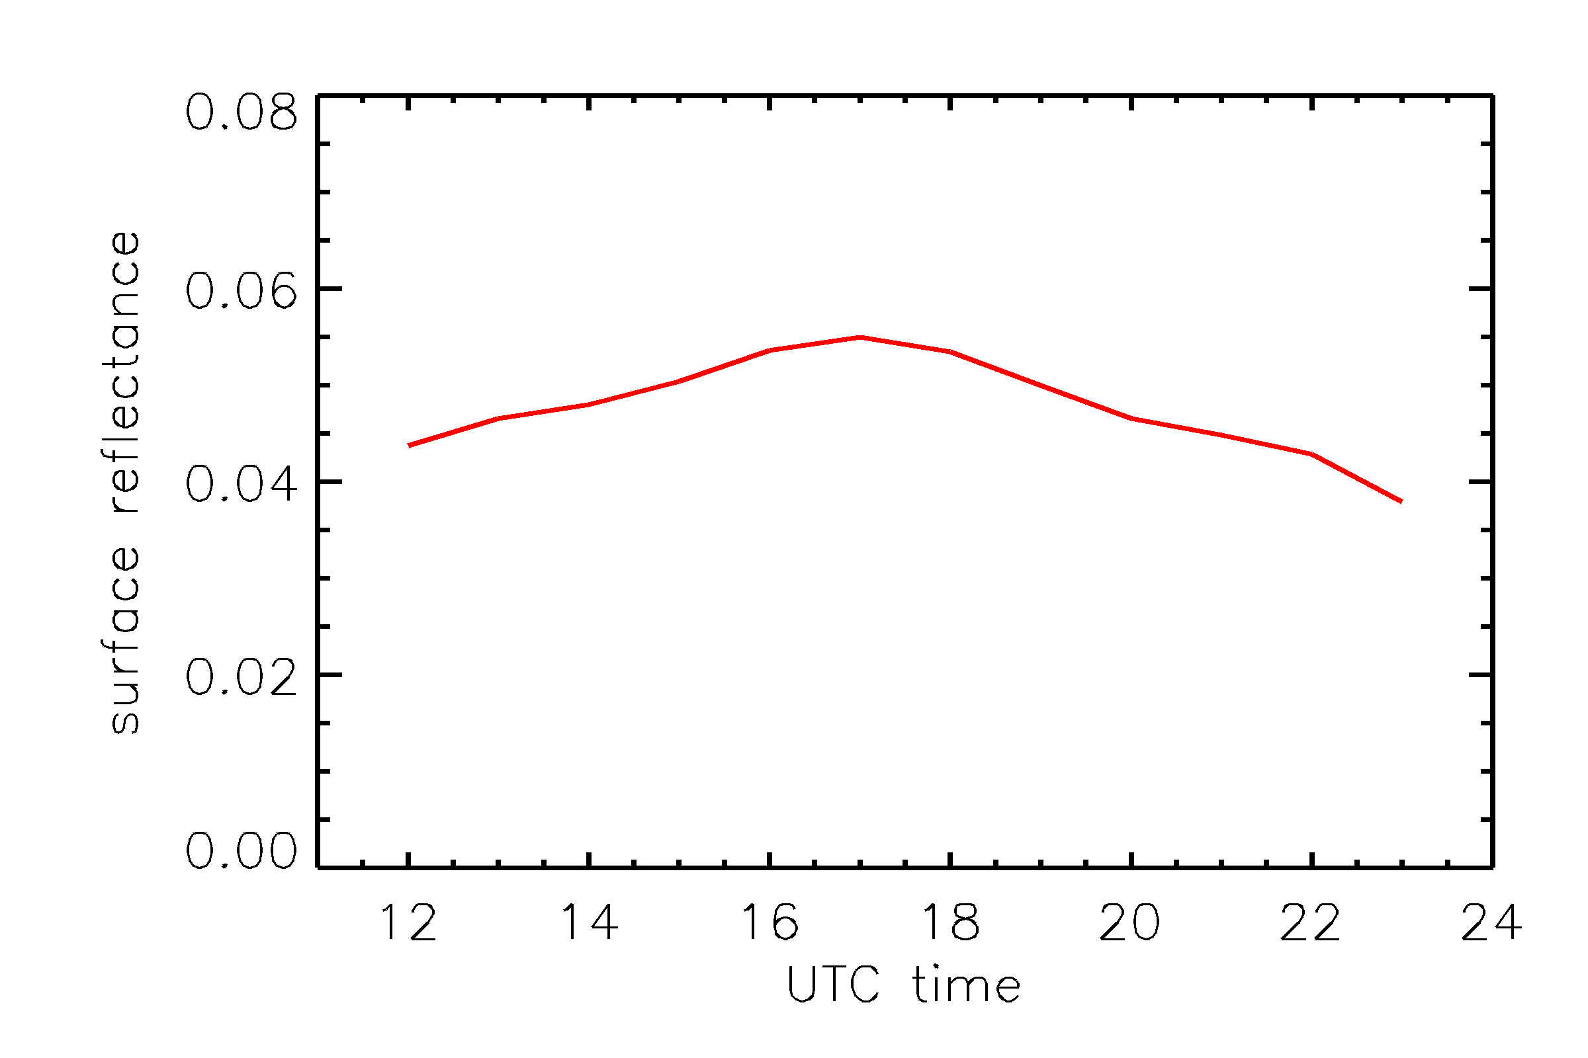
Surface reflectance vs. Sun-satellite geometry for GOES – an example
Satellite angles are fixed, solar angles change during a day
A selected pixel in the eastern US:
Satellite is fixed (relative to pixels on Earth)
Sun moves
θ_{s} : Solar zenith angle, changes
θ_{v} : Satellite zenith angle, fixed
φ_{s}- φ_{v} :Relative azimuth angle, changes

Slide 7
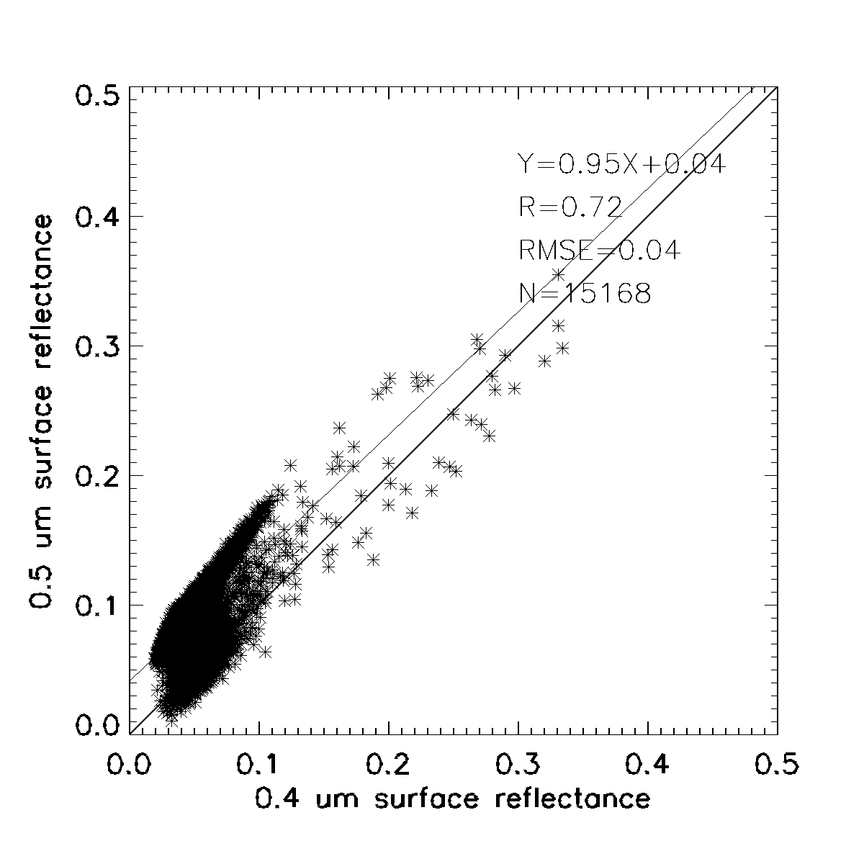
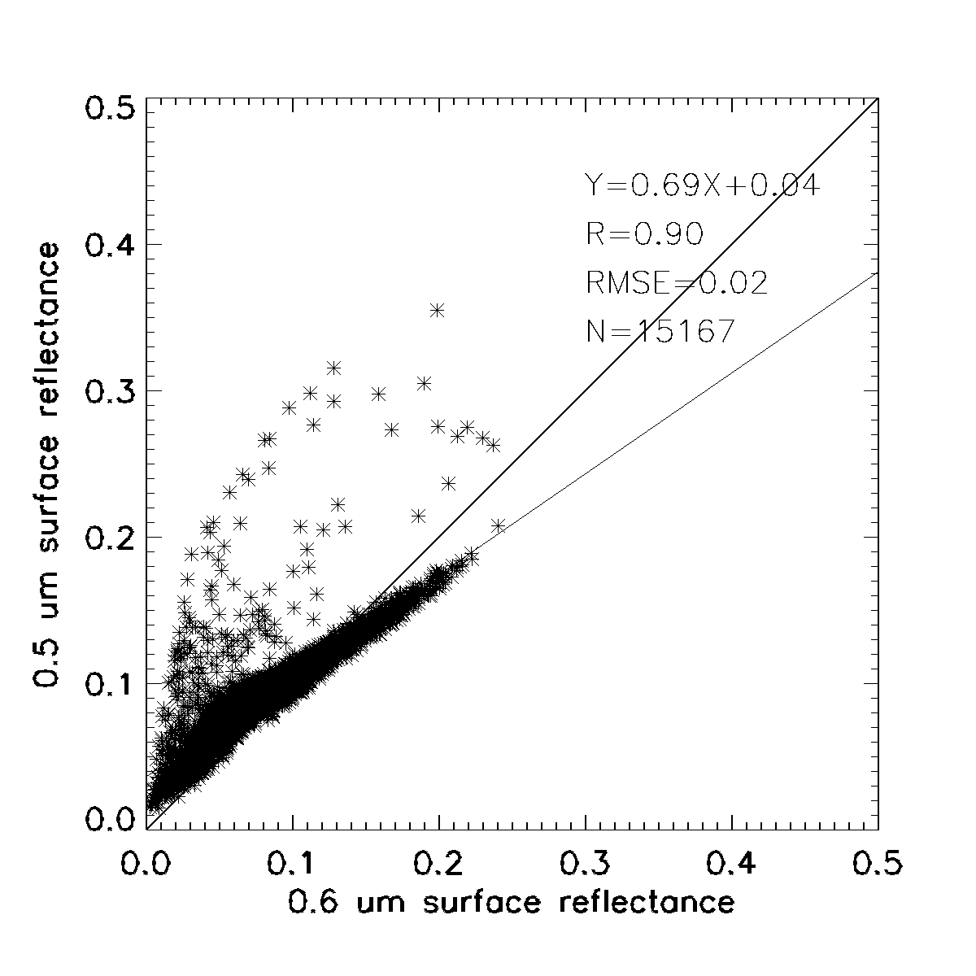
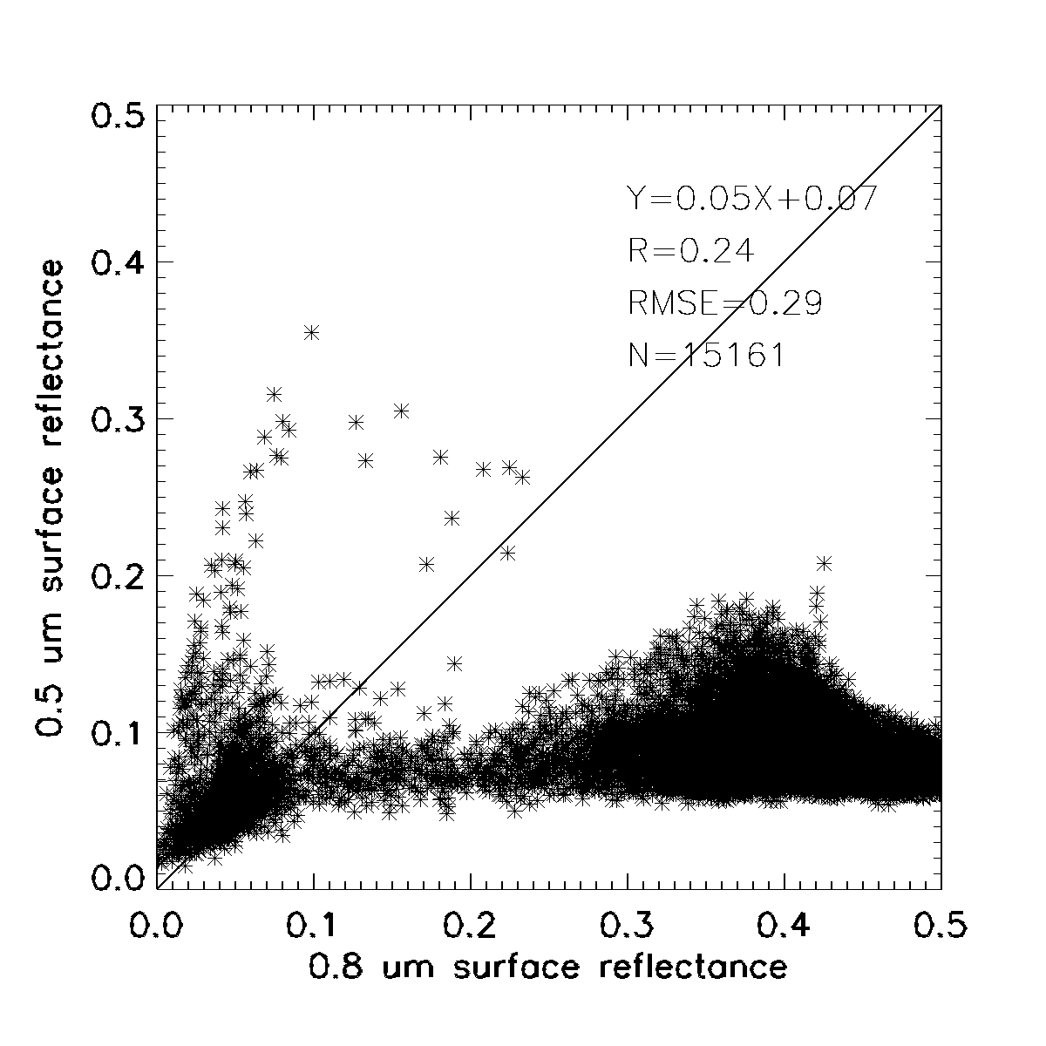
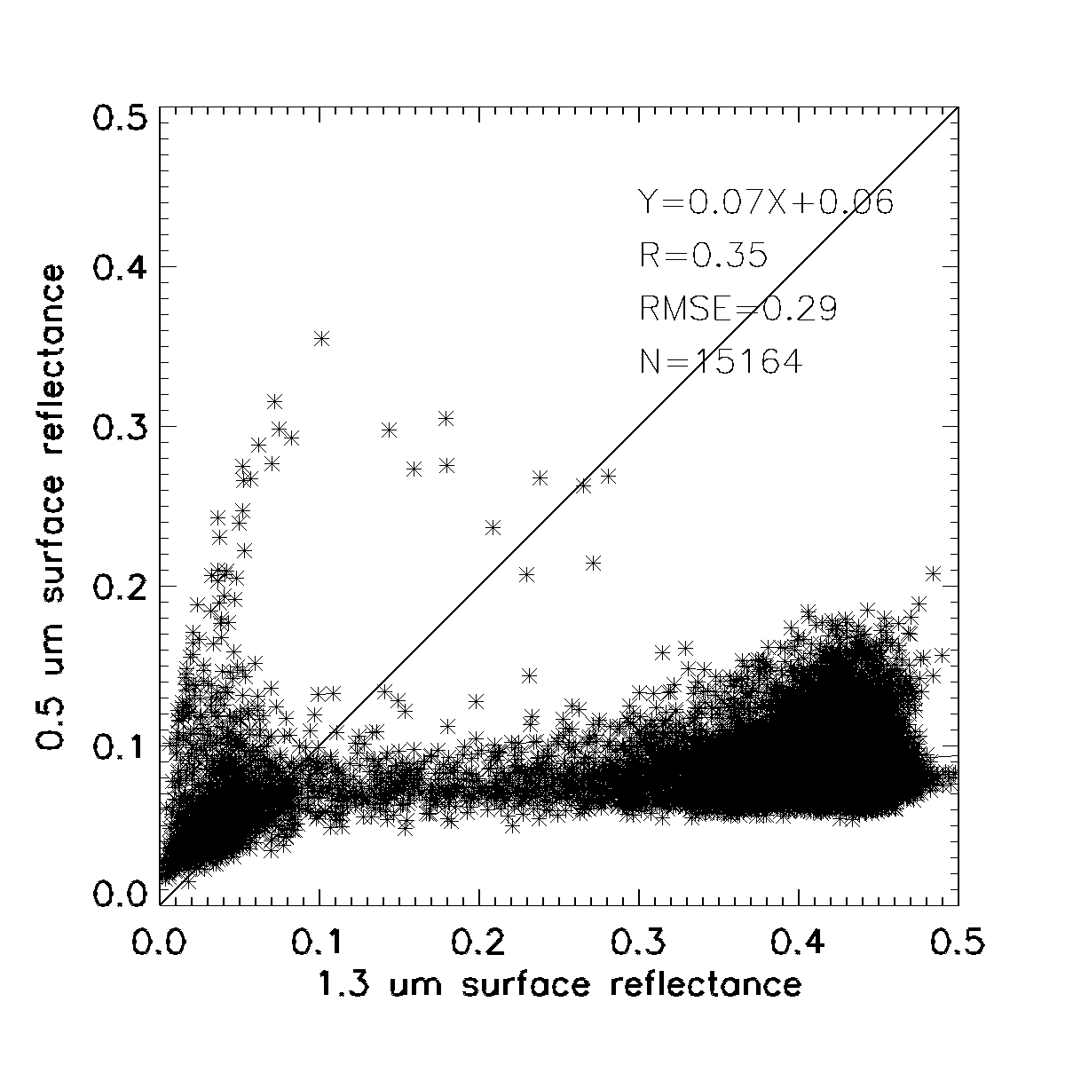
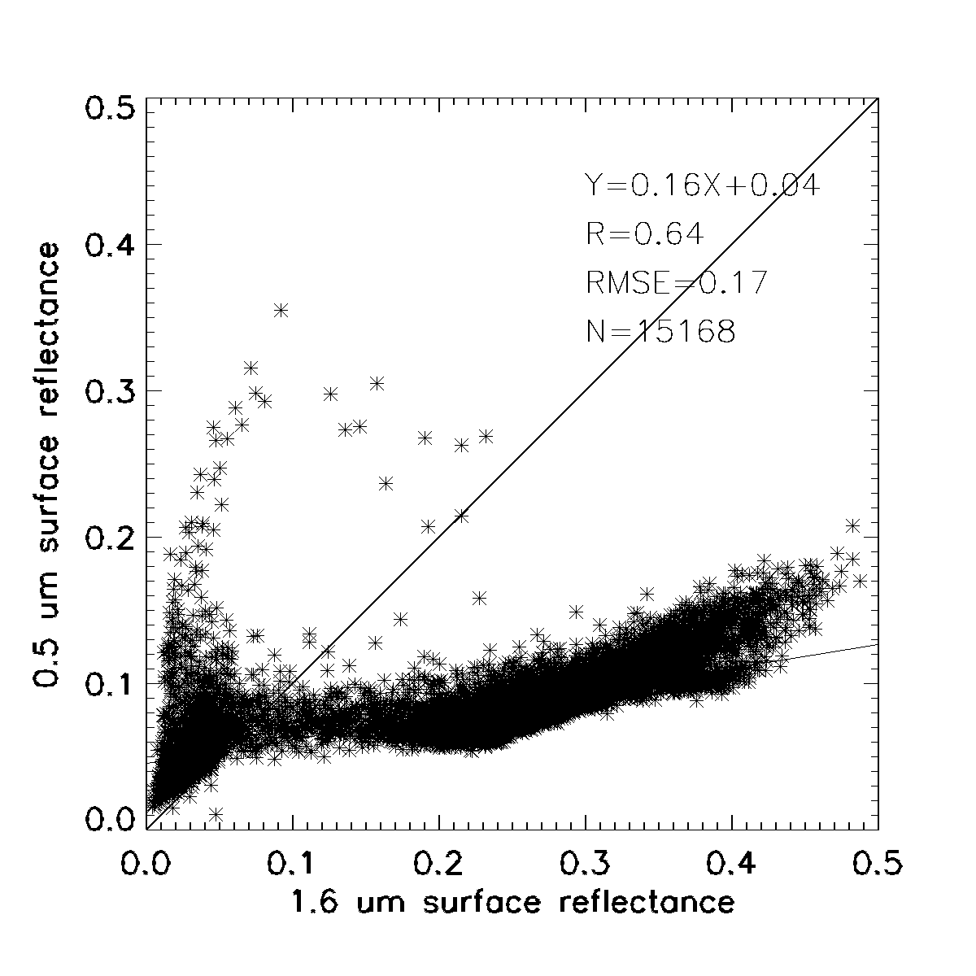
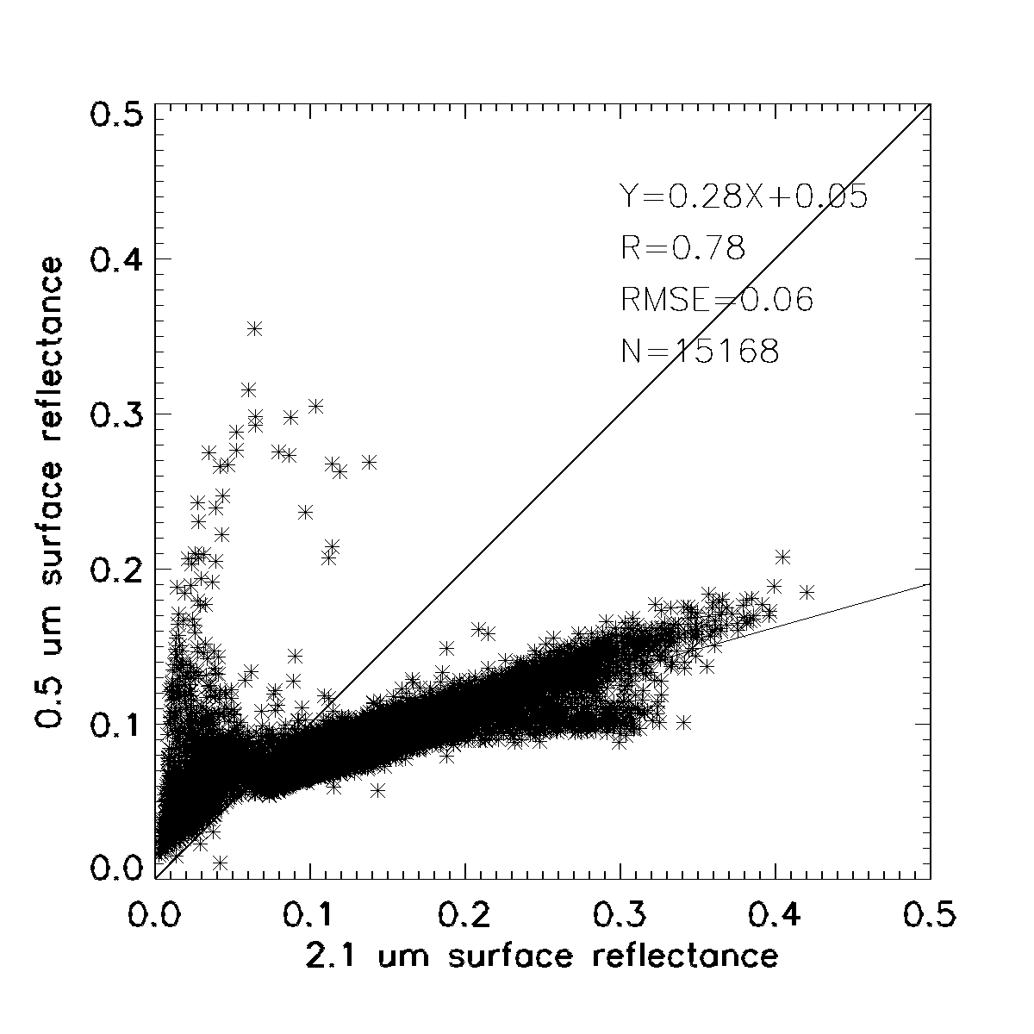
Scatter plots between green and GOES-R bands on land surface southeastern US area (summer 2011 demo)
The red channel has the best correlation with the green channel: 0.9

Slide 8
Natural color generation land for land surface (summer 2011 demo)
Land surface using derived green
Red=MODIS red
Green= 0.69*red+0.04
Blue=MODIS blue
MODIS RGB land surface

Slide 9
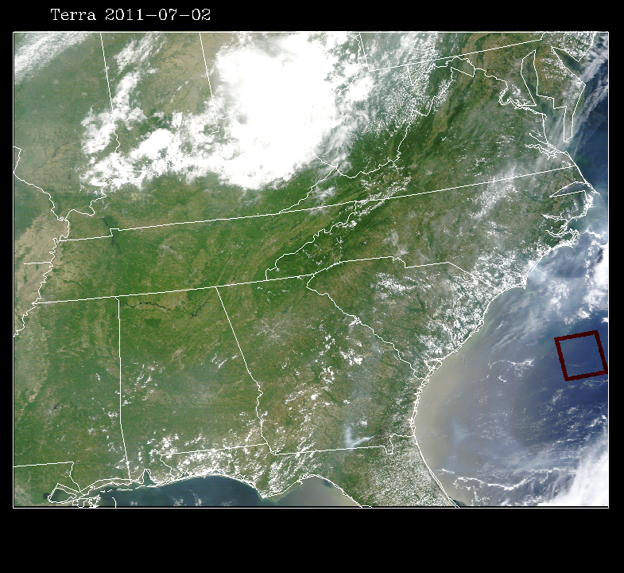
Ocean surface
Use a Rayleigh corrected MODIS scene to get relation on ocean surface

Slide 10
Algorithm flow chart for summer 2011 demo
Income GOES-R TOA reflectance proxy data
Rayleigh correction
Land surface?
No
Green=red×1.07+0.01
Natural color image generation
Yes
Green=red×0.69+0.04
Derived green
Output image

Slide 11
An example of natural color image animation from GOES-R proxy data (2011-7-26)

Slide 12
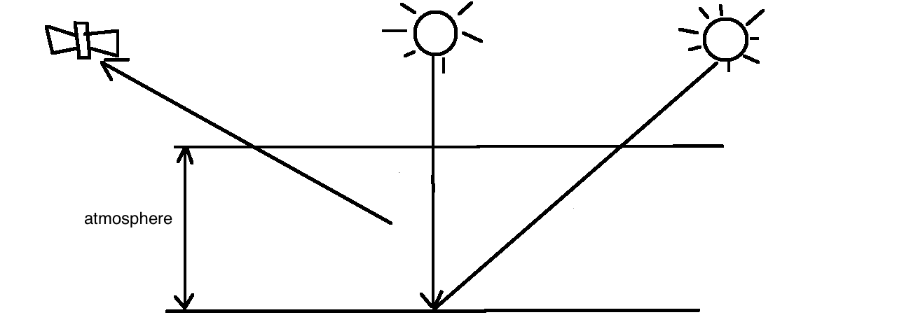
Explanation of image blurriness in the early morning and in the late afternoon
noon
TOA reflectance observed from satellite contains contribution from the surface and the atmosphere
The atmosphere contains aerosols even in clear days
In the early morning and late afternoon, solar zenith angle is large and hence the light
passes through more air mass or aerosols than at the noon.
Early morning
or late afternoon
Short path
through atmosphere
Long path through
atmosphere
surface
AOD=0.1
AOD=0.0
Atmosphere
contribution
Surface
contribution

Slide 13
Further improvement
The regression between red and green can be different
Different surface type
Different season
Different time during a day
Add blue channel
Can we improve?
Cloud and aerosol

Slide 14
Improvement #1: Land surface over US
Use MODIS BRDF to calculate surface reflectance at GOES-East geometry
Divide surface into 1°× 1° area
Investigate the linear regression relation between red and green for each area, season and time in a day
Build look-up-table (LUT)
Slope, intercept for each area, day in a year, time of a day
Use the LUT and input red signal to derive green

Slide 15
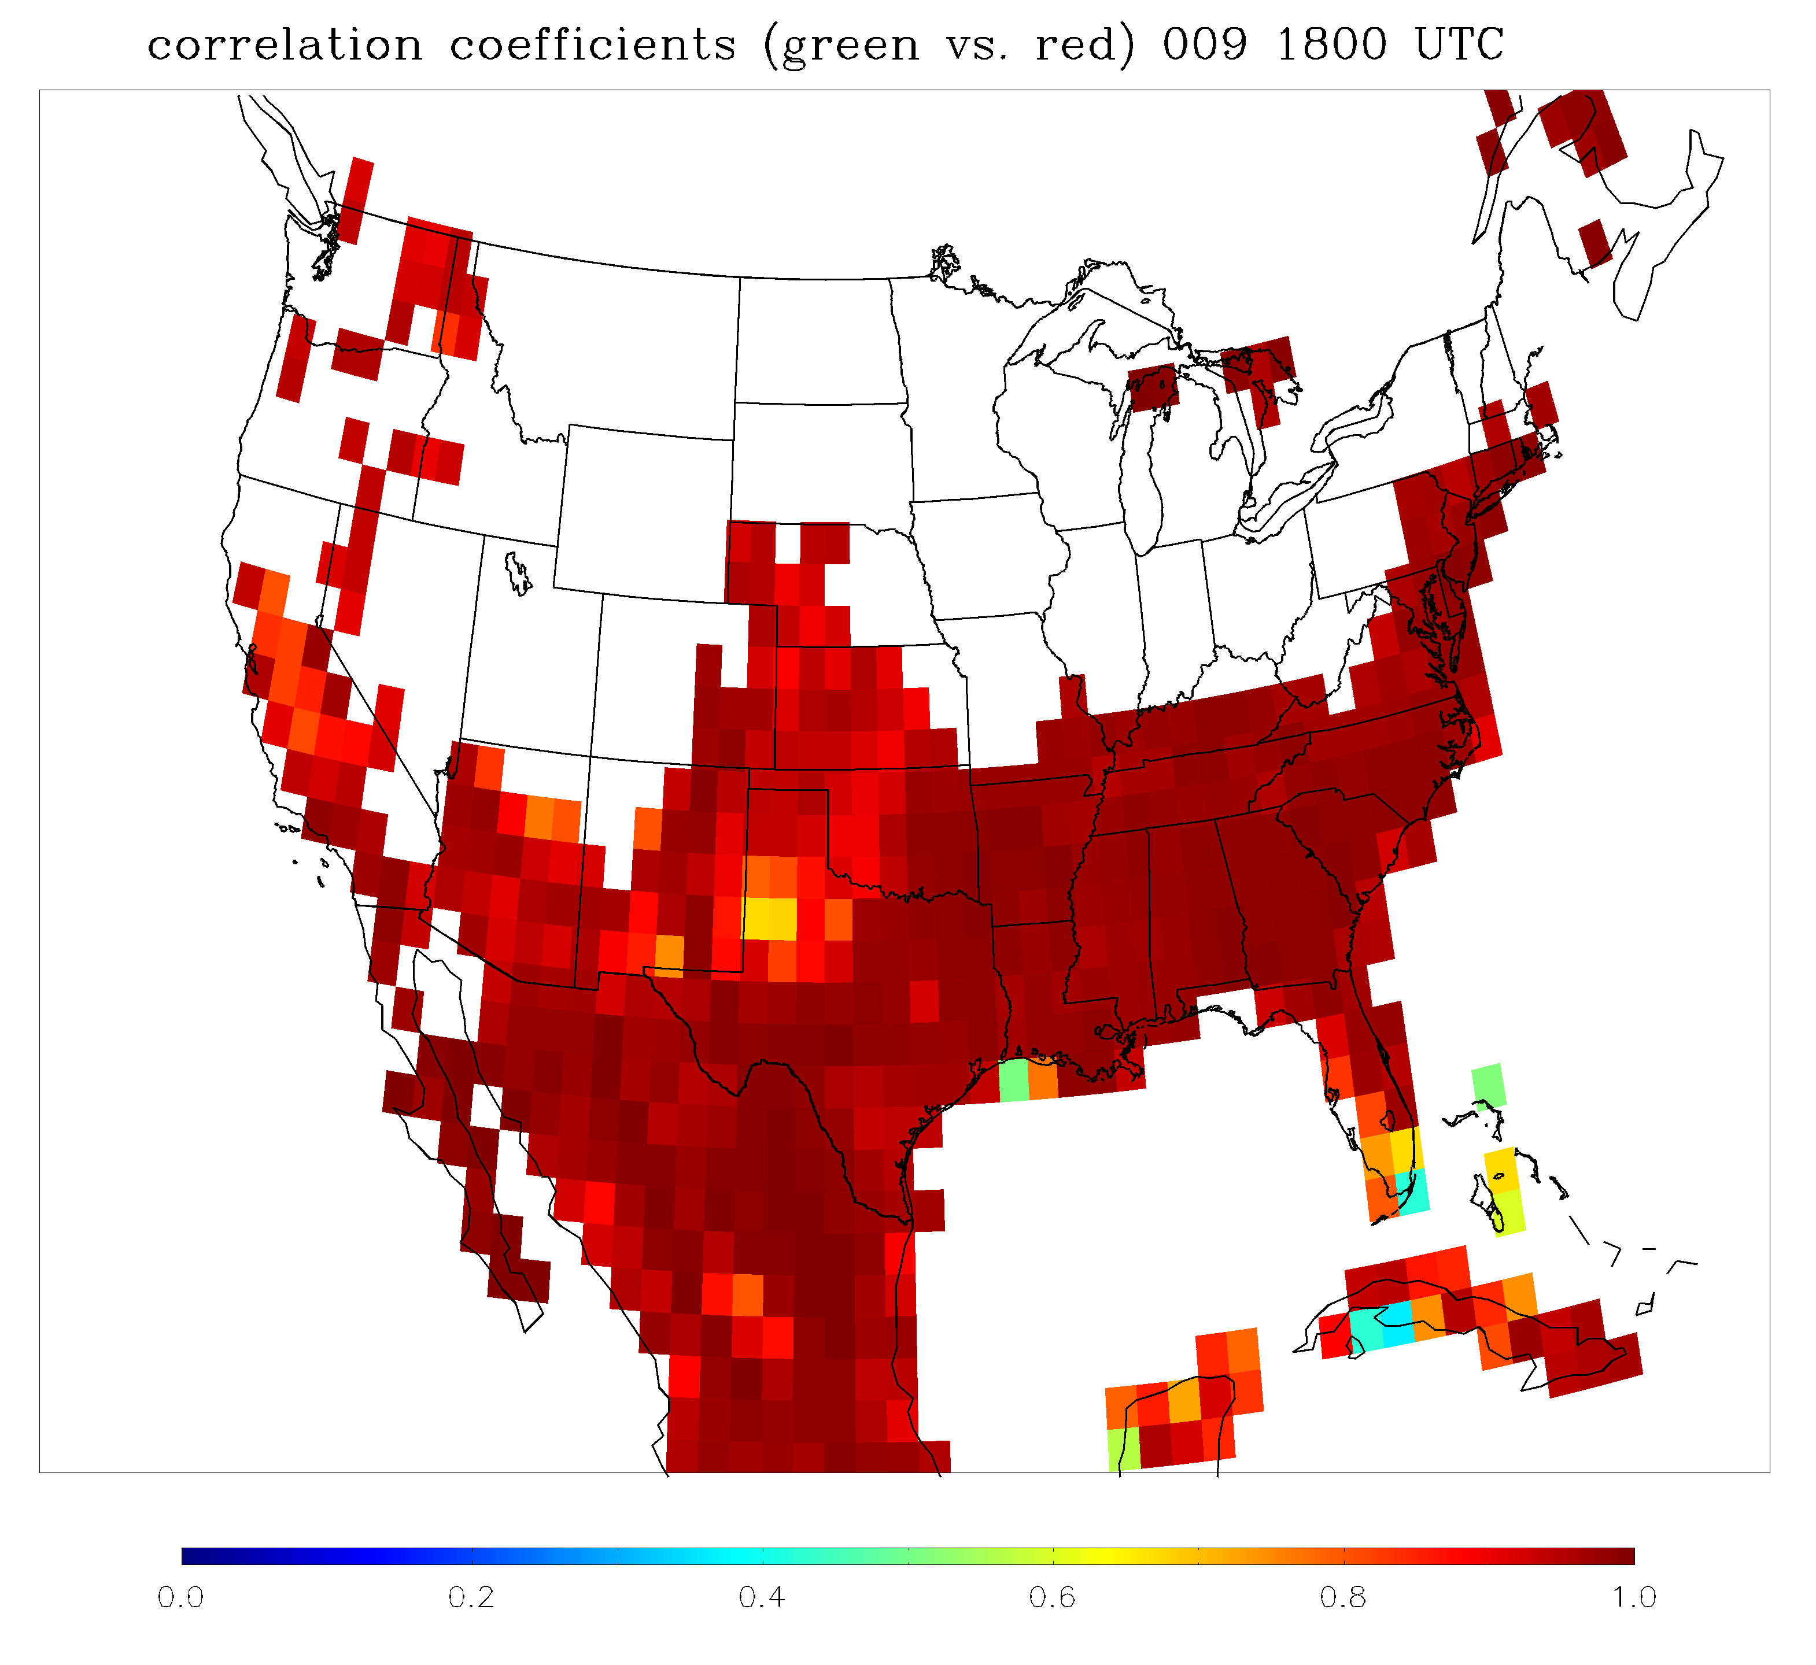
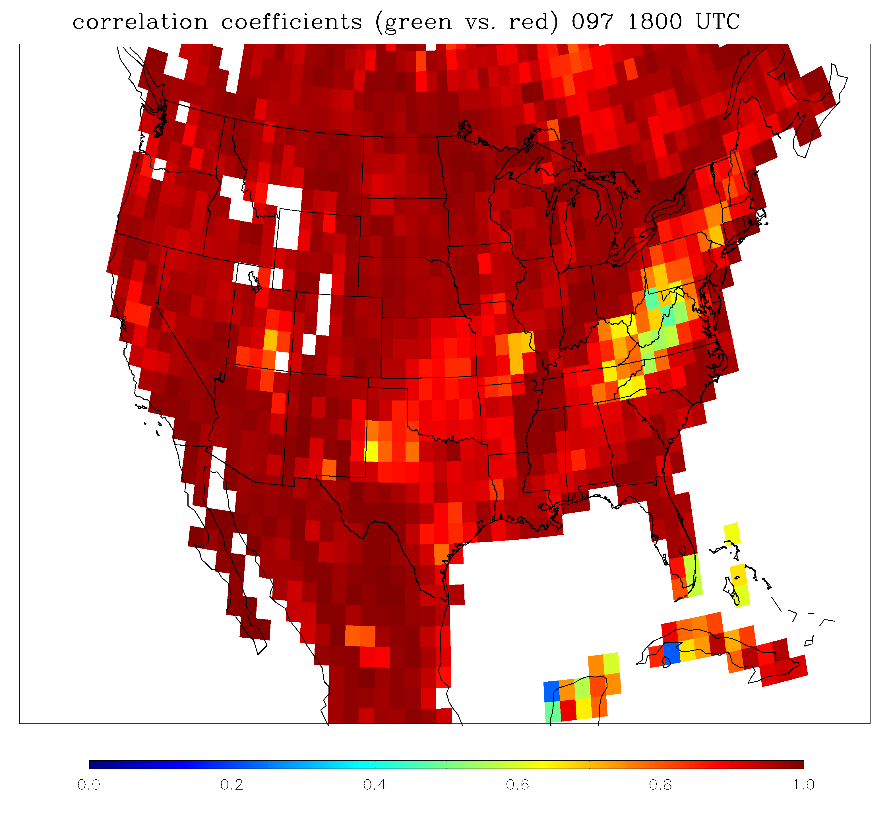
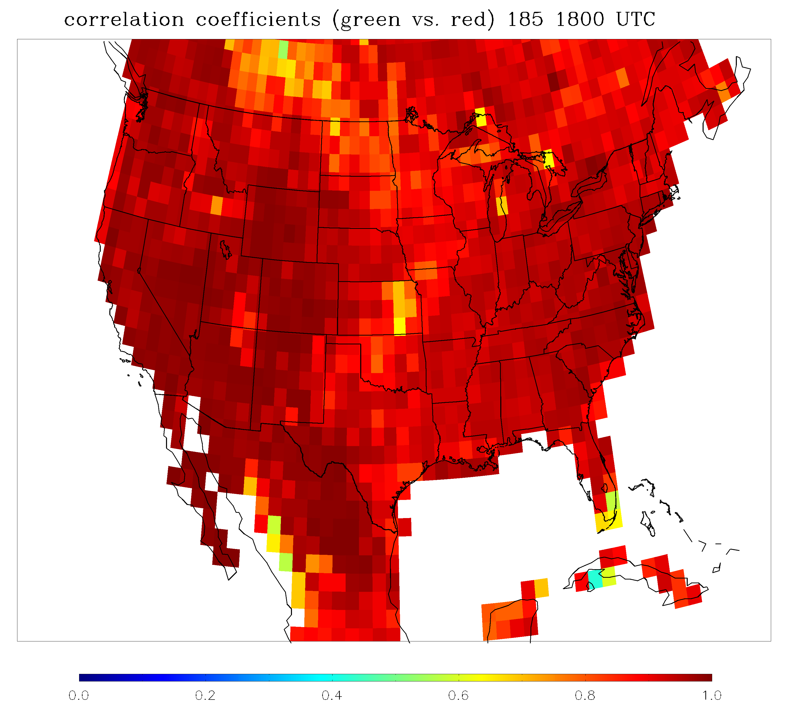
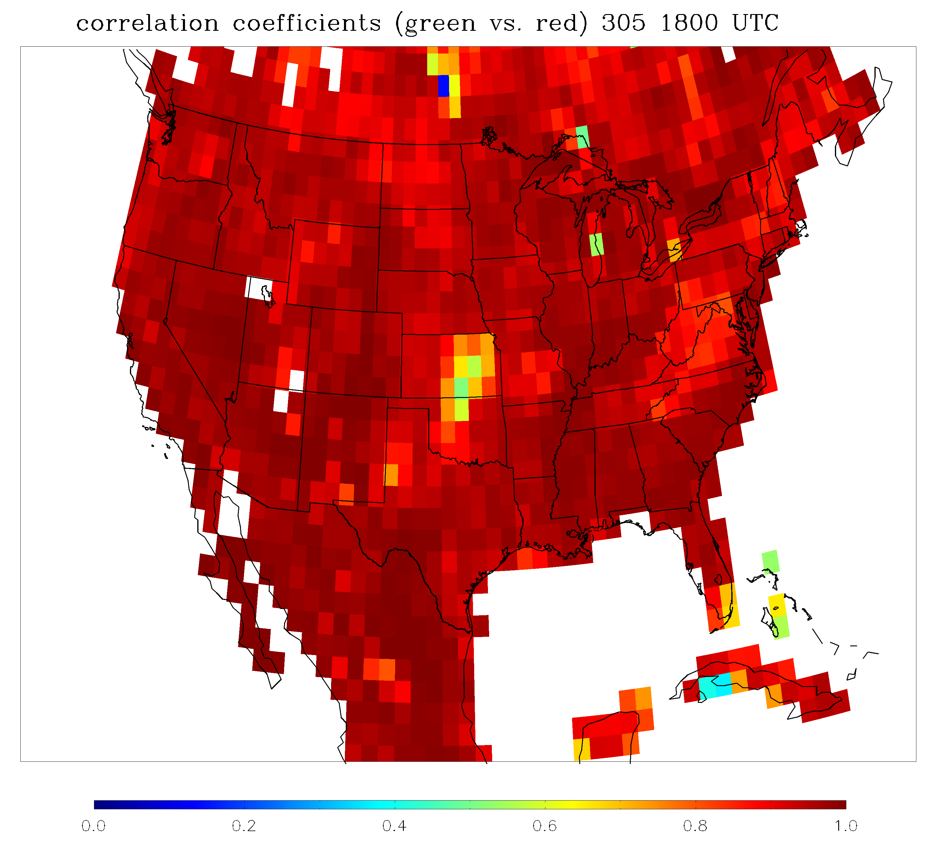
Seasonal change – correlation coefficient
Mostly above 0.9
winter
spring
0.0 0.5 1.0
0.0 0.5 1.0
0.0 0.5 1.0
summer
fall
0.0 0.5 1.0
0.0 0.5 1.0

Slide 16
Improvement #2: Add reflectance in blue channel
Assume the relation to be: green=A₁×red+A₂×blue+B
Repeat the same procedure as for red to build LUT
LUT include two slopes (A₁ and A₂) and one intercept (B) for different area, season, time of the day

Slide 17
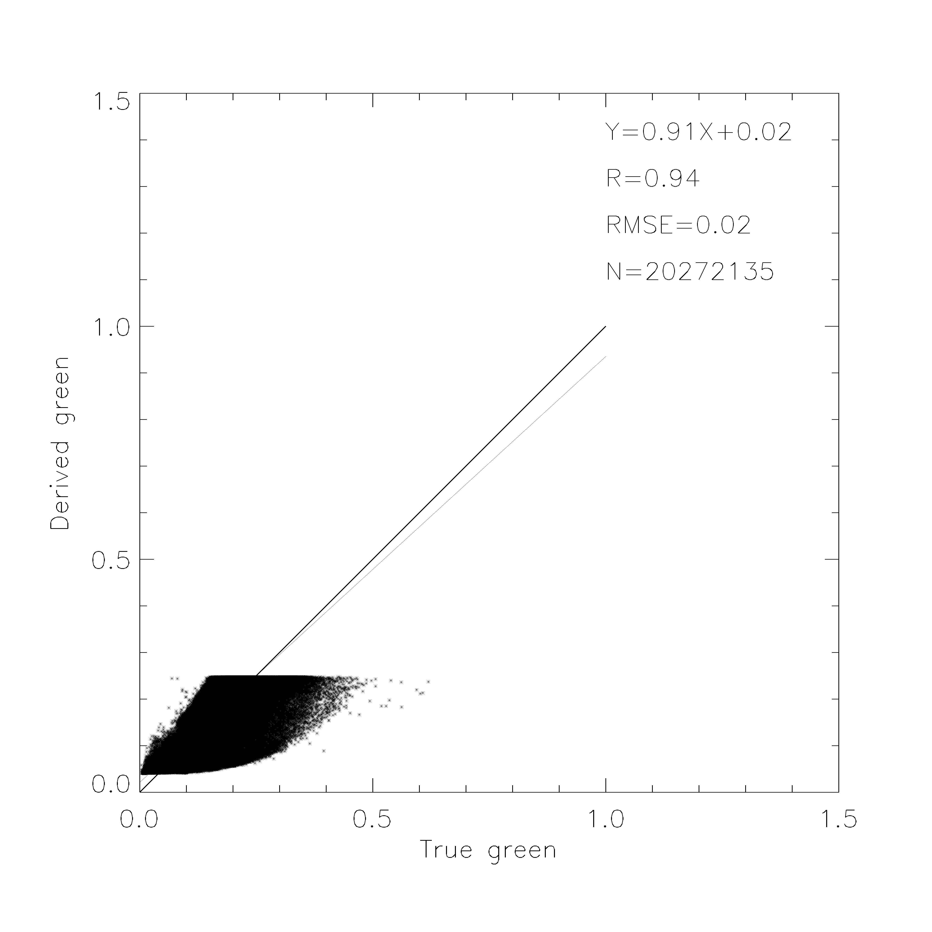
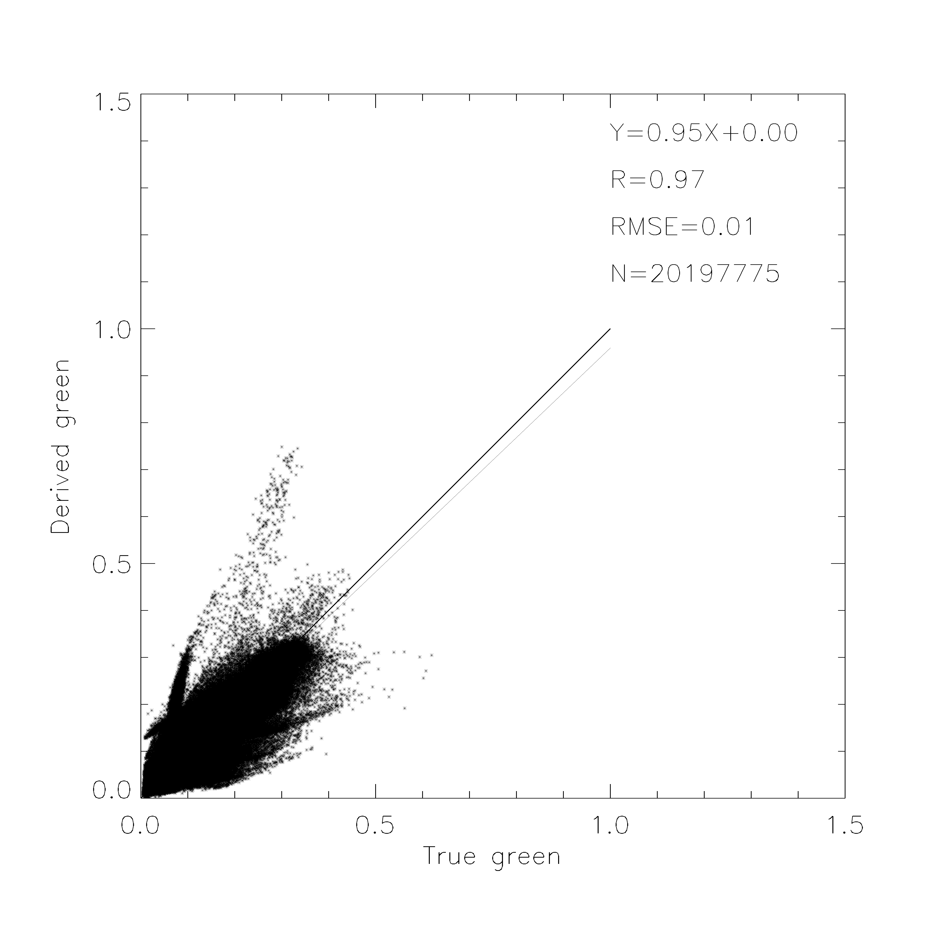
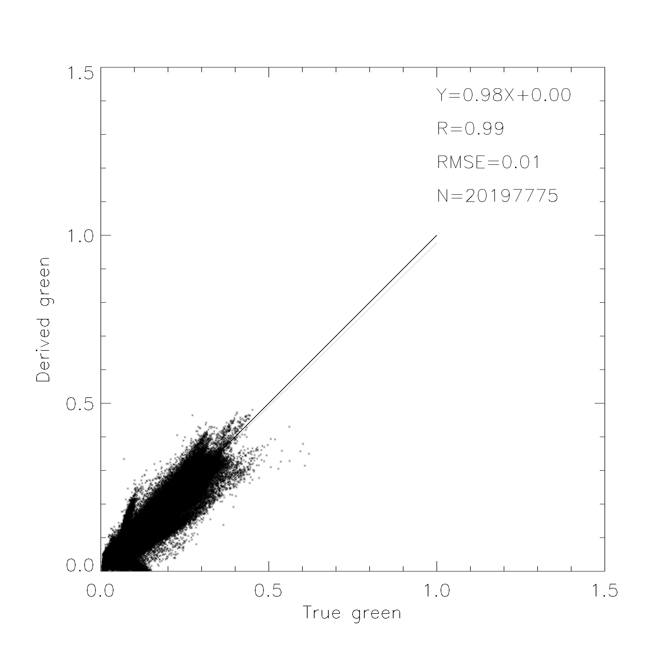
Comparison of the original and two improvements
Only apply the relation to surface reflectance in red less than 0.3
The comparison is over the whole US on day 137
green=0.69*red+0.04
Use red LUT
Use red and blue LUT

Slide 18
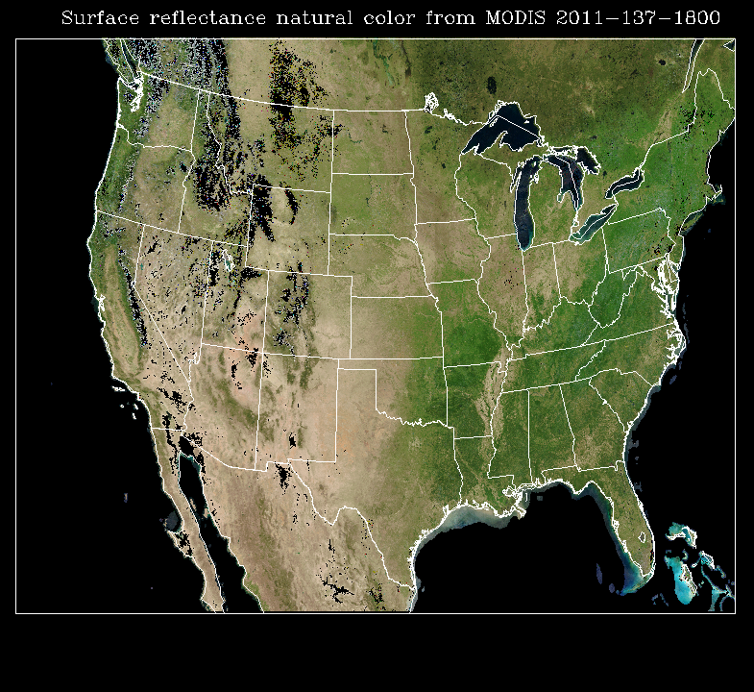
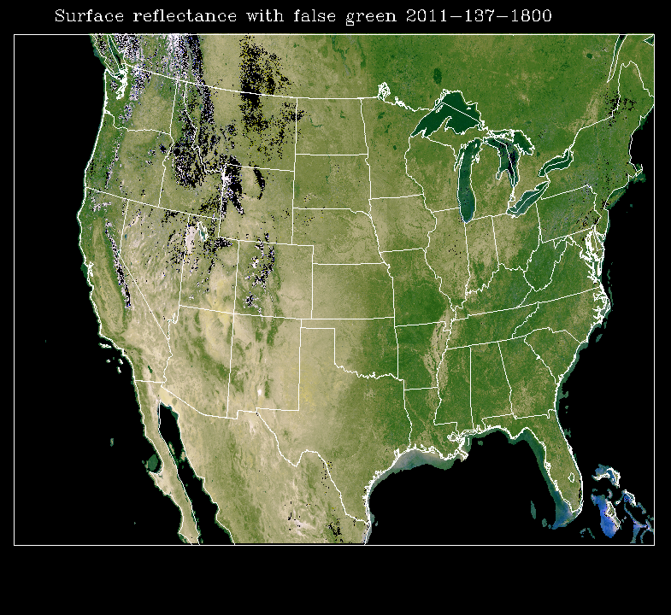
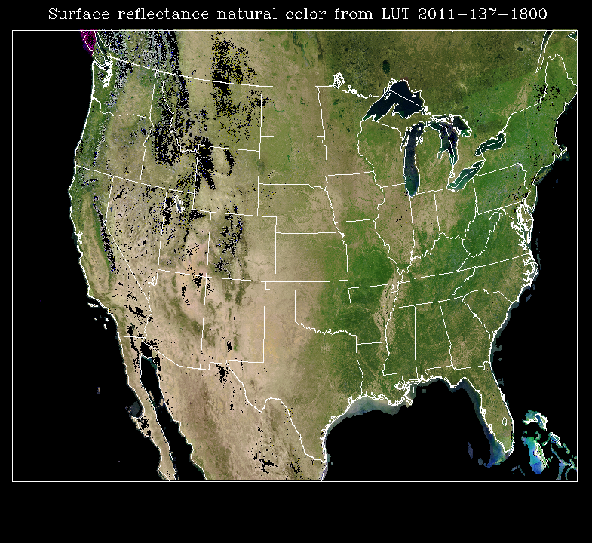
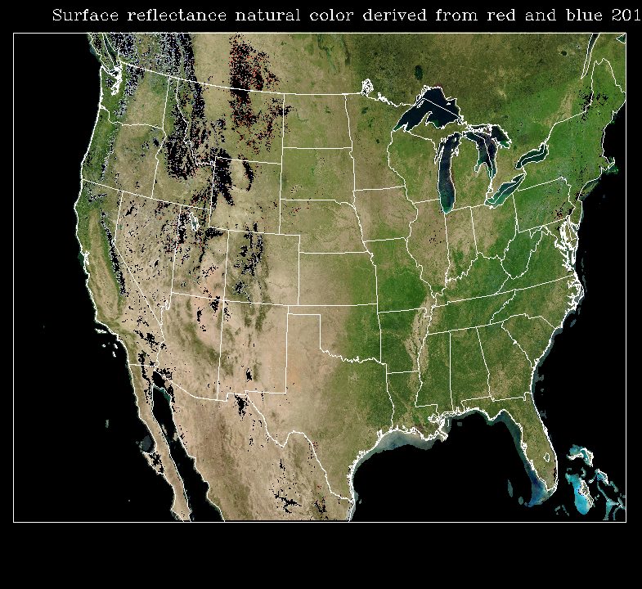
True color
Green=0.69*red+0.04
Natural color using derived green from LUT with red channel
Natural color using derived green from LUT with red and blue channel

Slide 19
Algorithm flow chart for improved method
Income GOES-R TOA reflectance proxy data
Rayleigh correction
Cloud with reflectance > 0.3?
No
Land surface?
No
Green=red×1.07+0.01
Yes
Yes
Green=redx0.96+0.02
Derive green from LUT
Derived green
Natural color image generation
Output image

Slide 20
Summary
Green reflectance can be derived from red and blue channels
The relationships are verified by analyzing MODIS RGB images and data
In summer 2011 demo, we use a fixed relationship to derive green reflectance from red
We improved the method:
Over land surface, we build LUT based on MODIS BRDF
Over ocean and clouds, we use fixed relation with red

