Slide 1
GOES-R Proving Ground
Steve Goodman and Jim Gurka
NOAA/NESDIS/GOES-R Program
Chief Scientist Office
AQPG Workshop, UMBC MD
September 14, 2010

Slide 2
Contributors
Timothy Schmit
NOAA/NESDIS/Center for Satellite Applications and Research, Madison, WI
Mark DeMaria and Daniel Lindsey
NOAA/NESDIS/Center for Satellite Applications and Research, Fort Collins, CO
Geoffrey Stano and Richard Blakeslee
NASA/MSFC Short-term Prediction Research and Transition (SPoRT) Center, Huntsville, AL
Russell Schneider and Chris Siewert
Cooperative Institute for Mesoscale Meteorological Studies, NOAA/NWS/Storm Prediction Center, Norman, OK
Donald MacGorman and Kristin Kuhlman
NOAA/ Office of Atmospheric Research/ NSSL
Wayne Feltz
Cooperative Institute for Meteorological Satellite Studies (CIMSS)

Slide 3
Outline
GOES-R Mission
What is the GOES-R Proving Ground?
Examples of GOES-R Proxy Products at:
Cooperative Institutes
SPC Spring Experiment
NHC 2010 Hurricane Season
AWG Issues
Summary

Slide 4
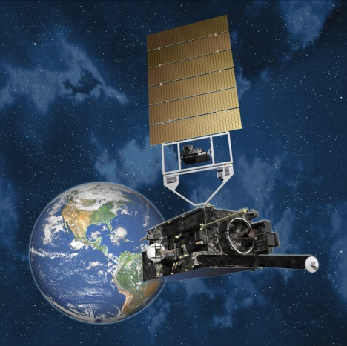
Continuity of GOES Operational Satellite Program
Calendar Year
As of May 10, 2010
07
08
09
10
11
12
13
14
15
16
17
18
19
20
21
22
23
24
25
26
27
28
29
30
31
32
33
34
35
36
GOES-11
GOES West
GOES-12*
Transitioning to South American Operations
GOES-13
GOES East
GOES-14
On-orbit spare
GOES-15
In post launch checkout
GOES-R
GOES-S
GOES-T
GOES-U
Satellite is operational
beyond design life
On-orbit GOES storage
* Backup and South American Coverage beginning June 2010
Operational
Future Options

Slide 5
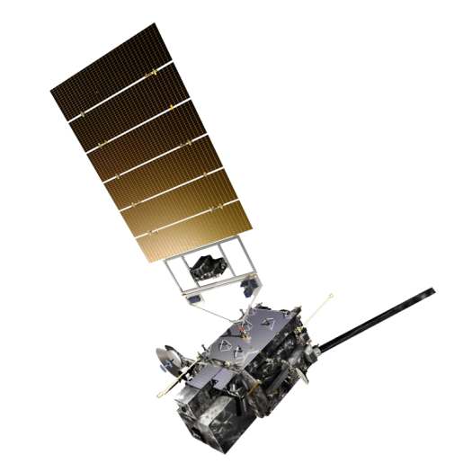
GOES-R Spacecraft
Specifications
Size: ~5.5 meters (from launch vehicle interface to top of ABI)
Mass: Satellite (spacecraft and payloads) dry mass <2800kg
Power Capacity: >4000W at end-of-life (includes accounting for limited array degradation)
Extreme UV/X-ray Irradiance Sensor (EXIS)
Solar UV Imager (SUVI)
Magnetometer
Space Environment In-situ Suite (SEISS)
Current Status
Lockheed-Martin Space Systems Co (LMSSC) began work on July 22, 2009
Spacecraft System Definition Review (SDR) completed March 9-10, 2010
Conducted Integrated Baseline Review (IBR) Apr 27, 2010
Geostationary Lightning Mapper (GLM)
Advanced Baseline Imager (ABI)
Unique Payload Services:
High Rate Information Transmission/Emergency Managers Weather Information Network (HRIT/EMWIN)
Data Collection System (DCS)
Search and Rescue Satellite Aided Tracking (SARSAT) Repeater
GOES-R Re-Broadcast (GRB)

Slide 6
GOES-R OPERATIONAL PRODUCTS
BASELINE (25)
OPTION 2 (34)
Clouds and Moisture Imagery
Clear Sky Mask
Temperature and Moisture Profiles
Total Precipitable Water
Stability Parameters (Lifted Index)
Cloud Top Pressure and Height
Cloud Top Phase
Cloud Particle Size Distribution
Cloud Optical Path
Rainfall Rate
Aerosols Optical Depth
Derived Motion Winds
Hurricane Intensity
Volcanic Ash
Fire/Hot Spot Characterization
Land and Sea Surface Temperature
Snow Cover
Downward Surface Insolation
Lightning Detection
Cloud Layer/Heights
Cloud Ice Water Path
Cloud Liquid Water
Cloud Type
Convective Initiation
Turbulence
Low Cloud and Fog
Visibility
Surface Albedo
Upward and Downward Longwave Radiation
Reflected and Absorbed Shortwave Radiation
Total Ozone
SO2 Detections (Volcanoes)
Surface Emissivity
Aerosol Particle Size
Vegetation Index
Vegetation Fraction
Snow Depth
Flood Standing Water
Rainfall probability and potential
Enhanced “V”/Overshooting Top
Aircraft Icing Threat
Ice Cover
Sea & Lake Ice Concentration, Age, Extent, Motion
Ocean Currents (vectors)
Advanced Baseline Imager (ABI)
Advanced Baseline Imager (ABI)
GLM

Slide 7
What is the GOES-R Proving Ground?
Collaborative effort between the GOES-R Program Office, selected NOAA/ NASA Cooperative Institutes, NWS forecast offices, NCEP National Centers, and NOAA Testbeds.
Where proxy and simulated GOES-R products are tested, evaluated and integrated into operations before the GOES-R launch
A key element of GOES-R User Readiness (Risk Mitigation)

Slide 8
Proving Ground Mission Statement
The GOES-R Proving Ground engages NWS in pre-operational demonstrations of selected capabilities of next generation GOES
Objective is to bridge the gap between research and operations by:
Utilizing current systems (satellite, terrestrial, or model/synthetic) to emulate future GOES-R capabilities
Infusing GOES-R products and techniques into NWS operations with emphasis on AWIPS and transitioning to AWIPS-II.
Engaging in a dialogue to provide feedback to developers from users
The Proving Ground accomplishes its mission through:
Sustained interaction between developers and end users for training, product evaluation, and solicitation of user feedback.
Close coordination with GOES-R Algorithm Working Group (AWG) and Risk Reduction programs as sources of demonstration products, promoting a smooth transition to operations
Intended outcomes are Day-1 readiness and maximum utilization for both the developers and users of GOES-R products, and an effective transition to operations

Slide 9
PG Program Plan
Program Plan Published in Feb. 2010
http://www.goes-r.gov
Provides framework and guiding principles for PG to provide early use of GOES-R capabilities
Purpose of plan:
Document vision and objectives of PG Program and concepts
Describe overall scope and management approach
Identify key decision points and checkpoints for effective management control

Slide 10
Proving Ground Organization
Executive Board:
Steve Goodman (Chair)- NESDIS/GOES-R Senior Program Scientist
Jaime Daniels-NESDIS/STAR/GOES-R AWG
Mark DeMaria-NESDIS/STAR/ GOES-R Risk Reduction
Jim Gurka- NESDIS/GOES-R Ground Segment Project Scientist
Mike W. Johnson, NWS/OST/Programs & Planning
Tim Schmit-NESDIS/STAR/ASPB
Kevin Schrab- NWS
Gary Jedlovec-NASA SPoRT
Advisory Team:
Tony Mostek-NWS/COMET
Russ Schneider- NWS/NCEP/SPC
Gary Hufford- NWS Alaska Region
Shanna Pitter- PPI, NWS WW Goal Team
Cecilia Miner- NWS, C&T Goal Team
Steve Miller- CIRA
Wayne Feltz-CIMSS
Shobha Kondragunta-NESDIS/STAR AQ IPT

Slide 11
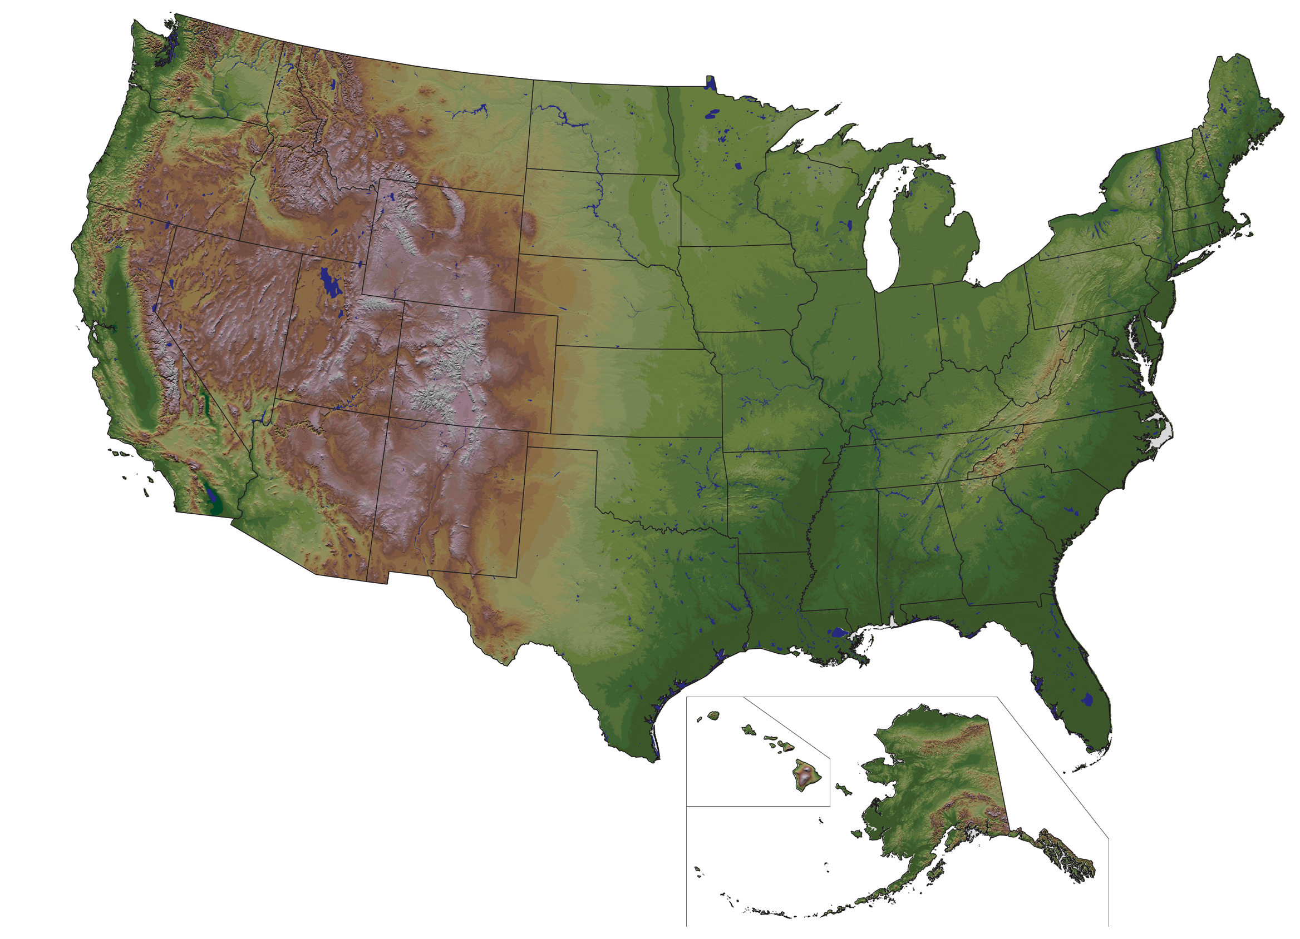
GOES-R Proving Ground Partners
75 Total Partners Preparing
Current as of December 2009
OTX
GGW
TFX
BPA
PDT
FGF
DLH
BYZ
MQT
BTV
MFR
ABR
MPX
GRB
EKA
RIW
UNR
ARX
BGM
CIMSS
MKX
CTP
ERH
REV
WRH
CYS
DMX
DVN
PBZ
UMBC
CIRA
LOT
IWX
CICS
NOAA/NWS Headquarters
(Silver Spring, MD); Center for Satellite Applications and Research; Office of Satellite Data Processing and Distribution.
GOES-R Program Office (Greenbelt, MD).
BOU
AWC/CRH
EAX
IND
LWX
EPA
MTR
AKQ
VEF
JKL
RNK
ICT
SGF
MRX
RAH
ABQ
AMA
TSA
OHX
GSP
SPC OUN
SPoRT
HUN
CAE
CHS
SRH
FWD
BMX
FFC
EPZ
MAF
MOB
3 Weather Service Offices served by the Cooperative Institute for Research in the Atmosphere (CIRA)
4 Weather Service Offices served by the Cooperative Institute for Climate and Satellites (CICS) via SPoRT
11 National/Regional
15 Weather Service Offices served by the NASA Short-term Prediction Research and Transition Center (SPoRT)
46 Weather Service Offices served by the Cooperative Institute for Meteorological Satellite Studies (CIMSS)
TAE
HGX SMG
MLB
CRP
NHC
PRH NWS Pacific Region HQ
MFL
AFG
KEY
AFC
AJK
ARH NWS Alaska Region HQ
Notes:
Last updated November 16, 2009; Jordan Gerth (CIMSS/SSEC)

Slide 12
GOES-R Proving Ground Partners
75 Total Partners Preparing
Current as of December 2009
Weather Service Offices served by the NASA Short-term Prediction Research and Transition Center (SPoRT)
15
• Albuquerque, New Mexico (ABQ) • Birmingham, Alabama (BMX) • Corpus Christi, Texas (CRP) • Great Falls, Montana (TFX) • Houston, Texas (HGX) • Huntsville, Alabama (HUN) • Key West WFO (KEY) • Melbourne, Florida (MLB) • Miami, Florida (MFL) • Mobile, Alabama (MOB) • Morristown, Tennessee (MRX) • Nashville, Tennessee (OHX) • Peachtree City WFO (FFC) • Spaceflight Meteorology Group (SMG) • Tallahassee, Florida (TAE)
46
Weather Service Offices served by the Cooperative Institute for Meteorological Satellite Studies (CIMSS)
OTX
• Aberdeen, South Dakota (ABR)
• Amarillo, Texas (AMA)
• Billings, Montana (BYZ)
• Binghamton, New York (BGM)
• Boulder, Colorado (BOU)
• Burlington, Vermont (BTV)
• Charleston, South Carolina (CHS)
• Chicago, Illinois (LOT)
• Columbia, South Carolina (CAE)
• Dallas/Fort Worth, Texas (FWD)
• Davenport, Iowa (DVN)
• Des Moines, Iowa (DMX)
• Duluth, Minnesota (DLH)
• El Paso, Texas (EPZ)
• Fargo, North Dakota (FGF)
• Glasgow, Montana (GGW)
• Green Bay, Wisconsin (GRB) • Greenville, South Carolina (GSP)
• Indianapolis, Indiana (IND)
• Jackson, Kentucky (JKL)
• Juneau, Alaska (AJK)
• Kansas City, Missouri (EAX)
• La Crosse, Wisconsin (ARX)
• Las Vegas, Nevada (VEF)
• Marquette, Michigan (MQT)
• Medford, Oregon (MFR)
• Midland, Texas (MAF)
• Milwaukee, Wisconsin (MKX)
• Minneapolis, Minnesota (MPX)
• Monterey, California (MTR)
• Nashville, Tennessee (OHX) • Norman, Oklahoma (OUN)
• Northern Indiana (IWX)
• Pendleton, Oregon (PDT) • Pittsburgh, Pennsylvania (PBZ)
• Raleigh, North Carolina (RAH)
• Rapid City, South Dakota (UNR)
• Reno, Nevada (REV)
• Riverton, Wyoming (RIW)
• Spokane, Washington (OTX)
• Springfield, Missouri (SGF)
• State College, Pennsylvania (CTP)
• Sterling, Virginia (LWX)
• Tulsa, Oklahoma (TSA)
• Wichita, Kansas (ICT)
• Spaceflight Meteorology Group (SMG)
4
Weather Service Offices served by the
Cooperative Institute for Climate
and Satellites (CICS) via SPoRT
• Blacksburg Virginia (RNK)
• Raleigh, North Carolina (RAH)
• Sterling, Virginia (LWX)
• Wakefield, Virginia (AKQ)
11
National and Regional Centers
• Alaska, Anchorage (ARH) • Anchorage and Fairbanks • Eastern, Bohemia, New York (ERH) • Central, Kansas City, Missouri (CRH) • Pacific, Honolulu, Hawaii (PRH) • Southern, Fort Worth, Texas (SRH) • Western, Salt Lake City, Utah (WRH) • Aviation Weather, Kansas City (AWC) • Bonneville Power Administration (BPA) • Environmental Protection Agency (EPA) • National Hurricane Center, Miami (NHC) • Storm Prediction Center, Norman (SPC)
Univ. of Maryland, Baltimore, Co.
Weather Service Offices served by the Cooperative Institute for Research in the Atmosphere (CIRA)
3
• State/Local/Tribal Air Quality
Forecast Offices (non-NOAA)
• Boulder, Colorado (BOU) • Cheyenne, Wyoming (CYS) • Eureka, California (EKA)
Notes:
Last updated November 16, 2009; Jordan Gerth (CIMSS/SSEC)

Slide 13
GOES-R Warning Product Set
The following list of products offers opportunity for high priority near-real time Warning Related utility.
Baseline Products:
Volcanic Ash: detection & Height
Cloud and Moisture Imagery
Hurricane Intensity
Lightning Detection: Events, Groups & Flashes
Rainfall Rate / QPE
Total Precipitable Water
Fire/Hot Spot Characterization
Option 2 Products:
Aircraft Icing Threat
Convective Initiation
Enhanced “V” / Overshooting Top Detection
Low Cloud and Fog
SO₂ Detection

Slide 14
SPC Spring Experiment
In 2010 experiment…Products evaluated include:
Convective Initiation (CI)
Lightning Detection
Enhanced V/ Overshooting Top Detection
Cloud and Moisture Imagery
“Nearcasting” model (risk reduction)
Hail Probability (risk reduction)
In 2010…. More robust GLM proxy data set
Total flash density product at 8 km resolution
More accurate simulation of future GLM products
Data from additional sites provided to support SPC
14

Slide 15
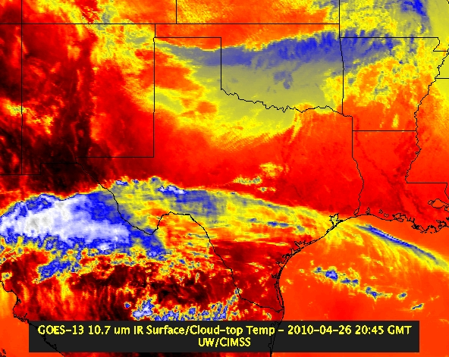
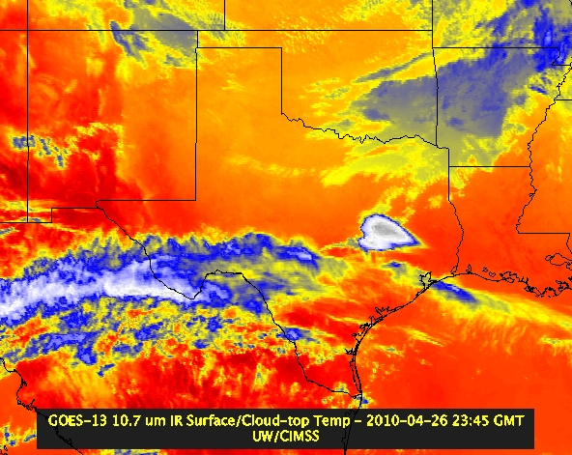
NSSL WRF and GOES Imager
“ABI” 21 UTC
“ABI” 00 UTC
GOES-13 21:15 UTC
GOES-13 23:45 UTC

Slide 16
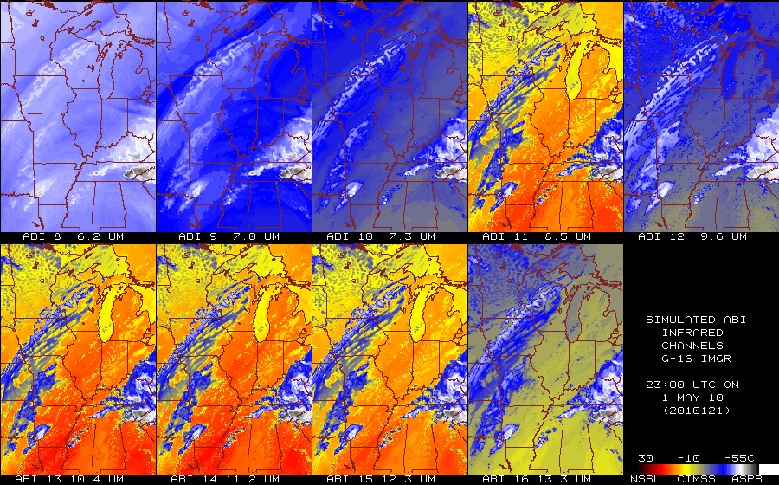
Estimated ABI Emitted-only Bands
From NSSL WRF
16

Slide 17
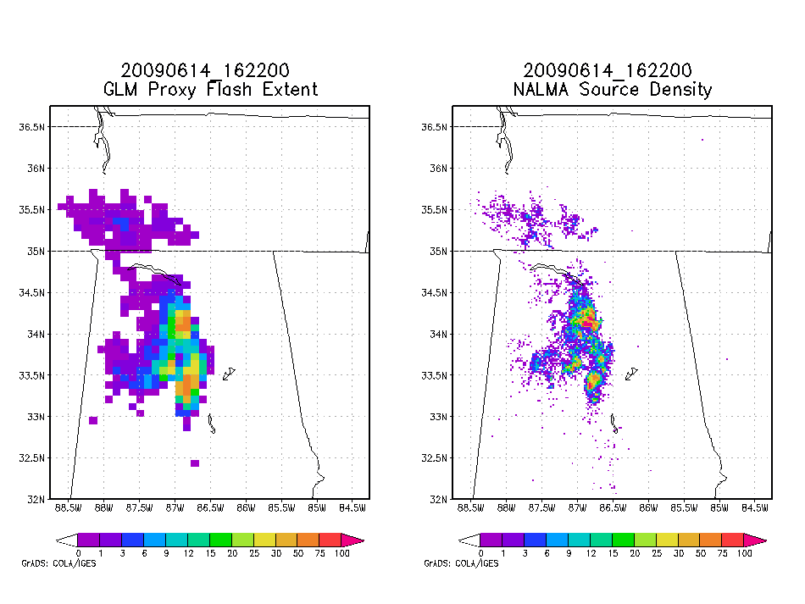
SPoRT Pseudo GLM Product
Provide forecaster exposure to GLM data, differences from LMA, applicability to severe weather forecasting – benefits transition of full AWG proxy when available
Pseudo GLM Flash Extent
LMA Source Densities
Flash Extent Density derived from LMA data at GLM resolution
different from AWG proxy - no optical data
forecaster demonstration and education
applicable to other total lightning networks
focus on AWIPS II development with user feedback
transitioning unique NASA data and research technologies to operations
Notes:
17

Slide 18
HWT Spring Experiment Final Report: Simulated Satellite Imagery
We have shown the simulated satellite imagery as a proof-of-concept of what is possible for new methods of displaying model output. There is much excitement regarding the possibilities of making simulated satellite imagery readily available alongside all the traditional and other experimental model fields. During the daily EFP briefings, participants were introduced to the idea of being able to sample three levels of water vapor from a geostationary instrument. While participants were excited by the availability of the three levels of water vapor information, they were unsure as to how this would be utilized operationally. This is something that we need to communicate further to the operational community during future experiments and demonstrations.
There is also a strong push for simulating GOES-R products and channel differences using the simulated satellite imagery as a decision aid. This is the single most captured comment from the participants regarding the simulated satellite imagery within the 2010 Spring Experiment. In the future we expect to leverage other high resolution model runs, such as the High Resolution Rapid Refresh (HRRR) model, to better simulate the GOES-R ABI temporal and spatial resolutions. The participants mentioned they would like to see product developers use this high resolution output to better simulate GOES-R products rather than using current observational datasets which do not have the spatial, temporal or spectral resolutions necessary to provide an in depth demonstration of these products.
Chris Siewert, HWT Proving Ground Coordinator

Slide 19
DC Regional Storms November 16, 2006 GLM Proxy: Resampled 5-min source density at 1 km and 10 km
LMA 1 km resolution
LMA 10 km resolution
http://branch.nsstc.nasa.gov/PUBLIC/DCLMA/

Slide 20
Lessons Learned at SPC
Convective Initiation (CI)/Cloud Top Cooling (CTC)
CTC is valuable product in itself
Diagnostic tool rather than prognostic over SE warm sector environments
Masked where thick cirrus present
Thin cirrus over land/water/water clouds and expanding edge false alarms
Avg. lead time ~15 minutes over radar (for successful nowcasts)
Full disk 30 min. scan limitations (false alarms/missed nowcasts)
Cloud detection limitations due to poor spatial/spectral resolution
Instantaneous fields more useful to forecasters than accumulated fields
Overlay on visible/IR essential to forecasters
Continue CTC after CI occurs (storm severity) interest from forecasters
Effective for terrain/dryline convection
CI misses some CTC signals
Works well in rapid scan operations

Slide 21
NHC Proving Ground
Hurricane products for 2010 PG:
Hurricane intensity estimate (baseline)
Super rapid scan imagery (baseline)
RGB aerosol/ dust product
Saharan air layer (SAL)
Rapid intensification index
Based on Global Lightning Detection Network
21

Slide 22
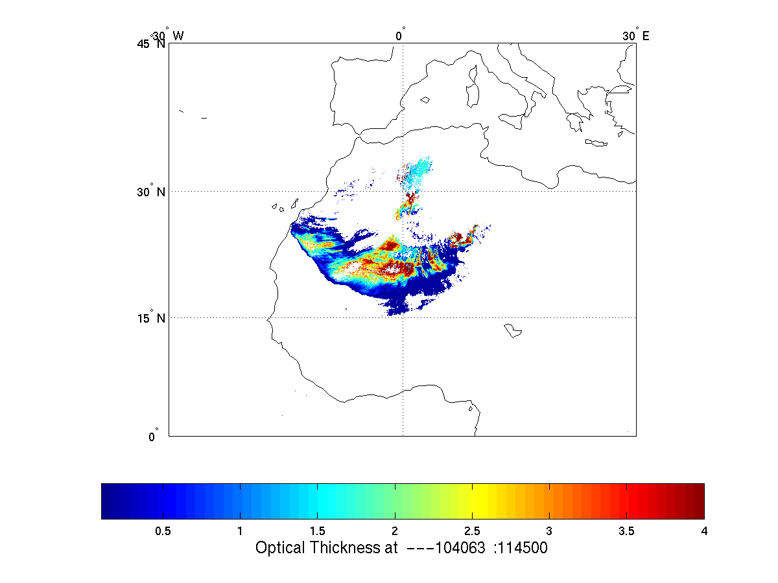
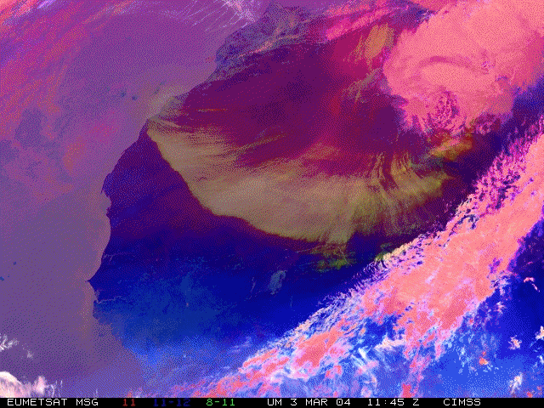
Aerosol/Dust Optical Thickness Retrieval
Results from SEVIRI@EUMETSAT
Figure courtesy of J. Li and P. Zhang

Slide 23
Summary
GOES-R Proving Ground provides mechanism to:
Involve CIs, AWG, National Centers, NOAA Testbeds and WFOs in user readiness
Get prototype GOES-R products in hands of forecasters
Keep lines of communication open between developers and forecasters
Allow end user to have have say in final product, how it is displayed and integrated into operations
For a GOES-R Success…Forecasters must be able to use GOES-R products on Day 1

