Slide 1
Update on Delivery System Options for ABI and VIIRS Air Quality Products
Ray Hoff

Slide 2
Proving Ground Goals
The Proving Ground brings together NOAA and its partners to bridge the gap between research and operations and provide a rich source of information contributing to user education and training on GOES-R applications through:
Utilizing current systems (satellite, terrestrial, or model/synthetic) to emulate various aspects of future GOES-R capabilities
Infusing GOES-R products and techniques into the NWS operational environment, with emphasis on the Advanced Weather Information Processing System (AWIPS) and transitioning from AWIPS-I ("AWIPS Legacy") to AWIPS-II ("AWIPS Migration")
Engaging in a two-way dialogue to provide feedback to the developers from the users

Slide 3
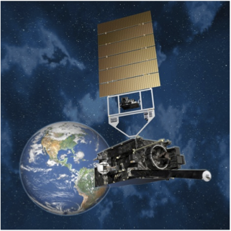
The Ideal World

Slide 4
GOES-R Data Dissemination
All Level 2 products including air quality products:
Aerosol Optical Depth
Suspended Matter
Aerosol type (urban, generic, dust, smoke)
Aerosol detection (smoke/dust mask)
Fires and emissions
Burned area
cloud mask
Operational product users with a capability to use AWIPS-II (e.g., WFOs)
AWIPS
GOES-R Ground System
(closed non-IP)
Environmental Protection Agency
United States Forest Service
National Weather Prediction (NWP) centers
OSDPD Data Distribution Server
(open IP access)

Slide 5
Since Last Year
Proving Ground Executive requested that the UMBC AQPG invest in an AWIPS-II workstation and server and investigate mechanisms to put ABI Proving Ground products on AWIPS-II
UMBC is not a WFO so we are not within the normal AWIPS-II data distribution stream
Data will come from NCAR Unidata via ftp pull and LDM (Local Data Manager) .. This is the mechanism being used by CIMSS at University of Wisconsin for their access to GOES-R Proxy products that they don’t produce.
To date (1/11/12), UMBC has not received the AWIPS-II distribution as some ITAR related features (Lightning Data Mapper) have to be stripped out of the code
We expect to have AWIPS-II up and running within 90 days

Slide 6
Air Quality Data Dissemination
Air quality products:
Aerosol Optical Depth
Suspended Matter
Aerosol type (urban, generic, dust, smoke)
Aerosol detection (smoke/dust mask)
Fires and emissions
Burned area
cloud mask
NESDIS Development
Servers
Product Tailoring:
compositing
zooming capabilities
time series
remapped to a pre-defined grid
overpass data for specific stations
overlays of different but related products (e.g., wind vectors over AOD)
geotiff, KML, etc.
GOES-R Ground System
Air quality forecasters
Visualization System
UMBC AWIPS-II
Development Workstation

Slide 7
VIIRS Data Dissemination
The Official Path
Users will get the data via requests to NCDC via the CLASS system
Data will be available in February
Product is an HDF5 file which can be subset for variables of interest
http://www.nsof.class.noaa.gov/saa/products/search?datatype_family=VIIRS

Slide 8
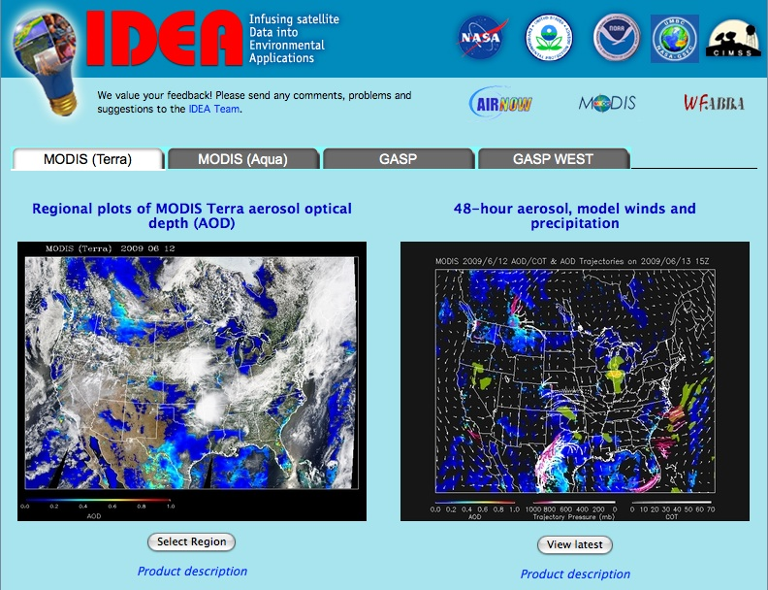
We expect to add a VIIRS Tab to IDEA
(http://star.nesdis.noaa.gov/smcd/spb/aq/)

