Slide 1
Review of PM2.5/AOD Relationships
Ray Hoff, UMBC

Slide 2
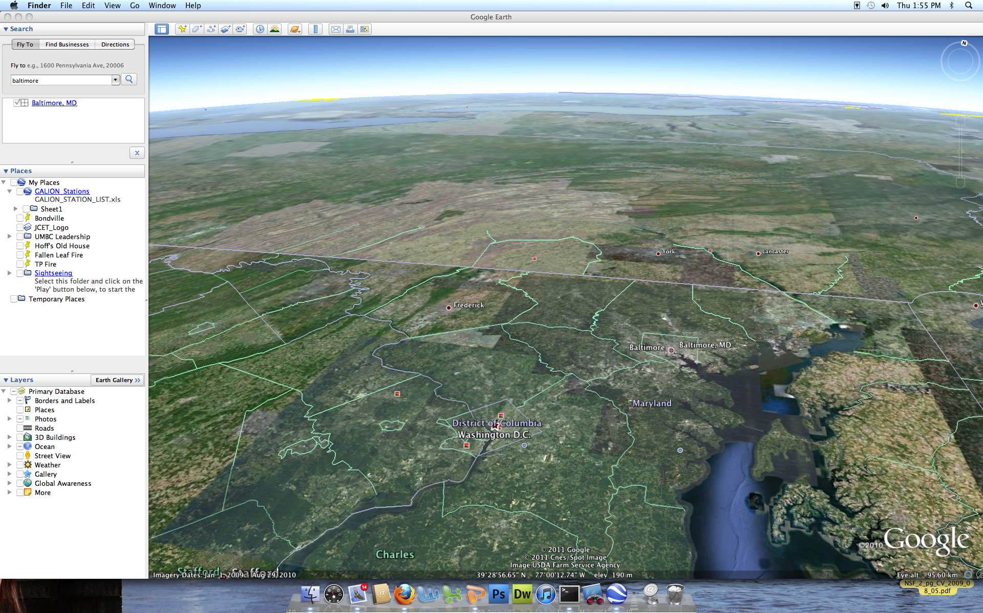
Fundamentals Relating PM to AOD
Near-surface pollution is one of the most challenging problems for Earth observations from space…
Near-surface information must be inferred from column-integrated quantities obtained by passive remote sensing from downward-looking satellite instruments.
From space, the size of the measurement pixel matters
It matters about how well the pollution is mixed
Height of the box matters
If we knew these well, ground concentrations would relate well to space measurements

Slide 3
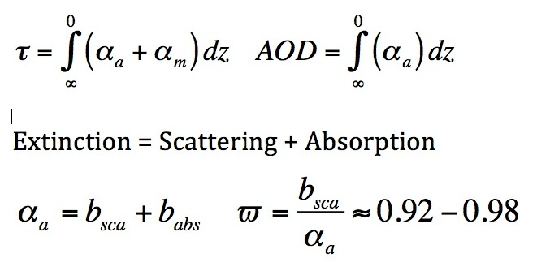
Aerosols
What matters at the surface is PM_{2.5}
What we measure from space is aerosol optical depth
We need the height of the box, PBL_{z}(m)
We need the extinction profile, α_{a} (z)
Need to get S_{a}, lidar ratio (α_{a}/β_{π}, 30-80 sr)
Specific extinction or scattering coefficient
SSC = b_{sca}/PM_{2.5} (should be ~3.0 m² g⁻¹)

Slide 4
The easy problem:
PBLH
α₀
AOD = α₀• PBLH = SSC•PBLH• PM_{2.5}
PM_{2.5} = (3e⁻⁶ m²/µg 1000m)⁻¹ AOD = 83 µg/m⁻³ AOD

Slide 5
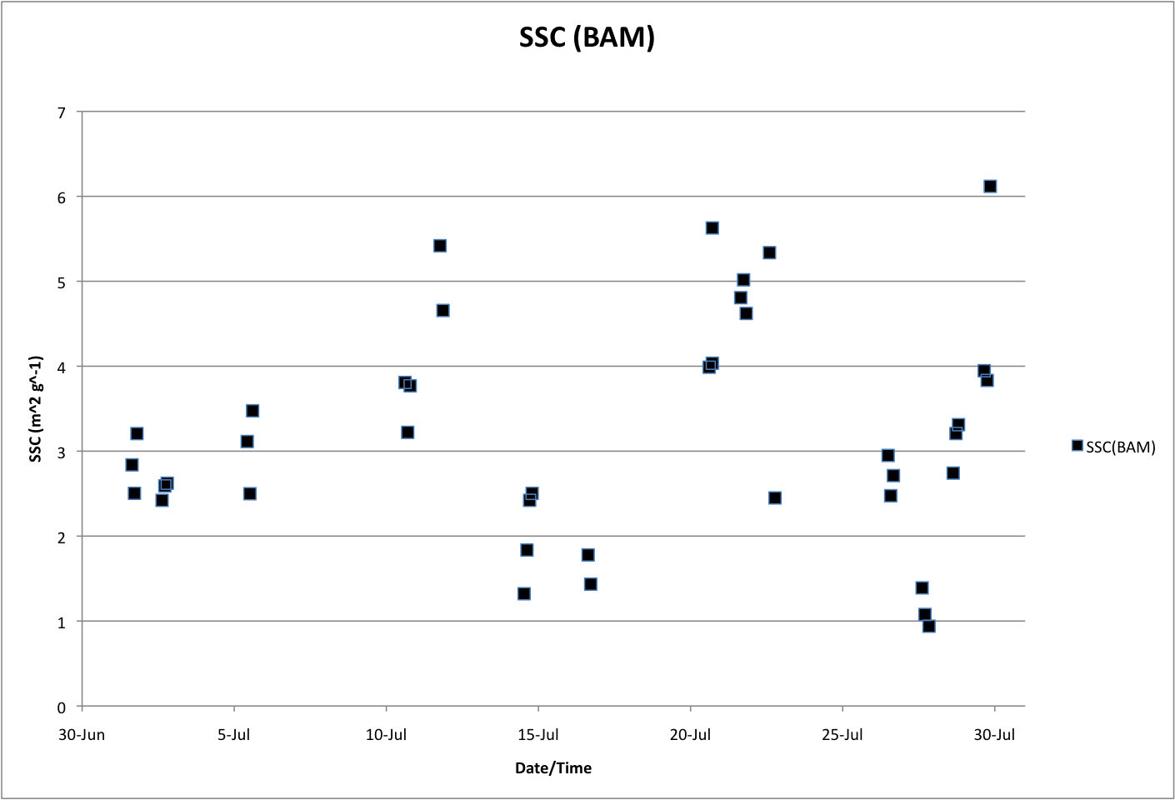
Specific Scattering Coefficient
SSC(BAM)= 3.2 ± 1.29 m² g⁻¹
There is a fundamental variability of about 30% between scattering
and mass

Slide 6
A more realistic situation
α_{d}
PM_{2.5}
α₀
RH
PM is well mixed; extinction varies with RH; aerosols aloft
There is no reason PM should correlate well with AOD except in
average sense.
α = f(RH) • α_{d} = f(RH) • SSC • PM_{2.5}

Slide 7
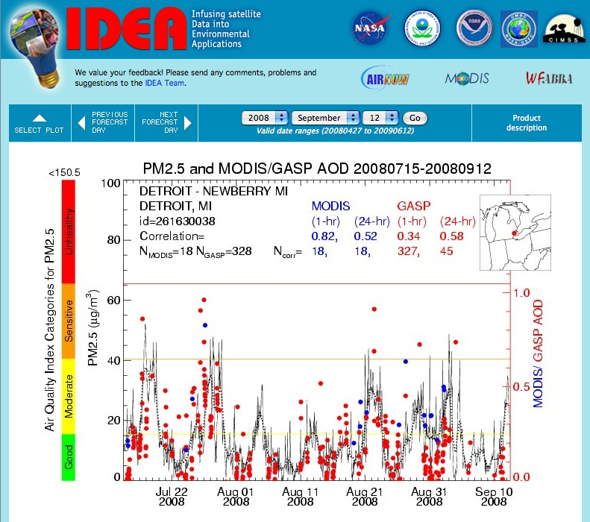
Correlations between AOD and PM_{2.5}
Simple ratio:
62 µg m⁻³ = 1 τ
Chu et al. (2003)

Slide 8
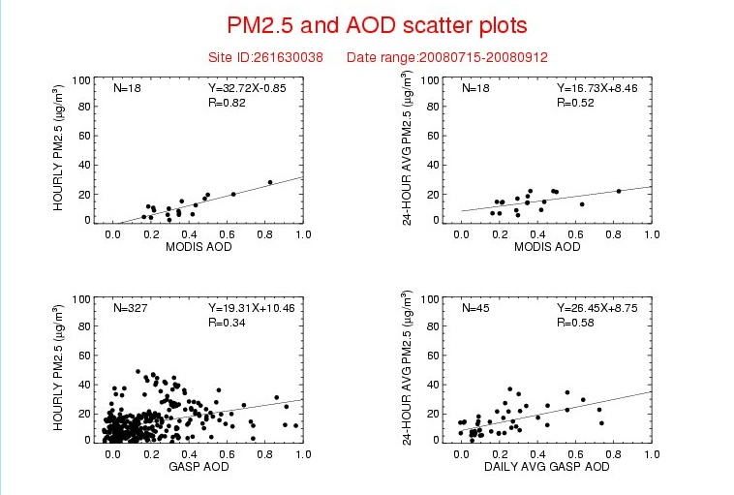
Correlations from the data?

Slide 9
National correlation map between surface PM2.5 and GASP aerosol optical depth
More than 600 hourly PM2.5 surface measurement sites
Correlation coefficient for each site for 60-day period

Slide 10
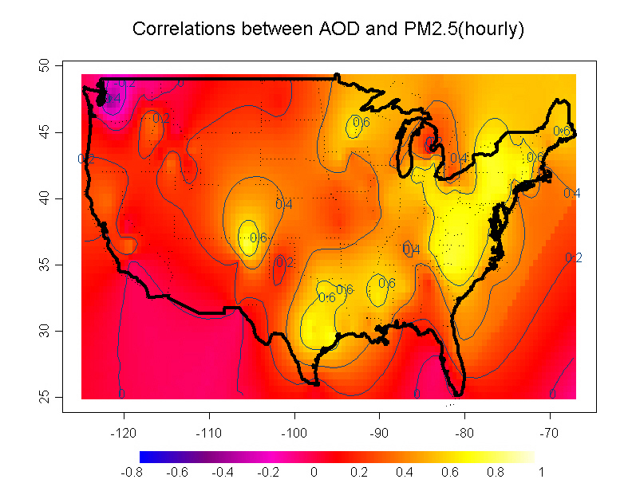
Linking optical properties and mass concentration
Engel-Cox et al. 2004

Slide 11
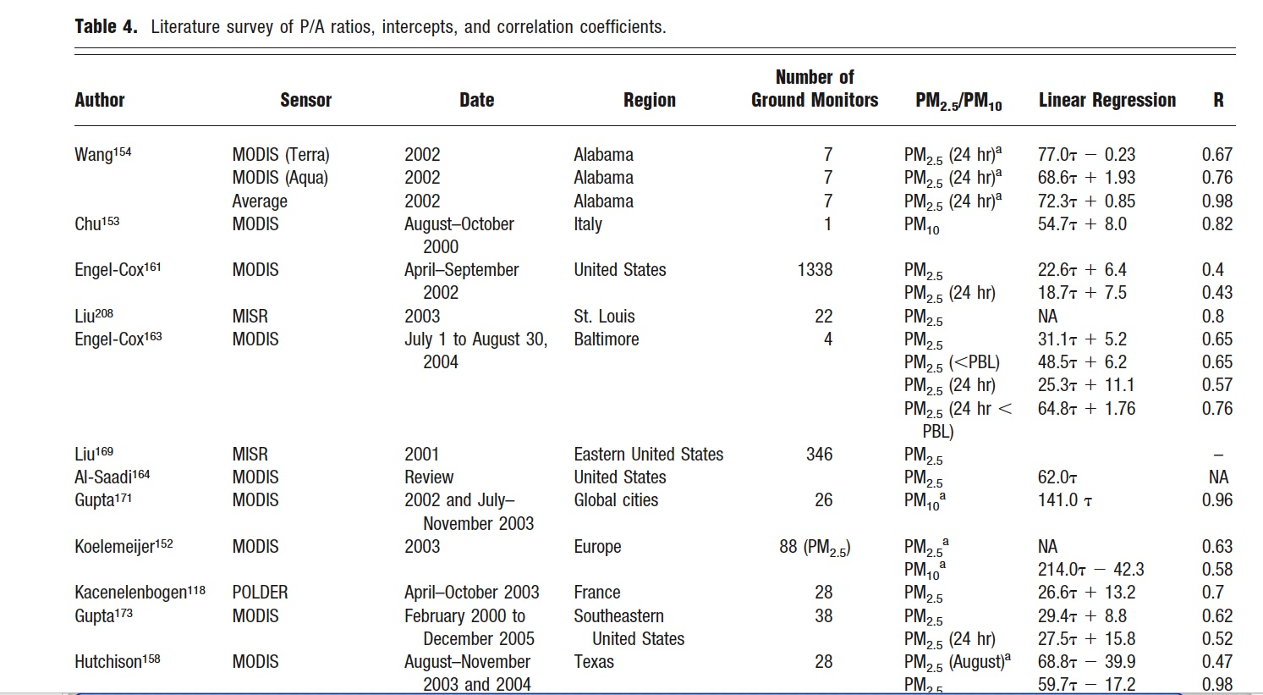
PM - AOD Relationships

Slide 12
Review of PM to AOD relationships
Widely (wildly) varying slopes on this regression
Seasonal dependence, humidity dependence, PBL dependence, regional dependence,
May not in fact be a linear relationship at all
Error in the slopes lead to propagated error in the PM_{2.5} predictions
Likely not useful for regulatory compliance

Slide 13
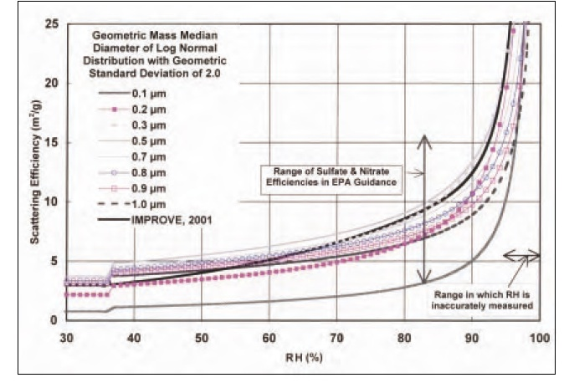
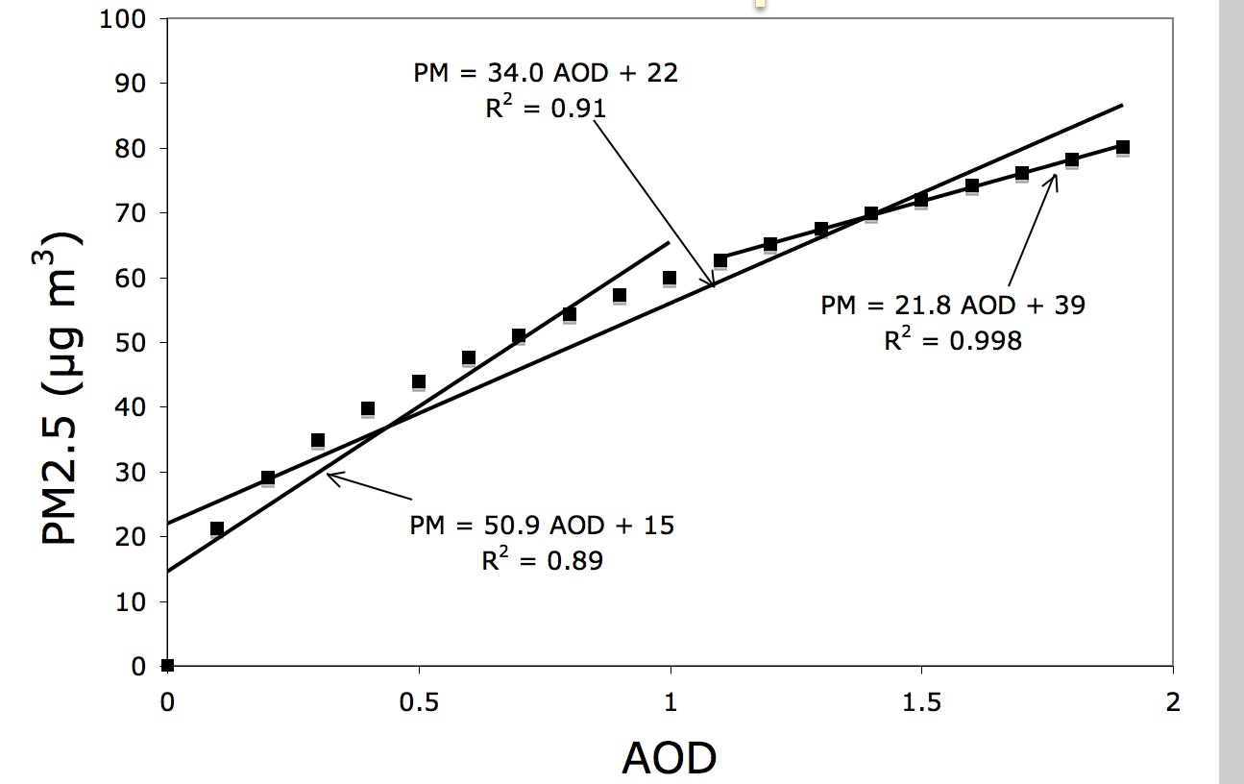
Back to the aerosol microphysics
RH
RH
H
α = PM_{2.5} S
Specific extinction efficiency at RH
Watson, 2002
Liu et al.
2005

Slide 14
How do we improve the science?
Add more satellite wavelength channels (expensive)
Improve the physics in the satellite retrievals (time consuming and still lack of surface BRDF)
If you could get extinction at the surface, you might get a better estimation of PM_{2.5}
Combine measurements from other instruments (profiles from a lidar in space - CALIPSO)

Slide 15
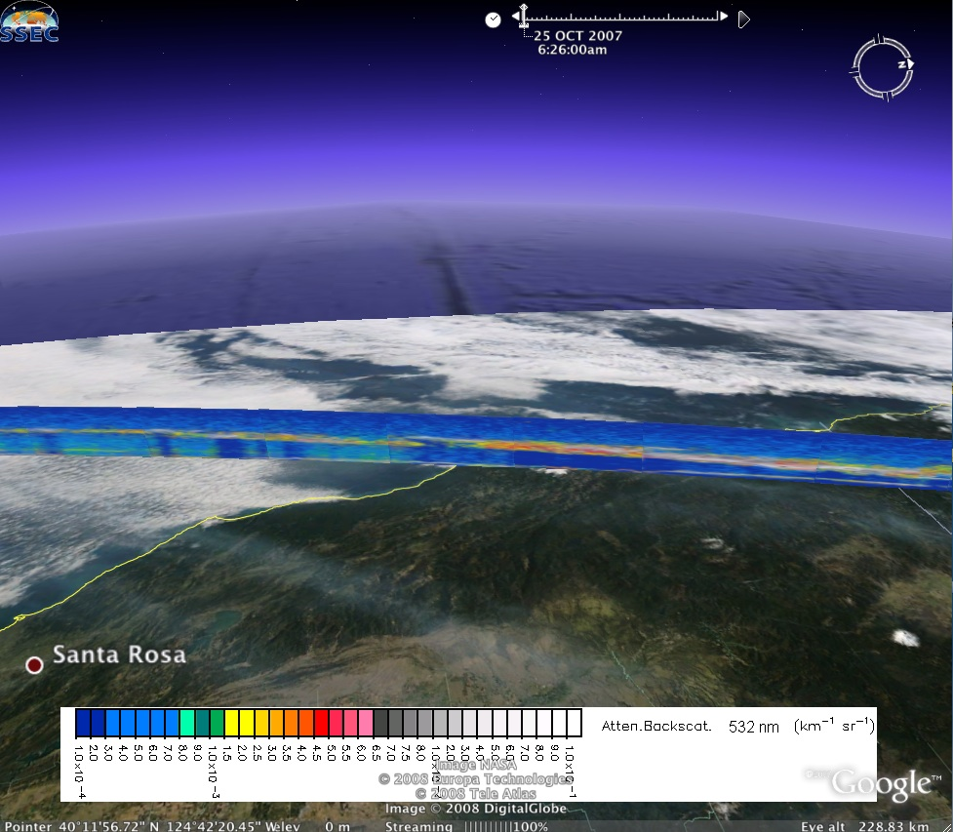
3D information from CALIPSO?
This was a core idea from the 3DAQS Project which is now embedded in EPA’s RSIG

Slide 16
Reaching the Promised Land
I heard NASA turned up the power on CALIPSO
© Biblestorymurals.com

Slide 17
DISCOVER- AQ 14 Overflight Days
July 1, 2, 5, 10, 11, 14, 16, 20, 21, 22, 26, 27, 28, 29
Profiles were taken over Beltsville and generally limited to <5000 ft so it was difficult to see PBL height at that site, except in morning
Distance between Beltsville and UMBC is 22 km (an interesting distance for aerosol scale)

Slide 18
HSRL covered the whole region (7/21)
UMBC

Slide 19
ELF vs HSRL on July 21
15 min ELF
5 km HSRL colors
Same shape as our “more realistic profile”
Cloud

Slide 20
DISCOVER-AQ Methods to get Extinction Profiles
TSI 3863 3λ nephelometer (measures b_{sca}) on aircraft (B. Anderson, PI) and ground (UMBC)
A/C Humidograph (humidified nephelometer)
550 nm (wet = 85% RH)
550 nm (dry = 45% RH)
High Spectral Resolution Lidar (α, β_{π},S_{a})
Ground-based lidars (β_{π}^{att} >> α(S_{a}))
PM (TEOM/BAM)
CIMEL Sunphotometers (UMBC Aeronet + DRAGONFIRE)

Slide 21
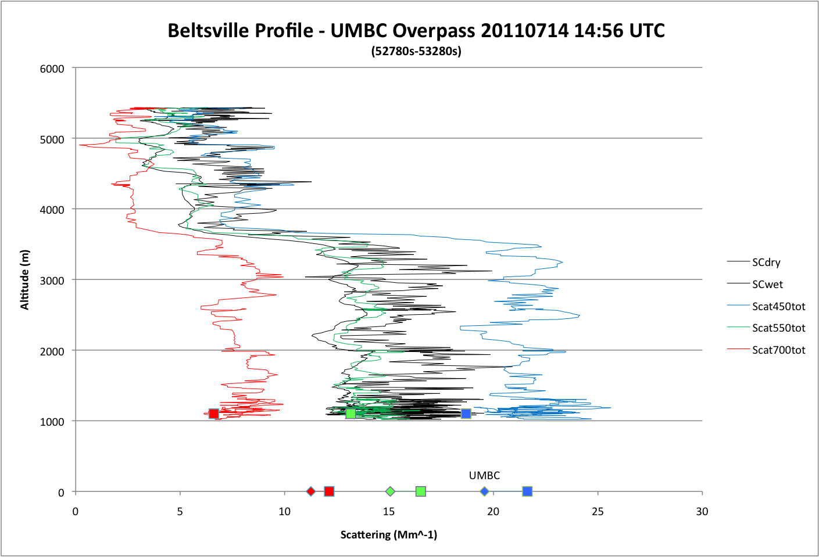
Very clean day ~ 5 μg m⁻³
Well defined PBL
Non-hygroscopic aerosol
Primary aerosol source at surface

Slide 22
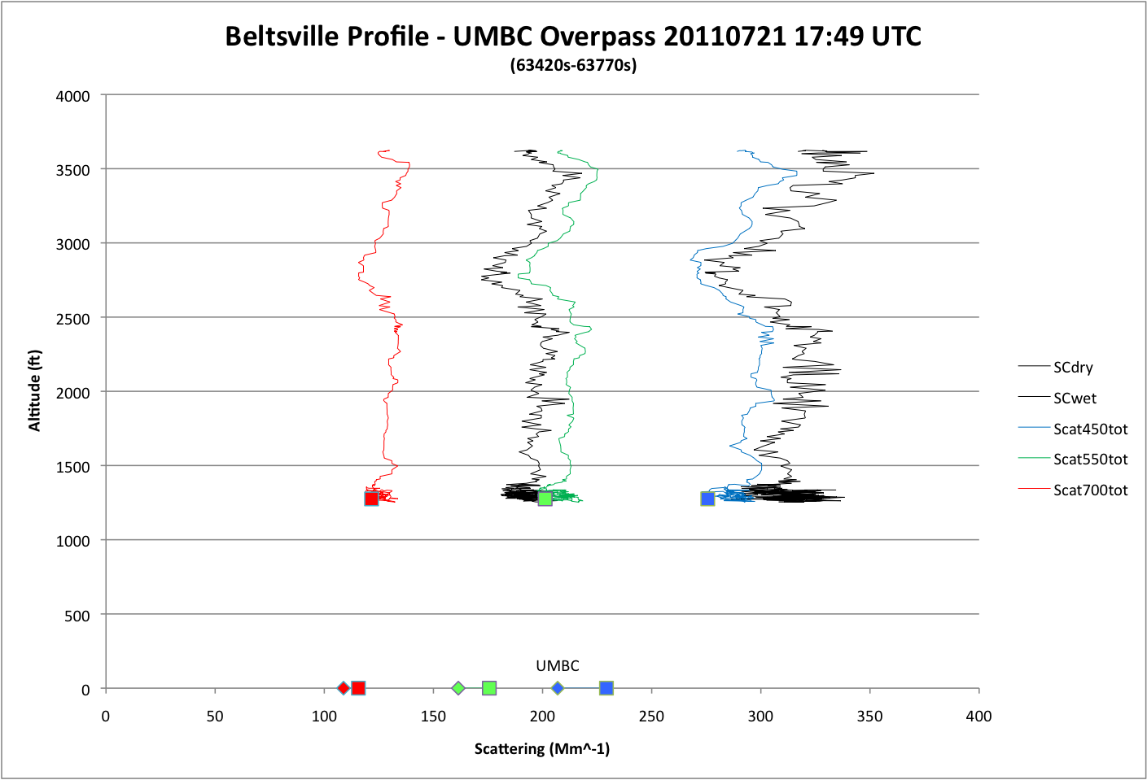
BAM = 39 μg m⁻³
Sloppy wet
~sulfate aerosol
Well mixed to 1km
Same gradient as
in the HSRL – ELF
profiles!

Slide 23
Lidars
Probably a record in that 14 lidars were used in this experiment
UMBC (ELF₅₃₂, MPL₅₃₂, Leosphere_{355 scanning}, Raman_{355,387,407)}
MPLNET (3 locations, not shown in this talk)
Sigmaspace MPL and mini-MPL (4 locations)
Leosphere windcube (Edgewood)
Beltsville ceilometer and Raman
BWI ceilometer
HSRL (airborne)

Slide 24
MPL results across the region
Berkoff et al. A13E-0372.
Field deployment and initial results from micro-pulse lidar systems during NASA’s DISCOVER AQ campaign

Slide 25
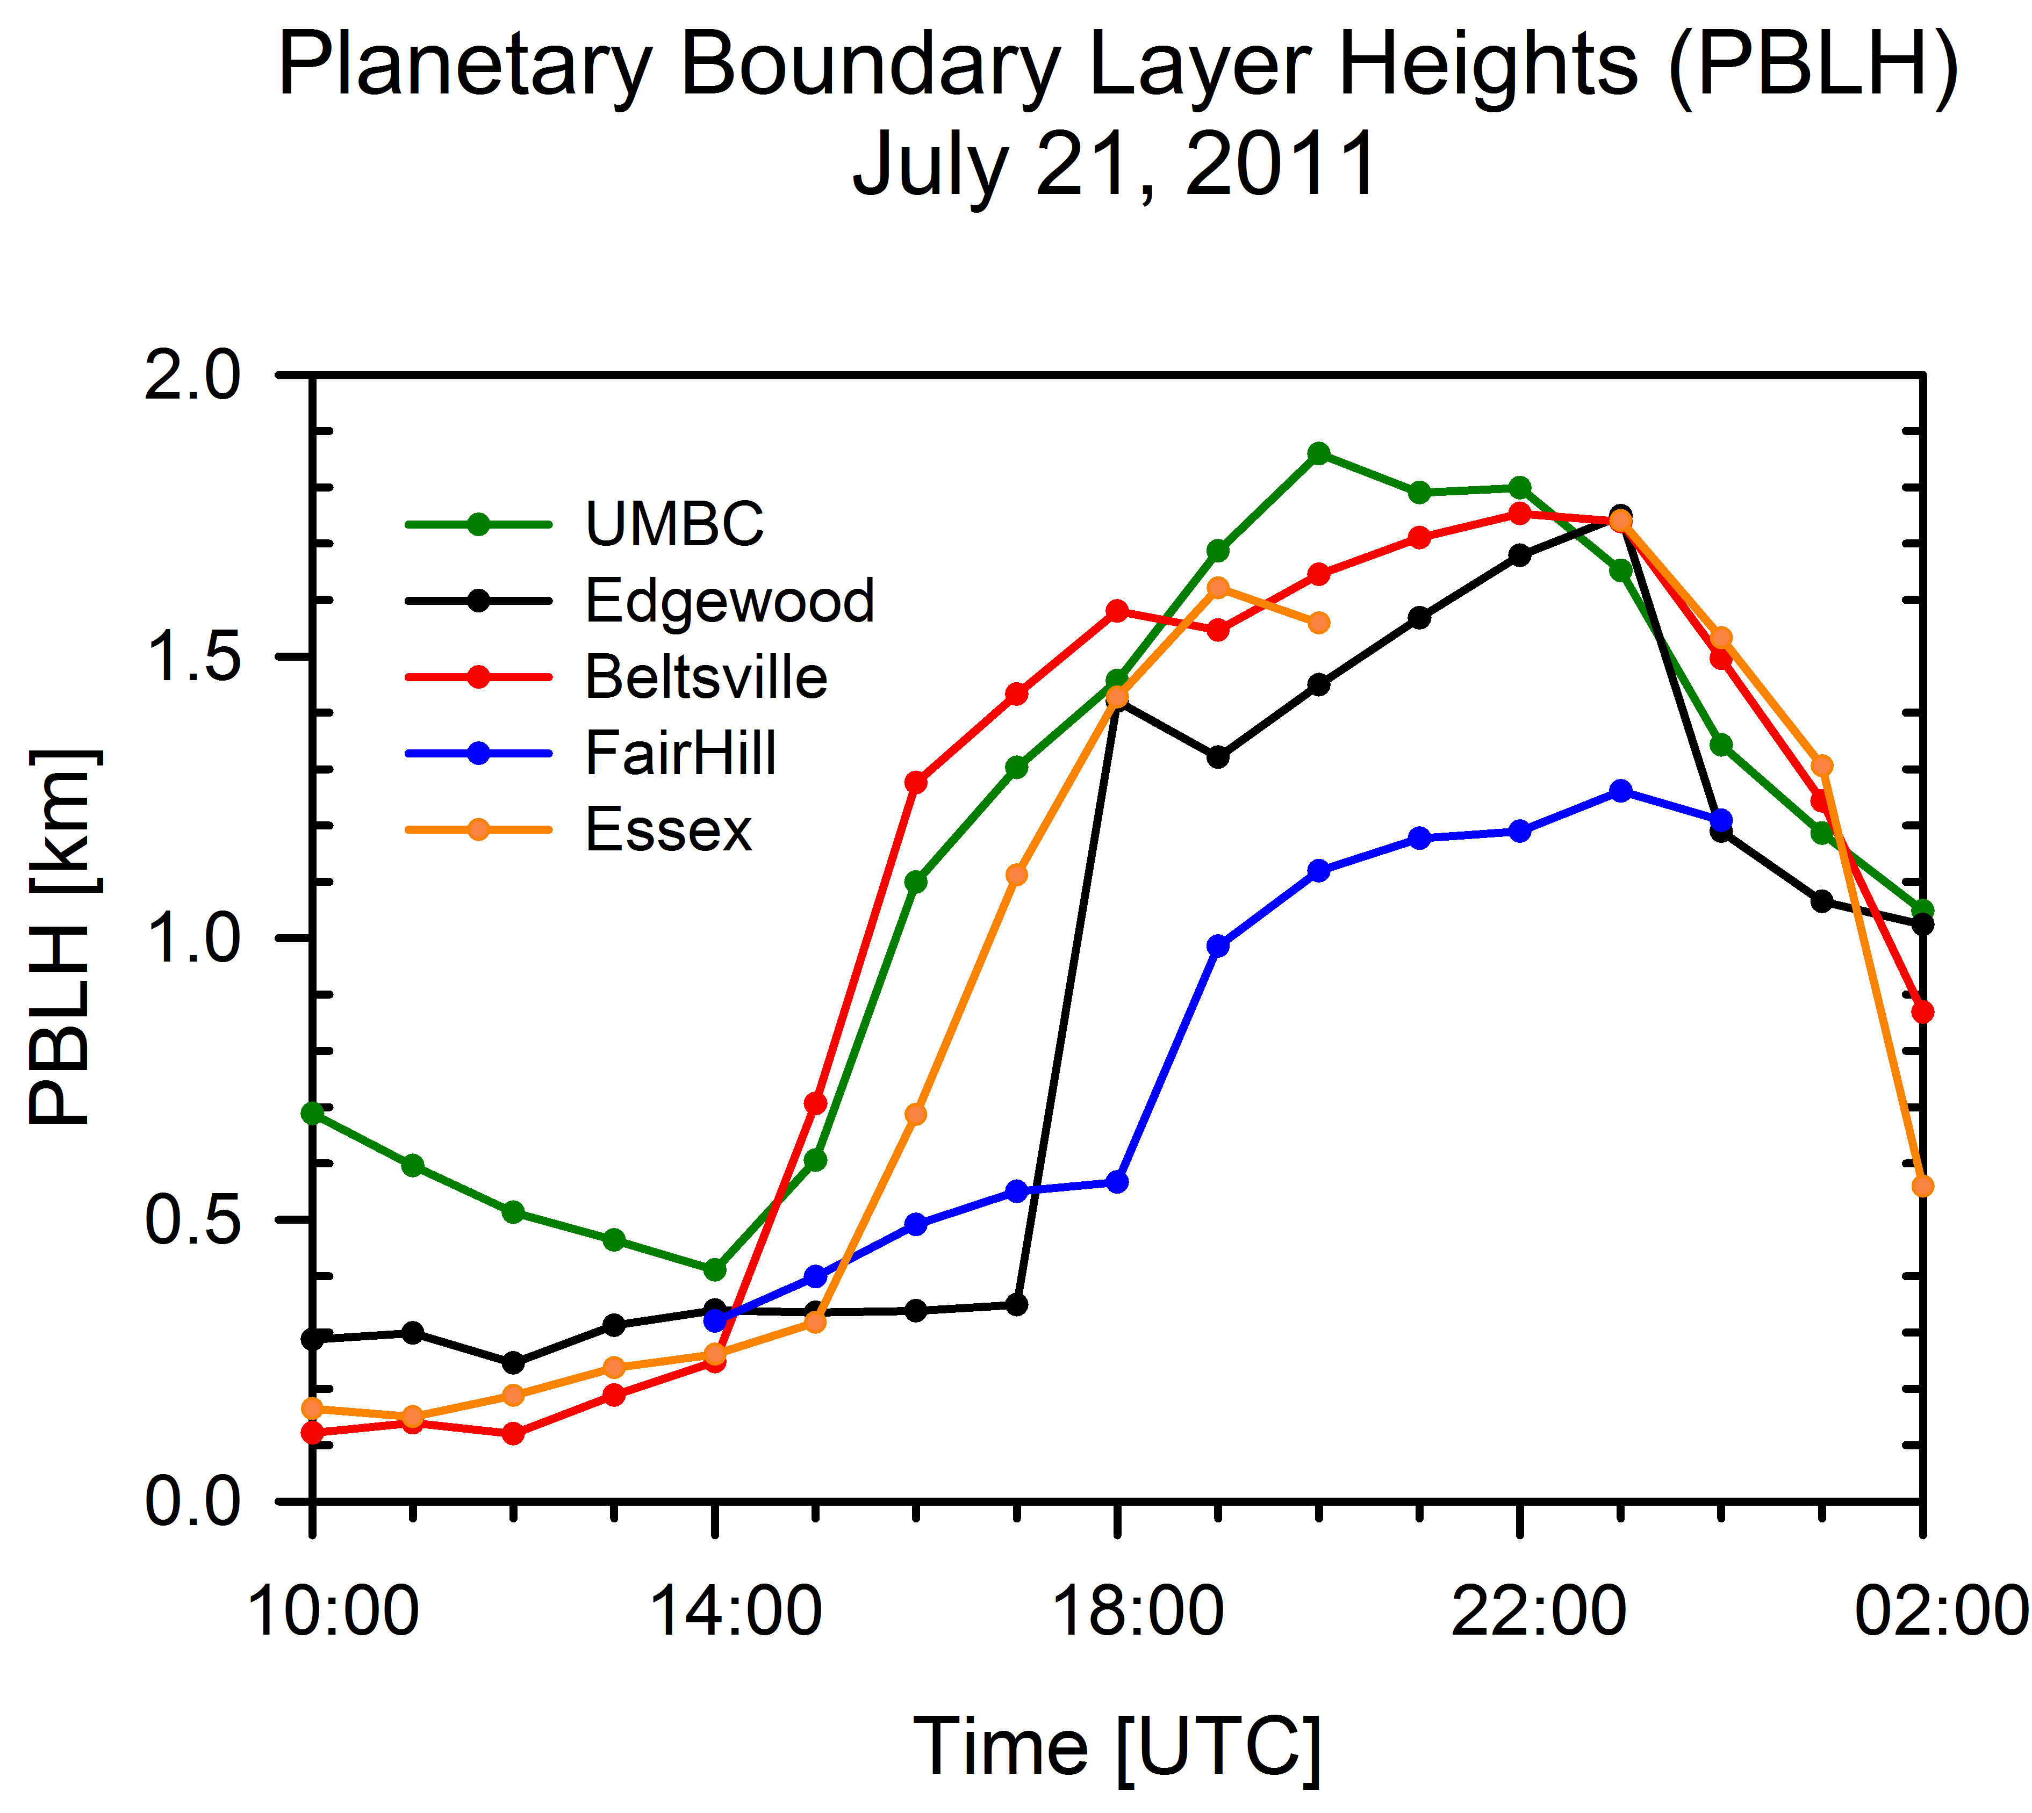
Initial PBL Heights are now available
Delgado et al.
A13E-0373.
Determination of Planetary Boundary Layer Heights on Short Spatial and Temporal Scales from Surface and Airborne Vertical Profilers during DISCOVER-AQ

Slide 26
Conclusions
PM2.5 to AOD relationships (as in IDEA) give a relative picture of the spatial variability in PM
The results are probably sufficient to predict AQI indicators (aggregated) – still need to quantify this with IDEA data
Models (neural network, generalized additive models, NCEP CMAQ, etc.) can improve PM-AOD relationships but are, as yet, untested operationally
Still no operational method to remove outliers from PM aloft.

