Slide 1
Case Studies of Simulated ABI Data for Past Air Quality Events
Ray Hoff, Mark Green, Amy Huff, Hai Zhang, Shobha Kondragunta, Brad Pierce, Sundar Christopher, Barry Gross

Slide 2
From Steve Goodman’s Presentation

Slide 3
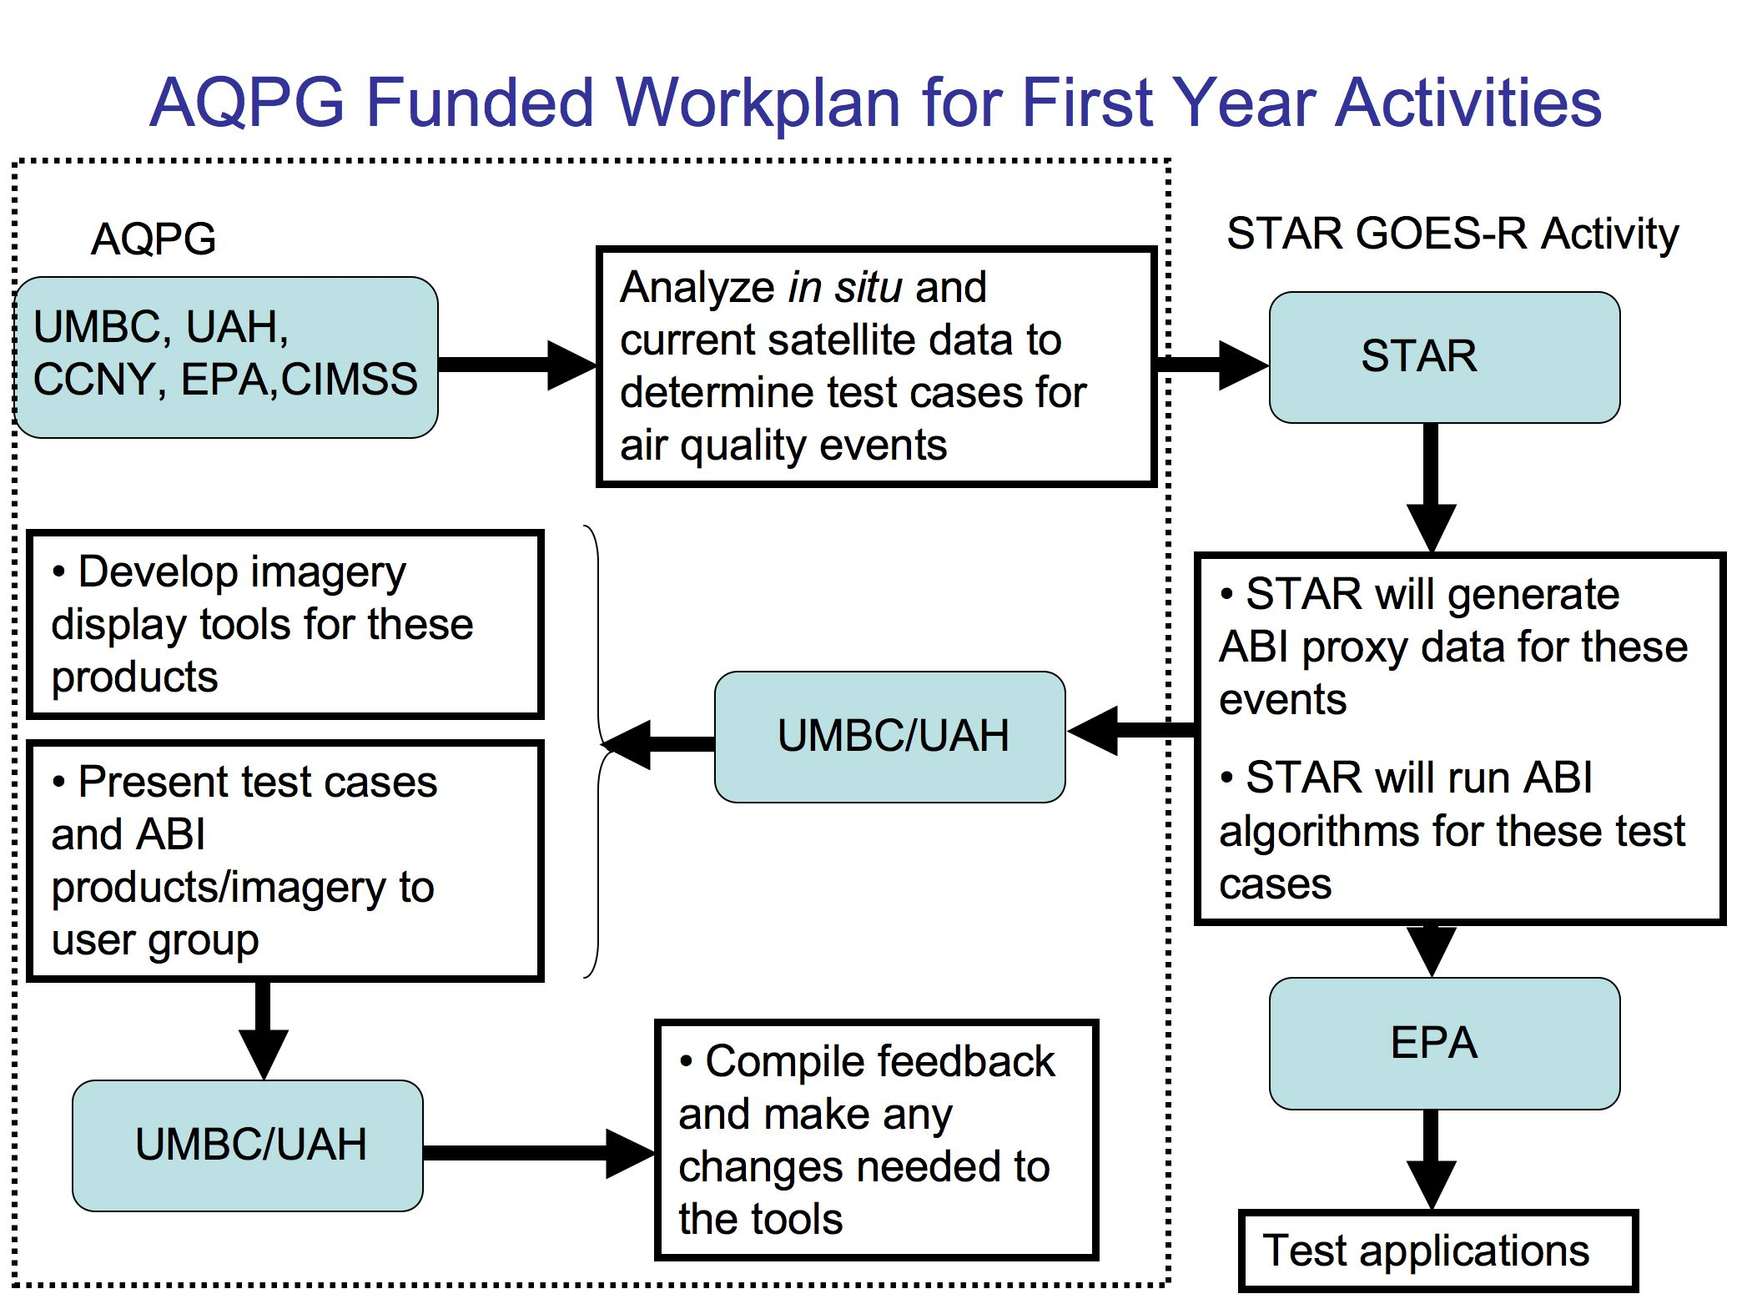
This Talk
This afternoon

Slide 4
Your Task: Tell Us What You See
We sought up to ten test cases where we could exercise the GOES-R ABI Algorithm
We were constrained by the availability of model data in a format that could be introduced to CRTM and then to the ABI algorithm
Only two cases could be run at this point (August 26, 2006 and May 24, 2007)
You’ve seen briefly what these cases look like on GOES-R ABI in Brad’s presentation

Slide 5
NOAA Air Quality Proving Ground Case Study 1 August 24, 2006
Smoke in Northern Rocky Mountain States Haze in Mid-Atlantic, Southeast, and Mississippi Valley Regions

Slide 6
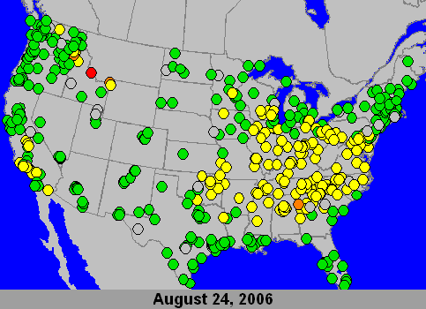
PM_{2.5} 24-hour Average AQI for August 24, 2006

Slide 7
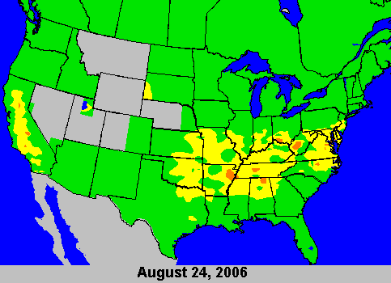
O₃ 8-hour Average Maximum AQI for August 24, 2006

Slide 8
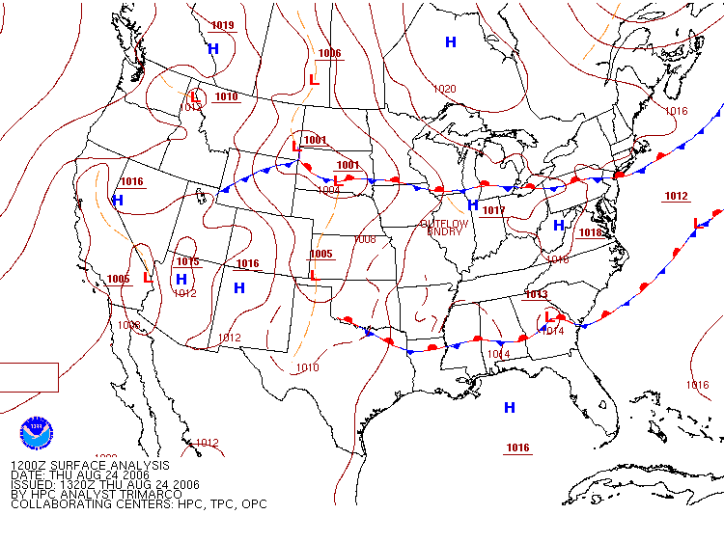
12 UTC Surface Analysis for August 24, 2006

Slide 9
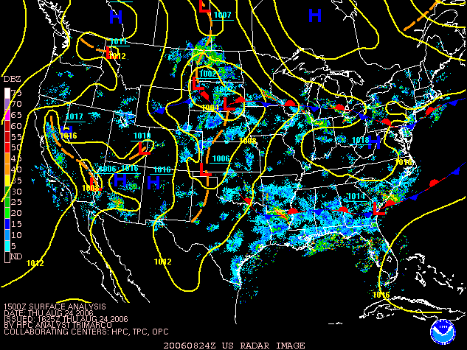
15 UTC Surface Analysis with Radar for August 24, 2006

Slide 10
NOAA Hazard Mapping System Fire and Smoke Analysis for August 24, 2006

Slide 11
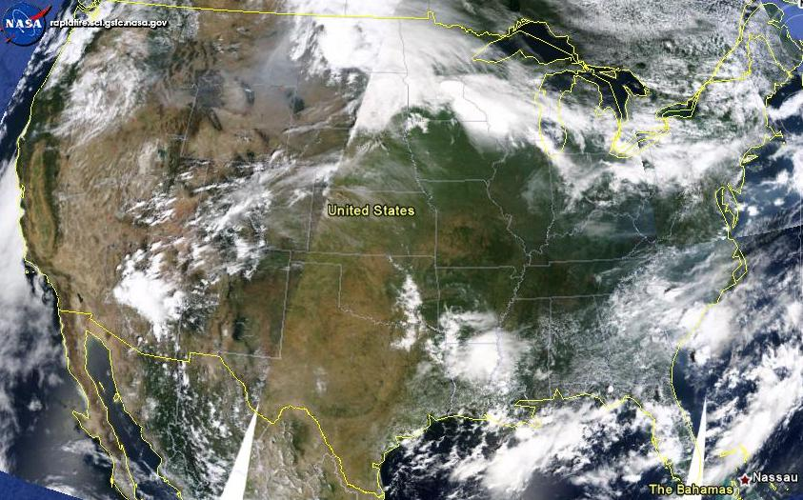
Terra MODIS True Color Image for August 24, 2006

Slide 12
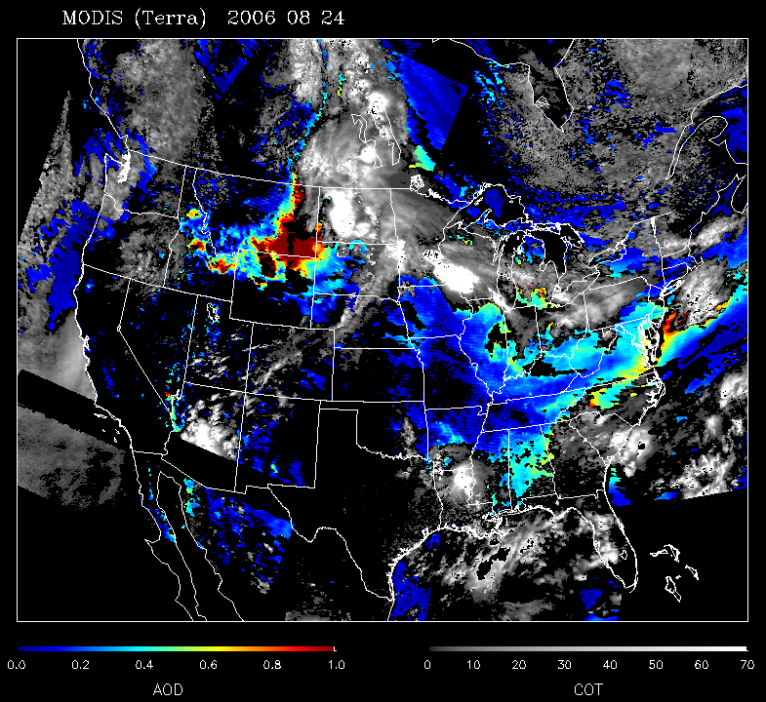
Terra MODIS Aerosol Optical Depth (AOD) for August 24, 2006

Slide 13
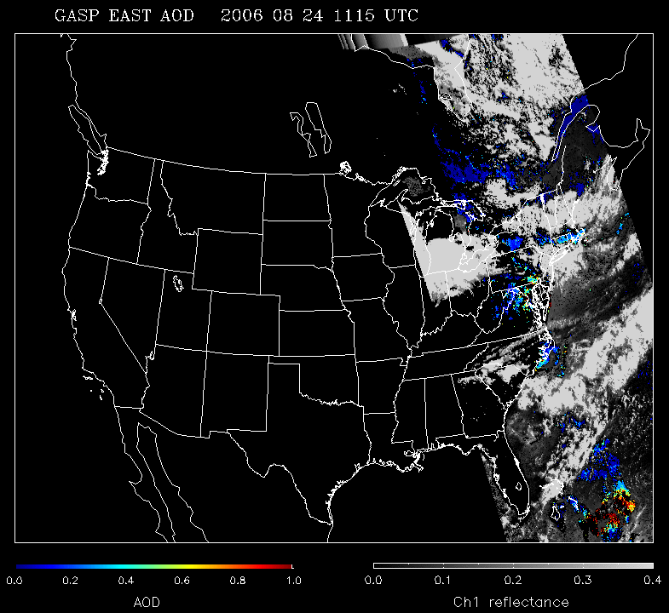
GOES Aerosol and Smoke Product (GASP) for August 24, 2006

Slide 14
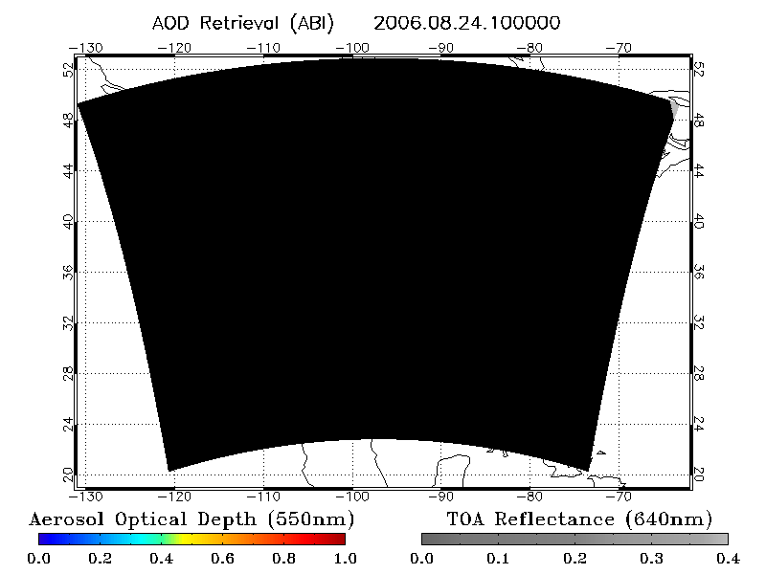
Simulated GOES-R ABI AOD Loop 10 UTC August 24 – 3 UTC August 25, 2006 (CONUS)

Slide 15
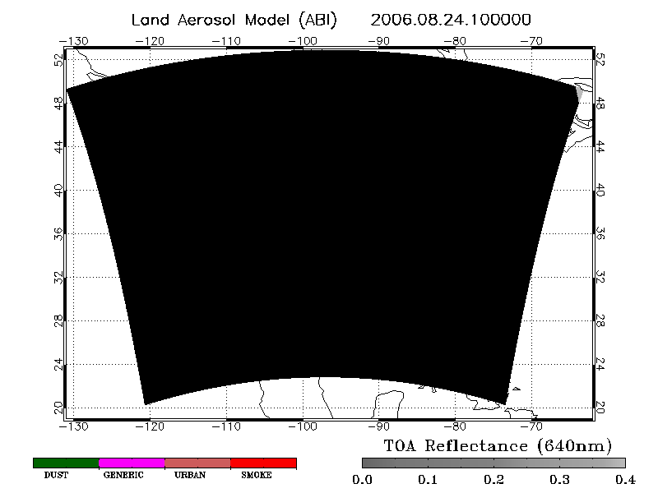
Aerosol speciation products
ABI Aerosol Type

Slide 16
NOAA Air Quality Proving Ground Case Study 2 May 22-24, 2007
(for Extra Credit)
Smoke and Haze in Great Lakes, Southeast, and Mississippi Valley Regions

Slide 17
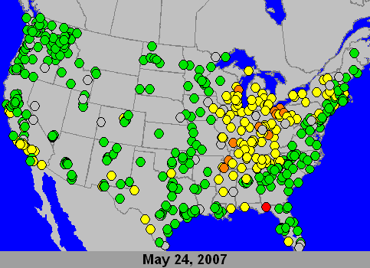
PM_{2.5} 24-hour Average AQI for May 24, 2007

Slide 18
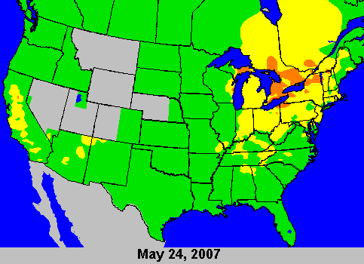
O₃ 8-hour Average Maximum AQI for May 24, 2007

Slide 19
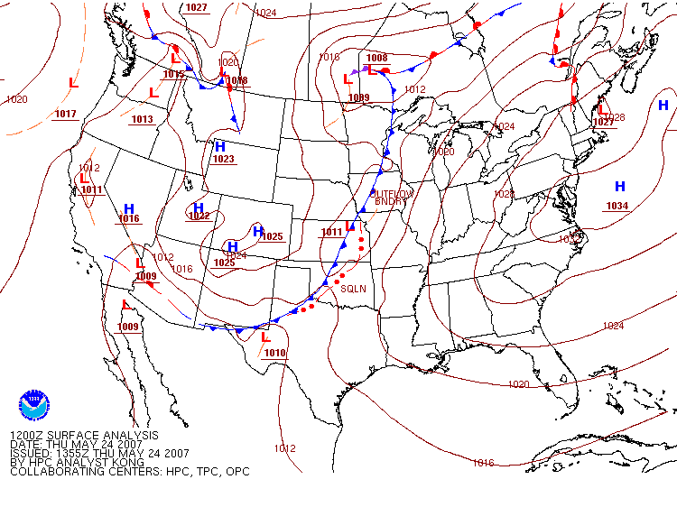
12 UTC Surface Analysis for May 24, 2007

Slide 20
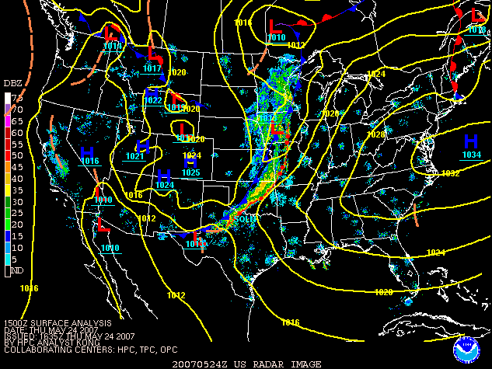
15 UTC Surface Analysis with Radar for May 24, 2007

Slide 21
NOAA Hazard Mapping System Fire and Smoke Analysis for May 24, 2007

Slide 22
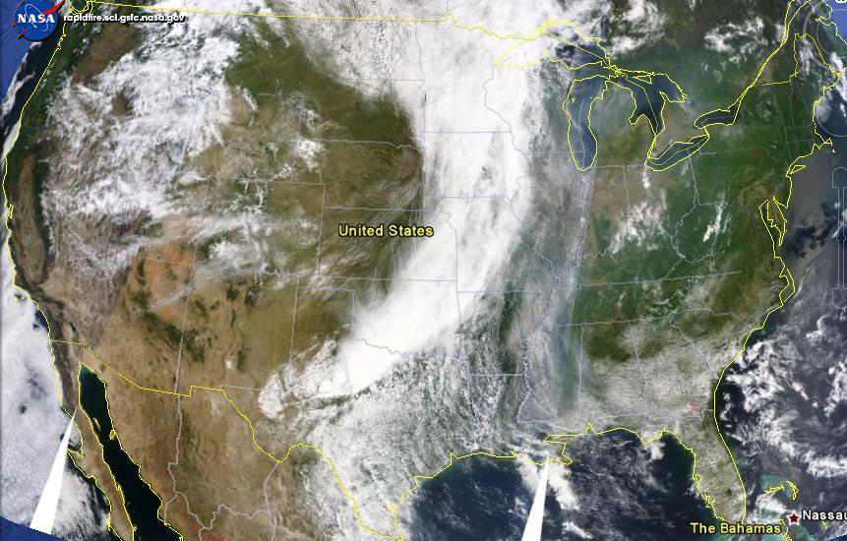
Terra MODIS True Color Image for May 24, 2007

Slide 23
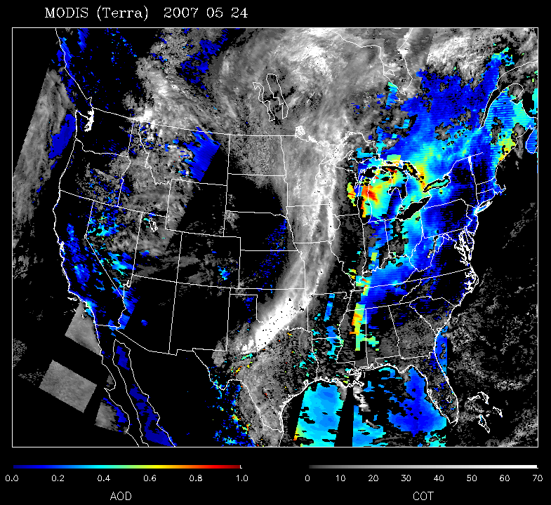
Terra MODIS Aerosol Optical Depth (AOD) for May 24, 2007

Slide 24
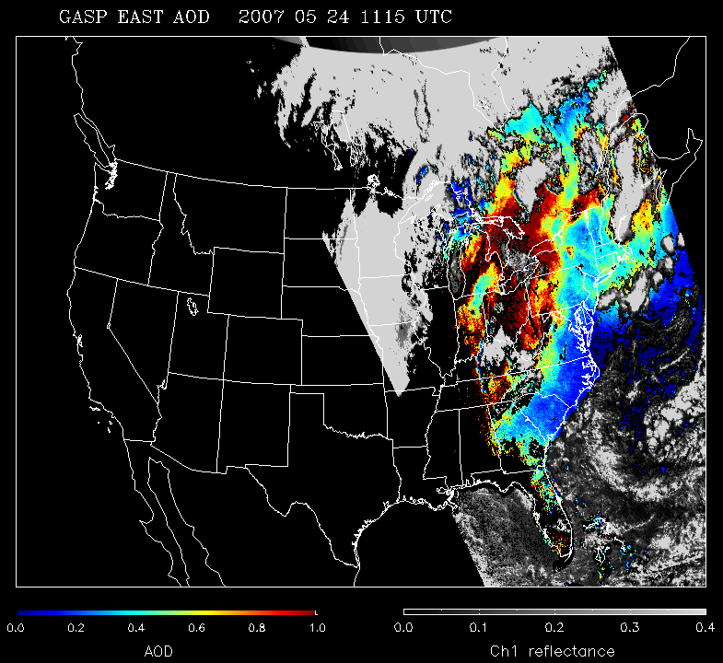
GOES Aerosol and Smoke Product (GASP) for May 24, 2007

Slide 25
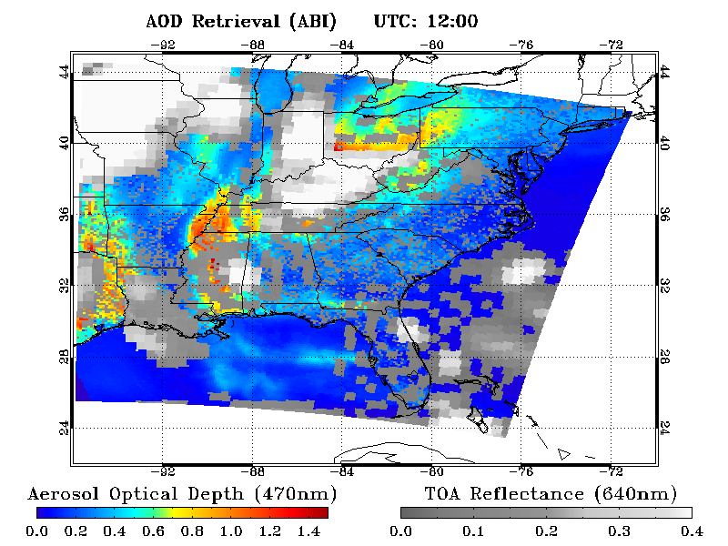
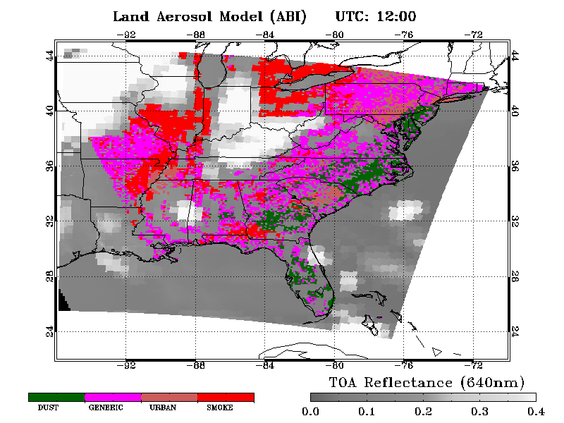
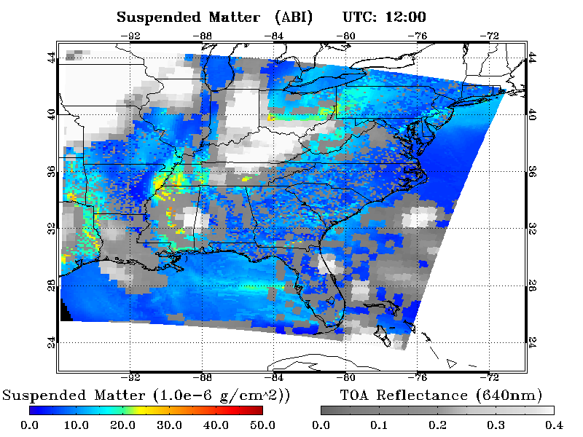
ABI Aerosol Type (land only)
Simulated GOES-R ABI AOD and Aerosol Properties Loops May 24, 2007 (CONUS)

Slide 26
Breakout Session (After Lunch)
Working in groups, you’ll be able to review these slides in detail, including:
static images of AQI and meteorological data
GASP and MODIS AOD images/loops
GOES-R ABI simulated data
On the accompanying worksheet, please answer the questions about the simulated ABI data
Your answers will be the basis of the discussion session – we want your feedback on what you find confusing, what you find most useful, and what is missing.

