Slide 1
GOES and GOES-R ABI Aerosol Optical Depth (AOD) Validation
Shobha Kondragunta and Istvan Laszlo (NOAA/NESDIS/STAR),
Chuanyu Xu (IMSG), Pubu Ciren (Riverside Technologies), and Hai Zhang (UMBC)
AERONET data courtesy of NASA (PI: Brent Holben)
Second GOES-R Air Quality Proving Ground Workshop, UMBC, Jan 12, 2012

Slide 2
Outline
GOES vs. GOES-R illustration
Strategy for GOES AOD validation
Analysis of GOES and DRAGON AERONET data during DISCOVER-AQ field campaign is to understand if GOES captures the aerosol spatial and temporal variability observed by DRAGON.
Analysis of GOES and AERONET AOD over CONUS for 2009 is to understand the limitations of GOES AOD.
Strategy for GOES-R AOD validation
Analysis of GOES-R and AERONET/MODIS AOD is to demonstrate that the product meets specifications, and the various online tools we developed to continuously monitor the product performance.

Slide 3
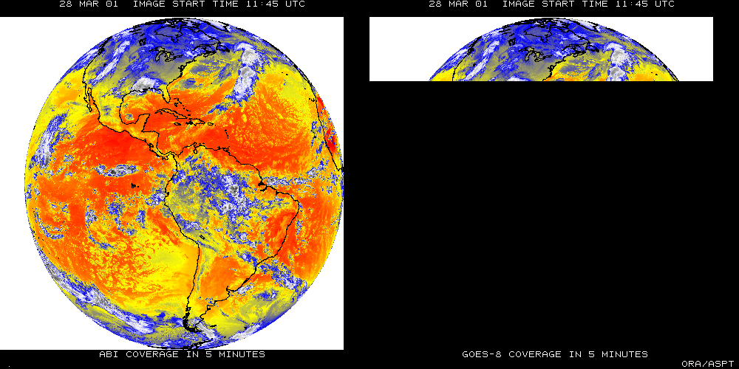
 |  | GOES | GOES-R
Spectral |  | 5 | 16
Spatial | Visible | 1 km | 0.5 km
 | Near-IR | N/A | 1 km
 | IR | 4 km | 2 km
Scan Mode/Temporal Resolution | Full Disk | 3 hr | 15 min
 | CONUS | 15 min | 5 min
 | Mesoscale | N/A | 30 sec
Courtesy of Tim Schmidt, NESDIS/STAR
There are two anticipated scan modes for the ABI:
full disk images every 15 minutes + CONUS images every 5 minutes + mesoscale.
Full disk every 5 minutes

Slide 4
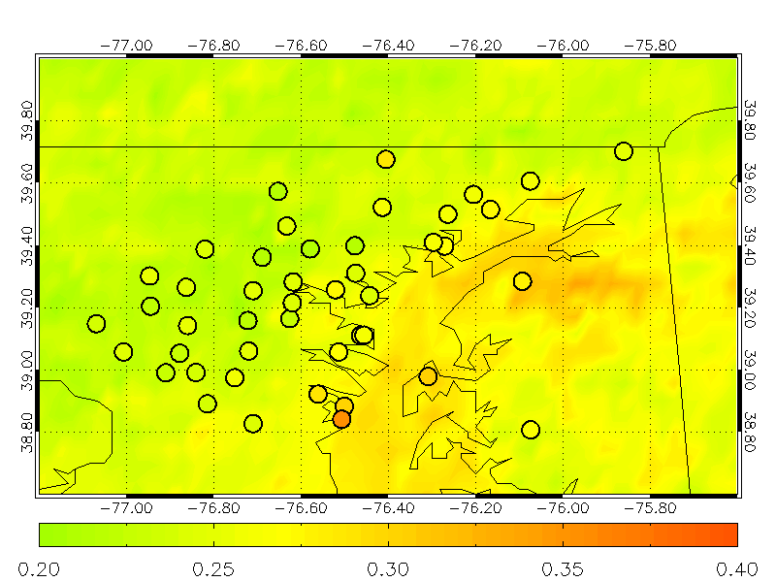
GOES and DRAGON Station AOD Data (June-July 2011)

Slide 5
June and July 2011
Mean DRAGON AOD
Mean GOES AOD

Slide 6
Correlation between GOES and DRAGON AOD for June and July 2011
Match-Up Criteria
Average GOES AOD from 3 X 3 pixels around DRAGON station
A minimum of three of the nine GOES pixels should be cloud-free
DRAGON station observations within ± 15 minutes of GOES observation

Slide 7
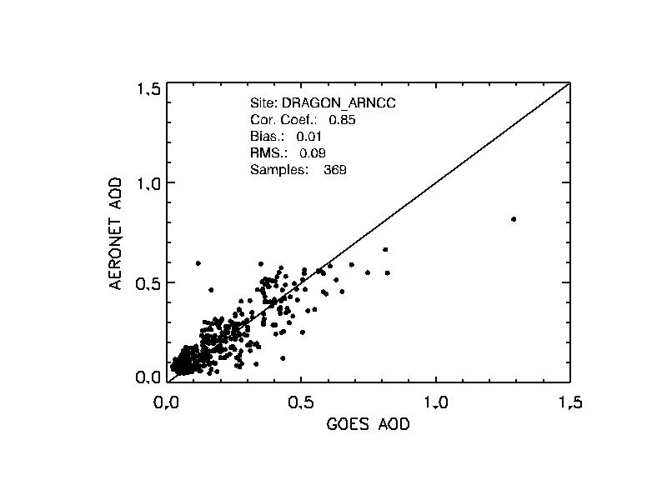
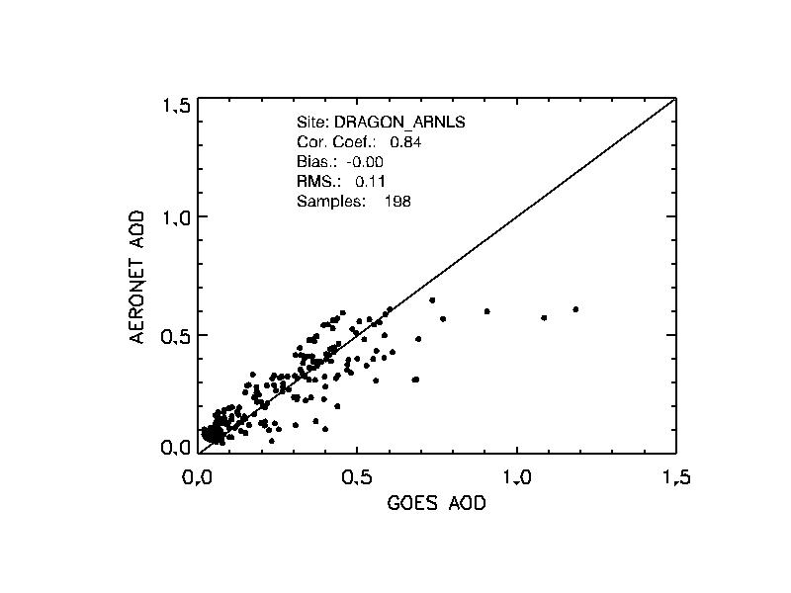
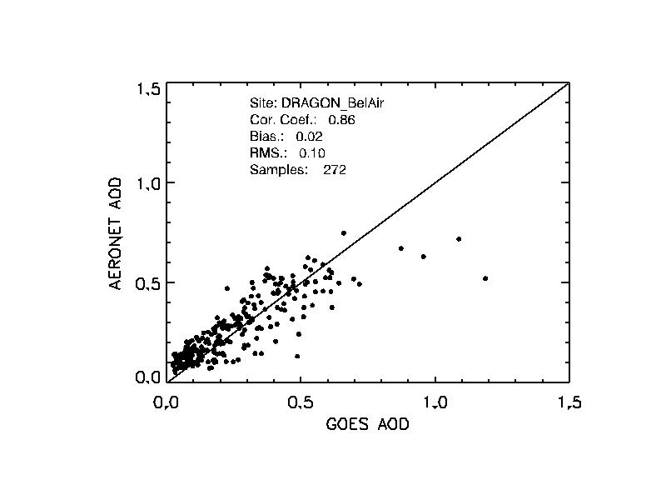
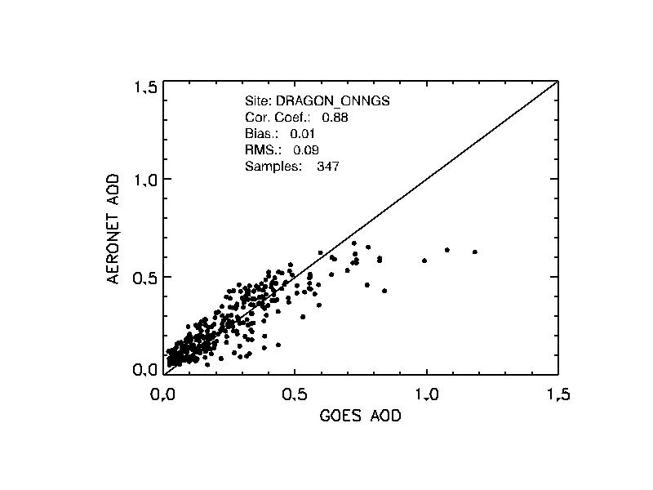
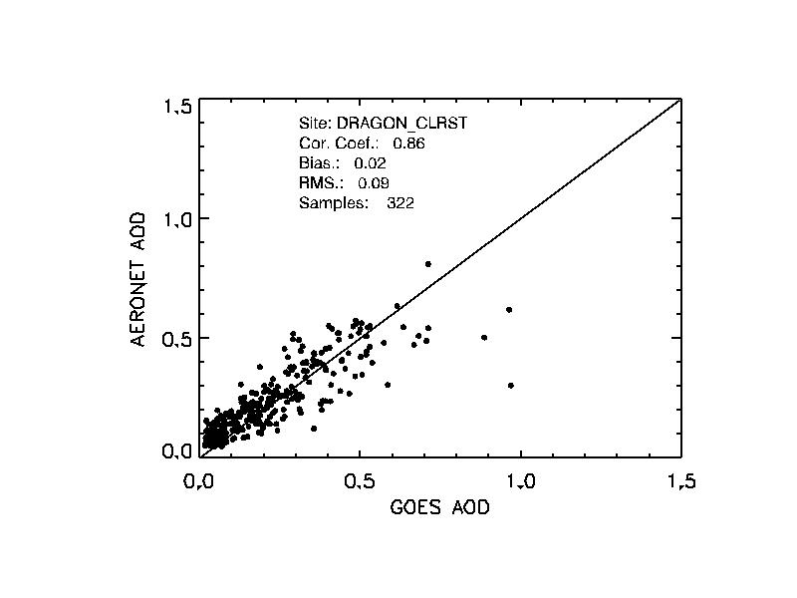
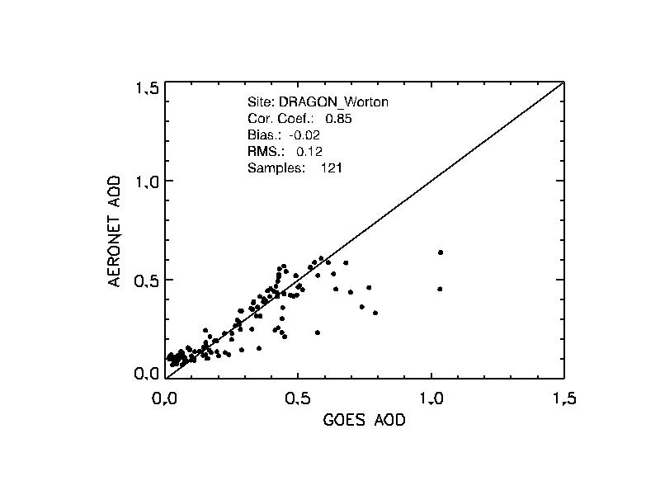
Examples for scatter plots between GOES and DRAGON AOD for individual sites (June and July 2011)

Slide 8
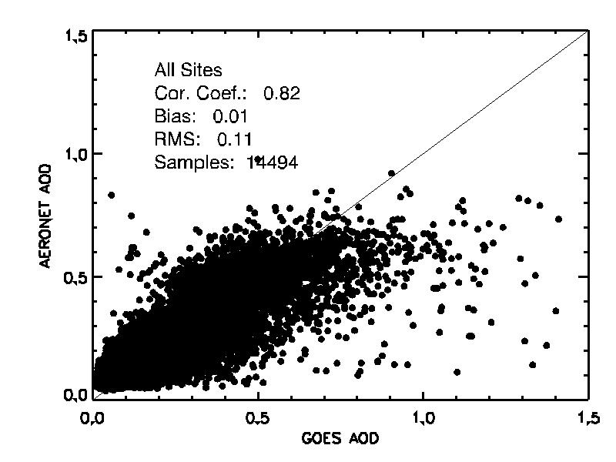
Correlation between GOES and DRAGON AOD (all stations) for June and July 2011

Slide 9
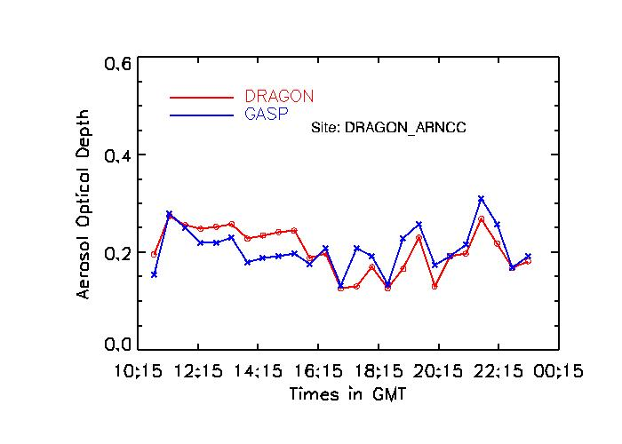
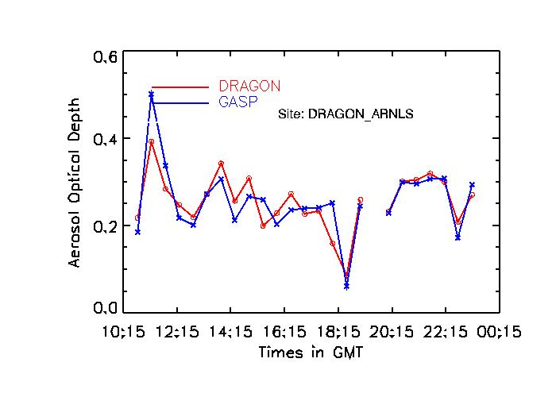
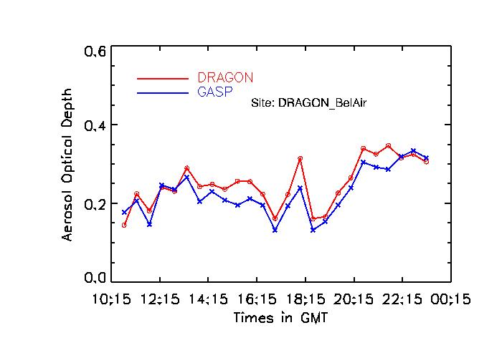
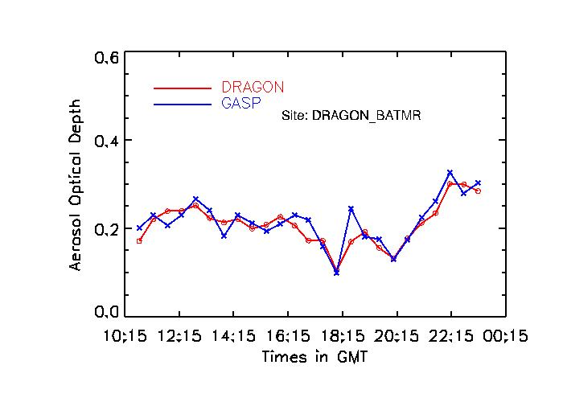
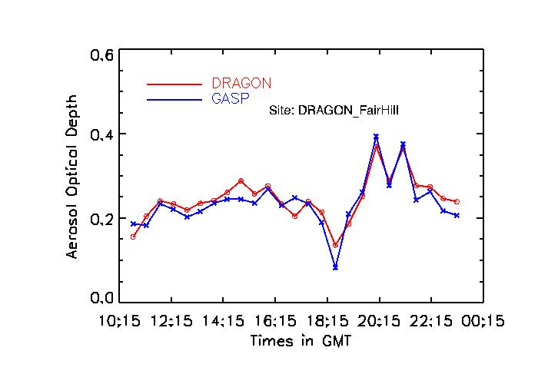
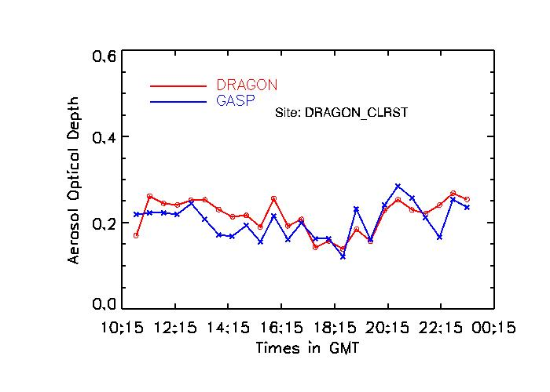
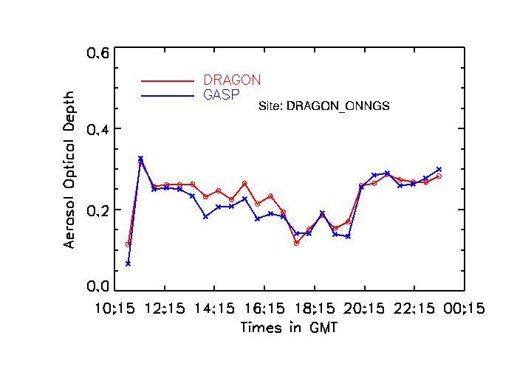
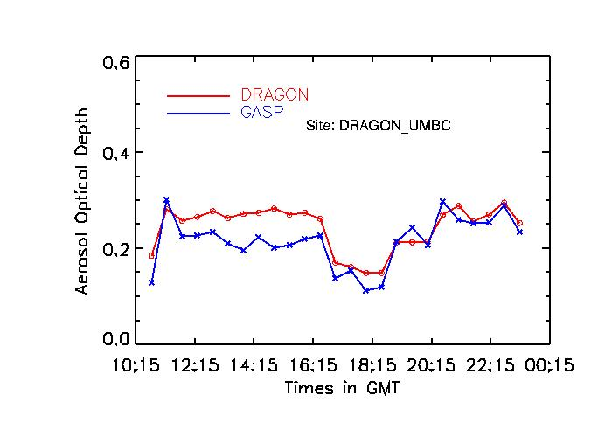
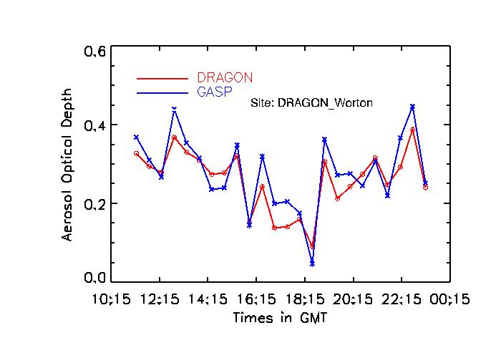
Examples for diurnal cycle for individual sites for June and July 2011

Slide 10
Diurnal Variation of AOD (Mean of all stations for June and July 2011)

Slide 11
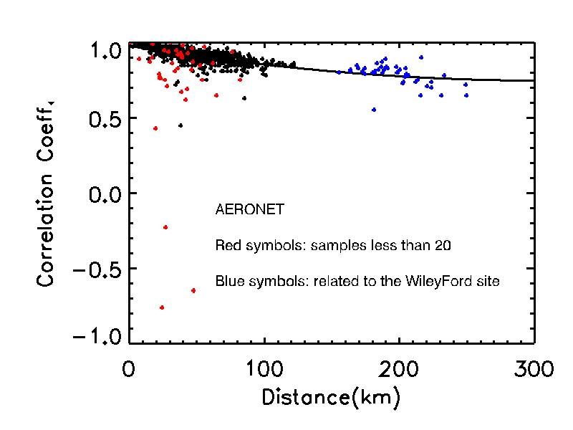
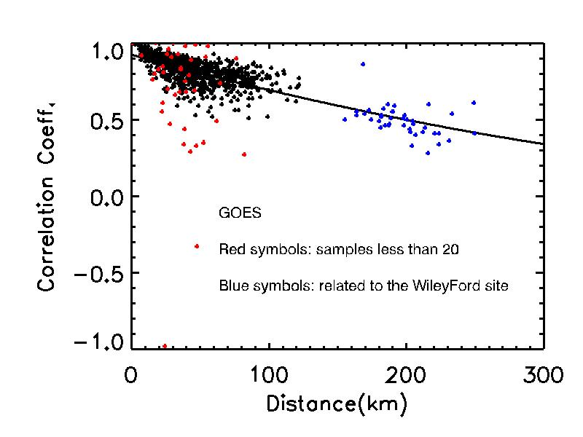
Station to Station Correlation
Findings based on June-July AOD Data
All stations except Wiley Ford (blue dots) located within ~ 100 km.
Poor correlation when sample size is small (red color).
DRAGON network showing high station to station correlation compared to GOES
Results indicate that urban station (Baltimore) has similar AOD as sub-urban stations

Slide 12
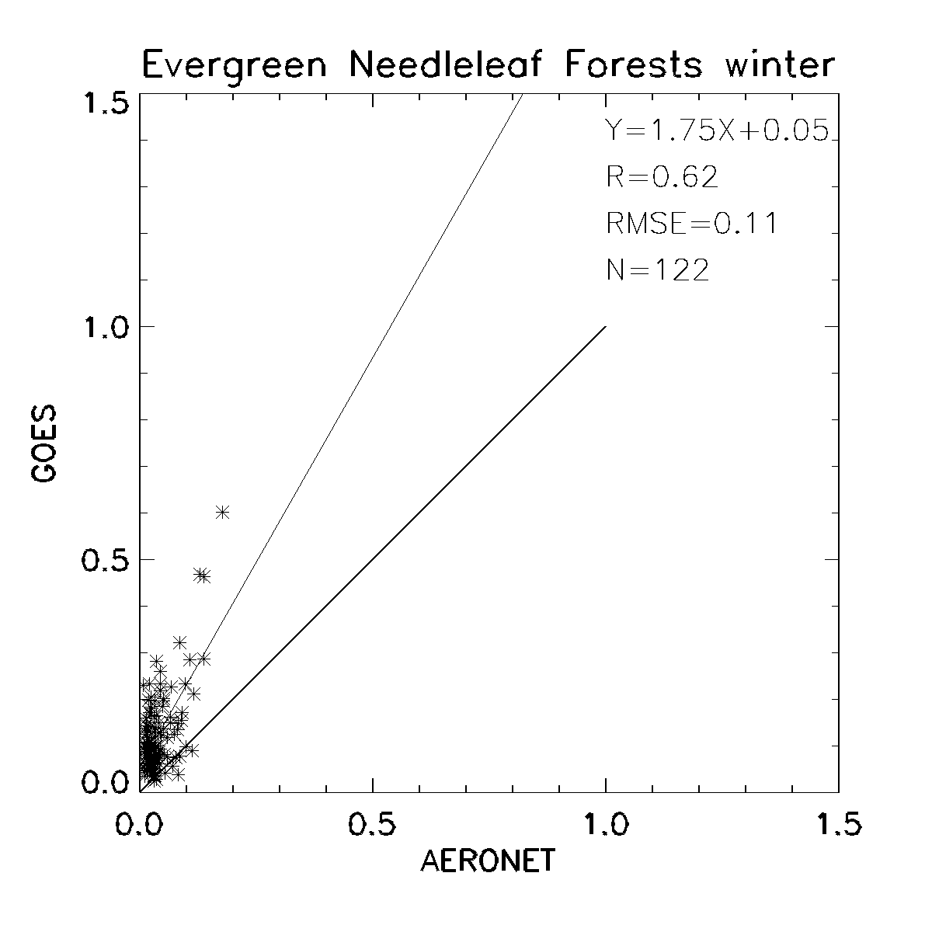
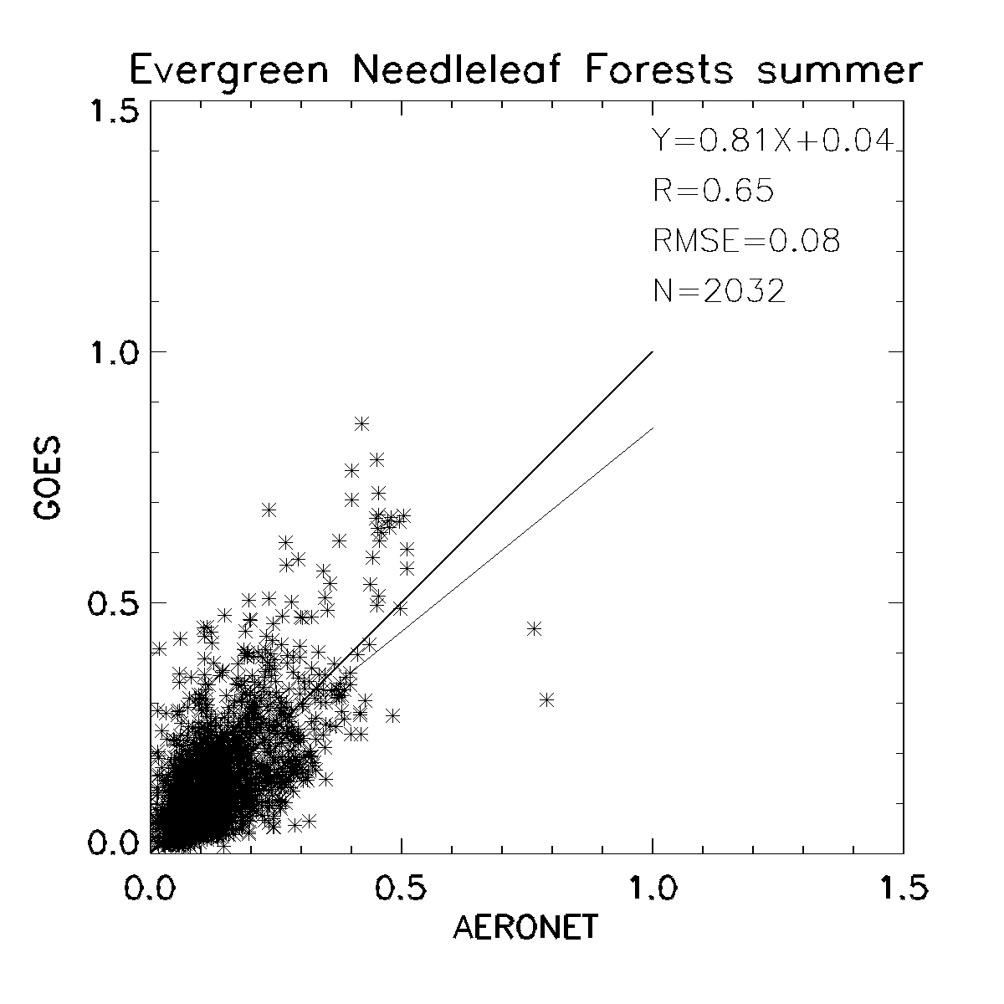
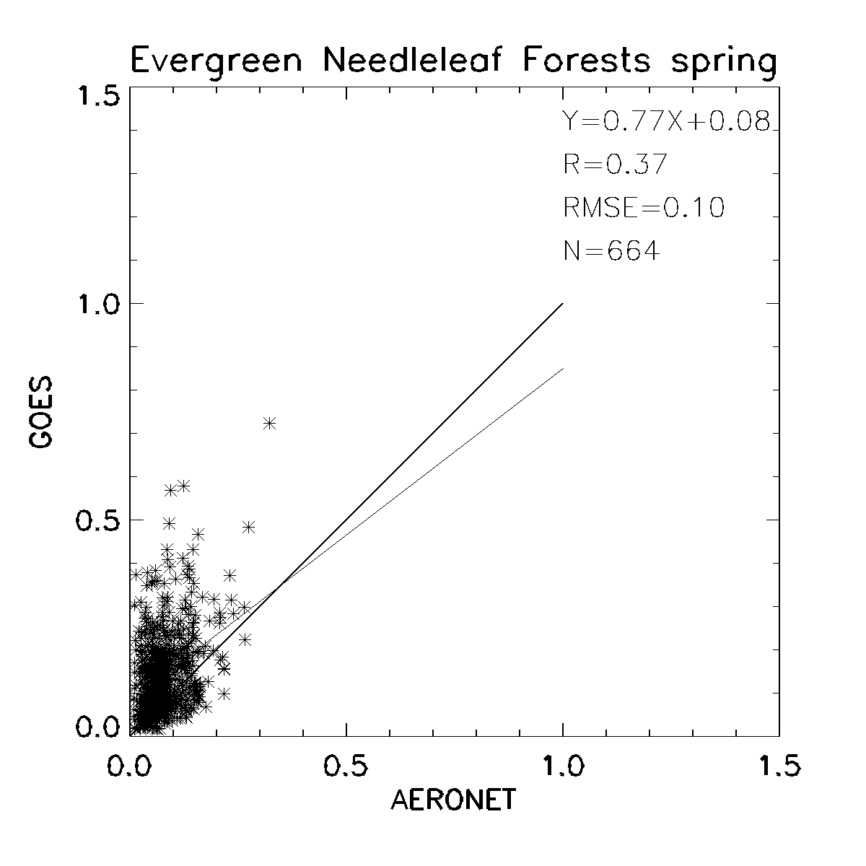
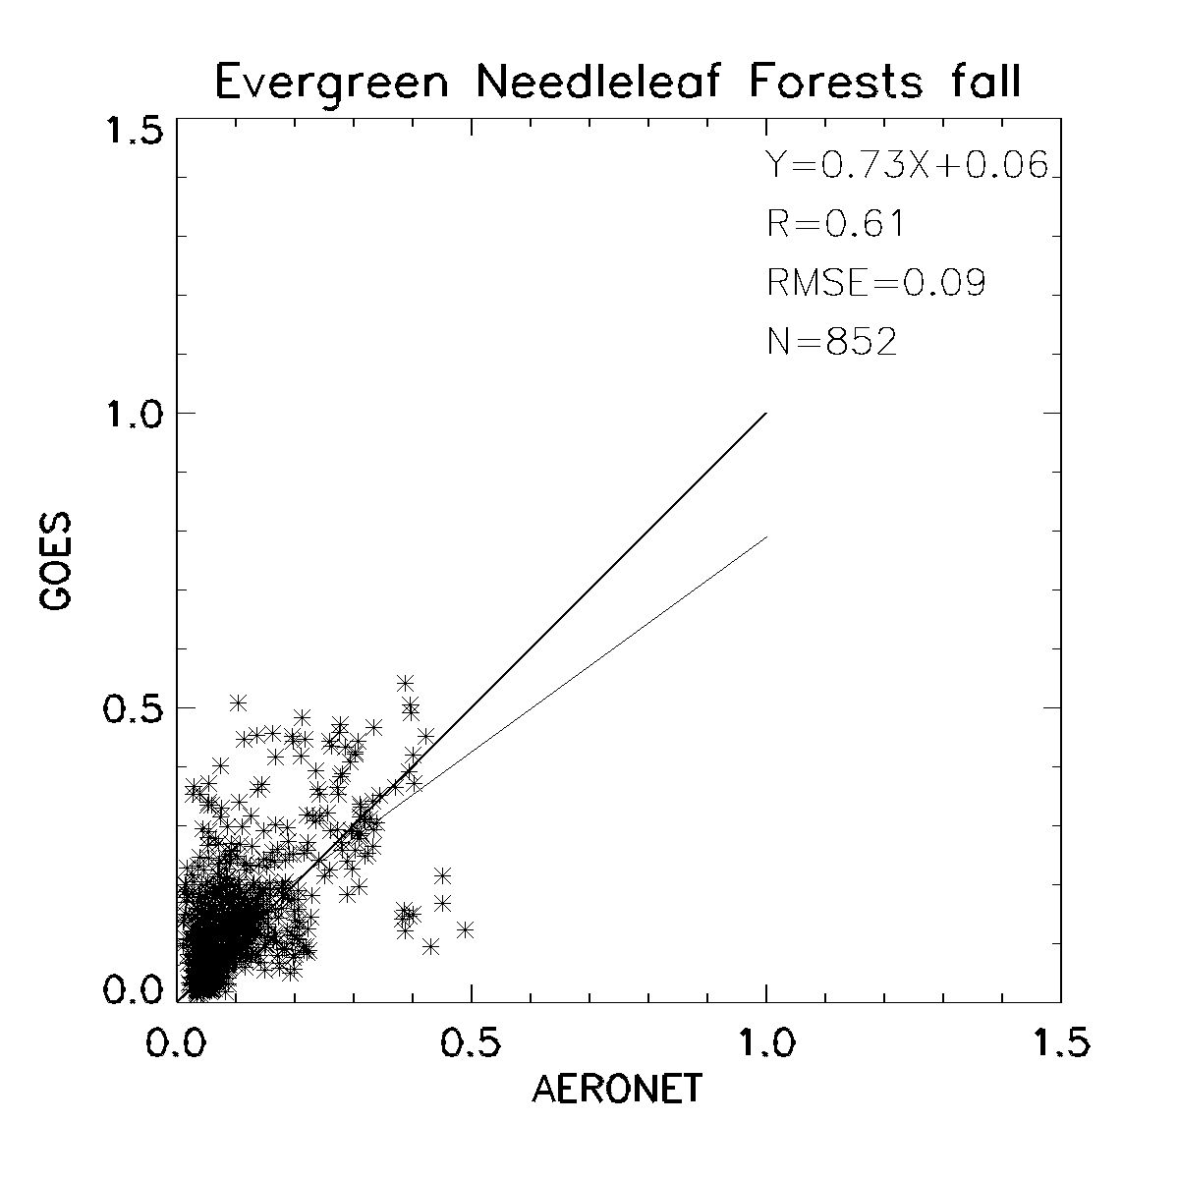
GOES vs. AERONET AOD for Evergreen Needleleaf Forests Surface Type in Different Seasons

Slide 13
GOES vs. AERONET AOD for 2009

Slide 14
GOES vs. AERONET AOD (cont.)

Slide 15
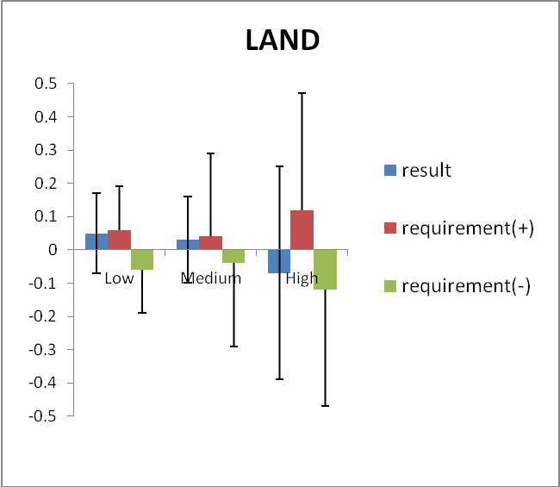
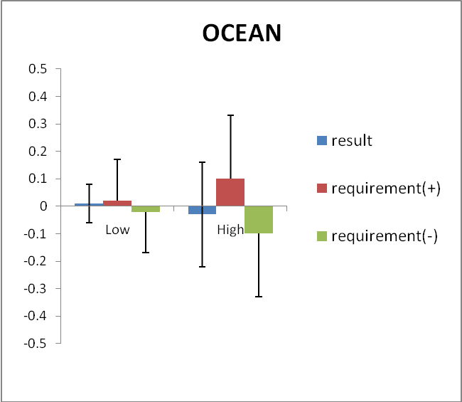
Accuracy and Precision Analysis of ABI AOD
Range | Land |  |  |  | Ocean
 | AOD | Accuracy | Precision | # of points | AOD | Accuracy | Precision | # of points
Low | <0.04 | 0.05 (0.06) | 0.12 (0.13) | 18,100 | <0.4 | 0.01 (0.02) | 0.07 (0.15) | 27,975
Medium | 0.04 - 0.8 | 0.03 (0.04) | 0.13 (0.25) | 109,308
High | > 0.8 | -0.07 (0.12) | 0.32 (0.35) | 3,225 | >0.4 | -0.03 (0.10) | 0.19 (0.23) | 2592
*numbers in parenthesis are the requirements

Slide 16
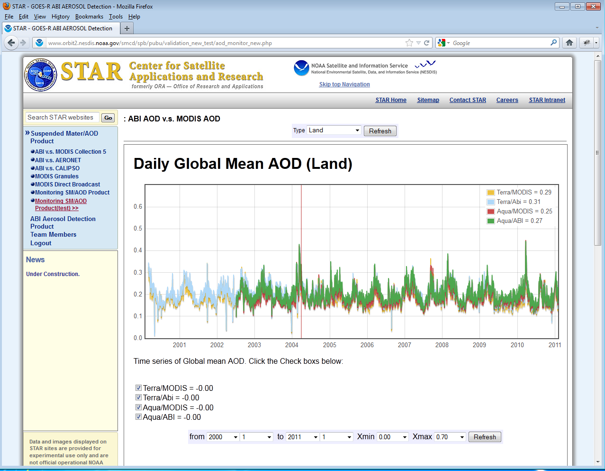
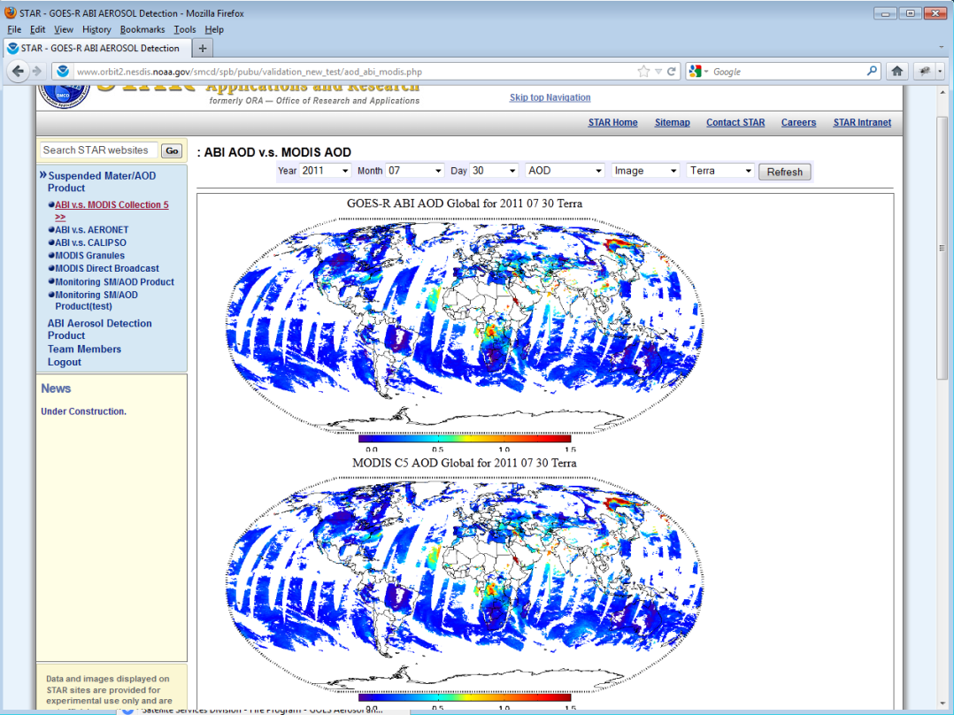
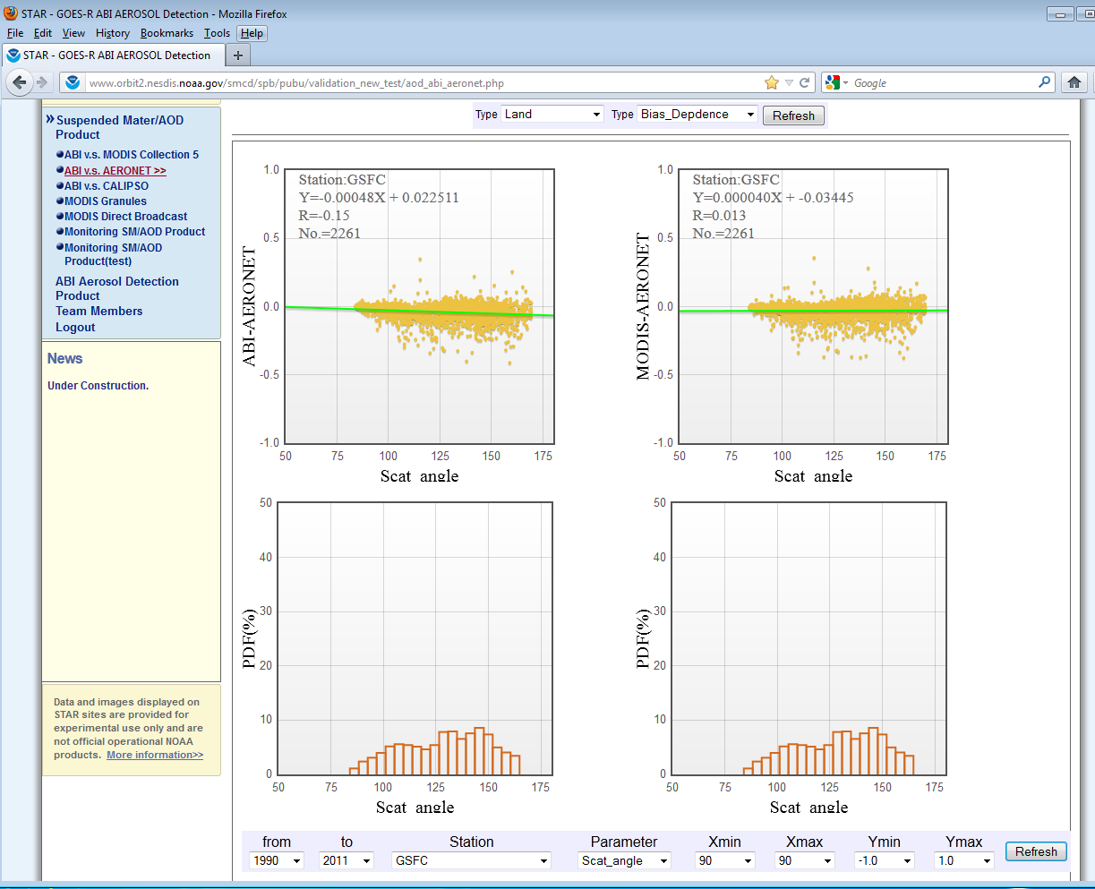
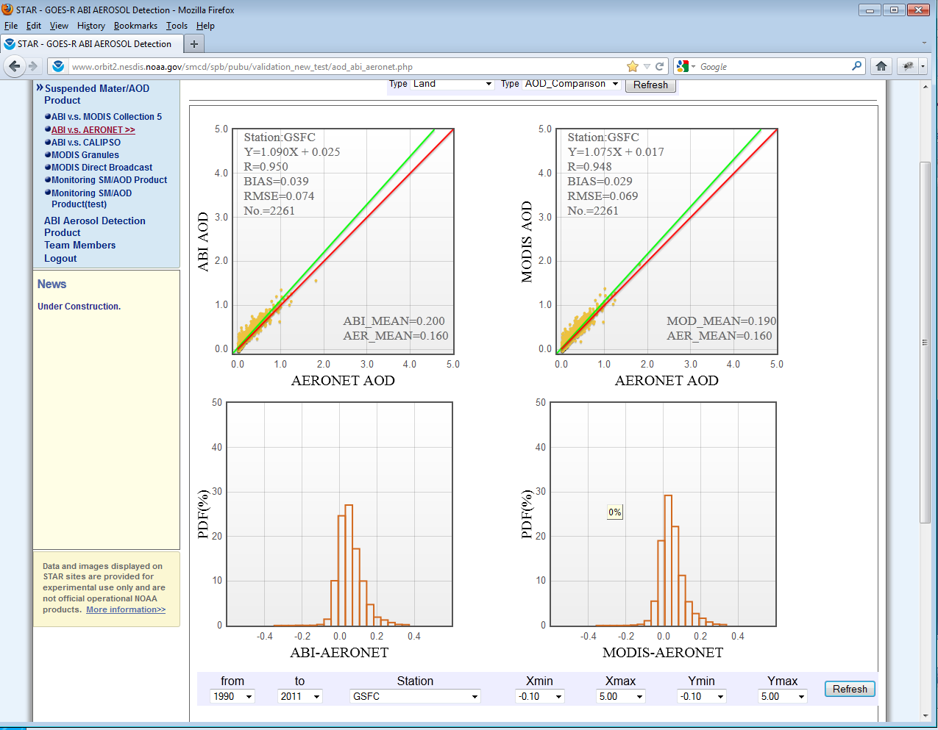

Slide 17
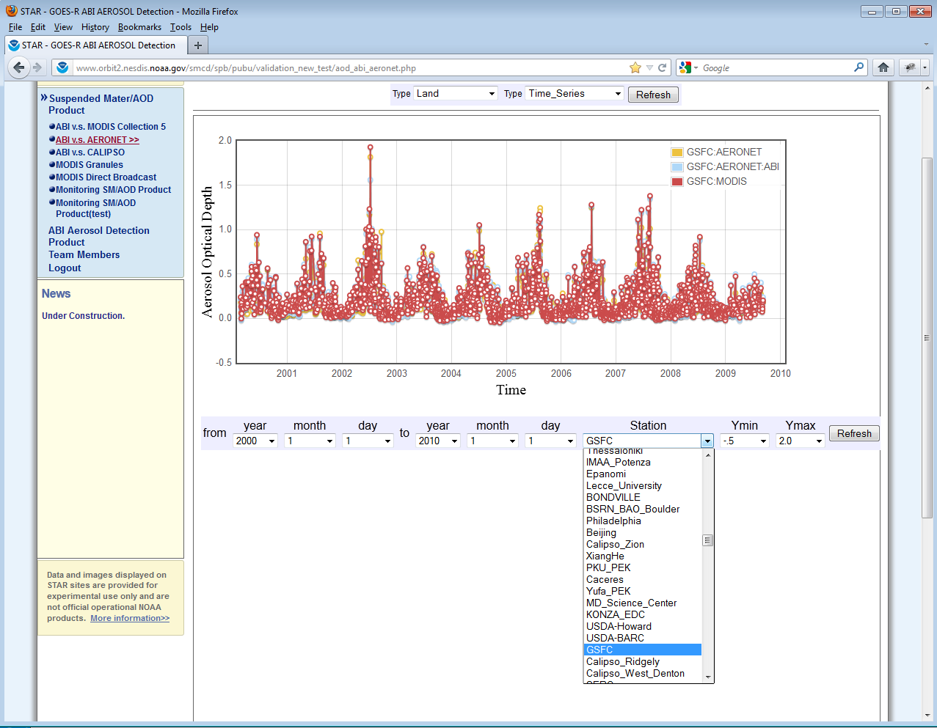

Slide 18
Summary
GOES AOD product is suitable for:
Semi-quantitative applications of air quality monitoring (e.g., identifying aerosol plume location and movement). Product is currently widely used by the users (more than a million hits for IDEA website each calendar year)
Summer time retrievals can be used quantitatively; in winter, AODs are low, surface characteristics change and retrievals are uncertain
GOES-R AOD product
Expected to be as good as MODIS but with better spatial and temporal coverage
Unlike the current GOES AOD product which is validated on an ad hoc basis, GOES-R AOD product will be monitored and validated on a routine basis

