Slide 1
Dissemination of ABI Air Quality Data from GOES-R
Ray Hoff

Slide 2
Proving Ground Goals
The Proving Ground brings together NOAA and its partners to bridge the gap between research and operations and provide a rich source of information contributing to user education and training on GOES-R applications through:
Utilizing current systems (satellite, terrestrial, or model/synthetic) to emulate various aspects of future GOES-R capabilities
Infusing GOES-R products and techniques into the NWS operational environment, with emphasis on the Advanced Weather Information Processing System (AWIPS) and transitioning from AWIPS-I ("AWIPS Legacy") to AWIPS-II ("AWIPS Migration")
Engaging in a two-way dialogue to provide feedback to the developers from the users

Slide 3
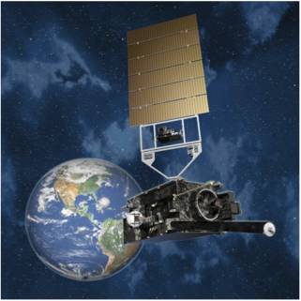
The Ideal World

Slide 4
GOES-R Data Dissemination
All Level 2 products including air quality products:
Aerosol Optical Depth
Suspended Matter
Aerosol type (urban, generic, dust, smoke)
Aerosol detection (smoke/dust mask)
Fires and emissions
Burned area
cloud mask
Operational product users with a capability to use AWIPS-II (e.g., WFOs)
AWIPS
GOES-R Ground System
(closed non-IP)
Environmental Protection Agency
United States Forest Service
National Weather Prediction (NWP) centers
OSDPD Data Distribution Server
(open IP access)

Slide 5
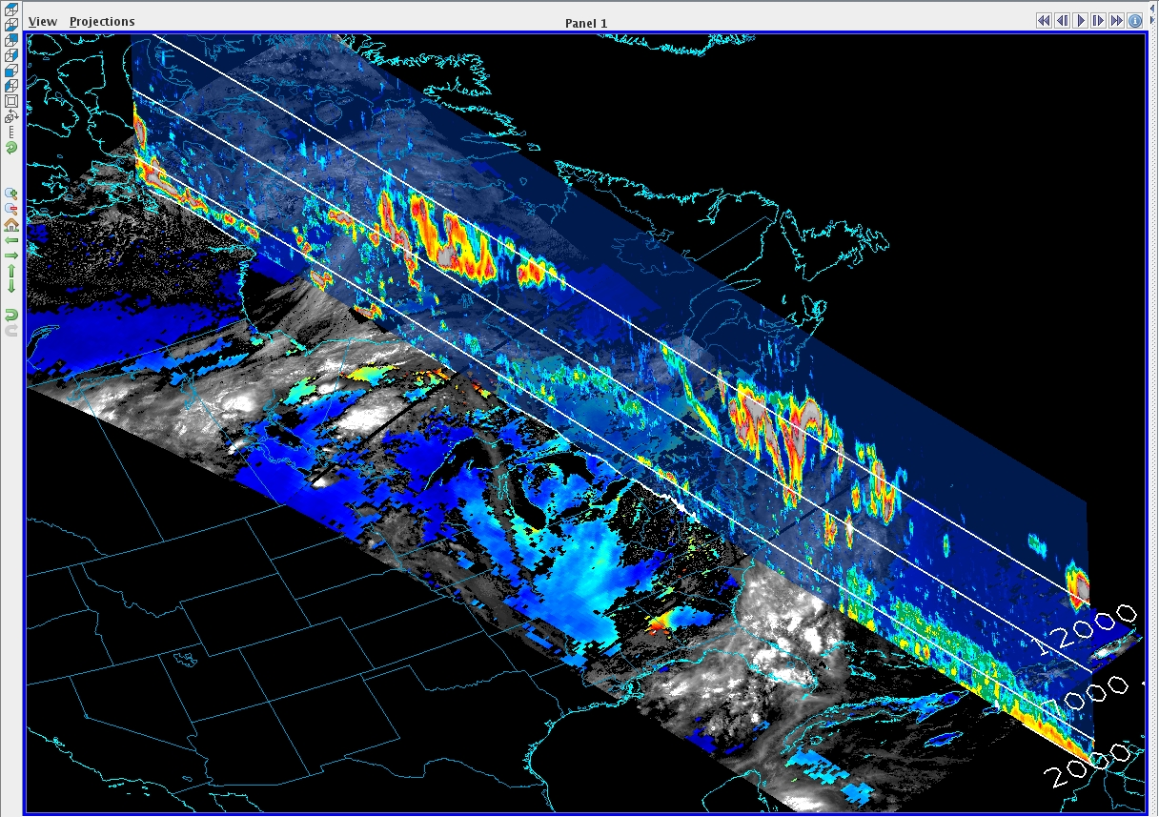
Visualization/Data Dissemination System for Air Quality Forecasters – McIDAS-V
CALIPSO slice
in vertical
MODIS 2D layer
McIDAS-V: Interactive Analysis, 4D Visualization and integration of
Geophysical Data. Time: 2006-07-07, 18Z

Slide 6
Air Quality Data Dissemination
Air quality products:
Aerosol Optical Depth
Suspended Matter
Aerosol type (urban, generic, dust, smoke)
Aerosol detection (smoke/dust mask)
Fires and emissions
Burned area
cloud mask
Product Tailoring:
compositing
zooming capabilities
time series
remapped to a pre-defined grid
overpass data for specific stations
overlays of different but related products (e.g., wind vectors over AOD)
geotiff, KML, etc.
GOES-R Ground System
Air quality forecasters
Visualization System
AQPG is building this over the next year
and will deliver this to OSDPD for
Implementation before launch

Slide 7
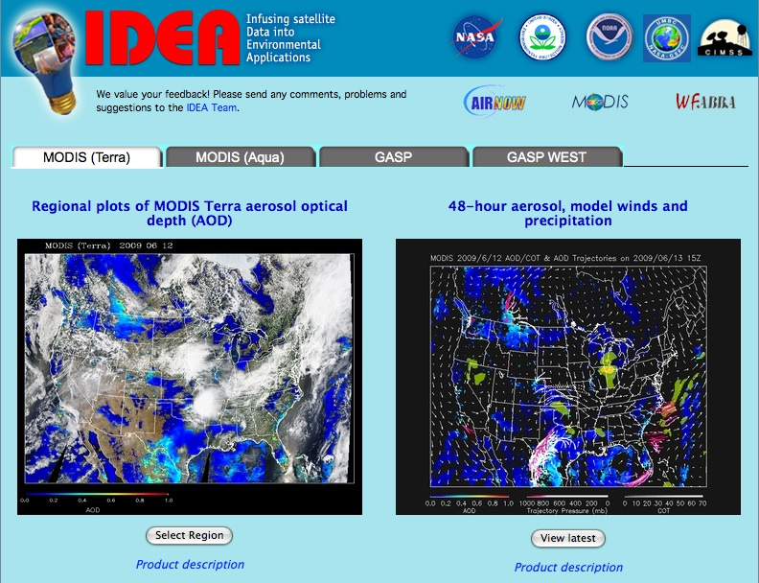
An Example of a Web-Based Visualization/Data Dissemination System for Air Quality Forecasters
(http://star.nesdis.noaa.gov/smcd/spb/aq/)

Slide 8
We will build a web portal at OSDPD but what should be there?
Imagery (like RGB, not RGB but close)
AOD Product?
Aerosol type product?
Nowcasting – motion?
PM estimation?
Verification panels?
Ability to manipulate? Zoom? Slice?
HMS?
Meteorology?
Active links to other GOES-R products?
What else?

