Slide 1
Introducing VIIRS aerosol products
Lorraine A. Remer
JCET UMBC
VIIRS Cal/Val Team:
Istvan Laszlo, Co-Chair (NOAA-STAR)
Shobha Kondragunta, Co-Chair (NOAA-STAR)
Hongqing Liu (IMSG NOAA)
Jingfeng Huang (ESSIC NOAA)
Ho-Chun Huang (ESSIC NOAA)
Hai Zhang (IMSG NOAA)
Sid Jackson (Northrup-Grumann)
Edward Hyer (NRL)
Min Oo (SSEC U.Wisc.)
Andrew Sayer (USRA NASA)
N. Christina Hsu (NASA-GSFC)
Robert Holz (SSEC U.Wisc.)

Slide 2
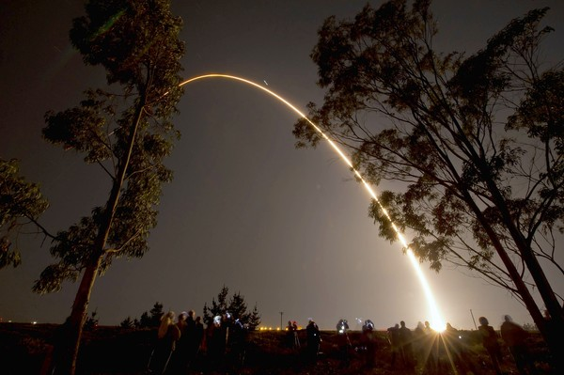
Suomi-NPP launch October 28, 2011

Slide 3
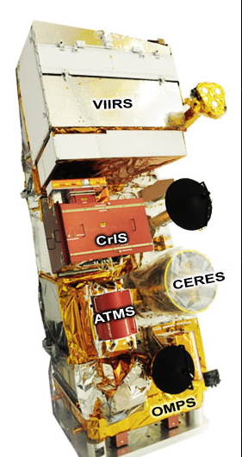
VIIRS: Visible-Infrared Imager/Radiometer Suite
CrIS: Cross-track Infrared Sounder
CERES: Cloud and Earth Radiant Energy System
ATMS: Advance Technology Microwave Sounder
OMPS: Ozone Mapping and Profiler Suite

Slide 4
VIIRS: Visible-Infrared Imager/Radiometer Suite
CrIS: Cross-track Infrared Sounder HIRS
CERES: Cloud and Earth Radiant Energy System CERES
ATMS: Advance Technology Microwave Sounder AMSU
OMPS: Ozone Mapping and Profiler Suite OMI

Slide 5
VIIRS: Visible-Infrared Imager/Radiometer Suite MODIS/AVHRR/ SeaWIFS
CrIS: Cross-track Infrared Sounder HIRS
CERES: Cloud and Earth Radiant Energy System CERES
ATMS: Advance Technology Microwave Sounder AMSU
OMPS: Ozone Mapping and Profiler Suite OMI

Slide 6
Heritage Capabilities
From Ed Hyer, NRL
VIIRS
DNB
MODIS
SeaWiFS
AVHRR
OLS
Low Light Imagery
0.4
0.5
0.6
0.7
0.8
0.9
1.2
1.8
2.4
4
6
8
10
12
14
Visible
Breaks in scale
Mid wave IR
Long wave IR
[micron]
Credit: Northrup Grumman & Raytheon

Slide 7
VIIRS is a multiwavelength imager, like MODIS
with similar wavelength bands in the aerosol range
 | MODIS | VIIRS
Orbit altitude | 690 km | 824 km
Equator crossing time | 13:30 LT | 13:30 LT
Granule size | 5 minutes | 86 seconds
swath | 2330 km | 3000 km
Pixel nadir | 0.5 km | 0.75 km
Pixel edge | 2 km | 1.5 km

Slide 8
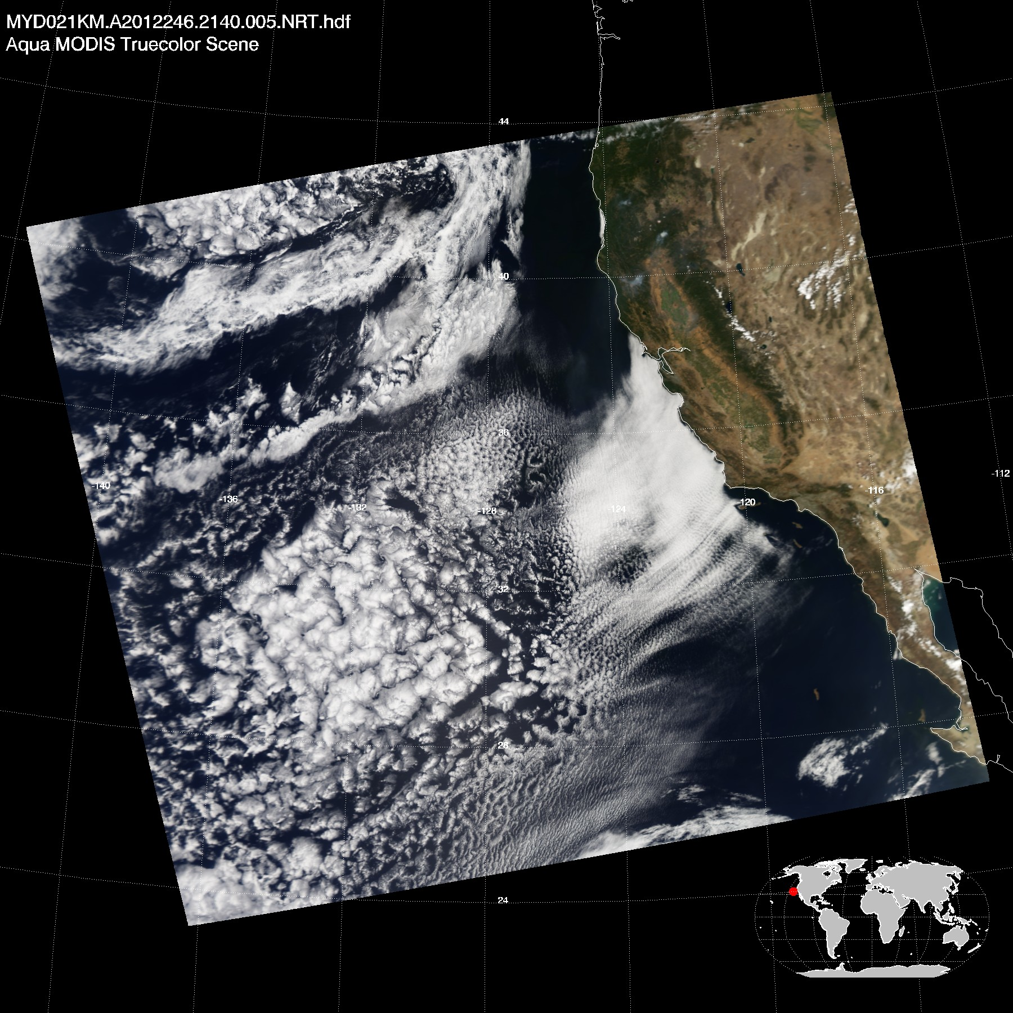
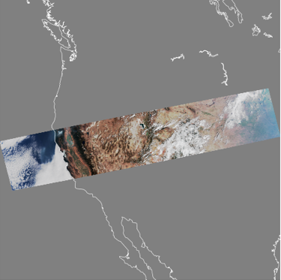
VIIRS granule
NASA MODIS Atmospheres
SSEC PEATE
MODIS
0.66 – 0.55 – 0.47 µm
2 Sep 2012
21:40 UTC
VIIRS
0.67 – 0.55 – 0.49 µm
2 Sep 2012
20:24:27.8 UTC

Slide 9
Don Hillger, NOAA

Slide 10
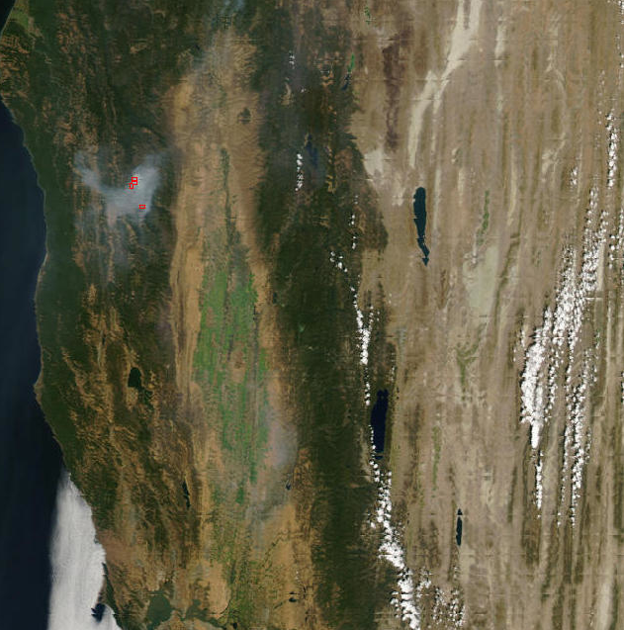
MODIS swath edge
‘bowtie’ effect
VIIRS doesn’t have this
From NASA LANCE

Slide 11
 | MODIS | VIIRS
Product resolution nadir | 10 km 3 km | 6 km 0.75 km
Product resolution edge | 40 km 12 km | 12 km 1.5 km
Products land | ΑΟΤ | ΑΟΤ, Angstrom exponent, (suspended matter)
Products ocean | ΑΟΤ, fine mode fraction | ΑΟΤ, Angstrom exponent, (suspended matter)
Angstrom exponent over land and suspended matter not ready for public use

Slide 12
VIIRS Aerosol Products:
Aerosol Optical Thickness
EDR (Environmental Data Record)
- in 10 wavelengths
- over land and ocean
- not over bright surfaces (deserts)
- not over snow, sunglint, fires, inland water
- 6 km resolution (nadir)
- about 12 km resolution (edge)
- Quality Flags (USE THEM!)

Slide 13
VIIRS aerosol products
Aerosol Optical Thickness
IP (Intermediate Product)
Same as EDR
About 1 km resolution nadir
About 2 km resolution edge
Now publicly available

Slide 14
Pixel size is 0.75 km
EDR retrieval box is 6 km
6 km
Over land retrieval masks out clouds and water
8 x 8 pixels

Slide 15
IP product
EDR product
35 individual 0.75 km AOT retrievals
1 value of AOT to represent the entire box

Slide 16
IP product
EDR product
EDR product is aggregated from IP product,
Not from original radiances

Slide 17
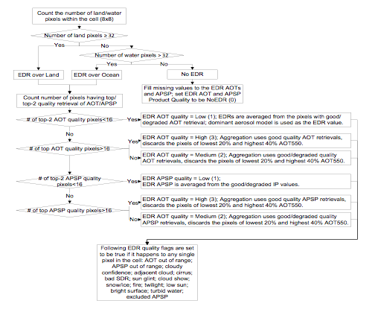
Aggregation from IP to EDR takes quality of IP retrievals into account and is not a simple average of retrieved IP within the box
VIIRS Users Manual

Slide 18
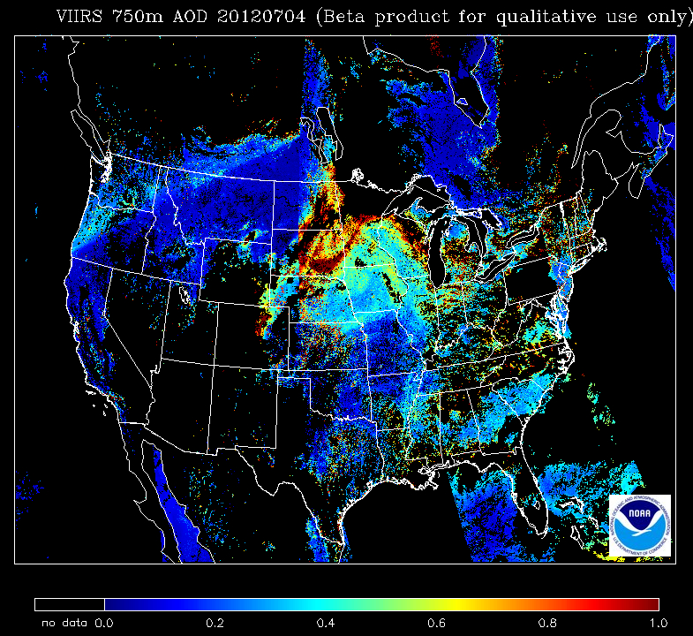
VIIRS AOT 550 nm 4 July 2012 IP 750 m
Kondragunta

Slide 19
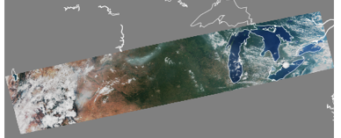
VIIRS AOT 550 nm 4 July 2012
VIIRS RGB
4 July 2012 19:07 UTC

Slide 20
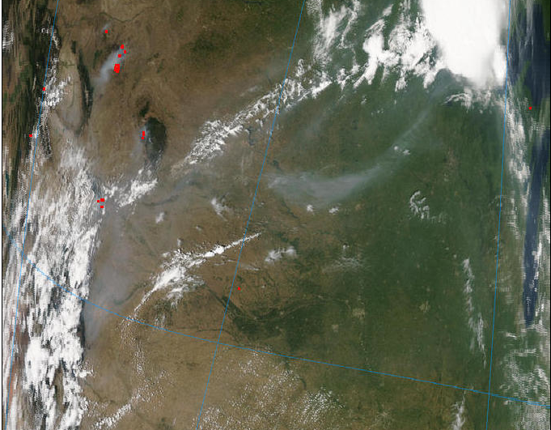
VIIRS RGB
4 July 2012 19:07 UTC
MODIS RGB 4 Jul 2012 19:40 UTC

Slide 21
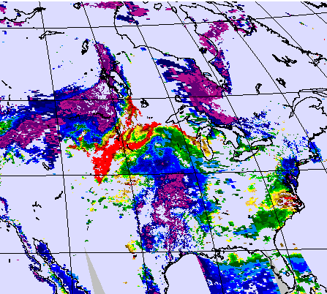
VIIRS AOT 550 nm 4 July 2012 IP 750 m
NASA MODIS Atmospheres
MODIS AOT 550 nm 4 July 2012
Aqua L2 Col51 10 km
Kondragunta

Slide 22
They who fail to use quality flags, get what they deserve.

Slide 23
Quality Flags:
EDR: 4 1-byte flags, each corresponding to a single EDR AOT retrieval.
QF1, QF2, QF3, QF4.
Bits 1 and 2 of QF1 describe quality of AOT retrieval
11 = 3 = High
10 = 2 = Medium
01 = 1 =Low
00 = 0 = Not Produced
Bits 3 and 4 of QF1 describe quality of Angstrom Exponent in
the same way as for AOT
IP: Bits 1 and 2 of QF1 describe quality of Intermediate Product
11 = 3 = Not Produced (fill values)
10 = 2 = Excluded (exist, but not in EDR)
01 = 1 =Degraded (in EDR, but may degrade QF)
00 = 0 = High

Slide 24
Important Dates:
Software production error
Aerosol product candidate provisional status
Initial instrument check out.
Tuning cloud mask parameters
Aerosol product at Beta status
Beta status
28 Oct
2011
2 May
2012
15 Oct
2012
22 Jan
2013
today
27 Nov
2012
Red periods: DO NOT USE the product.
Beta: Use with caution. Known biases. Frequent changes.
Provisional: Improved from Beta. Still under close scrutiny.

Slide 25
Product status during Beta period

Slide 26
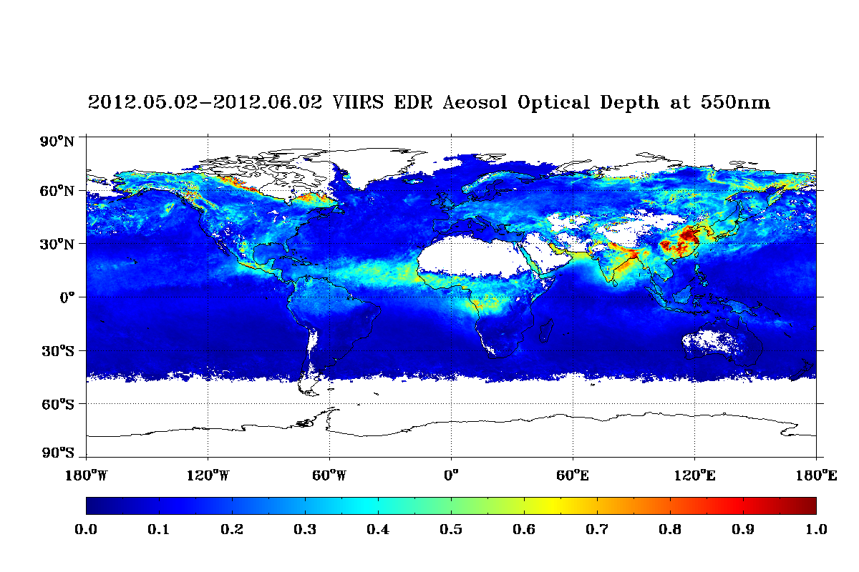
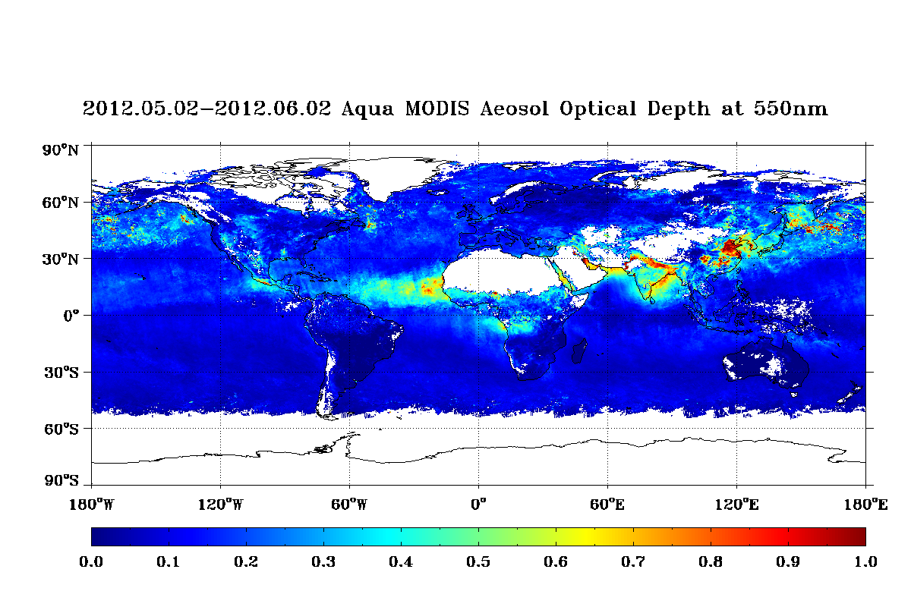
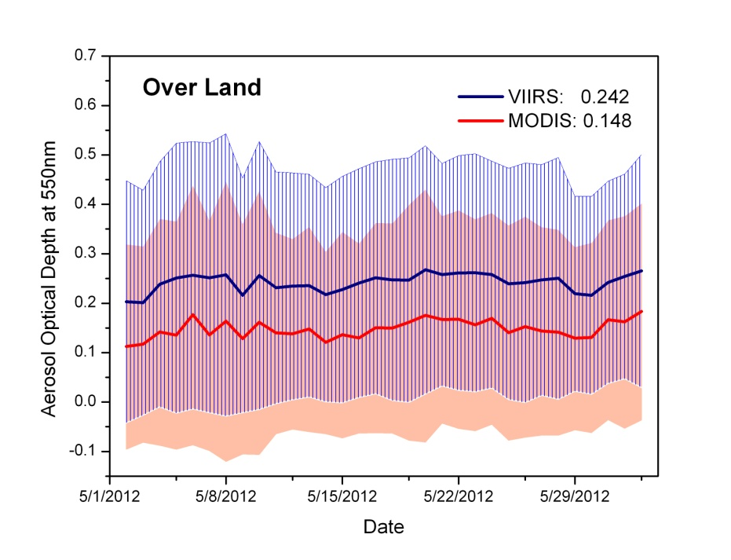
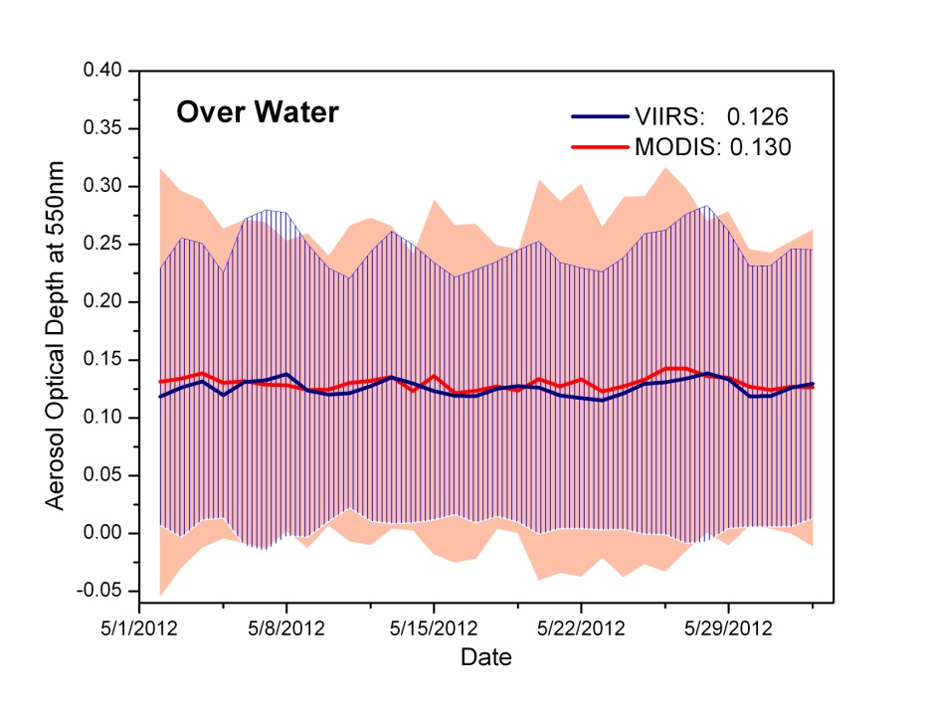
VIIRS monthly mean May
MODIS monthly mean May
Positive AOT bias over land (Beta)
Good match to MODIS ocean (Beta)
land
ocean
Hongqing Liu

Slide 27
Validation of VIIRS AOT (Beta)
Very good fit over ocean
Consistent high bias over land
Sid Jackson

Slide 28
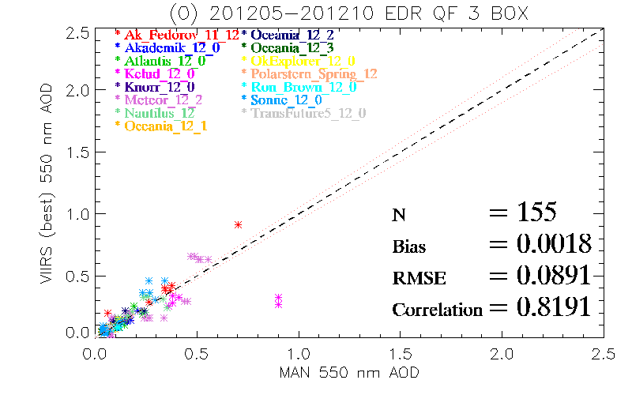
VIIRS vs. MAN data
Ho-Chun Huang

Slide 29
Product status since 23 January 2013
(after efforts to correct land bias, step 1)

Slide 30
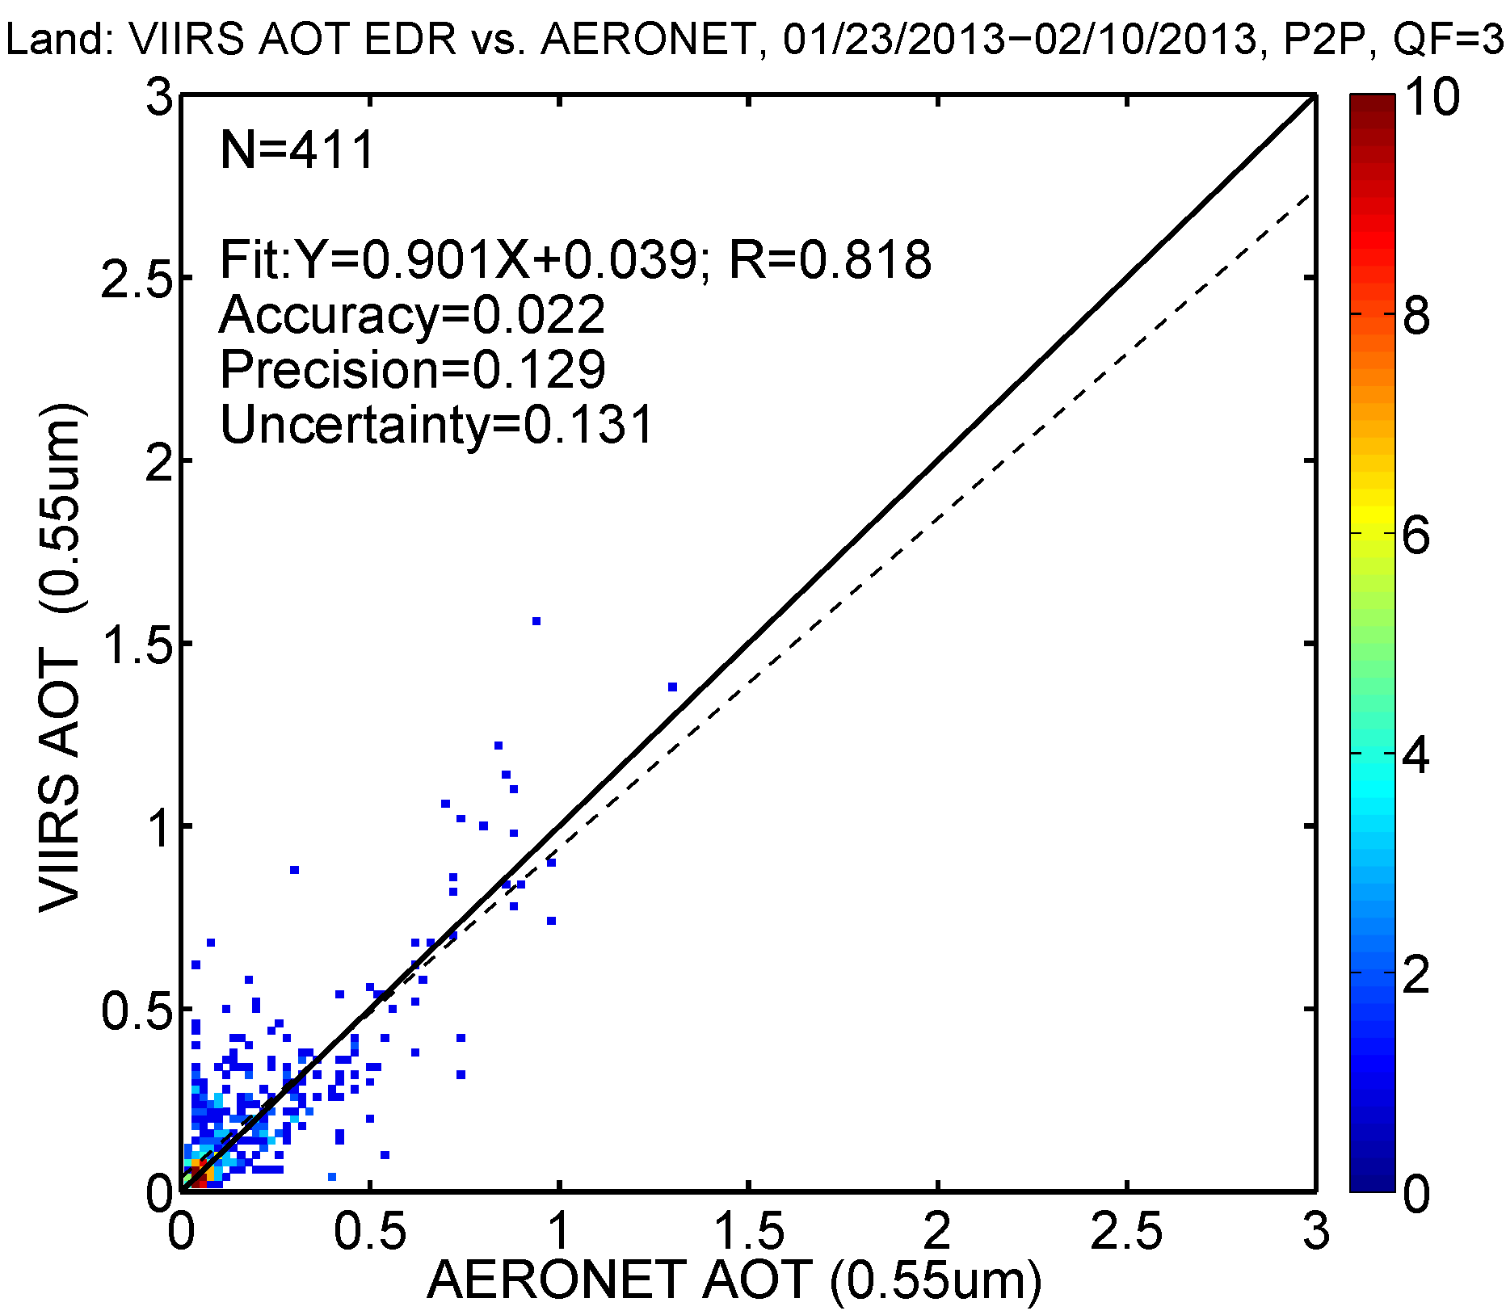
Jingfeng Huang

Slide 31
Wavelength | LAND, Point-2-Point, QA=3 | 01/23/2013-02/10/2013
550nm | R | 0.818
 | Accuracy | 0.022
 | Precision | 0.129
 | Uncertainty | 0.131
445nm | R | 0.853
 | Accuracy | 0.027
 | Precision | 0.152
 | Uncertainty | 0.155
672nm | R | 0.756
 | Accuracy | 0.015
 | Precision | 0.115
 | Uncertainty | 0.116
865nm | R | 0.603
 | Accuracy | 0.006
 | Precision | 0.106
 | Uncertainty | 0.106
0.712 (Beta)
0.045 (Beta)
VIIRS vs. AERONET
Much improvement in AOT over land
Jingfeng Huang

Slide 32
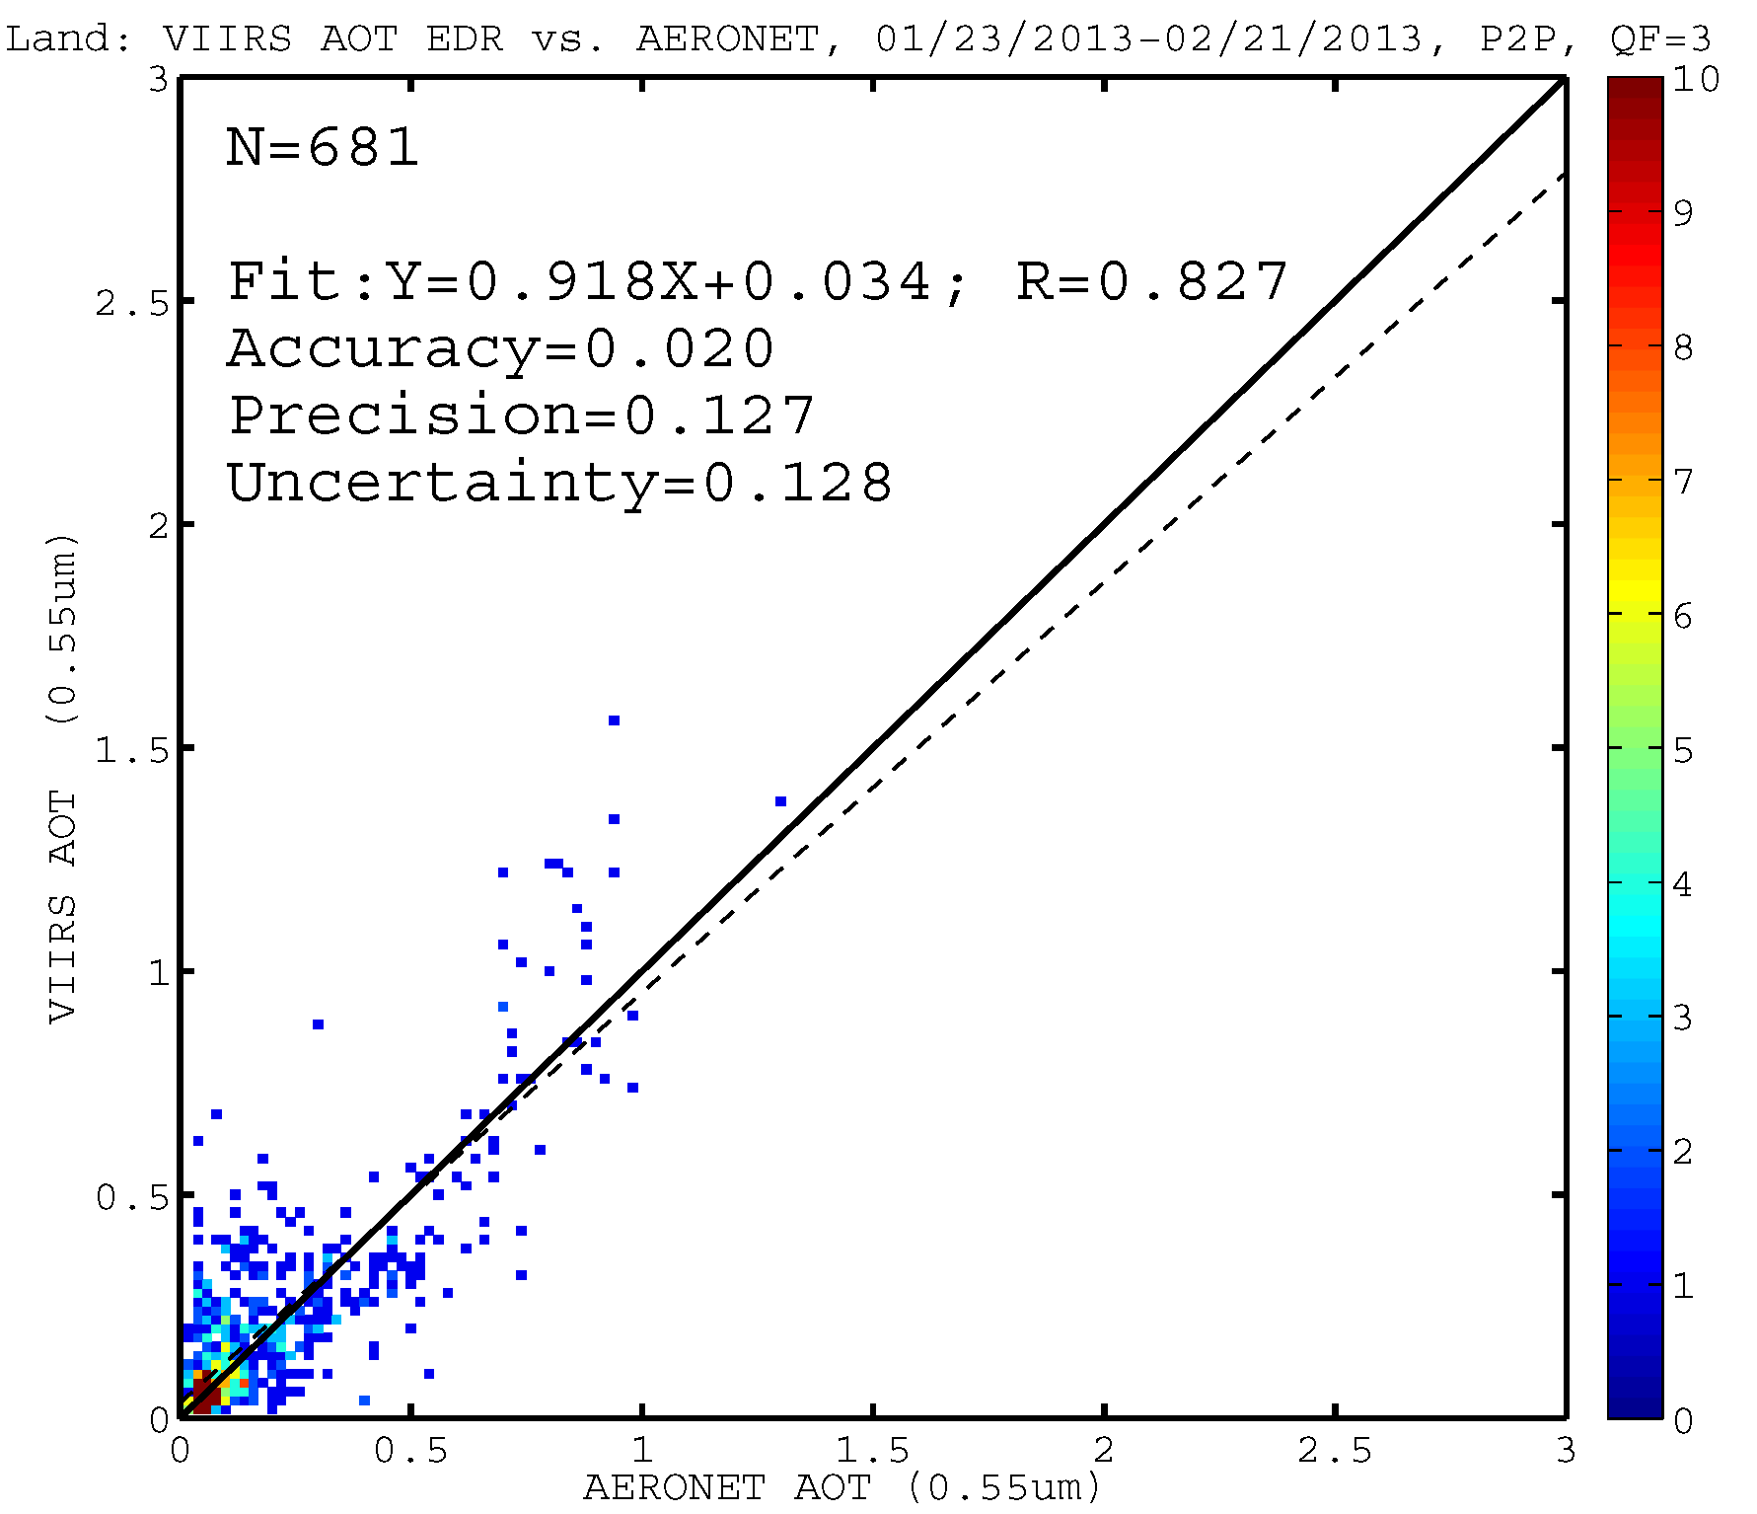
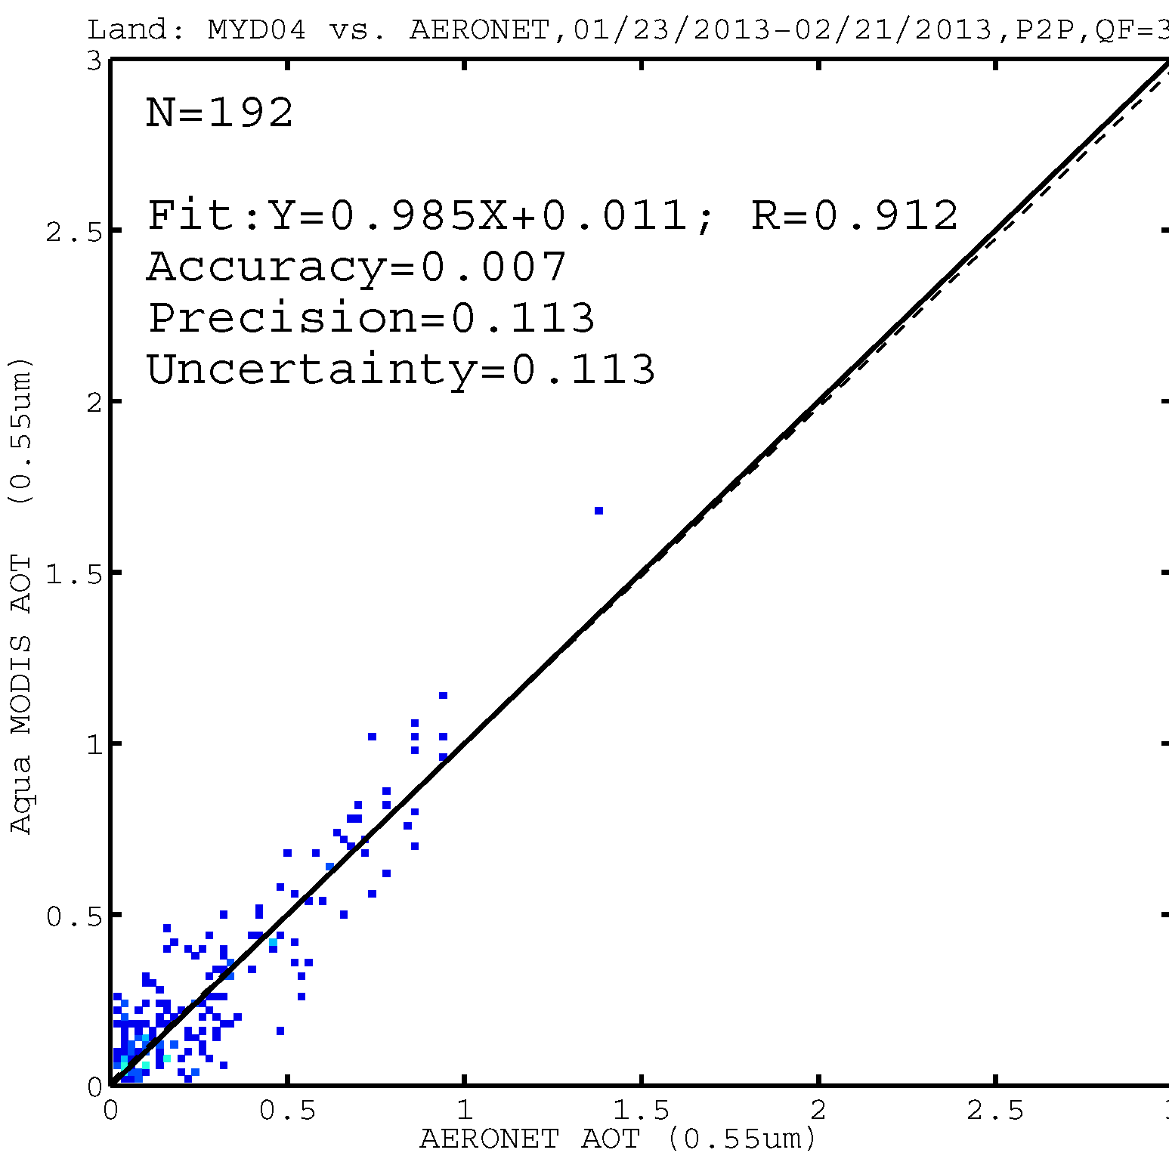
AOT
VIIRS N=681
MODIS N = 192
GLOBAL
VIIRS vs. AERONET
MODIS less scatter and lower bias,
but VIIRS still meeting reqs
GLOBAL
MODIS vs. AERONET
Jingfeng Huang

Slide 33
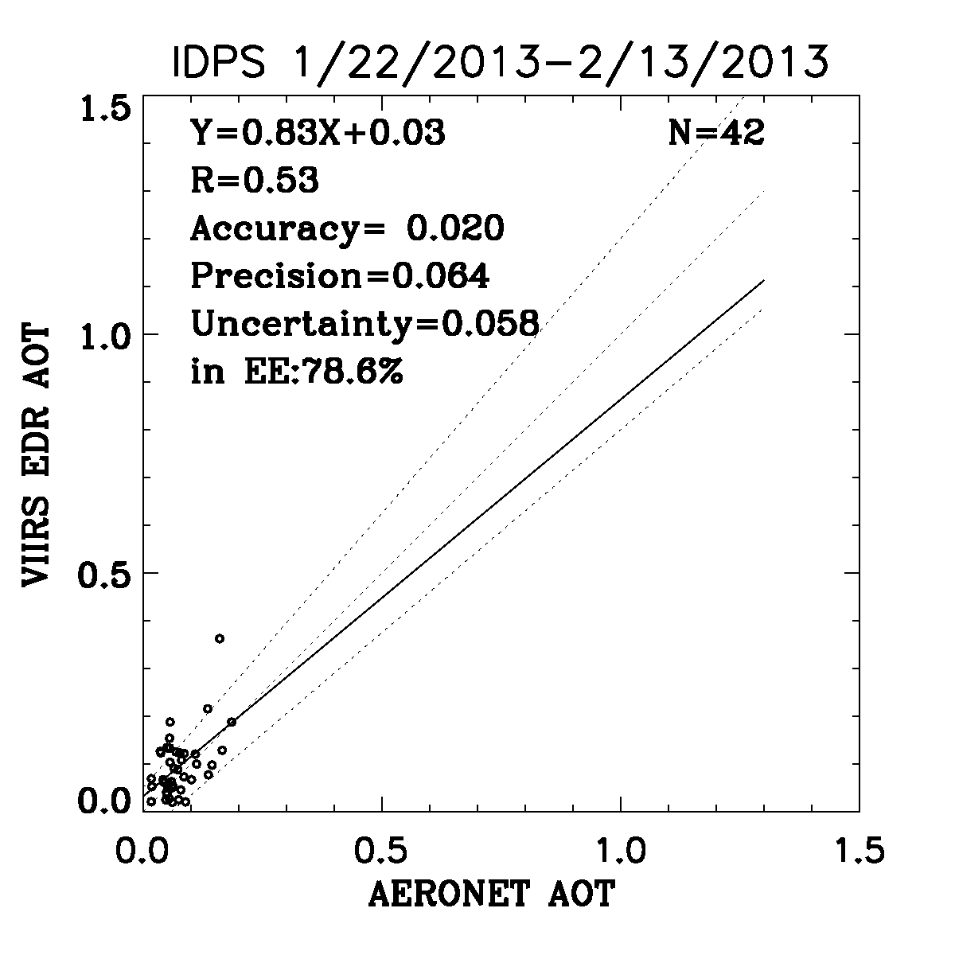
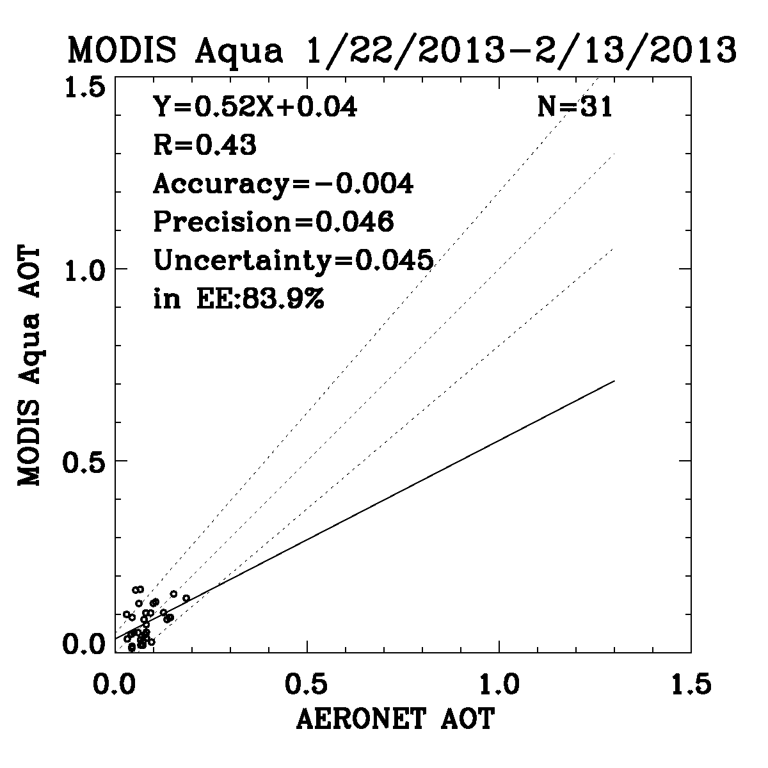
VIIRS vs. AERONET
MODIS vs. AERONET
Validation specifically for Eastern US
After 22 January 2013
Hai Zhang

Slide 34
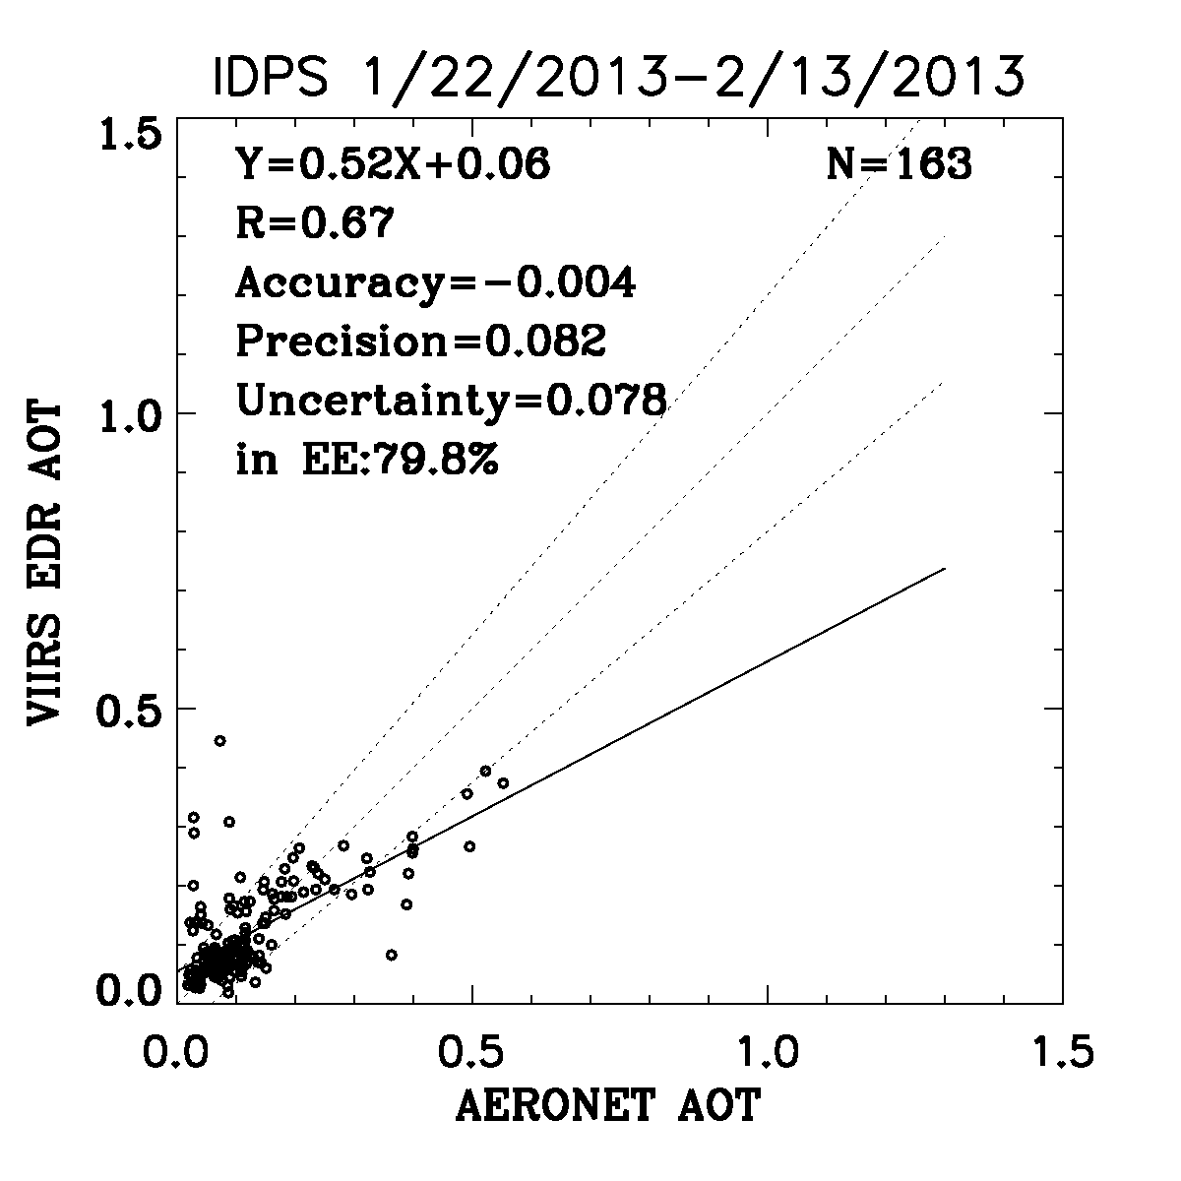
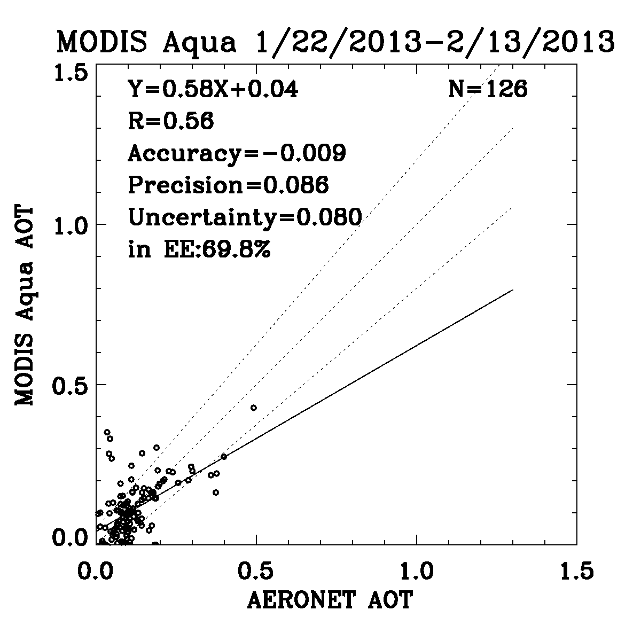
VIIRS vs AERONET
MODIS vs AERONET
Validation specifically for WESTERN US
After 22 January 2013
Hai Zhang

Slide 35
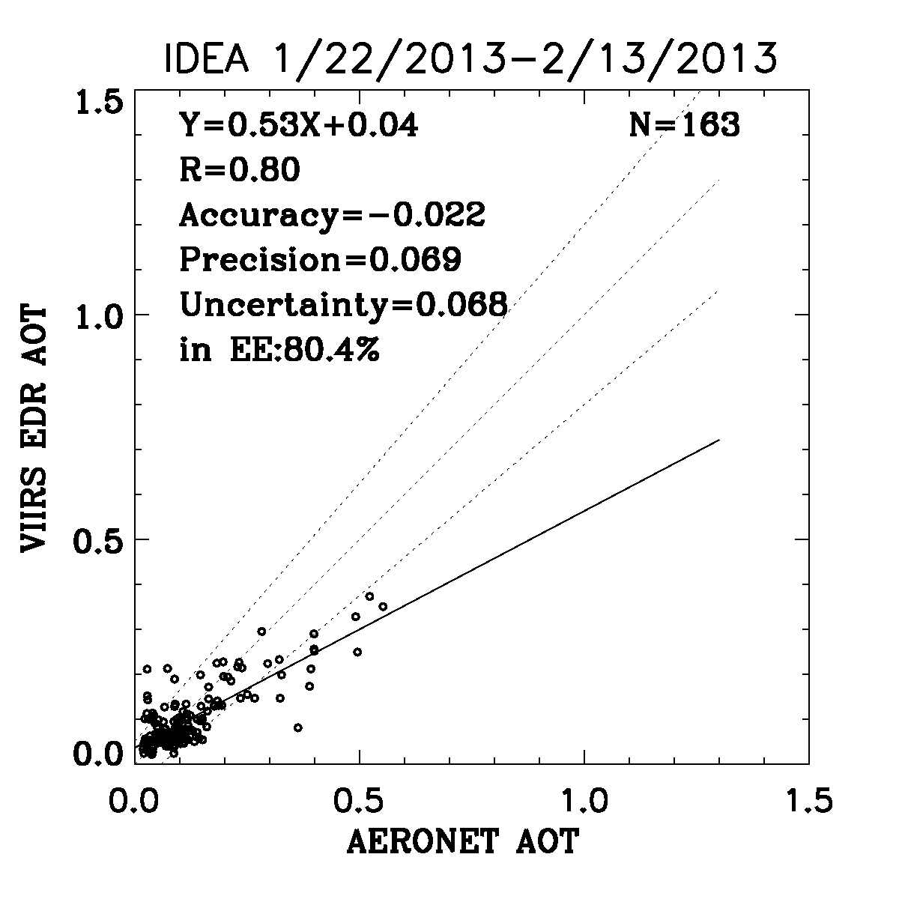
IDEA VIIRS vs AERONET
MODIS vs AERONET
Planned improvements to over land algorithm showing promising results for WESTERN US and elsewhere
Hai Zhang
35

Slide 36
Suspended matter is just another way to say “aerosol type”
Dust, smoke, sea salt, volcanic ash

Slide 37
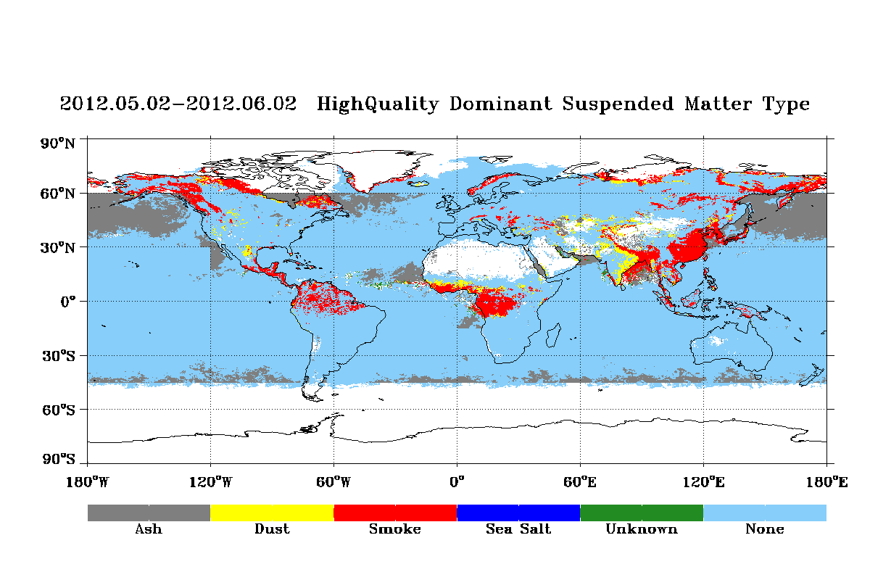
Kondragunta/Liu

Slide 38
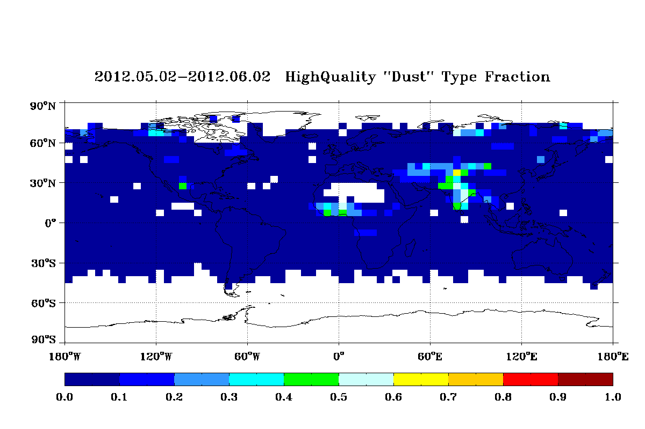
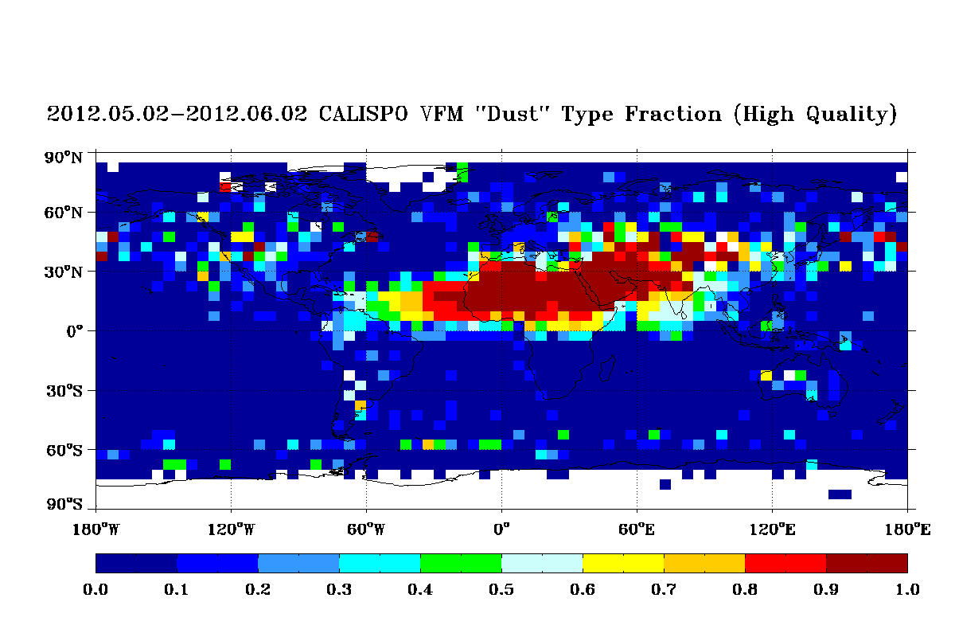
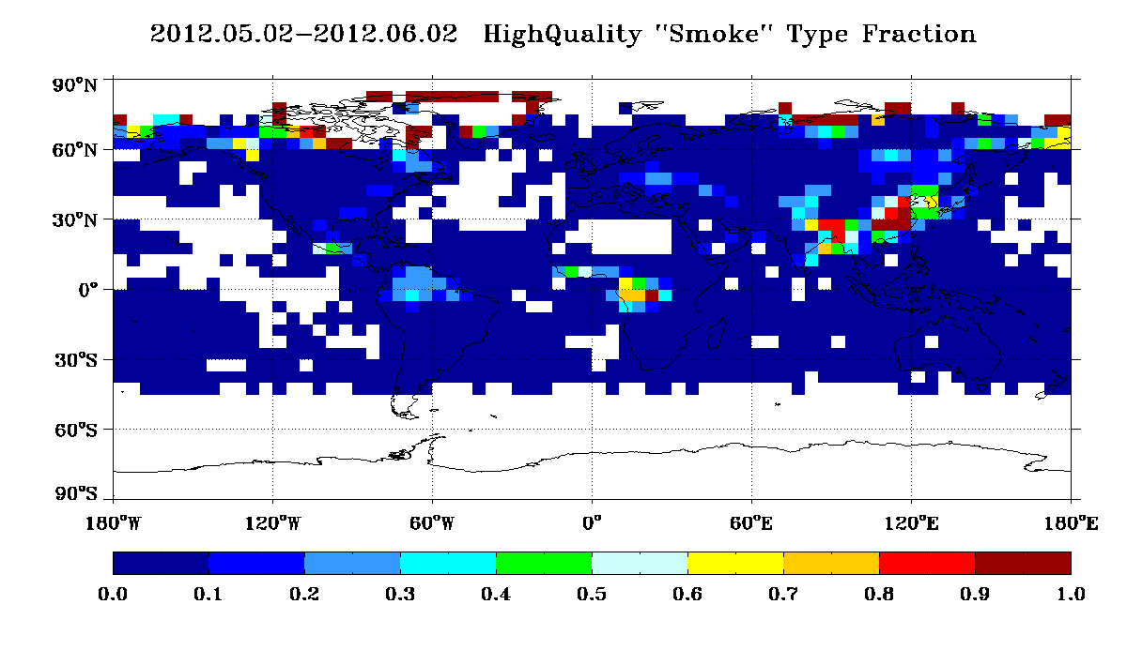
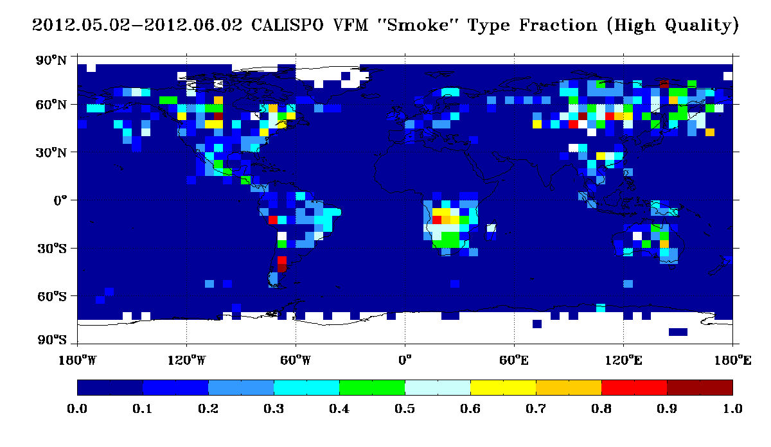
Kondragunta/Liu

Slide 39
Take home messages:
VIIRS and VIIRS aerosol products follow from MODIS heritage
Progression of improvement, from Beta to Provisional.
Now, Land AOT is very good.
Ocean AOT is excellent
Suspended matter needs an iteration
Use Quality Flags

Slide 40
Data (not SM) are available through CLASS:
http://www.class.noaa.gov
Users’ guide available at:
http://www.star.nesdis.noaa.gov/jpss/ATBD.php#S126472
README file under VIIRS aerosol (AOT) at:
http://www.nsof.class.noaa.gov/saa/products/welcome
Other documents are available at:
http://npp.gsfc.nasa.gov/science/documents.html

Slide 41
From the Users Guide
Data are available through CLASS:
http://www.class.noaa.gov
AEROSOL EDR Product File
VAOOO_npp_d20120626_t1958134_e1959376_b03440_c20120627024612139725_
noaa_ops.h5
HDF5 format
GAERO_npp_d20120626_t1958134_e1959376_b03440_c20120627021509002956_
noaa_ops.h5
AEROSOL geolocation file

Slide 42
AOT scale/offset
Integer AOT at selected wavelengths
Integer APSP
APSP scale/offset
Bitwise Quality Flags
Bitwise Small Mode Fraction
Metadata

Slide 43
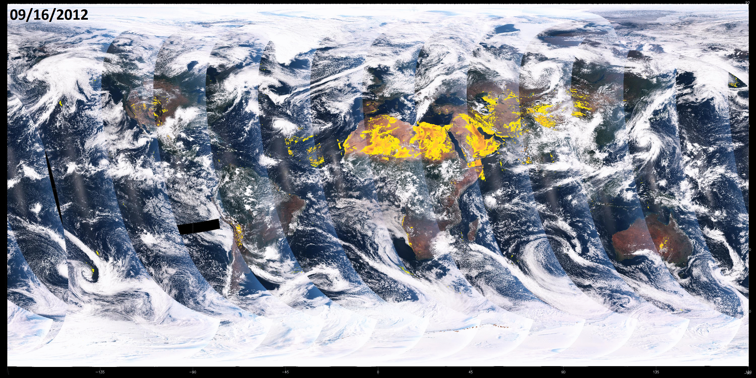
Suomi NPP VIIRS Global Dust Imagery
VIIRS experimental global dust index algorithm uses blue and mid-infrared bands (M1, M2, and M11) to generate a global dust index for National Weather Service air quality forecast applications. Movie loop shows dust outbreaks over the desert regions over a 3-day time period in September 2012. This algorithm will soon run at NESDIS STAR on VIIRS DB data covering the CONUS with a 30 minute latency.
Courtesy of Ciren (IMSG) and Kondragunta (NESDIS/STAR)

Slide 44
BACK UP SLIDES

Slide 45
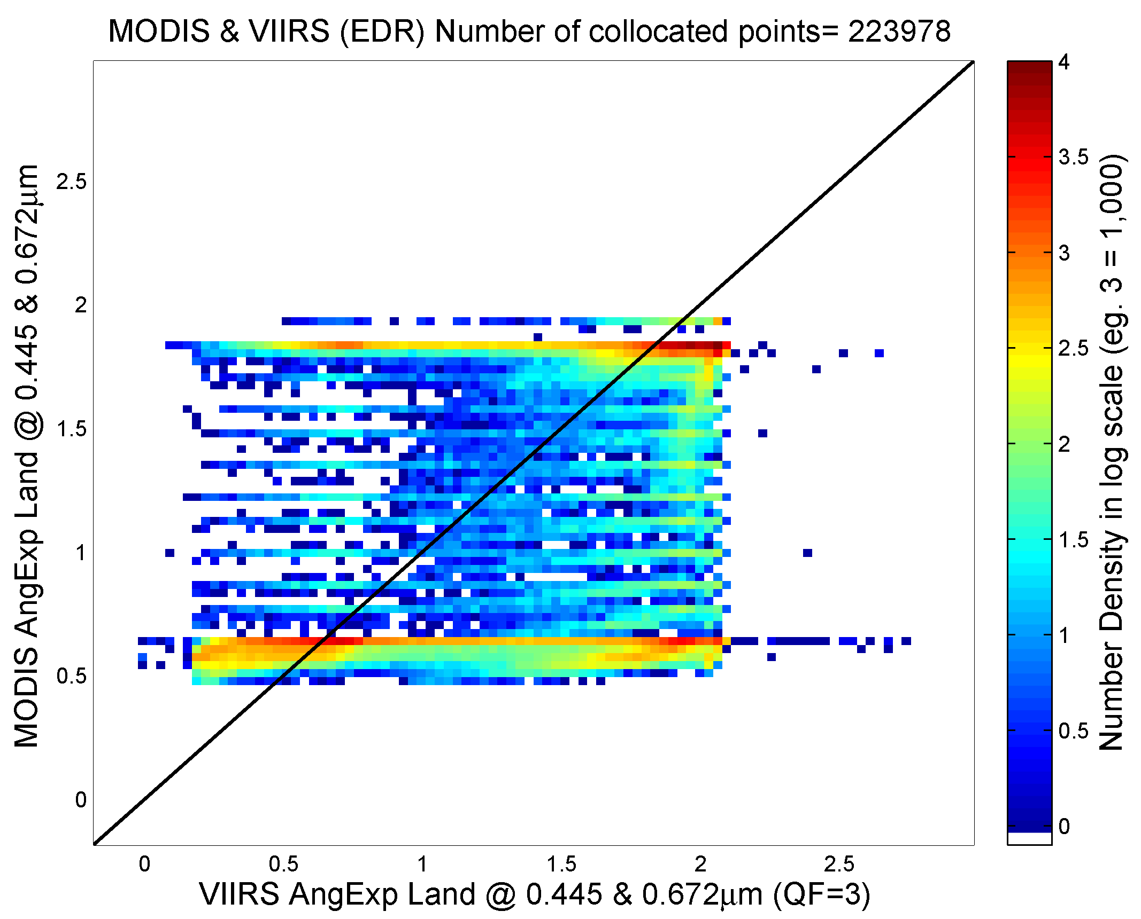
Angstrom Exponent over Land (Beta)
MODIS vs. VIIRS
Min Oo

Slide 46
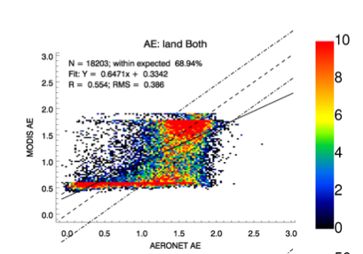
Angstrom Exponent over Land
MODIS vs. VIIRS
MODIS vs. AERONET
Both MODIS and VIIRS show no skill, globally, in retrieval of size parameters over land
Min Oo/ Robert Levy

Slide 47
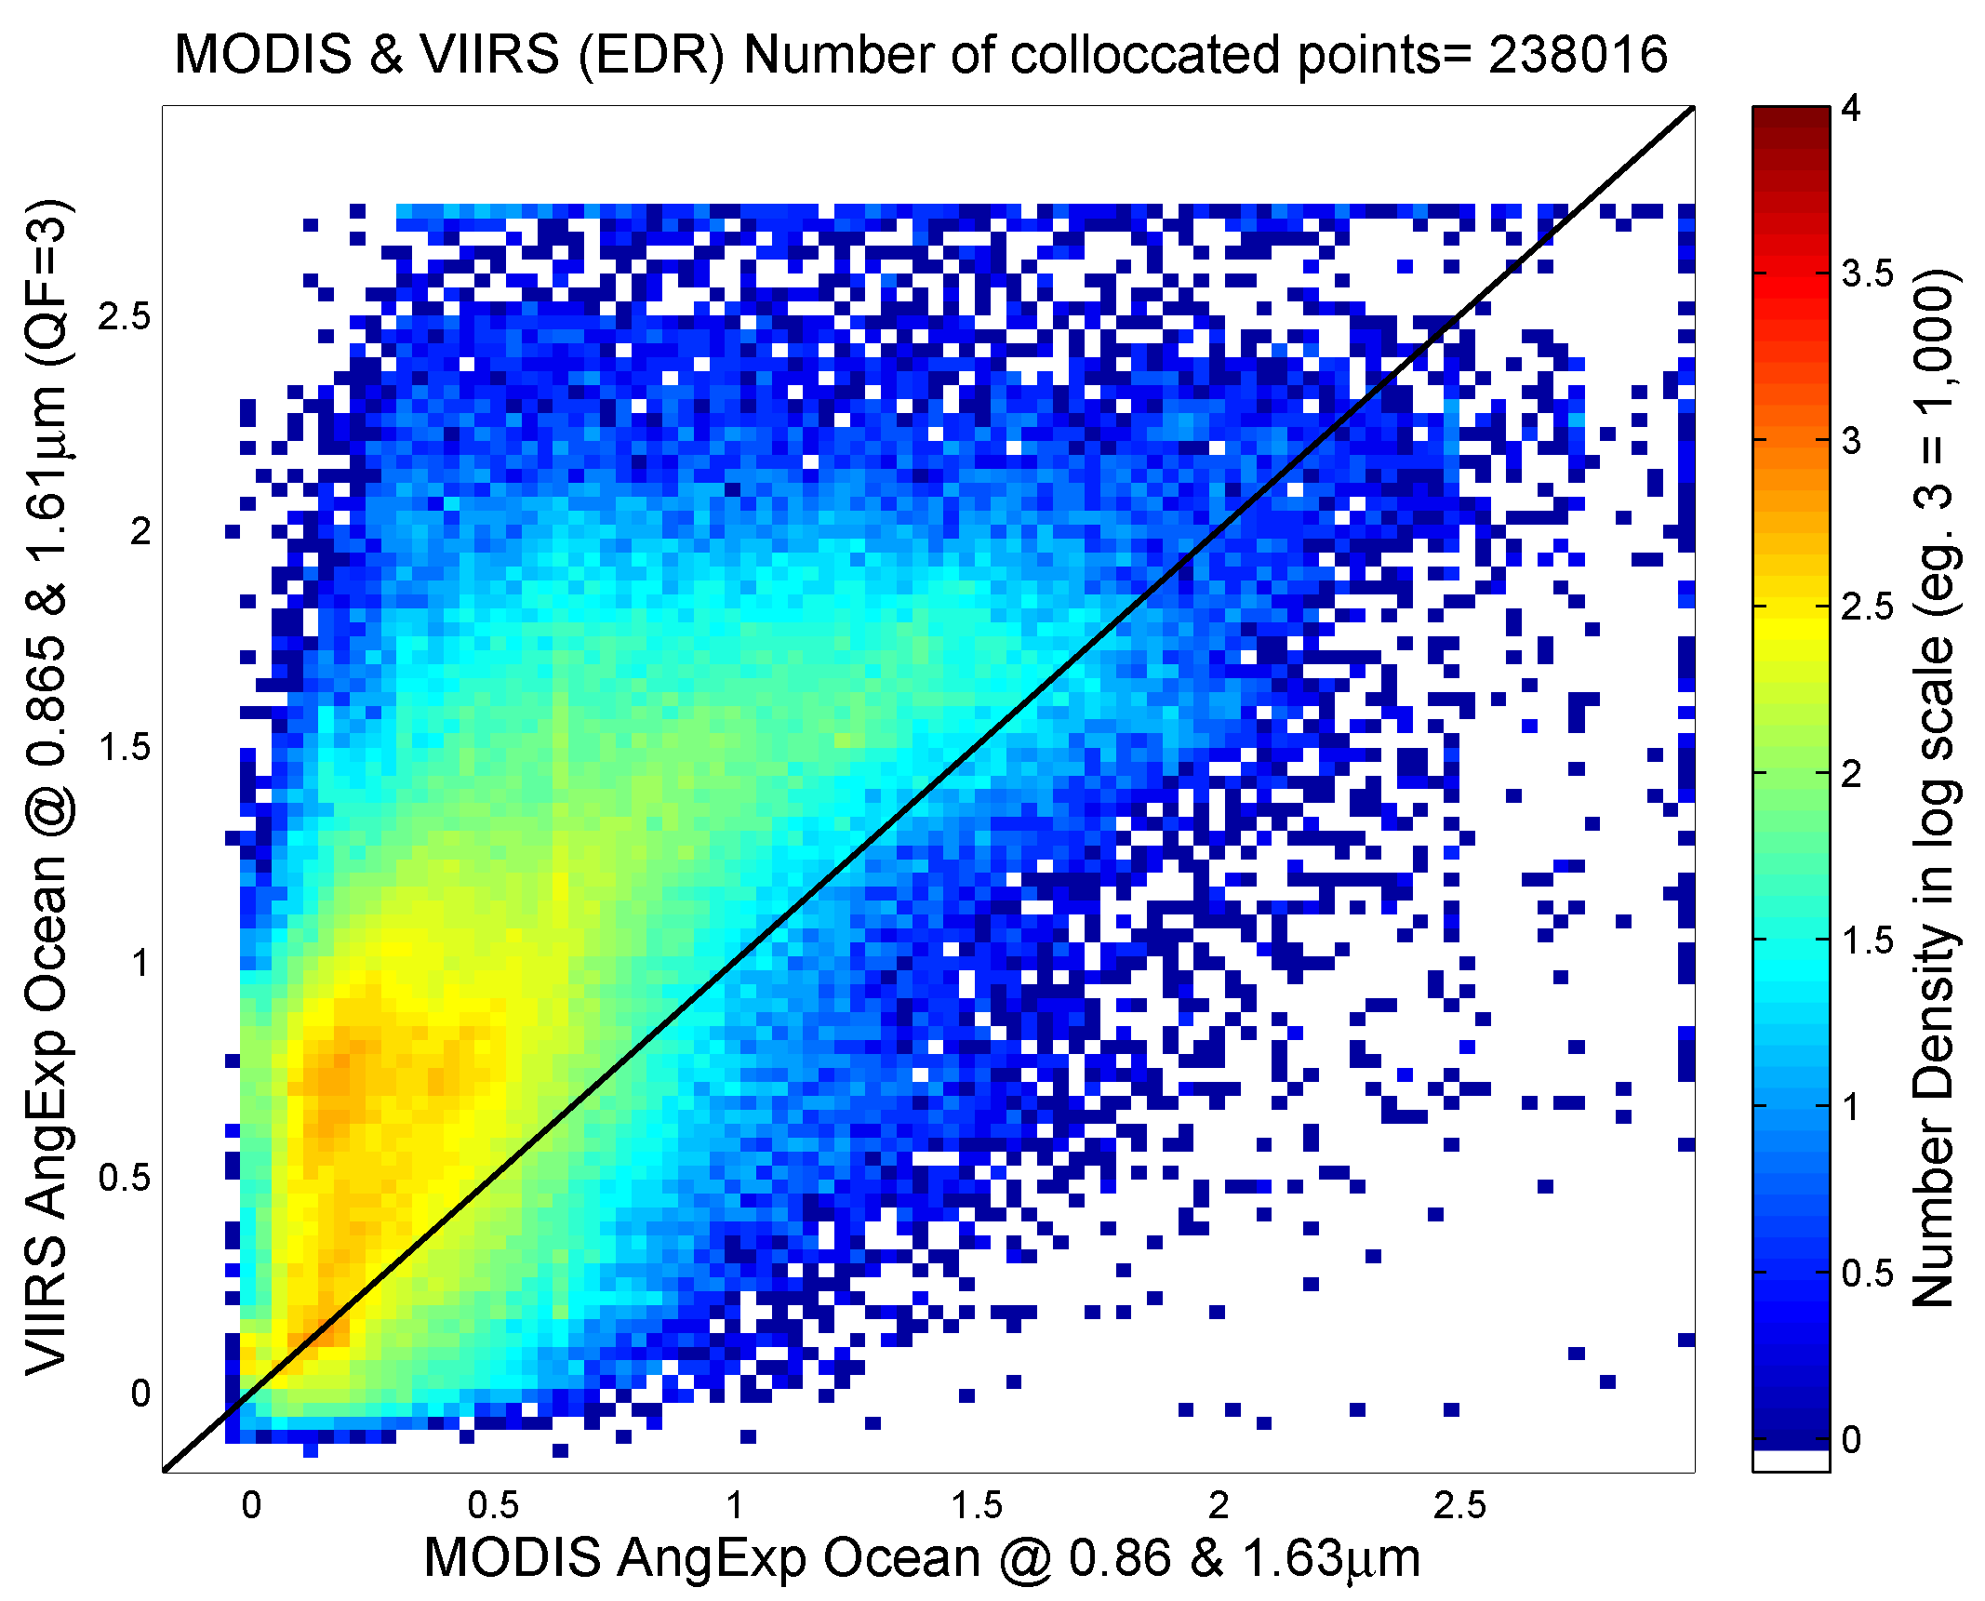
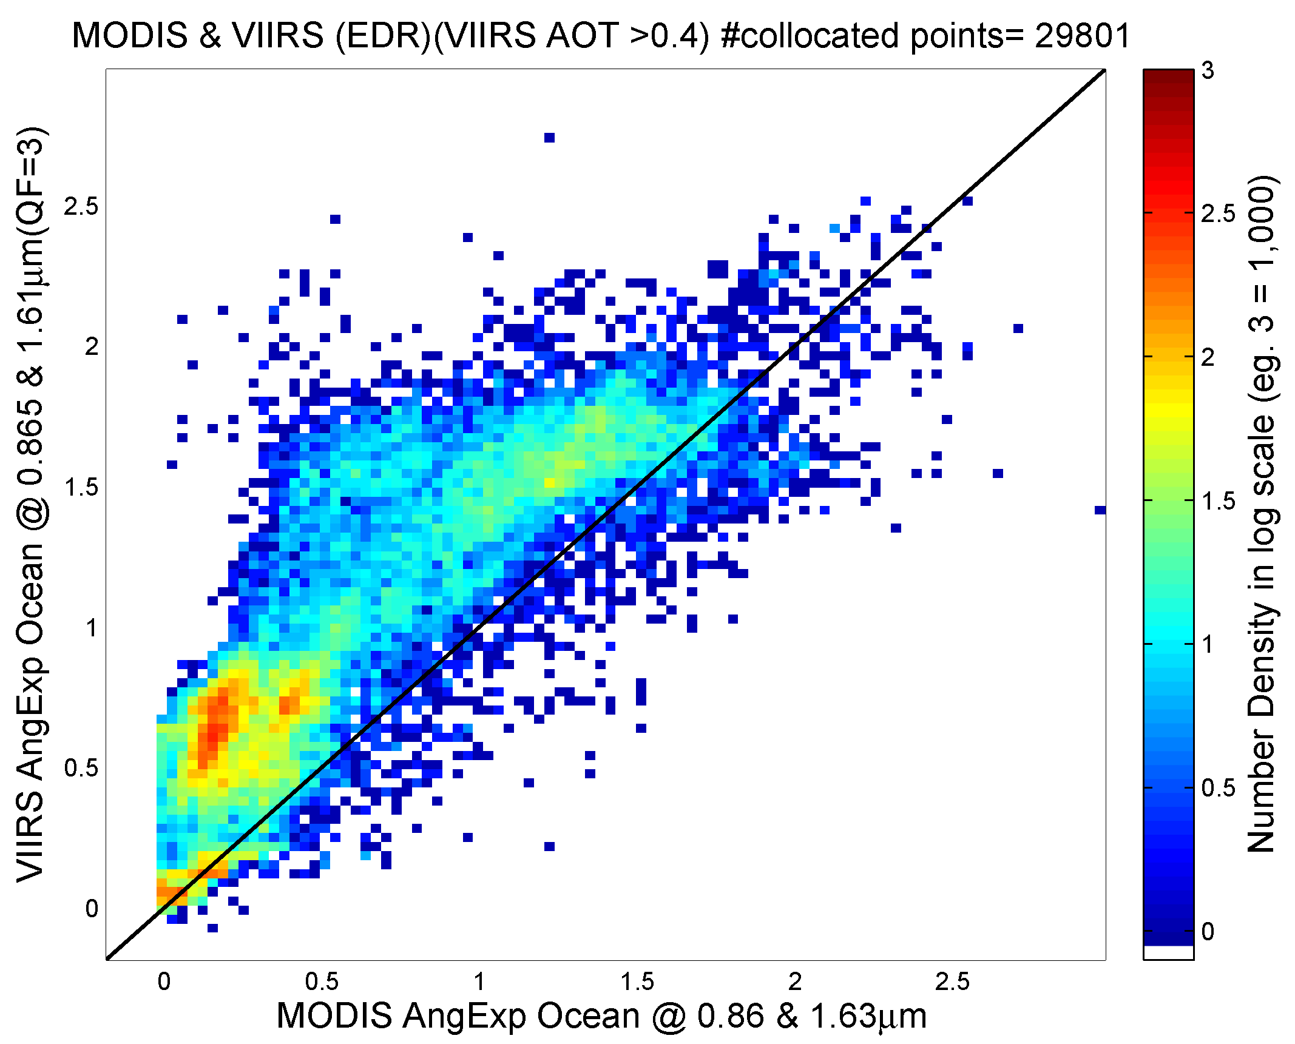
Angstrom Exponent over Ocean (Beta)
VIIRS vs MODIS
All AOT
VIIRS vs. MODIS
AOT > 0.40
Min Oo

Slide 48
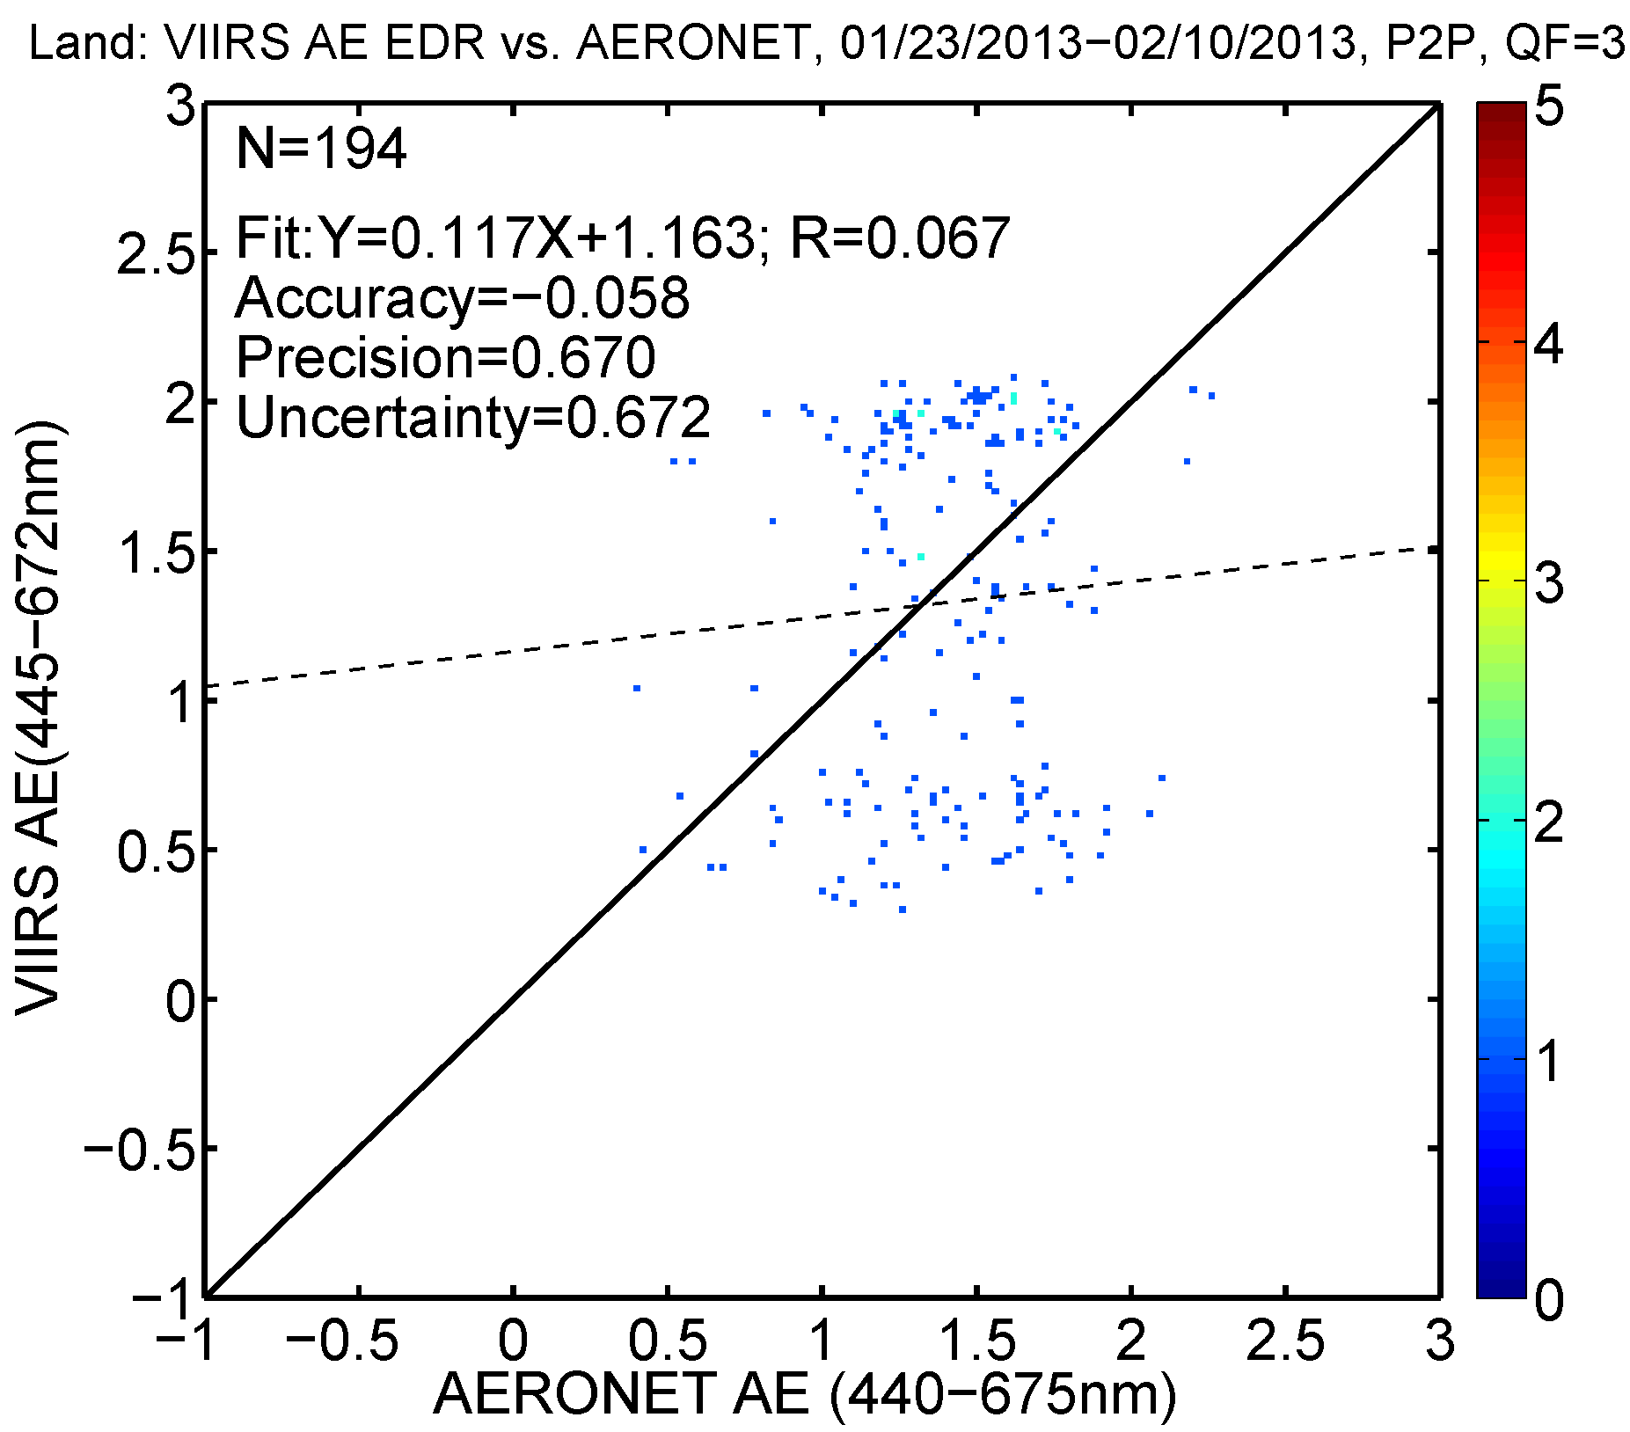
But not in Angstrom Exponent

Slide 49
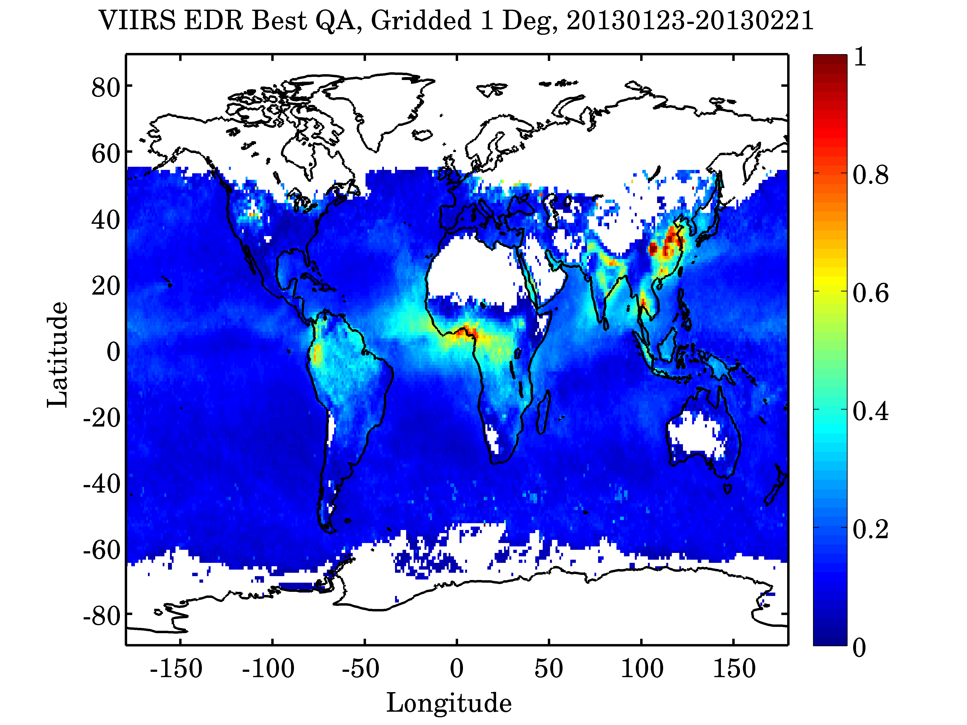
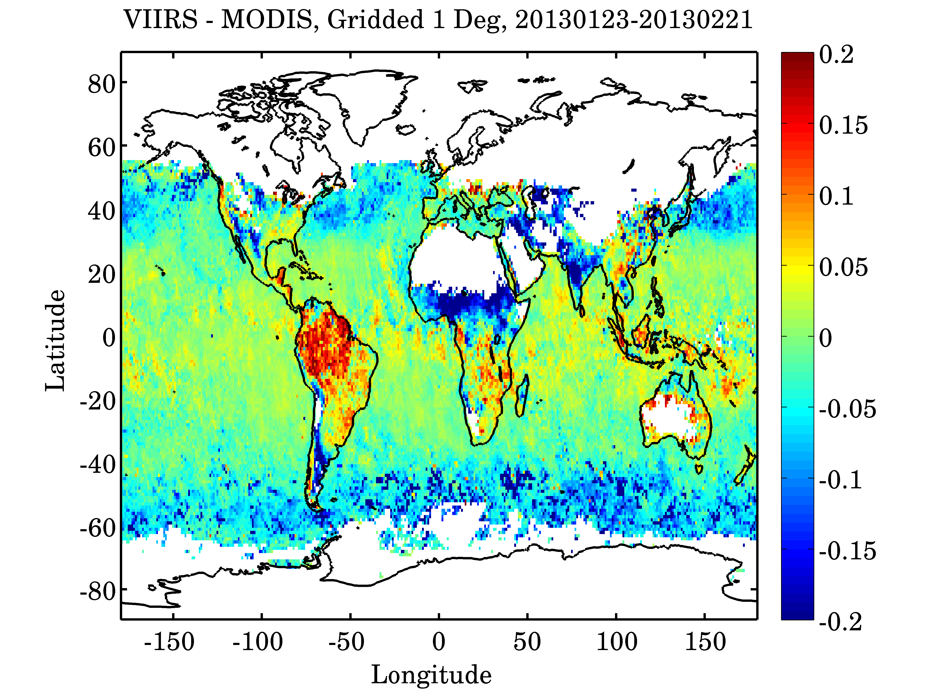
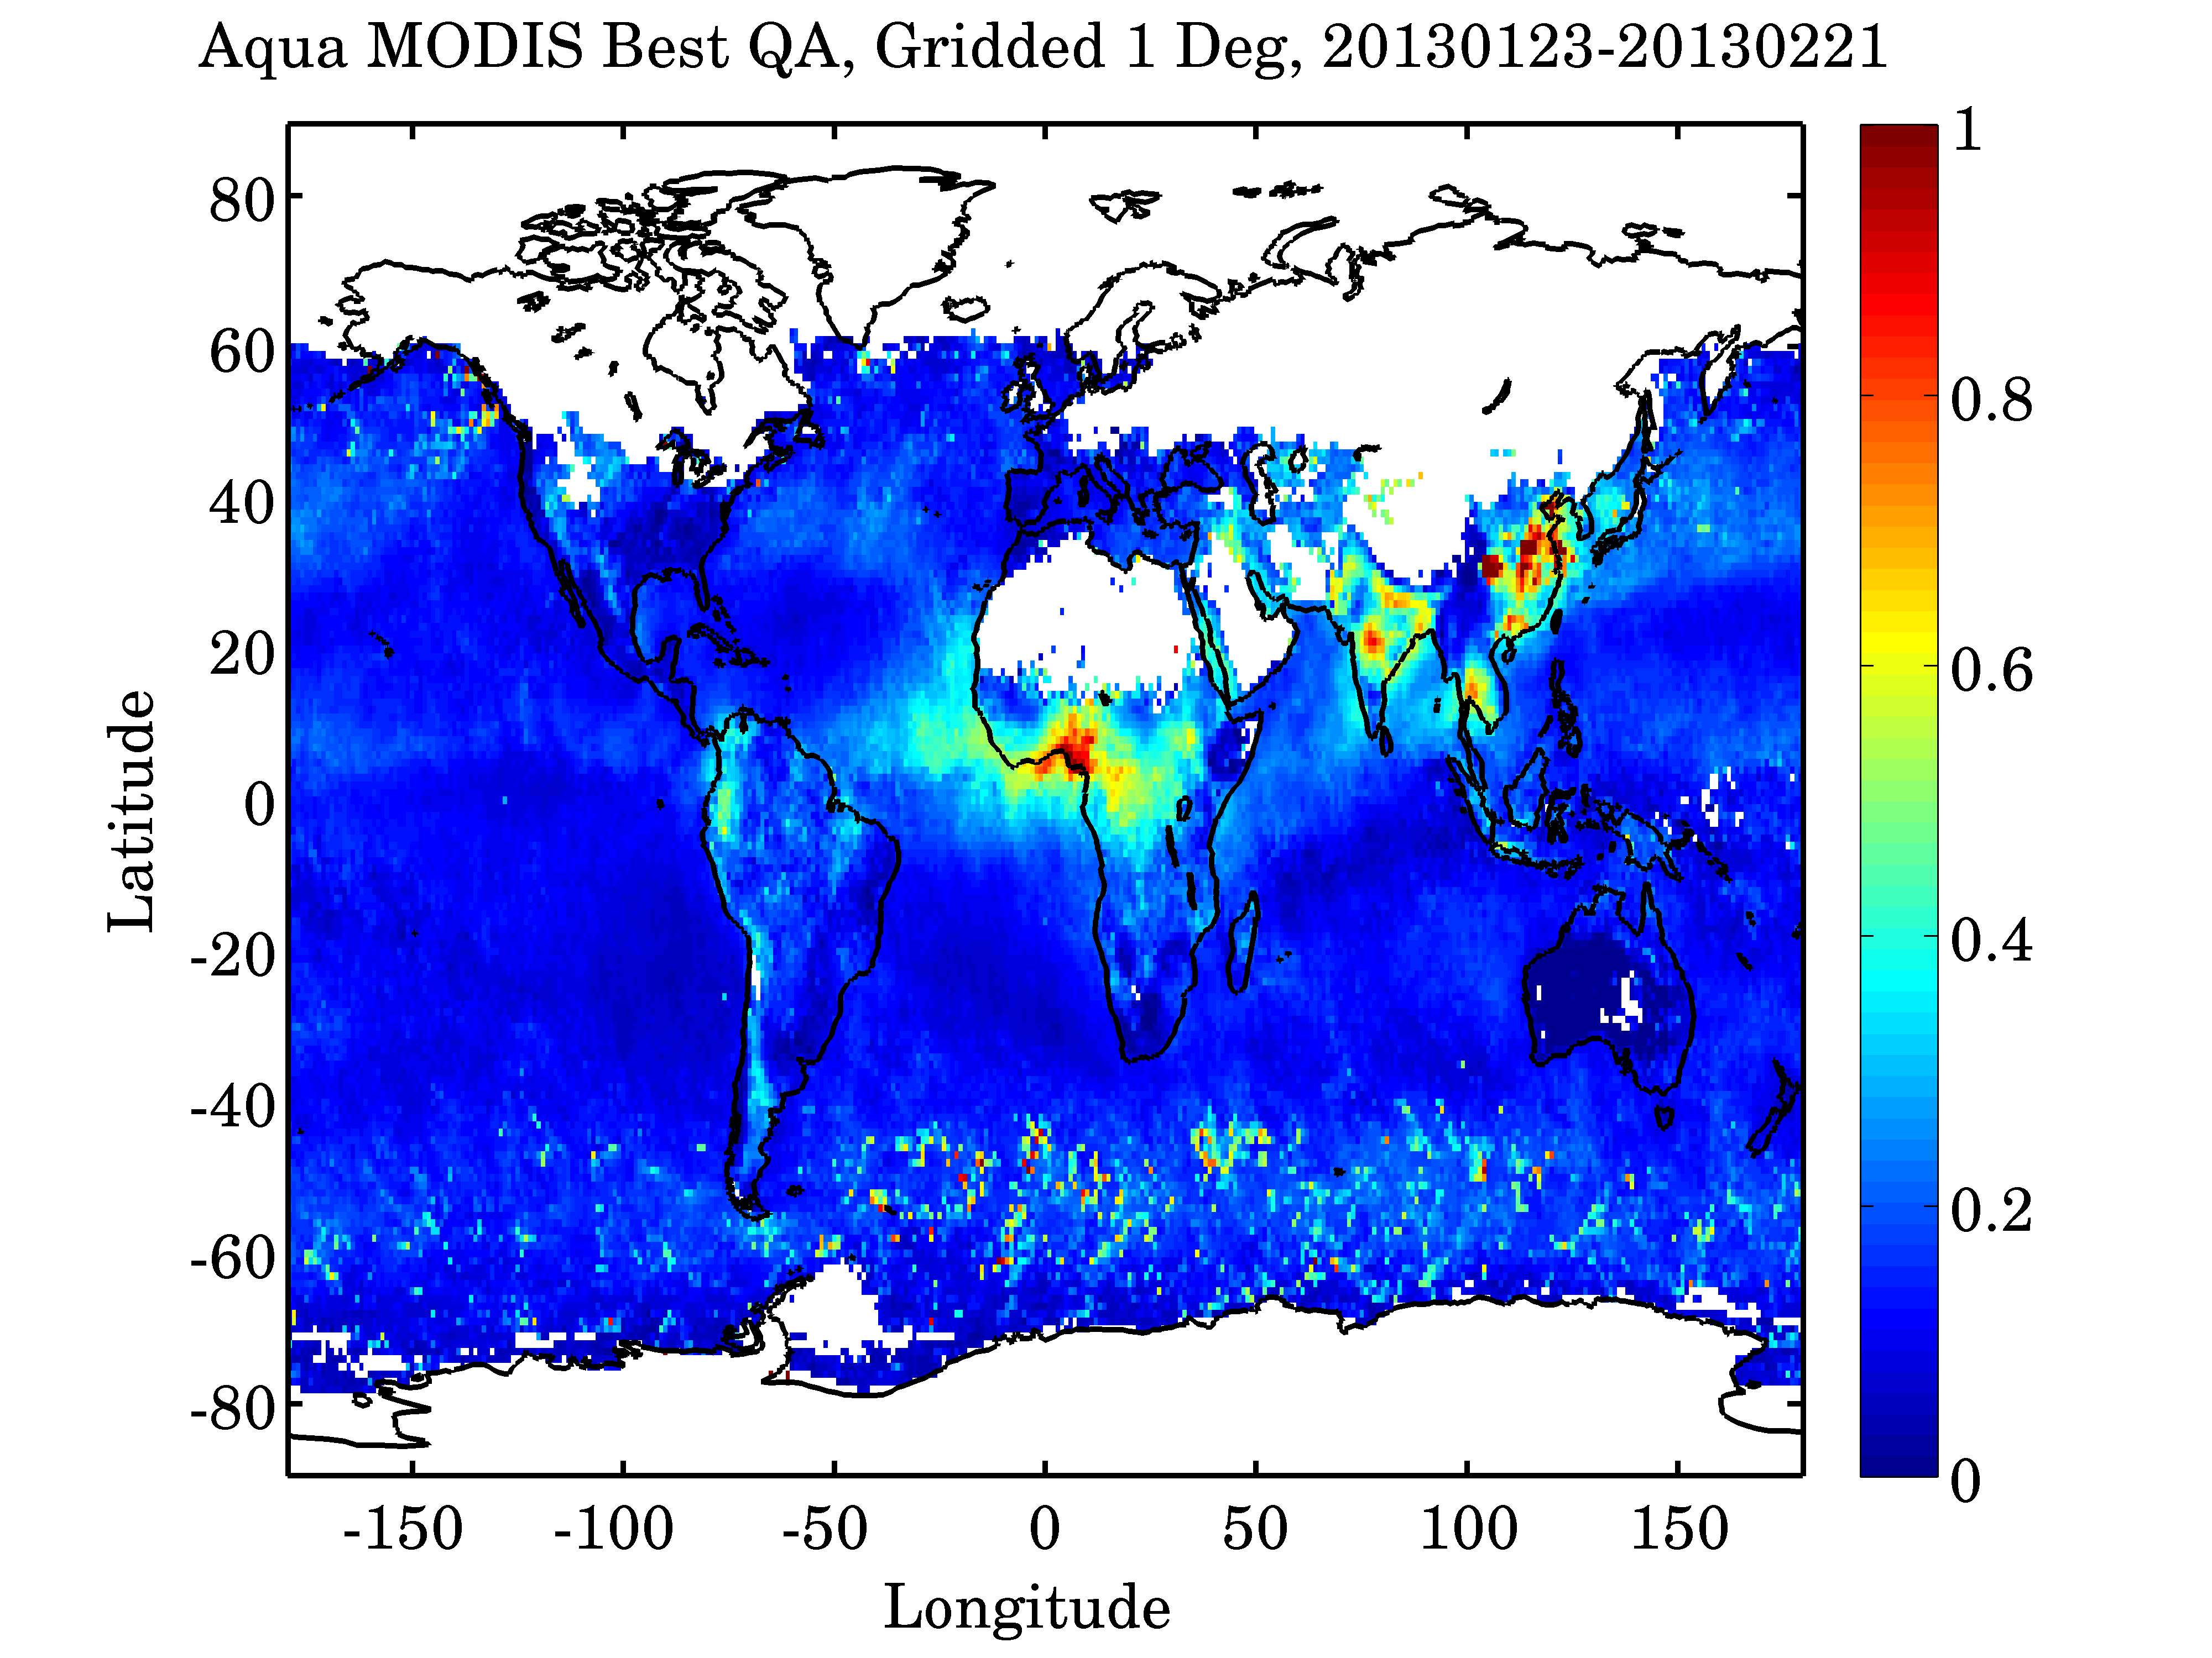

Slide 50
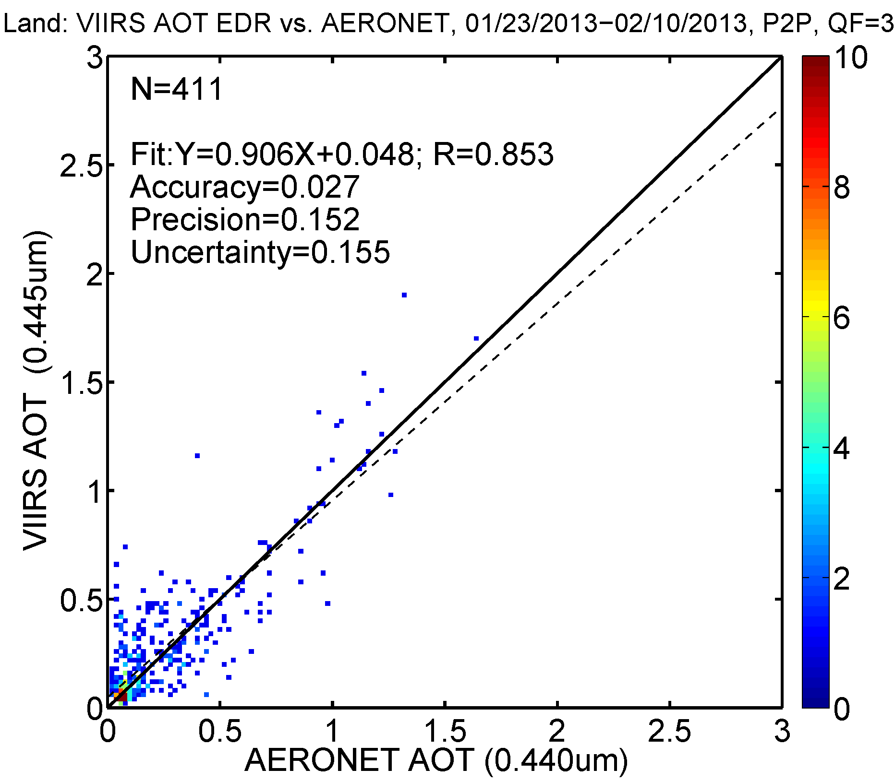
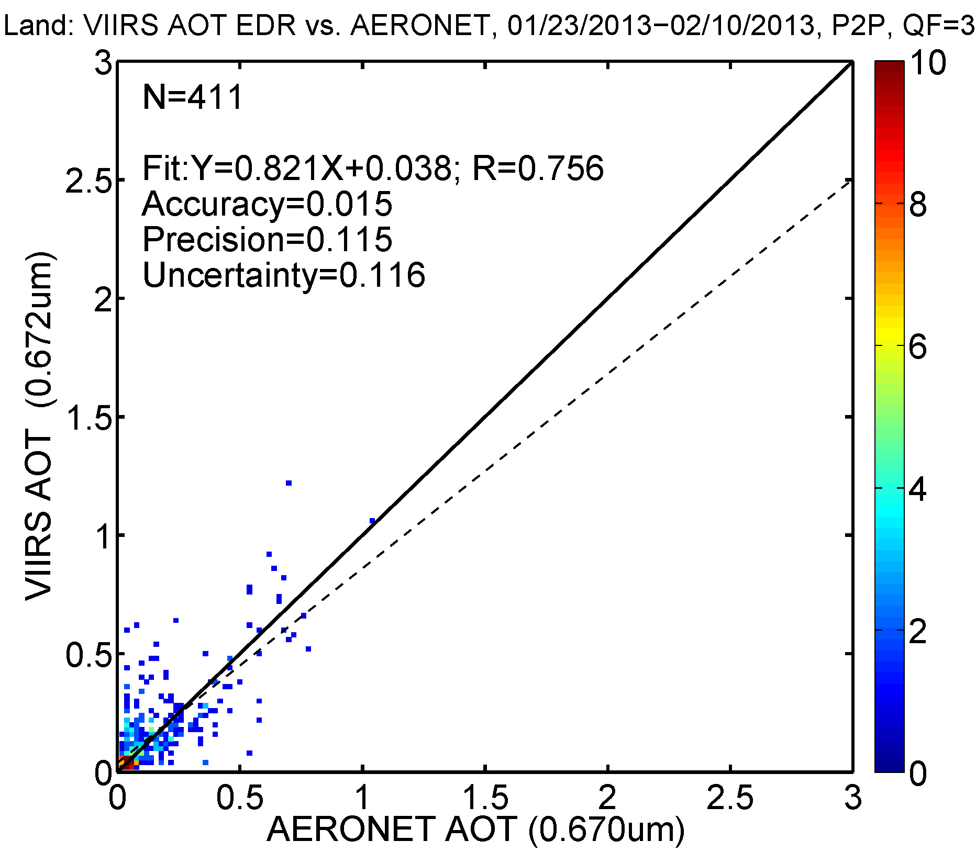
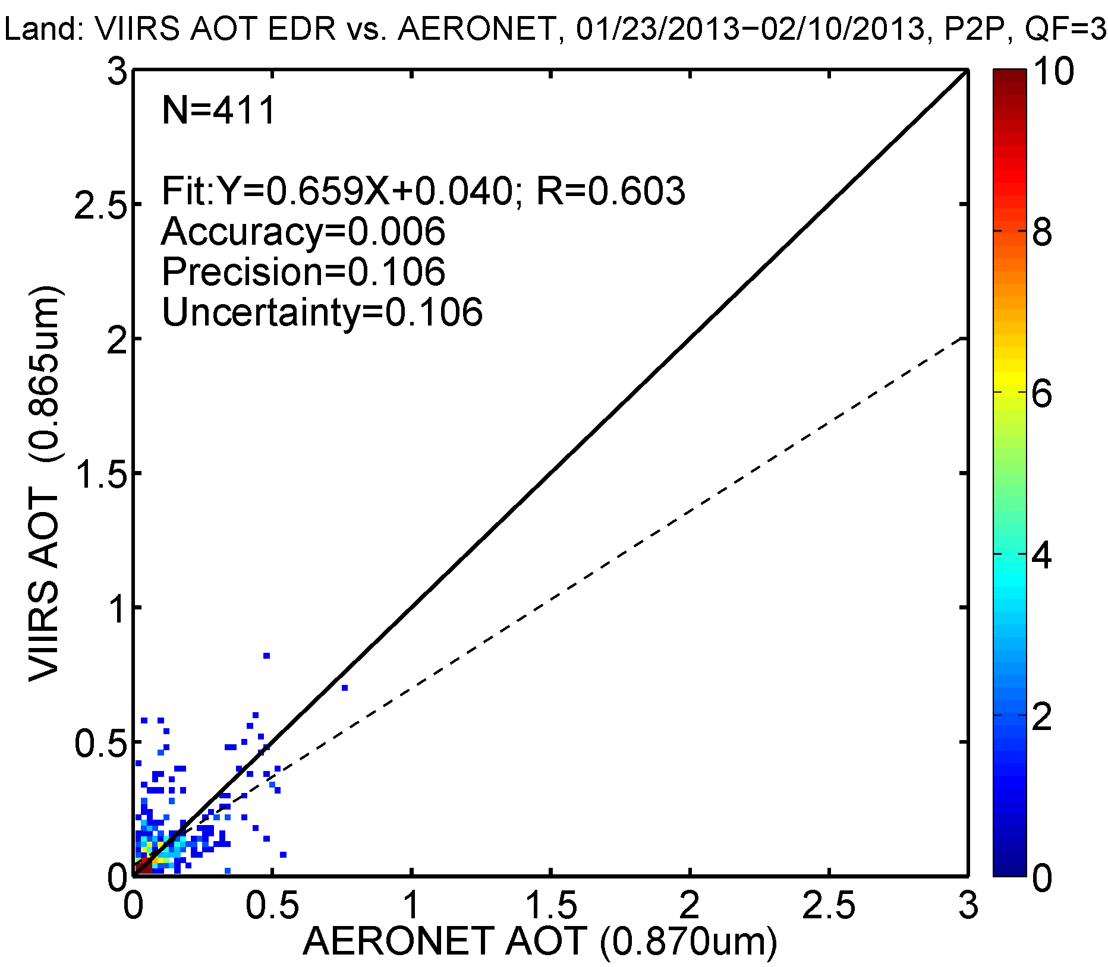

Slide 51
MODIS fine mode fraction (η)
= ηρ^{f} + (1-η)ρ^{c}
η = AOT(fine mode)/AOT
VIIRS Angstrom exponent (AE)

Slide 52
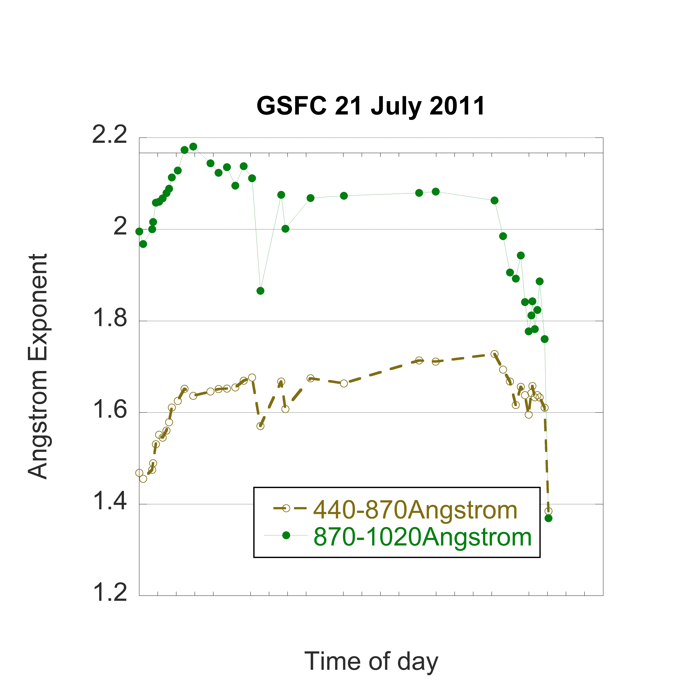
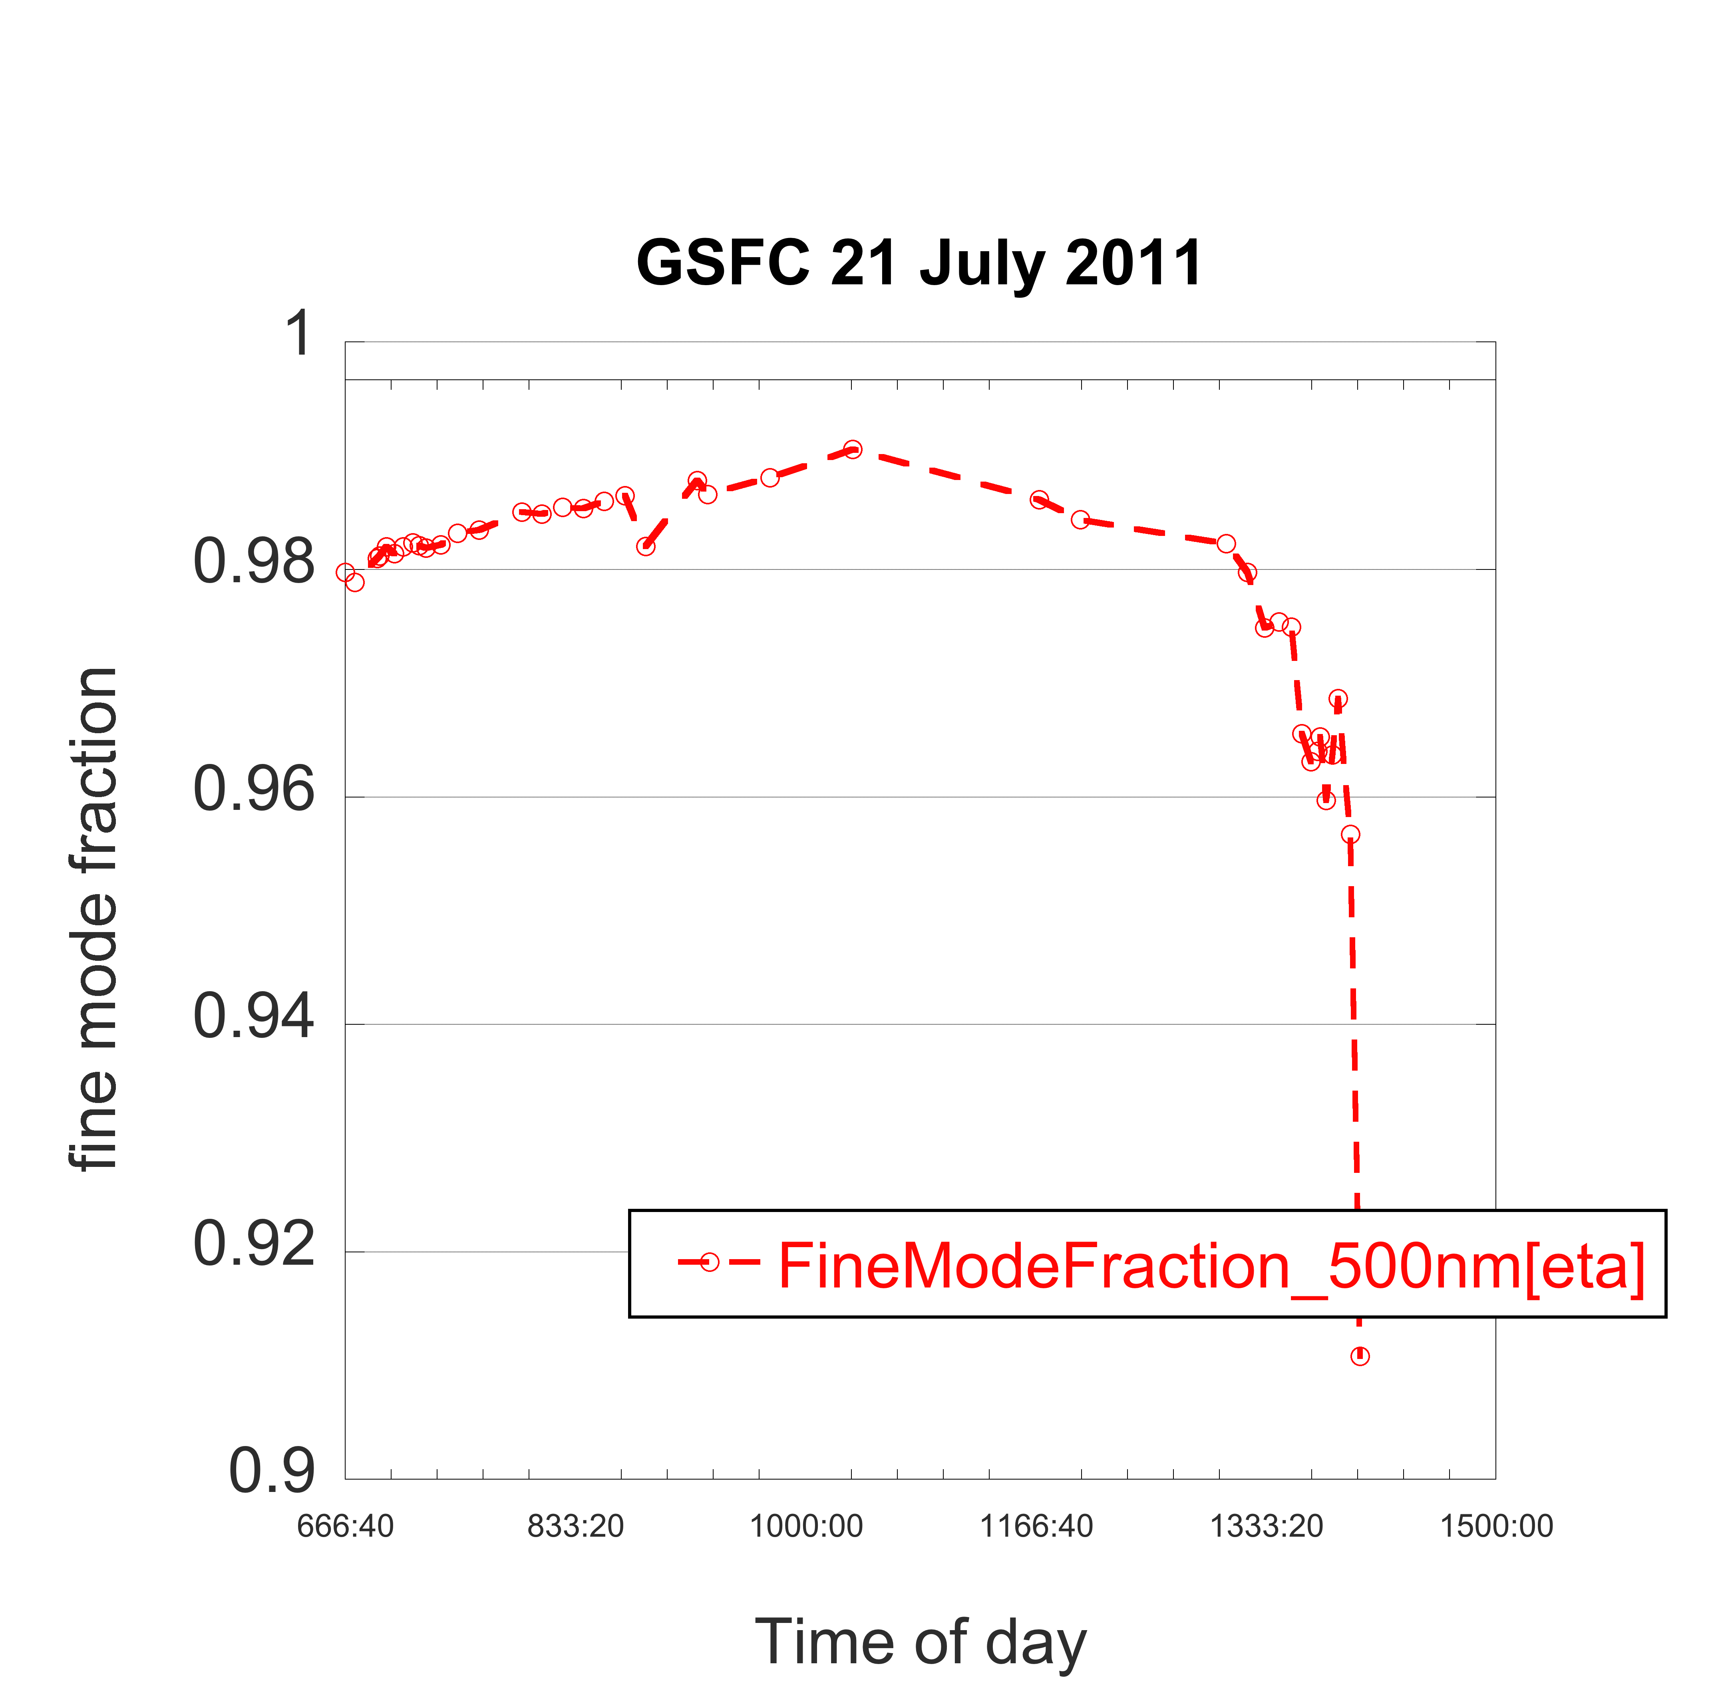
The larger η, the smaller the particles.
The larger AE, the smaller the particles.
Note that AE of different wavelength pairs produce different values of AE.

