Slide 1
NASA’s Applied Remote Sensing Training Program (ARSET): Connecting Stakeholders to NASA Earth Science and Principal Investigators
Pawan Gupta, Ana. I. Prados, Rich Kleidman, Yang Liu, Jacque Witte et al.,
NASA Goddard Space Flight Center
GESTAR/USRA/JCET/UMBC/SSAI

Slide 2
Applied Remote Sensing Training (ARSET)
GOAL:
Increase utilization of NASA
observational and model
data for decision-support
ARSET
DEVELOP
SERVIR
GOMI
NASA
Applied Sciences PIs
NASA
Applied Research
NASA Data Centers
Objectives:
Provide end-user communities and institutions with professional hands-on technical workshops
Build long term partnerships with end-user communities and institutions in the public and private sectors
ARSET disseminates the usage of
existing NASA data, web tools, Decision
Support Systems and applied research,
in addition to collaborating with other
capacity building programs within NASA
Notes:
ARSET’s goal is to promote utilization of NASA data. To achieve this goal, there are two main objectives 1) provide end-users with technical workshops and 2) build long term partnerships with these institutions. We spend a lot of time with partnership building, it is a key part of capacity building, and ARSET has worked with dozens of institutions. ARSET is fully integrated with other NASA programs, within and outside of Applied Sciences. This includes working closely with PIs who often participate in ARSET trainings and integrating their applied research into trainings, working various NASA data centers, and working the other capacity building programs, and in particular DEVELOP. HOWEVER, ARSET DOES NOT generate applied research, rather the focus is on disseminating existing applied research – such as the research discussed at this meeting.

Slide 3
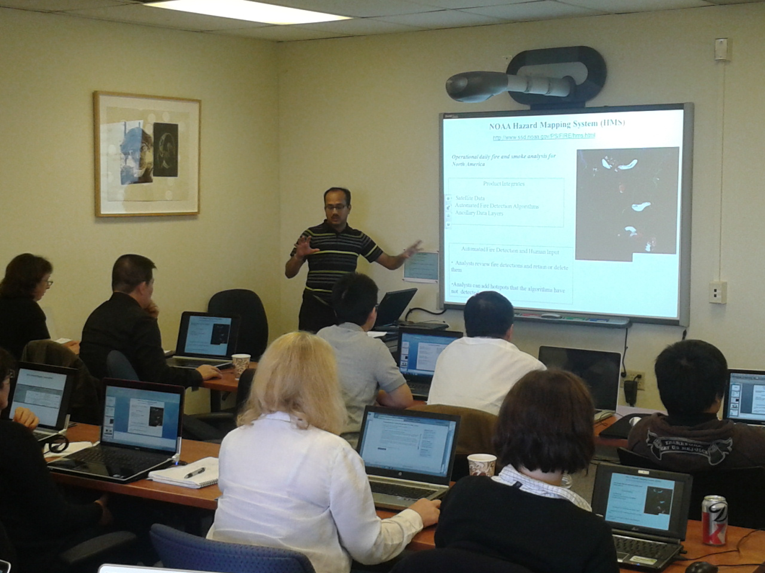
Applied Remote Sensing Training Program (ARSET)
Online and hands-on courses:
Who: policy makers, environmental
managers, modelers and other professionals
in the public and private sectors.
Where: U.S and internationally
When: throughout the year. Check websites.
Do NOT require prior remote- sensing
background.
Presentations and hands-on guided
computer exercises on how to access,
interpret and use NASA satellite images for
decision-support.
NASA Training at CMAS

Slide 4

Gradual Learning Approach
Basic Courses
Webinars
Hands-on
Assumes no prior knowledge of RS
Advanced Courses
Hands-on
Webinar course generally required
Focused on a specific application/problem: for example products and tools for flooding applications in Colombia
Notes:
Learning how to use NASA data for applications and/or decision-support is a multi step process. Most end-users have a technical background, but not a remote sensing background, we therefore require a basic online or in person course, that teaches remote sensing basics, before students can move into hands on and/or advanced courses. We recently also began advanced online courses, based on end-users requests. In the next slide, I will talk more about the online courses.

Slide 5
Increasingly Popular Webinar Courses
Screen shot from ARET advanced webinar series offered in July 2012 .
Software interface provides two-way visual and audio connectivity,
as well as the chat capability (lower left).
Presentations are recorded for those who cannot participate in real time.
Notes:
ARSET online courses/webinars have dramatically increased the number of end-users reached per year. Courses are free, and students do not have to travel. Because the time commitment is only 1 hour per week, most people can easily accommodate it into their busy schedules (you can pretty much read the text in the blue, which explains the different parts of the online screen). These online are becoming very popular, with over 80 participants subscribed to our Fall 2012 introductory webinar series.

Slide 6
ARSET Training Workshop Lifecycle
Advertise via list-serv and Webpage
Collaborate with NASA Applied Science PIs
Collaborate with NASA Data Centers
Work with Advisory Group
Attend professional conferences
Identify Host Institution
End-user Needs Assessment
Conduct Training :
Online
Presentations
Hands-on activities Case Studies
Adapt training modules
Project Evaluation: Surveys and Feedback

Slide 7
ARSET Trainings by Societal Benefit Area
2009 – 2013: +900 End-users Reached

Slide 8
S SSo where have we been ?

Slide 9
ARSET Reach Update: 2009 – June 2013
Number of participating organizations
per state (AQ + Water):
County
State
Tribal
Academic
Private Sector
Federal Agencies:
NOAA, USGS, USAID, USACE, BLM, Bureau Rec
NOAA, US Forest Service, National Park Service, EPA
NOAA, USAID, USGS
Notes:
This slide shows the number of organizations who have attended an ARSET trainings per state. These are primarily state air quality regulatory agencies, or health agencies. ARSET has focused on areas of the US with worse air quality, e.g. both coasts, some parts of the mid-west and Texas. Some of these regions don’t meet AQ standards, so the regulatory agencies there are more likely to be interested in NASA data for understanding and/or improving their attainment status, and for topics such as monitoring, exceptional events, CMAQ evaluation, etc.

Slide 10
ARSET Reach Update: 2009 – June 2013
129
Number of participating organizations per country: Air Quality and Water Resources
Notes:
ARSET also conducts international trainings. In Asia, supporting NASA campaigns, also supporting SERVIR in Central America. In Canada, trainings have been done in collaboration with the Air and Waste Management Association, so the end-users reached in Canada have been primarily private for-profit sector, also a few ad-hoc trainings have been conducted at international conferences.

Slide 11
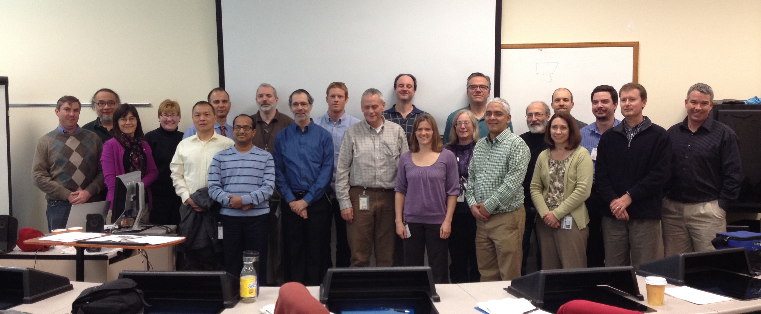
Training Activities Coming up: Air Quality
Hands-on course for NESCAUM
(Northeast States Coordinated
Air Use Management).
GOING ON NOW
Online course for Indian air quality professionals in (also supporting SERVIR node in Nepal).
Spring 2014.
Hands-on course for Texas Department of Environmental Quality (TCEQ)
Course Dates: February 24-27, 2014
Location: Austin Texas
Notes:
Here you have a list of trainings coming up. The online courses are very popular, and the September course filled up rather quickly, so register soon.
Contact Rich Kleidman if interested in the hands-on course.

Slide 12
Consider participating in an ARSET Training
ARSET works directly with NASA funded PIs.
You can participate online or during an in-person training.
Share with a wide end of end-users (100-200 for online courses) your research, methods, or decision support tools - become rich and famous !!
Disclaimer…….
Notes:
We want to encourage people to collaborate with us…

Slide 13
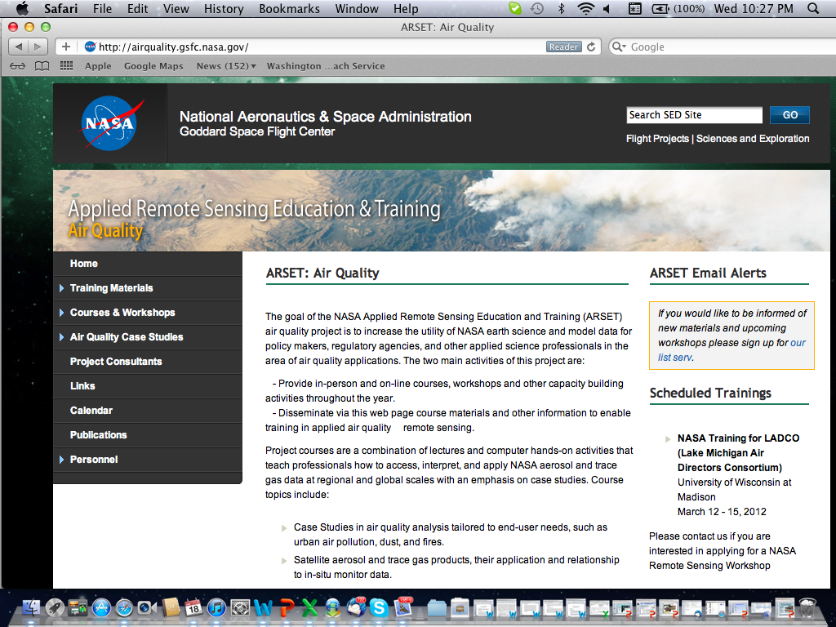
http://airquality.gsfc.nasa.gov/
Publicly available
Modules
Case
Studies
Upcoming trainings
Notes:
ARSET web page is used to announce courses, and to post trainings materials, and for online course registration. IF you’d like to contribute your materials, please contact the ARSET-AQ team.

Slide 14
ARSET Web Sites and Updates
http://water.gsfc.nasa.gov/ (Water)
http://airquality.gsfc.nasa.gov/ (Air Quality)
Updates and notification of upcoming workshops:
Water Resources/Disasters
https://lists.nasa.gov/mailman/listinfo/nasa-water-training
Air Quality
https://lists.nasa.gov/mailman/listinfo/arset
Notes:
We want to encourage people in particular to sign up to the listserv

Slide 15
Air Quality Topics
Fundamental of Satellite Remote Sensing
Introduction to Current Earth Observing Satellites
Image Access and Interpretation
Satellite data format and levels
Introduction to Aerosols and Trace Gas Sensors
MODIS Aerosol Products & Application
MISR & OMI Aerosol Products & Application
PM2.5 analysis using satellite data
OMI Trace Gas Products and Applications
Fire Products from MODIS, GOES, VIIRS
AERONET
VIIRS, MODIS 3Km, MAIAC, …

Slide 16
Online Tools/Web Services
  GIOVANNI
  MODIS Today
  MODIS rapid response
  Worldview
  MODIS-Atmosphere
  LADSWEB
  IDEA
  AERONET Synergy tool
  Earth Observatory
  Smog Blog
  CALIPSO Browse Image
  Hazard Mapping System Fire and Smoke Product
HDFLOOK
IDL
PANOPLY
Google Earth

Slide 17
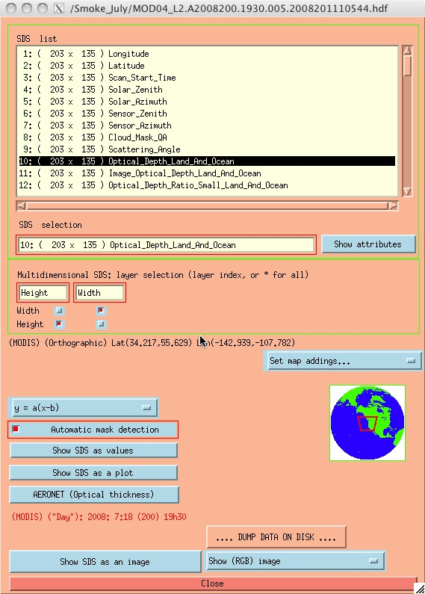
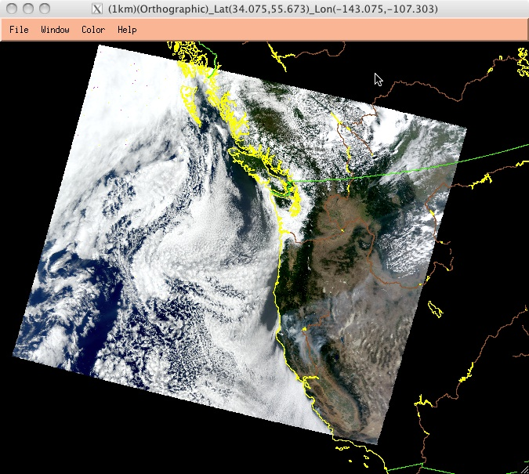
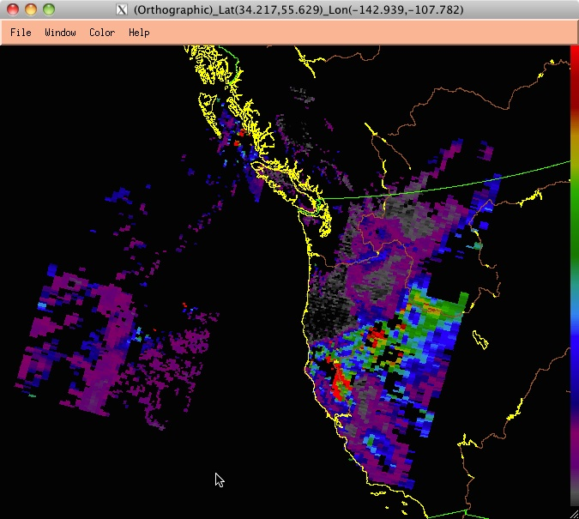
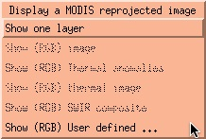
HDFLOOK to Read/Display hdf DATA

Slide 18
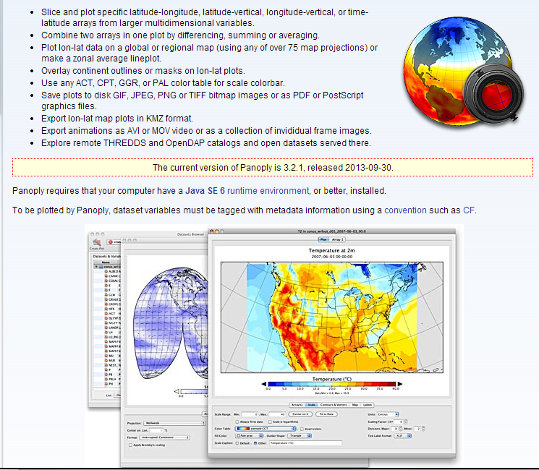
Panoply – to map the data
Can be output as KMZ file for Google Earth

Slide 19
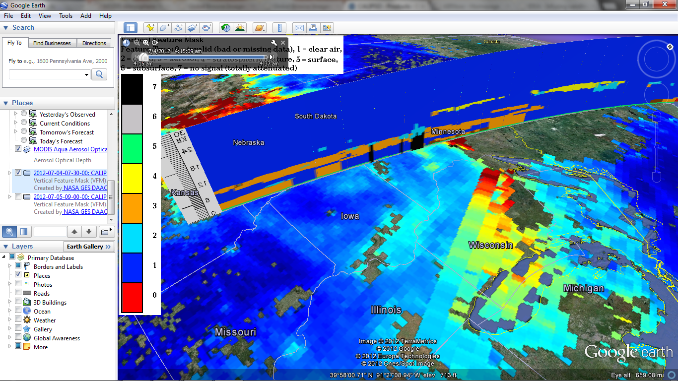
Open MODIS AOD & CALIPSO vertical Profile in Google Earth

Slide 20
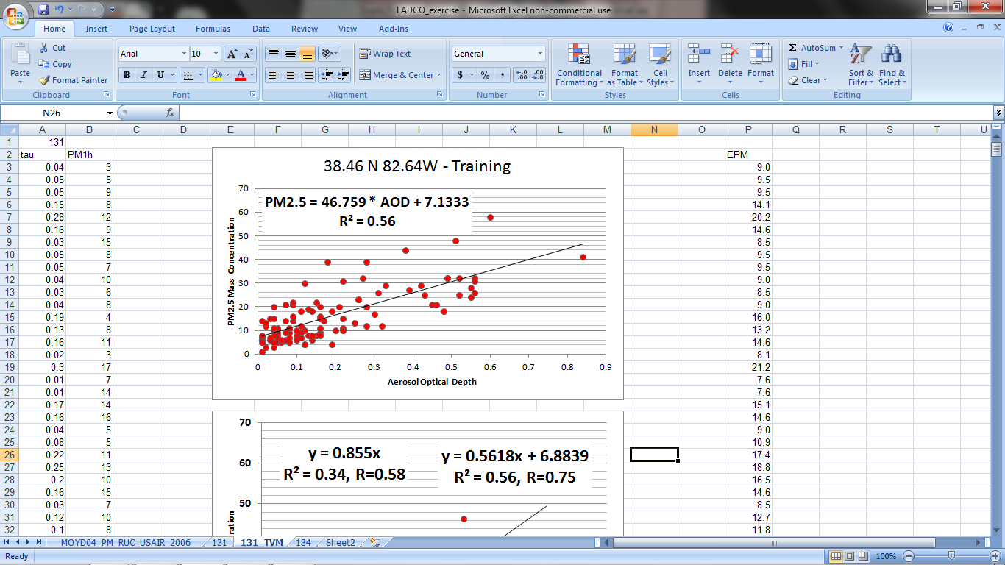
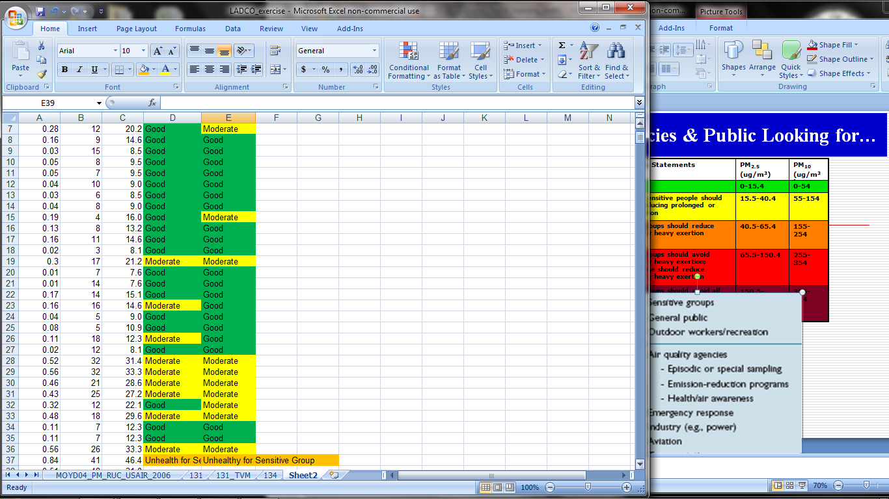
Some of Examples of hands on Training Modules
Training Module: From Satellite to PM_{2.5} to Air Quality Index
Training Exercise developed by Pawan Gupta . Course attendees compute satellite derived Air Quality Index (AQI) for the LADCO region with instructor provided IDL code and export it to excel. The last two columns show a comparison of satellite and ground based AQI. Satellite and surface measurements generally agree in predicting these categories.
Satellite versus monitor AQI for the U.S Midwest
Notes:
This is an example of a training module used during the LADCO trainings, where scripts provided by ARSET
Enabled users to obtain satellite derived AQI.

Slide 21
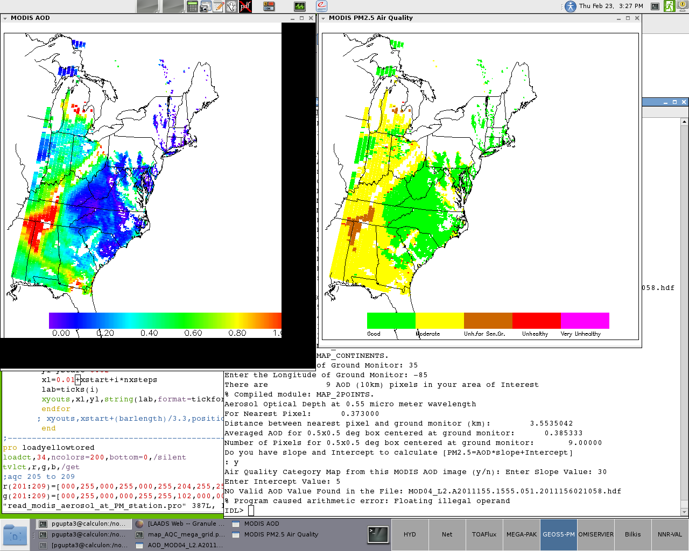
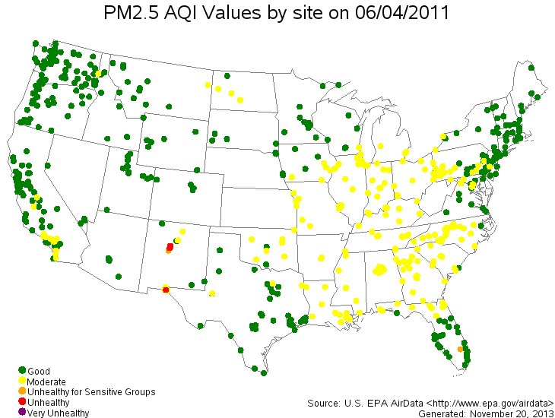
Creating Air Quality Category Map
Provide MODIS AOD file, slope and intercept to this code – will create AQC map

Slide 22
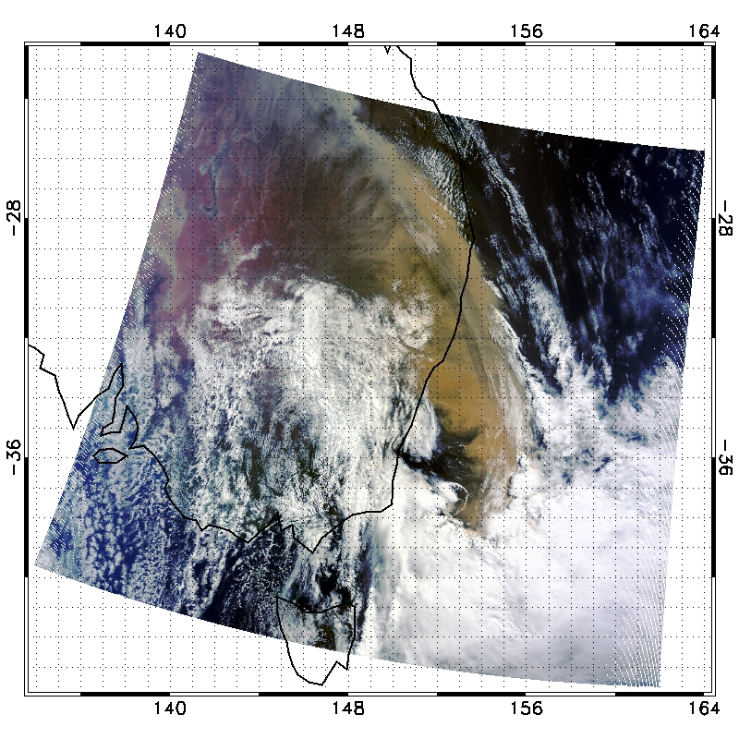
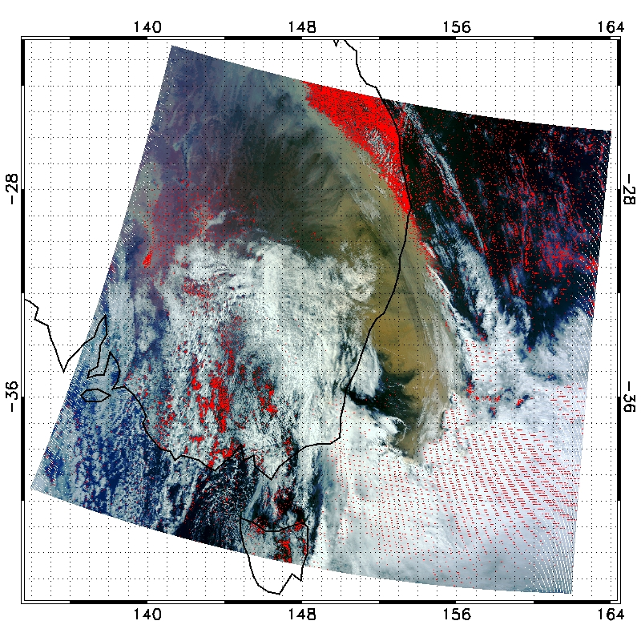
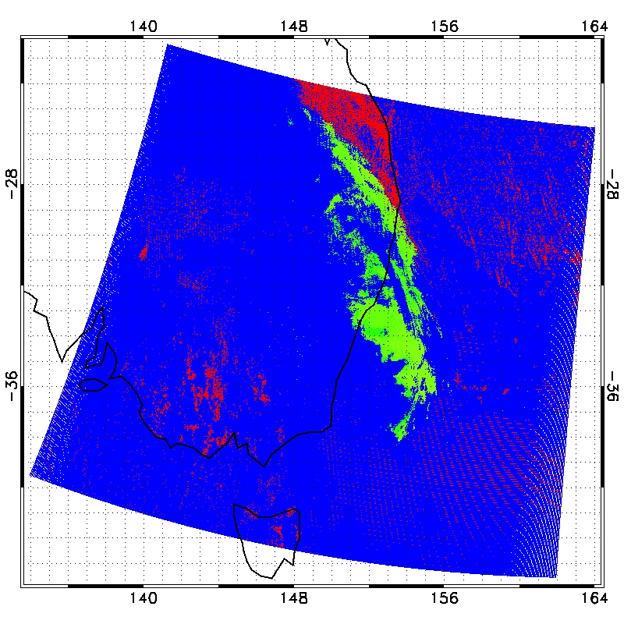
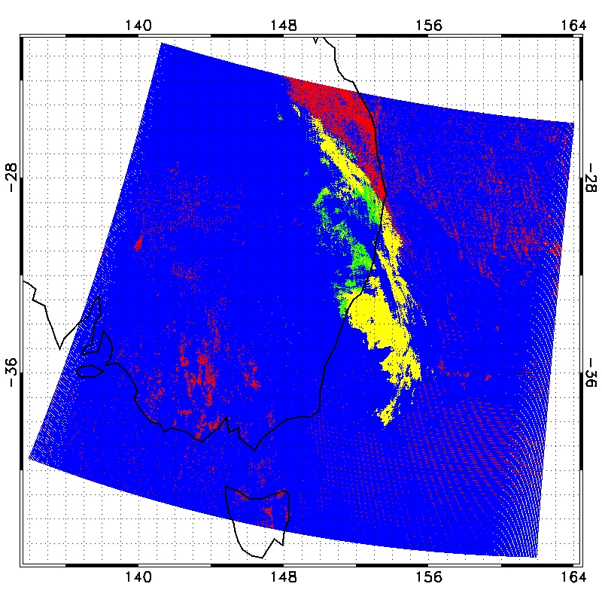
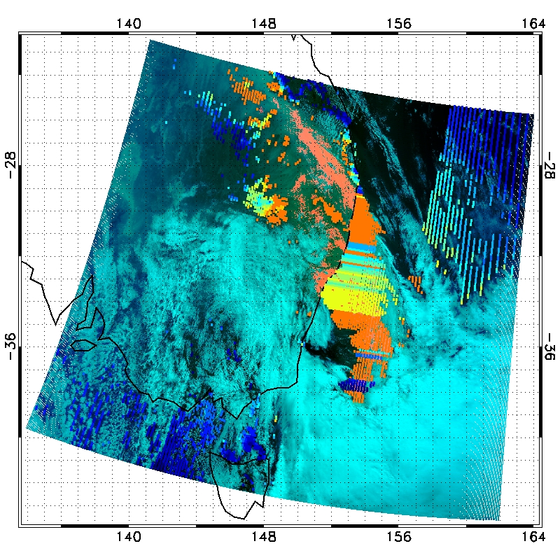
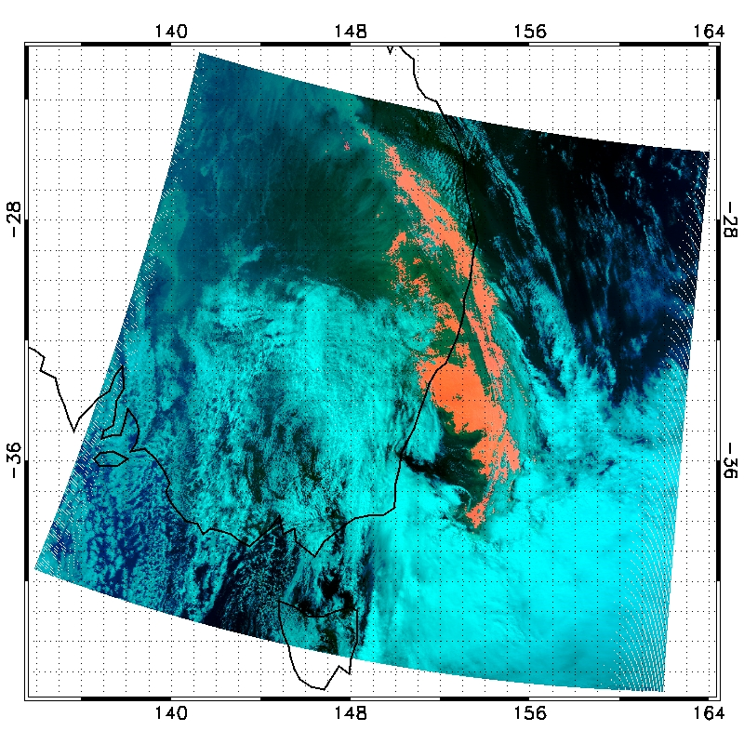
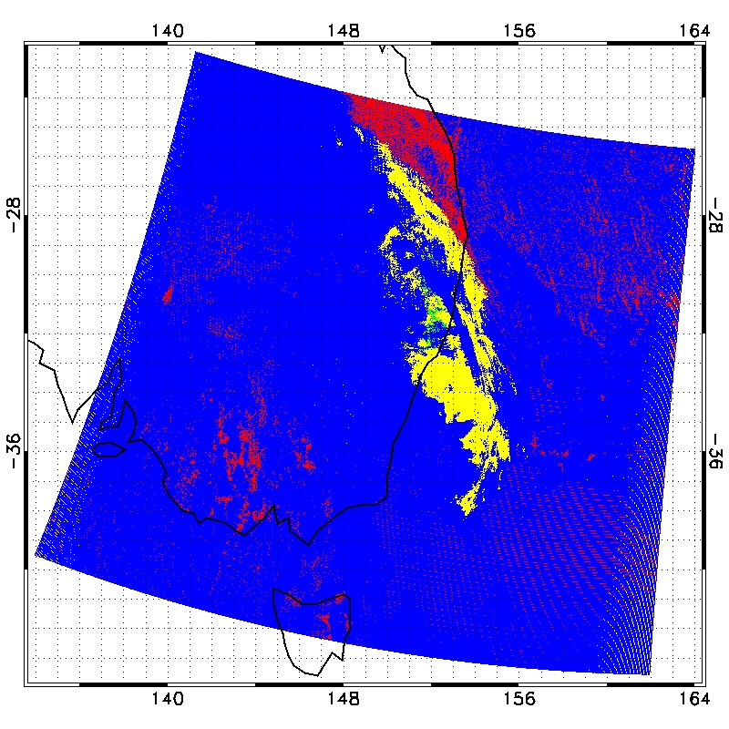
RGB
Dust Detection – Data Processing Chain
TEST # 1
TEST # 2
TEST # 3
AOD
DUST
TEST # 4

Slide 23
Wish List for VIIRS data
Easy Data Access
Data & Geo-location/metadata in the same file
Larger granule size if possible
Online and offline tools to read/map/analysis the data
  Image Archives for RGB, Level 2, & 3
Integration into online visualization tools
  GIOVANNI
  IDEA
  Worldview
  Data Search Tool – ECHO-REVERB
  LAADS Web

Slide 24
ARSET Team Members
Project Lead
Ana Prados (GSFC/UMBC)
Air Quality
Pawan Gupta (GSFC/GESTAR/USRA)
Richard Kleidman (GSFC/SSAI)
Yang Liu (Emory University)
Jacquie Witte (GSFC/SSAI)
Ecological/Land Management
Evan Johnson (Student/AMES/Baeri)
Cindy Schmidt (AMES/Baeri)
Water Resources
Brock Blevins (Student/UMBC)
Chris Mattmann (JPL/Caltech)
Amita Mehta (GSFC/UMBC)
Tom Painter (JPL/Caltech)
Program Evaluation
Annelise Carleton-Hug (Trillium A.)
Administrative Support
Marines Martins (GSFC/SSAI)
Module Translation (Spanish)
David Barbato (Student/UMBC)
Notes:
ARSET now has three core teams, AQ and Water Resources monitoring were the existing teams, and ARSET just added ecological/land management. Air quality is the part of the program I will talk about today. The program is not yet doing trainings related to health topics other than air quality.
ARSET currently has 9 scientists sy three NASA centers (plus myself, at Emory U. ☺), three students, and a program evaluator. Students help prepare course materials, and with the translation of material into Spanish.

