Slide 1
VIIRS Aerosol Products, Data Quality, and Visualization Tools
VIIRS Aerosol Cal/Val Team

Slide 2
Outline
VIIRS Aerosol Products
Environmental Data Record (EDR)
Intermediate Product (IP)
Data Quality
Validation of high quality EDR Aerosol Optical Thickness at 550nm
Visualization
Granule example

Slide 3
Data Quality
VIIRS high quality EDR AOT550
Time period
5/2/2012 – 9/1/2013 over ocean
1/23/2013 – 9/1/2013 over land
Compare with
Aqua MODIS level-2 AOT550
AERONET level-1.5 AOT550
MAN level-2.0 AOT550 (5/2/2012 – 6/30/2013)
Collocation
VIIRS vs. MODIS (5-minute; within MODIS grid)
VIIRS vs. AERONET; MODIS vs. AERONET (60-minute, 27.5km radius)
VIIRS vs. MAN (60-minute, 0.5° spatial domain)
H. Liu et al. (2013) Preliminary Evaluation of Suomi-NPP VIIRS Aerosol Optical Thickness. (under review)

Slide 4
Time Series
Processing Error
PCT Update
VIIRS – MODIS: -0.007 over ocean; 0.083/0.028 over land before/after PCT update

Slide 5
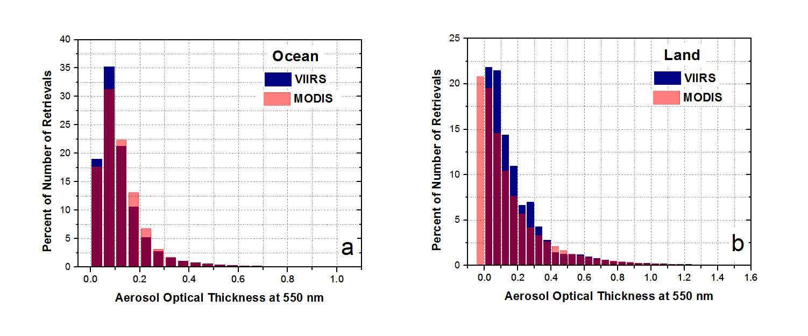
Histogram
Similar frequency distributions
Larger fraction of VIIRS retrievals at low AOT
No negative retrievals from VIIRS

Slide 6
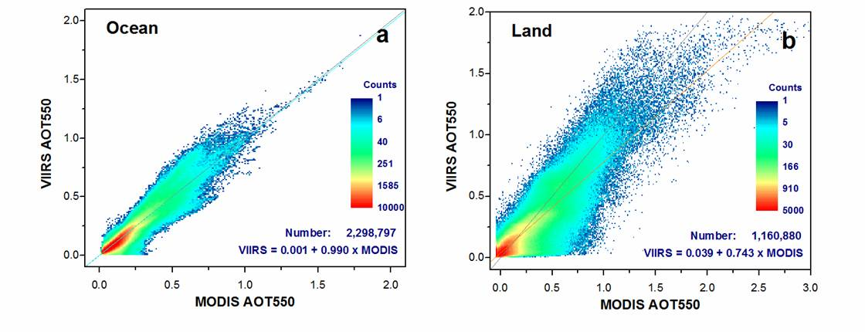
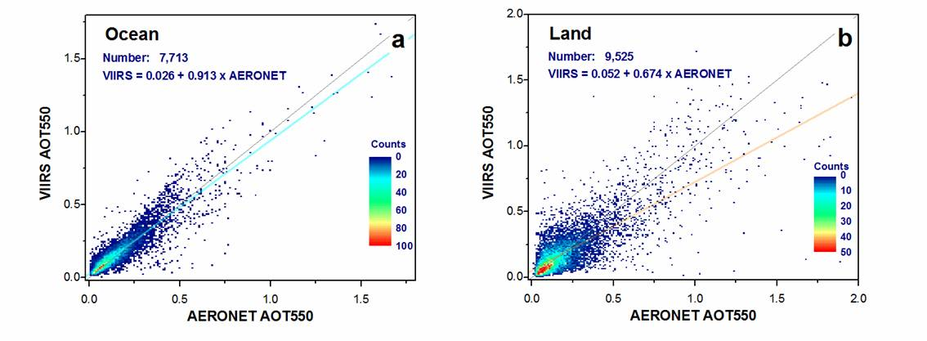
Scatter Plots

Slide 7
Statistics (over Ocean)
 | VIIRS vs. MODIS | VIIRS vs. AERONET | MODIS vs. AERONET
Number of Match-ups | 2,298,790 | 7,713 | 1,931
Bias | -0.0004 | 0.013 | 0.001
StdDev | 0.036 | 0.061 | 0.059
RMSE | 0.036 | 0.062 | 0.059
Correlation | 0.949 | 0.906 | 0.909
Percent within ±(0.03+0.05 τ) uncertainty range |  | 64.1% | 64.1%

Slide 8
Statistics (over Land)
 | VIIRS vs. MODIS | VIIRS vs. AERONET | MODIS vs. AERONET
Number of Match-ups | 1,160,880 | 9,525 | 4,990
Bias | -0.011 | -0.009 | -0.005
StdDev | 0.128 | 0.130 | 0.106
RMSE | 0.129 | 0.130 | 0.106
Correlation | 0.892 | 0.773 | 0.886
Percent within ±(0.05+0.15 τ) uncertainty range |  | 71.0% | 64.7%

Slide 9
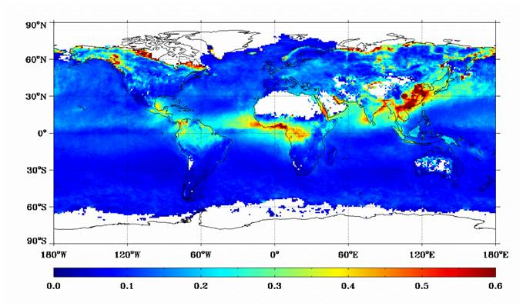
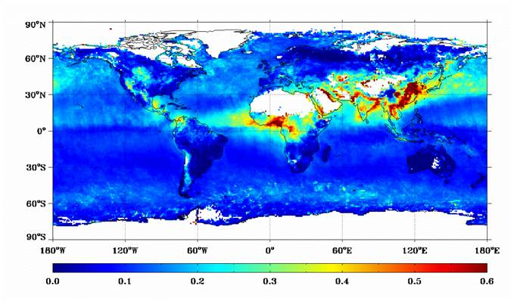
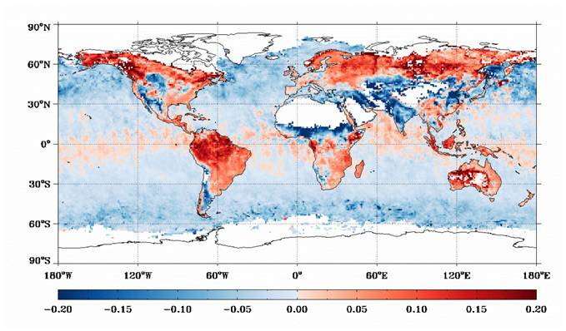
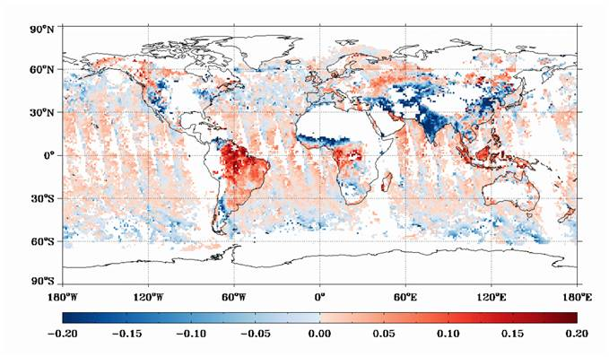
Global Images: 2013 Feb-May
VIIRS
MODIS
VIIRS-MODIS (Non-Collocated)
VIIRS-MODIS (Collocated)
Notes:
Similar patterns from VIIRS and MODIS
Similar patterns from collocated and non-collocated difference (algorithm difference)
Undetected snow in VIIRS
Over-stringent sea ice internal test

Slide 10
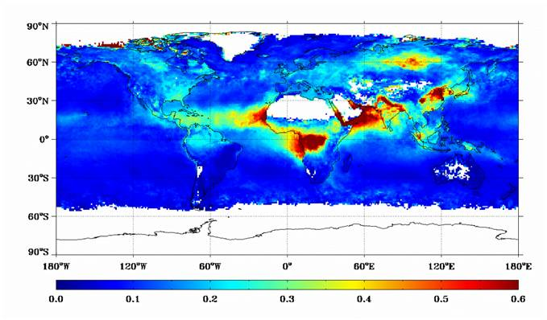
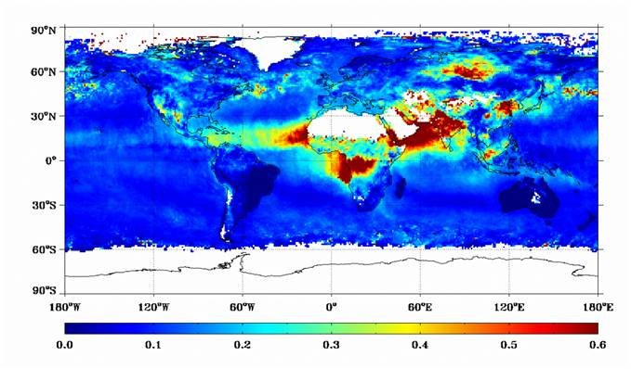
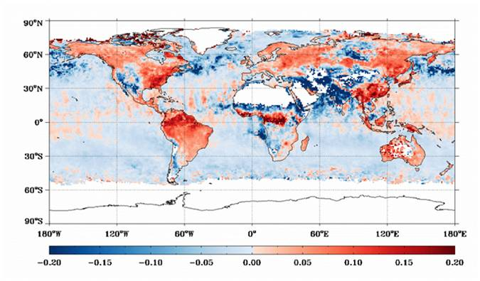
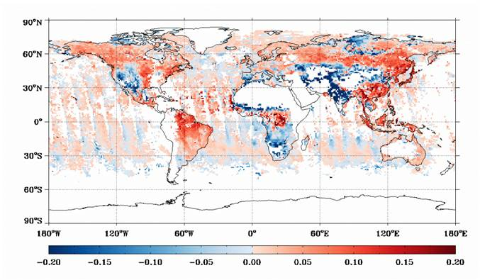
Global Images: 2013 Jun-Aug
VIIRS
MODIS
VIIRS-MODIS (Non-Collocated)
VIIRS-MODIS (Collocated)

Slide 11
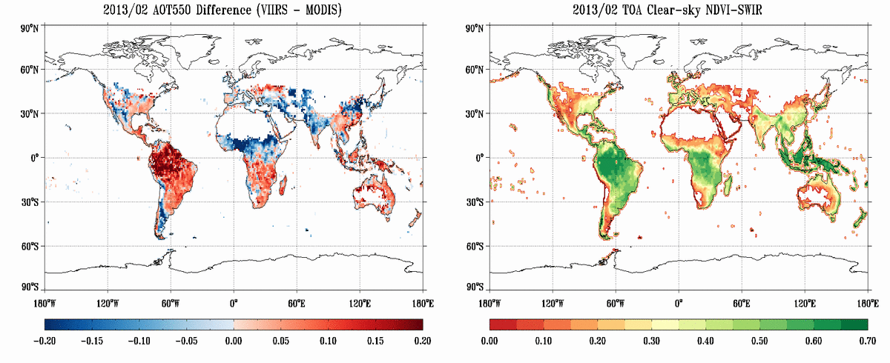
AOT Difference over Land
VIIRS-MODIS AOT550 difference has a strong dependence on the surface type
Higher VIIRS AOT (red) over vegetated areas (green)
Lower VIIRS AOT (blue) over soil (red)

Slide 12
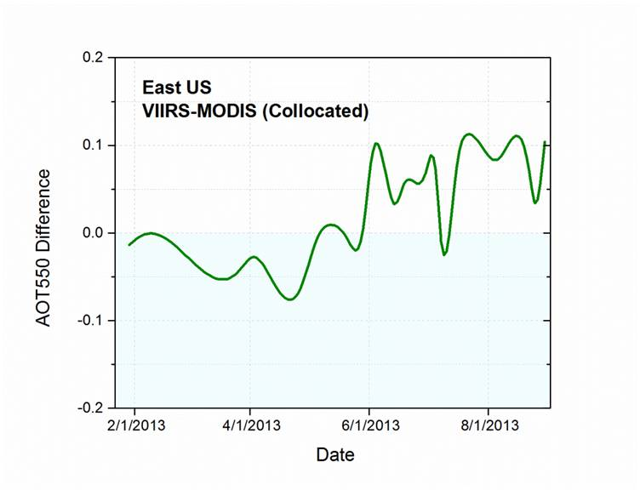
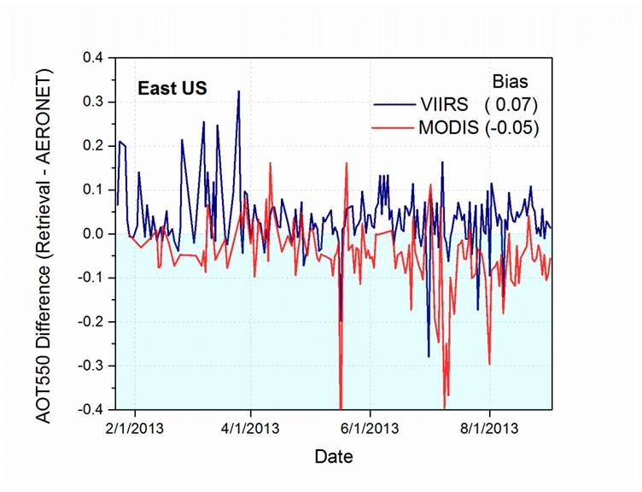
Regional Difference – East US

Slide 13
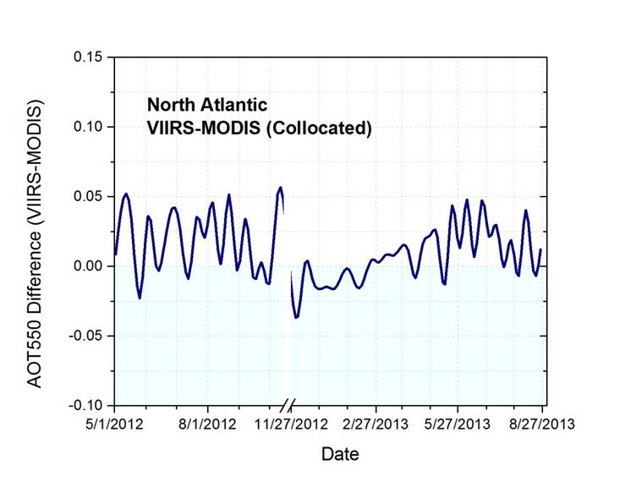
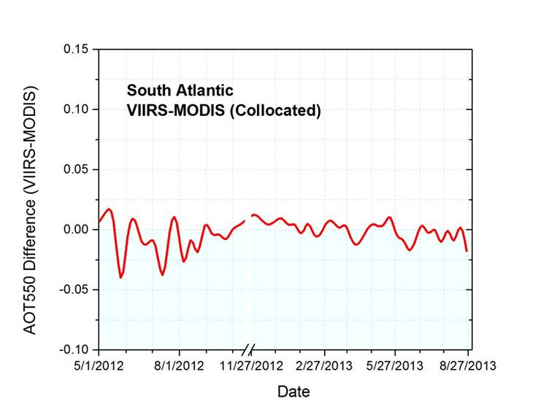
Regional Difference – Atlantic Ocean
Notes:
NA: 6-9 (dust)
SA: 1-3 (dust) 7-10 (smoke)
Ind: 5-9 (dust) 10-4 (pollution)

Slide 14
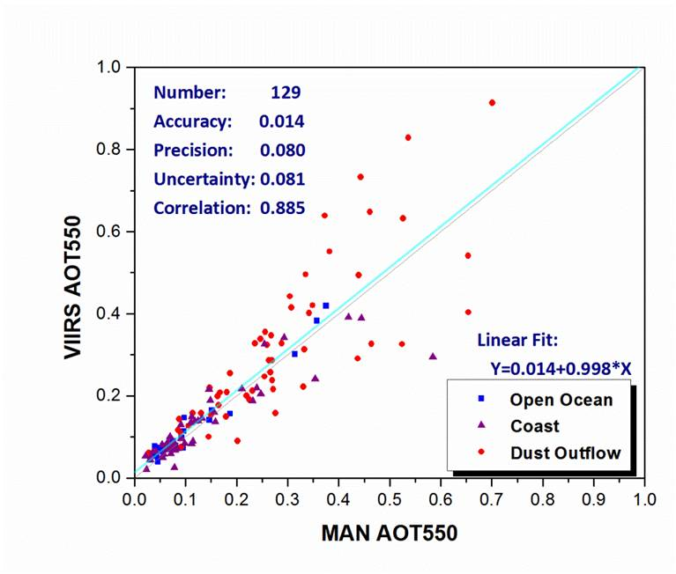
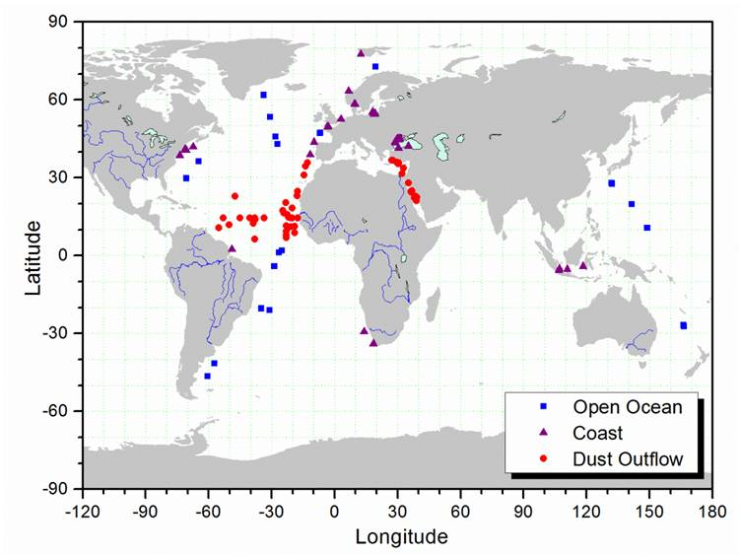
Validation with MAN
Notes:
62% within +/- (0.03+0.05tau)

Slide 15
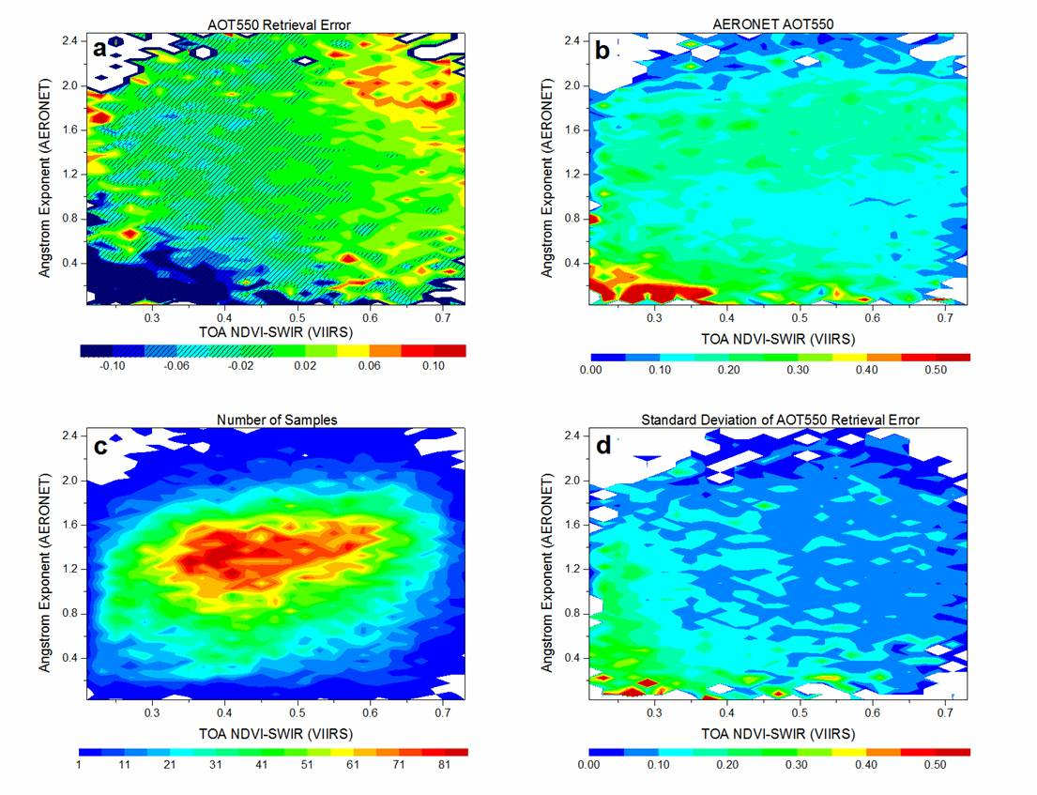
Validation over Land
Retrieval error as a function of:
aerosol type (AERONET Ångström Exponent)
Surface type (VIIRS TOA NDVI-SWIR)
Small bias for majority of cases
Positive bias over vegetated area
Negative bias over soil-dominated area
Larger uncertainties over soil-dominated area

Slide 16
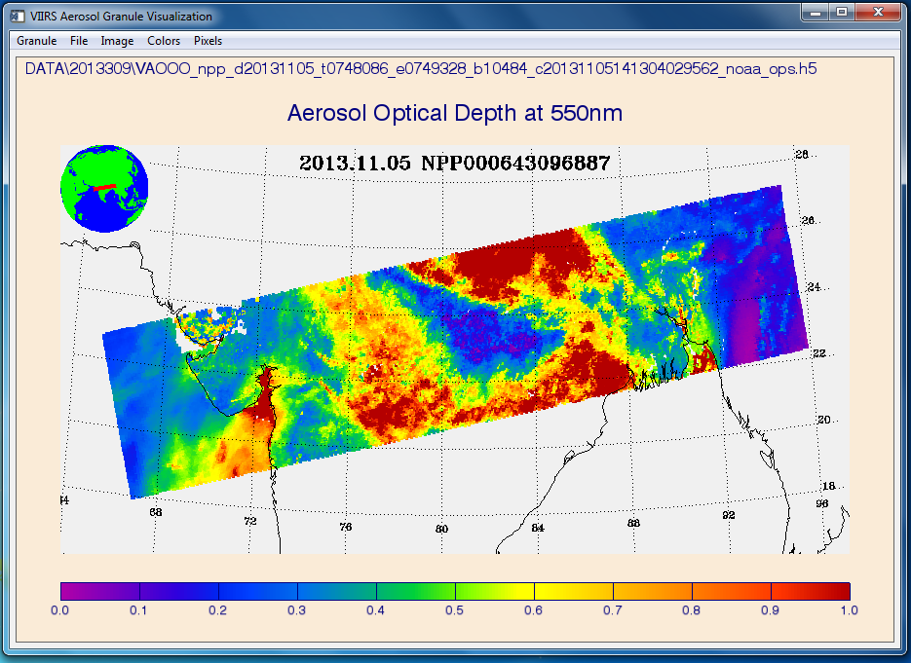
VIIRS Granule Visualization Tool
IDL software
Interactive interface
Display VIIRS aerosol products and satellite inputs

Slide 17
Backup

Slide 18
Statistics (over Ocean) - collocated
 | VIIRS vs. AERONET | MODIS vs. AERONET
Number of Match-ups | 1,652 | 1,281
Bias | 0.007 | -0.001
StdDev | 0.047 | 0.053
RMSE | 0.048 | 0.053
Correlation | 0.919 | 0.907
Percent within ±(0.03+0.05 τ) uncertainty range | 72.8% | 66.6%

Slide 19
Statistics (over Land) - collocated
 | VIIRS vs. AERONET | MODIS vs. AERONET
Number of Match-ups | 4,647 | 3,624
Bias | -0.028 | -0.014
StdDev | 0.098 | 0.099
RMSE | 0.102 | 0.100
Correlation | 0.866 | 0.892
Percent within ±(0.05+0.15 τ) uncertainty range | 77.2% | 67.2%

Slide 20
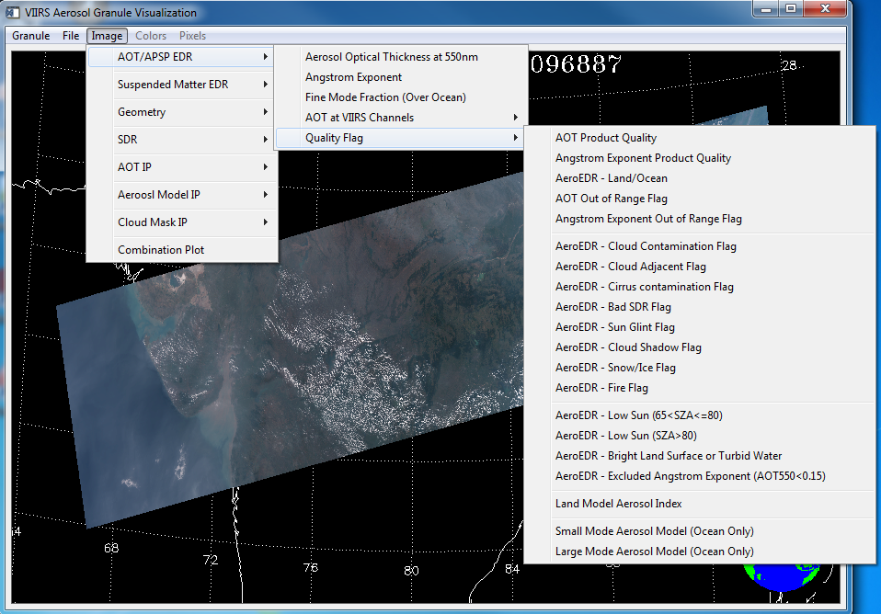
RGB

Slide 21
EDR AOT550

Slide 22
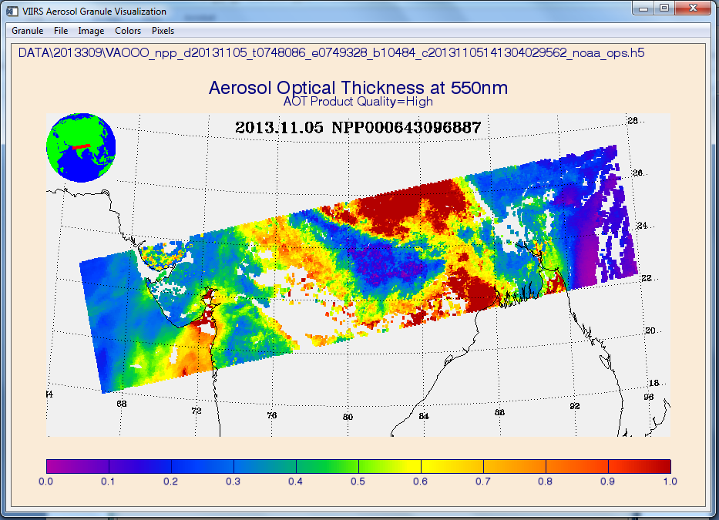
High Quality EDR AOT550

Slide 23
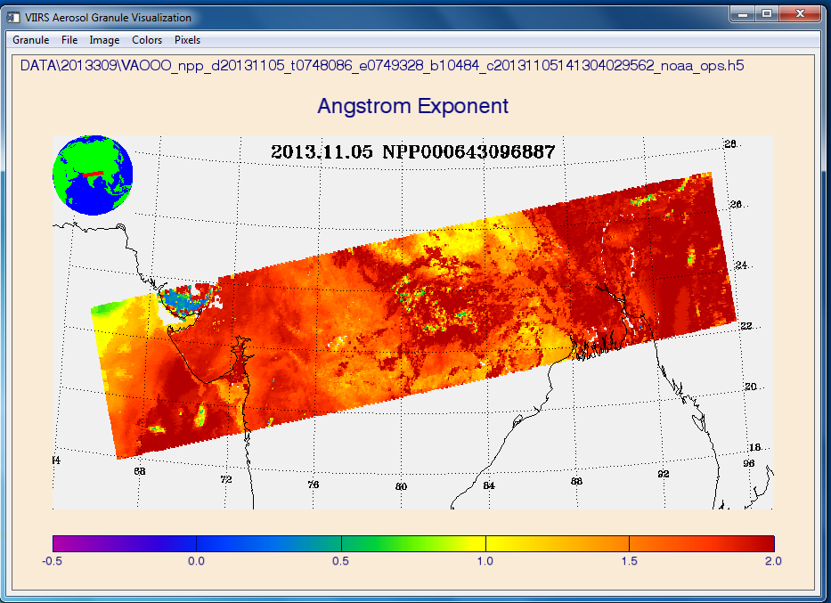
EDR Angstrom Exponent

Slide 24
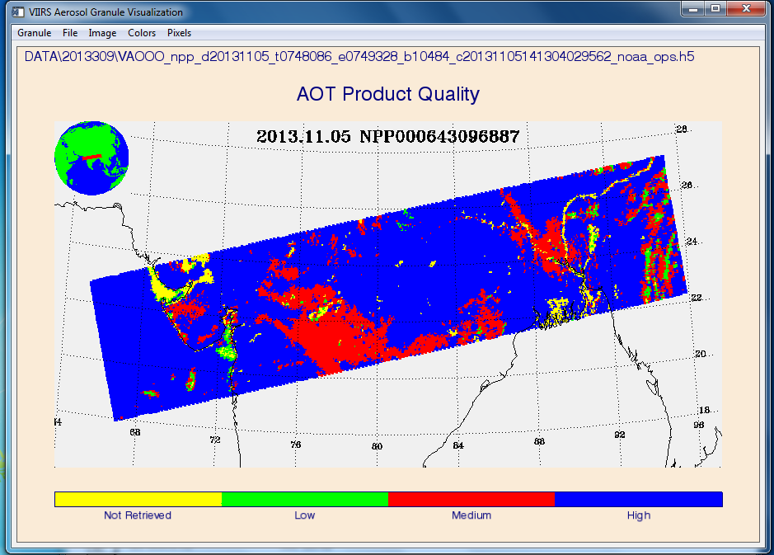
EDR AOT Quality

Slide 25
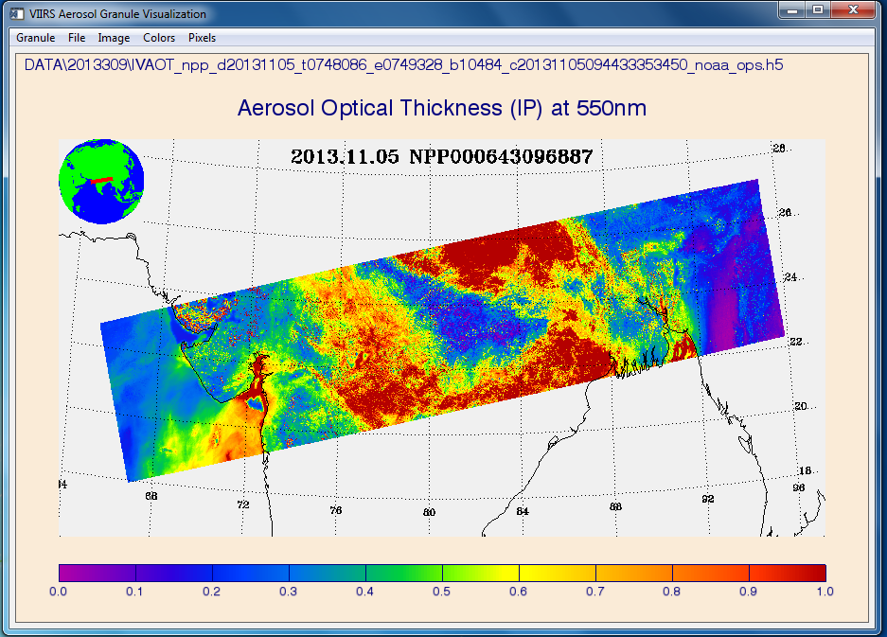
IP AOT550

Slide 26
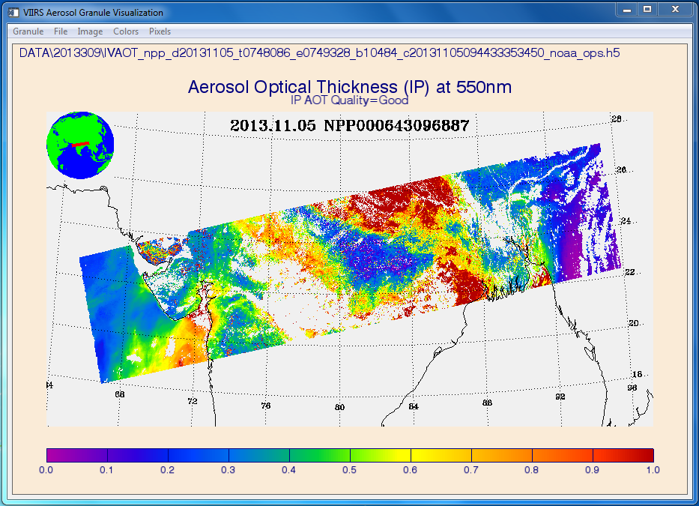
Good Quality IP AOT550

Slide 27
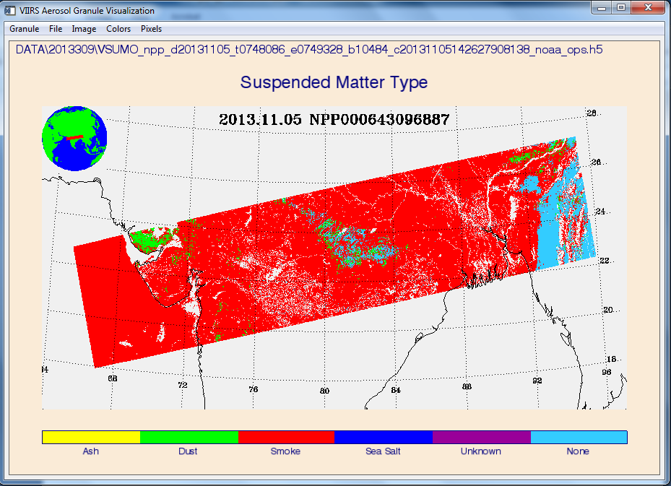
Suspended Matter Type

Slide 28
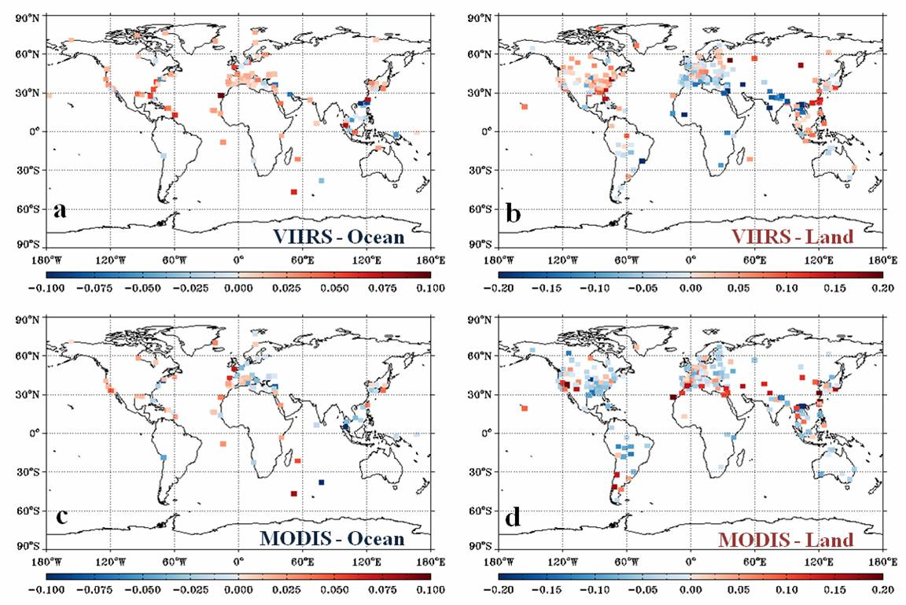

Slide 29
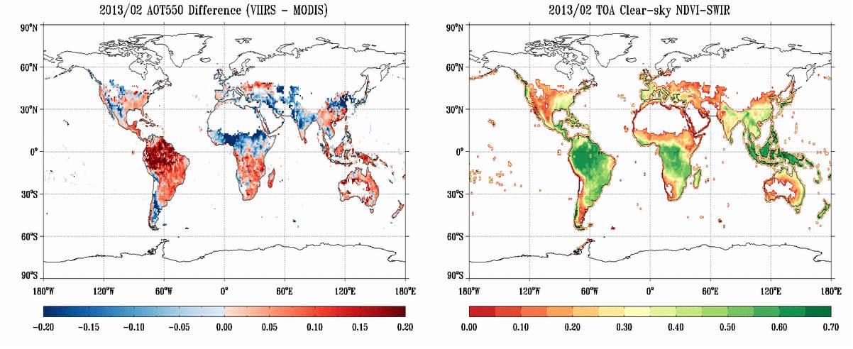

Slide 30
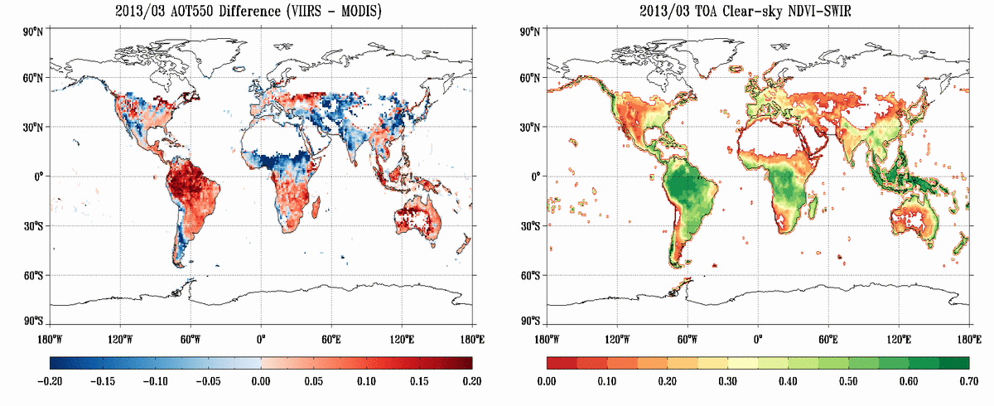

Slide 31
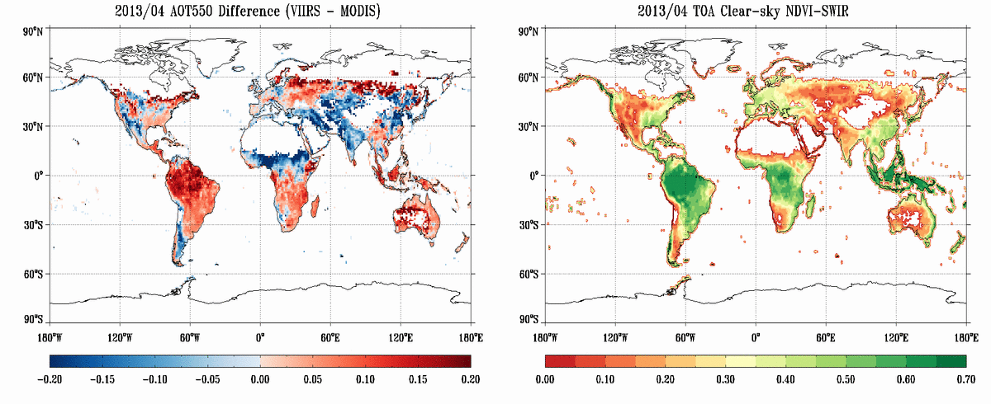

Slide 32
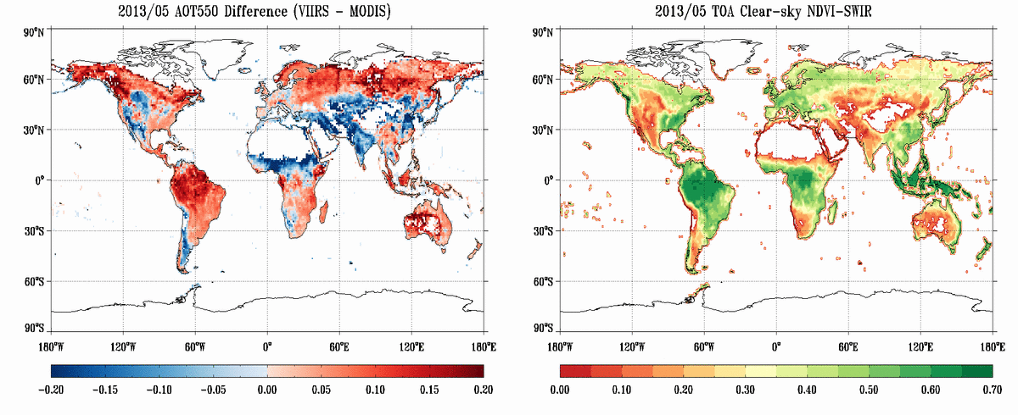

Slide 33
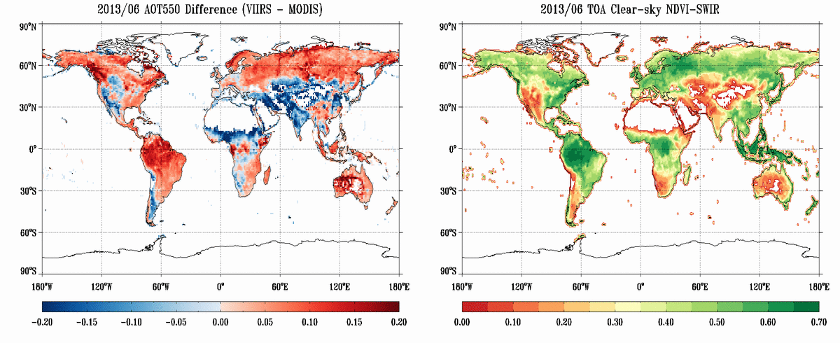

Slide 34
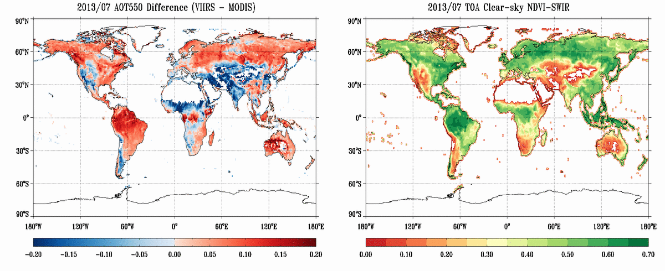

Slide 35
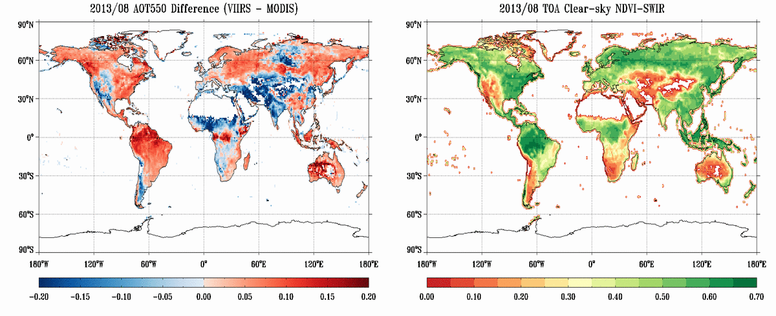

Slide 36
Regional Analysis
Six land domains:
(1) East US (2) East Asia (3) South America (4) South Africa (5) West US (6) India
Three ocean domains:
(1) North Atlantic (2) South Atlantic (3) North Indian Ocean

Slide 37
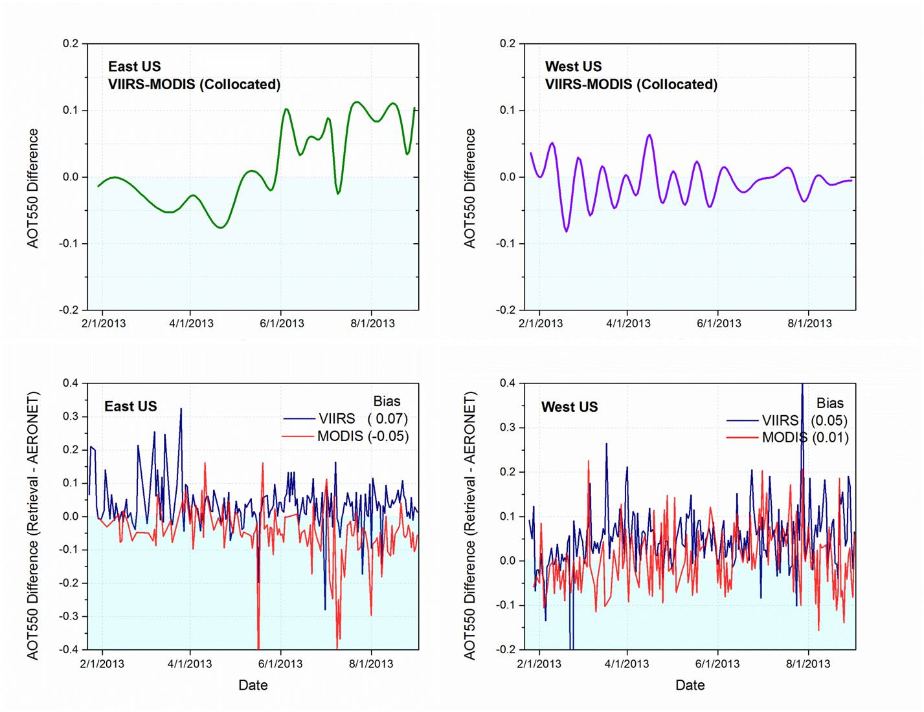

Slide 38
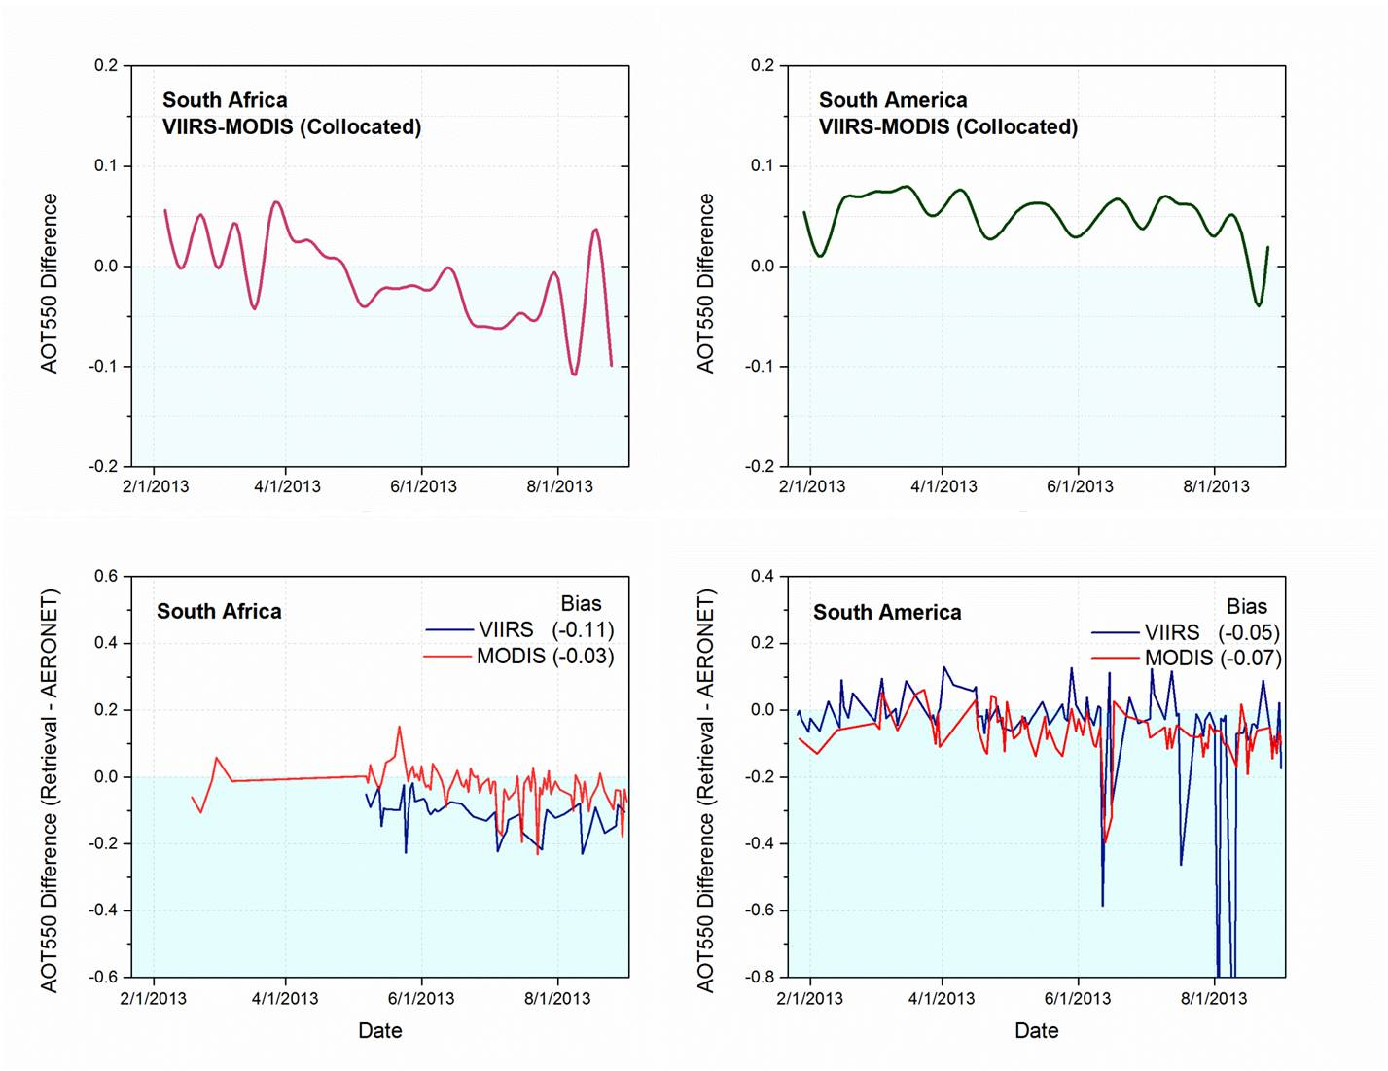

Slide 39
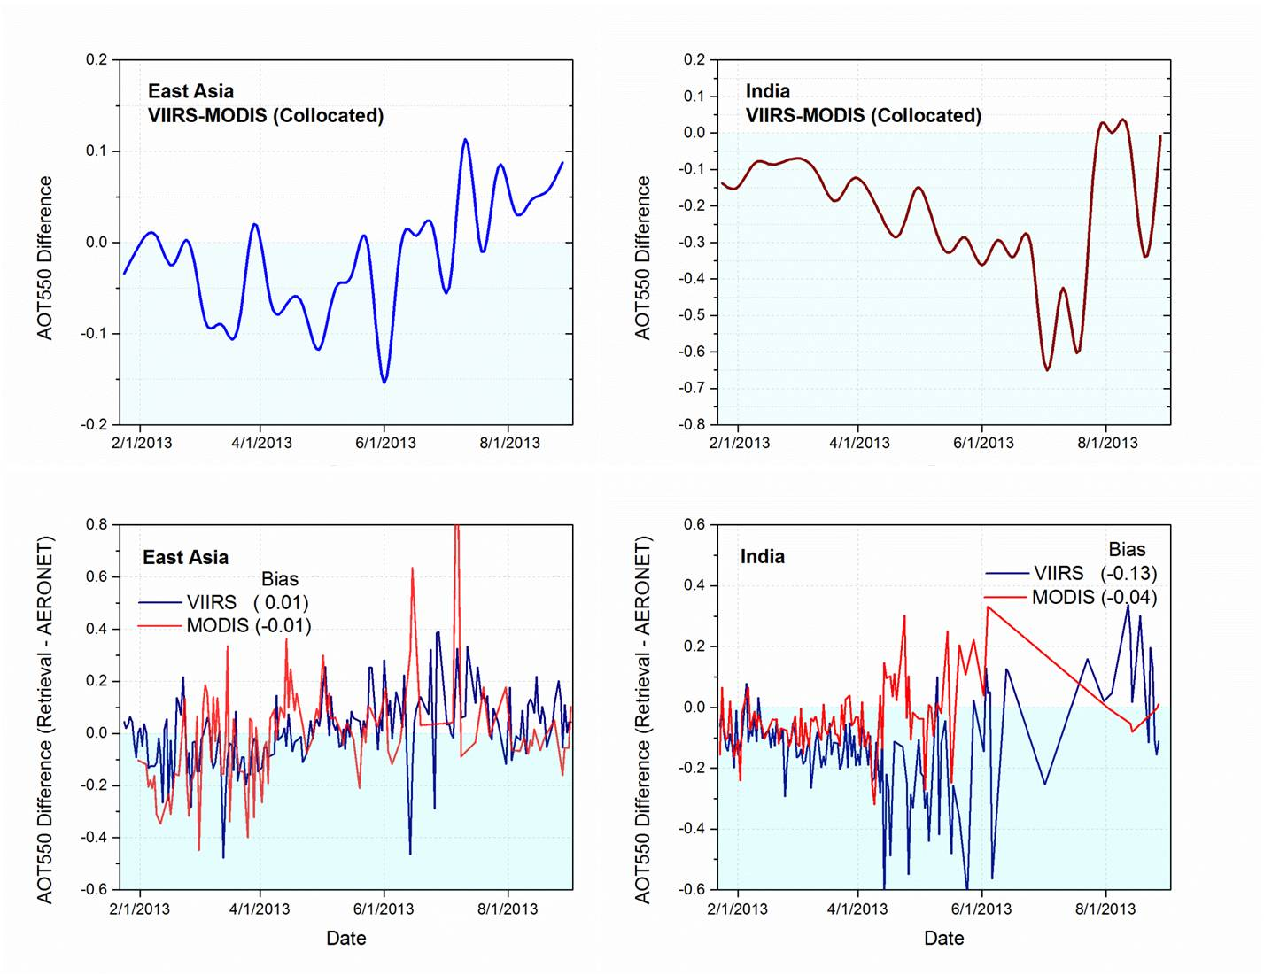

Slide 40
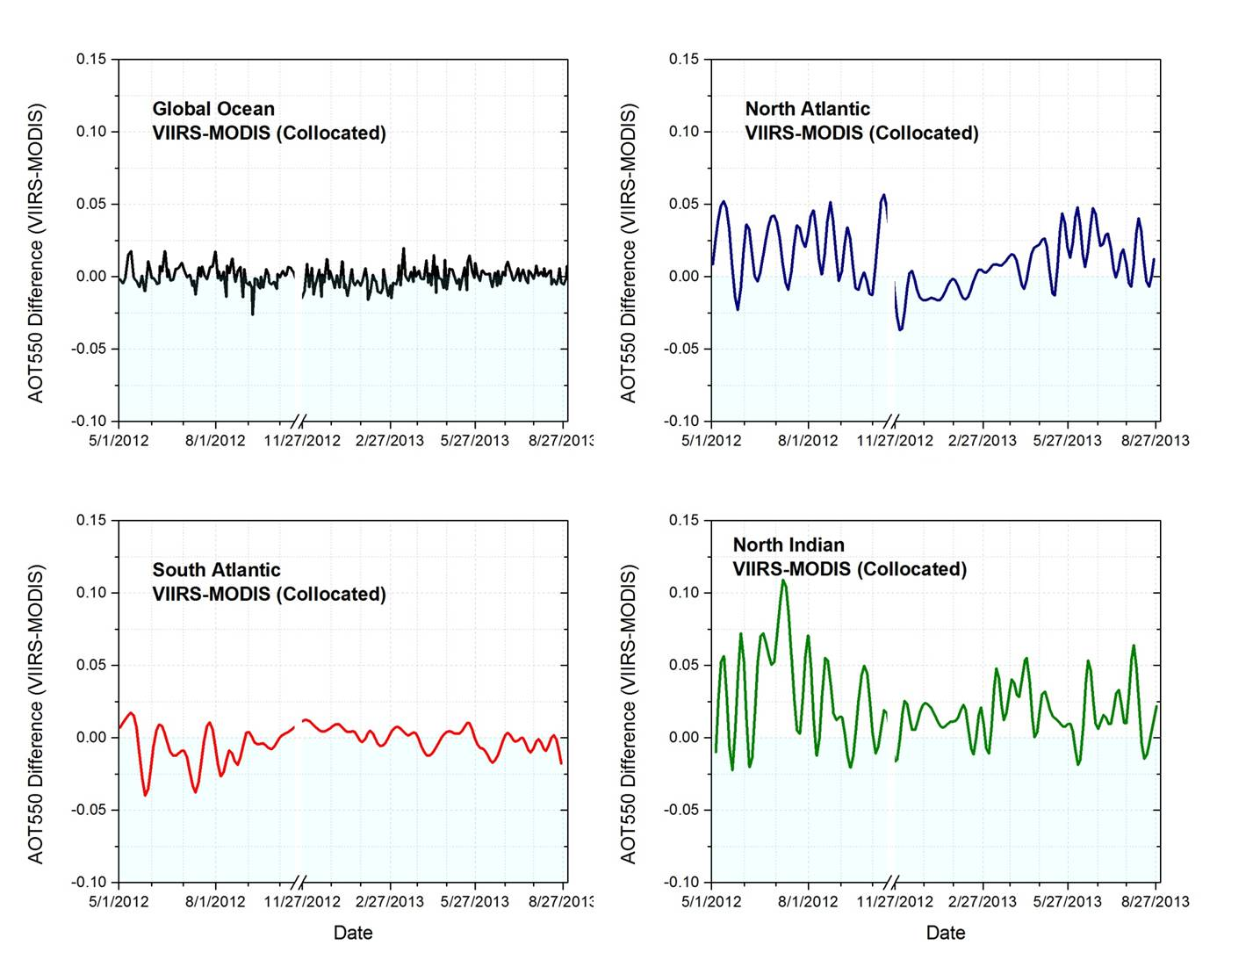
Notes:
NA: 6-9 (dust)
SA: 1-3 (dust) 7-10 (smoke)
Ind: 5-9 (dust) 10-4 (pollution)

