Slide 1
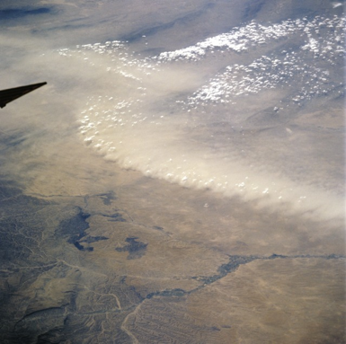

Transition from MODIS AOD → VIIRS AOD
Robert Levy (NASA-GSFC)
Shana Mattoo, Leigh Munchak (SSAI @ NASA-GSFC)
Falguni Patadia (GESTAR/Morgan State Univ. @ NASA-GSFC)
Lorraine Remer (JCET-UMBC)
VIIRS-2013 College Park, MD, November 2013

Slide 2
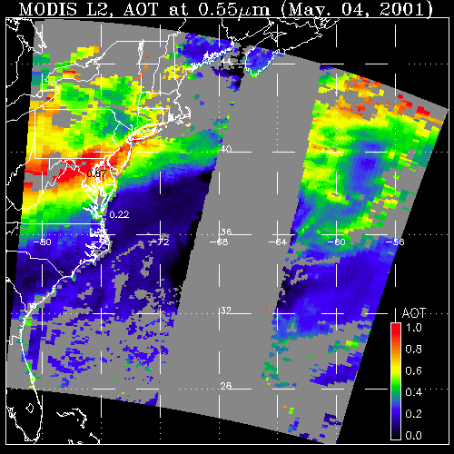
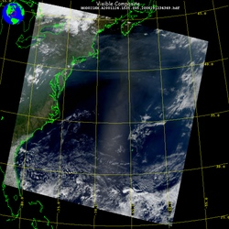
Aerosol retrieval from MODIS
What MODIS observes
Attributed to aerosol (AOD)
May 4, 2001; 13:25 UTC
Level 1 “reflectance”
May 4, 2001; 13:25 UTC
Level 2 “product”
LAND
OCEAN
GLINT
AOD
1.0
0.0
There are many different “algorithms” to retrieve aerosol from MODIS
Dark Target (“DT” ocean and land; Levy, Mattoo, Munchak, Remer, Tanré, Kaufman)
Deep Blue (“DB” desert and beyond; Hsu, Bettenhousen, Sayer,.. )
MAIAC (coupled with land surface everywhere; Lyapustin, Wang, Korkin,…)
Ocean color/atmospheric correction (McClain, Ahmad, …)
Etc (neural net, model assimilation, statistical, … )
Your own algorithm (many groups around the world)

Slide 3
A MODIS view of global aerosol system (over dark targets)
Collection 5
As envisioned by Y. Kaufman and D. Tanré
And produced by the MODIS-aerosol team at NASA GSFC
AOD
Remer et al, 2008
We have two sophisticated sensors (aboard Terra and Aqua), with stable orbits, excellent calibration teams and validated aerosol retrievals.
But we always want to do better.

Slide 4
Diverse users of MODIS AOD:
Designed for use in climate research
  Level 3 (gridded) for understanding global climate system: radiative forcing, global transport, aerosol/cloud interactions, geo-biology, etc.
Adapted for regional air quality monitoring
  Level 2 (ungridded) for understanding regional air quality, regional transport, urban studies, etc
Adapted for assimilation and aerosol forecasting
  Level 2 (ungridded) with error analysis to fill in model holes
→ All have different data requirements for accuracy, usability, etc.

Slide 5
Why has MODIS AOD has been so successful?
Yoram
MODIS was “new” (big jump from AVHRR)
Algorithm developers are also data users
Data are useful/accessible even if not perfect → user community “invested” into improvement process
Nearly 14 years since launch has created a huge community; tools and knowledge grew from zero (grassroots).
Lorraine and Shana → team continuity.
Reprocessing (traceable and consistent)

Slide 6
MODIS Collection 6: Improvements
Published in AMT
Levy, R. C., Mattoo, S., Munchak, L. A., Remer, L. A., Sayer, A. M., Patadia, F., and Hsu, N. C.: The Collection 6 MODIS aerosol products over land and ocean, Atmos. Meas. Tech., 6, 2989-3034, doi:10.5194/amt-6-2989-2013, 2013.
http://www.atmos-meas-tech.net/6/2989/2013/

Slide 7
Example of C6 changes: Aerosol over ocean

Slide 8
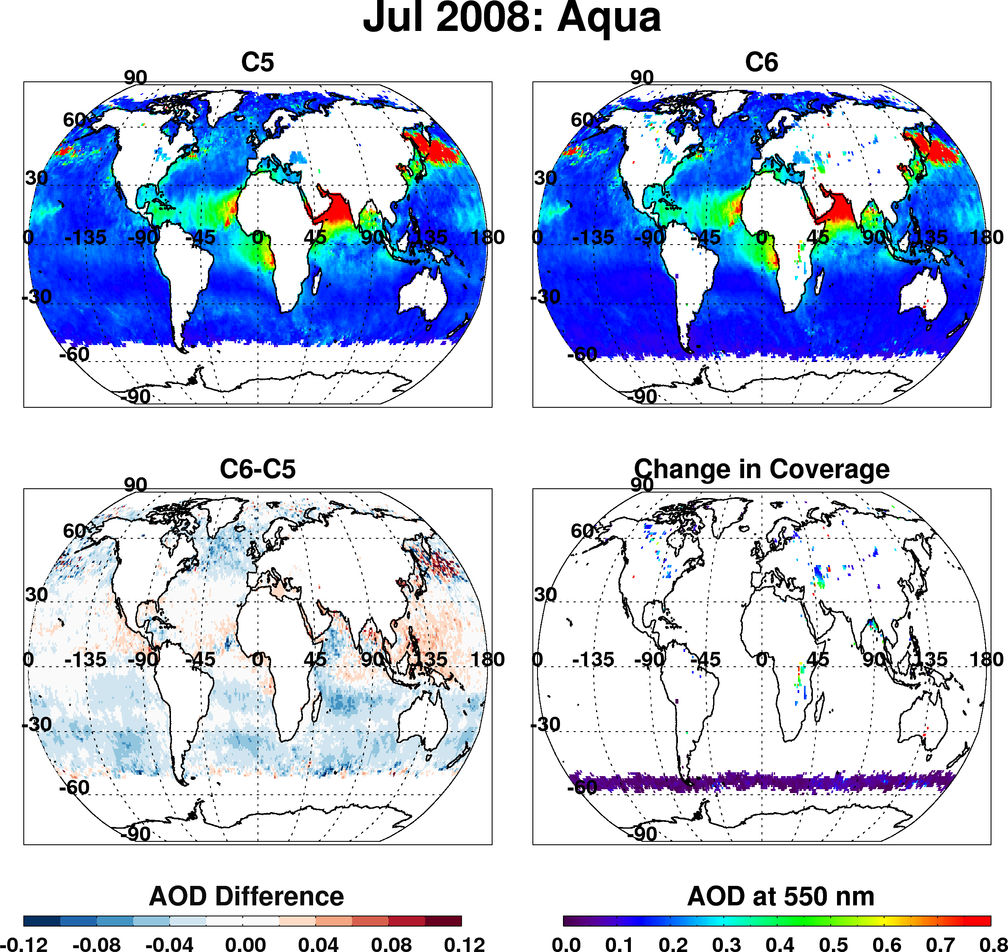
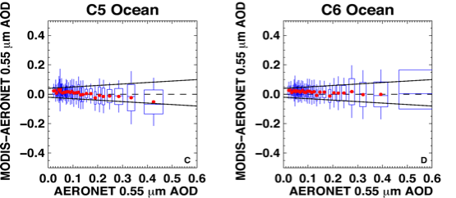
Dark target over ocean
Overall changes to products (Aqua, Jul 2008)
Overall decrease of AOD in mid-latitudes
Strong decrease in “roaring 40s” (even stronger in other months)
Overall increase in tropics
Coverage over inland lakes
Coverage toward poles

Slide 9
Why the changes?

Slide 10
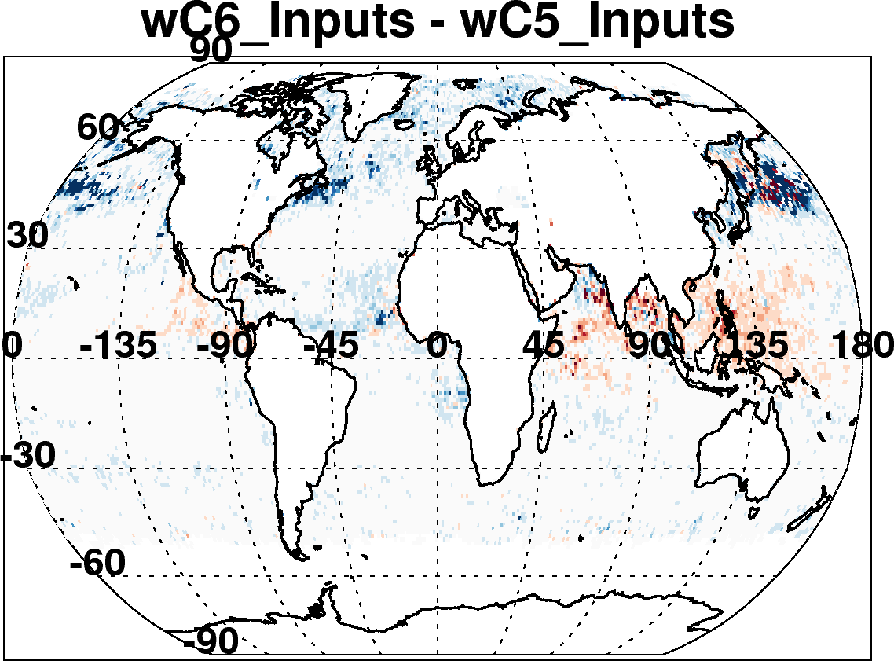
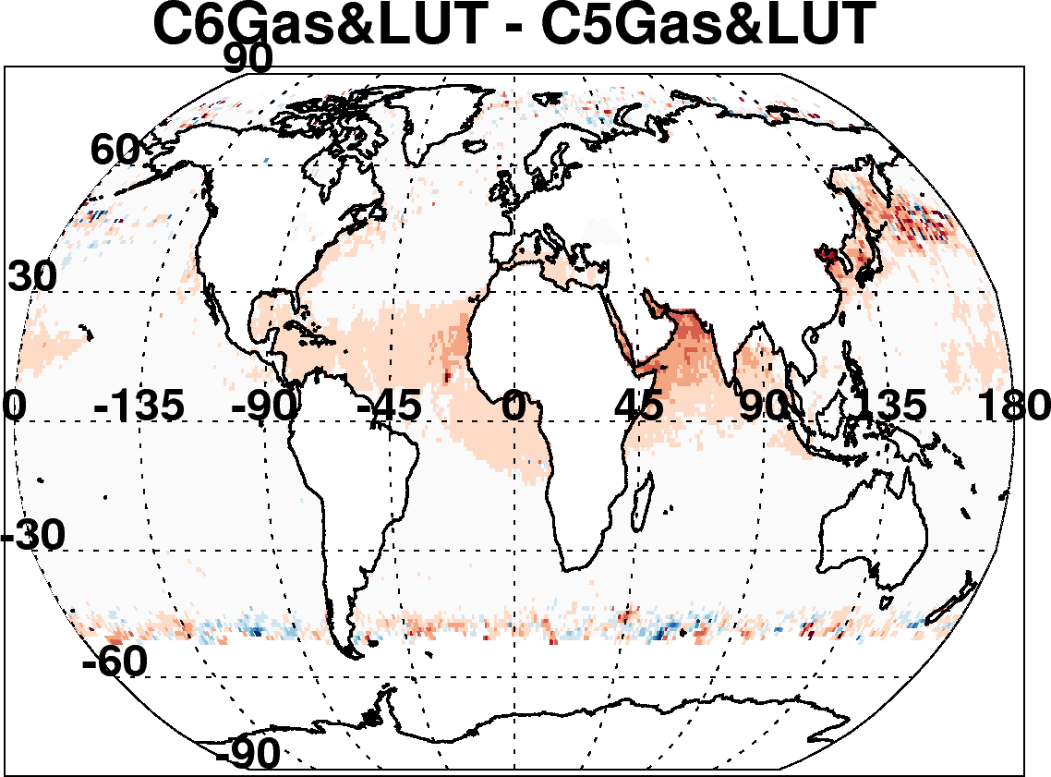
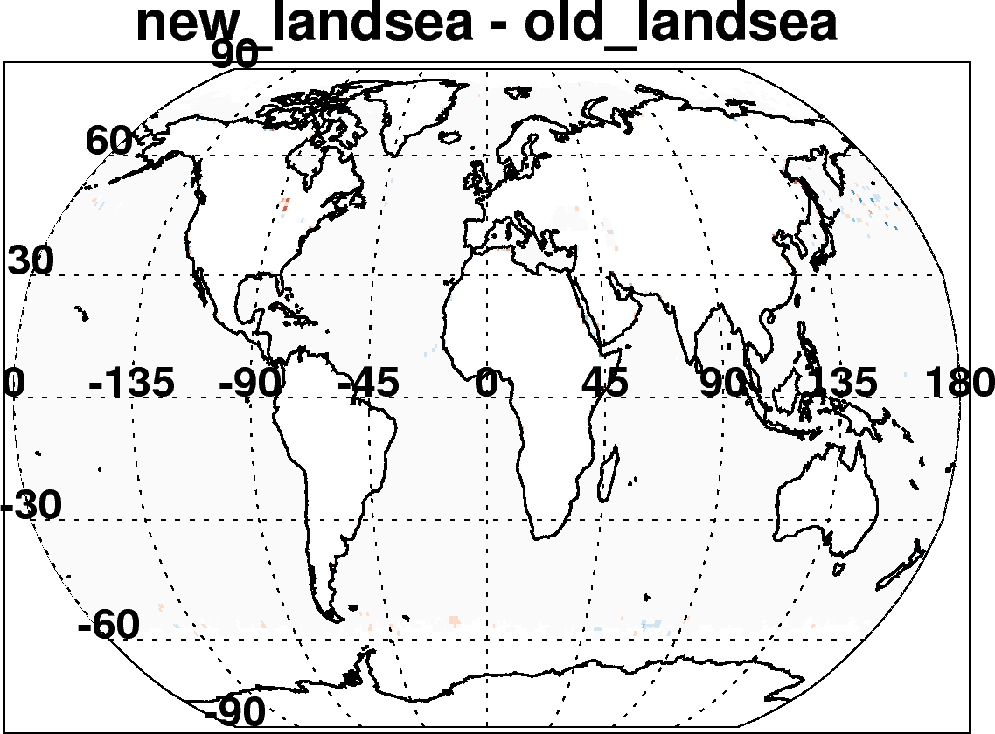
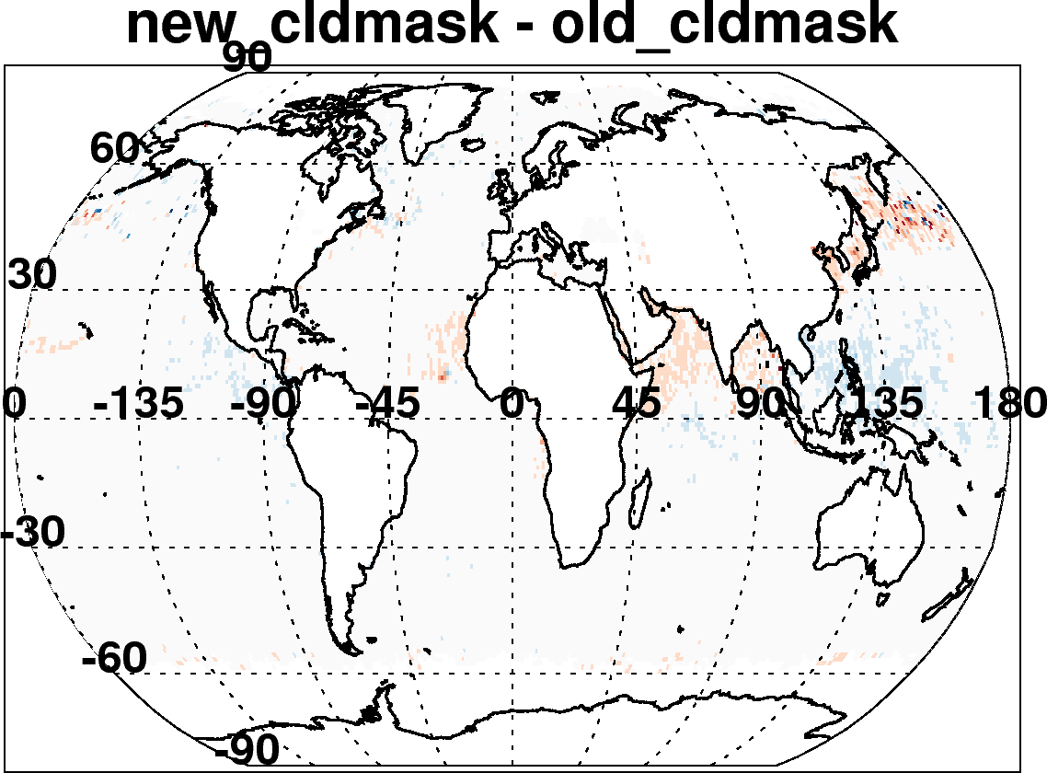
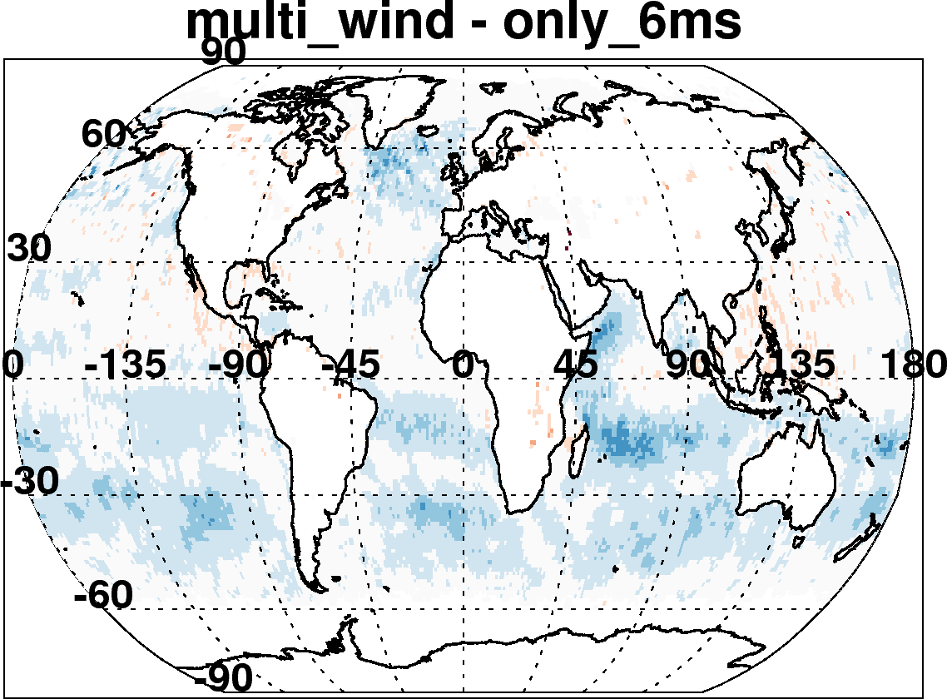

C6-C5 ocean: Due to many incremental changes
(Aqua, July 2008)
New reflectance, geo-location inputs, Wisconsin cloud mask
Updated radiative transfer
Re-define land and sea
Account for wind speed impact on surface
Improved cloud mask
Also changed “Quality Assurance” Filtering
Changed aerosol definitions of land and sea
Etc

Slide 11
Lessons learned from MODIS C6 development
There is always new “science” to implement
Iterating upon the “operational” environment allows for detailed testing
It is not just about “our” retrieval algorithm and product, it is also about “upstream” processing and products (e.g. calibration is very important)
Useful to have a friendly group of “beta-testers”
DETAILS ARE IMPORTANT!

Slide 12

MODIS: Climate Data Records (CDRs)?
“A time series of measurements of sufficient length, consistency, and continuity to determine climate variability and change.”
From: Climate Data Records from Environmental Satellites: Interim Report (2004)
  Some requirements
Measurements sustained over decades
Measurement of measurement performance (e.g. calibration, stability)
Acquired from multiple sensors / datasets
Have we sufficiently characterized the MODIS aerosol product?
(whatever that means)

Slide 13
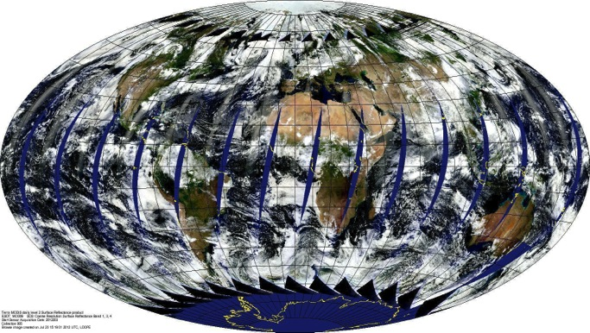
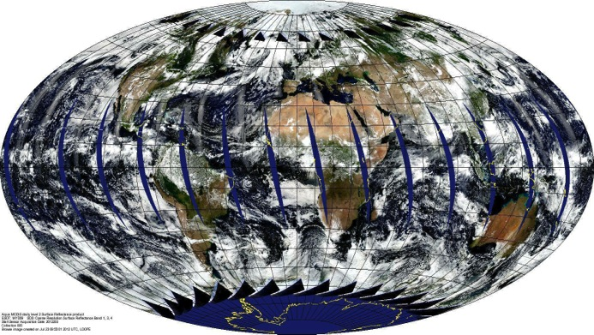
MODIS instruments = “identical twins”
Terra (10:30 Local Time, Descending)
Aqua (13:30 Local Time, Ascending)
Like human twins:
  Same parents (retrieval algorithm) for both instruments
  But each MODIS has had a different life experience
(pre-launch, during-launch, during orbit)
  They observe same world, but sample from different perspective
  MCST works very hard to monitor both sensors
Two instruments, one world view?

Slide 14
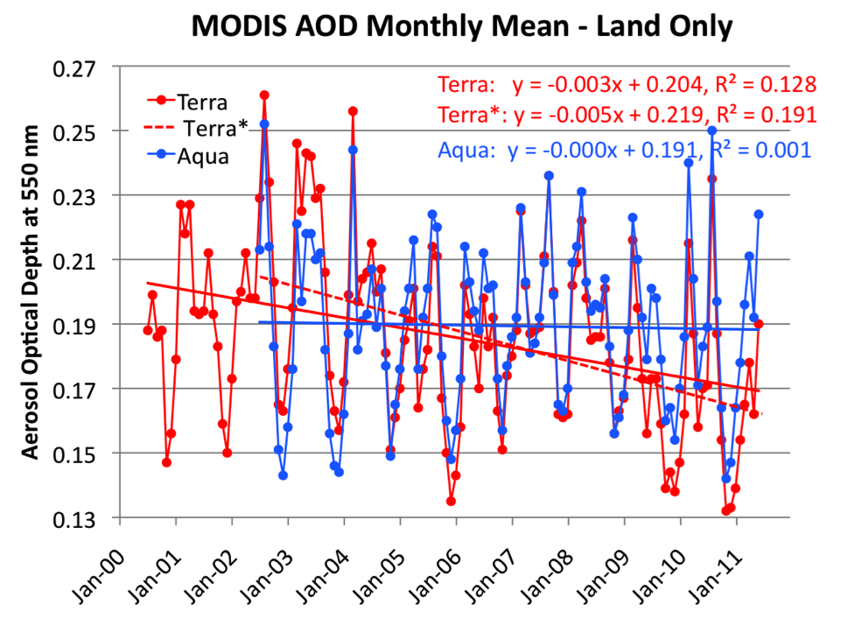
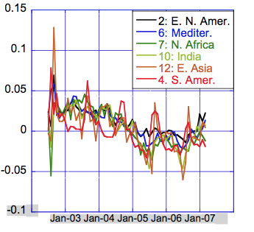
Global trends: If we had used Collection 5
Over land, Terra decreases (-0.04/decade), Aqua constant
Terra / Aqua divergence is the same everywhere on the globe!
In NH, observations are 1.5 hours apart, while SH are 4.5 hours
So, probably not due to diurnal cycle of aerosol

Slide 15
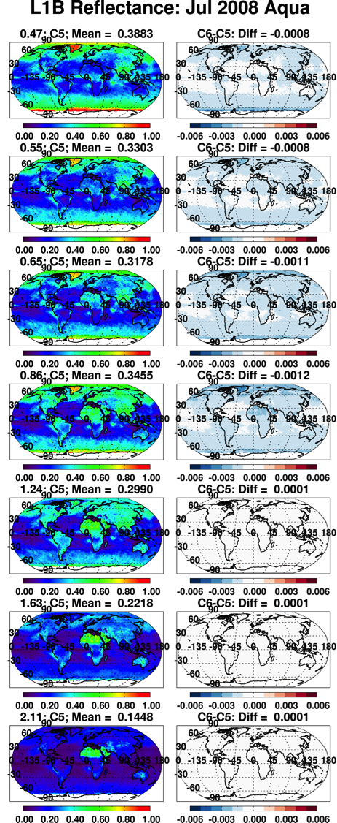
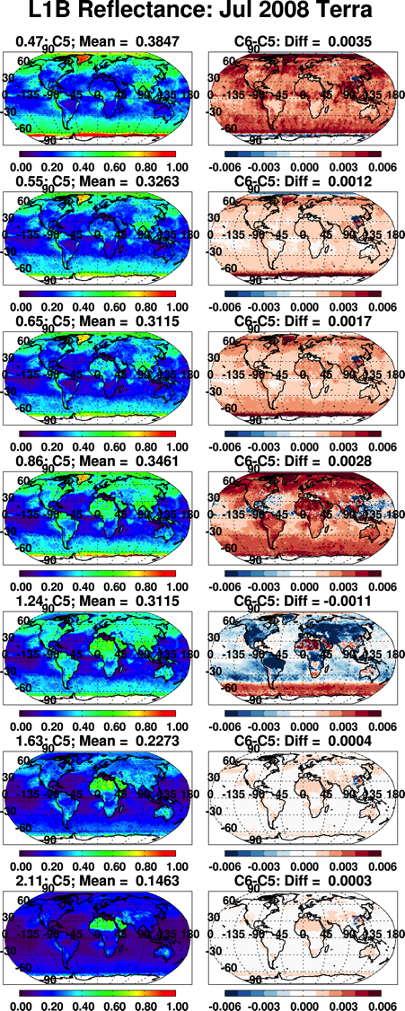


MCST improved “observed” reflectance for C6
“Global” Aqua changes in visible bands by -0.001 or less
“Global” Terra changes in visible bands by +0.002 or more
Overall Aqua changes are relatively stable, but Terra’s changes vary over time.
reflectance
Difference reflectance

Slide 16
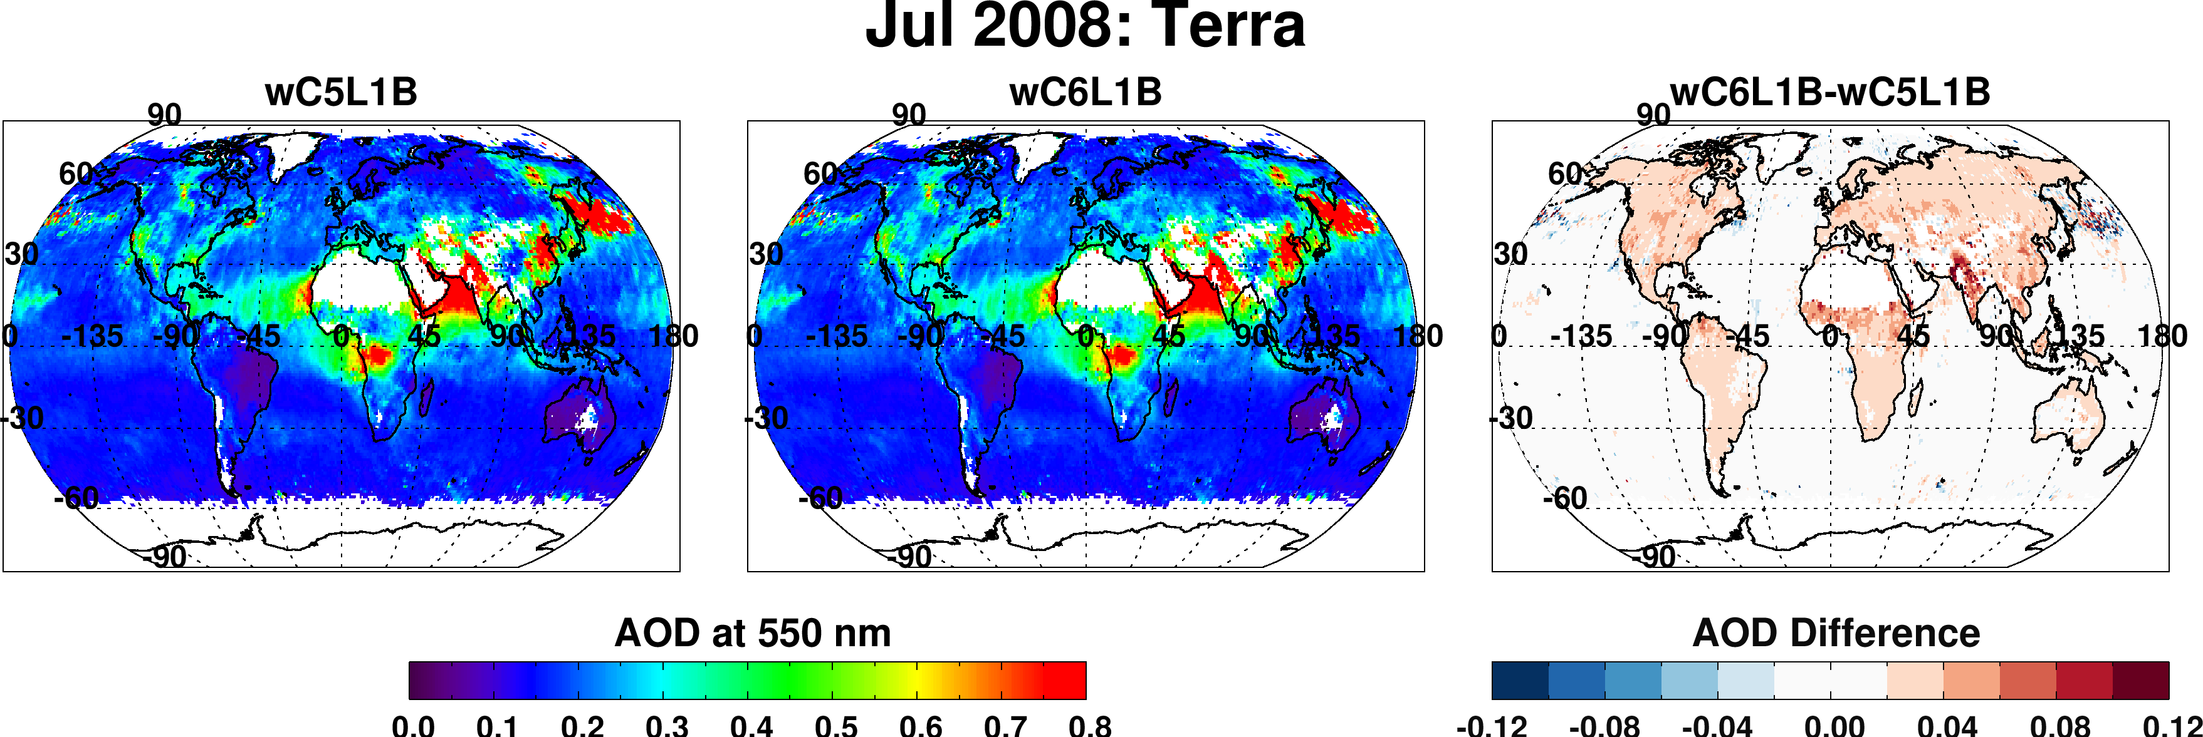
Impact of New Terra calibration
Big changes to blue and red bands
Biggest impacts over land
  Global increase by 0.02 (for this particular month). 10% of global mean!
Smaller impacts over ocean
  Global increase by 0.004 (for this particular month)

Slide 17
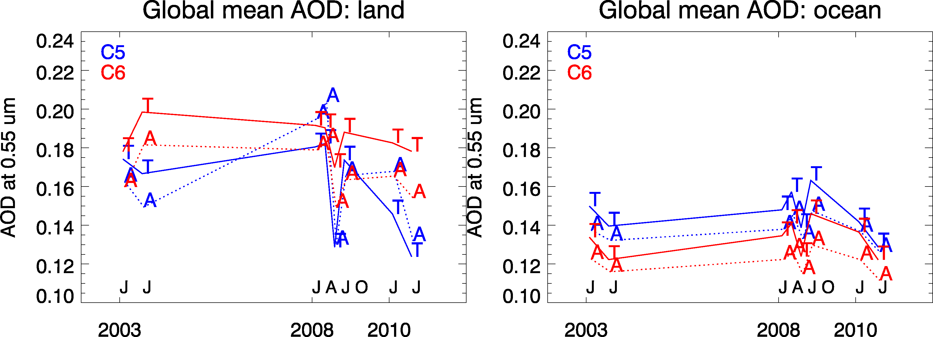
Impact of new calibration on trend
8 months processed with same dark-target aerosol algorithms
Terra (T) Approach II now “in sync” with Aqua (A) time series
Aqua AOD reduced from 0.14 to 0.12 over ocean
New calibration → Terra/Aqua divergence removed for C006!
(Terra-Aqua) offset remains 0.01 (ocean) and 0.015 (land)

Slide 18
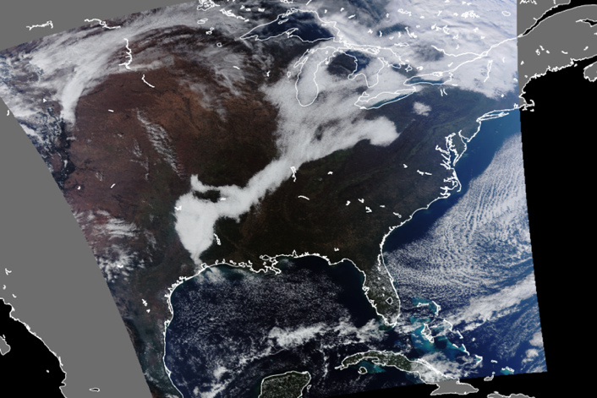
Beyond MODIS
Suomi-NPP VIIRS
Visible Infrared Imager Radiometer Suite
Multiple VIIRS granules stitched. Image by
Geoff Cureton, CIMSS
Will VIIRS “continue” the MODIS aerosol data record?

Slide 19

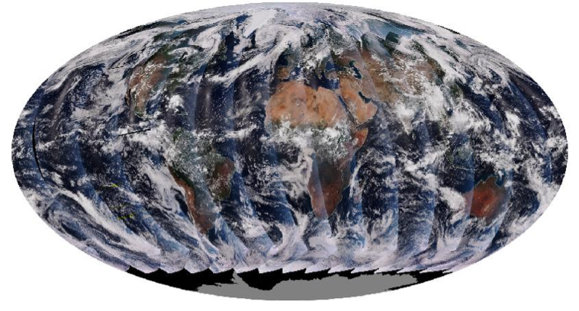
VIIRS versus MODIS
Orbit: 825 km (vs 705 km), sun-synchronous, over same point every 16 days
Equator crossing: 13:30 on Suomi-NPP, since 2012 (versus on Aqua since 2002)
Swath: 3050 km (vs 2030 km)
Spectral Range: 0.412-12.2μm (22 bands versus 36 bands)
Spatial Resolution: 375m (5 bands) 750m (17 bands): versus 250m/500m/1km
Wavelength bands (nm) used for DT aerosol retrieval: 482 (466), 551 (553) 671 (645), 861 (855), 2257 (2113) → differences in Rayleigh optical depth, surface optics, gas absorption.
Aerosol Retrieval: Created and maintained by scientists partnered with NOAA (NASA), with a strategy of maximizing environmental data record - EDR (climate data record – CDR)
ALSO: Different cloud masks, different aggregation techniques, different pixel selections.
Aqua (13:30 Local Time, Ascending)
Suomi-NPP (13:30 Local Time, Ascending);

Slide 20
What if MODIS disappeared today?
Will VIIRS “continue” MODIS?
How would we know?
Hsu et al.,
IF MODIS had died in 2012, we wouldn’t have much to work with. But VIIRS (and MODIS) teams have made major improvements

Slide 21
Will VIIRS “continue” MODIS?
How would we know?
Overall “validation” statistics compared with AERONET?
  We know that Terra and Aqua have similar statistics, but we also see differences in global pictures, trends
  According to VIIRS cal/val team, (after the early mission jitters and many changes), that V-EDR compared to AERONET is similar to MODIS-C5 compared to AERONET.
  For next few slides, we work with data produced in March-May 2013 (after jitters and many changes). But we use MODIS C6 as a baseline

Slide 22
Will VIIRS “continue” MODIS?
How would we know?
Do they see the same world when overlapped?
  Rare even with same equator crossing times

Slide 23
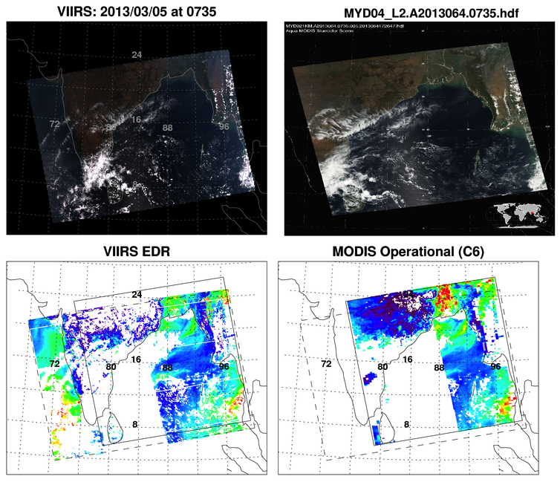
Overlapping MODIS/VIIRS image over India (Mar 5, 2013, 0735 UTC)
Notes:
VIIRS “5 minute” granule stitched from four 86 sec granules
High quality QA data only
Similar AOD structure
Differences in:
coverage
magnitudes
Why?
0.55 µm AOD
-0.05 0.05 0.15 0.25 0.35 0.45 0.55 0.65 0.75

Slide 24
IDP-VIIRS vs MODIS-C6
Instrument/Algorithm
  Swath/Orbit/Resolution/Wavelengths
  Cloud mask / pixel selection strategy
  Aggregation/Averaging (use of IP - retrieval)
  Bowtie issues
  Processing stream / granule size
Post-processing/Culture
  File Format
  Existence of Level 3
  Reprocessing
  Near Real Time
  Tools for data access
  Research vs Operations
  Climate vs Daily
  NOAA versus NASA outreach

Slide 25
Let’s homogenize as much as we can
Instrument/Algorithm
  Swath/Orbit/Resolution/Wavelengths
  Cloud mask / pixel selection strategy
  Aggregation/Averaging (use of IP - retrieval)
  Bowtie issues
  Processing stream / granule size
(with help from UW-PEATE)
ONE RETRIEVAL ALGORITHM: CONSISTENT ACROSS PLATFORMS

Slide 26
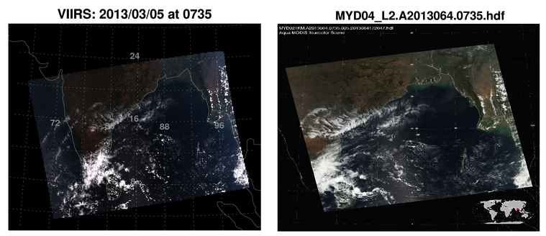
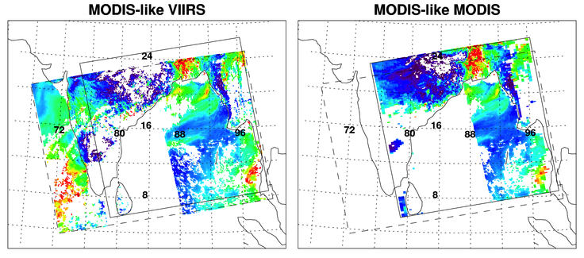
Run similar algorithm on VIIRS and MODIS (use “IFF” files)
Much more similar AOD structure
Still some differences in coverage/magnitude
Why?
0.55 µm AOD
-0.05 0.05 0.15 0.25 0.35 0.45 0.55 0.65 0.75

Slide 27
Will VIIRS “continue” MODIS?
How would we know?
Do overlapping granules look alike?
  Even with same equator crossing, true space and time overlaps are rare (every 16 days, and only over India)
  Now look “more” alike. We need to define how much “more” is good enough.

Slide 28
Will VIIRS “continue” MODIS?
How would we know?
Convergence of global mean (over land and ocean)?
  Note that Terra and Aqua expected different by ±0.015.
  What about seasonal cycle?
Convergence of global statistics?
  Here, I am thinking about standard deviation, min, max, ..
  How similar?
Convergence of global histogram?
  Here, I am thinking about the “lognormal-like” shape of the retrieved distribution.

Slide 29
Global Histogram convergence? March 2013
OCEAN
0.122
0.116
0.134
0.132
0.125
Relative convergence of OCEAN (even V_EDR vs M_C6)
M_C6 = MODIS C6
ML_M = MODIS like on MODIS 1 km IFF
ML_V = MODIS like on VIIRS 750 km IFF
ML_V64 = ML_V filtered by VZA < 64°
V_EDR = VIIRS EDR
LAND
0.244
0.249
0.258
0.259
0.239
Bigger differences over LAND (more similar for ML)
Numbers in boxes are “global mean”
Note few or no zeros/negatives for V-EDR

Slide 30
Will VIIRS “continue” MODIS?
How would we know?
Convergence of gridded (Level 3 –like) data?
  For a day? A month? A season?
  What % of grid boxes must be different by less than X in AOD?

Slide 31
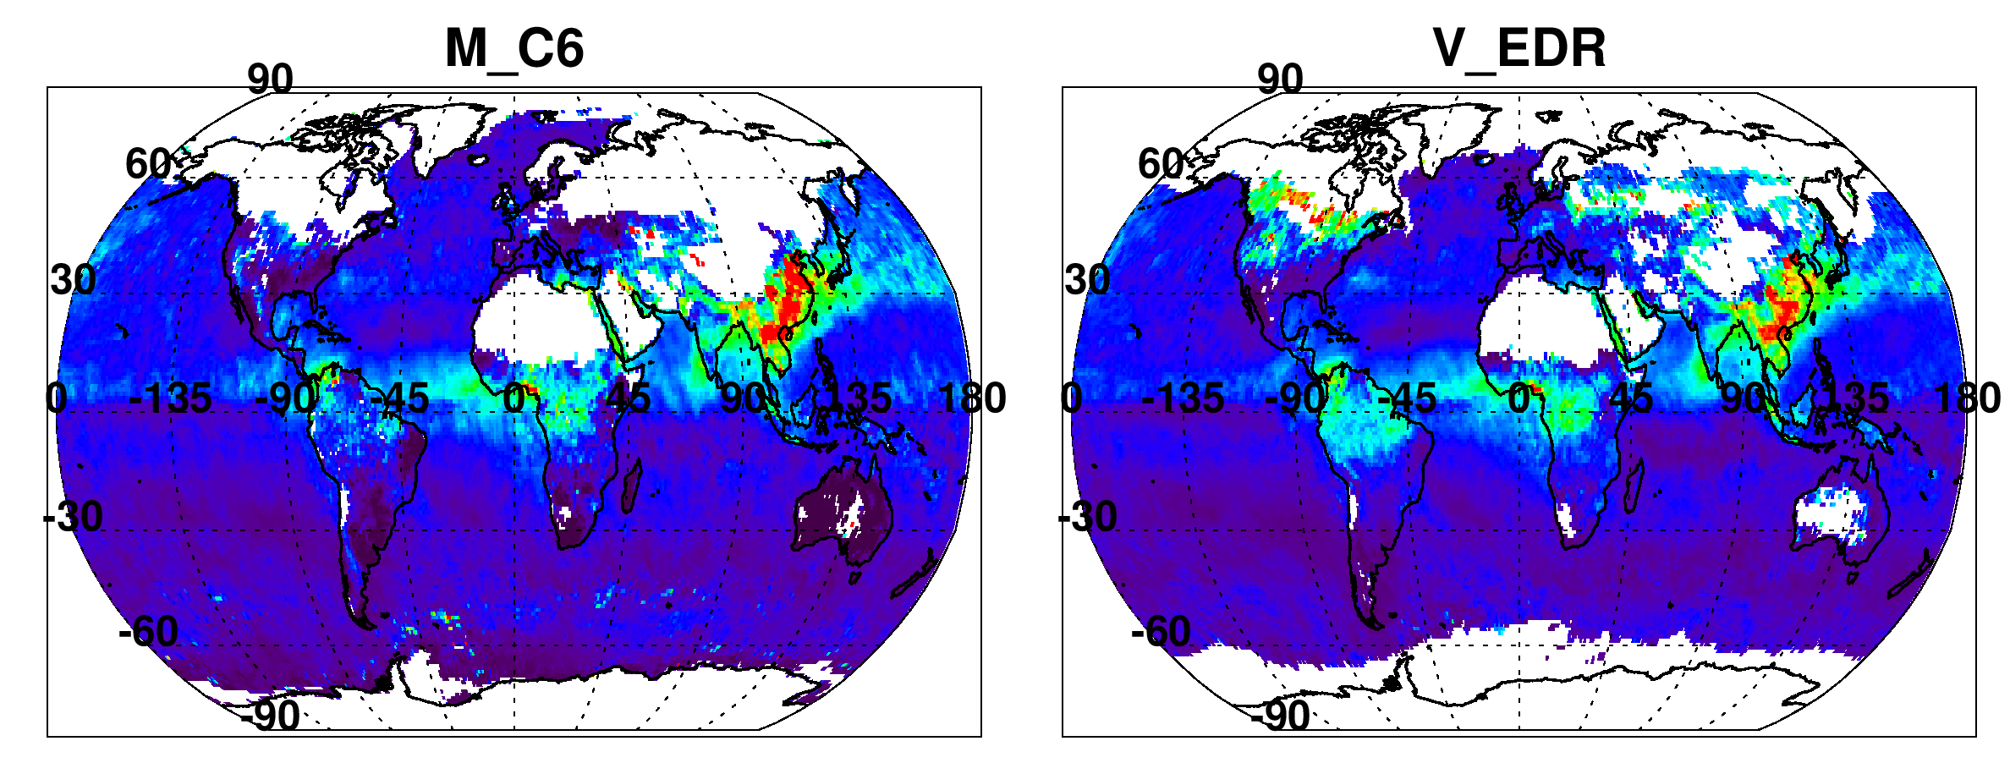

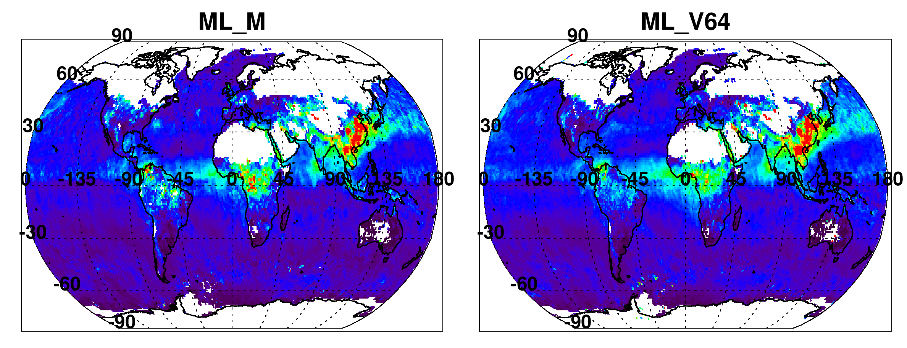
Convergence of Gridded Monthly? (Mar 2013)
Different snow thresholds?
Different SZA thresholds
Handling of zero
Still different, but much more similar over both land and ocean
Step by step, we make ML_M and ML_V consistent.

Slide 32
Will VIIRS “continue” MODIS?
How would we know?
What about “sampling”?
  Even if the mean, histograms and gridded data looked similar, what about the “retrievability?”
  Fraction of retrieved pixels / total pixels

Slide 33
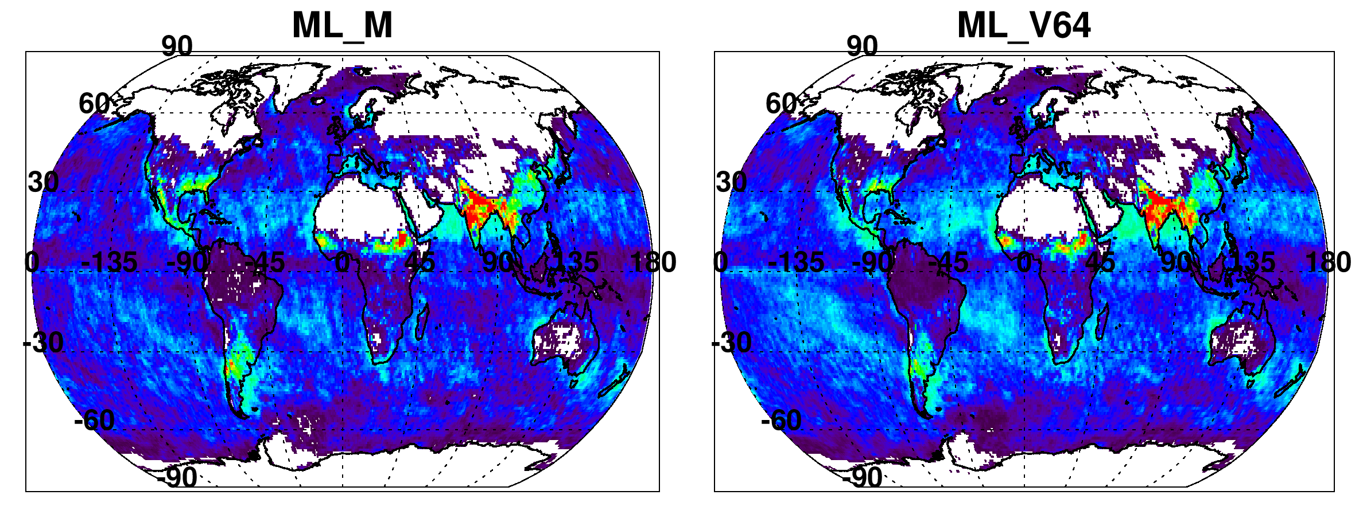
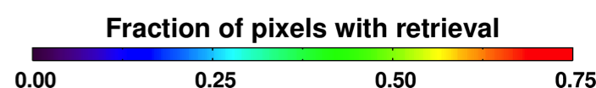
Convergence of Monthly “retrievability” (Mar 2013)
Are there places on the globe that cannot be retrieved by one satellite or another? Will they converge on cloud mask, pixel selection, availability of aerosol retrieval?

Slide 34
Still not homogenized yet
Instrument/Algorithm
  Swath/Orbit/Resolution/Wavelengths
  Cloud mask / pixel selection strategy
  Aggregation/Averaging (use of IP - retrieval)
  Bowtie issues
  Processing stream / granule size
But maybe we can quantify the remaining differences
We also need to run more months across MODIS / VIIRS record

Slide 35
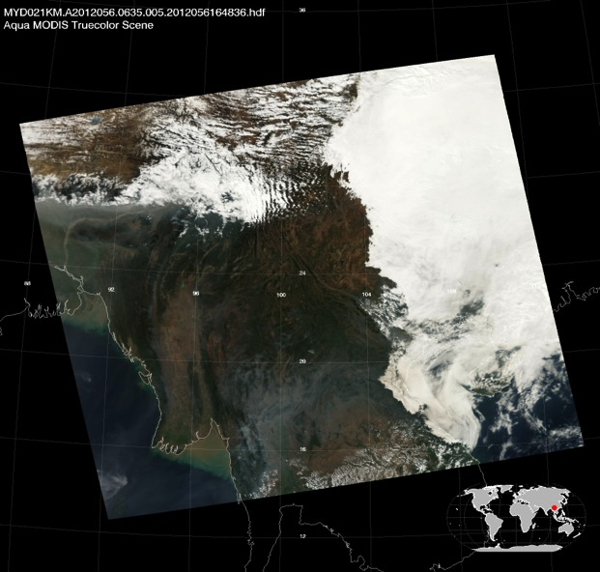
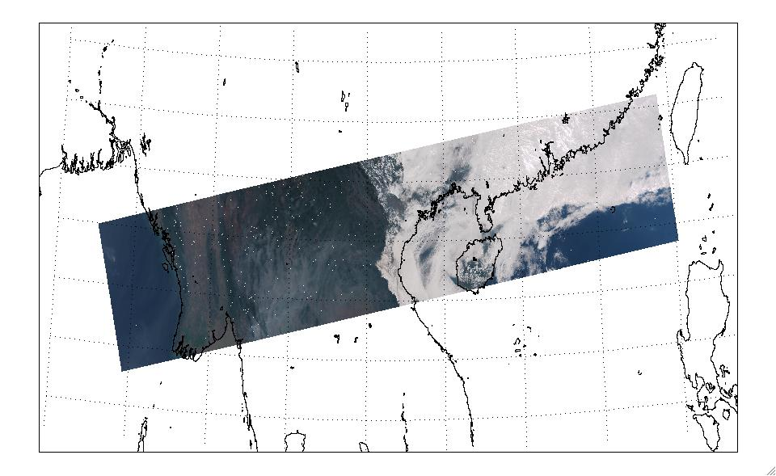
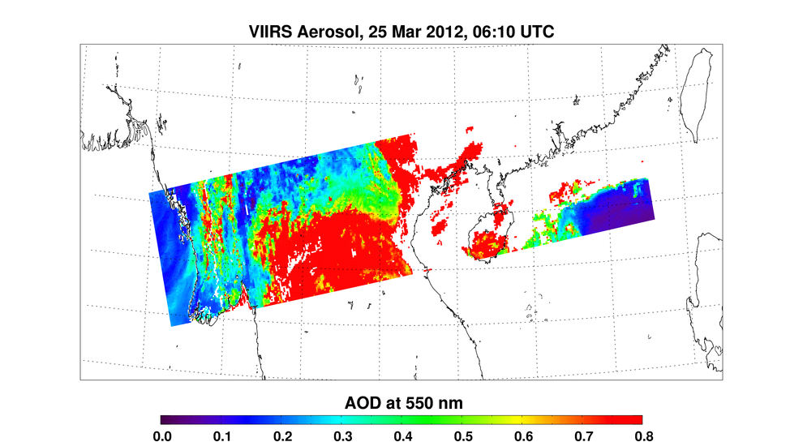
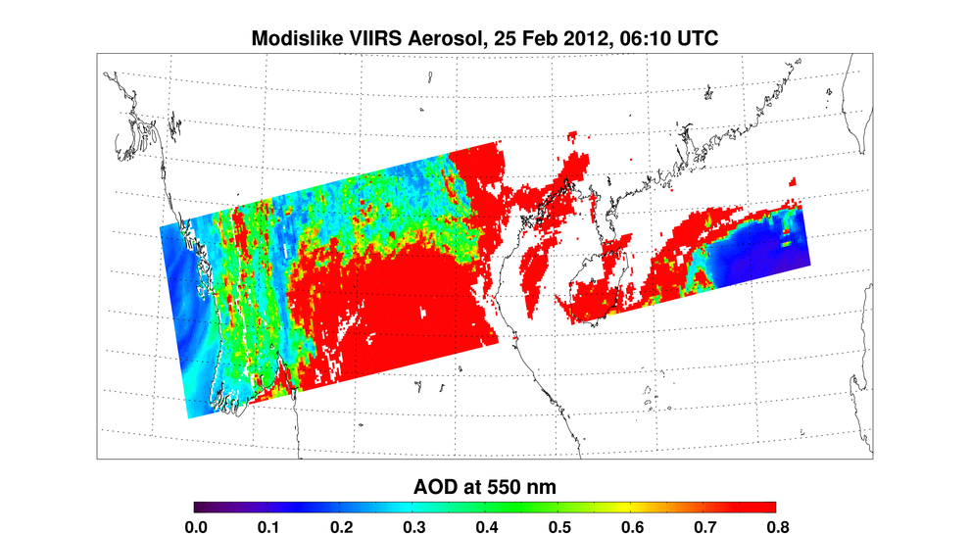
Summary (1)
There are many ways to retrieve aerosol properties from MODIS, and there is more than one set of algorithms/products
Dark-target algorithm/products are updated for C6
Changes are “modest” but can lead to significant changes in retrieved global aerosol
The MODIS aerosol product has matured for >13 years
MODIS has become indispensable, and the community is not yet ready to adopt something new.
MODIS RGB
MODIS Aerosol (06:35 UT)
MODIS RGB
MODIS Aerosol (06:35 UT)
The MODIS aerosol
cloud mask is more
conservative than
the VIIRS VCM.
The MODIS aerosol
cloud mask is more
conservative than
the VIIRS VCM.
VIIRS RGB
VIIRS Aerosol EDR
MODIS Algorithm, VIIRS Input
VIIRS RGB
VIIRS Aerosol EDR
MODIS Algorithm, VIIRS Input

Slide 36
Summary (2)
If MODIS died tomorrow
  NPP-VIIRS is online
  VIIRS is “similar”, yet different then MODIS
  How different?
  Can VIIRS continue the MODIS record?
Development of a common algorithm will help to quantify remaining differences between VIIRS and MODIS
We still need to define “how similar is good enough”?
Sorry, Lots of Questions, not many Answers!
MODIS RGB
MODIS Aerosol (06:35 UT)
MODIS RGB
MODIS Aerosol (06:35 UT)
The MODIS aerosol
cloud mask is more
conservative than
the VIIRS VCM.
The MODIS aerosol
cloud mask is more
conservative than
the VIIRS VCM.
VIIRS RGB
VIIRS Aerosol EDR
MODIS Algorithm, VIIRS Input
VIIRS RGB
VIIRS Aerosol EDR
MODIS Algorithm, VIIRS Input

