Slide 1
Use of Satellite Data in Operational Air Quality Prediction
Ivanka Stajner
NOAA/NWS/OST
VIIRS Aerosol Science and Operational Users Workshop
College Park, MD November 22, 2013

Slide 2
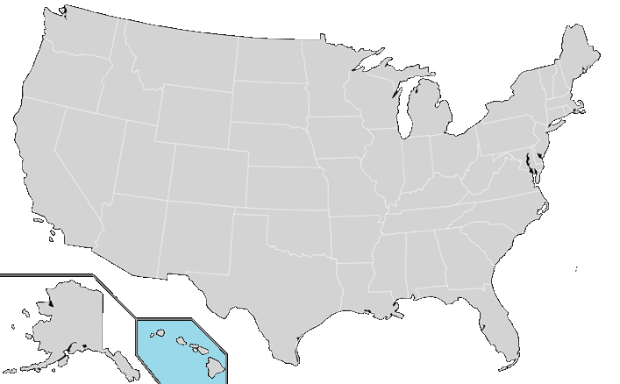
National Air Quality Forecast Capability
Capabilities as of 11/2013
Improving the basis for air quality alerts
Providing air quality information for people at risk
Prediction Capabilities:
Operations:
Ozone nationwide
Smoke nationwide
Dust over CONUS
Experimental testing:
  Ozone predictions
  Developmental testing:
Components for particulate matter (PM) predictions
2004: ozone
2007: ozone and smoke
2012: dust
2005: ozone
2009: smoke
2010: ozone
2010: ozone and smoke

Slide 3
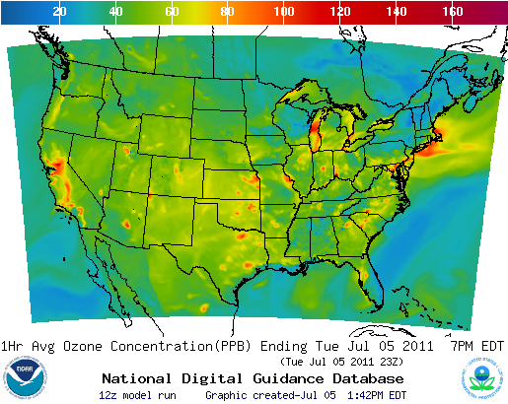
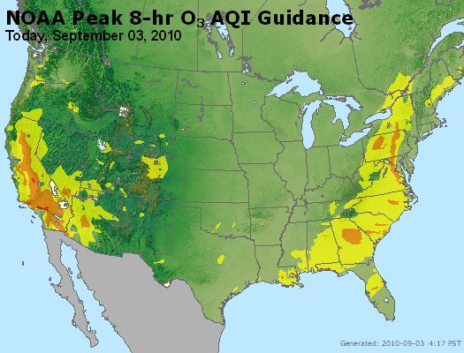
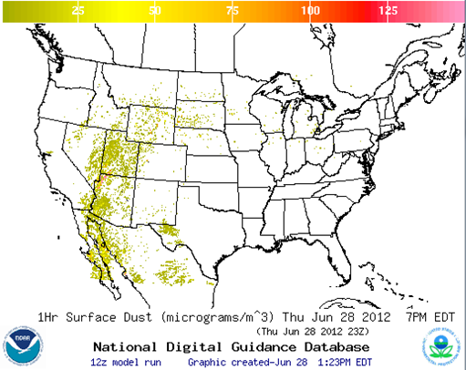
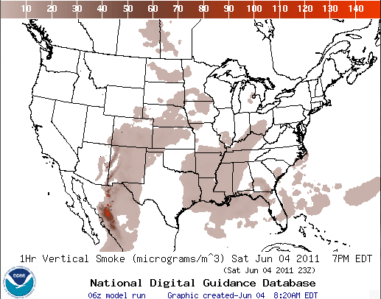
National Air Quality Forecast Capability
End-to-End Operational Capability
Model: Linked numerical prediction system
Operationally integrated on NCEP’s supercomputer
  NOAA NCEP mesoscale numerical weather prediction
  NOAA/EPA community model for air quality: CMAQ
  NOAA HYSPLIT model for smoke and dust prediction
Observational Input:
  NWS weather observations; NESDIS fire locations; climatology of regions with dust emission potential
  EPA emissions inventory
ozone
AIRNow
Gridded forecast guidance products
  On NWS servers: airquality.weather.gov and ftp-servers
  On EPA servers
  Updated 2x daily
Verification basis, near-real time:
  Ground-level AIRNow observations of surface ozone
  Satellite observations of smoke and dust
Customer outreach/feedback
  State & Local AQ forecasters coordinated with EPA
  Public and Private Sector AQ constituents
dust
smoke

Slide 4
Recent progress and updates
North American Meteorological model, currently Non-hydrostatic Multi-scale Model (NMMB) was updated and migrated to new supercomputers
  These meteorological predictions are used for all air quality predictions (July 2013)
Ozone - Substantial emission updates for 2012; reuse these emissions in 2013:
    Mobile6 used for mobile emissions, but with emissions scaled by growth/reduction rate from 2005 to 2012
    Non-road area sources use Cross State Rule Inventory
    Canadian emissions use 2006 inventory
Dust predictions implemented operationally in March 2012:
  Dust emissions are modulated by real-time soil moisture
  Longer time step to speed up dust predictions implemented in October 2012
Smoke updates implemented in July 2013:
  Increased maximum plume rise limit from 0.75 to 1.25 of the PBL depth; decreased wet removal, changed in daily emissions cycling; made horizontal puff dispersion rate more consistent with particle dispersion
All AQ predictions have migrated to new NCEP computers

Slide 5
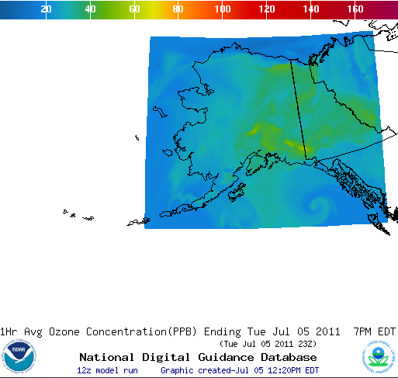
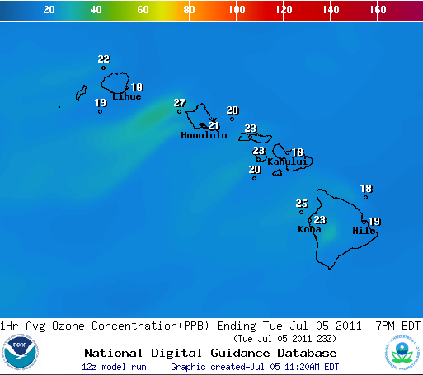
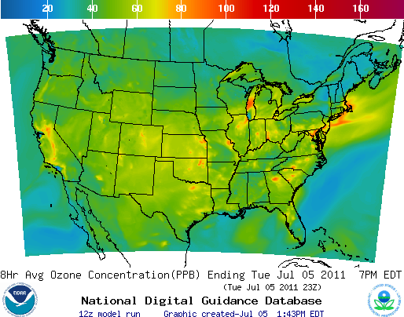

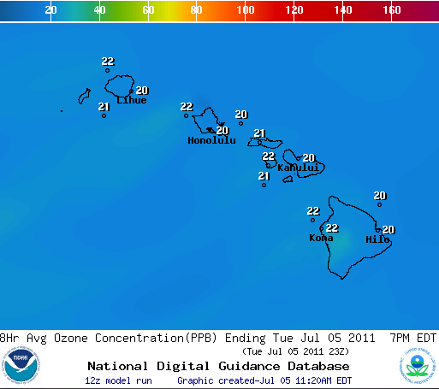
Ozone predictions
Operational predictions at http://airquality.weather.gov
over expanding domains since 2004
1-Hr Average Ozone
1-Hr Average Ozone
1-Hr Average Ozone
8-Hr Average Ozone
8-Hr Average Ozone
8-Hr Average Ozone
CONUS, wrt 75 ppb Threshold
Operational
Maintaining prediction accuracy as the warning threshold was lowered and emissions of pollutants are changing
Fraction correct of daily maximum of 8h average wrt 75 ppb threshold

Slide 6
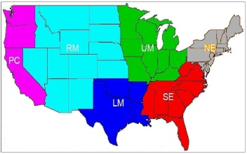
NOx emission change
NO_{x} emission change by day of week and holiday for July compared to those used in 2011
%
NO_{x} emission change by region for July compared to those used in 2011
%

Slide 7
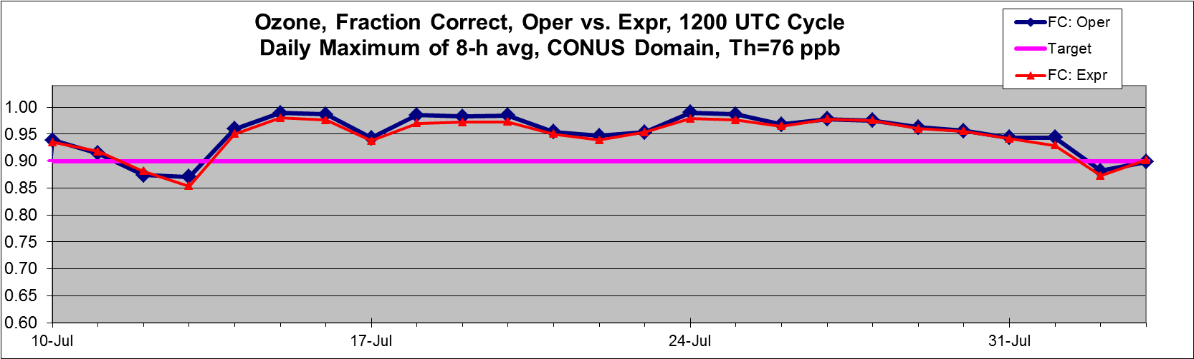
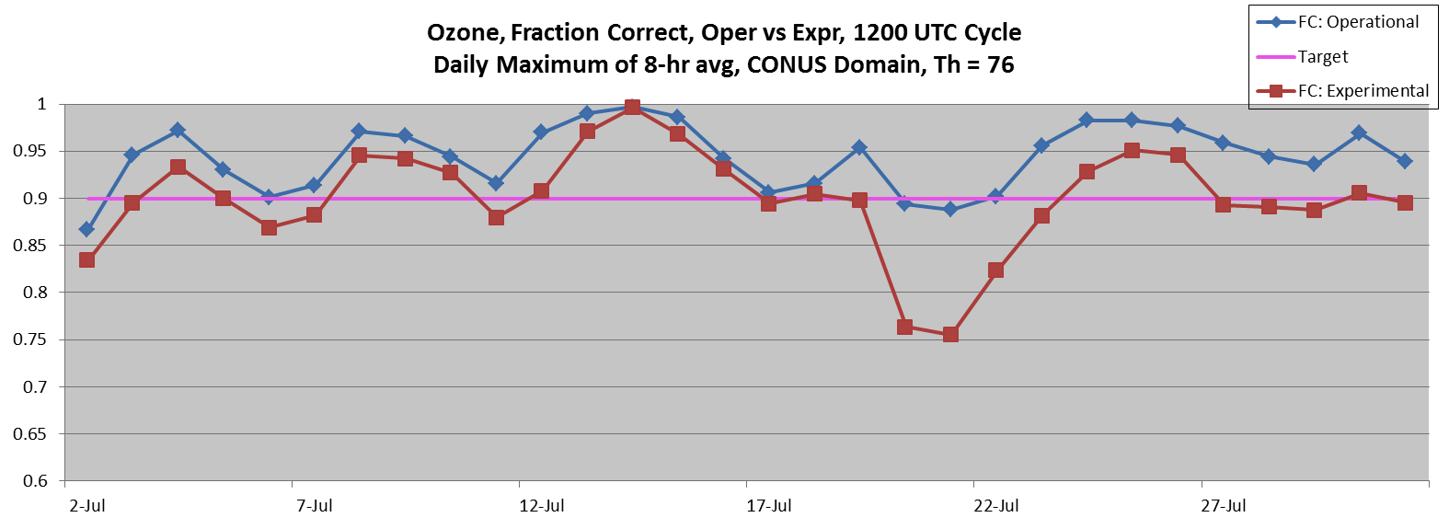
Operational and experimental predictions: fraction correct
2012
Performance of experimental predictions is closer to that of operational predictions
2011
Operational predictions used to be substantially better than experimental
 | 2011 | 2012 changes |  | 2013 changes
Operational CB-IV | WRF-NMM, 2005 NEI | NMM-B, 2012 emission projections |  | Reusing 2012 emissions
Experimental CB05 | WRF-NMM, 2005 NEI | NMM-B, 2012 emission projections | LBC, dry deposition, minimum PBL height | Reusing 2012 emissions

Slide 8
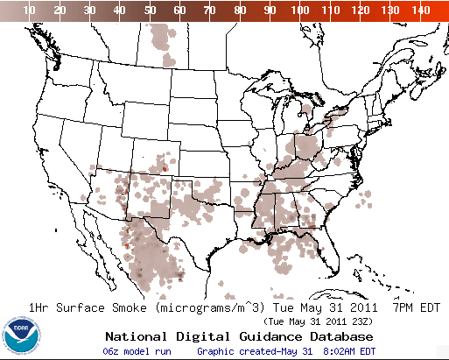
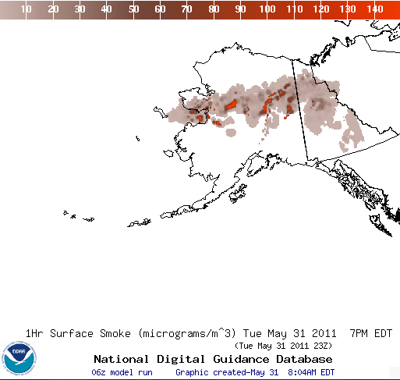
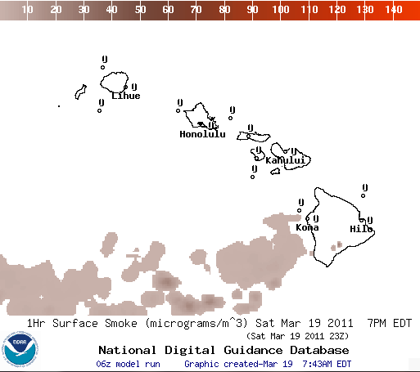
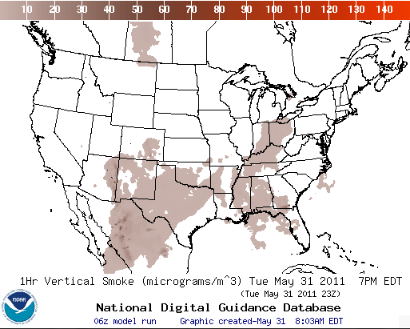
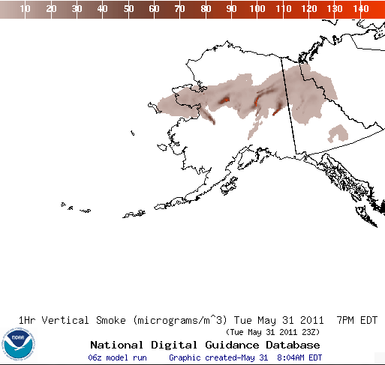
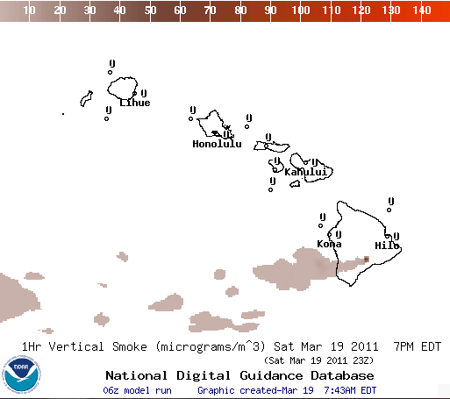
Smoke predictions
Operational predictions at http://airquality.weather.gov
Surface Smoke
Surface Smoke
Surface Smoke
Vertical Smoke
Vertical Smoke
Vertical Smoke

Slide 9
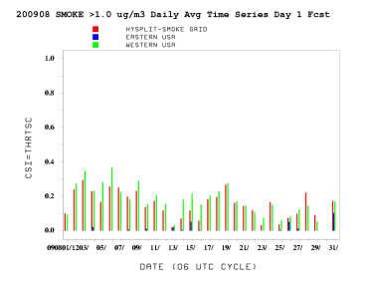
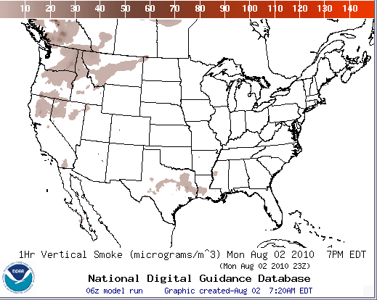
Smoke Forecast Tool
Major Components
NWP Model
NAM/NMMB
NOAA/NWS
Weather
Observations
NOAA
USFS
NESDIS HMS
Fire Locations
HYSPLIT Module:
NOAA/OAR
USFS’s BlueSky
Emissions Inventory:
USFS
Verification:
NESDIS/GASP Smoke
http://airquality.weather.gov/
9

Slide 10
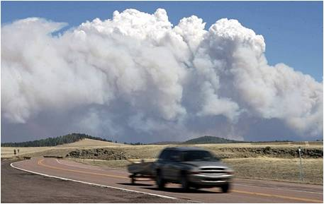
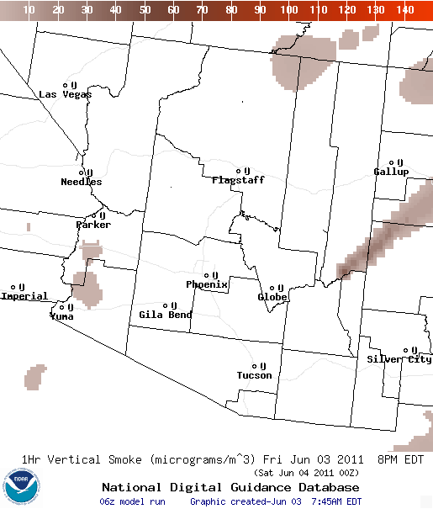
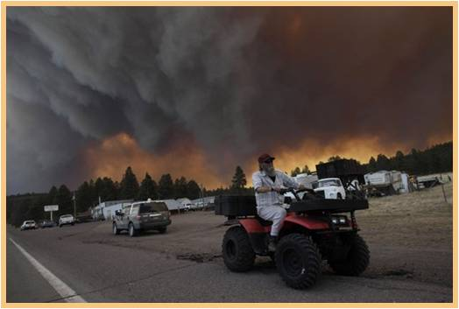
Wallow Wildfire in Arizona
June 6 (Luna, NM, AP)
Wallow fire, June 3 ¹
Fire began May 29, 2011, consumed more then 800 square miles and 32 homes ³
16 injuries ³; more then 9000 people evacuated ²
60mph winds contributed to its rapid spread ¹
Code orange air quality forecast issued for Albuquerque for 4 days (June 6,8,9,13) - NWS prediction included high smoke concentrations
Hazardous air quality predicted by NAQFC and observed in Springerville, AZ
NAQFC joined coordination calls with state, local, federal agencies in AZ and NM, and USFS Fire Science Lab in Seattle
Animation of NOAA’s prediction of smoke concentrations in column
Eastern Arizona wildfire still rages, AP, June 5, 2011. http://www.latimes.com/news/la-na-arizona-wildfires-20110606-pictures,0,6897558.photogallery
As Arizona wildfire rages, officials allow some to return home, CNN, June 12, 2011 http://www.cnn.com/2011/US/06/12/arizona.wildfires/
InciWeb, Incident information system, accessed on October 22, 2013 http://www.inciweb.org/incident/article/2262/

Slide 11
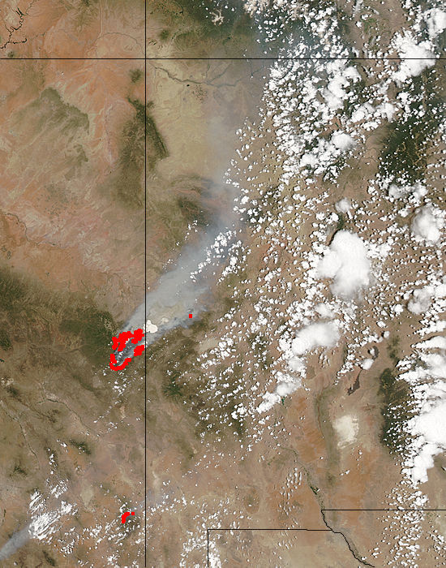
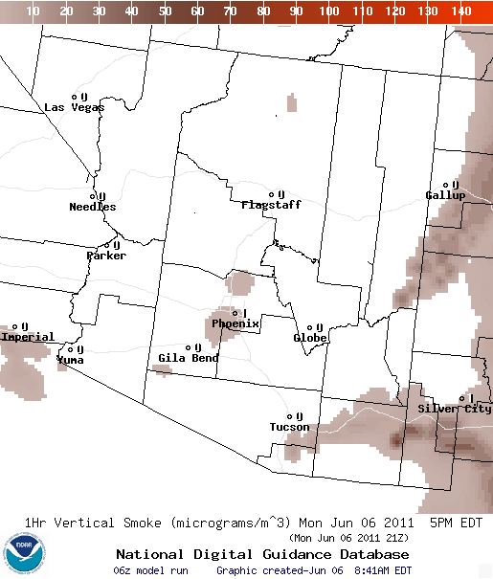
June 6, 2011
MODIS
NWS smoke prediction
Wallow North fire, Arizona : 2011/157 - 06/06 at 20:40 UTC
Aqua 1km pixel size
http://airquality.weather.gov
Vertical column smoke at 21 Z on 06/06

Slide 12
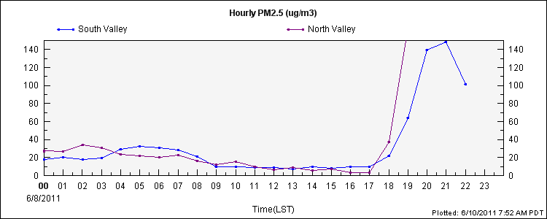
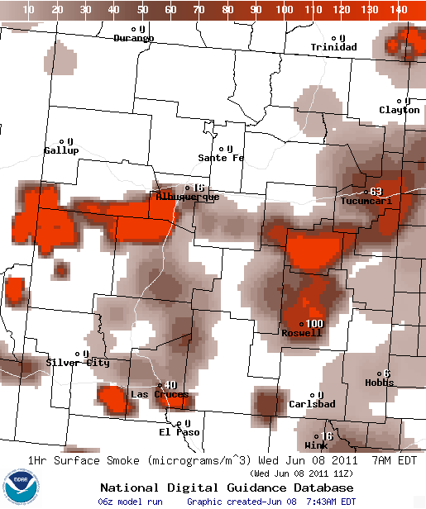
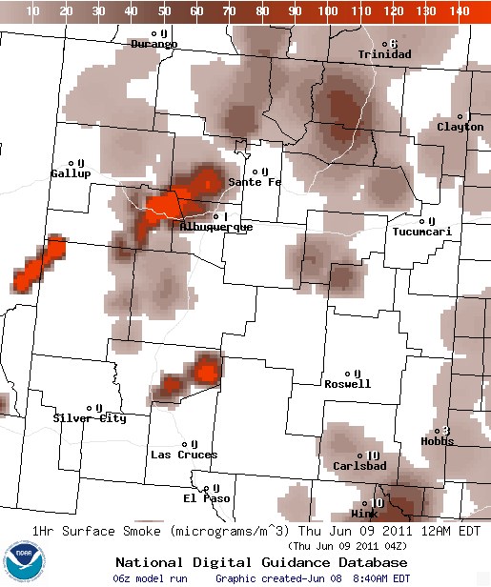
Albuquerque, NM
Surface PM2.5 observations
http://www.airnowtech.org/
NOAA’s predictions of surface smoke concentrations
airquality.weather.gov
11 Z on 06/08/2011
04 Z on 06/09/2011

Slide 13
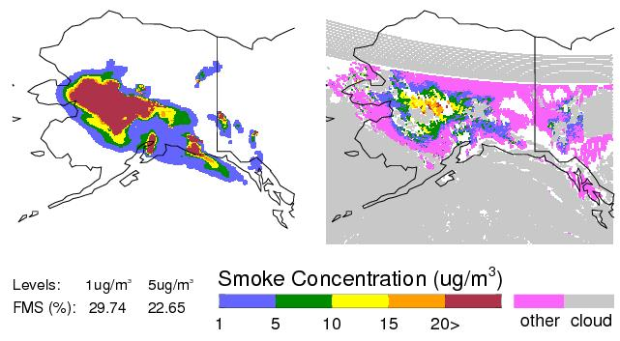
Smoke Verification:
July 13, 2009
7/13/09, 17-18Z, Prediction:
7/13/09, 17-18Z, Observation:
GOES smoke product: Confirms areal extent of peak concentrations
FMS = 30%, for column-averaged smoke > 1 ug/m³

Slide 14
Verification of smoke predictions
for CONUS
Daily time series of FMS for smoke concentrations larger than 1um/m3
Figure of merit in space (FMS), which is a fraction of overlap between predicted and observed smoke plumes; threshold is 0.08 marked by red line
NESDIS GOES Aerosol/Smoke Product is used for verification
Since July 26, 2013, the model includes the following updates: increased plume rise, decreased deposition, changes in daily emissions cycling

Slide 15
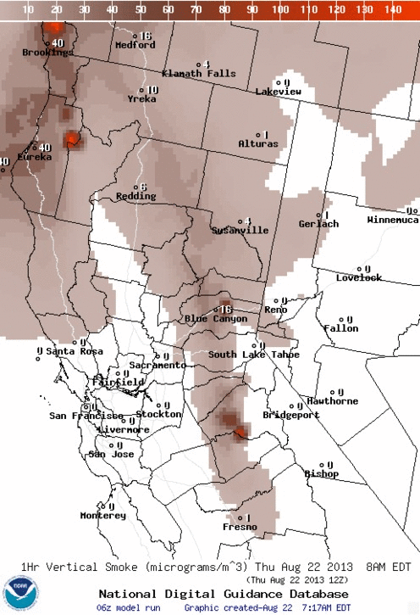
Rim Fire in California
The largest wildfire ever recorded in Yosemite National Park. Fire started on August 17. As of 9/25/2013 it was 85% contained.
Transport of smoke towards Reno, NV on 8/22 was confirmed by GOES-14 satellite imagery.
NWS office in Reno included smoke and haze in their forecast.
Observed PM2.5 concentrations peaked around 2 pm LST, predicted concentrations at the surface peaked at 1 pm, and the highest predicted concentration was lower than observed
http://airquality.weather.gov

Slide 16
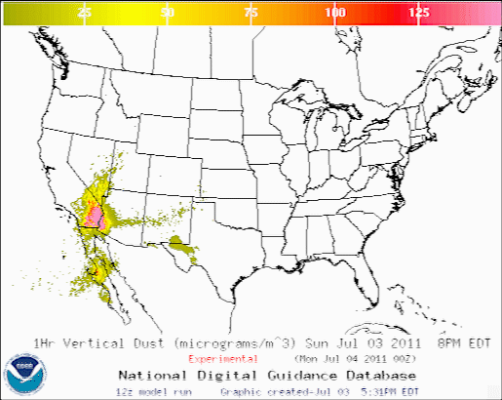
CONUS Dust Predictions
Operational Predictions at http://airquality.weather.gov/
  Standalone prediction of airborne dust from dust storms:
  Wind-driven dust emitted where surface winds exceed thresholds over source regions
Source regions with emission potential estimated from MODIS deep blue climatology (2003-2006).
  Emissions modulated by real-time soil moisture.
  HYSPLIT model for transport, dispersion and deposition (Draxler et al., JGR, 2010)
  Wet deposition updates in July 2013
  Developed satellite product for verification (Zeng and Kondragunta)

Slide 17
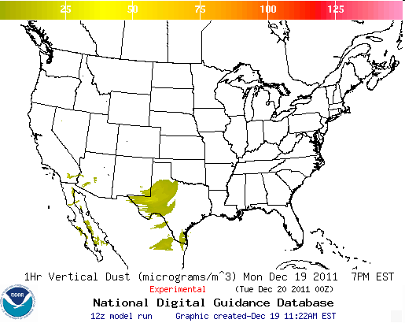
Dust Forecast Tool for CONUS
Major Components
NWP Model
NMMB
NOAA/NWS
Weather
Observations
NWP Post-processors
for AQ Modules
HYSPLIT Module:
NOAA/OAR
NOAA/GFDL
Map of possible
dust sources
Verification:
NESDIS Dust
http://airquality.weather.gov/
Notes:
17

Slide 18
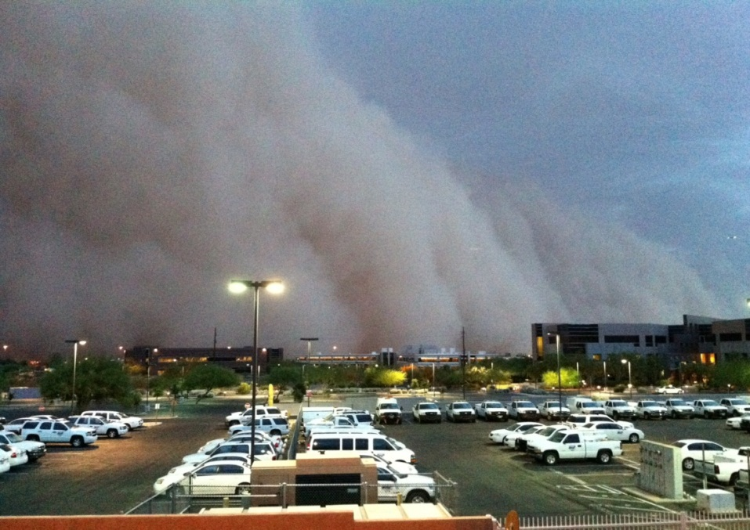
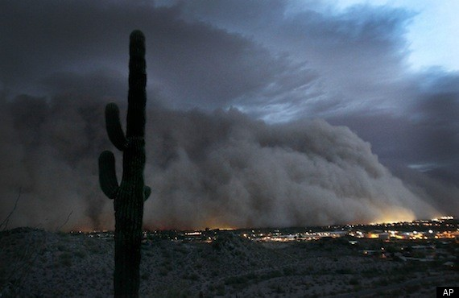
Phoenix, AZ dust event on July 5, 2011
Massive dust storm hit Phoenix, AZ in the evening on July 5, 2011
Cloud was reported to be 5,000 feet when it hit, radar shows heights from 8,000-10,000 feet tall and 50 miles wide
Source: http://www.wrh.noaa.gov/psr/pns/2011/July/DustStorm.php
Originated from convection near Tucson
Stopped air traffic for over an hour
Arizona DEQ reported a PM10 concentration of 6,348 ug/m³ during peak of storm at site in downtown Phoenix
Storm moved through Phoenix at 30-40 mph
Source: http://www.huffingtonpost.com/2011/07/06/phoenix-dust-storm-photos-video_n_891157.html

Slide 19
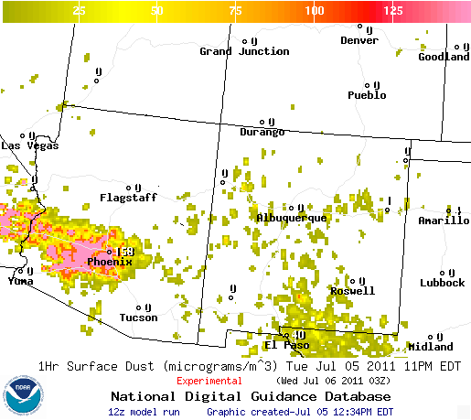
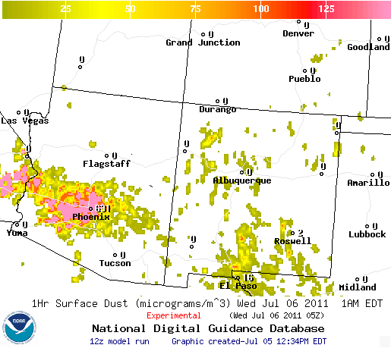
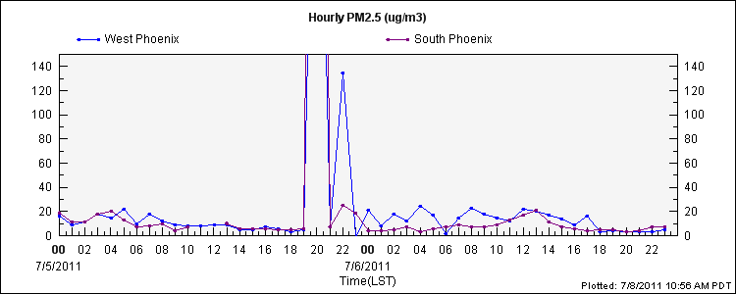
PM 2.5 observations in Phoenix
Based on observations, height of impact on Phoenix was between 8 PM and 10 PM LST
Predicted surface dust concentrations:
- 8PM 158 ug/m³
- 10PM 631 ug/m³
*Note* AZ three hours behind in summer
Timing of storm based on comparing predictions to observations looks accurate (albeit perhaps early – 63 ug/m³ predicted at 7 PM for Phoenix), however, the predictions keep the high levels seen at 10 PM LST for the next four to five hours, not seen in the observations
Peak values: 996 ug/m³ at South Phoenix station at 8PM and 506 ug/m³ at West Phoenix station at 8 PM (AIRNow Tech)

Slide 20
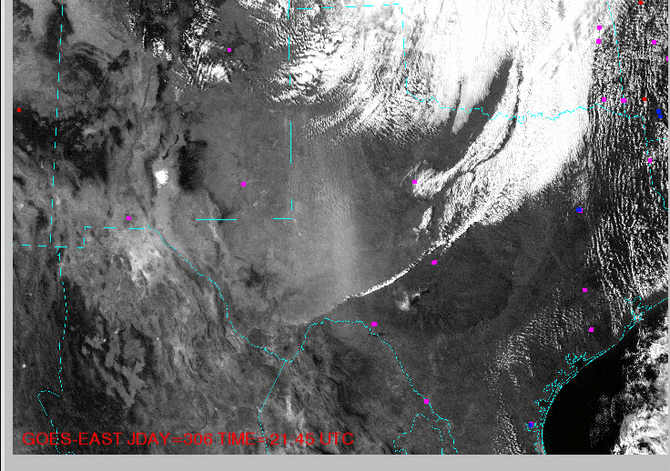
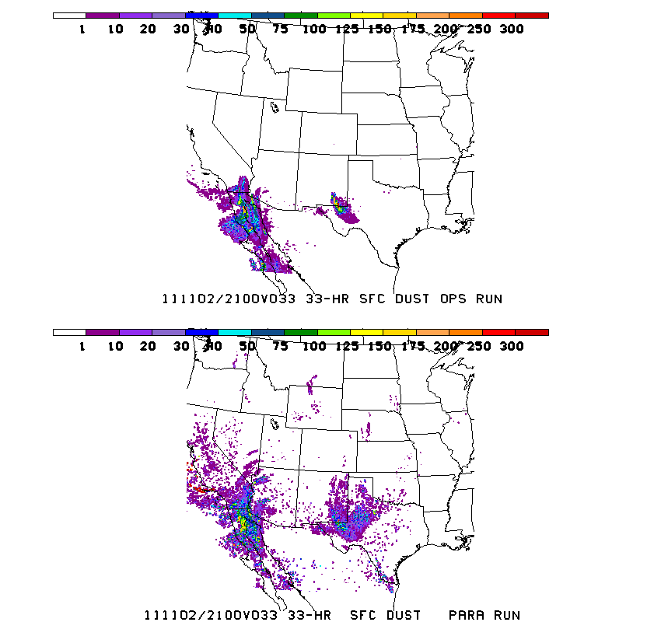
Texas dust event on November 2, 2011
Dust prediction updates
Modulating dust emissions using real-time soil moisture information
Predicted dust concentration (ug/m3) at the surface
Current model: emissions
modulated by
soil moisture
A widespread dust event occurred on Nov 2 beginning around 18Z in west central Texas. This event was the result of ~25kt synoptic scale winds ahead of a cold front. Through 0Z (Nov 3) the dust blew south covering all of west Texas and parts of southeast New Mexico.
Previous model:
emissions
not modulated by
soil moisture
Longer time step (10 min vs. 6 min) provides comparable predictions, but 30% faster
Reduced wet deposition

Slide 21
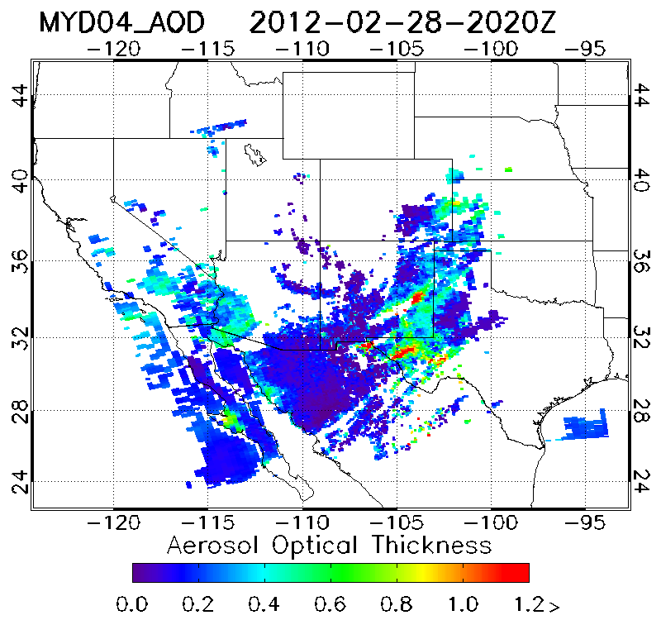
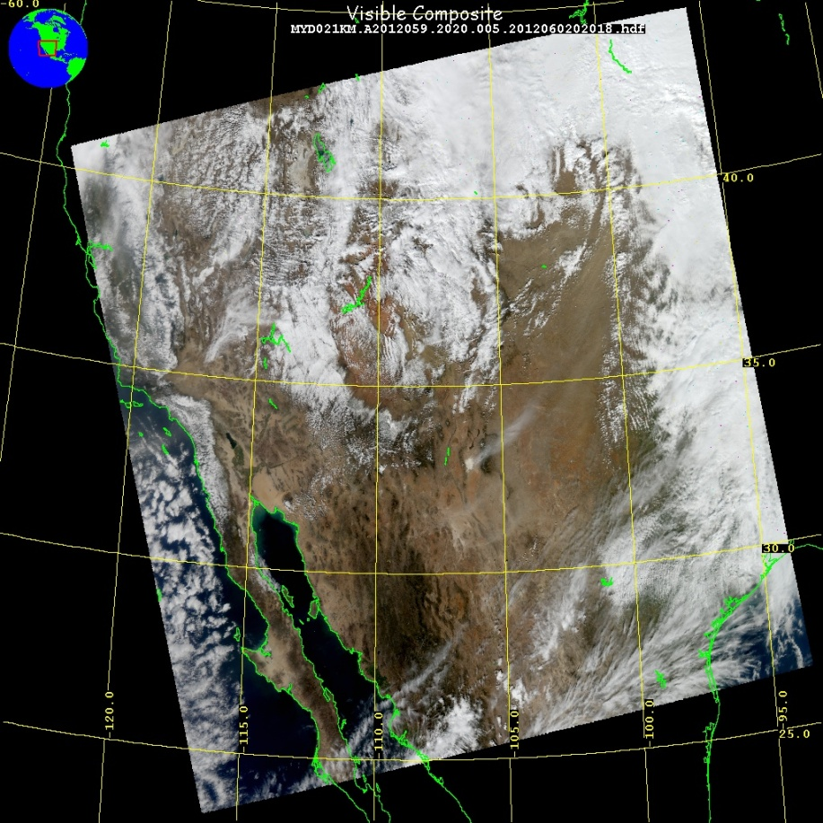
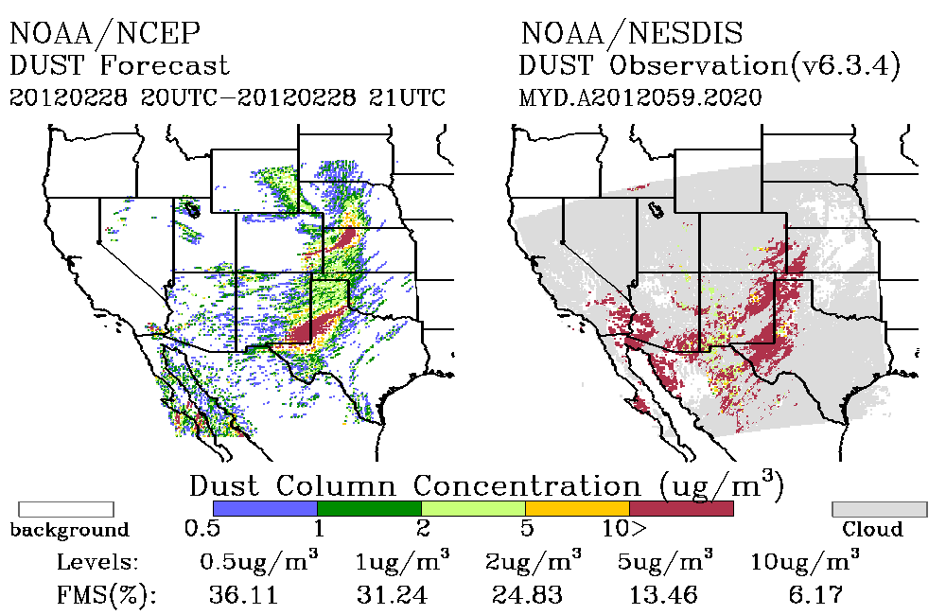
Dust Event and Verification on 02/28/2012
MODIS AOD
NESDIS developed dust retrieval using MODIS Deep Blue retrievals for verification of NWS dust predictions
Large dust storm occurred in Central Plains resulting in large swath of blowing dust
Generated from eastern New Mexico, Western Texas, Texas Panhandle, southeast Colorado, Oklahoma Panhandle, and Western Kansas
21

Slide 22
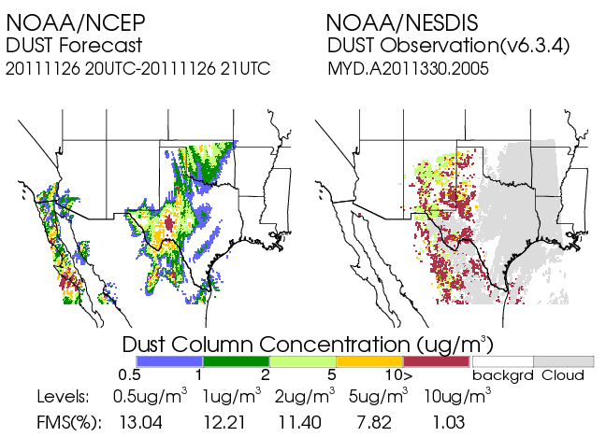
Real time verification examples
Using MODIS Dust Mask Algorithm from NOAA/NESDIS satellite imagery
“Footprint” comparison:
Threshold concentration > 1 µg/m³, for average dust in the column
Tracking threat scores, or figure-of-merit statistics:
(Area Pred ∩ Area Obs) / (Area Pred U Area Obs)
Initial skill target 0.05
22

Slide 23
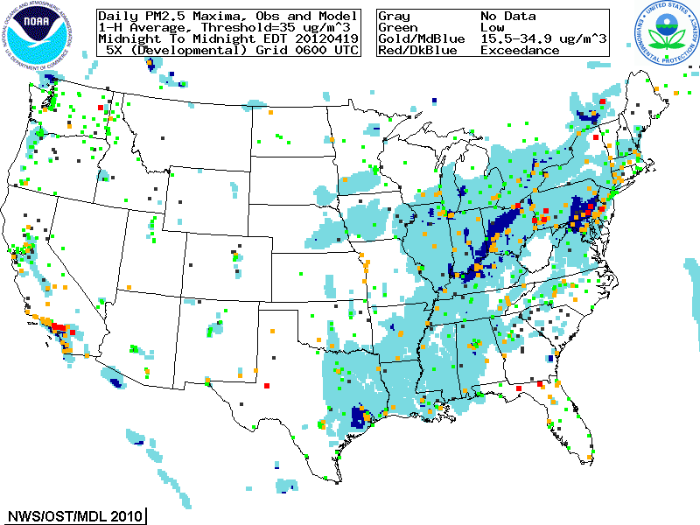
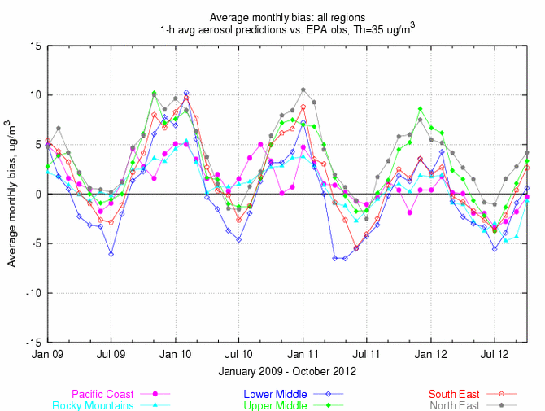
Quantitative PM performance
  Focus group access only, real-time as resources permit
  Aerosols over CONUS
    From NEI sources only
    CMAQ:
    CB05 gases, AERO-4 aerosols
    Sea salt emissions
  Wildfire smoke emissions and dust storms not included
Forecast challenges
Aerosol simulation using emission inventories:
  Show seasonal bias-- winter, overprediction; summer, underprediction
Intermittent sources
Chemical boundary conditions/trans-boundary inputs

Slide 24
Partnering with AQ Forecasters
Focus group, State/local AQ forecasters:
  Participate in real-time developmental testing of new capabilities, e.g. aerosol predictions
  Provide feedback on reliability, utility of test products
  Local episodes/case studies emphasis
  Regular meetings; working together with EPA’s AIRNow and NOAA
  Feedback is essential for refining/improving coordination
Examples of AQ forecaster feedback:
2013
Local and state forecasters urged NOAA to continue providing Air Quality Predictions
Evaluation of ozone predictions in the summer 2013 was hampered by unusually few high ozone events, especially in southeast US.
2012
In Connecticut, NOAA model outperformed [human] forecasts- 73% vs. 54%. The NOAA model past record of over-predicting during July-August didn’t occur this year. (Michael Geigert, Connecticut Dept.of Energy and Environmental Protection)
In Maryland, NOAA ozone predictions have improved since 2011: significant improvement in false alarm ratio (FAR) with some decrease in probability of detection (POD). (Laura Landry, Maryland Department of the Environment)

Slide 25
Summary and plans
US national AQ forecasting capability:
Smoke prediction nationwide
    GOES smoke product is used for verification
Dust prediction for CONUS sources
    MODIS dust product is used for verification
Ozone prediction nationwide
Prototype CMAQ aerosol predictions with NEI sources
If/when resources allow we plan to:
Maintain operational AQ predictions
Improve and transition currently experimental ozone into operations
Use lateral boundary conditions from global dust predictions in testing of PM2.5 predictions
Include intermittent smoke and dust emissions into testing of PM2.5 predictions

Slide 26
Acknowledgments:
AQF Implementation Team Members
Special thanks to Paula Davidson, OST chief scientist and former NAQFC Manager and to Jim Meager former NOAA AQ Matrix Manager
NOAA/NWS/OST Ivanka Stajner NAQFC Manager
NWS/OCWWS Jannie Ferrell Outreach, Feedback
NWS/OPS/TOC Cynthia Jones Data Communications
NWS/OST/MDL Jerry Gorline, Marc Saccucci, Dev. Verification, NDGD Product Development
Dave Ruth
NWS/OST Sikchya Upadhayay Program Support
NESDIS/NCDC Alan Hall Product Archiving
NWS/NCEP
  Jeff McQueen, Jianping Huang Perry Shafran AQF model interface development, testing, & integration
  *Sarah Lu Global dust aerosol and feedback testing
  *Brad Ferrier, *Eric Rogers, NAM coordination
  *Hui-Ya Chuang
  Geoff Manikin Smoke and dust product testing and integration
  Dan Starosta, Chris Magee NCO transition and systems testing
  Mike Bodner, Andrew Orrison HPC coordination and AQF webdrawer
NOAA/OAR/ARL
  Pius Lee, Daniel Tong, Tianfeng Chai CMAQ development, adaptation of AQ simulations for AQF
  Hyun-Cheol Kim
  Roland Draxler, Glenn Rolph, Ariel Stein HYSPLIT adaptations
NESDIS/STAR Shobha Kondragunta Smoke and dust verification product development
NESDIS/OSDPD Liqun Ma, Mark Ruminski Production of smoke and dust verification products,
HMS product integration with smoke forecast tool
EPA/OAQPS partners:
Chet Wayland, Phil Dickerson, Brad Johns, John White AIRNow development, coordination with NAQFC
  * Guest Contributors

Slide 27
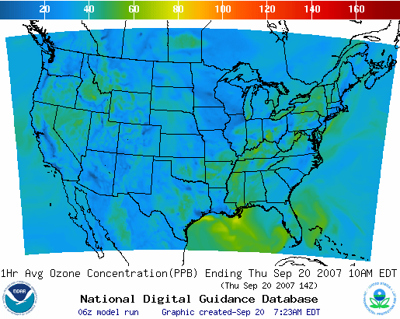
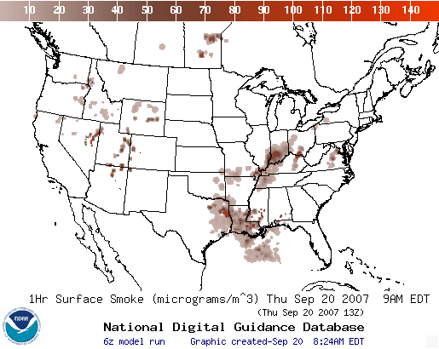
Operational AQ forecast guidance airquality.weather.gov
Ozone products
Nationwide since 2010
Smoke Products
Nationwide since 2010
Dust Products
Implemented in 2012
Further information: www.nws.noaa.gov/ost/air_quality

