Slide 1


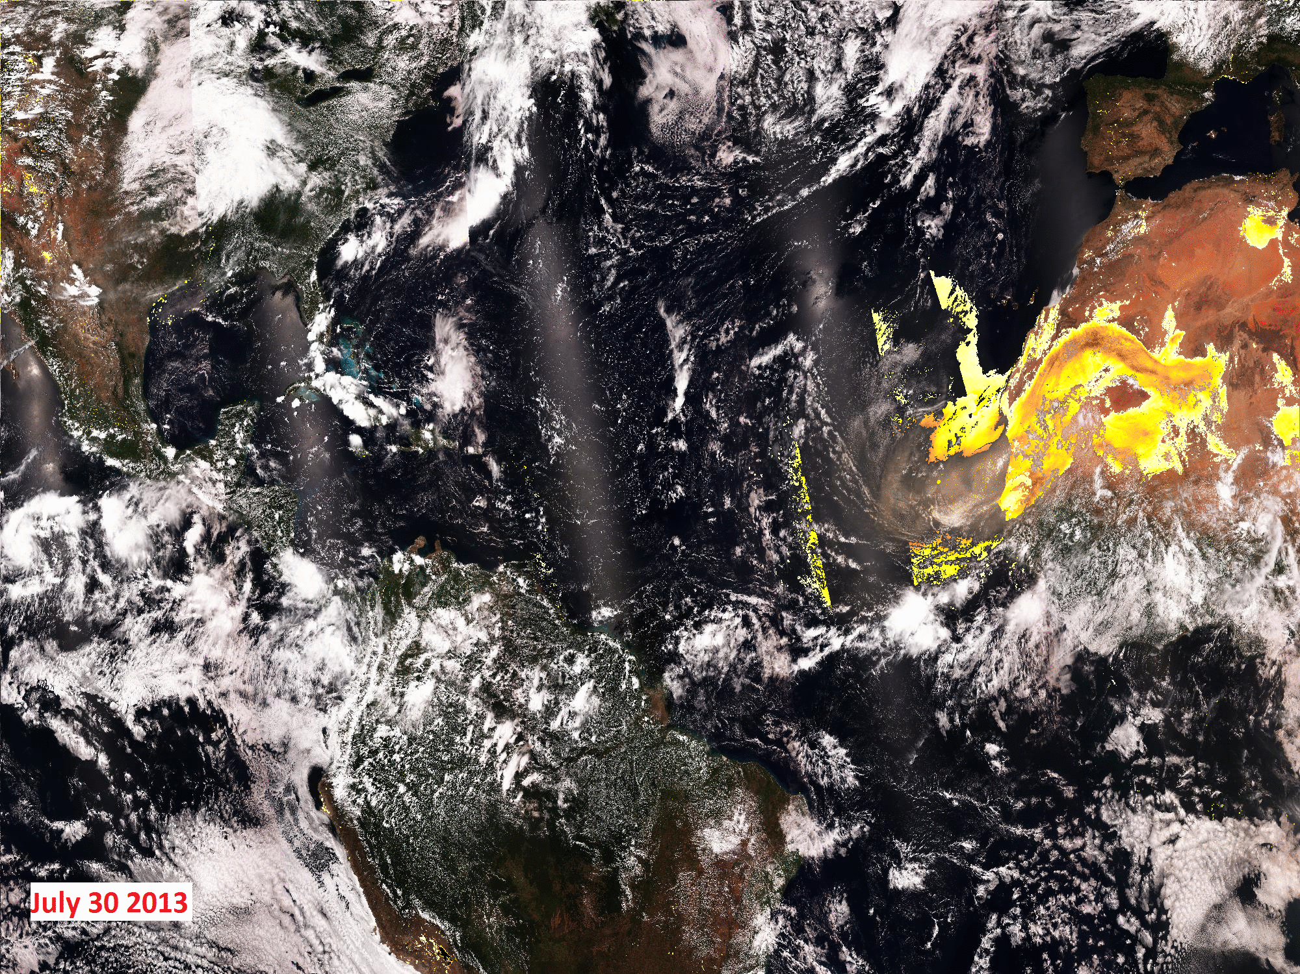
VIIRS Suspended Matter and Dust Aerosol Index Product
Shobha Kondragunta¹, Pubu Ciren^{1,2} and Ho-Chun Huang^{1,3}
¹NOAA/NESDIS
²IMSG
³UMD-CICS

Slide 2
Suspended Matter
Suspended matter consists of particles such as sand, dust, smoke,
volcanic ash, and urban/industrial particulate matter. It can damage
many different systems. For example, aircraft flying through these
materials can suffer damage to cockpit canopies or windscreens.
Additionally, aircraft engines suffer extremely high wear in the presence
of suspended matter, leading to increased sustainment or engine failure.
Volcanic ash plumes are a threat to military and civil aviation. DOC
participates in a civil aviation warning system for volcanic ash hazards
by monitoring these plumes in satellite imagery. DOC also monitors
smoke from large scale fire events to provide information to the relevant
agencies and the public. Suspended matter is detected in a pixel when
Aerosol Optical Thickness (AOT) is greater than 0.15 but for the quality
of the suspended matter type (dust/sand, smoke, volcanic ash, sea salt) to
be “high”, the AOTs should be at least 0.5 or higher.
From L1RD supplement

Slide 3
JPSS L1RD Supplement Requirements
Product | Threshold | Objective | Notes
SM | Dust, smoke, volcanic ash | Dust, smoke, volcanic ash, sea salt
Smoke plume | 0 to 150 µg/m³ | 0 to 200 µg/m³
Accuracy
SM | 80%
Smoke | 70%
Dust | 80%
Ash | 60% |  | Dust can be mis-identified as ash
Mixed Aerosol |  | 80% | Report not only dominant aerosol but other aerosol components as well

Slide 4
VIIRS SM Algorithm Overview
Ocean
Land
Dependence on Fine Mode Weight (FMW)
Fine Mode Weight (FMW)
AOT Model Selection
0.2 ≤ FMW < 0.5
FMW < 0.2
FMW ≥ 0.5
Dust Model
Any other Model
Dust
AOT
Smoke
Dust
Smoke
AOT < 0.3
AOT ≥ 0.3
VCM
Ash
Sea Salt
Undetermined
Tuned out due to too many false positives as of 11/2/2012
From SM ATBD prepared by NGAS, dated 3/17/2010

Slide 5
Heavy Aerosol Flag vs. SM
VCM attempts to identify the presence of heavy aerosol flag for scenes that are classified as “confidently/probably cloudy” and passes that information to aerosol algorithm.
  Aerosol algorithm uses it to reset “confidently/probably cloudy” pixels as clear sky to attempt AOT/Angstrom Exponent/SM retrieval.
  If heavy aerosols (dust and smoke) are indeed present, AOT up to 2.0 is retrieved. AOTs higher than 2.0 are flagged as “out of range”.
  If the pixels are indeed cloudy, AOTs will be high and likely out of range as well.
SM algorithm does not rely on heavy aerosol information from VCM except for “volcanic ash”.
  But, VCM tuned out all volcanic ash testing as of November 2, 2012

Slide 6
SM Product Validation
Qualitative comparison of monthly global maps of VIIRS SM (dominant aerosol type), dust fraction, and smoke fraction to CALIPSO and MISR products
    CALIPSO: 5º x 5º
      Coarser grid for CALIPSO is used to obtain a good sample size.
  MISR: 0.25º x 0.25º
  VIIRS: 0.25º x 0.25º
Direct matchups of CALIPSO and VIIRS SM to compute accuracy, probability of detection, and false alarm ratio.

Slide 7
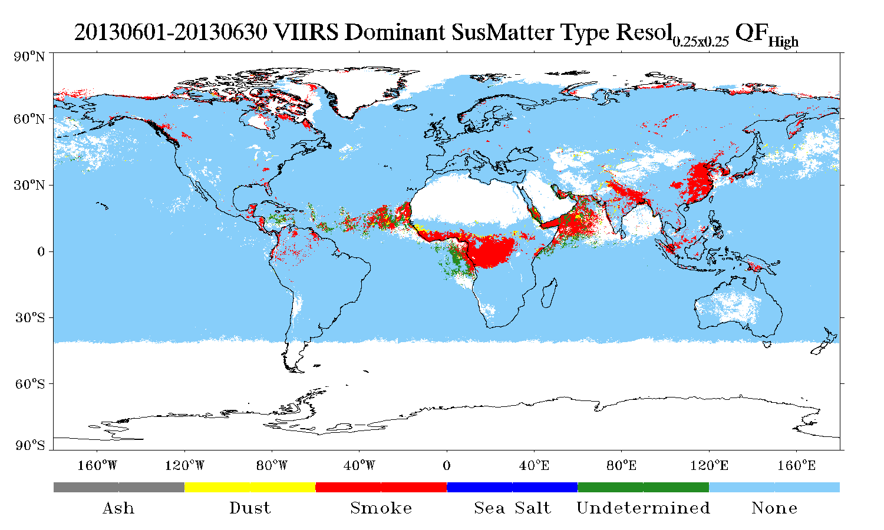
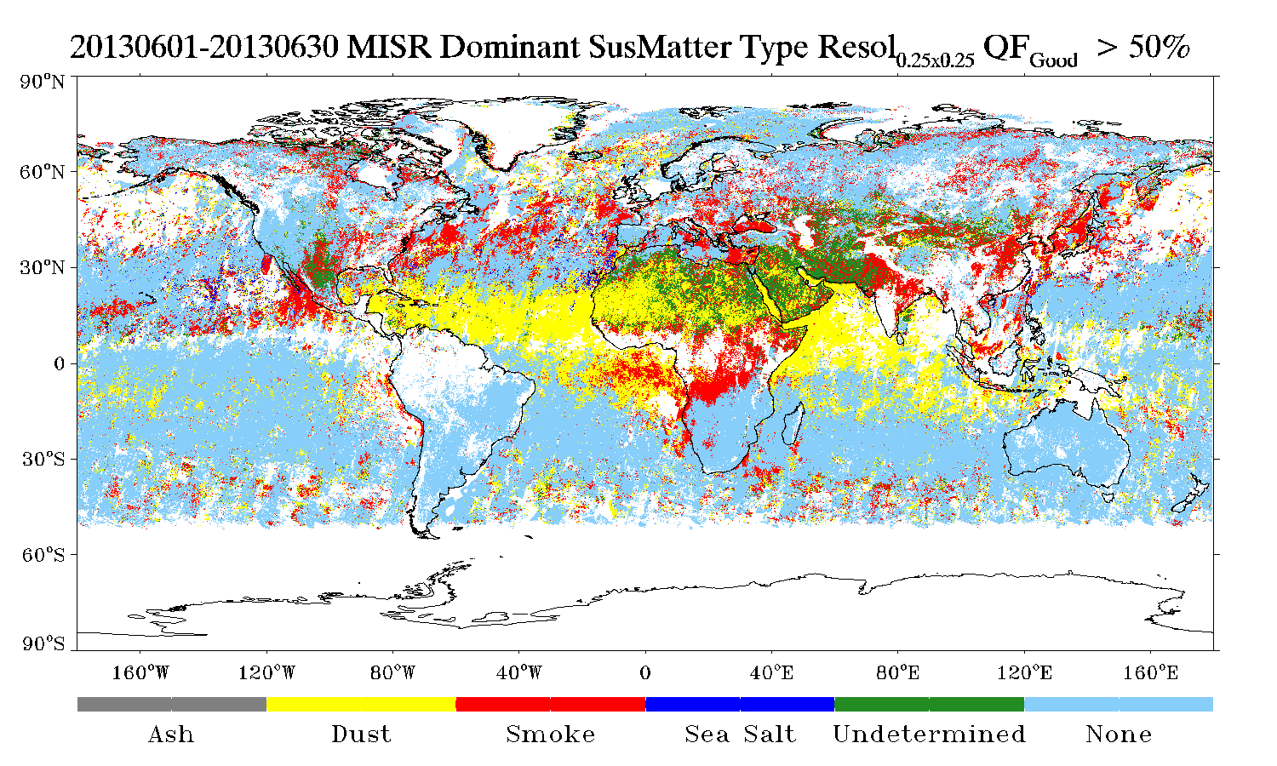
June 2013 VIIRS vs. MISR

Slide 8
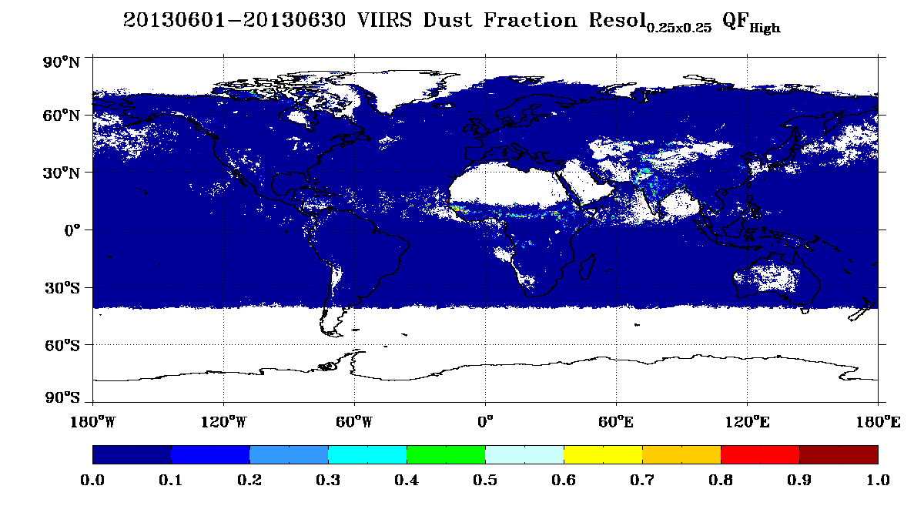
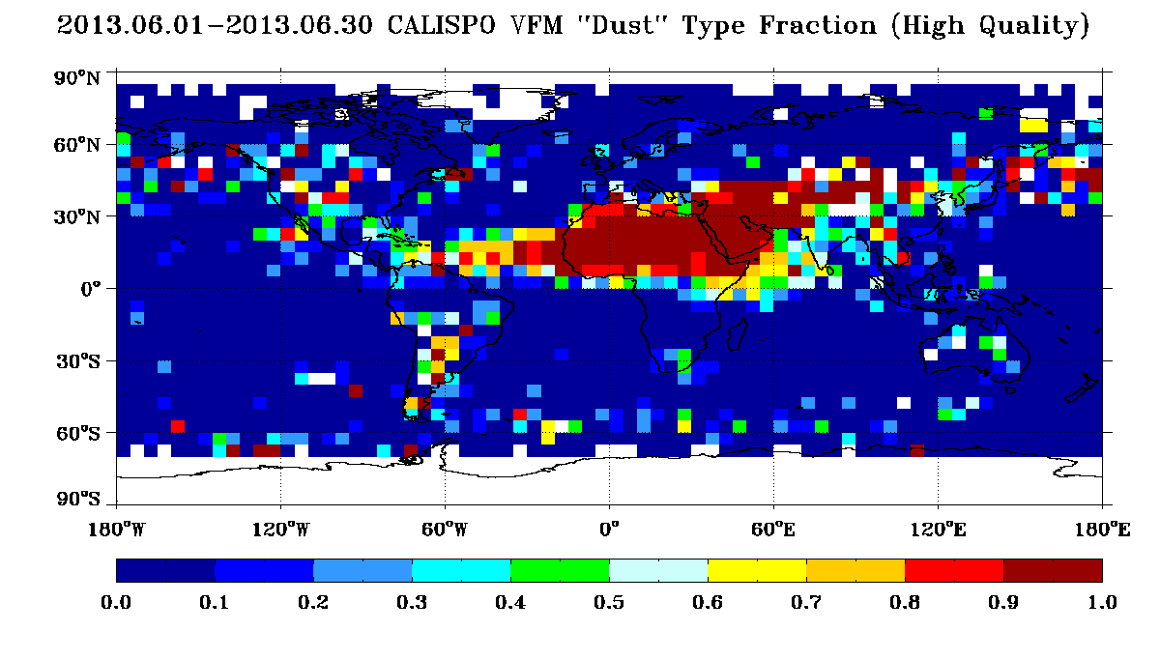
June 2013 VIIRS vs. CALIPSO

Slide 9
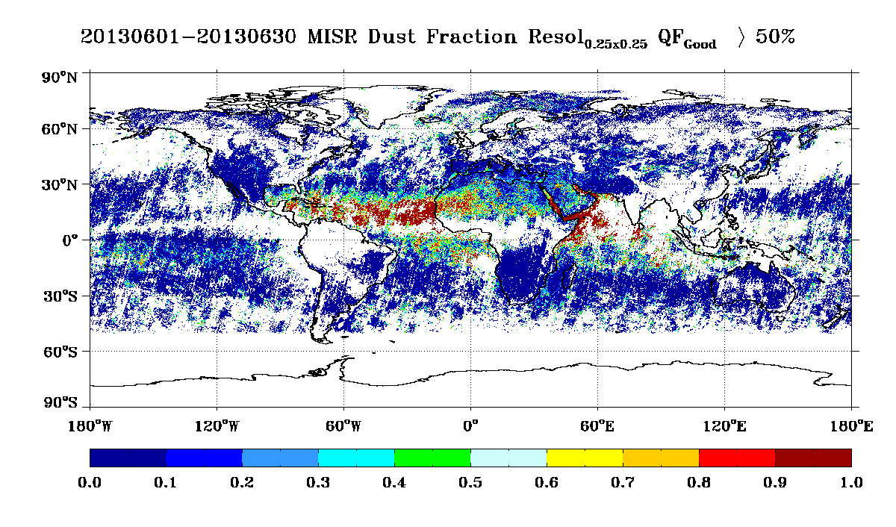
June 2013 VIIRS vs. MISR

Slide 10
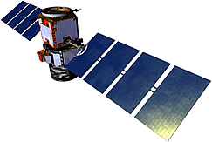
CALIPSO – VIIRS Matchups
CALIPSO
Time difference: ±2 minutes
Spatially , VIIRS pixels within ± 375m of the middle CALIPSO profile are selected.
Middle three profiles are used to determine aerosol type in the column
  All three profiles need to be cloud-free;
  Dominant aerosol type is determined through the calculation of dust (or smoke) fraction ( i.e., no of dust (or smoke) layers divided by the no. of aerosol layers from surface to 12km.
VIIRS SM data are filtered for high quality.
330m
VIIRS pixels
375m
5km
True Positive (TP): VIIRS and CALIPSO say dust
True Negative(TN): VIIRS and CALIPSO say no dust
False Negative(FN): VIIRS says no dust but CALIPSO says dust
False Positive(FP): VIIRS says dust when CALIPSO says no dust
POD = TP/(TP+FN)
Accuracy = (TP+TN)/(TP+TN+FP+FN)
FAR = FP/(FP+TP)

Slide 11
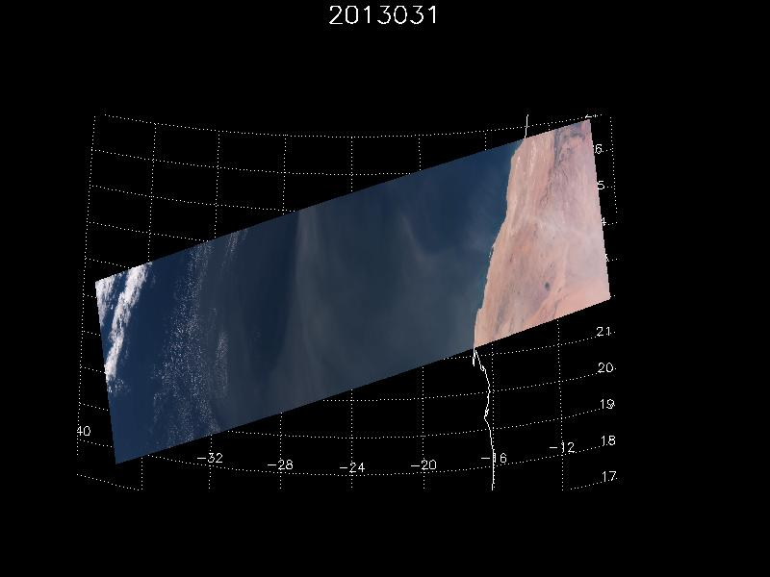
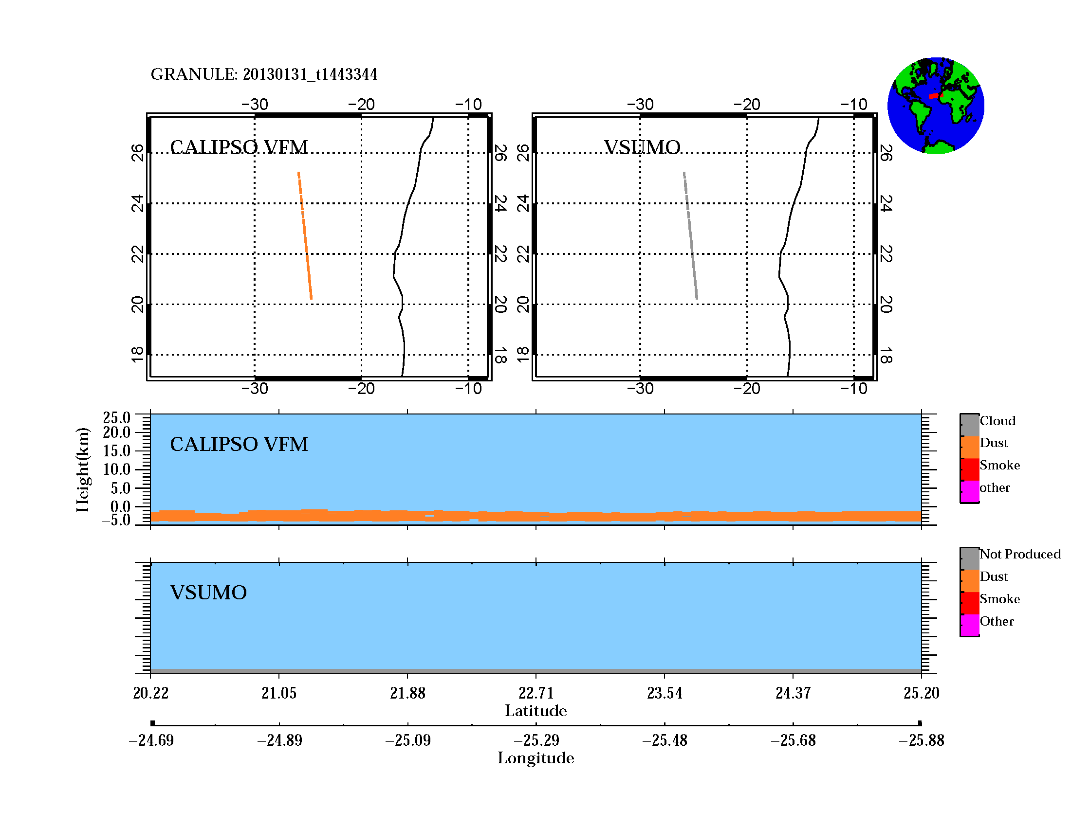
January 31, 2013
VIIRS vs. CALIPSO Matchup
Accuracy | 2.3%
Probability of Detection | 0.0%

Slide 12
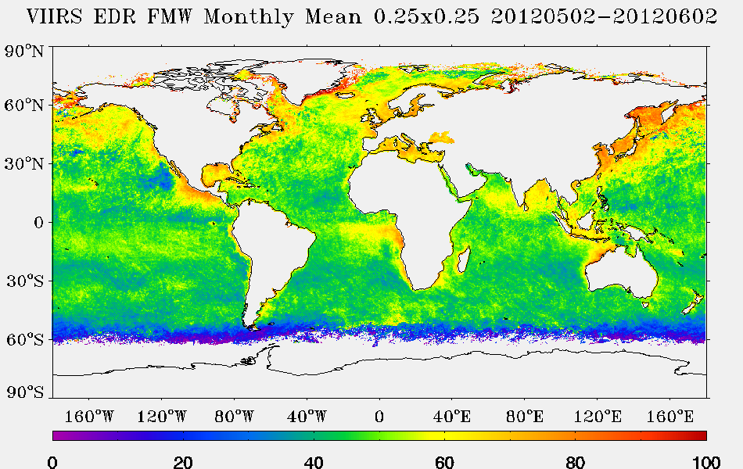
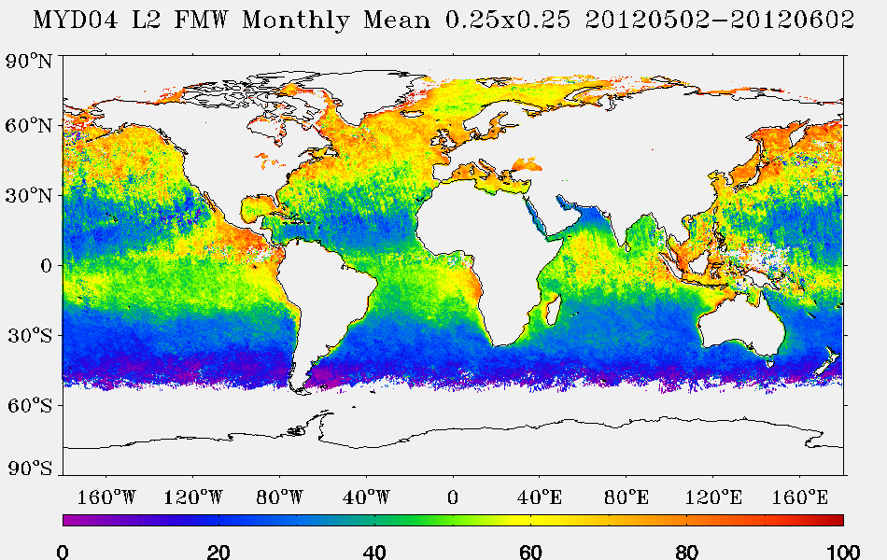
Analysis of VIIRS FMW
MODIS shows lower FMW near the dust source regions. This feature is missing in VIIRS due to which SM algorithm misses dust detection.

Slide 13
Dust Aerosol Index (DAI) Algorithm
Developed for MODIS
  Ciren and Kondragunta, JGR, in review, 2013
Algorithm adapted for VIIRS
  Only VIIRS dust results shown in this presentation. Figures related to algorithm are from MODIS and are used to illustrate the algorithm physics
  MODIS and VIIRS bands are similar but not identical

Slide 14
6S Radiative Transfer Simulations
6S Simulations:
MODIS C5 dust aerosol model used
Desert, vegetation, ocean BRDF with easterly wind speed of 6 m/s are used to represent surfaces in 6S
Finding:
DUST reduces the contrast between 412nm and 440 nm as a result of increasing absorption by dust with decreasing wavelength
R_{412nm}/R_{440nm}

Slide 15
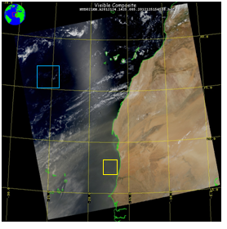
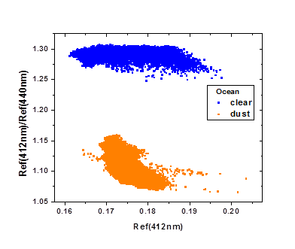
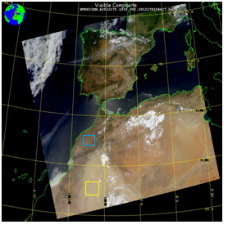
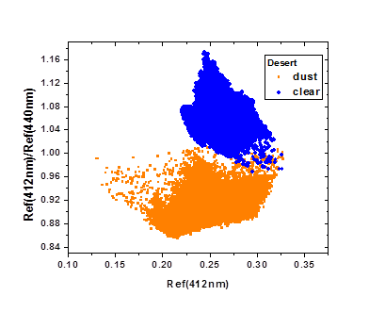
MODIS Observations

Slide 16
MODIS Observations
Ref(2130nm)
Smoke:
Has the same effect as dust in terms of the reduction in the contrast of 412 nm to 440 nm
But, smoke particles are smaller than dust. Reflectance at 2.13 µm can be used to separate dust from non-dust aerosols.

Slide 17
Dust Aerosol Index
DAI = 100*[log₁₀(R_{412nm}/R_{445nm})-log10(R’_{412nm}/R’_{445nm})]
NDAI = -10*[log₁₀(R_{412nm}/R_{2.25µm})]
Clouds over water are screened using 0.86 µm spatial variability test. Over land, clouds are screened by 1.38 µm test for cirrus and 412 nm spatial variability test
Bright desert surfaces are screened for by bright pixel index (normalized difference of 1.24 µm and 2.25 µm)
Sunglint, snow/ice, fire hot spots are also screened based on different tests (geometry, spectral etc.)
DAI and NDAI are computed for pixels that pass these tests:
  Water: DAI ≥ 4 and NDAI ≥ -10
  Land: DAI ≥ 12 and NDAI ≥ 0
6S Simulations for MODIS bands

Slide 18
Dust Aerosol Index
DAI = 100*[log₁₀(R_{412nm}/R_{445nm})-log10(R’_{412nm}/R’_{445nm})]
NDAI = -10*[log₁₀(R_{412nm}/R_{2.25um})]
Clouds over water are screened using 0.86 um spatial variability test. Over land, clouds are screened by 1.38 um test for cirrus and 412 nm spatial variability test
Bright desert surfaces are screened for by bright pixel index (normalized difference of 1.24 um and 2.25 um)
Sunglint, snow/ice, fire hot spots are also screened based on different tests (geometry, spectral etc.)
DAI and NDAI are computed for pixels that pass these tests:
  Water: DAI ≥ 4 and NDAI ≥ -10
  Land: DAI ≥ 12 and NDAI ≥ 0
MODIS observations

Slide 19
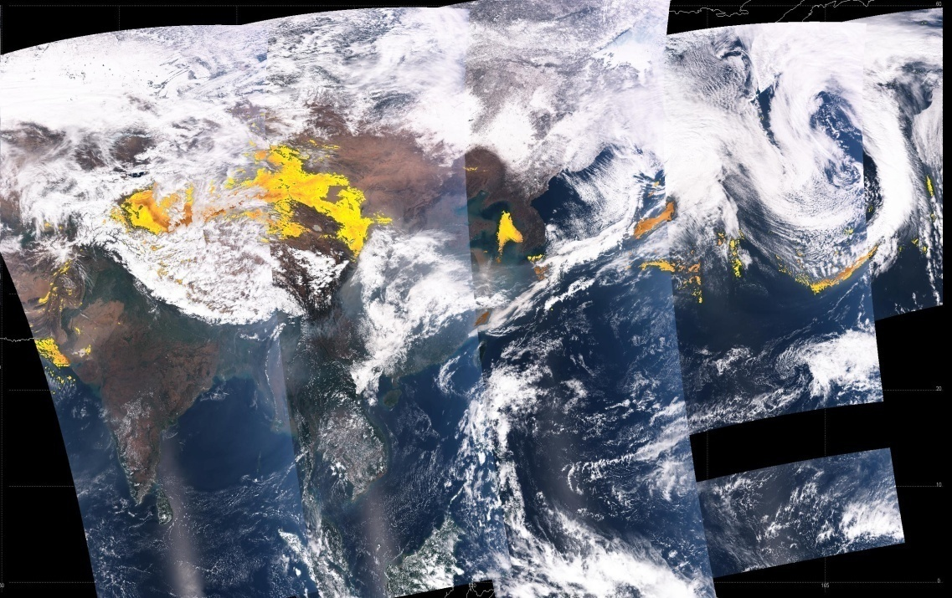
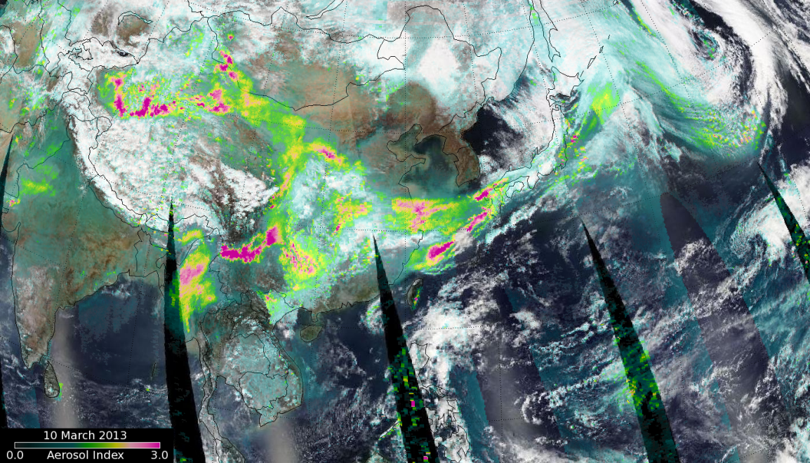
Dust Aerosol Index
VIIRS Dust Aerosol Index
03/10/2013
Dust
OMPS Aerosol Index
Haze

Slide 20
June 2013 VIIRS vs. MISR
Operational

Slide 21
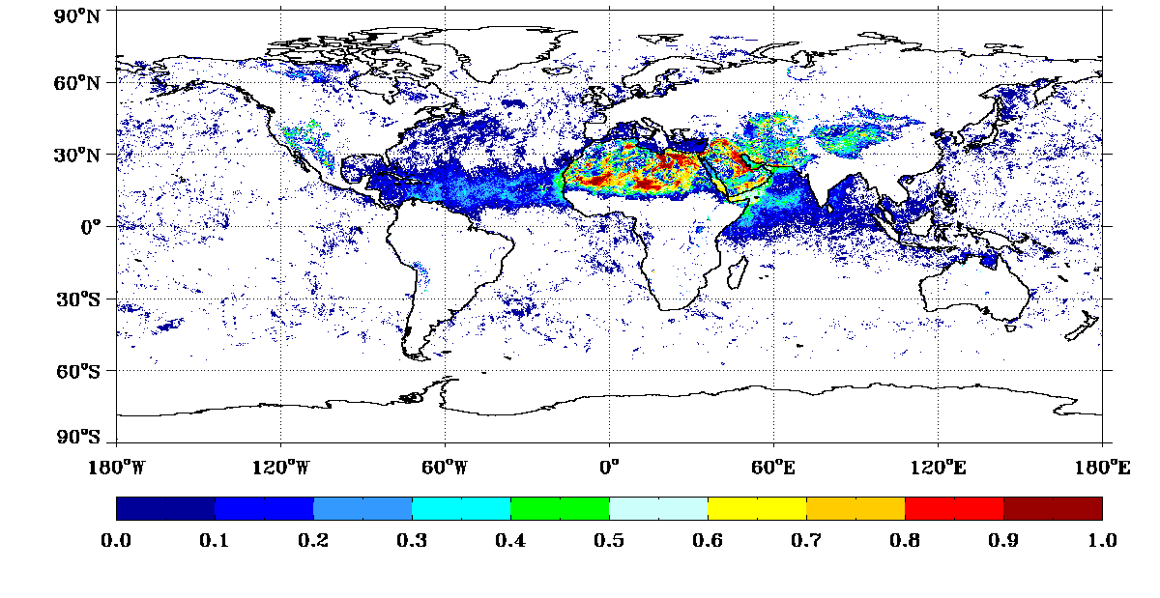
June 2013 VIIRS vs. MISR
Dust Frequency Map from DAI algorithm for June 2013
DAI

Slide 22
January 31, 2013
VIIRS vs. CALIPSO Matchup
SM Operational
Accuracy | 2.3%
Probability of Detection | 0.0%

Slide 23

January 31, 2013
VIIRS vs. CALIPSO Matchup
SM DAI
Accuracy | 83%
Probability of Detection | 85%

Slide 24
Some Key Remarks on SM
SM is not a legacy NASA MODIS product
VIIRS SM algorithm relies on AOT and other internal parameters (not validated) to identify and type SM.
  Aerosol FMW over ocean
  Aerosol model over land
SM product very difficult to evaluate and validate
  Reliance on other satellite (CALIPSO and MISR) data.
  In situ (IMPROVE network) data are available but with a 1 to 2 yr latency.
  AERONET Angstrom Exponent based classification can be used but not really “truth” like the AERONET AOT product is.
The VIIRS SM product is not recommended for use in any applications. DAI algorithm will be implemented in the future.

Slide 25
Acknowledgements
National Weather Service for partial funding to develop DAI algorithm for MODIS (FY08-FY13)
NASA for MODIS Level 1 radiances, MISR and CALIPSO retrieved products
JPSS program

