Slide 1
A Tutorial on MODIS and VIIRS Aerosol Products from Direct Broadcast Data on IDEA
Hai Zhang¹, Shobha Kondragunta², Hongqing Liu¹
IMSG at NOAA
NOAA NESDIS
11/22/2013
VIIRS Aerosol Science and Operational Users Workshop

Slide 2
IDEA: Infusing satellite Data into Environmental Applications
Provide near-real-time satellite aerosol information and analysis over the United States to the operational air quality community
Satellite data
MODIS Terra, Aqua, VIIRS, GASP East, GASP West
AOD (aerosol optical depth) or AOT (aerosol optical thickness)
RGB images (MODIS, VIIRS)
Other data for analysis
Meteorological data: wind, precipitation
In-situ PM2.5
OMI Aerosol Index (AI)
WF_ABBA (Wild Fire Automated Biomass Burning Algorithm), fire hotspots
Developed by NASA for MODIS and transitioned to NOAA. NOAA enhanced IDEA to include GOES-E, GOES-W, OMI, VIIRS and surface PM2.5 estimation.

Slide 3
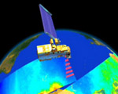
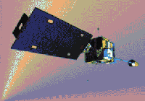
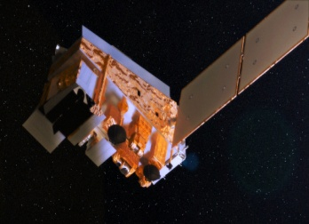
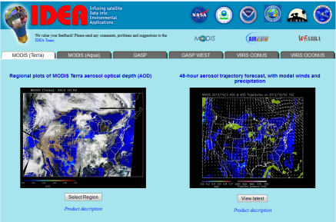
IDEA Data flow diagram
MODIS Terra and Aqua
GOES
East
and West
VIIRS
VIIRS L1B, cloud mask data
MODIS data processing L1B, aerosol products
GOES data processing
GASP Aerosol product
Generate VIIRS aerosol product locally (STAR research version)
EPA AIRNow PM2.5
NOAA
Meteorological data
Data processing, forward trajectories, composite plots, etc.
IDEA Website
Local computer at NOAA
NOAA
WF_ABBA
http://www.star.nesdis.noaa.gov/smcd/spb/aq/

Slide 4
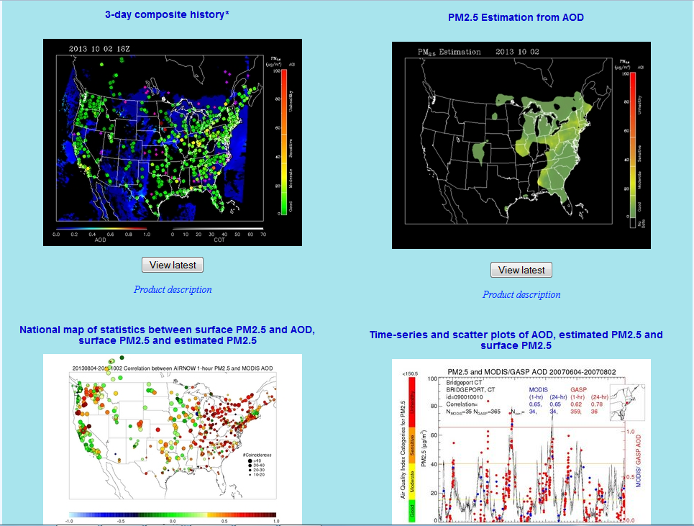
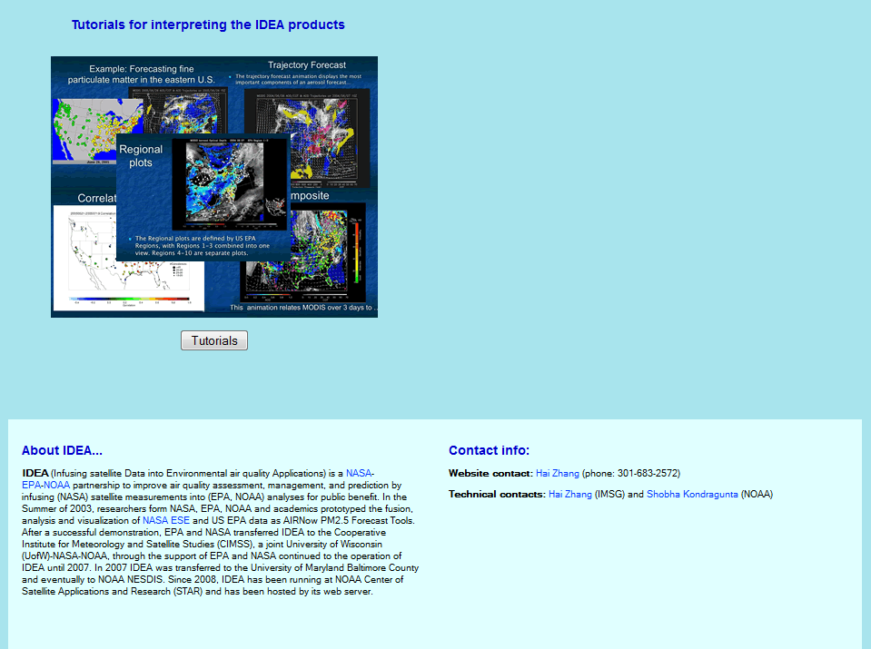
IDEA web page http://www.star.nesdis.noaa.gov/smcd/spb/aq/
Click tabs to select satellite
Click panels to select product

Slide 5
Products on IDEA
Satellite RGB and AOD images
48-hour forward trajectories
3-day composite history of AOD, wind, in-situ PM2.5, and fire hotspots
Daily PM2.5 estimates from MODIS AOD
AOD-PM2.5 correlation, Estimated PM2.5 vs in-situ PM2.5 correlation and RMSE maps
Time series, scatter plots, histogram, etc for AOD, estimated and in-situ PM2.5 at PM2.5 stations

Slide 6
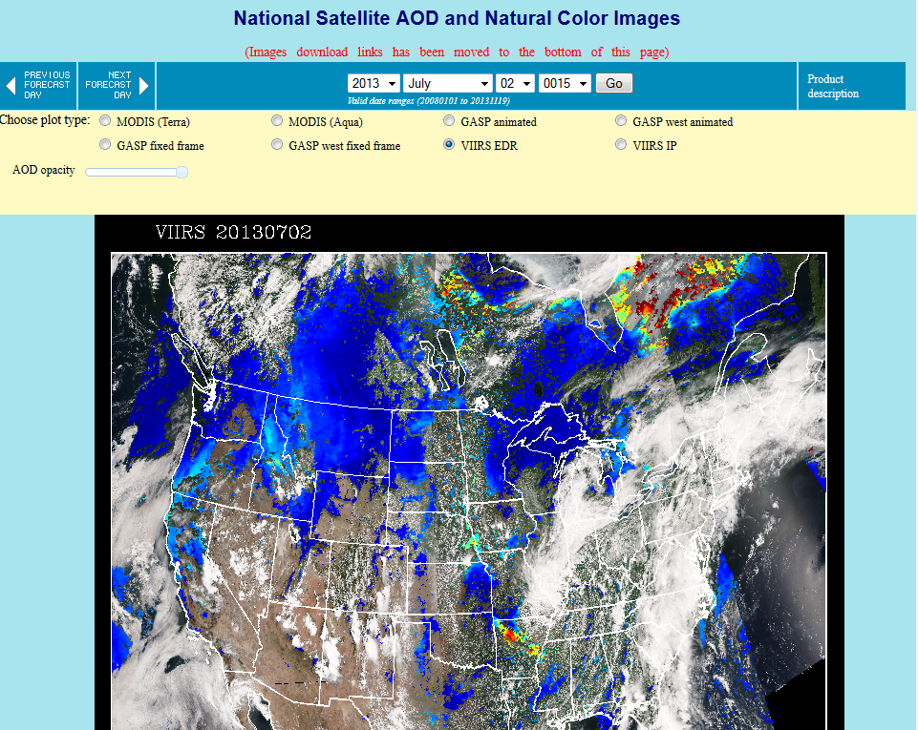
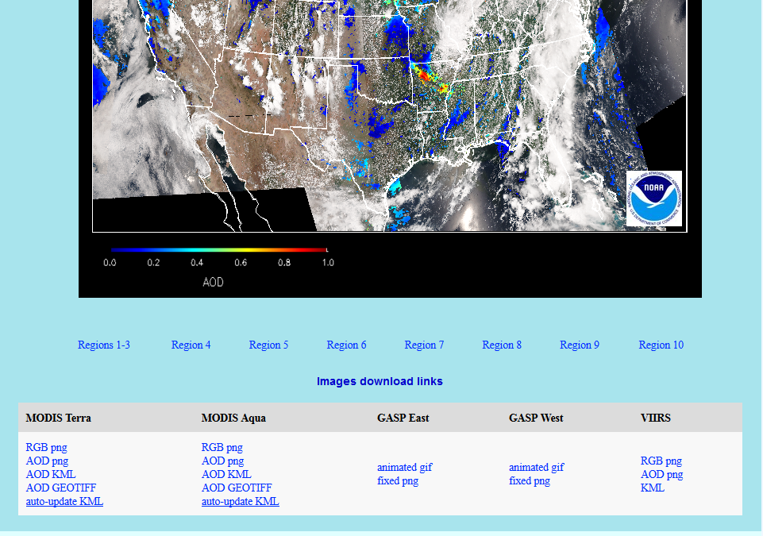
RGB and AOD images
select date
select satellite
Change AOD opacity
Click on individual regions to see regional AOD images
Download images or google earth kml file

Slide 7
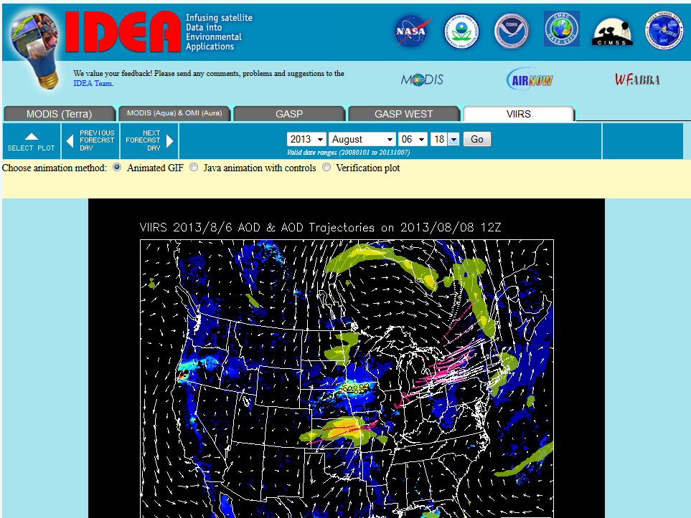
48-hour forward trajectory animation
AOD (red-blue)
850 mb winds (white arrows)
Precipitation (yellow)
Trajectories from high AOD regions (pink-white):
Dark pink – close to the surface
White – high above surface
Verification plot is linked to the AOD plot two days later

Slide 8
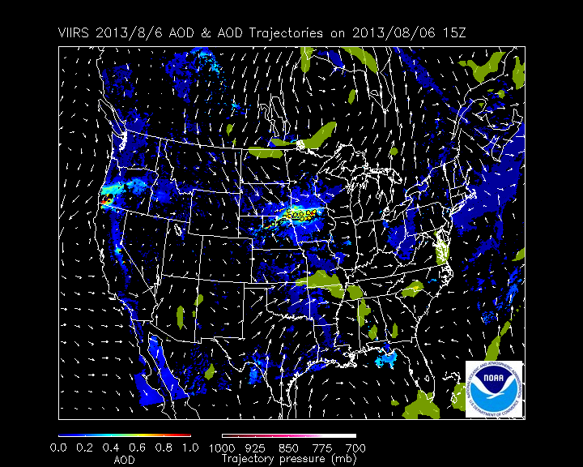
48-hour forward trajectory animation
AOD (red-blue)
850 mb winds (white arrows)
Precipitation (yellow)
Trajectories from high AOD regions (pink-white):
Dark pink – close to the surface
White – high above surface
Verification plot is linked to the AOD plot two days later

Slide 9
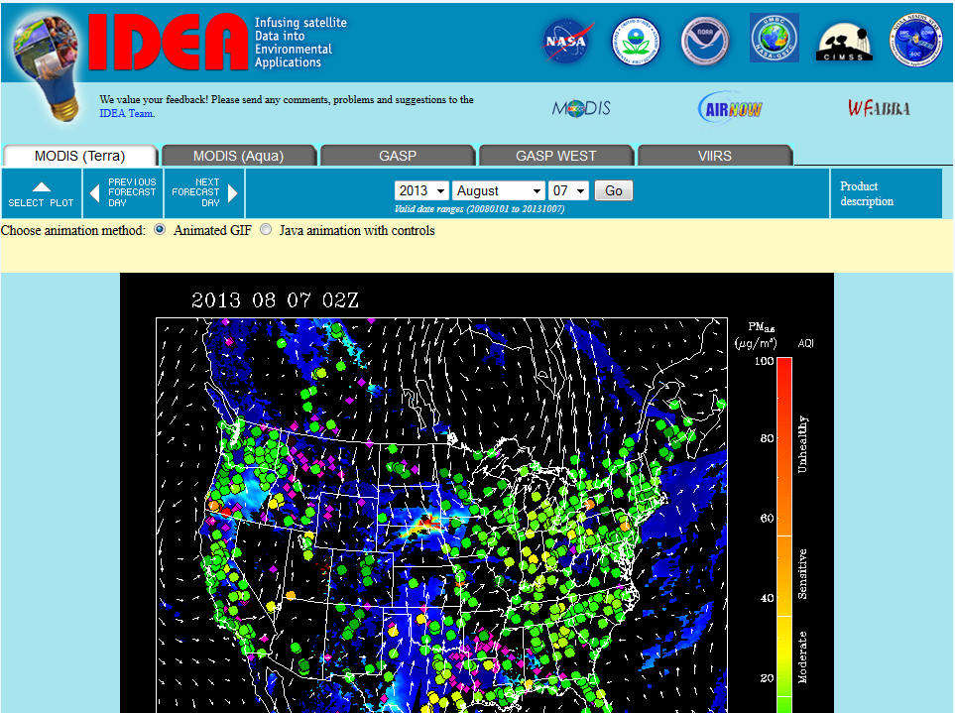
3-day composite history animation
AOD (blue-red)
850 mb wind (white arrows)
In-situ PM2.5 (green-yellow-orange-red filled circles)
Fire hotspots (pink dots)

Slide 10
Daily PM2.5 estimations from MODIS AOD
Derived from Aaron van Donkelaar’s algorithm
(Donkelaar et al. Environ. Sci. Tech. 2012)
Overlaid by in-situ PM2.5

Slide 11
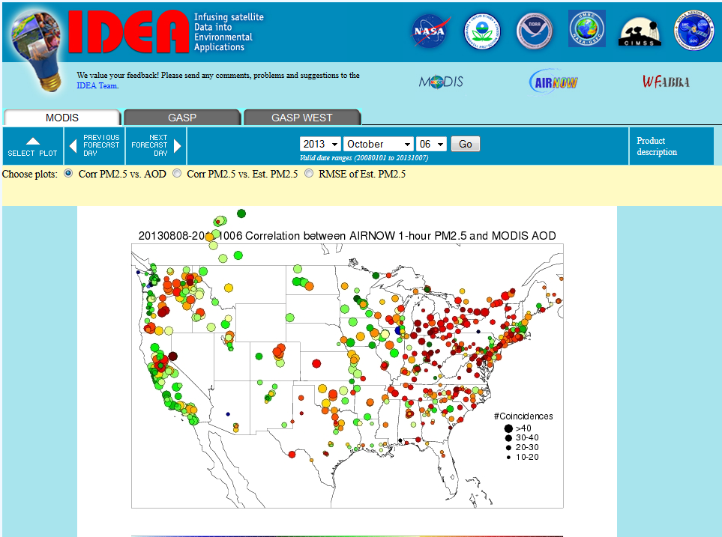
Correlation map between PM2.5 and AOD (MODIS, GASP) over CONUS
Correlation, RMSE between estimated PM2.5 from MODIS AOD and in-situ PM2.5

Slide 12
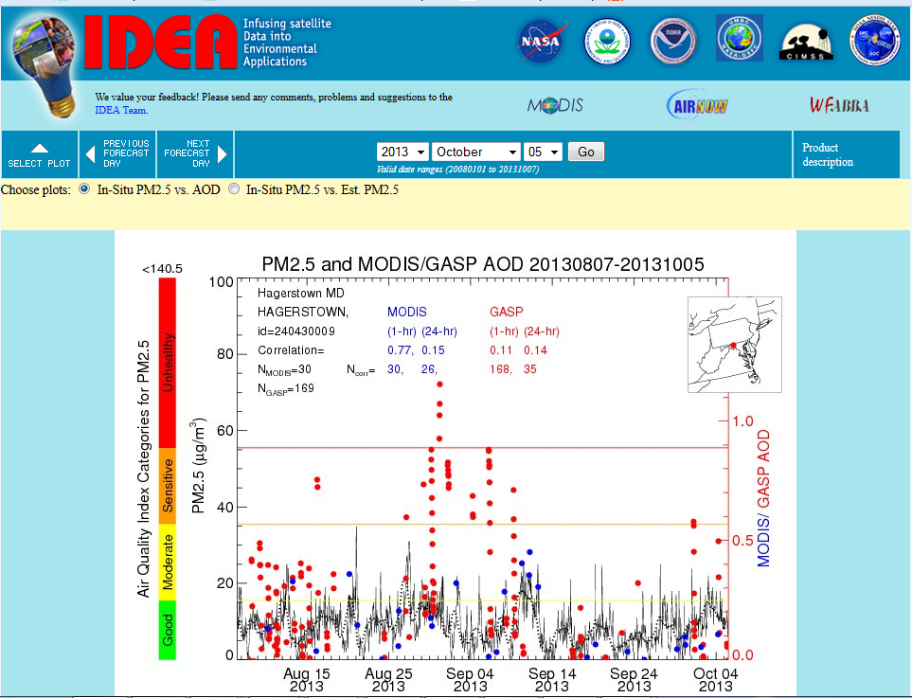
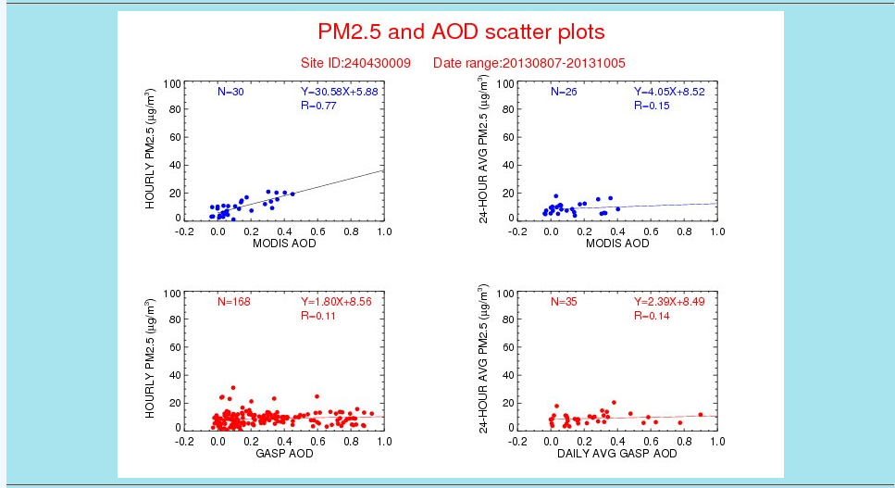
Time series, scatter plots, histograms at each PM2.5 station
MODIS, GASP AOD vs PM2.5
Time series
Scatter plots
Histogram
Estimated daily PM2.5 vs in-situ PM2.5
Time series
Scatter plots

Slide 13
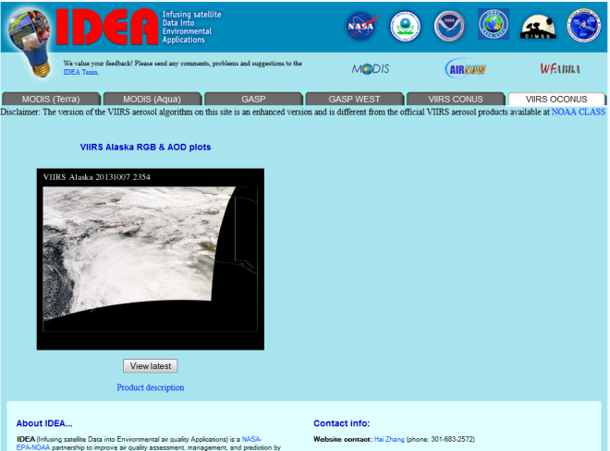
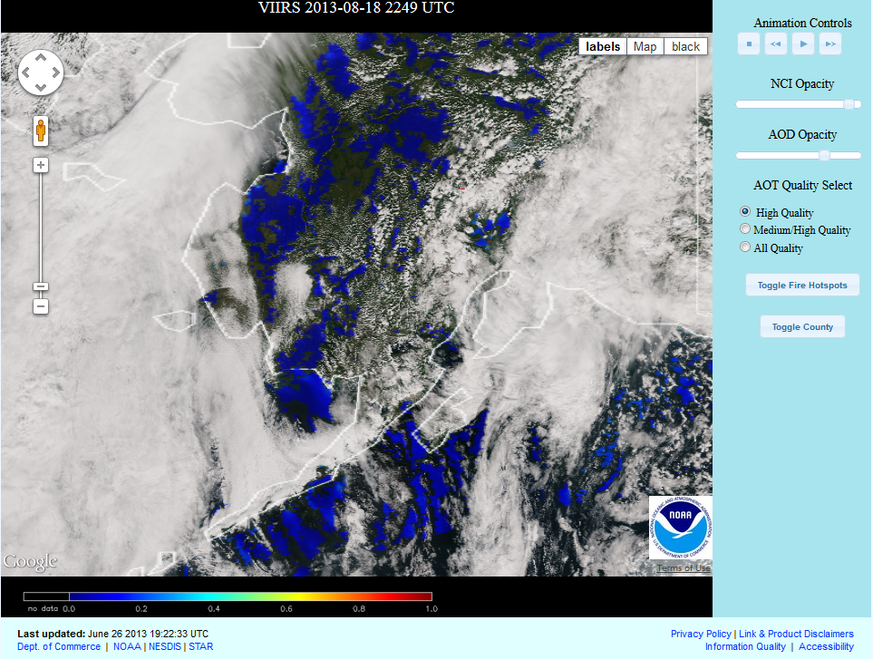
VIIRS images over Alaska
VIIRS OCONUS
Multiple images per day
Animation controls
Opacity sliders
AOD quality selections
Fire hotspots
County boundaries

Slide 14
Differences in AOD retrieval between MODIS and VIIRS
MODIS and VIIRS aerosol retrieval algorithms are different
Different bands are used
Retrieval algorithms are different
Cloud masks are different
Other internal screening tests are different over land: soil dominate, ephemeral water, etc
Spatial resolution
MODIS 10 km
VIIRS EDR 6 km, IP 750 m. We use high quality EDR AOD on IDEA unless specified
AOD retrieval range
MODIS [-0.05,5.0]
VIIRS [0,2.0] (will be extended to [-0.05,5.0] soon)
Therefore, MODIS and VIIRS AOD can have different values and data coverage

Slide 15
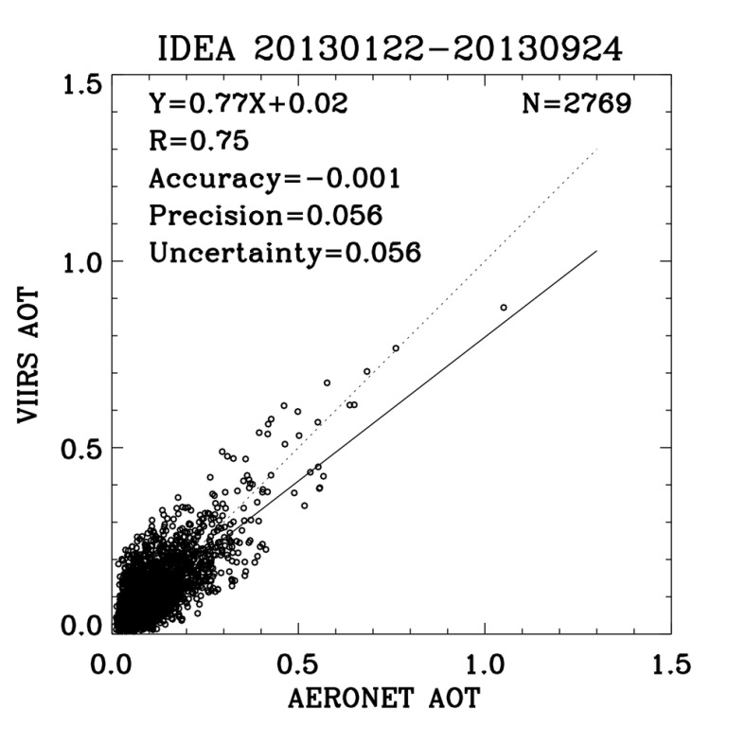
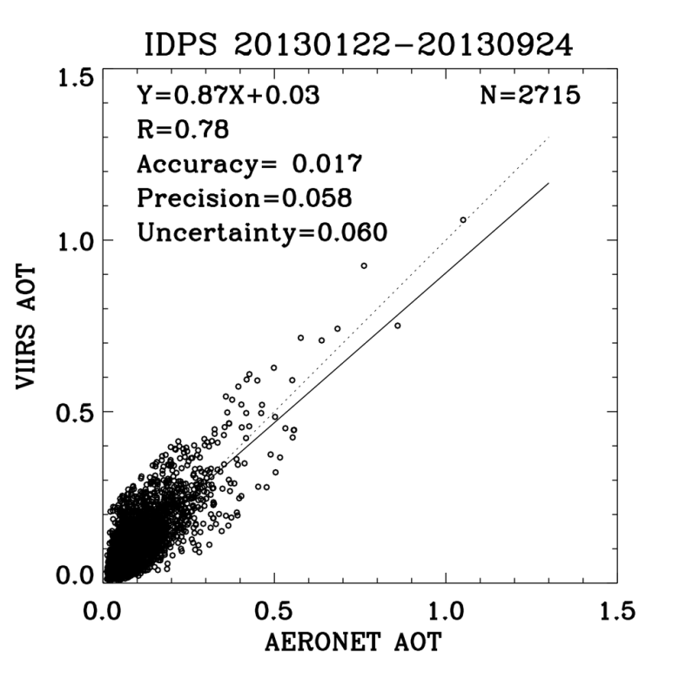
Validation over CONUS at AERONET sites
Aerosol retrieval on IDEA (STAR research version) is slightly different over land from the official IDPS algorithm. IDEA retrieval assumes the surface reflectance ratios between different bands are dependent on NDVI, while IDPS uses constant ratios.
The scatter plot shows that VIIRS AOD is comparable to MODIS AOD over CONUS

Slide 16
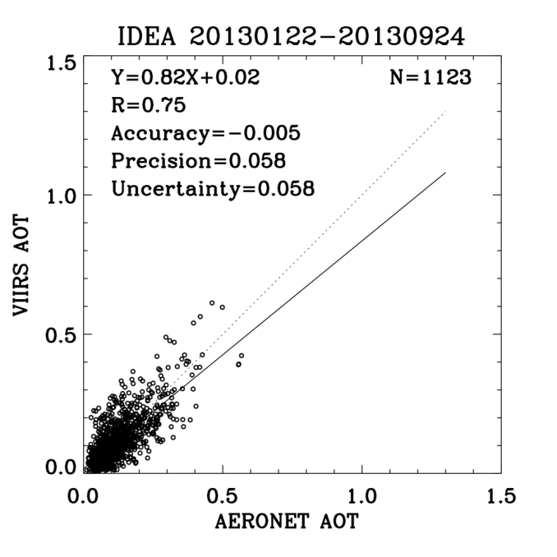
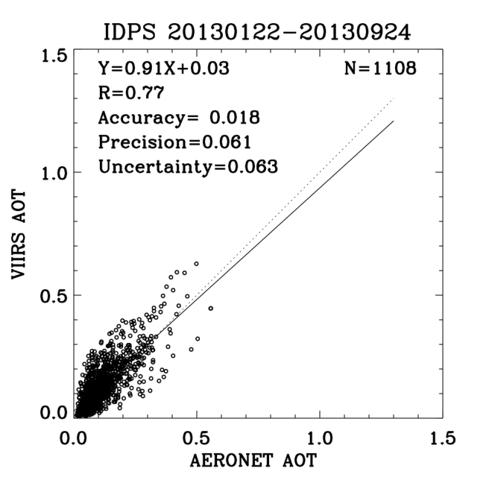
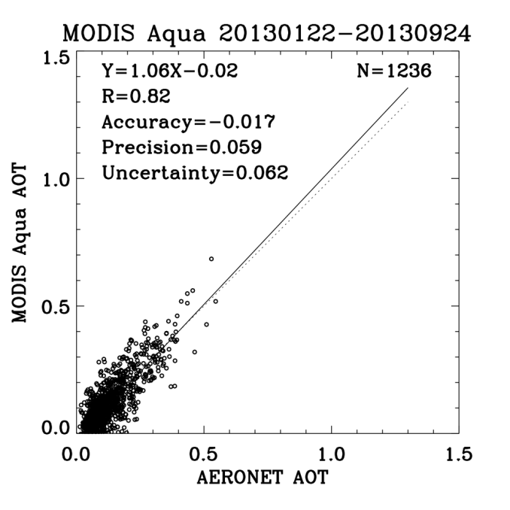
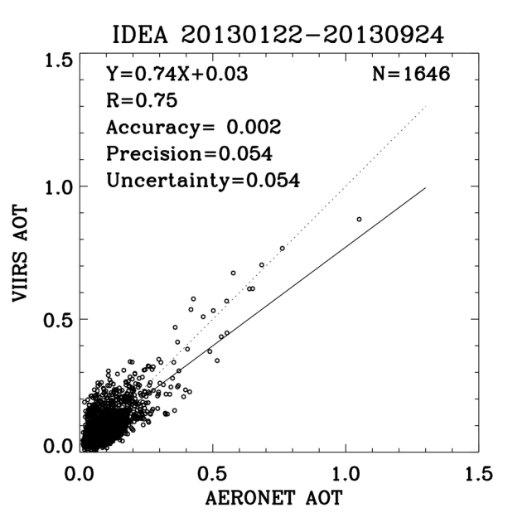
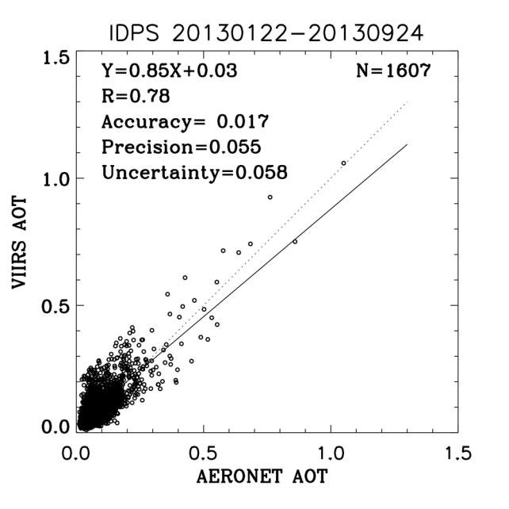
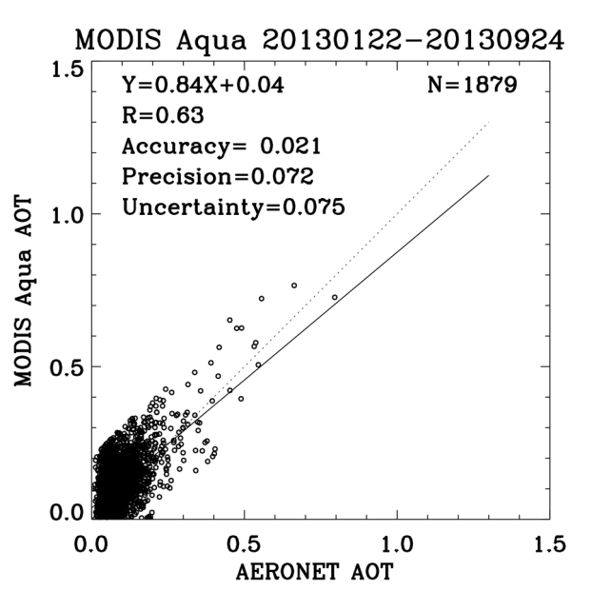
Eastern CONUS
Western CONUS

Slide 17
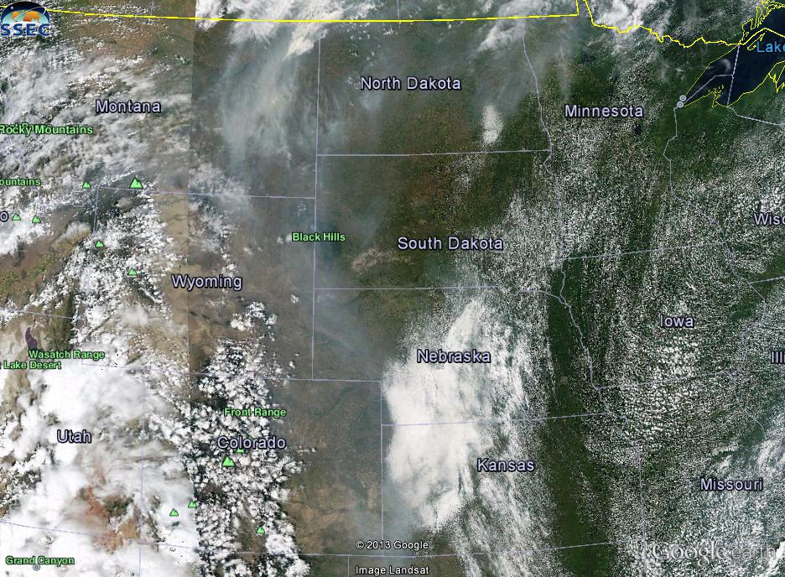
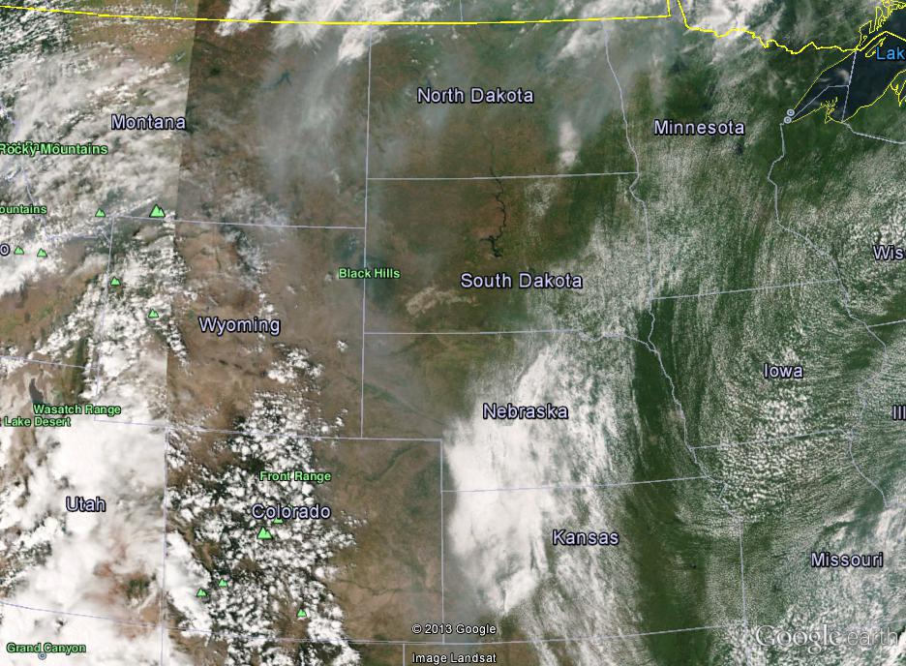
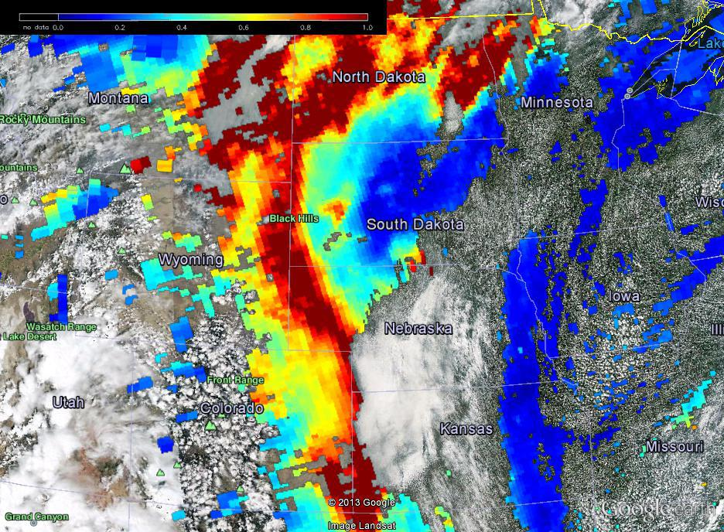
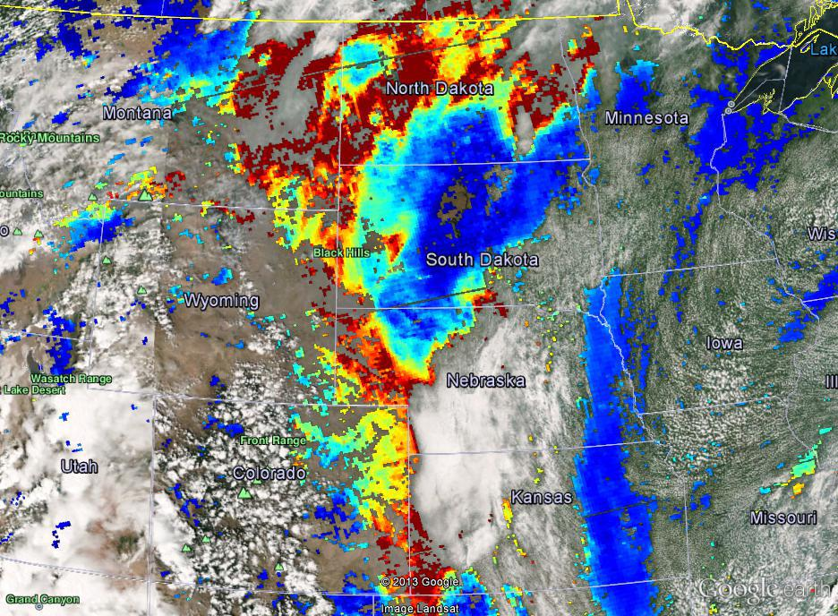
Some examples of case studies on data coverage
Example 1: smoke in central US 8/17/2013
Aqua RGB 20130817
VIIRS RGB 20130817
Aqua RGB & AOD 20130817
VIIRS RGB & EDR High Quality AOD 20130817
No AOT because it is soil dominated area

Slide 18
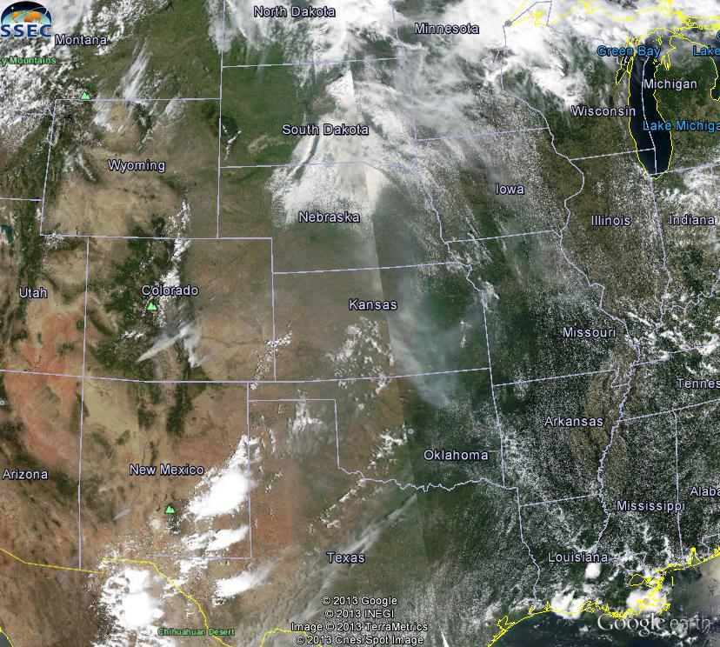
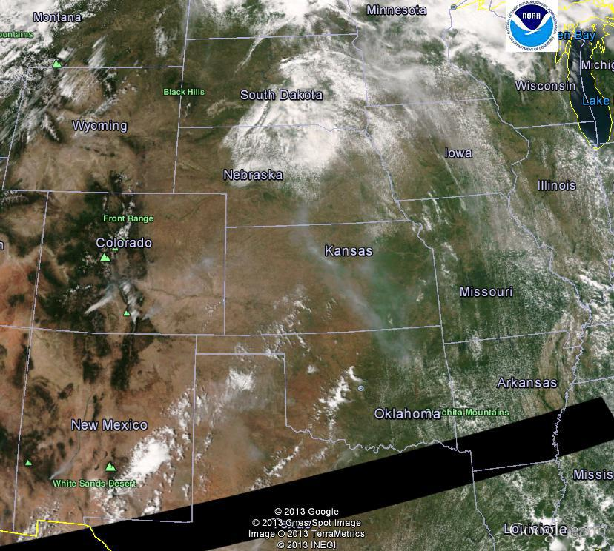
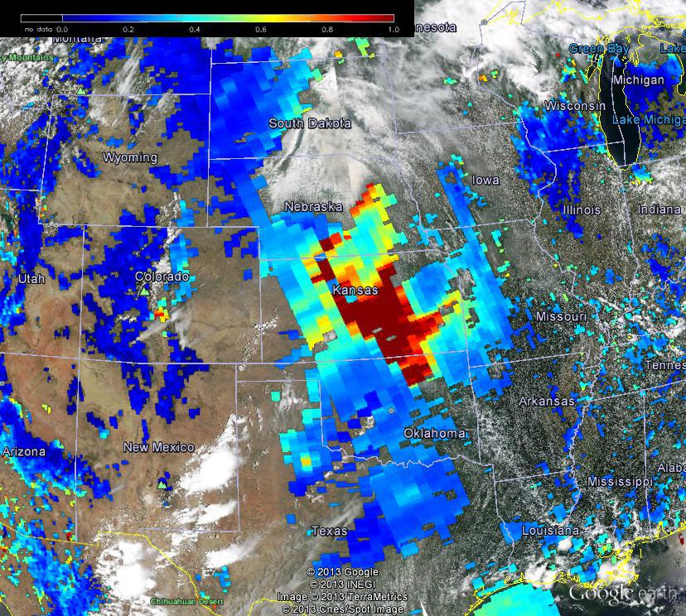
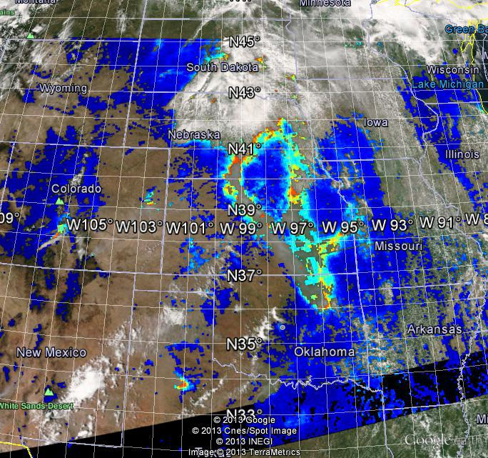
Example 2: 6/20/2013 Kansas smoke
MODIS Aqua RGB
VIIRS RGB
No AOT because the area is set as cirrus cloud by VIIRS cloud mask product
MODIS Aqua RGB & AOT
VIIRS RGB & EDR AOT (high quality)

Slide 19
Example 3: 8/23/2013 California fire
Aqua RGB & AOD
VIIRS RGB & EDR AOD high quality
Neither has retrieval over heavy smoke region
VIIRS retrieval identifies this area as ephemeral water

Slide 20
Display missing retrieval areas of VIIRS AOD
Use IP AOD, since pixels mask information are not in EDR AOD data
In addition to high quality IP AOD, also show AOD at pixels marked as
Soil dominated
Cirrus cloud
Ephemeral water

Slide 21
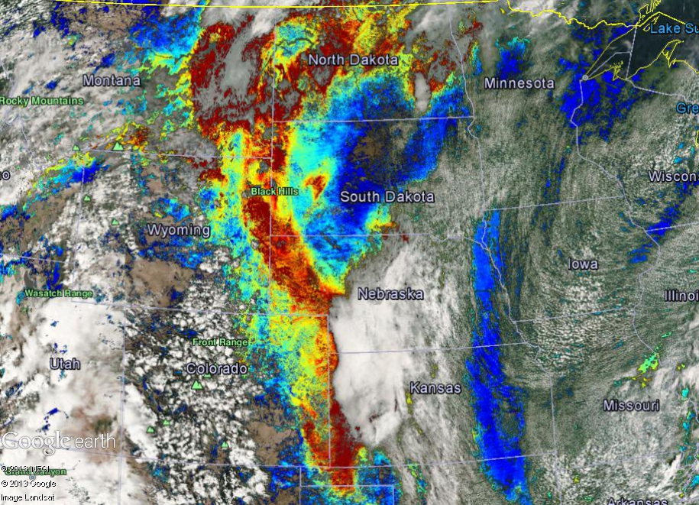
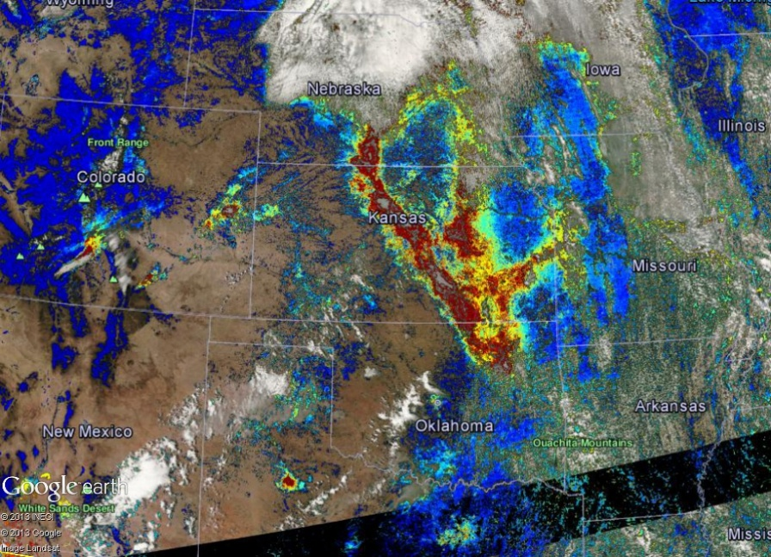
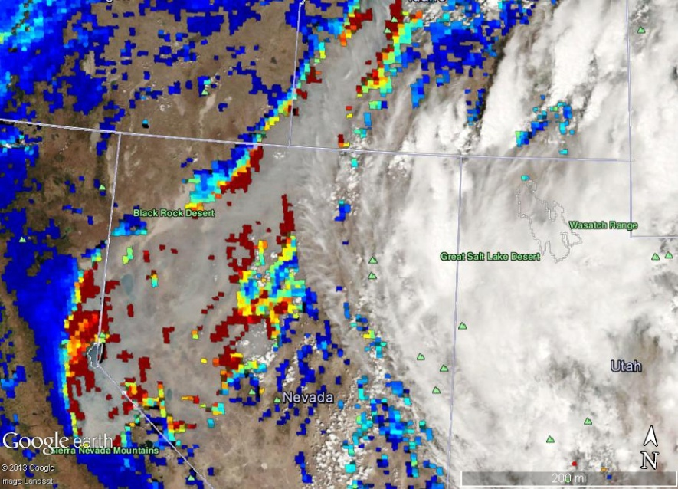
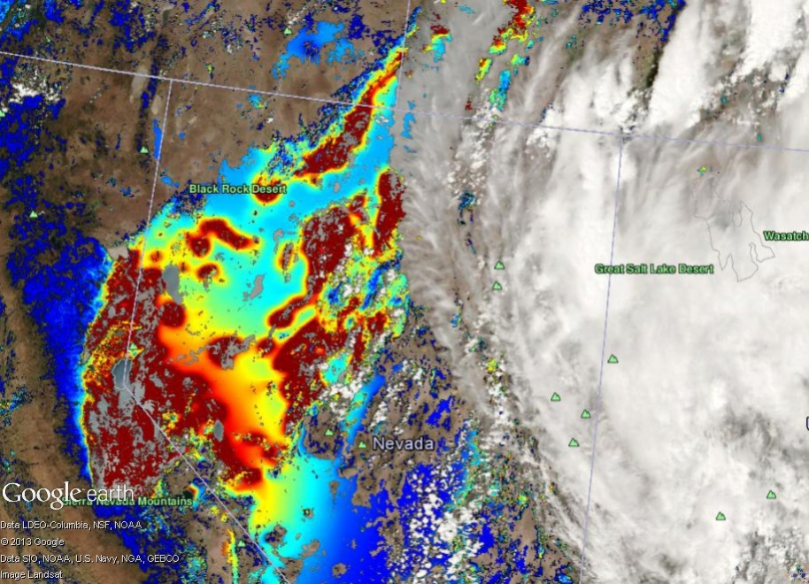
EDR AOD high quality
IP AOD for display
8/17/2013
smoke in central US
(soil dominated)
6/20/2013 Kansas smoke
(cirrus cloud)
8/23/2013 California fire
(ephemeral water)

Slide 22
Summary
Near-real-time MODIS, VIIRS aerosol and RGB images and analysis are available on IDEA
Comparing to AERONET AOD, VIIRS AOD has similar accuracy as MODIS AOD over CONUS
The data coverage may be different between MODIS and VIIRS due to the difference in screening algorithm
Modified IP AOD display to show missing retrievals in high quality EDR AOD

Slide 23
Acknowledgements
Liam Gumley and Kathy Strabala (University of Wisconsin Madison)
Direct broadcast VIIRS data over CONUS
Scott Macfarlane (Univ. of Alaska)
Direct broadcast VIIRS data over Alaska

