Slide 1
Logistics
No food in the auditorium.
Wi-fi available. Use “NOAA Guest” and open a browser. You will see a prompt for “email address”. Enter email address. No password required. Electrical outlets available.
Lunch is provided. In case you forgot your selection, you can find the list in your folder.
Bathrooms are located in the hallway.

Slide 2
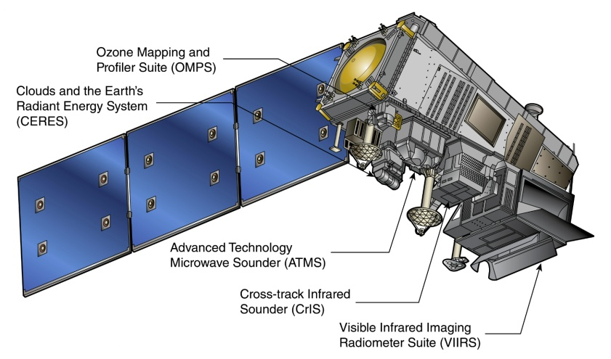
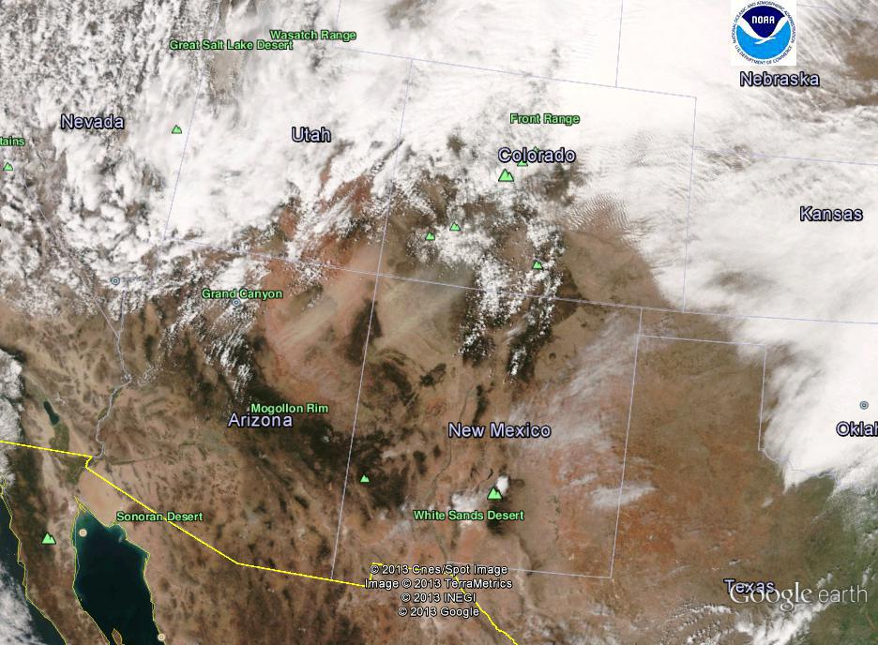
Suomi NPP VIIRS Aerosol Science and Operational User Workshop November 21-22, 2013
Shobha Kondragunta
NOAA/NESDIS Center for Satellite Applications and Research

Slide 3
Recent History
Mitch Goldberg talk (tomorrow) will provide a full overview of SNPP/JPSS programs
Will address questions on program direction etc.
STAR role and how we got to this point
Algorithm
Cal/val

Slide 4
Recent History
Name | Organization
Kurt F. Brueske | IIS/Raytheon
Ashley N. Griffin | PRAXIS, INC/NASA
Brent Holben | NASA/GSFC
Robert Holz | UW/CIMSS
Nai-Yung C. Hsu | NASA/GSFC
Ho-Chun Huang | UMD/CICS
Jingfeng Huang | UMD/CICS
Edward J. Hyer | NRL
John M. Jackson | NGAS
Shobha Kondragunta | NOAA/NESDIS
Istvan Laszlo | NOAA/NESDIS
Hongqing Liu | IMSG/NOAA
Min M. Oo | UW/CIMSS
Lorraine A. Remer | UMBC
Andrew M. Sayer | NASA/GESTAR
Hai Zhang | IMSG/NOAA
Cal/Val Team
NOAA Team

Slide 5
Recent History
Sid Jackson, Hongqing Liu, Istvan Laszlo, Shobha Kondragunta, Lorraine Remer, Jingfeng Huang, and Ho-Chun Huang, Suomi-NPP VIIRS aerosol algorithms and data products, JGR, in press, 2013
Hongqing Liu, Lorraine Remer, Jingfeng Huang, Ho-Chun Huang, Shobha Kondragunta, Istvan Laszlo, Min Oo, and Sid Jackson, Preliminary evaluation of Suomi NPP Aerosol Optical Thickness, JGR, in review, 2013
Pubu Ciren and Shobha Kondragunta, Dust Aerosol Index (DAI) algorithm for MODIS, JGR, in review, 2013

Slide 6
Workshop Objectives
Keep lines of communication open between product developers and operational users
Has been the theme for NOAA air quality proving ground (led by Ray Hoff and Amy Huff) over the last five years. Prepare the user for day 1.
Through this workshop, reach out to all users
VIIRS is a follow-on to MODIS and many science applications that need to transition to VIIRS once MODIS era ends

Slide 7
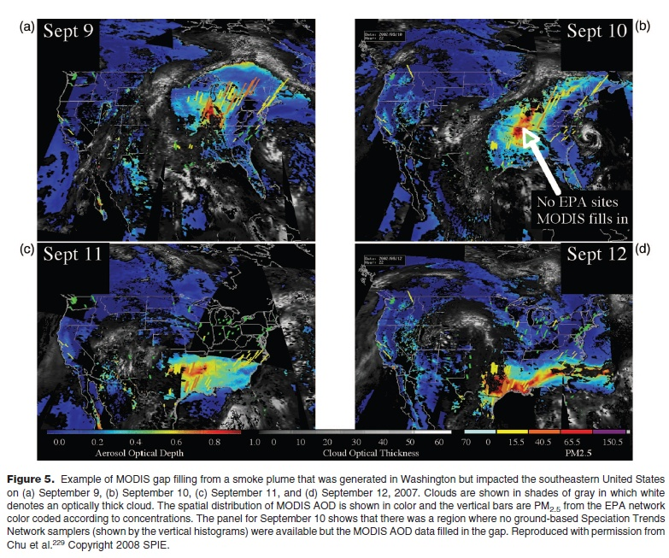
More than a decade’s worth of work has already been done…
Key Papers by:
Wang and Christopher, 2003
Chu et al., 2003
Engel-Cox et al., 2004
Liu et al., 2005
Al-Saadi et al., 2005
Gupta et al., 2006
Mathur, 2008
Kondragunta et al., 2009
Hoff et al., 2010
etc.
Hoff and Christopher, Remote sensing of particulate pollution: have we reached the promised land?, JAWMA, vol. 59, 2009

Slide 8
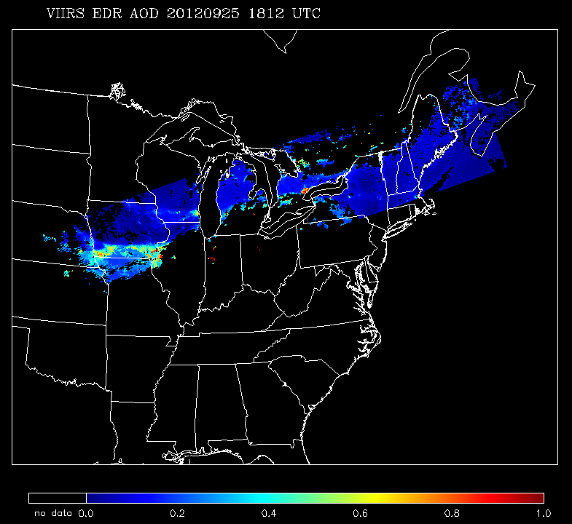
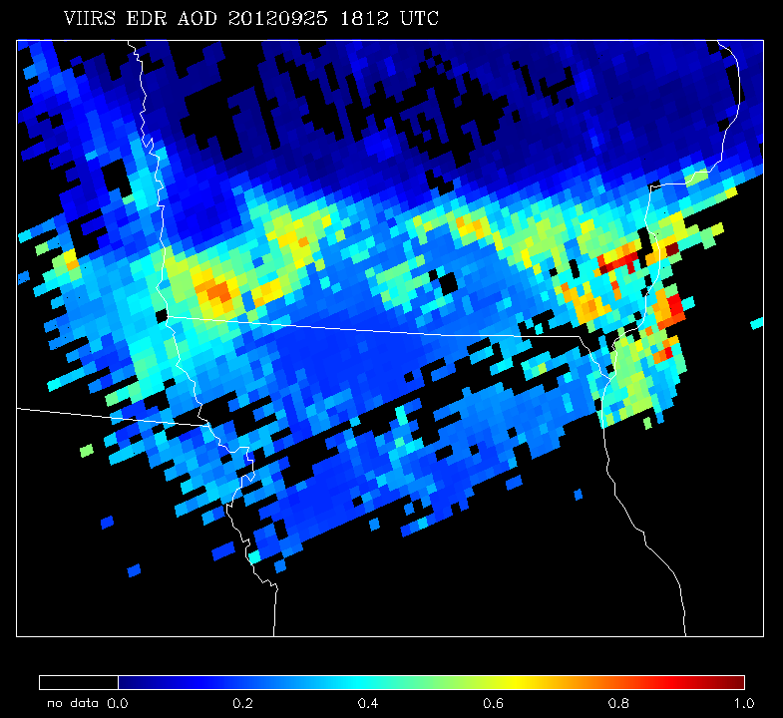
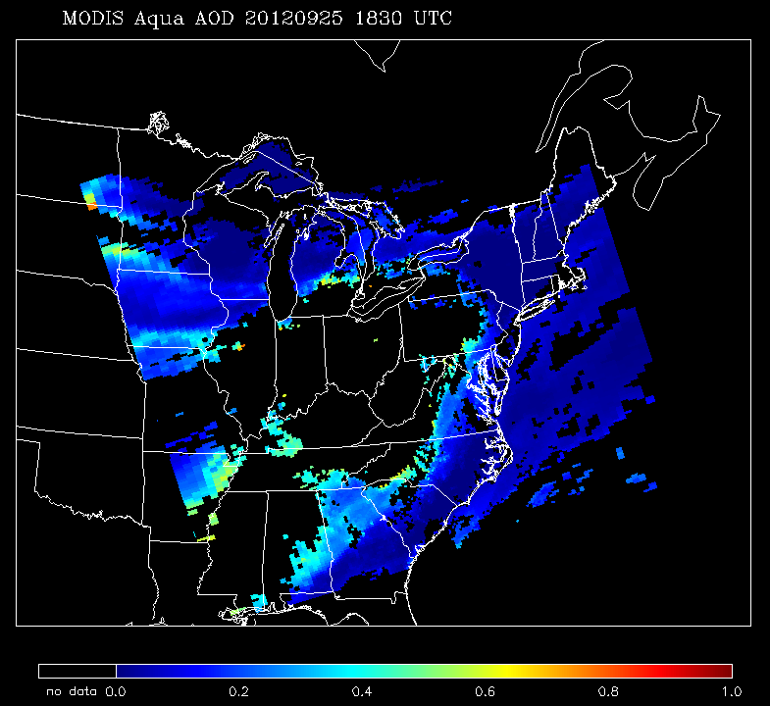
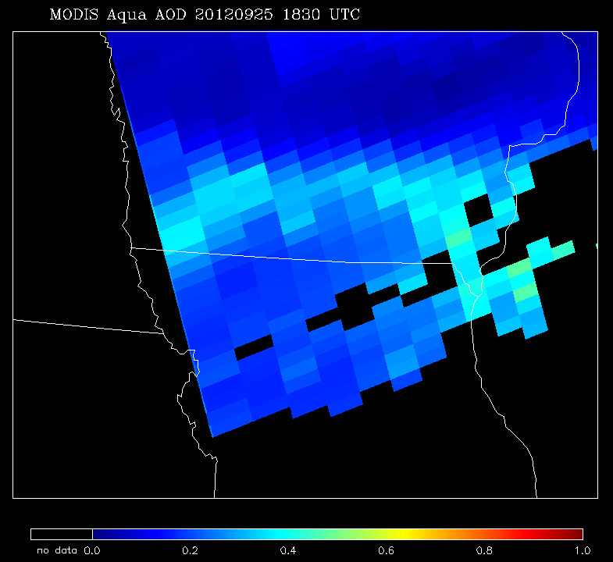
Is VIIRS a next generation instrument?
 | MODIS | VIIRS
Orbit altitude | 690 km | 824 km
Equator crossing time | 13:30 LT | 13:30 LT
Granule size | 5 min | 86 sec
swath | 2330 km | 3040 km
Pixel nadir | 0.5 km | 0.75 km
Pixel edge | 2 km | 1.5 km
EDR AOT Product nadir | 10 km | 6 km
EDR AOT Product EOS | 40 km | 12 km
VIIRS
MODIS
* Information applicable to current MODIS standard C5 products

Slide 9
Workshop Outcome
Capture the requirements/feedback from workshop participants
Implement feasible changes
Facilitate the use of VIIRS aerosol products for quantitative and qualitative use
Provide report to NOAA management
MODIS

Slide 10
Format
Day 1: reaching out to scientific community
Present details on algorithms, products, validation, and data access
Engage scientific community in open discussion about data needs, data formats, and data access
Day 2: reaching out to operational air quality community
Presentations from operational air quality community
Present details on IDEA web site including near real time access to various aerosol imagery
Case study breakout session and engage operational air quality community in open discussion about aerosol image formats etc.
Participants interested in downloading VIIRS data are welcome to use the breakout conference room to engage STAR members about VIIRS aerosol products and access. Hongqing Liu will gladly allow you to work hands-on with some data.

Slide 11
Movie prepared in collaboration with Dan Pisut, NOAA Environmental Visualization Lab

Slide 12
Movie prepared in collaboration with Dan Pisut, NOAA Environmental Visualization Lab

