Slide 1
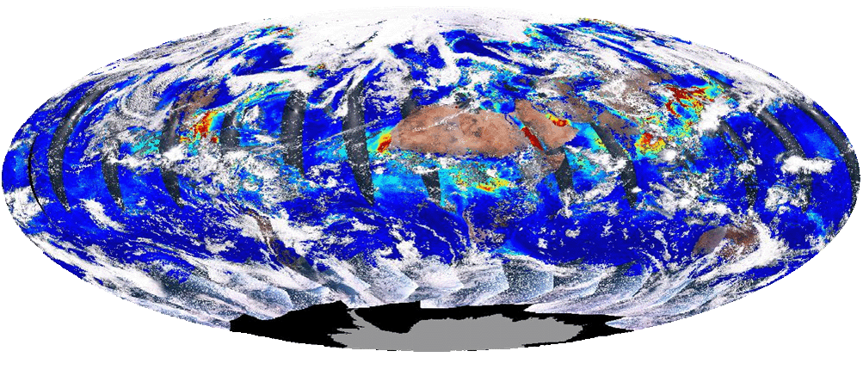
VIIRS Aerosol Optical Depth Algorithm and Products
Istvan Laszlo
NOAA
VIIRS Aerosol Science and Operational Users Workshop
November 21-22, 2013
National Center for Weather and Climate Prediction (NCWCP)
College Park, MD

Slide 2
VIIRS Aerosol Cal/Val Team
Name | Organization | Major Task
Kurt F. Brueske | IIS/Raytheon | Code testing support within IDPS
Ashley N. Griffin | PRAXIS, INC/NASA | JAM
Brent Holben | NASA/GSFC | AERONET observations for validation work
Robert Holz | UW/CIMSS | Product validation and science team support
Nai-Yung C. Hsu | NASA/GSFC | Deep-blue algorithm development
Ho-Chun Huang | UMD/CICS | SM algorithm development and validation
Jingfeng Huang | UMD/CICS | AOT Algorithm development and product validation
Edward J. Hyer | NRL | Product validation, assimilation activities
John M. Jackson | NGAS | VIIRS cal/val activities, liaison to SDR team
Shobha Kondragunta | NOAA/NESDIS | Co-lead
Istvan Laszlo | NOAA/NESDIS | Co-lead
Hongqing Liu | IMSG/NOAA | Visualization, algorithm development, validation
Min M. Oo | UW/CIMSS | Cal/Val with collocated MODIS data
Lorraine A. Remer | UMBC | Algorithm development, ATBD, liason to VCM team
Andrew M. Sayer | NASA/GESTAR | Deep-blue algorithm development
Hai Zhang | IMSG/NOAA | Algorithm coding, validation within IDEA

Slide 3
Outline
VIIRS instrument
Aerosol algorithm
  history
  over-land algorithm
  over-ocean algorithm
VIIRS vs. MODIS algorithm
VIIRS aerosol products
Summary

Slide 4
VIIRS
Band name | Wavelength (nm) | Bandwidth (nm) | Use in algorithm
M1* | 412 | 20 | L
M2* | 445 | 14 | L
M3* | 488 | 19 | L, TL TO
M4* | 555 | 21 | TO
M5* | 672 | 20 | L, O, TO
M6 | 746 | 15 | O
M7* | 865 | 39 | O, TL
M8 | 1,240 | 27 | O, TL, TO
M9 | 1,378 | 15 | TL
M10 | 1,610 | 59 | O, TL, TO
M11 | 2,250 | 47 | L, O, TL, TO
M12 | 3,700 | 191 | TL
M13 | 4,050 | 163 | none
M14 | 8,550 | 323 | none
M15 | 10,763 | 989 | TL, TO
M16 | 12,016 | 864 | TT, TO
Visible Infrared Imaging Radiometer Suite (VIIRS)
cross-track scanning radiometer with ~3000 km swath – full daily sampling
7 years lifetime
22 channels (412-12,016 nm)
  16 of these are M bands with 0.742 x 0.776 km nadir resolution
  aerosol retrieval is from M bands
high signal-to-noise ratio (SNR):
  M1-M7: ~200-400
  M8-M11: ~10-300
2% absolute radiometric accuracy
single look
no polarization
*dual gain, L: land, O: ocean; T: internal test

Slide 5
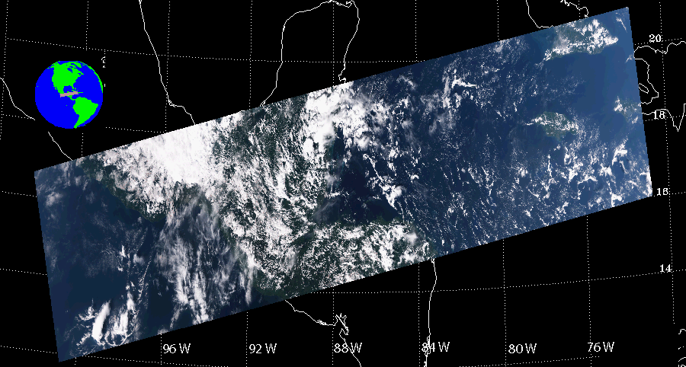
VIIRS (cont)
Sensor Data Records (SDRs), converted from raw VIIRS data (RDR), are used in the VIIRS aerosol algorithm
Processing is on a granule by granule basis
  VIIRS granule typically consists of 768 x 3200 (along-track by cross-track) 0.75-km pixels
Example VIIRS granule, 11/02/2013, 19:05 UTC
RGB image

Slide 6
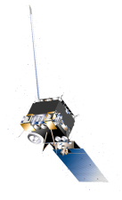
Aerosol Retrieval – Physical Basis
The satellite-observed reflectance (ρ_{toa}) is the sum of atmospheric (ρ_{atm}) and surface components (ρ_{srf}) .
The components are the result of reflection, scattering by molecules and aerosols and absorption by aerosols and gases.
The aerosol portion of the atmospheric component (aerosol reflectance) carries information about aerosol.
The aerosol reflectance is determined by the amount and type (size, shape and chemical composition) of aerosol.

Slide 7
VIIRS Aerosol Algorithm (1)
Separate algorithms used over land and ocean
Algorithm heritages
  over land: MODIS atmospheric correction
  over ocean: MODIS aerosol retrieval
The VIIRS aerosol algorithm is similar but NOT identical to the above MODIS algorithms
Many years of development work:
  Initial science version is by Raytheon
  Updates and modifications by NGAS
  Current Cal/Val Team is to maintain, evaluate and improve the algorithm

Slide 8
VIIRS Aerosol Algorithm (2)
AOT and aerosol model is simultaneously retrieved using reflected solar radiation in multiple VIIRS bands and ancillary data.
Optimal solution is searched for that best matches theoretical and observed reflectances.
  iteration through increasing values of AOT and candidate aerosol models
Must account for all important radiative processes
  molecular scattering, aerosol scattering and absorption, gas absorption, and surface reflection.
Approach in the vector RT Second Simulation of the Satellite Signal in the Solar Spectrum (6S-V1.1) [Kotchenova and Vermote, 2007] is adopted.
(1)
ρ_{R+A}, T_{R+A}, S_{R+A} are pre-calculated by 6S and stored in LUT; T_{g}s are parameterized.

Slide 9
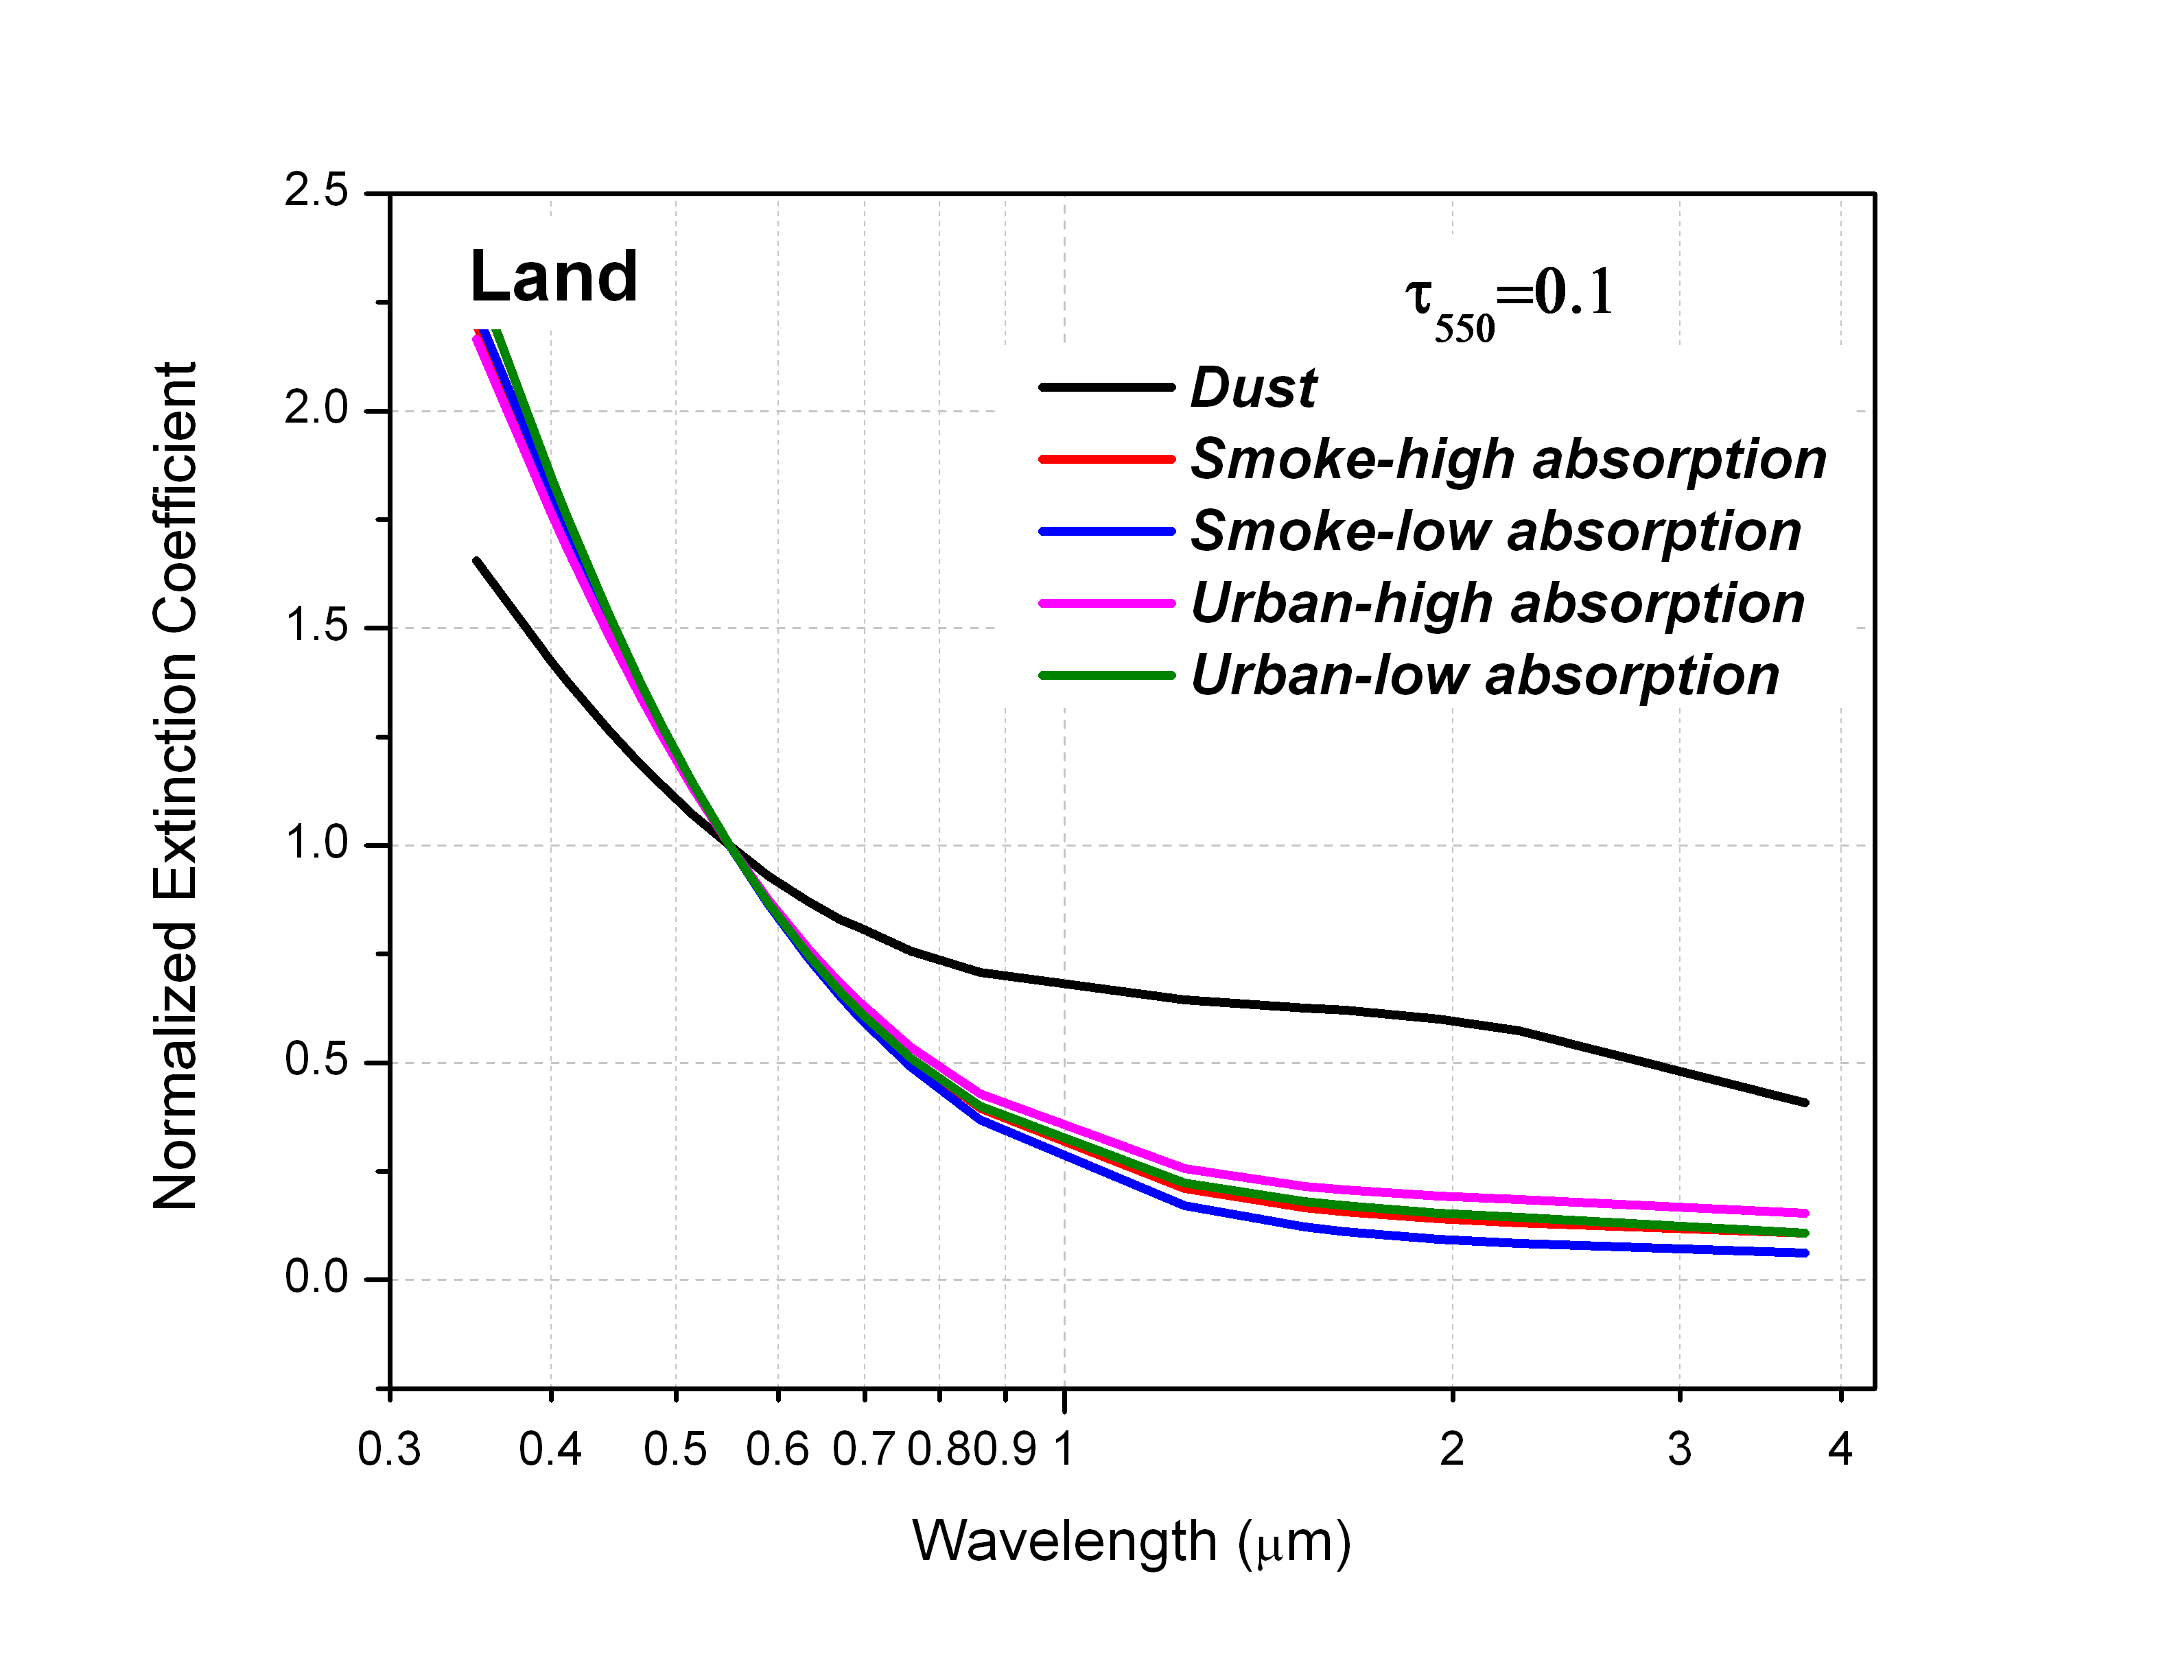
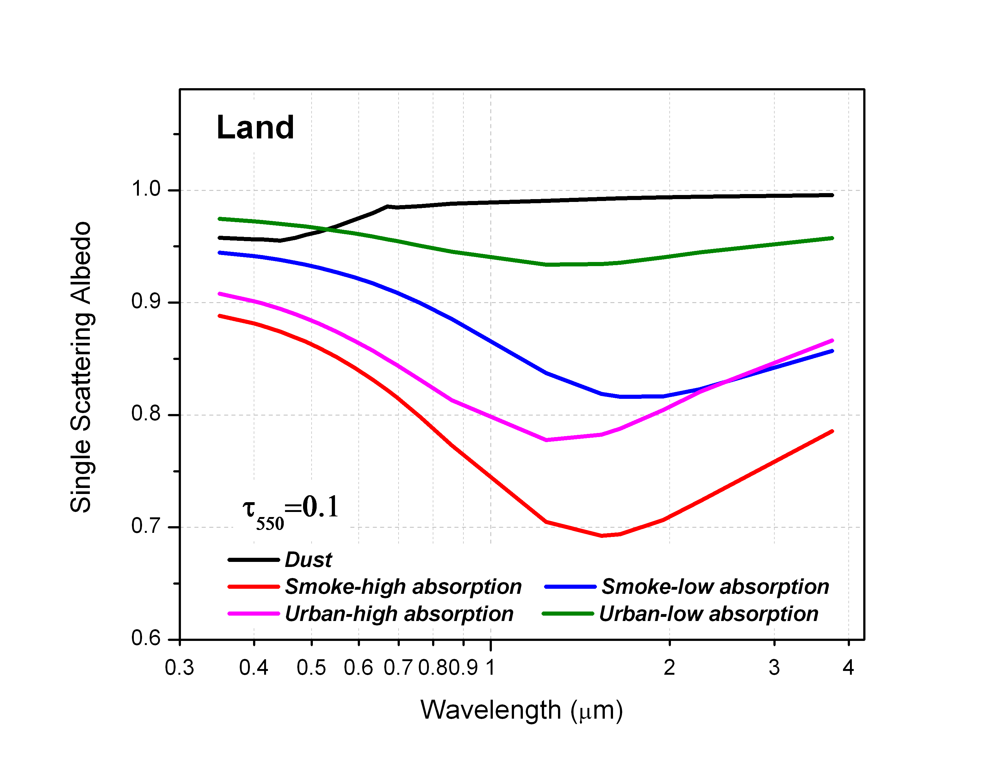
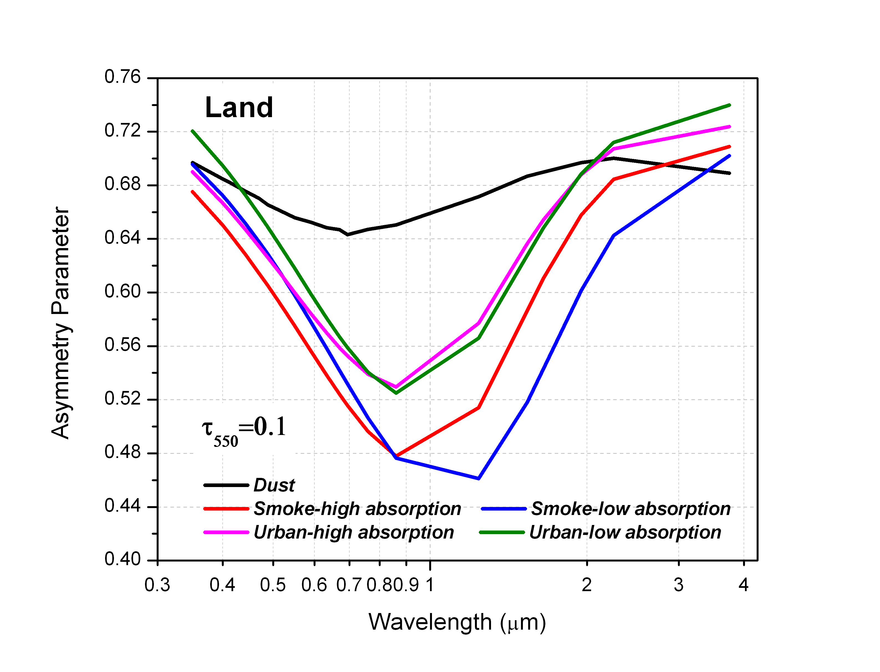
Over Land Retrieval
Atmospheric correction of reflectances [Vermote and Kotchenova, 2008]
  AOT and aerosol model are by-products of surface reflectance retrieval
Basis: aerosols change the ratios of spectral reflectances (spectral contrast) from those of the surface values.
AOT and aerosol model are the ones that provide the best match between ratios of surface reflectances retrieved in multiple channels and their expected values.
  Expected ratios are derived empirically by atmospherically correcting VIIRS TOA M-band reflectances using AERONET AOT (99 sites, ~60,000 matchups).
Eq. (1) is solved for ρ_{surf} assuming Lambertian reflection.
5 aerosol models [Dubovik et al. 2002]:
  dust
  smoke (high and low absorption)
  urban (clean & polluted)
  bimodal lognormal size distribution, function of AOT, spherical particles

Slide 10
Over Land Retrieval (2)
Surface + aerosol reflectance changes with increasing AOT.
  Surface: green vegetation
  Atmosphere:
    aerosol: urban clean
    Rayleigh: no
    Gas absorption: no
  SZA=0°, VZA=30°, RAZ=20°
Normalized spectral reflectance (“spectral shape”) also changes with increasing AOT.

Slide 11
Over Land Retrieval (3)
AOT is retrieved by marching through AOTs in LUT until the retrieved M3 surface reflectance is close to the one expected from the retrieved M5 value.
Aerosol model: urban-polluted

Slide 12
Over Land Retrieval (4)
0=dust; 1=smoke-high abs.; 2=smoke-low abs.;
3=urban-clean; 4=urban polluted

Slide 13
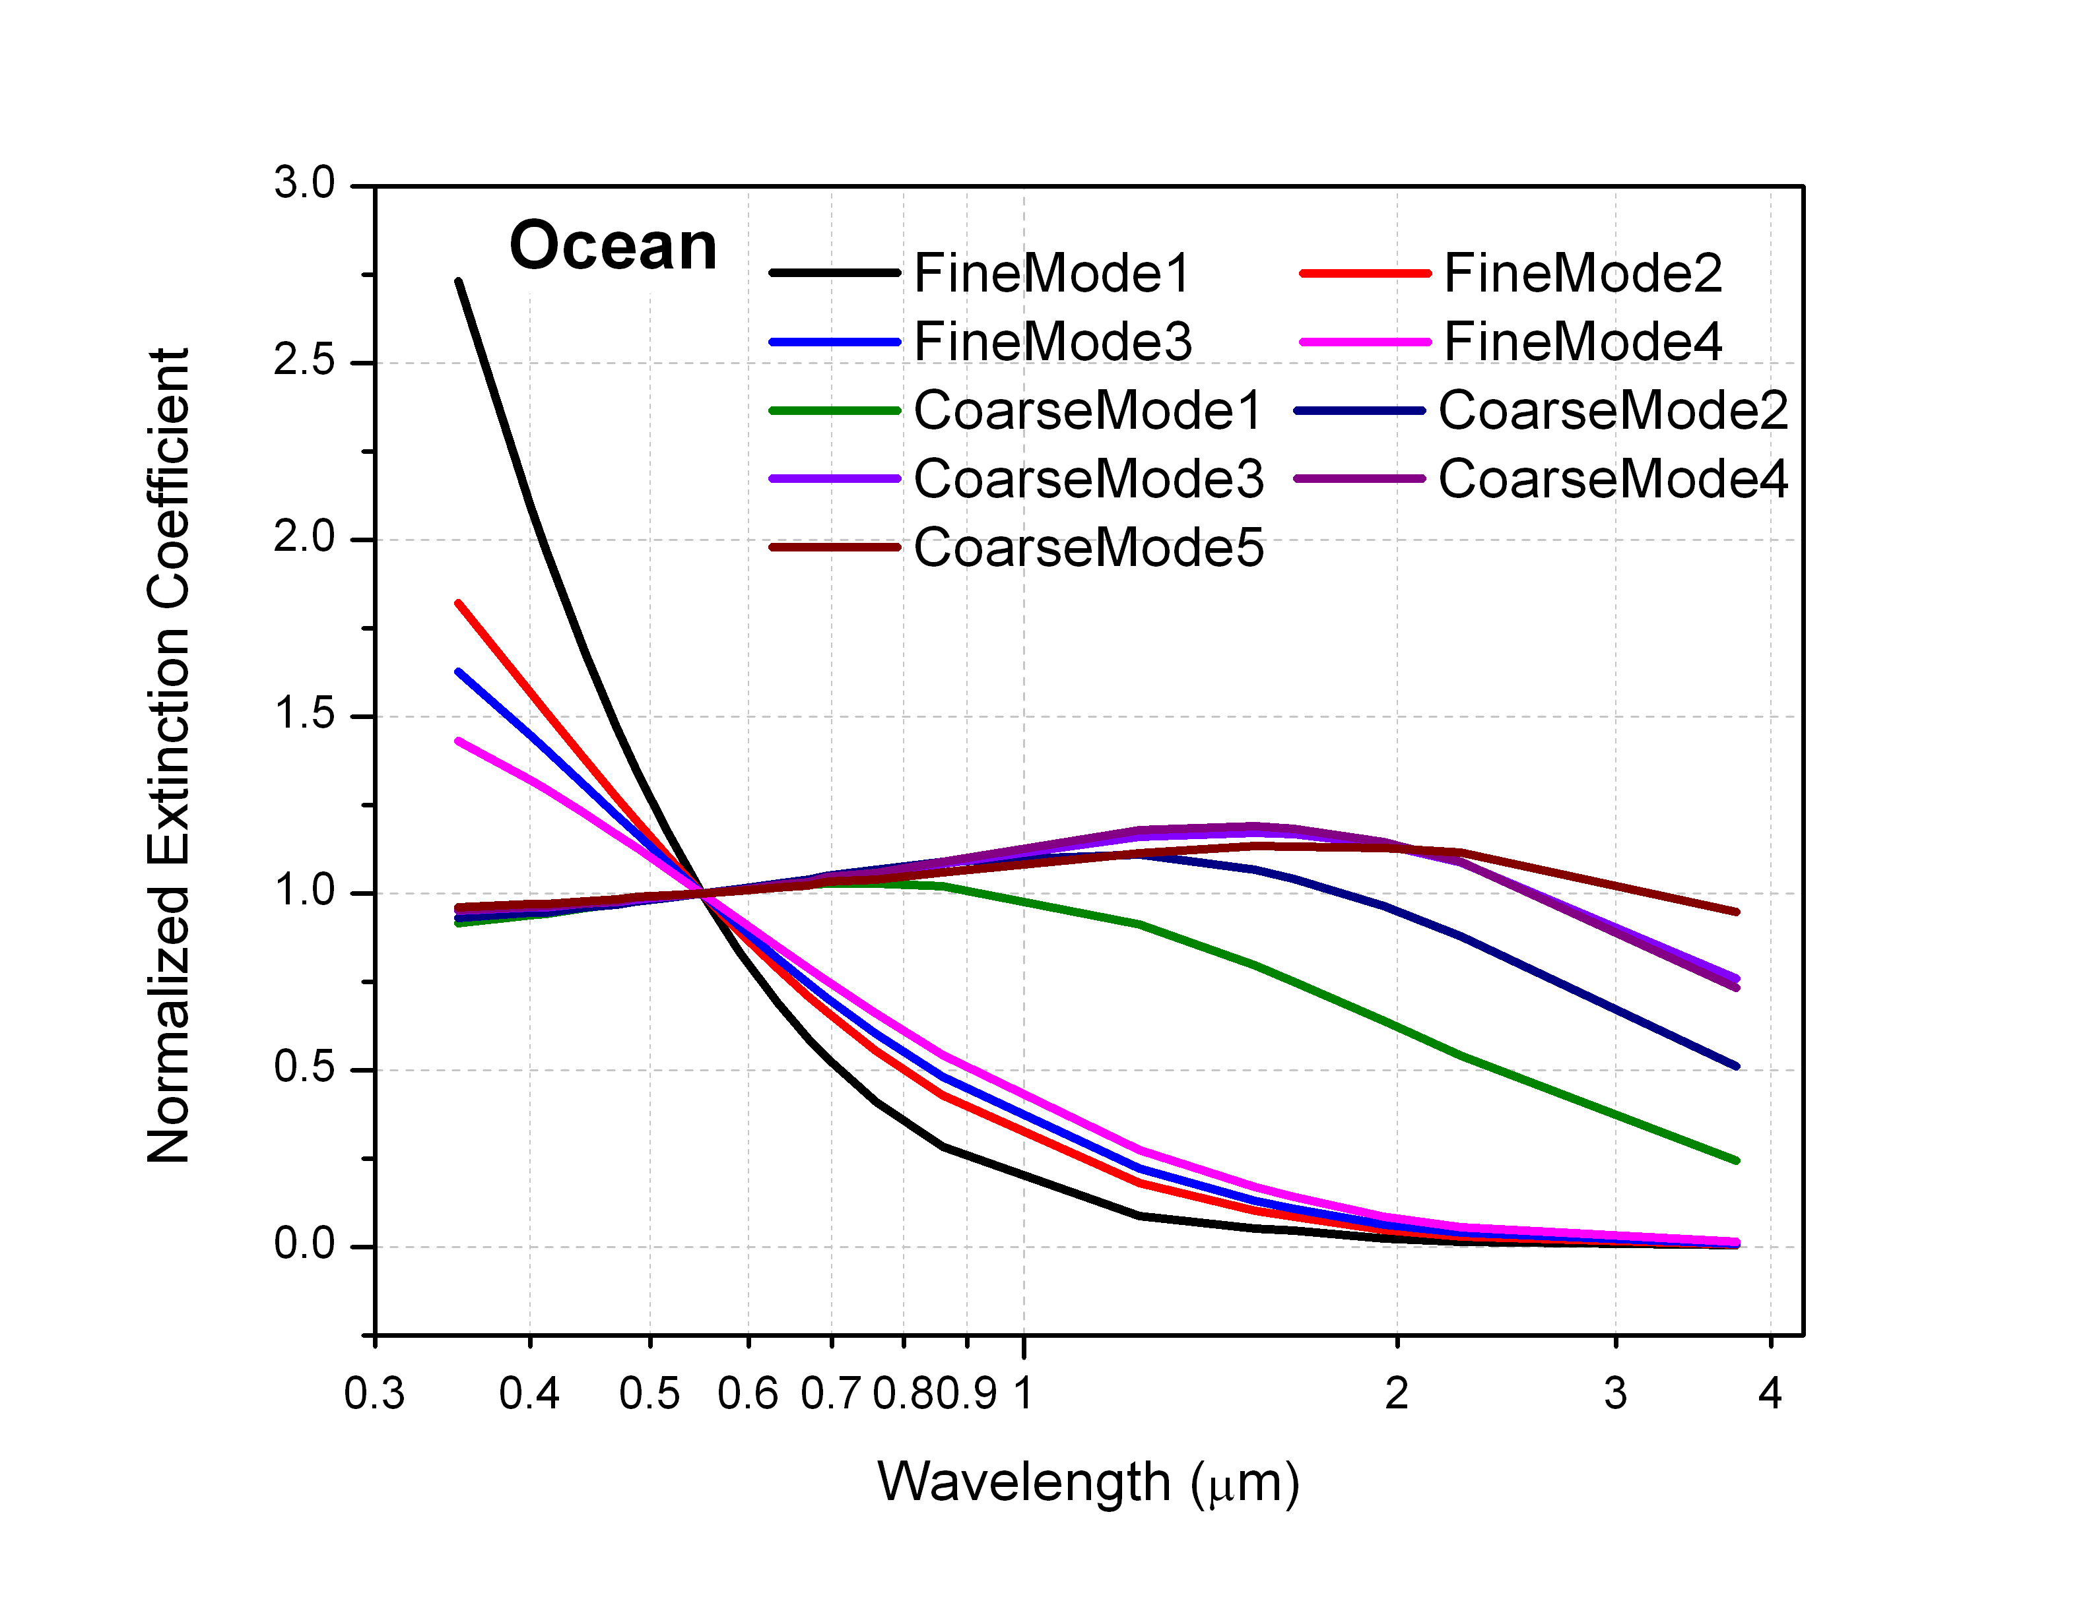
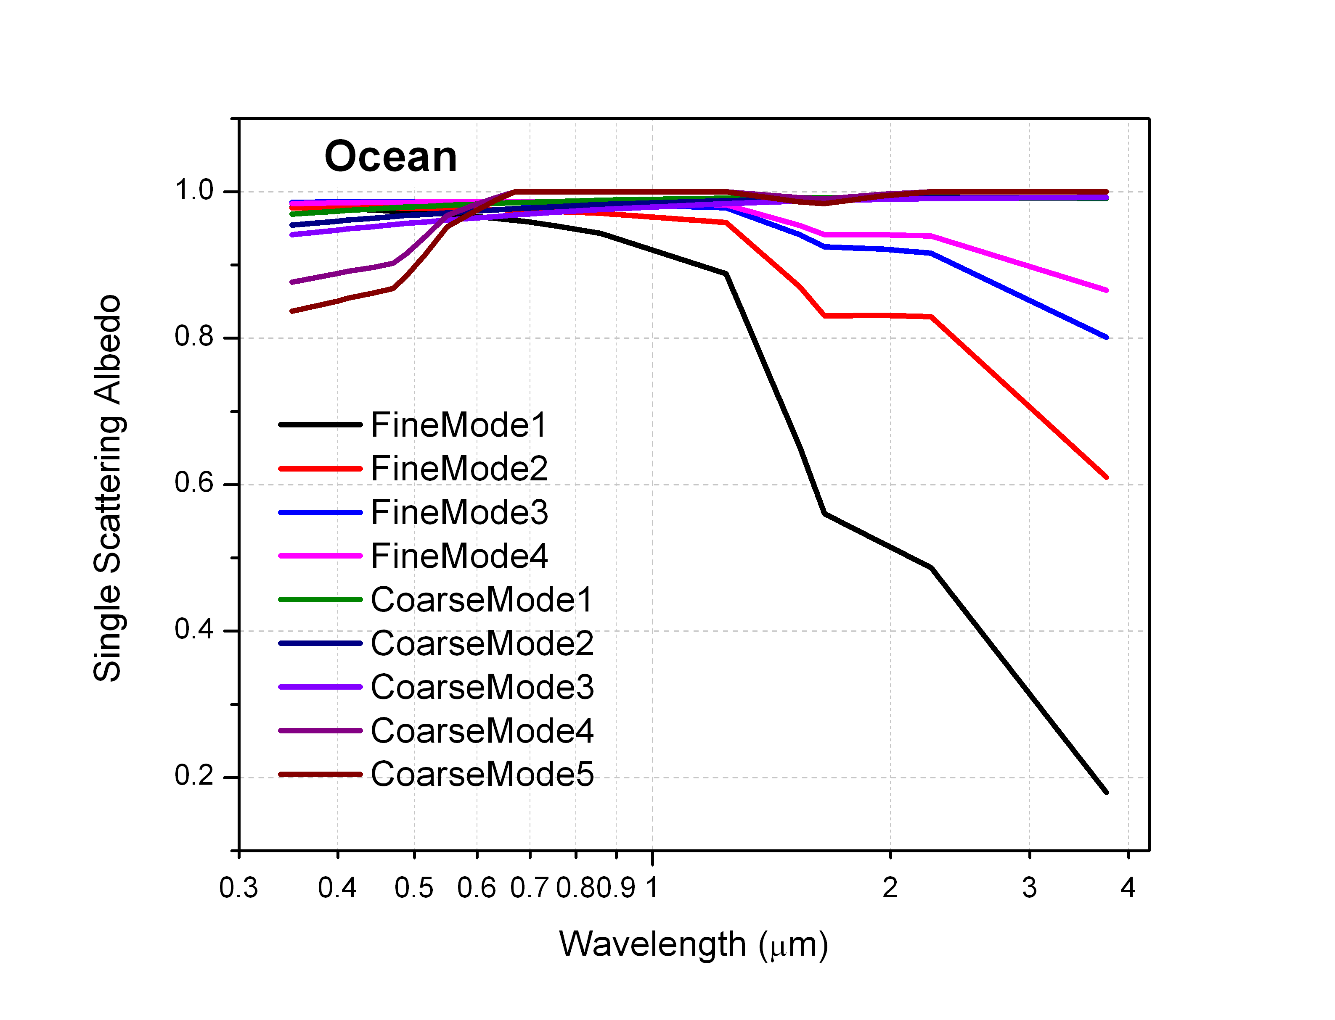
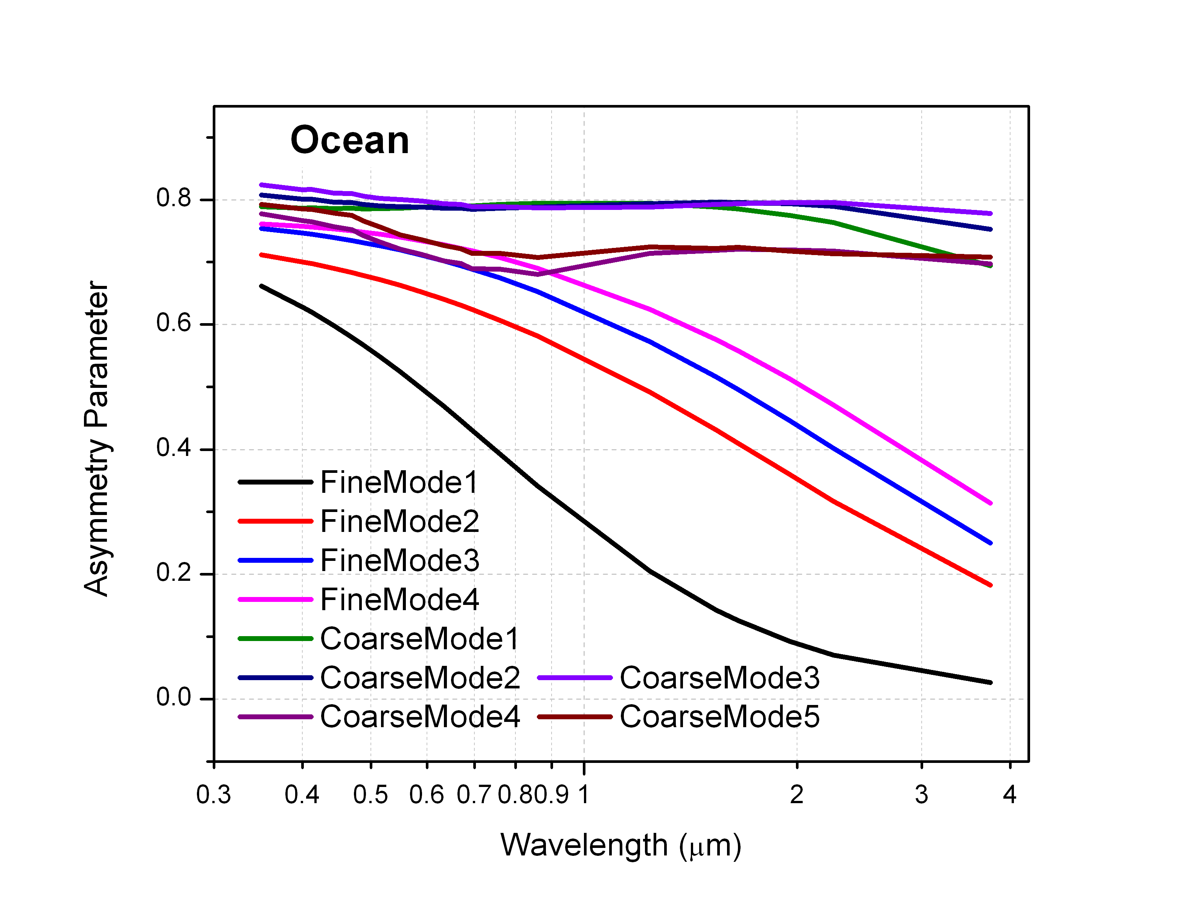
Over Ocean Retrieval
Close adaptation of the MODIS approach [Tanré et al., 1997]
  search for AOT and aerosol model that most closely reproduces the VIIRS-measured TOA reflectance in multiple bands.
  wind-dependent (speed and direction) ocean surface reflectance is calculated analytically.
    Accounts for water-leaving radiance (Lambertian, fixed pigment concentration), whitecap (Lambertian, wind-speed dependent) and specular reflection (dependent on wind speed and direction).
  Combines 5 fine mode and 4 coarse mode models with 0.01 increments in fine mode fraction (2020 models)
  TOA reflectances in selected M bands are calculated from Eq. 1 and compared to observed ones to retrieve AOT and aerosol model simultaneously.

Slide 14
Over Ocean Retrieval
  AOT for a given aerosol model is from matching calculated and observed M7 TOA reflectances.
  Retrieved AOT is used to calculate TOA reflectances in other channels.

Slide 15
Over Ocean Retrieval (2)

Slide 16
Pixel Selection & Quality Flags
Condition | Quality Flag |  |  | Applies to |  | Detected by
 | Not Produced | Excluded | Degraded | Land | Ocean | VCM | Internal Tests
Invalid SDR data | X |  |  | X | X |  | X
Cloud Contamination | X |  |  | X | X | X
Sun Glint | X |  |  | X | X | X | X
Snow/Ice | X |  |  | X | X | X | X
Fire | X |  |  | X |  | X | X
Bright Surface | X |  |  | X |  |  | X
Coastal or Inland Water | X |  |  |  |  | X
Turbid Water | X |  |  |  | X |  | X
Ephemeral Water | X |  |  | X |  |  | X
SolZA ≥ 80° | X |  |  | X | X |  | X
Out of Spec Range |  | X |  | X | X |  | X
Cloud Adjacency |  |  | X | X | X |  | X
Cloud Shadow |  |  | X | X | X | X
Cirrus |  |  | X | X | X | X | X
Soil Dominated |  |  | X | X |  |  | X
65° ≤ SolZA < 80° |  |  | X | X | X |  | X
Large Retrieval Residual |  |  | X | X | X |  | X

Slide 17
Planned Enhancements
Replace current fixed surface reflectance relationships with NDVI-dependent relationships.
Extend AOT reporting range from 2 to 5.
Update ocean aerosol models with those from MODIS algorithm.
Improve cloud/heavy-aerosol discrimination, snow/ice detection; add spatial variability internal test.
Add Deep-Blue module (Hsu & Sayer) to extend retrievals over bright surfaces.

Slide 18
VIIRS vs. MODIS
 | VIIRS | MODIS
Algorithm (general)
Main source of data screening | External VCM | Internal tests
Aggregation on | Outputs | Inputs
Residual calculated as | Absolute difference | Relative difference
Over-ocean algorithm
Channel used | 0.67, 0.74, 0.86, 1.24, 1.61, 2.25 µm | 0.55, 0.66, 0.86, 1.24, 1.61, 2.12 µm
Surface reflection | Non-lambertian, function of wind speed and direction | Lambertian, independent on wind (will change in C6)
Aerosol model | Combination of fine and coarse modes | Combination of fine and coarse modes
Match to | TOA reflectances | TOA reflectances
Retrieval over inland water | No | Yes
Over-land algorithm
Channel used | 0.41, 0.44, 0.48, 0.67, 2.25 µm | 0.47, 0.66, 2.12 µm
Aerosol model | Select one from five pre-defined models | Mix two assigned fine and coarse mode dominated models
Spectral surface reflectance | Constant ratios of 0.41, 0.44, 0.48, 2.25 µm over 0.67 µm (will depend on NDVI) | Linear relationship between 0.66 and 2.12 µm as a function of NDVI and scattering angle; constant linear relationship between 0.47 and 0.66 µm
Match to | Surface reflectances | TOA reflectances

Slide 19
VIIRS vs. MODIS (cont)
 | VIIRS | MODIS
Products
Nominal spatial resolution | 0.75 km (IP) 6 km (EDR) | 10 km (C5) 3 km (C6)
Granule size | 86 seconds | 5 minutes
AOT range | [0, 2] (will change) | [-0.05, 5]
Main product land | Spectral AOT | Spectral AOT
Main product ocean | Spectral AOT Ångström exponent | Spectral AOT Fine mode fraction
Orbit
Orbit altitude | 824 km | 690 km
Equator crossing time | 13:30 UTC | 13:30 UTC (Aqua)
Swath width | 3000 km | 2300 km
Pixel resolution (nadir) | 0.75 km | 0.5 km
Pixel resolution (swath edge) | 1.5 km | 2 km

Slide 20
Sensor and Other Inputs
VIIRS M-band SDRs (reflectances)
  M1-M12, M15, M16, and quality flags
Solar and view geometry
  zenith and azimuth angles
VIIRS Cloud Mask (VCM)
  pixel cloud flag (clear/cloudy, probably clear/cloudy), cloud shadow, land/water, snow/ice, fire, sunglint, heavy aerosol, volcanic ash
NCEP GFS data (backup:FNMOC/NAVGEM)
  Water vapor, ozone, surface pressure, winds (speed and direction)
Navy Aerosol Analysis and Prediction System (NAAPS) aerosol data
  used for filling in missing VIIRS IP retrievals

Slide 21
VIIRS Aerosol Products (1)
Aerosol Optical Thickness (AOT)
  for 11 wavelengths (10 M bands + 550 nm)
APSP (Aerosol Particle Size Parameter)
  Ångström Exponent derived from AOTs at M2 (445 nm) and M5 (672 nm) over land, and M7 (865 nm) and M10 (1610 nm) over ocean
  qualitative measure of particle size
  over-land product is not recommended!
Suspended Matter (SM)
  classification of aerosol type (dust, smoke, sea salt, volcanic ash) and smoke concentration
  currently, derived from VIIRS Cloud Mask (volcanic ash) and aerosol model identified by the aerosol algorithm
Only day time and over dark land and non-sunglint ocean

Slide 22
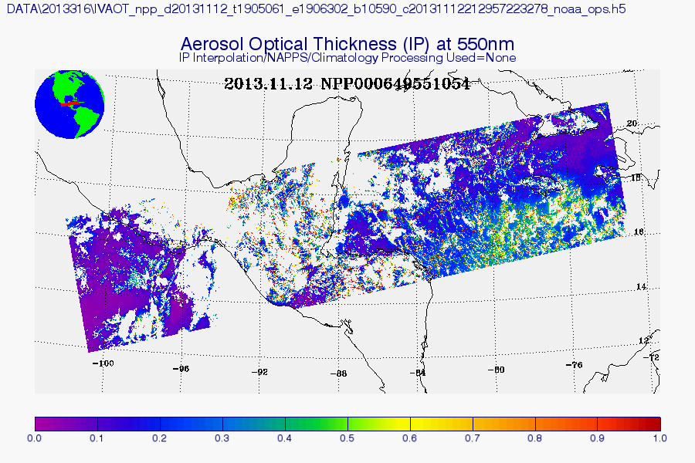
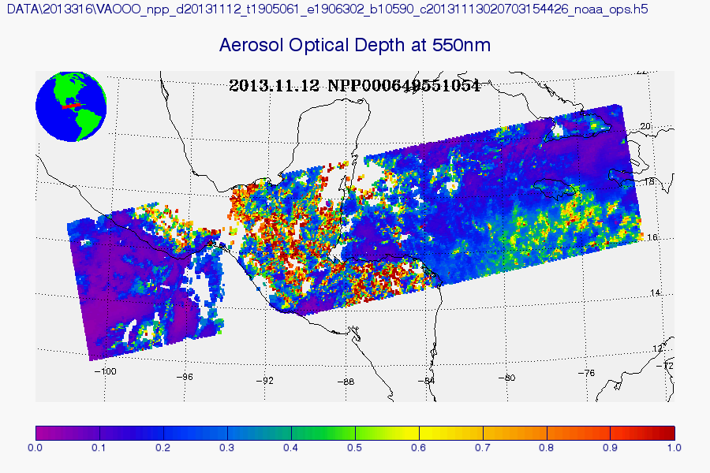
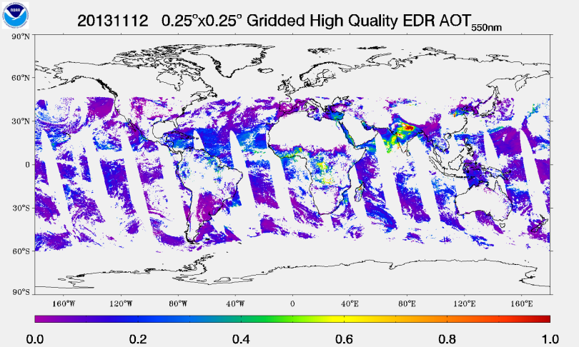
VIIRS Aerosol Products (2)
At NOAA Comprehensive Large Array-data Stewardship System (CLASS):
Intermediate Product (IP)
  0.75-km pixel
    AOT
    APSP
    AMI (Aerosol Model Information)
      land: single aerosol model
      ocean: indexes of fine and coarse modes and fine mode fraction
    quality flags
Environmental Data Record (EDR)
  6 km aggregated from 8x8 IPs filtered by quality flags
    granule with 96 x 400 EDR cells
    AOT
    APSP
    quality flags
  0.75 km
    SM
At NOAA/NESDIS/STAR
  Gridded 550-nm AOT EDR
    regular equal angle grid: 0.25°x0.25° (~28x28 km)
    only high quality AOT EDR is used

Slide 23
Summary
Algorithm documents
  Jackson, J., H. Liu, I. Laszlo, S. Kondragunta, L. A. Remer, J. Huang, H-C. Huang, 2013: Suomi-NPP VIIRS Aerosol Algorithms and Data Products, J. Geophys. Res. doi: 10.1002/2013JD020449
  ATBD (Draft)
  OAD
Product documents
  User’s Guide
  Readme files
VIIRS Aerosol Calibration and Validation website http://www.star.nesdis.noaa.gov/smcd/emb/viirs_aerosol/index.php

Slide 24
Summary (cont.)
Product quality:
  Liu, H., L. A. Remer, J. Huang, H-C. Huang, S. Kondragunta, I. Laszlo, M. Oo, J. M. Jackson, 2013: Preliminary Evaluation of Suomi-NPP VIIRS Aerosol Optical Thickness, J. Geophys. Res. (in review)
  Hongqing Liu: VIIRS Aerosol Products, Data Quality, and Visualization Tools (VIIRS Aerosol Science and Operational Users Workshop , November 21-22, 2013, College Park, MD)
Link to CLASS:
  http://www.class.ncdc.noaa.gov/saa/products/welcome
Link to gridded data:
  http://www.star.nesdis.noaa.gov/smcd/emb/viirs_aerosol/products_gridded.php

Slide 25
Backup

Slide 26
AOT Product Timeline
Products go trough various levels of maturity:
Initial instrument check out; Tuning cloud mask parameters | Beta status | Error | Beta status | Provisional status
28 Oct 2011
2 May 2012
15 Oct 2012
28 Nov 2012
23 Jan 2013
Red period: | Product is not available to public, or product should not be used.
Blue period: (Beta) | Product is available to public, but it should be used with caution, known problems, frequent changes.
Green period: (Provisional) | Product is available to public; users are encouraged to evaluate.
26

