Slide 1
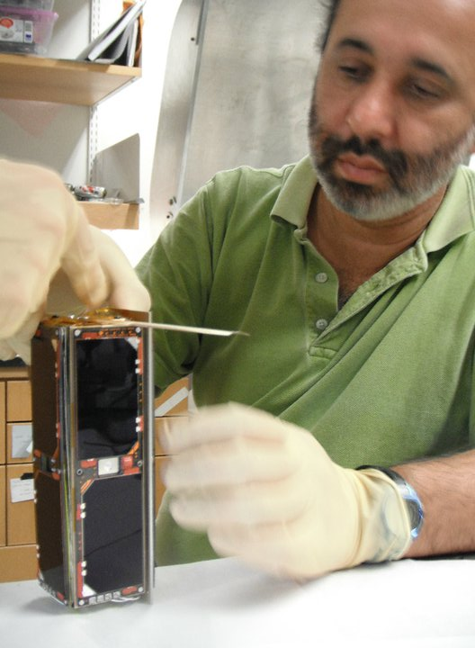
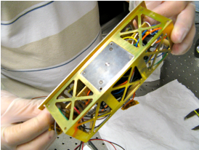
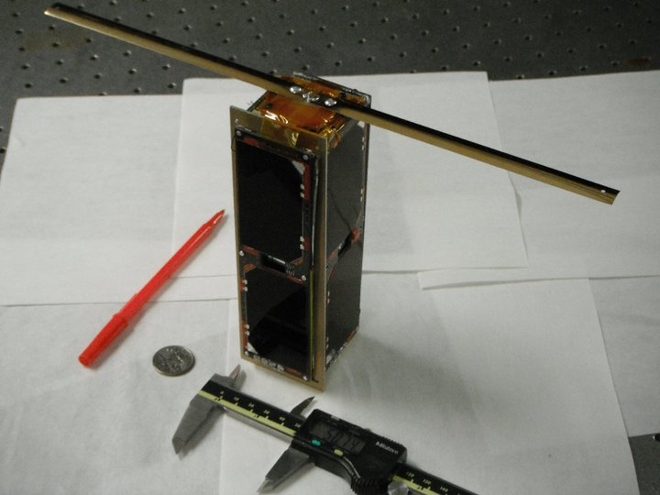
UMBC’s first space satellite, Qubescout was launched this morning 2:10 am EST on a Russian rocket!
PI: J. Vanderlei Martins
Head engineer: J. Dominik Cieslak

Slide 2
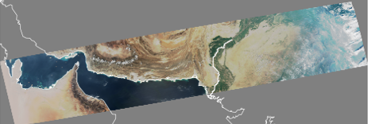
Global Case Studies of VIIRS Aerosol Products and Data Access
Lorraine Remer, UMBC
And the VIIRS Cal/Val Team

Slide 3
http://www.star.nesdis.noaa.gov/smcd/emb/viirs_aerosol/products_gridded.php
Search on Google:
NOAA STAR gridded VIIRS data

Slide 4
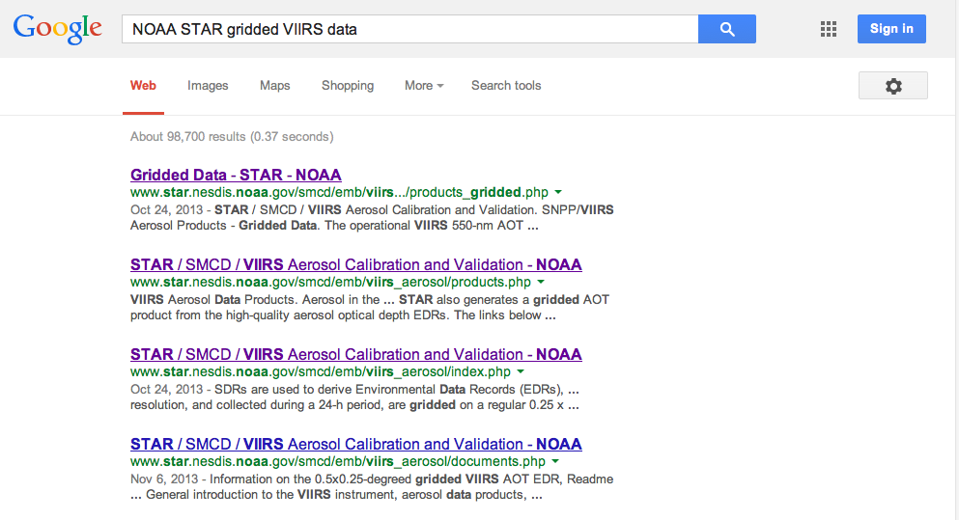
http://www.star.nesdis.noaa.gov/smcd/emb/viirs_aerosol/products_gridded.php

Slide 5
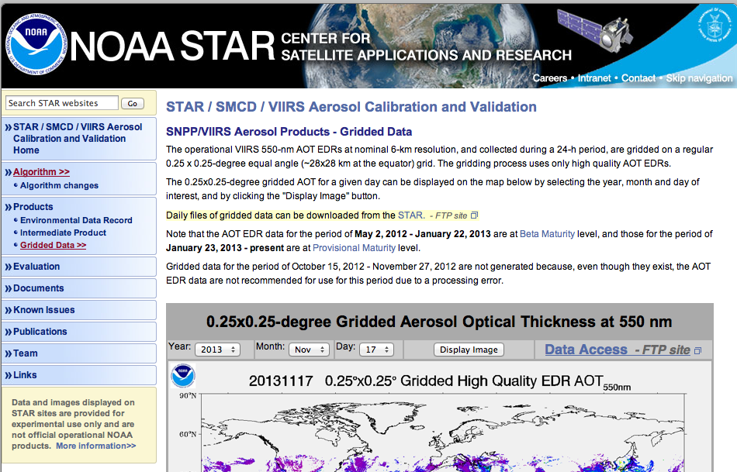

Slide 7
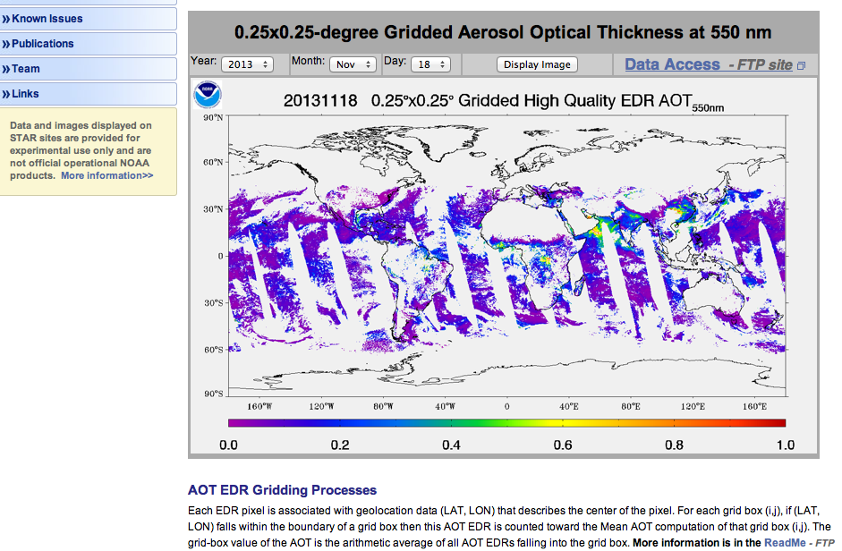

Slide 10
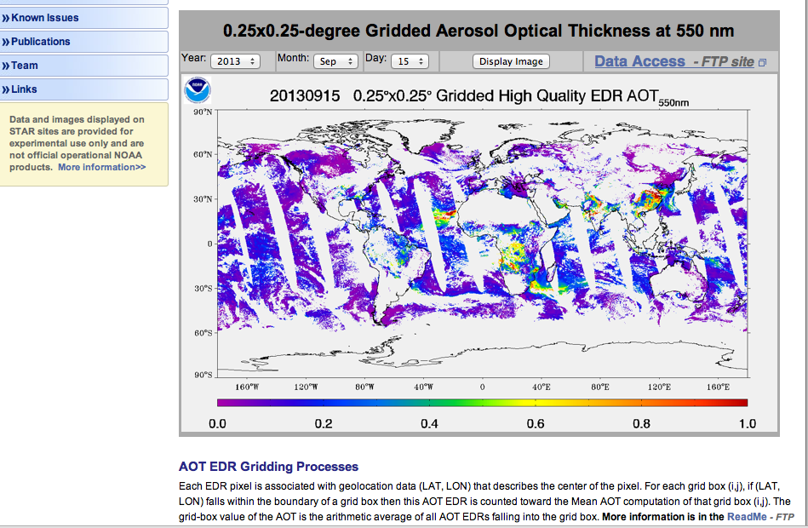
2013 Sep 15

Slide 11
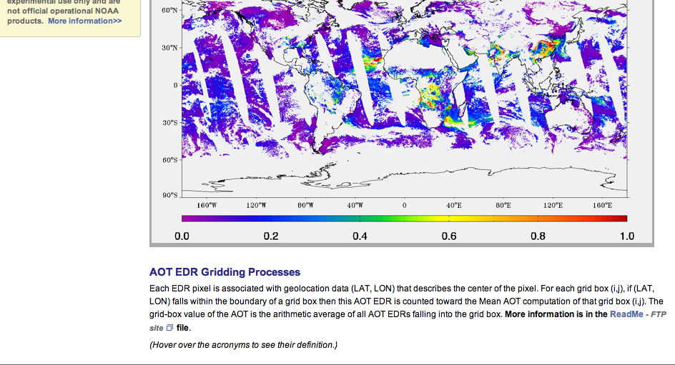

Slide 13
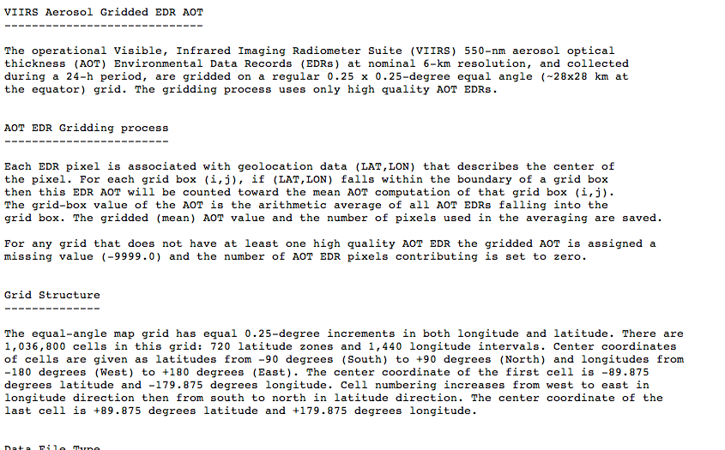
Gridded data README file

Slide 14
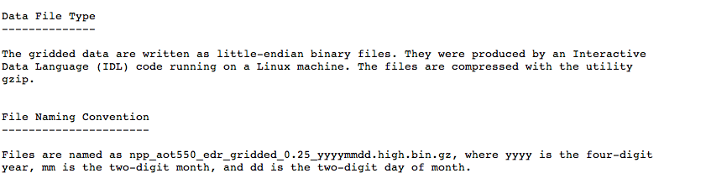
Gridded data README file

Slide 15
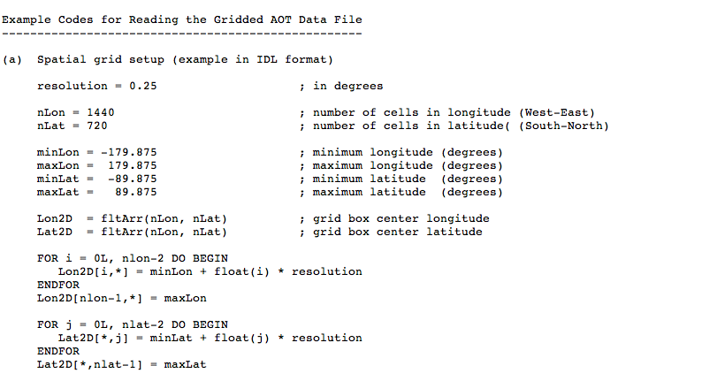
Gridded data README file

Slide 16
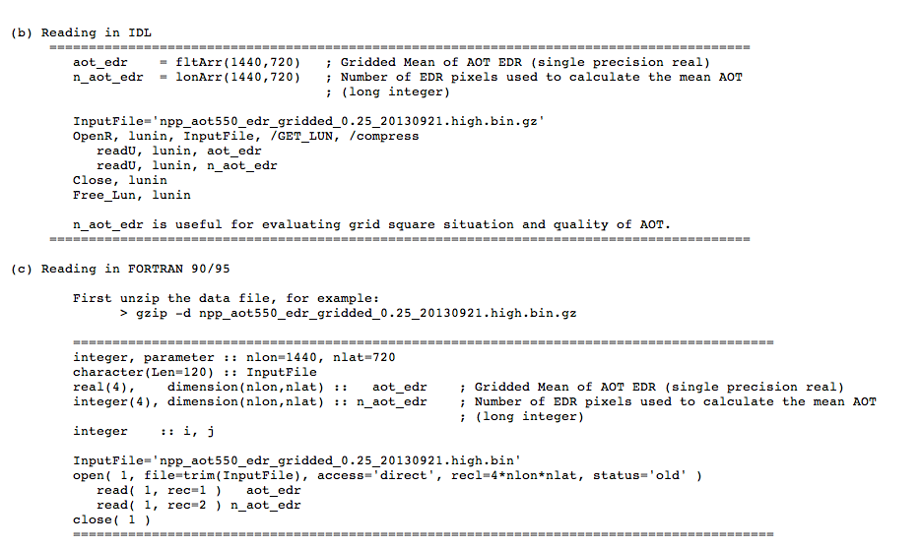
Gridded data README file

Slide 17
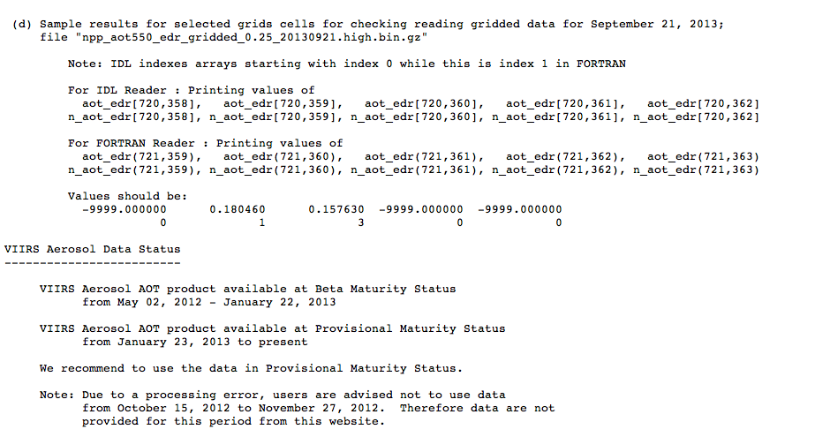
Gridded data README file

Slide 19
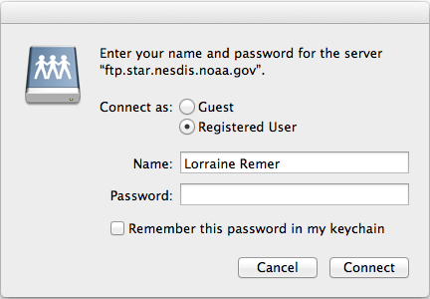
Connect to ftp as “Guest”. There will be no need for a password.

Slide 20
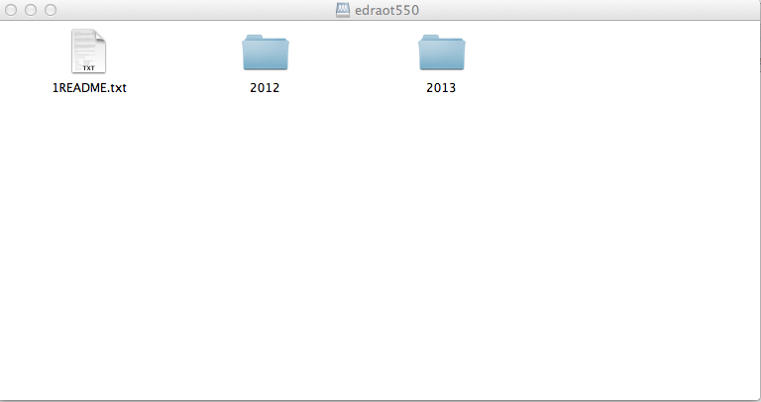
Daily files organized by year

Slide 21
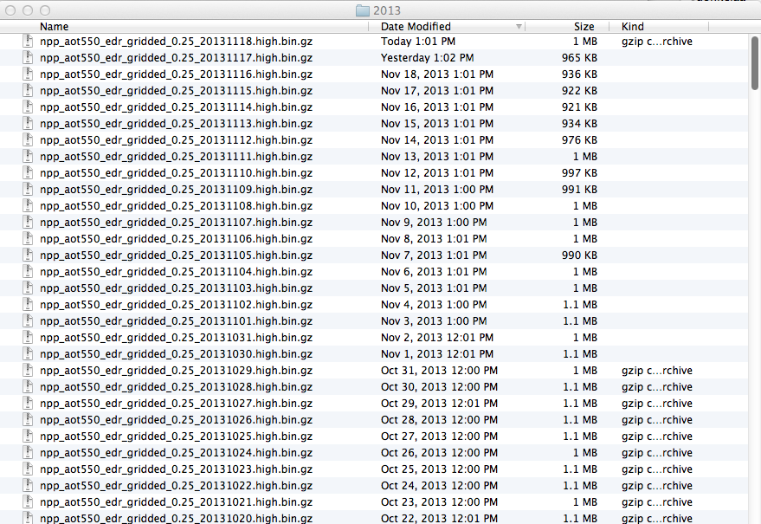
List of daily files for ftp to your computer

Slide 22

Site developed and maintain by NOAA STAR group.
Development led by Ho-Chun Huang

Slide 23
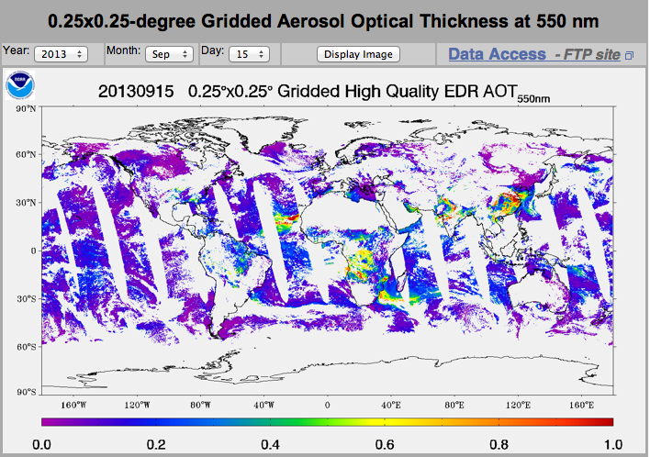

Slide 24
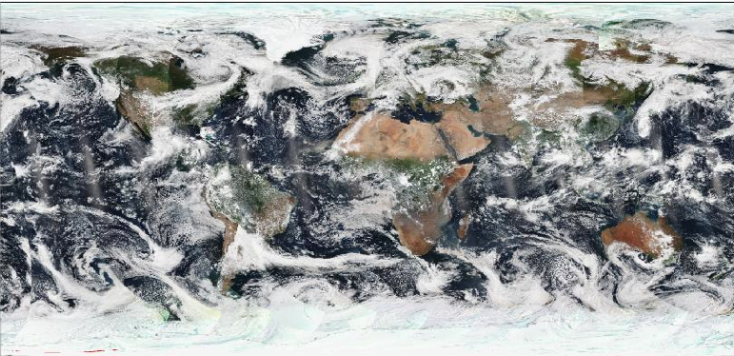
VIIRS global mosaic rgb image from Atmospheric PEATE
15 Sep 2013

Slide 25
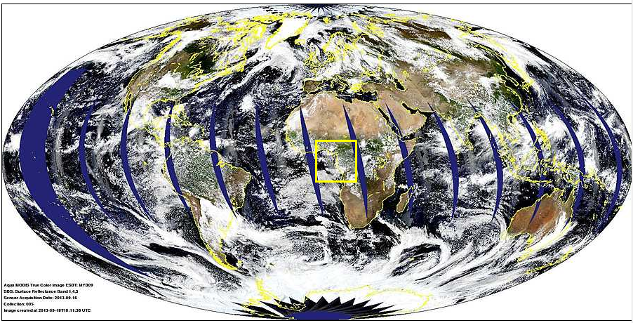
MODIS rgb mosaic from modis-atmos.gsfc.nasa.gov
15 Sep 2013

Slide 26
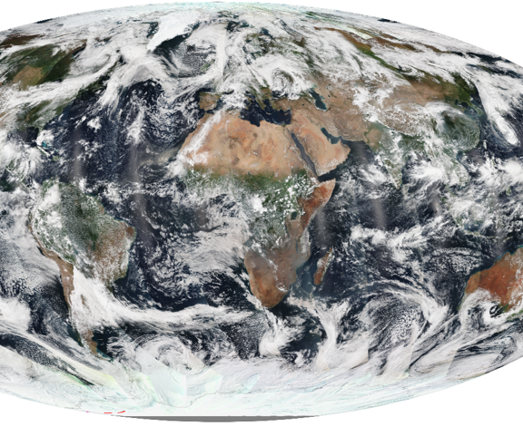
VIIRS
MODIS

Slide 27
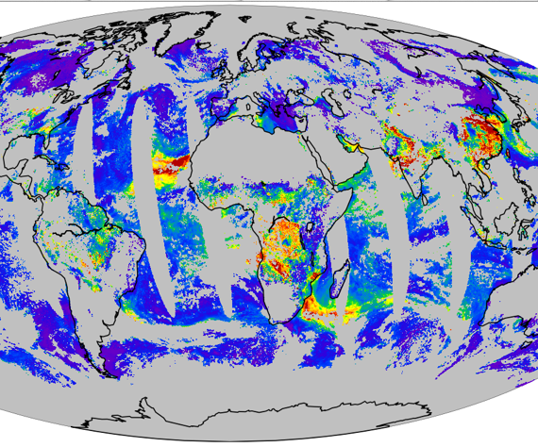
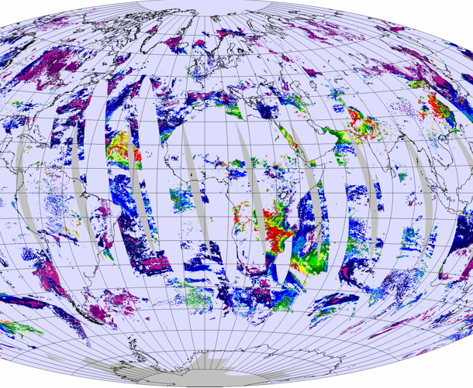
VIIRS Provisional
High quality
EDR
Both color bars [-0.05, 0.8]
MODIS C5
High quality
Level 2

Slide 28
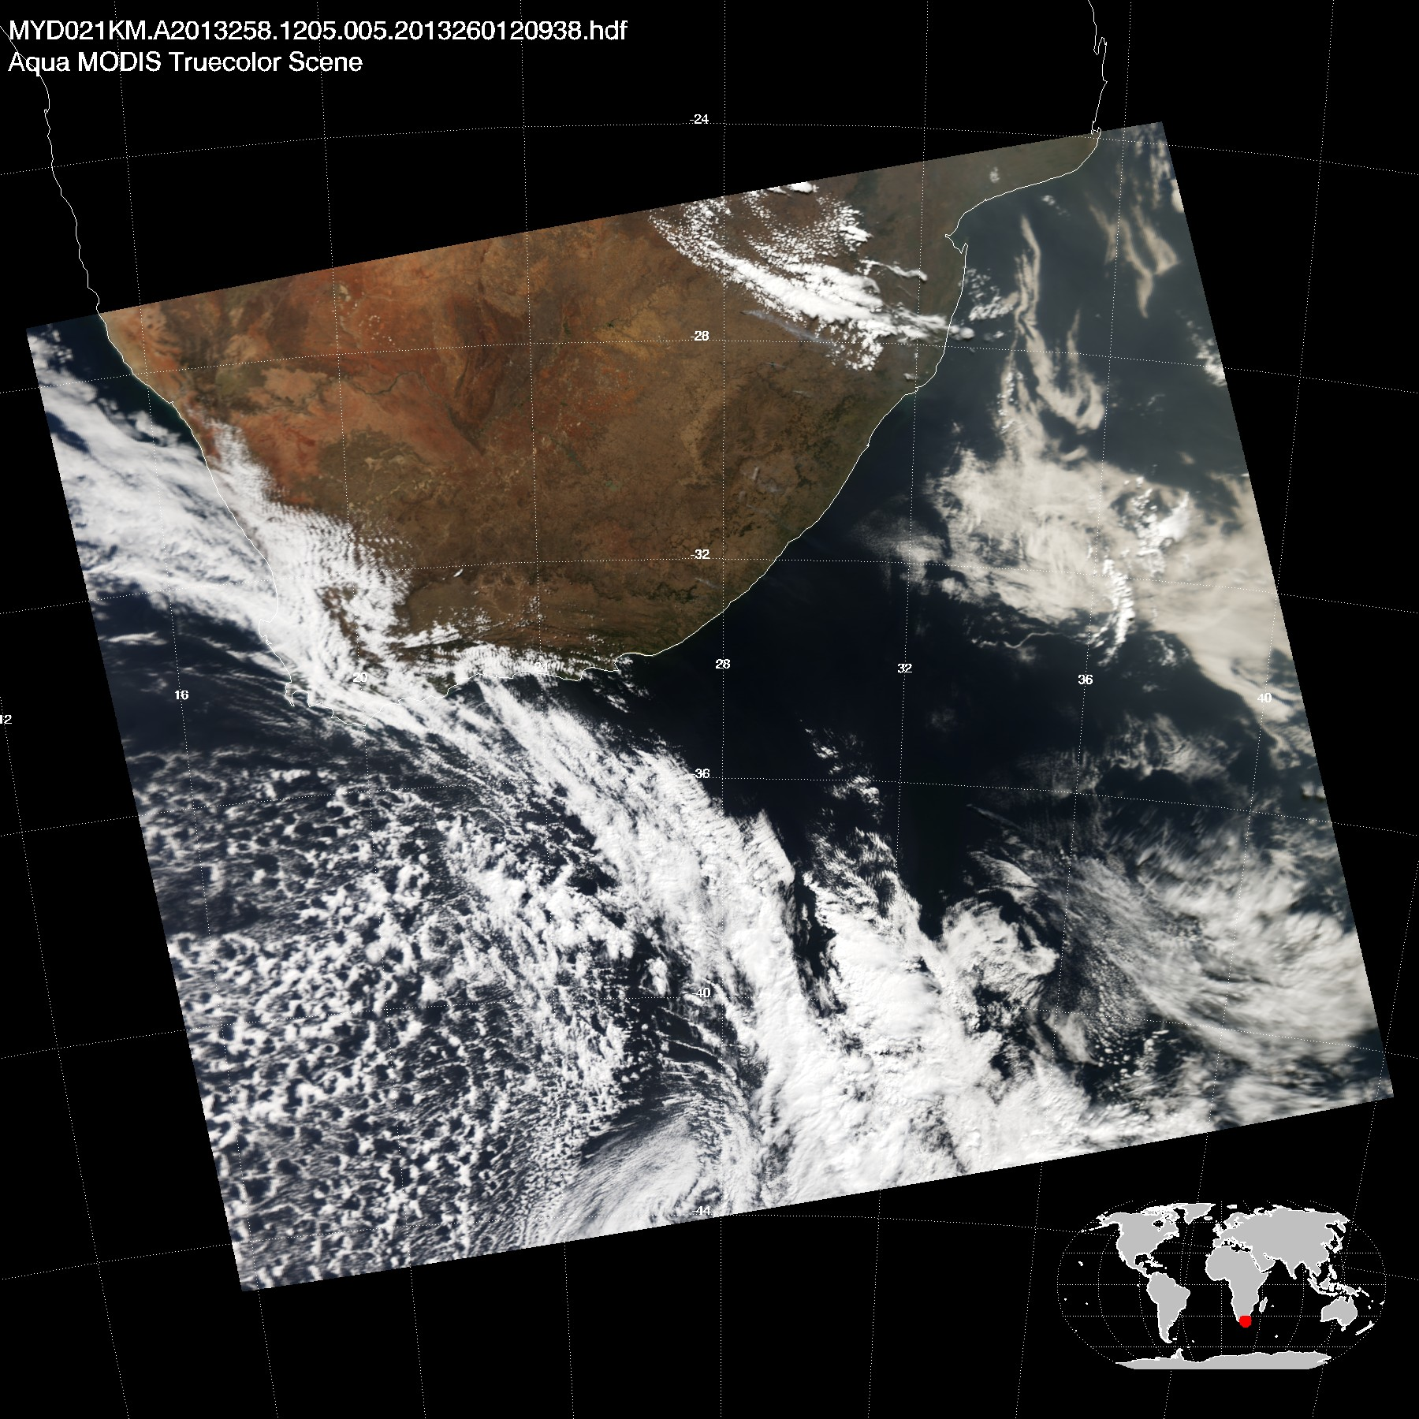
Aqua MODIS 15 Sep 2013 12:05

Slide 29
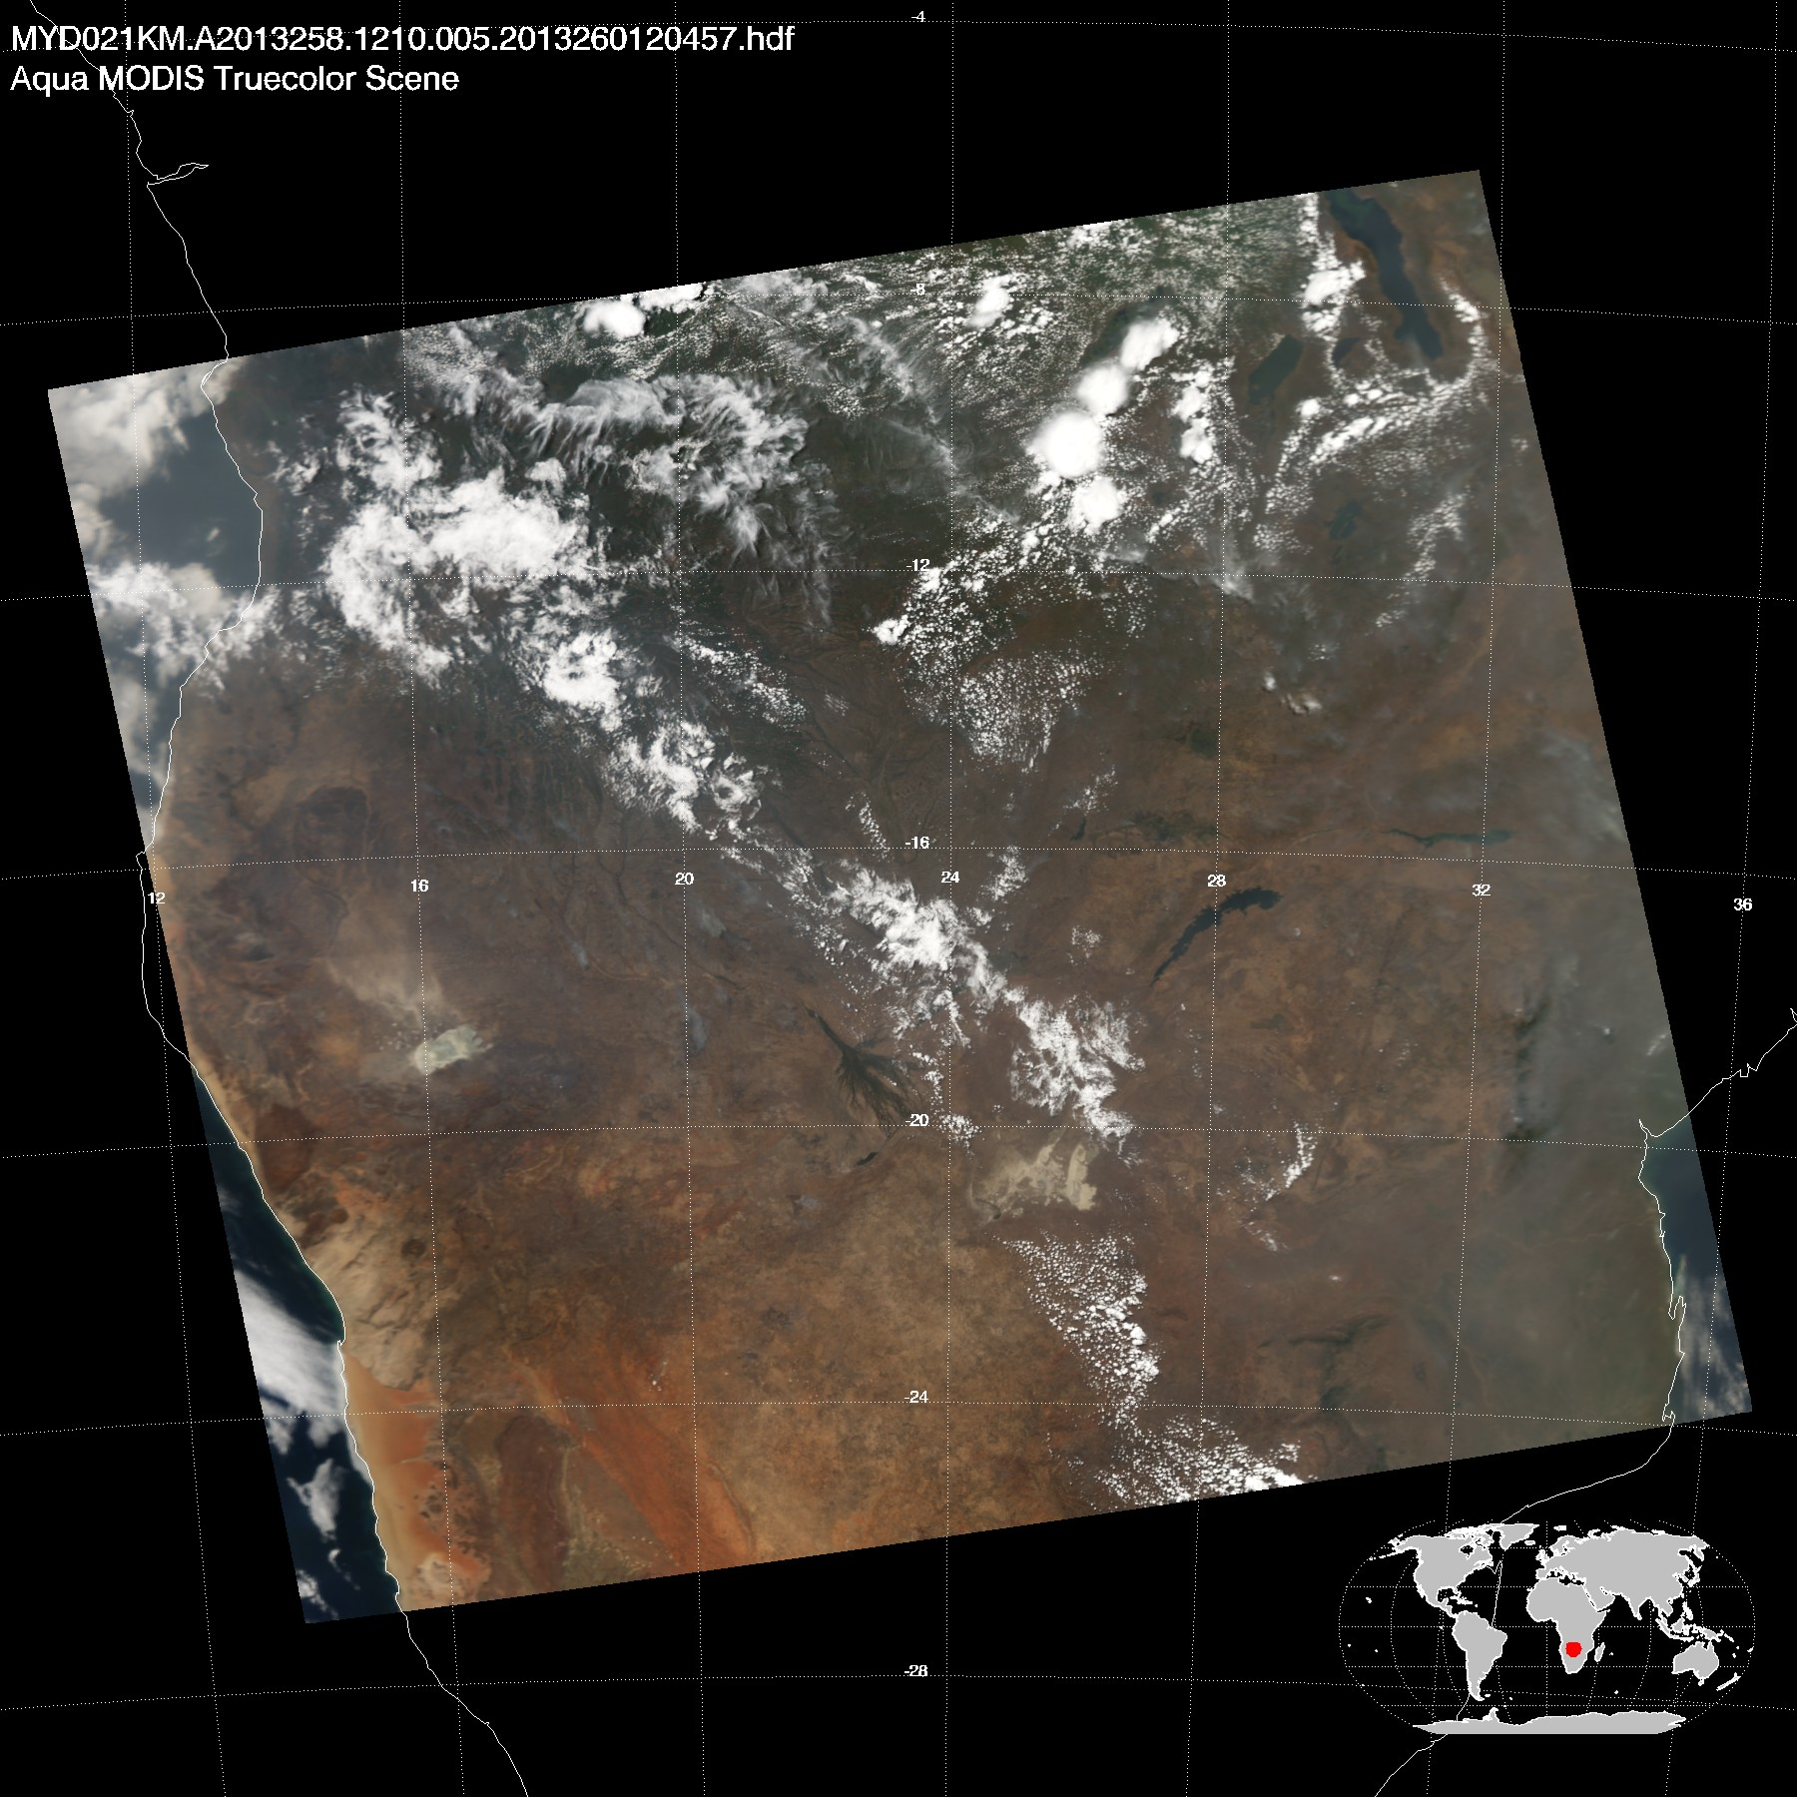
Aqua MODIS 15 Sep 2013 12:10

Slide 30
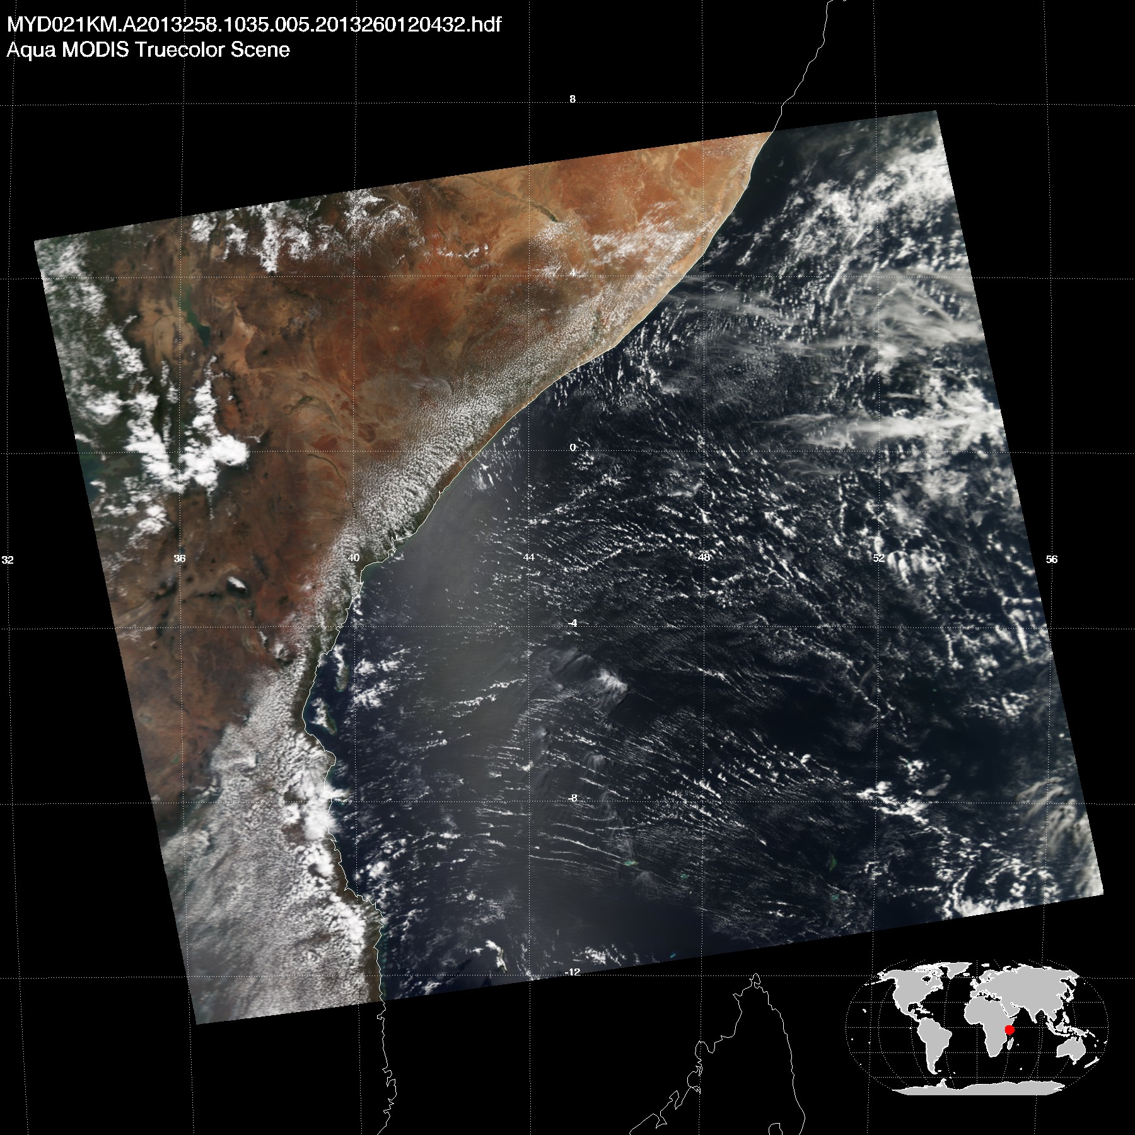
Aqua MODIS 15 Sep 2013 10:35

Slide 31
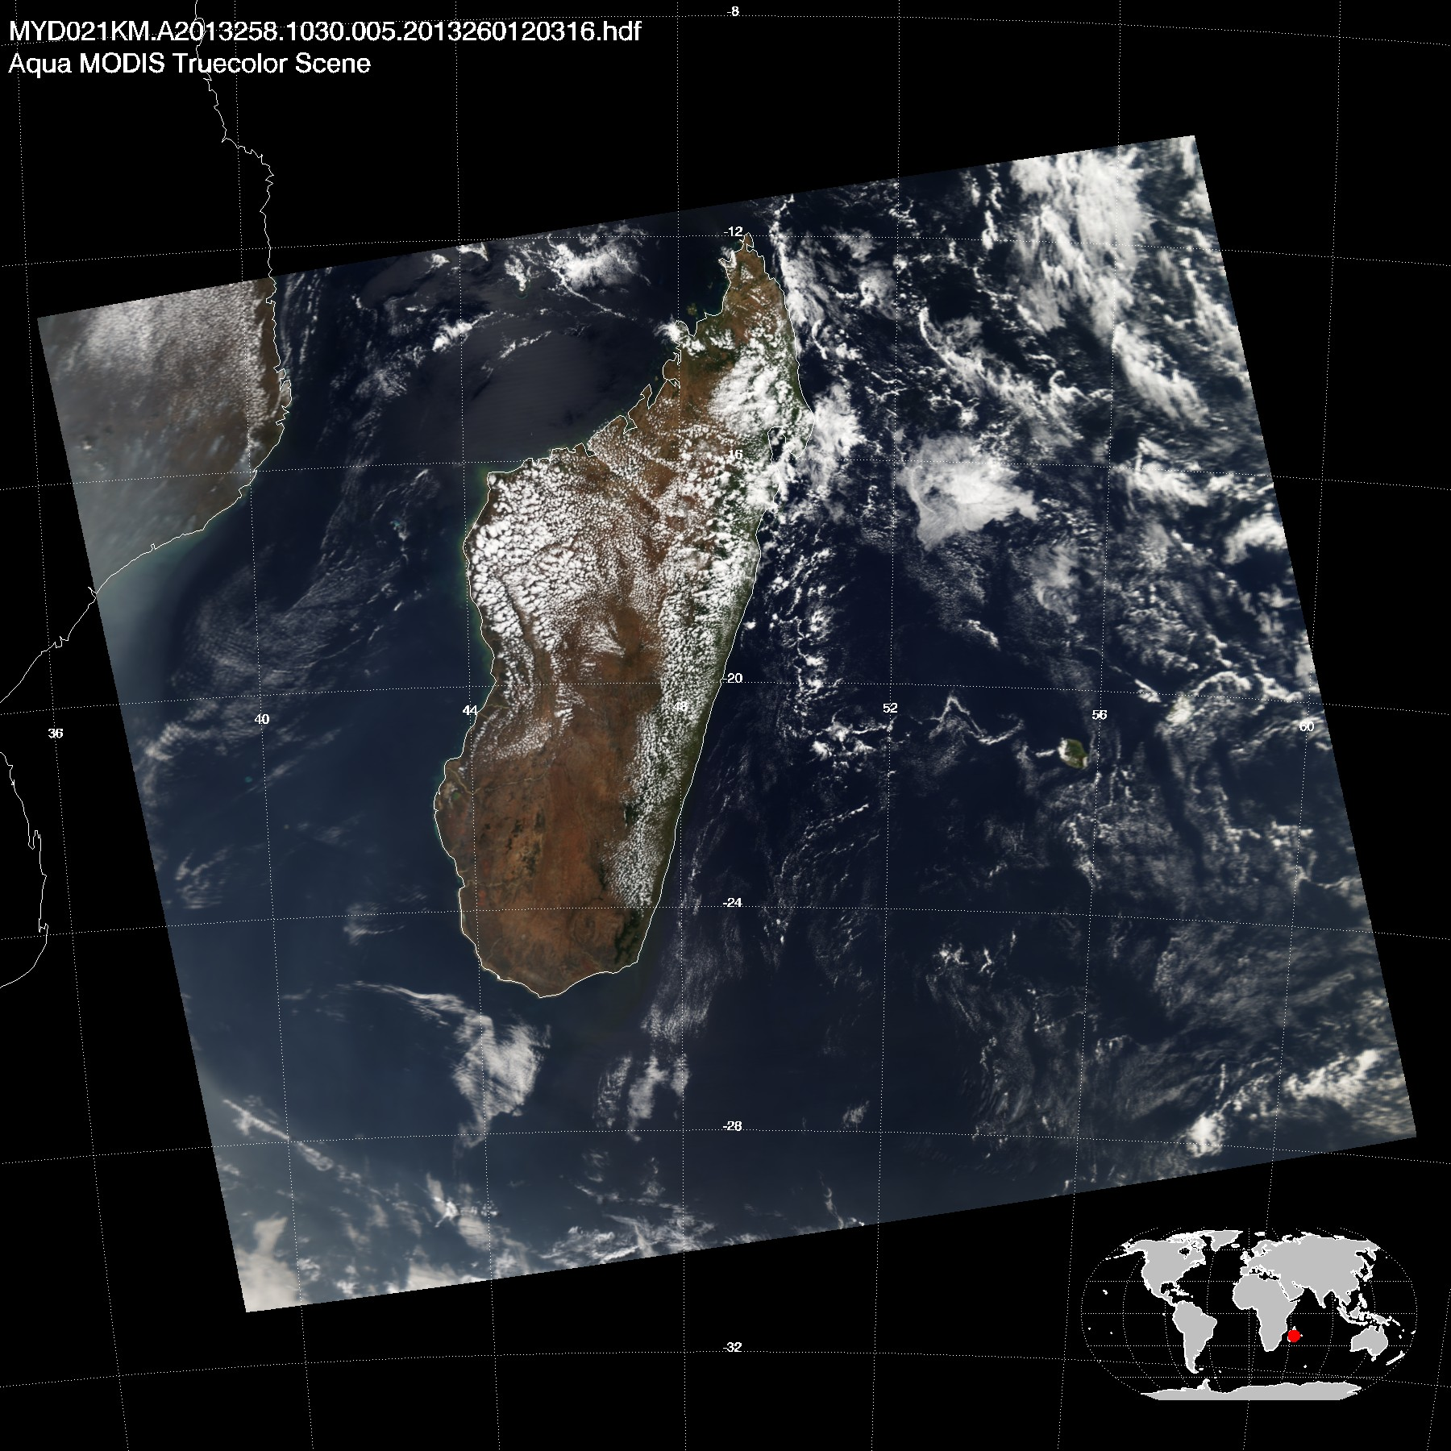
Aqua MODIS 15 Sep 2013 10:30

Slide 32
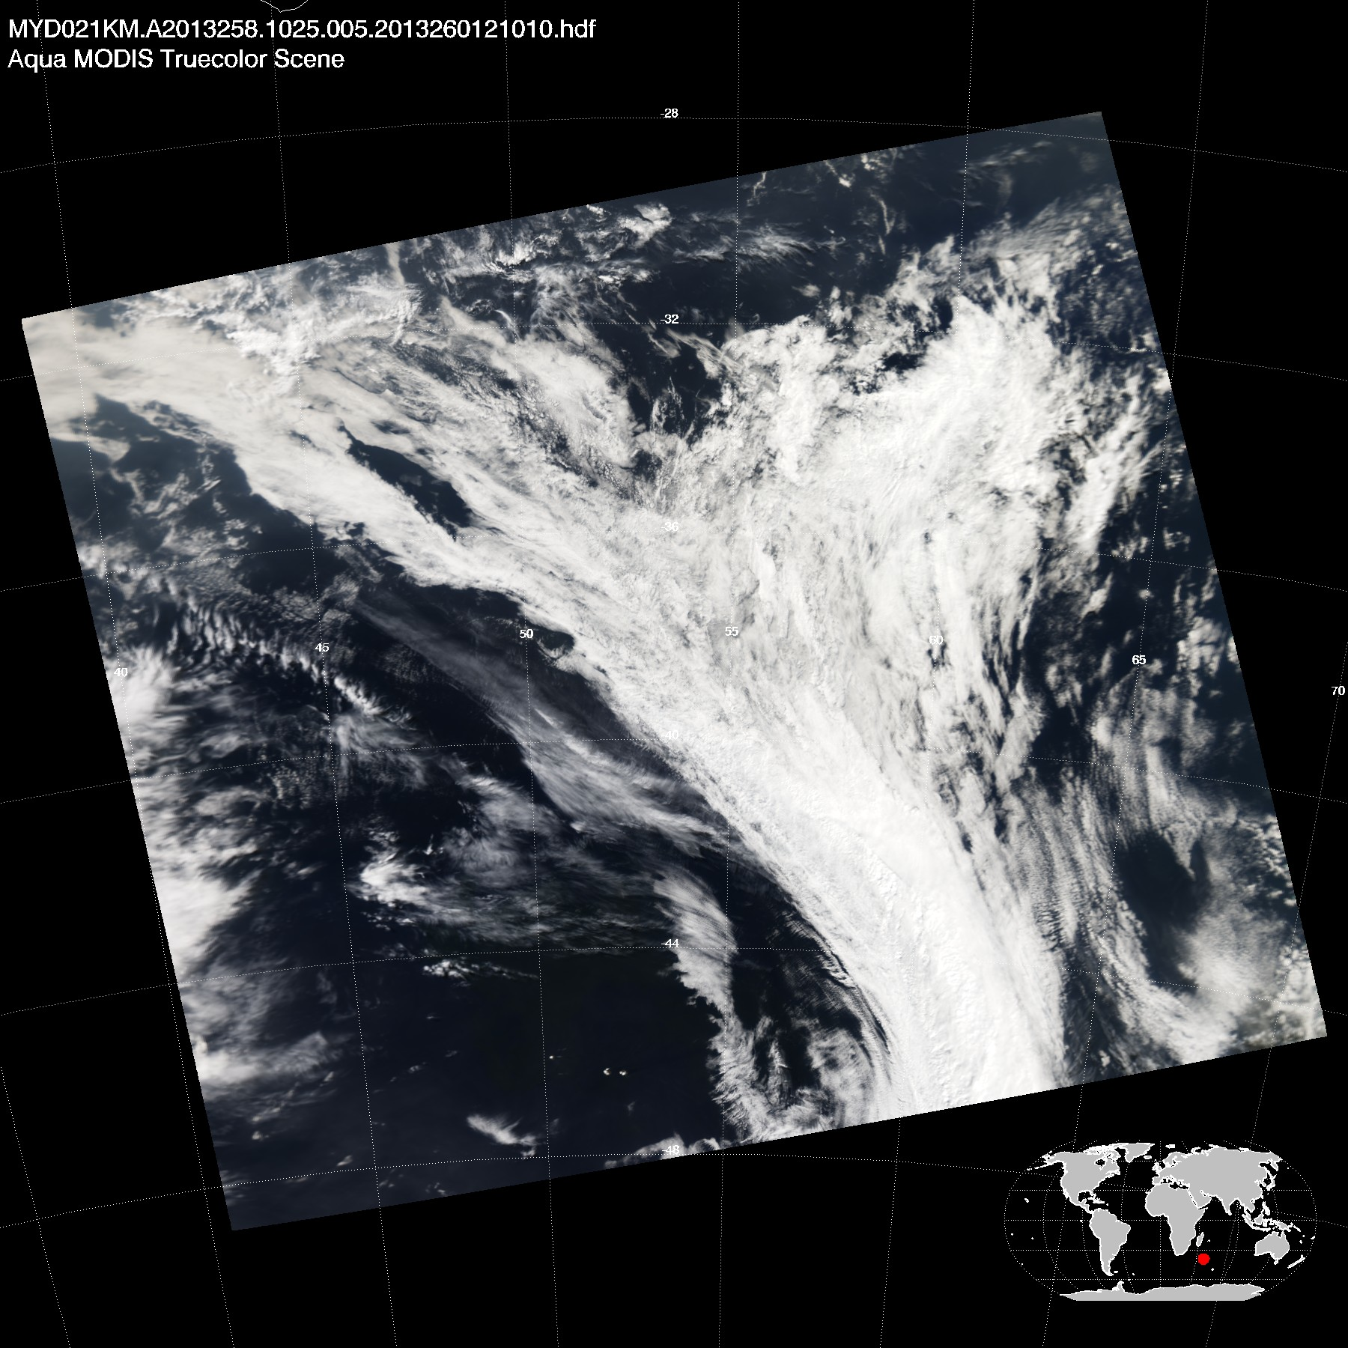
Aqua MODIS 15 Sep 2013 10:25

Slide 33
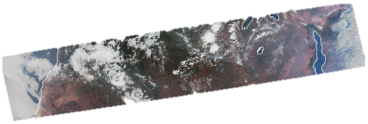
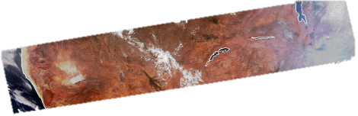
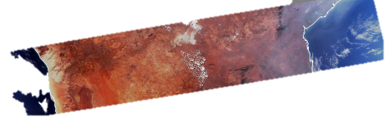
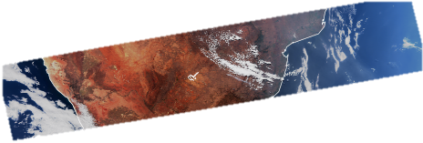
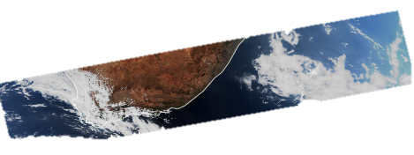
VIIRS rgb
15 Sep 2013
11:51.59 to
11:57:41

Slide 34
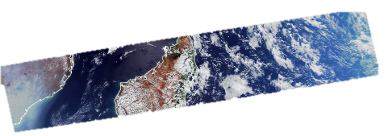
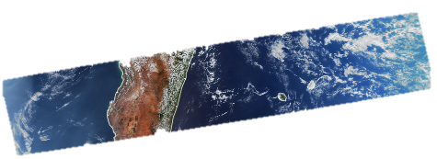
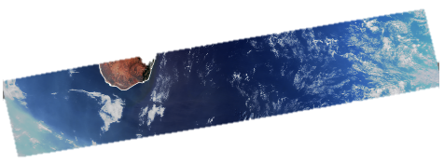

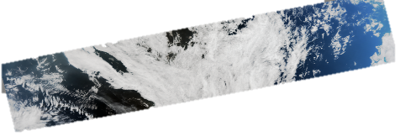
VIIRS rgb
15 Sep 2013
10:09.34 to
10:15:15

Slide 36
VIIRS 11:51.59 to
11:57:41
MODIS 12:10 to 12:15

Slide 37
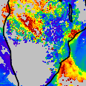
VIIRS rgb and
VIIRS AOT

Slide 38
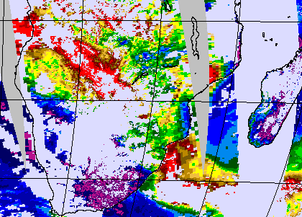
VIIRS AOT
MODIS AOT

Slide 39
VIIRS AOT
Pretoria AERONET site
VIIRS AOT550 0.30-0.35
MODIS AOT550 0.30-0.35
MODIS AOT

Slide 40
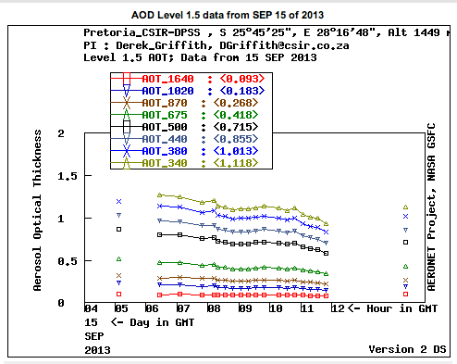

Slide 42
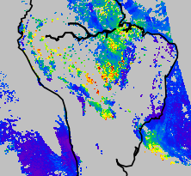
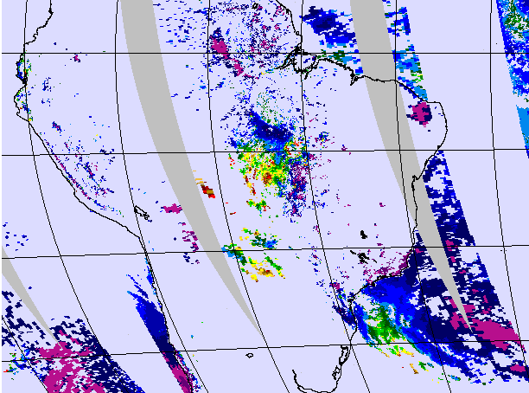
VIIRS
Aqua MODIS

Slide 43
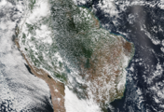
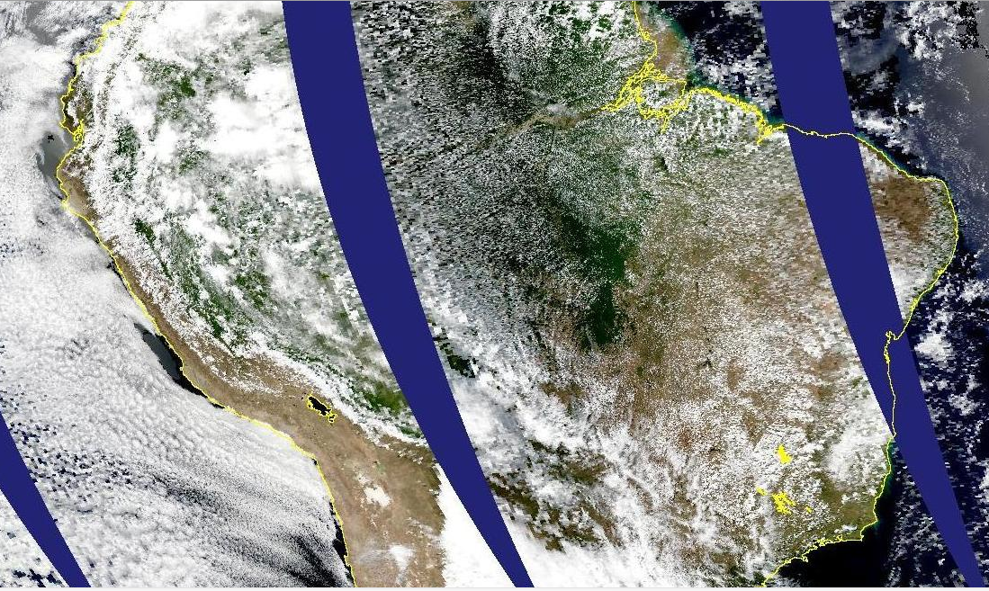
VIIRS
16:56 to 17:06
MODIS 17:05-17:10

Slide 44
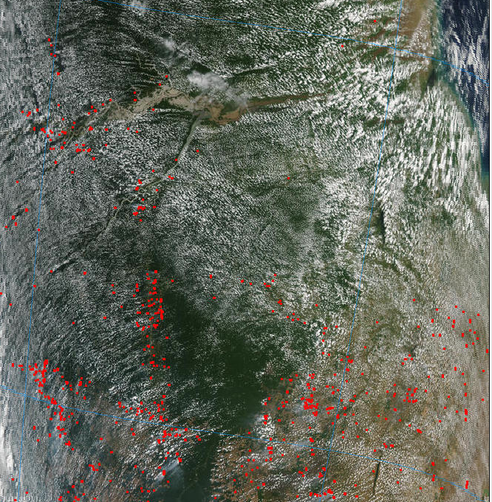
MODIS
From
LANCE site
Showing
fire hotspots

Slide 45
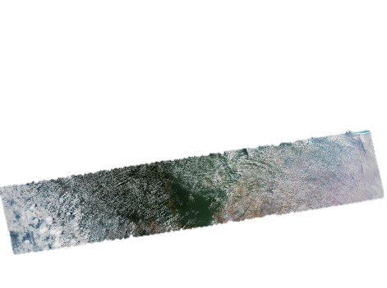
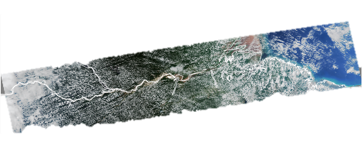

Slide 46
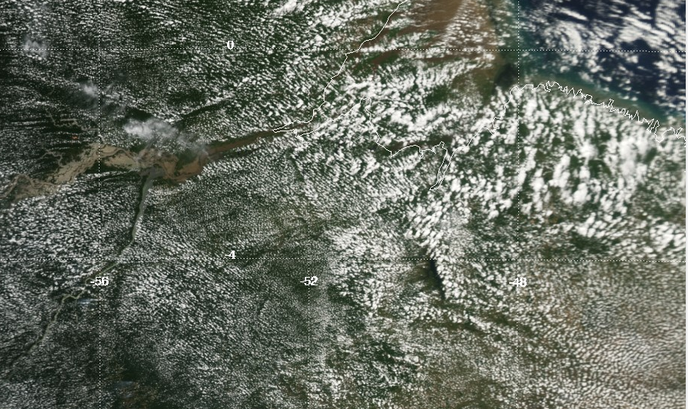
VIIRS AOT
MODIS rgb

Slide 47
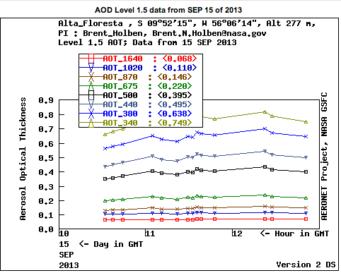
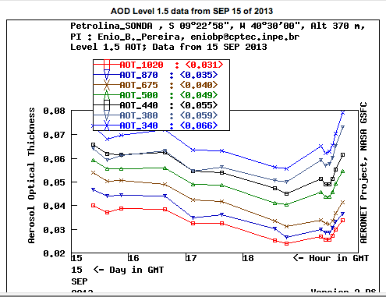



Slide 48
To get granule data.
Go to Google
NOAA CLASS
http://www.nsof.class.noaa.gov/saa/products/search?sub_id=0&datatype_family=VIIRS&submit.x=28&submit.y=6

Slide 49


Slide 50


Slide 52


Slide 53


Slide 54


Slide 55


Slide 56


Slide 57


Slide 58

Small order Search

Slide 59

Large order search

Slide 60
Points of discussion
VIIRS AOT data available either by granule or gridded
Wider swath has advantages for case studies
Offset from MODIS over pass has advantages
VIIRS offers a different view from MODIS…. Start thinking of VIIRS as an additional piece of information, not a MODIS follow-on.
What is missing now from VIIRS products or tools that would make VIIRS more desirable?

Slide 61
Backup

